Slide 1
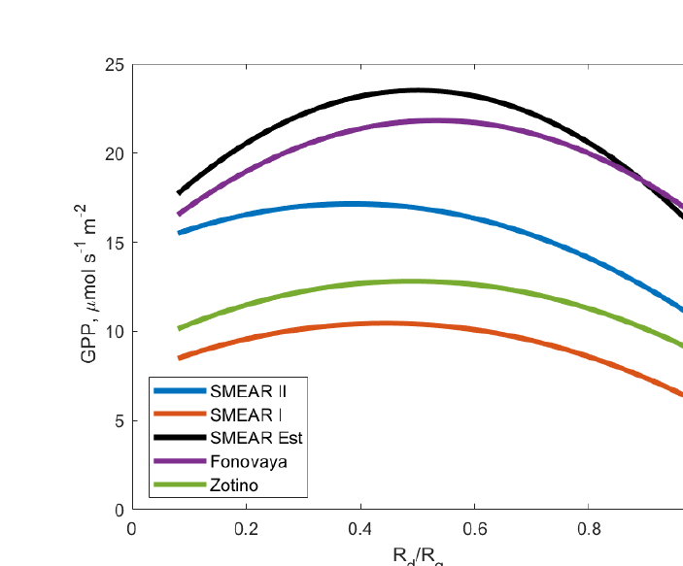
Evidence from natural ecosystems across the globe (I): forests
7 · Evidence
Region | Ecosystem | Effect | Aerosol impact | Reference
Finland, Estonia, Siberia | Boreal forest | ↑ | Diffuse fraction 0.11 → 0.2–0.27; GPP +6 to 14% | Ezhova et al., 2018
Harvard Forest, USA | Deciduous forest | ↑ | Pinatubo sulfate: noon GPP +23% (1992), +8% (1993) | Gu et al., 2003
Eastern USA | Deciduous/mixed forest | ↑ | Midday GPP +13% at AOD > 0.4 | Strada et al., 2015
Southeast USA | Deciduous/mixed forest | ↑ | NPP up to +35 g C m⁻²; negligible if LAI < 3 | Matsui et al., 2008
Boreal N. America | Boreal forest | ↑ | Fire aerosol: NPP +8 Tg C yr⁻¹ (2010s) | Yue et al., 2017
Amazon (Tapajós) | Tropical rainforest | ↑ | Smoke: uptake gain 80% diffuse light, 20% cooling | Doughty et al., 2010
Amazon | Tropical rainforest | ↑ | Fire aerosol: diffuse +3.4–6.8%, NPP +1.4–2.8% | Rap et al., 2015
Amazon | Tropical rainforest | ↑ | Fire aerosol: GPP +27% (2010, model) | Moreira et al., 2017
Southern Amazon | Semi-deciduous forest | ↑ | Smoke-season diffuse light raises net CO₂ uptake | Rodrigues et al., 2024
South America | Tropical forest | ↑/↓ | NEE +8.4–16% at AOD 0.83–1.26; falls at AOD > 1.7 | Oliveira et al., 2007
Amazon | Tropical forest | ↓ | Heavy smoke lowers photosynthetic efficiency | Cirino et al., 2014
Brazil | Tropical forest | ↔ | No AOD–NEE correlation for AOD < 0.7 | Yamasoe et al., 2006
India | Tropical forest zones | ↑/↓ | Forest NPP peaks at AOD 0.38, gain persists to 0.51 | Hari & Tyagi, 2022
GPP vs diffuse fraction (R_{d}/R_{g}) at five boreal and hemiboreal forest sites
GPP peaks at intermediate diffuse fraction
Source: Ezhova et al., 2018, Fig. 8
Pattern: forests mostly gain at moderate aerosol (+6 to 23%); the gain disappears or reverses under very heavy smoke.
↑ increase ↔ no clear change ↓ decrease ↑/↓ gain then loss at high AOD Crop ecosystems excluded
Notes:
This slide collects the evidence for forests across regions. Only natural ecosystems are included; crop ecosystems are left out. The effect column shows the sign at a glance: green up-arrows are increases, grey is no clear change, red is a decrease, and amber means a gain at moderate aerosol turning into a loss at high aerosol.
Boreal and temperate forests. In boreal and hemiboreal forests of Finland, Estonia and Siberia, Ezhova and colleagues, 2018, found that aerosol raised the clear-day diffuse fraction from about 0.11 to 0.2–0.27 and GPP by 6 to 14 percent; the figure shows GPP peaking at an intermediate diffuse fraction. At Harvard Forest, Gu and colleagues, 2003, showed that the scattering sulfate from Mount Pinatubo increased noon photosynthesis by 23 percent in 1992 and 8 percent in 1993. In the eastern United States, Strada and colleagues, 2015, found midday GPP of deciduous and mixed forests 13 percent higher when AOD exceeded 0.4. A regional model by Matsui and colleagues, 2008, gave NPP increases of up to 35 grams of carbon per square metre for forests but a negligible effect where leaf area index was below 3. For boreal North America, Yue and colleagues, 2017, modelled an NPP gain from fire aerosol of 8 teragrams of carbon per year in the 2010s, rising to 14 in the 2050s.
Tropical forests. In the Amazon, Doughty and colleagues, 2010, found that the extra CO2 uptake under smoke came 80 percent from diffuse light and 20 percent from canopy cooling. Rap and colleagues, 2015, modelled a 3.4 to 6.8 percent rise in diffuse radiation and a 1.4 to 2.8 percent rise in NPP from fire aerosol. Moreira and colleagues, 2017, modelled a 27 percent GPP increase in 2010. Rodrigues and colleagues, 2024, found that burning-season diffuse radiation increased net CO2 uptake of a semi-deciduous forest in the southern Amazon, also through lower temperature and VPD.
Contrasting results. Oliveira and colleagues, 2007, found net ecosystem exchange increased by 8.4 to 16 percent at AOD 0.83 to 1.26 but declined above 1.7, so the response reverses under very heavy smoke. Cirino and colleagues, 2014, found lower photosynthetic efficiency under heavy smoke than at low AOD. Yamasoe and colleagues, 2006, found no correlation between AOD and NEE for AOD below 0.7. In India, Hari and Tyagi, 2022, found NPP of the tropical forest zones peaking at AOD 0.38, with the gain persisting up to 0.51.
The pattern is that forests mostly gain at moderate aerosol, by 6 to 23 percent, but the gain disappears or reverses under very heavy smoke.

Slide 2
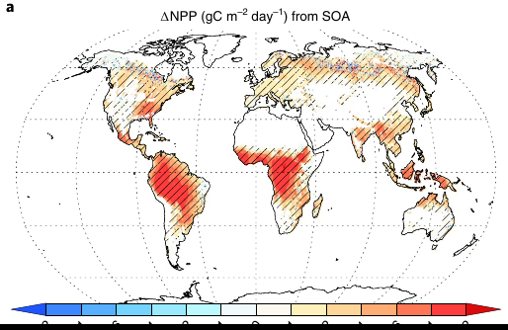
Evidence from natural ecosystems (II): open ecosystems and global
7 · Evidence
Region | Ecosystem | Effect | Aerosol impact | Reference
USA (AmeriFlux) | Grassland | ↓ | Uptake fell in grassland, rose in forest | Niyogi et al., 2004
Eastern USA | Grassland | ↓ | High AOD (> 0.6) harmed grassland | Strada et al., 2015
Northwest China | Short C3 grassland | ↓ | Aerosol gave negative carbon uptake | Jing et al., 2010
Northern Australia | Tropical savanna | ↔ | Diffuse fraction 11 → 21%: no significant change | Kanniah et al., 2010
Brazil (Pantanal) | Tropical wetland | ↓ | Black carbon cut PAR, lowered assimilation | Curado et al., 2024
California, USA | Restored wetland | ↑ | Wildfire smoke: LUE up, GPP +1.2–4.1% | Hemes et al., 2020
Global | All biomes | ↑ | Biogenic SOA raises NPP by 1.23 Pg C yr⁻¹ | Rap et al., 2018
Global | All biomes | ↑ | Aerosol GPP +1.0 Pg C yr⁻¹; fire aerosol only +0.05 | Yue & Unger, 2018
Global | All biomes | ↑ | GPP +0.95 Pg C yr⁻¹ (all-sky) vs +8.9 (clear-sky) | Zhou et al., 2022
Global | All biomes | ↑ | Aerosol GPP +1–2% | Strada & Unger, 2016
Global | All biomes | ↑ | Diffuse effect raised land sink ~¼ (1960–1999) | Mercado et al., 2009
Annual NPP change (g C m⁻² day⁻¹) from biogenic secondary organic aerosol
Largest gains over forests
Source: Rap et al., 2018, Fig. 3a
Pattern: grasslands, savannas and smoky wetlands gain little or lose; globally the net effect is a modest gain.
↑ increase ↔ no clear change ↓ decrease ↑/↓ gain then loss at high AOD Crop ecosystems excluded
Notes:
The second slide covers open ecosystems and global estimates, where results are more mixed.
Grasslands. At six AmeriFlux sites in the United States, Niyogi and colleagues, 2004, found that CO2 uptake increased with aerosol over forest but decreased over grassland. Strada and colleagues, 2015, similarly found that high AOD above 0.6 harmed grassland while forests gained. In north-west China, Jing and colleagues, 2010, found that clouds dominated the diffuse-light gain of a short C3 grassland, while aerosol led to negative carbon uptake.
Savannas and wetlands. In a northern Australian savanna, Kanniah and colleagues, 2010, found that an increase in diffuse fraction from 11 to 21 percent did not significantly change carbon flux, because the open canopy has few shaded leaves. In the Brazilian Pantanal wetland, Curado and colleagues, 2024, found that black carbon from biomass burning reduced PAR, raised air temperature and lowered carbon assimilation. In contrast, in a restored wetland in California, Hemes and colleagues, 2020, found that wildfire smoke increased light-use efficiency and raised GPP by 1.2 to 4.1 percent compared with the previous season.
Global estimates. These are totals over all vegetation from global models. Rap and colleagues, 2018, estimated that secondary organic aerosol formed from plant emissions raises global NPP by 1.23 petagrams of carbon per year; the map shows the largest gains over tropical and temperate forests. Yue and Unger, 2018, estimated a global aerosol GPP gain of about 1.0 petagram per year, of which fire aerosol contributes only 0.05. Zhou and colleagues, 2022, found 0.95 under all-sky conditions versus 8.9 under clear skies, showing how clouds limit the effect. Strada and Unger, 2016, estimated a gain of 1 to 2 percent, and Mercado and colleagues, 2009, estimated that the diffuse effect raised the land carbon sink by about one quarter between 1960 and 1999.
The pattern is that grasslands, savannas and smoky wetlands gain little or even lose, while globally the net effect on natural vegetation is a modest gain.

