Slide 1
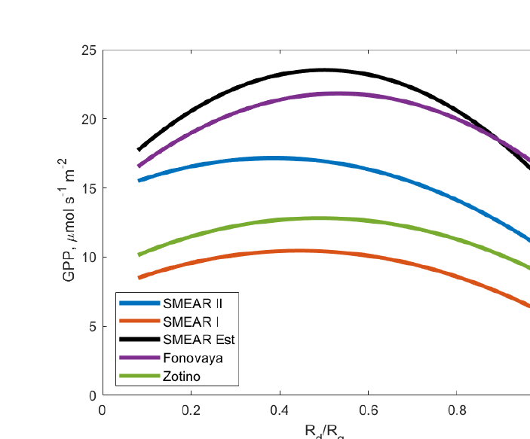
Evidence from natural ecosystems across the globe
7 · Evidence
Ecosystem | Effect | When positive or negative | Reason | References
Boreal & temperate forest | ↑ | Moderate AOD: GPP +6 to 14% (boreal); noon GPP +23% after Pinatubo | Deep canopy: diffuse light reaches shaded leaves; no gain if LAI < 3 | Ezhova et al., 2018 Gu et al., 2003 Matsui et al., 2008
Tropical forest (Amazon) | ↑/↓ | + moderate smoke: NEE +8.4–16% (AOD 0.83–1.26), NPP +1.4–2.8%; − at AOD > 1.7 | Gain: 80% diffuse light, 20% canopy cooling; heavy smoke cuts total PAR | Doughty et al., 2010 Rap et al., 2015 Oliveira et al., 2007 Cirino et al., 2014
Grassland & savanna | ↓/↔ | − grassland at AOD > 0.6; savanna: diffuse 11 → 21%, no significant change | Short, open canopy: few shaded leaves, lost direct light not regained | Strada et al., 2015 Jing et al., 2010 Kanniah et al., 2010
Wetland | ↑/↓ | + wildfire smoke: GPP +1.2–4.1% (California); − black carbon (Pantanal) | Scattering adds diffuse light; black carbon absorbs PAR | Hemes et al., 2020 Curado et al., 2024
All biomes (global) | ↑ | NPP +1.23 Pg C yr⁻¹; GPP +0.95 (all-sky) vs +8.9 (clear-sky); land sink ~¼ higher (1960–1999) | Gain mostly over forests; clouds already make light diffuse | Rap et al., 2018 Zhou et al., 2022 Mercado et al., 2009
GPP vs diffuse fraction, five boreal forest sites (Fig. 8)
GPP peaks at intermediate diffuse fraction
Source: Ezhova et al., 2018
↑ increase ↔ no clear change
↓ decrease ↑/↓ depends on load
Crop ecosystems excluded
Positive when: scattering aerosol, moderate AOD, deep multilayer canopy, clear skies. Negative when: very high AOD (> 0.6 grassland, > 1.7 tropical forest), absorbing black carbon, short open canopy.
Notes:
This slide brings together the evidence from natural ecosystems, grouped into five broad types. For each group the table shows the sign of the effect, the conditions under which it is positive or negative with the values reported, the reason, and the key references. Crop ecosystems are excluded here and treated separately.
Boreal and temperate forests show a consistent gain. In boreal and hemiboreal forests of Finland, Estonia and Siberia, Ezhova and colleagues, 2018, found that aerosol raised the clear-day diffuse fraction from about 0.11 to 0.2–0.27 and GPP by 6 to 14 percent; the figure shows GPP peaking at an intermediate diffuse fraction. At Harvard Forest, Gu and colleagues, 2003, found that sulfate from the Mount Pinatubo eruption raised noon photosynthesis by 23 percent in 1992. Supporting studies are Strada and colleagues, 2015, with midday GPP 13 percent higher at AOD above 0.4 in the eastern United States, and Yue and colleagues, 2017, with a fire-aerosol NPP gain of 8 teragrams of carbon per year in boreal North America. The reason is the deep, multilayer canopy: diffuse light penetrates to shaded leaves that are light-limited under direct sun. Matsui and colleagues, 2008, showed that the gain is negligible when leaf area index is below 3.
Tropical forests gain at moderate smoke but lose under very heavy smoke. In the Amazon, Oliveira and colleagues, 2007, found net ecosystem exchange increased by 8.4 to 16 percent at AOD 0.83 to 1.26, but declined above 1.7. Rap and colleagues, 2015, modelled an NPP increase of 1.4 to 2.8 percent from fire aerosol, and Moreira and colleagues, 2017, a GPP increase of 27 percent in 2010. Doughty and colleagues, 2010, found that 80 percent of the extra uptake came from diffuse light and 20 percent from canopy cooling. Cirino and colleagues, 2014, found lower photosynthetic efficiency under heavy smoke, because total PAR falls too much. Yamasoe and colleagues, 2006, found no correlation at AOD below 0.7, Rodrigues and colleagues, 2024, found a gain in a semi-deciduous forest of the southern Amazon, and in India Hari and Tyagi, 2022, found NPP of the forest zones peaking at AOD 0.38 with the gain persisting to 0.51.
Grasslands and savannas gain little or lose. Strada and colleagues, 2015, found that AOD above 0.6 harmed grassland while forests gained; Niyogi and colleagues, 2004, also found uptake falling over grassland and rising over forest; and Jing and colleagues, 2010, found aerosol gave negative carbon uptake in a short C3 grassland in north-west China. In a northern Australian savanna, Kanniah and colleagues, 2010, found that an increase in diffuse fraction from 11 to 21 percent did not significantly change carbon flux. The reason is the short, open canopy: there are few shaded leaves to benefit from diffuse light, so the loss of direct light is not regained.
Wetlands depend on the type of aerosol. In a restored wetland in California, Hemes and colleagues, 2020, found that scattering wildfire smoke raised light-use efficiency and GPP by 1.2 to 4.1 percent, while in the Brazilian Pantanal, Curado and colleagues, 2024, found that black carbon from biomass burning reduced PAR and carbon assimilation.
Globally the net effect is a modest gain. Rap and colleagues, 2018, estimated that secondary organic aerosol from plant emissions raises global NPP by 1.23 petagrams of carbon per year. Zhou and colleagues, 2022, found a GPP gain of 0.95 petagrams under all-sky conditions compared with 8.9 under clear skies, because clouds already make light diffuse. Mercado and colleagues, 2009, estimated that the diffuse effect raised the land carbon sink by about a quarter between 1960 and 1999. Yue and Unger, 2018, about 1.0 petagram per year, and Strada and Unger, 2016, 1 to 2 percent, give similar values. The gain comes mostly from forests.
The strip summarises the conditions. The effect is positive with scattering aerosol, moderate aerosol load, a deep multilayer canopy and clear skies. It is negative with very high aerosol load, above about 0.6 for grassland and 1.7 for tropical forest, with absorbing black carbon, and with short open canopies.

