Slide 1

Radiative Transfer Models in Agriculture
PROSPECT, SAIL and PROSAIL: physics, validation on wheat, inversion methods (LUT, GA, ANN, hybrid) and retrieval of LAI and chlorophyll — for the ISRO interview
LAI > Cab > CCC > Cw
RMSE 0.56
retrieval accuracy order (IARI wheat)
LAI from IRS LISS-3, Sheopur
Notes:
This deck explains radiative transfer models for crops, built from five papers: the PROSPECT+SAIL review by Jacquemoud et al. (2009), the retrieval-methods review by Verrelst et al. (2015), and three IARI Division of Agricultural Physics studies on wheat: the bidirectional reflectance validation of PROSAIL5B (Chakraborty et al. 2015), genetic-algorithm inversion (Mridha et al. 2014), and LUT versus neural-network inversion with a LISS-3 LAI map (Sehgal et al. 2016).

Slide 2



Forward and inverse problems: the whole story
FORWARD (simulate)
Leaf: N, Cab, Car, Cw, Cm
PROSPECT → leaf ρ, τ
Canopy: LAI, ALA, hotspot; soil; θs, θv, φ
SAIL → canopy reflectance
compare simulated vs observed
INVERSE (retrieve)
Satellite / field reflectance (LISS-3, MODIS, S-2)
Inversion: LUT · GA · ANN · hybrid ML
LAI, Cab, CCC = Cab × LAI, Cw
Use: N status, stress, yield, FASAL
Papers used
Why it matters
Main difficulty
Reviews: Jacquemoud 2009; Verrelst 2015
IARI wheat: Chakraborty 2015; Mridha 2014; Sehgal 2016
Generic physics: no local calibration
Many variables at once, any sensor
Ill-posed: different inputs give the same spectrum
Model assumptions (homogeneous canopy, Lambertian soil)
Notes:
A radiative transfer model runs in two directions. In forward mode, leaf biochemistry, canopy structure, soil and sun-view geometry go in, and canopy reflectance comes out: PROSPECT computes leaf reflectance and transmittance, and SAIL turns them into canopy reflectance. In inverse mode, we start from measured or satellite reflectance and search for the input variables that reproduce it, using look-up tables, optimisation such as genetic algorithms, or neural networks. The retrieved LAI, chlorophyll and water feed crop monitoring, nitrogen management and yield models.

Slide 3
Foundations
01
Why physical models, how light interacts with a canopy, and the families of RTMs
Notes:
Section 1 sets up the concepts: why vegetation indices are not enough, how light interacts with leaves and canopies across the spectrum, the sun-target-sensor geometry, and the main types of canopy models.

Slide 4



Why radiative transfer models instead of vegetation indices?
Empirical: vegetation indices
Physical: radiative transfer models
VI = f(few bands), e.g. NDVI, OSAVI, TCARI/OSAVI, MTCI
Regression with field data: LAI = a + b·VI
+ simple, fast, few bands needed
− site-, time-, crop- and sensor-specific
− saturates at high LAI; sensitive to soil and view angle
− one variable at a time, no uncertainty
Reflectance = model(leaf biochemistry, canopy structure, soil, geometry)
Based on absorption and scattering physics
+ generic: no local calibration; any sensor
+ full spectrum, several variables together
− computation; needs priors; ill-posed inversion
− only as good as model assumptions
IARI studies: VI relationships 'are site, time and crop specific, making a single relationship for a region unfeasible' → hence PROSAIL inversion (Sehgal et al. 2016).
Notes:
Remote sensing estimates of crop variables use either empirical relationships with vegetation indices or physically based radiative transfer models. Vegetation index regressions are simple and fast but site, season, crop and sensor specific, use only a few bands, handle one variable at a time and give no uncertainty. Radiative transfer models describe absorption and scattering in the canopy from physical laws, so they are generic, need no local calibration, use the full spectrum and retrieve several variables together. Their costs are computation, the need for prior information and the ill-posed inverse problem.

Slide 5
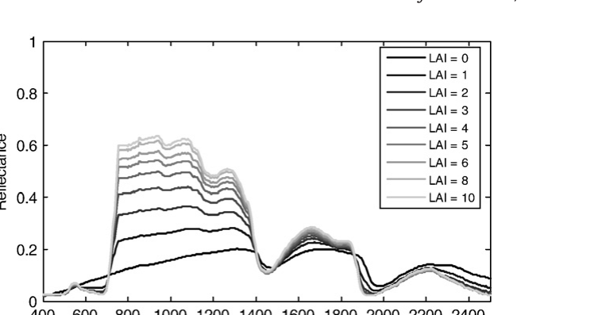
How a crop canopy shapes its reflectance spectrum
Region | Process | Controlled mainly by
VIS 400–700 nm | Pigment absorption | Cab (~60% of variance), Car
Red edge 680–750 nm | Steep rise; position shifts | Cab and LAI
NIR 750–1300 nm | Multiple scattering in leaves | LAI and leaf angle (ALA)
SWIR 1300–2500 nm | Water and dry-matter absorption | Cw (~50% at 1450–2100 nm), Cm, LAI
PROSAIL: canopy reflectance for LAI = 0 (bare soil) to 10. Jacquemoud et al. (2009) Remote Sens. Environ. 113:S56–S66, Fig. 3
LAI ↑ → red ↓, NIR ↑ (basis of NDVI). Sensitivity analysis: Cab drives VIS; LAI and ALA drive NIR; Cw drives SWIR.
Notes:
Different parts of the optical spectrum are controlled by different plant properties. In the visible, chlorophyll and carotenoids absorb strongly, so reflectance is low with a small green peak; chlorophyll controls about 60 percent of the variation. The red edge, between about 680 and 750 nanometres, shifts with chlorophyll and LAI. In the near infrared, leaves absorb little and scatter a lot, so reflectance is high and controlled by LAI and leaf angle. In the shortwave infrared, water absorption dominates, with leaf water explaining about half of the variation between 1450 and 2100 nanometres. The PROSAIL simulation shows how raising LAI from 0 to 10 lowers red reflectance and raises NIR.

Slide 6



Sun–target–sensor geometry: BRF, hotspot and anisotropy
nadir (θ_{v} = 0)
Key terms
BRF / BRDF: reflectance as a function of θ_{s}, θ_{v}, relative azimuth φ
Anisotropy: reflectance changes with view and sun direction
Hotspot: peak in backward direction when view ≈ sun direction; size ∝ leaf length / canopy height (SAIL hotspot parameter)
Darkspot: minimum in forward direction, shadows visible
Bowl shape: reflectance rises off-nadir (clear in NIR)
Multi-angle sensors: MISR (9), CHRIS (5), POLDER/PARASOL (up to 16 views)
θ_{s} sun zenith
forward = darkspot (shadows seen)
backward = hotspot (shadows hidden)
Principal plane: sun, target and sensor aligned (φ = 0° backward, 180° forward)
Notes:
Vegetation does not reflect equally in all directions; it is anisotropic. The bidirectional reflectance factor depends on the sun zenith angle, the view zenith angle and the relative azimuth between them. The principal plane contains the sun. Looking from the sun's side, the backward-scattering direction, the sensor sees sunlit leaves whose shadows are hidden behind them, giving a reflectance peak called the hotspot. Looking towards the sun, the forward direction, more shadows are visible and reflectance is lowest, the darkspot. Off-nadir views see more of the upper canopy, so reflectance usually rises with view angle: the bowl shape in the near infrared.

Slide 7
Families of canopy radiative transfer models
Canopy reflectance models
Turbid medium (1-D)
Geometric-optical
Hybrid
3-D / ray tracing
SAIL, SAILH, 4SAIL
Homogeneous layer of small leaves
Few inputs, fast, invertible
Best for crops (wheat, rice)
Crowns as cones / cylinders
Sunlit / shaded proportions
Forests, orchards
GeoSAIL, 4SAIL2 (crown clumping)
Turbid crowns + geometry
Row crops, sparse canopies
DART, FLIGHT, SPRINT, Monte Carlo
Realistic heterogeneity
Many inputs, slow, hard to invert
simple · fast · invertible
realistic · many inputs · slow
Leaf models: PROSPECT (broadleaf, monocots), LIBERTY (needles)
Notes:
Canopy models range from simple to very detailed. Turbid-medium models such as SAIL treat the canopy as a horizontally homogeneous layer of small, randomly placed leaves; they are fast and easy to invert. Geometric-optical models represent crowns as shapes casting shadows. Hybrid models such as GeoSAIL and 4SAIL2 combine the two to handle clumping. Three-dimensional and ray-tracing models such as DART, FLIGHT and SPRINT describe heterogeneous canopies realistically but need many inputs and are hard to invert. Leaf models such as PROSPECT supply leaf optical properties. Choosing a model is a trade-off between realism and invertibility.

Slide 8
PROSPECT + SAIL = PROSAIL
02
The leaf model, the canopy model, their coupling, and what the model tells us through sensitivity analysis
Notes:
Section 2 explains the most used canopy model, PROSAIL, from Jacquemoud et al. (2009).

Slide 9
PROSPECT: the leaf optical properties model
N
leaf structure (1–1.5 monocots)
Cab
chlorophyll a+b (µg cm⁻²)
Car
carotenoids (µg cm⁻²)
PROSPECT
N absorbing plates
(Allen et al. 1969)
Leaf ρ_{l}(λ), τ_{l}(λ)
400–2500 nm
to SAIL
canopy model
Cbrown
brown pigments
Cw
equivalent water thickness (cm)
Cm
dry matter (g cm⁻²)
Versions and facts
PROSPECT (Jacquemoud & Baret 1990) → PROSPECT-4 → PROSPECT-5: chlorophyll and carotenoids separated (Féret et al. 2008)
Each constituent has a specific absorption coefficient spectrum; total absorption = Σ k_{i}(λ)·C_{i}
Works well on broadleaves; reasonable for needles
Notes:
PROSPECT simulates leaf directional-hemispherical reflectance and transmittance from 400 to 2500 nanometres. It is based on the Allen plate model: the leaf is represented as N compact layers, each an absorbing plate with rough surfaces that scatter light isotropically. N describes mesophyll structure, the number of air–cell-wall interfaces; it is about 1 to 1.5 for monocots such as wheat. Absorption comes from the biochemical contents, each with its own specific absorption spectrum: chlorophyll a+b, carotenoids (separated from chlorophyll in PROSPECT-5), brown pigments, equivalent water thickness and dry matter. Its output feeds the canopy model.

Slide 10

SAIL: the canopy reflectance model
LAI
leaf area index
Four-stream fluxes
Outputs
LIDF / ALA
leaf angle distribution (avg. angle)
E_{s}
E₋
E₊
E_{o}
Bidirectional reflectance ρ_{c}
Hemispherical reflectance, albedo
fAPAR, gap fraction
canopy layer (turbid)
hspot
leaf length / canopy height
ρ_{soil}
soil reflectance (Lambertian; psoil)
skyl
diffuse / total irradiance
direct sun · diffuse down · diffuse up · towards observer
θ_{s}, θ_{v}, φ
sun zenith, view zenith, rel. azimuth
Version | Adds
SAILH | Hotspot (Kuusk 1991)
4SAIL | Fast, robust; thermal emission (Verhoef 2007)
GeoSAIL / 4SAIL2 | Clumping, crowns, vertical heterogeneity
FluorSAIL | Chlorophyll fluorescence
Notes:
SAIL, Scattering by Arbitrarily Inclined Leaves (Verhoef 1984), extends the Suits model. It treats the canopy as a turbid medium: a horizontally homogeneous, infinite layer of small flat leaves with a given leaf angle distribution. It solves four radiative fluxes, direct solar, diffuse downward, diffuse upward and the flux towards the observer, and outputs bidirectional reflectance and other optical properties. The hotspot effect was added in SAILH, using the ratio of leaf size to canopy height. 4SAIL is a fast, numerically robust version used in PROSAIL-5B. Other versions add heterogeneity (GeoSAIL, 4SAIL2), fluorescence (FluorSAIL) and thermal emission.

Slide 11
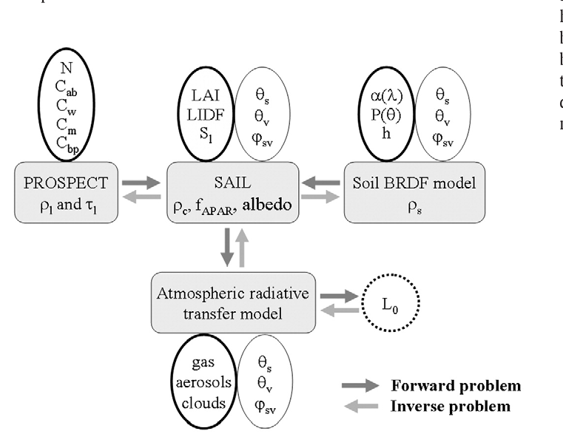

PROSAIL: coupling leaf and canopy models
Model | Variable | Unit
PROSPECT | N, Cab, Car, Cbrown, Cw (cm), Cm (g cm⁻²) | µg cm⁻²
SAIL | LAI, LIDF / ALA, hotspot s_{L} | m² m⁻², °
Soil | ρ_{s} (Lambertian) or Hapke BRDF | —
Illumination | SKYL, θ_{s}, θ_{v}, φ | °
Why coupling helps inversion
SAIL alone: 3 unknowns per wavelength (ρ_{l}, τ_{l}, ρ_{s}) → under-determined
PROSAIL: ~5 leaf + ~3 canopy variables explain the whole spectrum
Still compensations (e.g. LAI ↔ ALA) → use canopy-level Cab × LAI
PROSAIL coupling: forward (dark arrows) and inverse (light arrows). Jacquemoud et al. (2009) Remote Sens. Environ. 113:S56–S66, Fig. 2
Notes:
PROSAIL passes PROSPECT's leaf reflectance and transmittance into SAIL. On its own SAIL cannot be inverted from multispectral data, because leaf reflectance, leaf transmittance and soil reflectance are unknown at every wavelength. Coupling with PROSPECT replaces those many spectral unknowns with a few biochemical variables, imposing a strong spectral constraint. The figure from Jacquemoud et al. shows the full chain, optionally with a soil BRDF model and an atmospheric model to reach top-of-atmosphere radiance. Grey arrows show the forward problem and white arrows the inverse problem. Outputs include canopy reflectance, fAPAR and albedo.

Slide 12
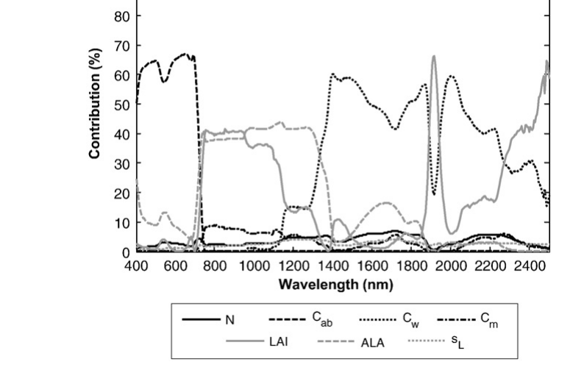

Sensitivity analysis: which variable controls which band?
What to remember
VIS: Cab ≈ 60%; weaker at 550 and 700 nm (no saturation → red-edge indices)
NIR: LAI and ALA ≈ equal → they compensate in inversion
SWIR: Cw ≈ 50% (1450–2100 nm); LAI takes over at strong water bands
N (structure) has small effect everywhere
Interactions: Cab×LAI, Cab×ALA ≈ 8% (VIS); LAI×ALA 5–6% (NIR)
Contribution (%) of each PROSAIL variable to reflectance variance, 400–2500 nm. Jacquemoud et al. (2009) Remote Sens. Environ. 113:S56–S66, Fig. 4
Leaf biochemical signals can be enhanced up to ~2× at canopy level (Baret et al. 1994) — but LAI and ALA must be known well.
Notes:
Global sensitivity analysis (DOES, EFAST) quantifies how much of the reflectance variance each input explains at each wavelength. Chlorophyll explains about 60 percent in the visible, less near 550 and 700 nanometres where absorption does not saturate. In the near infrared, average leaf angle and LAI share the influence equally. In the shortwave infrared, water content contributes about half between 1450 and 2100 nanometres. Interactions, such as chlorophyll with LAI in the visible, add a few percent each. This tells us which bands to use for each variable and explains why leaf water is hard to retrieve from broadbands.

Slide 13
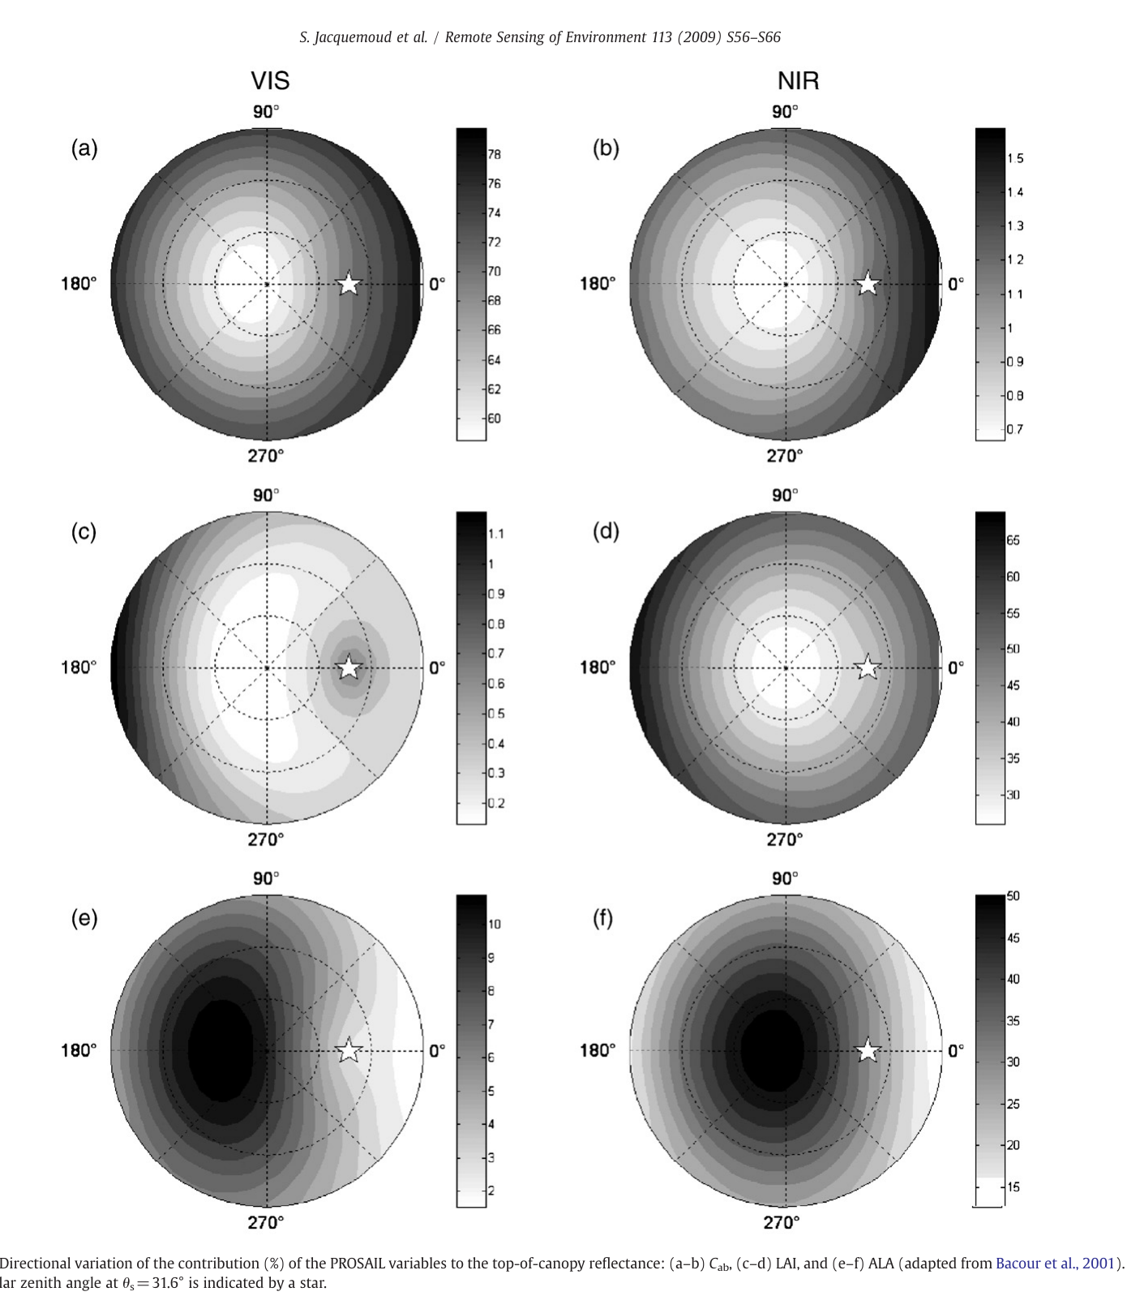
Directional sensitivity: where to look from
Variable | Most informative view
Cab (VIS) | Backward (shadows hidden)
LAI (NIR) | Oblique forward and backward
ALA | Near nadir (soil visible)
Implications
Nadir-only view is poor for LAI
Best joint retrieval of Cab, LAI, ALA needs ≥ 3 views: forward, nadir, backward
IARI inversions used the hotspot view (40° backward, principal plane) where inversion performed best
Directional contribution of Cab (a,b), LAI (c,d) and ALA (e,f) in VIS and NIR; star = sun. Jacquemoud et al. (2009) Remote Sens. Environ. 113:S56–S66, Fig. 6
Notes:
The same analysis across view directions shows where each variable is most visible. In the visible, chlorophyll influences reflectance most in the backward direction, where shadows are hidden. LAI is best seen in oblique forward and backward directions where photons have interacted with more leaves. Leaf angle influences most near nadir, where the soil can be seen. So a single nadir view carries little information about LAI compared with oblique views, and the most accurate joint estimate of chlorophyll, LAI and leaf angle needs at least three views: forward, nadir and backward. This is the motivation for multi-angle sensors and for goniometer studies like the IARI work.

Slide 14


Using PROSAIL in forward mode
Generate databases
Simulated spectra for known inputs (e.g. 54,000 cases)
Design / test VIs
TCARI/OSAVI, MTCI, NDWI; red-edge position
Sensitivity analysis
DOES, EFAST → optimal bands and angles
Sensor design
Simulate missions before launch (CHRIS, Sentinel-2)
Train retrieval
LUT and ML training sets (hybrid methods)
Example: red edge
PROSAIL showed red-edge shifts come mainly from Cab and LAI and are almost insensitive to soil and atmosphere; at 1 nm resolution the red-edge position jumps from ~695 to ~725 nm when Cab > 45 µg cm⁻² (Le Maire et al. 2004)
Notes:
Before any inversion, PROSAIL is useful in forward mode. It can generate large simulated databases of spectra for known variables, which are used to design and test vegetation indices that are sensitive to one variable but not to others, such as TCARI/OSAVI for chlorophyll or water indices. It is used in sensitivity analyses to choose optimal bands and view angles, and to design future sensors long before launch, as was done for CHRIS. And the simulated databases are the training data for look-up tables and machine-learning retrieval, which is the hybrid approach.

Slide 15
Validating PROSAIL on wheat (IARI)
03
Bidirectional reflectance of wheat under contrasting nitrogen, and how well PROSAIL5B reproduces it
Notes:
Section 3 is the IARI field study by Chakraborty, Sehgal, Sahoo, Pradhan and Gupta (2015), which measured wheat bidirectional reflectance with a goniometer and tested PROSAIL5B.

Slide 16
Experimental methodology: goniometer BRF of wheat
Wheat PBW-502, rabi 2010–11; N0 vs N120 kg ha⁻¹ (6 × 6 m plots, 3 reps)
Parameter | N0 46 DAS | N0 106 | N120 46 | N120 106
LAI | 0.48 | 1.70 | 0.60 | 3.20
Cab (µg cm⁻²) | 28 | 29 | 52 | 65
Cw (cm) | 0.033 | 0.027 | 0.024 | 0.030
Avg. leaf angle (°) | 70 | 35 | 70 | 45
hspot | 0.79 | 0.22 | 0.78 | 0.32
1
ASD FieldSpec-3 (350–2500 nm), FOV 10°, on field goniometer
2
8 azimuths (0–315°) × 6 zenith angles (nadir, 20–60°); BaSO₄ panel each view
3
Plant inputs: LAI (LAI-2000), Cab (DMSO, 645/663 nm), Cm, Cw, leaf angle, hspot
4
BRF surface plots at LISS-3 centres: 568, 660, 790, 1634 nm
Why two N extremes?
5
Sparse low-chlorophyll (N0) vs dense high-chlorophyll (N120) canopy → tests the model over a wide range
Run PROSAIL5B with measured inputs → compare in principal plane (RMSE, nRMSE)
6
Notes:
The experiment was at the IARI farm, New Delhi, with spring wheat PBW-502 in rabi 2010–11. Two extreme nitrogen treatments, zero and 120 kilograms per hectare, created a wide range of crop parameters. Bidirectional reflectance was measured between 11:00 and 13:00 on clear days with an ASD FieldSpec-3 spectroradiometer, field of view reduced to 10 degrees, on a portable goniometer, at eight relative azimuths and six zenith angles, with a barium sulphate reference panel at each position. Plant inputs for PROSAIL were measured the same day: LAI with an LAI-2000, chlorophyll by DMSO extraction, leaf area, specific leaf weight, leaf water, leaf angle and the hotspot parameter.

Slide 17
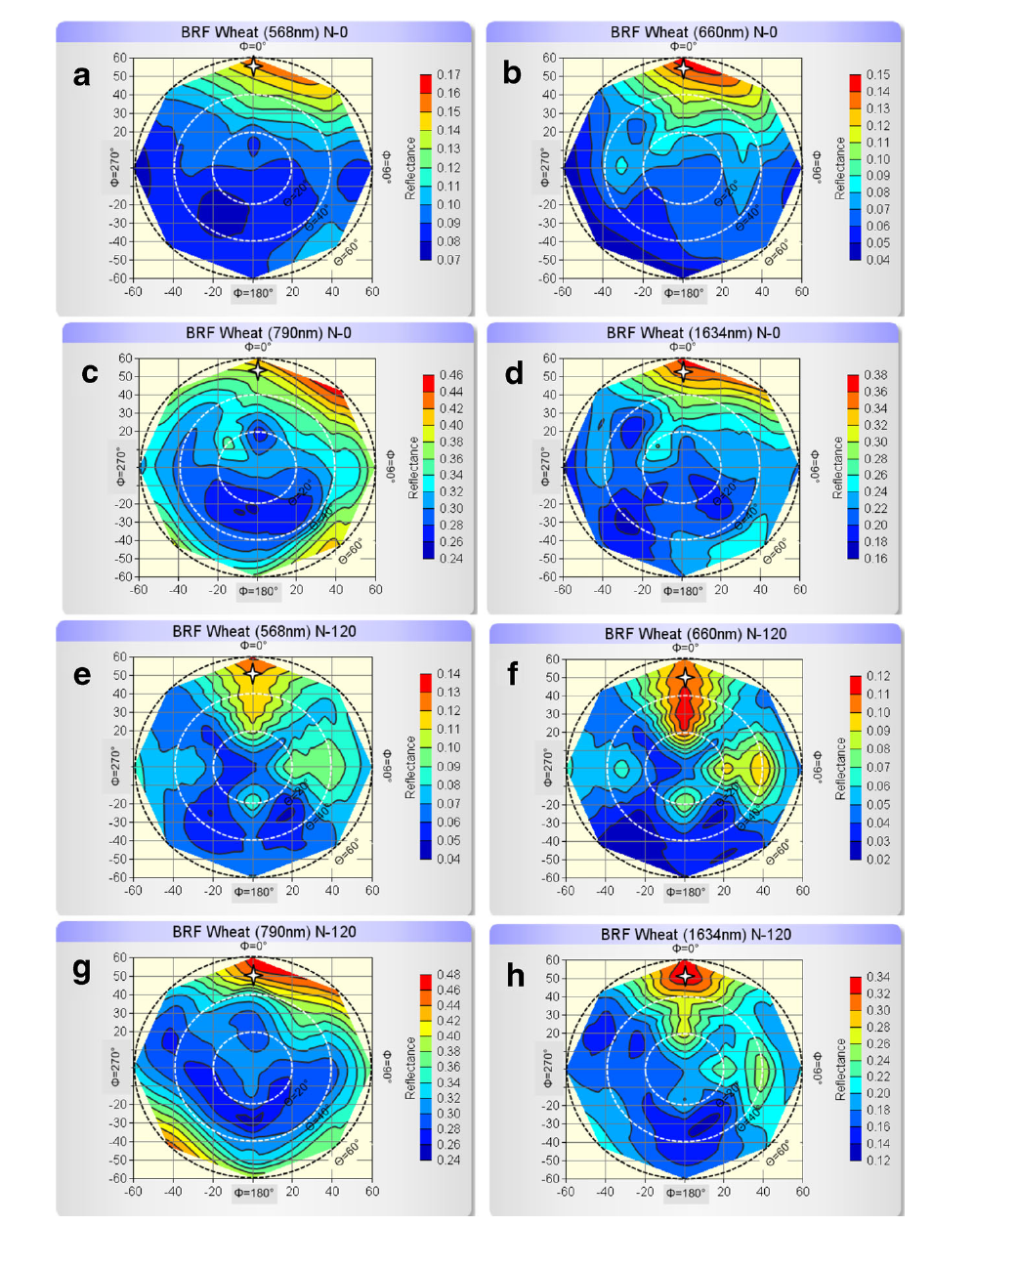
Result 1: wheat reflectance is strongly anisotropic
Findings
Backward > forward at all wavelengths and treatments
Hotspot in principal plane, backward, 50–60° view zenith (synchronised with sun zenith)
Darkspot in forward direction at high view zenith (more shadow)
NIR (790 nm): reflectance ↑ with view angle in all directions → bowl shape
Hotspot broadens with growth (LAI, leaf size, planophile leaves, lower sun zenith)
Sparse N0 at 46 DAS: hotspot shifted to 45° azimuth → soil (strongly anisotropic) dominates
Pattern holds equally in SWIR
BRF polar plots at 568, 660, 790, 1634 nm; N0 (a–d) and N120 (e–h), 46 DAS. Chakraborty, Sehgal, Sahoo et al. (2015) J. Indian Soc. Remote Sens. 43:297–310, Fig. 1
Notes:
The polar plots show reflectance at the four LISS-3 band centres for all view directions, with the sun marked by a star. In every band and treatment, reflectance was higher in the backward direction than the forward. The maximum, the hotspot, occurred in the principal plane at 50 to 60 degrees view zenith in the backward direction, matching the sun position. The minimum was in the forward direction at high view angles, the darkspot. In the near infrared, reflectance rose with view angle in all directions, a bowl shape. As the crop grew, from 46 to 106 days, the hotspot broadened because of higher LAI, bigger leaves and more planophile leaves.

Slide 18
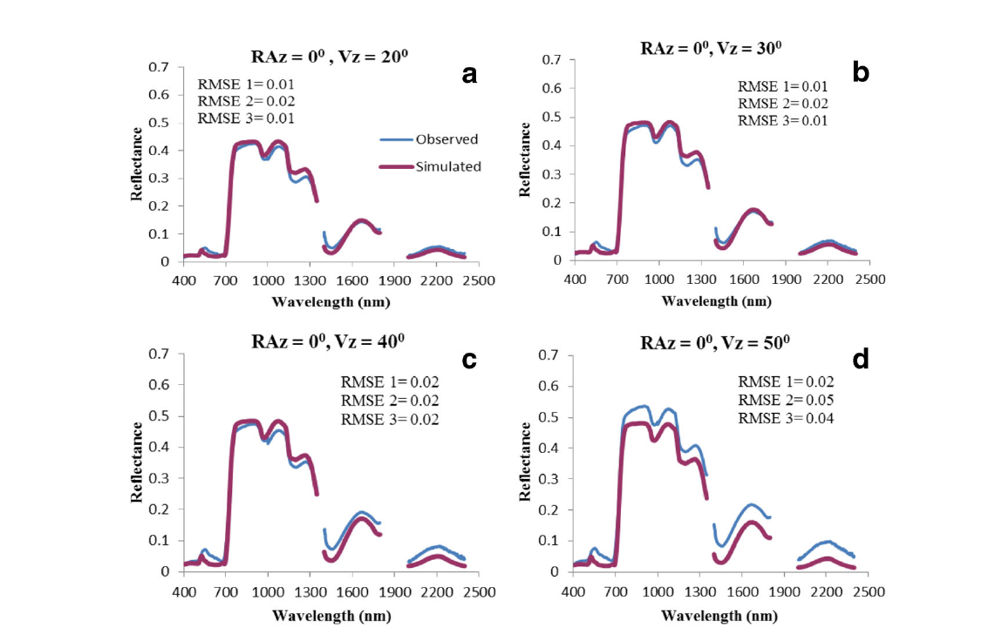
Result 2: PROSAIL5B reproduces the spectral shape
PROSAIL5B setting | Value
N (structure) | 1.0 (best fit, monocot)
Car / Cbrown | 1 µg cm⁻² / 0.05
skyl (diffuse %) | 10 (clear sky)
psoil | 0.1 (shaded soil)
Other inputs | measured LAI, Cab, Cw, Cm, ALA, hspot
Errors
RMSE VIS 0.01–0.02; NIR 0.02–0.05; SWIR 0.01–0.04 (backward)
Forward direction better; worst near hotspot
Green peak simulated at 525 vs 550 nm
Observed vs PROSAIL5B spectra, N120, 106 DAS, backward principal plane, view zenith 20–50°. Chakraborty, Sehgal, Sahoo et al. (2015) J. Indian Soc. Remote Sens. 43:297–310, Fig. 3
Water bands 1350–1400, 1800–2000, 2400–2500 nm excluded (atmospheric noise)
Notes:
PROSAIL5B was run with the measured inputs. Fixed values were N equal to 1.0, which gave the best fit for monocot wheat, carotenoids 1 microgram per square centimetre, brown pigment 0.05, diffuse fraction 10 percent for clear sky, and a soil coefficient of 0.1 matched to shaded soil. The simulated spectra matched the observed shape at all view zenith angles in the principal plane and responded correctly to view angle. Errors were small in absolute terms, about 0.01 to 0.02 in the visible and up to 0.05 in the near infrared. The model performed better in the forward direction, and errors were largest at 50 to 60 degrees backward, near the hotspot. The simulated green peak was shifted to 525 nanometres instead of the observed 550.

Slide 19
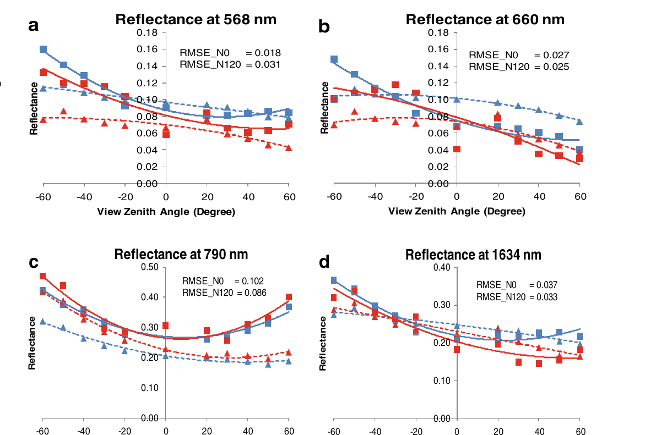
Result 3: where PROSAIL works and where it fails
NIR
SWIR
VIS
best (nRMSE ~0.14 for N120)
second
worst (nRMSE ~0.33–0.38)
Conclusions
Average error over spectrum and angles ≈ 26%
Underestimates near hotspot (backward)
NIR bowl shape reproduced; not in VIS / SWIR
Dense canopy (N120) ≫ sparse (N0): Lambertian soil assumption fails at low LAI
Observed (solid) vs simulated (dashed) in principal plane, −60° to +60°; N0 blue, N120 red, 46 DAS. Chakraborty, Sehgal, Sahoo et al. (2015) J. Indian Soc. Remote Sens. 43:297–310, Fig. 5
Need: an anisotropic soil BRDF (e.g. Hapke) in SAIL for sparse crops, and better VIS simulation for chlorophyll retrieval.
Notes:
At the four band centres across the principal plane, the model matched reflectance magnitude reasonably but underestimated near the hotspot in the backward direction and generally overestimated in the forward direction, except at 790 nanometres. The near-infrared bowl shape was simulated very well, but not at the other bands. In relative terms the model performed best in the near infrared, then shortwave infrared, and worst in the visible, with an average error of about 26 percent. Performance was much better for the dense N120 canopy than the sparse N0 canopy, because SAIL assumes a Lambertian soil, while real soil is anisotropic and dominates sparse canopies.

Slide 20
Inverting PROSAIL
04
The inverse problem, look-up tables, genetic algorithms, neural networks — and a LAI map from IRS LISS-3
Notes:
Section 4 covers how the model is inverted to retrieve LAI, chlorophyll and water, with the two IARI inversion studies.

Slide 21
The inverse problem and why it is ill-posed
R = m(x) + ε
δ² = Σ[(R_{i} − m_{i}(x))/σ_{Ri}]² + Σ[(x_{j} − x_{j}^{prior})/σ_{xj}]²
measurement / model misfit + prior information on variables (Jacquemoud et al. 2009, Eq. 2)
Why ill-posed?
How to regularise
More unknowns than independent observations
Compensation: LAI ↔ ALA give similar NIR; Cab ↔ LAI in VIS
Measurement noise + model error (e.g. Lambertian soil)
Hadamard: unique, stable solution often not guaranteed
Prior ranges / distributions from field data and literature
Fix poorly sensitive inputs (N, Car, Cbrown, psoil)
Retrieve canopy-level variables: CCC = Cab × LAI, Cw × LAI
Use more bands / view angles; spatial or temporal constraints
Take mean of several best solutions (LUT-II)
Notes:
Formally, reflectance equals the model output for a set of variables plus error. Inversion finds the variables that minimise a cost function. The general cost function has two parts: the squared differences between observed and simulated reflectance, weighted by measurement and model uncertainty, and the squared differences between the variables and their prior values, weighted by prior uncertainty. Without the prior term, the solution may not be unique: different combinations of LAI and leaf angle, for example, give almost the same spectrum. This ill-posedness is reduced by using prior information and realistic ranges, more bands or view angles, canopy-level variables such as chlorophyll times LAI, and spatial or temporal constraints.

Slide 22
Inversion strategies compared
PROSAIL inversion methods
Iterative optimisation
Genetic algorithm
Look-up table (LUT)
ANN / ML (hybrid)
Simplex, quasi-Newton
+ accurate, no training
− slow per pixel, local minima, needs start values
Population, selection, crossover, mutation
+ global search, no derivatives, no initial guess
− many model runs
Pre-computed simulations; search best match
+ global minimum, fast, simple
− large table; bounded by ranges
Trained on simulated spectra
+ fastest, operational (MODIS, S-2)
− black box; varies with training
← observation space (minimise reflectance misfit)
variable space (map reflectance → variables) →
Jacquemoud et al.: no universal best method — accuracy depends more on model uncertainty and prior information than on the algorithm.
Notes:
Inversion approaches fall into two groups. Observation-space methods minimise the distance between measured and simulated reflectance: iterative numerical optimisation such as simplex, quasi-Newton or genetic algorithms, Markov chain Monte Carlo, and look-up tables. Variable-space methods fit a mapping directly from reflectance to variables: vegetation indices calibrated with the model, and machine learning such as neural networks trained on simulations. Optimisation is accurate but slow per pixel and can be trapped in local minima. Look-up tables find the global minimum if sampling is dense and are fast. Neural networks are very fast once trained but depend on the training set. Genetic algorithms avoid the initial-guess problem.

Slide 23
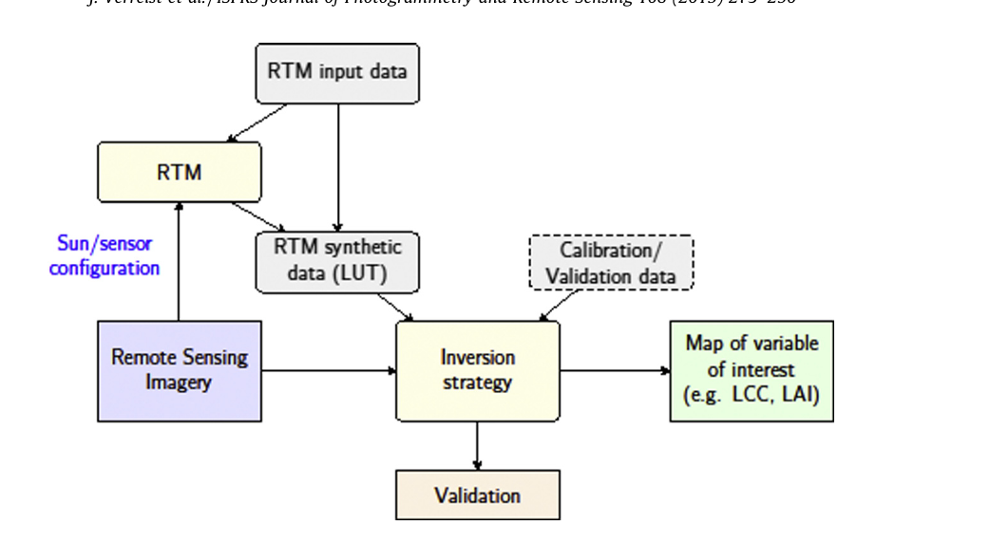
Look-up table inversion: step-by-step methodology
Set free variable ranges (prior) and fixed inputs
1
Sample combinations → forward PROSAIL runs
2
Convolve spectra to sensor bands with RSR (e.g. LISS-3 B2–B5)
3
Cost function per entry, e.g. rMSE = Σ[(R_{obs} − R_{LUT})/R_{obs}]²
4
Generalised LUT inversion. Verrelst et al. (2015) ISPRS J. Photogramm. Remote Sens. 108:273–290, Fig. 3
Sort; solution = best fit (LUT-I) or mean of best n% (LUT-II)
5
Design choices
Validate vs field data (r, RMSE, nRMSE, target diagram) → map
Table size vs accuracy; sampling (uniform / priors); cost function (RMSE, rMSE, spectral angle); number of solutions averaged
6
Notes:
The look-up table method is the simplest robust inversion. Define realistic ranges for the free variables from field data and literature and fix the insensitive ones. Run PROSAIL forward for every combination. Convolve each simulated spectrum to the sensor's bands using its relative spectral response. For each observed pixel, compute a cost function between its reflectance and every table entry, sort the entries, and take either the single best match or the mean of the best few percent. Finally validate against field measurements. The generalised flowchart from Verrelst et al. shows the same logic.

Slide 24
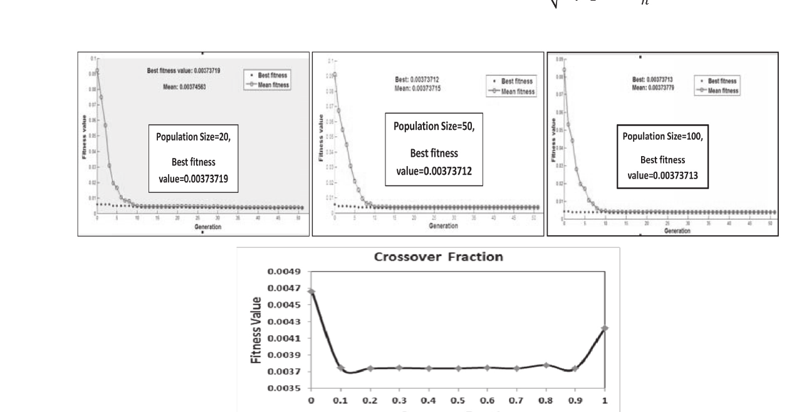
Genetic-algorithm inversion of PROSAIL (Mridha et al. 2014)
Initial population
random Cab, LAI, Cw in ranges
Free variable | Range
Cw | 0.01–0.045 cm
Cab | 30–100 µg cm⁻²
LAI | 0.5–6.5
Run PROSAIL
simulate spectrum / bands
Fitness = MSE
vs observed reflectance
no: next gen.
Fixed
Effect of population size and crossover fraction on fitness. Mridha, Sahoo, Nagesh Kumar, Sehgal et al. (2014) J. Agric. Physics 14:87–95, Fig. 1
Selection
stochastic uniform
Cm 0.0046 g cm⁻²
N 1.0; psoil 0.1; Cbrown 0.05
ALA measured per date
View: hotspot, 40° backward
Sun zenith 51°, 45°, 33°
Why GA?
Works on many points in parallel; needs only a fitness function (no derivatives); probabilistic selection keeps global exploration → avoids initial-guess and local-minimum problems
Crossover + mutation
scattered (0.8), adaptive feasible
Converged?
best individual = solution
Notes:
In the GA study, wheat PBW-502 was measured at IARI on three dates with the goniometer setup. Only three variables were free: leaf water 0.01 to 0.045 centimetres, chlorophyll 30 to 100 micrograms per square centimetre, and LAI 0.5 to 6.5. Dry matter was fixed at the measured 0.0046, N at 1.0, soil coefficient 0.1 and brown pigment 0.05; leaf angle was the measured value per date. The view geometry was fixed at the hotspot, 40 degrees backward in the principal plane, because inversion performed best there. Spectra were also convolved to MODIS, Landsat TM and LISS-3 bands. The genetic algorithm in MATLAB used mean squared error as fitness, a feasible initial population, stochastic-uniform selection, scattered crossover with fraction 0.8 and adaptive-feasible mutation.

Slide 25
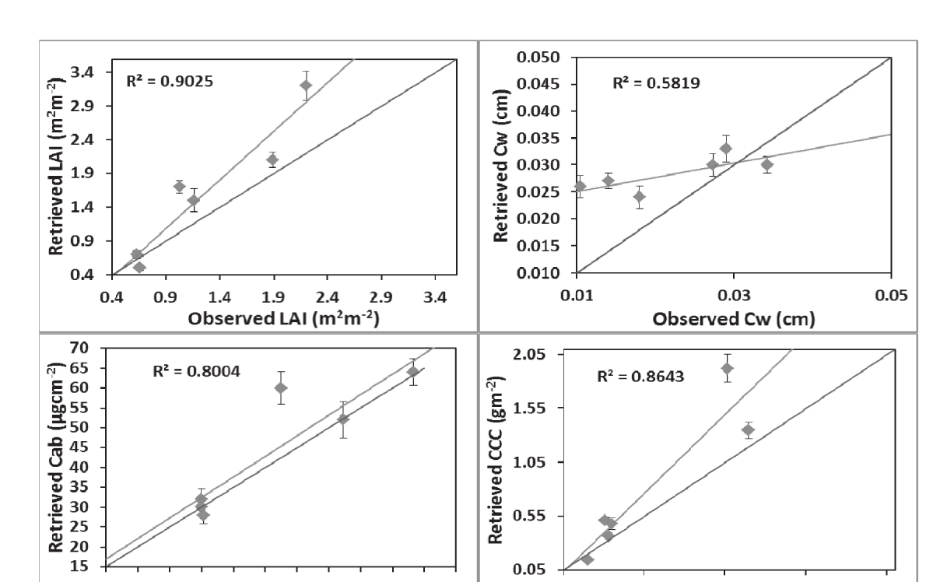
GA results: LAI retrieved best, leaf water worst
Variable | MODIS | TM | LISS-3 | Whole spectrum
LAI (R²) | 0.92 | 0.90 | 0.93 | 0.90
LAI RMSE | 0.40 | 0.36 | 0.40 | 0.52
CCC (R²) | 0.88 | 0.86 | 0.81 | 0.86
Cab (R²) | 0.73 | 0.82 | 0.78 | 0.80
Cab RMSE (µg cm⁻²) | 8.1 | 9.4 | 7.0 | 7.3
Cw (R²) | 0.40 | 0.48 | 0.37 | 0.58
GA retrievals vs observed, whole spectrum: LAI, Cw, Cab, CCC. Mridha, Sahoo, Nagesh Kumar, Sehgal et al. (2014) J. Agric. Physics 14:87–95, Fig. 5
Accuracy order LAI > CCC > Cab > Cw. Structure dominates canopy reflectance; VIS has low dynamic range; leaf-to-canopy signal is weak for Cab and Cw.
Table 3 values; RDP > 1 for LAI, Cab, CCC (good), < 1 for Cw with whole spectrum
Notes:
Observed versus retrieved values lay close to the one-to-one line for LAI, chlorophyll and canopy chlorophyll. LAI had R squared of 0.90 to 0.93 for all band sets, with slight overestimation at low values and underestimation at high values. Canopy chlorophyll followed, then leaf chlorophyll, while leaf water was poor except with the full spectrum. Broadband MODIS, TM and LISS-3 reflectance performed about as well as the full 400 to 2500 nanometre spectrum. LAI is easiest because structural variables dominate canopy reflectance, and the red and NIR bands are highly sensitive to it; chlorophyll is harder because the visible has a low dynamic range and leaf signals weaken at canopy scale.

Slide 26
LUT vs neural network inversion (Sehgal et al. 2016): method
Field spectra (N0/N60/N120)
→ LISS-3 bands via RSR
LUT-I
single best rMSE match
Retrieve Cab, LAI, Cw
CCC = Cab × LAI
PROSAIL5B LUT
Cab 20–80 (1), LAI 0.1–6 (0.2), Cw 0.01–0.04 (0.001)
= 54,000 cases
LUT-II
mean of best 100 / 500 / 1000 / 10%
ANN
3-layer feed-forward BP; train 70%, validate 30% of LUT
Evaluate
r, RMSE, nRMSE, target diagram
rMSE = Σ_{i}[(R_{obs,i} − R_{LUT,i}) / R_{obs,i}]²
Target diagram
x = centred RMSD, y = bias; distance from origin = total RMSD; inside unit circle = good
Notes:
The 2016 study compared three inversion techniques using LISS-3 broadband reflectance from the IARI wheat experiment with N0, N60 and N120 treatments. The look-up table varied chlorophyll from 20 to 80 in steps of 1, LAI from 0.1 to 6 in steps of 0.2 and leaf water from 0.01 to 0.04 in steps of 0.001, giving 54,000 PROSAIL5B simulations convolved to the four LISS-3 bands. The cost function was relative mean squared error. LUT-I took the single best match; LUT-II took the mean of the best 100, 500, 1000 or 10 percent of entries. The neural network was a three-layer feed-forward back-propagation network trained on 70 percent of the table and validated on 30 percent. Retrievals were compared with r, RMSE, nRMSE and a target diagram.

Slide 27
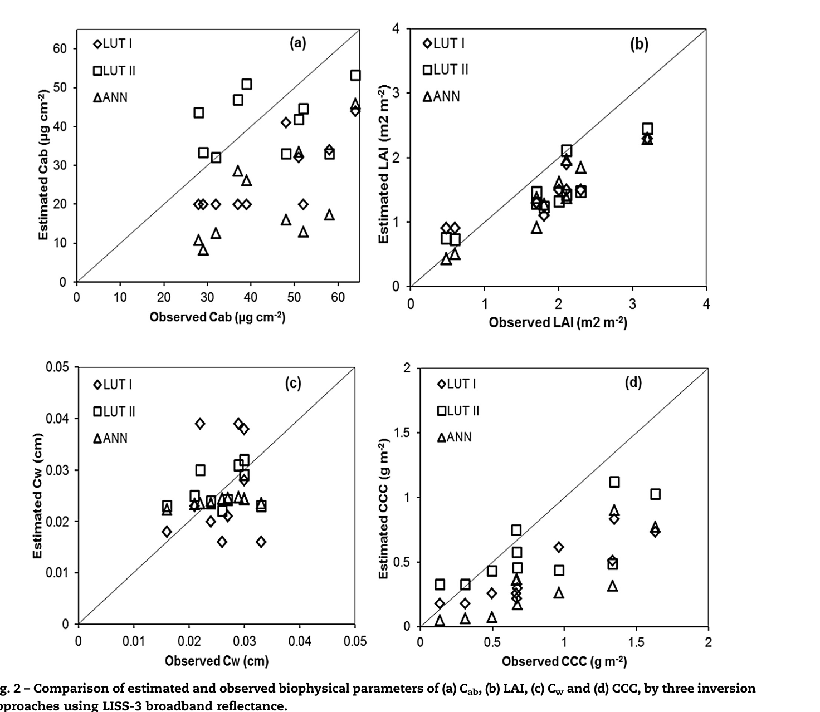
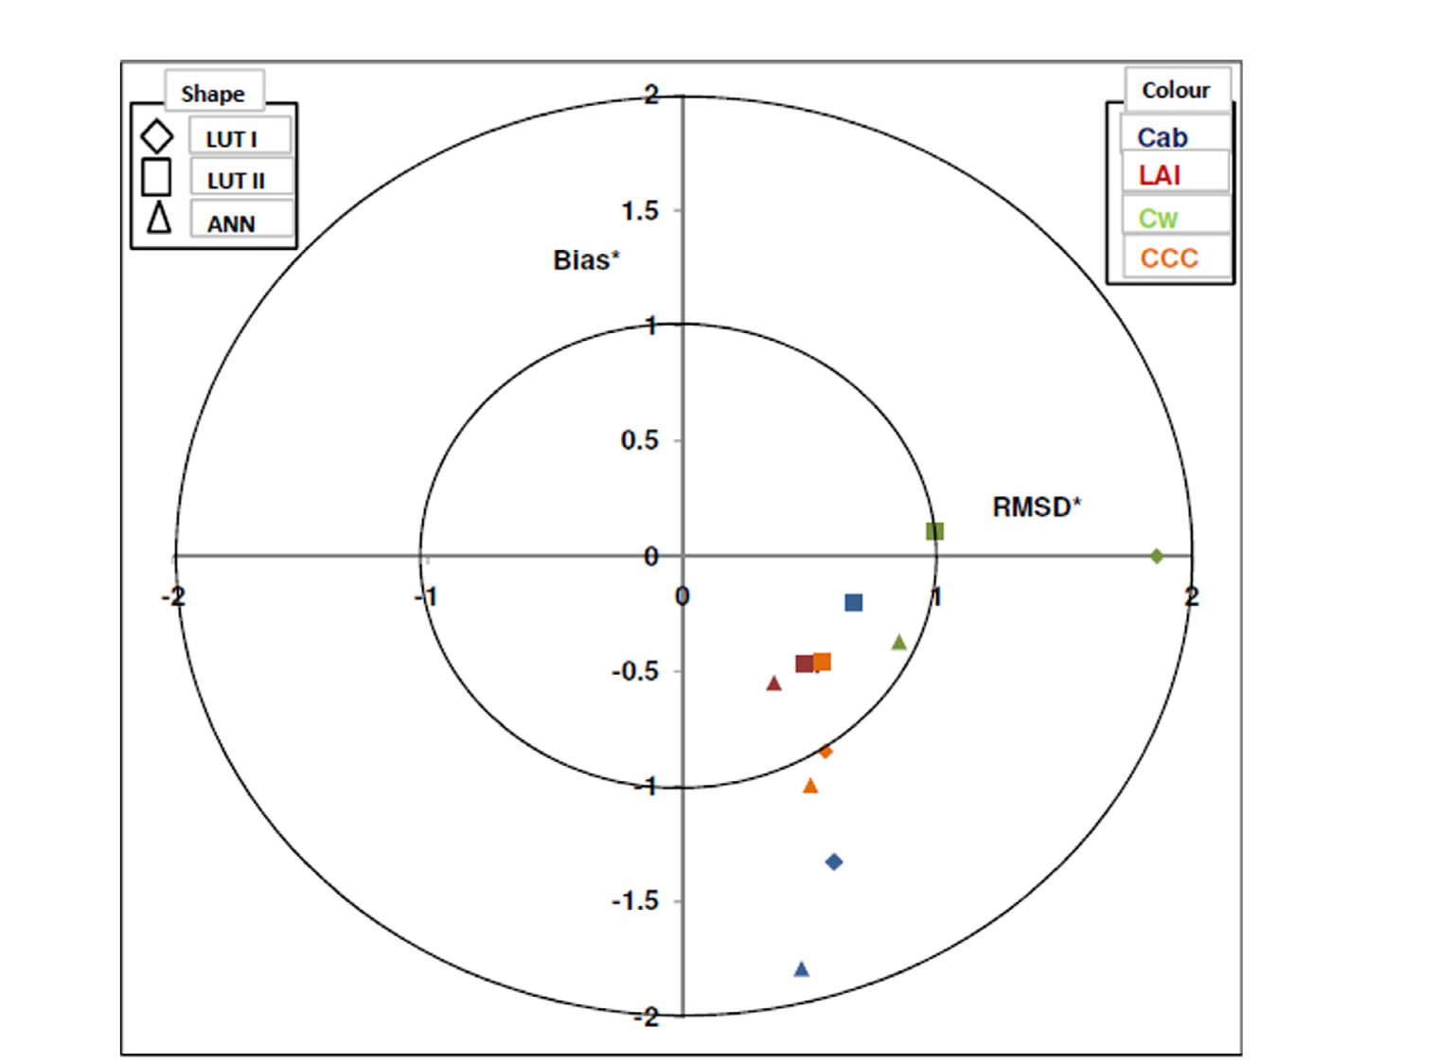
LUT-II (mean of best 10%) wins; ANN is worst
 | LUT-I | LUT-II | ANN
Cab r / RMSE | 0.78 / 18.3 | 0.71 / 9.06 | 0.87 / 23.3
LAI r / RMSE | 0.90 / 0.56 | 0.90 / 0.47 | 0.94 / 0.52
CCC r / RMSE | 0.89 / 0.49 | 0.89 / 0.35 | 0.92 / 0.54
Cw r | 0.17 ns | 0.30 ns | 0.74
Why
LUT is radiometric: seeks best spectral match; ANN minimises error in variable space
ANN changes with each training set; LUT is consistent
Cw range too narrow (N trial)
Estimated vs observed Cab, LAI, Cw, CCC (LUT-I ◇, LUT-II □, ANN △). Sehgal, Chakraborty & Sahoo (2016) Inf. Process. Agric. 3:107–118, Fig. 2
Target diagram (bias vs centred RMSD). Sehgal, Chakraborty & Sahoo (2016) Inf. Process. Agric. 3:107–118, Fig. 3
Order LAI > Cab > CCC > Cw in all methods → PROSAIL's VIS errors and Lambertian soil limit accuracy more than the algorithm.
Notes:
All three methods captured the variation, but accuracy differed. ANN had the highest correlations but the largest errors and strong underestimation, so correlation alone is misleading. Averaging the best 10 percent of LUT solutions steadily reduced error: chlorophyll RMSE fell from 18.3 for the single best fit to 9.1, and LAI RMSE to 0.47. The target diagram confirms LUT-II as best for all variables, with normalised total error below one. Leaf water could not be retrieved, because its observed range was narrow, the treatments varied nitrogen only. The order was LAI, then chlorophyll, then canopy chlorophyll, then water. The authors conclude model deficiencies matter more than the inversion method.

Slide 28
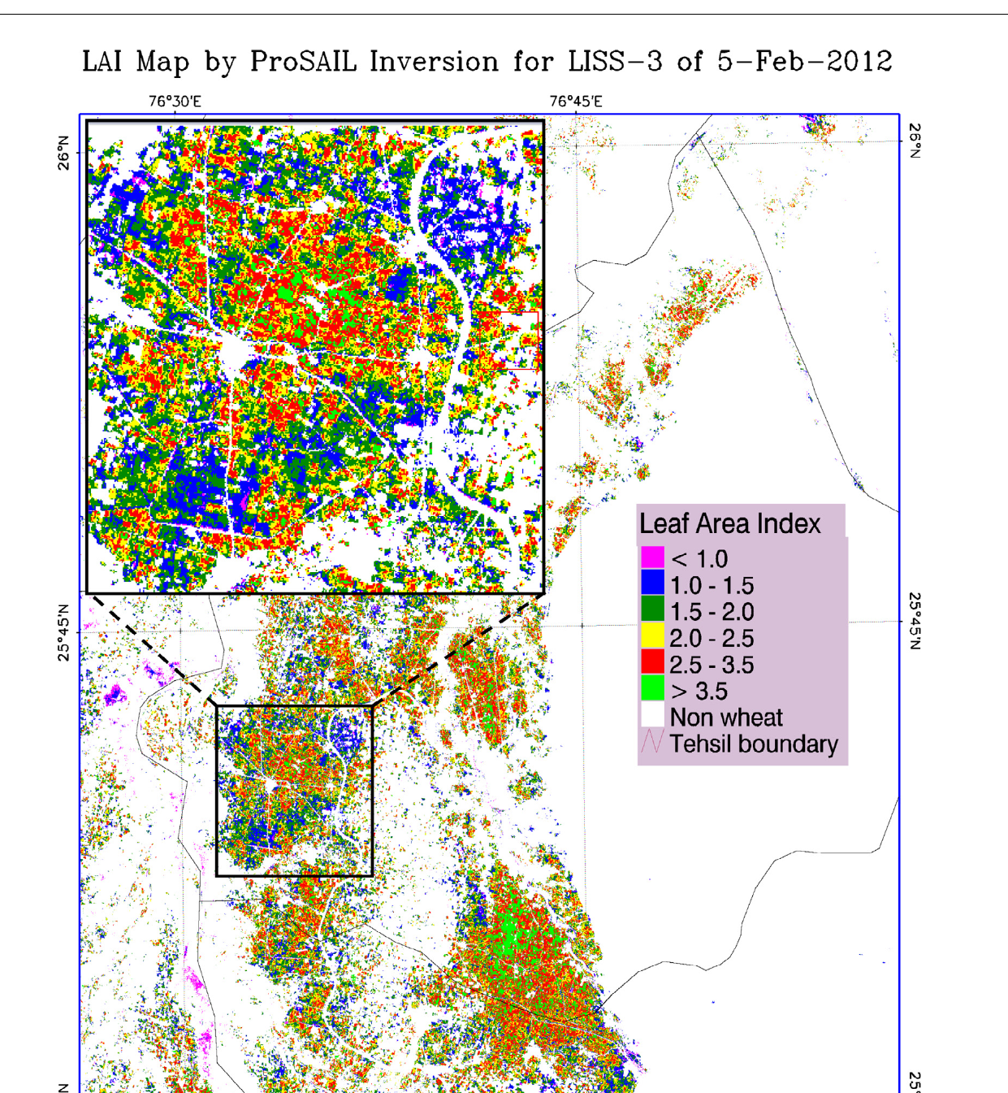
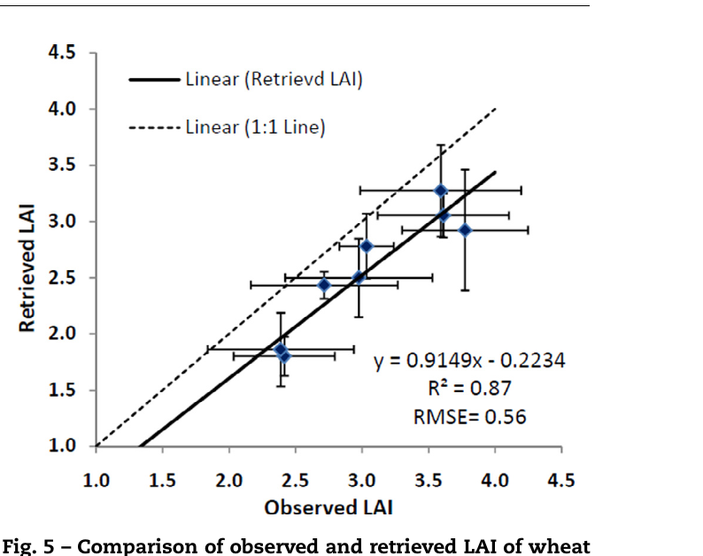
From field to region: wheat LAI map from IRS LISS-3
LISS-3 image (5 Feb 2012, path 96 / row 53)
Geometric correction (SOI GCPs)
DN → radiance (gain, offset)
FLAASH → surface reflectance
MLC classification → wheat mask
Retrieved vs observed LAI. Sehgal, Chakraborty & Sahoo (2016) Inf. Process. Agric. 3:107–118, Fig. 5
LUT-II per pixel → LAI map
0.56
0.55–4.5
LAI RMSE (R² 0.87)
LAI range; mostly ~2
Validate: LAI-2000 + GPS
Wheat LAI by PROSAIL5B LUT-II, Sheopur (MP). Sehgal, Chakraborty & Sahoo (2016) Inf. Process. Agric. 3:107–118, Fig. 4
Errors mainly from model simulation, not inversion
Notes:
The best method, LUT-II, was applied to an IRS-P6 LISS-3 image of 5 February 2012 over Sheopur district, Madhya Pradesh. The image was geometrically corrected with ground control points from Survey of India maps, converted from digital numbers to radiance with gain and offset, and atmospherically corrected to surface reflectance with FLAASH. Wheat was classified with a maximum-likelihood classifier and other pixels masked. LUT-II was then run on every wheat pixel's four-band reflectance. LAI ranged from 0.55 to 4.5, mostly around 2. Compared with ground LAI measured with an LAI-2000 and GPS, the retrieval was consistently underestimated, with RMSE 0.56 and R squared 0.87, similar to the field-scale error.

Slide 29
Retrieval methods: the big picture
05
Parametric, non-parametric, physically-based and hybrid approaches (Verrelst et al. 2015)
Notes:
Section 5 places RTM inversion within all optical retrieval methods, from the ISPRS review by Verrelst and colleagues.

Slide 30
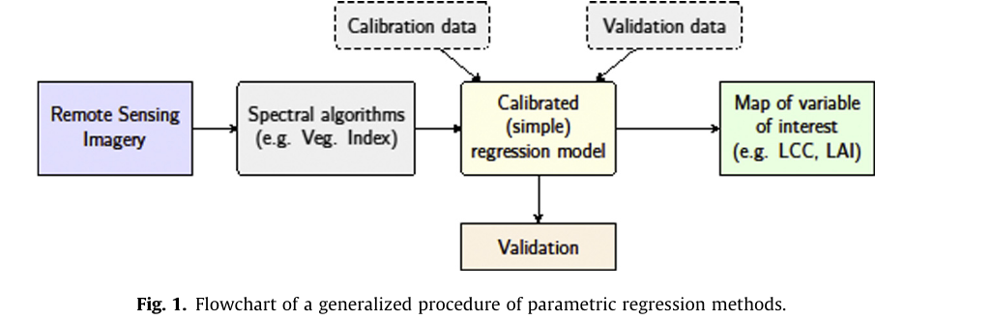
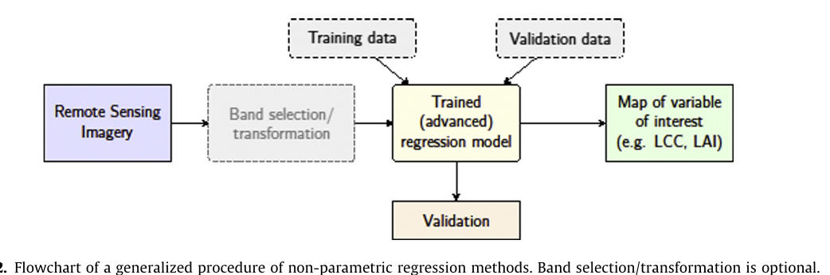
Statistical methods: parametric vs non-parametric
Parametric regression. Verrelst et al. (2015) ISPRS J. Photogramm. Remote Sens. 108:273–290, Fig. 1
Non-parametric regression. Verrelst et al. (2015) ISPRS J. Photogramm. Remote Sens. 108:273–290, Fig. 2
Parametric (VIs)
Non-parametric
2-band: SR, NDVI, PRI, OSAVI, chlorophyll index
3-band: TVI, MCARI, TCARI; 4+: TCARI/OSAVI
Shape: red-edge position, continuum removal, derivatives
− sensor/site-specific, one variable, no uncertainty
Linear: SMLR, PCR, PLSR (handles collinearity)
Trees: bagging, random forest
ANN; kernel methods: SVR, KRR, GPR
+ full spectrum, non-linear; GPR gives uncertainty and band relevance
− needs field training data; black box; may not transfer
Notes:
Parametric regression relates a few bands, usually combined into a vegetation index, to a variable with an explicit fitted function: linear, exponential or power. Examples are two-band indices such as NDVI, OSAVI and the chlorophyll index, three-band indices such as MCARI and TCARI, combinations such as TCARI/OSAVI, and shape indices such as red-edge position and continuum removal. It is simple and fast but dataset- and sensor-specific, uses little of the spectrum and gives no uncertainty. Non-parametric methods learn from training data and can use the full spectrum. Linear ones include stepwise regression, principal components regression and partial least squares. Non-linear machine learning includes decision trees and random forests, neural networks, and kernel methods: support vector regression, kernel ridge regression and Gaussian process regression.

Slide 31
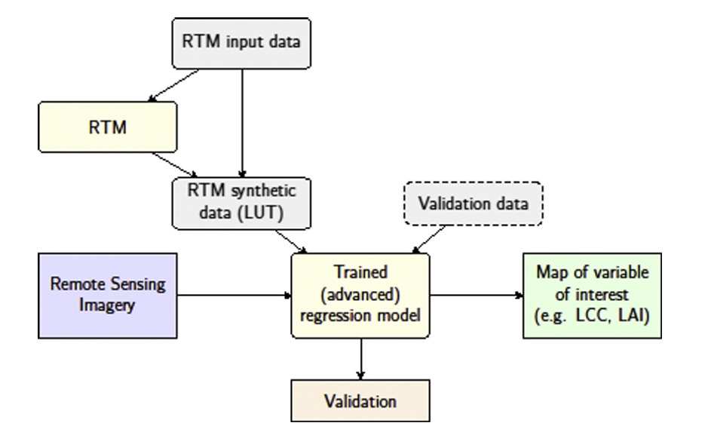
Physically-based and hybrid methods
Hybrid in practice
ANN + PROSAIL / SAIL: CYCLOPES, GEOV1 (LAI, fAPAR, fCover)
Recommended next: GPR / kernel (speed + uncertainty)
Physically-based (LUT). Verrelst et al. (2015) ISPRS J. Photogramm. Remote Sens. 108:273–290, Fig. 3
Hybrid: RTM-simulated data train an ML model. Verrelst et al. (2015) ISPRS J. Photogramm. Remote Sens. 108:273–290, Fig. 4
Physically-based: strengths / weaknesses
Hybrid: strengths / weaknesses
+ generic, multi-output, uncertainty via residuals. − slow per pixel; needs priors; LUT bounded by ranges; noise-sensitive
+ physics + ML speed; no field training needed. − quality depends on RTM realism and how well simulations cover reality
Notes:
Physically-based retrieval inverts an RTM by optimisation or LUT; it is generic and gives multiple outputs, but is computationally demanding, depends on model quality and priors, and LUT estimates cannot go beyond the imposed bounds. Hybrid methods combine the two worlds: the RTM generates a large simulated database, and a non-parametric regression such as a neural network or Gaussian process is trained on it, then applied to images. This keeps the generality of physics with the speed of machine learning, and is how operational products are made: global LAI and fAPAR products such as CYCLOPES and GEOV1 use neural networks trained on PROSAIL-type simulations. Verrelst et al. recommend Bayesian kernel methods such as GPR for next-generation hybrid chains because they add uncertainty estimates.

Slide 32
Comparing the four families on five criteria
Criterion | Parametric (VI) | Non-parametric (ML) | Physically-based (RTM) | Hybrid (RTM + ML)
Variables | Any measured; one at a time | Any measured (incl. N, cellulose) | Only RTM state variables (LAI, Cab, Cw, Cm…) | RTM state variables
Multiple outputs | No | Some (PLSR, ANN, GPR, KRR) | Yes | Yes
Transparency | High | Low (GPR, trees: some insight) | High (physics) | Medium
Mapping speed | Very fast | Fast once trained | Slow per pixel (LUT faster) | Fast
Uncertainty | No | GPR yes | Via residuals | With GPR yes
Field data needed | Yes (calibration) | Yes (training) | Validation only | Validation only
Verrelst et al. verdict: parametric methods are not state of the art for operational mapping; hybrid with Bayesian kernel ML (GPR) is the most promising for Sentinel-2/3, EnMAP, PRISMA, FLEX.
Notes:
Verrelst et al. compared the families on five criteria: which variables can be retrieved, whether several outputs come at once, transparency, mapping speed and whether uncertainty is given. Parametric regression is transparent and fast but one variable at a time with no uncertainty, so the authors judge it not state of the art for operational mapping. Non-parametric machine learning is powerful and fast once trained, especially Bayesian methods that give uncertainty, but mostly black boxes. Physically-based inversion is physically transparent and multi-output but slow. Hybrid methods combine the advantages and are the recommended direction.

Slide 33
End-to-end RTM retrieval methodology
1. Field campaign
spectra + LAI, Cab, Cw, Cm, ALA; N or water treatments
2. Validate forward PROSAIL
measured inputs; RMSE by band and angle
3. Priors and fixed inputs
ranges from field + literature; fix N, Car, psoil
4. Simulate LUT / training set
forward runs; convolve with sensor RSR
5. Invert
LUT-II · GA · ANN / GPR (hybrid)
6. Validate retrievals
r, RMSE, nRMSE, target diagram
Regional application
Satellite image (LISS-3, S-2, MODIS)
Geometric + atmospheric correction
Crop mask (classification)
Per-pixel inversion → LAI, Cab, CCC map
Applications: N management, stress, crop models, yield
best method from field step
Notes:
This flow chart combines all the papers into one methodology you can describe in an interview. In the field, measure canopy spectra and the PROSAIL inputs at different growth stages and treatments. Validate the forward model and fix insensitive inputs. Build a look-up table or training set from priors, convolve to the sensor bands, and invert with LUT, GA or a trained ML model. Validate retrievals in the field. Then process the satellite image: geometric and atmospheric correction, crop mask, per-pixel inversion, and validation against ground LAI. Products feed nitrogen management, stress detection, crop models and yield forecasting.

Slide 34
Limitations of PROSAIL and the way forward
Limitations found
Way forward
Lambertian soil → errors in sparse canopies (N0, early growth)
Homogeneous turbid medium: no rows, clumping
VIS simulated worst → Cab less accurate than LAI
Cw: weak in broadbands; needs SWIR and wide range
Ill-posed inversion; compensation LAI ↔ ALA
Inversion is 'still a job for a specialist' (Jacquemoud et al.)
Soil BRDF (Hapke) in SAIL; 4SAIL2 clumping; 3-D (DART)
PROSPECT-5/D: separate pigments (carotenoids, anthocyanins)
Fluorescence + thermal (FluorSAIL, SCOPE) → FLEX
Hyperspectral: PRISMA, EnMAP, ISRO HySIS
Hybrid GPR with uncertainty for operational products
Data assimilation of LAI into crop models
For India: LISS-3 four-band LUT-II inversion already gave LAI RMSE 0.56 at district scale — a path to operational crop biophysical products (Sehgal et al. 2016).
Notes:
The papers agree on PROSAIL's limitations. SAIL assumes a horizontally homogeneous turbid canopy and a Lambertian soil, which fails for sparse, early-stage or row crops; the IARI study found errors largest at low LAI. The visible region is simulated least well, limiting chlorophyll retrieval, and leaf water needs a wide range of conditions and the shortwave infrared. Inversion is ill-posed and needs priors. The way forward: soil BRDF models, clumping and 3-D models, better leaf models, fluorescence and thermal extensions for missions like FLEX, and hybrid machine-learning retrieval for new hyperspectral and superspectral sensors.

Slide 35
Likely interview questions with one-line answers
Q. What is PROSAIL?
Q. Why RTM, not NDVI?
Q. What is the hotspot?
→ PROSPECT leaf model (N, Cab, Car, Cw, Cm → leaf ρ, τ) coupled with SAIL canopy model (LAI, ALA, hotspot, soil, geometry)
→ Physics-based, no local calibration, many variables at once; VI relations are site, crop and sensor specific
→ Reflectance peak in backward direction when view ≈ sun; shadows hidden; SAIL hotspot = leaf length / height
Q. Why is inversion ill-posed?
Q. LUT vs ANN?
Q. Why GA?
→ Different inputs give the same spectrum (LAI ↔ ALA); fix with priors, canopy-level CCC, more views
→ LUT seeks best spectral match, consistent; ANN fast but varies with training; LUT-II (best 10%) won at IARI
→ Global search, no derivatives or initial guess; fitness = MSE; LAI R² ≈ 0.9
Q. Which variable is easiest?
Q. Main PROSAIL weakness?
Q. What is a hybrid method?
→ LAI > Cab/CCC > Cw: structure dominates reflectance; VIS low dynamic range
→ Lambertian soil and homogeneous canopy → poor for sparse crops; VIS errors
→ Train ML (ANN, GPR) on RTM simulations; used for global LAI products
Read: Jacquemoud et al. 2009 (PROSAIL review) · Verrelst et al. 2015 (retrieval methods) · Chakraborty et al. 2015 (wheat BRF, PROSAIL5B validation) · Mridha et al. 2014 (GA inversion) · Sehgal et al. 2016 (LUT vs ANN; LISS-3 LAI map)
Notes:
Practise these answers aloud. Each is a sentence or two; the earlier slides give the detail if the panel asks a follow-up.

