Slide 1
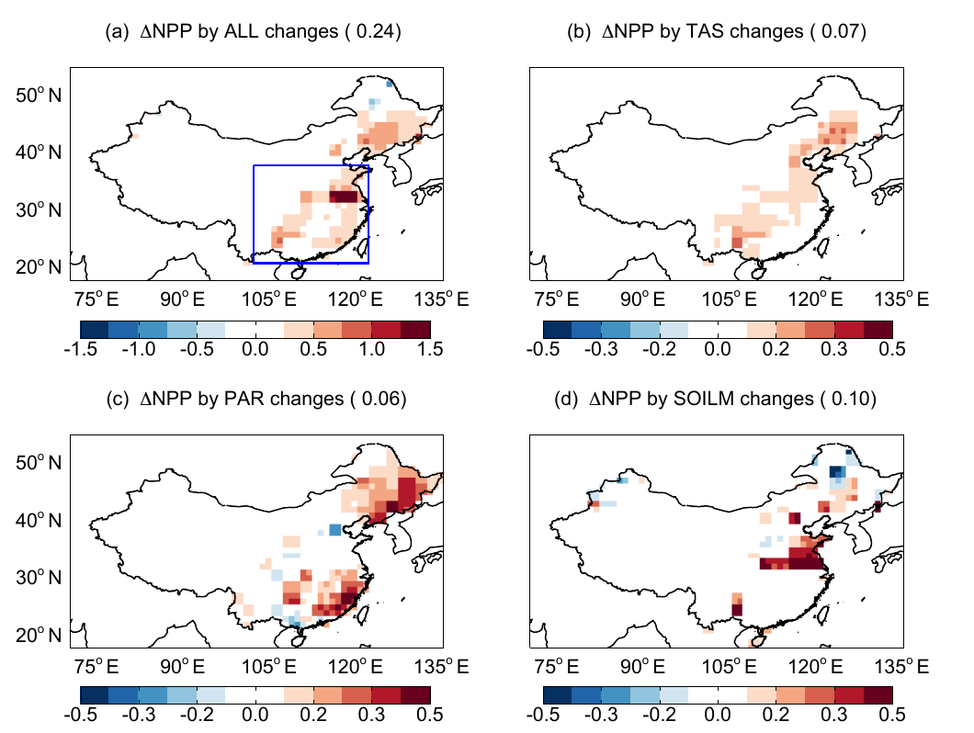
Climate route: temperature, humidity, water and rain
6 · Mechanisms of aerosol impact
Pathway | Mechanism | Evidence
Leaf temperature | Less sunlight → cooler leaves, nearer the 25 °C optimum | Steiner & Chameides, 2005; Yue et al., 2017
Humidity, VPD | Lower VPD enhances sun‑leaf photosynthesis | Zhang et al., 2023
Soil moisture | Less evaporation → wetter soil, less water stress | Yue et al., 2017
Night warming | AOD tracks minimum more than maximum temperature | Jannat et al., 2026
Monsoon rain | Less sea evaporation, stable lower air → less rain | Auffhammer et al., 2006
China: summer NPP change from each aerosol pathway
(a) all (b) temperature (c) PAR (d) soil moisture
China, 2010 (annual) | ΔNPP (Pg C yr⁻¹) | What it shows
Radiation (PAR) | +0.09 | More light reaches shaded leaves
Soil moisture | +0.07 | Less evaporation, less water stress
Leaf cooling | +0.03 | Summer leaves nearer the 25 °C optimum
Direct effects, total | +0.20 (+5%) | Net gain without cloud effects
With cloud and rain | −0.20 (−4%) | Summer rain −13% → drought
Yue et al., 2017, Fig. 8
Table values: Yue et al., 2017, Table 3
Rain can outweigh light: cloud effects turned the +5% gain into a −4% loss
Notes:
The light route is only half of the story. When aerosols reduce sunlight at the surface, they also change temperature, humidity, soil water and even rainfall, and each of these changes plant growth. This is the climate route.
Leaf temperature. Less sunlight means cooler leaves; Steiner and Chameides, 2005, showed this aerosol cooling in models. Whether cooling helps depends on the starting temperature, because photosynthesis has an optimum near 25 degrees Celsius. Yue and colleagues, 2017, found that in summer, when leaves are warmer than the optimum, aerosol cooling brings them closer to it and raises NPP; in spring and autumn the effect was neutral, because reduced photosynthesis was balanced by reduced plant respiration.
Humidity and VPD. Cooler air lowers the vapour pressure deficit. Yue and colleagues found aerosol cooled the summer surface of eastern China by 0.63 degrees and raised relative humidity. Zhang and colleagues, 2023, found from satellite data that higher aerosol loading induces lower VPD over cropland, grassland and mixed forest, and lower VPD enhances the photosynthesis of sun leaves, so part of an apparent diffuse-light effect is really a humidity effect.
Soil moisture. Less radiation means less evaporation, so the soil stays wetter. The benefit in China was largest in the central east, where short-rooted C3 crops depend on topsoil water.
Night warming. In Bangladesh, Jannat and colleagues, 2026, found that aerosol was more strongly associated with minimum temperature, with R squared up to 0.625, than with maximum temperature, suggesting aerosol-induced night-time warming as an additional pathway alongside the photosynthetic response.
Monsoon rain. Auffhammer and colleagues, 2006, explain that brown clouds reduce rainfall because lower surface radiation reduces evaporation from the sea, and absorbing aerosol heats and stabilises the lower atmosphere. Indian rice harvests rise with June to September rainfall, so this route matters for rainfed farming.
The lower table gives the only study that separates these routes in numbers. Yue and colleagues switched on one aerosol-driven change at a time for China in 2010. Through radiation, the net effect of dimming and diffuse light, annual NPP rose by 0.09 petagrams of carbon; through wetter soil by 0.07; through leaf cooling by 0.03. The direct effects together gave about 0.20 petagrams, or 5 percent of China's NPP. When aerosol effects on clouds were added, summer rainfall fell by 0.9 millimetres per day, or 13 percent, soil moisture fell, and the total became a loss of 0.20 petagrams, or 4 percent, hitting the north-east and the North China Plain hardest.
The maps show the summer pattern of each pathway: the combined effect in panel a, temperature in b, PAR in c, with gains in the south-east and north-east where AOD is moderate, and soil moisture in d, with gains in the central east. As the strip says, the rain route can outweigh the light route.

