Slide 1
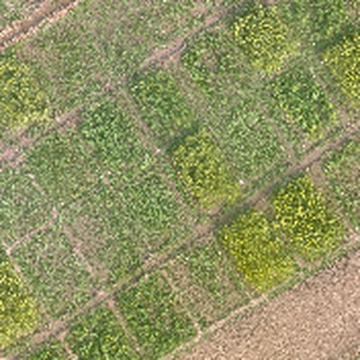
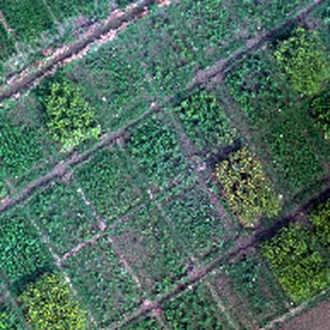
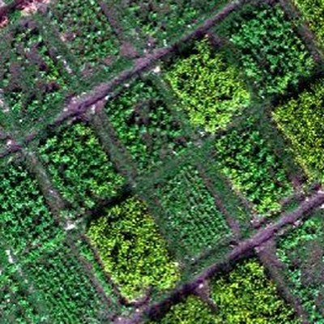
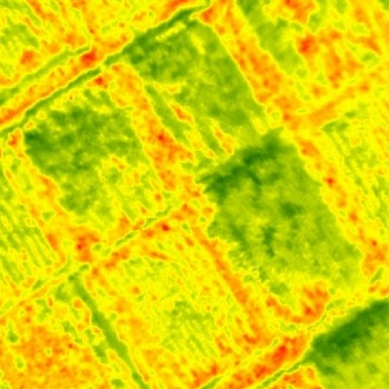
MuDAS-AI · Conceptual Framework
From drone images to a white rust severity map
1
2
3
4
5
Select disease features
RGB
Multispectral
Top
Underside
Pustules hide under the leaf
Fuse four sensors
0 Healthy DI 0
Hyperspectral
Thermal
1 Very low DI 1–5%
2 Low DI 6–10%
Spotted too late to spray
+ field disease scores for training
3 Moderate DI 11–25%
Classify severity
4 High DI 26–50%
5 Very high DI >50%
White rust problem
UAV imaging
Multimodal data
AI engine
Severity map
Early detection
Targeted spraying
Less fungicide
Protected yield
Cleaner soil & water
Notes:
Conceptual framework, in five steps. 1 Problem: white rust pustules hide under the leaf, so it is spotted too late to spray. 2 UAV imaging: one drone flight over the mustard plots. 3 Multimodal data: RGB, multispectral, hyperspectral and thermal images from our trial, plus field disease scores for training. 4 AI engine: select disease-specific features, fuse the four sensors, classify severity. 5 Severity map: every plot in six classes, from healthy (DI 0) to very high (DI above 50%). Impact: early detection, targeted spraying, less fungicide, protected yield, cleaner soil and water.

