Slide 1
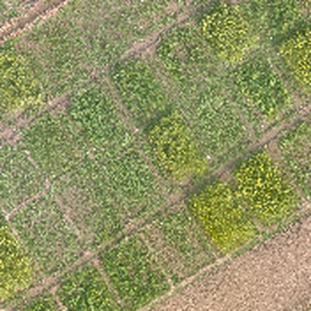
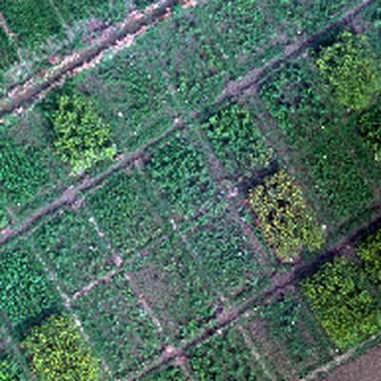
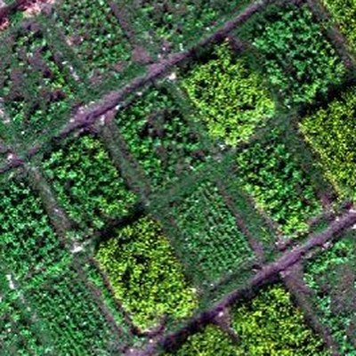
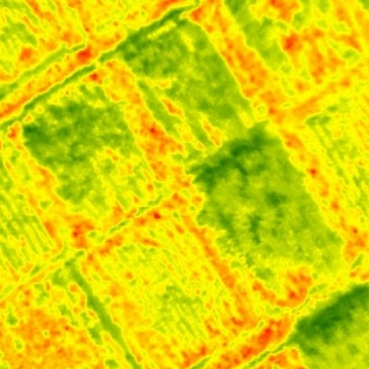
MuDAS-AI · Conceptual Framework
One drone flight → AI → a white rust severity map
1
Problem
2
UAV data
3
AI engine
4
Severity map
PHASE 1
PHASE 2
PHASE 3
Disease features
Best per sensor
Sensor fusion
VIF/SPA → SFFS
RGB
keep
MS
Top
Underside
HS
AI
Pustules hide under the leaf
RGB
Multispectral
TIR
RF
SVM
KNN
0 Healthy DI 0
ANOVA
JM
Best feature set & model for each sensor
Feature-level fusion + SFFS
Spotted too late to spray
ReliefF
Boruta
1 Very low DI 1–5%
2 Low DI 6–10%
Hyperspectral
Thermal
3 Moderate DI 11–25%
6 classes
0
1
2
3
4
5
Tested on unseen plots
4 High DI 26–50%
Where & when to spray?
+ Field DI scores (labels)
5 Very high DI >50%
Early detection
Targeted spraying
Less fungicide
Protected yield
Cleaner soil & water
Notes:
Conceptual framework on one slide. 1 Problem: white rust pustules hide under the leaf, so it is spotted too late to spray. 2 UAV data: one drone flight gives RGB, multispectral, hyperspectral and thermal images (shown from our trial), with field Disease Index scores as labels. 3 AI engine: Phase 1 keeps only disease-specific features (ANOVA or Kruskal-Wallis, JM distance, ReliefF, Boruta). Phase 2 removes redundant features (VIF, SPA), picks the best subset with SFFS and trains RF, SVM and KNN for each sensor. Phase 3 joins the selected features of all four sensors and classifies into six severity classes; always tested on unseen plots. 4 Severity map: every plot from healthy (DI 0) to very high (DI above 50%). Impact: early detection, targeted spraying, less fungicide, protected yield, cleaner soil and water.

