Slide 1
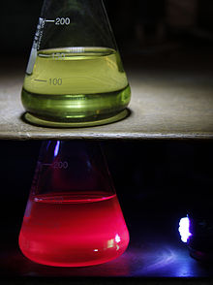
Chlorophyll Fluorescence & Sun-Induced Fluorescence
From PSII photophysics and PAM fluorometry to remote sensing of SIF from space — a systematic, diagram-led guide
Chlorophyll extract: green in white light, glowing red under UV
Based on Murchie & Lawson (2013) J. Exp. Bot. 64: 3983–3998 · Mohammed et al. (2019) Remote Sens. Environ. 231: 111177 · course slides on Chl a fluorescence
Notes:
What this deck covers: how chlorophyll re-emits a small part of the light it absorbs, how we measure that glow, and what it tells us about photosynthesis.
Two ways of measuring are covered. Active fluorometry (PAM) uses the instrument's own lights on a leaf, so we can control the conditions and calculate efficiencies. Passive sun-induced fluorescence (SIF) uses sunlight as the light source and is measured from towers, drones, aircraft and satellites over whole canopies and the globe.
The photo shows a chlorophyll extract in alcohol. In white light it looks green because chlorophyll reflects and transmits green. Under UV light it glows red: that red glow is fluorescence. In a living leaf the same red glow exists but is much weaker and hidden by reflected light, which is why special methods are needed.
Main sources: Murchie & Lawson (2013) for PAM fluorescence, Mohammed et al. (2019) for SIF, and the course slides.

Slide 2
Roadmap of this deck
01
Foundations
02
Measuring it
03
Induction kinetics
What fluorescence is and where it comes from
Ambient light problem, PAM modulation, instruments
Kautsky effect, OJIP and the slow PSMT phase
04
PSII redox & quenching
05
PAM parameters
06
Good practice
Open/closed centres, qP, NPQ, saturating pulse
Fo, Fm, Fv/Fm, ΦPSII, qP, qL, NPQ, worked example
Dark adaptation, pitfalls, CO₂ link, protocols
07
Imaging & monitoring
08
Sun-induced fluorescence
09
Synthesis
Fluorescence imaging, applications, LIFT
Spectra, retrieval, models, platforms, satellites
Concept map, formula sheet, FAQs, references
Notes:
The deck has nine modules, and each depends on the earlier ones.
Modules 1–3 build the basics: what fluorescence is, how it is measured, and how it changes when a dark leaf is suddenly lit (the Kautsky curve).
Modules 4–6 are the core of PAM analysis: open and closed reaction centres, quenching, the saturating pulse, every parameter (Fv/Fm, ΦPSII, qP, qL, NPQ) and the common mistakes.
Module 7 moves from a single point to images and long-term monitoring.
Module 8 is the remote-sensing side: SIF, from the physics of the spectrum to satellites.
Module 9 summarises everything: a concept map, formula sheet, common doubts and references.
Study tip: if a parameter in module 5 is confusing, go back to module 4 (open vs closed centres). If SIF is confusing, go back to module 1 (the three fates of absorbed energy). Almost every doubt traces back to those two ideas.

Slide 3
Foundations
01
What chlorophyll fluorescence is, where it comes from, and why a tiny glow tells us so much about photosynthesis
Notes:
Module 1: foundations.
The single most important idea of the whole topic is introduced here. When chlorophyll absorbs light, the energy has only three ways out: it can drive photochemistry (photosynthesis), be lost as heat, or be re-emitted as light (fluorescence). These three compete for the same energy.
Because they compete, a change in one shows up in the others. We cannot easily see photochemistry or heat loss directly in a leaf, but we can measure fluorescence. So fluorescence acts as a window: by watching how it changes, we infer what is happening to photosynthesis and to heat dissipation.
Keep this "three taps from one tank" picture in mind for every later slide.

Slide 4
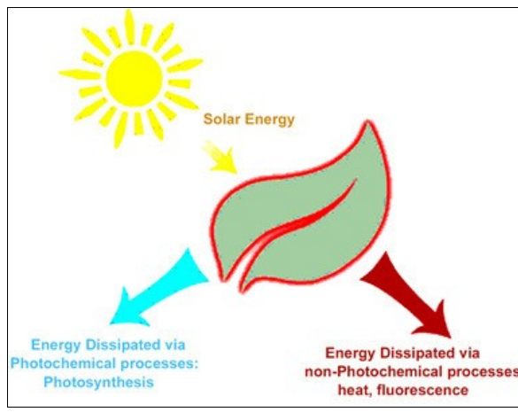
What is chlorophyll fluorescence?
Definition: light re-emitted by chlorophyll molecules as they return from the excited to the ground (non-excited) state.
Why it matters
Non-invasive measure of photosystem II (PSII) activity — no harvesting, no chemicals
PSII is highly sensitive to abiotic and biotic factors → a broad indicator of how plants respond to environmental change
Indicator of photosynthetic energy conversion in higher plants, algae and bacteria
Cheap, fast and portable → widely used in plant physiology, breeding and phenotyping
Spectral signature: emission between ~650 and 800 nm with two peaks, ~685 nm (red) and ~740 nm (far-red)
Left: chlorophyll extract in alcohol — green under white light (top), red fluorescence under UV (bottom). Right: absorbed solar energy is dissipated by photochemistry or by non-photochemical routes (heat, fluorescence).
Notes:
Definition: chlorophyll fluorescence is light re-emitted by chlorophyll molecules as they return from an excited state to the ground state.
Step by step: a photon is absorbed, an electron in the chlorophyll molecule jumps to a higher energy level, and within nanoseconds the molecule must lose that energy. A small part is lost by emitting a new photon of longer wavelength (red/far-red). That photon is the fluorescence.
Why it is so useful:
1. It is non-invasive: we do not cut, extract or harm the leaf.
2. It mainly reports on photosystem II (PSII), the part of the photosynthetic chain most sensitive to stress such as heat, drought, high light, salinity, disease or herbicides.
3. Measurements take seconds and instruments are portable, so it is ideal for field work, crop breeding and phenotyping.
Spectral signature: emission lies between about 650 and 800 nm, with two peaks, around 685 nm (red) and 740 nm (far-red). Remember these two peaks; they come back in the SIF module.
Likely question: "Why is fluorescence a good stress indicator?" Answer: PSII responds quickly to almost every stress, and any change in PSII efficiency changes the fluorescence yield.

Slide 5
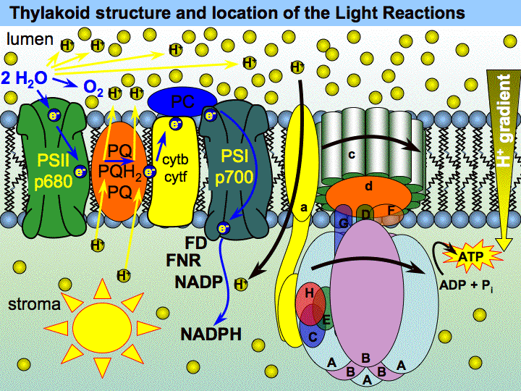



Where does it come from? The pigment–protein complexes
Light-harvesting complexes (LHC)
Antenna pigment–protein complexes (Chl a, Chl b, carotenoids) that capture photons and transfer excitation energy to a reaction centre.
Photosystem II (P680)
Core proteins D1, D2, CP43, CP47; splits water (OEC), passes electrons via pheophytin → Q_{A} → Q_{B}. Main source of variable fluorescence.
Photosystem I (P700)
Thylakoid membrane: PSII, cytochrome b₆f, PSI and ATP synthase, with water splitting on the lumen side
Receives electrons from plastocyanin and reduces NADP⁺ via ferredoxin. Emits weakly, mostly in the far-red (>700 nm).
Notes:
Where fluorescence comes from inside the leaf.
Chlorophyll is not floating freely; it is bound to proteins in the thylakoid membranes of the chloroplast. The left figure shows the membrane with PSII, the cytochrome b6f complex, PSI and ATP synthase.
1. Light-harvesting complexes (LHCs) are antennae. Hundreds of chlorophyll a, chlorophyll b and carotenoid molecules capture photons and pass the excitation energy, like a relay, to a reaction centre.
2. Photosystem II has the special chlorophyll P680. It splits water at the oxygen-evolving complex, releasing O2, and passes electrons to pheophytin, then to QA and QB. Most of the variable fluorescence we measure comes from PSII and its antenna.
3. Photosystem I has P700. It receives electrons from plastocyanin and uses them to reduce NADP+ to NADPH. PSI fluoresces weakly, mostly in the far-red above 700 nm, and its fluorescence hardly changes with conditions.
Key point: because the PSII signal changes with the state of photosynthesis and the PSI signal does not, fluorescence analysis focuses on PSII.

Slide 6
The photophysics: excitation and emission
Three rules that clear most doubts
S₂
higher excited singlet
Excitation colour does not matter: everything relaxes to S₁ first, so emission is always red/far-red (Kasha's rule)
Emission is at longer wavelength than absorption (Stokes shift)
Processes from S₁ compete: the faster one route is, the less goes to the others
Blue absorption
~430–450 nm
Internal conversion
(heat, femtoseconds)
Photochemistry
S₁
lowest excited singlet
Numbers worth remembering
Red absorption
~660–680 nm
Fluorescence quantum yield in vivo: typically 0.5–3 % (always <10 %)
Fluorescence lifetime: tens to hundreds of picoseconds
Emission peaks: F₆₈₅ (PSII) and F₇₄₀ (PSII + PSI)
Charge separation in an open PSII centre is very fast, so photochemistry normally wins
T₁ triplet
Fluorescence
650–800 nm
¹O₂ risk; quenched by carotenoids
Heat
(NPQ)
S₀
ground state
Notes:
This is an energy-level (Jablonski) diagram. Horizontal lines are energy states of chlorophyll: S0 is the ground state, S1 the first excited singlet state, S2 a higher one; dashed lines are vibrational sub-levels.
Step by step:
1. Blue light (about 430–450 nm) has more energy and lifts the molecule to S2. Red light (about 660–680 nm) lifts it only to S1.
2. From S2 the molecule drops to S1 almost instantly (femtoseconds) by internal conversion, losing the extra energy as heat.
3. Everything useful starts from S1. From there the energy can go to photochemistry (green arrow up to the reaction centre), to heat (NPQ), to fluorescence (red arrow down), or to the triplet state T1.
4. The triplet state is dangerous: it can transfer energy to oxygen and form singlet oxygen, a reactive species that damages proteins. Carotenoids quench triplets to prevent this.
Three rules that clear most doubts:
- Whatever the colour of the light absorbed, emission comes from S1, so fluorescence is always red/far-red (Kasha's rule).
- Emitted light has a longer wavelength than absorbed light (Stokes shift).
- The routes from S1 compete: the faster one route, the less energy goes to the others.
Numbers to remember: fluorescence yield in a living leaf is only about 0.5–3%; its lifetime is tens to hundreds of picoseconds.

Slide 7

Three competing fates of absorbed light energy
① Photochemistry rate k_{P}
Drives charge separation in PSII → electron transport → ATP + NADPH → CO₂ assimilation
The competition rule
Φ_{P} + Φ_{N} + Φ_{F} = 1
Φ_{F} = k_{F} / (k_{F} + k_{P} + k_{N})
Centres closed → k_{P} ≈ 0 → fluorescence rises
NPQ switched on → k_{N} ↑ → fluorescence falls
So fluorescence reports photochemistry and heat loss indirectly
Chl∗
② Heat (NPQ) rate k_{N}
Safe dissipation of excess energy; photoprotective (ΔpH, PsbS, zeaxanthin)
excited
Absorbed photon
③ Fluorescence rate k_{F}
Re-emitted as red / far-red light (650–800 nm); the part we measure
Analogy: three taps fed by one water tank. Close the photochemistry tap (saturating pulse) and the level in the fluorescence tap jumps — that jump is what PAM fluorometry measures.
Notes:
This is the key slide of the whole deck.
An absorbed photon creates an excited chlorophyll (Chl*). The energy leaves by one of three competing routes:
1. Photochemistry: drives charge separation in PSII, electron transport, ATP and NADPH, and finally CO2 fixation. Rate constant kP.
2. Heat dissipation (non-photochemical quenching, NPQ): a safety valve that removes excess energy. Rate constant kN.
3. Fluorescence: re-emission as red/far-red light. Rate constant kF.
Because every excitation must leave by one route, the fractions (quantum yields) add up to one: ΦP + ΦN + ΦF = 1. The fluorescence yield is ΦF = kF / (kF + kP + kN).
How to use this:
- If reaction centres close (kP becomes almost zero, e.g. during a very bright flash), fluorescence rises.
- If heat dissipation switches on (kN increases), fluorescence falls.
- If photosynthesis speeds up (kP increases), fluorescence also falls.
Analogy: one water tank with three taps. Close the photochemistry tap with a saturating flash and more water comes out of the fluorescence tap. PAM fluorometry measures exactly that jump.
Likely question: "Why does fluorescence decrease when photosynthesis increases?" Because they compete for the same energy.

Slide 8
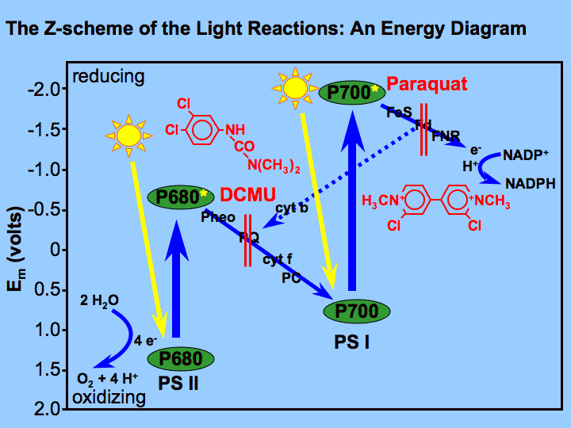
Why we treat the signal as coming from PSII
PSII dominates the variable signal
At room temperature, changes in fluorescence are attributed to PSII only
PSI contributes little below 700 nm → ignored in most PAM work
PSII emits at both 685 and 740 nm; PSI mostly at ~740 nm
Why this is useful
Photochemistry supplies the energy (ATP) and reducing power (NADPH) for CO₂ assimilation
Fluorescence yield ⇒ quantum efficiency of PSII photochemistry and heat dissipation
PSII is the most stress-sensitive part of the chain → early warning of stress
Caveat for SIF: far-red SIF also contains PSI emission
Z-scheme: electrons flow from water through PSII (P680) and PSI (P700) to NADP⁺; herbicides DCMU and paraquat block specific steps
Notes:
Why the measured signal is treated as coming from PSII.
1. At room temperature, the part of fluorescence that changes with conditions (variable fluorescence) comes from PSII. PSI fluorescence is weak and almost constant.
2. PSI emits mostly above 700 nm. Most PAM instruments detect fluorescence above about 700 nm but are designed and calibrated assuming PSII dominates; the PSI contribution is a small, roughly constant offset that is usually ignored.
3. PSII is the most stress-sensitive step of the photosynthetic chain, so it is the right target for stress detection.
The Z-scheme figure shows the electron path: water → PSII (P680) → plastoquinone → cytochrome b6f → plastocyanin → PSI (P700) → ferredoxin → NADP+. The herbicide DCMU blocks electron flow just after PSII (at QB); paraquat diverts electrons from PSI.
Why this matters for photosynthesis: photochemistry supplies the ATP and NADPH used to fix CO2. So the yield of fluorescence gives information on how efficiently PSII is converting light, and on how much is lost as heat.
Caveat for later: in SIF, far-red emission at 740–760 nm includes a real PSI contribution, so the "PSII only" assumption is weaker there.

Slide 9
Measuring fluorescence
02
How to see a weak red glow against bright light: modulated (PAM) fluorometry and the instruments used
Notes:
Module 2: how fluorescence is measured.
The practical problem: fluorescence is weak (a few percent of absorbed light) and red, and sunlight or lamp light also contains red light that the leaf reflects. A simple detector cannot tell the difference.
The solution, explained on the next slide, is modulation: excite fluorescence with a light that flickers at a known frequency and only record signal at that frequency. This is the basis of PAM (pulse-amplitude modulation) fluorometers, the standard instruments since the 1980s.

Slide 10


The ambient-light problem and the PAM solution
Measuring beam
Measuring light (ML)
weak, modulated (µs pulses at a fixed frequency)
Too weak to drive electron transport, but enough to excite F_{o}
Ambient / actinic light
Actinic light (AL)
strong but un-modulated (constant)
Drives photosynthesis (photochemistry); the leaf's 'working' light
Detector after lock-in
Saturating pulse (SP)
only fluorescence excited by the beam is kept
Time →
Very bright (≥4000 µmol m⁻² s⁻¹), <1 s; closes all PSII centres → F_{m}, F_{m}′
Result: measurements can be made without darkening the leaf. Older non-modulated systems needed darkness or tightly controlled light. Non-modulated devices are returning for fast OJIP transients from a 1 s pulse on dark-adapted leaves.
Far-red light (FR)
Excites PSI preferentially, drains electrons from Q_{A}/PQ → accurate F_{o}′
Notes:
Left side, the principle of modulation:
1. The measuring beam is weak and switched on and off very rapidly (microsecond pulses at a fixed frequency).
2. Ambient or actinic light is strong but constant (not modulated).
3. The detector is coupled to a lock-in amplifier that only keeps the signal varying at the measuring-beam frequency. So it records only the fluorescence excited by the measuring beam and ignores the steady background.
Result: we can measure fluorescence in full daylight without darkening the leaf. Older non-modulated systems needed darkness or strictly controlled light. Non-modulated "continuous excitation" devices are still used for the fast OJIP rise on dark-adapted leaves.
Right side, the four lights of a PAM fluorometer:
- Measuring light (ML): too weak to drive photosynthesis; gives the minimum level Fo.
- Actinic light (AL): drives photosynthesis; it is the leaf's working light.
- Saturating pulse (SP): very bright (4000 µmol m⁻² s⁻¹ or more) and short (under 1 s); closes all PSII centres to give Fm or Fm′.
- Far-red light (FR): excites PSI more than PSII, drains electrons from QA and the PQ pool, so we can measure an accurate Fo′.
Remember which light gives which level; every parameter later is built from these levels.

Slide 11
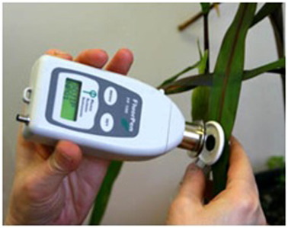
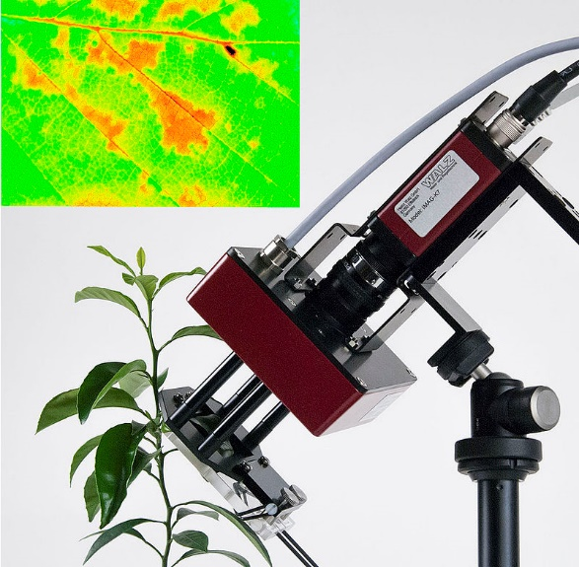
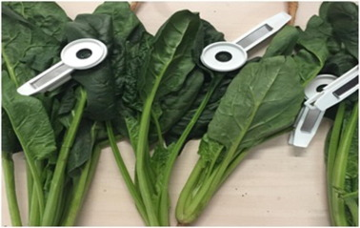
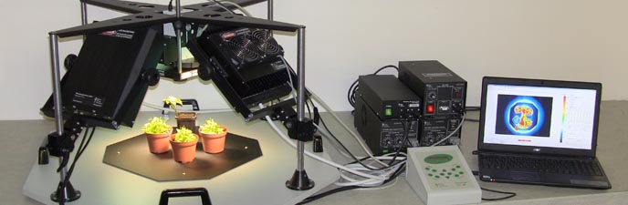

Instruments: from leaf clips to imaging systems
Dark-adaptation leaf clips
Hand-held fluorometer on a leaf
Laboratory chlorophyll fluorescence imaging system
Imaging head and Ft image of a leaf surface
Modulated (PAM) fluorometers
Continuous-excitation (OJIP) meters
Work in light or dark; full quenching analysis (Fv/Fm, ΦPSII, NPQ, qP)
Large, well-tested physiological framework
Fast induction transient during a 1 s pulse on dark-adapted leaves
Popular for screening; complex derived parameters need caution
Notes:
The instruments all use the same principles; they differ in what area they measure and how.
1. Dark-adaptation leaf clips: small clips with a shutter that keep part of the leaf dark for 20–30 minutes before measuring Fv/Fm in the field.
2. Hand-held fluorometers: measure a spot a few millimetres across, in seconds. Used for quick screening of many plants.
3. Imaging systems: LED panels for the lights and a camera instead of a single detector, so every pixel gets its own value. They show how efficiency varies across a leaf or between plants.
4. Imaging head showing an Ft (steady-state) image of a leaf surface.
Two families:
- Modulated (PAM) fluorometers work in light or dark and give the full quenching analysis (Fv/Fm, ΦPSII, NPQ, qP). They have a large, well-tested scientific framework.
- Continuous-excitation (OJIP) meters record the fast fluorescence rise during a 1 s pulse on dark-adapted leaves. They are fast and popular for screening, but many derived "JIP-test" parameters need careful interpretation.
Also mentioned in the course slides: multiparametric fluorometers that combine chlorophyll fluorescence with flavonol signals to detect nitrogen deficiency.

Slide 12
Induction kinetics
03
What happens when a dark-adapted leaf is suddenly illuminated: the Kautsky effect, the OJIP rise and the slow PSMT phase
Notes:
Module 3: induction kinetics, meaning how fluorescence changes over time when a dark-adapted leaf is suddenly illuminated.
This was historically the first evidence that fluorescence is linked to photosynthesis. The curve has a fast rise (under a second) and a slow decline (minutes). The fast rise tells us about the filling of PSII's electron acceptors; the slow decline tells us about photosynthesis and heat dissipation switching on.

Slide 13
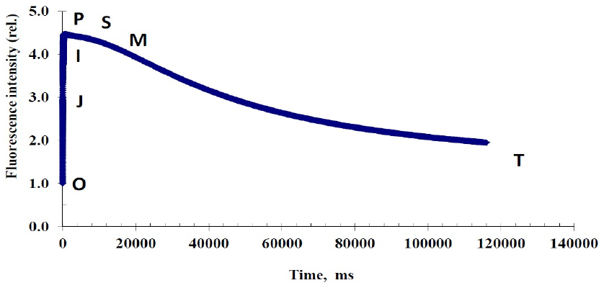
The Kautsky effect (fluorescence induction)
What you see
Dark-adapted leaf + continuous light
Fast phase (<1 s): exponential rise O → J → I → P
Slow phase (minutes): decline P → S → M → T to a steady state
What it means
Kautsky curve of a healthy green leaf: fast rise O → P (<1 s), then slow decay P → S → M → T over minutes
Rise = PSII acceptors (Q_{A}, PQ pool) become reduced → centres close
Decline = quenching: Calvin cycle activation, stomatal opening and NPQ
Kautsky & Hirsch (1931) linked the decline to the onset of CO₂ assimilation
A true Kautsky effect is seen at moderate light (<200 µmol m⁻² s⁻¹); at high irradiance (≥500 µmol m⁻² s⁻¹) the trace looks like the stylised PAM trace in Module 05.
Notes:
The Kautsky effect, discovered by Kautsky and Hirsch in 1931.
What you do: keep a leaf in darkness, then switch on continuous light.
What you see:
1. Fast phase (under 1 s): fluorescence rises quickly from O (origin) through J and I to P (peak).
2. Slow phase (minutes): fluorescence declines through S, M and T to a steady state.
What it means:
- The rise happens because PSII's electron acceptors (QA and the plastoquinone pool) start empty (oxidised). Light fills them with electrons faster than the rest of the chain can empty them. Once QA is reduced, that reaction centre is "closed", photochemistry stops there, and more energy leaves as fluorescence.
- The decline is "quenching": over the next minutes the Calvin-cycle enzymes are activated by light, stomata open, electrons are drained away so centres reopen (photochemical quenching), and heat dissipation (NPQ) switches on.
Kautsky and Hirsch noticed that the decline mirrored the start of CO2 fixation: the first hint of the inverse relation between fluorescence and photosynthesis.
Note: a true Kautsky curve is seen at moderate light (under about 200 µmol m⁻² s⁻¹). At high light the trace looks more like the stylised PAM trace in module 5.

Slide 14
Zooming into the fast rise: the OJIP transient
O
20–50 µs
F_{o}: all Q_{A} oxidised, centres open
J
~2 ms
Q_{A}⁻ accumulates (photochemical phase)
I
~30 ms
Plastoquinone pool partly reduced
P
~300 ms+
F_{m}: all Q_{A} reduced, centres closed
Interpretation follows the JIP-test convention (Strasser et al. 2004). Murchie & Lawson caution that complex OJIP-derived parameters still lack broad empirical support.
Notes:
Zooming into the first second on a logarithmic time axis reveals clear steps, called O, J, I and P.
1. O (about 20–50 µs): the origin, equal to Fo. All QA is oxidised, so all centres are open.
2. O to J (up to about 2 ms): the photochemical phase. QA becomes reduced (QA⁻) faster than electrons move on to QB.
3. J to I (about 30 ms): the plastoquinone pool is progressively reduced.
4. I to P (about 300 ms and beyond): the electron carriers beyond PSI, up to ferredoxin and NADP+, fill up. At P all QA is reduced and fluorescence reaches its maximum, Fm.
The chart is idealised: the time axis labels are spaced logarithmically, which is why a rise that takes less than a second spreads across the whole graph.
Uses: OJIP analysis (the "JIP-test" of Strasser and colleagues) derives many parameters, such as Fv/Fm, a performance index and fluxes per reaction centre. Murchie & Lawson caution that the complex derived parameters rest on model assumptions and have limited independent validation; Fv/Fm from OJIP is reliable, the others should be interpreted carefully.
Likely question: "What does the J step represent?" Accumulation of reduced QA (QA⁻).

Slide 15
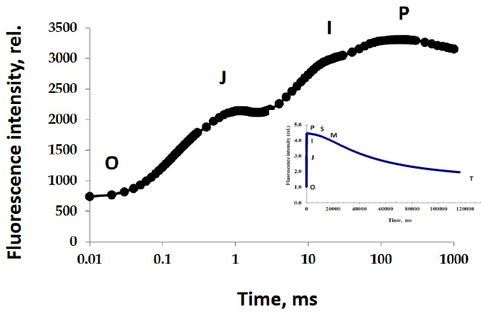
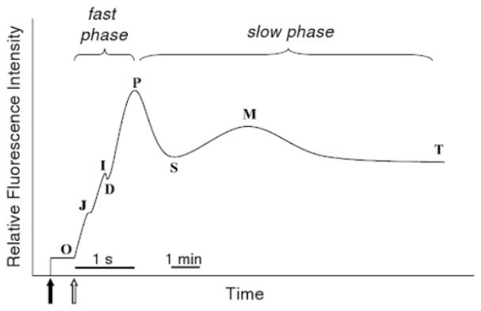
Fast phase vs slow phase (OJIP vs PSMT)
Measured OJIP rise on a log time axis (inset: the whole Kautsky curve)
Full induction: fast phase O-J-I-P (~1 s) then slow phase P-S-M-T (minutes)
Fast phase OJIP (<1 s)
Slow phase PSMT (minutes)
Reduction of PSII acceptors; used for dark-adapted parameters such as F_{o}, F_{m}, F_{v}/F_{m}.
Energy transduction, ATP synthesis, CO₂ fixation, state transitions, NPQ.
Notes:
Comparing the two phases of the induction curve (figures from the course slides).
Fast phase, OJIP (under one second):
- Driven by the reduction of PSII's acceptor side (QA, PQ pool).
- Used for dark-adapted parameters: Fo (at O), Fm (at P) and Fv/Fm.
- Little to do with CO2 fixation yet; the Calvin cycle has not started.
Slow phase, PSMT (minutes):
- P = peak, S = semi-steady state, M = a secondary maximum, T = terminal steady state.
- Reflects the rest of the plant catching up: build-up of the proton gradient and ATP synthesis, activation of Calvin-cycle enzymes and CO2 fixation, state transitions (LHCII moving between PSII and PSI), and non-photochemical quenching.
Why this matters: the slow phase mixes photochemical and non-photochemical quenching. To separate them we need the saturating-pulse method of module 4. That is why modern PAM work applies pulses during the slow phase instead of only watching the curve.

Slide 16
PSII redox state & quenching
04
Open vs closed reaction centres, photochemical and non-photochemical quenching, and the saturating-pulse trick
Notes:
Module 4: PSII redox state and quenching.
This module explains the mechanism behind every PAM parameter. Three ideas:
1. A reaction centre is either open (able to do photochemistry) or closed (temporarily blocked).
2. Fluorescence is lowered (quenched) by photochemistry and by heat dissipation.
3. A very bright, short saturating pulse closes all centres, which lets us separate the two kinds of quenching.
If you understand these three ideas, the formulas in module 5 become simple.

Slide 17
Open and closed PSII reaction centres
H₂O → OEC
P680
Pheo
Q_{A}
Q_{B}
PQ pool
Cyt b₆f
PSI → NADPH
e⁻ flow →
Q_{A} accepts only ONE electron at a time
Q_{A}
OPEN centre
Q_{A}⁻
CLOSED centre
Q_{A} oxidised — ready to accept an electron
Q_{A}⁻ reduced — waiting to pass its electron to Q_{B}
Photochemistry possible
Fluorescence low (e.g. F_{o} in the dark)
Excitation energy is used
No photochemistry until Q_{A} re-oxidises
Fluorescence high (e.g. F_{m} in a pulse)
Quantum efficiency of PSII declines
Light intensity and temperature (via metabolic state) set how many centres are closed at any moment. More closure → lower PSII quantum efficiency → higher fluorescence (unless NPQ rises too).
Notes:
Top: the electron transport chain from water to NADPH. The key box is QA, the first stable electron acceptor of PSII.
Step by step:
1. P680 (the PSII reaction-centre chlorophyll) is excited and gives an electron to pheophytin (Pheo).
2. Pheophytin passes it to QA, a plastoquinone bound tightly to the PSII protein.
3. QA can hold only one electron. It must pass it on to QB before it can accept another.
4. While QA holds an electron (QA⁻), that reaction centre cannot use new excitation: it is closed.
Open centre: QA oxidised, ready. Photochemistry is possible, fluorescence is low (as at Fo in the dark).
Closed centre: QA reduced. No photochemistry until QA is re-oxidised, fluorescence is high (as at Fm during a pulse), and PSII efficiency falls.
What decides how many centres are closed? Light intensity (how fast electrons arrive) versus how fast downstream processes (Calvin cycle, photorespiration) remove them. Temperature matters because it controls enzyme activity. High light with a slow Calvin cycle closes many centres.
Likely question: "What is a closed reaction centre?" One whose QA is reduced and cannot accept another electron.

Slide 18
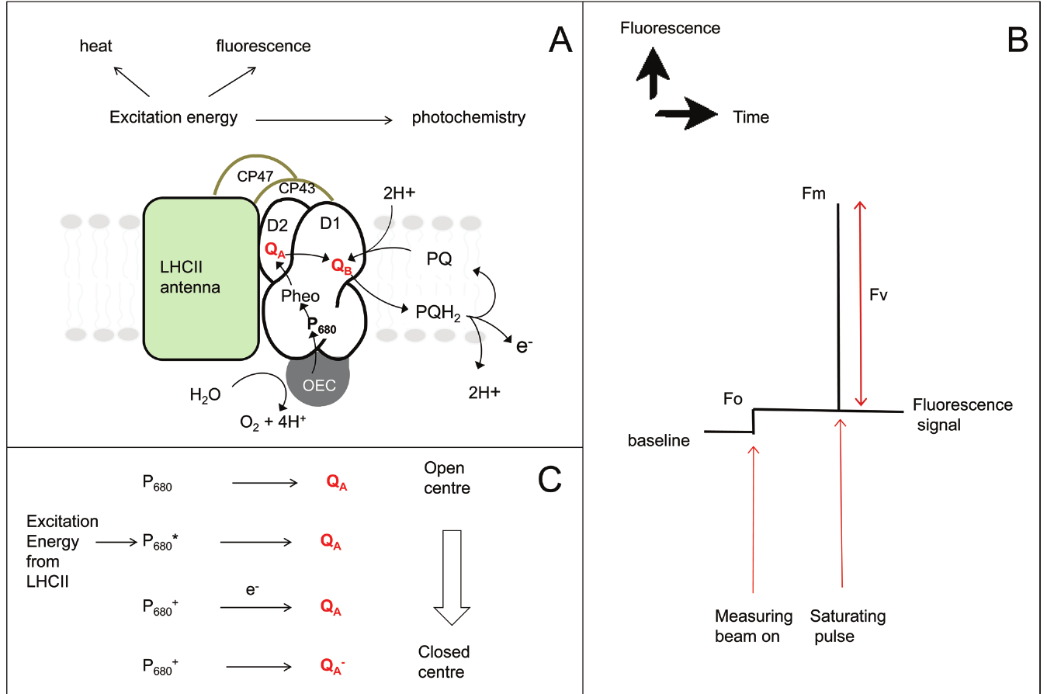
Paper Figure 1: events in PSII behind the parameters
A
Excitation energy in LHCII goes to photochemistry, heat (NPQ) or fluorescence. Electrons: H₂O → OEC → P680 → Pheo → Q_{A} → Q_{B} → PQ.
B
Measuring beam on → F_{o} (centres open). Saturating pulse → F_{m} (centres closed). F_{v} = F_{m} − F_{o}.
C
P680 → P680∗ (excited) → P680⁺Q_{A}⁻ after charge separation. Q_{A}⁻ cannot accept another electron → closed centre.
Murchie & Lawson (2013), Fig. 1 — (A) PSII electron transport, (B) Fo and Fm in a dark-adapted leaf, (C) open → closed centre
Notes:
Figure 1 of Murchie & Lawson (2013), explained panel by panel.
Panel A, the PSII complex: light is absorbed by the LHCII antenna and passed through CP43 and CP47 to the reaction-centre proteins D1 and D2, which hold P680. The energy then has three fates: photochemistry, heat (NPQ) or fluorescence. Electrons go from water at the oxygen-evolving complex (OEC) to P680, pheophytin, QA, QB and the plastoquinone pool (PQ, PQH2).
Panel B, a dark-adapted leaf: the measuring beam switched on gives the minimum level Fo, when all centres are open. A saturating pulse closes them all and gives the maximum Fm. The difference is the variable fluorescence Fv = Fm − Fo.
Panel C, open to closed: P680 absorbs energy (P680*), charge separation gives P680⁺ and QA⁻, and P680⁺ is refilled from water. Because QA⁻ cannot take another electron, the centre is closed until QA⁻ passes its electron to QB.
Take-away: the size of Fv relative to Fm (Fv/Fm) tells us what fraction of absorbed light PSII could use for photochemistry when all centres are open.

Slide 19
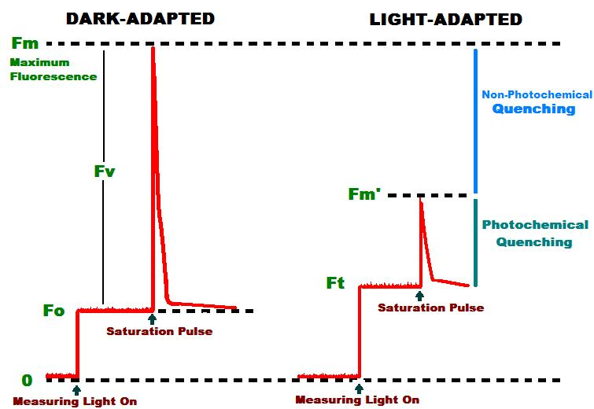

What is 'quenching'?
① Photochemical quenching (qP)
Light activates Calvin-cycle enzymes; metabolite pools in stroma and cytosol increase
Stomata open → more CO₂ for Rubisco (stomata respond ~10× slower than photosynthesis)
More electron sinks → Q_{A} re-oxidised → centres re-open
② Non-photochemical quenching (NPQ)
Rapid rise in the rate constant of heat dissipation on illumination
Photoprotective: removes excess excitation, prevents damaging free radicals
Competes with both fluorescence and photochemistry
Dark-adapted vs light-adapted traces: Fm′ < Fm because of non-photochemical quenching; Ft (F′) < Fm′ because of photochemical quenching
Takes several minutes or longer from darkness; varies with species and environment.
Notes:
Quenching means anything that lowers fluorescence. After the initial rise under actinic light, fluorescence falls over minutes. There are two families of causes.
1. Photochemical quenching (qP): photosynthesis itself switches on.
- Light activates Calvin-cycle enzymes (for example Rubisco activase, FBPase, SBPase) and metabolite pools build up in the stroma and cytosol.
- Stomata open, giving Rubisco more CO2. Stomata respond roughly ten times more slowly than photosynthesis, so this can take many minutes.
- More electron sinks means QA is re-oxidised faster, centres reopen, and fluorescence falls.
2. Non-photochemical quenching (NPQ): heat dissipation increases.
- The rate constant for converting excitation to heat rises quickly on illumination.
- It is photoprotective: it removes excess energy and prevents the formation of damaging reactive oxygen species.
- It competes with both fluorescence and photochemistry.
The figure compares dark-adapted and light-adapted traces. Fm′ (maximum in light) is lower than Fm (maximum in dark) because of NPQ. The steady level F′ is below Fm′ because of photochemical quenching.
Timing: from darkness, these processes take several minutes or longer to reach steady state, depending on species and conditions.

Slide 20
How NPQ is switched on: the molecular mechanism
Excess light
Linear + cyclic e⁻ flow pump H⁺ into lumen
Lumen acidifies: ΔpH builds up
Key facts
Regulated by acidification of the lumen (ΔpH)
Needs PsbS and the xanthophyll cycle
Xanthophylls are carotenoids
A 'safe' valve: competes with photochemistry and fluorescence
Lowers F_{m}′ below F_{m} — the basis of the NPQ parameter
PsbS protein
becomes protonated
VDE activated:
violaxanthin → zeaxanthin
Conformational change in PSII antenna →
excitation dissipated as heat (qE)
Notes:
How NPQ is switched on, as a chain of cause and effect.
1. Excess light: more light is absorbed than photosynthesis can use.
2. Linear and cyclic electron flow pump protons (H+) into the thylakoid lumen.
3. The lumen becomes acidic, building a large pH difference (ΔpH) across the membrane.
4. This acidity triggers two things in parallel:
a. The PsbS protein becomes protonated; it acts as a pH sensor.
b. The enzyme violaxanthin de-epoxidase (VDE) is activated and converts violaxanthin into zeaxanthin (the xanthophyll cycle).
5. Both cause a change in the shape of the PSII antenna, which then converts excitation energy into heat. This fast, energy-dependent part of NPQ is called qE.
Key facts:
- NPQ is regulated by lumen acidity, so it responds within seconds to minutes.
- It needs PsbS and the xanthophyll cycle; xanthophylls are carotenoids.
- It is a "safe" valve: it competes with photochemistry and fluorescence.
- Because it increases heat loss, it lowers Fm′ below Fm. That difference is how we measure NPQ.
Likely question: "Name two molecular players in NPQ." PsbS and zeaxanthin.

Slide 21

The xanthophyll cycle in detail
VDE: high light · acidic lumen (low pH) · ascorbate →
Violaxanthin
2 epoxides
Antheraxanthin
1 epoxide
Zeaxanthin
0 epoxides · quencher
← ZE: low light / darkness
Fast & reversible
Sustained
Optical signature
Zeaxanthin + protonated PsbS give rapid qE that relaxes in seconds–minutes in the dark.
Retained zeaxanthin (e.g. over-wintering evergreens) keeps quenching on and lowers F_{v}/F_{m}.
De-epoxidation changes reflectance at ~531 nm — the basis of the PRI index used with SIF.
Notes:
The xanthophyll cycle step by step.
Forward reaction (in excess light):
1. The lumen is acidic and ascorbate is available.
2. Violaxanthin de-epoxidase (VDE) removes one epoxide group from violaxanthin (2 epoxides), giving antheraxanthin (1 epoxide).
3. It removes the second, giving zeaxanthin (no epoxide).
4. Zeaxanthin, together with protonated PsbS, promotes heat dissipation in the antenna.
Back reaction (in low light or darkness): zeaxanthin epoxidase (ZE) adds the epoxide groups back, returning to violaxanthin. This is slower.
Three consequences:
- Fast and reversible: zeaxanthin plus PsbS give the rapid qE that relaxes within seconds to minutes in the dark.
- Sustained: if zeaxanthin is retained (for example in over-wintering evergreens or under long stress), quenching stays on even after dark adaptation and lowers Fv/Fm.
- Optical signature: de-epoxidation slightly changes leaf reflectance near 531 nm. The Photochemical Reflectance Index (PRI) uses this and is often combined with SIF to estimate NPQ remotely.
Some shade-tolerant and woody species also have a second cycle, the lutein epoxide cycle.

Slide 22


The saturating-pulse principle
Before the pulse (steady light)
During the saturating pulse
open
closed
open
open
closed
open
closed
closed
closed
closed
closed
closed
closed
open
open
closed
open
closed
closed
closed
closed
closed
closed
closed
Some centres open, some closed → level F′
All centres closed → q_{P} = 0 → level F_{m}′ (or F_{m} if dark-adapted)
Pulse properties
What it separates
Old method
Very bright (typically ~0.8 s at ≥4000 µmol m⁻² s⁻¹), shorter than 1 s so it does not change the leaf's state.
F_{q}′ = F_{m}′ − F′ is the photochemical part; F_{m} − F_{m}′ reflects NPQ.
Herbicides (e.g. DCMU) blocking Q_{B} removed photochemistry — not practical routinely.
Notes:
The saturating-pulse principle, the key trick of PAM fluorometry.
Problem: under light, fluorescence is lowered by both photochemistry and heat loss. How can we tell how much is due to each?
Old solution: herbicides such as DCMU block electron transport and remove photochemistry. Not practical for routine work.
Modern solution:
1. Apply a very bright flash (typically around 0.8 s at 4000 µmol m⁻² s⁻¹ or more).
2. The flash delivers so many photons that every QA becomes reduced: all centres close.
3. During the flash photochemical quenching is effectively zero; only non-photochemical quenching remains.
4. The fluorescence reached (Fm in a dark leaf, Fm′ in a light-adapted leaf) is the level the leaf would have with no photochemistry.
5. The flash is short enough not to change the leaf's NPQ state.
The left panel shows the situation before the pulse (some centres open, some closed, level F′); the right panel during the pulse (all closed, level Fm′).
What it separates:
- Fq′ = Fm′ − F′ is the photochemical part (fluorescence quenched by open centres).
- Fm − Fm′ reflects NPQ (fluorescence lowered by heat dissipation).
Everything in module 5 is built on these two differences.

Slide 23
PAM protocol & parameters
05
Reading a fluorescence trace: every level, every ratio, and a fully worked numerical example
Notes:
Module 5: the PAM protocol and the parameters.
We will read a full fluorescence trace step by step, define each fluorescence level, then build each parameter from them: Fv/Fm, ΦPSII, qP, qL and NPQ. The module ends with a summary table and a worked numerical example you can use for practice.
Golden rule for notation: a prime (′) means the leaf is light-adapted; no prime means dark-adapted.

Slide 24
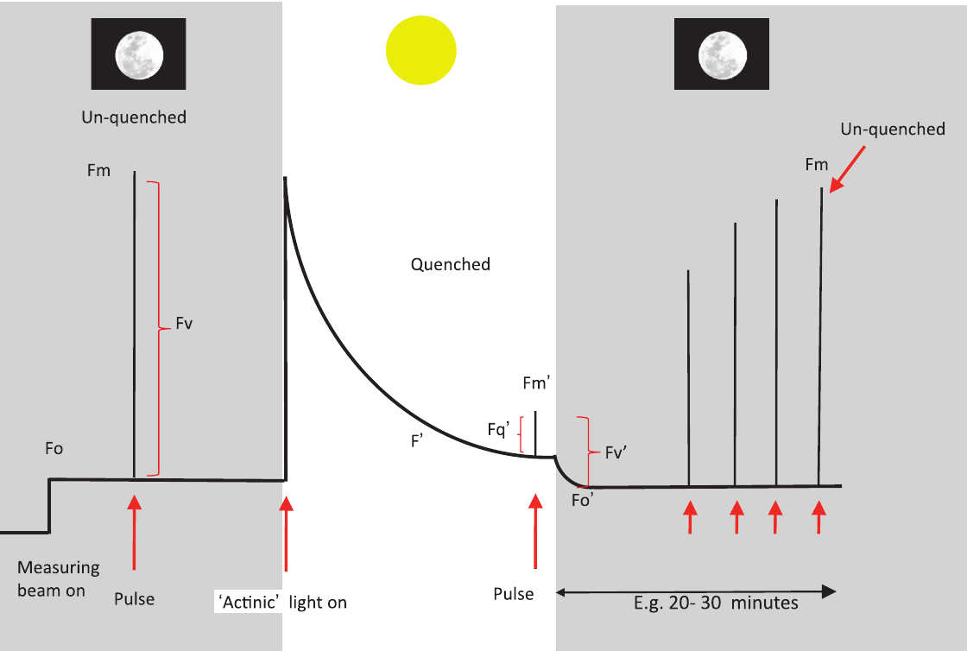
The typical PAM trace, step by step
1
Measuring beam on (dark)
Minimum fluorescence F_{o} — all centres open, no NPQ
2
Saturating pulse (dark)
Maximum F_{m} — all centres closed; F_{v} = F_{m} − F_{o}
3
Actinic light on
Rise, then quenching to steady state F′ (minutes to >20 min)
4
Pulses in the light
F_{m}′ < F_{m} because of NPQ; F_{q}′ = F_{m}′ − F′
5
Actinic off (+ far-red)
Minimal level in light-adapted state F_{o}′; F_{v}′ = F_{m}′ − F_{o}′
6
Pulses in the dark
Murchie & Lawson (2013), Fig. 2 — stylised trace of a dark-adapted leaf exposed to actinic light, darkness and saturating pulses
F_{m}′ recovers towards F_{m} as NPQ relaxes (20–30 min)
Notes:
Murchie & Lawson Figure 2, a stylised trace of a dark-adapted leaf. Follow the six numbered steps.
1. Measuring beam on in darkness: minimum fluorescence Fo. All centres are open and there is no NPQ.
2. Saturating pulse in darkness: maximum fluorescence Fm. All centres closed, still no NPQ. Variable fluorescence Fv = Fm − Fo.
3. Actinic light on: fluorescence first rises (centres close), then declines over minutes (quenching) to a steady state F′. Reaching steady state can take from a few minutes to more than 20 minutes.
4. Saturating pulses under actinic light: each gives Fm′. Fm′ is lower than Fm because NPQ is now active. The photochemical part is Fq′ = Fm′ − F′.
5. Actinic light off, often with a brief far-red light: fluorescence drops to Fo′, the minimum level in the light-adapted state. Fv′ = Fm′ − Fo′.
6. Further pulses in darkness: Fm′ gradually recovers towards Fm as NPQ relaxes, typically over 20–30 minutes. The speed of recovery separates the NPQ components (module 6).
Steps 1–2 give the dark-adapted measurement, steps 3–4 the light-adapted one, steps 5–6 the relaxation analysis. This trace corresponds to an induction at high irradiance (500 µmol m⁻² s⁻¹ or more).

Slide 25
Glossary of fluorescence levels
F_{o}
F_{m}
F_{v}
F′ (F_{s}, F_{t})
DARK
DARK
DARK
LIGHT
Minimal fluorescence, dark-adapted
Maximal fluorescence, dark-adapted
Variable fluorescence
Steady-state fluorescence in light
All PSII centres open, no NPQ
Saturating pulse closes all centres; no NPQ
F_{v} = F_{m} − F_{o}
Some centres closed, NPQ present
F_{m}′
F_{o}′
F_{q}′
F_{v}′
LIGHT
LIGHT
LIGHT
LIGHT
Maximal fluorescence in light
Minimal fluorescence in light
Photochemical quenching by open centres
Variable fluorescence in light
Pulse under actinic light; lowered by NPQ
Just after actinic off (+FR) or calculated
F_{q}′ = F_{m}′ − F′
F_{v}′ = F_{m}′ − F_{o}′
Notes:
The eight building blocks. Dark (navy) labels are dark-adapted levels; light (amber) labels are light-adapted.
Dark-adapted:
- Fo: minimal fluorescence; all PSII centres open, no NPQ.
- Fm: maximal fluorescence; saturating pulse closes all centres, no NPQ.
- Fv: variable fluorescence, Fv = Fm − Fo.
Light-adapted:
- F′ (also written Fs or Ft): steady-state fluorescence under actinic light; some centres closed, NPQ present.
- Fm′: maximal fluorescence in the light; a pulse closes all centres but NPQ remains, so Fm′ is less than Fm.
- Fo′: minimal fluorescence in the light; measured just after the actinic light is switched off (with far-red) or calculated.
- Fq′: photochemical quenching by open centres, Fq′ = Fm′ − F′.
- Fv′: variable fluorescence in the light, Fv′ = Fm′ − Fo′.
How to remember: "o" = open (minimum), "m" = maximum (all closed), "v" = variable (the difference), prime = in the light.
Usual order of size in a healthy leaf: Fm > Fm′ > F′ > Fo, and Fo′ is usually a little below Fo because NPQ also quenches the minimum level.

Slide 26
F_{v}/F_{m}: maximum quantum efficiency of PSII
Reading the value (dark-adapted leaf)
~0.83
0.5
0.6
0.7
0.8
< 0.6: severe PSII damage
0.6–0.78: photoinhibition / sustained quenching
≈ 0.8–0.83: healthy
typical F_{v}/F_{m} of an unstressed leaf
Scale starts at 0.5. Zone limits are approximate; compare with non-stressed controls of the same species.
F_{v}/F_{m} = (F_{m} − F_{o}) / F_{m}
How to measure
What lowers it
Dark-adapt ≥20 min (leaf clip)
Check zero; set measuring beam so it causes no rise
Measure F_{o}, then a saturating pulse → F_{m}
Pre-dawn values for long-term stress
Photoinhibition: inactivation/damage of PSII (D1 protein)
Sustained quenching (e.g. retained zeaxanthin, drought, winter)
Rise in F_{o} → damage; fall in F_{m} → quenching
Meaning
Correlates with the maximum quantum yield of photosynthesis (O₂ or CO₂ per photon) at limiting light.
Notes:
Fv/Fm, the maximum quantum efficiency of PSII.
Formula: Fv/Fm = (Fm − Fo)/Fm.
Meaning: the fraction of absorbed light that PSII could use for photochemistry if every centre were open and there were no NPQ. It is measured on fully dark-adapted leaves.
Why it works: at Fo all centres are open and photochemistry is at its maximum; at Fm photochemistry is zero. So Fv is the fluorescence "taken away" by photochemistry, and dividing by Fm turns it into an efficiency.
Typical values:
- About 0.83 (0.81–0.83) in healthy, unstressed leaves of most species.
- 0.6–0.78: photoinhibition or sustained quenching.
- Below about 0.6: severe PSII damage. (These cut-offs are approximate guides; always compare with unstressed controls.)
How to measure: dark-adapt at least 20 minutes, check the measuring beam causes no rise, record Fo, then a saturating pulse for Fm. Pre-dawn measurements are used for long-term stress such as drought.
What lowers it:
- Photoinhibition: damage or inactivation of PSII, especially the D1 protein.
- Sustained quenching: retained zeaxanthin, drought, cold.
- A rise in Fo suggests damage; a fall in Fm suggests quenching.
Fv/Fm correlates with the maximum quantum yield of photosynthesis (O2 or CO2 per photon) at limiting light.

Slide 27

Φ_{PSII} = F_{q}′/F_{m}′: PSII operating efficiency
Φ_{PSII} = F_{q}′ / F_{m}′ = (F_{m}′ − F′) / F_{m}′
also written ΔF/F_{m}′ · Y(II) · 'yield'
Decomposition
F_{q}′/F_{m}′
operating efficiency
=
F_{q}′/F_{v}′ (qP)
fraction of centres open
×
F_{v}′/F_{m}′
max efficiency in light
↓ F_{v}′/F_{m}′ means NPQ ↑
Electron transport rate (ETR)
Why it is popular — and the catch
ETR = Φ_{PSII} × PAR × 0.84 × 0.5
0.84 = typical leaf absorptance; 0.5 = share of light to PSII (both are assumptions)
No dark adaptation needed; quick in the field
Strongly depends on current PAR — always record light at the leaf surface
Notes:
ΦPSII, the PSII operating efficiency.
Formula: ΦPSII = Fq′/Fm′ = (Fm′ − F′)/Fm′. Also written ΔF/Fm′, Y(II) or simply "yield".
Meaning: the fraction of absorbed light actually used by PSII photochemistry right now, under the current light. Unlike Fv/Fm, it needs no dark adaptation.
Decomposition (very useful):
Fq′/Fm′ = (Fq′/Fv′) × (Fv′/Fm′), that is ΦPSII = qP × Fv′/Fm′.
- qP is the fraction of centres that are open.
- Fv′/Fm′ is how efficient an open centre is, given the current NPQ. A fall in Fv′/Fm′ means NPQ has increased.
So a fall in ΦPSII can be due to closed centres, more NPQ, or both, and the decomposition tells you which.
Electron transport rate: ETR = ΦPSII × PAR × 0.84 × 0.5.
- PAR is light at the leaf surface (µmol photons m⁻² s⁻¹).
- 0.84 is a typical leaf absorptance; 0.5 assumes absorbed light is shared equally between PSII and PSI. Both are assumptions that may not hold for every leaf.
Popular because it is fast and needs no dark adaptation. The catch: it depends strongly on the current light, so always record PAR at the leaf surface, and wait for steady state before the pulse.

Slide 28


qP and qL: how many PSII centres are open?
qP — photochemical quenching
qL — the 'lake model' version
qP = F_{q}′/F_{v}′ = (F_{m}′ − F′)/(F_{m}′ − F_{o}′)
Proportion of PSII centres that are open (approx.)
1 − qP ≈ closed centres (excitation pressure)
Non-linear with true open fraction — use with care
qL = (F_{q}′/F_{v}′) × (F_{o}′/F′) = qP × F_{o}′/F′
Estimates the fraction of open PSII centres
Accounts for energy sharing between connected PSII units
Considered a more accurate redox-state indicator
Picture it: 10 PSII centres under actinic light
Use cases
Onset of photoinhibition
Level of photoprotective quenching
Requires F_{o}′ (measured with FR or calculated)
6 open (green) · 4 closed (red) → q_{L} ≈ 0.6 ; 1 − q_{L} ≈ 0.4
qP and qL are both 1 when all centres are open; they differ in between because of antenna connectivity.
Notes:
How many PSII centres are open?
qP (photochemical quenching):
Formula: qP = Fq′/Fv′ = (Fm′ − F′)/(Fm′ − Fo′).
It compares the photochemical part (Fq′) with the maximum possible variable fluorescence in the light (Fv′). It approximates the fraction of open centres. 1 − qP approximates the fraction of closed centres, often used as a measure of "excitation pressure" and the onset of photoinhibition.
The problem: qP assumes each PSII unit is isolated (the "puddle" model). In reality PSII units share antennae, so energy from a closed centre can hop to an open neighbour (the "lake" model). This makes qP non-linear with the true open fraction.
qL (lake model):
Formula: qL = qP × Fo′/F′.
It corrects for connectivity between PSII units and is considered a more accurate indicator of the redox state of QA. It needs Fo′.
Picture: 10 centres, 6 open (green) and 4 closed (red). Ideally qL ≈ 0.6 and 1 − qL ≈ 0.4.
Both qP and qL equal 1 when all centres are open; they differ in between.

Slide 29
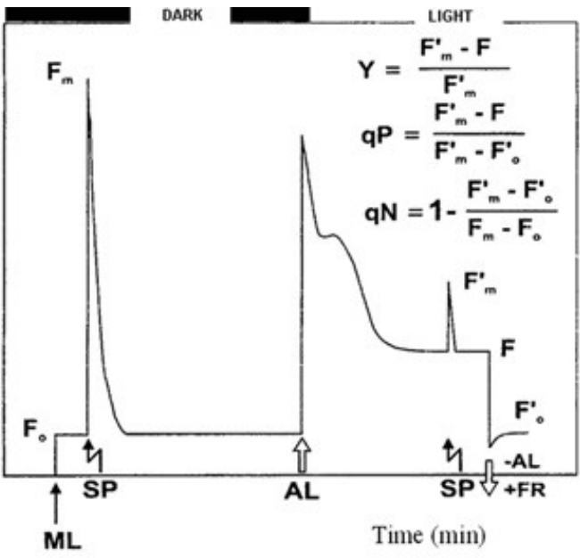
NPQ: non-photochemical quenching
NPQ = (F_{m} − F_{m}′) / F_{m}′
Meaning
Estimates the rate constant for heat loss from PSII
0 in a fully dark-adapted leaf; typically rises to ~1–3+ in high light
Caution
Needs a true F_{m}: if dark-adapted F_{v}/F_{m} is well below 0.83, treat NPQ with caution
Photoinhibited leaves have lower F_{m} → NPQ underestimated → don't compare across different F_{v}/F_{m}
Classic notation: Y = (Fm′−F)/Fm′, qP = (Fm′−F)/(Fm′−Fo′), qN = 1 − (Fm′−Fo′)/(Fm−Fo); ML, SP, AL, FR markers
Notes:
NPQ, non-photochemical quenching (Stern–Volmer form).
Formula: NPQ = (Fm − Fm′)/Fm′.
Meaning: it estimates the rate constant of heat loss from PSII, relative to the dark-adapted state. It is 0 in a fully dark-adapted leaf and typically rises to about 1–3 or more in high light.
Why this formula: Fm is the maximum with no NPQ; Fm′ is the maximum with NPQ. The more heat dissipation, the lower Fm′, and the bigger the difference.
Important: NPQ is the only common parameter that needs the dark-adapted Fm. This creates a trap:
- If the leaf is already photoinhibited, its "dark" Fm is lower than it should be.
- Then Fm − Fm′ is smaller, so NPQ looks lower even if heat dissipation is high.
- Therefore do not compare NPQ between leaves with different Fv/Fm values, and treat NPQ with caution if Fv/Fm is well below 0.83.
The figure (from the course slides) shows the classic notation: Y = (Fm′ − F)/Fm′, qP = (Fm′ − F)/(Fm′ − Fo′), and the older qN = 1 − (Fm′ − Fo′)/(Fm − Fo), with arrows marking the measuring light (ML), saturating pulses (SP), actinic light (AL) and far-red (FR).
qN and NPQ both measure non-photochemical quenching but scale differently; NPQ is preferred today.

Slide 30
Summary table of commonly used parameters
Parameter | Also known as | Formula | Description | Needs
F_{v}/F_{m} | — | (F_{m} − F_{o})/F_{m} | Maximum quantum efficiency of PSII photochemistry | dark
F_{v}′/F_{m}′ | — | (F_{m}′ − F_{o}′)/F_{m}′ | Maximum efficiency of PSII in the light, if all centres were open | F_{o}′
F_{q}′/F_{m}′ | Φ_{PSII}, ΔF/F_{m}′, Y(II) | (F_{m}′ − F′)/F_{m}′ | PSII operating efficiency: quantum efficiency of PSII electron transport in the light | —
F_{q}′/F_{v}′ | qP | (F_{m}′ − F′)/(F_{m}′ − F_{o}′) | Photochemical quenching; non-linear with fraction of open centres (see qL) | F_{o}′
NPQ | — | (F_{m} − F_{m}′)/F_{m}′ | Non-photochemical quenching: rate constant for heat loss from PSII | dark
qL | — | (F_{q}′/F_{v}′)(F_{o}′/F′) | Estimates the fraction of open PSII centres | F_{o}′
'Needs': dark = requires dark-adapted F_{o}/F_{m}; F_{o}′ = requires measured (far-red) or calculated F_{o}′.
Notes:
Table 1 of Murchie & Lawson (2013), with one extra column showing what each parameter needs.
- Fv/Fm = (Fm − Fo)/Fm: maximum quantum efficiency of PSII. Needs a dark-adapted leaf.
- Fv′/Fm′ = (Fm′ − Fo′)/Fm′: maximum efficiency of PSII in the light if all centres were open. Needs Fo′.
- Fq′/Fm′ (ΦPSII) = (Fm′ − F′)/Fm′: operating efficiency in the light. Needs neither dark adaptation nor Fo′, which explains why it is the most used.
- Fq′/Fv′ (qP) = (Fm′ − F′)/(Fm′ − Fo′): photochemical quenching; non-linear with the open fraction. Needs Fo′.
- NPQ = (Fm − Fm′)/Fm′: non-photochemical quenching. Needs dark-adapted Fm.
- qL = (Fq′/Fv′)(Fo′/F′): fraction of open centres (lake model). Needs Fo′.
How to use it in an exam: for any parameter, first ask "does it need a dark measurement?" and "does it need Fo′?" That tells you the protocol required (see the protocols slide in module 6).

Slide 31
Worked example: calculate every parameter
Readings from one leaf (arbitrary units)
Parameter | Calculation | Result | Meaning
F_{v}/F_{m} | (1000 − 200)/1000 | 0.80 | Healthy PSII
F_{v}′/F_{m}′ | (600 − 180)/600 | 0.70 | Max efficiency in light (NPQ lowers it)
Φ_{PSII} | (600 − 400)/600 | 0.33 | ⅓ of absorbed light used by PSII
qP | (600 − 400)/(600 − 180) | 0.48 | ≈ half of centres open
Check | qP × F_{v}′/F_{m}′ = 0.476 × 0.70 | 0.33 | = Φ_{PSII} ✓
qL | 0.476 × 180/400 | 0.21 | Lake-model open fraction
NPQ | (1000 − 600)/600 | 0.67 | Moderate heat dissipation
ETR | 0.333 × 1000 × 0.84 × 0.5 | 140 | µmol e⁻ m⁻² s⁻¹
F_{o}′ calc. | 200/(0.80 + 200/600) | 176 | vs 180 measured ✓
F_{o}
F_{m}
200
1000
F′
F_{m}′
400
600
F_{o}′
PAR
180
1000
Dark (navy) · light-adapted (amber). PAR in µmol m⁻² s⁻¹.
Notes:
Worked example. Readings from one leaf: Fo = 200, Fm = 1000 (dark); F′ = 400, Fm′ = 600, Fo′ = 180 (light); PAR = 1000 µmol m⁻² s⁻¹. These are realistic made-up numbers for practice.
Step by step:
1. Fv/Fm = (1000 − 200)/1000 = 0.80 → healthy PSII.
2. Fv′/Fm′ = (600 − 180)/600 = 0.70 → open centres are less efficient in the light because of NPQ.
3. ΦPSII = (600 − 400)/600 = 0.33 → one third of absorbed light is used by PSII.
4. qP = (600 − 400)/(600 − 180) = 200/420 = 0.48 → about half the centres are open.
5. Check: qP × Fv′/Fm′ = 0.476 × 0.70 = 0.33 = ΦPSII. The decomposition works.
6. qL = 0.476 × 180/400 = 0.21 → by the lake model, fewer centres are open than qP suggests.
7. NPQ = (1000 − 600)/600 = 0.67 → moderate heat dissipation.
8. ETR = 0.333 × 1000 × 0.84 × 0.5 = 140 µmol electrons m⁻² s⁻¹.
9. Fo′ calculated (Oxborough & Baker) = 200/(0.80 + 200/600) = 200/1.133 = 176, close to the measured 180.
Interpretation: a healthy leaf in fairly high light, using a third of absorbed light for PSII photochemistry, with about half its centres closed and moderate photoprotective heat loss.
Practice: change Fm′ to 500 and recalculate; ΦPSII and qP fall, NPQ rises.

Slide 32
Good practice & pitfalls
06
How long to dark-adapt, what Fv/Fm can and cannot tell you, problems in the light, and the link to CO₂ assimilation
Notes:
Module 6: good practice and pitfalls.
Most errors in fluorescence studies are not instrument errors but interpretation errors: wrong dark adaptation, non-saturating pulses, assuming lower Fv/Fm always means lower photosynthesis, or comparing NPQ between damaged and healthy leaves. This module goes through these one by one and ends with standard protocols.

Slide 33
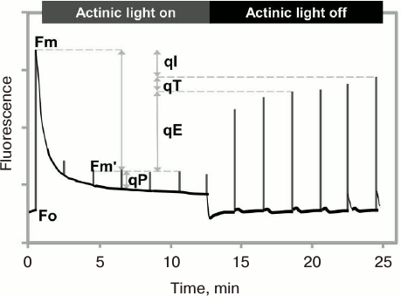


To dark-adapt or not? The components of NPQ
Relaxation time in darkness
qE · ΔpH, PsbS, zeaxanthin
qT · state transitions
qI · photoinhibition, D1 repair, retained zeaxanthin
seconds
minutes
~30 min
hours
days
NPQ relaxation after actinic light off: qE (fast), qT and qI (slow) separate
Practical rule
Best answer
Long-term stress
20–30 min dark usually removes qE and qT for a plant in a moderate environment.
Test it: dark-adapt non-stressed controls and measure F_{v}/F_{m} every 5–10 min until stable.
Use pre-dawn F_{v}/F_{m} (e.g. drought, over-wintering evergreens).
Notes:
How long should a leaf be dark-adapted? It depends on which NPQ components you want to remove. NPQ has three components that relax at different speeds in the dark (see the timeline and the figure):
1. qE, energy-dependent quenching: driven by ΔpH, PsbS and zeaxanthin. Relaxes within seconds to a few minutes once the proton gradient collapses.
2. qT, state transitions: LHCII antenna moving between PSII and PSI. Relaxes over minutes; important mainly in low light.
3. qI, photoinhibitory or sustained quenching: includes damage and repair of the D1 protein and retained zeaxanthin. Relaxes over hours or longer.
The figure shows a trace after actinic light is switched off: Fm′ recovers in stages, and the size of each stage gives qE, qT and qI.
Practical rules:
- 20–30 minutes in the dark usually removes qE and qT for a plant in a moderate environment. Whatever remains is qI.
- Best practice: test it. Dark-adapt unstressed control leaves and measure Fv/Fm every 5–10 minutes until it stops changing.
- For long-term stress (drought, winter), measure pre-dawn Fv/Fm, after a full night of darkness.

Slide 34
Pitfalls in measuring F_{o} and F_{m}
Measuring beam too strong
Q_{A} partly reduced in the dark
NPQ not fully relaxed
Induces electron transport → false (high) F_{o}. Lower intensity / frequency if F_{o} drifts up.
Chlororespiration reduces PQ. Use a far-red pulse to oxidise Q_{A} before F_{o}.
Zeaxanthin quenching relaxes slowly → F_{m} underestimated. Dark-adapt long enough.
Pulse not saturating
High modulation frequency in the dark
Quenching during the pulse
~2000 µmol m⁻² s⁻¹ may miss true F_{m}′ in high light; aim 4000–8000 (more for C₄).
Useful during pulses but not for F_{o}; most devices switch automatically.
Check there is no decline during the pulse (pulse too long).
Notes:
Six common pitfalls when measuring Fo and Fm.
1. Measuring beam too strong: it drives some photochemistry, closes some centres and gives a falsely high Fo. Fix: lower intensity or frequency; check that switching the beam on causes no rise.
2. QA partly reduced in darkness: chlororespiration can reduce the PQ pool in the dark, raising Fo. Fix: give a brief far-red pulse before measuring Fo to oxidise QA.
3. NPQ not fully relaxed: slowly relaxing zeaxanthin-dependent quenching lowers Fm. Fix: dark-adapt long enough (previous slide).
4. Pulse not saturating: about 2000 µmol m⁻² s⁻¹ may be enough for dark-adapted Fm but not for Fm′ under strong actinic light. Aim for 4000–8000; C4 plants may need more.
5. High modulation frequency in the dark: high frequency is useful during pulses but can act as actinic light when measuring Fo. Most instruments switch frequency automatically.
6. Quenching during the pulse: if the pulse is too long, fluorescence may start to decline during it. Check the pulse shape is flat at the top.
These matter because errors in Fo or Fm propagate into every parameter (Fv/Fm, NPQ, qP).

Slide 35
Interpreting F_{v}/F_{m}: four common misconceptions
(i) Cause is hard to assign
(ii) Lower F_{v}/F_{m} ≠ lower photosynthesis
Leaf optical properties change under stress (e.g. drought) → F_{m} and F_{o} change via absorptance. The ratio removes this, but its cause still needs other data.
F_{v}/F_{m} relates to the light-limited quantum yield. A leaf can have reduced F_{v}/F_{m} with no penalty at high, saturating light.
Imaging F_{v}/F_{m} of plants
(iii) Stress may need high light to show
(iv) It only sees PSII
Takeaway
Inactivation of PSII may only appear when light is high enough; otherwise no difference between treatments.
Stress elsewhere (e.g. roots) may not change F_{v}/F_{m}. Fluorescence is not a generic stress detector.
Use F_{v}/F_{m} with light-adapted data, controls and other measurements.
Notes:
Four common misconceptions about Fv/Fm (Murchie & Lawson).
1. The cause is hard to assign. Stress such as drought can change leaf optical properties, so Fm and Fo may change because absorptance changed. The ratio Fv/Fm cancels much of this, but finding the cause of a change still needs other measurements.
2. Lower Fv/Fm does not necessarily mean lower photosynthesis. Fv/Fm relates to the light-limited quantum yield. A leaf can have reduced Fv/Fm with no loss of photosynthesis at high, light-saturated conditions.
3. Stress may need high light to show. Inactivation of PSII may only appear when light is strong enough to cause damage; under low light, stressed and control plants may give the same Fv/Fm.
4. It only sees PSII. Stress in another part of the plant, such as roots, may not change Fv/Fm at all. Chlorophyll fluorescence is not a generic stress detector.
Take-away: Fv/Fm is a valuable, robust measurement of PSII health, but it should be combined with light-adapted parameters, proper controls and other measurements such as gas exchange.
The image shows an imaging system used to map Fv/Fm across plants.

Slide 36
Problems with measurements in the light
Φ_{PSII} depends on light
Errors in F_{o}′ → calculate it
Varies substantially with even small PAR changes
Record PAR at the leaf surface, or measure when PAR is saturating
Ensure steady state (F′ stable) before the pulse
F_{o}′ = F_{o} / [ (F_{v}/F_{m}) + (F_{o}/F_{m}′) ]
Oxborough & Baker (1997). Valid if: PSII centres open at F_{o}; no change in down-regulation between F_{o}/F_{m}; no change in photoinhibition between F_{m}′ and F_{m}.
ETR assumptions
Other small errors
Absorptance 0.84 and PSII share 0.5 are averages, not constants
Don't compare ETR of drought-stressed (low turgor) vs hydrated leaves
Pigment content and PSII:PSI stoichiometry change these values
PSI fluorescence above 700 nm adds to the signal
Multiple turnovers of PSII during the pulse
Mostly minor: Φ_{PSII} agrees well with quantum yield of CO₂ assimilation
Notes:
Problems with measurements in the light.
1. ΦPSII depends on light. Even small changes in PAR change ΦPSII. Always record PAR at the leaf surface, or measure when light is saturating. Wait until F′ is stable before applying the pulse.
2. ETR assumptions. ETR = ΦPSII × PAR × 0.84 × 0.5 assumes leaf absorptance of 0.84 and equal light sharing between PSII and PSI. Pigment content, leaf structure, water status and PSII:PSI ratio all change these values. Do not compare ETR between drought-stressed (low turgor) and well-watered leaves without measuring absorptance.
3. Errors in Fo′. If the far-red light does not fully oxidise QA, or NPQ relaxes quickly after the actinic light is off, the measured Fo′ is wrong. Instead calculate it with the Oxborough & Baker (1997) equation:
Fo′ = Fo / [(Fv/Fm) + (Fo/Fm′)].
This is valid if centres are open at Fo, down-regulation does not differ between Fo and Fm, and photoinhibition does not change between the Fm′ and Fm measurements.
4. Other small errors: PSI fluorescence above 700 nm adds to the signal; multiple turnovers of PSII during the pulse. These are usually minor, and ΦPSII still agrees well with the quantum yield of CO2 assimilation.

Slide 37

Linking fluorescence to CO₂ assimilation
CO₂ assimilation (Calvin cycle)
~4 e⁻ per CO₂ when photorespiration is blocked
C₃ vs C₄
C₃: close correlation at 2 % O₂; photorespiration breaks linearity
C₄: CO₂-concentrating mechanism suppresses photorespiration → more linear
PSII electron
transport (ETR)
Photorespiration (C₃)
Rises with stomatal closure, heat
Mehler reaction / cyclic flow
Alternative sinks under stress
Measuring PSI too
P700 redox via near-infrared absorbance (810–840 nm)
Combine Φ_{PSI} with Φ_{PSII}; cyclic flow affects ΔpH and NPQ
PSII:PSI ETR ratios need stoichiometry corrections
Implication
Linear F_{q}′/F_{m}′ ↔ CO₂ uptake only holds when the allocation of electrons is constant — hard to guarantee in the field.
Notes:
How fluorescence links to CO2 fixation.
PSII electron transport (ETR) produces ATP and NADPH, which the Calvin cycle uses to fix CO2. Ideally about 4 electrons are needed per CO2 fixed (when photorespiration is blocked). So ΦPSII and the quantum yield of CO2 fixation are related.
But electrons have other destinations (the diagram):
1. CO2 assimilation in the Calvin cycle.
2. Photorespiration (in C3 plants): Rubisco fixing O2 instead of CO2, which increases when stomata close or temperature rises.
3. The Mehler reaction (electrons to oxygen) and cyclic electron flow around PSI: alternative sinks under stress.
Implication: a straight-line relation between Fq′/Fm′ and CO2 uptake only holds when the share of electrons going to each sink stays constant, which is hard to guarantee in the field.
C3 vs C4:
- C3: close correlation only at low O2 (2%), where photorespiration is suppressed.
- C4: the CO2-concentrating mechanism suppresses photorespiration, so the relation is more linear.
PSI can also be measured: P700 redox state by near-infrared absorbance at 810–840 nm. Combining ΦPSI with ΦPSII helps detect cyclic electron flow, which affects ΔpH and therefore NPQ.

Slide 38
Standard measurement protocols (A, B, C)
A · F_{v}/F_{m}
B · Φ_{PSII} and NPQ
C · qP (F_{q}′/F_{v}′)
1
Dark-adapt ≥20 min (leaf clip); keep dark throughout
1
Follow A, then switch on actinic light
1
As B, but F_{o}′ is also needed
2
Detector on, measuring beam off: check zero
2
Wait for steady state (minutes); record PAR
2
After the pulse switch actinic off
3
Beam on: check it causes no rise; adjust
3
If ambient light: wait until F′ is stable
3
Measure F_{o}′ after a few seconds
4
Measure F_{o}
4
Apply saturating pulse → F_{m}′
4
Use far-red to oxidise PSI, Q_{A} and carriers
5
Saturating pulse ~0.8 s at ≥4000 µmol m⁻² s⁻¹ → F_{m}
5
NPQ needs dark-adapted F_{m} from A
5
Or calculate F_{o}′ from F_{o} (Oxborough & Baker)
6
Check no quenching during pulse
6
Calculate using Table 1
7
Non-stressed control should give 0.81–0.83
Notes:
Three standard protocols from the review.
Protocol A, Fv/Fm:
1. Dark-adapt at least 20 minutes (leaf clip), keeping the leaf dark throughout.
2. Detector on, measuring beam off: check the zero.
3. Measuring beam on: check it causes no rise; adjust if needed.
4. Record Fo.
5. Saturating pulse of about 0.8 s at 4000 µmol m⁻² s⁻¹ or more: record Fm.
6. Check there is no quenching during the pulse.
7. An unstressed control should give 0.81–0.83.
Protocol B, ΦPSII and NPQ:
1. Follow A, then switch on actinic light.
2. Wait for steady state (minutes) and record PAR.
3. In ambient light, wait until F′ is stable.
4. Apply a saturating pulse: record Fm′.
5. NPQ uses Fm from protocol A.
6. Calculate using the parameter table.
Protocol C, qP:
1. As B, but Fo′ is also needed.
2. After the pulse, switch the actinic light off.
3. Measure Fo′ after a few seconds.
4. Use far-red light to oxidise PSI, QA and the other carriers.
5. Or calculate Fo′ from Fo with the Oxborough & Baker equation.
Most instruments run these automatically; knowing the steps lets you check the data make sense.

Slide 39
Imaging, applications & monitoring
07
From single-spot measurements to images, screening platforms and remote, long-term monitoring
Notes:
Module 7: imaging and monitoring.
So far we measured one spot on one leaf. Imaging uses the same lights and the same parameters, but with a camera, so every pixel gets a value. This reveals patterns invisible to a point measurement: patchy stomatal closure, infection sites, damaged areas, differences between plants. The module ends with long-term field monitoring and the step up to remote sensing.

Slide 40
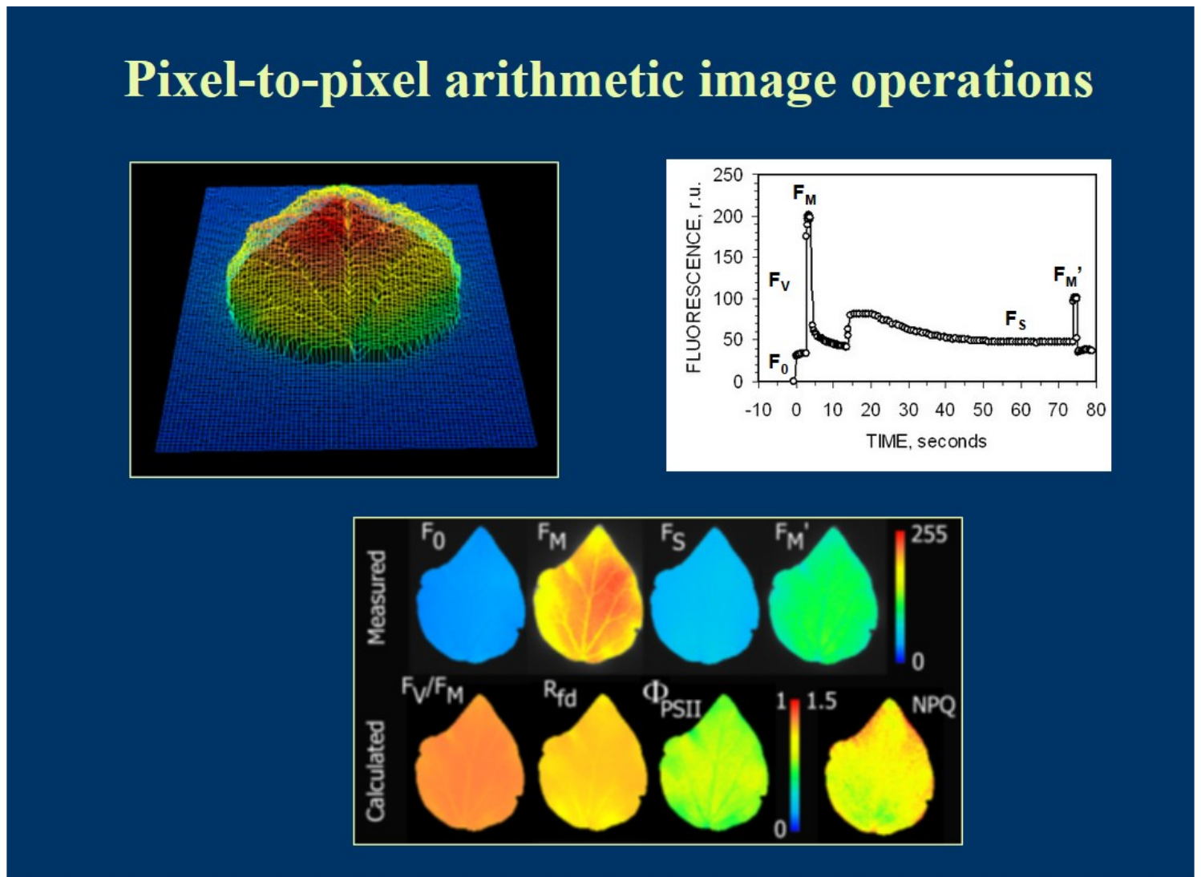
Chlorophyll fluorescence imaging
Advantages
Requirements
Spatial heterogeneity within leaves/plants
Screening many plants under identical conditions
Resolution from chloroplasts and guard cells to whole plants
Leaf flat, horizontal, at correct height
Even actinic illumination over the area
Pulse saturating everywhere (4000–8000 µmol m⁻² s⁻¹)
Combined techniques
Limitations
+ IRGA gas exchange: CO₂ diffusion, guard-cell photosynthesis
+ thermography: stomatal behaviour, water-use efficiency
+ hyperspectral: disease detection (e.g. head blight)
Costlier; large LED banks; mostly lab-based
Often no FR source → F_{o}′ is calculated
Field versions: e.g. Imaging-PAM MINI, FluorCam, rover systems
Pixel-to-pixel image arithmetic: measured F₀, Fm, Fs, Fm′ → calculated Fv/Fm, ΦPSII, NPQ maps
Notes:
Chlorophyll fluorescence imaging.
How it works: banks of LEDs provide measuring, actinic and saturating light over the whole leaf or plant, and a camera records the fluorescence. The images are processed pixel by pixel: from measured images of Fo, Fm, Fs (F′) and Fm′, the software calculates maps of Fv/Fm, ΦPSII and NPQ (the figure shows this image arithmetic).
Advantages:
- Shows spatial heterogeneity within leaves and between plants.
- Many plants can be screened at once under identical conditions.
- Resolution ranges from single chloroplasts and guard cells (with microscopes) to whole plants.
Combined techniques: with gas exchange (IRGA) for CO2 diffusion and guard-cell photosynthesis; with thermal imaging for stomatal behaviour and water-use efficiency; with hyperspectral imaging for disease detection, such as Fusarium head blight.
Requirements: the leaf should be flat, horizontal and at the right distance; actinic light must be even over the area; the pulse must be saturating everywhere (4000–8000 µmol m⁻² s⁻¹).
Limitations: more expensive, large LED panels, mostly laboratory-based; often no far-red source, so Fo′ is calculated. Field versions exist (for example Imaging-PAM MINI, FluorCam, rover-mounted systems).

Slide 41
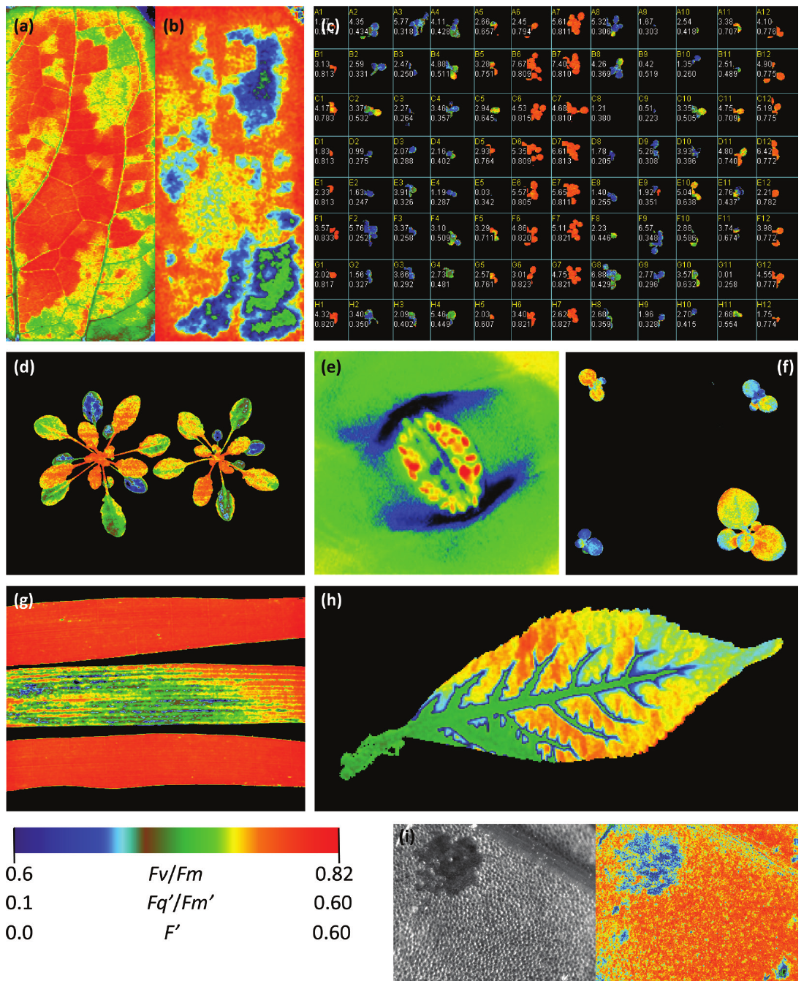
Paper Figure 3: what imaging can reveal
a · b
Steady-state F′ and Φ_{PSII} of a leaf in a chamber: patchy stomatal closure after humidity drop
c
Herbicide screening of Arabidopsis seedlings in a 96-well plate (F_{v}/F_{m})
d
Φ_{PSII} heterogeneity of Arabidopsis after high light
e
F_{v}/F_{m} of guard-cell chloroplasts (high-resolution microscope)
f
Screening transgenic plants with reduced SBPase
g
F_{v}/F_{m} of wheat varieties: rust susceptibility
h
Φ_{PSII} decline as DCMU travels in via the petiole
i
Cadmium effect on Φ_{PSII} in Lemna
Notes:
Figure 3 of Murchie & Lawson: nine examples of what imaging reveals.
a, b: Steady-state fluorescence (F′) and ΦPSII of a leaf in a gas-exchange chamber after a drop in humidity: the patchy pattern shows that stomata closed unevenly ("patchy stomatal closure").
c: Herbicide screening of Arabidopsis seedlings in a 96-well plate, using Fv/Fm. Damaged seedlings show low values.
d: Heterogeneity of ΦPSII between and within Arabidopsis plants after high light.
e: Fv/Fm of guard-cell chloroplasts in Tradescantia epidermis, imaged with a microscope: guard cells do photosynthesis too.
f: Screening transgenic plants with reduced SBPase (a Calvin-cycle enzyme); they show lower photosynthetic efficiency.
g: Fv/Fm of wheat varieties with different susceptibility to rust infection.
h: ΦPSII declining as the herbicide DCMU moves into a leaf through the petiole and veins.
i: The effect of cadmium on ΦPSII in the aquatic plant Lemna.
Colour scale: usually warm colours (red) for low values and cool or bright colours for high values; read the colour bar on each panel.

Slide 42
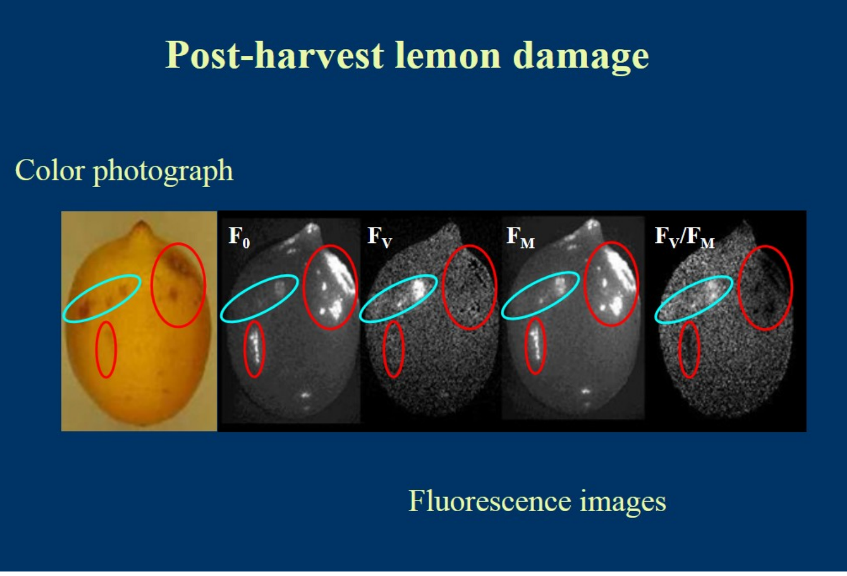
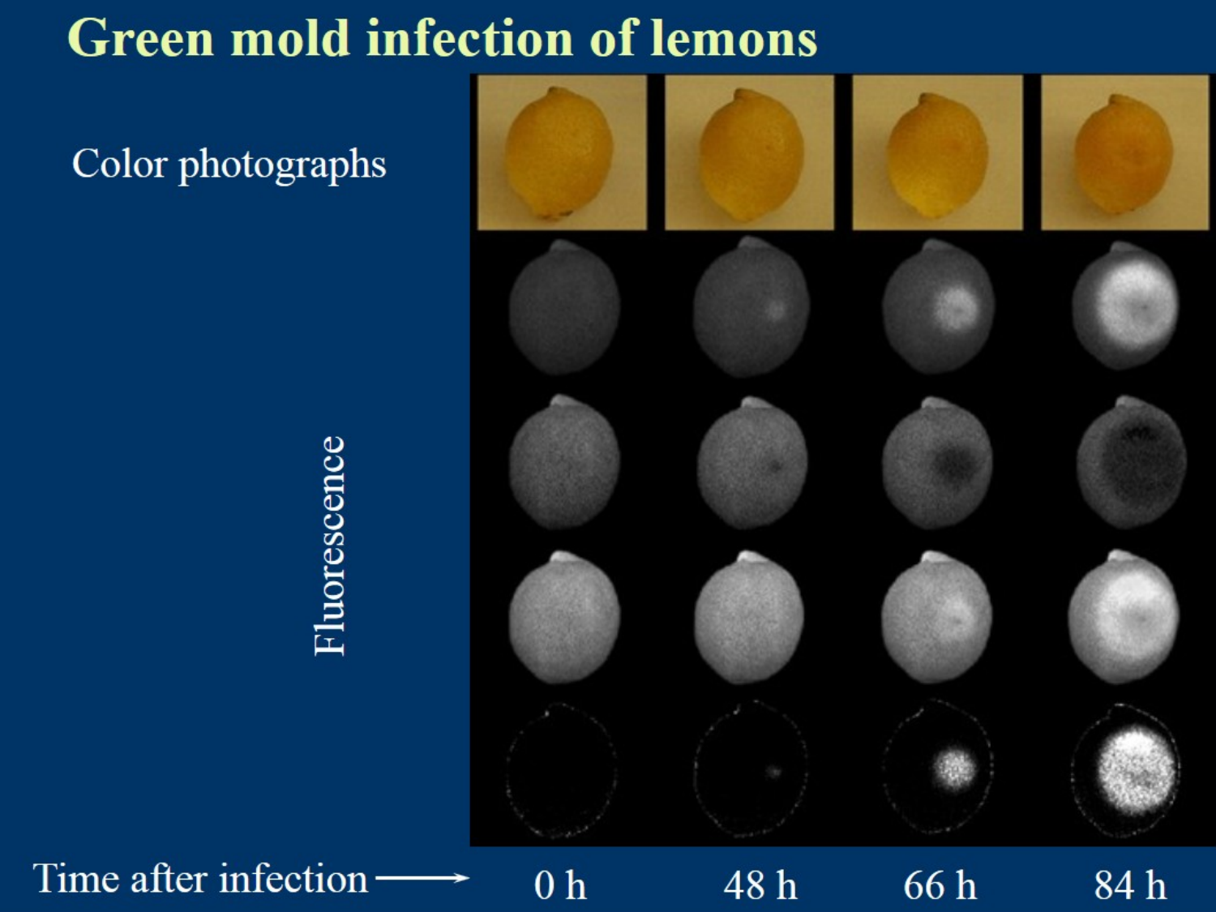
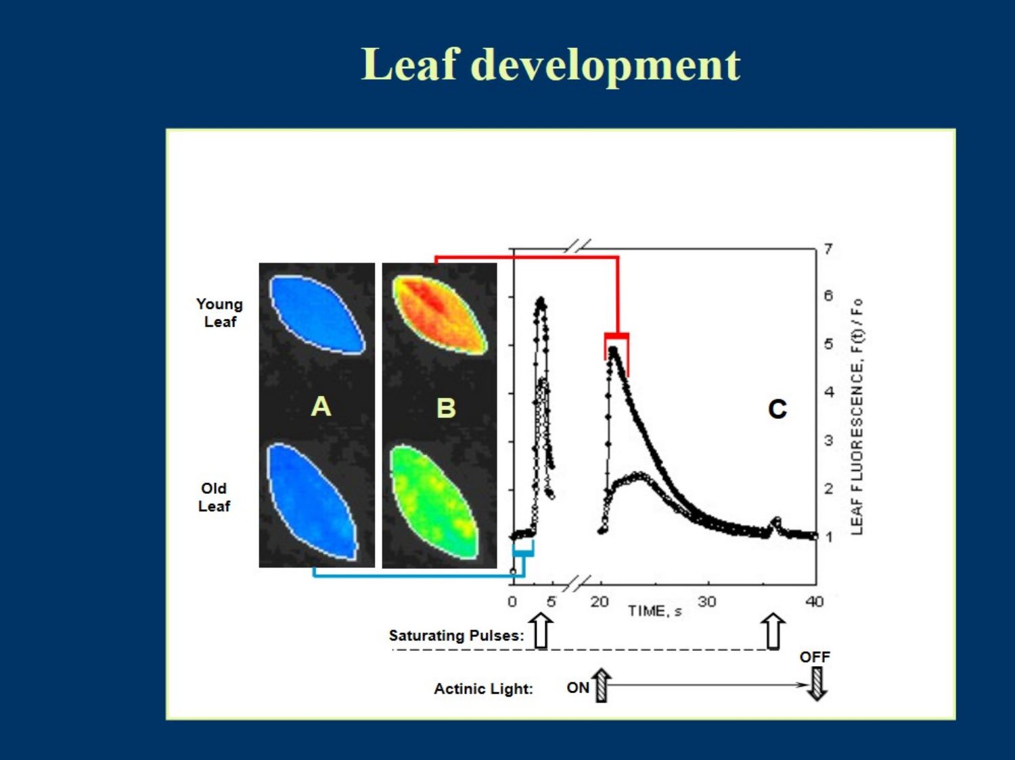
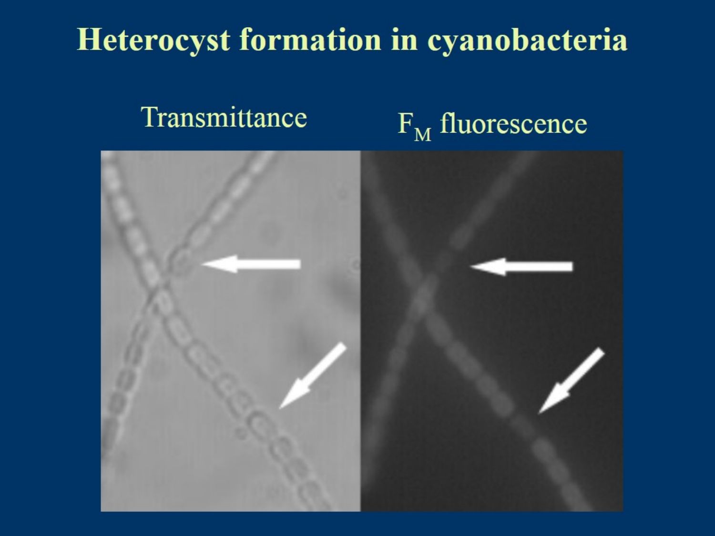
Imaging applications: fruit, development and cyanobacteria
Post-harvest lemon damage: F₀, Fs, Fm and Fv/Fm images reveal damaged areas
Green mould infection of lemons over 0–84 h
Leaf development: young vs old leaf images and kinetics
Heterocysts (arrows) in cyanobacteria are dark in Fm fluorescence
Notes:
Examples from the course slides.
1. Post-harvest lemon damage: Fo, Fs, Fm and Fv/Fm images show damaged areas of the peel that are not yet visible in a normal photograph. Used in fruit quality control.
2. Green mould infection of lemons over 0–84 hours: fluorescence images show the infection spreading before symptoms are obvious to the eye.
3. Leaf development: young and old leaves differ in their fluorescence kinetics and images; young leaves often have lower efficiency while their photosynthetic machinery is still assembling.
4. Heterocysts in cyanobacteria (arrows): these are specialised cells that fix nitrogen. They switch off PSII (to protect the oxygen-sensitive nitrogenase), so they appear dark in Fm fluorescence images while normal cells are bright.
Common message: fluorescence imaging detects changes in PSII activity early and maps where they occur.

Slide 43
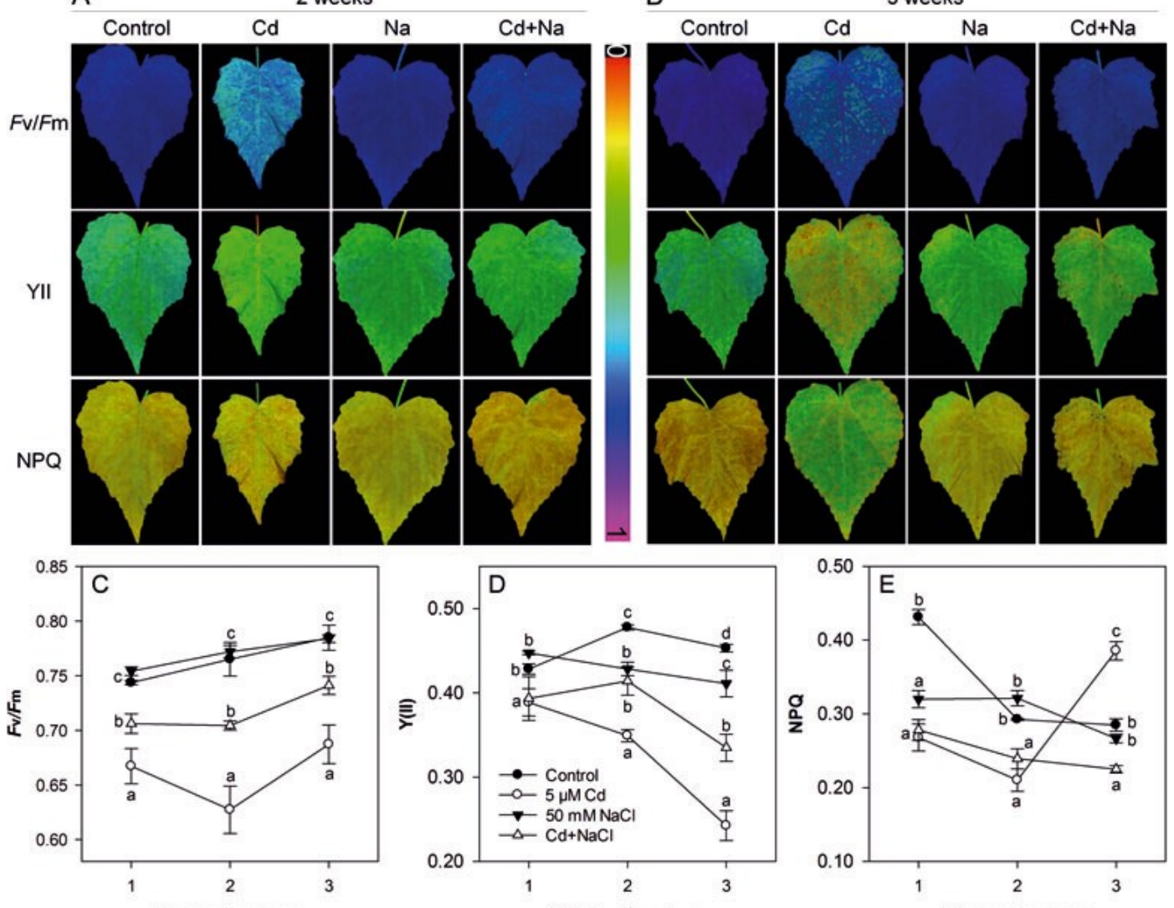
Stress phenotyping example: cadmium and salt
How to read it
Rows: F_{v}/F_{m}, Y(II), NPQ
Columns: Control, Cd, Na, Cd+Na at 2 and 3 weeks
Colour scale: blue/purple = high, yellow/red = low
Lessons
Parameters respond differently and over different times
Images show where in the leaf damage starts
Combine dark (F_{v}/F_{m}) and light (Y(II), NPQ) parameters
Fv/Fm, YII and NPQ images and time courses under Cd, NaCl and Cd+NaCl stress
Notes:
A stress-phenotyping example (course slides): leaves under control, cadmium (Cd), salt (NaCl) and combined Cd + NaCl stress, imaged after 2 and 3 weeks.
How to read it:
- Rows: Fv/Fm, Y(II) (which is ΦPSII) and NPQ images.
- Columns: Control, Cd, Na, Cd + Na, at 2 and 3 weeks.
- Colour scale: blue/purple means high, yellow/red means low.
- Bottom graphs: time courses of each parameter for each treatment.
Lessons:
1. Each parameter responds differently and with a different timing. For example, NPQ may rise early as a protective response while Fv/Fm falls only later when damage occurs.
2. Images show where in the leaf damage starts (often at the edges or between veins).
3. Combining dark-adapted (Fv/Fm) and light-adapted (Y(II), NPQ) parameters gives a much fuller picture than Fv/Fm alone.

Slide 44




Towards long-term and remote monitoring
Leaf clip PAM
Monitoring PAM
LIFT (laser)
UAV / airborne
Satellite
mm–cm · seconds
fixed heads · weeks–seasons
5–50 m · canopy, active
m · passive SIF
300 m–km · passive SIF
ACTIVE (instrument supplies the light)
PASSIVE (sunlight only) →
Monitoring PAM
LIFT
Passive sensing
Modular heads measure F′ and, with pulses, F_{m}′; used for annual NPQ in boreal forest and rice canopies.
Laser projects a ~100 mm spot onto the canopy; telescope + photodiode give PSII yield and electron transport at 5–50 m.
No saturating pulse and uneven illumination, but continuous, large-area coverage → SIF.
Notes:
Going up in scale, from seconds on a leaf to seasons over a landscape.
1. Leaf clip PAM: millimetres to centimetres, seconds.
2. Monitoring PAM: measuring heads fixed on leaves for weeks or whole seasons, powered by solar panels. At night Fm′ and Fo′ become Fm and Fo, giving daily Fv/Fm. Used, for example, to follow annual NPQ cycles in boreal forest and in rice canopies.
3. LIFT (laser-induced fluorescence transient): a laser excites a spot of about 10 cm on the canopy from 5–50 m away, and a telescope with a photodiode records the response. It gives PSII efficiency and electron transport remotely. Still active (the instrument supplies the light).
4. UAV and airborne: passive SIF.
5. Satellite: 300 m to tens of km pixels, passive SIF.
The key transition: beyond LIFT range we can no longer saturate a canopy with an artificial pulse, and illumination is uneven. So we switch to passive measurement of fluorescence excited by sunlight, using dark absorption lines in the solar spectrum. That is SIF, the next module.
The trade-off: passive sensing loses the saturating pulse (so no direct NPQ or Fv/Fm), but gains continuous, large-area coverage.

Slide 45
Sun-induced fluorescence (SIF)
08
Measuring the same red glow passively under sunlight — from leaf to satellite. Based on Mohammed et al. (2019), '50 years of progress'
Notes:
Module 8: sun-induced fluorescence (SIF), based on Mohammed et al. (2019), "50 years of progress".
The physics is the same as PAM: absorbed light, three competing fates, red and far-red emission. The difference is the measurement: the sun is the light source, and we must separate a very small fluorescence signal from the much larger reflected sunlight. The trick is to look in narrow wavelength bands where sunlight is dim (Fraunhofer lines and oxygen absorption bands).
The module covers: active vs passive, history, the emission spectrum, re-absorption, the retrieval problem and methods, confounders, models, the link to GPP, platforms, satellites, applications and challenges.

Slide 46
Active (PAM) vs passive (SIF) fluorescence
 | Active — PAM fluorometry | Passive — SIF
Light source | Instrument (ML, AL, SP, FR) | The sun
Saturating pulse | Yes → F_{m}, F_{m}′ | No
What it gives | Yields and ratios (F_{v}/F_{m}, Φ_{PSII}, NPQ) | Absolute flux (mW m⁻² sr⁻¹ nm⁻¹)
Scale | Leaf, single plants (cm–m) | Leaf to globe (m–km)
Spectral bands | Usually one broad band >700 nm | Red (~687) and far-red (~760) bands or full 650–800 nm
Main challenge | Protocol, dark adaptation | Signal is ~1–5 % of reflected radiance; atmosphere; canopy structure
Typical use | Plant physiology, phenotyping | GPP, stress mapping, ecosystem monitoring
Notes:
The table compares the two approaches row by row.
- Light source: PAM uses the instrument's lights (measuring, actinic, saturating pulse, far-red); SIF uses the sun.
- Saturating pulse: PAM yes, giving Fm and Fm′; SIF no.
- What it gives: PAM gives yields and ratios (Fv/Fm, ΦPSII, NPQ), which are dimensionless. SIF gives an absolute flux of emitted light (radiance in mW m⁻² sr⁻¹ nm⁻¹).
- Scale: PAM works on leaves and single plants; SIF from leaf to globe.
- Spectral bands: PAM usually one broad band above 700 nm; SIF uses red (~687 nm) and far-red (~760 nm) bands or the full 650–800 nm spectrum.
- Main challenge: for PAM, the measurement protocol and dark adaptation; for SIF, the signal is only about 1–5% of reflected radiance, plus atmospheric and canopy-structure effects.
- Typical use: PAM for plant physiology and phenotyping; SIF for estimating photosynthesis (GPP), mapping stress and monitoring ecosystems.
Key concept: SIF = absorbed light × fluorescence yield × escape fraction. So SIF depends on how much light the canopy absorbs, not just on physiology. This is the biggest conceptual difference from PAM yields.

Slide 47
A short history of SIF
Brewster: red light from laurel leaf extract
Müller: link to assimilation
McAlister & Myers: two processes vs CO₂
Plascyk: Fraunhofer Line Discriminator (FLD)
Zarco-Tejada: SIF in canopy reflectance
ESA selects FLEX (8th Earth Explorer)
1834
1874
1940
1975
2000
2015
1852
1931
1963
1986
2011
2017
Stokes coins 'fluorescence'
Kautsky & Hirsch: induction kinetics
Duysens & Sweers: modulated light, NPQ concept
Schreiber: PAM fluorometer
GOSAT: first global SIF maps
TROPOMI (Sentinel-5P) launched
Active, leaf-level science
Passive, remote sensing
Notes:
A short history, from discovery to satellites.
- 1834: Brewster saw red light from an alcohol extract of laurel leaves.
- 1852: Stokes named the phenomenon "fluorescence" and described the shift to longer wavelengths.
- 1874: Müller suggested a link between fluorescence and assimilation.
- 1931: Kautsky and Hirsch described the induction kinetics (the Kautsky curve).
- 1940: McAlister and Myers found both inverse and direct relations between fluorescence and CO2 uptake.
- 1963: Duysens and Sweers pioneered modulated light and described what we now call NPQ.
- 1975: Plascyk built the Fraunhofer Line Discriminator (FLD), the first passive method.
- 1986: Schreiber introduced the PAM fluorometer.
- 2000: Zarco-Tejada showed fluorescence signals in canopy reflectance.
- 2011: GOSAT gave the first global SIF maps.
- 2015: ESA selected FLEX, the first satellite mission designed for SIF.
- 2017: TROPOMI on Sentinel-5P launched, giving daily near-global SIF.
Green milestones are mostly leaf-level science; red ones are remote sensing. The two fields developed separately and are now joining.

Slide 48
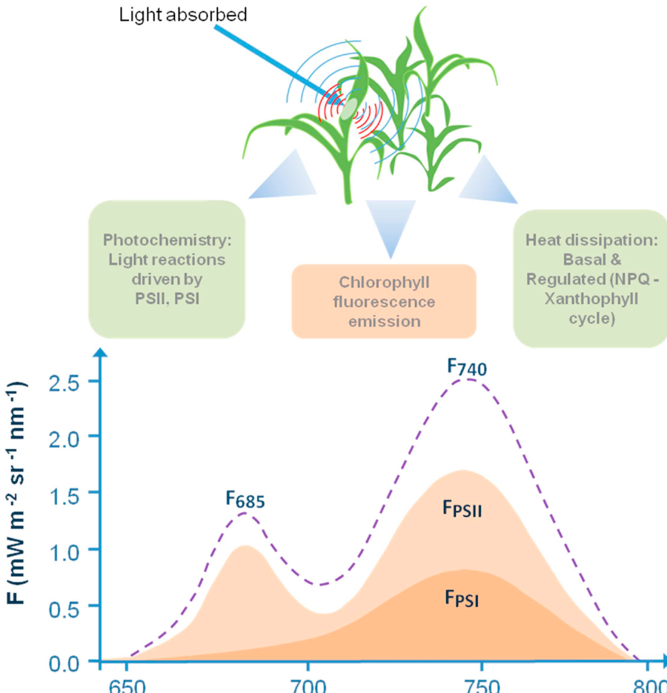
The SIF emission spectrum
Red peak F₆₈₅
Far-red peak F₇₄₀
~685–690 nm
Mostly PSII
Strongly re-absorbed by chlorophyll
~730–740 nm
PSII + PSI
Escapes the canopy more easily
Key numbers & terms
Fluorescence quantum yield in vivo <10 %, typically 0.5–3 %
Steady-state fluorescence (F_{s}, F_{t}) is what SIF measures under sunlight
Thermal dissipation: constitutive (basal) + regulated (NPQ, xanthophyll cycle)
Units: mW m⁻² sr⁻¹ nm⁻¹ (radiance)
Mohammed et al. (2019), Fig. 1 — energy partitioning and the leaf fluorescence spectrum (PSII + PSI contributions)
Notes:
The SIF emission spectrum (Mohammed et al. Fig. 1).
Top part: absorbed light is partitioned into photochemistry (light reactions in PSII and PSI), fluorescence emission, and heat dissipation (both basal and regulated NPQ through the xanthophyll cycle).
Bottom part: the spectrum emitted by a leaf, from 650 to 800 nm.
1. Red peak near 685–690 nm (F685): mostly from PSII. Strongly re-absorbed by chlorophyll inside the leaf.
2. Far-red peak near 730–740 nm (F740): from both PSII and PSI. Escapes the leaf much more easily.
The shaded areas show the separate PSII and PSI contributions.
Key numbers and terms:
- Fluorescence quantum yield in vivo is below 10%, typically 0.5–3%.
- Under sunlight what is measured is steady-state fluorescence (Fs or Ft), not Fo or Fm.
- Heat dissipation has a constitutive (basal) part and a regulated part (NPQ).
- SIF is expressed as radiance, in mW m⁻² sr⁻¹ nm⁻¹.
Why the red peak is lower than the far-red peak in green leaves: re-absorption by chlorophyll, explained on the next slide.

Slide 49
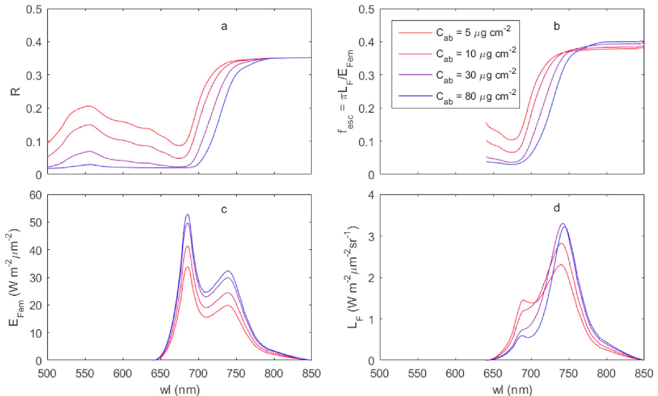

Re-absorption and scattering: leaf to canopy
Leaf level
Red emission overlaps chlorophyll absorption → re-absorbed
Red/far-red ratio ↓ as chlorophyll ↑
Canopy level
Escape probability f_{esc} ≈ shape of reflectance
LAI, leaf angle, clumping, sun/shade leaves change SIF
Only a little red SIF leaves the shaded side of leaves
Mohammed et al. (2019), Fig. 7 — SCOPE: (a) reflectance, (b) escape probability f_esc, (c) emitted fluorescence, (d) top-of-canopy SIF for Cab 5–80 µg cm⁻²
Consequence: a change in SIF may come from physiology or from structure and pigments — models are needed to tell them apart.
Notes:
Why the signal seen from above is not the signal emitted inside the leaves.
Leaf level: chlorophyll absorbs strongly from about 400 to 700 nm, overlapping the red emission peak. So red fluorescence is largely re-absorbed before it leaves the leaf, while far-red escapes. As chlorophyll content increases, the red/far-red ratio decreases. This is the basis of chlorophyll-content indices such as Gitelson's F735/F700.
Canopy level: fluorescence is scattered and re-absorbed again by other leaves. The fraction that finally leaves the canopy towards the sensor is the escape probability, fesc. Its spectral shape looks very similar to canopy reflectance. Leaf area index (LAI), leaf angle, clumping, and the mix of sunlit and shaded leaves all change it.
The figure (SCOPE model simulation for four chlorophyll contents, 5–80 µg cm⁻²):
a) reflectance, b) escape probability, c) fluorescence emitted by all leaves, d) top-of-canopy SIF. Note how much the red part shrinks from (c) to (d).
Consequence: a change in SIF can come from physiology (yield) or from structure and pigments (absorption and escape). Models are needed to tell them apart.

Slide 50
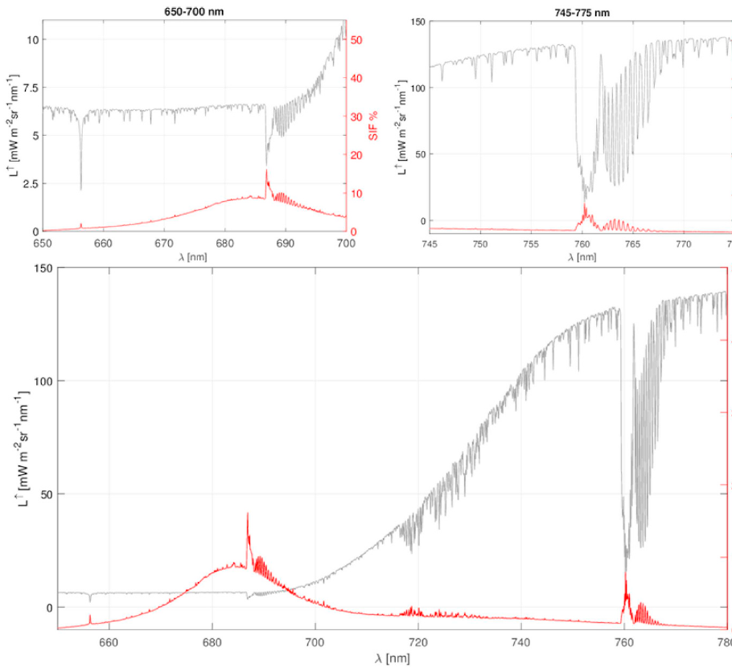
The core difficulty: SIF is tiny compared with reflected light
~1–5 %
>10 %
of total radiance outside absorption bands
inside the O₂-A and O₂-B bands
1–5 % is an approximate range for the overall contribution.
Why the bands help
Inside a band the sun's light is strongly attenuated → reflected radiance is low
Fluorescence is emitted at all wavelengths → it fills in the band
Red: SIF fraction high (reflectance is low) despite re-absorption
Needs high spectral resolution (sub-nm) and high SNR
Mohammed et al. (2019), Fig. 8 — SIF (red, right axis %) vs total radiance (grey) at 0.1 nm; insets: O₂-B (left) and O₂-A (right)
Notes:
The core difficulty of measuring SIF (Mohammed et al. Fig. 8).
The grey curve is total radiance leaving a dense summer canopy at 0.1 nm resolution; the red curve is SIF alone (right axis in % of total).
- Across most wavelengths SIF is only about 1–5% of the total radiance; the rest is reflected sunlight.
- But inside narrow absorption bands, where incoming sunlight is very dim, SIF makes up a much larger share: more than 10% in the O2-A band (760 nm) and the O2-B band (687 nm). The insets zoom into these bands.
Why the bands help:
1. Inside a band, sunlight is strongly absorbed (by oxygen in Earth's atmosphere or by gases in the Sun's atmosphere), so reflected light is very low.
2. Fluorescence is emitted by the plant at all wavelengths, including inside the band.
3. So fluorescence "fills in" the band: the band looks shallower over vegetation than in the incoming sunlight.
4. Measuring that in-filling requires very fine spectral resolution (below 1 nm) and a high signal-to-noise ratio.
In the red region the SIF fraction is also helped by low leaf reflectance there.

Slide 51
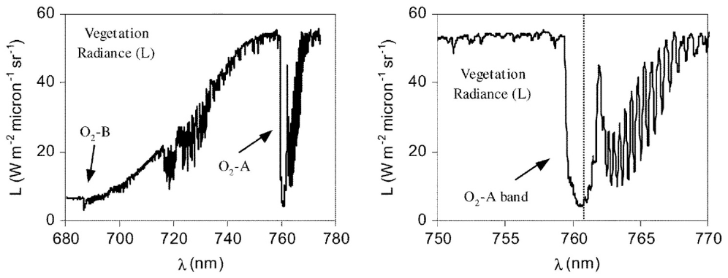

Where to look: Fraunhofer lines and oxygen bands
Fraunhofer lines (solar)
Narrow; small in-filling signal
Earth's atmosphere does not change relative depth → simpler correction
Used by GOSAT, GOME-2, OCO-2, TROPOMI
Mohammed et al. (2019), Fig. 4 — olive canopy radiance showing O₂-B and O₂-A (left) and the O₂-A band in detail (right)
O₂ bands (telluric)
Feature | Wavelength | Origin | Used for
Hα | 656.3 nm | Fraunhofer line | Early FLD work (narrow, ~0.1 nm)
O₂-B | ~687 nm | Telluric (Earth O₂) | Red SIF
Fraunhofer lines | 745–758 nm, K I 770 nm | Solar atmosphere | Far-red SIF from satellites
O₂-A | ~760 nm | Telluric (Earth O₂) | Far-red SIF; deepest band
Wide and deep → strong in-filling
Depth depends on path length, pressure, aerosols, direct/diffuse light
Needs accurate atmospheric modelling (FLEX design)
Notes:
Where to look: two kinds of dark lines in the sunlight reaching plants.
1. Fraunhofer lines: produced by gases in the Sun's own atmosphere. They are narrow (about 0.1 nm) and fairly shallow, so the in-filling signal is small. But their relative depth is hardly changed by Earth's atmosphere, so atmospheric correction is simpler. This is why most satellites (GOSAT, GOME-2, OCO-2, TROPOMI) use Fraunhofer lines in the 745–758 nm and 770 nm regions.
2. Telluric oxygen bands (O2-B at 687 nm, O2-A at 760 nm): produced by oxygen in Earth's atmosphere. They are wide and deep, giving a strong in-filling signal. But their depth depends on the path length through the atmosphere, surface pressure, aerosols and the mix of direct and diffuse light, so they need accurate atmospheric modelling. FLEX is designed for this.
The figure (olive canopy) shows radiance with the O2-B and O2-A bands marked, and the O2-A band in detail.
Table summary: Hα at 656.3 nm (early FLD work); O2-B ~687 nm (red SIF); Fraunhofer lines 745–758 nm and K I at 770 nm (far-red SIF from satellites); O2-A ~760 nm (far-red SIF, the deepest band).

Slide 52
The retrieval equation and the FLD principle
L(λ) = r(λ)·E(λ)/π + SIF(λ)
L = radiance at sensor · E = incident irradiance · r = reflectance
Two-band FLD solution
Inside band: L_{in} = r·E_{in}/π + F
Outside band: L_{out} = r·E_{out}/π + F
F = (E_{out}·L_{in} − E_{in}·L_{out}) / (E_{out} − E_{in})
Assumption to remember
r and F are constant across the narrow window — refined by 3FLD, iFLD, cFLD and spectral fitting.
Notes:
The retrieval equation and the Fraunhofer Line Discrimination (FLD) method.
Basic equation: radiance at the sensor L(λ) = r(λ)·E(λ)/π + SIF(λ).
E is the incoming irradiance, r the reflectance, and π converts irradiance to radiance for a diffuse surface. There are two unknowns at each wavelength (r and SIF), so one measurement is not enough.
FLD step by step:
1. Measure E and L at one wavelength inside the band (Ein, Lin) and one just outside (Eout, Lout).
2. Assume r and SIF are the same at both wavelengths (they are very close together).
3. Two equations: Lin = r·Ein/π + F and Lout = r·Eout/π + F.
4. Solve: F = (Eout·Lin − Ein·Lout)/(Eout − Ein).
The chart shows the idea: normalised to the band shoulder, the canopy radiance dip (red) is shallower than the irradiance dip (grey). The difference is the fluorescence in-filling.
The weakness is assumption 2: reflectance and fluorescence do change slightly across the window. Improved versions relax it: 3FLD uses two reference bands on either side, iFLD and cFLD use correction factors, and spectral fitting methods model r and F as smooth functions over a wider window.

Slide 53
Families of SIF retrieval methods
SIF retrieval methods
① Selected absorption bands
② Full SIF spectrum (650–800 nm)
O₂ bands
Fraunhofer lines
Spectrum fitting
Model inversion
FLD (Plascyk 1975)
3FLD, iFLD, cFLD (refined r, F shapes)
SFM spectral fitting over tens of nm
Physically based (Frankenberg 2011)
Data-driven PCA / SVD (Guanter, Joiner, Köhler)
Used by satellites (GOSAT, GOME-2, OCO-2, TROPOMI)
FSR, aFSR (basis spectra from SCOPE)
F-SFM full-spectrum fitting
SpecFit (piecewise cubic spline)
Invert canopy RTM (SCOPE) at TOA/TOC
Verhoef 2018 (FLEX + Sentinel-3)
Celesti 2018 · also gives Cab, LAI, fAPAR
Notes:
Families of SIF retrieval methods (Mohammed et al. Table 2).
Class 1, SIF at selected absorption bands:
a) O2 bands: FLD (Plascyk 1975); refined versions 3FLD, iFLD, cFLD; spectral fitting methods (SFM) that fit reflectance and fluorescence over tens of nanometres around the band.
b) Fraunhofer lines: physically based methods (Frankenberg 2011), and data-driven methods using principal component analysis or singular value decomposition (Guanter, Joiner, Köhler). The data-driven ones learn what the spectrum looks like without fluorescence from non-vegetated pixels (deserts, ice, clouds), then attribute the remaining in-filling to SIF. Used for GOSAT, GOME-2, OCO-2 and TROPOMI.
Class 2, the full SIF spectrum (650–800 nm):
c) Spectrum fitting: FSR and aFSR (basis spectra from SCOPE simulations), F-SFM (full-spectrum fitting), SpecFit (piecewise cubic splines).
d) Model inversion: inverting a canopy radiative-transfer model such as SCOPE at the top of the atmosphere or top of canopy (Verhoef 2018 for FLEX + Sentinel-3; Celesti 2018). This also returns chlorophyll content, LAI and fAPAR.
Rule of thumb: band methods are simpler and robust; full-spectrum methods give more information but need more spectral data and modelling.

Slide 54



Atmosphere, illumination and observation: the confounders
Atmospheric correction
Direct vs diffuse light
Anisotropy & geometry
O₂ bands need accurate RT (MODTRAN, T-18 system); one-step vs two-step schemes
Diffuse light travels a longer path → deeper band → SIF over/under-estimated (up to 20 % at O₂-A)
Sun/view angles change sunlit vs shaded fraction seen by the sensor
Clouds & aerosols
Zero-level offset
Sensor performance
Contaminate large footprints; moderate broken clouds tolerated for Fraunhofer lines
Non-zero SIF retrieved where none exists (e.g. Sahara) — found first in GOSAT
Spectral resolution, SNR, stray light, calibration drift and degradation
Notes:
Six effects that can mimic or hide SIF.
1. Atmospheric correction: O2 bands need very accurate atmospheric radiative-transfer modelling (MODTRAN, for example). Either correct from top of atmosphere to top of canopy first and then retrieve (two steps), or do both together (one step).
2. Direct vs diffuse light: diffuse sky light has travelled a longer path through the atmosphere, so the O2 band is deeper in it. If the direct/diffuse ratio is wrong, SIF at O2-A can be over- or under-estimated by up to about 20%.
3. Anisotropy and geometry: sun and view angles change how many sunlit and shaded leaves the sensor sees, so the same canopy gives different SIF from different angles.
4. Clouds and aerosols: they contaminate large satellite footprints. Fraunhofer-line methods tolerate moderate broken cloud better.
5. Zero-level offset: retrievals can show non-zero SIF where there is no vegetation (such as the Sahara). This was first found in GOSAT data and is corrected with non-vegetated reference areas.
6. Sensor performance: spectral resolution, signal-to-noise ratio, stray light, calibration drift and degradation over time.
Take-away: retrieving SIF is as much an atmospheric and instrument problem as a plant problem.

Slide 55
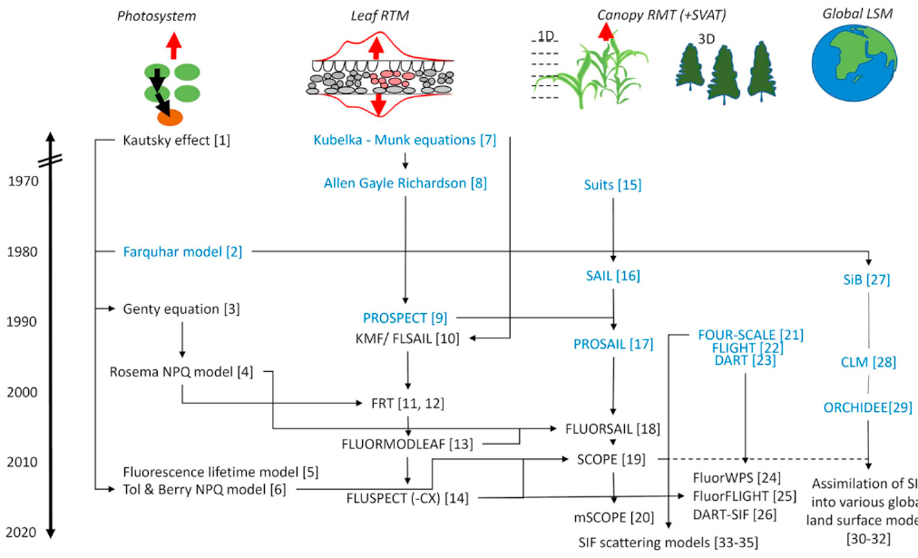
Modelling SIF: from photosystem to globe
Photosystem
Kautsky, Genty, Rosema NPQ, van der Tol & Berry
Leaf RTM
PROSPECT → FluorMODleaf → Fluspect
Canopy 1D
SAIL → FluorSAIL → SCOPE (with energy balance)
Canopy 3D
DART, FluorFLIGHT, FluorWPS
Global LSM
CLM, BETHY, ORCHIDEE assimilate SIF
Mohammed et al. (2019), Fig. 5 — history of leaf and canopy models; blue = models without fluorescence
SCOPE = Soil–Canopy Observation of Photosynthesis and Energy fluxes; DART = Discrete Anisotropic Radiative Transfer
Notes:
Models are needed to interpret SIF, and they work at four nested levels (Mohammed et al. Fig. 5 shows their history; blue boxes are models without fluorescence).
1. Photosystem level: how absorbed energy is split between photochemistry, heat and fluorescence. Examples: Kautsky kinetics, the Genty equation, the Rosema NPQ model, van der Tol & Berry's model linking fluorescence yield to photosynthesis.
2. Leaf radiative transfer: how light is absorbed inside a leaf, and how fluorescence is emitted and re-absorbed. PROSPECT (reflectance) led to FluorMODleaf and Fluspect (which add fluorescence).
3. Canopy, 1D: horizontally uniform layers. SAIL led to FluorSAIL and then SCOPE (Soil–Canopy Observation of Photosynthesis and Energy fluxes), which also includes the leaf energy balance, so it links SIF, photosynthesis and leaf temperature.
4. Canopy, 3D: full 3D scenes. DART (Discrete Anisotropic Radiative Transfer), FluorFLIGHT, FluorWPS.
5. Global land-surface models: CLM, BETHY and ORCHIDEE assimilate satellite SIF to improve their estimates of photosynthesis.
SCOPE is the most widely used model in SIF studies.

Slide 56
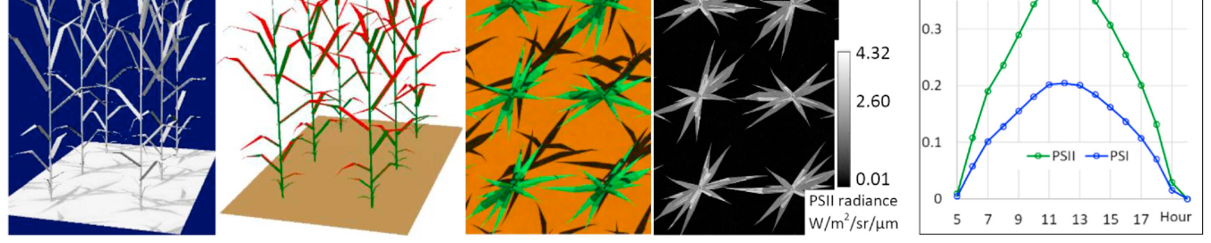

3D modelling example: DART simulation of a maize canopy
Mohammed et al. (2019), Fig. 6 — (a) irradiance, (b) sunlit (red) and shaded (blue) leaves, (c) true-colour reflectance, (d) PSII SIF image, (e) hourly PSII and PSI SIF at 742.5 nm
What 3D models add
SCOPE's niche
Uses
Shadows, clumping, row structure, leaf angles — effects 1D models cannot represent.
The only canopy model with leaf energy balance → links SIF, photosynthesis and temperature.
Interpret signals, design sensors, correct scattering/re-absorption, downscale SIF to photosystems.
Notes:
A 3D modelling example (Mohammed et al. Fig. 6): DART simulation of a maize canopy.
Panels:
a) irradiance reaching each plant element;
b) sunlit (red) and shaded (blue) leaves at one moment;
c) a true-colour reflectance image;
d) an image of PSII fluorescence (bright where leaves are sunlit and well exposed);
e) hourly PSII and PSI SIF at 742.5 nm through the day: canopy SIF follows the daily course of sunlight, peaking around noon.
What 3D models add: shadows, clumping, row structure and leaf angles, which 1D models like SCOPE cannot represent. This matters for row crops, orchards and forests.
SCOPE's niche: the only canopy model with a leaf energy balance, linking SIF to photosynthesis and temperature.
Uses of models: interpreting measured signals, designing sensors and missions, correcting for scattering and re-absorption, and "downscaling" canopy SIF to what the photosystems actually emit.

Slide 57
Why SIF tracks photosynthesis (GPP)
GPP = APAR × LUE
SIF = APAR × Φ_{F} × f_{esc}
Shared term APAR (absorbed photosynthetically active radiation) explains much of the correlation. LUE = light-use efficiency; Φ_{F} = fluorescence yield; f_{esc} = escape probability.
What studies show
Shape of the relation
Why NPQ matters
Strong far-red SIF–GPP correlation from tower to satellite
Mostly driven by APAR & chlorophyll
At constant APAR, SIF explained <35 % of GPP variability (Wohlfahrt 2018)
Hyperbolic on stress-free days, linear under stress
Becomes linear when aggregated over space/time
Differs for C₃ vs C₄ (e.g. Indo-Gangetic Plains)
In high light NPQ diverts energy from both P and F
Midday depression of far-red SIF linked to NPQ
PRI (531 nm) helps track NPQ alongside SIF
Notes:
Why SIF tracks photosynthesis (gross primary production, GPP).
The two equations:
- GPP = APAR × LUE (absorbed PAR times light-use efficiency).
- SIF = APAR × ΦF × fesc (absorbed PAR times fluorescence yield times escape probability).
Both contain APAR. Much of the observed correlation between SIF and GPP simply comes from both scaling with how much light the canopy absorbs (which depends on chlorophyll and leaf area).
What studies show:
- Far-red SIF correlates strongly with GPP from tower to satellite scale.
- The correlation is mostly driven by APAR and chlorophyll.
- At constant APAR, SIF explained less than 35% of GPP variability in one study (Wohlfahrt 2018), showing that the yield information is real but smaller.
Shape of the relationship: often hyperbolic on stress-free days (GPP saturates at high light while SIF keeps rising), more linear under stress, and it becomes linear when averaged over space or time. It differs between C3 and C4 crops, for example in the Indo-Gangetic Plains.
Why NPQ matters: in high light NPQ diverts energy from both photochemistry and fluorescence, so their relation is not fixed. A midday dip in far-red SIF has been linked to NPQ; PRI (531 nm) can help track NPQ alongside SIF.

Slide 58
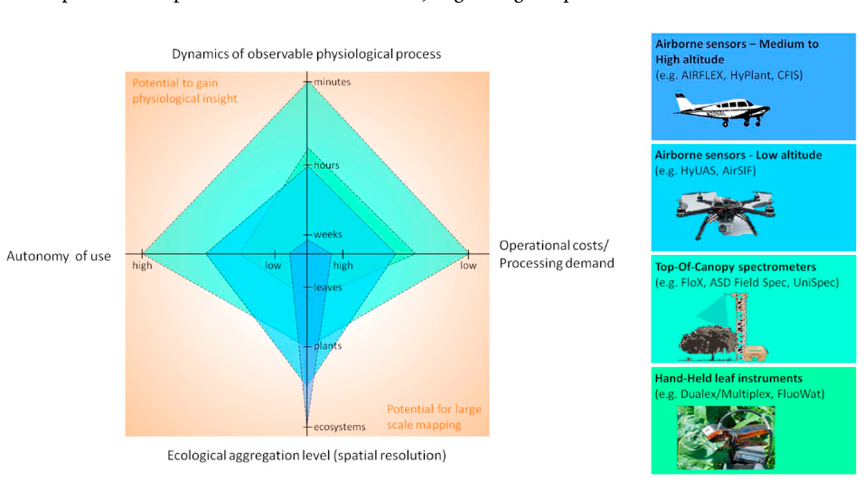
Measurement platforms: leaf to aircraft
Hand-held leaf
FluoWat clip + spectrometer; full spectrum; up- or downward SIF
Top-of-canopy
FloX, FluoSpec (0.13 nm), PhotoSpec, AutoSIF, NASA FUSION; diurnal & seasonal
UAV
Mohammed et al. (2019), Fig. 9 — trade-offs of hand-held, top-of-canopy and airborne instruments
AirSIF, HyUAS, Piccolo doppio; 30–40 cm pixels over tree crowns
Trade-off
Airborne
Higher platforms → larger area and lower cost per area, but less physiological detail per pixel.
AIRFLEX, HyPlant (FLEX demonstrator), CFIS (OCO-2 validation)
Notes:
Measurement platforms from leaf to aircraft (Mohammed et al. Fig. 9 shows the trade-offs).
1. Hand-held leaf instruments: for example the FluoWat leaf clip with a spectrometer and a short-pass filter that blocks reflected light above 650 nm, giving the full upward or downward fluorescence spectrum of a single leaf.
2. Top-of-canopy tower spectrometers: FloX, FluoSpec (0.13 nm resolution), PhotoSpec, AutoSIF, NASA FUSION. They run automatically to capture daily and seasonal dynamics, and are used to validate satellite products.
3. UAV (drone) systems: AirSIF, HyUAS, Piccolo Doppio. Very high spatial resolution (30–40 cm pixels), so single tree crowns can be separated from soil and shadow.
4. Airborne imagers: AIRFLEX, HyPlant (the FLEX demonstrator) and CFIS (used to validate OCO-2). They map whole fields and landscapes.
The trade-off (the radar-style diagram): the higher the platform, the larger the area covered and the lower the cost per area, but the less physiological detail per pixel and the more atmospheric correction needed. Hand-held instruments give the most detail but cover the least area.

Slide 59
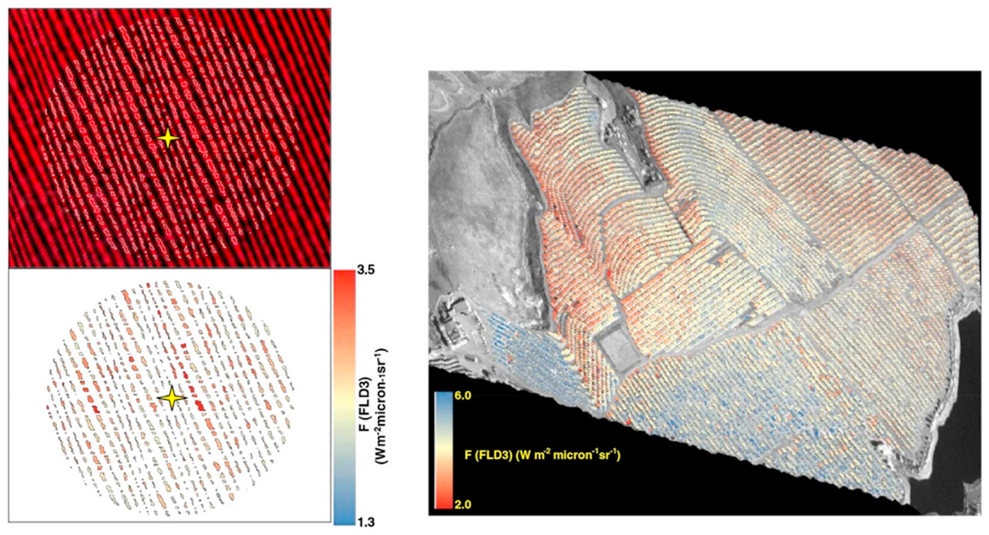
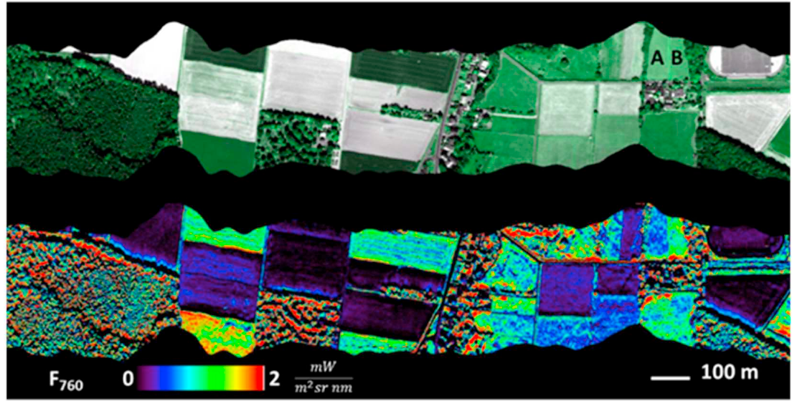
UAV and airborne SIF maps
Fig. 10 — UAV SIF (O₂-A, 3FLD) over an olive orchard (left) and water-stressed citrus (right)
Fig. 11 — HyPlant reflectance (top) vs F₇₆₀ SIF (bottom); fields A and B differ only in SIF
UAV strength
Airborne strength
Very high spatial resolution, flexible on-demand flights; must stay light yet keep SNR.
HyPlant: 0.25 nm resolution, 670–780 nm; maps both red and far-red SIF.
Notes:
Two examples of SIF maps.
Left (Fig. 10), UAV: a fixed-wing drone with a micro-hyperspectral imager retrieved SIF in the O2-A band using the 3FLD method, with 30–40 cm pixels. Over an olive orchard and a water-stressed citrus field it separated pure tree-crown pixels from shadows and soil, so SIF could be related to the water stress of individual trees.
Right (Fig. 11), airborne: HyPlant over Klein Altendorf, Germany. Top: the reflectance image; bottom: far-red SIF at 760 nm (F760). Fields A and B look almost identical in reflectance but have very different SIF. This shows that fluorescence carries information about photosynthetic activity that ordinary reflectance (and indices like NDVI) cannot see.
UAV strength: very high resolution and flexible flights on demand; the challenge is keeping the sensor light while maintaining signal-to-noise ratio.
Airborne strength: HyPlant has 0.25 nm resolution over 670–780 nm, so it maps both red and far-red SIF.

Slide 60
Satellites that measure SIF
Mission / sensor | Status (2019) | Footprint (km²) | Overpass | Repeat | Range (nm) | FWHM (nm) | SIF
FLEX / FLORIS | Selected | 0.3 × 0.3 | 10:00 | 27 day | 500–780 | 0.3–2.0 | Red, far-red, full, PRI
Sentinel-5P / TROPOMI | In orbit | 7 × 7 | 13:30 | 16 day† | 675–775 + | 0.5 | Far-red, full, (red)
MetOp / GOME-2 | In orbit | 40 × 40 / 40 × 80 | 09:30 | 29 day† | 270–790 | 0.5 | Far-red, full, (red)
OCO-2 | In orbit | 1.3 × 2.25 | 13:30 | 16 day | 757–775 | 0.04 | Far-red
GOSAT / TANSO-FTS | In orbit | 10 × 10 | 13:00 | 3 day | 758–775 + | 0.025 | Far-red
TanSat / ACGS | In orbit | 2 × 2 | 13:30 | 16 day | 758–778 + | 0.04 | Far-red
TEMPO · Sentinel-4 · GeoCARB | Selected (GEO) | ~3–8 km | GEO | hourly | various | 0.05–0.6 | Far-red (± red)
Simplified from Table 3 of Mohammed et al. (2019). †Daily near-global coverage thanks to wide swaths; repeat cycle refers to identical orbit tracks. '+' = additional bands at longer wavelengths.
Rule of thumb: high spectral resolution, high SNR, small footprint and frequent revisit cannot all be maximised at once.
Notes:
Satellites that measure SIF (simplified from Mohammed et al. Table 3).
Important history: none of the early satellites were designed for SIF. They were built to measure CO2, methane or ozone, but their very high spectral resolution near the O2-A band allowed far-red SIF retrieval from Fraunhofer lines.
Reading the table:
- FLEX/FLORIS (selected, not yet launched): 300 m pixels, 500–780 nm, red, far-red and full spectrum plus PRI. The first mission designed for SIF.
- TROPOMI on Sentinel-5P (in orbit since 2017): 7 × 7 km, daily near-global coverage thanks to its wide swath.
- GOME-2 on MetOp: 40 × 40 or 40 × 80 km, long record since 2007.
- OCO-2: small footprint (1.3 × 2.25 km), very high resolution (0.04 nm), but sparse narrow tracks.
- GOSAT/TANSO-FTS: 10 km, 0.025 nm, the first global SIF maps.
- TanSat: 2 × 2 km.
- Geostationary missions (TEMPO, Sentinel-4, GeoCARB): hourly observations over one region.
The "†" marks: the repeat cycle refers to identical orbit tracks, but wide swaths give daily near-global coverage.
Rule of thumb: high spectral resolution, high signal-to-noise ratio, small footprint and frequent revisit cannot all be maximised at once; every mission picks a compromise.

Slide 61
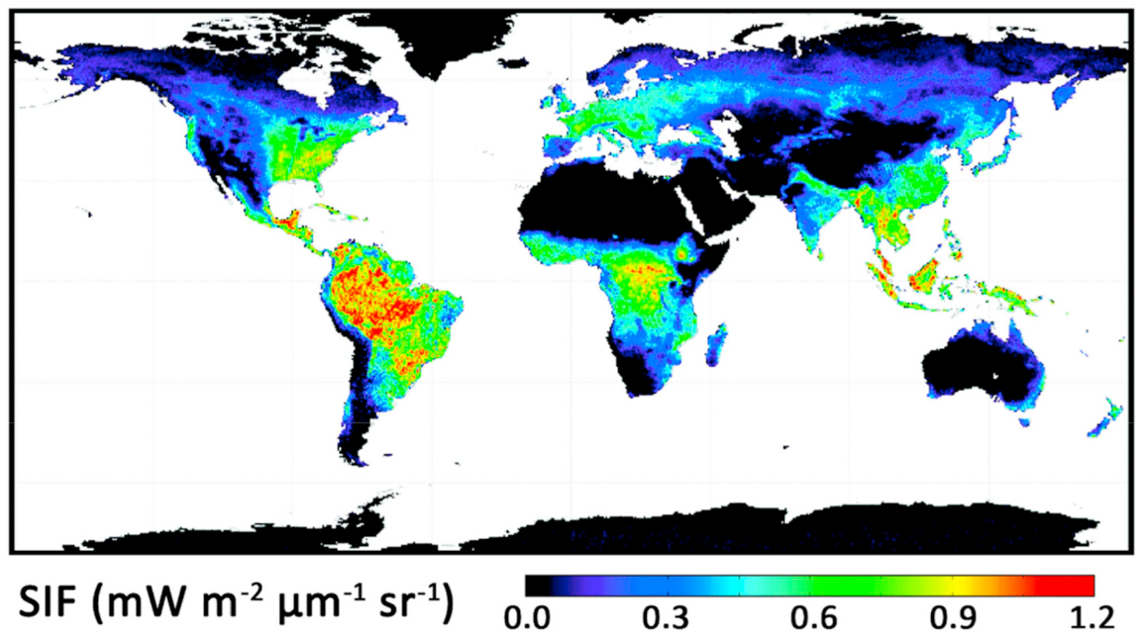

Global far-red SIF from space
Reading the map
Red/yellow: highest SIF (tropics, intensive cropland)
Black: deserts, ice — no vegetation
Seasonal maps reveal phenology and drought
Satellite findings
GOME-2 SIF captured high US Corn Belt GPP that vegetation indices missed
Drought & heat stress signals at ecosystem scale
Mohammed et al. (2019), Fig. 13 — 2009 annual average far-red SIF from GOME-2 (Joiner et al. 2013)
Notes:
A global annual map of far-red SIF for 2009 from GOME-2 (Joiner et al. 2013, shown in Mohammed et al. Fig. 13).
Reading it:
- Red and yellow: highest SIF, meaning strongest photosynthesis. Tropical rainforests (Amazon, Congo, South-east Asia) and intensive cropland stand out.
- Green and blue: moderate SIF.
- Black: deserts and ice, with no vegetation.
- Seasonal versions of this map show phenology (green-up and senescence) and drought impacts.
GOME-2 has about 0.5 nm spectral resolution and a signal-to-noise ratio above 1000 near 740 nm, enough for monthly 0.5° maps. TROPOMI now gives daily data at 7 km.
Notable finding: GOME-2 SIF captured the very high summer GPP of the US Corn Belt, which models and vegetation indices had underestimated. SIF has also detected drought and heat-stress effects at ecosystem scale.
India in the map: high SIF in the Indo-Gangetic Plains during the crop season and in the Western Ghats and north-east forests.

Slide 62
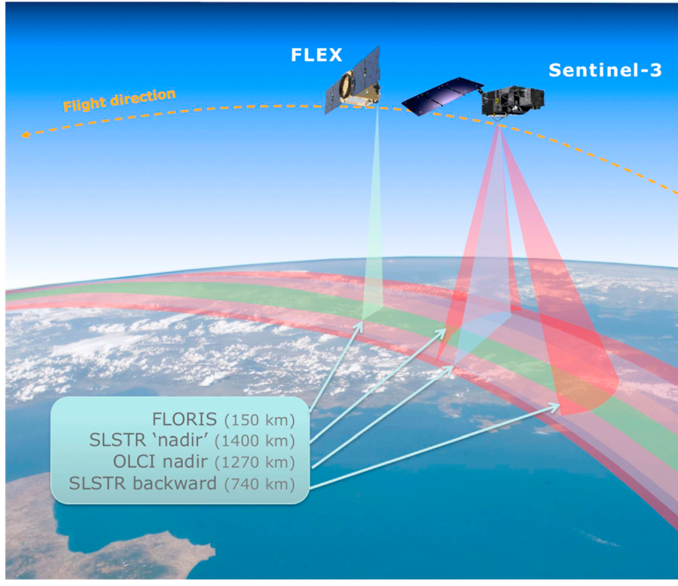

FLEX: the first satellite designed for SIF
300 m
500–780
pixel size
nm spectral range
10:00
150 km
equatorial overpass
FLORIS swath
Planned products
Total fluorescence F_{tot} (650–780 nm); F₆₈₅, F₇₄₀; F₆₈₇, F₇₆₀
Photosynthetic activity, NPQ indicators (PRI), fAPAR_{chl}, LAI, chlorophyll
5-year mission, 56°S–75°N land and coastal zones
Mohammed et al. (2019), Fig. 12 — FLEX (FLORIS, 150 km swath) in tandem with Sentinel-3 (OLCI 1270 km; SLSTR nadir 1400 km, backward 740 km)
Notes:
FLEX, ESA's FLuorescence EXplorer, the 8th Earth Explorer mission and the first satellite designed specifically for SIF (Mohammed et al. Fig. 12).
Design:
- It flies in tandem with Sentinel-3, a few seconds apart, observing the same scene.
- Its single instrument, FLORIS, is a dual imaging spectrometer covering 500–780 nm with high spectral resolution (0.3–2 nm) in the red and far-red.
- Sentinel-3's OLCI (1270 km swath) and SLSTR (nadir 1400 km, backward 740 km) provide atmospheric information, surface temperature and land-cover context.
Key numbers: 300 m pixels, 150 km FLORIS swath, 10:00 equatorial overpass, 500–780 nm range.
Planned products: the total fluorescence spectrum (650–780 nm), the red and far-red peaks (F685, F740), the O2-B and O2-A values (F687, F760), photosynthetic activity indicators, NPQ indicators from PRI, fAPAR of chlorophyll, LAI and chlorophyll content. The mission is planned for 5 years over land and coastal zones from 56°S to 75°N.
Note: the review gave a projected launch of 2022; the launch has since been moved later.

Slide 63




What SIF is used for
GPP & carbon uptake
Phenology & seasons
Drought & water stress
Heat stress
Empirical and model-based GPP from tower to globe
Green-up, peak, senescence; seasonal dynamics
SIF ↓ with water deficit; pair with canopy–air temperature
Detected from satellite during heat waves
Nitrogen deficit
Plant disease
Herbicide damage
Transpiration
Red/far-red SIF ratio ↑ with N deficiency
Xylella in olive (>80 %), Verticillium, Phytophthora
Detected before visible symptoms; reflectance unchanged
Linked to stomatal behaviour in unstressed crops
Notes:
What SIF is used for (Mohammed et al. Table 4).
Photosynthesis and carbon:
- GPP and carbon uptake: empirical and model-based estimates from tower to globe.
- Phenology and seasons: green-up, peak and senescence dates.
Stress detection:
- Drought and water stress: SIF falls with water deficit; best combined with canopy-minus-air temperature.
- Heat stress: detected from satellites during heat waves.
- Nitrogen deficit: the red/far-red SIF ratio increases with nitrogen deficiency.
- Plant disease: for example Xylella fastidiosa in olive trees, detected with more than 80% accuracy when SIF was combined with thermal and other indices; also Verticillium and Phytophthora.
- Herbicide damage: detected before visible symptoms, while reflectance is still unchanged.
- Transpiration: linked to stomatal behaviour in unstressed crops.
SIF is usually combined with other indices: NDVI (greenness), PRI (NPQ), MTCI (chlorophyll) and canopy temperature. On its own, SIF tells you that something changed; combined data tell you why.

Slide 64
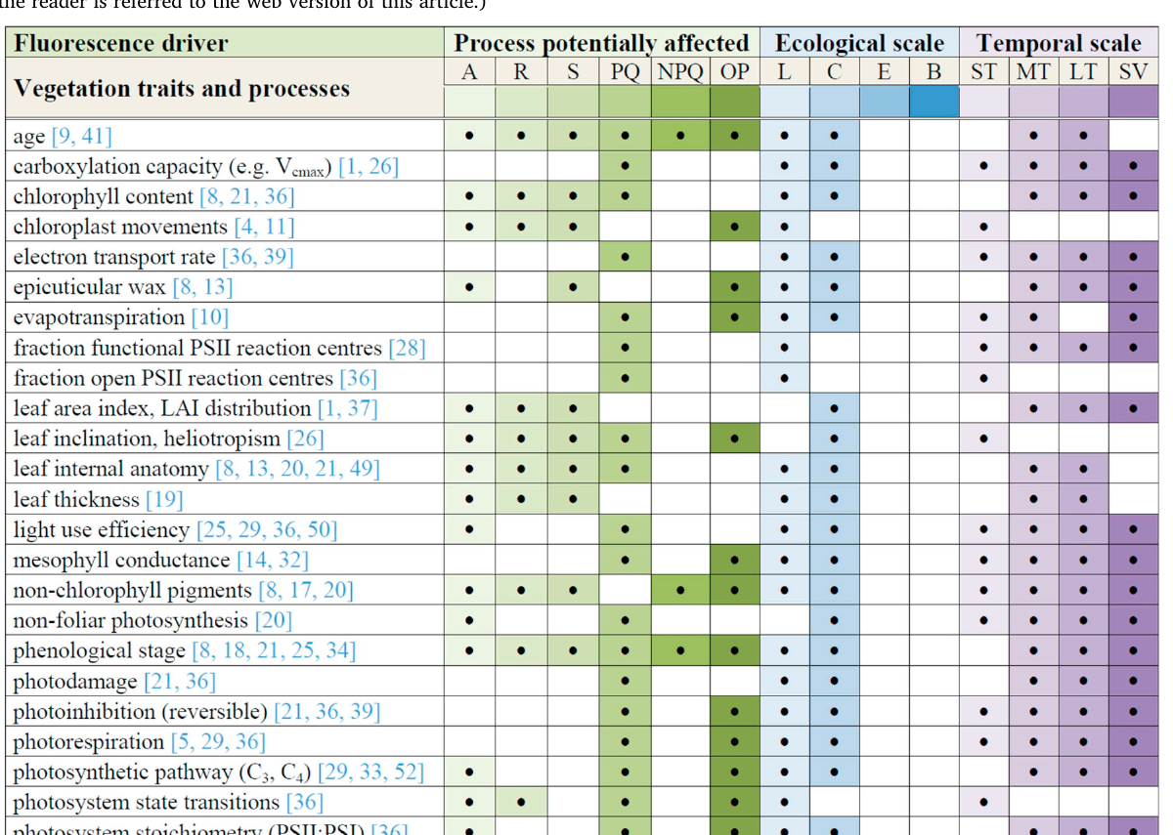
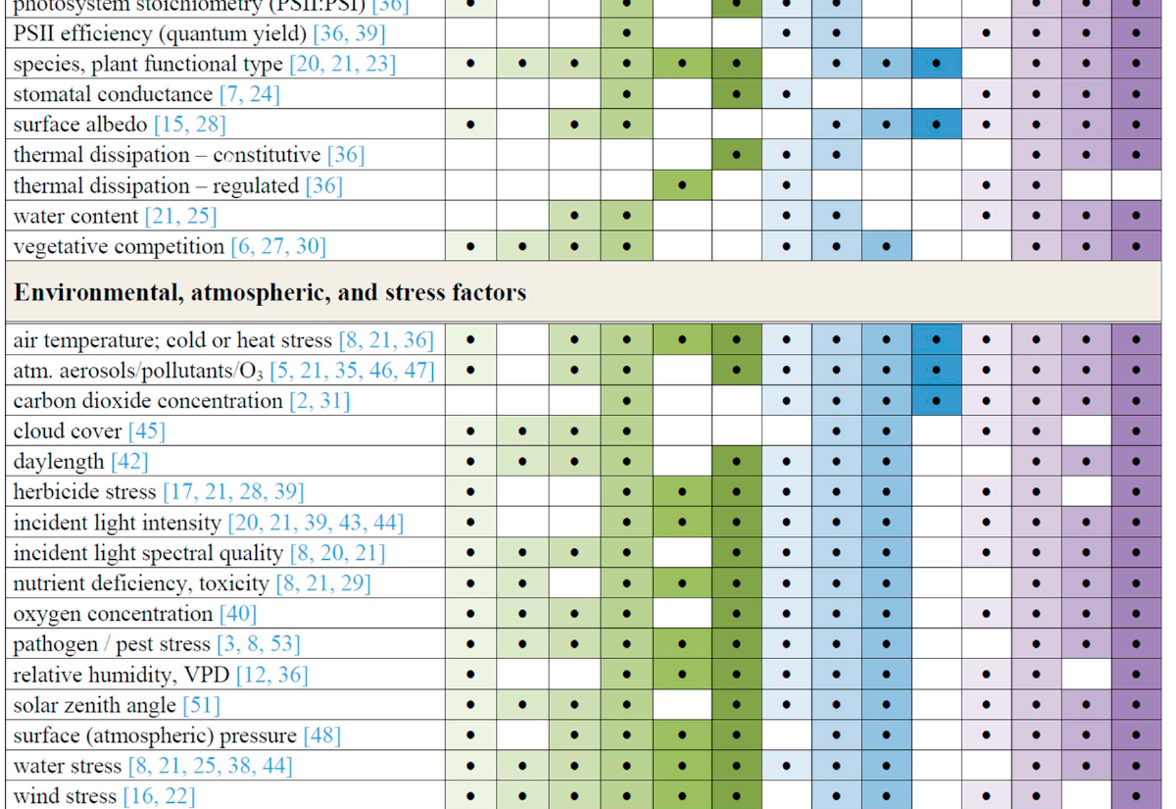
What drives SIF? (Table 5 of the review)
Table 5 (part 1): vegetation traits and processes
Table 5 (part 2): environmental, atmospheric and stress factors
Process: A absorption · R re-absorption · S scattering · PQ photochemical quenching · NPQ · OP other photoprotection Scale: L leaf · C canopy · E ecosystem · B biome Time: ST short · MT medium · LT long-term · SV seasonal
Notes:
Table 5 of the review: everything that can change SIF. Use it as a checklist before saying "photosynthesis changed".
How to read the columns:
- Process potentially affected: A = absorption of incoming light, R = re-absorption of fluorescence, S = scattering, PQ = photochemical quenching, NPQ = non-photochemical quenching, OP = other photoprotection.
- Ecological scale: L = leaf, C = canopy, E = ecosystem, B = biome.
- Temporal scale: ST = short term, MT = medium term, LT = long term, SV = seasonal variation.
Part 1, vegetation traits and processes: chlorophyll content, LAI, leaf angle, leaf anatomy, pigments, phenological stage, photosynthetic pathway (C3/C4), stomatal conductance, photosystem stoichiometry, thermal dissipation and others.
Part 2, environmental, atmospheric and stress factors: light intensity and quality, solar zenith angle, cloud cover, temperature, water stress, humidity and VPD, nutrients, pathogens, herbicides, pollutants, CO2 and O2 concentration, surface pressure and wind.
Message: many factors act through absorption and structure (A, R, S), not through physiology. Separating the two is the central challenge of interpreting SIF.

Slide 65

Challenges and future directions
Disentangle drivers
Quantify NPQ
Validate retrievals
Separate physiology from structure, pigments and illumination using models + ancillary data
PRI, reflectance 500–600 nm, canopy–air temperature to constrain the SIF–photosynthesis link
Ground towers, UAVs and airborne demonstrators (HyPlant, CFIS) under satellite tracks
Scale bridging
Better sensors
Operational products
Downscale coarse satellite SIF; correct directional effects; combine sensors
Red + far-red + full spectrum; high spectral resolution and SNR; VNIR for inversion
Assimilation in land surface models; ML emulators; tools for non-experts
Notes:
Challenges and future directions from the review.
1. Disentangle the drivers: separate physiological changes from changes in structure, pigments and illumination, using models (SCOPE, DART) plus extra data.
2. Quantify NPQ: use PRI, reflectance between 500 and 600 nm, and canopy-minus-air temperature to constrain the SIF–photosynthesis link.
3. Validate retrievals: networks of tower instruments, UAV campaigns and airborne demonstrators (HyPlant, CFIS) flown under satellite tracks.
4. Bridge scales: downscale coarse satellite SIF to field level, correct for viewing-angle effects, and combine sensors.
5. Better sensors: red plus far-red plus full-spectrum coverage, high spectral resolution and signal-to-noise ratio, and visible to near-infrared bands for model inversion.
6. Operational products: assimilate SIF into land-surface models, use machine-learning emulators to speed up models, and build tools for non-specialists.
Practical requirements: farming needs about 20 m resolution with frequent revisits; forests need high spatial detail; high latitudes need very high signal-to-noise ratio because light levels are low.
Outlook: geostationary missions, FLEX and machine learning are expected to move SIF from a research tool to operational monitoring.

Slide 66
Synthesis & self-check
09
Bringing PAM and SIF together, a one-page formula sheet, and answers to the most common doubts
Notes:
Module 9: synthesis and self-check.
The next slides bring PAM and SIF together in one picture, list every formula on one page, and answer the questions students ask most often. Use them for revision: try to answer each question before reading the answer.

Slide 67
One concept, two ways of measuring it
Absorbed light energy
Φ_{P} + Φ_{N} + Φ_{F} = 1
ACTIVE · PAM fluorometry
PASSIVE · Sun-induced fluorescence
Controls light: ML, AL, saturating pulse, FR
Measures yields: F_{v}/F_{m}, Φ_{PSII}, qP, qL, NPQ
Separates photochemical vs non-photochemical quenching
Leaf / plant scale; mechanistic understanding
Sunlight as source; in-filling of O₂ bands / Fraunhofer lines
Measures flux: SIF = APAR × Φ_{F} × f_{esc}
Linked to GPP mainly via APAR; NPQ and structure confound
Canopy to global scale; ecosystem monitoring
Notes:
The whole topic on one slide.
Both approaches start from the same physics: absorbed light energy is split between photochemistry, heat and fluorescence, and the three yields add to one (ΦP + ΦN + ΦF = 1).
Active, PAM fluorometry:
- Controls the light: measuring light, actinic light, saturating pulse, far-red.
- Measures yields: Fv/Fm, ΦPSII, qP, qL, NPQ.
- The saturating pulse separates photochemical from non-photochemical quenching.
- Works at leaf and plant scale and gives mechanistic understanding.
Passive, sun-induced fluorescence:
- Uses sunlight and measures in-filling of oxygen bands and Fraunhofer lines.
- Measures a flux: SIF = APAR × ΦF × fesc.
- Relates to GPP mainly through APAR; NPQ and canopy structure complicate the link.
- Works from canopy to global scale for ecosystem monitoring.
How they help each other: PAM research explains what the fluorescence yield means; SIF scales that understanding up to whole regions. Leaf-level PAM measurements are used to validate and interpret SIF.

Slide 68
Formula sheet
F_{v}
F_{m} − F_{o}
NPQ
(F_{m} − F_{m}′)/F_{m}′
F_{v}/F_{m}
(F_{m} − F_{o})/F_{m} ≈ 0.83 healthy
qN (old)
1 − (F_{m}′ − F_{o}′)/(F_{m} − F_{o})
F_{q}′
F_{m}′ − F′
ETR
Φ_{PSII} × PAR × 0.84 × 0.5
F_{v}′
F_{m}′ − F_{o}′
F_{o}′ (calc.)
F_{o}/[(F_{v}/F_{m}) + (F_{o}/F_{m}′)]
Φ_{PSII}
(F_{m}′ − F′)/F_{m}′ = qP × F_{v}′/F_{m}′
TOC radiance
L = r·E/π + SIF
qP
(F_{m}′ − F′)/(F_{m}′ − F_{o}′)
FLD
F = (E_{out}L_{in} − E_{in}L_{out})/(E_{out} − E_{in})
qL
qP × F_{o}′/F′
SIF / GPP
SIF = APAR·Φ_{F}·f_{esc} ; GPP = APAR·LUE
Prime (′) = light-adapted. No prime = dark-adapted. Green = PAM parameters; red = PAM extras and SIF.
Notes:
All formulas in one place. Prime (′) means light-adapted; no prime means dark-adapted.
PAM parameters (left):
- Fv = Fm − Fo
- Fv/Fm = (Fm − Fo)/Fm, about 0.83 in healthy leaves
- Fq′ = Fm′ − F′
- Fv′ = Fm′ − Fo′
- ΦPSII = (Fm′ − F′)/Fm′ = qP × Fv′/Fm′
- qP = (Fm′ − F′)/(Fm′ − Fo′)
- qL = qP × Fo′/F′
Extras and SIF (right):
- NPQ = (Fm − Fm′)/Fm′
- qN (older) = 1 − (Fm′ − Fo′)/(Fm − Fo)
- ETR = ΦPSII × PAR × 0.84 × 0.5
- Fo′ (calculated) = Fo/[(Fv/Fm) + (Fo/Fm′)]
- Radiance at the sensor: L = r·E/π + SIF
- FLD: F = (Eout·Lin − Ein·Lout)/(Eout − Ein)
- SIF = APAR × ΦF × fesc; GPP = APAR × LUE
Memory tricks: every PAM efficiency is "something minus something, divided by a maximum". NPQ is the odd one out: it divides by Fm′, not Fm.

Slide 69

Clearing common doubts (1/2): PAM
Why does fluorescence rise when reaction centres close?
Why is F_{m}′ lower than F_{m}?
Photochemistry stops (k_{P} ≈ 0), so the same excitation must leave by heat or fluorescence. Competition → fluorescence yield rises to F_{m}.
In the light NPQ is active. Even with all centres closed by the pulse, extra heat dissipation competes with fluorescence.
Why measure F_{v}/F_{m} in the dark but Φ_{PSII} in the light?
Does a drop in F_{v}/F_{m} mean lower photosynthesis?
F_{v}/F_{m} needs all centres open and NPQ = 0 (maximum potential). Φ_{PSII} describes actual efficiency under the current light.
Not necessarily: it reflects light-limited yield; light-saturated photosynthesis may be unchanged, and stress elsewhere may not show.
Notes:
Common doubts about PAM, with fuller answers.
1. Why does fluorescence rise when reaction centres close?
Photochemistry stops (kP close to zero), so the same excitation energy must leave by heat or fluorescence. Fluorescence therefore rises, up to Fm when all centres are closed.
2. Why is Fm′ lower than Fm?
In the light, NPQ is active. Even with all centres closed by the pulse, extra heat dissipation competes with fluorescence, so the maximum is lower. The bigger the gap, the larger the NPQ.
3. Why measure Fv/Fm in the dark but ΦPSII in the light?
Fv/Fm should describe the maximum potential: all centres open and NPQ zero, which only happens after dark adaptation. ΦPSII describes the actual efficiency under the current working light, so it must be measured in that light.
4. Does a drop in Fv/Fm mean lower photosynthesis?
Not necessarily. Fv/Fm reflects the light-limited quantum yield of PSII. Light-saturated photosynthesis may be unchanged, and stress in other parts of the plant (such as roots) may not show up in Fv/Fm at all.

Slide 70
Clearing common doubts (2/2): SIF
If fluorescence competes with photosynthesis, why does SIF correlate positively with GPP?
Why is red SIF lower than far-red SIF?
Both scale with absorbed light (APAR). Across space and seasons, APAR variation dominates; yield changes are smaller and partly co-vary.
Chlorophyll re-absorbs red light (absorption up to ~720 nm); far-red mostly escapes. PSI also adds far-red.
Why use absorption bands at all?
Why can't satellites measure NPQ like PAM?
Outside the bands SIF is ~1–5 % of reflected radiance; inside O₂ bands sunlight is dim and in-filling by SIF can exceed 10 %.
No saturating pulse can be applied from space. NPQ is approached indirectly, e.g. with PRI or temperature.
Notes:
Common doubts about SIF, with fuller answers.
1. If fluorescence competes with photosynthesis, why does SIF correlate positively with GPP?
At leaf level under controlled light they compete. But across space and seasons, the biggest variation is in how much light is absorbed (APAR): more leaves and more chlorophyll mean both more photosynthesis and more fluorescence. The yield changes are smaller and partly move together, so the overall correlation is positive.
2. Why is red SIF lower than far-red SIF?
Chlorophyll absorbs up to about 720 nm, so red fluorescence is re-absorbed inside leaves and the canopy. Far-red mostly escapes. PSI also adds emission in the far-red.
3. Why use absorption bands at all?
Outside the bands SIF is only about 1–5% of the reflected light and cannot be separated. Inside the oxygen bands the sunlight is so dim that SIF can exceed 10% of the signal, and its in-filling can be measured.
4. Why can't satellites measure NPQ the way PAM does?
No saturating pulse can be applied to a whole landscape from space, so Fm′ cannot be measured. NPQ is estimated indirectly, for example from PRI or canopy temperature.

Slide 71
Key references
Murchie E.H., Lawson T. (2013). Chlorophyll fluorescence analysis: a guide to good practice and understanding some new applications. J. Exp. Bot. 64(13): 3983–3998. doi:10.1093/jxb/ert208
Mohammed G.H. et al. (2019). Remote sensing of solar-induced chlorophyll fluorescence (SIF) in vegetation: 50 years of progress. Remote Sens. Environ. 231: 111177. doi:10.1016/j.rse.2019.04.030
Baker N.R. (2008). Chlorophyll fluorescence: a probe of photosynthesis in vivo. Annu. Rev. Plant Biol. 59: 89–113.
Maxwell K., Johnson G.N. (2000). Chlorophyll fluorescence — a practical guide. J. Exp. Bot. 51: 659–668.
Genty B., Briantais J.M., Baker N.R. (1989). Quantum yield of photosynthetic electron transport and quenching of chlorophyll fluorescence. BBA 990: 87–92.
Kramer D.M. et al. (2004). New fluorescence parameters for the determination of Q_{A} redox state. Photosynth. Res. 79: 209–218.
Oxborough K., Baker N.R. (1997). Resolving chlorophyll a fluorescence images… calculation of qP and Fv′/Fm′ without measuring Fo′. Photosynth. Res. 54: 135–142.
Strasser R.J. et al. (2004). Analysis of the chlorophyll a fluorescence transient. In: Advances in Photosynthesis and Respiration 19: 321–362.
Meroni M. et al. (2009). Remote sensing of solar-induced chlorophyll fluorescence: review of methods and applications. Remote Sens. Environ. 113: 2037–2051.
Drusch M. et al. (2017). The FLuorescence EXplorer mission concept — ESA's Earth Explorer 8. IEEE TGRS 55: 1273–1284.
Notes:
Primary sources.
The two review papers are the backbone of this deck:
- Murchie & Lawson (2013), Journal of Experimental Botany: the guide to good practice in PAM fluorescence (modules 1–7).
- Mohammed et al. (2019), Remote Sensing of Environment: the review of 50 years of SIF research (module 8).
For deeper reading:
- Baker (2008), Annual Review of Plant Biology: a probe of photosynthesis in vivo.
- Maxwell & Johnson (2000): a short practical guide, good for beginners.
- Genty, Briantais & Baker (1989): the paper that introduced ΦPSII.
- Kramer et al. (2004): the qL parameter and the lake model.
- Oxborough & Baker (1997): calculating Fo′ without measuring it.
- Strasser et al. (2004): the OJIP/JIP-test.
- Meroni et al. (2009): an earlier review of SIF retrieval methods.
- Drusch et al. (2017): the FLEX mission concept.
Suggested reading order: Maxwell & Johnson, then Murchie & Lawson, then Mohammed et al.

