Slide 1
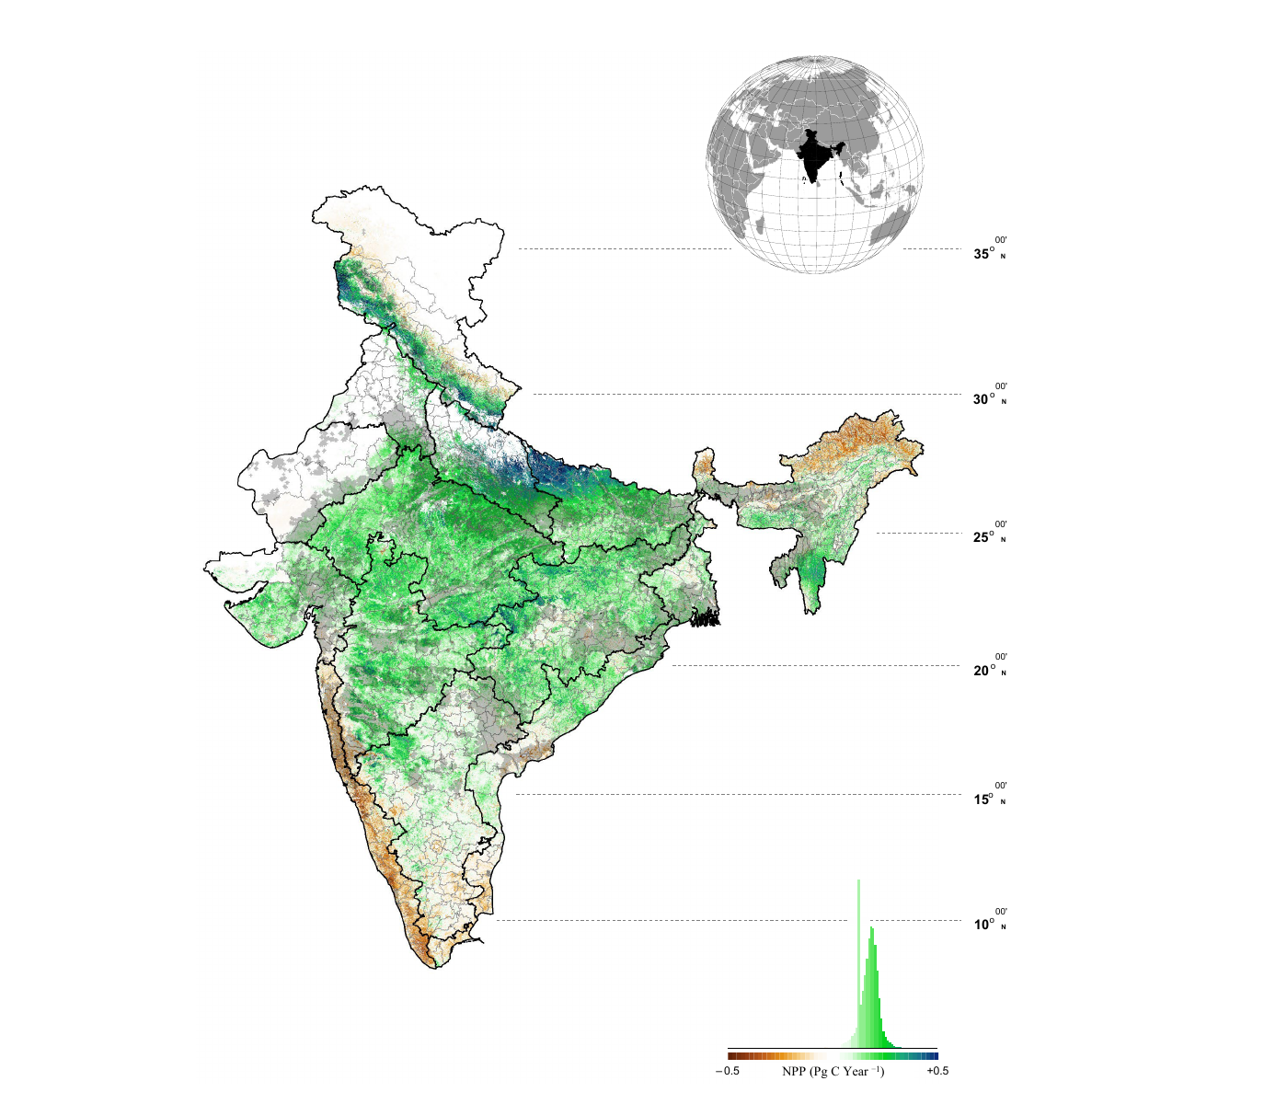
Ecosystem-wise productivity trends in India
7 · Evidence
Spatial NPP trend (2001–2020)
Zone-level NPP trend (ITA, 2001–2020)
Trend | Agroecological zones
Declining | LGP, MGP, TGP, ECP, EPlat, EH, WCP
Increasing | CPlat, SPlat, GP, UGP, WP
India total | 1.09 → 1.33 Pg C yr⁻¹; decadal trend −2.51%
−2.51% decadal trend = rate of NPP increase is slowing; India greens but progressively less rapidly
Key findings from AOD–NPP sensitivity analysis
In forest ecosystems, NPP peaks at AOD 0.38; positive effect persists up to AOD 0.51
In agro zones, diffuse PAR increases with AOD only up to ≈0.54, then declines
Within AOD-sensitive pixels of Gangetic agro zones (LGP, MGP, TGP, UGP), NPP was ~11% lower than zone average — quantifying the aerosol penalty on cropland
Maximum negative effect: Western and Eastern Plateau, post-monsoon season (peak aerosol loading from biomass burning)
Map: green = NPP increase; brown = NPP decrease
Black shading: zones where NPP trend is significantly linked to AOD (p < 0.05)
Source: Hari & Tyagi, 2022, Fig. 5
Pattern: India is still greening, but the pace is decelerating; high-AOD cropland zones lose NPP while forests gain under moderate aerosol
Notes:
This slide presents Hari and Tyagi's 2022 study, which used the CASA model to estimate NPP across India's fifteen agroecological zones from 2001 to 2020.
LEFT SIDE — THE MAP:
The map shows the pixel-level spatial trend of NPP. Green pixels gained productivity; brown pixels lost it. The black-shaded regions are where the NPP trend was statistically correlated with AOD at p < 0.05 — these are the aerosol-sensitive zones. Notice they concentrate over the Indo-Gangetic corridor and eastern India — the aerosol-heavy belt.
RIGHT SIDE — THE TABLE:
This groups the fifteen zones by their zone-averaged NPP trend from the Innovative Trend Analysis. A zone listed as 'Declining' means its area-averaged NPP fell over the two decades. Note this is the zone average, not pixel-level — so a 'Declining' zone like ECP can still have green pixels on the map, with the decline driven by specific aerosol-sensitive sub-regions.
THE 11% FIGURE:
This is the aerosol penalty. The study overlaid the AOD-sensitive pixels (black zones from the map) onto the four Gangetic agroecological zones — LGP, MGP, TGP, UGP. Within those sensitive pixels, NPP was about 11% lower than the overall zone average. This quantifies how much aerosol loading dragged down cropland productivity relative to what it would have been without the aerosol effect.
KEY MECHANISM:
Forest canopies are multi-layered and vertically complex. Moderate aerosol scattering sends diffuse light deeper into the canopy, reaching photon-efficient shaded leaves. NPP peaks at AOD 0.38, effect persists to 0.51.
Croplands have flat, single-layer canopy — no vertical structure for diffuse light to exploit. Diffuse PAR in agro zones rises only up to AOD 0.54, then falls. These zones routinely exceed that threshold — MGP averages 0.57, TGP peaks at 0.91 during monsoon.
MAXIMUM NEGATIVE EFFECT:
Western Plateau (WPlat) and Eastern Plateau (EPlat) showed the maximum negative effect, particularly in post-monsoon season. This is because post-monsoon should be peak NPP season (ideal conditions after monsoon rains), but aerosol loading from biomass burning and industrial emissions peaks at the same time, suppressing the most productive window.

