Slide 1

Climatic Classification and Types of Climate
Köppen, Thornthwaite (1931 and 1948) and Trewartha schemes, their indices and boundaries, and the main climatic types with location, temperature, rainfall and vegetation
3 schemes
8 types
Köppen · Thornthwaite · Trewartha
Af to Cf with climographs
Notes:
This deck covers every classification in the course notes on climatic classification: the definition, objectives, uses and bases of classification; Köppen's scheme with de Candolle's vegetation groups, the five main groups, the small letters and the revisions; Thornthwaite's 1931 scheme based on precipitation and thermal effectiveness and his 1948 scheme based on potential evapotranspiration; and Trewartha's modified scheme. The last section describes eight climatic types: equatorial, savanna, tropical monsoon, hot desert, low- and middle-latitude steppe, Mediterranean and China type.

Slide 2
Three schemes, one goal: organise the world's climates
Köppen (1900 → 1953)
Thornthwaite 1931
Thornthwaite 1948
Trewartha (1980)
Empirical, vegetation-based; critical values of monthly T and P; letters A–E + f, m, w, s
Precipitation effectiveness (P/E) + thermal efficiency (T/E); 32 types mapped
Potential evapotranspiration (PE); moisture index Im; 4-letter code (e.g. AA'a'r)
Simplified Köppen; 6 groups A–F; empirical + genetic
Climatic types covered (section 05)
Af
Equatorial
Aw
Savanna
Am
Tropical monsoon
BWh
Hot desert
BSh
Low-latitude steppe
BSk
Mid-latitude steppe
Cs
Mediterranean
Cf
China type
Notes:
This roadmap shows how the schemes relate. All three use temperature and precipitation, but in different ways. Köppen, a German botanist, used vegetation limits to fix critical monthly temperature and rainfall values. Thornthwaite, an American, first used precipitation and thermal efficiency in 1931, then rebuilt his scheme around potential evapotranspiration in 1948. Trewartha simplified Köppen and added some genetic, cause-based reasoning. The last part describes the main climatic types themselves.

Slide 3

What is climatic classification?
Climatic region = area with approximately homogeneous climate → its set of conditions = climatic type
Five objectives of an ideal scheme
Uses in agriculture
Clearly differentiate all major climate types on Earth
Show the relationships among these types
Apply to the whole world
Provide a framework for further subdivision of local climates
Ideally, show the factors that cause each climate
Agroclimatic zoning
Selection of crops and varieties
Planning of land resources
Determining optimum sowing dates
Irrigation scheduling and water-use management
Assessing potential productivity zones
Notes:
Climatic classification organises the huge variety of atmospheric conditions on Earth into a manageable number of groups. A climatic region is an area over which a roughly uniform set of climatic conditions is produced by the combined effect of climatic controls, and that particular set of conditions is called a climatic type. The notes list five objectives of an ideal classification and seven agricultural uses, from agroclimatic zoning to irrigation scheduling and identifying potential productivity zones.

Slide 4

Basis of classification: empirical vs genetic
Empirical basis
Genetic basis
Based on statistics of climatic elements (T, P, PE) from observations
Numerical boundaries; easy to apply to any station
Stable; rarely needs revision
Ignores causes (air masses, fronts)
Examples: Köppen, Thornthwaite 1931 and 1948
Based on causes: air masses, pressure belts, winds, circulation
Explains why a climate occurs
Harder to quantify and map
Popular with meteorologists
Trewartha blends empirical boundaries with genetic reasoning
Remember: Köppen and Thornthwaite are empirical and quantitative; Trewartha is a simplified, partly genetic modification of Köppen
Notes:
World climates are classified on two bases. Empirical classifications use observed statistics of climatic elements such as temperature and rainfall, so boundaries are defined by numbers; because they rest on observations they are stable. Genetic classifications use the causes of climate: air masses, pressure and wind belts and the general circulation. Köppen and Thornthwaite are empirical; Trewartha's modified scheme blends both.

Slide 5
Köppen's classification
01
Empirical and quantitative; built on de Candolle's vegetation groups and critical values of monthly temperature and precipitation
Notes:
Wladimir Köppen, a German botanist and climatologist, proposed his first classification in 1900 using de Candolle's world vegetation map. He believed natural vegetation is the best expression of the totality of climate, so many boundaries follow vegetation limits.

Slide 6
De Candolle's plant groups: the starting point
Group | Climate requirement | Natural vegetation | → Köppen
A Megatherms | Uniformly high temperature; coldest month > 18 °C; abundant moisture, at least one very wet month | Tropical rain forest | A (tropical humid)
B Xerophytes | Aridity; high temperature at least for a short season | Semi-arid steppe and hot desert plants | B (dry)
C Mesotherms | Moderate heat and moisture; 22–45° latitude; coldest month < 18 °C, warmest about 22 °C | Mixed temperate forests | C (warm temperate)
D Microtherms | Warmest month 10–22 °C, coldest < 6 °C; cool short summers, snowy winters | Evergreen/deciduous forests, steppes | D (cold snow-forest)
E Hekistotherms | Snow-bound Arctic, beyond polar tree limit | Mosses, lichens | E (polar)
Key idea: Köppen used vegetation as a 'natural meteorological instrument' — the climate boundaries are the climatic limits of these plant groups
Notes:
Köppen adopted the plant classification proposed by A. de Candolle in 1874. It has five principal biological groups controlled largely by temperature and moisture, and they map almost directly onto Köppen's letters A to E. Megatherms need uniformly high temperature and abundant moisture; xerophytes prefer aridity; mesotherms need moderate heat and moisture; microtherms need lower temperatures and cold winters; hekistotherms are the mosses and lichens beyond the polar tree line.

Slide 7


Development and revisions of Köppen's scheme
1874
1900
1918
1931
1936
1953
de Candolle plant groups
First classification (vegetation map)
Monthly and annual T, P and seasonality
Second revision
Third revision
Köppen–Geiger–Pohl
Principles
Modern use
Natural vegetation = best expression of the totality of climate
Boundaries chosen at vegetation limits
Uses critical values of T of warmest and coldest months, P of wettest and driest months
A, C, D, E by temperature; B by precipitation (dryness)
Köppen–Geiger world maps from station or gridded data (Peel et al. 2007; Beck et al. 2018, 1 km)
Used to map climate shifts under warming
Basis of many agroclimatic zonings
Notes:
Köppen revised his scheme several times. The 1918 revision gave greater weight to monthly and annual averages of temperature and precipitation and their seasonal distribution. Further revisions came in 1931 and 1936, and the 1953 version is known as the Köppen–Geiger–Pohl classification. The modern Köppen–Geiger maps (for example Peel et al. 2007, Beck et al. 2018) use the same letters with gridded data.

Slide 8
Köppen's five main groups and how to assign them
Annual P < dryness threshold?
yes
B Dry
Evaporation > precipitation; constant water deficit
no
Coldest month ≥ 18 °C?
yes
A Humid tropical
Winterless; all months > 18 °C
no
Warmest month < 10 °C?
yes
E Polar
Summerless; warmest month < 10 °C
no
Coldest month > −3 °C?
yes
C Humid mesothermal
Mild winter: coldest −3 to 18 °C; warmest > 10 °C
no
D Humid microthermal
Severe winter: coldest < −3 °C; warmest > 10 °C
P_{th} (mm) = 20T + 280 / +140 / +0 · BW if P < 0.5 P_{th}
Notes:
The five capital letters are assigned in a fixed order. First test for dryness: if annual precipitation is below a threshold that rises with temperature, the climate is B, whatever its temperature. Otherwise, use the coldest and warmest monthly means: above 18 °C in every month is A; warmest month below 10 °C is E; coldest month between minus 3 and 18 °C is C; colder than minus 3 °C is D. A, C, D and E are temperature-based; B is precipitation-based. The dryness threshold shown is the modern Köppen–Geiger form (Peel et al. 2007), not given in the notes.

Slide 9
Small letters and Köppen subtypes
Letter | Meaning
f | Rain throughout the year; ≥ 6 cm every month (in A: coldest month > 18 °C)
m | Monsoon: short dry season, driest month < 6 cm but very wet season
w | Winter dry season
s | Well-defined summer dry season
W / S (in B) | Desert (arid) / steppe (semi-arid)
h / k (in B) | Hot (mean annual T ≥ 18 °C) / cold
a / b / c / d | Hot summer (≥ 22 °C) / warm / cool / very cold winter
T / F (in E) | Tundra (warmest 0–10 °C) / ice cap (< 0 °C)
Subtype | Name
Af | Tropical rainforest
Am | Tropical monsoon
Aw | Tropical savanna
BS | Steppe (semi-arid)
BW | Desert (arid)
Cf | Humid, no dry season
Cw | Winter dry (subtropical highland/monsoon)
Cs | Mediterranean (summer dry)
Df | Cold, humid all year
Dw | Cold, winter dry
ET / EF | Tundra / ice cap
Letter definitions for W/S, h/k, a–d and T/F follow the standard Köppen–Geiger key (Peel et al. 2007).
Notes:
Small letters add the seasonal pattern of rainfall and, in the full scheme, temperature detail. From the notes: f means rainfall throughout the year, with at least 6 cm in every month; m is monsoon, with a short dry season and the driest month below 6 cm; w is a dry winter; s is a dry summer. Köppen divided the five groups into 11 subtypes based on rainfall regime and the nature of aridity and cold. The standard extra letters for temperature, h, k, a, b, c and d, are added from the standard Köppen–Geiger key.

Slide 10
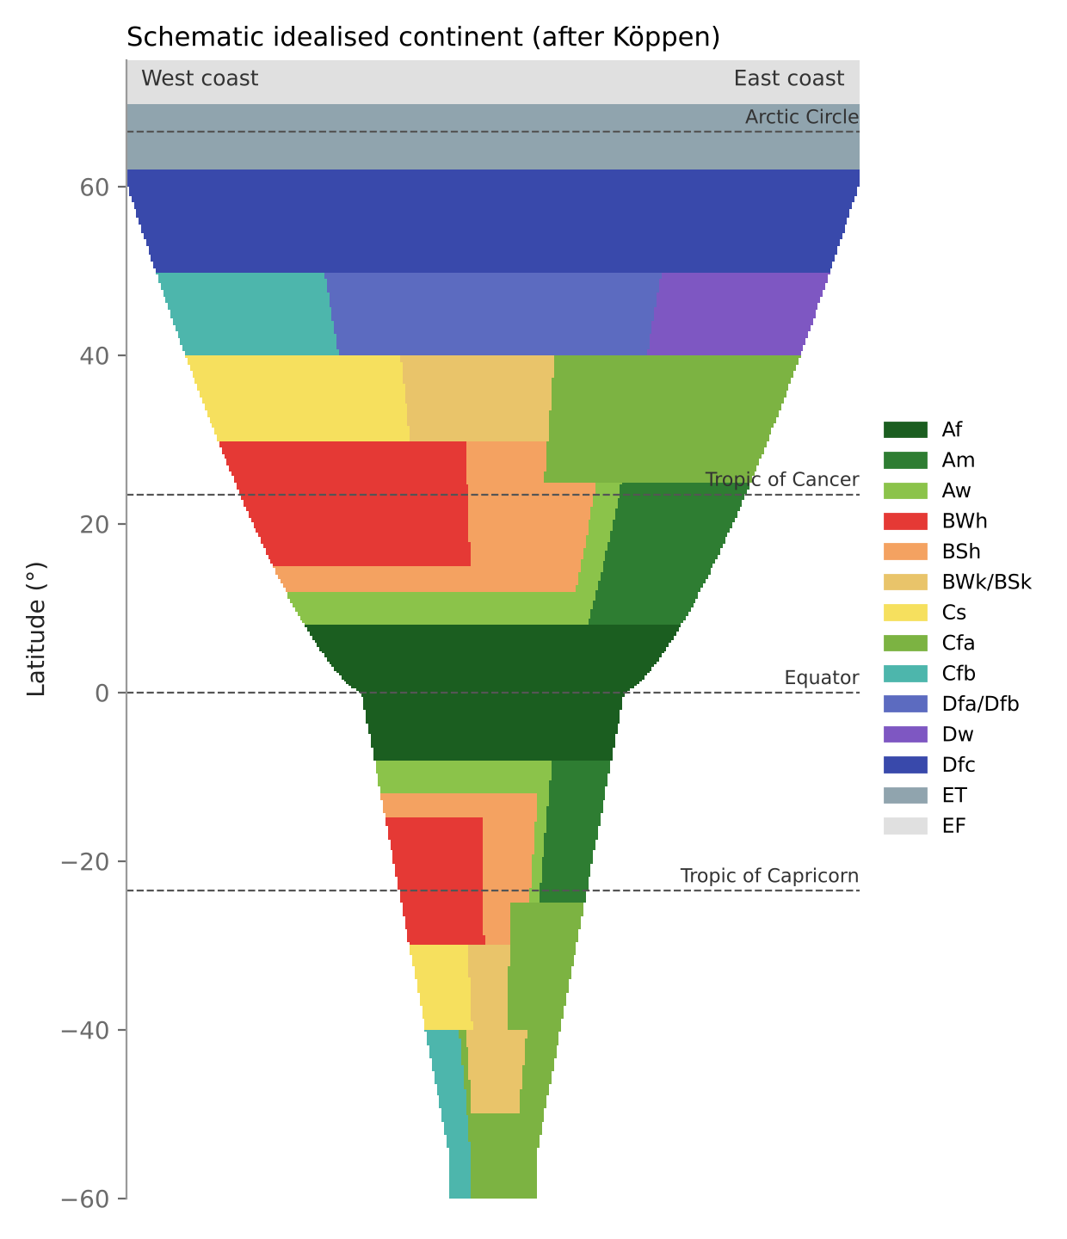
Where Köppen climates occur: the idealised continent
Equator outwards
Af → Aw/Am → BS → BW (≈15–30°)
West vs east coast at 30–40°
West: Cs (Mediterranean); east: Cfa (China type)
Poleward west coasts
Cfb marine climate (westerlies all year)
Large northern interiors
D climates (Df, Dw); no D in the Southern Hemisphere (little land)
Poles
Schematic, drawn for this deck (after Köppen's idealised continent)
ET tundra, EF ice cap
Notes:
This schematic continent shows how Köppen types are arranged by latitude and by position on a continent. Af straddles the equator; savanna and monsoon follow; hot deserts sit on the western sides between about 15 and 30 degrees under the subtropical highs; Mediterranean climates lie on western margins around 30 to 40 degrees, while humid subtropical China-type climates occupy the eastern margins at the same latitudes; marine west-coast climates lie poleward; cold D climates fill the interiors of large northern continents; and tundra and ice cap lie near the poles. Boundaries here are simplified for teaching.

Slide 11


Köppen: advantages and disadvantages
Advantages
Disadvantages
Uses temperature and precipitation: easy to measure, widely available
Statistical boundaries: each region precisely defined
T and P show the effects of climatic controls clearly
Considers evaporation via effective precipitation (dryness threshold)
Matches vegetation types; descriptive, generalised and simple — widely used
Undue weight on monthly means; ignores rainfall intensity, cloudiness, rainy days, daily extremes, winds
Purely empirical: causes (air masses, fronts) ignored
Many letter symbols for secondary and tertiary types: hard to memorise
Vegetation boundaries do not always coincide with climatic ones
Notes:
Köppen's scheme is popular because it uses temperature and precipitation, which are easy to measure, defines each region precisely by numbers, reflects climatic controls, considers evaporation through effective precipitation, and matches vegetation, which appeals to geographers. Its weaknesses are reliance on monthly means while ignoring rainfall intensity, cloudiness, rainy days, extremes and winds; being purely empirical, ignoring causes such as air masses; and its many letter symbols are hard to remember.

Slide 12
Thornthwaite's classifications
02
1931: precipitation effectiveness and thermal efficiency. 1948: potential evapotranspiration and the moisture index
Notes:
C. W. Thornthwaite, an American climatologist, produced two classifications. The 1931 scheme, like Köppen's, uses vegetation but adds evaporation through precipitation effectiveness and thermal efficiency, and was mapped worldwide. The 1948 scheme is built on potential evapotranspiration and a water budget, and was never mapped for the whole world.

Slide 13


Thornthwaite 1931 (1): precipitation effectiveness
P/E ratio = 11.5 (r / (t − 10))^{10/9}
Seasonal rainfall letters
r adequate rainfall in all seasons
s rainfall deficient in summer
w rainfall deficient in winter
d rainfall deficient in all seasons
P/E index = Σ_{12 months} 11.5 (r / (t − 10))^{10/9}
r = mean monthly rainfall (inches) · t = mean monthly temperature (°F)
Humidity zone | Vegetation | P/E index
A Wet | Rain forest | ≥ 128
B Humid | Forest | 64–127
C Subhumid | Grassland | 32–63
D Semi-arid | Steppe | 16–31
E Arid | Desert | < 16
Why P/E?
Same rainfall is more effective in a cool place than a hot one
P/E ratio = available rain per unit evaporation
Each humidity zone subdivided into 20 sub-humidity zones by season of rain (per notes)
Notes:
Thornthwaite accepted that precipitation and temperature control vegetation, but argued evaporation must be included. Precipitation effectiveness is the part of rainfall actually available to plants. The P/E ratio is monthly precipitation divided by monthly evaporation; summing it over 12 months gives the P/E index. Because evaporation data were rarely available, he gave an empirical formula using rainfall in inches and temperature in Fahrenheit. Five humidity zones are set by the P/E index, each matching a vegetation type, and seasonal letters r, s, w and d describe when rain is deficient.

Slide 14
Thornthwaite 1931 (2): thermal efficiency and climatic types
T/E index = Σ₁₂ (t − 32) / 4 (t in °F)
The 32 climatic types mapped (1931)
A wet
B humid
C subhumid
D semi-arid
E arid
Cold
Temperature province | T/E index
A′ Tropical | ≥ 128
B′ Mesothermal | 64–127
C′ Microthermal | 32–63
D′ Taiga | 16–31
E′ Tundra | 1–15
F′ Frost | 0
AA′r
BA′r
CA′r
DA′w
EA′d
D′
AB′r
BA′w
CA′w
DA′d
EB′d
E′
AC′r
BB′r
CA′d
DB′w
EC′d
F′
BB′w
CB′r
DB′s
BB′s
CB′w
DB′d
BC′r
CB′s
DC′d
BC′s
CB′d
CC′r
CC′s
5 humidity × 6 thermal × 4 seasonal = 120 possible types; 32 mapped
CC′d
Notes:
Thermal efficiency is the positive departure of monthly mean temperature from freezing: the T/E ratio is t minus 32 divided by 4, in Fahrenheit, and the T/E index sums it over 12 months. Six temperature provinces run from tropical A-prime to frost F-prime. Combining five humidity zones, six temperature provinces and four seasonal letters gives 120 possible combinations, but only 32 climatic types were shown on his world map; they are listed on the right.

Slide 15





Thornthwaite 1931: evaluation
Similar to Köppen
Two indices
32 types
Quantitative boundaries, vegetation basis, letter codes
P/E and T/E make boundaries difficult and vague
About three times as many as Köppen
Letters alone
Data problem
Reception
Types recognisable from symbols alone
Evaporation data unavailable for many places
Liked by botanists, geographers; not by meteorologists (no causes)
Notes:
The notes give seven evaluation points. The 1931 scheme resembles Köppen's in defining boundaries quantitatively and in its vegetation basis, and it uses letter combinations. Using two indices makes boundaries hard and vague to draw. It produced 32 types, about three times Köppen's. Types can be recognised from letters alone. Evaporation data were not available everywhere, which limits precise boundaries. It became popular with zoologists, botanists and geographers, but not with meteorologists, because causes of climate are not included.

Slide 16
Thornthwaite 1948 (1): potential evapotranspiration
PE (cm) = 1.6 (10t / I)ª
From data to climate code
Monthly t, P
I = Σ₁₂ (t/5)^{1.514}
PE (Thornthwaite)
a = 6.75×10⁻⁷I³ − 7.71×10⁻⁵I² + 0.01792I + 0.49239
Water budget with soil storage → S, D
t = mean monthly temperature (°C); PE for a 30-day month of 12-hour days
Correct for actual day length and days in month
Exponent a: standard form, not given in the notes
Im, PE, aridity/humidity, summer concentration
4-letter code, e.g. AA′a′r
Notes:
The 1948 scheme is built on potential evapotranspiration, PE, which represents the transfer of both moisture and heat from soil and vegetation to the atmosphere and so is a function of solar energy. PE is calculated, not measured, from mean monthly temperature in Celsius, for a standard 30-day month with 12-hour days, and then corrected for real day length and month length. The heat index I sums (t/5) to the power 1.514 over the year, and the exponent a is a cubic function of I. The flow chart shows how PE and a monthly water budget lead to the four indices and the climate code.

Slide 17
Thornthwaite 1948 (2): the four indices
I Moisture index
Im = (100S − 60D) / PE
Sum over 12 months = annual Im; sets humidity province (A … E)
II Thermal efficiency
TE = annual PE (cm)
Sets thermal province (A′ … E′)
III Aridity / humidity
Ia = 100 D / PE (moist climates); Ih = 100 S / PE (dry climates)
Seasonal moisture adequacy (r, s, w, s₂, w₂, d)
IV Summer concentration
% of annual PE in the 3 summer months
a′ … d′ (lower % = more oceanic/tropical)
S = water surplus, D = water deficit (from monthly budget with soil storage). Thornthwaite & Mather (1955) later used Im = 100(S − D)/PE.
Notes:
Four indices define the boundaries. The moisture index Im combines water surplus S and deficit D from a monthly water budget that includes stored soil moisture; in the 1948 form the deficit is weighted 0.6 because a surplus in one season can partly offset a deficit through stored soil water. Thermal efficiency is simply annual PE in centimetres. The aridity index applies to moist climates and the humidity index to dry ones, describing seasonal moisture adequacy. Summer concentration is the percentage of annual PE occurring in the three summer months.

Slide 18
Thornthwaite 1948 (3): moisture and thermal provinces
Moisture index Im | Humidity province
≥ 100 | A Perhumid
80 to 100 | B4 Humid
60 to 80 | B3 Humid
40 to 60 | B2 Humid
20 to 40 | B1 Humid
0 to 20 | C2 Moist subhumid
−33.3 to 0 | C1 Dry subhumid
−66.7 to −33.3 | D Semi-arid
−100 to −66.7 | E Arid
Thermal efficiency (PE, cm) | Thermal province
≥ 114 | A′ Megathermal
99.7–114.0 | B′4 Mesothermal
85.5–99.7 | B′3 Mesothermal
71.2–85.5 | B′2 Mesothermal
57.0–71.2 | B′1 Mesothermal
42.7–57.0 | C′2 Microthermal
28.5–42.7 | C′1 Microthermal
14.2–28.5 | D′ Tundra
< 14.2 | E′ Frost
Moist climates: A, B, C2 (Im > 0) · Dry climates: C1, D, E (Im < 0)
Notes:
On the basis of the moisture index, Thornthwaite recognised nine moisture or humidity provinces, from perhumid A with Im of 100 or more, through four humid classes B1 to B4, moist and dry subhumid C2 and C1, to semi-arid D and arid E. On the basis of thermal efficiency, nine thermal provinces run from megathermal A-prime above 114 cm of annual PE to frost E-prime below 14.2 cm.

Slide 19
Thornthwaite 1948 (4): seasonal adequacy and the code
Summer conc. (%) | Type
< 48.0 | a′
48.0–51.9 | b′4
51.9–56.3 | b′3
56.3–61.6 | b′2
61.6–68.0 | b′1
68.0–76.3 | c′2
76.3–88.0 | c′1
> 88.0 | d′
Symbol | Moist climates (A, B, C2) | Aridity index
r | Little or no water deficit | 0–10
s | Moderate summer deficit | 10–20
w | Moderate winter deficit | 10–20
s₂ | Large summer deficit | > 20
w₂ | Large winter deficit | > 20
Symbol | Dry climates (C1, D, E) | Humidity index
d | Little or no water surplus | 0–16.7
s | Moderate winter surplus | 16.7–33.3
w | Moderate summer surplus | 16.7–33.3
s₂ | Large winter surplus | > 33.3
w₂ | Large summer surplus | > 33.3
Reading a climate code:
A
A′
a′
r
Moisture: perhumid
Thermal: megathermal
Summer conc. < 48%
Little/no deficit
= AA′a′r
Notes:
Summer concentration of thermal efficiency gives eight classes, from a-prime below 48 percent to d-prime above 88 percent. Seasonal moisture adequacy gives ten subtypes: for moist climates the aridity index decides r, s, w, s2 and w2; for dry climates the humidity index decides d, s, w, s2 and w2. The climate of a place is written with four letters in the order moisture, thermal, summer concentration, seasonal adequacy. For example AA-prime a-prime r is perhumid, megathermal, summer concentration below 48 percent, with little or no water deficit.

Slide 20
Thornthwaite 1948: evaluation
Strengths
Limitations (from the notes)
Uses potential evapotranspiration and a soil water budget: physically meaningful for plants
Moisture index links climate directly to water surplus and deficit
Basis of the Thornthwaite–Mather water balance, used in agroclimatic zoning and drought indices (e.g. moisture adequacy)
Four indices → very many types; no world map could be prepared
PE data not available for all places
Complex empirical formulae: need regular data and lots of calculation
Temperature-based PE underestimates in dry, windy climates
 | Thornthwaite 1931 | Thornthwaite 1948
Basis | Vegetation; P/E and T/E indices | Potential evapotranspiration; water budget
Indices | 2 (P/E, T/E) + seasonal letters | 4 (Im, TE, Ia/Ih, summer concentration)
Map | World map: 32 types | No world map
Notes:
The 1948 scheme is physically sounder because it uses a water balance, and it became the basis for many agricultural water-balance and agroclimatic studies. But the notes point out three problems: with four indices it produced so many types that no world map could be drawn; PE data were not available everywhere; and the complex empirical formulae need regular data and long calculations for each station.

Slide 21
Trewartha's classification
03
A simplified Köppen scheme (1980) blending empirical boundaries with genetic reasoning: six groups A–F
Notes:
Glenn T. Trewartha, an American climatologist, gave his latest modification in An Introduction to Climate (1980). He kept a small number of principal types, usually fewer than 15, and allowed second- and third-order subdivisions when needed.

Slide 22

Trewartha's six climatic groups
Trewartha (1980): 6 groups
A Tropical humid
B Dry
C Subtropical / mid-latitude wet
D Temperate
E Boreal
F Polar
All months warm; no winter; adequate rain
Af, Aw, Am
Evaporation > precipitation
BW, BS (h, k)
Coldest month < 18 °C, mild winter
Cs, Ca, Cb
Westerlies in summer, polar winds in winter; 4–7 months ≥ 10 °C
Da, Db, Dc, Dd
1–3 months ≥ 10 °C; short cool summer
—
No month > 10 °C
Ft, Ff
Basis
Philosophy
A, C, D, E, F: temperature · B: precipitation
Few principal types (< 15); subdivide only when needed
Notes:
Trewartha used the two basic elements, temperature and precipitation. Five of his six groups, A, C, D, E and F, are defined by temperature; the dry group B is defined by precipitation. Compared with Köppen he separates boreal E and polar F, and he explains each type with the controlling pressure and wind systems, which is the genetic element of his scheme.

Slide 23
Trewartha subtypes: A, B and C groups
Type | Definition (Trewartha, from notes) | Controls / location
Af Tropical wet | Adequate rain all year; uniformly high temperature; no winter | 5–10° of equator; ITCZ, equatorial westerlies
Aw Tropical wet-dry (savanna) | High temperature; > 2 dry months | Winter: trades/subtropical highs; summer: ITCZ
Am Monsoon | > 80% of annual rain in 4 summer monsoon months | Seasonal wind reversal
BWh / BSh | Hot desert / hot steppe; ≥ 8 months with mean > 10 °C | Dry trades and subtropical anticyclones
BWk / BSk | Cold desert / cold steppe (coldest month < 0 °C) | Lee of mountains, continental interiors; winter cold anticyclones
Cs Dry-summer subtropical | Mediterranean: wet winter, dry summer | West sides; summer subtropical high, winter westerlies
Ca Humid subtropical | Rain all seasons, summer maximum ('China type') | East sides of continents
Cb Marine | Mild, rain all year | Westerlies throughout the year
Equatorward limit of C: 18 °C isotherm of the coldest month · h/k boundary in B: 0 °C coldest month
Notes:
Within the tropical humid group, Af is the tropical wet or rainforest climate within 5 to 10 degrees of the equator under the ITCZ; Aw is tropical wet-and-dry savanna with more than two dry months; and Am is monsoon, with more than 80 percent of annual rain in four summer months. Dry climates are split into desert BW and steppe BS, each hot h or cold k, using the 0 °C coldest-month isotherm. C climates are split into dry-summer Cs on western margins, humid subtropical Ca on eastern margins and marine Cb under westerlies all year.

Slide 24
Trewartha subtypes: D, E and F groups
Type | Definition (from notes)
Da | Continental humid; warmest month > 25 °C
Db | Continental humid; warmest month < 22 °C
Dc | Subpolar; short summer
Dd | Coldest month < −38 °C
E Boreal | Super-continental; 1–3 months ≥ 10 °C; long very cold winter, very short frost-free season
Ft Tundra | Warmest month 0–10 °C; equatorward limit = 10 °C summer isotherm; small annual range
Ff Ice cap | All months below freezing; permanent ice and snow
Temperature ladder (months ≥ 10 °C)
C (subtropical)
≥ 8 months ≥ 10 °C
D (temperate)
4–7 months ≥ 10 °C
E (boreal)
1–3 months ≥ 10 °C
F (polar)
0 months ≥ 10 °C
Ladder uses Trewartha's standard 8 / 4 / 1 month criteria; the notes give 4 and 6 months for the D limits.
Notes:
Temperate D climates occupy the high middle latitudes, influenced by westerlies in summer and polar winds in winter. In the notes their poleward and equatorward limits are set by months with mean temperature of 10 °C or more: four months at the poleward edge and six at the equatorward edge. They are subdivided by summer temperature into Da, Db, Dc and Dd. Boreal E climates have only one to three months at 10 °C or above. Polar F climates have no month above 10 °C and are split into tundra Ft and ice cap Ff.

Slide 25

Trewartha vs Köppen: departures and evaluation
Point | Köppen | Trewartha
h / k boundary in B | 18 °C mean annual temperature | 0 °C (32 °F) isotherm of coldest month
C / D boundary | −3 °C (26.6 °F) coldest month | 0 °C coldest month (per notes)
Subdivision of C | Cs (summer dry), Cw (winter dry), Cf (no dry season) | Cs, Ca (humid subtropical), Cb (marine)
Subdivision of D | By precipitation: Dw, Df | By summer temperature: Da, Db, (Dc), Dd
Cold groups | E (polar) only | E boreal + F polar
Note: the course PDF calls the −3 °C line the B/C boundary; in Köppen it separates C from D.
Simple and unambiguous
Empirical + genetic
Only T and P; no heavy calculation
Includes land–water effects
Notes:
The notes list four departures. For the hot–cold boundary in dry climates Köppen used the 18 °C mean annual isotherm while Trewartha used 0 °C in the coldest month. For the C/D boundary Köppen used minus 3 °C in the coldest month and Trewartha 0 °C. Köppen split C by rainfall season into Cs, Cw and Cf, while Trewartha used Cs, Ca and Cb. Köppen split D by rainfall into Dw and Df; Trewartha split it by summer temperature. Trewartha's scheme is simple, unambiguous, a mixture of empirical and genetic methods, avoids heavy calculation and includes land–water effects.

Slide 26
Comparing the three schemes
 | Köppen | Thornthwaite 1931 | Thornthwaite 1948 | Trewartha
Who / when | German botanist; 1900, revised to 1953 | American climatologist; 1931 | Same; 1948 | American; 1980 version
Basis | Vegetation limits; empirical | Vegetation + P/E, T/E; empirical | Potential ET, water budget; empirical | Köppen simplified; empirical + genetic
Variables | Monthly T and P (warmest/coldest, wettest/driest) | Monthly r (in), t (°F) | Monthly t (°C), P, soil water | Monthly T and P
Groups / types | 5 groups (A–E), 11 subtypes | 5 humidity × 6 thermal; 32 mapped | 9 moisture × 9 thermal × 8 × 10 | 6 groups (A–F), < 15 types
Code example | Aw, BWh, Cs, Dfc | BB′w | AA′a′r | Ca, Da, Ft
Strength | Simple, widely used, matches vegetation | Includes evaporation | Physically based water balance | Simple; explains causes
Weakness | Ignores causes, extremes; many symbols | Vague boundaries; evaporation data | Too many types; no world map | Still mainly T and P based
Notes:
This table brings the three schemes together for quick revision: who proposed each, what it is based on, the variables and indices, the number of types, and the main strength and weakness. In an interview, a good short answer is: Köppen is vegetation-based and simple; Thornthwaite brings in evaporation and the water balance; Trewartha simplifies Köppen and adds causes.

Slide 27
Climatic types and their distribution
04
Location, temperature, pressure and winds, rainfall and natural vegetation of eight major types
Notes:
Following Trewartha, a climatic region is any part of the Earth's surface over which the important climatic elements, and so the broad climatic characteristics, are similar but not necessarily identical. Regions are combined into types, and types into groups. The climographs on the next slides are schematic, with typical values for teaching.

Slide 28
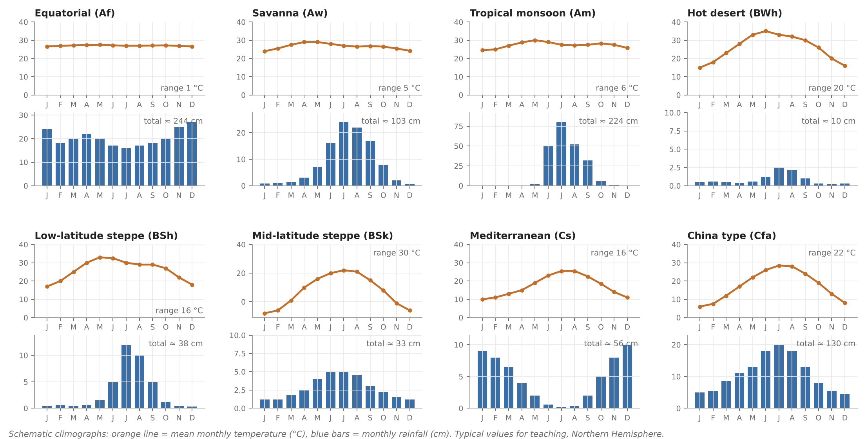
Eight climatic types at a glance
Schematic climographs drawn for this deck: orange = mean monthly temperature, blue = monthly rainfall (Northern Hemisphere, typical values)
Notes:
These schematic climographs compare the eight types. Look at two things: the shape of the temperature line, which shows the annual range, and the timing of the rainfall bars. Equatorial climates are flat and wet all year; savanna and monsoon have a summer wet season, the monsoon one far stronger; the hot desert has a large range and almost no rain; the steppes are drier versions of their neighbours; the Mediterranean has winter rain; and the China type has rain all year with a summer maximum.

Slide 29
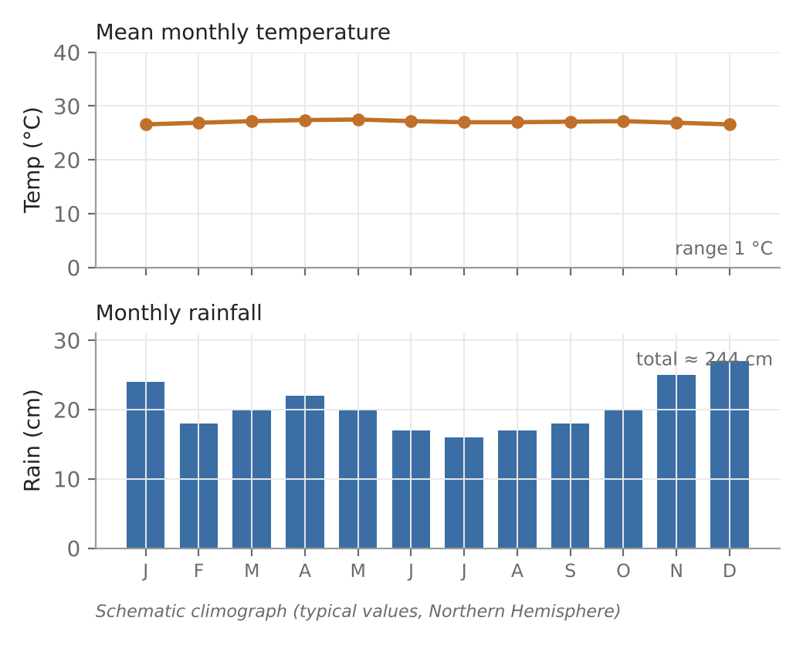
Tropical rainforest / equatorial climate (Af)
Location
Temperature
5–10° N and S of equator (to 15–20° on east coasts)
Shifts with seasonal migration of pressure belts
All months > 18 °C (24–27 °C)
Annual range 2–3 °C < diurnal 5–14 °C
Winds and rain
Vegetation
Doldrums: light, variable winds
> 200–250 cm; driest month > 6 cm; daily convection, ITCZ
~60% cloud, peak 3–4 pm
Selva: dense broad-leaved evergreen forest
Competition for sunlight
Schematic climograph (typical values)
'Night is the winter of the tropics' — the diurnal range exceeds the annual range
Notes:
The equatorial climate lies within 5 to 10 degrees of the equator, sometimes up to 15 to 20 degrees on eastern margins. The midday sun is always high, so insolation is greatest and every month averages over 18 °C, usually 24 to 27 °C. The annual range is only 2 to 3 °C, smaller than the diurnal range of 5 to 14 °C, which is why night is called the winter of the tropics. It lies in the doldrums with light variable winds. Rain falls every month, totalling over 200 to 250 cm, from daily afternoon convection, ITCZ convergence and thunderstorms, with about 60 percent cloud cover peaking around 3 to 4 pm. The vegetation is the dense, broad-leaved evergreen rainforest called selva.

Slide 30
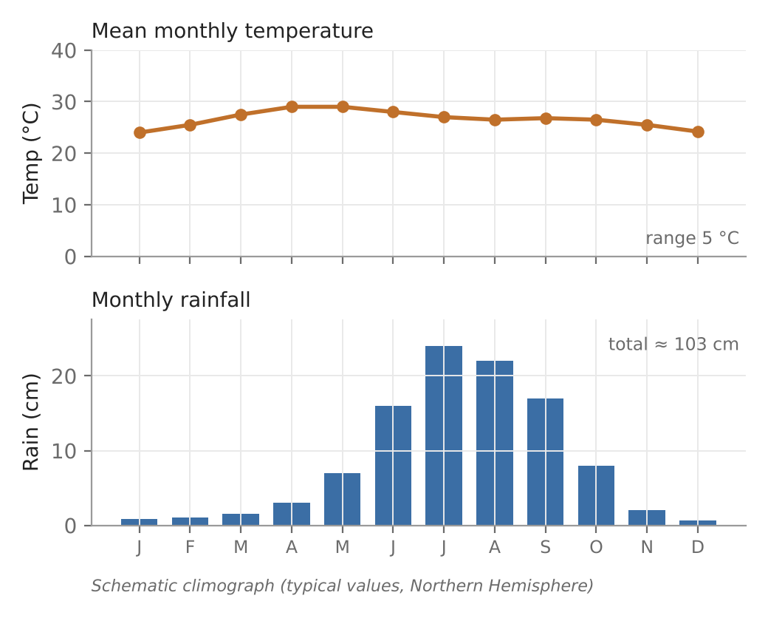
Tropical wet-and-dry / savanna climate (Aw)
Location
Temperature
5–20° N and S
Between equatorial low (ITC) and subtropical high
24–27 °C; no month < 20 °C
Annual range 3–8 °C
Pressure, wind, rain
Vegetation
Summer: ITC + disturbances → rain
Winter: anticyclone → dry
100–150 cm
Grassland with scattered trees and bushes
Deciduous trees, long roots
Schematic climograph (typical values)
Climatologists use savanna for the climate; botanists use it for the grass-dominated vegetation
Notes:
The savanna, or Sudan type, climate lies between 5 and 20 degrees latitude, between the equatorial low and the subtropical highs. It has distinct wet and dry seasons, mean temperatures of 24 to 27 °C, no month below 20 °C and an annual range of 3 to 8 °C. In summer the ITCZ moves poleward and brings rain-bearing disturbances; in winter the subtropical high brings sinking, dry air; eastern coasts get trade winds and tropical cyclones affect the warm season. Annual rainfall is 100 to 150 cm, varying with distance from the equator and relief. The vegetation is grassland with scattered drought-deciduous trees with long roots; grasses are taller and trees denser towards the equator.

Slide 31
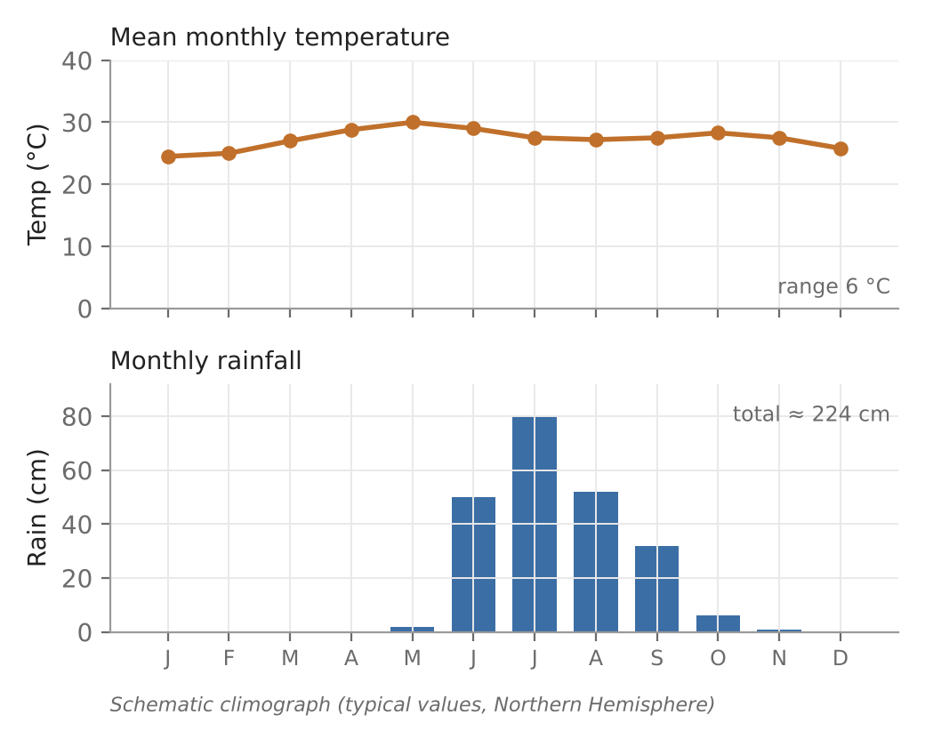


Tropical monsoon climate (Am): the Indian case
Seasons (India)
Winds
Dry warm summer: Mar–Jun (Loo; 38–48 °C max)
Humid warm: Jul–Oct
Dry winter: Nov–Feb
Complete seasonal reversal
Summer SW (onshore, ITC to 20–25° N)
Winter NE trades (dry; rain on TN/AP coast)
Rainfall
Vegetation
Avg ~150 cm; < 50 cm in rain shadow
Cyclonic and orographic; WDs in Jan–Feb over Ganga plains
Deciduous: sal, teak, bamboo, mango, mahua, neem, shisham
Fewer species than Af
Schematic climograph (typical values)
Climograph shows a west-coast station; much of India receives 75–150 cm
Notes:
The monsoon climate occurs where winds reverse completely with the seasons, between about 5 and 30 degrees, most clearly in south and east Asia: India, Myanmar, Bangladesh, southern China and the Philippines. India has three seasons: dry warm summer from March to June, humid warm summer from July to October, and dry winter from November to February. May and June maxima reach 38 to 48 °C with the hot Loo wind. In summer the ITC moves to 20 to 25 degrees north and moist onshore south-west winds bring heavy rain; in winter dry north-east trades return, though they bring rain to the Tamil Nadu and Andhra coasts after crossing the Bay of Bengal, and western disturbances give winter rain to the Ganga plains. Average rainfall is about 150 cm, very variable. Vegetation is deciduous: sal, teak, bamboo, mango, mahua, jamun, neem and shisham.

Slide 32
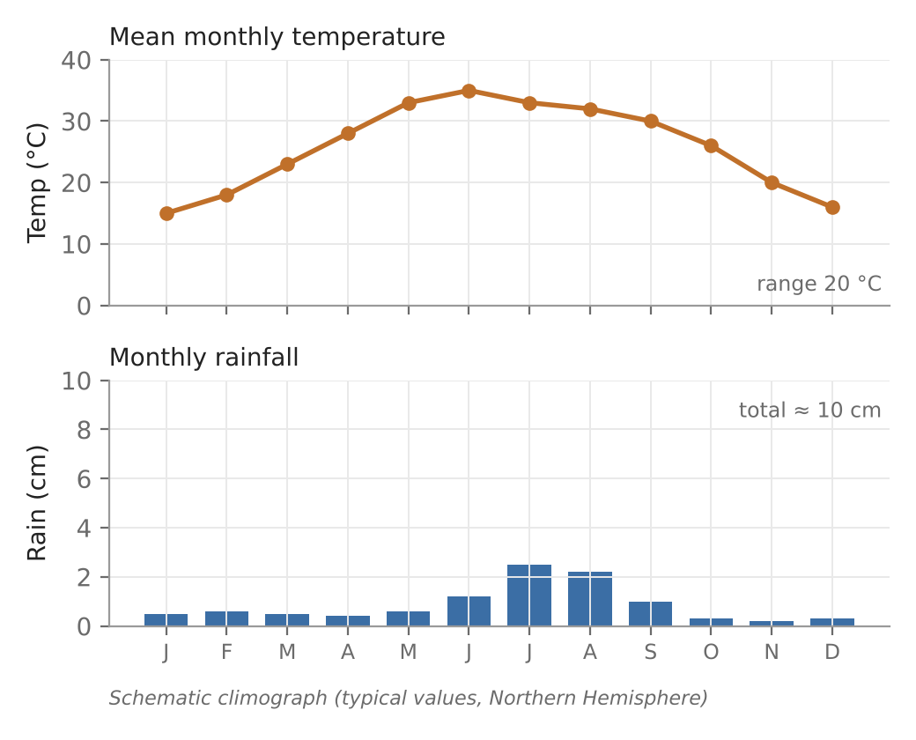

Tropical–subtropical hot desert climate (BWh)
Location
Why always dry
15–35° on western sides of continents
Sahara, Thar (India–Pakistan)
No temperate cyclones or ITC
Trades dry on west sides; subsiding air warms adiabatically
Divergence; rain evaporates (virga)
Temperature
Rain and plants
Highest on Earth
Annual range 17–22 °C; diurnal 22–28 °C
< 12 cm, highly unreliable (50–75 cm on humid margins)
Sparse xerophytic bushes
Schematic climograph (typical values)
Notes:
Hot deserts lie between about 15 and 35 degrees on the western sides of continents, including the Thar desert of India and Pakistan. They are permanently dry because temperate cyclones and the ITC do not reach them, the trades lose their moisture on eastern margins, sinking air in the subtropical anticyclone warms adiabatically and lowers relative humidity, surface winds diverge, and any raindrops evaporate before reaching the ground. Insolation and temperatures are the highest on Earth, with an annual range of 17 to 22 °C and a diurnal range of 22 to 28 °C because of clear skies, bare ground and low humidity. Rainfall is unreliable and usually under 12 cm. Vegetation is sparse xerophytic scrub.

Slide 33
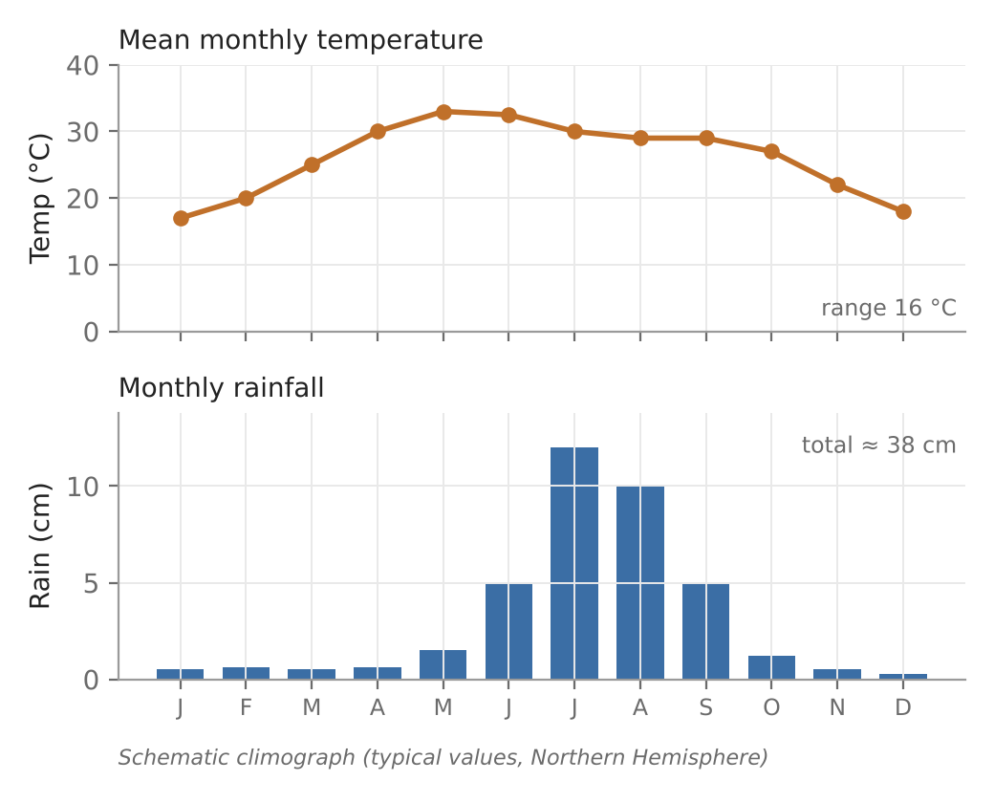
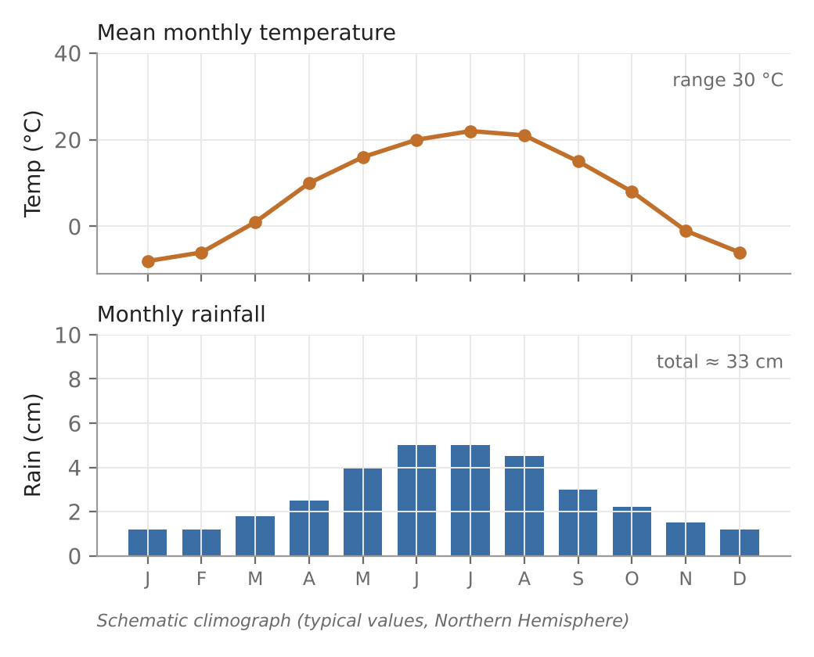
Steppe climates: BSh and BSk
Key idea
Semi-arid: P just over half of potential evaporation
Köppen BS vs BW: steppe if P between 0.5 and 1 × dryness threshold
Extreme continentality is the keynote of BSk
BSh (schematic)
BSk (schematic)
 | BSh (low-latitude) | BSk (middle-latitude)
Location | Around hot deserts; margins of subtropical highs/trades; India: around Thar, Peninsular rain shadow | Continental interiors of temperate zone (Central Asia, Great Plains)
Temperature | Hot summers, cold winters; annual mean > 18 °C; large daily range | Warm summers, cold winters; large annual range (smaller in S. Hemisphere)
Rainfall | 25–50 cm; < potential evaporation; variable | 20–50 cm; humid years then drought years
Vegetation | Short, shallow-rooted grasses | Short grasses and shrubs
Notes:
Steppes are semi-arid transition belts between deserts and humid climates, where rainfall is just over half the potential evaporation. Low-latitude steppe surrounds hot deserts on the margins of the subtropical highs and trades, getting a short rainy season as the belts shift; in India it encircles the Thar and covers the rain-shadow parts of the Peninsula. It has hot summers, cool winters, an annual mean above 18 °C and 25 to 50 cm of variable rain, supporting short shallow-rooted grasses. Middle-latitude steppe lies in continental interiors of the temperate zone, cut off from marine influence: warm summers, cold winters, large annual ranges and 20 to 50 cm of unreliable rain with drought years, supporting short grasses and shrubs.

Slide 34
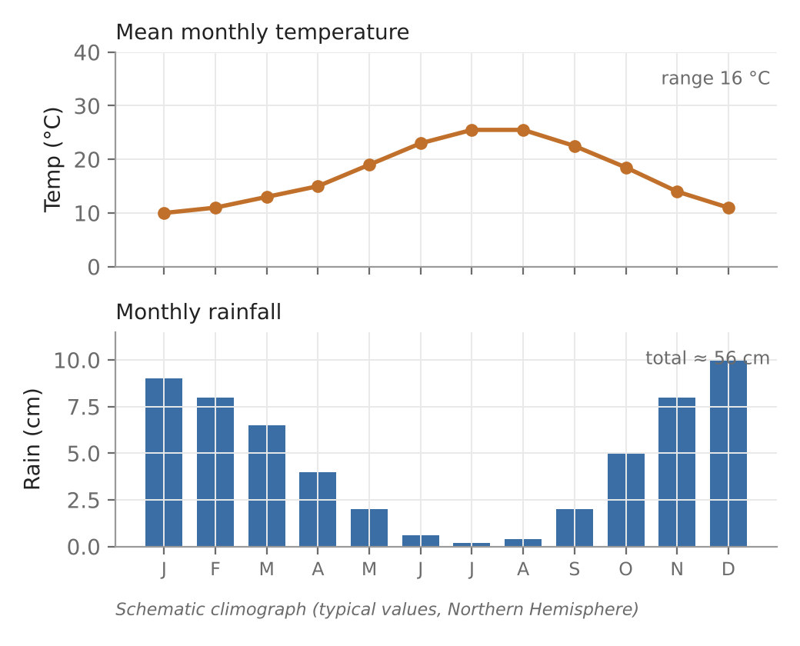
Mediterranean climate (Cs)
Location
Pressure and winds
30–40° on western sides of continents
Mediterranean Sea, California, central Chile, SW Australia, Cape Town
Summer: subtropical high → dry
Winter: westerlies + temperate cyclones → rain
Temperature and rain
Vegetation
Winter 5–10 °C; summer 20–27 °C; range 15–17 °C
37–65 cm, > 75% in winter; Csa / Csb
Sclerophyllous: thick, shiny leaves, deep roots
Pine, oak, cedar; citrus, olive, grapes
Schematic climograph (typical values)
A 'resort climate': dry sunny summers, mild wet winters; sunshine 90% in summer, 50–60% in winter
Notes:
The subtropical dry-summer or Mediterranean climate lies between 30 and 40 degrees on the western sides of continents and covers about 1.7 percent of the globe. It results from the seasonal shift of pressure and wind belts: in winter moist westerlies with temperate cyclones bring rain, and in summer the subtropical high brings sinking, stable, dry air. Winters are 5 to 10 °C, summers 20 to 27 °C, an annual range of 15 to 17 °C. Csa has hot summers inland and Csb mild summers on coasts. Rainfall is 37 to 65 cm, over 75 percent in winter, with abundant sunshine. Vegetation is sclerophyllous, hard-leaved and drought resistant, with pine, oak, cedar, walnut and chestnut where moister.

Slide 35
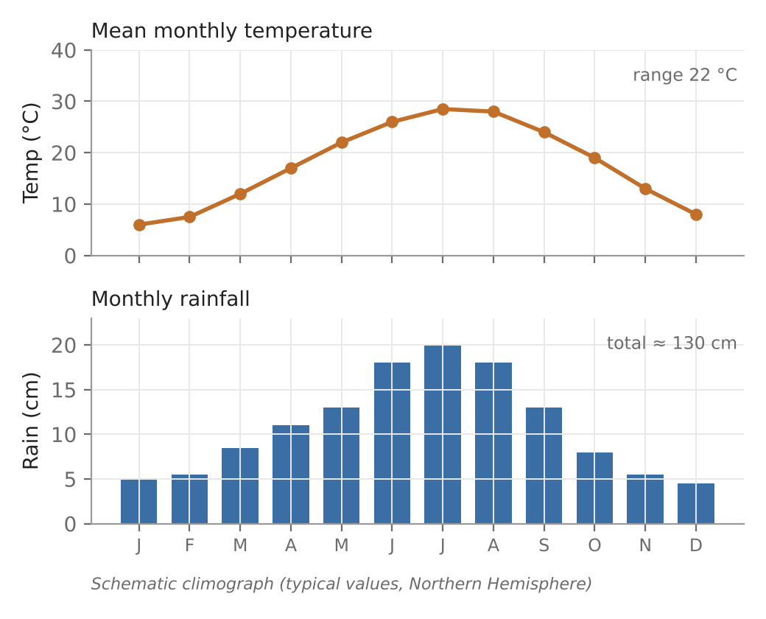
Humid subtropical / China type climate (Cf / Ca)
Location
Temperature
20–40° on eastern sides of continents
S China, SE USA, SE Brazil–Argentina, E Australia
Hot summers; winters 4.4–12.8 °C
Warm ocean currents on coasts
Rainfall
Cs vs Cf
75–150 cm (to 250 cm); all seasons
Summer max: convection, tropical cyclones; winter: westerly cyclones
Cs west side, Cf east side
Cs winter rain, Cf summer maximum
Cf wetter overall
Schematic climograph (typical values)
Long growing season (7–12 months): evergreen forests in humid parts, deciduous forest and grassland where drier
Notes:
The China type, or humid subtropical, climate lies between 20 and 40 degrees on the eastern sides of continents, flanked by dry interiors to the west, monsoon areas to the south and humid continental climates to the north. Warm ocean currents raise coastal temperatures. Summers are hot and winters mild, averaging 4.4 to 12.8 °C, with damp cold spells from passing cyclones. Rainfall is 75 to 150 cm, up to 250 cm in favoured places, falling in all seasons with a summer maximum from convection and tropical cyclones, and winter rain from westerly cyclones. A growing season of 7 to 12 months supports evergreen forests in wetter areas and deciduous forest and grassland elsewhere. The table contrasts it with the Mediterranean climate at the same latitudes.

Slide 36

Summary and quick questions
Q. Empirical vs genetic?
Q. Basis of Köppen?
Q. A vs C vs D boundaries?
→ Empirical uses observed T and P statistics (Köppen, Thornthwaite); genetic uses causes such as air masses
→ De Candolle's vegetation groups; critical monthly T and P; A, C, D, E by temperature, B by precipitation
→ A: coldest month ≥ 18 °C; C: −3 to 18 °C; D: < −3 °C; E: warmest < 10 °C
Q. What do f, m, w, s mean?
Q. Thornthwaite 1931 indices?
Q. Thornthwaite 1948 basis?
→ f: wet all year (≥ 6 cm every month); m: monsoon; w: dry winter; s: dry summer
→ P/E = 11.5 (r/(t−10))^{10/9}; T/E = (t − 32)/4; 32 types mapped
→ PE = 1.6(10t/I)^a; Im = (100S − 60D)/PE; 4-letter code e.g. AA′a′r
Q. Trewartha's groups?
Q. Mediterranean vs China type?
Q. Why are hot deserts dry?
→ A, B, C, D, E (boreal), F (polar); simple, empirical + genetic
→ Same 30–40° belt; Cs west coast with winter rain, Cf east coast with summer maximum
→ Subsiding air in subtropical highs, dry trades on west coasts, no ITC or cyclones
Read: course notes 'Classification and Type of Climate' · Köppen (1936) Handbuch der Klimatologie · Thornthwaite (1931) Geogr. Rev. 21:633; (1948) Geogr. Rev. 38:55 · Trewartha & Horn (1980) An Introduction to Climate · Peel et al. (2007) HESS 11:1633
Notes:
These short questions cover what is most often asked about climatic classification. Practise answering each in one sentence, then adding a detail such as a threshold or an example.

