Slide 1
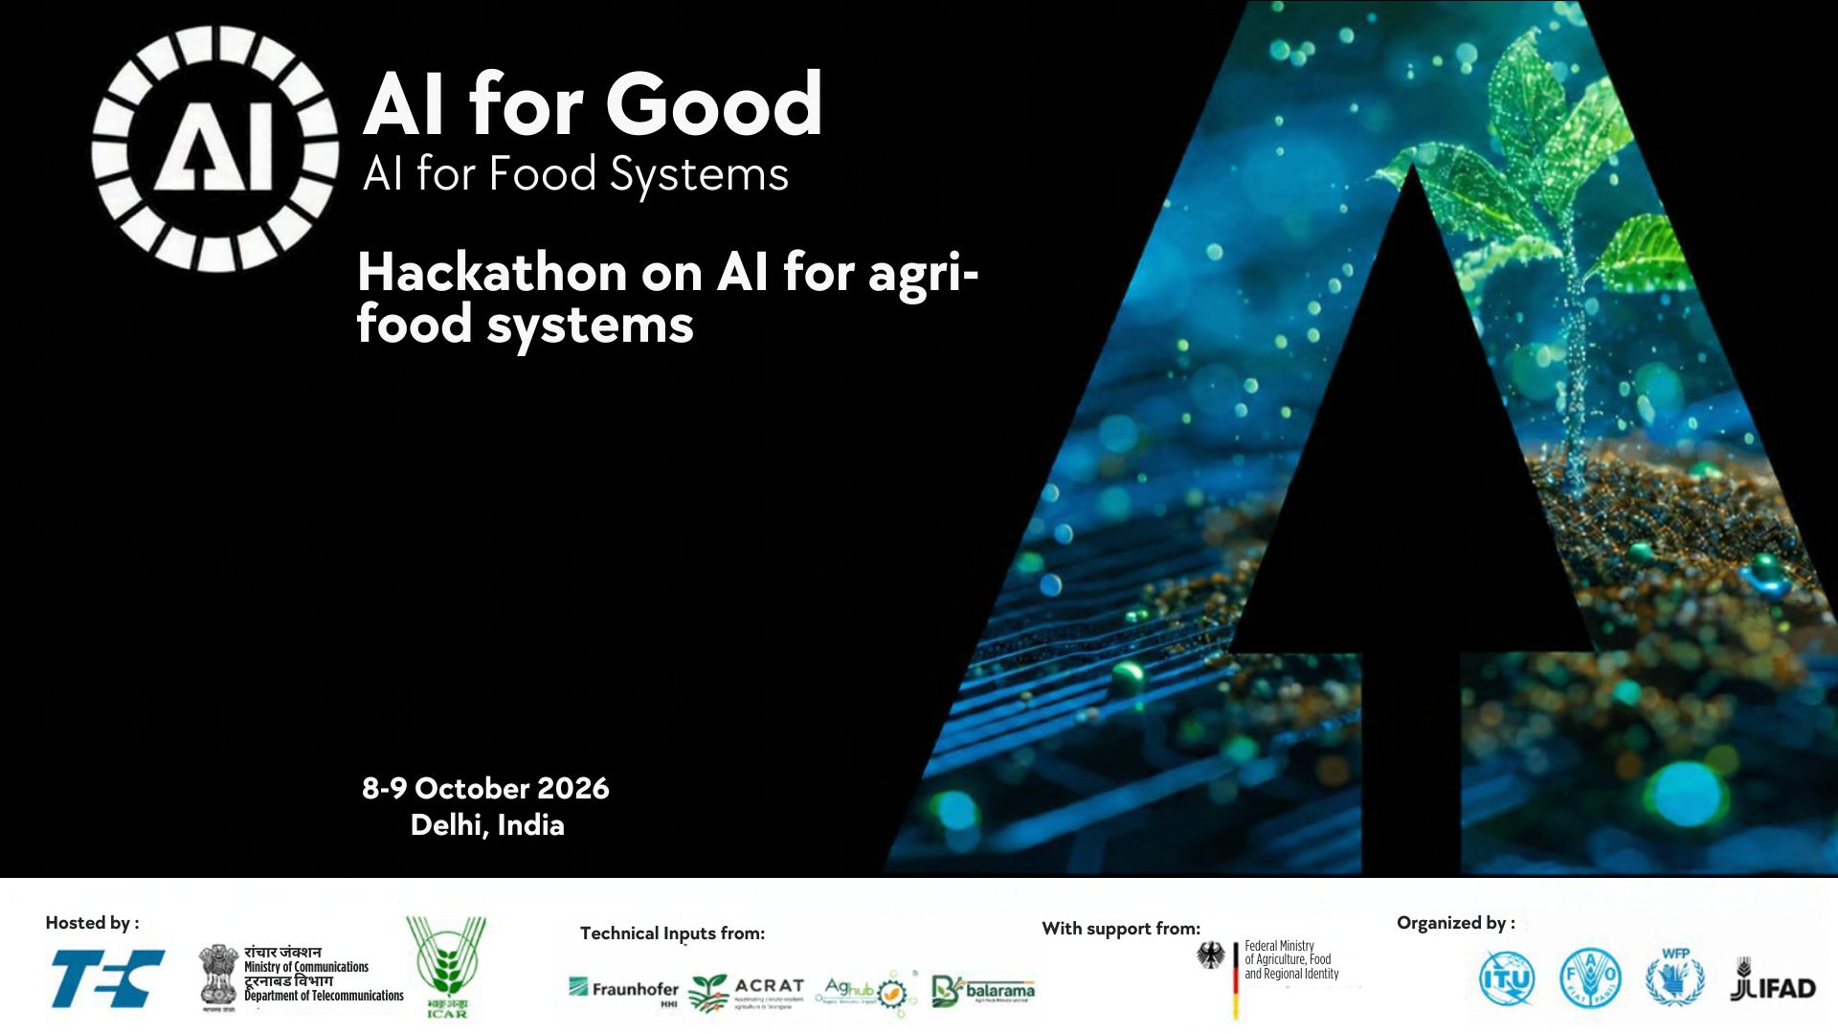
Team: MuDAS-AI
Multimodal Disease Assessment using Artificial Intelligence
Thematic Area: Crop Intelligence and Decision Support
Presenter: Animesh Panda (ICAR-IARI)

Slide 2
Farmers need to know when and where to spray before it is too late.
The problem
Target user / beneficiary
Why it matters
Mustard white rust causes 20–60% yield loss
Pustules form on the leaf underside, hidden from above
Visible signs (chlorosis, staghead) appear after the spray window
Manual scouting is slow, subjective and not scalable
UAV studies use single sensors; no multimodal fusion exists
Small and marginal mustard farmers (1–2 ha)
Rajasthan, MP, UP, Haryana, Gujarat, West Bengal
Reached via drone service providers and FPOs
Extension: KVKs and state agriculture departments
Unmet need: when and where to spray
Mustard: >6 Mha, ~27% of India’s oilseed output
Priority crop of NMEO-OS to cut edible-oil imports
Late or blanket spraying: yield loss, cost, chemical load
Drone access is expanding (Kisan Drones, Namo Drone Didi)

Slide 3
One drone flight, and AI turns it into a disease severity map.
Your solution
AI, data & technology
Innovation & interoperability
Using UAV based RGB, multispectral, thermal, hyperspectral data, AI maps every plot / grid into 6 severity classes.
Drone flight → one geo-referenced disease severity map: decide Skip / Spray / Too late
Workflow: fly → pre-process → feature selection → fusion → classify → map
Why AI: fuses weak, non-linear signals of 4 sensors that no single sensor or human eye can detect
Phase 1: disease-specific features (ANOVA, JM, Relief, Boruta, RFE etc.)
Phase 2: per-sensor VIF/SPA + ML-SFFS → OFCs →ML classification
Phase 3: feature-level fusion of all sensors + ML-SFFS
Validated in three tiers, IARI research plots → IIRMR Bharatpur→ farmers' fields, so the model is accurate, transferable and usable.
First multimodal fusion framework for mustard white rust and interpretable features linked to plant physiology
Interested in integrating with the GI-AI4AFS Open Reference Architecture
Finds the best model and the cheapest sensor set that is accurate enough

Slide 4
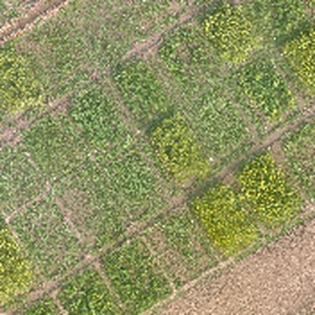
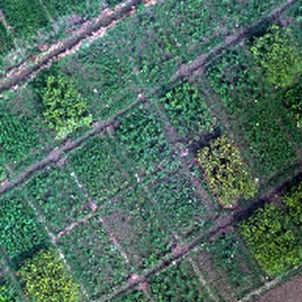
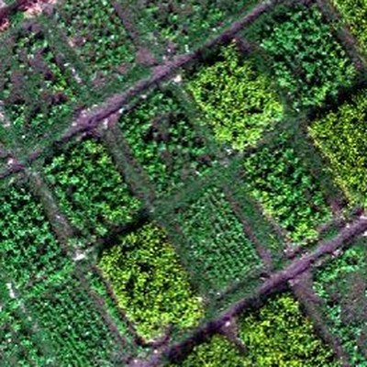
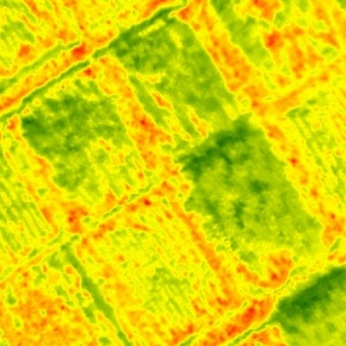
MuDAS-AI · Conceptual Framework
Drone flight → AI → a white rust severity map
1
Problem
2
UAV data
3
AI engine
4
Severity map
PHASE 1
PHASE 2
PHASE 3
Disease features
Best per sensor
Sensor fusion
VIF/SPA → SFFS
RGB
keep
MS
Top
Underside
HS
AI
Pustules hide under the leaf
RGB
Multispectral
TIR
RF
SVM
KNN
0 Healthy DI 0
ANOVA
JM
Best feature set & model for each sensor
Feature-level fusion + SFFS
Spotted too late to spray
ReliefF
Boruta
1 Very low DI 1–5%
2 Low DI 6–10%
Hyperspectral
Thermal
3 Moderate DI 11–25%
6 classes
0
1
2
3
4
5
Tested on unseen plots
4 High DI 26–50%
Where & when to spray?
+ Field DI scores (labels)
5 Very high DI >50%

Slide 5
Targeted spraying saves farmers money and fungicide, and the approach can scale to other regions, crops and diseases
Potential impact
Feasibility & scale
What you will build
Value for farmers: Early detection and targeted spraying at early stages
Outcomes: Expected 15-30% less pesticide, action within the spray window protects yield.
Sustainability: Less chemical load on soil and water. Maps for surveillance, insurance
Technical and operational feasibility: Availability of commercial drone sensors and lightweight ML models.
Data, Partners, Resources: UAV based images from different sensors, ICAR, KVKs, FPOs, drone service providers
Reused and Rescale: Other crops and diseases: same pipeline, new disease specific features and can be applied in wider coverage
Pipeline: Image pre processing → disease feature extraction →AI severity classification, comparing single sensors with fusion
Upload drone images and get back a severity map
Mentoring needs: cloud deployment, GI-AI4AFS integration and how DL based pixel level fusion can be done

