Slide 1
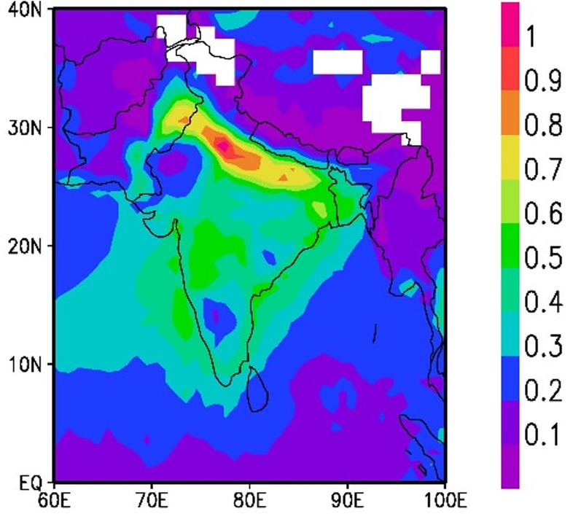
PhD CREDIT SEMINAR
Remote Sensing for Quantifying Aerosol Impact on Terrestrial Ecosystem Productivity
Presented by: Animesh Panda
Roll No. 13098 · Ph.D. 2nd Year
Chairman: Rabi N. Sahoo
Seminar Leader: Subash Nataraja Pillai
MODIS aerosol optical depth, post-monsoon: haze over the Indo-Gangetic Plain
Source: Ramachandran & Rupakheti, 2026
Notes:
Good morning. My seminar is on remote sensing for quantifying aerosol impact on terrestrial ecosystem productivity. I am Animesh Panda, Roll No. 13098, Ph.D. second year. The chairman is Dr Rabi N. Sahoo and the seminar leader is Dr Subash Nataraja Pillai.
The map on the right is real satellite data: MODIS aerosol optical depth over South Asia in the post-monsoon season, from Ramachandran and Rupakheti, 2026. The red and orange band along the Indo-Gangetic Plain, at the foot of the Himalaya, is the aerosol haze from crop-residue burning, industry and vehicles, lying over the most important cropland of India. How this haze changes the light reaching crops and forests, and how satellites can quantify the effect on productivity, is the subject of this seminar.

Slide 2
Seminar outline
Outline
1
Introduction
Why aerosol–productivity interactions matter; conceptual framework
6
Mechanisms of aerosol impact
Light, climate and water-cycle routes; ozone and aerosol species; optimum load
2
Atmospheric aerosols
Types, distribution, trends, optical properties and radiative effects
7
Evidence
Ecosystems, crops, India; aerosol vs climate drivers; past and future carbon sink
3
Remote sensing of aerosols and radiation
Ground networks, satellite retrieval, product accuracy, direct and diffuse PAR
8
Case studies
Wang et al., 2021 · Shu et al., 2022
4
Remote sensing of productivity
Productivity concepts, flux towers, vegetation indices, SIF and GPP products
9
Challenges
Uncertainties in attributing productivity change to aerosol
5
Linking aerosols to productivity
Statistical designs, natural experiments, process models
10
Conclusions
Take-home messages
Notes:
This is the plan of the seminar in ten parts. Part 1 explains why the interaction between aerosols and ecosystem productivity matters and presents the conceptual framework that links emissions, aerosol properties, atmospheric perturbations, canopy responses and productivity. Part 2 introduces atmospheric aerosols: their types and sources, their distribution and trends over the globe and South Asia, their optical properties and their radiative effects. Part 3 explains how aerosols and the light they modify are measured: ground networks, the satellite retrieval principle and algorithms, lidar and reanalysis, the accuracy of satellite AOD products against AERONET, and how direct and diffuse PAR are estimated. Part 4 covers the measurement of productivity: carbon-flux concepts, flux towers, vegetation indices, solar-induced fluorescence and gridded products. Part 5 explains how the two are linked through statistical designs, natural experiments and process models. Part 6 describes the mechanisms: the light route, the climate route, the water-cycle route, ozone and aerosol species, the optimum aerosol load, and the factors that decide the outcome. Part 7 brings the evidence from natural ecosystems, crops and India, compares aerosol with climate drivers of Indian crop yield, and looks at the past and future diffuse-radiation effect on the global carbon sink. Part 8 is the two case studies, Wang et al., 2021 and Shu et al., 2022. Part 9 covers the uncertainties in attributing productivity change to aerosol, and Part 10 gives the take-home messages.

Slide 3
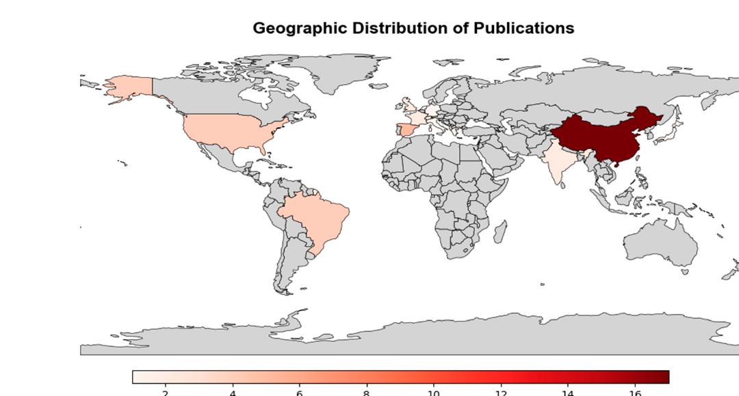
Why aerosol–productivity interactions matter
1 · Introduction
30%
of human CO₂ emissions absorbed by land ecosystems
Friedlingstein et al., 2023
−1.3 W m⁻²
aerosol forcing: largest uncertainty in human climate forcing
Forster et al., 2021
≈ ¼
rise in the land carbon sink from global dimming, 1960–1999
Mercado et al., 2009
Where aerosol–PAR studies were done (2021–2025)
⅔ of India's food grains
grown in north-west India, under the IGP haze
Jethva et al., 2019
Satellites
map aerosol, light and vegetation where ground sites are sparse
Wei et al., 2020
China 17 of 22 studies; India only 2: a clear research gap
Source: de Oliveira et al., 2025
Core idea: aerosols change both the amount and the quality (direct vs diffuse) of light reaching vegetation, and so change how much carbon ecosystems fix.
Notes:
Why should we care about aerosols and productivity. The five cards give five reasons. First, land ecosystems absorb about 30 percent of the carbon dioxide that humans emit, according to the Global Carbon Budget of Friedlingstein and colleagues, so even a few percent change in photosynthesis matters for the global carbon cycle. Second, aerosols are the largest uncertainty in human climate forcing: the IPCC Sixth Assessment Report, Forster and colleagues, puts aerosol effective radiative forcing at about minus 1.3 watts per square metre, offsetting part of greenhouse warming. Third, aerosols do not only reduce light; they make it more diffuse, and canopies use diffuse light more efficiently. Mercado and colleagues estimated that the global dimming period, with more scattering aerosol, increased the land carbon sink by about one quarter between 1960 and 1999. Fourth, the topic matters for food security in India: north-west India, the breadbasket that grows about two-thirds of India's food grains, lies exactly under the Indo-Gangetic Plain aerosol plume, as Jethva and colleagues point out. Fifth, the problem needs remote sensing, because ground stations for aerosol, radiation and carbon flux are sparse, while satellites observe aerosol, light and vegetation consistently over large areas, as reviewed by Wei and colleagues.
The map, from the 2025 systematic review by de Oliveira and colleagues, shows where aerosol–PAR studies were carried out between 2021 and 2025. Of the 22 studies, 17 were from China and only two from India. So the most aerosol-loaded agricultural region of the world is one of the least studied.
The core idea in the bottom strip is that aerosols change both the amount of light and its quality, the split between direct and diffuse light, and this changes how much carbon ecosystems fix.

Slide 4
Conceptual framework: from emissions to ecosystem productivity
1 · Introduction
Drivers
Aerosol
Atmospheric perturbation
Canopy response
Productivity
Emission sources
Fossil fuel and industry
Crop-residue burning
Desert dust
Plant VOCs → SOA
Aerosol properties
Load (AOD)
Scattering vs absorbing (SSA)
Size (Ångström)
Vertical profile
Radiation
PAR ↓ (dimming), diffuse fraction ↑
Shaded leaves gain, sunlit leaves lose; LUE ↑
Kanniah et al., 2012
GPP · NPP · NEE · yield
Net effect = diffuse gain − dimming loss ± climate effects − ozone damage
Inverted-U response to AOD
Climate
Temperature ↓, VPD ↓, soil moisture ↑, rain ↓
Stomata open, less water stress; less rain
Yue et al., 2017
Co-pollutant
Surface ozone ↑ from the same emissions
Stomatal ozone uptake damages leaves
Yue & Unger, 2018
Modulators: cloud cover · aerosol load (optimum) · aerosol type · canopy structure · C3 vs C4 · growth stage
Feedbacks: larger harvest → more residue fires → more aerosol (Jethva et al., 2019) · plant VOCs → secondary organic aerosol → more diffuse light (Rap et al., 2018)
Notes:
This framework organises the whole seminar as a causal chain from emissions to productivity. On the left are the drivers: fossil-fuel and industrial emissions, crop-residue burning, desert dust, and volatile organic compounds from plants that form secondary organic aerosol. These produce an aerosol population described by four properties: the load, measured as aerosol optical depth; whether particles scatter or absorb, given by the single-scattering albedo; their size, given by the Ångström exponent; and their vertical profile.
The aerosol then perturbs the atmosphere through three routes, shown as three lanes. The radiation route: aerosol reduces photosynthetically active radiation, the dimming effect, but increases the diffuse fraction. The canopy responds because shaded leaves receive more light while sunlit leaves lose some, so canopy light-use efficiency rises, as reviewed by Kanniah and colleagues. The climate route: aerosol cools the surface, lowers vapour pressure deficit, keeps soil wetter and can reduce rainfall; the canopy responds with more open stomata and less water stress, but less rain; Yue and colleagues quantified these routes for China. The co-pollutant route: the same emissions produce surface ozone, which enters leaves through stomata and damages photosynthesis, as shown globally by Yue and Unger.
The three routes combine into productivity, expressed as GPP, NPP, net ecosystem exchange or crop yield. The net effect is the diffuse-light gain minus the dimming loss, plus or minus the climate effects, minus ozone damage, which produces an inverted-U response to AOD.
The strength of each route depends on modulators: cloud cover, the aerosol load relative to the optimum, aerosol type, canopy structure, the C3 or C4 photosynthetic pathway and the crop growth stage. Finally, there are feedbacks. Over north-west India, Jethva and colleagues showed that larger harvests leave more residue, which is burnt and adds aerosol. Globally, Rap and colleagues showed that plant emissions form secondary organic aerosol that increases diffuse light and so feeds back on productivity. The rest of the seminar follows this chain from left to right.

Slide 5
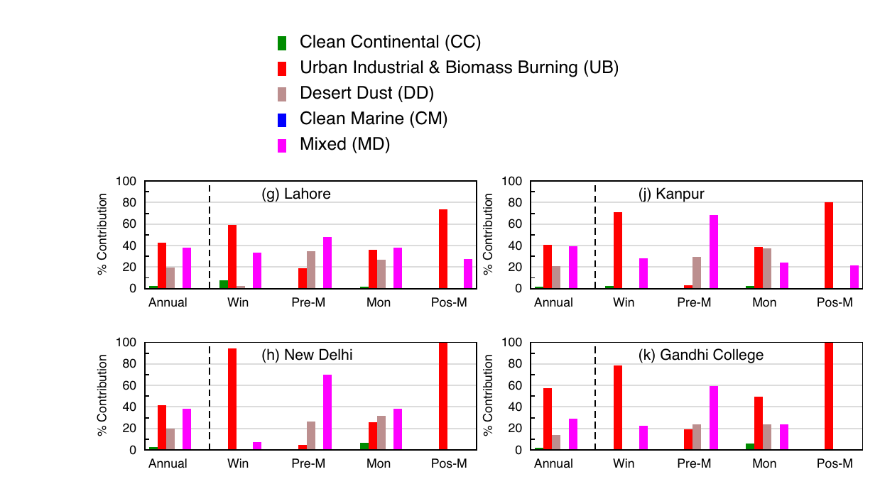
Aerosol types and sources
2 · Atmospheric aerosols
Aerosol type | Main sources (India examples) | Size · light interaction
Sulfate & nitrate Seinfeld & Pandis 2016 | SO₂, NOₓ, NH₃ from coal power, vehicles, fertilizer | Fine · strong scattering, swell in humid air
Black carbon Bond 2013 | Diesel, brick kilns, biomass and residue burning | Fine · strongly absorbing
Organic carbon & SOA Andreae & Gelencsér 2006 | Biomass burning; oxidised plant VOCs | Fine · mostly scattering; brown carbon absorbs UV–blue
Mineral dust Ginoux 2012 | Thar and Arabian deserts, dry soils | Coarse · scatters, weakly absorbs blue
Sea salt Hess 1998 | Ocean spray along the coasts | Coarse · scattering, hygroscopic
Aerosol types over the western and central IGP (AOD–α classification)
Urban-industrial and biomass-burning aerosol dominates; dust peaks before the monsoon
Source: Ramachandran & Rupakheti, 2026
Primary particles are emitted directly; secondary particles form from gases. Fine mode: radius ≤ 1 µm (modal radius 0.1–0.3 µm); coarse mode: ≥ 1 µm (modal radius 2–5 µm) (Ramachandran & Rupakheti, 2026).
Notes:
Aerosols are solid or liquid particles suspended in the air, and their composition decides how they interact with sunlight. Sulfate and nitrate form from sulfur dioxide, nitrogen oxides and ammonia emitted by coal power plants, vehicles and fertilizer use; they are fine particles that scatter light very efficiently and grow when the air is humid. Black carbon, from diesel engines, brick kilns and biomass and crop-residue burning, is fine and strongly absorbing: it removes light and heats the air. Organic carbon and secondary organic aerosol come from biomass burning and from the oxidation of volatile organic compounds released by plants; they mostly scatter, although the 'brown carbon' part absorbs ultraviolet and blue light. Mineral dust from the Thar and Arabian deserts and from dry soils is coarse, scatters light and absorbs weakly in the blue. Sea salt from ocean spray is coarse, scattering and hygroscopic.
The figure, from Ramachandran and Rupakheti, 2026, classifies aerosol types at AERONET sites over the western and central Indo-Gangetic Plain using aerosol optical depth and the Ångström exponent. Urban-industrial and biomass-burning aerosol, shown in red, dominates in most seasons, while dust, shown in grey, peaks in the pre-monsoon season.
Two definitions are useful. Primary particles are emitted directly, such as dust, sea salt and black carbon; secondary particles form in the atmosphere from gases, such as sulfate, nitrate and secondary organics. By size, the same study defines fine-mode particles as those with radius up to 1 micrometre, with a modal radius of 0.1 to 0.3 micrometre, and coarse-mode particles as those above 1 micrometre, with a modal radius of 2 to 5 micrometres. Size matters because fine particles scatter far more light per unit mass, and this will come back when we discuss optical properties.

Slide 6
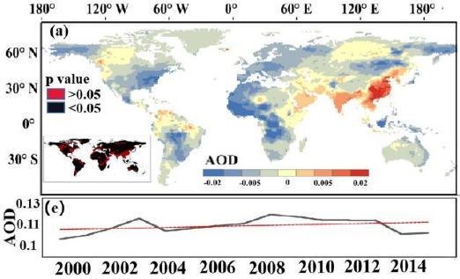
AOD trends: global
2 · Atmospheric aerosols
Region | AOD trend | Reference
USA, Europe | Decreasing (satellite record, 1997-2010) | Hsu et al., 2012
China, India | Rose to ~2013; −4 to −8% yr⁻¹ (2013–20) | Hsu et al., 2012
Fire regions | Global burned area −24% (1998–2015) → less smoke | Andela et al., 2017
Global mean | Total AOD reached a maximum of ~0.12 around 2000; projected to fall steeply under mitigation | Mercado et al., 2009
AOD trend 2000–2014 (map) and global mean (e)
Red: rising (India, E China); blue: falling
Source: Shu et al. 2022, Fig. 3
Aerosol has shifted, not disappeared: clean-air policies lowered aerosol over North America and Europe, while emissions grew over South and East Asia, so the aerosol–productivity question is now mainly an Asian one.
Notes:
Before focusing on South Asia, it helps to see how aerosol is changing worldwide. Satellite records analysed by Hsu and colleagues in 2012, and summarised in the review by Wei and colleagues, show that between 1997 and 2010 aerosol optical depth decreased over the United States and Europe, while it increased over China and India. The decrease in the West reflects clean-air legislation that cut sulfur emissions. In fire-dominated regions, mainly the African savannas and tropical grasslands, Andela and colleagues found that global burned area declined by about 24 percent between 1998 and 2015, largely because of agricultural expansion, which means less smoke from those regions.
The figure, from Mercado and colleagues in 2009, shows the long-term global picture. The black line is atmospheric carbon dioxide and the red line is total aerosol optical depth. AOD rose through the twentieth century with industrialisation and reached a maximum of about 0.12 around the year 2000. Under a mitigation scenario with rapid cuts in sulfate and black carbon emissions, it is projected to fall steeply, while carbon dioxide stays high. One consequence, which Mercado discussed, is that the diffuse-light fertilization that helped the carbon sink in the late twentieth century will shrink in the future.
The message in the strip is that aerosol has shifted rather than disappeared: it fell in North America and Europe but grew in South and East Asia. The question of how aerosol affects productivity is therefore now mainly an Asian question, and South Asia, which we look at next, is the region where aerosol is still clearly rising.

Slide 7
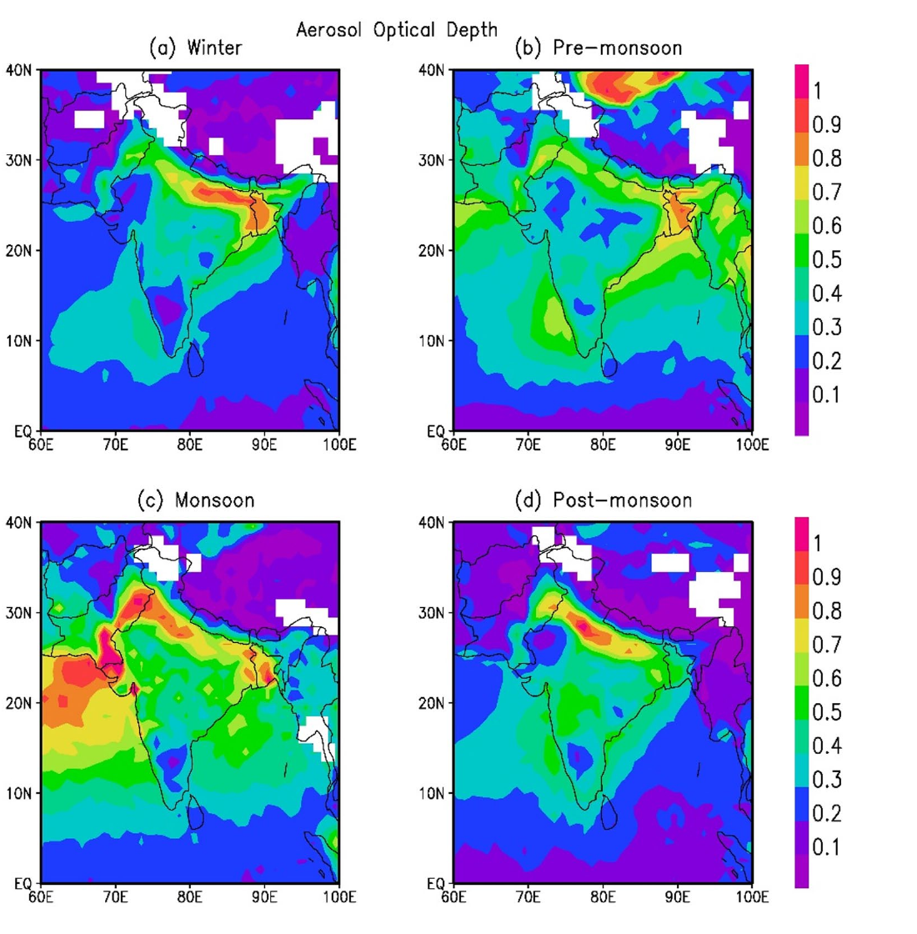
Spatial and seasonal distribution of aerosols over South Asia
2 · Atmospheric aerosols
MODIS AOD (550 nm): winter, pre-monsoon, monsoon, post-monsoon
Season | Dominant aerosol and cause
Winter (Dec–Feb) | Combustion aerosol trapped under a shallow boundary layer; fog
Pre-monsoon (Mar–May) | Dust transported from the Thar and Arabian deserts
Monsoon (Jun–Sep) | Rain washes out aerosol; lowest AOD of the year
Post-monsoon (Oct–Nov) | Crop-residue burning in Punjab–Haryana; smoke over the IGP
Key facts
The Indo-Gangetic Plain (IGP) is the persistent AOD hotspot of South Asia
Fine-mode aerosol gives > 80% of AOD in post-monsoon and winter (Ramachandran & Rupakheti, 2026)
AOD trends are strongest in the dry months, December–March (Babu et al., 2013)
Source: Ramachandran & Rupakheti, 2026
Notes:
This slide shows where and when aerosols occur over South Asia. The four MODIS maps of aerosol optical depth at 550 nanometres, for winter, pre-monsoon, monsoon and post-monsoon, all show the same feature: the Indo-Gangetic Plain, the belt from Punjab to West Bengal along the foot of the Himalaya, is the persistent aerosol hotspot. It is enclosed by the Himalaya to the north, so emissions and transported particles accumulate there.
The seasonal calendar in the table explains the pattern. In winter, December to February, combustion aerosol from vehicles, industry and domestic burning is trapped under a shallow, stable boundary layer, often with fog. In the pre-monsoon, March to May, hot dry winds bring dust from the Thar and Arabian deserts. During the monsoon, June to September, rain washes aerosol out of the air, giving the lowest AOD of the year in most places. In the post-monsoon, October and November, burning of rice residue in Punjab and Haryana sends smoke over the whole plain.
The key facts summarise three points. The IGP is the persistent hotspot. In the post-monsoon and winter seasons fine-mode aerosol contributes more than 80 percent of AOD at almost all sites, according to Ramachandran and Rupakheti, 2026, which means combustion and smoke dominate. And the long-term increase in AOD is strongest in the dry months from December to March, as Babu and colleagues reported in 2013. This dry season coincides with the rabi wheat season, so the crop that is growing when aerosol is highest is wheat.

Slide 8
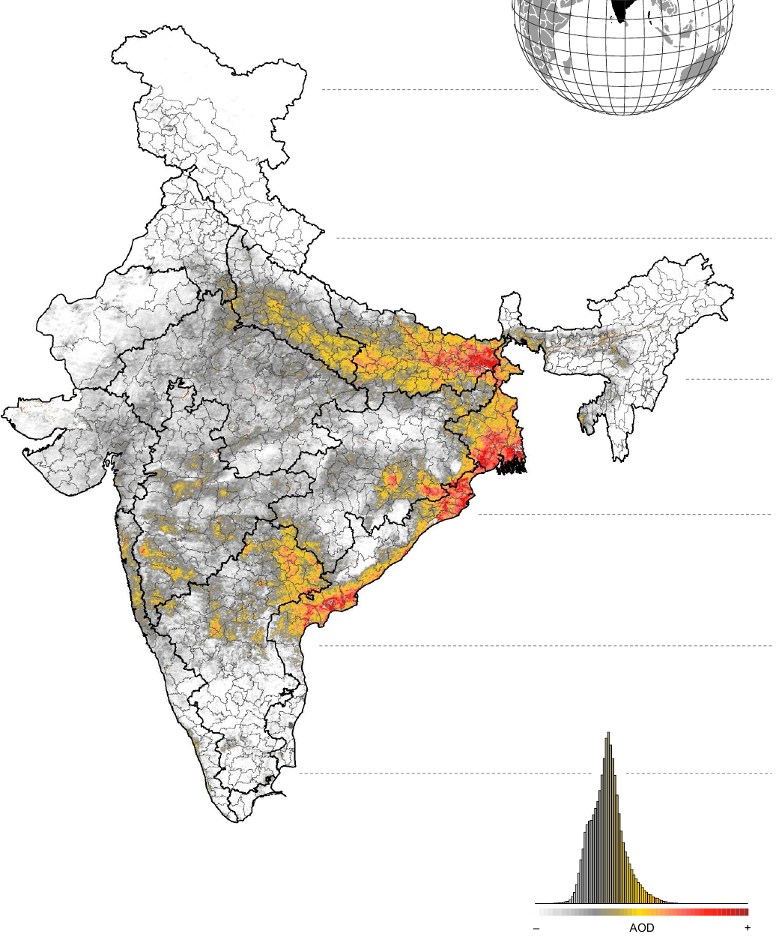
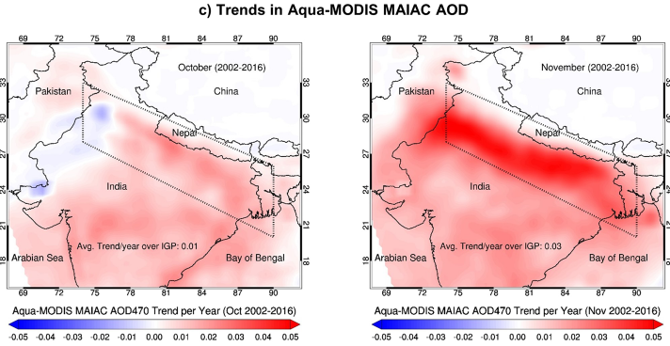
AOD trends: South Asia
2 · Atmospheric aerosols
India AOD trend, 2001–2020
MAIAC AOD trend over the IGP, October (left) and November (right), 2002–2016
Reported AOD rise
India: +0.006 yr⁻¹ (1998–2019) Gupta et al., 2024
India: +0.29 (2001–2020) Hari & Tyagi, 2022
IGP: +43% (2002–2016); +45% post-monsoon Jethva et al., 2019
IGP, November: +0.03 yr⁻¹ (extinction), +0.003 yr⁻¹ (absorption) Jethva et al., 2019
Kanpur AERONET: +34% (2002–2016) Jethva et al., 2019
Steepest rise in November, the residue-burning month
Source: Jethva et al., 2019, Fig. 6c
Drivers: industry, power plants, vehicles, residue burning (Oct–Nov) and winter stagnation as surface winds weaken (Ramachandran & Rupakheti, 2026). TGP monsoon AOD reaches 0.91 (Hari & Tyagi, 2022).
Strongest rise: IGP, east coast, Odisha
Source: Hari & Tyagi, 2022, Fig. S2
Notes:
South Asia is the clearest example of rising aerosol. The map on the left, from Hari and Tyagi, 2022, shows the MODIS AOD trend over India from 2001 to 2020: the strongest increase is along the Indo-Gangetic Plain, the east coast and Odisha. Over India as a whole they report an increase of about 0.29 in AOD over these twenty years. Gupta and colleagues, 2024, found the annual mean AOD over India rising at 0.006 per year between 1998 and 2019.
The middle figure is from Jethva and colleagues, 2019, using the 1-kilometre MAIAC product. It compares the AOD trend in October, on the left, with November, on the right, between 2002 and 2016. In October the trend is weak, but in November, the main month of rice-residue burning in Punjab and Haryana, the trend is strongly positive over the entire plain. Their numbers, listed in the table, are an overall increase of about 43 percent in aerosol loading over the IGP and 45 percent in the post-monsoon season; in November the trend is 0.03 per year in extinction AOD and 0.003 per year in absorption AOD, meaning that both scattering and absorbing smoke are increasing. The AERONET station at Kanpur, in the centre of the plain, confirms a 34 percent increase over the same period, so the satellite trend is not an artefact.
The drivers are industry, thermal power plants, vehicles, crop-residue burning in October and November, and in winter, stagnant air: Ramachandran and Rupakheti note that weakening surface winds over the IGP intensify winter pollution. Seasonal AOD in the Trans-Gangetic Plain reaches about 0.91 during the monsoon, according to Hari and Tyagi. These are among the highest aerosol loads anywhere over cropland, which is why the region is central to this seminar.

Slide 9
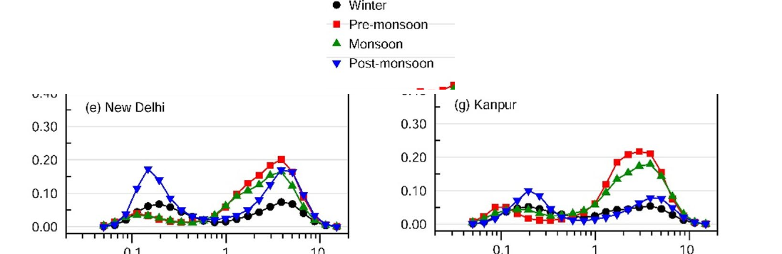
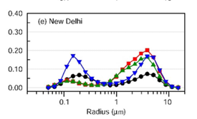
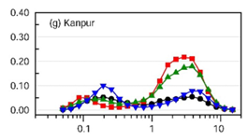

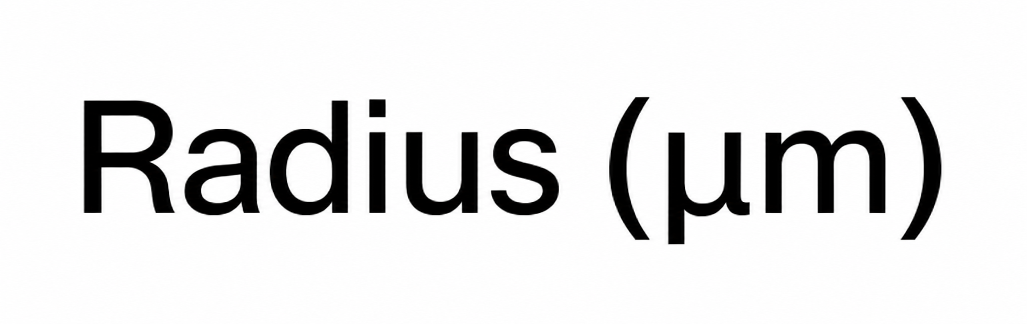
Aerosol optical properties that control light at the canopy
2 · Atmospheric aerosols
Property | Typical values | Relevance to productivity
Aerosol optical depth (τ) | Clean < 0.1; IGP often 0.5–1.0 | Sets how much PAR is lost and how much becomes diffuse
Ångström exponent & fine-mode fraction | α > 1: smoke, pollution; α < 0.5: dust | Fine particles scatter more light per unit mass
Single-scattering albedo (ω₀) | Sulfate ≈ 0.98; dust ≈ 0.92–0.95; smoke ≈ 0.84–0.94 | High ω₀ → diffuse gain; low ω₀ → light lost as heat
Asymmetry (g) & humidity growth | g ≈ 0.6–0.75; sulfate radius doubles near 95% RH | Forward scattering keeps light reaching canopies
Seasonal aerosol size distribution: New Delhi, Kanpur
Fine mode peaks after the monsoon (smoke); coarse mode before it (dust)
Source: Ramachandran & Rupakheti 2026
Key relations
Beer–Lambert: I = I₀ e^{−τ/cosθ}
Ångström: τ(λ) = β λ^{−α}
Absorption AOD: τ_{abs} = (1 − ω₀) τ
For plants, AOD alone is not enough: two hazes with the same AOD can have opposite effects; scattering haze can raise canopy photosynthesis, absorbing haze mostly removes light.
20% → 80%
diffuse share of sunlight as AOD rises from 0.2 to 1.0
Kanniah et al., 2012
Notes:
Four optical properties determine what aerosol does to the light that reaches a canopy. Aerosol optical depth, tau, is the total extinction of light by the column of particles; in clean air it is below 0.1, while over the Indo-Gangetic Plain it is often 0.5 to 1.0. AOD sets how much photosynthetically active radiation is lost and how much is turned into diffuse light. The Ångström exponent and the fine-mode fraction describe particle size: values of alpha above 1 indicate fine smoke and pollution particles, and values below 0.5 indicate coarse dust. Fine particles scatter much more light per unit mass. The single-scattering albedo, omega-zero, is the fraction of extinction that is scattering rather than absorption. For sulfate it is about 0.98, for dust 0.92 to 0.95, and for smoke 0.84 to 0.94, values compiled by Dubovik and colleagues from AERONET. This is the key property for plants: high values mean the light is redirected as diffuse light that can still be used, low values mean the light is absorbed and lost as heat. Finally the asymmetry parameter, about 0.6 to 0.75, means scattering is mostly forward, so scattered light still reaches the ground, and hygroscopic growth means particles such as sulfate roughly double in radius near 95 percent relative humidity, which raises AOD in humid air.
The relations box gives the three equations used in retrievals: Beer–Lambert attenuation of the direct beam, the Ångström power law linking AOD to wavelength, and absorption optical depth as one minus omega-zero times tau. The size-distribution figure from Ramachandran and Rupakheti for New Delhi and Kanpur shows two modes: a fine mode that peaks after the monsoon, from smoke, and a coarse mode that peaks before the monsoon, from dust. The callout, from the review by Kanniah and colleagues, shows how strongly AOD controls light quality: the diffuse share of sunlight is about 20 percent at an AOD of 0.2 and rises to about 80 percent at an AOD of 1. The main lesson is that AOD alone is not enough: two hazes with the same AOD can have opposite effects on plants depending on whether they scatter or absorb.

Slide 10
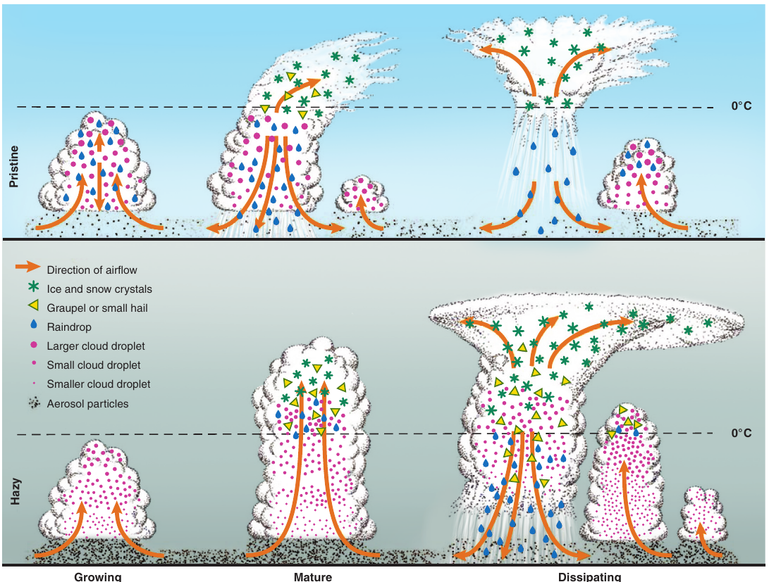
Aerosol radiative effects
2 · Atmospheric aerosols
Direct effect (aerosol–radiation)
Scattering and absorption of sunlight
Surface dimming; diffuse fraction ↑
Kanniah et al., 2012
Convective clouds in clean (top) and polluted (bottom) air
Aerosol layer
AOD, SSA, size, height
Semi-direct effect
Black carbon absorbs and heats the layer
Stable air; clouds evaporate
Forster et al., 2021
Indirect effect (aerosol–cloud)
More CCN → more, smaller droplets
Brighter, longer-lived clouds; rain delayed
Rosenfeld et al., 2008
Source: Rosenfeld et al., 2008, Fig. 2
Quantifying the forcing
ARF = F_{with aerosol} − F_{clean}; ARF_{atm} = ARF_{TOA} − ARF_{sfc}
Global ERF: aerosol–radiation ≈ −0.3, aerosol–cloud ≈ −1.0 W m⁻² (Forster et al., 2021)
NE India: reanalysis ARF = −8 − 35.8·AOD, about half the ground-based slope (Latha et al., 2018)
At the surface
Less total PAR, more diffuse PAR, cooler days, warmer aerosol layer, changed rain
Monsoon: absorbing aerosol weakens the South Asian monsoon (Bollasina et al., 2011); rain is invigorated up to AOD ≈ 0.25 and suppressed beyond (Rosenfeld et al., 2008).
Notes:
Aerosols change the radiation reaching the surface through three effects, shown in the flowchart. The direct effect, now called aerosol–radiation interaction, is the scattering and absorption of sunlight by the particles themselves; it dims the surface and increases the diffuse fraction of light, which is the key change for plants, as reviewed by Kanniah and colleagues. The semi-direct effect comes from absorbing aerosol such as black carbon: it heats the aerosol layer, stabilises the lower atmosphere and can evaporate clouds; the IPCC assessment of Forster and colleagues treats this as an adjustment within the aerosol–radiation forcing. The indirect effect, or aerosol–cloud interaction, acts through clouds: aerosol particles serve as cloud condensation nuclei, so polluted clouds have more, smaller droplets; they are brighter, live longer and delay rain. All three converge at the surface: less total photosynthetically active radiation, more diffuse radiation, cooler days, a warmer aerosol layer and changed rainfall.
The figure, from Rosenfeld and colleagues, 2008, shows the cloud pathway. In clean air, on top, droplets grow large and rain out early. In polluted air, at the bottom, the many small droplets do not rain before reaching the freezing level; they freeze, release latent heat higher up and can invigorate the cloud. Rosenfeld and colleagues found that this invigoration works only up to a modest aerosol optical depth of about 0.25; beyond it, the reduction of surface sunlight weakens convection and rain is suppressed. Over South Asia, Bollasina and colleagues, 2011, showed that anthropogenic aerosol has weakened the summer monsoon, which matters for rainfed crops.
The forcing card shows how the effect is quantified. Aerosol radiative forcing is the difference in net flux with and without aerosol; the atmospheric forcing is the top-of-atmosphere forcing minus the surface forcing, and it is large when absorbing aerosol is present. Globally, the IPCC Sixth Assessment Report gives an effective radiative forcing of about minus 0.3 watts per square metre from aerosol–radiation interaction and about minus 1.0 from aerosol–cloud interaction. Over north-east India, Latha and colleagues found that forcing from the MERRA reanalysis followed ARF equals minus 8 minus 35.8 times AOD, a slope about half that of ground-based estimates, so reanalysis underestimates surface dimming.

Slide 11
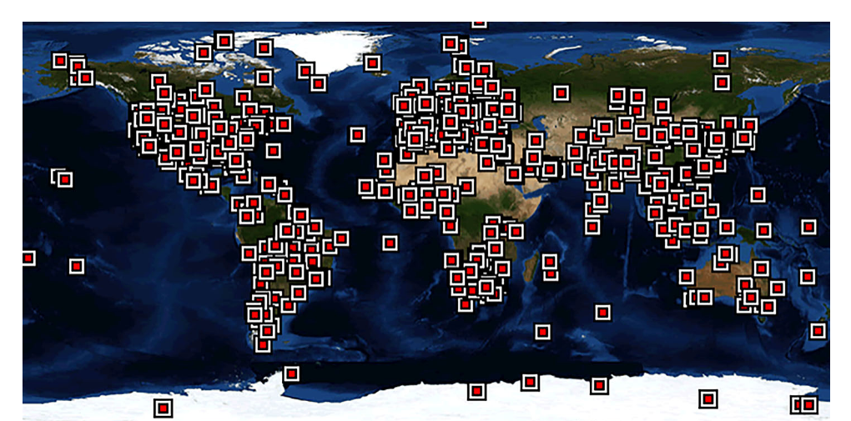
Ground-based aerosol measurement
3 · Remote sensing of aerosols and radiation
Direct-sun radiance
Langley calibration (V₀)
Beer–Lambert → total τ
Remove Rayleigh and gases → AOD
Quality levels 1.0 → 1.5 → 2.0
Sun/sky photometer
In-situ sampling
AERONET sun-photometer network
AERONET (CIMEL), SKYNET, ISRO ARFINET
→ AOD at 340–1020 nm, α, SSA, size
Holben et al., 1998
Nephelometer, aethalometer, BAM
→ Scattering, black carbon, PM_{2.5}
Drinovec et al., 2015
Ground lidar
Radiometers
MPLNET, EARLINET, Raman lidar
→ Vertical profile, boundary-layer height
Pappalardo et al., 2014
Pyranometer, shadow-band, PAR sensors (BSRN)
→ Total and diffuse radiation
Ohmura et al., 1998
Indian sites include Kanpur, Delhi, Jaipur, Gandhi College and Pune
Source: Wei et al., 2020, Fig. 1
Role: AERONET Level 2.0 is the ground truth used to validate every satellite AOD product; its limitation is sparse point coverage, especially over Indian croplands.
Notes:
Remote sensing of aerosol starts on the ground, because ground instruments provide the reference for everything else. The flow at the top shows how a sun photometer works. It points at the sun and measures the direct-sun radiance at several wavelengths. It is calibrated by the Langley method, which extrapolates measurements at different air masses to the signal at the top of the atmosphere, V-zero. With this calibration, the Beer–Lambert law gives the total optical depth; subtracting Rayleigh scattering by air molecules and absorption by gases such as ozone and water vapour leaves the aerosol optical depth. AERONET data pass through three quality levels, 1.0 raw, 1.5 cloud-screened and 2.0 quality-assured, and Level 2.0 is used for validation. Sky scans also give single-scattering albedo and size distribution.
The four cards show the families of ground methods. Sun and sky photometers in AERONET, the Japanese SKYNET and ISRO's ARFINET give AOD from 340 to 1020 nanometres, the Ångström exponent, single-scattering albedo and size, following Holben and colleagues. In-situ instruments such as nephelometers, aethalometers and beta-attenuation monitors measure scattering, black carbon and PM2.5 at the surface. Ground lidars in MPLNET and EARLINET give the vertical profile and boundary-layer height. Radiometers such as pyranometers, shadow-band instruments and PAR sensors, standardised by the Baseline Surface Radiation Network, measure total and diffuse radiation, which is essential for productivity studies.
The map, from Wei and colleagues, shows the global AERONET network; India has only a few sites, such as Kanpur, Delhi, Jaipur, Gandhi College and Pune. So AERONET is the ground truth for satellite AOD, but its coverage over croplands is sparse.

Slide 12
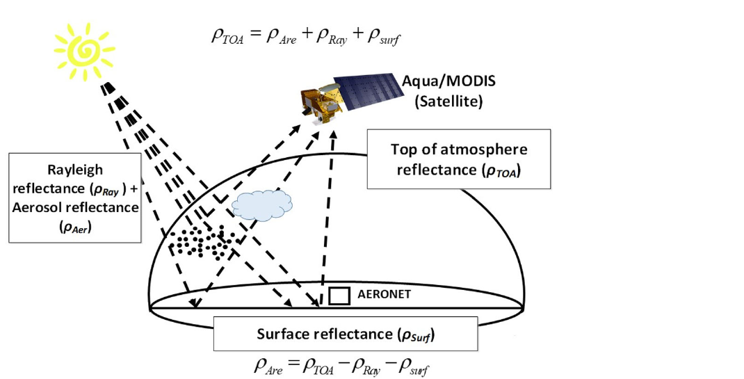
Satellite aerosol retrieval principle
3 · Remote sensing of aerosols and radiation
What the satellite sees: aerosol, air and surface signals
1. Observe
Top-of-atmosphere reflectance at several wavelengths
2. Screen
Remove cloud, snow, water and sun glint
3. Remove Rayleigh
Subtract scattering by air molecules
4. Estimate surface
Dark pixels, blue band, time series or multi-angle
5. Invert
Match look-up tables of aerosol models → AOD
Source: Wei et al., 2020, Fig. 6
6. Validate
Compare with AERONET; assign quality flag
ρ_{TOA} = ρ_{aer} + ρ_{Ray} + ρ_{surf}. Rayleigh scattering is easy to compute; the surface term is the hard part, so every algorithm is a different way of estimating it.
Notes:
Every satellite aerosol algorithm solves the same basic problem, which the figure from Wei and colleagues illustrates. The sensor, here MODIS on Aqua, measures reflectance at the top of the atmosphere. That signal is the sum of three parts: light scattered back by aerosol, light scattered by air molecules, called Rayleigh scattering, and light reflected by the surface and transmitted back through the atmosphere. The aerosol part is what we want.
The six steps on the right are common to all algorithms. First, observe the top-of-atmosphere reflectance at several wavelengths. Second, screen out pixels that cannot be used: clouds, snow, water and sun glint. Third, remove the Rayleigh contribution, which can be calculated accurately from pressure and geometry. Fourth, estimate the surface reflectance, which is the difficult step: algorithms use dark vegetated pixels, the blue band where bright surfaces look dark, time series of the same pixel, or several viewing angles. Fifth, invert: compare the remaining signal with pre-computed look-up tables for different aerosol models and AOD values and choose the AOD that matches. Sixth, validate against AERONET and assign a quality flag.
The equation in the strip summarises it: top-of-atmosphere reflectance equals the aerosol term plus the Rayleigh term plus the surface term. Because the Rayleigh term is easy, the whole difference between algorithms is how they estimate the surface. Over bright, heterogeneous land such as Indian croplands in the dry season, this is the main source of error.

Slide 13
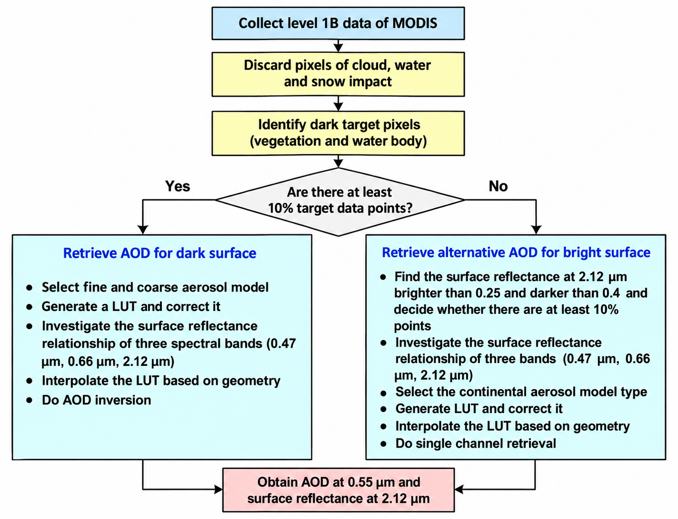
Satellite aerosol algorithms and sensors
3 · Remote sensing of aerosols and radiation
Algorithm | Key idea | Resolution
Dark Target | Dark vegetation; surface from the 2.1 µm band | 10 and 3 km
Deep Blue | Bright land is dark at 412-470 nm | 6–10 km
MAIAC | Time series: slow surface, fast aerosol | 1 km
MISR | Nine view angles separate surface and aerosol | 17.6 km
Polarimetry | Polarization gives size and SSA (POLDER, PACE) | 6 × 7 km
UV sensors | OMI, TROPOMI aerosol index flags absorbing aerosol | 13 × 24 km
Geostationary | INSAT-3D/3DR, Himawari: AOD every 10–30 min | 0.5–4 km
Dark target AOD retrieval algorithm for MODIS observations over land (Remer et al., 2005).
Choice for productivity studies: MAIAC for field and district scale, UV sensors for absorbing smoke, geostationary sensors for the diurnal cycle.
Notes:
The algorithms differ mainly in how they handle the surface. Dark Target, the classic MODIS algorithm described by Levy and colleagues, works over dark vegetation and estimates visible surface reflectance from the 2.1 micrometre band; it gives AOD at 10 and 3 kilometres. Its expected error over land, shown in the callout, is plus or minus 0.05 plus 15 percent of AOD. Deep Blue, by Hsu and colleagues, uses the blue bands at 412 to 470 nanometres where deserts and cities are dark, so it works over bright surfaces at 6 to 10 kilometres. MAIAC, by Lyapustin and colleagues, uses a time series of observations on the assumption that the surface changes slowly while aerosol changes quickly; it gives AOD at 1 kilometre, the right scale for fields and districts. MISR uses nine viewing angles to separate surface and aerosol and gives particle shape and size, at 17.6 kilometres in the standard product. Polarimeters such as POLDER and the new PACE mission use polarisation, which is sensitive to particle size and single-scattering albedo. Ultraviolet sensors such as OMI and TROPOMI give an aerosol index that detects absorbing smoke and dust even above clouds. Geostationary sensors such as INSAT-3D and 3DR over India and Himawari over East Asia give AOD every 10 to 30 minutes, which captures the diurnal cycle.
The figure from Wei and colleagues shows the history: from AVHRR and TOMS in the late 1970s, through Dark Target in 1988, MODIS and MISR in 2000, MAIAC, Deep Blue and CALIPSO in the 2000s, to geostationary sensors such as Himawari and INSAT-3DR after 2013. For productivity studies, MAIAC suits field and district analysis, ultraviolet sensors help separate absorbing smoke, and geostationary sensors capture the daily cycle that a single polar overpass misses.

Slide 14
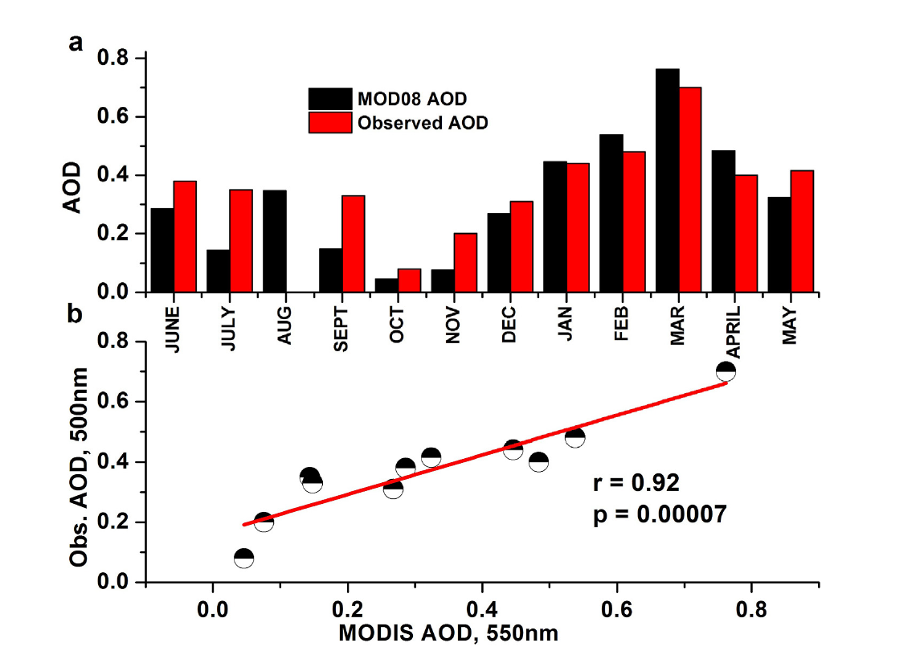
Lidar, reanalysis and validation of aerosol products
3 · Remote sensing of aerosols and radiation
Spaceborne lidar
Laser backscatter and depolarization (CALIOP 2006–23; EarthCARE ATLID 2024–) → vertical profile, aerosol type
Winker et al., 2009
MODIS vs ground-measured AOD, Dibrugarh, Assam (r = 0.92)
1
Reanalysis
Satellite AOD assimilated into transport models (MERRA-2, CAMS) → gap-free AOD by species
Randles et al., 2017; Inness et al., 2019
2
Surface PM_{2.5}
AOD scaled with boundary-layer height and humidity → PM_{2.5} maps
van Donkelaar et al., 2010
3
Validation
Satellite vs AERONET within ±30 min and ~25 km → R, RMSE, % within error
Ichoku et al., 2002
4
MODIS underestimates AOD in monsoon and post-monsoon, overestimates in winter and pre-monsoon
Source: Latha et al., 2018, Fig. 4
Best data for productivity studies: MAIAC (field scale) · OMI and AERONET SSA (absorption) · CALIOP (layers) · MERRA-2 and CAMS (species, gap-free).
Notes:
Passive sensors give only a column total. Spaceborne lidar adds the vertical dimension: CALIOP on CALIPSO, from 2006 to 2023, and now the ATLID lidar on EarthCARE, launched in 2024, measure laser backscatter and depolarisation, which give the height of aerosol layers and distinguish dust from smoke and pollution, as described by Winker and colleagues. Reanalyses such as MERRA-2 and the Copernicus CAMS system assimilate satellite AOD into chemical transport models; they provide gap-free AOD, even under clouds, split into species such as dust, sulfate, black carbon and organic carbon, at a resolution of about half a degree. AOD can also be converted into surface PM2.5 by scaling with boundary-layer height and humidity, as van Donkelaar and colleagues did globally.
Every product has to be validated. The standard method of Ichoku and colleagues matches satellite pixels within about 25 kilometres of an AERONET station with sun-photometer measurements within plus or minus 30 minutes of the overpass, and reports the correlation, the root-mean-square error and the percentage of points within the expected error.
The figure, from Latha and colleagues, 2018, shows this validation for Dibrugarh in Assam. Monthly MODIS AOD follows the ground observations closely, with a correlation of about 0.92, but MODIS underestimates AOD in the monsoon and post-monsoon months and overestimates it in winter and pre-monsoon, so seasonal biases must be checked before using satellite AOD for crop studies. The strip lists the best data for productivity work: MAIAC for field scale, OMI and AERONET single-scattering albedo for absorption, CALIOP for layer height, and MERRA-2 and CAMS for species and gap-free coverage.

Slide 15
Accuracy of satellite AOD products against AERONET
3 · Remote sensing of aerosols and radiation
Share of retrievals within the expected error (%)
Validation over India (MODIS, 2017–2019)
Jaipur: r = 0.90, RMSE 0.12, 89% within error (n = 522)
Kanpur: r = 0.86, RMSE 0.20, 74% within error (n = 788)
MODIS AOD ≈ 8% lower than AERONET overall
Hari & Tyagi, 2022
± (0.05 + 0.15τ)
expected error of MODIS Dark Target AOD over land
Levy et al., 2013
Data: Wei et al., 2020 (compiled from product validations)
Implication: about 20–40% of retrievals fall outside the expected error; accuracy depends on surface brightness, season and aerosol type, so products must be validated locally before crop studies.
Notes:
This slide examines how accurate the satellite aerosol products are. The chart, compiled from the review by Wei and colleagues, shows the share of retrievals that fall within the expected error envelope when compared with AERONET. For MODIS over land, about 68 percent of the early Collection 4 retrievals, 72 percent of Collection 5 and 69.4 percent of Collection 6 Dark Target retrievals fall within the expected error, with correlations of about 0.8 to 0.9. The multi-angle MISR product improved from 75 percent in version 22 to 80.2 percent in version 23, the most accurate of these products. POLDER retrievals over China reached only about 62 percent. So even for the best products, roughly 20 to 40 percent of retrievals fall outside the expected error.
The expected error itself, shown in the callout, is defined for MODIS Dark Target over land as plus or minus 0.05 plus 15 percent of the AOD, following Levy and colleagues; it grows with the aerosol load, so in hazy regions the absolute uncertainty is large.
For India, Hari and Tyagi validated MODIS AOD against the two AERONET stations that met their data criteria for 2017 to 2019. At Jaipur the correlation was 0.90, the root-mean-square error 0.12 and 89 percent of points were within the error envelope, from 522 matchups; at Kanpur, in the central Indo-Gangetic Plain, the correlation was 0.86, the error 0.20 and 74 percent were within the envelope, from 788 matchups. Overall, MODIS AOD was about 8 percent lower than AERONET.
The implication is that satellite AOD is good enough for regional patterns and trends, but its accuracy depends on surface brightness, season and aerosol type, so it should be validated locally before it is used to attribute crop-productivity changes.

Slide 16
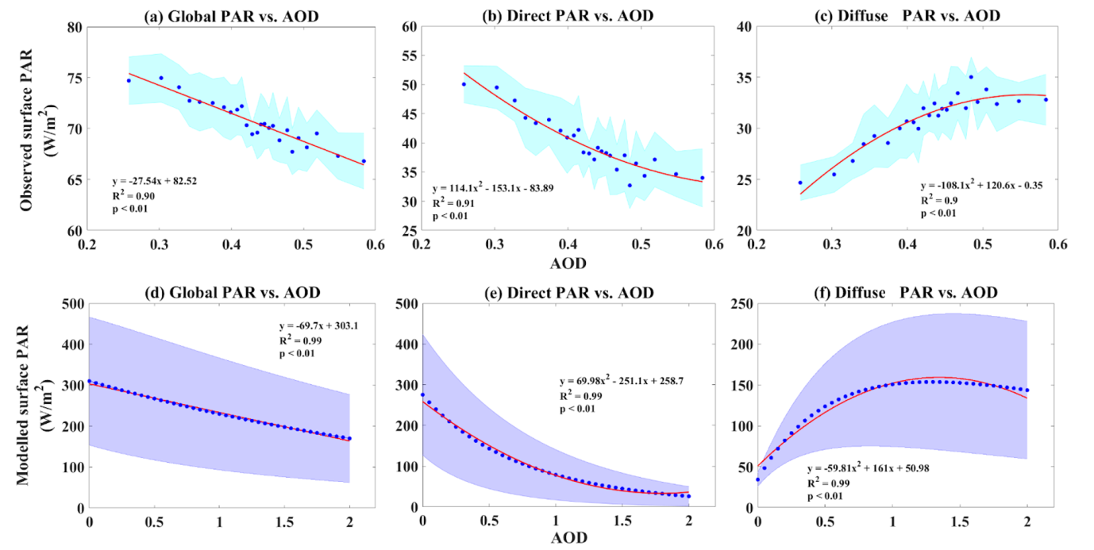
Estimating direct and diffuse PAR from aerosol data
3 · Remote sensing of aerosols and radiation
Radiative transfer models: SBDART, TUV, 6S
Tie et al., 2016; Sankhla et al., preprint
Punjab: global, direct and diffuse PAR vs AOD (observed, top; SBDART, bottom)
Inputs
AOD, ω₀, sun angle, atmosphere, clouds
Empirical partitioning: Clearness index, sunshine, AOD
Spitters et al., 1986; Feng et al., 2020
Output
Direct PAR, diffuse PAR, diffuse fraction
Satellite products: BESS (5 km), CERES SYN1deg, MCD18
Ryu et al., 2018; Rutan et al., 2015
Direct PAR falls and diffuse PAR rises as AOD increases
Reanalysis: MERRA-2, ERA5 surface radiation
Gelaro et al., 2017
Source: Sankhla et al., preprint, Fig. 3
Why it matters: the diffuse fraction is the variable that links aerosol to canopy light use; models give the mechanism, satellite products give maps, and measured diffuse PAR is needed for validation.
Notes:
For productivity studies, aerosol optical depth is not enough: we need to know how much photosynthetically active radiation arrives as direct beam and how much as diffuse light. The diagram shows the four routes from aerosol inputs to direct and diffuse PAR. The inputs are AOD, single-scattering albedo, sun angle, the atmospheric profile and clouds. Radiative-transfer models such as SBDART, TUV and 6S compute direct and diffuse PAR physically; Tie and colleagues used TUV for China and Sankhla and colleagues used SBDART for Punjab. Empirical partitioning, such as the scheme of Spitters and colleagues, estimates the diffuse fraction from the clearness index, sunshine duration or AOD; Feng and colleagues used this to drive a two-leaf model. Satellite products such as BESS at 5 kilometres, CERES SYN1deg and the MODIS MCD18 PAR product provide gridded direct and diffuse radiation. Reanalyses such as MERRA-2 and ERA5 provide surface radiation with and without aerosol. The output in every case is direct PAR, diffuse PAR and the diffuse fraction.
The figure, from Sankhla and colleagues over Punjab during the wheat season, shows global, direct and diffuse PAR against AOD, with observations at the top and SBDART simulations at the bottom. Both show that direct PAR falls steeply, diffuse PAR rises and global PAR falls only moderately as AOD increases, and the agreement gives confidence in the radiative-transfer approach.
The diffuse fraction is the variable that links aerosol to canopy light use. Models are best for the mechanism, satellite products for mapping, and measured diffuse PAR is needed to validate both.

Slide 17
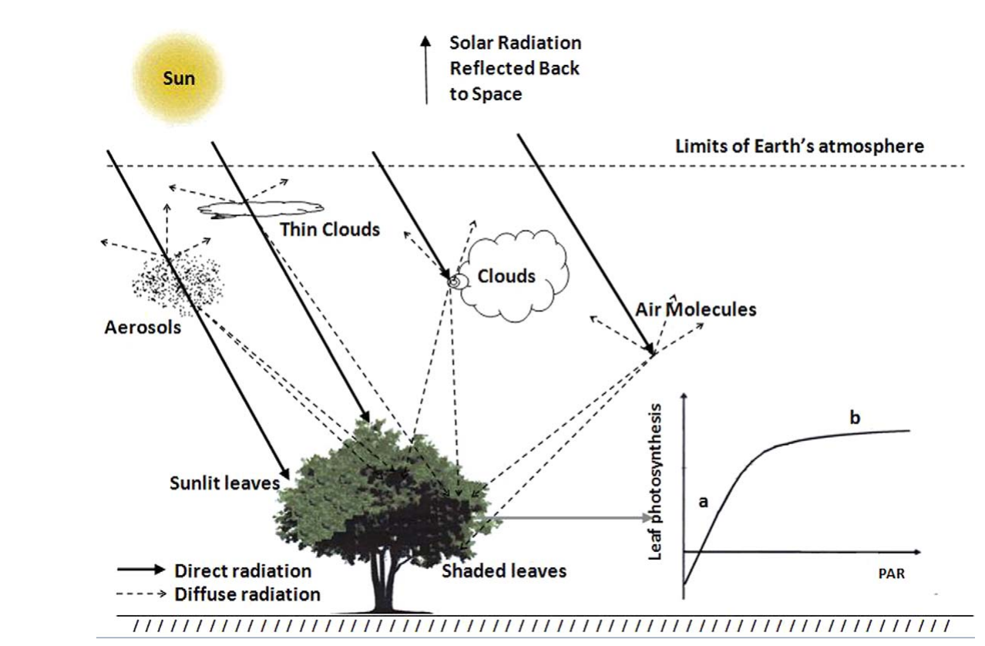
Ecosystem productivity: key concepts
4 · Remote sensing of productivity
PAR
Sunlight 400–700 nm
APAR
PAR × FAPAR
GPP
APAR × LUE
NPP
GPP − plant respiration
NEP
NPP − soil respiration
Yield
Biomass × harvest index
Term | Measured or estimated by
GPP | Flux towers, SIF, light-use-efficiency models
NPP | MOD17, CASA
NEE / NEP | Eddy-covariance towers
APAR | MODIS FAPAR and PAR
Light-use efficiency (ε) | LUE and two-leaf models
Sunlit vs shaded leaves | Two-leaf canopy models
Direct and diffuse radiation in a canopy: sunlit and shaded leaves
Source: Kanniah et al., 2012, Fig. 1
Notes:
Now we move to the other side of the problem: productivity. The chain at the top defines the terms. Photosynthetically active radiation, PAR, is sunlight between 400 and 700 nanometres. The fraction absorbed by the canopy, FAPAR, gives absorbed PAR, or APAR. Gross primary productivity, GPP, is the total carbon fixed by photosynthesis, which light-use-efficiency models write as APAR times the light-use efficiency epsilon. Net primary productivity, NPP, is GPP minus plant, or autotrophic, respiration, and represents biomass growth. Net ecosystem productivity, NEP, is NPP minus soil, or heterotrophic, respiration, and is the net carbon gained by the ecosystem; with the opposite sign it is net ecosystem exchange, NEE, measured by flux towers. For crops, the end point is yield, which is biomass multiplied by the harvest index.
The table shows how each term is obtained. GPP comes from flux towers, from solar-induced fluorescence and from light-use-efficiency models. NPP comes from products such as MODIS MOD17 and models such as CASA. NEE and NEP come from eddy-covariance towers. APAR comes from MODIS FAPAR combined with PAR. Light-use efficiency is the parameter of LUE and two-leaf models, and the split between sunlit and shaded leaves needs two-leaf canopy models.
The figure, from the review by Kanniah and colleagues, shows how radiation enters a canopy. The direct beam, the solid lines, reaches only the sunlit leaves at the top and on the sun-facing side, while diffuse radiation, the dashed lines, comes from the whole sky and reaches shaded leaves inside the canopy as well. This distinction between sunlit and shaded leaves is the basis of the light mechanism that we discuss in section 6.

Slide 18
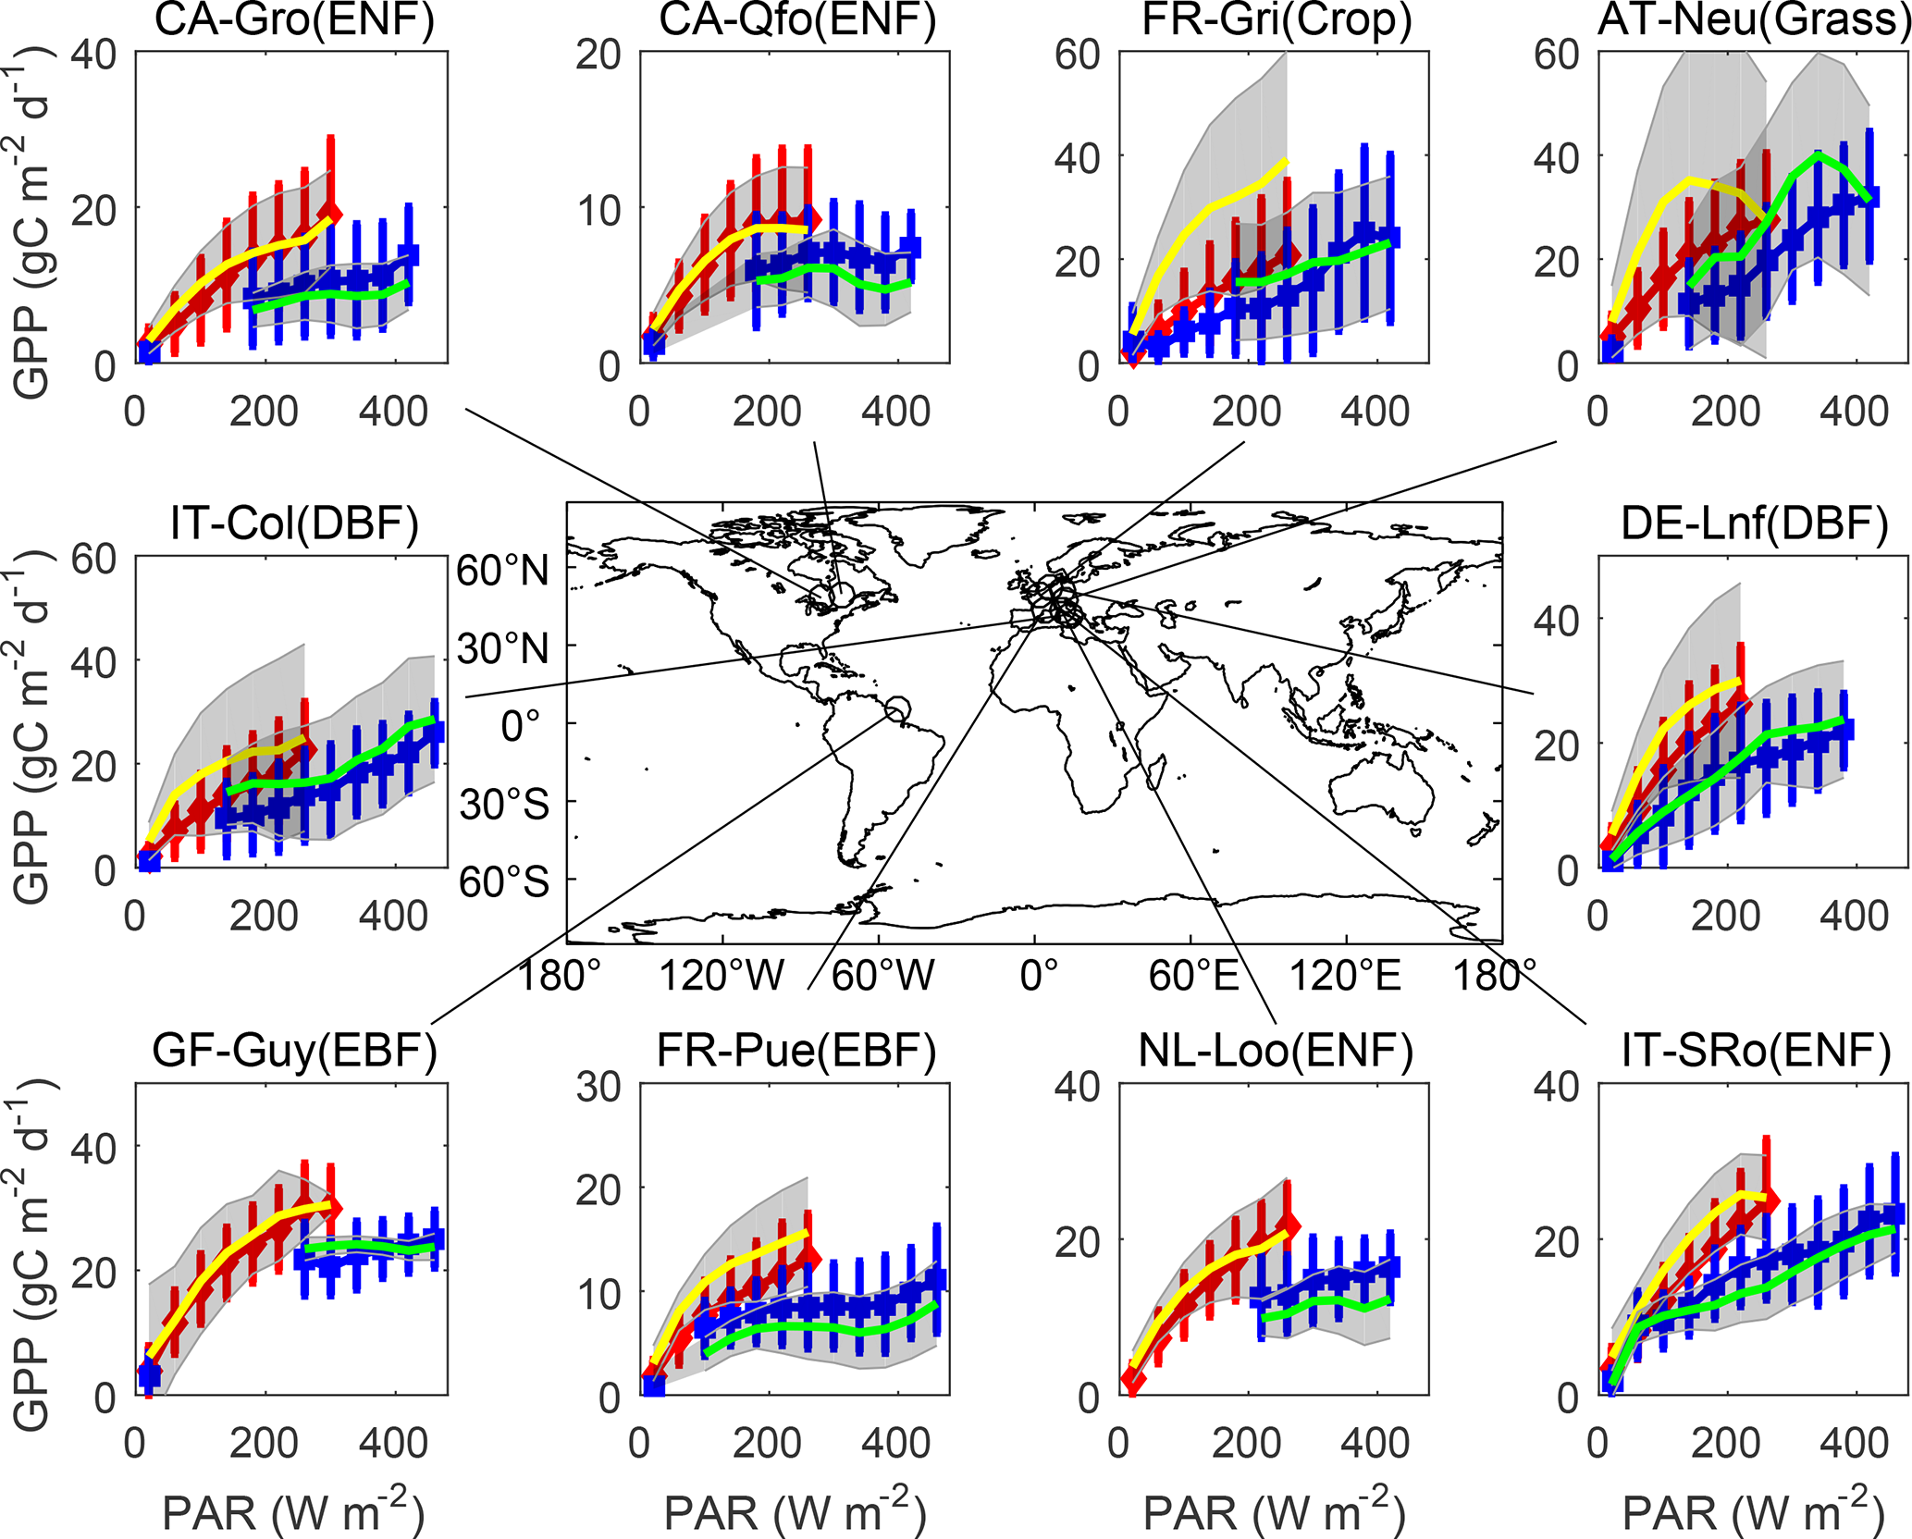
Measuring productivity on the ground
4 · Remote sensing of productivity
Flux tower: NEE = ρ_{a} · cov(w′, c′); GPP = R_{eco} − NEE
GPP vs PAR under diffuse (red) and direct (blue) light at 10 FLUXNET sites
Approach | What is measured | Link to aerosol
Eddy covariance Baldocchi, 2003 | Half-hourly CO₂ flux → GPP by partitioning | GPP on clear vs hazy days at the same PAR
Leaf gas exchange Farquhar et al., 1980 | Leaf CO₂ uptake and stomatal conductance | Calibrates sun- and shade-leaf photosynthesis
Harvest & crop statistics | Biomass and grain yield | Yield regressed on AOD across years
Radiation sensors Ohmura et al., 1998 | Direct and diffuse PAR | Shows the diffuse-fraction pathway
The same PAR gives more GPP when light is diffuse
+0.3–0.7%
GPP per extra W m⁻² of diffuse PAR (24 FLUXNET sites)
Yue & Unger, 2018
Strength: direct, half-hourly carbon flux. Limit: ~1 km² footprint; very few towers over Indian croplands.
Source: Zhou et al., 2022, Fig. 1
Notes:
On the ground we come closest to measuring productivity directly. An eddy-covariance flux tower measures the vertical wind speed and the CO2 concentration ten or twenty times a second; the covariance of their fluctuations, multiplied by air density, gives the net ecosystem exchange, NEE, every half hour, as Baldocchi described. GPP is obtained by partitioning: ecosystem respiration is estimated from night-time fluxes and temperature, and GPP equals respiration minus NEE. Leaf gas-exchange chambers, interpreted with the Farquhar photosynthesis model, measure leaf CO2 uptake and stomatal conductance and are used to calibrate the photosynthesis of sunlit and shaded leaves. Harvest and crop statistics give biomass and yield, which can be regressed on AOD across years. Radiation sensors measure direct and diffuse PAR, which is needed to show the diffuse-fraction pathway.
The figure, from Zhou and colleagues, 2022, shows what towers reveal. At ten FLUXNET sites covering forests, crops and grassland, hourly GPP is plotted against PAR separately for diffuse conditions, in red, and direct conditions, in blue. At the same amount of PAR, GPP is clearly higher when the light is diffuse. Yue and Unger, 2018, quantified this across 24 FLUXNET sites: GPP increases by 0.3 to 0.7 percent for every additional watt per square metre of diffuse PAR.
The strength of towers is that they measure carbon flux directly and continuously. The limitation is that each tower represents only about a square kilometre, and there are very few towers over Indian croplands, which is why satellite proxies are needed to scale up.

Slide 19
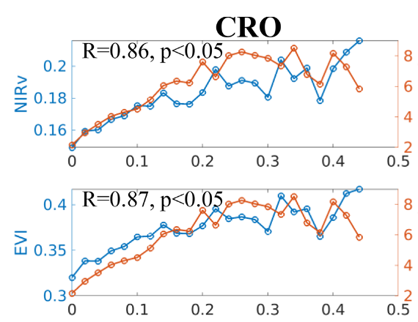
Satellite productivity proxies I: vegetation indices and canopy structure
4 · Remote sensing of productivity
Index | Formula · product | Strength / limit
NDVI Tucker, 1979 | (NIR − Red)/(NIR + Red); MOD13, 250 m | Simple; saturates in dense canopies
EVI Huete et al., 2002 | Adds blue band and soil term; MOD13 | Less saturation; good for cropland
NIRv Badgley et al., 2017 | NDVI × NIR reflectance | Tracks the photosynthesising canopy
kNDVI Camps-Valls et al., 2021 | tanh(NDVI²), kernel NDVI | Robust for shrubs and forests
LAI & FAPAR Myneni et al., 2002 | MOD15, 500 m, 8-day | Leaf area and light absorbed (APAR)
Cropland: NIRv and EVI (blue) and tower GPP (orange) across AOD bins
VIs follow GPP (cropland: EVI R = 0.87, NIRv R = 0.86)
Source: Zhang et al., 2023, Fig. 6
Caution: greenness is not photosynthesis; a green but stressed canopy can still look productive.
Notes:
Satellites cannot measure photosynthesis directly, so we use proxies. The first family is vegetation indices, which measure canopy greenness and structure. NDVI, introduced by Tucker, is the normalised difference of near-infrared and red reflectance; it is simple and available from MODIS at 250 metres, but it saturates in dense canopies. EVI, by Huete and colleagues, adds the blue band and a soil adjustment term, so it saturates less and works well over cropland. NIRv, by Badgley and colleagues, multiplies NDVI by near-infrared reflectance and tracks the photosynthesising part of the canopy closely. kNDVI, by Camps-Valls and colleagues, is a kernel version of NDVI, the hyperbolic tangent of NDVI squared, which is more robust for shrubs and forests. Leaf area index and FAPAR from the MODIS MOD15 product, at 500 metres every 8 days, give the leaf area and the fraction of light absorbed, the APAR term of light-use-efficiency models.
The figure, from Zhang and colleagues, 2023, tests whether vegetation indices capture the aerosol effect. For cropland flux sites, they averaged NIRv, EVI and tower GPP in AOD bins of 0.02. The indices, in blue, rise and fall together with GPP, in orange, across the AOD range. For cropland, the correlation between the indices and GPP was 0.87 for EVI and 0.86 for NIRv, so these two indices are the best candidates for monitoring aerosol effects on crop productivity from space.
The caution in the strip is important: greenness is not photosynthesis. A canopy can remain green while its photosynthesis is reduced by stress, so vegetation indices respond slowly. For faster, physiological signals we need fluorescence, which is the next slide.

Slide 20
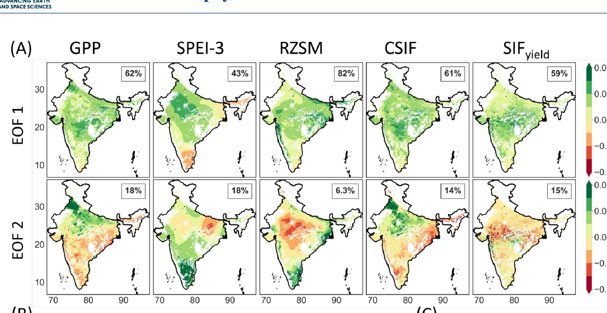
Satellite productivity proxies II: SIF and productivity products
4 · Remote sensing of productivity
Product | What it is | Use / limit
SIF: GOME-2, OCO-2, TROPOMI Joiner et al., 2013; Köhler et al., 2018 | Chlorophyll fluorescence near 740 nm | Tracks photosynthesis within hours; noisy
GOSIF Li & Xiao, 2019 | 0.05°, 8-day SIF from OCO-2 + MODIS | Long, continuous record
SIF yield Behera et al., 2025 | SIF / APAR: physiological signal | Detects stress 1–2 months earlier
MOD17 GPP / NPP Running et al., 2004 | LUE model, 500 m, 8-day | No diffuse-light term
FLUXCOM GPP Jung et al., 2020 | Machine-learning upscaling of FLUXNET | Gridded but coarse
Yield statistics & crop models Jones et al., 2003 | District yield; DSSAT, WOFOST | Agricultural end point
India: leading spatial patterns (EOF) of GPP, drought indices, CSIF and SIF yield
SIF yield follows GPP and leads other indicators
Source: Behera et al., 2025, Fig. 1a
Notes:
The second family of proxies is solar-induced chlorophyll fluorescence, SIF. During photosynthesis a small part of the light absorbed by chlorophyll is re-emitted as fluorescence near 740 nanometres. Because it comes from the photosynthetic machinery itself, SIF responds within hours to changes in light and stress, unlike vegetation indices. It is retrieved from GOME-2, OCO-2 and TROPOMI, as described by Joiner and colleagues and Köhler and colleagues, but individual retrievals are noisy and sparse. GOSIF, by Li and Xiao, combines OCO-2 SIF with MODIS data to give a continuous record at 0.05 degree and 8 days. SIF yield, which is SIF divided by APAR, removes the effect of the amount of light and isolates the physiological signal.
The figure, from Behera and colleagues, 2025, is an Indian example. They decomposed GPP, the SPEI-3 drought index, root-zone soil moisture, continuous SIF and SIF yield over India into their leading spatial patterns. SIF yield shows the strongest positive relationship with GPP and, compared with other indicators, detects emerging stress one to two months earlier. This makes it useful for detecting the physiological effect of stresses, including reduced light under heavy haze.
The remaining rows are productivity products. MOD17, by Running and colleagues, gives GPP and NPP at 500 metres every 8 days from a light-use-efficiency model, but it has no diffuse-light term, so it cannot represent the aerosol effect. FLUXCOM, by Jung and colleagues, upscales FLUXNET towers with machine learning to give gridded GPP at coarse resolution. For crops, district yield statistics and crop models such as DSSAT and WOFOST give the agricultural end point.

Slide 21
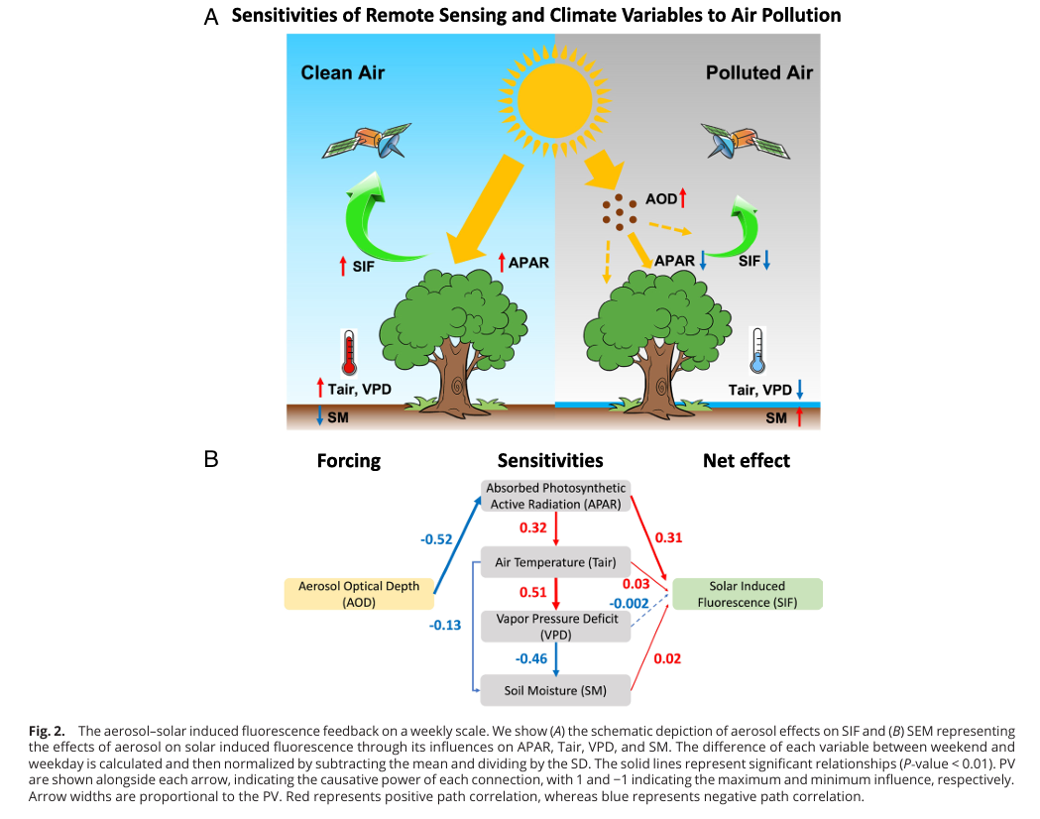
Statistical designs for linking aerosols to productivity
5 · Linking aerosols to productivity
1. AOD binning
2. Regression
Europe: causal paths from AOD to SIF
Compare productivity across AOD classes at similar PAR and season
Niyogi et al., 2004; Zhang et al., 2023
Productivity ~ AOD + temperature + rain + soil moisture + FAPAR
Liu & Desai, 2021; Gupta et al., 2024
3. Relative sensitivity
4. Causal path models (SEM)
Slope of NPP on AOD within 0.1 AOD bins, scaled by its error
Hari & Tyagi, 2022
Separate light, temperature, VPD and soil-moisture routes
He et al., 2023
AOD → APAR (−0.52) → SIF: dimming dominates
Source: He et al., 2023, Fig. 2
Correlation is not attribution: each design must remove the effects of weather, season, ozone and technology that change together with aerosol.
Notes:
Section 5 asks how we link aerosol to productivity, starting with statistical designs, shown as four cards. AOD binning compares productivity across classes of AOD while holding PAR and season similar; Niyogi and colleagues used it with flux towers in the United States and Zhang and colleagues with vegetation indices. Regression models express productivity or yield as a function of AOD together with temperature, rainfall, soil moisture and FAPAR, so the aerosol coefficient is estimated while other factors are controlled; Liu and Desai used county statistics for the United States and Gupta and colleagues used Earth-observation data for India. Relative sensitivity analysis, used by Hari and Tyagi, regresses NPP on AOD within AOD bins of 0.1 and scales the slope by its error, which shows at which AOD the response changes sign. Structural equation models trace causal paths through intermediate variables.
The figure is the structural equation model of He and colleagues, 2023, for Europe. Aerosol affects SIF through absorbed PAR, air temperature, vapour pressure deficit and soil moisture. The strongest path is AOD to APAR, with a coefficient of minus 0.52, and then APAR to SIF, while the temperature, VPD and soil-moisture routes are weak. So in Europe dimming dominates and aerosol reduces photosynthesis.
The caution in the strip is that correlation is not attribution: aerosol changes together with weather, season, ozone and technology, and a design is useful only if it removes these confounders. Natural experiments, on the next slide, are one of the best ways to do so.

Slide 22
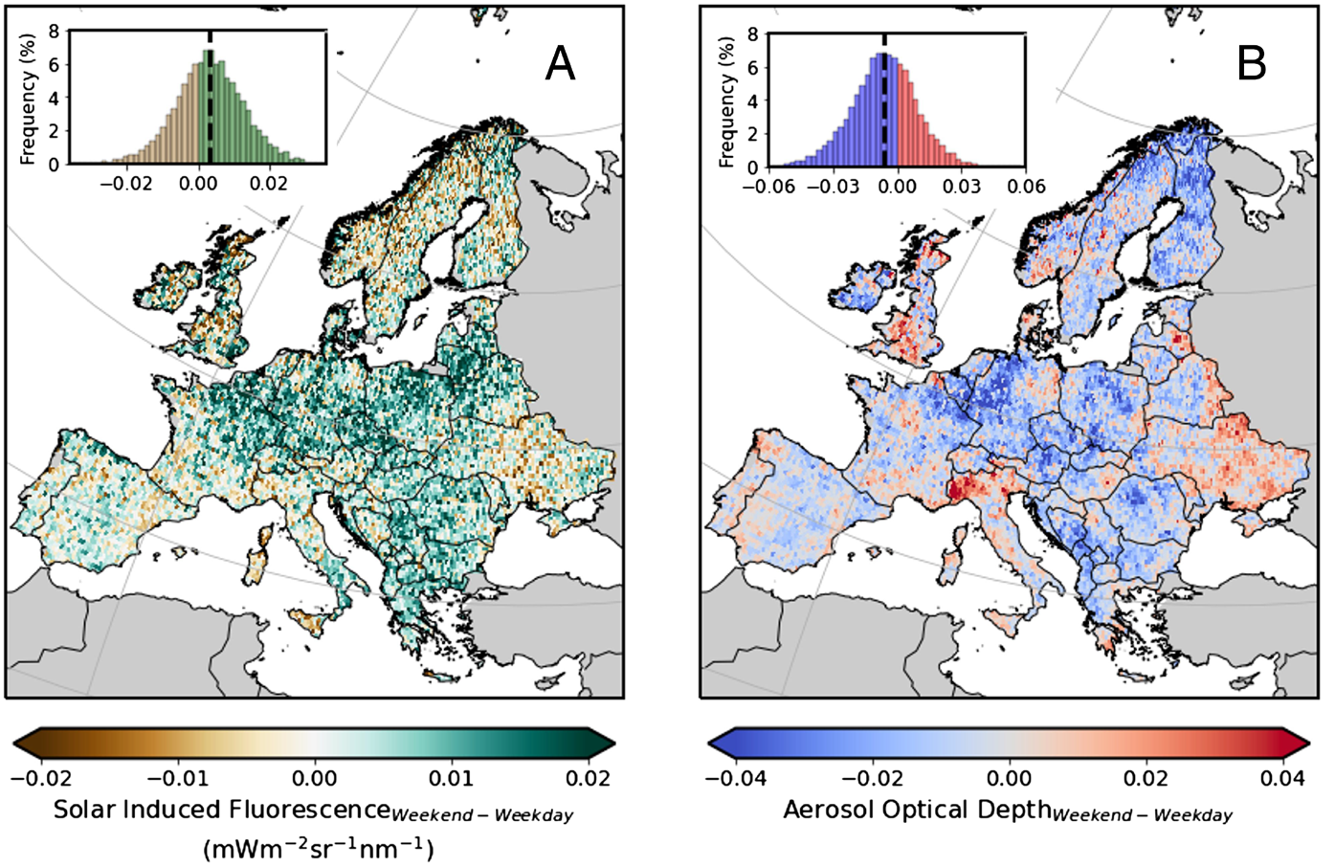
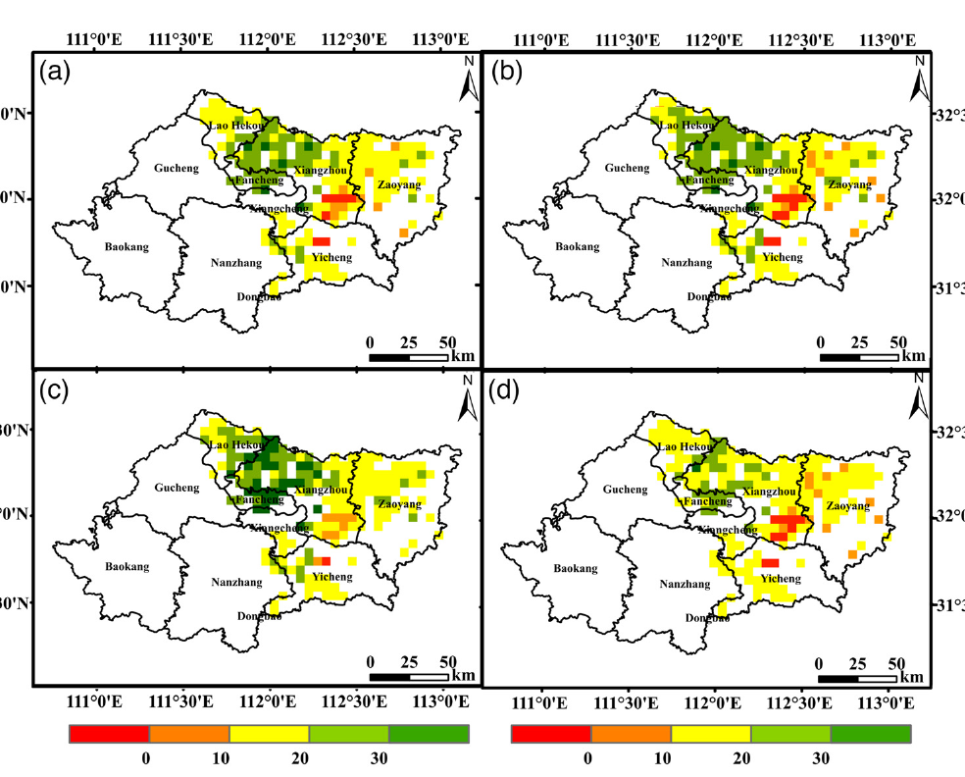
Natural experiments: when aerosol switches on or off
5 · Linking aerosols to productivity
+16.5%
winter-wheat GPP when AOD fell 23.8% (Hubei lockdown, 2020)
Bai et al., 2022
+5%
rice GPP and NPP when AOD fell ~30% (NE China lockdown)
de Oliveira et al., 2025
64%
of European regions with higher SIF at low-AOD weekends
He et al., 2023
−9%
global maize yield after volcanic dimming (soy, rice, wheat about −5%)
Proctor et al., 2018
Hubei lockdown: % change in AOD (a), WUE (b), GOSIF GPP (c), FLUXSAT GPP (d)
Weekend minus weekday: SIF (A), AOD (B), APAR (C)
Source: Bai et al., 2022, Fig. 4
Source: He et al., 2023, Fig. 1
Notes:
Natural experiments are events in which aerosol changes suddenly while technology and land use stay the same, so the response can be attributed to aerosol more confidently than in ordinary correlations. The four cards show four such experiments.
The best-known is the COVID-19 lockdown of 2020. In Hubei province in China, Bai and colleagues found that AOD fell by 23.8 percent compared with the previous three years and winter-wheat GPP rose by 16.5 percent. The left figure shows these percentage changes: AOD in panel a, water-use efficiency in b, and GPP from two independent satellite products, GOSIF in c and FLUXSAT in d. A similar result was reported for rice in north-east China in the review by de Oliveira and colleagues: about a 30 percent reduction in AOD increased rice GPP and NPP by about 5 percent. In these polluted regions, removing aerosol increased productivity, which means the crops were above the optimum aerosol load.
A second design uses the weekly cycle of emissions: traffic and industry are lower at weekends, so aerosol is lower. He and colleagues compared weekend and weekday satellite data across Europe; the right figure shows the weekend-minus-weekday difference in SIF, AOD and APAR. SIF was higher at weekends in 64 percent of European regions.
A third design uses volcanic eruptions as a statistical instrument. Proctor and colleagues used the sunlight reduction after major eruptions to estimate the effect of scattering aerosol on crops: maize yields fell by about 9 percent and soy, rice and wheat by about 5 percent, because the loss of total light outweighed any diffuse benefit for crops.
The caveat is that other things also change: lockdowns also cut ozone, and eruptions cool the climate, so even natural experiments need care.

Slide 23
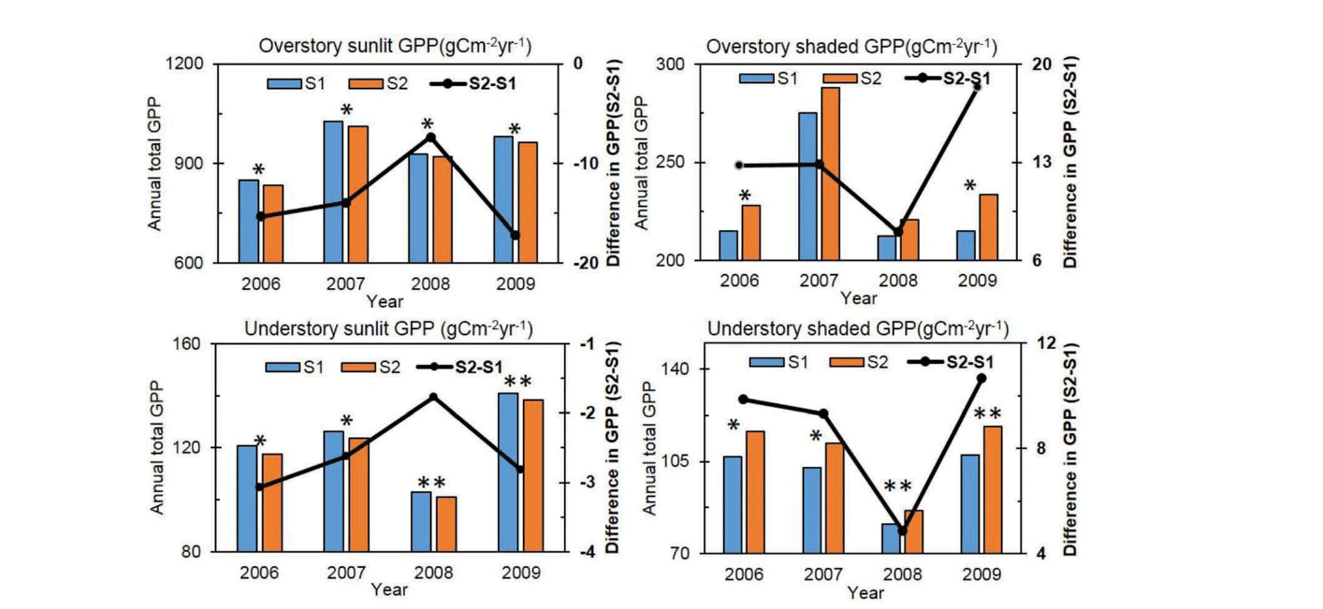
Process models that link aerosols to productivity
5 · Linking aerosols to productivity
GPP = ε × FAPAR × PAR; ε = ε_{dir}(1 − f_{dif}) + ε_{dif} f_{dif}, with ε_{dif} > ε_{dir}
BEPS cropland GPP without (S1) and with (S2) aerosol
Model family | Examples | What it adds
Light-use efficiency Yuan et al., 2007 | MOD17, CASA, VPM, EC-LUE | Separate efficiency for diffuse light
Two-leaf process Chen et al., 1999 | BEPS, Biome-BGC | Sunlit-leaf GPP falls, shaded-leaf GPP rises
Crop simulation Greenwald et al., 2006 | CERES/DSSAT, WOFOST, APSIM | Yield under hazy vs clean-sky light
Global land models Mercado et al., 2009 | JULES, ORCHIDEE, YIBs | Global GPP/NPP change in Pg C yr⁻¹
Sunlit leaves lose, shaded leaves gain
Source: Feng et al., 2020, Fig. 7
Common workflow: AOD → split PAR into direct and diffuse → productivity model → run with and without aerosol → difference = aerosol effect.
Notes:
The third way to link aerosol and productivity is with process models, which compute productivity from light and climate and can be run with and without aerosol. The equation at the top shows the simplest idea. In a light-use-efficiency model, GPP equals efficiency times FAPAR times PAR. To include the aerosol effect, the efficiency is made a weighted average of a direct-light efficiency and a diffuse-light efficiency, weighted by the diffuse fraction, with the diffuse efficiency higher than the direct one. Models such as MOD17, CASA, VPM and EC-LUE, described for example by Yuan and colleagues, belong to this family; the standard MOD17 has no diffuse term, but modified versions do.
Two-leaf models, such as BEPS developed by Chen and colleagues, compute photosynthesis separately for sunlit and shaded leaves, so the effect of diffuse light emerges from the physics. The figure is from Feng and colleagues, 2020, who used an improved BEPS model with satellite aerosol data for seven cropland sites in North China. Comparing a scenario without aerosol, S1, with a scenario with aerosol, S2, the GPP of sunlit leaves falls while the GPP of shaded leaves rises; the total depends on which effect is larger.
Crop simulation models such as CERES in DSSAT, WOFOST and APSIM, used for example by Greenwald and colleagues, give yield under hazy and clean-sky light. Global land models such as JULES, ORCHIDEE and YIBs, used by Mercado and colleagues, give the global change in GPP or NPP in petagrams of carbon per year.
The common workflow is in the strip: convert AOD into direct and diffuse PAR, run the productivity model, run it again without aerosol, and the difference is the aerosol effect. The weakness is that the result depends on how well the model represents the diffuse-light response.

Slide 24
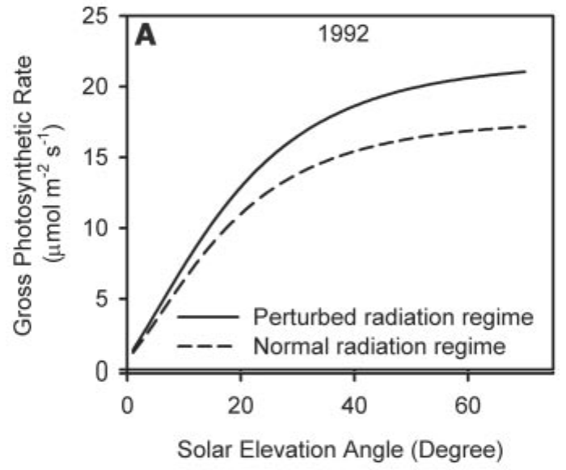
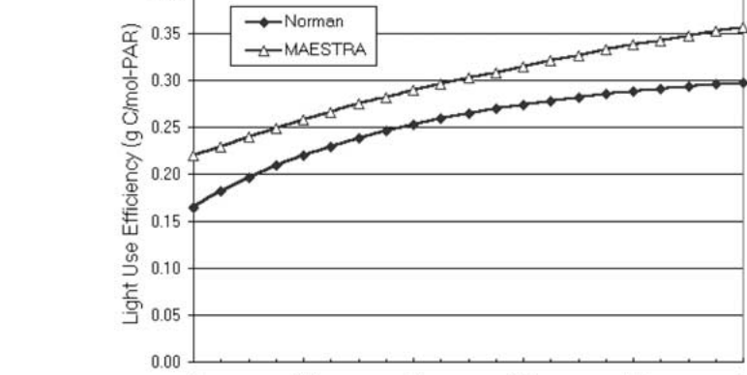
Light route: dimming vs diffuse fertilization
6 · Mechanisms of aerosol impact
Pathway | Mechanism and evidence | Reference
1. Dimming | Scattering and absorption cut PAR; clear-sky PAR −30% as AOD rises from 0.05 to 1.0 | Greenwald et al., 2006
2. Diffuse fertilization | Diffuse light reaches shaded, light-limited leaves; LUE 1.12–1.80 times higher under diffuse light | Kanniah et al., 2012
Proof: Pinatubo | Volcanic sulfate raised diffuse light; noon forest photosynthesis +23% (1992), +8% (1993) | Gu et al., 2003
Net balance | Outcome = loss of total PAR vs gain in diffuse fraction | Mercado et al., 2009
Harvard Forest after Pinatubo, 1992: volcanic (solid) vs normal (dashed)
Source: Gu et al., 2003, Fig. 2a
Canopy LUE rises with AOD (clear sky)
Why: sunlit leaves are often light-saturated, so the lost direct light costs little; diffuse light reaches shaded leaves that are light-limited, so canopy light-use efficiency rises.
Source: Cohan et al., 2002, Fig. 6
Notes:
Section 6 explains the mechanisms, starting with the light route, which has two opposing parts. The first is dimming: scattering and absorption reduce the total PAR reaching the canopy. Greenwald and colleagues computed that under clear skies PAR falls by about 30 percent as AOD rises from a background value of 0.05 to 1.0, while the diffuse fraction more than triples. The second part is diffuse fertilization. Light scattered by aerosol arrives from the whole sky, so it reaches shaded leaves deep in the canopy. The review by Kanniah and colleagues reports that canopy light-use efficiency is 1.12 to 1.80 times higher under diffuse light than under direct light.
The classic proof comes from the 1991 Mount Pinatubo eruption, which filled the stratosphere with scattering sulfate and increased diffuse radiation worldwide for two years. Gu and colleagues, 2003, estimated that at Harvard Forest this enhanced noon-time canopy photosynthesis by 23 percent in 1992 and 8 percent in 1993 under cloudless skies. The top-right figure shows canopy photosynthesis against solar elevation in 1992: the solid line, with volcanic aerosol, lies above the dashed line for normal conditions. The lower figure, from Cohan and colleagues, 2002, shows modelled canopy light-use efficiency rising steadily as AOD increases under clear skies in two canopy models.
The net outcome, as Mercado and colleagues put it, is a balance between the reduction in total PAR, which lowers photosynthesis, and the increase in the diffuse fraction, which raises it. The strip explains why the balance can be positive. Sunlit leaves at the top of the canopy are often light-saturated, so losing part of the direct beam costs little; shaded leaves are light-limited, so the extra diffuse light is used efficiently, and the canopy as a whole becomes more efficient.

Slide 25
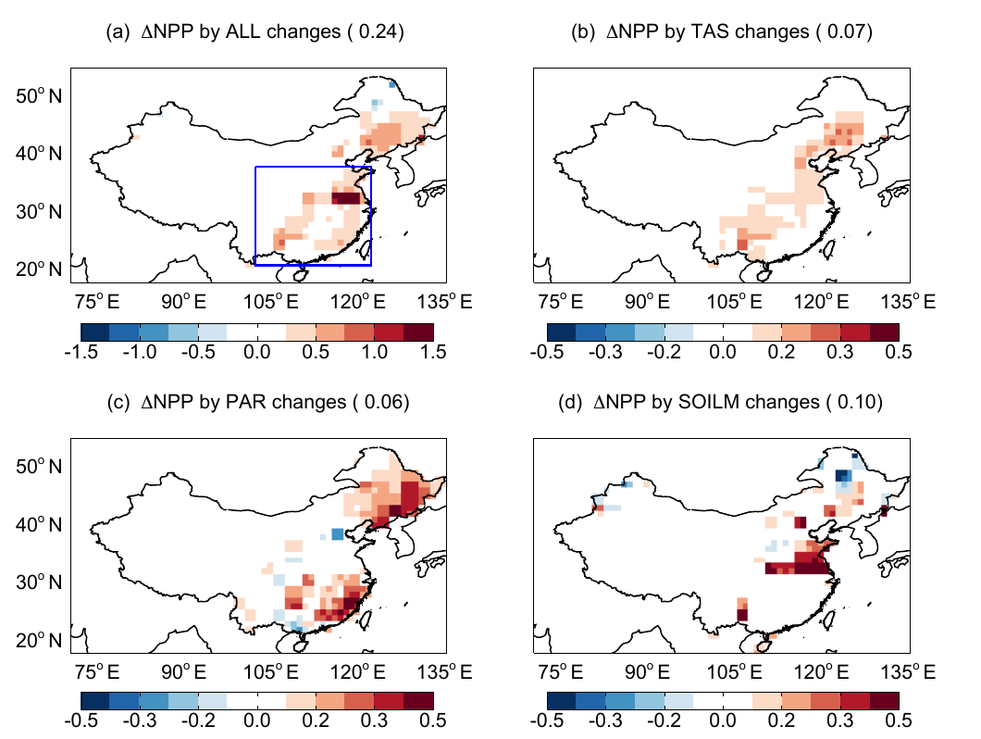
Climate route: temperature, humidity, water and rain
6 · Mechanisms of aerosol impact
Pathway | Mechanism | Evidence
Leaf temperature | Less sunlight → cooler leaves, nearer the 25 °C optimum | Steiner & Chameides, 2005
Humidity, VPD | Lower VPD keeps stomata open | Zhang et al., 2023
Soil moisture | Less evaporation → wetter soil | Yue et al., 2017
Night warming | Higher Tmin → more respiration | Jannat et al., 2026
Monsoon rain | Less evaporation, stable air → less rain | Auffhammer et al., 2006
China: NPP change from each aerosol pathway
Aerosol route (China, 2010) | ΔNPP (Pg C yr⁻¹) | What it shows
Diffuse radiation | +0.09 | More light reaches shaded leaves
Soil moisture | +0.07 | Less evaporation, less water stress
Leaf cooling | +0.03 | Summer leaves nearer the 25 °C optimum
Light + climate, total | +0.20 (+5%) | Net gain without cloud effects
Adding cloud and rain effects | −0.20 (−4%) | Summer rain −13% → drought
(a) all (b) temperature (c) PAR (d) soil moisture
Source: Yue et al., 2017
Notes:
Aerosol also acts through climate. Cooler leaves can be closer to the photosynthetic optimum; lower vapour pressure deficit keeps stomata open; less evaporation keeps soil wetter; but warmer nights increase respiration, and over seasons aerosol weakens monsoon rain. Yue and colleagues separated these routes for China: light, soil moisture and cooling together raised NPP by 0.2 petagrams of carbon, but adding aerosol effects on clouds and rain turned it into a loss of 0.2. In Amazon smoke, 80 percent of the extra uptake came from light and 20 percent from cooling. In India, rice harvests follow monsoon rainfall closely, which brown clouds reduce.

Slide 26
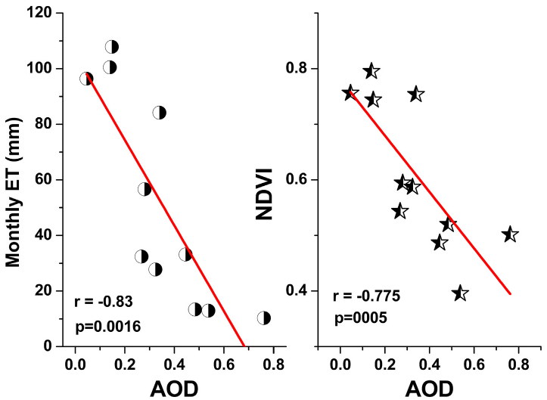
Water-cycle route: evapotranspiration and water-use efficiency
6 · Mechanisms of aerosol impact
Dibrugarh, Assam: monthly ET (left) and NDVI (right) vs AOD
Evapotranspiration
A 0.1 rise in AOD lowers ET by 8.4 W m⁻² at constant NDVI (Dibrugarh tea canopy)
Latha et al., 2018
Water-use efficiency
Cleaner air in the Hubei lockdown raised winter-wheat WUE by 17.0%; PAR explained 42.1% of WUE variation
Bai et al., 2022
Evaporative demand
AOD–ET₀ correlation negative in the dry Boro season in 6 of 8 districts (r = −0.21 to −0.69)
Jannat et al., 2026
ET and NDVI both fall as AOD rises over a dense tea canopy
Source: Latha et al., 2018, Fig. 5
Net water effect: aerosol dimming lowers evaporative demand and water loss and can raise water-use efficiency, but it also suppresses rain, so the outcome for rainfed crops depends on season.
Notes:
Aerosol also changes the water cycle of ecosystems, which links back to productivity. The figure, from Latha and colleagues, 2018, is from Dibrugarh in Assam, a region of dense tea plantations. Both monthly evapotranspiration and NDVI fall as AOD rises. To separate the aerosol effect from vegetation, they fitted ET as a function of both AOD and NDVI; at constant NDVI, a 0.1 increase in AOD lowers ET by about 8.4 watts per square metre, because aerosol radiative forcing reduces the energy available for evaporation.
The second card shows the water-use efficiency side, from the same Hubei lockdown discussed earlier. Bai and colleagues found that winter-wheat water-use efficiency rose by 17.0 percent when the air became cleaner, and their GeoDetector analysis showed that PAR explained 42.1 percent of the variation in water-use efficiency, more than rainfall. So in that polluted region, more light improved both carbon gain and water use.
The third card is from Bangladesh. Jannat and colleagues found that the correlation between AOD and reference evapotranspiration, the atmospheric demand for water, was negative during the dry Boro rice season in six of eight districts, with r between minus 0.21 and minus 0.69: aerosol lowers evaporative demand.
The net water effect is therefore mixed. Dimming lowers evaporative demand and water loss and can raise water-use efficiency, which helps in dry conditions, but aerosol also suppresses rain, as discussed under radiative effects. For rainfed crops the outcome depends on the season.

Slide 27
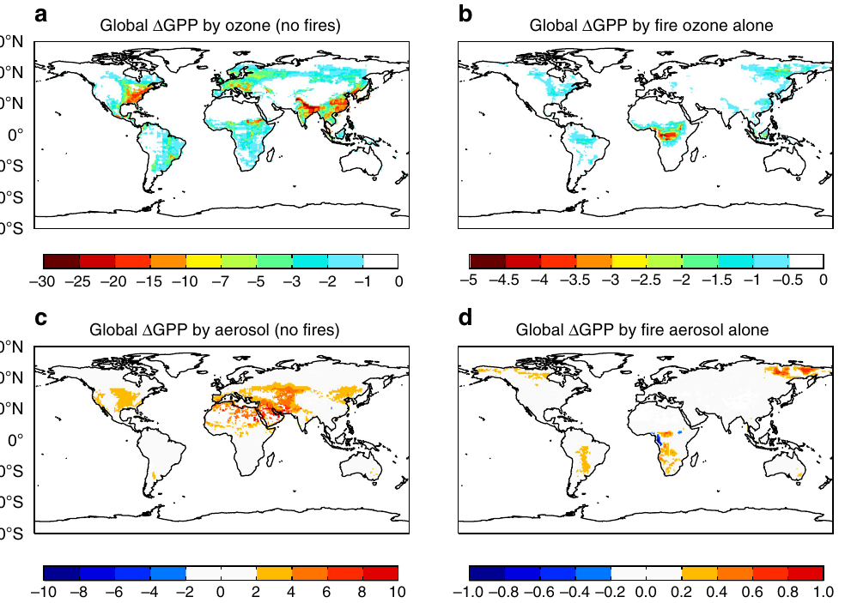
Co-pollutant ozone and aerosol type
6 · Mechanisms of aerosol impact
% change in global GPP: ozone (a, b) and aerosol (c, d); left: all sources except fire; right: fire alone
Effect on GPP or NPP | Pg C yr⁻¹
Ozone, global (non-fire sources) | −4.0 ± 1.9
Aerosol, global (non-fire sources) | +1.0 ± 0.2
Fire pollution: ozone / aerosol / net | −0.91 / +0.05 / −0.86
Black carbon, global (all-sky) | −0.28
Ozone, China NPP (2010) | −0.59 (−14%)
Yue & Unger, 2018; Zhou et al., 2022; Yue et al., 2017
Lesson: a pollution effect is not an aerosol effect. Ozone damage usually exceeds the aerosol benefit; absorbing black carbon lowers GPP, while scattering sulfate and organics give the benefit.
Source: Yue & Unger, 2018
Notes:
Two further factors decide whether pollution helps or harms plants: the co-pollutant ozone, and the type of aerosol. Ozone forms from the same emissions as aerosol, nitrogen oxides and volatile organic compounds, and it enters leaves through the stomata and damages photosynthesis. Yue and Unger, 2018, combined models and measurements for 2002 to 2011. With all emission sources except fires, ozone reduces global GPP by about 4.0 petagrams of carbon per year, while aerosol increases it by only about 1.0 petagram. For fire pollution alone, ozone reduces GPP by 0.91 and aerosol adds only 0.05, giving a net loss of 0.86 petagrams per year. The maps show the percentage change in GPP from ozone in the top row and from aerosol in the bottom row, for non-fire sources on the left and fire on the right. Ozone losses are widespread over eastern China, India, Europe and the eastern United States.
Aerosol type matters as well. Zhou and colleagues, 2022, found that black carbon, which absorbs light and adds little diffuse light, reduces global GPP by 0.28 petagrams per year under all-sky conditions, whereas scattering sulfate and organic aerosols provide the positive diffuse effect. And in China, Yue and colleagues found that ozone reduced NPP by 0.59 petagrams, or 14 percent, larger than any aerosol term.
The lesson is that a 'pollution effect' is not an 'aerosol effect'. A study that relates productivity to pollution without separating ozone and aerosol type cannot attribute the result to the diffuse-light mechanism.

Slide 28
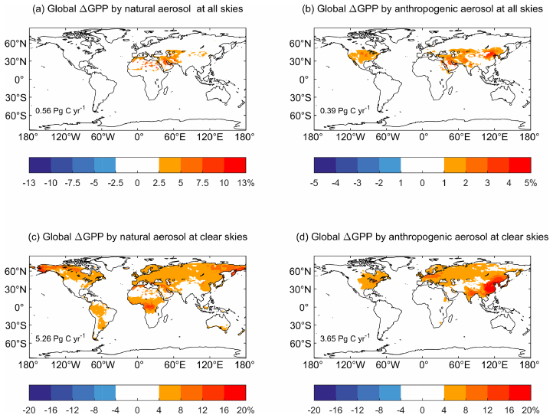
Which aerosols drive the diffuse-light effect: species and sources
6 · Mechanisms of aerosol impact
Global GPP gain by species, all-sky (Pg C yr⁻¹)
Change in GPP (%) from natural (a, c) and anthropogenic (b, d) aerosol; all skies (top), clear skies (bottom)
Data: Zhou et al., 2022 (natural share = total − anthropogenic)
Source: Zhou et al., 2022, Fig. 4
41% vs 25%
anthropogenic share of the GPP gain vs of the extra diffuse PAR
+0.93 vs +0.33 W m⁻²
diffuse PAR added by natural vs anthropogenic aerosol
E China, India, E USA
regions where anthropogenic aerosol dominates PAR changes
Notes:
Not all aerosols contribute equally to the diffuse-light effect. Zhou and colleagues, 2022, separated the global GPP enhancement by aerosol species and by source using a chemistry–vegetation model for 2001 to 2014. The stacked chart shows the all-sky GPP gain by species, split into anthropogenic and natural parts. Sulfate and nitrate aerosols give the largest gain, 0.79 petagrams of carbon per year, of which 0.58 is anthropogenic. Organic carbon gives 0.47, of which 0.32 is from natural sources such as plant emissions and fires. Dust and sea salt, which are natural and come from non-vegetated areas, add 0.17 and 0.06 by being transported over vegetation downwind. Black carbon, discussed on the previous slide, is the exception that reduces GPP.
The maps show where the gains occur. Natural aerosol, panels a and c, mainly affects areas downwind of North Africa because of dust, while anthropogenic aerosol, panels b and d, dominates over eastern China, India and the eastern United States because of large human emissions. Under clear skies, bottom row, the gains are much larger everywhere.
The callouts give three key results. Anthropogenic aerosols provide 41 percent of the total GPP gain although they contribute only 25 percent of the increase in diffuse radiation, because they are emitted over productive vegetated regions. Natural aerosols add 0.93 watts per square metre of diffuse PAR globally under all-sky conditions, compared with 0.33 from anthropogenic aerosols. And anthropogenic aerosol dominates PAR changes over eastern China, India and the eastern United States, which is why South Asia is a key region for this topic.

Slide 29
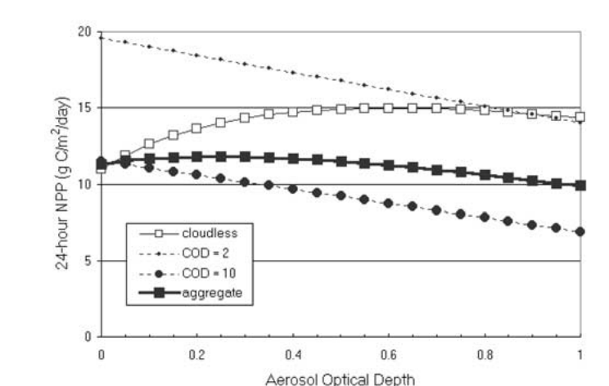
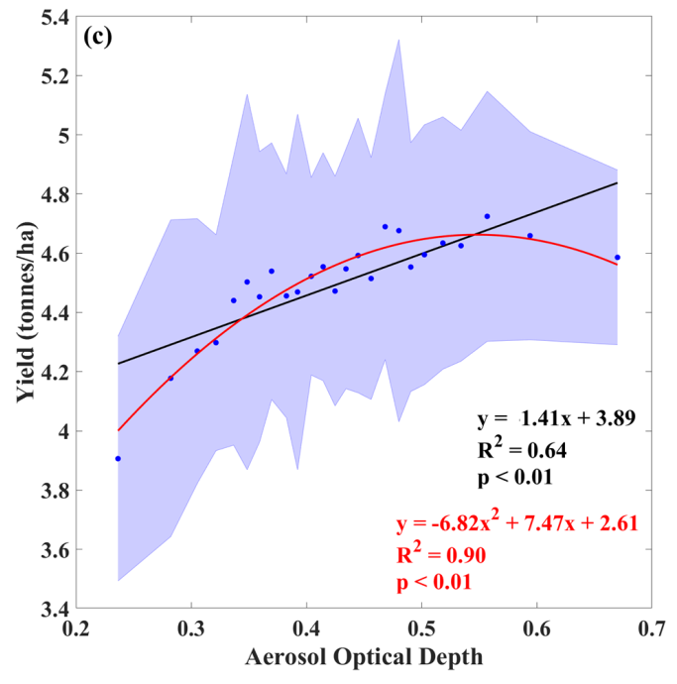
The optimum aerosol load: an inverted-U response
6 · Mechanisms of aerosol impact
Model canopies
Cohan et al., 2002
≈ 0.6 (NPP +30%, clear sky)
Modelled canopy NPP vs AOD: clear sky peaks, cloud only lowers
NE China cropland
Feng et al., 2020
0.3–0.6 (diffuse fraction 30–40%)
Punjab wheat
Sankhla et al., preprint
≈ 0.55 (R² = 0.90)
Indian forests
Hari & Tyagi, 2022
0.38, gain persists to 0.51
Source: Cohan et al., 2002, Fig. 4
Indian agro zones
Hari & Tyagi, 2022
0.49, restricted above 0.59
Punjab wheat yield vs AOD: quadratic fit
0.0
0.2
0.4
0.6
0.8
1.0
Aerosol optical depth at which productivity peaks
Why an optimum: diffuse gain grows with AOD until shaded leaves saturate; beyond it, total light loss dominates. Flux sites peak at a diffuse fraction of 0.4–0.6 (Yue & Unger, 2018). IGP AOD of 0.5–1.0 puts crops near or above the optimum.
Source: Sankhla et al., Fig. 2c
Notes:
Because dimming and diffuse fertilization pull in opposite directions, productivity follows an inverted-U response to aerosol: it rises at first, reaches a maximum and then falls. The scale on the left places the reported optima on a common AOD axis. In the canopy models of Cohan and colleagues, 2002, NPP peaks near an AOD of 0.6 under clear skies, with an enhancement of about 30 percent; the top figure shows that under cloudy skies, where light is already diffuse, aerosol only reduces NPP. For cropland in north-east China, Feng and colleagues found that AOD between 0.3 and 0.6, with a diffuse fraction of 30 to 40 percent, increases total GPP. In Punjab, Sankhla and colleagues found a significant non-linear relationship between AOD and wheat yield, with R squared of 0.90, peaking near AOD 0.55, as the lower figure shows. For India's ecological zones, Hari and Tyagi found that forest NPP is highest at AOD 0.38 and keeps increasing up to 0.51, while agricultural NPP is highest at 0.49 and is restricted above 0.59.
The optimum can also be expressed as a diffuse fraction: across flux sites, Yue and Unger note that photosynthesis reaches its maximum when the diffuse fraction is between 0.4 and 0.6.
The reason for the optimum is that the diffuse gain grows with AOD only until the shaded leaves themselves become light-saturated; beyond that, the loss of total light dominates. Since AOD over the Indo-Gangetic Plain is often 0.5 to 1.0, crops there are likely near or above the optimum, so further increases in aerosol are expected to reduce productivity.

Slide 30
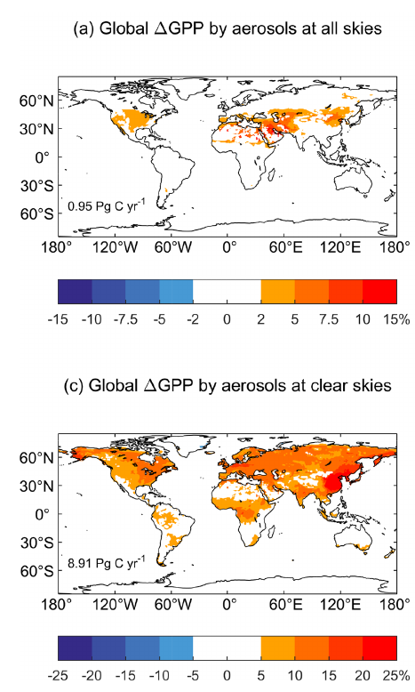
Factors that decide the aerosol impact
6 · Mechanisms of aerosol impact
Factor | How it changes the impact | Reference
Aerosol load | Gain only up to an optimum; heavy haze → loss | Cohan 2002
Aerosol type (ω₀) | Scattering aerosol helps; black carbon and smoke mainly dim | Zhou 2022
Cloud cover | Global aerosol gain: +8.9 Pg C yr⁻¹ under clear sky, only +0.95 under all skies | Zhou et al., 2022
Canopy structure | Dense, multi-layer canopies gain; sparse ones gain little. Uptake rose in forest but fell in | Niyogi 2004
C3 vs C4 plants | C4 plants rarely light-saturate; soybean (C3) LUE gain ~50% higher than maize (C4) | Kanniah 2012
Latitude, season, growth stage | Low sun is already diffuse; grain filling is most sensitive | Ezhova 2018; Gupta 2025
Water stress & ozone | Cooling eases VPD stress; ozone adds damage | Rap 2015; Ghude 2014
Aerosol effect on GPP (%): all skies (top) vs clear skies (bottom)
Clouds cut the global gain from 8.9 to 0.95 Pg C yr⁻¹
Source: Zhou et al. 2022, Fig. 3
Rule of thumb: the largest gain comes from a dense C3 canopy under moderate, scattering aerosol and clear sky; sparse C4 crops under cloud gain little.
Notes:
The last mechanism slide covers the conditions that decide how large the effect is. The most important is cloud cover. Zhou and colleagues, 2022, found that aerosols increase global GPP by 8.9 petagrams of carbon per year under clear skies, but only 0.95 under real, all-sky conditions, because cloudy light is already diffuse and aerosol then only dims. The two maps show this: the top map, for all skies, has small changes, while the bottom map, for clear skies, shows increases of more than 4 percent over most land areas. Zhou and colleagues also found that anthropogenic aerosols account for 41 percent of the global GPP gain, so human emissions contribute a large share of the diffuse effect.
Canopy structure is the second condition. At flux towers in the United States, Niyogi and colleagues, 2004, found that CO2 uptake increased with aerosol loading over forest and cropland but decreased over grassland, because only taller, multi-layer canopies have many shaded leaves that can use the extra diffuse light. The third condition is the photosynthetic pathway. C4 plants such as maize and sugarcane do not become light-saturated under high irradiance, so redistributing light helps them less. The review by Kanniah and colleagues cites a theoretical result that the increase in light-use efficiency under more diffuse light was about 50 percent higher for soybean, a C3 crop, than for maize, a C4 crop.
The rule of thumb summarises the mechanisms: the largest gain comes from a dense C3 canopy under moderate, scattering aerosol and clear skies, while sparse C4 crops under cloud gain little.

Slide 31
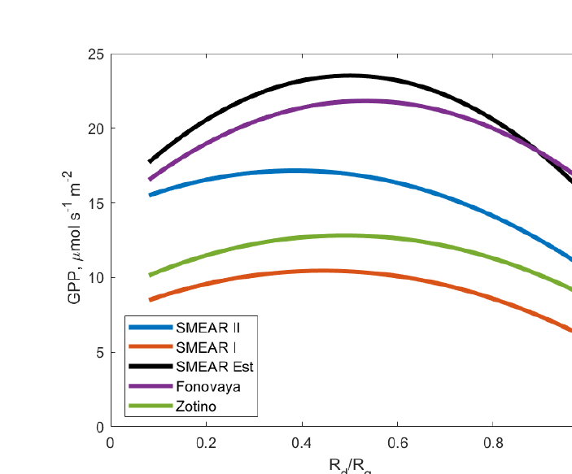
Evidence from natural ecosystems across the globe
7 · Evidence
+6 to 14% GPP
boreal and hemiboreal forest as diffuse fraction rose from 0.11 to 0.2–0.27
Ezhova et al., 2018
+1.4 to 2.8% NPP
Amazon rainforest under fire smoke (diffuse fraction 0.5–0.7)
Rap et al., 2015; Cirino et al., 2014
GPP vs diffuse fraction (R_{d}/R_{g}), five boreal and hemiboreal forest sites
No significant change
savanna carbon flux when diffuse fraction rose from 11 to 21%
Kanniah et al., 2012
+1.23 Pg C yr⁻¹
global NPP from biogenic secondary organic aerosol
Rap et al., 2018
GPP peaks at an intermediate diffuse fraction
Source: Ezhova et al., 2018, Fig. 8
Range: from no significant change (savanna) to +14% GPP (boreal forest); globally, the net effect on natural vegetation is a gain.
Notes:
Section 7 brings the evidence, starting with natural ecosystems; the four cards summarise four studies. In boreal and hemiboreal forests of Finland, Estonia and Siberia, Ezhova and colleagues, 2018, found that aerosol raised the diffuse fraction from about 0.11 on clean days to 0.2 to 0.27 on more polluted days, increasing GPP by 6 to 14 percent. The figure shows their estimated GPP against diffuse fraction at five sites: GPP rises, peaks at an intermediate diffuse fraction and then declines, the inverted-U response at ecosystem scale.
In the Amazon, Rap and colleagues, 2015, estimated that smoke from fires increases forest NPP by 1.4 to 2.8 percent through diffuse radiation, and Cirino and colleagues, 2014, measured diffuse fractions of 0.5 to 0.7 in the burning season, with carbon uptake falling again under very heavy smoke. In a northern Australian savanna, an increase in diffuse fraction from 11 to 21 percent did not significantly change the carbon flux, as reported in the review by Kanniah and colleagues. Globally, Rap and colleagues, 2018, estimated that secondary organic aerosol formed from plant emissions raises global NPP by 1.23 petagrams of carbon per year, a natural feedback in which vegetation helps itself through the aerosol it produces.
So the effect ranges from no significant change in savanna to a gain of up to 14 percent in boreal forest, and globally the net effect on natural vegetation is a gain, in contrast to the crops we look at next.

Slide 32
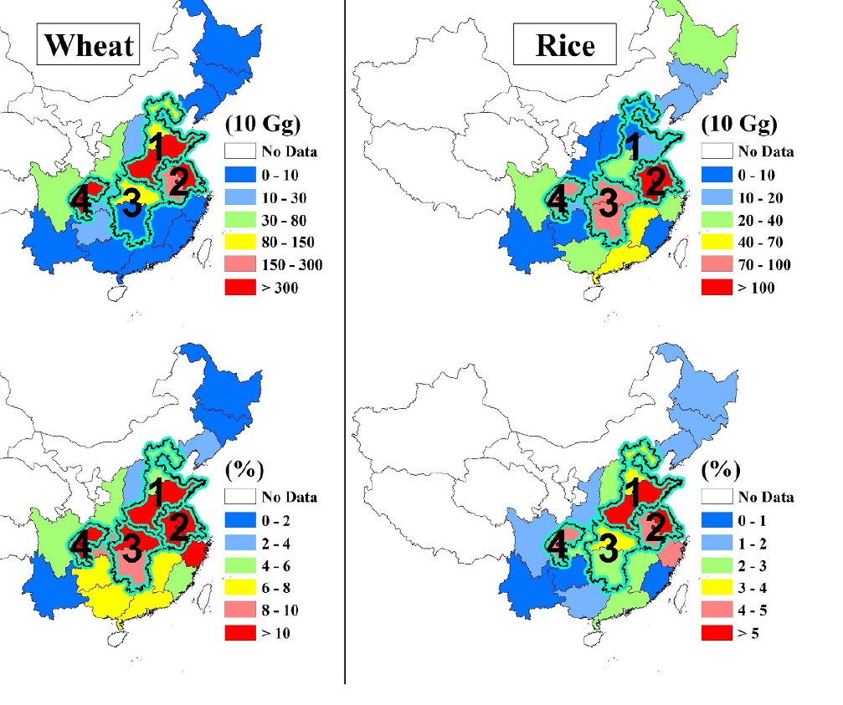
Evidence from crops outside South Asia
7 · Evidence
Region | Crop | Aerosol effect | Reference
China | rice, wheat | Haze cuts sunlight 5–30%; optimal yields fall by a similar amount | Chameides et al., 1999
China | rice, wheat | Sunlight −28 to 49% in hazy regions; national rice −2%, wheat −8% | Tie et al., 2016
Global sites | maize, wheat, rice | Maize −10 to 0%, wheat ±5%, rice ±10%; up to +30% at very sunny sites | Greenwald et al., 2006
Global | maize, wheat, rice | PM +9 to +16% (max diffuse response); net with O₃: +5.6, −3.7, +4.5% | Schiferl & Heald, 2018
USA | maize, soybean | Aerosol yield loss: maize 11.3%, soybean 23.2%; shrinking as air cleans | Liu & Desai, 2021
Europe | cropland | SIF −2.4% per 0.1 rise in AOD | He et al., 2023
Haze-related loss of wheat (left) and rice (right) production in China
Top: loss (10 Gg); bottom: loss (%)
Source: Tie et al., 2016, Fig. 3
Pattern: models assuming a strong diffuse response find gains; observations in polluted regions mostly find losses.
Notes:
For crops outside South Asia, the result depends on the method and the region. Chameides and colleagues, 1999, using a radiation and crop model, estimated that regional haze in eastern China cuts sunlight by 5 to 30 percent and reduces optimal yields of rice and wheat by a similar amount. Tie and colleagues, 2016, used MODIS AOD with a radiation model and found that solar irradiance is reduced by 28 to 49 percent in China's heavily polluted regions, reducing national production by about 2 percent for rice and 8 percent for wheat. The maps show where these losses occur: the upper maps give the loss in units of 10 gigagrams, the lower maps the percentage loss, both concentrated in the North China Plain, the Yangtze River Delta and the Sichuan Basin.
Greenwald and colleagues, 2006, used the CERES crop model at sites worldwide and found changes of minus 10 to 0 percent for maize, plus or minus 5 percent for wheat and plus or minus 10 percent for rice, with gains of up to 30 percent only under exceptionally sunny conditions such as California's Central Valley. Schiferl and Heald, 2018, with a global chemistry model, found that particulate matter could raise production by 9 to 16 percent, but only if crops respond strongly to diffuse light; including ozone damage, the net effect was plus 5.6 percent for maize, minus 3.7 for wheat and plus 4.5 for rice.
Observational studies mostly find losses. Liu and Desai, 2021, using county statistics for 1980 to 2019, found historical aerosol yield losses of 11.3 percent for maize and 23.2 percent for soybean in the United States, which have shrunk as air quality improved. In Europe, He and colleagues found that cropland SIF decreases by 2.4 percent for every 0.1 increase in AOD. The pattern is that models assuming a strong diffuse benefit find gains, while observations in polluted regions find losses.

Slide 33
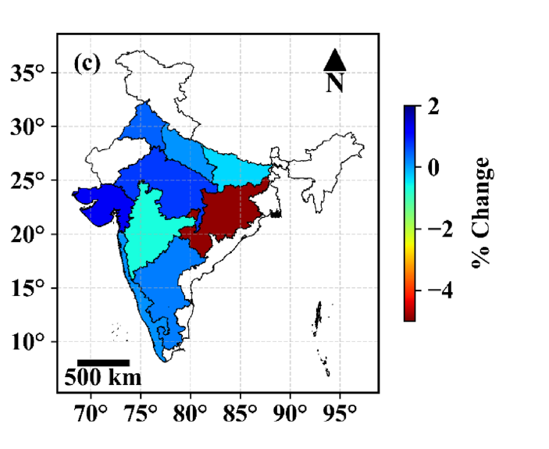
Evidence from India and South Asia
7 · Evidence
Region · system | Aerosol impact | Reference
India · rice | Brown clouds alone cut rice harvest 10.6%; with GHGs 14.4% (1985–1998) | Auffhammer et al., 2006
India · wheat | Climate and pollution trends (black carbon, O₃): wheat yield up to 36% lower | Burney & Ramanathan, 2014
India · rice, maize | Aerosol lowered yield: rice −7.9%, maize −8.8% (1998–2019) | Gupta et al., 2024
India (agroclimatic zones) · rice | AOD lowered rice yield by 0.73% per year (1998–2019) | Gupta et al., 2025
Assam (Dibrugarh) · vegetation | Evapotranspiration falls as AOD rises (r = 0.83) | Latha et al., 2018
Bangladesh · Boro rice | Positive effect in 5 districts, negative in 3 | Jannat et al., 2026
Median change in rice yield (% per year) due to AOD, 1998–2019
Largest losses in the east (Odisha)
Source: Gupta et al., 2025, Fig. 11c
India: high, rising and partly absorbing aerosol mostly lowers yield, but the sign varies by crop, season and region.
Notes:
In India and South Asia, most evidence shows losses. Auffhammer and colleagues, 2006, combined a statistical model of historical rice harvests with regional climate scenarios. They estimated that atmospheric brown clouds alone reduced India's rice harvest by 10.6 percent during 1985 to 1998, and that reducing brown clouds and greenhouse gases together would have increased the harvest by 14.4 percent, mainly through rainfall and night temperature. Burney and Ramanathan, 2014, attributed a wheat-yield gap of up to 36 percent to recent climate and pollution trends, mostly short-lived pollutants such as black carbon and ozone; this is a model counterfactual and has been debated. Gupta and colleagues, 2024, using Earth-observation data from 1998 to 2019, estimated that rising aerosol reduced rice yield by 7.9 percent and maize yield by 8.8 percent. In their 2025 study across agroclimatic zones, AOD lowered rice yield by about 0.73 percent per year; the map shows the largest losses in the east, especially Odisha.
Two regional studies show other effects. In Assam, Latha and colleagues found that evapotranspiration over dense vegetation falls as AOD rises, with a correlation of 0.83, because aerosol forcing reduces the energy available for evaporation. In Bangladesh, Jannat and colleagues found that the effect of aerosol on Boro rice was positive in five districts and negative in three, so the sign can differ even within a small country.
The conclusion for India is that high, rising and partly absorbing aerosol mostly lowers yield, but the sign varies by crop, season and region, so regional analysis is essential.

Slide 34
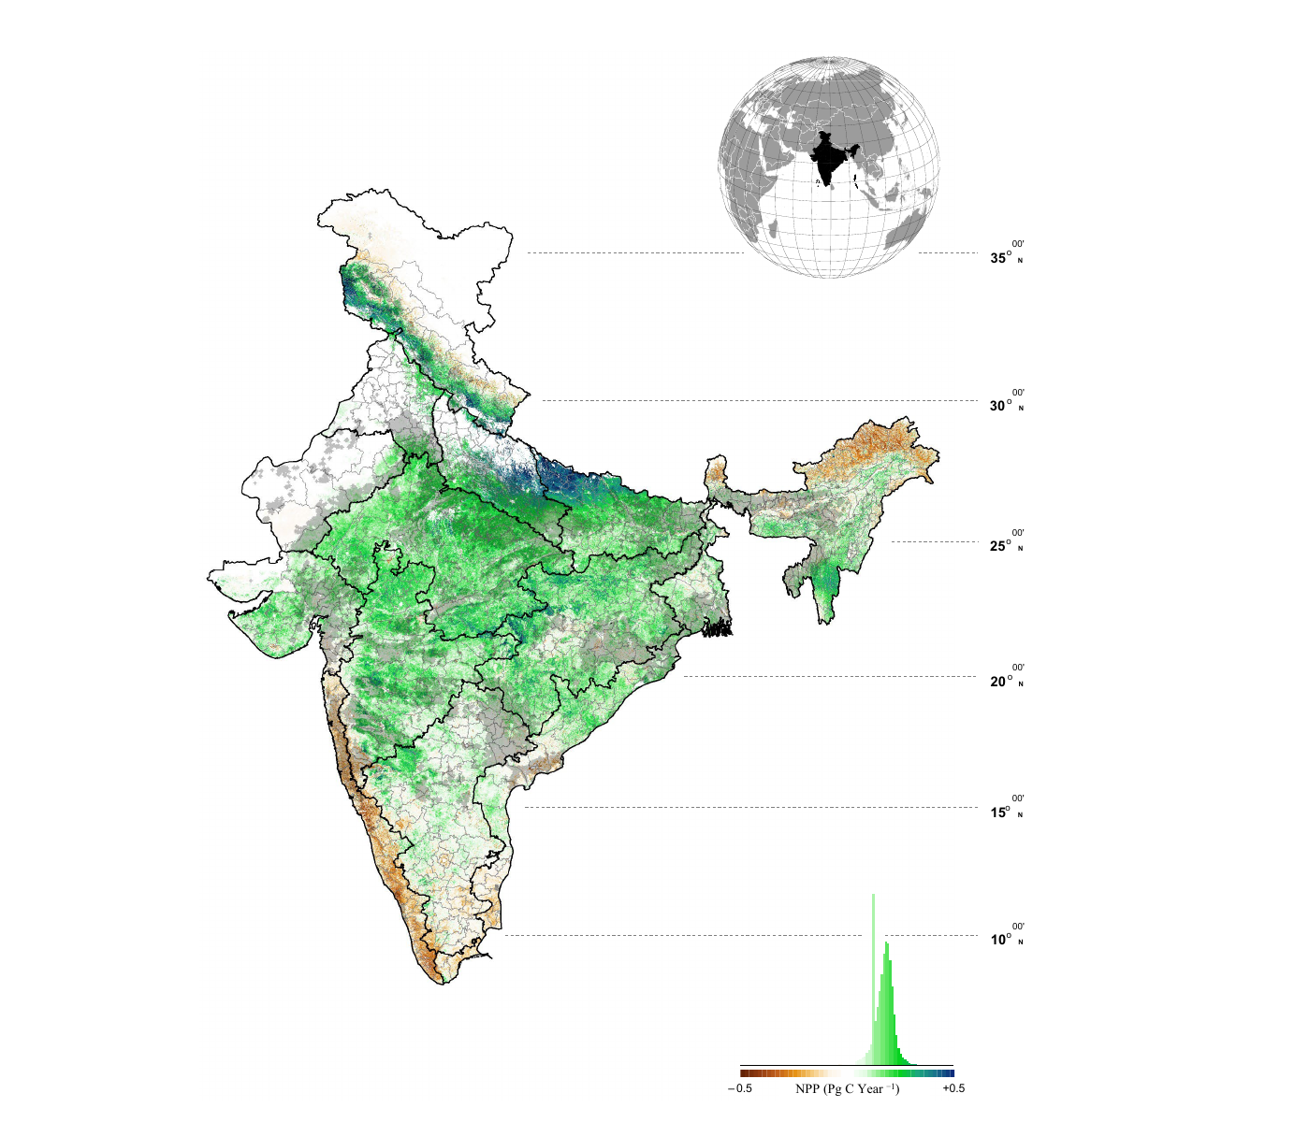
Ecosystem-wise productivity trends in India
7 · Evidence
NPP trend 2001–2020; black = zones sensitive to AOD (p < 0.05)
Zone group | NPP trend (2001–2020)
Negative | LGP, MGP, TGP, ECP, EPlat, EH, WCP
Positive | CPlat, SPlat, GP, UGP, WP
India total | 1.09 → 1.33 Pg C yr⁻¹; decadal trend −2.51%
Key results
Diffuse PAR rises with AOD only up to ≈ 0.54 in agro zones, then falls
Aerosol altered NPP of the Gangetic agro zones by about 11%
Maximum negative effect: Western and Eastern Plateau, post-monsoon
Pattern: India is still greening, but more slowly, and high-AOD cropland zones lose NPP.
Source: Hari & Tyagi, 2022, Fig. 5
Notes:
The last evidence slide looks inside India, using the zone-wise study of Hari and Tyagi, 2022. They modelled NPP with the CASA model for India's agroecological zones from 2001 to 2020 and related it to MODIS AOD. The map shows the NPP trend: green means increasing and brown decreasing, and black stippling marks the areas where NPP is significantly sensitive to AOD.
Using their Innovative Trend Analysis, the NPP trend is negative in the Lower, Middle and Trans-Gangetic Plains, the East Coast Plain, the Eastern Plateau, the Eastern Himalaya and the West Coast Plain, and positive in the Central and Southern Plateaus, the Gujarat Plain, the Upper Gangetic Plain and the Western Plain. India's total NPP rose from about 1.09 to 1.33 petagrams of carbon per year, but the decadal trend weakened by 2.51 percent, which is the 'slowing greening' in the title of their paper.
Three results connect this to the mechanisms. Using the SBDART radiative-transfer model, they found that in the agricultural zones diffuse PAR increases with AOD only up to about 0.54 and then decreases, because heavy aerosol removes light overall. Aerosol altered the NPP of the four Gangetic agricultural zones by about 11 percent. And the maximum negative effect occurred over the Western and Eastern Plateau in the post-monsoon season, when aerosol load is highest.
The pattern is that India is still greening, but more slowly, and the high-AOD cropland zones lose NPP. This brings us to the two case studies.

Slide 35
Aerosol versus climate drivers of Indian rice yield
7 · Evidence
Mean annual change in India's rice yield by driver, 1998–2019 (% yr⁻¹)
Weather-driven yield losses, India (1998–2019)
Rice: Tmax −2.55%, Tmin −2.92%, rain −2.78%, RH −4.84%, soil moisture −2.90%, FAPAR −2.82%
Maize: Tmax −5.12%, Tmin −6.57%, rain −6.93%, RH −6.54%, soil moisture −4.97%, FAPAR −5.84%
Gupta et al., 2024
Interaction with heat
US air-pollution yield losses of 20–30% act together with heat stress; warming dominates future losses
Liu & Desai, 2021
Data: Gupta et al., 2025
Message: heat is the largest single driver, but aerosol is comparable to night-time warming and larger than rainfall, so it must be included when attributing Indian yield trends.
Notes:
To judge how important aerosol is, it has to be compared with the climate drivers acting on the same crops. The chart is from Gupta and colleagues, 2025, who attributed the year-to-year change in India's rice yield from 1998 to 2019 to each driver. Rising maximum temperature had the largest negative effect, about minus 4.1 percent per year, followed by minimum temperature at about minus 1.1 percent and aerosol at about minus 0.7 percent, while rainfall fluctuations contributed only minus 0.1 percent. On the positive side, soil moisture, relative humidity and FAPAR contributed plus 1.2, plus 0.6 and plus 0.1 percent per year.
The card on the right, from Gupta and colleagues, 2024, shows the yield losses linked to unusual weather in the same period. For rice the losses were about 2.6 percent from maximum temperature, 2.9 from minimum temperature, 2.8 from rainfall, 4.8 from relative humidity, 2.9 from soil moisture and 2.8 from FAPAR; maize was roughly twice as sensitive, with losses between 5 and 7 percent. Aerosol therefore acts at the same scale as individual weather drivers.
The second card adds the interaction with heat from the United States: Liu and Desai found that air pollution reduced crop yields by 20 to 30 percent over four decades, acting together with heat stress, and that future losses will be dominated by warming.
The message is that heat is the largest single driver of Indian rice yield, but aerosol is comparable to night-time warming and larger than rainfall, so it must be included when Indian yield trends are attributed.

Slide 36
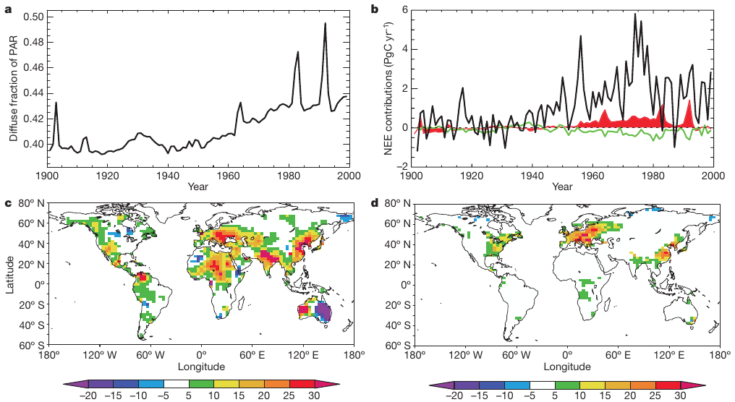
Diffuse fertilization of the global carbon sink: past and future
7 · Evidence
20th century: diffuse fraction (a), its NEE contribution (b, red), % change in diffuse fraction (c) and sink gain (d), 1950–1980
China NPP change from O₃ + aerosol (Pg C yr⁻¹)
Data: Yue et al., 2017, Table 3
Future outlook
Diffuse fertilization falls to near zero by 2100 as sulfate declines (Mercado et al., 2009)
All-sky diffuse effect rose 2.9% yr⁻¹ (2001–2014) as cloud cover fell (Zhou et al., 2022)
Cleaner air can cut crop output where the PM benefit dominates (Schiferl & Heald, 2018)
Source: Mercado et al., 2009, Fig. 3
−14.4% → +9.3%
land sink change from radiation, without vs with diffuse effect
Mercado et al., 2009
≤ 30 g C m⁻² yr⁻¹
regional sink gain, 1950–1980 (Europe, E USA, E Asia)
Mercado et al., 2009
Notes:
This slide places the aerosol effect in a century-long perspective. The figure, from Mercado and colleagues, 2009, reconstructs the twentieth century with a global land model. Panel a shows that the global diffuse fraction of PAR rose from about 0.40 to 0.44 over the century, with spikes after volcanic eruptions. Panel b shows, in red, the contribution of diffuse-fraction changes to the land carbon sink. Panel c maps the percentage change in diffuse fraction between 1950 and 1980, from minus 20 to plus 30 percent, and panel d maps the resulting gain in carbon accumulation, which reached up to 30 grams of carbon per square metre per year over Europe, the eastern United States and East Asia, as in the second callout. The first callout gives their key result: if the diffuse effect is ignored, as in most models, the reduction in total PAR would have changed the land sink by minus 14.4 percent; including diffuse fertilization, the overall radiation change gives a net enhancement of plus 9.3 percent.
The right side looks forward. The chart, from Yue and colleagues, 2017, shows the combined effect of ozone and aerosol on China's NPP: minus 0.39 petagrams of carbon per year in 2010, a larger loss of minus 0.43 in 2030 under current legislation because ozone keeps rising, and only minus 0.12 under the maximum technically feasible reduction scenario, which relieves about 70 percent of the damage.
The outlook card adds three points. Mercado and colleagues projected that under a climate-mitigation scenario in which sulfate aerosol declines, diffuse-radiation fertilization falls rapidly to near zero by 2100. Zhou and colleagues found that the all-sky diffuse effect increased by 2.9 percent per year from 2001 to 2014, mainly because cloud cover declined. And Schiferl and Heald caution that, where crops benefit from particulate matter, cleaner air can reduce crop production, although ozone reductions work in the opposite direction. So air-quality policy changes productivity through several routes at once, and the net outcome must be assessed region by region.

Slide 37
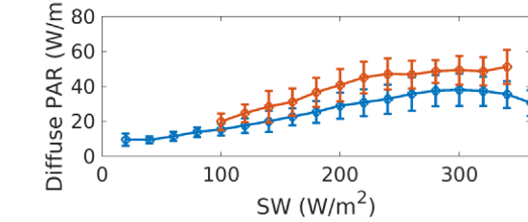
Uncertainties and challenges
9 · Challenges
Challenge | Problem and evidence | Remedy
Satellite AOD error Ramachandran & Rupakheti, 2026 | < 70% of MODIS AOD within expected error over South Asia vs ≥ 80% over N. America and Europe | MAIAC; AERONET bias correction
Cloud contamination Várnai & Marshak, 2009 | Clear-sky retrievals only; cloud-edge brightening inflates AOD | Strict masks; all-sky analysis
Scale mismatch Chu et al., 2021 | Tower footprint ~1 km² vs 1–50 km satellite pixels | Footprint-weighted matching
Reverse causation Jethva et al., 2019 | Bigger harvest → more residue fires → higher AOD (vegetation index +21%, fires +60%) | Pre-burning AOD; lagged tests
Ozone confounding Liu & Desai, 2021 | Same sources and season; US ozone yield losses 8.7% (maize), 4.8% (soybean) | Add ozone as a covariate
Circular reasoning Zhang et al., 2023; Ryu et al., 2018 | BESS/CERES diffuse PAR is computed from MODIS aerosol | Use measured diffuse PAR
BESS diffuse PAR by AOD bin (cropland)
Rises with AOD partly by construction
Source: Zhang et al., 2023, Fig. 10
Key point: most aerosol–productivity results are associations; robust attribution needs accurate AOD over South Asia, measured diffuse PAR, ozone data and designs that rule out reverse causation.
Notes:
Six problems can distort the link between aerosol and productivity. First, satellite AOD error: Ramachandran and Rupakheti, citing Ansari and Ramachandran, report that fewer than 70 percent of MODIS AOD values fall within the expected error over South Asia, compared with at least 80 percent over North America and Europe; the remedy is MAIAC and correction against AERONET. Second, cloud contamination: AOD can only be retrieved in clear skies, and near cloud edges scattered light brightens pixels and inflates AOD, as Várnai and Marshak showed; strict cloud masks and all-sky analyses are needed. Third, scale mismatch: a flux tower sees about one square kilometre, while satellite pixels are 1 to 50 kilometres, so footprints must be matched carefully, as discussed by Chu and colleagues. Fourth, reverse causation: Jethva and colleagues showed that in north-west India the vegetation index rose by 21 percent and post-harvest fires by about 60 percent, so a bigger harvest produces more residue, more fires and more aerosol; productivity can drive AOD, not only the reverse. Using pre-burning AOD and lagged tests helps. Fifth, ozone confounding: ozone shares sources and season with aerosol; Liu and Desai found US yield losses from ozone of 8.7 percent for maize and 4.8 percent for soybean, so ozone must be included as a covariate. Sixth, circular reasoning: satellite diffuse-PAR products such as BESS and CERES are computed from MODIS aerosol, so showing that their diffuse PAR rises with AOD is partly circular. The figure from Zhang and colleagues shows BESS diffuse PAR increasing across AOD bins for cropland. The key point is that most results are associations; robust attribution needs better AOD over South Asia, measured diffuse PAR, ozone data and designs that exclude reverse causation.

Slide 38
Conclusions and take-home messages
10 · Conclusions
Aerosols change both the amount (dimming) and the quality (diffuse fraction) of light reaching vegetation
The response is non-linear: productivity gains at moderate AOD but falls at high AOD or under cloud
1
2
Dense C3 canopies gain most; grasslands, C4 crops and sparse canopies gain little
Remote sensing (MAIAC AOD, SIF, vegetation indices, LUE and two-leaf models) quantifies the link from field to globe, with ground validation
3
4
Over India, high, rising and partly absorbing aerosol mostly lowers crop yield and slows greening; evidence is still sparse
Priorities: accurate AOD over South Asia, measured diffuse PAR and ozone-aware attribution
5
6
Take-home: over the Indo-Gangetic Plain, where AOD is above the optimum and still rising, aerosol is likely reducing crop and ecosystem productivity.
Notes:
To conclude, six messages. First, aerosols change both the amount of light reaching vegetation, through dimming, and its quality, through the diffuse fraction. Second, the response of productivity is non-linear: it gains at moderate aerosol loads but falls at high loads or under cloud, giving an optimum aerosol load. Third, the ecosystem matters: dense C3 canopies such as forests gain most, while grasslands, C4 crops and sparse canopies gain little. Fourth, remote sensing makes it possible to quantify this link from the field to the globe, using MAIAC AOD, fluorescence, vegetation indices and light-use-efficiency and two-leaf models, always validated with ground measurements. Fifth, over India, high, rising and partly absorbing aerosol mostly lowers crop yield and is slowing the greening trend, but the evidence is still sparse. Sixth, the priorities are more accurate AOD over South Asia, measured diffuse radiation and attribution that accounts for ozone.
The single take-home message is that over the Indo-Gangetic Plain, where aerosol loading is already above the optimum and still rising, aerosol is likely reducing crop and ecosystem productivity. Thank you; I welcome your comments.

