Slide 1
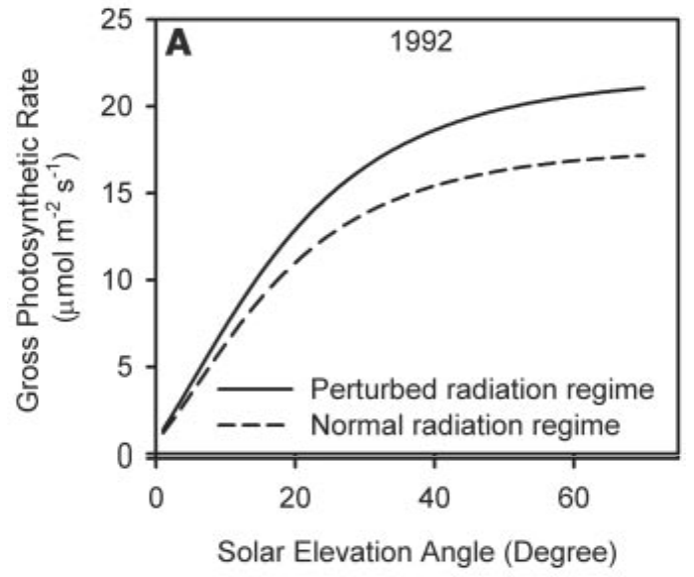
Light route: dimming vs diffuse fertilization
6 · Mechanisms of aerosol impact
↓
1 · Dimming
↑
2 · Diffuse fertilization
Harvard Forest, 1992: volcanic (solid) vs normal (dashed)
Scattering and absorption cut total PAR
Clear‑sky PAR −30% as AOD rises from 0.05 to 1.0
Diffuse light reaches shaded, light‑limited leaves
LUE 1.12–1.80 times higher than under direct light
Greenwald et al., 2006
Kanniah et al., 2012
Proof: Mount Pinatubo eruption, 1991
Volcanic sulfate raised diffuse light; noon photosynthesis at Harvard Forest rose 23% in 1992 and 8% in 1993 under cloudless skies
Gu et al., 2003
Gu et al., 2003, Fig. 2a
Net effect = diffuse gain − loss of total PAR (Mercado et al., 2009). Sunlit leaves are often light‑saturated, so lost direct light costs little; shaded leaves are light‑limited, so they use the diffuse light efficiently.
Notes:
Section 6 explains how aerosols change productivity, starting with the light route, which has two opposing parts.
The first is dimming. Aerosols scatter and absorb sunlight, so less total PAR reaches the canopy. Greenwald and colleagues, 2006, computed that under clear skies PAR falls by about 30 percent as AOD rises from a background value of 0.05 to 1.0, while the diffuse fraction increases strongly.
The second is diffuse fertilization. Light scattered by aerosol comes from the whole sky, so it reaches shaded leaves deep in the canopy, and illumination becomes more uniform with a smaller part of the canopy light-saturated. The review by Kanniah and colleagues, 2012, reports that canopy light-use efficiency under diffuse radiation is 1.12 to 1.80 times that under direct radiation, from flux-tower data.
The classic proof is the 1991 Mount Pinatubo eruption, which filled the stratosphere with scattering sulfate and almost doubled clear-sky diffuse radiation. Gu and colleagues, 2003, found that at Harvard Forest, a deciduous forest, noon-time canopy photosynthesis increased by 23 percent in 1992 and by 8 percent in 1993 under cloudless conditions. The figure shows gross photosynthesis against solar elevation in 1992: the solid line, with volcanic aerosol, lies above the dashed line for the normal radiation regime at almost every sun angle.
The strip gives the net balance. As Mercado and colleagues, 2009, put it, the net effect depends on the balance between the reduction in total PAR, which tends to reduce photosynthesis, and the increase in the diffuse fraction, which tends to increase it. The balance can be positive because sunlit leaves at the top of the canopy are often light-saturated, so losing part of the direct beam costs little, while shaded leaves are light-limited and use the extra diffuse light efficiently.

Slide 2
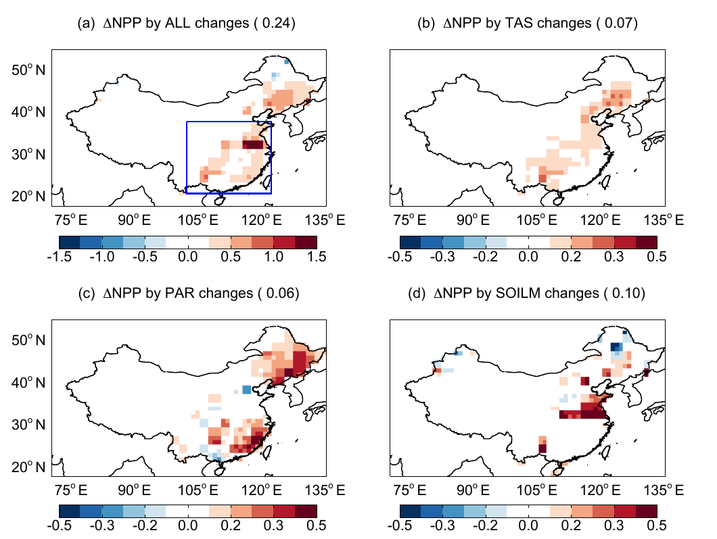
Climate route: temperature, humidity, water and rain
6 · Mechanisms of aerosol impact
Leaf temperature
Less sunlight → cooler leaves, nearer the 25 °C optimum
China: summer NPP change from each aerosol pathway
Steiner & Chameides, 2005; Yue et al., 2017
Humidity, VPD
Lower VPD under haze supports photosynthesis
Zhang et al., 2023
Soil moisture
Less evaporation → wetter soil, less water stress
Yue et al., 2017
Night warming
AOD tracks minimum more than maximum temperature
Jannat et al., 2026
Monsoon rain
Less sea evaporation, stable lower air → less rain
Auffhammer et al., 2006
China, 2010: aerosol effect on NPP (Pg C yr⁻¹)
Yue et al., 2017
Radiation
+0.09
Soil moisture
+0.07
Temperature
+0.03
Total
+0.20 (+5%)
With cloud, rain
−0.20 (−4%)
(a) all (b) temperature (c) PAR (d) soil moisture
Yue et al., 2017, Fig. 8
Rain can outweigh light: with aerosol–cloud effects, summer rain fell 13% and the NPP gain became a loss
Notes:
Aerosol also changes productivity through climate, not only through light. Five pathways are shown.
Leaf temperature: less sunlight cools leaves, as Steiner and Chameides, 2005, showed in their modelling. Whether this helps depends on how far the leaf is from the photosynthetic optimum of about 25 degrees Celsius; Yue and colleagues, 2017, found that in summer the aerosol-induced cooling brings leaf temperature closer to that optimum. Humidity: Zhang and colleagues, 2023, found that higher aerosol loading goes with lower vapour pressure deficit over cropland, grassland and mixed forest, and lower VPD enhances photosynthesis, so the vegetation response to aerosol is not only a diffuse-light effect. Soil moisture: less radiation means less evaporation, which keeps the soil wetter in the short term. Night temperature: in Bangladesh, Jannat and colleagues, 2026, found that aerosol was more strongly associated with minimum temperature, with R squared up to 0.625, than with maximum temperature, suggesting that aerosol-induced night-time warming is an additional pathway alongside the photosynthetic response. Monsoon rain: Auffhammer and colleagues, 2006, explain that brown clouds reduce rainfall because lower surface radiation reduces evaporation from the sea, and absorption in the lower atmosphere heats and stabilises it; India's rice harvest rises with June–September rainfall.
The chips give the only study that separates these routes, for China in 2010. Yue and colleagues, 2017, switched on one aerosol-driven change at a time in an Earth system model. Annual NPP rose by 0.09 petagrams of carbon through radiation, 0.07 through soil moisture and 0.03 through temperature, a total of about 0.20 petagrams or 5 percent. The figure shows the summer pattern of each pathway: total in panel a, temperature in b, PAR in c and soil moisture in d.
But when aerosol effects on clouds were included, summer precipitation fell by 0.9 millimetres per day, or 13 percent, soil moisture fell, and the aerosol effect became a loss of 0.20 petagrams, or 4 percent. So, as the strip says, for rain-dependent ecosystems the rain route can outweigh the light route.

Slide 3
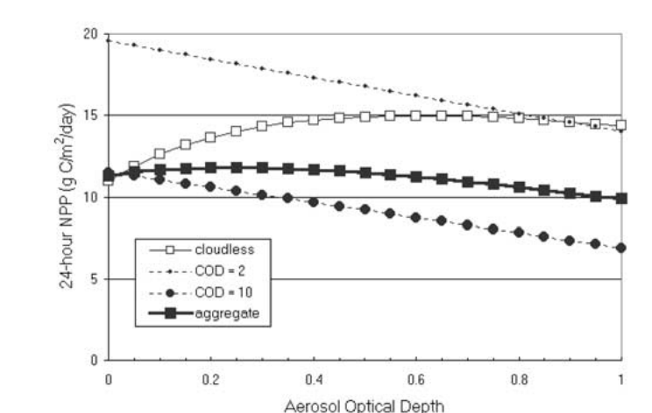
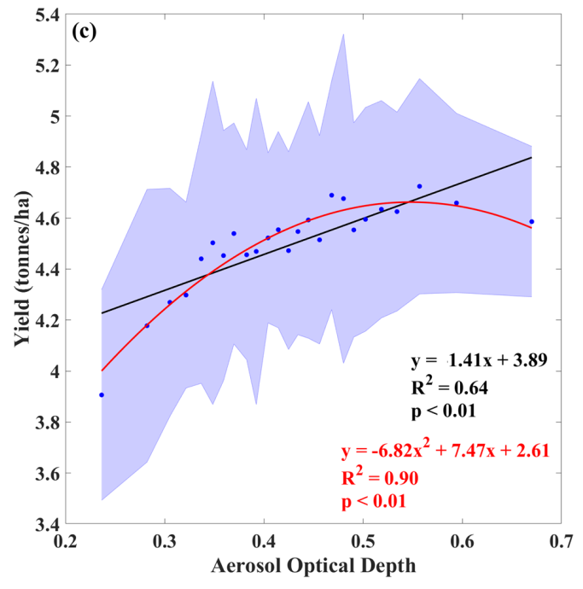
The optimum aerosol load: an inverted-U response
6 · Mechanisms of aerosol impact
Reported optima
Soybean canopy NPP vs AOD: clear sky peaks, cloud only lowers
Punjab wheat yield vs AOD, 2000–2018
AOD ≈ 0.6: soybean canopy NPP +30%, clear sky (model)
Cohan et al., 2002
AOD 0.3–0.6 (diffuse fraction 30–40%): GPP gain, North China cropland
Feng et al., 2020
Diffuse fraction 0.4–0.6: photosynthesis maximum in site studies
Yue & Unger, 2018
AOD ≈ 0.55: Punjab wheat yield rises, then saturates (R² = 0.90)
Sankhla et al.
AOD 0.38 / 0.49: NPP peak in Indian forests / agro zones
Hari & Tyagi, 2022
AOD > 0.59: NPP growth restricted in Indian agro zones
Hari & Tyagi, 2022
Aggregate (40% clear, 60% overcast): flat to AOD 0.4, then falls
Red: quadratic fit; black: linear (R² = 0.64)
Cohan et al., 2002, Fig. 4
Sankhla et al., Fig. 2c
Why an optimum: diffuse gain rises with AOD at first; beyond it, loss of total light and sunlit‑leaf photosynthesis dominates (Zhou et al., 2022)
Notes:
Because dimming and diffuse fertilization pull in opposite directions, productivity follows an inverted-U response to aerosol: it rises at first, reaches a maximum and then falls.
The card lists the reported optima. In the canopy model of Cohan and colleagues, 2002, for a mature soybean canopy on cloudless days, the maximum NPP enhancement of about 30 percent occurs at an AOD of about 0.6, and NPP declines somewhat above that. The left figure, for 30 degrees north on 15 July, shows this: the open squares, for cloudless skies, rise and level off, while under cloud, with cloud optical depth 2 or 10, aerosol only reduces NPP because diffuse light is already high. The thick aggregate line assumes clear skies 40 percent of the time and thick cloud 60 percent of the time; it is essentially flat up to an AOD of 0.4 and then falls, by about 15 percent at an AOD of 1. For cropland in North China, Feng and colleagues, 2020, found that an AOD of 0.3 to 0.6, with a diffuse fraction around 30 to 40 percent, can largely increase total GPP. Yue and Unger, 2018, summarising site-level studies, note that photosynthesis reaches its maximum when the diffuse fraction is between 0.4 and 0.6, whether the diffuse light comes from cloud or aerosol. In Punjab, Sankhla and colleagues related binned AOD to wheat yield for 2000 to 2018: a second-order polynomial fits much better, with R squared of 0.90, than a straight line, with R squared of 0.64, and yield increases with AOD up to about 0.55 and thereafter saturates or decreases; this is a preprint that is not yet peer reviewed. For India's ecological zones, Hari and Tyagi, 2022, found maximum NPP in forest ecosystems at an AOD of 0.38, with growth persisting up to 0.51, and in agroecosystems maximum growth at 0.49, with growth restricted by 0.59.
The reason for the optimum is in the strip. At low aerosol loading the gain from diffuse light grows faster than the loss of total light. Beyond the optimum, as Zhou and colleagues, 2022, explain, a further increase in diffuse fraction dampens GPP because photosynthesis of the sunlit leaves falls, and total light becomes limiting.

Slide 4
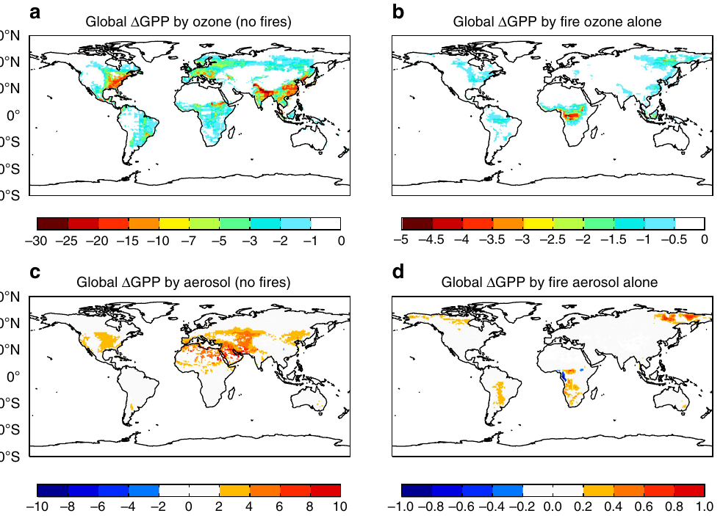
Factors that decide the aerosol impact
6 · Mechanisms of aerosol impact
Aerosol type
Co-pollutant ozone
% change in global GPP: ozone (top), aerosol (bottom); left: non-fire, right: fire
Scattering sulfate and organics help; black carbon cuts GPP by 0.28 Pg C yr⁻¹
Global GPP: ozone −4.0, aerosol +1.0 Pg C yr⁻¹; fire pollution net −0.86
Zhou et al., 2022
Yue & Unger, 2018
Cloud cover
Canopy structure
Aerosol gain +8.91 Pg C yr⁻¹ under clear sky, only +0.95 under all skies
Uptake rose with aerosol in forest and cropland, fell in grassland
Zhou et al., 2022
Niyogi et al., 2004
C3 vs C4 plants
Emission source
C4 plants rarely light‑saturate; soybean LUE gain ~50% above maize
Anthropogenic aerosol gives 41% of the global GPP gain
Yue & Unger, 2018
Kanniah et al., 2012
Zhou et al., 2022
Lesson: a pollution effect is not an aerosol effect; the largest gain comes from scattering aerosol over a dense C3 canopy under clear sky
Notes:
The last mechanism slide brings together the factors that decide whether, and how much, aerosol helps or harms productivity.
Aerosol type: scattering aerosols such as sulfate and organics produce the diffuse-light benefit, but black carbon absorbs light and adds little diffuse light; Zhou and colleagues, 2022, found that black carbon reduces global GPP by 0.28 petagrams of carbon per year under all-sky conditions.
Co-pollutant ozone: ozone forms from the same emissions as aerosol and damages leaves after entering through the stomata. Yue and Unger, 2018, found that for all emission sources except fire, ozone reduces global GPP by 4.0 plus or minus 1.9 petagrams per year while aerosol increases it by only 1.0 plus or minus 0.2. For fire pollution alone, ozone removes 0.91 and aerosol adds only 0.05, a net loss of 0.86. The maps show this: ozone losses in the top row are widespread over eastern China, India, Europe and the eastern United States, while aerosol gains in the bottom row are small. In China, Yue and colleagues, 2017, found ozone reduced NPP by 0.59 petagrams, or 14 percent, much more than the aerosol gain.
Cloud cover: Zhou and colleagues, 2022, found an aerosol gain of 8.91 petagrams per year under clear skies but only 0.95 under real, all-sky conditions, because cloudy light is already diffuse. Canopy structure: at US flux towers, Niyogi and colleagues, 2004, found that CO2 uptake increased with aerosol loading over forest and cropland but decreased over grassland, because only taller, multi-layer canopies have many shaded leaves to use the diffuse light. Photosynthetic pathway: C4 plants such as maize do not become light-saturated under high irradiance, so redistributing light helps them less; the review by Kanniah and colleagues, 2012, cites a 50 percent larger increase in light-use efficiency for soybean, a C3 crop, than for maize. Emission source: Zhou and colleagues found that anthropogenic aerosols provide 41 percent of the global GPP gain, although they contribute only 25 percent of the increase in diffuse radiation.
The lesson is that a pollution effect is not the same as an aerosol effect. The largest gain comes from scattering aerosol over a dense C3 canopy under clear skies; absorbing aerosol, ozone, cloud, open canopies and C4 crops all reduce or reverse it.

