Slide 1
Airborne hyperspectral imaging for the detection of powdery mildew in wheat
Franke, J., Mewes, T., Menz, G. (2008). Imaging Spectrometry XIII, Proc. SPIE 7086, 708609. doi:10.1117/12.795040
Paper review and its use in MuDAS-AI (endmembers and spectral unmixing) · Animesh Panda, ICAR-IARI
Notes:
Figures are screenshots from the paper (Franke et al., 2008). Fig. 2 was stored as two image halves in the PDF and has been re-joined.

Slide 2
The paper at a glance
OVERVIEW
126
54
3
r = 0.82
HyMap bands, 450–2480 nm, 4 m pixels
field sample points with % infected leaf area
endmembers: healthy wheat, 100% infected wheat (modelled), soil
infected-endmember fraction vs disease severity (r² = 0.67)
Question
Answer
Can airborne hyperspectral data quantify powdery mildew severity in wheat?
How can we get an endmember for infected wheat when no pure infected pixel exists in the image?
Only a healthy-wheat endmember could be found in the image
A 100%-infected endmember was modelled by unmixing a 30%-infected pixel
Its MTMF fraction correlated with field severity: r = 0.82
For MuDAS-AI: this is the method behind your SMACC endmember workbook: build endmembers, select representative ones, unmix, and relate the infected fraction to disease index.

Slide 3
Background: why hyperspectral and why spectral unmixing
INTRODUCTION
Precision agriculture
Why hyperspectral
Why unmixing
Fungal diseases vary strongly in space and time
Site-specific fungicide use needs accurate, early, mapped detection
Visual field scouting is slow, costly and cannot map whole fields
Multispectral data were only moderately suitable for early detection (Franke & Menz, 2007)
Narrow, contiguous bands describe phenology and plant condition in more detail
Earlier work: Hyperion for sugarcane rust (Apan et al., 2004); unmixing for citrus pests (Du et al., 2004)
A 4 m pixel mixes healthy leaves, infected leaves and soil
Spectral mixture analysis (SMA) estimates the fraction of each component in a pixel
The infected fraction should track disease severity
The difficulty: finding a pure infected spectrum (endmember)
For MuDAS-AI: your UAV pixels (2–5 cm) are much finer, but plot spectra still mix healthy tissue, pustules, chlorosis, flowers and soil, so the same logic applies.

Slide 4
Objectives
INTRODUCTION
1
Test the potential of airborne hyperspectral (HyMap) data to quantify powdery mildew severity in wheat
2
Derive appropriate endmembers from the image itself using an optimal endmember-selection procedure
3
Test whether a modelled infected endmember can estimate disease severity by spectral mixture analysis
For MuDAS-AI: objectives 2 and 3 are exactly the two problems you face with the SMACC endmembers: which ones are representative, and how to get a pure 'white rust' endmember.

Slide 5
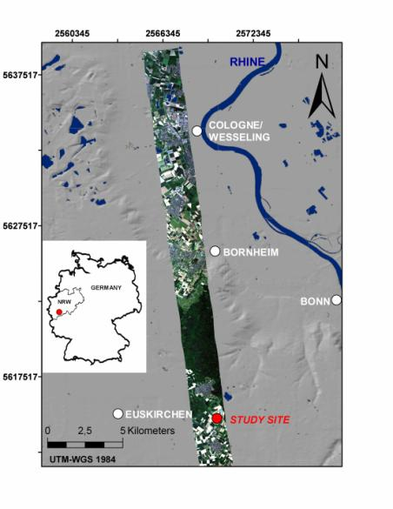
Study area
METHODS · SITE
Site
Experimental farm Klein-Altendorf, University of Bonn, Germany
50°37′N, 6°59′E, 175 m a.s.l., between Bonn and Cologne (North Rhine-Westphalia)
Field of 6 ha, chosen for its flat topography so that terrain does not disturb the spectra
Season 2004–2005
Fig. 1 – Location of the study area; true-colour HyMap scene (Franke et al., 2008)
For MuDAS-AI: flat, uniform fields simplify interpretation; at IARI and Bharatpur note slope, soil and border effects that could look like disease.

Slide 6
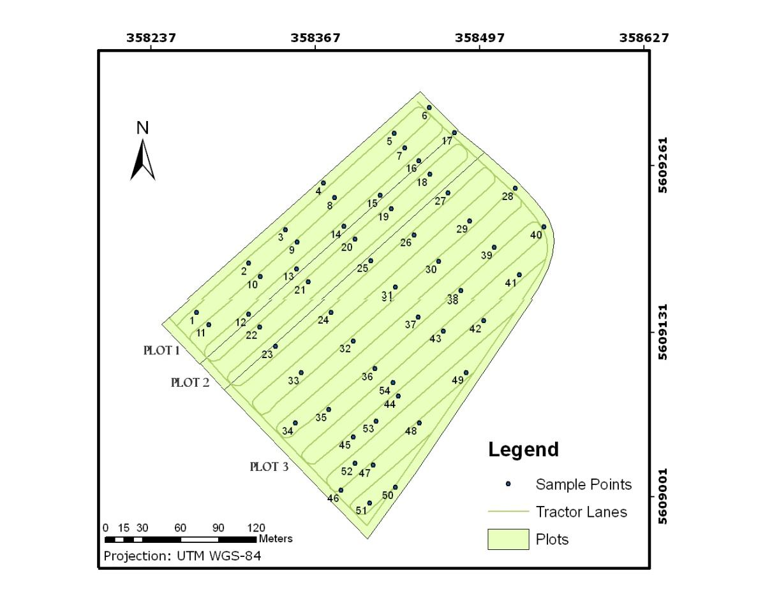
Experimental design: a fungicide-driven severity gradient
METHODS · FIELD
Design
Winter wheat cv. 'Chancellor' (susceptible to powdery mildew), sown November 2004
Uniform fertiliser and herbicide to remove other stresses (N deficiency, weeds)
Plot 1 (45 m): fungicide twice (11 May, BBCH 34; 9 June, BBCH 57) → disease-free
Plot 2 (30 m): fungicide once (11 May) → reduced or delayed infection
Plot 3 (~120 m): no fungicide → natural infection
Fig. 2 – Three sub-plots, tractor lanes and 54 sample points (UTM WGS-84)
For MuDAS-AI: same logic as your design: controls versus inoculated plots give the severity range; uniform management keeps other stresses out of the spectra.

Slide 7
Ground truth and hyperspectral image data
METHODS · DATA
Ground truth at 54 sample points
HyMap (DLR), 28 May 2005
Disease severity = % infected leaf area
Growth stage, plant height, DGPS position
Nadir photos → % vegetation cover (soil fraction) by image analysis
Airborne whisk-broom scanner
126 bands, 450–2480 nm, 16 nm bandwidth in VIS/NIR
Nominal pixel size 4 m
Severity class | Vital wheat | Low infected | Mid infected | Strong infected
% infected leaf area | < 10% | 10–20% | 21–30% | > 30%
Sample points (n) | 34 | 14 | 3 | 3
For MuDAS-AI: note the imbalance (only 6 points above 20%); your design of 36 inoculated plots and several dates gives a much better spread of severity.

Slide 8
Workflow of the study
METHODS · OVERVIEW
Library
Select
Healthy only
Model EM
MTMF
Relate
1–2 Library and selection
3–4 Endmember modelling
5–6 Mapping and validation
Pixel spectra at the 54 points, labelled with severity and vegetation cover
4 severity classes; representative endmember per class sought with VIPER tools
Healthy-wheat endmember found; no infected endmember
Soil removed from the healthy spectrum; then a 30%-infected pixel unmixed → 100% infected wheat spectrum
MTMF on the MNF-transformed image for healthy, infected and soil
Mean MF fraction in a 4 m buffer around each point, correlated with severity
For MuDAS-AI: your pipeline can follow the same six boxes, with SMACC providing the candidate endmembers per plot.

Slide 9
Concept: linear spectral mixture analysis (SMA)
METHODS · THEORY
DNᵢ = Σⱼ ( Rᵢⱼ · Fⱼ ) + Eᵢ (Adams et al., 1986)
Symbol | Meaning
DNᵢ | reflectance of the pixel in band i
Rᵢⱼ | known reflectance of endmember j in band i
Fⱼ | fraction of the pixel covered by endmember j
Eᵢ | residual error in band i
In words
A pixel spectrum is the area-weighted sum of its pure components (endmembers)
If the endmember spectra are known, the fractions Fⱼ are solved band by band by least squares
Fully constrained SMA adds Fⱼ ≥ 0 and ΣFⱼ = 1
Example: pixel = 0.6 × healthy + 0.25 × infected + 0.15 × soil
For MuDAS-AI: for white rust the components could be healthy canopy, white-rust-affected canopy, soil, shadow and (at flowering) yellow flowers.

Slide 10
Selecting representative endmembers: CoB, EAR and MASA
METHODS · ENDMEMBER SELECTION
Method | What it computes | Best endmember
Count-based selection (CoB) | How many spectra of its own class a candidate can model (in-CoB) and of other classes (out-CoB) within fraction, RMSE and residual limits; CoBI = in-CoB / (out-CoB × n in class) | High in-CoB and high CoBI
Endmember Average RMSE (EAR) | Average RMSE when the candidate is used to model all other spectra of its class | Lowest EAR
Minimum Average Spectral Angle (MASA) | Average spectral angle between the candidate and all other spectra of its class | Lowest MASA
Pixel Purity Index (PPI) | Counts how often a pixel is extreme in random projections (no class labels needed) | Highest count
CoB, EAR and MASA are in VIPER tools (ENVI add-in, UC Santa Barbara); they need class labels for each spectrum
Result in this study: only 'vital wheat' had an endmember with high CoBI and low EAR and MASA; no representative endmember was found for any infected class
For MuDAS-AI: apply EAR and MASA to your SMACC endmembers of each class (healthy, infected, soil, flower) to pick one representative spectrum per class across the 48 plots.

Slide 11
Key idea: modelling a pure 'infected wheat' endmember
METHODS · ENDMEMBER MODELLING
Healthy pixel
Remove soil
Pure healthy
30% pixel
Unmix
Infected EM
R_infected = ( R_pixel − F_healthy · R_healthy − F_soil · R_soil ) / F_infected
Why it was needed
Caution
Early in an epidemic, no pixel is fully infected; infected tissue is always mixed
So a pure infected spectrum cannot be found in the image; it must be derived
The modelled spectrum is an approximation; the authors note that parts of it differ from the expected physiology
The exact fractions used for the 30% pixel are not given in the paper
For MuDAS-AI: when no SMACC endmember looks like 'white rust', model one from a high-DI plot in the same way, but only from training plots.

Slide 12
Mixture Tuned Matched Filtering (MTMF), simply explained
METHODS · PARTIAL UNMIXING
1. MNF transform
2. Matched filter (MF)
3. Mixture tuning
Minimum Noise Fraction rotates the bands so that signal and noise are separated
Noise-dominated components are dropped
Measures how much of one target endmember a pixel contains, while suppressing the unknown background
MF score ≈ 0 for background, ≈ 1 for a pure target pixel
Only the target spectrum is needed (partial unmixing)
An infeasibility score flags pixels whose spectra are not a plausible mix of target and background
Removes false positives with high MF but wrong spectral shape
Result: one MF-fraction image per endmember
For MuDAS-AI: MTMF suits your case because you can define a 'white rust' target without needing every other component; ENVI implements it, and the matched filter is easy to code in Python.

Slide 13
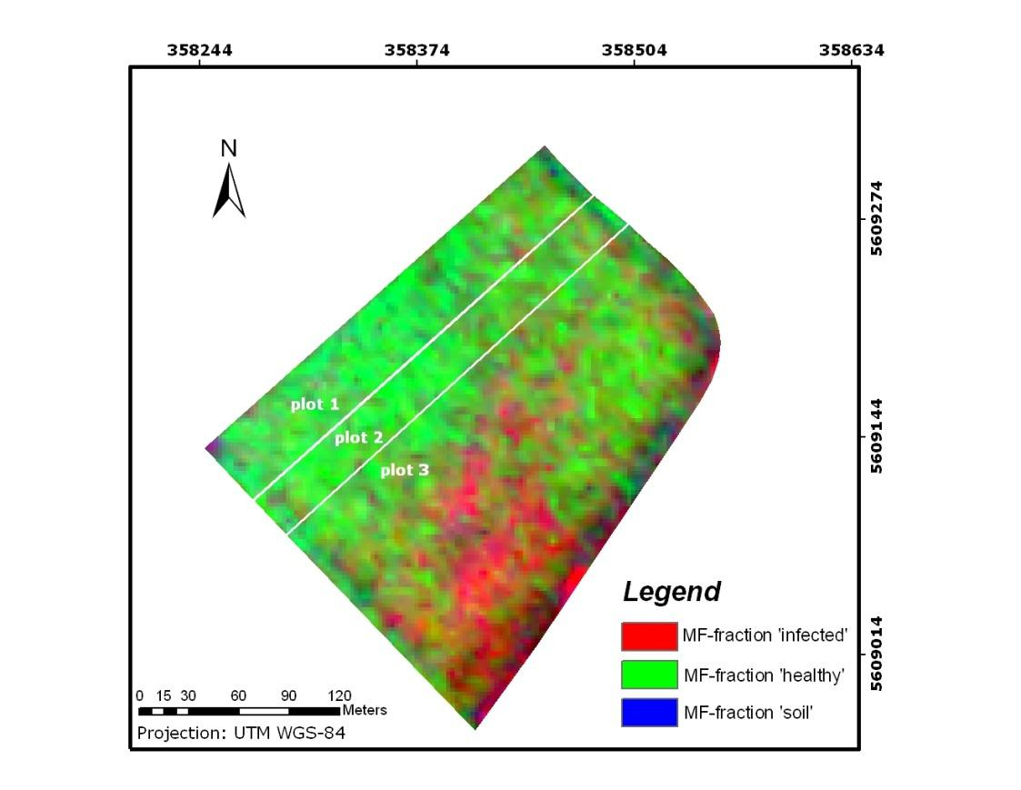
Result 1: fraction map of the field
RESULTS · FIG. 3
What the map shows
Red = high fraction of infected wheat; green = healthy wheat; blue = soil
A large infected area in plot 3 (no fungicide), matching field observations
Plots 1 and 2 (fungicide) mostly green
Spatial pattern visible within plot 3: infection is patchy, not uniform
Fig. 3 – MF fractions: infected (red), healthy (green), soil (blue)
For MuDAS-AI: an infected-fraction map per date gives the within-plot hotspot map you need (Moran's I, Gi*) and spray zones.

Slide 14
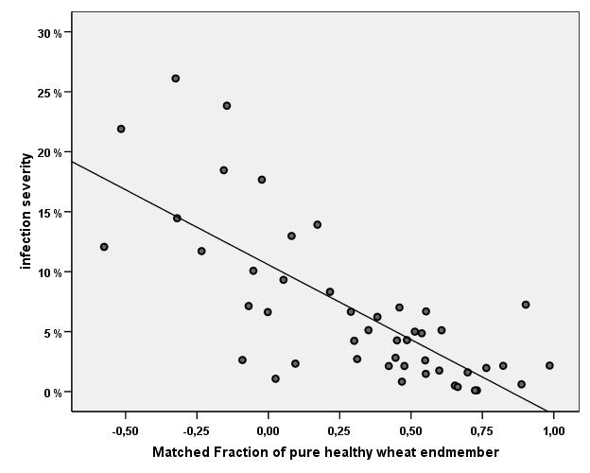
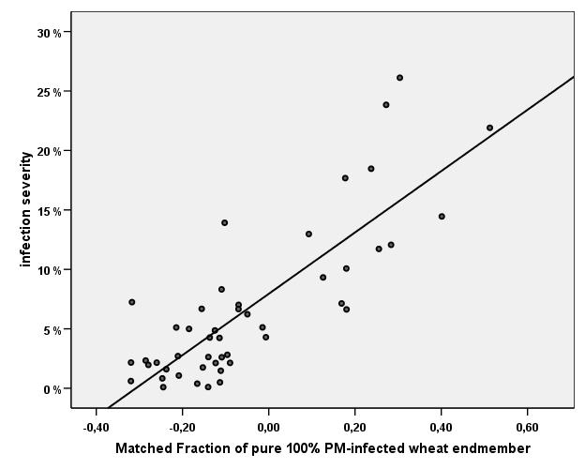
Result 2: fractions versus field-measured severity
RESULTS · FIGS. 4 AND 5
Validation
Mean MF fraction in a 4 m buffer around each of the 54 points
Pearson correlation with % infected leaf area
Direct (infected EM) beat indirect (healthy EM)
Fig. 4 – Healthy-wheat MF fraction: r = −0.74, r² = 0.55
Fig. 5 – Infected-wheat MF fraction: r = 0.82, r² = 0.67
For MuDAS-AI: relate the plot-mean infected fraction to DI per date; report it as a feature in Phase 1 and as a stand-alone, physically interpretable severity estimate.

Slide 15
Discussion and conclusions of the authors
DISCUSSION
Main points
Practical meaning
Airborne hyperspectral data can detect powdery mildew using SMA
Endmember selection itself is informative: no representative infected endmember existed, so early direct detection is hard
Indirect detection works: anything that is 'not healthy' is suspected stress (r² = 0.55)
Direct detection with the modelled infected endmember works better (r² = 0.67)
Infected areas were identified while fungicide application was still possible
Even earlier detection looks possible
Hyperspectral data outperform multispectral for early detection
Operational use needs sensors with suitable spatial, temporal and spectral resolution
For MuDAS-AI: UAV hyperspectral is that operational sensor: centimetre pixels, flexible dates, narrow bands.

Slide 16
Critical appraisal: limitations to keep in mind
DISCUSSION · LIMITATIONS
Study design
Analysis
One date, one field, one cultivar; a short conference paper
54 points, strongly imbalanced (34 below 10%, only 6 above 20%)
4 m pixels versus point-scale severity; a 4 m buffer mean partly fixes this
The infected endmember was modelled from one sample pixel that is also among the 54 validation points (some circularity)
Only correlation is reported; no independent test set or prediction error (RMSE)
MTMF infeasibility thresholds and the fractions used to model the endmember are not reported
Pearson r on skewed severity data; a few high points drive the fit
For MuDAS-AI: derive endmembers from training plots only, keep validation plots separate, report RMSE and rank correlation, and repeat per date.

Slide 17
How this paper maps onto MuDAS-AI
APPLICATION
Franke et al. (2008) | MuDAS-AI (white rust, mustard)
HyMap airborne hyperspectral, 4 m | UAV hyperspectral (and ASD), centimetre pixels
Spectral library of 54 pixels + severity | SMACC endmembers of 48 plots × 4 dates (your workbook) + plot DI
4 severity classes for endmember selection | Your DI classes; plus non-disease classes: soil, shadow, flowers
CoB, EAR, MASA (VIPER tools) | EAR and MASA in Python on the SMACC endmembers; pick one per class
Only healthy endmember found | Expected early on: control plots give healthy; infected may be missing
Modelled 100% infected endmember | Model a 'white rust' endmember from a high-DI training plot
MTMF fraction images | MTMF or fully constrained unmixing → infected-fraction maps
4 m buffer mean vs severity (r = 0.82) | Plot-mean and percentile infected fraction vs DI, per date, grouped CV
Fraction map of the field | Within-plot hotspot maps and spray zones
For MuDAS-AI: the infected fraction is a physically meaningful feature that can join Phase 1 alongside indices, texture and thermal features.

Slide 18
Step-by-step recipe with your SMACC endmembers
APPLICATION · STEP BY STEP
1
Pool candidates
2
Label classes
3
Select per class
SMACC endmembers from all plots and dates, each tagged with plot, date, treatment and DI
Healthy canopy, infected canopy, soil, shadow, flowers (SAM to reference spectra + visual check)
EAR and MASA (and CoB if possible); keep the endmember with lowest EAR/MASA
4
Model if missing
5
Unmix images
6
Use fractions
No pure infected endmember? Unmix a high-DI training plot with healthy + soil (+ flower) endmembers
MTMF or fully constrained SMA → fraction maps per plot and date
Plot mean and P90 of infected fraction → correlate with DI; add to Phase 1; map hotspots
For MuDAS-AI: steps 3–4 must use training plots only; the plot used to model the infected endmember cannot be a test plot.

Slide 19
Formulas to implement EAR, MASA and unmixing
APPLICATION · CALCULATIONS
EARₑ = (1 / (n − 1)) · Σᵢ≠ₑ RMSE(spectrum i modelled by e)
MASAₑ = (1 / (n − 1)) · Σᵢ≠ₑ θ(e, i), θ = arccos( ⟨e, i⟩ / (‖e‖·‖i‖) )
Fully constrained SMA: min ‖ r − E·f ‖² subject to f ≥ 0, Σ f = 1
n = number of candidate spectra in the class; e = candidate endmember; i = other spectra of the same class
In Python: numpy for EAR and MASA; scipy.optimize.nnls with an added row of ones (strong weight) for fully constrained unmixing
Run selection inside training folds; apply the chosen endmembers to all plots
For MuDAS-AI: these are short functions; they can sit next to s04_endmembers.py in your pipeline.

Slide 20
Differences to keep in mind for white rust
APPLICATION · CAUTIONS
Scale
Symptoms
Extra components
4 m HyMap pixels vs your 2–5 cm UAV pixels
At UAV scale more near-pure pixels exist (leaf, soil, flower), so selection may find more endmembers
Pustules (1–2 mm) are still sub-pixel
Powdery mildew: white mycelium on the leaf surface, clearly visible from above
White rust: pustules mainly on the lower surface; the top view sees chlorosis and deformation
Expect a weaker, less specific infected endmember
Mustard flowers (bright yellow) need their own endmember
Shadow and soil change between dates
Select endmembers per date or include a date-specific healthy endmember
For MuDAS-AI: test the infected-fraction feature honestly against simple indices (NDRE, PRI) with the same grouped CV; keep it if it adds information.

Slide 21
Take-home messages
SUMMARY
Unmixing gives a physical severity measure
Infected-endmember fraction correlated with % infected leaf area (r = 0.82)
Endmember quality decides everything
Use EAR, MASA, CoB to pick representative spectra
No pure infected pixel? Model one
Unmix a known infected pixel with healthy and soil endmembers
Direct beats indirect
Infected endmember (r² 0.67) better than 'not healthy' (r² 0.55)
Validate properly
Separate plots for modelling and testing; report errors, not only r
Reference: Franke, J., Mewes, T., Menz, G. (2008). Airborne hyperspectral imaging for the detection of powdery mildew in wheat. Proc. SPIE 7086, Imaging Spectrometry XIII, 708609. https://doi.org/10.1117/12.795040

