Slide 1
UAV-based multi-sensor data fusion and machine learning algorithm for yield prediction in wheat
Fei, S., Hassan, M.A., Xiao, Y., Su, X., Chen, Z., Cheng, Q., Duan, F., Chen, R., Ma, Y. (2023). Precision Agriculture 24, 187–212. doi:10.1007/s11119-022-09938-8
Paper review and its use in MuDAS-AI · Animesh Panda, ICAR-IARI
Notes:
Figures in this deck are screenshots from the paper (Fei et al., 2023). Numbers are quoted from the paper's text and tables.

Slide 2
The paper at a glance
OVERVIEW
180
3
5 + 1
0.692
plots (30 cultivars × 3 irrigation × 2 reps)
UAV sensors: RGB, multispectral, thermal
ML base learners + stacking (ridge)
best test R² (all sensors, stacking)
Question
Answer
Does fusing UAV RGB + multispectral + thermal features improve wheat grain-yield prediction?
Does stacking ensemble learning beat the best single ML model?
Fusion raised R² by up to 31% over single sensors; stacking by up to 5%
Sensors were complementary (VIF < 5 between sensor predictions); ML models were redundant (VIF > 10)
RGB + thermal alone was almost as good as all three
For MuDAS-AI: same three sensor types as MuDAS-AI (MicaSense RedEdge-MX is the identical MS camera), same plot-level feature fusion, and texture computed on thermal and height maps.

Slide 3
Background and research gap
INTRODUCTION
Why UAV phenotyping
Why fusion
Why ensemble learning
Yield estimation from secondary traits is destructive, slow and costly
UAV sensors give low-cost, high-throughput phenotyping
A single sensor has limits for complex traits such as yield
RGB, MS and thermal carry spectral, structural, textural and temperature information
Fusion improved chlorophyll, biomass, LAI, N and yield estimates in earlier work (e.g. Maimaitijiang et al., 2017, 2020)
The best ML model changes with crop, trait and site (RF best for wheat biomass, poor for alfalfa yield)
Single models overfit with small training sets
Stacking (Wolpert, 1992) combines diverse learners
Gap: no wheat-yield study had combined multiple sensors with stacking
For MuDAS-AI: the same argument holds for white rust: one sensor sees one symptom; fusion and a fair comparison of models is the thesis contribution.

Slide 4
Objectives
INTRODUCTION
Evaluate UAV-based multi-sensor data fusion (RGB, MS, TIR) for wheat yield prediction at the grain-filling stage
1
Develop an ensemble (stacking) learning framework to improve the yield-prediction accuracy of individual ML models
2
For MuDAS-AI: your Objective O3 (fusion) and the decision-level comparison (E3) map onto these two objectives one-to-one.

Slide 5
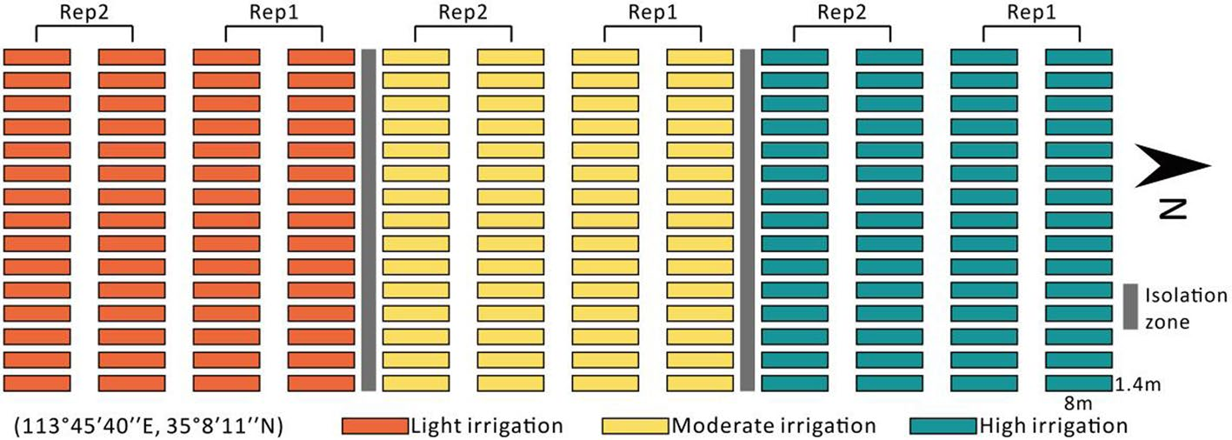
Experimental design
METHODS · FIELD
Design
CAAS research station, Xinxiang, Henan, China; season 2019–2020
30 cultivars of the Yellow and Huai Valleys winter wheat zone
3 irrigation treatments: light, moderate, high (sprinkler)
Randomised blocks, 2 replicates → 180 plots of 8 m × 1.4 m (11.2 m²), 6 rows at 0.20 m
Fertiliser, pests and diseases managed optimally
Fig. 1 – Experimental layout: three irrigation blocks, two replicates (Fei et al., 2023)
Irrigation creates a wide yield range, which helps the models; it also means part of the signal is the treatment itself (see limitations).
For MuDAS-AI: your 48 plots (12 control, 36 inoculated) are the same plot-level design; inoculation plays the role that irrigation plays here.

Slide 6
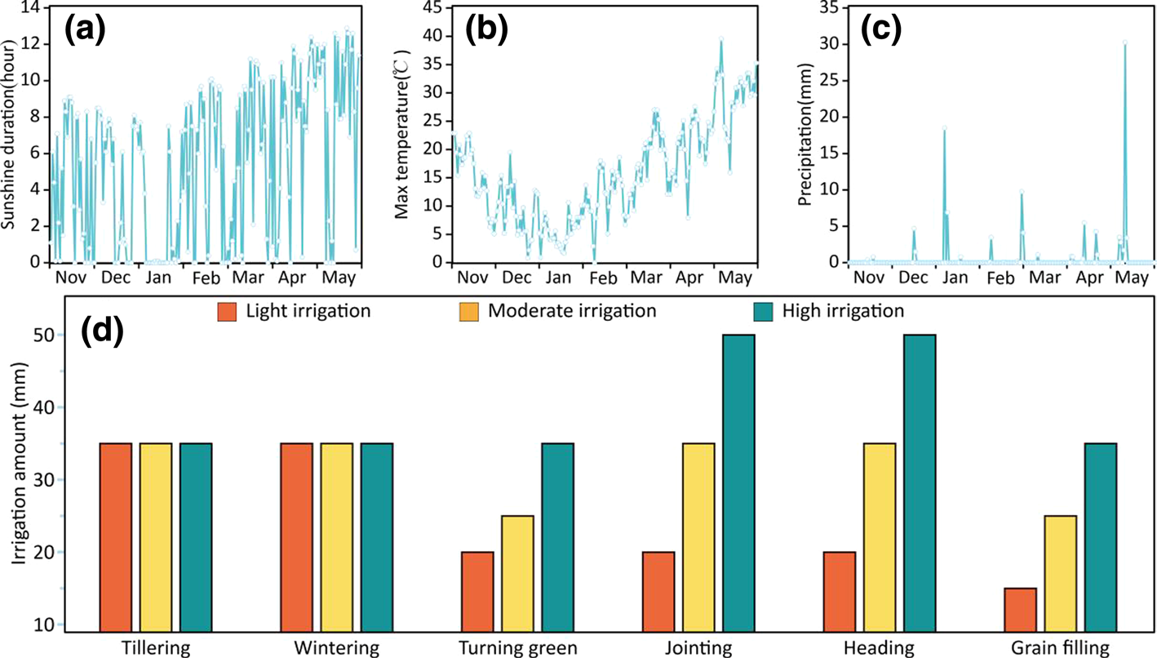
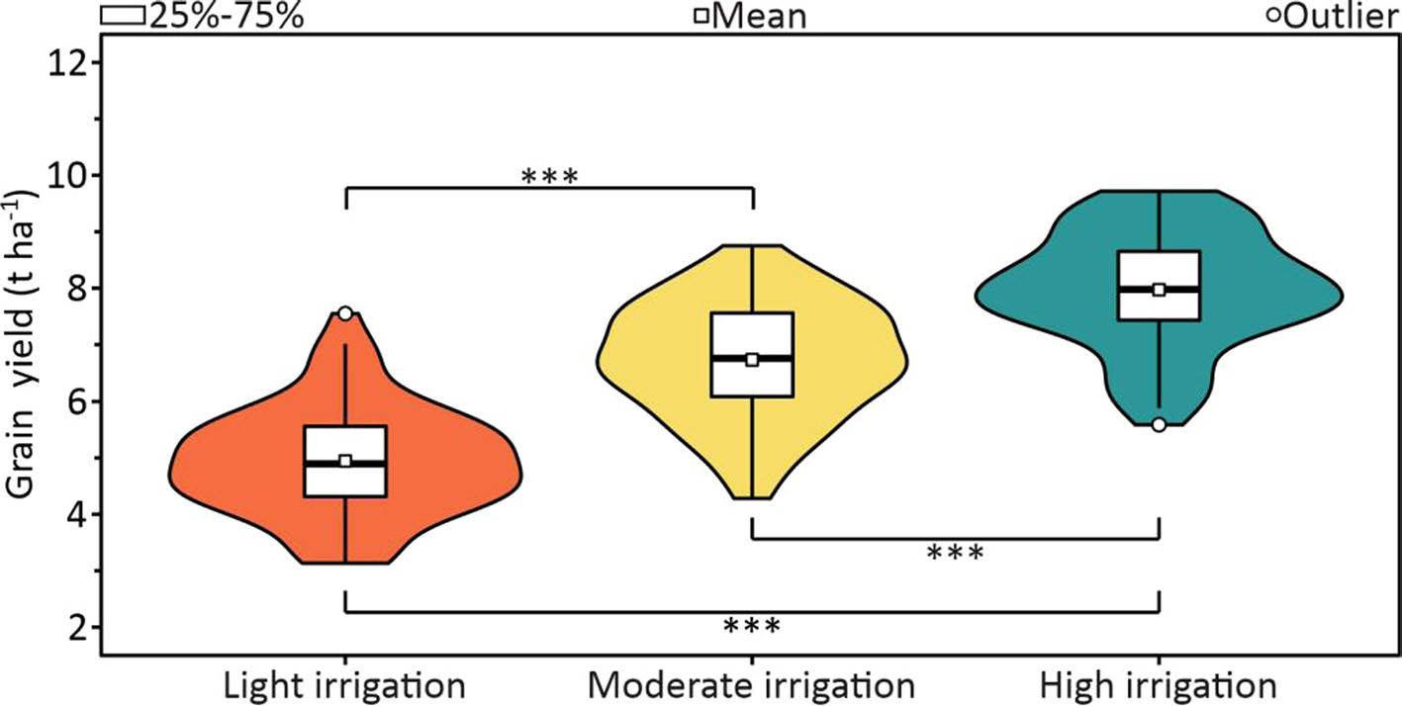
Growing conditions and measured yield
METHODS · FIELD
Fig. 3 – Measured yield by irrigation (t-test, P < 0.001)
Plots harvested by plot combine in early June; grain weighed at ~12.5% moisture
Yield differed significantly between all three irrigation levels
Fig. 2 – Sunshine, max temperature, precipitation and irrigation volume by stage
For MuDAS-AI: record weather on every flight date (thermal features depend on it) and test treatment effects on the label first, as in Fig. 3.

Slide 7
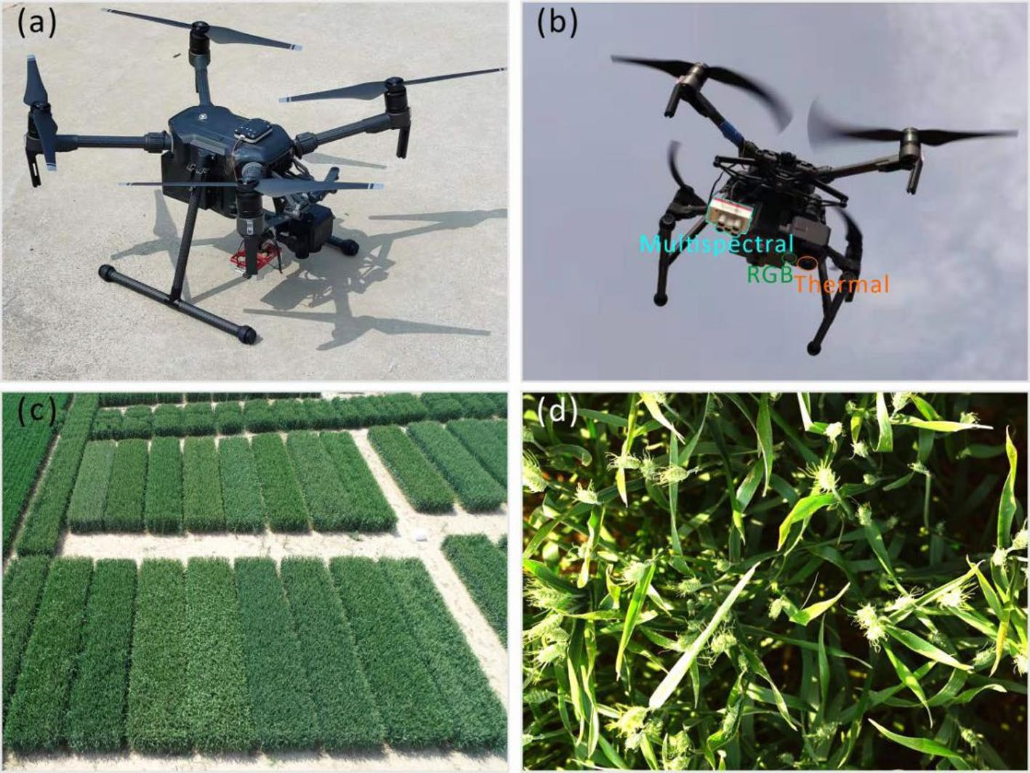
UAV platform and sensors
METHODS · ACQUISITION
Camera | Type | Band / range | Resolution
Red-Edge MX | Multispectral | B 475, G 560, R 668, RE 717, NIR 842 nm | 1280 × 960
Zenmuse XT2 | Thermal | 7.5–13.5 µm | 640 × 512
Zenmuse XT2 | RGB | visible | 4000 × 3000
MS bandwidths: 10 nm (red, red edge), 20 nm (blue, green), 40 nm (NIR)
Sunlight sensor (DLS) on the MS camera corrects ambient light
Flights only at grain filling: a stage known to give good yield predictions
Fig. 4 – DJI M210 with Red-Edge MX and Zenmuse XT2; crop at acquisition
For MuDAS-AI: the MS camera and bands are identical to your MicaSense RedEdge-MX, so their MS indices can be copied directly.

Slide 8
Flight settings and radiometric calibration
METHODS · ACQUISITION
Flights
Multispectral
Thermal
11:00–13:00, clear sky
30 m altitude, 85% front / 80% side overlap, all cameras
Built-in GNSS + GCPs surveyed with differential GNSS (mm precision)
Mission planning: DJI Ground Station Pro
Calibration board imaged before and after each flight
DN → reflectance with known panel reflectance
DLS corrects irradiance changes
Blackboard targets; surface temperature measured with a portable thermometer during flights
Linear DN → temperature: T = 0.2813·DN − 295.98
Check: R² = 0.94, RMSE = 1.73 °C (Fig. 6a)
Canopy temperature differed between irrigation levels (Fig. 6b)
For MuDAS-AI: copy the thermal procedure: reference boards in every flight, handheld IR thermometer readings, a per-flight linear calibration, and report its R²/RMSE.

Slide 9
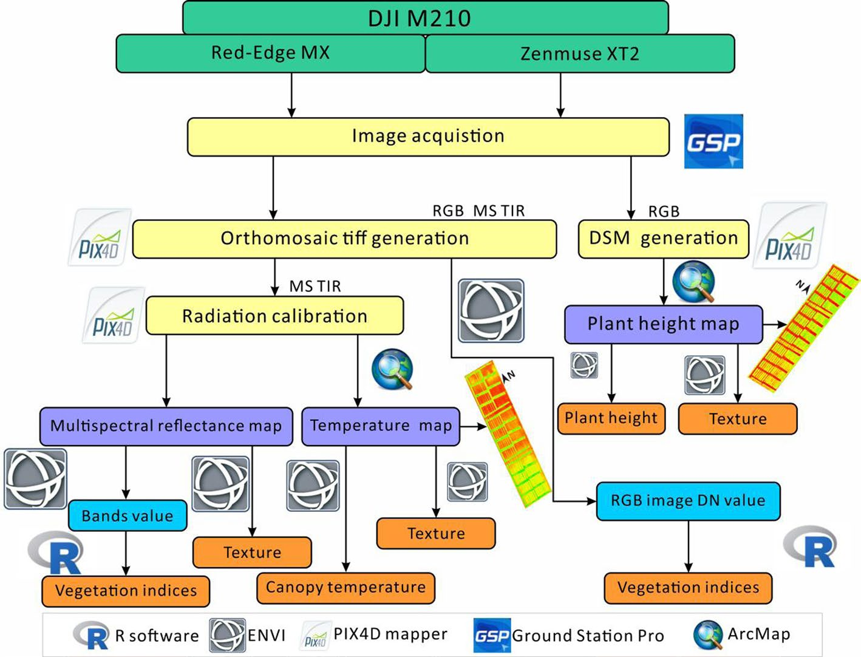
Image processing and feature extraction workflow
METHODS · PROCESSING
Steps
Pix4Dmapper: geolocation, GCP import, alignment, dense point cloud (SfM), DSM and orthomosaics, radiometric calibration
ArcMap 10.5: 180 plot polygons; plot edges omitted to avoid border effects
ENVI 5.3: vegetation indices and GLCM texture from the rasters
Plot feature = mean of all pixel values inside the polygon
R: models
Fig. 5 – Data acquisition, processing and feature extraction workflow
For MuDAS-AI: same structure as your s01–s05 pipeline: orthomosaics → plot polygons with inset → per-plot features from every sensor.

Slide 10
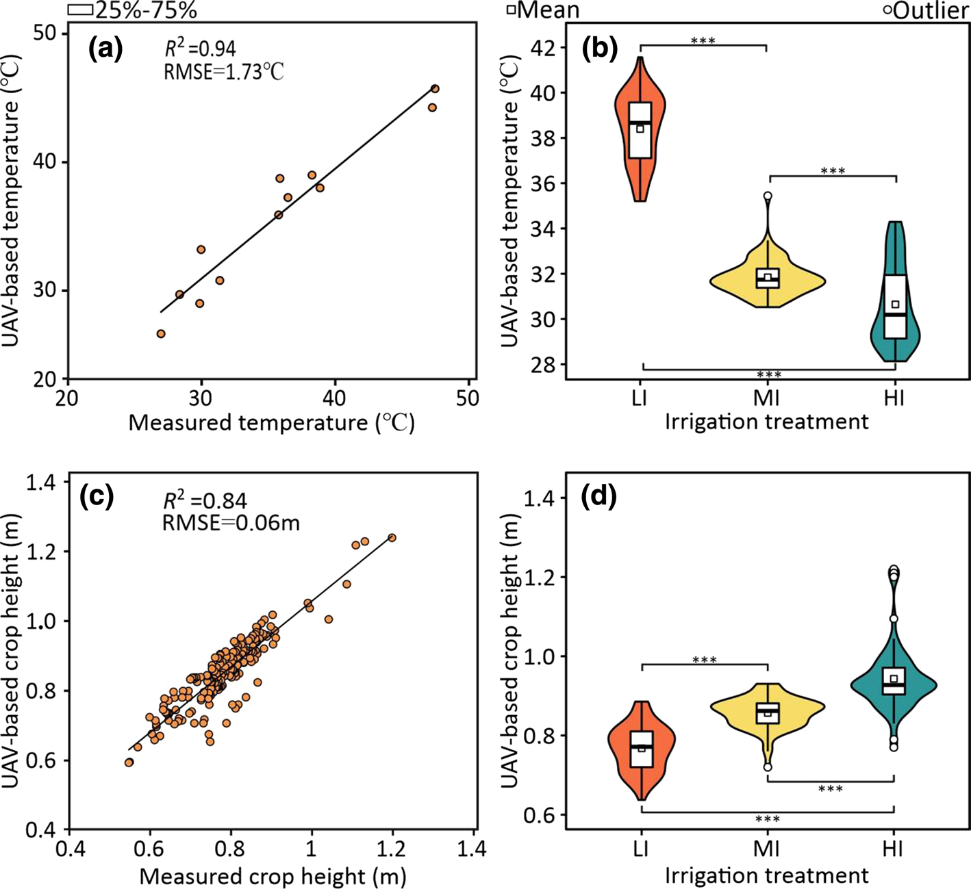
Validating canopy temperature and crop height
METHODS · QUALITY CHECKS
Crop height model (CHM)
Bare-soil DEM from RGB flight before emergence (24 Oct 2019)
DSM from RGB flight on 20 Apr 2020
CHM = DSM − DEM (pixel by pixel)
Validation: 10 plants per plot measured; R² = 0.84, RMSE = 0.06 m
Height and canopy temperature both differed significantly between irrigation levels (P < 0.001)
Fig. 6 – (a) thermal calibration; (b) canopy temperature by treatment; (c) UAV vs measured height; (d) height by treatment
For MuDAS-AI: fly an RGB bare-soil flight after sowing to get the DEM; then canopy height (stunting, stagheads) becomes a structure feature, validated against measured height.

Slide 11
Features extracted from each sensor
METHODS · FEATURES (TABLE 2)
Sensor | Vegetation indices / variables | Texture (GLCM, 8 measures each)
RGB (DN values) | INT, IKAW, IPCA, ExR, ExG, ExGR, MGRVI, RGBVI; crop height (DSM − DEM) | On crop height
Multispectral (reflectance) | NDVI, GNDVI, RVI, NDREI, EVI, OSAVI, MCARI, TCARI, NRI, TVI, MSR, SIPI, PSRI, CIRE, MCARI/OSAVI, TCARI/OSAVI | On blue, green, red, red-edge and NIR bands
Thermal | Canopy temperature (CT) | On canopy temperature
GLCM measures: mean (ME), variance (VA), homogeneity (HO), contrast (CO), dissimilarity (DI), entropy (EN), second moment (SE), correlation (COR) (Haralick et al., 1973)
8 RGB indices + 16 MS indices (24 VIs), height, CT, and 8 texture measures × 7 layers (height, 5 MS bands, CT)
PSRI is adapted to the camera bands: (R − B)/NIR
For MuDAS-AI: most of these features are already in your candidate list; what is new is GLCM texture on canopy temperature and on crop height.

Slide 12
Focus: texture of canopy temperature (thermal GLCM)
METHODS · KEY IDEA FOR YOUR STUDY
What it is
Measure | Formula
Mean (ME) | Σ i·P(i,j)
Variance (VA) | Σ (i − µ)²·P(i,j)
Homogeneity (HO) | Σ P(i,j) / (1 + (i − j)²)
Contrast (CO) | Σ (i − j)²·P(i,j)
Dissimilarity (DI) | Σ |i − j|·P(i,j)
Entropy (EN) | −Σ P(i,j)·ln P(i,j)
Second moment (SE) | Σ P(i,j)²
Correlation (COR) | Σ (i − µᵢ)(j − µⱼ)P(i,j) / (σᵢσⱼ)
The thermal orthomosaic (°C) is quantised into grey levels
A grey-level co-occurrence matrix P(i, j) counts how often level i sits next to level j (set distance and direction) inside a moving window
The 8 measures summarise that matrix; ENVI writes one texture raster per measure
The plot mean of each texture raster is the feature
It describes the spatial heterogeneity of temperature, not its level
The paper does not report window size, number of grey levels, distance or direction: fix and report these in your study.
For MuDAS-AI: patchy white rust should make canopy temperature more uneven inside a plot: expect higher VA, CO, DI and EN and lower HO and SE in infected plots.

Slide 13
Machine-learning models and hyper-parameters
METHODS · MODELLING (TABLE 3)
Model | Type | Hyper-parameters searched
Cubist | Rule-based model trees | Committees 1–25; neighbours 1–9
SVM | Kernel regression (RBF) | Sigma 0.01–0.02 (step 0.0001); C 0.5–0.7 (step 0.01)
DNN | Deep neural network | Units 10–100; epochs 2–120; 1–4 hidden layers; dropout; ReLU
RR | Ridge regression | K (penalty) 0–0.02 (step 0.001)
RF | Random forest | ntree 1000–10,000 (step 500); mtry 1–100 (step 2)
StRR | Stacking with ridge as level-2 learner | Inputs: out-of-fold predictions of the 5 base learners
Five diverse learners: rules (Cubist), kernels (SVM), neural networks (DNN), linear (RR) and trees (RF)
Diversity between base learners is what lets stacking add information
For MuDAS-AI: use RF, SVM and KNN (your base learners) and add stacking as the decision-level fusion experiment E3; for classes, use a logistic-regression level-2 learner.

Slide 14
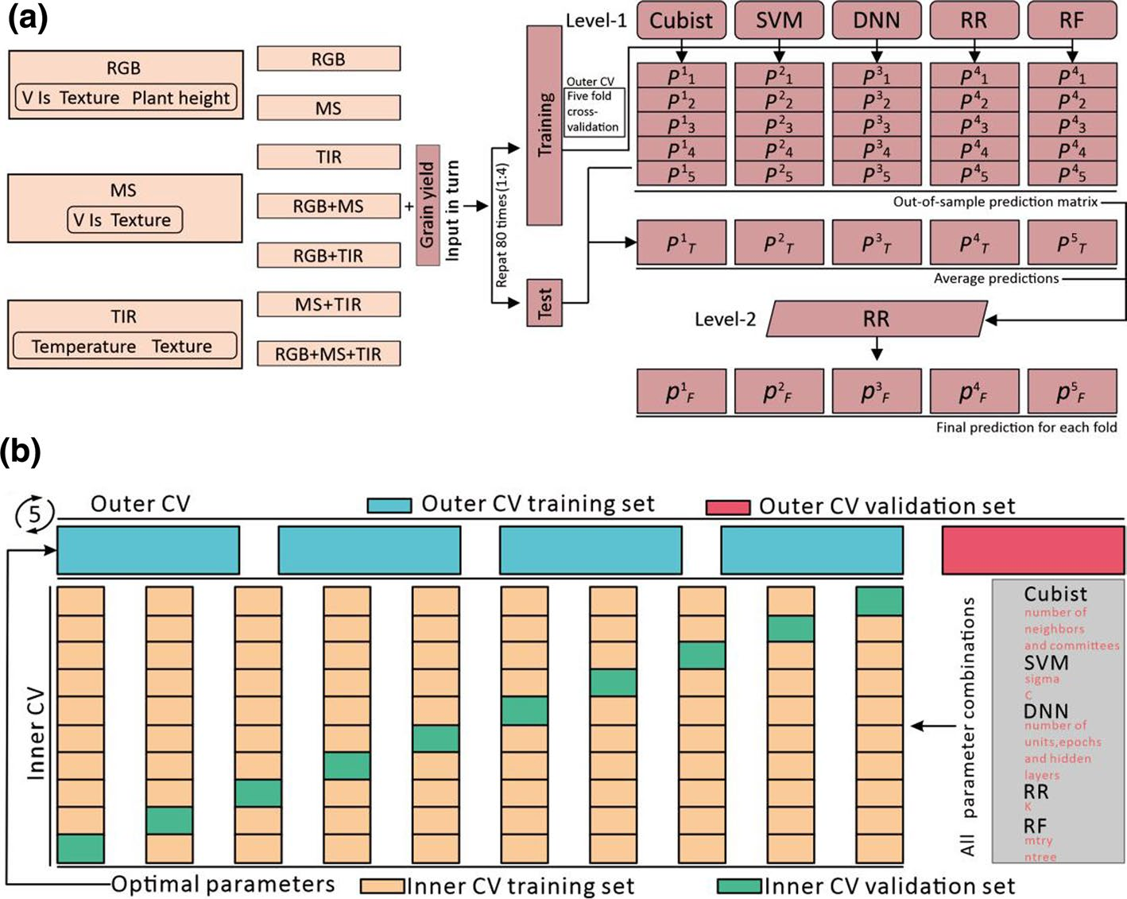
Stacking ensemble and nested cross-validation
METHODS · VALIDATION DESIGN
How it works
Data split 4:1 into training and test sets
Outer 5-fold CV on the training set → out-of-fold predictions of each base learner
Inner 10-fold CV inside each outer fold → hyper-parameter tuning
Level 2: ridge regression trained on the out-of-fold prediction matrix
Test predictions averaged over the 5 outer models
Whole procedure repeated for 80 random splits → 400 tests; same splits for every model and sensor set
Fig. 7 – (a) fusion and stacking workflow; (b) outer and inner cross-validation
For MuDAS-AI: same nested logic as your plan, but split by plot group so that related plots never sit on both sides (see limitations).

Slide 15
Accuracy metrics and collinearity analysis
METHODS · EVALUATION
Accuracy metrics (mean of 400 tests)
Variance inflation factor (VIF)
R² = 1 − Σ(ŷ − y)² / Σ(y − ȳ)²
RMSE = √[Σ(ŷ − y)² / n]
RPD = SD / RMSE
RPIQ = IQ / RMSE (interquartile range of measured yield)
Lower RMSE and higher R², RPD, RPIQ = better
VIF = 1 / (1 − R²ᵢ), regressing one predictor on the others
Applied to model outputs, not raw features:
(a) VIF between predictions made from each sensor → are the sensors redundant?
(b) VIF between predictions of each ML model → are the models redundant?
VIF > 10 = strong collinearity
For MuDAS-AI: computing VIF between single-sensor predictions is a simple, quantitative way to show examiners that your sensors are complementary (the multimodality argument).

Slide 16
Results: test accuracy of every sensor set and model
RESULTS · TABLE 4 (R², MEAN OF 400 TESTS)
Sensor set | Cubist | SVM | DNN | RR | RF | StRR (stacking)
RGB | 0.514 | 0.597 | 0.606 | 0.556 | 0.605 | 0.624
MS | 0.498 | 0.502 | 0.489 | 0.477 | 0.509 | 0.532
TIR | 0.529 | 0.553 | 0.578 | 0.563 | 0.599 | 0.617
RGB + MS | 0.541 | 0.638 | 0.648 | 0.605 | 0.622 | 0.662
RGB + TIR | 0.527 | 0.615 | 0.631 | 0.603 | 0.670 | 0.671
MS + TIR | 0.543 | 0.591 | 0.596 | 0.592 | 0.629 | 0.640
RGB + MS + TIR | 0.563 | 0.666 | 0.670 | 0.630 | 0.665 | 0.692
Key numbers
Best single sensor: RGB (DNN 0.606); MS weakest (≤ 0.532)
Best fusion, single model: DNN 0.670 (all three); RF 0.670 (RGB + TIR)
Best overall: StRR on all sensors: R² 0.692, RMSE 0.916 t/ha, RPD 1.771, RPIQ 2.602
Stacking was best in every row
Highlighted: best overall (stacking, all sensors) and RGB + TIR with RF, which nearly matches it with one sensor fewer.
For MuDAS-AI: build the same table for your 15 sensor combinations × RF/SVM/KNN/stacking, with macro-F1 and weighted kappa instead of R².

Slide 17
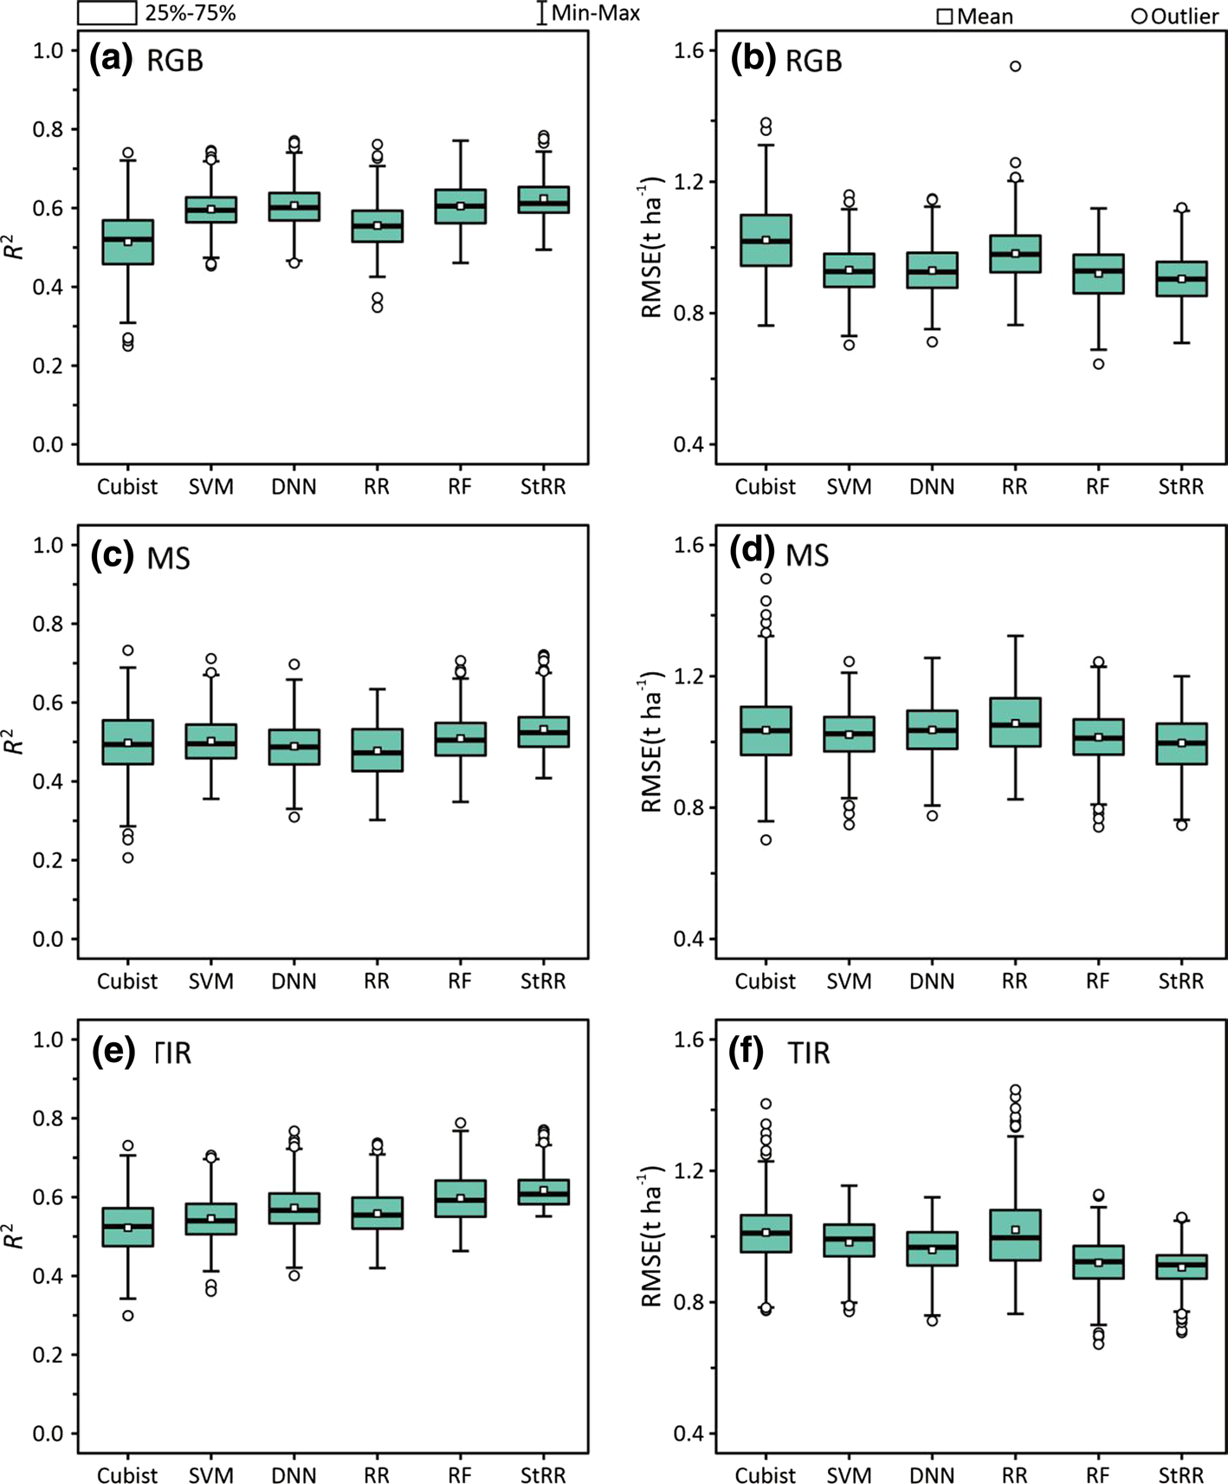
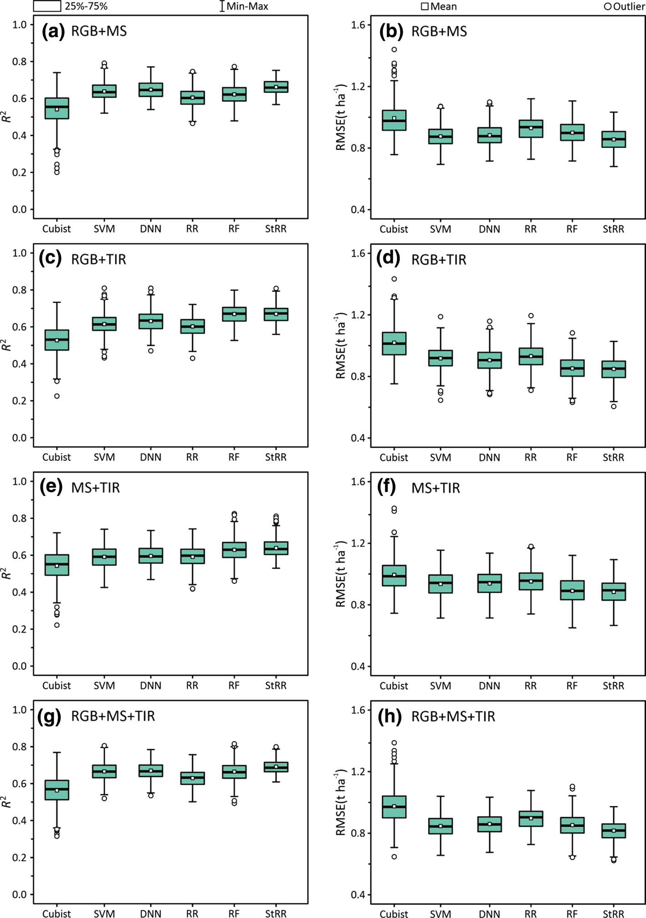
Distribution of accuracy over 400 tests
RESULTS · FIGS. 8 AND 9
Reading the boxplots
Individual models fluctuate widely between the 400 tests
Stacking narrows the spread: more stable predictions
Fusion also narrows the spread for every model
Reporting the distribution, not one split, is good practice
Fig. 8 – Single sensors: R² and RMSE
Fig. 9 – Sensor fusion: R² and RMSE
For MuDAS-AI: repeat your outer CV with several seeds and show boxplots of macro-F1 per sensor set and model, as here.

Slide 18
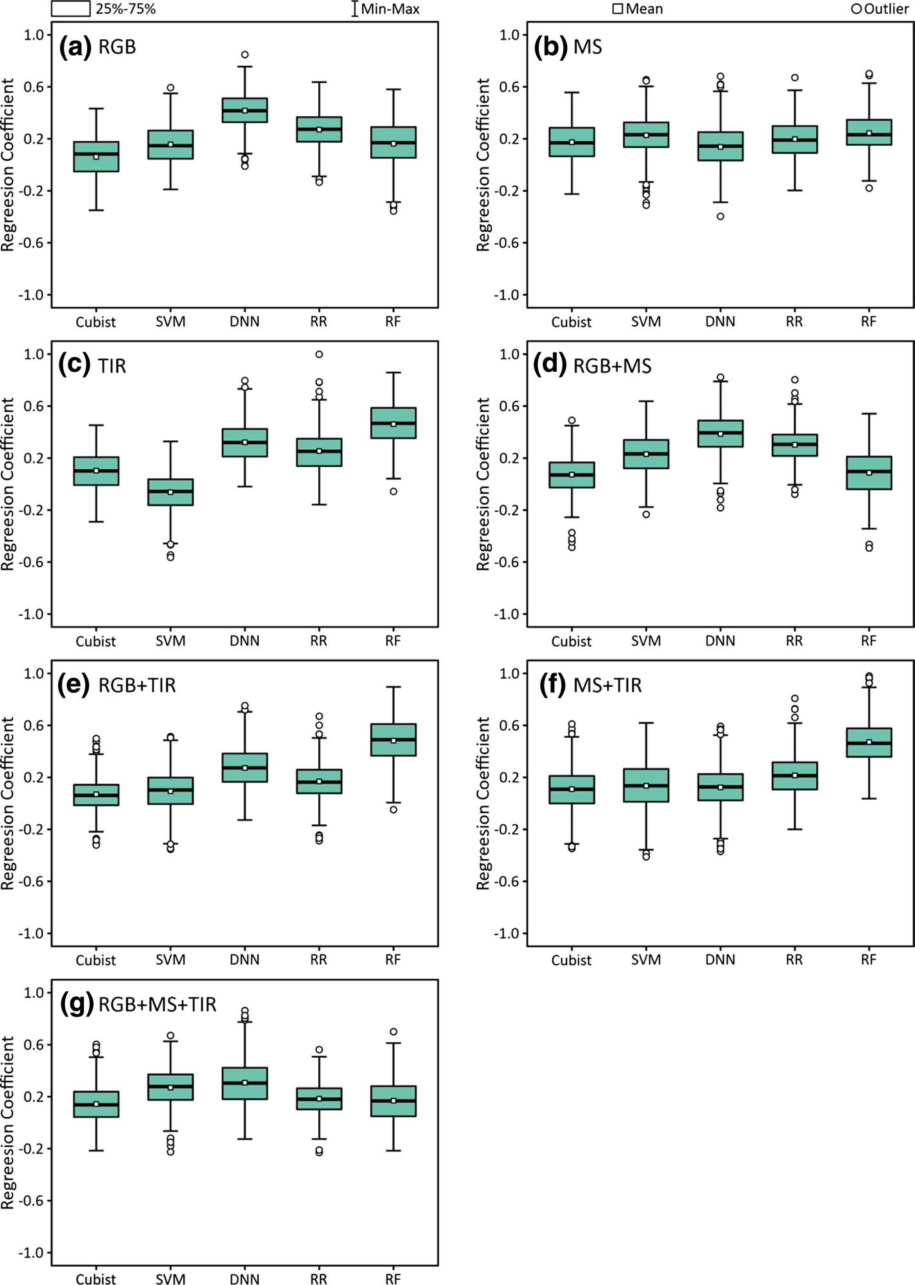
Which base learners does stacking trust?
RESULTS · FIG. 10
Findings
Larger ridge coefficient = larger weight of that base learner in the ensemble
Learners that were accurate on their own received larger weights (e.g. DNN for RGB; RF for TIR, RGB + TIR and MS + TIR)
So the ensemble's performance depends on having at least one strong base learner
Interpretation tool: the level-2 weights show which model the ensemble relies on, just as gating weights would show which sensor a DL fusion network relies on
Fig. 10 – Ridge coefficients of each base learner in the level-2 model
For MuDAS-AI: report the level-2 weights of your stacking model per date; a stable pattern supports the robustness of the decision-level fusion.

Slide 19
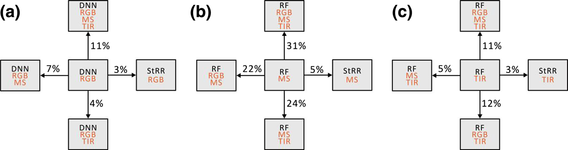
Fusion helps more than ensembling
RESULTS · FIG. 11
Fig. 11 – R² gains of ensemble learning (horizontal) and data fusion (vertical) over the best single model
Ensemble learning
Multi-sensor fusion
R² gain up to 5% over the best individual model
R² gain up to 31% over the single sensor (MS → RGB + MS + TIR)
For MuDAS-AI: expect the sensor choice (fusion) to matter more than the algorithm choice; put more effort into features and sensors than into tuning many models.

Slide 20
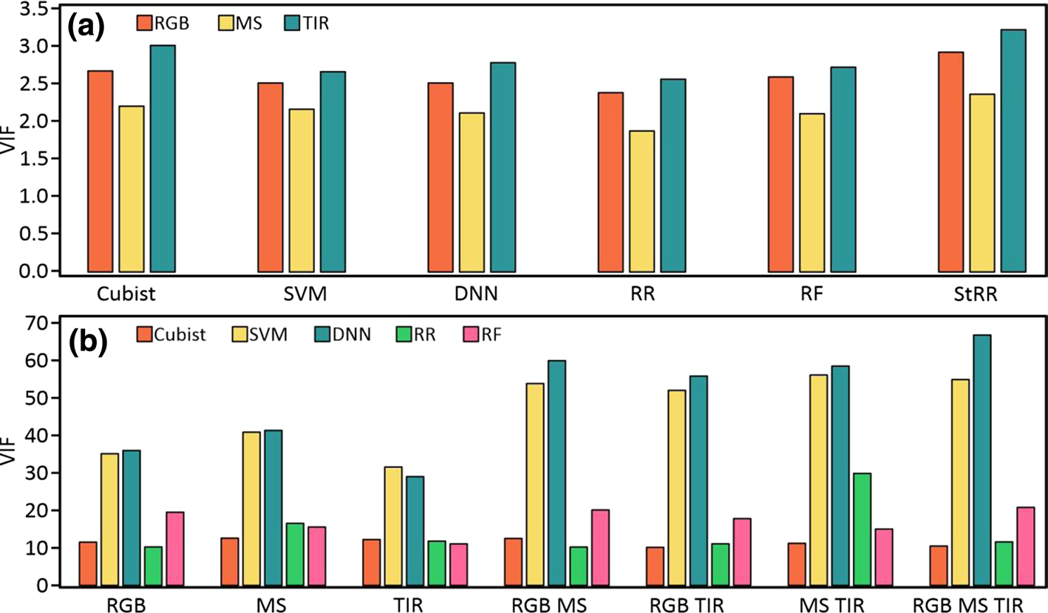
Sensors are complementary, models are redundant
RESULTS · FIG. 12
Interpretation
(a) Predictions from RGB, MS and TIR: VIF < 5 → modest collinearity → each sensor adds new information
(b) Predictions from the five ML models: VIF > 10 for several models → they largely say the same thing
Hence fusion of sensors improved accuracy far more than fusion of models
Fig. 12 – VIF of predictions from (a) each sensor and (b) each ML model
For MuDAS-AI: repeat analysis (a) with your four sensors on white rust: low VIF between sensor-wise predictions is direct evidence for multimodal complementarity.

Slide 21
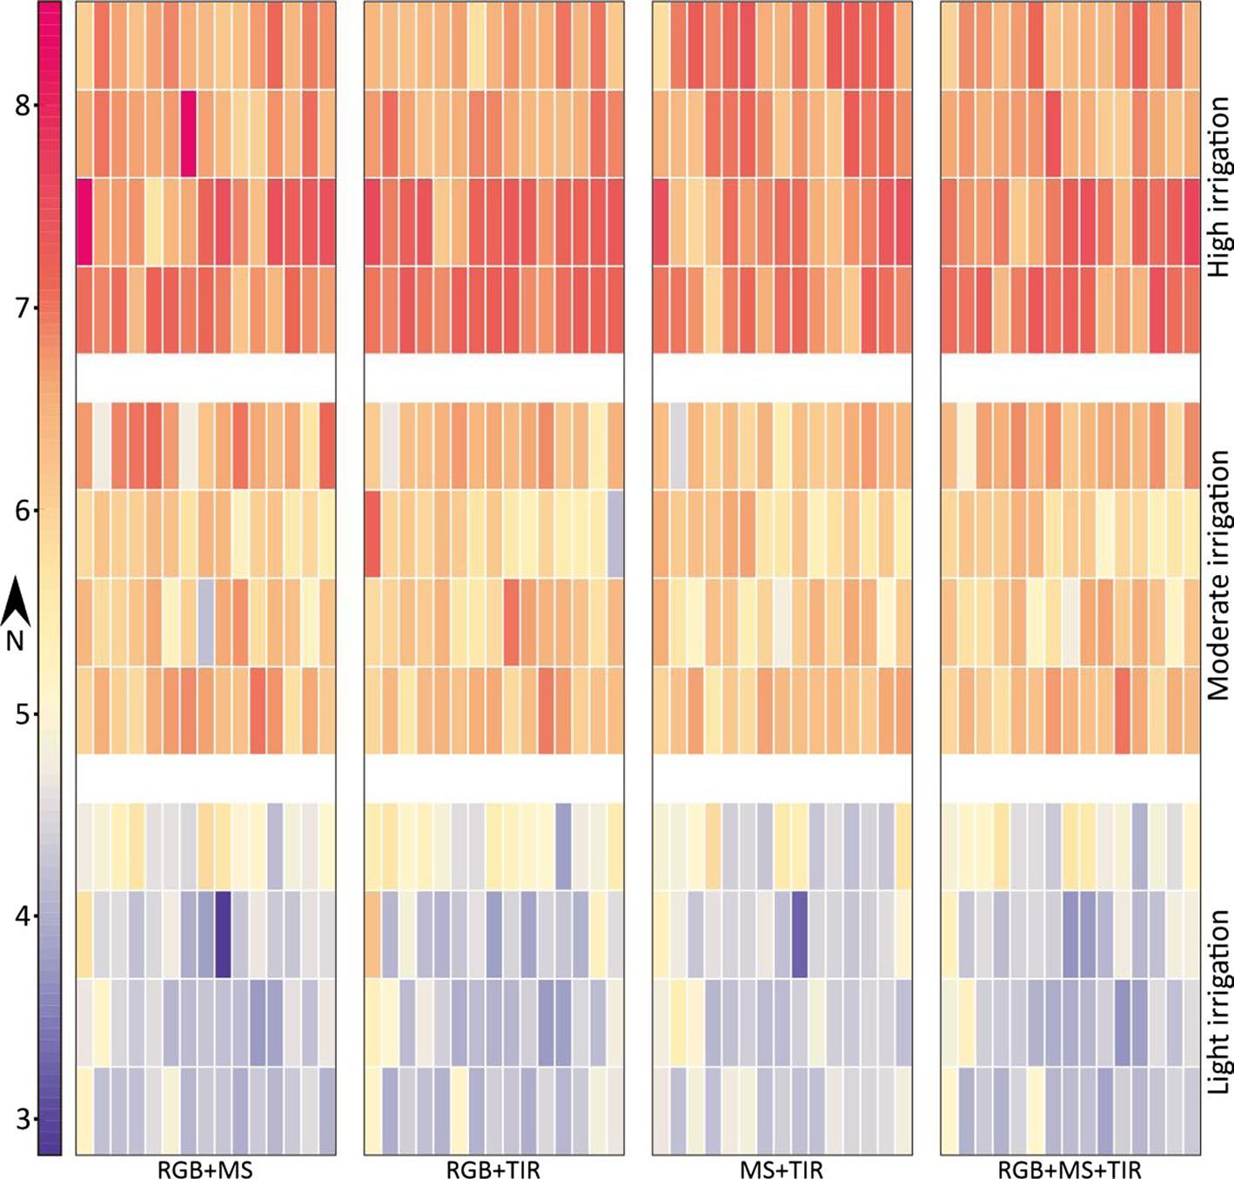
Mapping predicted yield
RESULTS · FIG. 13
What the maps show
2,800 test predictions from 80 splits; the final value per plot is their average
Yield rises clearly from light to high irrigation in all fusion sets
Predicted yields differ significantly between irrigation treatments, as do the measured yields
Maps are at plot scale (one value per plot), not pixel scale
Fig. 13 – Plot-level yield maps from stacking with each fusion set
For MuDAS-AI: the same plot-scale map is your first severity map: one predicted class per plot per date, averaged over repeated CV runs.

Slide 22
Discussion: why the sensors behaved as they did
DISCUSSION
MS was weakest
RGB was strongest
Thermal was strong
MS indices saturate in dense green canopies
Coarser pixels → more mixed pixels of wheat and soil
MS texture added little beyond MS indices
Highest spatial resolution
Crop height from the RGB DSM is closely linked to biomass and yield
Removing RGB features hurt accuracy most (Table S1)
Canopy temperature tracks plant water status, which drove yield under the irrigation treatments
Thermal features do not saturate like VIs
Removing TIR was the second-largest loss; RGB + TIR was almost as good as all three
For MuDAS-AI: for white rust the ranking may differ (pustules and chlorosis are spectral and textural); test it, and use the cost argument (RGB + TIR) for Objective O4.

Slide 23
Critical appraisal: limitations to keep in mind
DISCUSSION · LIMITATIONS
Stated by the authors
Additional points
One site, one season, one growth stage (grain filling)
Cultivars mostly from one region
Ensembles cost more training time
Raw images with deep learning could add information (future work)
Random 4:1 splits of plots: the other plots of the same cultivar (other replicate, other irrigation levels) can sit in training, which may make test accuracy optimistic
Treatment-driven range: much of the yield variance is between irrigation levels, which also change temperature and height; within-treatment accuracy is not reported
GLCM settings (window, grey levels, distance, direction) are not reported
Many features, no feature selection; relies on RR/RF regularisation
For MuDAS-AI: group your CV folds by plot, report accuracy within inoculated plots as well as overall, and state all texture parameters.

Slide 24
How this paper maps onto MuDAS-AI
APPLICATION
Element in Fei et al. (2023) | Use in MuDAS-AI (white rust, mustard) | Where
RGB + MicaSense RedEdge-MX + thermal on one UAV | Same sensors; add hyperspectral as the 4th modality | Acquisition
Blackboard + handheld thermometer, linear DN → °C | Thermal calibration per flight; report R², RMSE; convert to CTD / NRCT | Step 2–3
Bare-soil DEM + DSM → CHM, validated (R² 0.84) | Canopy height, stunting and staghead structure; measure 10 plants/plot | Features
24 VIs + GLCM on 5 MS bands, CHM and CT | Add GLCM on CT/CTD and on CHM to Phase 1 candidates | Phase 1
Plot polygons with edges omitted; plot-mean features | Plot inset (≈ 0.4 m); add percentiles to plot means | Features
7 sensor combinations × 5 models + stacking | 15 combinations × RF/SVM/KNN + stacking (E2, E3) | Phase 3
VIF between sensor-wise predictions | Quantitative proof of sensor complementarity | Results
80 repeated splits, boxplots of accuracy | Repeated, plot-grouped nested CV; boxplots of macro-F1 | Validation
Plot-scale yield maps | Plot-scale severity maps per date | Objective O5
For MuDAS-AI: most of the paper's workflow can be reused directly; the main changes are a classification target, grouped CV and multiple dates.

Slide 25
Recipe: texture of canopy temperature for white rust
APPLICATION · STEP BY STEP
1
Calibrate
2
Mask
3
Quantise
DN → °C with reference boards (per flight); CTD = Tc − Tair
Keep canopy pixels (NDVI/ExG mask from RGB or MS); remove soil and flowers
Fixed range across dates (e.g. CTD −8 to +8 °C) into 32 or 64 grey levels
4
GLCM
5
Plot features
6
Select & fuse
Window 5 × 5 (or 7 × 7), distance 1, average of 4 directions
Plot mean (and SD) of ME, VA, HO, CO, DI, EN, SE, COR inside the inset
Phase 1 screening, VIF, ML-SFFS; fuse with spectral and RGB features
For MuDAS-AI: use the same fixed range and grey levels on every date; otherwise texture changes with the weather instead of the disease.

Slide 26
Take-home messages
SUMMARY
Fusion > single sensor
R² rose by up to 31% when RGB, MS and thermal features were combined
Stacking adds a little
Up to 5% R² gain and more stable predictions
Sensors complement each other
VIF < 5 between sensor predictions; models were redundant (VIF > 10)
Texture on non-optical layers
GLCM on canopy temperature and crop height is a cheap, new feature type
Validate carefully
Group splits by plot or cultivar; report within-treatment accuracy and texture settings
Reference: Fei, S., et al. (2023). UAV-based multi-sensor data fusion and machine learning algorithm for yield prediction in wheat. Precision Agriculture 24, 187–212. https://doi.org/10.1007/s11119-022-09938-8

