Slide 1
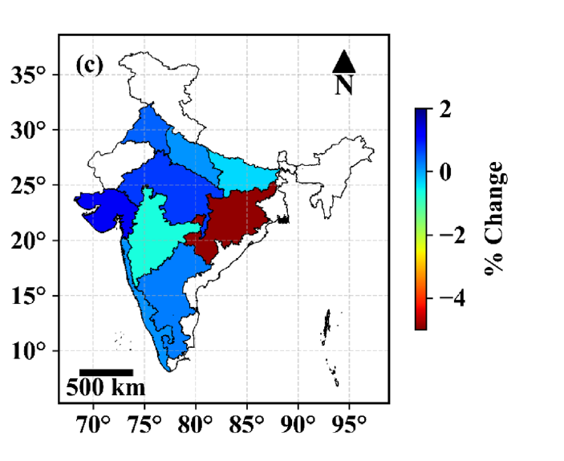
Evidence from India and South Asia
7 · Evidence
Region | System | Aerosol impact | Reference
India (9 rainfed rice states) | Rice · 1966–1998 | +10.6% harvest without brown clouds (via rain) | Auffhammer et al., 2006
India (district-level) | Wheat · 1980–2010 | Up to −36% (black carbon + ozone) | Burney & Ramanathan, 2014
India (cropland) | Rice, maize · 1998–2019 | Rice −7.9%, maize −8.8% | Gupta et al., 2024
India (9 agroclimatic zones) | Rice | India −0.73% yr⁻¹; EPH −4.88% yr⁻¹ | Gupta et al., 2025
India | Wheat · 1981–2009 | 1 SD less AOD → +4.8% yield | Gupta et al., 2017
Bangladesh (8 divisions) | Boro rice · 2007–2023 | + in 5 divisions, − in 3 | Jannat et al., 2026
Rice yield change due to AOD by agroclimatic zone
Largest losses in the Eastern Plateau and Hills
Source: Gupta et al., 2025
India: high, rising and partly absorbing aerosol mostly lowers yield, through less sunlight, weaker monsoon rain and warmer nights; gains appear only where AOD is moderate.
Notes:
This slide presents the evidence on how aerosol affects agricultural productivity in India and South Asia, with six studies spanning different crops, locations and time periods.
Auffhammer and colleagues, 2006, studied nine rainfed rice-growing states of India: Assam, Bihar, Karnataka, Kerala, Madhya Pradesh, Maharashtra, Orissa, Uttar Pradesh and West Bengal, from 1966 to 1998. They found that removing Asian Brown Clouds alone would have raised rice harvests by 10.6 percent by the late 1990s, primarily because the aerosol weakened monsoon rainfall, reducing both the area planted and the yield per hectare.
Burney and Ramanathan, 2014, used district-level data across all of India for wheat from 1980 to 2010. They found that the combined direct effects of black carbon and tropospheric ozone, beyond their indirect climate effects, reduced wheat yields by up to 36 percent, making air pollution a major threat to Indian food security.
Gupta and colleagues, 2024, analysed cropland areas across India from 1998 to 2019 using satellite-derived aerosol optical depth and found that aerosol pollution reduced rice yield by 7.9 percent and maize yield by 8.8 percent.
Gupta and colleagues, 2025, examined rice yields across nine agroclimatic zones of India. The all-India average decline due to aerosol was 0.73 percent per year, but the Eastern Plateau and Hills, labelled EPH on the map, suffered the most at 4.88 percent per year. The map on the right shows the spatial pattern of this AOD-related yield change.
Gupta and colleagues, 2017, analysed the impact of temperature, solar radiation and aerosols on wheat yields across India from 1981 to 2009. They found that a decrease in aerosol optical depth equivalent to one standard deviation would raise wheat yields by 4.8 percent, showing a clear negative impact of aerosol loading on wheat productivity.
Jannat and colleagues, 2026, studied boro rice across the eight administrative divisions of Bangladesh from 2007 to 2023. The aerosol effect was positive, meaning higher AOD raised yield, in five divisions: Khulna, Barisal, Rangpur, Mymensingh and Sylhet, and negative in three: Chattogram, Dhaka and Rajshahi.
The bottom strip summarises the overall pattern: India's aerosol is high, rising and partly absorbing, which mostly lowers yields through less sunlight reaching the crop, weakened monsoon rainfall and warmer nights. Gains appear only where AOD is moderate.

