Slide 1
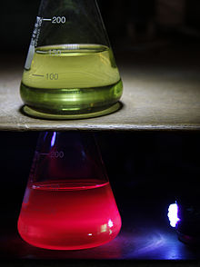
Chlorophyll Fluorescence & Sun-Induced Fluorescence
From PSII photophysics and PAM fluorometry to remote sensing of SIF from space — a systematic, diagram-led guide
Chlorophyll extract: green in white light, glowing red under UV
Based on Murchie & Lawson (2013) J. Exp. Bot. 64: 3983–3998 · Mohammed et al. (2019) Remote Sens. Environ. 231: 111177 · course slides on Chl a fluorescence
Notes:
This deck builds the topic from the ground up: the physics of how chlorophyll re-emits light, how we measure it actively with PAM fluorometers, how each parameter is derived, the pitfalls, and then how the same signal is measured passively under sunlight (SIF) from towers, drones, aircraft and satellites.

Slide 2
Roadmap of this deck
01
Foundations
02
Measuring it
03
Induction kinetics
What fluorescence is and where it comes from
Ambient light problem, PAM modulation, instruments
Kautsky effect, OJIP and the slow PSMT phase
04
PSII redox & quenching
05
PAM parameters
06
Good practice
Open/closed centres, qP, NPQ, saturating pulse
Fo, Fm, Fv/Fm, ΦPSII, qP, qL, NPQ, worked example
Dark adaptation, pitfalls, CO₂ link, protocols
07
Imaging & monitoring
08
Sun-induced fluorescence
09
Synthesis
Fluorescence imaging, applications, LIFT
Spectra, retrieval, models, platforms, satellites
Concept map, formula sheet, FAQs, references
Notes:
Each module builds on the previous one. If a later slide is confusing, go back to the module it depends on: parameters (05) depend on the open/closed reaction-centre idea (04), and SIF (08) depends on the energy-partitioning idea (01).

Slide 3
Foundations
01
What chlorophyll fluorescence is, where it comes from, and why a tiny glow tells us so much about photosynthesis
Notes:
Key idea of this module: absorbed light energy has three possible fates that compete. Fluorescence is the one we can see, so it reports on the other two.

Slide 4
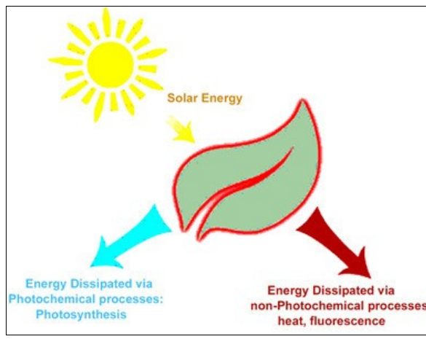
What is chlorophyll fluorescence?
Definition: light re-emitted by chlorophyll molecules as they return from the excited to the ground (non-excited) state.
Why it matters
Non-invasive measure of photosystem II (PSII) activity — no harvesting, no chemicals
PSII is highly sensitive to abiotic and biotic factors → a broad indicator of how plants respond to environmental change
Indicator of photosynthetic energy conversion in higher plants, algae and bacteria
Cheap, fast and portable → widely used in plant physiology, breeding and phenotyping
Spectral signature: emission between ~650 and 800 nm with two peaks, ~685 nm (red) and ~740 nm (far-red)
Left: chlorophyll extract in alcohol — green under white light (top), red fluorescence under UV (bottom). Right: absorbed solar energy is dissipated by photochemistry or by non-photochemical routes (heat, fluorescence).
Notes:
Definition first. Chlorophyll absorbs light, becomes excited, and a small fraction of that energy is re-emitted as red/far-red light as the molecule returns to its ground state. Because PSII is very sensitive to stress, this re-emission is a cheap, fast, non-invasive window into how the photosynthetic machinery is coping.

Slide 5
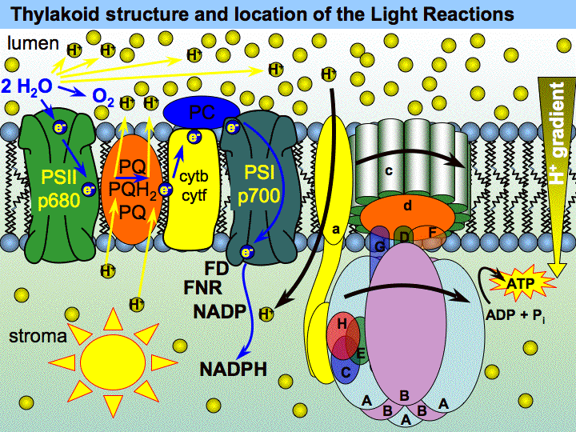



Where does it come from? The pigment–protein complexes
Light-harvesting complexes (LHC)
Antenna pigment–protein complexes (Chl a, Chl b, carotenoids) that capture photons and transfer excitation energy to a reaction centre.
Photosystem II (P680)
Core proteins D1, D2, CP43, CP47; splits water (OEC), passes electrons via pheophytin → Q_{A} → Q_{B}. Main source of variable fluorescence.
Photosystem I (P700)
Thylakoid membrane: PSII, cytochrome b₆f, PSI and ATP synthase, with water splitting on the lumen side
Receives electrons from plastocyanin and reduces NADP⁺ via ferredoxin. Emits weakly, mostly in the far-red (>700 nm).
Notes:
Chlorophyll is not free in the leaf; it is bound to proteins in the thylakoid membrane. The light-harvesting complexes (LHCII, LHCI) act as antennae and funnel excitation energy to the reaction centres P680 (PSII) and P700 (PSI). Fluorescence comes mainly from the PSII antenna and core.

Slide 6
The photophysics: excitation and emission
Three rules that clear most doubts
S₂
higher excited singlet
Excitation colour does not matter: everything relaxes to S₁ first, so emission is always red/far-red (Kasha's rule)
Emission is at longer wavelength than absorption (Stokes shift)
Processes from S₁ compete: the faster one route is, the less goes to the others
Blue absorption
~430–450 nm
Internal conversion
(heat, femtoseconds)
Photochemistry
S₁
lowest excited singlet
Numbers worth remembering
Red absorption
~660–680 nm
Fluorescence quantum yield in vivo: typically 0.5–3 % (always <10 %)
Fluorescence lifetime: tens to hundreds of picoseconds
Emission peaks: F₆₈₅ (PSII) and F₇₄₀ (PSII + PSI)
Charge separation in an open PSII centre is very fast, so photochemistry normally wins
T₁ triplet
Fluorescence
650–800 nm
¹O₂ risk; quenched by carotenoids
Heat
(NPQ)
S₀
ground state
Notes:
Why does blue light make red fluorescence? Blue photons lift chlorophyll to the higher excited state S2, which relaxes within femtoseconds to S1 by internal conversion (heat). All useful work and all fluorescence start from the lowest excited singlet S1, so emission is always red, whatever the excitation colour, and it is shifted to longer wavelengths than the red absorption band (Stokes shift). From S1 the energy can go to photochemistry, heat, fluorescence, or into the triplet state, which can form harmful singlet oxygen unless carotenoids quench it.

Slide 7

Three competing fates of absorbed light energy
① Photochemistry rate k_{P}
Drives charge separation in PSII → electron transport → ATP + NADPH → CO₂ assimilation
The competition rule
Φ_{P} + Φ_{N} + Φ_{F} = 1
Φ_{F} = k_{F} / (k_{F} + k_{P} + k_{N})
Centres closed → k_{P} ≈ 0 → fluorescence rises
NPQ switched on → k_{N} ↑ → fluorescence falls
So fluorescence reports photochemistry and heat loss indirectly
Chl∗
② Heat (NPQ) rate k_{N}
Safe dissipation of excess energy; photoprotective (ΔpH, PsbS, zeaxanthin)
excited
Absorbed photon
③ Fluorescence rate k_{F}
Re-emitted as red / far-red light (650–800 nm); the part we measure
Analogy: three taps fed by one water tank. Close the photochemistry tap (saturating pulse) and the level in the fluorescence tap jumps — that jump is what PAM fluorometry measures.
Notes:
The single most important concept. Because the three routes compete for the same excitation, their yields add up to one. If photochemistry slows (reaction centres closed) or heat dissipation is low, fluorescence rises. If photochemistry or NPQ increases, fluorescence is 'quenched'. Measuring fluorescence under controlled conditions therefore lets us infer the other two.

Slide 8
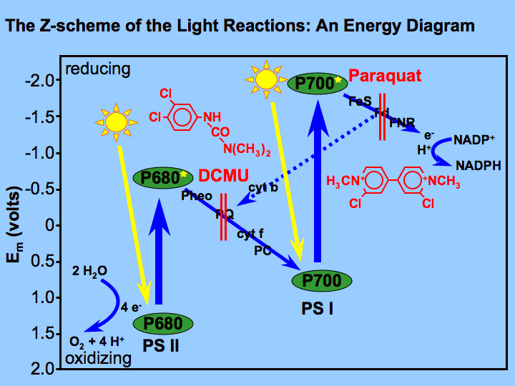
Why we treat the signal as coming from PSII
PSII dominates the variable signal
At room temperature, changes in fluorescence are attributed to PSII only
PSI contributes little below 700 nm → ignored in most PAM work
PSII emits at both 685 and 740 nm; PSI mostly at ~740 nm
Why this is useful
Photochemistry supplies the energy (ATP) and reducing power (NADPH) for CO₂ assimilation
Fluorescence yield ⇒ quantum efficiency of PSII photochemistry and heat dissipation
PSII is the most stress-sensitive part of the chain → early warning of stress
Caveat for SIF: far-red SIF also contains PSI emission
Z-scheme: electrons flow from water through PSII (P680) and PSI (P700) to NADP⁺; herbicides DCMU and paraquat block specific steps
Notes:
At room temperature the variable part of the fluorescence signal comes from PSII. PSI fluorescence is weak, emitted mostly above 700 nm and does not vary much with the redox state, so with detectors that read below ~700 nm we can ignore it. This becomes important again for SIF because far-red SIF at 740–760 nm includes a PSI contribution.

Slide 9
Measuring fluorescence
02
How to see a weak red glow against bright light: modulated (PAM) fluorometry and the instruments used
Notes:
Problem: fluorescence is weak and red, and ambient light also contains red. Solution: modulate the excitation and detect only the modulated signal.

Slide 10


The ambient-light problem and the PAM solution
Measuring beam
Measuring light (ML)
weak, modulated (µs pulses at a fixed frequency)
Too weak to drive electron transport, but enough to excite F_{o}
Ambient / actinic light
Actinic light (AL)
strong but un-modulated (constant)
Drives photosynthesis (photochemistry); the leaf's 'working' light
Detector after lock-in
Saturating pulse (SP)
only fluorescence excited by the beam is kept
Time →
Very bright (≥4000 µmol m⁻² s⁻¹), <1 s; closes all PSII centres → F_{m}, F_{m}′
Result: measurements can be made without darkening the leaf. Older non-modulated systems needed darkness or tightly controlled light. Non-modulated devices are returning for fast OJIP transients from a 1 s pulse on dark-adapted leaves.
Far-red light (FR)
Excites PSI preferentially, drains electrons from Q_{A}/PQ → accurate F_{o}′
Notes:
Pulse-amplitude modulation: the measuring beam is switched on and off at a known frequency. A lock-in detector only amplifies signal at that frequency, so steady sunlight or actinic light (which is not modulated) is ignored. That is why modern PAM measurements can be done in daylight without darkening the leaf. The three other light sources are used to manipulate the photosynthetic state.

Slide 11
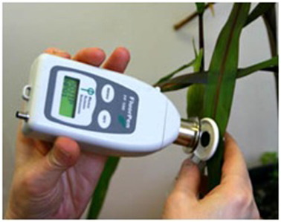
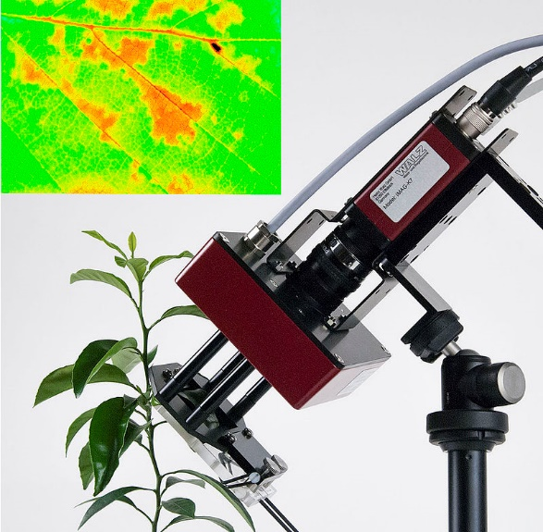
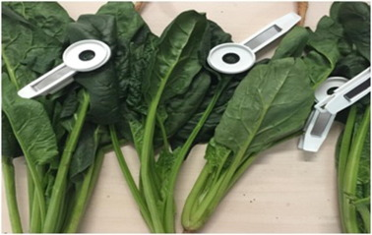
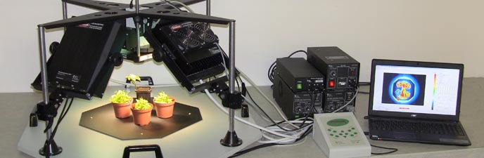

Instruments: from leaf clips to imaging systems
Dark-adaptation leaf clips
Hand-held fluorometer on a leaf
Laboratory chlorophyll fluorescence imaging system
Imaging head and Ft image of a leaf surface
Modulated (PAM) fluorometers
Continuous-excitation (OJIP) meters
Work in light or dark; full quenching analysis (Fv/Fm, ΦPSII, NPQ, qP)
Large, well-tested physiological framework
Fast induction transient during a 1 s pulse on dark-adapted leaves
Popular for screening; complex derived parameters need caution
Notes:
All of these use the same principles. Hand-held PAM or OJIP meters measure a small spot; leaf clips allow dark adaptation in the field; imaging fluorometers measure whole leaves or plants with LEDs; multiparametric fluorometers combine chlorophyll and flavonol signals, for example to detect nitrogen deficiency.

Slide 12
Induction kinetics
03
What happens when a dark-adapted leaf is suddenly illuminated: the Kautsky effect, the OJIP rise and the slow PSMT phase
Notes:
Historical and conceptual bridge: the induction curve was the first evidence that fluorescence tracks photosynthesis.

Slide 13
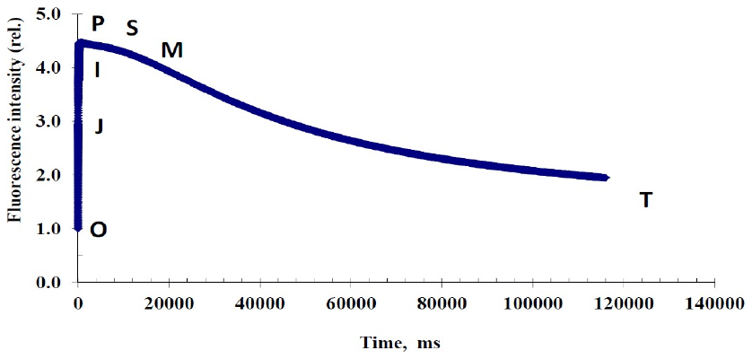
The Kautsky effect (fluorescence induction)
What you see
Dark-adapted leaf + continuous light
Fast phase (<1 s): exponential rise O → J → I → P
Slow phase (minutes): decline P → S → M → T to a steady state
What it means
Kautsky curve of a healthy green leaf: fast rise O → P (<1 s), then slow decay P → S → M → T over minutes
Rise = PSII acceptors (Q_{A}, PQ pool) become reduced → centres close
Decline = quenching: Calvin cycle activation, stomatal opening and NPQ
Kautsky & Hirsch (1931) linked the decline to the onset of CO₂ assimilation
A true Kautsky effect is seen at moderate light (<200 µmol m⁻² s⁻¹); at high irradiance (≥500 µmol m⁻² s⁻¹) the trace looks like the stylised PAM trace in Module 05.
Notes:
Kautsky and Hirsch (1931) watched dark-adapted leaves suddenly illuminated: fluorescence rose to a peak within about a second, then declined over minutes to a steady state. They noticed that the decline mirrored the start of CO2 assimilation. The fast rise reflects the filling up (reduction) of the electron acceptors of PSII; the slow decline reflects quenching as photosynthesis and NPQ switch on.

Slide 14
Zooming into the fast rise: the OJIP transient
O
20–50 µs
F_{o}: all Q_{A} oxidised, centres open
J
~2 ms
Q_{A}⁻ accumulates (photochemical phase)
I
~30 ms
Plastoquinone pool partly reduced
P
~300 ms+
F_{m}: all Q_{A} reduced, centres closed
Interpretation follows the JIP-test convention (Strasser et al. 2004). Murchie & Lawson caution that complex OJIP-derived parameters still lack broad empirical support.
Notes:
Plotting the first second on a logarithmic time axis reveals steps O, J, I and P. The common interpretation (JIP-test, Strasser et al. 2004): O is Fo with all QA oxidised; O to J is the photochemical phase where QA is reduced; J to I and I to P reflect progressive reduction of the plastoquinone pool and the PSI acceptor side. Many parameters are derived from these points, but the paper warns that the more complex ones lack strong empirical support.

Slide 15
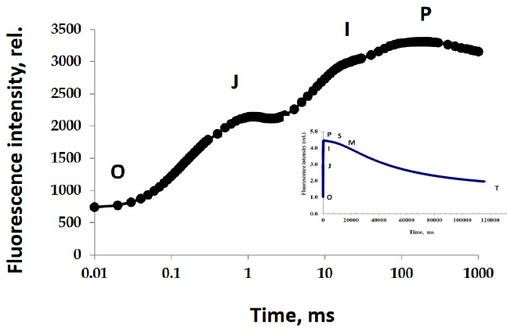
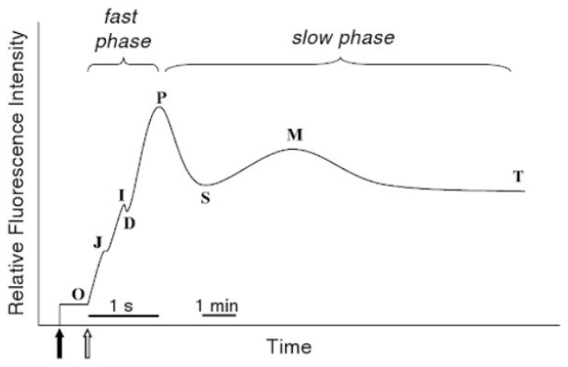
Fast phase vs slow phase (OJIP vs PSMT)
Measured OJIP rise on a log time axis (inset: the whole Kautsky curve)
Full induction: fast phase O-J-I-P (~1 s) then slow phase P-S-M-T (minutes)
Fast phase OJIP (<1 s)
Slow phase PSMT (minutes)
Reduction of PSII acceptors; used for dark-adapted parameters such as F_{o}, F_{m}, F_{v}/F_{m}.
Energy transduction, ATP synthesis, CO₂ fixation, state transitions, NPQ.
Notes:
The fast phase OJIP (under a second) is about filling the electron acceptors of PSII. The slow phase PSMT (minutes) is about the rest of the plant metabolism catching up: ATP synthesis and energy transduction, Calvin cycle activation and CO2 fixation, state transitions and non-photochemical quenching. These slow changes are what quenching analysis with saturating pulses separates.

Slide 16
PSII redox state & quenching
04
Open vs closed reaction centres, photochemical and non-photochemical quenching, and the saturating-pulse trick
Notes:
This module explains the mechanism behind every PAM parameter.

Slide 17
Open and closed PSII reaction centres
H₂O → OEC
P680
Pheo
Q_{A}
Q_{B}
PQ pool
Cyt b₆f
PSI → NADPH
e⁻ flow →
Q_{A} accepts only ONE electron at a time
Q_{A}
OPEN centre
Q_{A}⁻
CLOSED centre
Q_{A} oxidised — ready to accept an electron
Q_{A}⁻ reduced — waiting to pass its electron to Q_{B}
Photochemistry possible
Fluorescence low (e.g. F_{o} in the dark)
Excitation energy is used
No photochemistry until Q_{A} re-oxidises
Fluorescence high (e.g. F_{m} in a pulse)
Quantum efficiency of PSII declines
Light intensity and temperature (via metabolic state) set how many centres are closed at any moment. More closure → lower PSII quantum efficiency → higher fluorescence (unless NPQ rises too).
Notes:
P680 ejects an electron (from water splitting) to pheophytin and then to QA, a bound quinone. QA can hold only one electron. Until QA passes it to QB, that reaction centre cannot do photochemistry: it is 'closed'. Closed centres cannot use excitation energy, so more of it leaves as fluorescence or heat. The fraction of closed centres depends on light intensity and on how fast downstream metabolism takes electrons away.

Slide 18
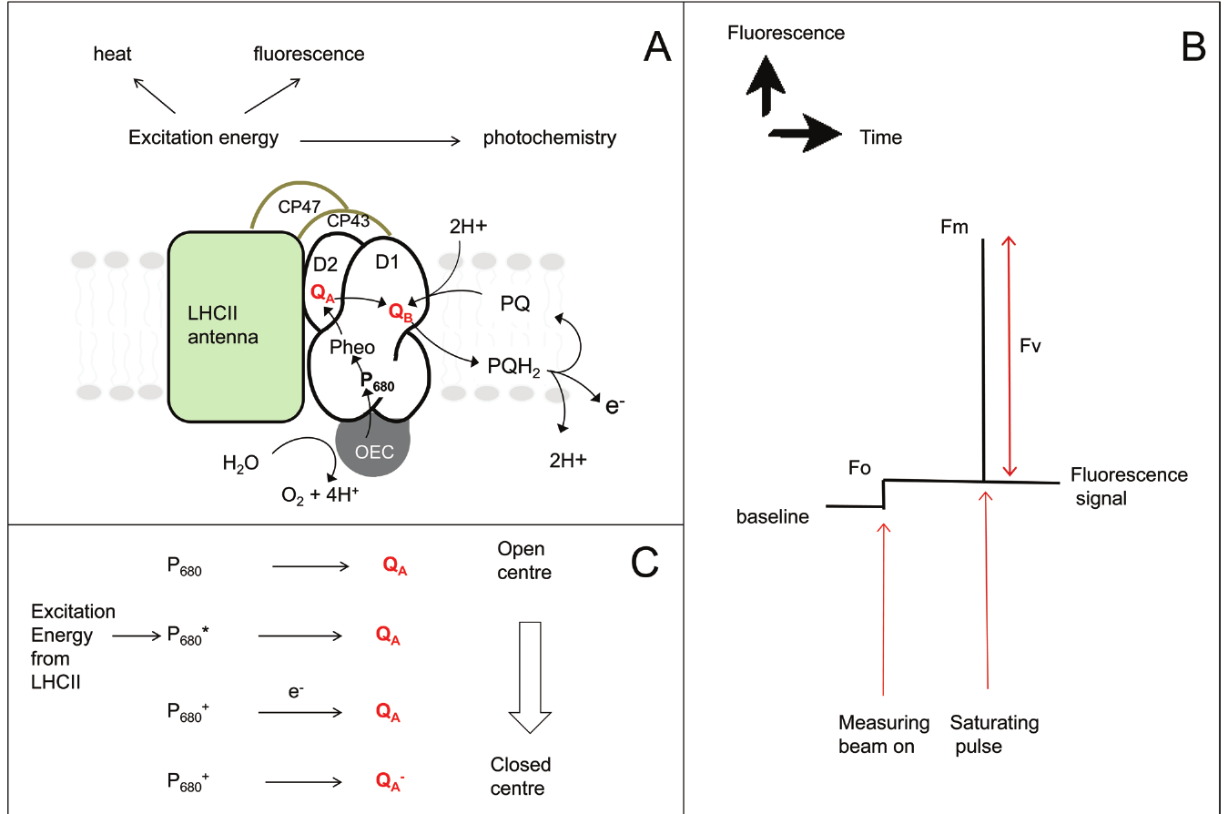
Paper Figure 1: events in PSII behind the parameters
A
Excitation energy in LHCII goes to photochemistry, heat (NPQ) or fluorescence. Electrons: H₂O → OEC → P680 → Pheo → Q_{A} → Q_{B} → PQ.
B
Measuring beam on → F_{o} (centres open). Saturating pulse → F_{m} (centres closed). F_{v} = F_{m} − F_{o}.
C
P680 → P680∗ (excited) → P680⁺Q_{A}⁻ after charge separation. Q_{A}⁻ cannot accept another electron → closed centre.
Murchie & Lawson (2013), Fig. 1 — (A) PSII electron transport, (B) Fo and Fm in a dark-adapted leaf, (C) open → closed centre
Notes:
Panel A shows the PSII complex: LHCII antenna feeding CP43/CP47, the D1/D2 core with P680, pheophytin, QA and QB, and the oxygen-evolving complex. Panel B shows a dark-adapted trace: the measuring beam gives Fo (centres open), a saturating pulse gives Fm (centres closed), and their difference is Fv. Panel C shows the sequence that turns an open centre into a closed one.

Slide 19
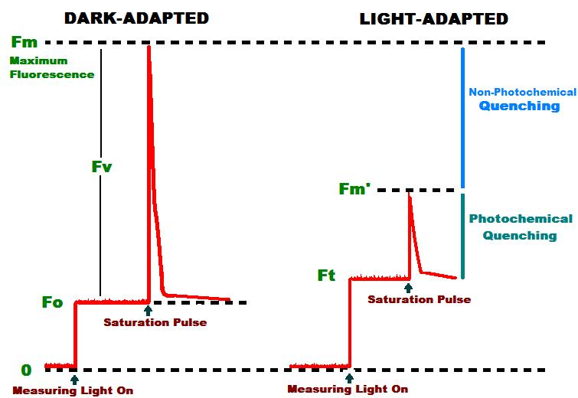

What is 'quenching'?
① Photochemical quenching (qP)
Light activates Calvin-cycle enzymes; metabolite pools in stroma and cytosol increase
Stomata open → more CO₂ for Rubisco (stomata respond ~10× slower than photosynthesis)
More electron sinks → Q_{A} re-oxidised → centres re-open
② Non-photochemical quenching (NPQ)
Rapid rise in the rate constant of heat dissipation on illumination
Photoprotective: removes excess excitation, prevents damaging free radicals
Competes with both fluorescence and photochemistry
Dark-adapted vs light-adapted traces: Fm′ < Fm because of non-photochemical quenching; Ft (F′) < Fm′ because of photochemical quenching
Takes several minutes or longer from darkness; varies with species and environment.
Notes:
After the initial rise under actinic light, fluorescence declines over minutes. Anything that lowers fluorescence is called quenching. Two families exist. Photochemical quenching: photosynthesis itself switches on (Calvin cycle enzymes activated, metabolite pools build up, stomata open) so electrons are drained and centres re-open. Non-photochemical quenching: the rate constant for heat dissipation increases.

Slide 20
How NPQ is switched on: the molecular mechanism
Excess light
Linear + cyclic e⁻ flow pump H⁺ into lumen
Lumen acidifies: ΔpH builds up
Key facts
Regulated by acidification of the lumen (ΔpH)
Needs PsbS and the xanthophyll cycle
Xanthophylls are carotenoids
A 'safe' valve: competes with photochemistry and fluorescence
Lowers F_{m}′ below F_{m} — the basis of the NPQ parameter
PsbS protein
becomes protonated
VDE activated:
violaxanthin → zeaxanthin
Conformational change in PSII antenna →
excitation dissipated as heat (qE)
Notes:
Trace the chain: excess light drives linear and cyclic electron flow, which pumps protons into the thylakoid lumen. The resulting ΔpH (acid lumen) does two things: it protonates the PsbS protein and it activates violaxanthin de-epoxidase, which converts violaxanthin to zeaxanthin. Both cause conformational changes in the PSII antenna that let it dump excitation energy as heat. This energy-dependent quenching is called qE.

Slide 21

The xanthophyll cycle in detail
VDE: high light · acidic lumen (low pH) · ascorbate →
Violaxanthin
2 epoxides
Antheraxanthin
1 epoxide
Zeaxanthin
0 epoxides · quencher
← ZE: low light / darkness
Fast & reversible
Sustained
Optical signature
Zeaxanthin + protonated PsbS give rapid qE that relaxes in seconds–minutes in the dark.
Retained zeaxanthin (e.g. over-wintering evergreens) keeps quenching on and lowers F_{v}/F_{m}.
De-epoxidation changes reflectance at ~531 nm — the basis of the PRI index used with SIF.
Notes:
In excess light the lumen becomes acidic and violaxanthin de-epoxidase (VDE) removes epoxide groups: violaxanthin to antheraxanthin to zeaxanthin. Zeaxanthin promotes heat dissipation in the antenna. In low light or darkness zeaxanthin epoxidase (ZE) reverses the reactions. Retained zeaxanthin causes long-lived (sustained) quenching. A second cycle, the lutein-epoxide cycle, occurs in some shade-tolerant or woody species.

Slide 22


The saturating-pulse principle
Before the pulse (steady light)
During the saturating pulse
open
closed
open
open
closed
open
closed
closed
closed
closed
closed
closed
closed
open
open
closed
open
closed
closed
closed
closed
closed
closed
closed
Some centres open, some closed → level F′
All centres closed → q_{P} = 0 → level F_{m}′ (or F_{m} if dark-adapted)
Pulse properties
What it separates
Old method
Very bright (typically ~0.8 s at ≥4000 µmol m⁻² s⁻¹), shorter than 1 s so it does not change the leaf's state.
F_{q}′ = F_{m}′ − F′ is the photochemical part; F_{m} − F_{m}′ reflects NPQ.
Herbicides (e.g. DCMU) blocking Q_{B} removed photochemistry — not practical routinely.
Notes:
Herbicides that block QB were once used to remove photochemical quenching, which is impractical. Instead, a brief (<1 s), very bright flash temporarily closes every PSII centre. During the flash photochemical quenching is effectively zero and only non-photochemical processes remain. So the fluorescence measured during the pulse (Fm or Fm′) is the level the leaf would have with no photochemistry; the gap between that and the level just before the pulse is the photochemical part.

Slide 23
PAM protocol & parameters
05
Reading a fluorescence trace: every level, every ratio, and a fully worked numerical example
Notes:
Everything here comes from comparing fluorescence levels in darkness, under actinic light, and during saturating pulses.

Slide 24
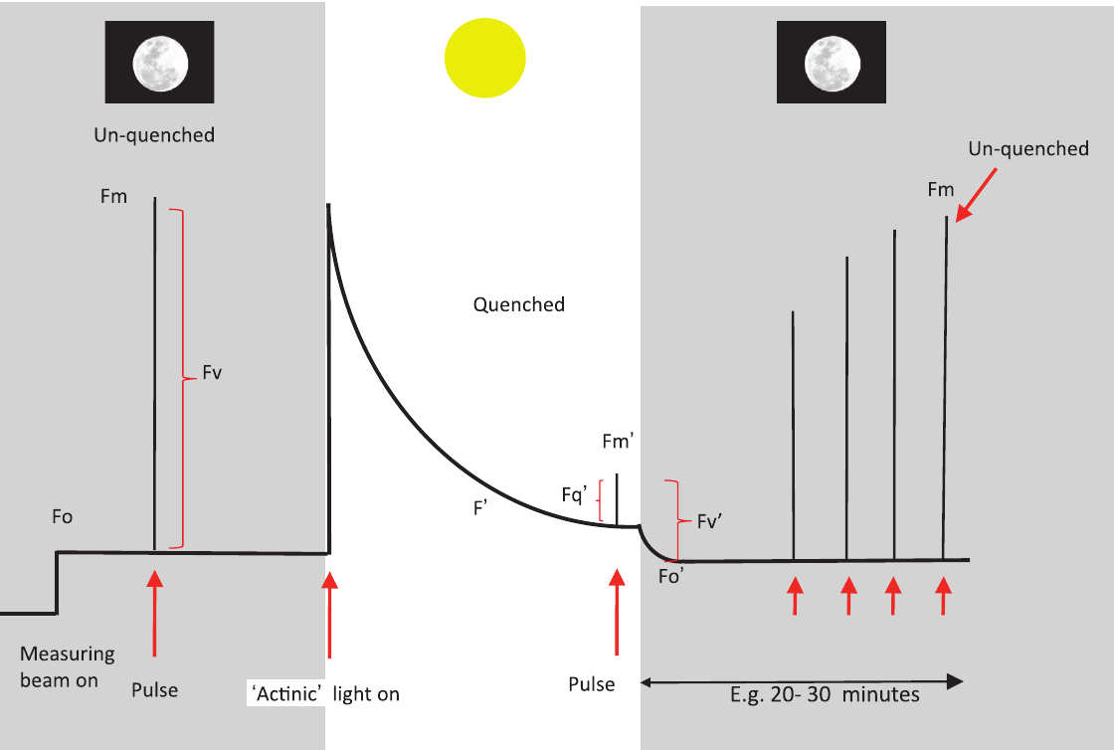
The typical PAM trace, step by step
1
Measuring beam on (dark)
Minimum fluorescence F_{o} — all centres open, no NPQ
2
Saturating pulse (dark)
Maximum F_{m} — all centres closed; F_{v} = F_{m} − F_{o}
3
Actinic light on
Rise, then quenching to steady state F′ (minutes to >20 min)
4
Pulses in the light
F_{m}′ < F_{m} because of NPQ; F_{q}′ = F_{m}′ − F′
5
Actinic off (+ far-red)
Minimal level in light-adapted state F_{o}′; F_{v}′ = F_{m}′ − F_{o}′
6
Pulses in the dark
Murchie & Lawson (2013), Fig. 2 — stylised trace of a dark-adapted leaf exposed to actinic light, darkness and saturating pulses
F_{m}′ recovers towards F_{m} as NPQ relaxes (20–30 min)
Notes:
Follow the numbers on the right with the trace. Steps 1 to 2 are the dark-adapted measurement, 3 to 4 the light-adapted measurement, and 5 to 6 the dark relaxation used to study NPQ components. This stylised trace corresponds to an induction at high irradiance (≥500 µmol m-2 s-1).

Slide 25
Glossary of fluorescence levels
F_{o}
F_{m}
F_{v}
F′ (F_{s}, F_{t})
DARK
DARK
DARK
LIGHT
Minimal fluorescence, dark-adapted
Maximal fluorescence, dark-adapted
Variable fluorescence
Steady-state fluorescence in light
All PSII centres open, no NPQ
Saturating pulse closes all centres; no NPQ
F_{v} = F_{m} − F_{o}
Some centres closed, NPQ present
F_{m}′
F_{o}′
F_{q}′
F_{v}′
LIGHT
LIGHT
LIGHT
LIGHT
Maximal fluorescence in light
Minimal fluorescence in light
Photochemical quenching by open centres
Variable fluorescence in light
Pulse under actinic light; lowered by NPQ
Just after actinic off (+FR) or calculated
F_{q}′ = F_{m}′ − F′
F_{v}′ = F_{m}′ − F_{o}′
Notes:
These eight symbols are the building blocks for every ratio. Keep one rule in mind: a prime (′) means the leaf is light-adapted; no prime means dark-adapted.

Slide 26
F_{v}/F_{m}: maximum quantum efficiency of PSII
Reading the value (dark-adapted leaf)
~0.83
0.5
0.6
0.7
0.8
< 0.6: severe PSII damage
0.6–0.78: photoinhibition / sustained quenching
≈ 0.8–0.83: healthy
typical F_{v}/F_{m} of an unstressed leaf
Scale starts at 0.5. Zone limits are approximate; compare with non-stressed controls of the same species.
F_{v}/F_{m} = (F_{m} − F_{o}) / F_{m}
How to measure
What lowers it
Dark-adapt ≥20 min (leaf clip)
Check zero; set measuring beam so it causes no rise
Measure F_{o}, then a saturating pulse → F_{m}
Pre-dawn values for long-term stress
Photoinhibition: inactivation/damage of PSII (D1 protein)
Sustained quenching (e.g. retained zeaxanthin, drought, winter)
Rise in F_{o} → damage; fall in F_{m} → quenching
Meaning
Correlates with the maximum quantum yield of photosynthesis (O₂ or CO₂ per photon) at limiting light.
Notes:
Fv/Fm is the fraction of absorbed light that PSII could use for photochemistry if every centre were open and there were no NPQ. It is measured on fully dark-adapted leaves. In unstressed leaves it is remarkably constant, around 0.83. A drop means PSII damage (photoinhibition) or sustained quenching. Because it is so easy, it is the most common 'stress' measurement, but see the pitfalls in Module 06.

Slide 27

Φ_{PSII} = F_{q}′/F_{m}′: PSII operating efficiency
Φ_{PSII} = F_{q}′ / F_{m}′ = (F_{m}′ − F′) / F_{m}′
also written ΔF/F_{m}′ · Y(II) · 'yield'
Decomposition
F_{q}′/F_{m}′
operating efficiency
=
F_{q}′/F_{v}′ (qP)
fraction of centres open
×
F_{v}′/F_{m}′
max efficiency in light
↓ F_{v}′/F_{m}′ means NPQ ↑
Electron transport rate (ETR)
Why it is popular — and the catch
ETR = Φ_{PSII} × PAR × 0.84 × 0.5
0.84 = typical leaf absorptance; 0.5 = share of light to PSII (both are assumptions)
No dark adaptation needed; quick in the field
Strongly depends on current PAR — always record light at the leaf surface
Notes:
PhiPSII is the fraction of absorbed light actually used by PSII photochemistry right now, under the current light. It needs no dark adaptation, which is why it is the most used light parameter. It factorises into two terms: how many centres are open (qP) times how efficient an open centre is given the current NPQ (Fv′/Fm′). Multiply by absorbed light to get the electron transport rate.

Slide 28


qP and qL: how many PSII centres are open?
qP — photochemical quenching
qL — the 'lake model' version
qP = F_{q}′/F_{v}′ = (F_{m}′ − F′)/(F_{m}′ − F_{o}′)
Proportion of PSII centres that are open (approx.)
1 − qP ≈ closed centres (excitation pressure)
Non-linear with true open fraction — use with care
qL = (F_{q}′/F_{v}′) × (F_{o}′/F′) = qP × F_{o}′/F′
Estimates the fraction of open PSII centres
Accounts for energy sharing between connected PSII units
Considered a more accurate redox-state indicator
Picture it: 10 PSII centres under actinic light
Use cases
Onset of photoinhibition
Level of photoprotective quenching
Requires F_{o}′ (measured with FR or calculated)
6 open (green) · 4 closed (red) → q_{L} ≈ 0.6 ; 1 − q_{L} ≈ 0.4
qP and qL are both 1 when all centres are open; they differ in between because of antenna connectivity.
Notes:
qP compares the photochemical part of the light-adapted variable fluorescence to its maximum, so it approximates the fraction of open centres. 1 − qP approximates the closed fraction and has been used as an indicator of excitation pressure and photoinhibition onset. The relation with open centres is not linear because PSII units share antennae (connectivity), so qL, which adds the correction Fo′/F′, is considered a better indicator of the redox state of QA.

Slide 29
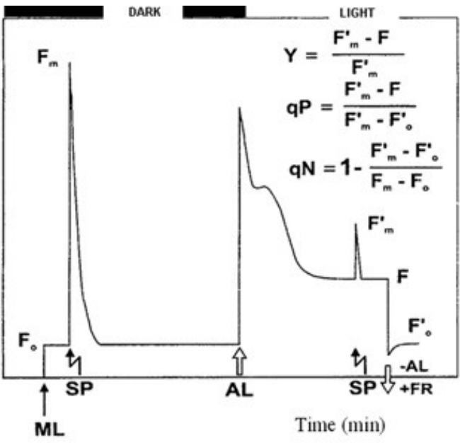
NPQ: non-photochemical quenching
NPQ = (F_{m} − F_{m}′) / F_{m}′
Meaning
Estimates the rate constant for heat loss from PSII
0 in a fully dark-adapted leaf; typically rises to ~1–3+ in high light
Caution
Needs a true F_{m}: if dark-adapted F_{v}/F_{m} is well below 0.83, treat NPQ with caution
Photoinhibited leaves have lower F_{m} → NPQ underestimated → don't compare across different F_{v}/F_{m}
Classic notation: Y = (Fm′−F)/Fm′, qP = (Fm′−F)/(Fm′−Fo′), qN = 1 − (Fm′−Fo′)/(Fm−Fo); ML, SP, AL, FR markers
Notes:
NPQ (Stern–Volmer form) estimates the rate constant of heat loss from PSII relative to the dark-adapted state. It compares Fm in the dark with Fm′ in the light, so it is the only parameter that needs dark-adapted values. Danger: if a leaf is already photoinhibited, its Fm is lower, so NPQ appears lower even when heat dissipation is high. Do not compare NPQ between leaves whose Fv/Fm values differ. Older literature used qN = 1 − Fv′/Fv.

Slide 30
Summary table of commonly used parameters
Parameter | Also known as | Formula | Description | Needs
F_{v}/F_{m} | — | (F_{m} − F_{o})/F_{m} | Maximum quantum efficiency of PSII photochemistry | dark
F_{v}′/F_{m}′ | — | (F_{m}′ − F_{o}′)/F_{m}′ | Maximum efficiency of PSII in the light, if all centres were open | F_{o}′
F_{q}′/F_{m}′ | Φ_{PSII}, ΔF/F_{m}′, Y(II) | (F_{m}′ − F′)/F_{m}′ | PSII operating efficiency: quantum efficiency of PSII electron transport in the light | —
F_{q}′/F_{v}′ | qP | (F_{m}′ − F′)/(F_{m}′ − F_{o}′) | Photochemical quenching; non-linear with fraction of open centres (see qL) | F_{o}′
NPQ | — | (F_{m} − F_{m}′)/F_{m}′ | Non-photochemical quenching: rate constant for heat loss from PSII | dark
qL | — | (F_{q}′/F_{v}′)(F_{o}′/F′) | Estimates the fraction of open PSII centres | F_{o}′
'Needs': dark = requires dark-adapted F_{o}/F_{m}; F_{o}′ = requires measured (far-red) or calculated F_{o}′.
Notes:
This is Table 1 of Murchie & Lawson (2013). Notice which parameters need a dark-adapted measurement (Fv/Fm, NPQ) and which need Fo′ (Fv′/Fm′, qP, qL). PhiPSII needs neither, which explains its popularity.

Slide 31
Worked example: calculate every parameter
Readings from one leaf (arbitrary units)
Parameter | Calculation | Result | Meaning
F_{v}/F_{m} | (1000 − 200)/1000 | 0.80 | Healthy PSII
F_{v}′/F_{m}′ | (600 − 180)/600 | 0.70 | Max efficiency in light (NPQ lowers it)
Φ_{PSII} | (600 − 400)/600 | 0.33 | ⅓ of absorbed light used by PSII
qP | (600 − 400)/(600 − 180) | 0.48 | ≈ half of centres open
Check | qP × F_{v}′/F_{m}′ = 0.476 × 0.70 | 0.33 | = Φ_{PSII} ✓
qL | 0.476 × 180/400 | 0.21 | Lake-model open fraction
NPQ | (1000 − 600)/600 | 0.67 | Moderate heat dissipation
ETR | 0.333 × 1000 × 0.84 × 0.5 | 140 | µmol e⁻ m⁻² s⁻¹
F_{o}′ calc. | 200/(0.80 + 200/600) | 176 | vs 180 measured ✓
F_{o}
F_{m}
200
1000
F′
F_{m}′
400
600
F_{o}′
PAR
180
1000
Dark (navy) · light-adapted (amber). PAR in µmol m⁻² s⁻¹.
Notes:
Use these made-up but realistic readings to check you can compute everything by hand. Notice the internal consistency: PhiPSII equals qP times Fv′/Fm′, and the calculated Fo′ (Oxborough & Baker) is close to the measured one. Interpretation: PSII is healthy (0.80), one third of absorbed light is used photochemically at this light, about half the centres are open by qP, and NPQ is moderate.

Slide 32
Good practice & pitfalls
06
How long to dark-adapt, what Fv/Fm can and cannot tell you, problems in the light, and the link to CO₂ assimilation
Notes:
Most mistakes in fluorescence work are interpretation mistakes, not instrument mistakes.

Slide 33
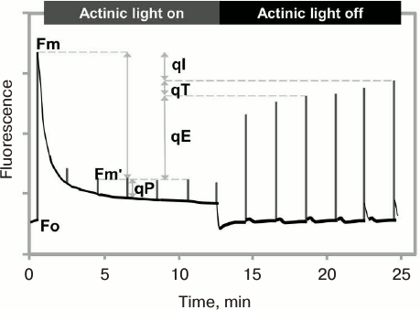


To dark-adapt or not? The components of NPQ
Relaxation time in darkness
qE · ΔpH, PsbS, zeaxanthin
qT · state transitions
qI · photoinhibition, D1 repair, retained zeaxanthin
seconds
minutes
~30 min
hours
days
NPQ relaxation after actinic light off: qE (fast), qT and qI (slow) separate
Practical rule
Best answer
Long-term stress
20–30 min dark usually removes qE and qT for a plant in a moderate environment.
Test it: dark-adapt non-stressed controls and measure F_{v}/F_{m} every 5–10 min until stable.
Use pre-dawn F_{v}/F_{m} (e.g. drought, over-wintering evergreens).
Notes:
NPQ is not one process. qE, energy-dependent quenching, relaxes within seconds to minutes once ΔpH collapses. qT, state transitions, moves LHCII between PSII and PSI over minutes and matters mostly in low light. qI, photoinhibitory or sustained quenching, relaxes slowly over hours or longer; it includes D1 damage and repair and long-lived zeaxanthin. So the dark adaptation time decides which components you have removed. For a plant adapted to its environment, 20-30 min usually removes qE and qT; whatever remains is qI.

Slide 34
Pitfalls in measuring F_{o} and F_{m}
Measuring beam too strong
Q_{A} partly reduced in the dark
NPQ not fully relaxed
Induces electron transport → false (high) F_{o}. Lower intensity / frequency if F_{o} drifts up.
Chlororespiration reduces PQ. Use a far-red pulse to oxidise Q_{A} before F_{o}.
Zeaxanthin quenching relaxes slowly → F_{m} underestimated. Dark-adapt long enough.
Pulse not saturating
High modulation frequency in the dark
Quenching during the pulse
~2000 µmol m⁻² s⁻¹ may miss true F_{m}′ in high light; aim 4000–8000 (more for C₄).
Useful during pulses but not for F_{o}; most devices switch automatically.
Check there is no decline during the pulse (pulse too long).
Notes:
Fo can be falsely high if the measuring beam is too strong or modulated too fast, because it then drives some charge separation; check that switching on the beam causes no rise. QA can also be partly reduced in the dark by chlororespiration; a far-red pulse before Fo oxidises it. For Fm the pulse must be truly saturating: about 2000 µmol m-2 s-1 is probably enough for dark-adapted Fm but often not for Fm′ under high actinic light; most instruments give 4000-8000, and C4 plants may need more.

Slide 35
Interpreting F_{v}/F_{m}: four common misconceptions
(i) Cause is hard to assign
(ii) Lower F_{v}/F_{m} ≠ lower photosynthesis
Leaf optical properties change under stress (e.g. drought) → F_{m} and F_{o} change via absorptance. The ratio removes this, but its cause still needs other data.
F_{v}/F_{m} relates to the light-limited quantum yield. A leaf can have reduced F_{v}/F_{m} with no penalty at high, saturating light.
Imaging F_{v}/F_{m} of plants
(iii) Stress may need high light to show
(iv) It only sees PSII
Takeaway
Inactivation of PSII may only appear when light is high enough; otherwise no difference between treatments.
Stress elsewhere (e.g. roots) may not change F_{v}/F_{m}. Fluorescence is not a generic stress detector.
Use F_{v}/F_{m} with light-adapted data, controls and other measurements.
Notes:
These four points from the review prevent the classic over-interpretation that any drop in Fv/Fm means the plant is photosynthesising less, or that fluorescence is a generic plant stress detector.

Slide 36
Problems with measurements in the light
Φ_{PSII} depends on light
Errors in F_{o}′ → calculate it
Varies substantially with even small PAR changes
Record PAR at the leaf surface, or measure when PAR is saturating
Ensure steady state (F′ stable) before the pulse
F_{o}′ = F_{o} / [ (F_{v}/F_{m}) + (F_{o}/F_{m}′) ]
Oxborough & Baker (1997). Valid if: PSII centres open at F_{o}; no change in down-regulation between F_{o}/F_{m}; no change in photoinhibition between F_{m}′ and F_{m}.
ETR assumptions
Other small errors
Absorptance 0.84 and PSII share 0.5 are averages, not constants
Don't compare ETR of drought-stressed (low turgor) vs hydrated leaves
Pigment content and PSII:PSI stoichiometry change these values
PSI fluorescence above 700 nm adds to the signal
Multiple turnovers of PSII during the pulse
Mostly minor: Φ_{PSII} agrees well with quantum yield of CO₂ assimilation
Notes:
PhiPSII depends strongly on the current light, so PAR at the leaf surface must be measured. Converting PhiPSII to ETR assumes absorptance 0.84 and equal light sharing between PSII and PSI; these break down for drought-stressed leaves, leaves with different pigment content or acclimation state. Fo′ can be wrong if the far-red light does not fully oxidise QA or if NPQ relaxes quickly after actinic off; then calculate Fo′ instead with the Oxborough & Baker equation. PSI contributes to fluorescence above 700 nm and multiple turnovers during the pulse add small errors.

Slide 37

Linking fluorescence to CO₂ assimilation
CO₂ assimilation (Calvin cycle)
~4 e⁻ per CO₂ when photorespiration is blocked
C₃ vs C₄
C₃: close correlation at 2 % O₂; photorespiration breaks linearity
C₄: CO₂-concentrating mechanism suppresses photorespiration → more linear
PSII electron
transport (ETR)
Photorespiration (C₃)
Rises with stomatal closure, heat
Mehler reaction / cyclic flow
Alternative sinks under stress
Measuring PSI too
P700 redox via near-infrared absorbance (810–840 nm)
Combine Φ_{PSI} with Φ_{PSII}; cyclic flow affects ΔpH and NPQ
PSII:PSI ETR ratios need stoichiometry corrections
Implication
Linear F_{q}′/F_{m}′ ↔ CO₂ uptake only holds when the allocation of electrons is constant — hard to guarantee in the field.
Notes:
ATP and NADPH from linear electron transport are used in carbon fixation in fixed ratios, so PhiPSII and the quantum yield of CO2 fixation correlate. In C3 plants the link is cleanest when photorespiration is suppressed (2% O2): then about 4 electrons are needed per CO2. Photorespiration, the Mehler reaction and cyclic electron flow are alternative electron sinks that change the ratio, for example during stomatal closure, temperature change or stress. In C4 plants the CO2-concentrating mechanism suppresses photorespiration, so the relation is more linear. PSI redox (P700 absorbance at 810–840 nm) can be measured alongside.

Slide 38
Standard measurement protocols (A, B, C)
A · F_{v}/F_{m}
B · Φ_{PSII} and NPQ
C · qP (F_{q}′/F_{v}′)
1
Dark-adapt ≥20 min (leaf clip); keep dark throughout
1
Follow A, then switch on actinic light
1
As B, but F_{o}′ is also needed
2
Detector on, measuring beam off: check zero
2
Wait for steady state (minutes); record PAR
2
After the pulse switch actinic off
3
Beam on: check it causes no rise; adjust
3
If ambient light: wait until F′ is stable
3
Measure F_{o}′ after a few seconds
4
Measure F_{o}
4
Apply saturating pulse → F_{m}′
4
Use far-red to oxidise PSI, Q_{A} and carriers
5
Saturating pulse ~0.8 s at ≥4000 µmol m⁻² s⁻¹ → F_{m}
5
NPQ needs dark-adapted F_{m} from A
5
Or calculate F_{o}′ from F_{o} (Oxborough & Baker)
6
Check no quenching during pulse
6
Calculate using Table 1
7
Non-stressed control should give 0.81–0.83
Notes:
These are the three protocols given at the end of the review. Most devices calculate the values automatically; the careful user should check these steps and compare results with the stylised trace.

Slide 39
Imaging, applications & monitoring
07
From single-spot measurements to images, screening platforms and remote, long-term monitoring
Notes:
Imaging uses the same principles but over an area, which reveals heterogeneity a point measurement would miss.

Slide 40
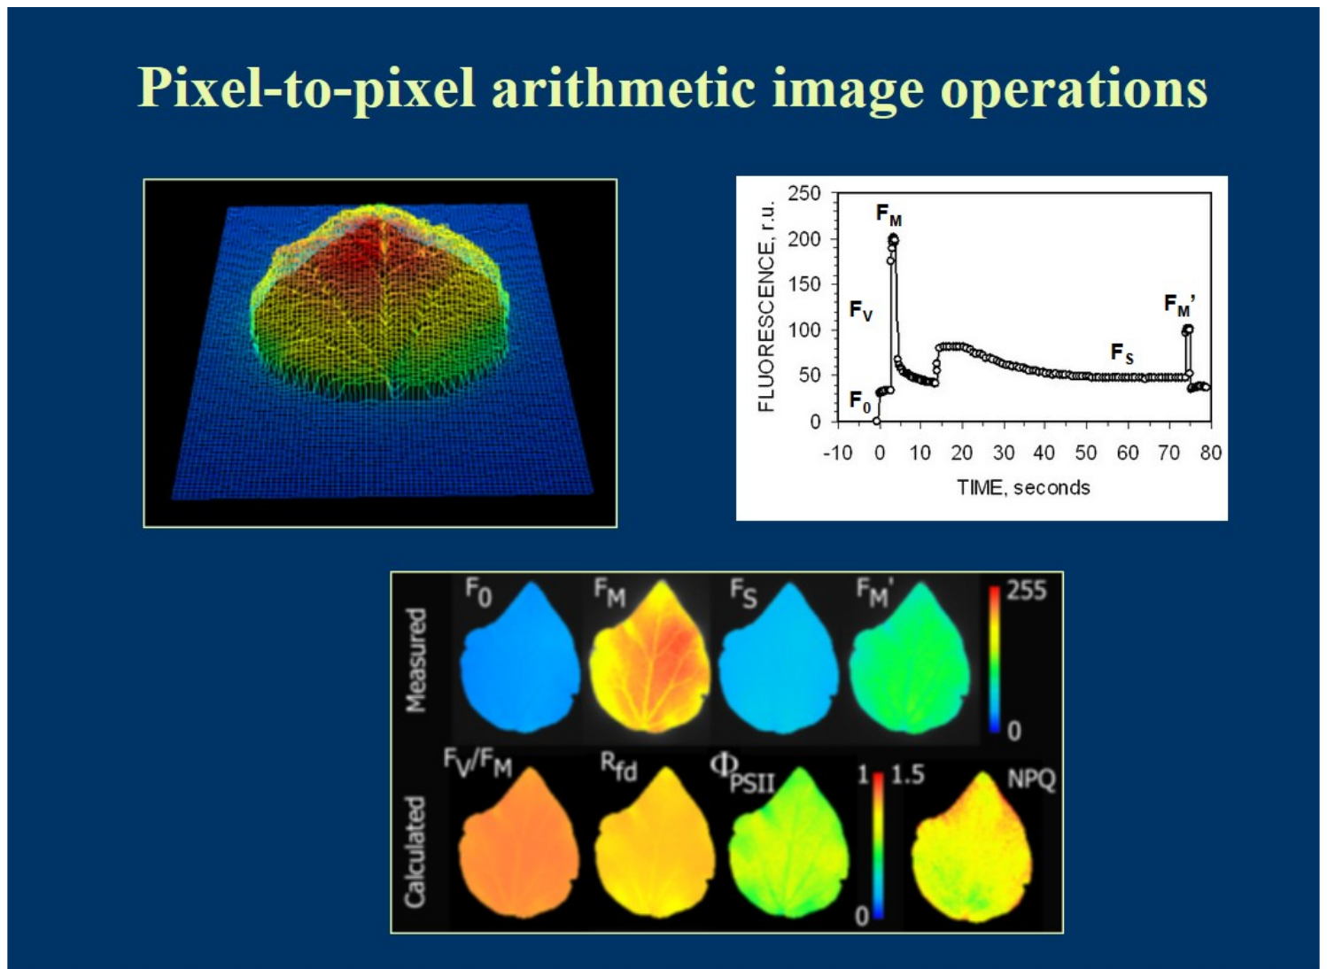
Chlorophyll fluorescence imaging
Advantages
Requirements
Spatial heterogeneity within leaves/plants
Screening many plants under identical conditions
Resolution from chloroplasts and guard cells to whole plants
Leaf flat, horizontal, at correct height
Even actinic illumination over the area
Pulse saturating everywhere (4000–8000 µmol m⁻² s⁻¹)
Combined techniques
Limitations
+ IRGA gas exchange: CO₂ diffusion, guard-cell photosynthesis
+ thermography: stomatal behaviour, water-use efficiency
+ hyperspectral: disease detection (e.g. head blight)
Costlier; large LED banks; mostly lab-based
Often no FR source → F_{o}′ is calculated
Field versions: e.g. Imaging-PAM MINI, FluorCam, rover systems
Pixel-to-pixel image arithmetic: measured F₀, Fm, Fs, Fm′ → calculated Fv/Fm, ΦPSII, NPQ maps
Notes:
Imaging systems use banks of LEDs for measuring, actinic and saturating light and a camera instead of a fibre-optic probe. Each pixel gets its own Fv/Fm, PhiPSII or NPQ. This reveals spatial heterogeneity (e.g. patchy stomatal closure, infection sites), lets many plants be screened at once under identical conditions, and can be combined with gas exchange, thermography or hyperspectral sensors.

Slide 41
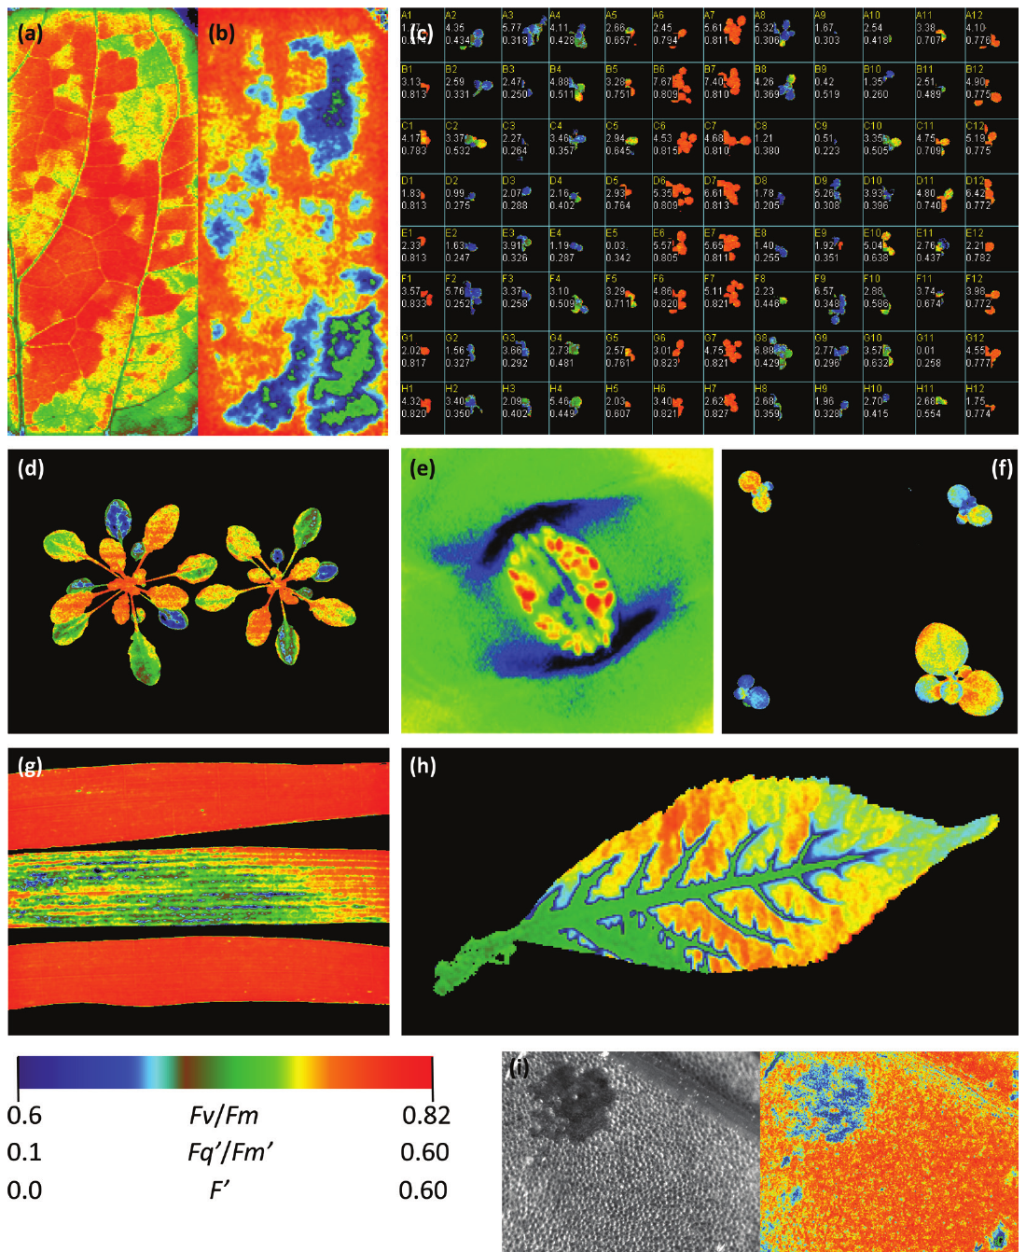
Paper Figure 3: what imaging can reveal
a · b
Steady-state F′ and Φ_{PSII} of a leaf in a chamber: patchy stomatal closure after humidity drop
c
Herbicide screening of Arabidopsis seedlings in a 96-well plate (F_{v}/F_{m})
d
Φ_{PSII} heterogeneity of Arabidopsis after high light
e
F_{v}/F_{m} of guard-cell chloroplasts (high-resolution microscope)
f
Screening transgenic plants with reduced SBPase
g
F_{v}/F_{m} of wheat varieties: rust susceptibility
h
Φ_{PSII} decline as DCMU travels in via the petiole
i
Cadmium effect on Φ_{PSII} in Lemna
Notes:
(a, b) steady-state fluorescence and PhiPSII showing patchy stomatal closure after a humidity drop; (c) herbicide screening of Arabidopsis in a 96-well plate; (d) heterogeneity in PhiPSII of two Arabidopsis plants; (e) guard-cell chloroplasts in Tradescantia epidermis at high resolution; (f) transgenic plants with reduced SBPase; (g) wheat varieties with different rust susceptibility; (h) DCMU uptake via the petiole; (i) cadmium effects in the aquatic plant Lemna.

Slide 42
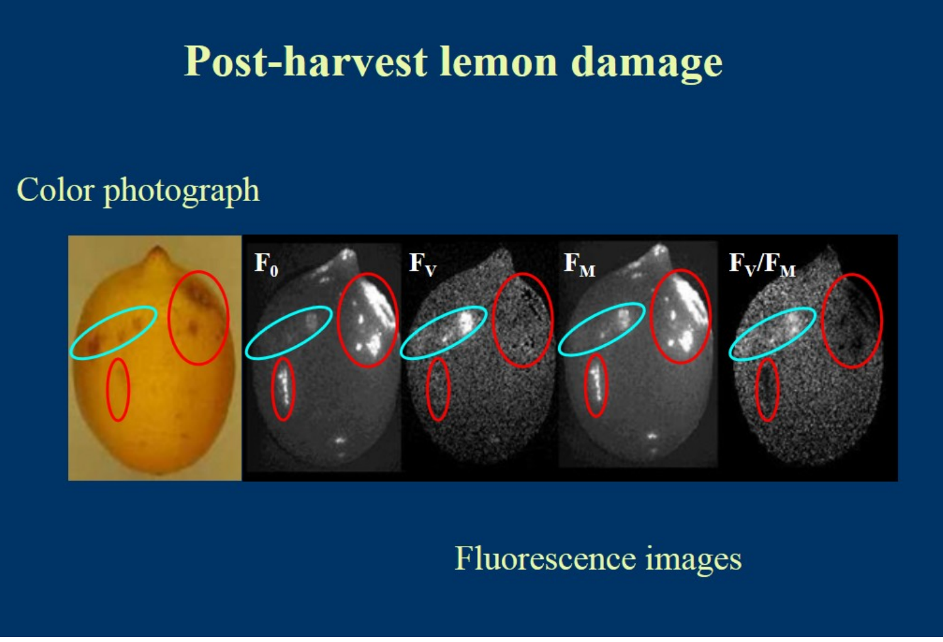
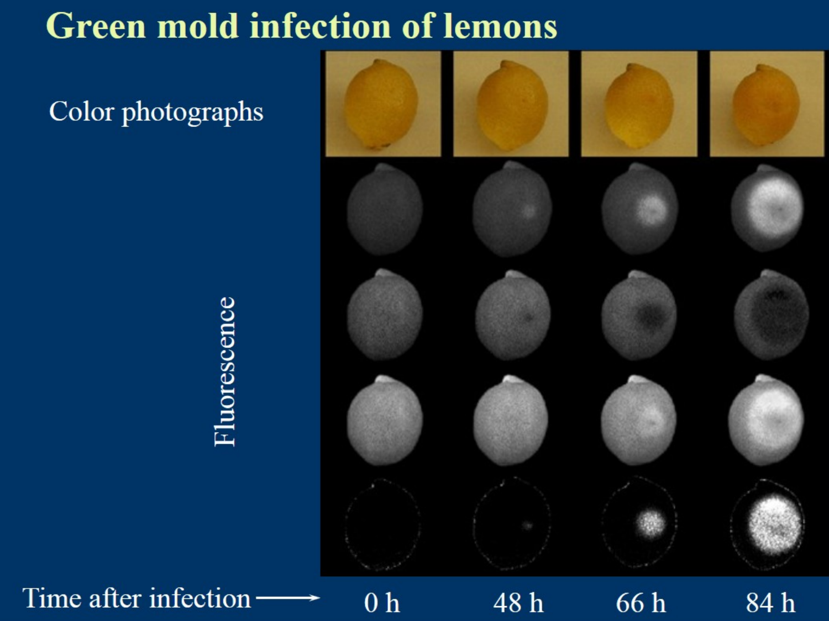
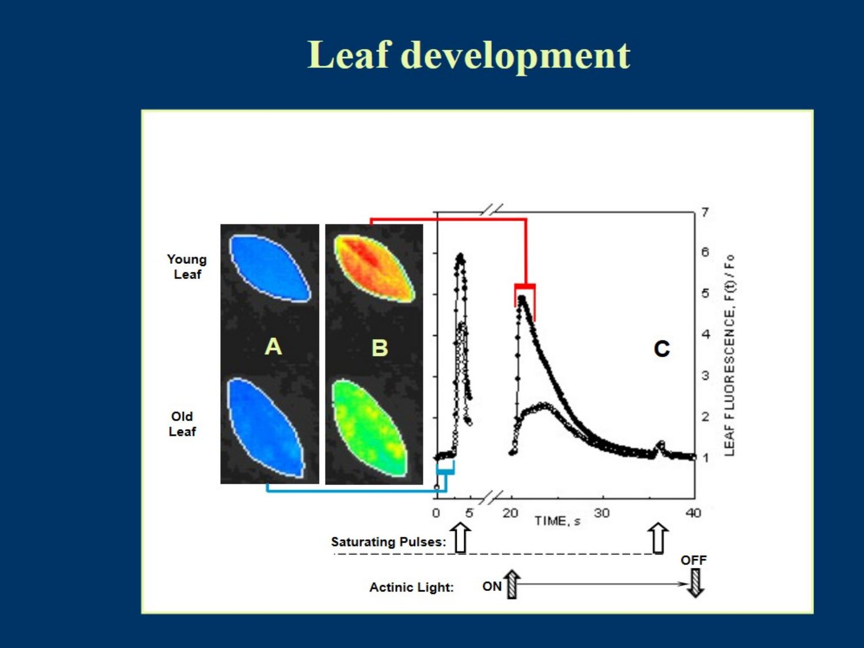
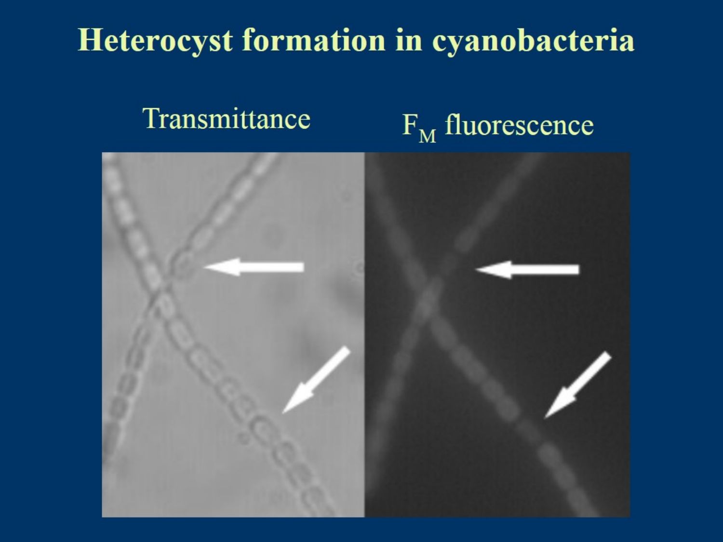
Imaging applications: fruit, development and cyanobacteria
Post-harvest lemon damage: F₀, Fs, Fm and Fv/Fm images reveal damaged areas
Green mould infection of lemons over 0–84 h
Leaf development: young vs old leaf images and kinetics
Heterocysts (arrows) in cyanobacteria are dark in Fm fluorescence
Notes:
These examples from the original slides show how Fm and other images reveal damage before it is visible: post-harvest damage and green mould infection of lemons appear in fluorescence images, young and old leaves differ in their kinetics, and heterocysts in cyanobacteria (which do not have PSII activity) appear dark in Fm images.

Slide 43
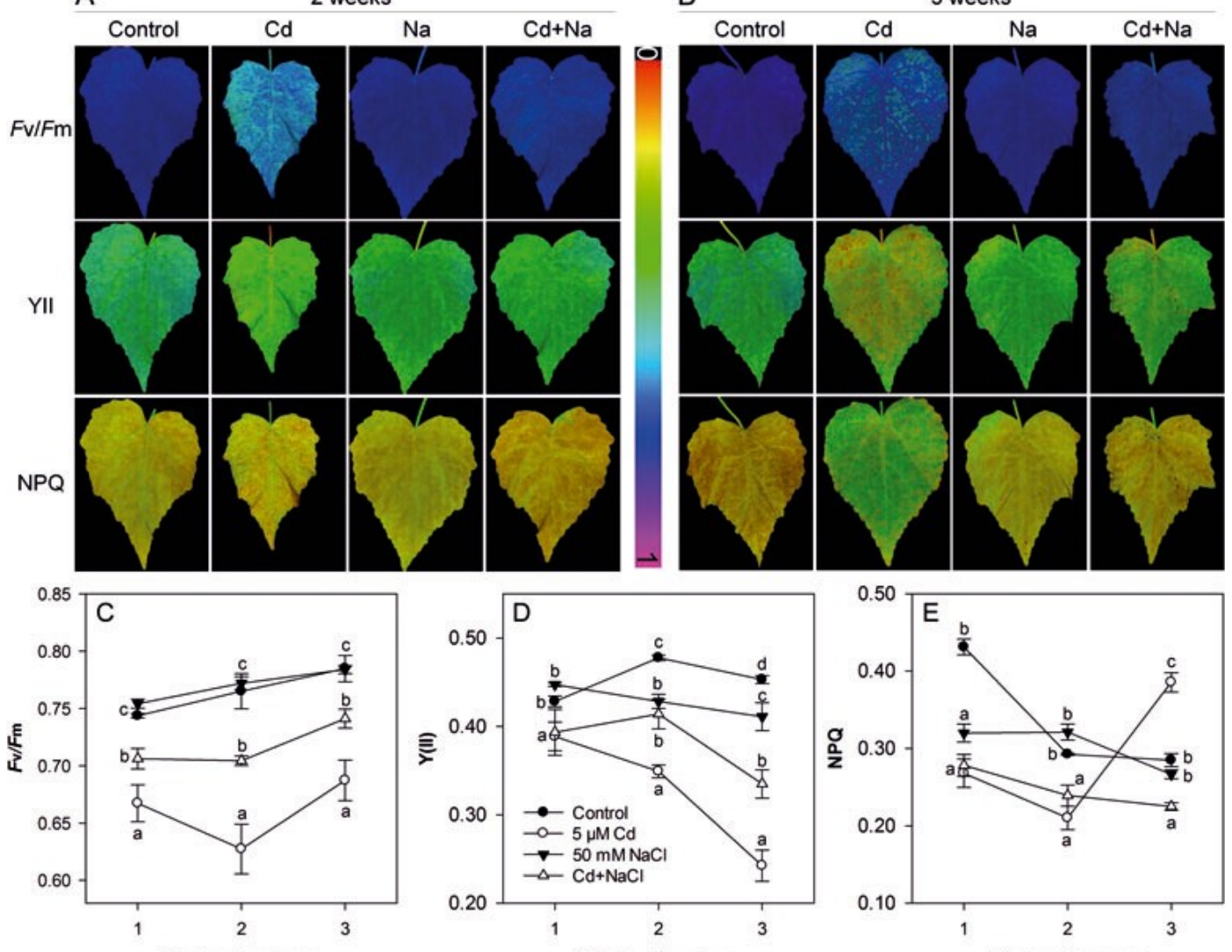
Stress phenotyping example: cadmium and salt
How to read it
Rows: F_{v}/F_{m}, Y(II), NPQ
Columns: Control, Cd, Na, Cd+Na at 2 and 3 weeks
Colour scale: blue/purple = high, yellow/red = low
Lessons
Parameters respond differently and over different times
Images show where in the leaf damage starts
Combine dark (F_{v}/F_{m}) and light (Y(II), NPQ) parameters
Fv/Fm, YII and NPQ images and time courses under Cd, NaCl and Cd+NaCl stress
Notes:
Images of Fv/Fm, Y(II) (= PhiPSII) and NPQ of leaves under control, cadmium, NaCl and combined stress after 2 and 3 weeks, with the corresponding time courses below. Note that each parameter responds differently and with a different time course, which is why measuring several parameters is more informative than Fv/Fm alone.

Slide 44




Towards long-term and remote monitoring
Leaf clip PAM
Monitoring PAM
LIFT (laser)
UAV / airborne
Satellite
mm–cm · seconds
fixed heads · weeks–seasons
5–50 m · canopy, active
m · passive SIF
300 m–km · passive SIF
ACTIVE (instrument supplies the light)
PASSIVE (sunlight only) →
Monitoring PAM
LIFT
Passive sensing
Modular heads measure F′ and, with pulses, F_{m}′; used for annual NPQ in boreal forest and rice canopies.
Laser projects a ~100 mm spot onto the canopy; telescope + photodiode give PSII yield and electron transport at 5–50 m.
No saturating pulse and uneven illumination, but continuous, large-area coverage → SIF.
Notes:
Field physiologists need to link second-scale measurements to growth over weeks and months. Monitoring PAM systems leave measuring heads clipped on leaves for weeks, powered by solar panels; at night Fm′ and Fo′ become Fm and Fo. LIFT uses a laser to excite canopies from 5–50 m and measures PSII yield remotely. Beyond that, no artificial light can saturate a canopy, so we switch to passive sensing of sunlight-induced fluorescence in Fraunhofer lines and oxygen bands: this is SIF.

Slide 45
Sun-induced fluorescence (SIF)
08
Measuring the same red glow passively under sunlight — from leaf to satellite. Based on Mohammed et al. (2019), '50 years of progress'
Notes:
SIF uses the sun as the excitation source and exploits dark absorption lines in the solar spectrum to separate a tiny fluorescence signal from reflected light.

Slide 46
Active (PAM) vs passive (SIF) fluorescence
 | Active — PAM fluorometry | Passive — SIF
Light source | Instrument (ML, AL, SP, FR) | The sun
Saturating pulse | Yes → F_{m}, F_{m}′ | No
What it gives | Yields and ratios (F_{v}/F_{m}, Φ_{PSII}, NPQ) | Absolute flux (mW m⁻² sr⁻¹ nm⁻¹)
Scale | Leaf, single plants (cm–m) | Leaf to globe (m–km)
Spectral bands | Usually one broad band >700 nm | Red (~687) and far-red (~760) bands or full 650–800 nm
Main challenge | Protocol, dark adaptation | Signal is ~1–5 % of reflected radiance; atmosphere; canopy structure
Typical use | Plant physiology, phenotyping | GPP, stress mapping, ecosystem monitoring
Notes:
The physics is the same, but the measurement is completely different. PAM controls the light and uses saturating pulses to obtain yields. SIF cannot control the light: it measures the absolute fluorescence flux emitted under ambient sunlight, which depends on how much light is absorbed (APAR), the fluorescence yield, and how much escapes the canopy.

Slide 47
A short history of SIF
Brewster: red light from laurel leaf extract
Müller: link to assimilation
McAlister & Myers: two processes vs CO₂
Plascyk: Fraunhofer Line Discriminator (FLD)
Zarco-Tejada: SIF in canopy reflectance
ESA selects FLEX (8th Earth Explorer)
1834
1874
1940
1975
2000
2015
1852
1931
1963
1986
2011
2017
Stokes coins 'fluorescence'
Kautsky & Hirsch: induction kinetics
Duysens & Sweers: modulated light, NPQ concept
Schreiber: PAM fluorometer
GOSAT: first global SIF maps
TROPOMI (Sentinel-5P) launched
Active, leaf-level science
Passive, remote sensing
Notes:
Fluorescence was first seen in 1834 by Brewster in a laurel extract. Stokes coined the word in 1852; Müller in 1874 suggested a link with assimilation; Kautsky and Hirsch in 1931 established it. McAlister and Myers showed both inverse and direct relationships with CO2 uptake; Duysens and Sweers pioneered modulated light and described what we now call NPQ. Plascyk's Fraunhofer Line Discriminator (1975) and Schreiber's PAM (1986) followed. Around 2000 Zarco-Tejada demonstrated fluorescence in canopy reflectance; in 2011 GOSAT gave the first global SIF maps; FLEX was selected by ESA in 2015, and TROPOMI launched in 2017.

Slide 48
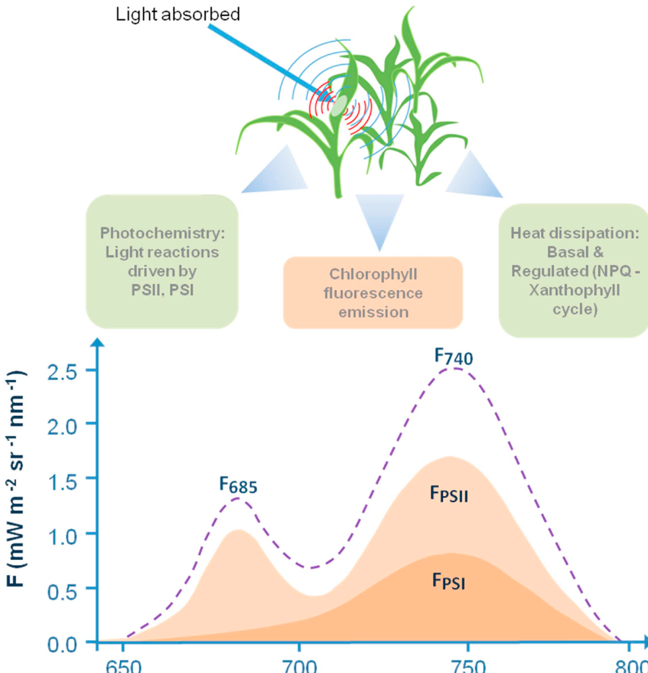
The SIF emission spectrum
Red peak F₆₈₅
Far-red peak F₇₄₀
~685–690 nm
Mostly PSII
Strongly re-absorbed by chlorophyll
~730–740 nm
PSII + PSI
Escapes the canopy more easily
Key numbers & terms
Fluorescence quantum yield in vivo <10 %, typically 0.5–3 %
Steady-state fluorescence (F_{s}, F_{t}) is what SIF measures under sunlight
Thermal dissipation: constitutive (basal) + regulated (NPQ, xanthophyll cycle)
Units: mW m⁻² sr⁻¹ nm⁻¹ (radiance)
Mohammed et al. (2019), Fig. 1 — energy partitioning and the leaf fluorescence spectrum (PSII + PSI contributions)
Notes:
In an intact leaf, fluorescence spans about 650–800 nm with two peaks: red near 685–690 nm (F685) and far-red near 730–740 nm (F740). PSII emits in both regions; PSI mainly in the far-red. In healthy green leaves the red peak is lower than the far-red peak because chlorophyll re-absorbs red fluorescence on its way out of the leaf. The same figure also restates the three fates of absorbed energy.

Slide 49
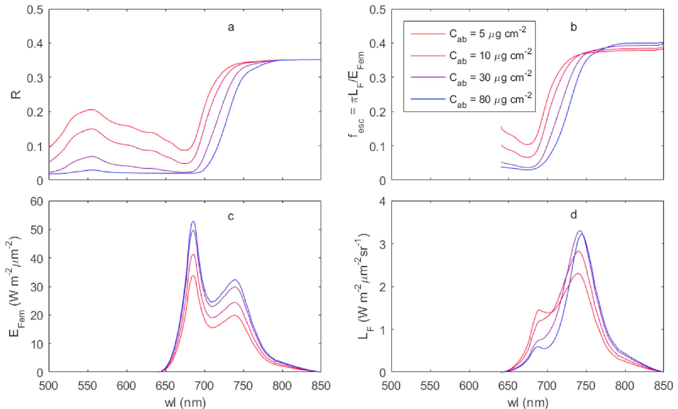

Re-absorption and scattering: leaf to canopy
Leaf level
Red emission overlaps chlorophyll absorption → re-absorbed
Red/far-red ratio ↓ as chlorophyll ↑
Canopy level
Escape probability f_{esc} ≈ shape of reflectance
LAI, leaf angle, clumping, sun/shade leaves change SIF
Only a little red SIF leaves the shaded side of leaves
Mohammed et al. (2019), Fig. 7 — SCOPE: (a) reflectance, (b) escape probability f_esc, (c) emitted fluorescence, (d) top-of-canopy SIF for Cab 5–80 µg cm⁻²
Consequence: a change in SIF may come from physiology or from structure and pigments — models are needed to tell them apart.
Notes:
Chlorophyll absorbs between ~400 and 720 nm, overlapping the red emission, so red fluorescence is re-absorbed inside the leaf and canopy, and saturates quickly as chlorophyll increases. Far-red escapes much more. Therefore the red/far-red ratio falls as chlorophyll content rises (Gitelson's F735/F700 index). In the canopy, scattering and re-absorption shape the observed SIF: the fluorescence escape probability fesc looks very similar to reflectance. The SCOPE simulation shows this for four leaf chlorophyll contents.

Slide 50
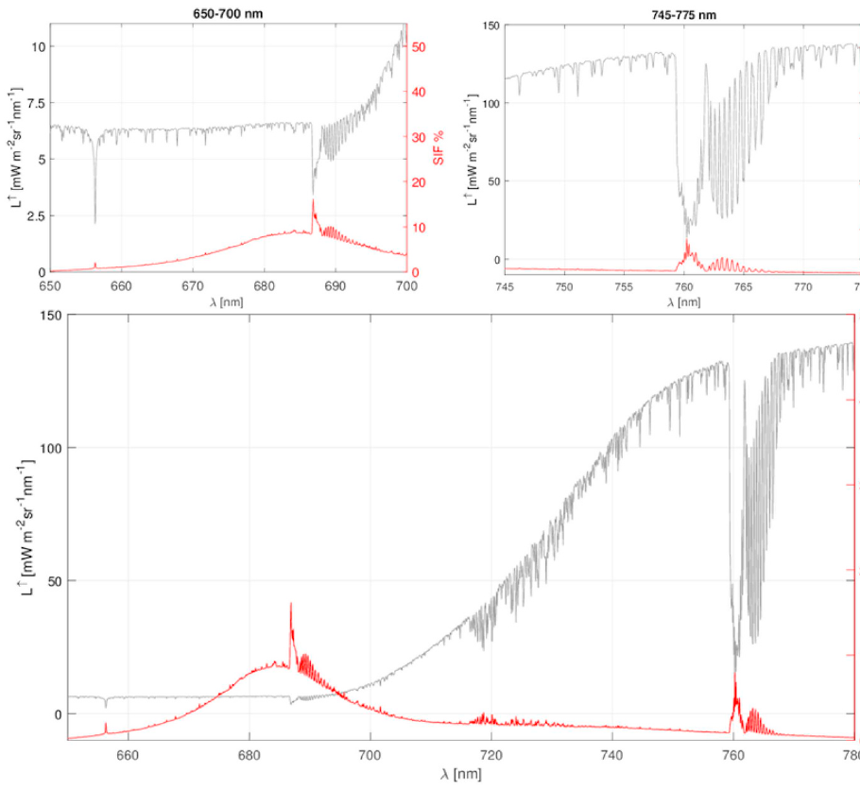
The core difficulty: SIF is tiny compared with reflected light
~1–5 %
>10 %
of total radiance outside absorption bands
inside the O₂-A and O₂-B bands
1–5 % is an approximate range for the overall contribution.
Why the bands help
Inside a band the sun's light is strongly attenuated → reflected radiance is low
Fluorescence is emitted at all wavelengths → it fills in the band
Red: SIF fraction high (reflectance is low) despite re-absorption
Needs high spectral resolution (sub-nm) and high SNR
Mohammed et al. (2019), Fig. 8 — SIF (red, right axis %) vs total radiance (grey) at 0.1 nm; insets: O₂-B (left) and O₂-A (right)
Notes:
Plotted at 0.1 nm resolution for dense summer vegetation, top-of-canopy radiance (grey) is dominated by reflected sunlight; SIF (red) is only a few per cent of it overall. But inside narrow absorption bands where incoming sunlight is very dim, the relative contribution of SIF jumps: more than 10% in the O2-A (760 nm) and O2-B (687 nm) bands. That is the trick every retrieval method uses.

Slide 51
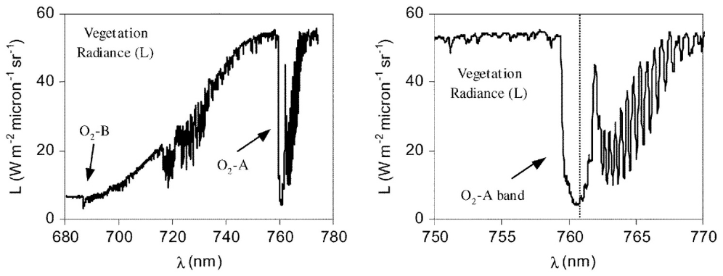

Where to look: Fraunhofer lines and oxygen bands
Fraunhofer lines (solar)
Narrow; small in-filling signal
Earth's atmosphere does not change relative depth → simpler correction
Used by GOSAT, GOME-2, OCO-2, TROPOMI
Mohammed et al. (2019), Fig. 4 — olive canopy radiance showing O₂-B and O₂-A (left) and the O₂-A band in detail (right)
O₂ bands (telluric)
Feature | Wavelength | Origin | Used for
Hα | 656.3 nm | Fraunhofer line | Early FLD work (narrow, ~0.1 nm)
O₂-B | ~687 nm | Telluric (Earth O₂) | Red SIF
Fraunhofer lines | 745–758 nm, K I 770 nm | Solar atmosphere | Far-red SIF from satellites
O₂-A | ~760 nm | Telluric (Earth O₂) | Far-red SIF; deepest band
Wide and deep → strong in-filling
Depth depends on path length, pressure, aerosols, direct/diffuse light
Needs accurate atmospheric modelling (FLEX design)
Notes:
Two kinds of dark lines exist in the sunlight reaching vegetation. Fraunhofer lines are produced by gases in the sun's own atmosphere; they are narrow and fairly shallow, but the Earth's atmosphere hardly affects their relative depth, so atmospheric modelling is easier, which is why satellites use them. Telluric oxygen bands are produced by O2 in Earth's atmosphere; they are wide and deep, giving a strong in-filling signal, but they require accurate atmospheric correction.

Slide 52
The retrieval equation and the FLD principle
L(λ) = r(λ)·E(λ)/π + SIF(λ)
L = radiance at sensor · E = incident irradiance · r = reflectance
Two-band FLD solution
Inside band: L_{in} = r·E_{in}/π + F
Outside band: L_{out} = r·E_{out}/π + F
F = (E_{out}·L_{in} − E_{in}·L_{out}) / (E_{out} − E_{in})
Assumption to remember
r and F are constant across the narrow window — refined by 3FLD, iFLD, cFLD and spectral fitting.
Notes:
Top-of-canopy radiance is the sum of reflected sunlight and fluorescence. With two unknowns (r and SIF) at each wavelength we need two measurements: one inside the absorption band and one just outside. If r and SIF are assumed equal at both, we can solve for SIF. The chart shows the idea: normalised to the shoulder, the radiance dip is shallower than the irradiance dip, because fluorescence fills it in. 3FLD, iFLD and cFLD improve on the constant-r/F assumption.

Slide 53
Families of SIF retrieval methods
SIF retrieval methods
① Selected absorption bands
② Full SIF spectrum (650–800 nm)
O₂ bands
Fraunhofer lines
Spectrum fitting
Model inversion
FLD (Plascyk 1975)
3FLD, iFLD, cFLD (refined r, F shapes)
SFM spectral fitting over tens of nm
Physically based (Frankenberg 2011)
Data-driven PCA / SVD (Guanter, Joiner, Köhler)
Used by satellites (GOSAT, GOME-2, OCO-2, TROPOMI)
FSR, aFSR (basis spectra from SCOPE)
F-SFM full-spectrum fitting
SpecFit (piecewise cubic spline)
Invert canopy RTM (SCOPE) at TOA/TOC
Verhoef 2018 (FLEX + Sentinel-3)
Celesti 2018 · also gives Cab, LAI, fAPAR
Notes:
Table 2 of the review groups methods into two classes. Class one retrieves SIF only at selected absorption bands: either O2 bands (FLD and variants, spectral fitting methods SFM) or Fraunhofer lines (simple physically based fitting, or data-driven PCA/SVD approaches using non-vegetated reference pixels). Class two retrieves the full SIF spectrum: spectrum fitting with basis spectra (FSR, F-SFM, SpecFit) or inversion of a canopy radiative transfer model, which also returns parameters like chlorophyll, LAI and fAPAR.

Slide 54



Atmosphere, illumination and observation: the confounders
Atmospheric correction
Direct vs diffuse light
Anisotropy & geometry
O₂ bands need accurate RT (MODTRAN, T-18 system); one-step vs two-step schemes
Diffuse light travels a longer path → deeper band → SIF over/under-estimated (up to 20 % at O₂-A)
Sun/view angles change sunlit vs shaded fraction seen by the sensor
Clouds & aerosols
Zero-level offset
Sensor performance
Contaminate large footprints; moderate broken clouds tolerated for Fraunhofer lines
Non-zero SIF retrieved where none exists (e.g. Sahara) — found first in GOSAT
Spectral resolution, SNR, stray light, calibration drift and degradation
Notes:
Even with a good algorithm, several effects can mimic or hide SIF. For O2 bands, the atmosphere must be modelled very accurately (path length, pressure, aerosols) either in two steps (TOA to TOC, then retrieval) or in one step. The direct-to-diffuse ratio changes band depth (up to ~20% error at O2-A). Canopy anisotropy and sun–sensor geometry change what fraction of sunlit and shaded leaves is seen. Satellites also suffer zero-level offsets, cloud and aerosol contamination and sensor degradation.

Slide 55
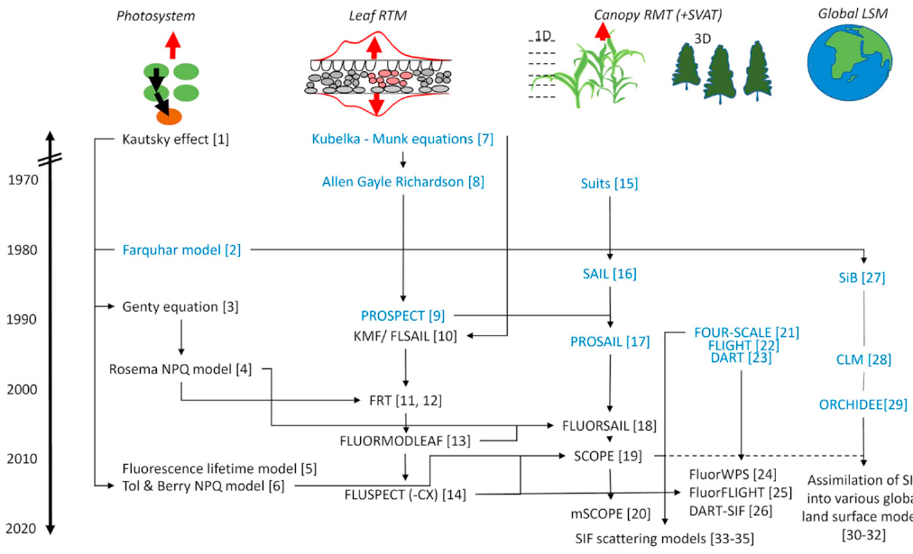
Modelling SIF: from photosystem to globe
Photosystem
Kautsky, Genty, Rosema NPQ, van der Tol & Berry
Leaf RTM
PROSPECT → FluorMODleaf → Fluspect
Canopy 1D
SAIL → FluorSAIL → SCOPE (with energy balance)
Canopy 3D
DART, FluorFLIGHT, FluorWPS
Global LSM
CLM, BETHY, ORCHIDEE assimilate SIF
Mohammed et al. (2019), Fig. 5 — history of leaf and canopy models; blue = models without fluorescence
SCOPE = Soil–Canopy Observation of Photosynthesis and Energy fluxes; DART = Discrete Anisotropic Radiative Transfer
Notes:
Models are essential to interpret SIF. Leaf physiological models describe how absorbed energy is partitioned (Genty equation, Rosema NPQ model, van der Tol & Berry). Leaf radiative transfer models describe absorption, emission and re-absorption inside the leaf (PROSPECT, FluorMODleaf, Fluspect). Canopy models add structure (FluorSAIL, SCOPE in 1D; DART, FluorFLIGHT, FluorWPS in 3D). Finally SIF is assimilated into global land surface models (CLM, BETHY, ORCHIDEE).

Slide 56
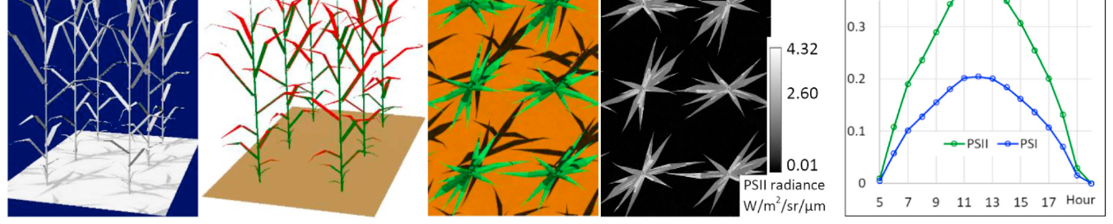

3D modelling example: DART simulation of a maize canopy
Mohammed et al. (2019), Fig. 6 — (a) irradiance, (b) sunlit (red) and shaded (blue) leaves, (c) true-colour reflectance, (d) PSII SIF image, (e) hourly PSII and PSI SIF at 742.5 nm
What 3D models add
SCOPE's niche
Uses
Shadows, clumping, row structure, leaf angles — effects 1D models cannot represent.
The only canopy model with leaf energy balance → links SIF, photosynthesis and temperature.
Interpret signals, design sensors, correct scattering/re-absorption, downscale SIF to photosystems.
Notes:
DART represents every plant element in 3D, computes sunlit and shaded leaves through the day, and simulates reflectance and PSII/PSI fluorescence images. The hourly curve shows that canopy SIF follows the daily course of sunlight, with PSII and PSI contributions at 742.5 nm.

Slide 57
Why SIF tracks photosynthesis (GPP)
GPP = APAR × LUE
SIF = APAR × Φ_{F} × f_{esc}
Shared term APAR (absorbed photosynthetically active radiation) explains much of the correlation. LUE = light-use efficiency; Φ_{F} = fluorescence yield; f_{esc} = escape probability.
What studies show
Shape of the relation
Why NPQ matters
Strong far-red SIF–GPP correlation from tower to satellite
Mostly driven by APAR & chlorophyll
At constant APAR, SIF explained <35 % of GPP variability (Wohlfahrt 2018)
Hyperbolic on stress-free days, linear under stress
Becomes linear when aggregated over space/time
Differs for C₃ vs C₄ (e.g. Indo-Gangetic Plains)
In high light NPQ diverts energy from both P and F
Midday depression of far-red SIF linked to NPQ
PRI (531 nm) helps track NPQ alongside SIF
Notes:
Both GPP and SIF are proportional to absorbed PAR. GPP = APAR × light-use efficiency; SIF = APAR × fluorescence yield × escape probability. Much of the observed SIF–GPP correlation therefore comes from APAR (shared absorption by chlorophyll). The yield terms add physiological information, but their relationship is not fixed: it depends on NPQ, stress, structure and scale. Under stress-free days the relationship can be hyperbolic, under stress more linear; aggregation over space and time tends to linearise it.

Slide 58
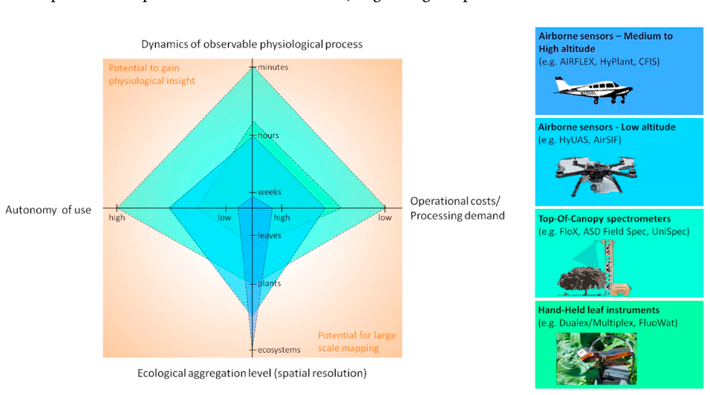
Measurement platforms: leaf to aircraft
Hand-held leaf
FluoWat clip + spectrometer; full spectrum; up- or downward SIF
Top-of-canopy
FloX, FluoSpec (0.13 nm), PhotoSpec, AutoSIF, NASA FUSION; diurnal & seasonal
UAV
Mohammed et al. (2019), Fig. 9 — trade-offs of hand-held, top-of-canopy and airborne instruments
AirSIF, HyUAS, Piccolo doppio; 30–40 cm pixels over tree crowns
Trade-off
Airborne
Higher platforms → larger area and lower cost per area, but less physiological detail per pixel.
AIRFLEX, HyPlant (FLEX demonstrator), CFIS (OCO-2 validation)
Notes:
Each platform trades autonomy, cost and spatial coverage against physiological detail. Hand-held leaf devices (FluoWat leaf clip with short-pass filter) give the full SIF spectrum of single leaves. Top-of-canopy spectrometers on towers (FloX, FluoSpec, PhotoSpec, AutoSIF, FUSION) run automatically to capture diurnal and seasonal dynamics. UAVs give very high spatial resolution. Airborne imagers (AIRFLEX, HyPlant, CFIS) map fields and validate satellites.

Slide 59
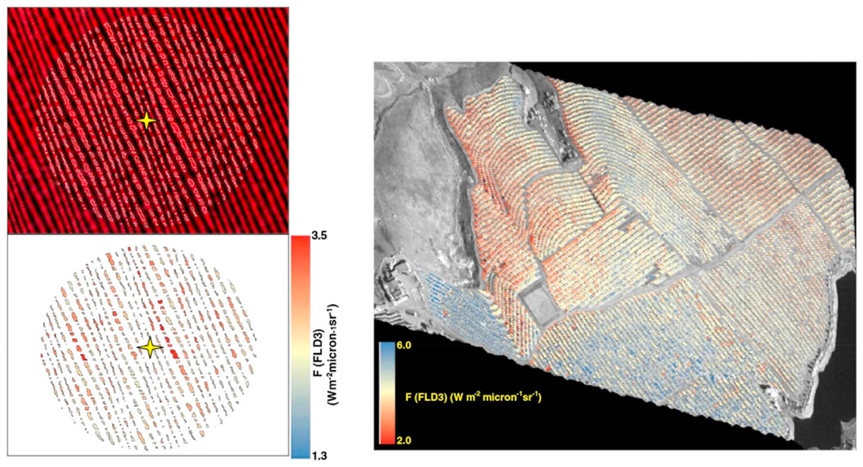
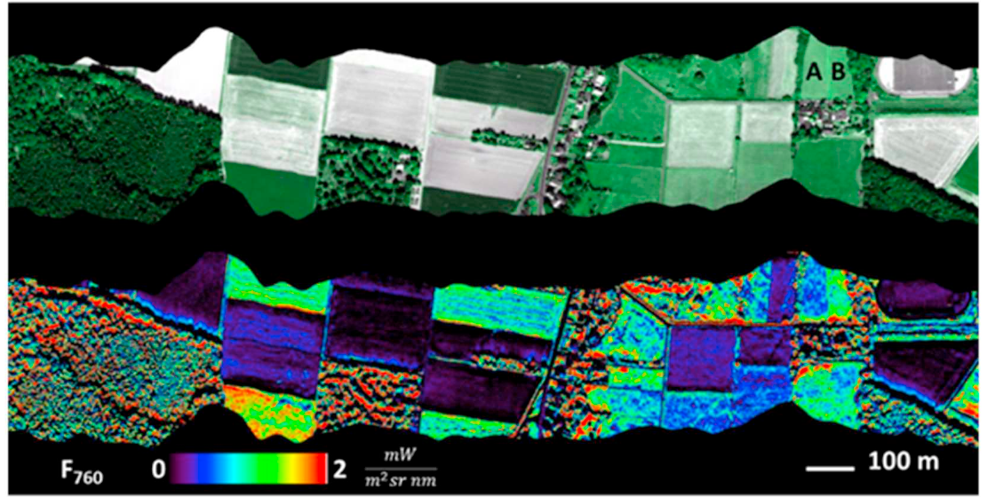
UAV and airborne SIF maps
Fig. 10 — UAV SIF (O₂-A, 3FLD) over an olive orchard (left) and water-stressed citrus (right)
Fig. 11 — HyPlant reflectance (top) vs F₇₆₀ SIF (bottom); fields A and B differ only in SIF
UAV strength
Airborne strength
Very high spatial resolution, flexible on-demand flights; must stay light yet keep SNR.
HyPlant: 0.25 nm resolution, 670–780 nm; maps both red and far-red SIF.
Notes:
Left: a fixed-wing UAV with a micro-hyperspectral imager retrieved SIF (3FLD, O2-A) from 30–40 cm pixels over an olive orchard and a water-stressed citrus field, isolating pure tree crowns from shadow and soil. Right: HyPlant maps over Klein Altendorf, Germany. Fields A and B look almost identical in reflectance but have very different SIF, showing that fluorescence carries information not visible in reflectance.

Slide 60
Satellites that measure SIF
Mission / sensor | Status (2019) | Footprint (km²) | Overpass | Repeat | Range (nm) | FWHM (nm) | SIF
FLEX / FLORIS | Selected | 0.3 × 0.3 | 10:00 | 27 day | 500–780 | 0.3–2.0 | Red, far-red, full, PRI
Sentinel-5P / TROPOMI | In orbit | 7 × 7 | 13:30 | 16 day† | 675–775 + | 0.5 | Far-red, full, (red)
MetOp / GOME-2 | In orbit | 40 × 40 / 40 × 80 | 09:30 | 29 day† | 270–790 | 0.5 | Far-red, full, (red)
OCO-2 | In orbit | 1.3 × 2.25 | 13:30 | 16 day | 757–775 | 0.04 | Far-red
GOSAT / TANSO-FTS | In orbit | 10 × 10 | 13:00 | 3 day | 758–775 + | 0.025 | Far-red
TanSat / ACGS | In orbit | 2 × 2 | 13:30 | 16 day | 758–778 + | 0.04 | Far-red
TEMPO · Sentinel-4 · GeoCARB | Selected (GEO) | ~3–8 km | GEO | hourly | various | 0.05–0.6 | Far-red (± red)
Simplified from Table 3 of Mohammed et al. (2019). †Daily near-global coverage thanks to wide swaths; repeat cycle refers to identical orbit tracks. '+' = additional bands at longer wavelengths.
Rule of thumb: high spectral resolution, high SNR, small footprint and frequent revisit cannot all be maximised at once.
Notes:
None of the early satellites were designed for SIF; they were built for atmospheric chemistry (CO2, methane, ozone), but their high spectral resolution near the O2-A band allowed far-red SIF retrieval from Fraunhofer lines. FLEX will be the first mission designed specifically for SIF. Note the trade-offs: GOSAT and OCO-2 have very high spectral resolution but sparse sampling; GOME-2 large footprints; TROPOMI daily global coverage at 7 km.

Slide 61
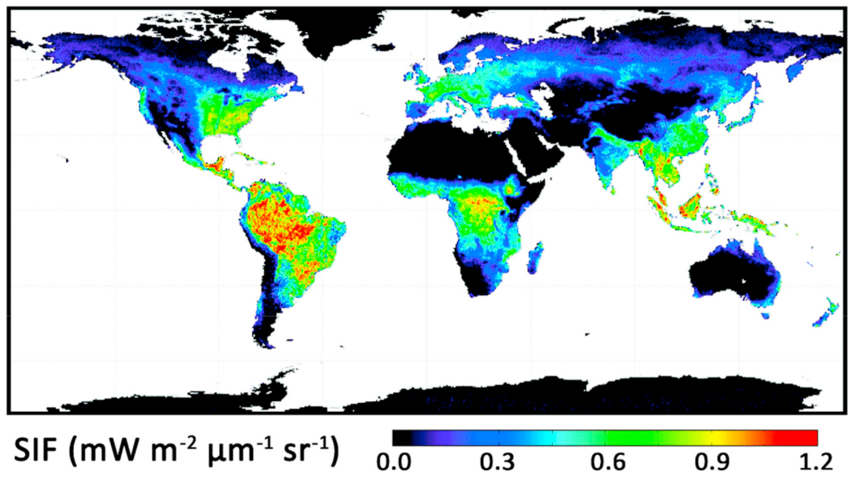

Global far-red SIF from space
Reading the map
Red/yellow: highest SIF (tropics, intensive cropland)
Black: deserts, ice — no vegetation
Seasonal maps reveal phenology and drought
Satellite findings
GOME-2 SIF captured high US Corn Belt GPP that vegetation indices missed
Drought & heat stress signals at ecosystem scale
Mohammed et al. (2019), Fig. 13 — 2009 annual average far-red SIF from GOME-2 (Joiner et al. 2013)
Notes:
This annual 2009 map from GOME-2 shows where photosynthesis is most active: tropical forests, the US Corn Belt in summer, eastern China and northern India croplands. GOME-2 has about 0.5 nm resolution and SNR above 1000 near 740 nm, allowing monthly 0.5° maps. TROPOMI now gives daily data at 7 × 7 km, enough to see biome-scale patterns in much finer detail.

Slide 62
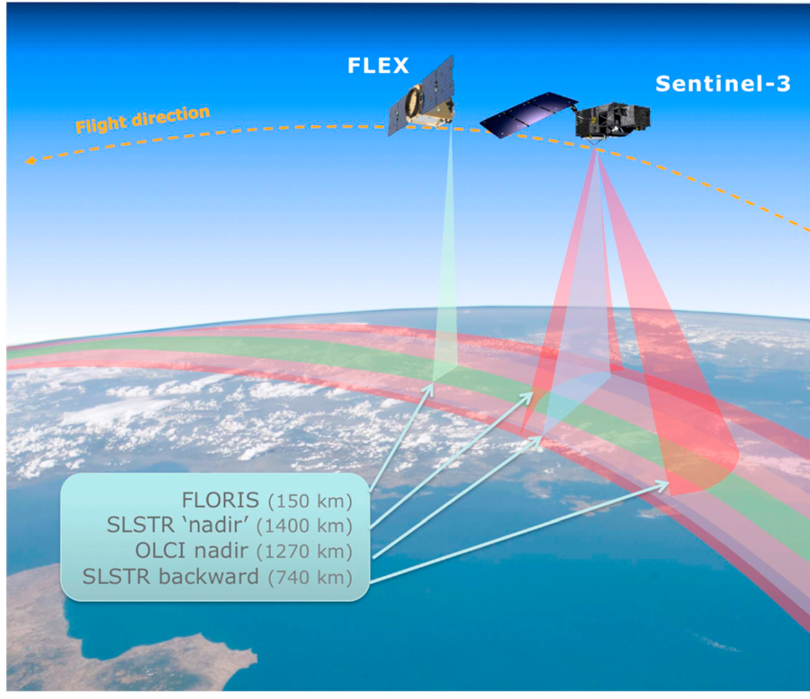

FLEX: the first satellite designed for SIF
300 m
500–780
pixel size
nm spectral range
10:00
150 km
equatorial overpass
FLORIS swath
Planned products
Total fluorescence F_{tot} (650–780 nm); F₆₈₅, F₇₄₀; F₆₈₇, F₇₆₀
Photosynthetic activity, NPQ indicators (PRI), fAPAR_{chl}, LAI, chlorophyll
5-year mission, 56°S–75°N land and coastal zones
Mohammed et al. (2019), Fig. 12 — FLEX (FLORIS, 150 km swath) in tandem with Sentinel-3 (OLCI 1270 km; SLSTR nadir 1400 km, backward 740 km)
Notes:
ESA's FLuorescence EXplorer, the 8th Earth Explorer, flies in tandem with Sentinel-3. Its single payload, FLORIS, is a dual imaging spectrometer covering 500–780 nm with high spectral resolution in the red and far-red, giving the full fluorescence spectrum, the red and far-red peaks, O2-B and O2-A features, and reflectance indices such as PRI. Sentinel-3's OLCI and SLSTR provide atmospheric, thermal and land-cover information. The review gave a projected launch of 2022; the launch has since moved later.

Slide 63




What SIF is used for
GPP & carbon uptake
Phenology & seasons
Drought & water stress
Heat stress
Empirical and model-based GPP from tower to globe
Green-up, peak, senescence; seasonal dynamics
SIF ↓ with water deficit; pair with canopy–air temperature
Detected from satellite during heat waves
Nitrogen deficit
Plant disease
Herbicide damage
Transpiration
Red/far-red SIF ratio ↑ with N deficiency
Xylella in olive (>80 %), Verticillium, Phytophthora
Detected before visible symptoms; reflectance unchanged
Linked to stomatal behaviour in unstressed crops
Notes:
Table 4 of the review lists applications. In photosynthesis: APAR, diurnal and seasonal dynamics, GPP (empirical and modelled), light-use efficiency, phenology, vegetation type. In stress detection: bacterial infection (Xylella fastidiosa in olive, detected with >80% accuracy combined with thermal and other indices), fungal infection, heat, herbicide, nitrogen deficit, transpiration and drought. SIF is often combined with ancillary indices like NDVI, PRI, MTCI and canopy-minus-air temperature.

Slide 64
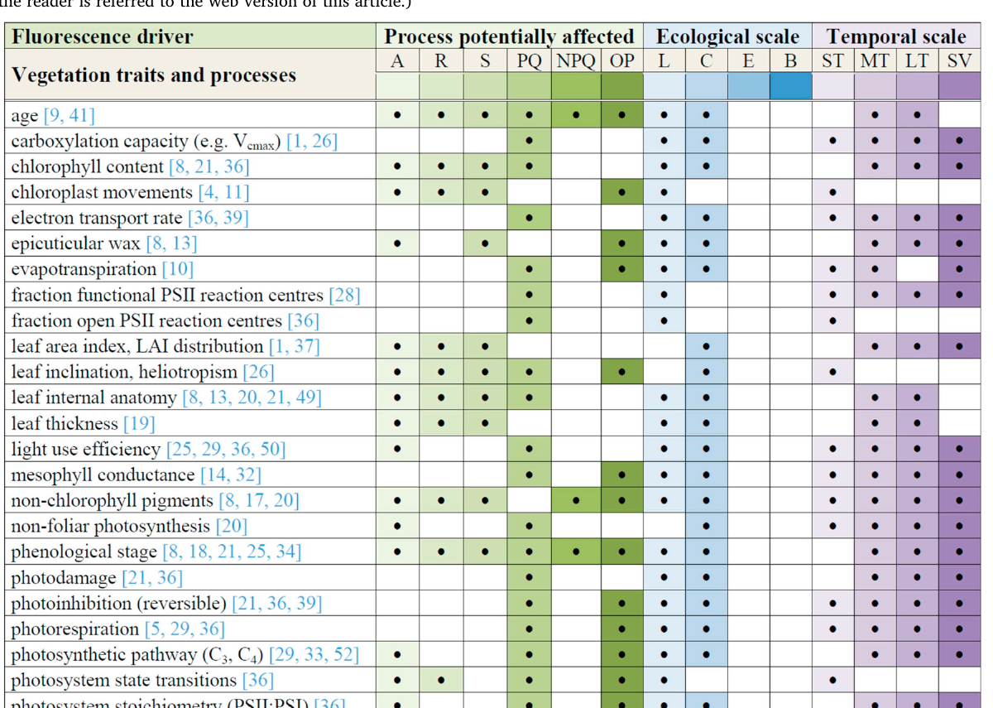
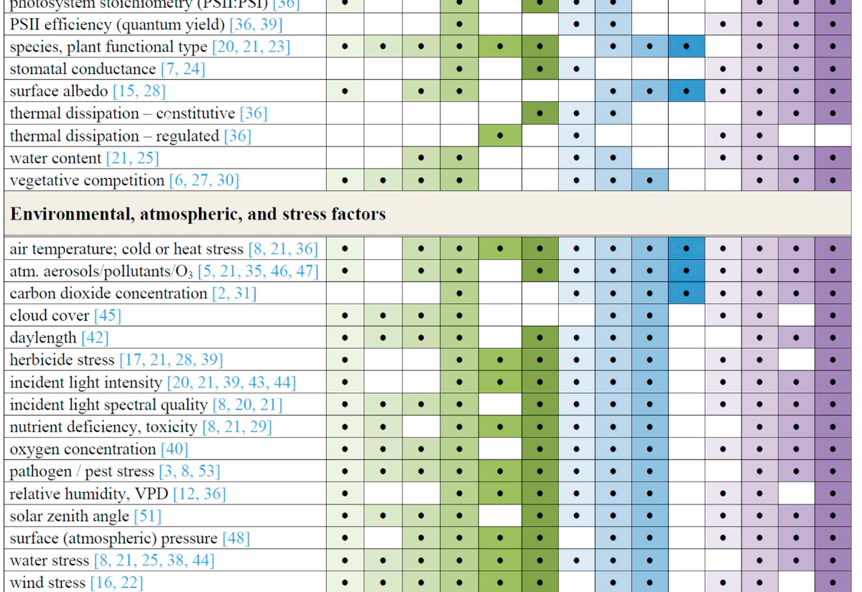
What drives SIF? (Table 5 of the review)
Table 5 (part 1): vegetation traits and processes
Table 5 (part 2): environmental, atmospheric and stress factors
Process: A absorption · R re-absorption · S scattering · PQ photochemical quenching · NPQ · OP other photoprotection Scale: L leaf · C canopy · E ecosystem · B biome Time: ST short · MT medium · LT long-term · SV seasonal
Notes:
Every factor in this table can change SIF through one or more processes: absorption of incident light (A), re-absorption (R), scattering (S), photochemical quenching (PQ), NPQ, or other photoprotection (OP). The right-hand columns show at which ecological scale (leaf, canopy, ecosystem, biome) and timescale each matters. Use it as a checklist before interpreting a SIF change as 'photosynthesis changed'.

Slide 65

Challenges and future directions
Disentangle drivers
Quantify NPQ
Validate retrievals
Separate physiology from structure, pigments and illumination using models + ancillary data
PRI, reflectance 500–600 nm, canopy–air temperature to constrain the SIF–photosynthesis link
Ground towers, UAVs and airborne demonstrators (HyPlant, CFIS) under satellite tracks
Scale bridging
Better sensors
Operational products
Downscale coarse satellite SIF; correct directional effects; combine sensors
Red + far-red + full spectrum; high spectral resolution and SNR; VNIR for inversion
Assimilation in land surface models; ML emulators; tools for non-experts
Notes:
The review's main messages: understand confounding factors, validate satellite retrievals with ground and airborne data, quantify NPQ (with PRI or temperature differences), deliver user-friendly products, and combine spatial and temporal scales. Practical farming needs ~20 m spatial resolution and frequent revisits; forests need high spatial detail; high latitudes need very high SNR. Geostationary missions, FLEX and machine-learning emulators are expected to move SIF from research to operational use.

Slide 66
Synthesis & self-check
09
Bringing PAM and SIF together, a one-page formula sheet, and answers to the most common doubts
Notes:
Use these slides for revision.

Slide 67
One concept, two ways of measuring it
Absorbed light energy
Φ_{P} + Φ_{N} + Φ_{F} = 1
ACTIVE · PAM fluorometry
PASSIVE · Sun-induced fluorescence
Controls light: ML, AL, saturating pulse, FR
Measures yields: F_{v}/F_{m}, Φ_{PSII}, qP, qL, NPQ
Separates photochemical vs non-photochemical quenching
Leaf / plant scale; mechanistic understanding
Sunlight as source; in-filling of O₂ bands / Fraunhofer lines
Measures flux: SIF = APAR × Φ_{F} × f_{esc}
Linked to GPP mainly via APAR; NPQ and structure confound
Canopy to global scale; ecosystem monitoring
Notes:
Both approaches start from the same partitioning of absorbed energy into photochemistry, heat and fluorescence. PAM manipulates light to measure yields and separate photochemical from non-photochemical quenching. SIF measures the fluorescence flux under natural light, which combines how much light is absorbed with the yield and escape of fluorescence, and is related to GPP mainly through APAR.

Slide 68
Formula sheet
F_{v}
F_{m} − F_{o}
NPQ
(F_{m} − F_{m}′)/F_{m}′
F_{v}/F_{m}
(F_{m} − F_{o})/F_{m} ≈ 0.83 healthy
qN (old)
1 − (F_{m}′ − F_{o}′)/(F_{m} − F_{o})
F_{q}′
F_{m}′ − F′
ETR
Φ_{PSII} × PAR × 0.84 × 0.5
F_{v}′
F_{m}′ − F_{o}′
F_{o}′ (calc.)
F_{o}/[(F_{v}/F_{m}) + (F_{o}/F_{m}′)]
Φ_{PSII}
(F_{m}′ − F′)/F_{m}′ = qP × F_{v}′/F_{m}′
TOC radiance
L = r·E/π + SIF
qP
(F_{m}′ − F′)/(F_{m}′ − F_{o}′)
FLD
F = (E_{out}L_{in} − E_{in}L_{out})/(E_{out} − E_{in})
qL
qP × F_{o}′/F′
SIF / GPP
SIF = APAR·Φ_{F}·f_{esc} ; GPP = APAR·LUE
Prime (′) = light-adapted. No prime = dark-adapted. Green = PAM parameters; red = PAM extras and SIF.
Notes:
All formulas in one place for revision.

Slide 69

Clearing common doubts (1/2): PAM
Why does fluorescence rise when reaction centres close?
Why is F_{m}′ lower than F_{m}?
Photochemistry stops (k_{P} ≈ 0), so the same excitation must leave by heat or fluorescence. Competition → fluorescence yield rises to F_{m}.
In the light NPQ is active. Even with all centres closed by the pulse, extra heat dissipation competes with fluorescence.
Why measure F_{v}/F_{m} in the dark but Φ_{PSII} in the light?
Does a drop in F_{v}/F_{m} mean lower photosynthesis?
F_{v}/F_{m} needs all centres open and NPQ = 0 (maximum potential). Φ_{PSII} describes actual efficiency under the current light.
Not necessarily: it reflects light-limited yield; light-saturated photosynthesis may be unchanged, and stress elsewhere may not show.
Notes:
Questions students most often ask. Try answering each before reading the answer.

Slide 70
Clearing common doubts (2/2): SIF
If fluorescence competes with photosynthesis, why does SIF correlate positively with GPP?
Why is red SIF lower than far-red SIF?
Both scale with absorbed light (APAR). Across space and seasons, APAR variation dominates; yield changes are smaller and partly co-vary.
Chlorophyll re-absorbs red light (absorption up to ~720 nm); far-red mostly escapes. PSI also adds far-red.
Why use absorption bands at all?
Why can't satellites measure NPQ like PAM?
Outside the bands SIF is ~1–5 % of reflected radiance; inside O₂ bands sunlight is dim and in-filling by SIF can exceed 10 %.
No saturating pulse can be applied from space. NPQ is approached indirectly, e.g. with PRI or temperature.
Notes:
Questions students most often ask. Try answering each before reading the answer.

Slide 71
Key references
Murchie E.H., Lawson T. (2013). Chlorophyll fluorescence analysis: a guide to good practice and understanding some new applications. J. Exp. Bot. 64(13): 3983–3998. doi:10.1093/jxb/ert208
Mohammed G.H. et al. (2019). Remote sensing of solar-induced chlorophyll fluorescence (SIF) in vegetation: 50 years of progress. Remote Sens. Environ. 231: 111177. doi:10.1016/j.rse.2019.04.030
Baker N.R. (2008). Chlorophyll fluorescence: a probe of photosynthesis in vivo. Annu. Rev. Plant Biol. 59: 89–113.
Maxwell K., Johnson G.N. (2000). Chlorophyll fluorescence — a practical guide. J. Exp. Bot. 51: 659–668.
Genty B., Briantais J.M., Baker N.R. (1989). Quantum yield of photosynthetic electron transport and quenching of chlorophyll fluorescence. BBA 990: 87–92.
Kramer D.M. et al. (2004). New fluorescence parameters for the determination of Q_{A} redox state. Photosynth. Res. 79: 209–218.
Oxborough K., Baker N.R. (1997). Resolving chlorophyll a fluorescence images… calculation of qP and Fv′/Fm′ without measuring Fo′. Photosynth. Res. 54: 135–142.
Strasser R.J. et al. (2004). Analysis of the chlorophyll a fluorescence transient. In: Advances in Photosynthesis and Respiration 19: 321–362.
Meroni M. et al. (2009). Remote sensing of solar-induced chlorophyll fluorescence: review of methods and applications. Remote Sens. Environ. 113: 2037–2051.
Drusch M. et al. (2017). The FLuorescence EXplorer mission concept — ESA's Earth Explorer 8. IEEE TGRS 55: 1273–1284.
Notes:
Primary sources for this deck. The two review papers are the backbone; the others are classics cited within them for deeper reading.

