Slide 1
Digital Soil Mapping and Soil Moisture Mapping
Concepts, geostatistics, machine learning and two Indian case studies
Animesh Panda
Division of Agricultural Physics, ICAR-Indian Agricultural Research Institute, New Delhi
Notes:
Title slide. The talk covers what DSM is, the conventional geostatistical toolkit (variograms, kriging, regression-kriging), the machine-learning toolkit, two case studies (SOC in the Himalaya and surface soil moisture at the IARI farm) and a synthesis.

Slide 2
Outline of the talk
1
Concepts of DSM
scorpan model, workflow, sampling design
2
Conventional geostatistics
semivariogram, kriging family, regression-kriging
3
Machine-learning approaches
bagging, boosting, stacking, feature selection, validation
4
Case study I: SOC mapping
Indian Himalayan region, RF vs SVR vs XGB at 30 m
5
Case study II: Soil moisture mapping
Sentinel-1 + Landsat-8 fusion, stacking ensemble
6
Synthesis
comparison of approaches, gaps, conclusions
Notes:
Six parts. Spend most time on parts 2 to 5.

Slide 3
Concepts of digital soil mapping
Why soil information must become quantitative, spatial and uncertainty-aware

Slide 4
From conventional soil survey to digital soil mapping
Conventional soil survey
Digital soil mapping (DSM)
Tacit soil–landscape model in the surveyor's head
Polygon maps of soil series / mapping units
Typical scale 1:50,000 to 1:250,000
Static, labour intensive, hard to update
Within-polygon variation and accuracy unknown
Explicit numerical model: soil = f(covariates) + spatial error
Raster maps of properties (30 m to 250 m pixels)
Covariates from RS, DEM, climate and geology layers
Reproducible, updatable, cloud-scale (GEE)
Pixel-wise uncertainty (kriging variance, bootstrap PI)
DSM: building spatial soil information systems with numerical models that infer the spatial (and temporal) variation of soil types and properties from soil observations and related environmental variables.
Definition paraphrased from McBratney et al. (2003) Geoderma 117:3–52
Notes:
Conventional survey relies on the surveyor's mental model of soil-landscape relationships, drawn as polygons. DSM makes that model explicit and numerical: point observations plus exhaustive covariates feed a statistical or ML model, and the output is a raster with an uncertainty layer that can be updated when new data arrive.

Slide 5
The scorpan model: covariates for the soil-forming factors
S = f ( s, c, o, r, p, a, n ) + ε
s
c
o
r
p
a
n
Soil
Climate
Organisms
Relief
Parent material
Age
Space
Legacy maps; brightness, coloration, redness, clay & bare-soil indices
CHELSA bioclim (MAT, MAP, Bio1–19); MODIS LST mean & SD
Landsat bands, EVI mean & SD, NDVI; LULC map
SRTM DEM: slope, aspect, curvature, TPI, TRI, MRVBF, MRRTF, LS
Lithological groups (GSI 1:50k), geology map
Geomorphic surface age, landform stage
Coordinates, distance fields, neighbourhood terms
ε = spatially auto-correlated residual. Geostatistics models ε; regression/ML models f; hybrid methods model both.
Jenny (1941); McBratney et al. (2003); covariate examples from Kalambukattu et al. (2025) Discover Soil 2:35, Table 1
Notes:
Jenny's clorpt factors were extended by McBratney et al. (2003) with s (existing soil information) and n (spatial position). In practice every factor is represented by one or more raster covariates. The examples here are the ones actually used in the Himalayan SOC study (55 covariates).

Slide 6
Generic DSM workflow
Sampling design
(stratified, cLHS, grid)
Field sampling
(GPS, depth 0–15 cm)
Lab / sensor analysis
(Walkley–Black, ThetaProbe)
Point database
(x, y, z)
Overlay →
regression
matrix
Remote sensing
(Landsat, Sentinel-1/2)
DEM derivatives
(SRTM 30 m)
Climate, LULC,
lithology layers
Covariate stack
(resample, reproject)
Feature selection
Boruta, RFE,
correlation
Model calibration
Kriging / ML /
hybrid; k-fold CV
Validation
R², RMSE, CCC,
RPD, bias
Prediction map
apply to every
30 m pixel
Uncertainty map
kriging variance,
bootstrap 90% PI
model-building loop
Synthesised from Kalambukattu et al. (2025) Fig. 2 and Das et al. (2022) Fig. 2
Notes:
Two input streams meet at the overlay step: point observations from the field and lab, and an exhaustive covariate stack on a common grid. Everything after the regression matrix is model building and checking. Both case studies follow this skeleton.

Slide 7
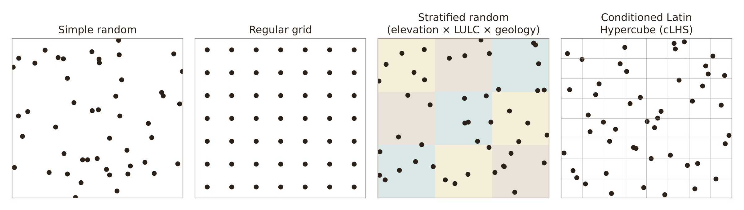
Sampling design decides map quality
Stratified random
SOC study: 21 strata (elevation × LULC × geology) covering >80% of the district; 421 sites.
cLHS
Soil-moisture study: sites chosen with the clhs R package; 622 readings over 6 satellite dates.
Rule of thumb
For a reliable variogram aim for at least 100–150 points; for kriging, spacing below half the effective range.
Schematic drawn for this talk; facts from Kalambukattu et al. (2025), Das et al. (2022) and Oliver & Webster (2014) Catena 113:56–69
Notes:
Sampling must cover the covariate space, not just geographic space. cLHS stratifies each covariate into equal-probability intervals and picks sites so the sample reproduces the multivariate distribution. Stratified random sampling is easier to explain and was used in the Himalayan SOC work where access is the constraint.

Slide 8
DSM methodology step by step
Five-step workflow from Minasny et al. (2013) Adv. Agron. 118:1–47, with techniques reviewed by Sindhushree et al. (2025)
Notes:
This section explains the methodology of digital soil mapping in detail, using two papers. Minasny, McBratney, Malone and Wheeler (2013) review digital mapping of soil carbon and set out the five general activities of any DSM study, plus the practical problems of depth, bulk density, sampling, covariates, uncertainty and change. Sindhushree et al. (2025) review DSM concepts and techniques, from geostatistics to deep learning. Each step is shown as a flow chart with figures from the papers.

Slide 9
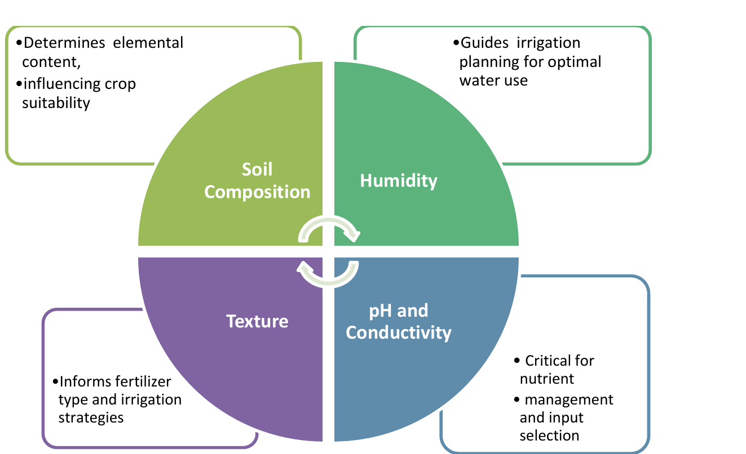
What DSM is made of: soil data, spatial data and models
Soil data
profiles, lab analyses, legacy maps
Soil property / class map
Numerical model
statistics, geostatistics, ML / DL
Spatial data
climate, DEM, satellite imagery, vegetation
Uncertainty map
Fig. 1 of Sindhushree et al. (2025): key soil parameters mapped and why they matter
Standardisation
consistent data and models; less surveyor bias
Continuity
continuous surfaces, not fixed polygon boundaries
Scalability
large or hard-to-reach areas from fewer samples
Cost efficiency
remote sensing + models replace much field and lab work
Components and advantages from Sindhushree et al. (2025) Digital soil mapping: a review of techniques, applications and emerging trends. J. Sci. Res. Rep. 31(7):1151–58
Notes:
Sindhushree et al. describe DSM as three linked components. Soil data come from surveys: profiles, sample analyses and existing maps. Spatial data represent the soil-forming environment: climate, digital elevation models, satellite imagery and vegetation maps. Numerical models, statistical, geostatistical and machine learning, link the two so soil properties can be predicted everywhere. The output is a continuous map with an uncertainty estimate. Compared with conventional survey, DSM is standardised, continuous rather than polygon-based, scalable to large or remote areas, and cheaper because it relies on remote sensing and predictive models.

Slide 10
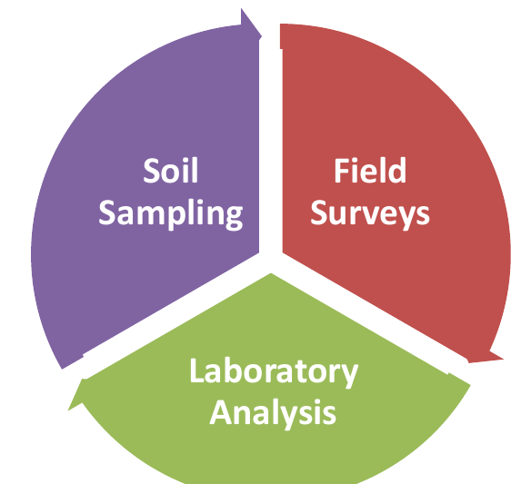
From traditional survey to predictive soil mapping
Three DSM concepts
Predictive soil mapping (PSM): statistical / ML models extrapolate properties from limited samples + environmental variables
Prediction of soil properties: texture, moisture, organic carbon at unsampled locations
GIS: integrates, overlays and visualises terrain, land use, vegetation and samples
Technique types
Classification → discrete soil types or classes
Regression → continuous pH, organic matter, moisture
Supporting technologies
Satellite imagery; drones
Kriging and variogram analysis
Open data and crowdsourcing to fill data gaps
Fig. 2 of Sindhushree et al. (2025): core techniques of traditional soil mapping
Traditional data stay essential: they become the training and validation points for DSM models.
Sindhushree et al. (2025) Digital soil mapping: a review of techniques, applications and emerging trends. J. Sci. Res. Rep. 31(7):1151–58, Sections 1.2–1.3
Notes:
Traditional soil mapping rests on three core techniques: soil sampling, field surveys and laboratory analysis. DSM keeps these as the source of training data but adds three concepts. Predictive soil mapping is the heart of DSM: statistical and machine learning models extrapolate soil properties from limited samples using environmental variables. Prediction of soil properties means estimating texture, moisture or organic carbon at unsampled places. GIS integrates and visualises all the layers. Techniques are of two types: classification predicts discrete soil classes, regression predicts continuous properties. Supporting technologies are satellite imagery, drones, kriging, variogram analysis, and open data and crowdsourcing.

Slide 11
The five-step DSM workflow (Minasny et al., 2013)
1. Soil observations
2. Covariates
3. Calibrate
4. Predict
5. Validate + uncertainty
Database of profiles / samples; harmonise depth, units, bulk density
Compile scorpan layers: climate, organisms, relief, parent material, age, space
Train S = f(scorpan) + e: regression, trees, RF, NN, regression-kriging
Apply the function to every grid cell: 2-D map or pseudo-3-D with depth
Cross-validation, holdback, independent sample; prediction intervals
Feedback: add samples where uncertainty is high, then re-train
S = f( s, c, o, r, p, a, n ) + ε
Minasny, McBratney, Malone & Wheeler (2013) Digital mapping of soil carbon. Adv. Agron. 118:1–47, Section 2.2
Notes:
Minasny et al. reviewed many soil carbon mapping studies and found they all follow five activities. One: build a database of soil observations for the area. Two: compile covariates that represent the scorpan soil-forming factors. Three: calibrate or train a spatial prediction function on the observations. Four: interpolate or extrapolate that function over the whole area to make the map. Five: validate with existing or independent data and report uncertainty. Where uncertainty is high, new samples can be added and the loop repeated. The next slides open up each step.

Slide 12
Step 1a: carbon concentration, density and stock
Soil sample
Lab: C_{m} (kg kg⁻¹)
× bulk density ρ_{b}
C_{v} (kg m⁻³)
∫ over depth
Stock C_{d} (kg m⁻²)
C_{v} = C_{m} × ρ_{b}
C_{d} = ∫₀^{z} C_{v}(z) dz
Laboratory methods
Dry combustion → total C
Wet oxidation → SOC
Vis–NIR / MIR spectroscopy: cheap, but needs a calibrated spectral library
Before modelling
SOC is positively skewed → log (or square-root) transform
Separate SOC from inorganic C (CaCO₃)
Map C fractions or C/N if needed
Worked example
C_{m} = 1 g 100 g⁻¹ = 0.01 kg kg⁻¹
ρ_{b} = 1.3 Mg m⁻³, layer = 0.10 m
C_{v} = 0.01 × 1300 = 13 kg m⁻³
Stock = 13 × 0.10 = 1.3 kg C m⁻² (13 t C ha⁻¹)
Minasny, McBratney, Malone & Wheeler (2013) Digital mapping of soil carbon. Adv. Agron. 118:1–47, Section 3.1 (Eqs. 2–3); worked example added for this talk
Notes:
Soil carbon is measured as a concentration on a mass basis, for example grams per 100 grams. To know how much carbon is stored, it must be converted to a volume basis by multiplying by bulk density, then integrated over depth to give carbon density per square metre, which is the stock. Total carbon is measured by dry combustion and organic carbon by wet oxidation. Visible, near- and mid-infrared spectroscopy is a cheaper alternative, but it needs a spectral library calibrated against a standard method. Because carbon concentration is positively skewed, most studies log-transform it before modelling.

Slide 13
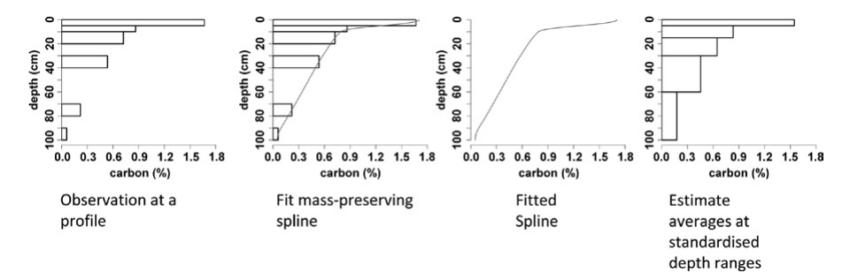
Step 1b: harmonising depth with the equal-area spline
Depth functions
Exponential (Russell & Moore 1968):
C = C₀ e^{−kz}
Generalised (Minasny 2006):
C = C_{a} e^{−kz} + C_{b}
Problem: one local deviation degrades the whole fit
Equal-area spline (Ponce-Hernandez 1986; Bishop 1999)
Local quadratics, knots at horizon boundaries
Area under curve = layer value → layer mean preserved
Fig. 1.2 of Minasny et al. (2013): equal-area spline fitted to a profile and averaged to standard depths (Edgeroi, Australia)
Horizon / layer data
Fit equal-area spline
Continuous depth curve
Average at standard depths
GlobalSoilMap depths: 0–5, 5–15, 15–30, 30–60, 60–100, 100–200 cm at 3 arc-sec (~90 m) with prediction confidence
Minasny, McBratney, Malone & Wheeler (2013) Digital mapping of soil carbon. Adv. Agron. 118:1–47, Sections 3.2 and 5.5
Notes:
Soil samples come from horizons or depth layers that differ between surveys, so depths must be harmonised before modelling. Carbon usually declines exponentially with depth, so early studies fitted an exponential function. But a single local deviation spoils the whole fit. The equal-area spline is more flexible: it is a series of local quadratic pieces joined at horizon boundaries, and the area under the curve in each layer equals the measured layer value, so layer means are preserved. The fitted spline is then averaged over standard depths, for example the six GlobalSoilMap depths. The figure shows the four stages: observed layers, fitted mass-preserving spline, the continuous curve, and averages at standard depths.

Slide 14
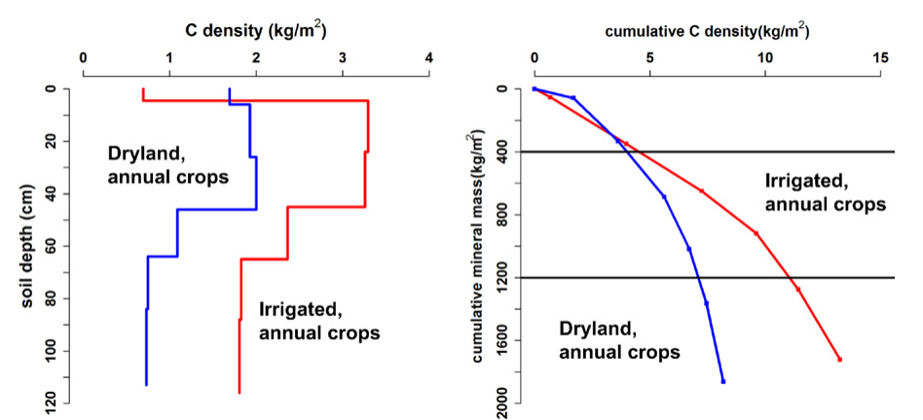
Step 1c: bulk density and the mass coordinate system
Pedotransfer function for bulk density (Tranter 2009)
ρ_{b} = ρ_{m} + Δρ + ε
ρ_{m} = a + b·sand + c·sand² + d·log(depth)
ρ_{m} mineral part (texture, depth); Δρ structure (organic C, tillage)
Organic matter effect: ρ_{b} = 100 / [OM%/ρ_{OM} + (100 − OM%)/ρ_{m}], ρ_{OM} = 0.224 g cm⁻³
Why fixed depths mislead
Same 1% C, 10 cm layer: ρ_{b} 1.0 vs 1.3 Mg m⁻³ → stock 1.0 vs 1.3 kg m⁻²
Tillage, compaction, swelling change mass per depth
Fix: equivalent soil mass (Ellert & Bettany 1995) or mass coordinate system (Gifford & Roderick 2003): C vs cumulative mineral mass
Fig. 1.3 of Minasny et al. (2013): C density by depth (left) and cumulative C vs cumulative mineral mass (right) for two sites
Minasny, McBratney, Malone & Wheeler (2013) Digital mapping of soil carbon. Adv. Agron. 118:1–47, Sections 3.3 and 5.3
Notes:
Carbon stock needs bulk density, but legacy data rarely include it, so it is predicted with a pedotransfer function. Tranter's model splits bulk density into a mineral part that depends on sand and depth, plus a structural part related to organic matter and tillage. A second issue is that tillage, compaction and swelling change bulk density, so a fixed depth contains different soil masses at different times or sites. Comparing stocks at a fixed depth is then unfair. The equivalent soil mass method corrects to the heaviest layer, but the simpler approach is the mass coordinate system: plot cumulative carbon against cumulative mineral soil mass. The figure shows that dryland and irrigated soils that look different by depth can be compared fairly at 400 or 1200 kilograms of mineral soil per square metre.

Slide 15
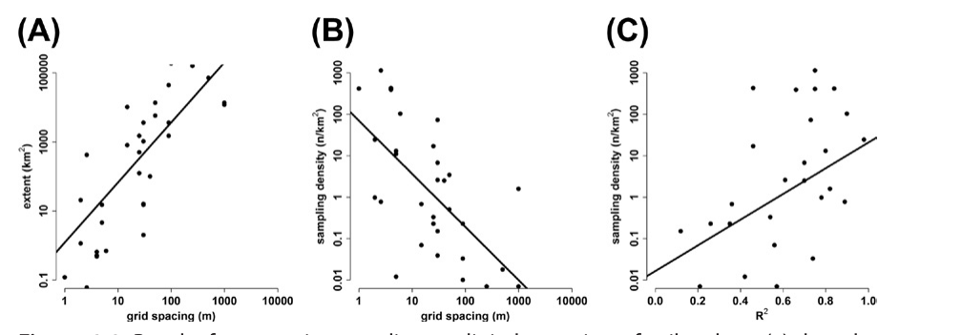
Step 1d: where to sample, and how to use legacy data
Covariates available?
Yes → stratify: cluster covariates, fixed n per stratum
No → grid / geographic coverage
cLHS: cover the full distribution of every covariate
Fig. 1.1 of Minasny et al. (2013): (A) grid spacing vs extent, (B) sampling density vs grid spacing, (C) density vs R²
Only legacy data?
no statistical design, may be biased
Check hypercube occupancy in covariate space (Carré 2007)
What the review of past studies shows
Densities ranged 0.002 to 1100 samples km⁻²
Map resolution coarsens with extent; finer with denser sampling
Accuracy (R²) rises logarithmically with sampling density
Weight data; add samples in under-observed hypercubes
Minasny, McBratney, Malone & Wheeler (2013) Digital mapping of soil carbon. Adv. Agron. 118:1–47, Sections 2.2.2 and 4
Notes:
Sampling design decides map quality. With no covariate information, a grid or even geographic coverage is recommended. With covariates, the area is stratified: cluster analysis groups the covariates into similar classes and a fixed number of samples is taken in each. Conditioned Latin hypercube sampling chooses sites so that the full distribution of every covariate is covered. Regional and national studies usually depend on legacy data from traditional surveys, which have no statistical design and can be biased. Their coverage can be checked by dividing covariate space into hypercubes and seeing which are over- or under-observed; new samples then go into the empty hypercubes. The review found sampling densities from 0.002 to 1100 per square kilometre and that accuracy rises with the logarithm of sampling density.

Slide 16
Step 2: covariates, and why they change with scale
C = k₀ + k₁MAP + k₂MAT + k₃parent rock + k₄slope + k₅flora + k₆latitude (Jenny 1968)
Continental / global: Climate: rainfall (MAP), temperature (MAT), moisture index
Regional: Native vegetation; gamma radiometrics (clay, wetness); lithology
Landscape: Terrain: <100 m → slope, aspect, curvature; >100 m → landscape position (n)
Field / farm: Current land use and management; erosion and deposition
Remote sensing: NDVI = productivity proxy; bare-soil Vis–NIR / hyperspectral maps C directly where vegetation is absent
Minasny, McBratney, Malone & Wheeler (2013) Digital mapping of soil carbon. Adv. Agron. 118:1–47, Section 5.2
Notes:
Jenny's 1968 model was an early empirical carbon model using rainfall, temperature, parent rock, slope, flora and latitude; rainfall was the strongest predictor. Minasny et al. stress that covariates should have a biophysical reason: they represent carbon input through productivity and decomposition through temperature and moisture. Which covariates matter depends on scale. At continental to regional scale climate dominates. Regionally, native vegetation and gamma radiometrics, which track clay and wetness, are important. At landscape scale, terrain controls erosion and deposition: below about 100 m resolution local slope, aspect and curvature work; above 100 m, landscape position matters more. At farm scale current land use and management dominate. NDVI is a good proxy for productivity, and bare-soil spectra can map carbon directly.

Slide 17
Step 3: models for the spatial prediction function
Spatial prediction function S = f(covariates) + e
Statistical / ML
Geostatistical / hybrid
Deep learning
Linear & non-linear regression
ANN, SVM
Regression trees
Random forest: most used
Kriging, co-kriging
Regression-kriging: trend + kriged residuals
GWR: coefficients vary in space
CNN: covariate image windows → spatial context
1-D CNN on soil spectra
ResNet / LSM-ResNet for SOM
Output type: classification → soil classes · regression → continuous properties. Limits: data needs, non-linearity, preprocessing, stationarity assumptions
Sindhushree et al. (2025) Digital soil mapping: a review of techniques, applications and emerging trends. J. Sci. Res. Rep. 31(7):1151–58, Section 2
Notes:
Sindhushree et al. group DSM models into families. Statistical and machine learning models learn the relationship between soil and covariates: artificial neural networks, support vector machines, regression trees, and random forest, which is the most widely used. Geostatistical and hybrid models also use spatial autocorrelation at the sample points: co-kriging uses a correlated auxiliary variable, regression-kriging adds kriged residuals to a regression trend, and geographically weighted regression lets coefficients vary in space. Deep learning extracts features automatically: convolutional networks use windows of covariate images to capture spatial context, 1-D CNNs work on spectra, and residual networks such as LSM-ResNet predicted soil organic matter better than random forest. Limitations include data needs, preprocessing and assumptions such as stationarity.

Slide 18
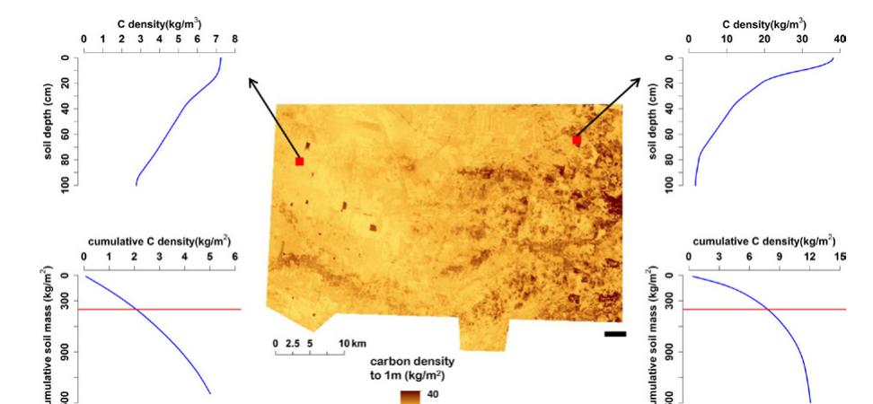
Step 4: from 2-D maps to pseudo-3-D soil carbon (Edgeroi)
1
Compile soil observations + covariates
2
Bulk density by pedotransfer function
3
SOC on volume basis (kg m⁻³)
4
Fit equal-area spline to SOC and ρ_{b}
5
Join with covariates → calibration set
6
Model spline parameters from covariates
Fig. 1.8 of Minasny et al. (2013): carbon density to 1 m, Edgeroi; profiles of C density and cumulative C vs soil mass at two points
7
Map whole area (90 m) for SOC and ρ_{b}
Edgeroi, NSW: 1500 km²; 341 profiles (210 on a 2.8 km triangular grid); 6 depths to 2.6 m; covariates: DEM derivatives, Landsat TM, gamma radiometrics
8
Calculate prediction uncertainty
Minasny, McBratney, Malone & Wheeler (2013) Digital mapping of soil carbon. Adv. Agron. 118:1–47, Sections 5.4–5.6 (after Malone et al. 2009)
Notes:
Most soil carbon maps are 2-D: one depth interval at a time. Mapping carbon as a continuous function of depth lets the stock be calculated to any depth. In the Edgeroi example, 1500 square kilometres in Australia, 341 profiles were used, 210 on a 2.8 km triangular grid, sampled at six depths. The steps were: compile observations and covariates; predict bulk density with a pedotransfer function; convert carbon to a volume basis; fit equal-area splines to carbon and bulk density; join with covariates; model the spline parameters from the covariates; map them over the whole area at 90 m; and calculate uncertainty. The figure shows the carbon density map to 1 m with depth profiles at two points.

Slide 19
Step 5: uncertainty and validation
Empirical uncertainty (Malone et al. 2011)
Validation options
Covariate space
Other methods
Kriging variance
Monte Carlo, bootstrap, Bayesian (1000–10 000 runs: costly)
Error propagation (Goidts 2009): main sources = SOC concentration and rock fragments
Cross-validation
Leave-one-out or n-fold
Fuzzy k-means with extragrades → clusters
Random holdback
~30% withheld from calibration
Model errors per cluster → prediction interval
Independent probability sample
Stratified simple random; unbiased map accuracy (Brus 2011)
Pixel PI = membership-weighted average
Half the reviewed studies reported no validation; most reported no uncertainty
Upper / lower limit maps
Minasny, McBratney, Malone & Wheeler (2013) Digital mapping of soil carbon. Adv. Agron. 118:1–47, Section 6
Notes:
Every DSM product should come with uncertainty, yet the review found most studies did not report it. Geostatistical methods give kriging variance directly. Monte Carlo, bootstrapping and Bayesian methods are general but expensive, because thousands of map realisations are needed. Malone et al. 2011 proposed an empirical method: cluster the covariate space with fuzzy k-means with extragrades, derive a prediction interval for each cluster from the model errors, and give each pixel a prediction interval weighted by its cluster memberships; extragrades flag pixels outside the calibration domain. For validation, half the studies did none. Options are leave-one-out or n-fold cross-validation, random holdback of about 30%, or independent probability sampling, which Brus et al. 2011 recommend because only it gives unbiased map accuracy.

Slide 20
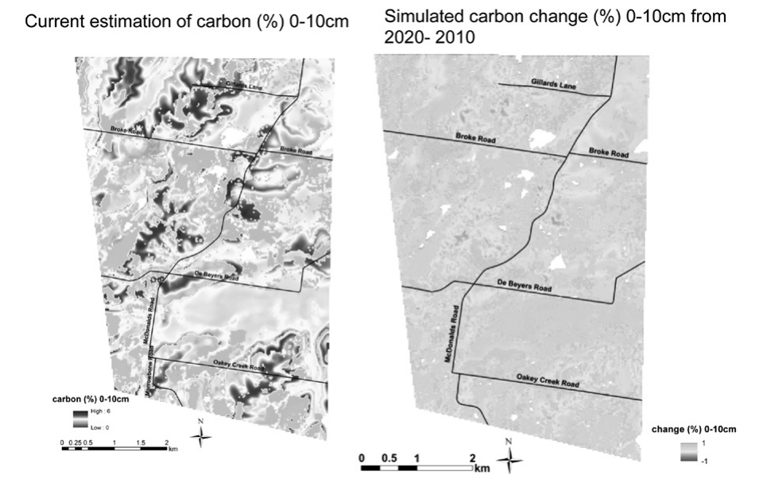
Mapping and predicting soil carbon change
DSM map of current soil carbon
(1) Dynamic–mechanistic
(2) Static–empirical
Run a C model in every pixel under a scenario
dC/dt = hI − kC
Spatial: dC/dt = I − kC + q_{m} + (q_{a} − q_{l})
Hunter Valley, vineyard → pasture: SOC 2.9 → 3.3 g 100 g⁻¹ (2010–2020)
Semi-dynamic scorpan: shift a factor by its trend and re-predict
c(t + Δt) = c + (Δc/Δt)·Δt
Monitoring networks map observed change (England & Wales: −0.6% yr⁻¹, 1978–2003)
Fig. 1.11 of Minasny et al. (2013): current SOC 0–10 cm (left) and simulated change 2010–2020 after land-use change (right), Hunter Valley
Minasny, McBratney, Malone & Wheeler (2013) Digital mapping of soil carbon. Adv. Agron. 118:1–47, Section 7
Notes:
A DSM map shows carbon at one time. Change can be mapped where there is a monitoring network; for example, England and Wales lost carbon at about 0.6 percent per year between 1978 and 2003. To predict change there are two routes. The dynamic-mechanistic route feeds the map into a carbon model run in each pixel under a scenario. Minasny et al. used the two-compartment Hénin–Dupuis model for a Hunter Valley area where vineyards were assumed to change to pasture: mean SOC was predicted to rise from 2.9 to 3.3 grams per 100 grams between 2010 and 2020. A spatial version adds vertical mixing and lateral gains and losses. The static-empirical route is the semi-dynamic scorpan model: change a scorpan factor, such as climate, by its expected trend and re-run the prediction function.

Slide 21
Methodology lessons and interview one-liners
Representative samples
Biased samples give a biased model
Covariate quality
Poor covariates → map artefacts
Scale
Covariate–soil links change with resolution
Time
Standardise legacy data; link to process models
Q. Five steps of DSM?
→ Observations → covariates → calibrate → predict → validate + uncertainty
Q. What is an equal-area spline?
→ Quadratic pieces joined at horizons; preserves each layer mean
Q. Why bulk density?
→ To convert concentration to stock: C_{v} = C_{m}·ρ_{b}, integrate over depth
Q. What is cLHS?
→ Sampling that covers the full distribution of every covariate
Q. How is a DSM map validated?
→ CV, 30% holdback or independent probability sample; report R², RMSE
Q. Pseudo-3-D map?
→ Map depth-function parameters → carbon at any depth
Minasny, McBratney, Malone & Wheeler (2013) Digital mapping of soil carbon. Adv. Agron. 118:1–47, Section 8; Sindhushree et al. (2025)
Notes:
The review's conclusions: representative samples are essential because the scorpan model only learns the correlations in the data; maps reflect the quality of the covariates; covariate importance changes with scale; and soil carbon changes with time, so maps need a time dimension and links to process models. The question cards give short answers to likely interview questions on this section.

Slide 22
Conventional approach: geostatistics
Regionalised variable theory: model the spatial autocorrelation, then predict by kriging

Slide 23
Spatial interpolation: concept and method families
Ẑ(x₀) = Σ λ_{i} z(x_{i}), Σ λ_{i} = 1
Ways to classify a method
Exact (honours data) vs inexact (smooths)
Global (all points) vs local (neighbourhood)
Deterministic (no error) vs stochastic (error map)
Every method is a weighted average of neighbours; methods differ only in how the weights λ_{i} are chosen. Tobler: near things are more alike than distant things.
Spatial interpolation
Deterministic
geometry only, no error estimate
Geostatistical
weights from the variogram + error
Hybrid
covariates + spatial residuals
Global: trend surface
Local: Thiessen / nearest neighbour, IDW, splines / RBF, local polynomial, natural neighbour
Kriging: simple, ordinary, universal / KED, co-kriging, indicator, block
Simulation: sequential Gaussian
Regression-kriging
Kriging with external drift
ML + kriged residuals
Compiled from Oliver & Webster (2014) Catena 113:56–69; Webster & Oliver (2007) Geostatistics for Environmental Scientists; Sindhushree et al. (2025)
Notes:
Spatial interpolation predicts a soil property at an unsampled location from nearby measured points. It rests on Tobler's first law of geography: near things are more alike than distant things. Almost every method can be written as a weighted average of the observed values, with weights that sum to one. The methods differ only in how the weights are chosen. Deterministic methods use geometry alone: nearest neighbour, inverse distance, splines and trend surfaces. Geostatistical methods derive the weights from a model of spatial autocorrelation, the variogram, and so also give a prediction error. Hybrid methods add covariates. Methods are also classified as exact or inexact, global or local, and gradual or abrupt.

Slide 24
A general workflow for any interpolation
1. Data QC
outliers, duplicates, clustering
2. Explore (EDA)
histogram, skew → log; trend?
3. Choose method
deterministic or geostatistical
Cross-validation metrics
ME = mean(Ẑ − z): bias
RMSE = √mean(Ẑ − z)²: accuracy
MSDR = mean[(Ẑ − z)²/σ²_{K}]: kriging variance correct if ≈ 1
Also R², bias, RPD
Deterministic
set power, neighbours, tension
Geostatistical
experimental variogram → fit model
poor CV → change method / parameters
4. Predict on a regular grid (search neighbourhood: 7–25 points)
5. Cross-validate
ME ≈ 0, RMSE small, MSDR ≈ 1
6. Map
back-transform; prediction + error
Workflow compiled from Oliver & Webster (2014) Catena 113:56–69; Webster & Oliver (2007) Geostatistics for Environmental Scientists
Notes:
Whatever the method, the workflow is similar. First check and clean the data and look for clustering. Then explore the data: histogram and skewness, a log transform if needed, outliers, and any trend with coordinates or covariates. Choose a method. A deterministic method needs only its parameters, such as the IDW power, number of neighbours or spline tension. A geostatistical method needs the experimental variogram and a fitted model. Predict on a regular grid. Cross-validate: leave one point out, predict it, and compute mean error and RMSE, plus the mean squared deviation ratio for kriging. If the result is poor, go back and change the method or parameters. Finally back-transform and map the prediction and its uncertainty.

Slide 25
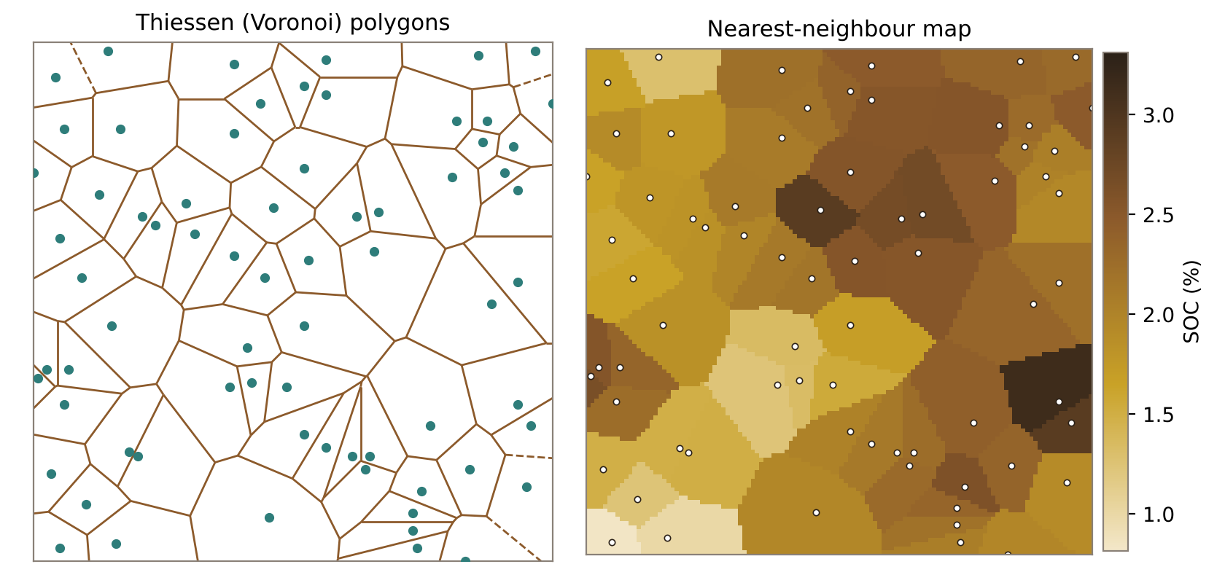
Thiessen polygons and nearest-neighbour interpolation
Ẑ(x₀) = z(x_{nearest})
λ = 1 for the nearest point, 0 for all others
1
Join neighbouring points (Delaunay triangles)
2
Draw perpendicular bisectors → polygons
3
Assign each polygon its point's value
LOOCV RMSE here: 0.184
Illustration computed for this talk on a synthetic SOC field (1 km × 1 km, 70 samples): Voronoi tessellation (left) and the resulting nearest-neighbour map (right)
+ exact, fast, no parameters; good for categorical data and areal rainfall (gauge value × polygon area). − abrupt jumps at edges, ignores all but one point, no error estimate
Illustration computed for this talk on a synthetic SOC field (1 km × 1 km, 70 samples); method after Thiessen (1911)
Notes:
The simplest method. Perpendicular bisectors between neighbouring points divide the area into Thiessen, or Voronoi, polygons. Every location inside a polygon gets the value of the sample point in it, so the weight is one for the nearest point and zero for all others. The surface is exact but abrupt, with jumps at polygon edges, and gives no error estimate. It is quick and useful for categorical data and for areal averages, for example the Thiessen polygon method for areal rainfall from rain gauges, where each gauge's value is weighted by its polygon area.

Slide 26
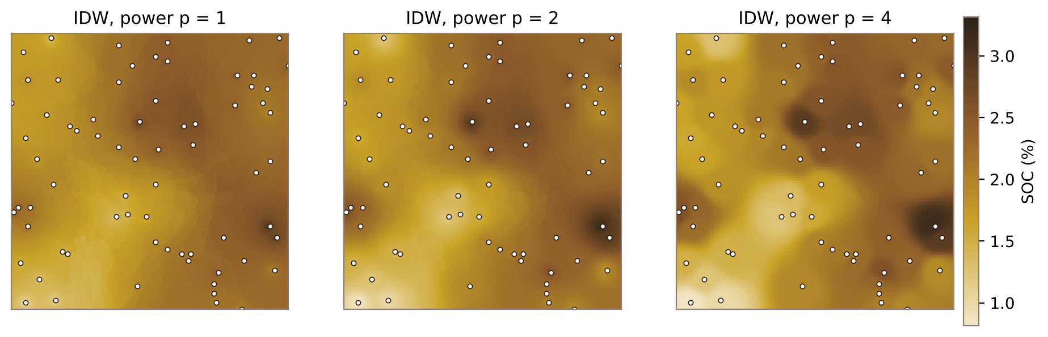
Inverse distance weighting (IDW)
Illustration computed for this talk on a synthetic SOC field (1 km × 1 km, 70 samples): larger power → more local, 'bull's-eye' surface
Ẑ(x₀) = Σ z_{i} d_{i}^{−p} / Σ d_{i}^{−p}
Search neighbours (k or radius)
Distances d_{i}
Weights d_{i}^{−p}, normalise
Weighted average
d_{i} = distance to point i; p = power (usually 2)
+ exact, simple, few assumptions. − bull's-eyes; no extrapolation beyond data range; ignores clustering and anisotropy; no error map. LOOCV RMSE (p = 2): 0.203
Illustration computed for this talk on a synthetic SOC field (1 km × 1 km, 70 samples); IDW after Shepard (1968)
Notes:
IDW assumes each sample's influence falls with distance. For each grid node, the method finds the neighbours within a search radius or the nearest k points, computes their distances, gives each a weight proportional to one over distance to the power p, normalises the weights to sum to one, and takes the weighted average. The power controls smoothness: p equal to one gives a smooth surface, two is the default, and large powers approach nearest neighbour. IDW is exact and simple but produces bull's-eyes around isolated points, cannot predict beyond the data range, ignores clustering and direction, and gives no error estimate. The figure shows the same data with powers 1, 2 and 4.

Slide 27
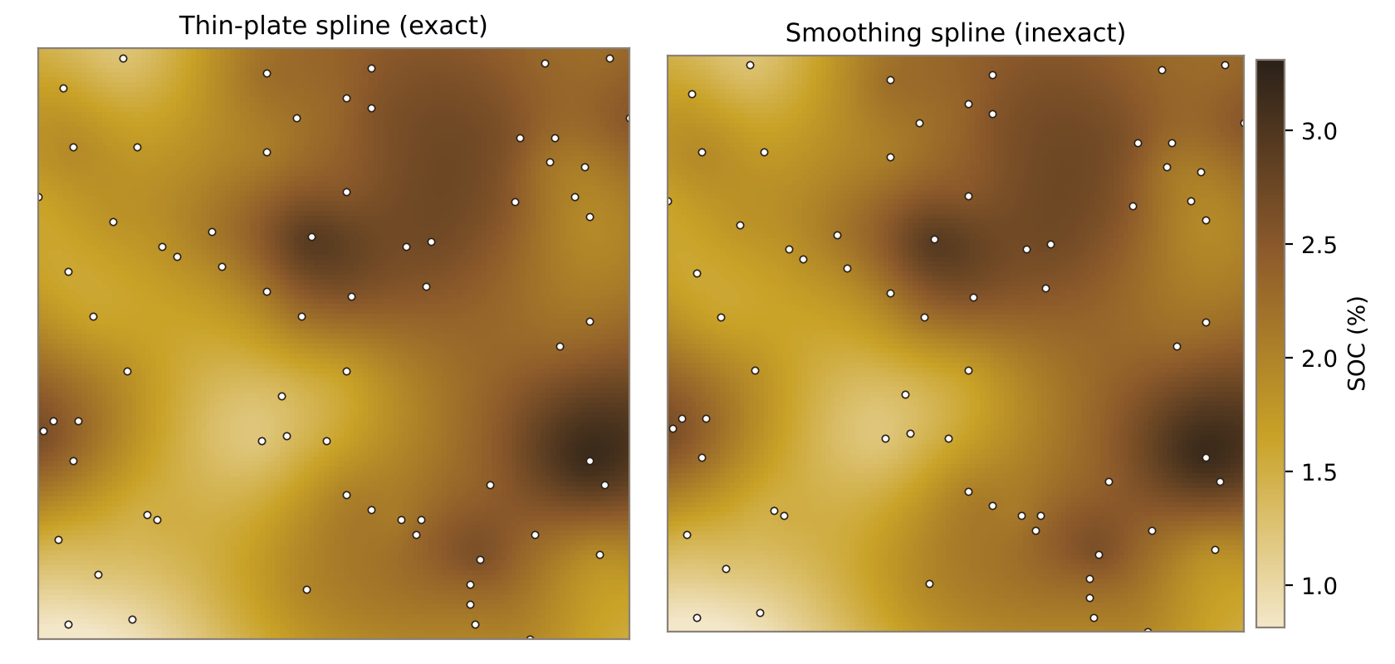
Splines and radial basis functions
Ẑ(x) = a₀ + a₁x + a₂y + Σ w_{i} φ(r_{i})
Thin-plate: φ(r) = r² log r
Mechanism
Minimise surface curvature (bending energy)
Solve one linear system for w_{i} and a_{k}
Smoothing parameter → inexact; tension → stiffness
Illustration computed for this talk on a synthetic SOC field (1 km × 1 km, 70 samples): exact thin-plate spline vs smoothing spline
+ smooth, visually realistic; best for gently varying surfaces (elevation, rainfall, temperature; ANUSPLIN climate grids). − overshoots near sharp changes; no error map. LOOCV RMSE here: 0.148 (lowest of all methods)
Illustration computed for this talk on a synthetic SOC field (1 km × 1 km, 70 samples); thin-plate splines after Hutchinson (1995)
Notes:
A spline fits a smooth surface through the points that minimises total curvature, like bending a thin flexible sheet so it touches every point. The thin-plate spline is the classic case: the surface is a low-order polynomial plus a weighted sum of radial basis functions, r squared log r, centred on each data point. The weights come from solving one linear system. With no smoothing it is exact; adding a smoothing parameter makes it inexact, which is useful when data are noisy. Tension controls stiffness. Splines suit gently varying surfaces such as elevation, rainfall and temperature; ANUSPLIN thin-plate splines underlie many climate grids. They can overshoot where data change sharply, and give no direct error estimate. On our test data the thin-plate spline had the lowest cross-validation error.

Slide 28
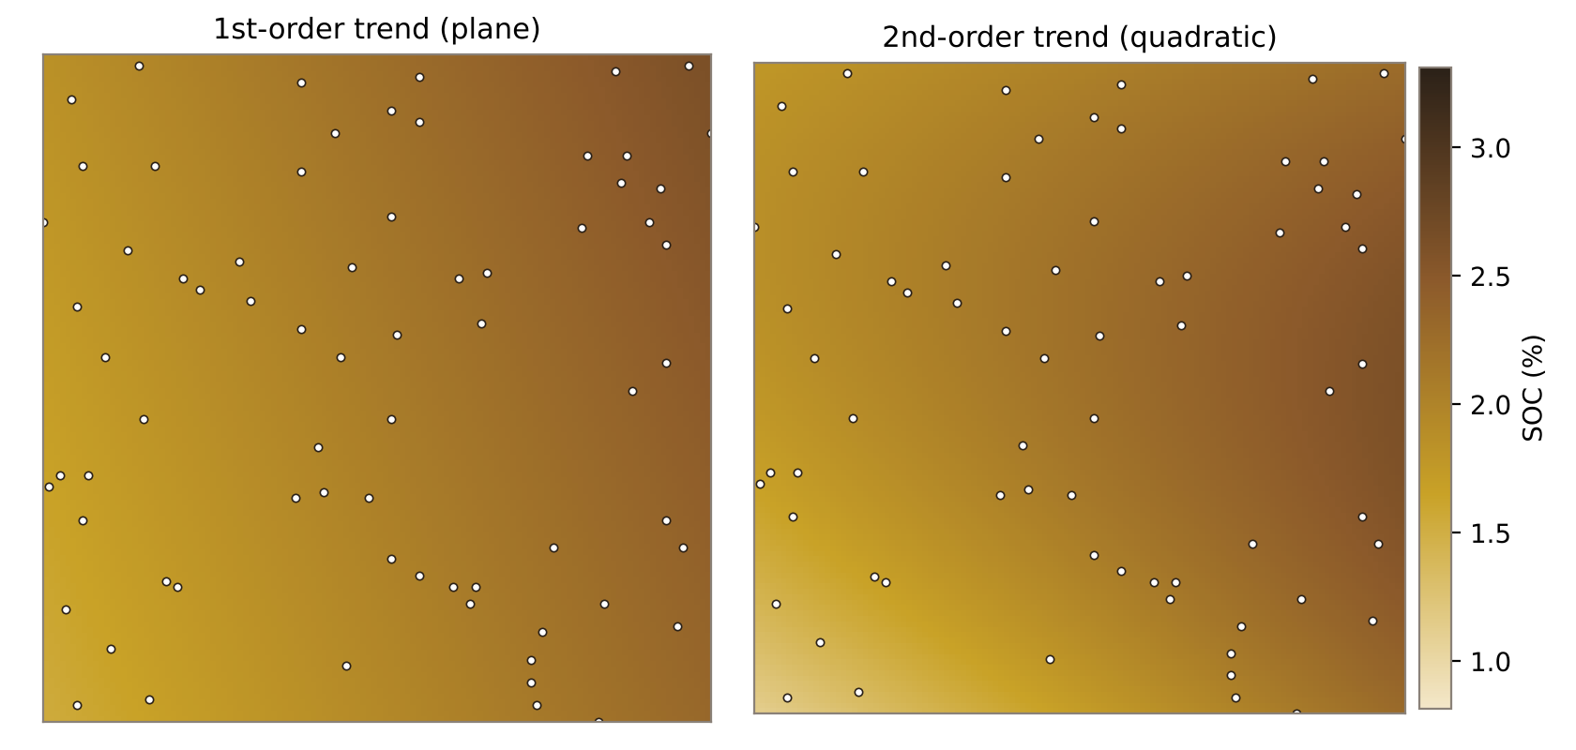
Trend surface analysis and local polynomial interpolation
z = b₀ + b₁x + b₂y + b₃x² + b₄xy + b₅y² + ε
Mechanism
Fit polynomial in coordinates by least squares (global)
Test order by R² / F-test; avoid high orders (edge effects)
Local polynomial: same fit in a moving window
Residuals = local variation → krige them
Illustration computed for this talk on a synthetic SOC field (1 km × 1 km, 70 samples): the trend captures only the broad gradient
+ simple; separates regional trend (drift) from local variation — the first step of universal kriging and regression-kriging. − inexact, misses local detail. LOOCV RMSE here: 0.399 (worst)
Illustration computed for this talk on a synthetic SOC field (1 km × 1 km, 70 samples); Oliver & Webster (2014) Catena 113:56–69; Webster & Oliver (2007) Geostatistics for Environmental Scientists
Notes:
Trend surface analysis fits one polynomial in the x and y coordinates to all the data by least squares. A first-order trend is a tilted plane; a second-order trend is a quadratic bowl or saddle. It is global and inexact, so it captures broad regional patterns but misses local detail; on our test data it had by far the largest error. Its main use is to describe and remove large-scale drift: the residuals from the trend are then kriged, which is the idea behind universal kriging and regression-kriging. Local polynomial interpolation fits the polynomial in a moving window instead, which keeps more local detail. Watch for edge effects with higher orders.

Slide 29
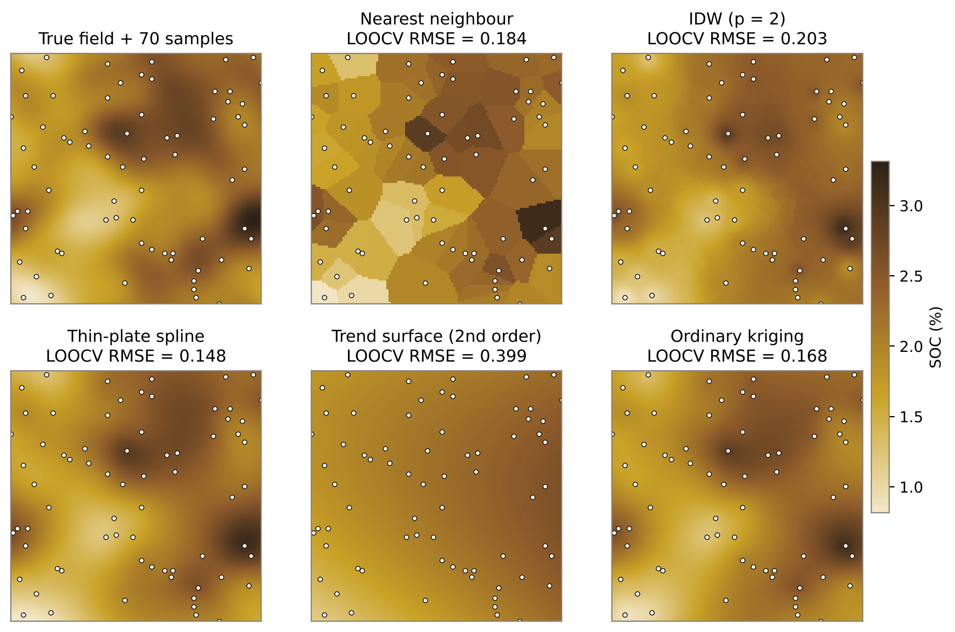
Same data, five methods: which interpolator wins?
Method | RMSE | ME
Thin-plate spline | 0.148 | +0.006
Ordinary kriging | 0.168 | +0.010
Nearest neighbour | 0.184 | +0.011
IDW (p = 2) | 0.203 | +0.029
Trend surface (2nd order) | 0.399 | +0.002
Lessons
No universal winner — choose by cross-validation
Smooth fields favour splines and kriging
Only kriging also gives an error map
Illustration computed for this talk on a synthetic SOC field (1 km × 1 km, 70 samples); leave-one-out cross-validation; true field shown top-left
Notes:
Here all five methods are applied to the same 70 samples from a known synthetic field, and each is scored by leave-one-out cross-validation. On this smooth field, the thin-plate spline had the lowest RMSE, ordinary kriging was close behind, nearest neighbour and IDW were worse, and the global trend surface was much worse because it ignores local variation. The lesson is that no interpolator is always best; the choice should be made by cross-validation on your own data. Kriging's advantage is that it also gives a prediction variance and handles clustering properly.

Slide 30
Geostatistics: concept, assumptions and workflow
Z(x) = m(x) + ε′(x) + ε″
EDA: normality, trend, outliers
m(x) mean or trend · ε′(x) spatially autocorrelated part · ε″ uncorrelated noise (nugget) — Matheron's regionalised variable theory
Experimental variogram γ(h)
Assumptions and principles
Second-order stationarity: constant mean; covariance depends only on lag h
Intrinsic hypothesis: Var[Z(x) − Z(x+h)] = 2γ(h) depends only on h
BLUE: best (minimum variance), linear, unbiased (Σλ = 1) estimator
Kriging variance depends on sample layout and variogram, not on data values → can design sampling before measuring
Non-stationary mean → universal kriging / regression-kriging
Fit model: nugget, sill, range, anisotropy
Solve kriging system for λ
Prediction Ẑ + kriging variance σ²_{K}
Cross-validate: ME, RMSE, MSDR
Matheron (1963); Oliver & Webster (2014) Catena 113:56–69; Webster & Oliver (2007) Geostatistics for Environmental Scientists
Notes:
Geostatistics, from Matheron's regionalised variable theory, treats a soil property as one realisation of a random function. The value at a location is a deterministic mean or trend, plus a spatially autocorrelated random component, plus uncorrelated noise. To estimate the autocorrelation from one realisation we need stationarity: second-order stationarity means a constant mean and a covariance that depends only on separation; the weaker intrinsic hypothesis needs only that the variance of differences depends on separation, which is exactly what the variogram measures. Kriging is then the best linear unbiased predictor: unbiased because the weights sum to one, and best because it minimises the estimation variance. The workflow runs from exploratory analysis to the experimental variogram, model fitting, the kriging system, prediction with kriging variance, and cross-validation.

Slide 31
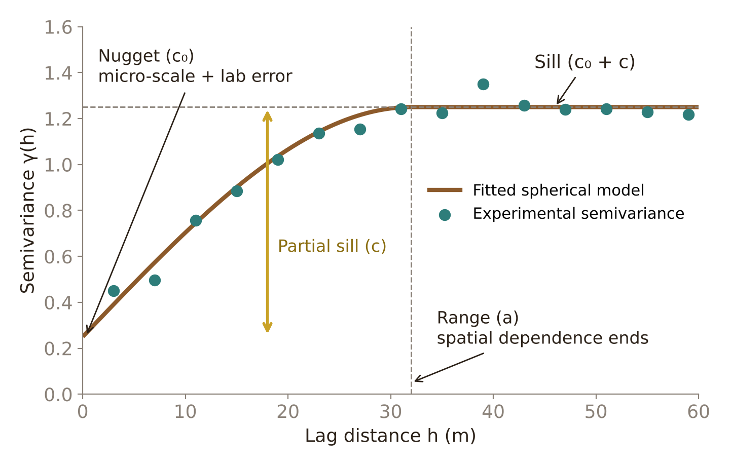
The semivariogram: describing spatial dependence
γ(h) = 1 ⁄ 2N(h) Σ [ z(xᵢ) − z(xᵢ + h) ]²
Matheron's method-of-moments estimator; N(h) = number of pairs at lag h
Nugget (c₀): variance at zero lag — measurement error plus variation finer than the sampling interval
Sill (c₀ + c): total variance once pairs are independent
Range (a): distance limit of autocorrelation; guides sample spacing and kriging neighbourhood
Nugget : sill ratio <25% strong, 25–75% moderate, >75% weak spatial dependence
Illustrative variogram drawn for this talk; formula after Oliver & Webster (2014); dependence classes after Cambardella et al. (1994)
Notes:
Pairs of points are binned by separation distance; half the mean squared difference is plotted against lag. Close points are similar (low semivariance); beyond the range the pairs are independent and semivariance levels at the sill. A nugget-to-sill ratio below 25% is usually called strong spatial dependence, 25–75% moderate, above 75% weak (Cambardella et al. 1994).

Slide 32
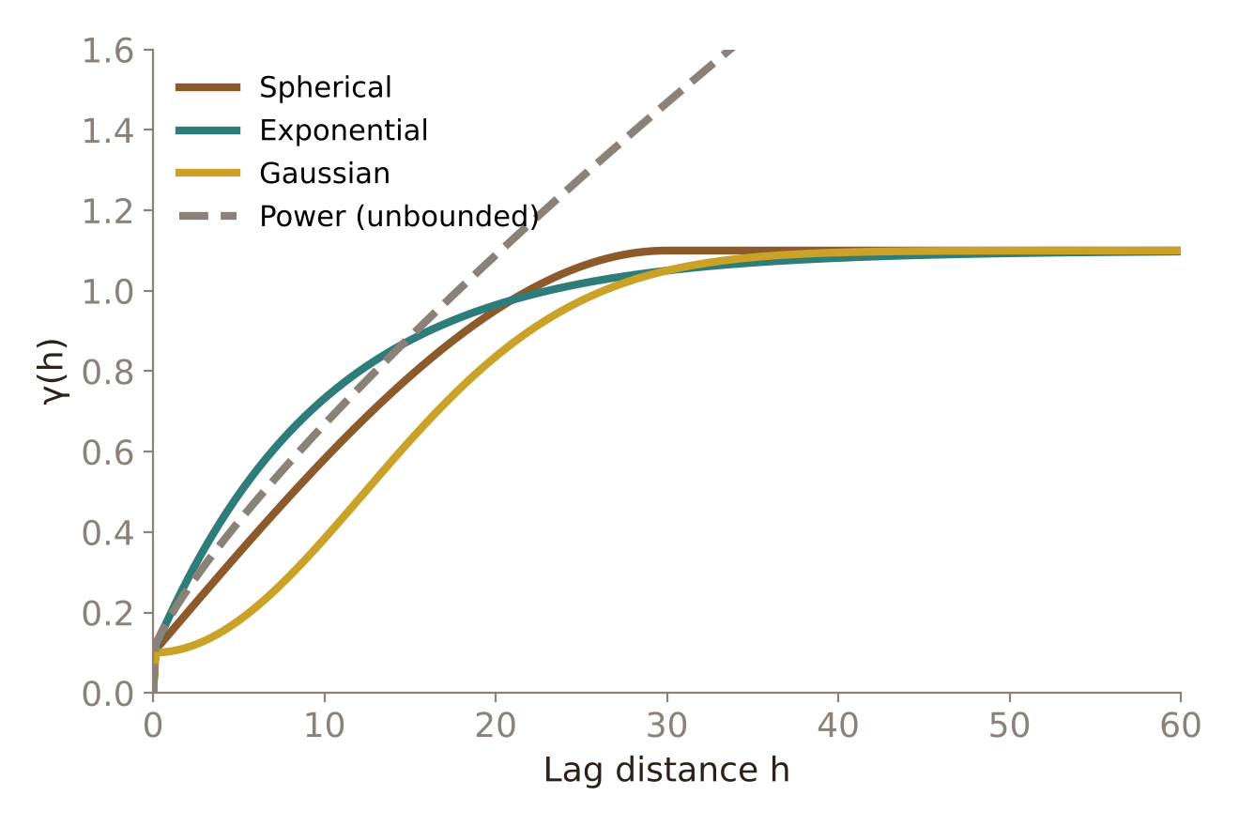
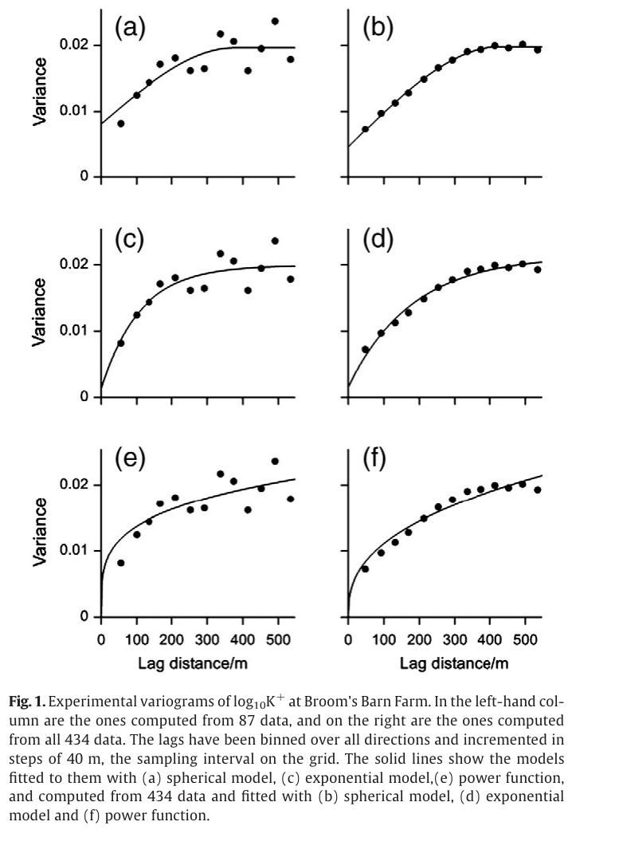
Choosing and fitting a variogram model
Common authorised models (same nugget, sill and range)
Spherical / exponential: bounded; the workhorses of soil science
Gaussian: very smooth processes (e.g. elevation)
Power: unbounded — signals a trend or large-scale drift
Experimental variograms of log₁₀K⁺: 87 points (left) vs 434 points (right)
Right panel: Oliver & Webster (2014) Catena 113:56–69, Fig. 1
Notes:
Only authorised (conditional negative semi-definite) functions guarantee non-negative kriging variances. Fit by weighted least squares and choose with AIC or cross-validation. Oliver and Webster show how the empirical variogram from 87 points is much noisier than from 434 points of the same field.

Slide 33
The kriging family and its relatives
Method | Treatment of the mean / extra information | Typical soil use
IDW, splines, Thiessen | Deterministic weights by distance; no variogram, no error estimate | Quick exploratory maps
Simple kriging (SK) | Known, constant mean over the area | Residuals with mean zero
Ordinary kriging (OK) | Unknown, locally constant mean; Σλ = 1 | Default for a single soil property
Universal kriging / KED | Mean is a trend in coordinates or covariates | Properties tied to relief or climate
Co-kriging | Uses a correlated secondary variable sampled at points | Sparse target, dense cheap proxy (e.g. EC)
Regression-kriging (RK) | Regression on raster covariates + OK of residuals | DSM with RS/DEM covariates
Indicator kriging | Probability of exceeding a threshold | Risk maps (salinity, contamination)
Block kriging | Predicts block averages, lower variance | Field- or management-zone means
Compiled from Oliver & Webster (2014) and Hengl et al. (2004) Geoderma 120:75–93
Notes:
All kriging variants are best linear unbiased predictors that differ in how they treat the mean. Deterministic interpolators give no error estimate. Regression-kriging (equivalent in prediction to kriging with external drift / universal kriging) is the bridge to covariate-based DSM.

Slide 34
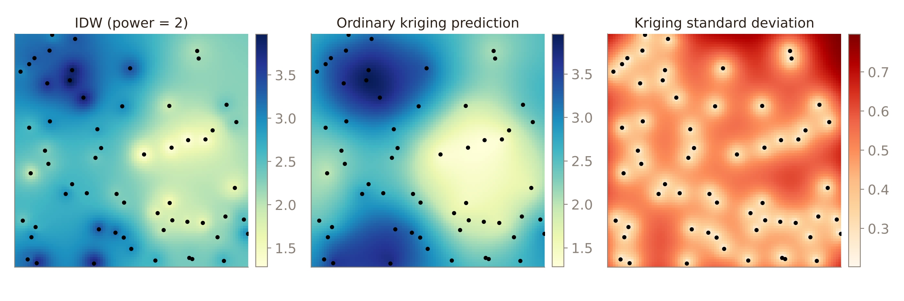
Ordinary kriging: prediction plus its own error map
Predictor
Ẑ(x₀) = Σ λᵢ z(xᵢ), Σ λᵢ = 1
Kriging system
Σ λⱼ γ(xᵢ, xⱼ) + ψ = γ(xᵢ, x₀), i = 1…n
Kriging variance
σ²(x₀) = Σ λᵢ γ(xᵢ, x₀) + ψ
Synthetic illustration computed for this talk (spherical model, 60 samples); equations after Oliver & Webster (2014), Appendix A
Notes:
The kriging weights come from solving the variogram-based system with a Lagrange multiplier that forces the weights to sum to one. Compared with IDW, kriging removes the bull's-eye artefacts around samples and, importantly, gives the kriging variance, which is lowest at sampled points and grows in gaps. The demo is synthetic: 60 points on a smooth field, spherical variogram.

Slide 35
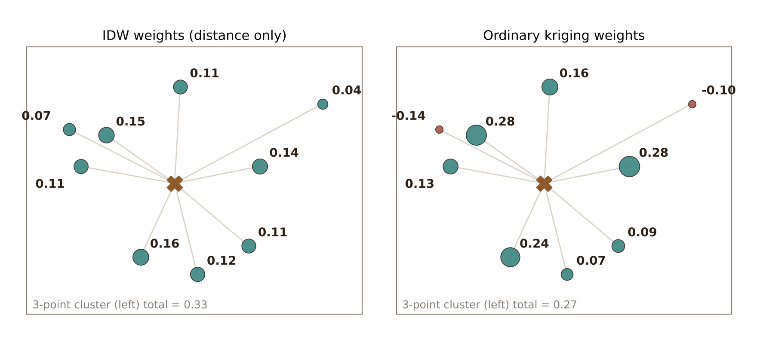
How kriging chooses its weights
Kriging system (ordinary kriging)
Σ_{j} λ_{j} γ(x_{i}, x_{j}) + ψ = γ(x_{i}, x₀), i = 1…n
Σ_{j} λ_{j} = 1
σ²_{K}(x₀) = Σ λ_{i} γ(x_{i}, x₀) + ψ
Minimise estimation variance subject to Σλ = 1 (Lagrange multiplier ψ)
What the figure shows
Declustering: 3-point cluster total weight 0.33 (IDW) → 0.27 (kriging)
Screening: points hidden behind nearer points get negative weights
Weights follow the variogram, not distance alone
Weights for one target (✕), same 9 points; ordinary kriging with a spherical variogram (range 400 m). Computed for this talk
σ²_{K} needs only the sample layout + variogram, not the data values → optimise sampling design before going to the field
Oliver & Webster (2014) Catena 113:56–69; Webster & Oliver (2007) Geostatistics for Environmental Scientists; illustration computed for this talk
Notes:
Kriging chooses the weights that minimise the estimation variance subject to the unbiasedness constraint that the weights sum to one. Using a Lagrange multiplier gives a set of linear equations, the kriging system, built entirely from variogram values between the samples and between each sample and the target. The figure contrasts IDW and kriging weights for the same configuration. IDW gives the three clustered points on the left a large combined weight because it only sees distance. Kriging recognises they carry redundant information and reduces their combined weight, which is declustering. Points hidden behind closer points can even get negative weights, the screening effect. Because the kriging variance does not depend on the data values, it can be used to plan sampling before any measurements are made.

Slide 36
Simple, ordinary and universal kriging (and KED)
Simple kriging (SK)
Mean m known, constant
Ẑ = m + Σλ_{i}[z(x_{i}) − m]
Constraint: no constraint on λ
Which one? Decision tree
Trend in the data?
Ordinary kriging (OK)
No → mean known?
Yes → trend from?
Mean constant but unknown (locally)
Ẑ = Σλ_{i} z(x_{i})
Constraint: Σλ_{i} = 1
Yes → SK
No → OK
Coordinates → UK
Covariates → KED / RK
Universal kriging / KED
Mean = trend in coordinates (UK) or covariates (KED)
m(x) = Σ β_{k} f_{k}(x)
Constraint: Σλ_{i} f_{k}(x_{i}) = f_{k}(x₀); residual variogram
KED and regression-kriging give the same prediction when the same covariates and residual variogram are used (Hengl et al. 2007)
Oliver & Webster (2014) Catena 113:56–69; Webster & Oliver (2007) Geostatistics for Environmental Scientists; Hengl, Heuvelink & Rossiter (2007) Comput. Geosci. 33:1301–1315
Notes:
The main kriging types differ in how they treat the mean. Simple kriging assumes the mean is known and constant everywhere, so it predicts deviations from that mean and needs no constraint on the weights. Ordinary kriging, the workhorse, assumes the mean is constant but unknown within each search neighbourhood; the weights must sum to one. Universal kriging models the mean as a trend in the coordinates, and kriging with external drift models it as a function of covariates available at every pixel, such as elevation or NDVI; both add constraints so the weights reproduce the trend functions, and both need the variogram of the residuals. The decision tree shows how to choose.

Slide 37
Co-kriging: borrowing strength from a secondary variable
Ẑ₁(x₀) = Σ λ_{1i} z₁(x_{i}) + Σ λ_{2j} z₂(x_{j})
Primary z₁ (sparse) + secondary z₂ (dense)
Constraints: Σλ_{1i} = 1, Σλ_{2j} = 0
Direct variograms γ₁₁, γ₂₂
γ₁₂(h) = ½ E{[z₁(x) − z₁(x+h)][z₂(x) − z₂(x+h)]}
Cross-variogram γ₁₂
Cross-variogram: how the two variables co-vary with distance
Linear model of coregionalisation (valid fit)
When to use
Primary sparse and costly (lab SOC, clay); secondary dense and cheap (EC_{a}, Vis–NIR, gamma radiometrics, yield)
Works best when correlation is strong (|r| ≳ 0.5)
Secondary known at every pixel → use KED / RK instead
Co-kriging system → λ₁, λ₂
Map Ẑ₁ + co-kriging variance
Oliver & Webster (2014) Catena 113:56–69; Webster & Oliver (2007) Geostatistics for Environmental Scientists; Webster & Oliver (2007) Ch. 10
Notes:
Co-kriging is used when the target variable is expensive and sparsely sampled, but a cheaper correlated variable is measured more densely: for example lab soil organic carbon with many apparent electrical conductivity readings or spectroscopy predictions, or clay with gamma radiometrics. It needs the variograms of both variables and their cross-variogram, fitted together with a linear model of coregionalisation so the system is valid. The prediction is a weighted sum of both variables; the primary weights sum to one and the secondary weights sum to zero. It helps most when the secondary variable is dense and well correlated. If the secondary variable is available at every pixel, kriging with external drift or regression-kriging is simpler.

Slide 38
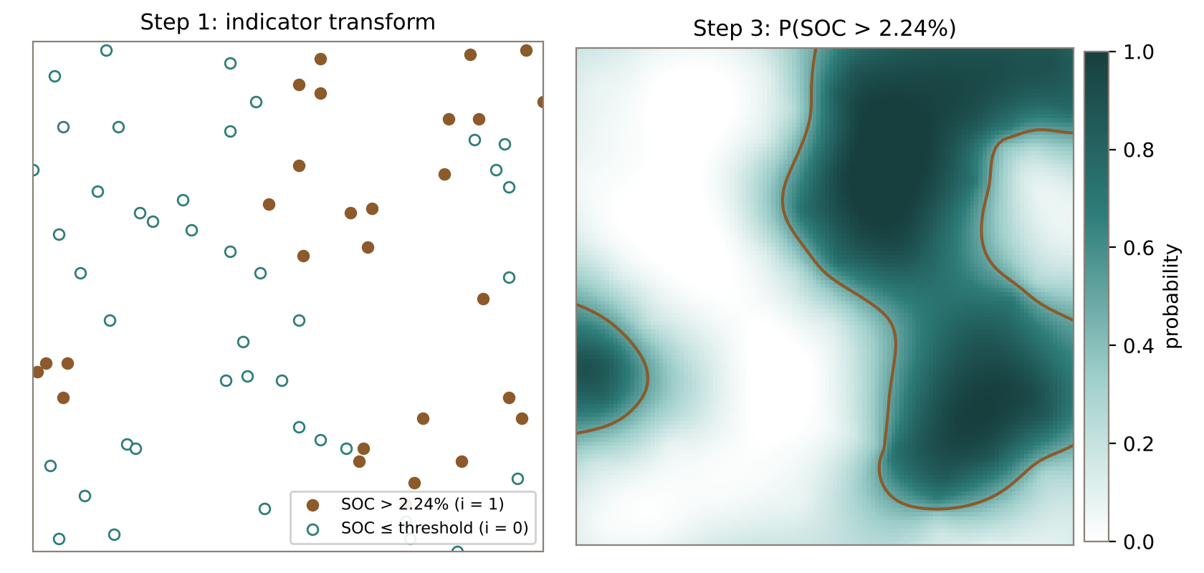
Indicator kriging: probability and risk maps
Choose threshold z_{k}
Indicator i(x) = 1 if z > z_{k}, else 0
Indicator variogram → fit model
Krige indicators → P(Z > z_{k})
Probability / risk map
Illustration computed for this talk on a synthetic SOC field (1 km × 1 km, 70 samples): threshold = 60th percentile (2.24% SOC); contour = P = 0.5
+ no normality assumption; gives probabilities; several thresholds → full distribution. Uses: P(EC_{e} > 4 dS m⁻¹) salinity risk, heavy metal above limit, SOC below critical level. − order-relation corrections; information lost by coding
Illustration computed for this talk on a synthetic SOC field (1 km × 1 km, 70 samples); Journel (1983); Oliver & Webster (2014) Catena 113:56–69; Webster & Oliver (2007) Geostatistics for Environmental Scientists
Notes:
Indicator kriging is non-parametric: it does not need normally distributed data. Each observation is converted to an indicator, one if it exceeds a threshold and zero otherwise. The indicator variogram is computed and modelled, and the indicators are kriged. Because the indicators are zeros and ones, the kriged value is an estimate of the probability that the property exceeds the threshold. Repeating for several thresholds builds a full conditional distribution at every location. Typical uses are risk maps: the probability that salinity exceeds 4 deciSiemens per metre, that a heavy metal exceeds a regulatory limit, or that soil carbon is below a critical level. In the illustration the threshold is the 60th percentile of the samples, and the brown contour marks a probability of one half.

Slide 39
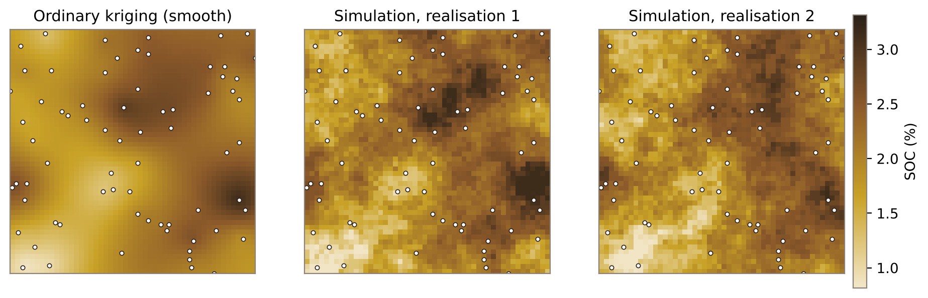
Block kriging and conditional simulation
Illustration computed for this talk on a synthetic SOC field (1 km × 1 km, 70 samples): SD of true field 0.46, kriging 0.42 (smoothed), simulations 0.48
Block kriging
Predict mean over a block V (pixel, field): γ(x_{i}, x₀) → γ̄(x_{i}, V)
Smaller variance (nugget averages out) → management zones
Sequential Gaussian simulation
Normal-score transform
Variogram of normal scores
Random path through nodes
SK mean + variance from data + simulated
Draw value, add to data
Back-transform; repeat → realisations
Illustration computed for this talk on a synthetic SOC field (1 km × 1 km, 70 samples); Oliver & Webster (2014) Catena 113:56–69; Webster & Oliver (2007) Geostatistics for Environmental Scientists
Notes:
Two extensions. Block kriging predicts the average over an area, such as a 30 metre pixel or a whole field, rather than at a point. Point-to-sample variogram values are replaced by their averages over the block. Block estimates have much smaller variance, because the nugget averages out, which suits management units. Kriging maps are smooth: they under-represent the real variability. Sequential Gaussian simulation fixes this. Data are transformed to normal scores, the variogram is modelled, and grid nodes are visited in random order. At each node the simple kriging mean and variance are computed from the data and previously simulated nodes, a random value is drawn from that distribution and added to the data. Each run gives an equally probable realisation that honours the data and the variogram. Many realisations quantify uncertainty, for example for spatial totals or risk. In our example the kriging map's standard deviation was lower than the true field's, while the simulations reproduced it.

Slide 40
Choosing an interpolation method
Method | Exact? | Needs | Error estimate | Best for
Thiessen / nearest neighbour | Yes | Points only | No | Categorical data, areal rainfall
IDW | Yes | Power, neighbours | No | Quick maps, dense even data
Splines / RBF | Yes / no | Tension, smoothing | No | Smooth surfaces: DEM, climate
Trend surface | No | Polynomial order | Regression SE | Regional drift; detrending
Ordinary kriging | Yes | Variogram (≥100–150 pts) | Yes | Single property, no trend
Universal kriging / KED / RK | Yes | Trend + residual variogram | Yes | Trend or strong covariates
Co-kriging | Yes | Cross-variogram | Yes | Dense correlated secondary
Indicator kriging | — | Thresholds, indicator variograms | Probability | Risk / exceedance maps
Block kriging | — | Variogram, block size | Yes (smaller) | Field or pixel averages
Gaussian simulation | Yes | Normal scores, variogram | Many realisations | Uncertainty of totals, risk
Rule: pick by data density, trend, covariates and purpose — then confirm with cross-validation
Compiled from Oliver & Webster (2014) Catena 113:56–69; Webster & Oliver (2007) Geostatistics for Environmental Scientists; Hengl et al. (2007)
Notes:
This table summarises all the methods: whether they are exact, what they need, whether they give an error estimate, and when each is best. In an interview, the key points are: deterministic methods need no model but give no error; kriging gives the best linear unbiased prediction with an error map but needs enough data for a reliable variogram, roughly 100 to 150 points; use universal kriging, kriging with external drift or regression-kriging when there is a trend or good covariates; co-kriging when a correlated variable is densely sampled; indicator kriging for probability or risk; block kriging for area averages; simulation when you need realistic variability and uncertainty for totals.

Slide 41
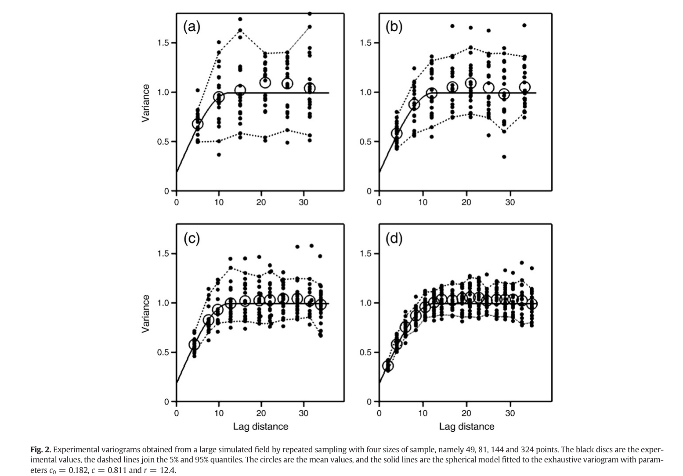
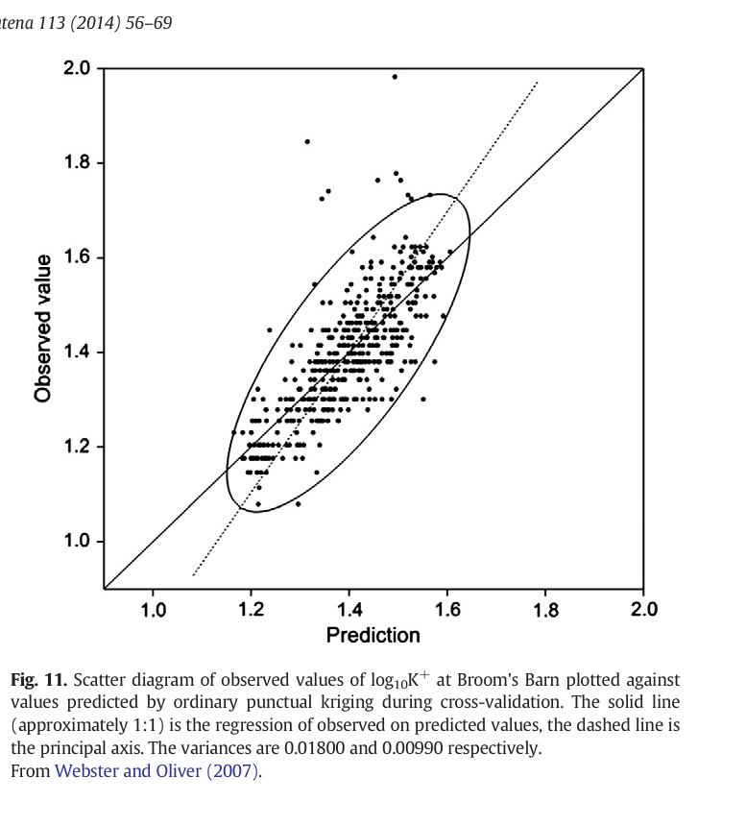
Good geostatistical practice (Oliver & Webster, 2014)
1
Sample enough, without bias
≥100–150 points; even coverage at < ½ effective range
2
Explore the data
Marginal distribution, outliers, transform (log) if skewed
3
Compute & fit the variogram
Method of moments, WLS fit; REML on residuals if trend
Cross-validation scatter
Variograms at increasing sample size
4
Krige
OK without trend, UK with trend; neighbourhood ≈ 7–25 points
Leave-one-out cross-validation diagnostics
ME, mean error ≈ 0 (unbiased)
MSE, mean squared error: as small as possible
MSDR = mean(squared error ⁄ kriging variance) ≈ 1: the most telling check of the variogram
5
Map and validate
Map estimates and kriging variances; cross-validate
Oliver & Webster (2014) Catena 113:56–69, Section 5 and Figs. 2 & 11
Notes:
The tutorial closes with a five-step checklist; these are the steps and what to report. Cross-validation: leave each point out, krige it, then compute ME (should be about 0), MSE (small) and MSDR, the mean squared error divided by the kriging variance (should be about 1). MSDR is the most telling of the three.

Slide 42
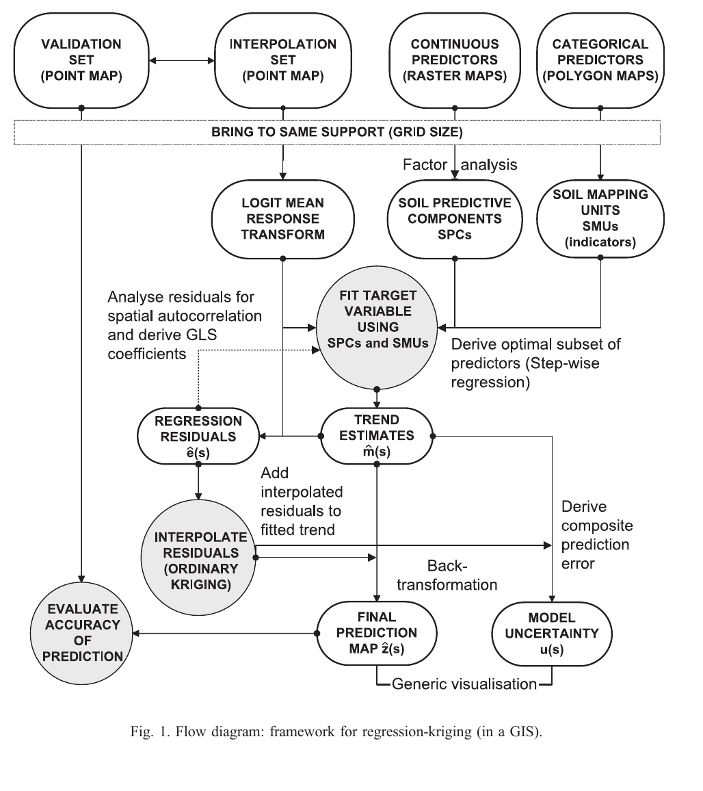
Regression-kriging: a hybrid framework (Hengl et al., 2004)
ẑ(s₀) = Σ β̂ₖ qₖ(s₀) + Σ λᵢ e(sᵢ)
trend from covariates + kriged residuals
Data: 135 soil profiles, Croatia (100 for interpolation, 35 for validation); targets OM, topsoil pH, topsoil depth
Predictors: 6 relief parameters (DEM, slope, curvature, CTI, SPI, viewshed) + 9 soil-mapping units
Steps: logit transform → PCA of predictors → stepwise GLS regression → OK of residuals → back-transform
Output: prediction and relative error shown together (HSI colour visualisation)
Left: Hengl et al. (2004) Geoderma 120:75–93, Fig. 1
Notes:
RK splits the target into a deterministic part explained by covariates and a stochastic residual. Hengl et al. logit-transform the target to keep predictions in the physical range, replace correlated predictors by principal components (SPCs) plus soil-mapping-unit indicators, fit stepwise regression by GLS, krige the residuals and add them back. The final map can be shown together with its relative error.

Slide 43
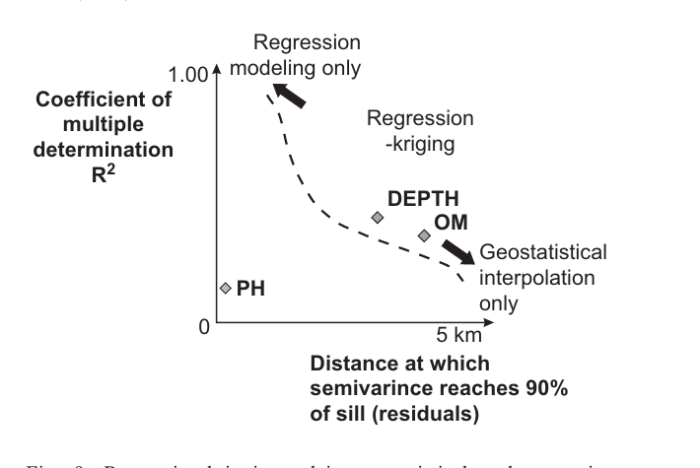
Regression-kriging vs ordinary kriging: results
When each method suits: R² of regression vs residual range
Depth: RK 66.5% vs OK 83.3%; bias 0.15 vs 0.69 cm
OM: RK 53.3% vs OK 66.5%
pH: >110% for all methods
Data: Hengl et al. (2004) Table 3; right panel: Hengl et al. (2004) Fig. 9
Notes:
Relative RMSE at the 35 validation profiles (lower is better). RK beat OK for OM and depth and gave the lowest error and bias for depth. For OM the plain regression had the lowest RMSE in this table, so the gain depends on how strongly covariates explain the target versus how much spatial structure remains in the residuals; pH was hard for every method. The right panel is the authors' decision diagram.

Slide 44
Machine-learning approaches
Learning non-linear soil–covariate relationships from data

Slide 45
Ensemble learning: bagging, boosting and stacking
Bagging → lower variance
Boosting → lower bias
Stacking → combine strengths
Training data
Tree 1
fit y
Cubist
GBM
RF
Bootstrap 1
→ tree
Bootstrap 2
→ tree
Bootstrap 3
→ tree
Level 0: base learners
Tree 2
fit residual 1
Meta-learner
(elastic net)
Level 1
Tree 3
fit residual 2
Average
Final prediction
Weighted sum (learning rate η)
Example: Random forest
Example: GBM, XGBoost
Example: Cubist + GBM + RF → ELNET
Cubist
rules + local linear models
SVR (RBF)
kernel regression in ε-tube
ANN / DNN
multilayer non-linear fits
QRF
quantiles → prediction intervals
CNN
uses covariate neighbourhoods
Schematics drawn for this talk after Das et al. (2022) Sections 2.5.2–2.5.5
Notes:
Bagging (random forest) trains many trees on bootstrap samples in parallel and averages them, reducing variance. Boosting (GBM, XGBoost) adds shallow trees one after another, each fitted to the remaining errors, reducing bias. Stacking trains different algorithms and lets a meta-learner (here elastic net) learn how to combine them. Both case studies use these families.

Slide 46
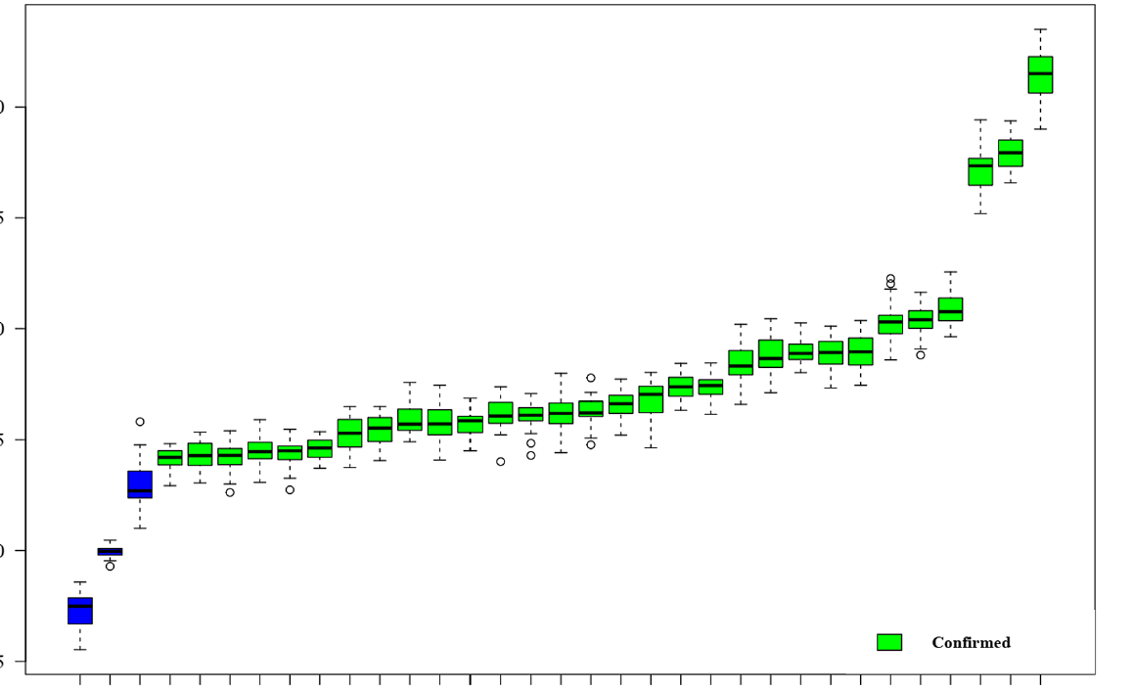
Feature selection with the Boruta algorithm
1
Shuffle copies
Create a shadow copy of every covariate with values permuted
2
Train RF
Fit RF on real + shadow covariates; compute importance Z-scores
3
Compare
Test each covariate against the maximum shadow Z-score (MZSA)
4
Decide
Confirm, reject or keep tentative; repeat until stable
Soil-moisture study: Sigma0_VV, MNDWI and LST stand out (blue = shadow features)
SOC study
55 → 32 covariates kept
Soil-moisture study
30 of 30 confirmed
Kursa & Rudnicki (2010); figure: Das et al. (2022) Catena 217:106485, Fig. 3
Notes:
Boruta is a wrapper around random forest. Every covariate gets a shuffled copy (a shadow feature) that has no real relationship with the target. A covariate is confirmed only if its importance is consistently higher than the best shadow feature, rejected if consistently lower, otherwise tentative. In the soil-moisture study all 30 covariates were confirmed; in the SOC study 32 of 55 were kept.

Slide 47
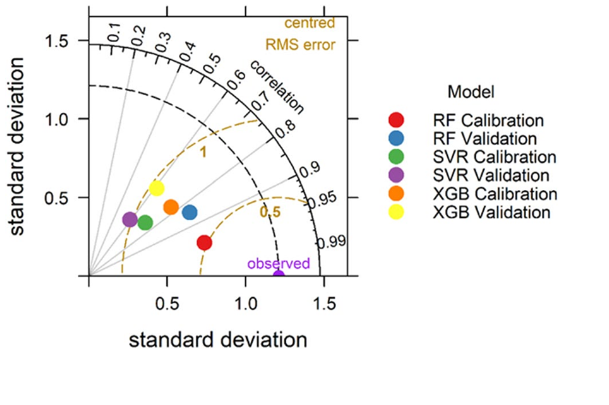
Validation metrics and uncertainty
R² / r
Share of variance explained (correlation)
RMSE
Typical error size, in units of the target
MAE
Mean absolute error, less outlier-sensitive
Uncertainty
Kriging variance (geostatistics)
Bootstrap: 50 refits → 5th & 95th percentile = 90% PI
Quantile regression forest
PICP vs confidence level should follow 1:1
Bias / MBE
Mean (predicted − observed): over- or under-prediction
CCC
Lin's concordance: agreement with the 1:1 line
RPD
SD ⁄ RMSE: ≥2 excellent, 1.4–2 good, <1.4 poor
Model comparison at a glance: a Taylor diagram (right, SOC study) places each model by its correlation with observations, its standard deviation and its centred RMSE. Points nearer the "observed" marker are better; RF calibration and validation sit closest.
Chang et al. (2001); Kalambukattu et al. (2025) Sections 2.10–2.11 and Fig. 7
Notes:
Train/test split (70:30) plus 10-fold cross-validation for tuning. Report several metrics, because R² alone hides bias. RPD classes after Chang et al. (2001) are used in both papers. For uncertainty, the SOC paper refits each model on 50 bootstrap samples and maps the 5th and 95th percentiles; PICP checks whether a nominal 90% interval really contains about 90% of observations.

Slide 48
Case study I: SOC mapping in the Indian Himalaya
Kalambukattu, Kumar, Das & Roy (2025) Discover Soil 2:35 — RF, SVR and XGB at 30 m

Slide 49
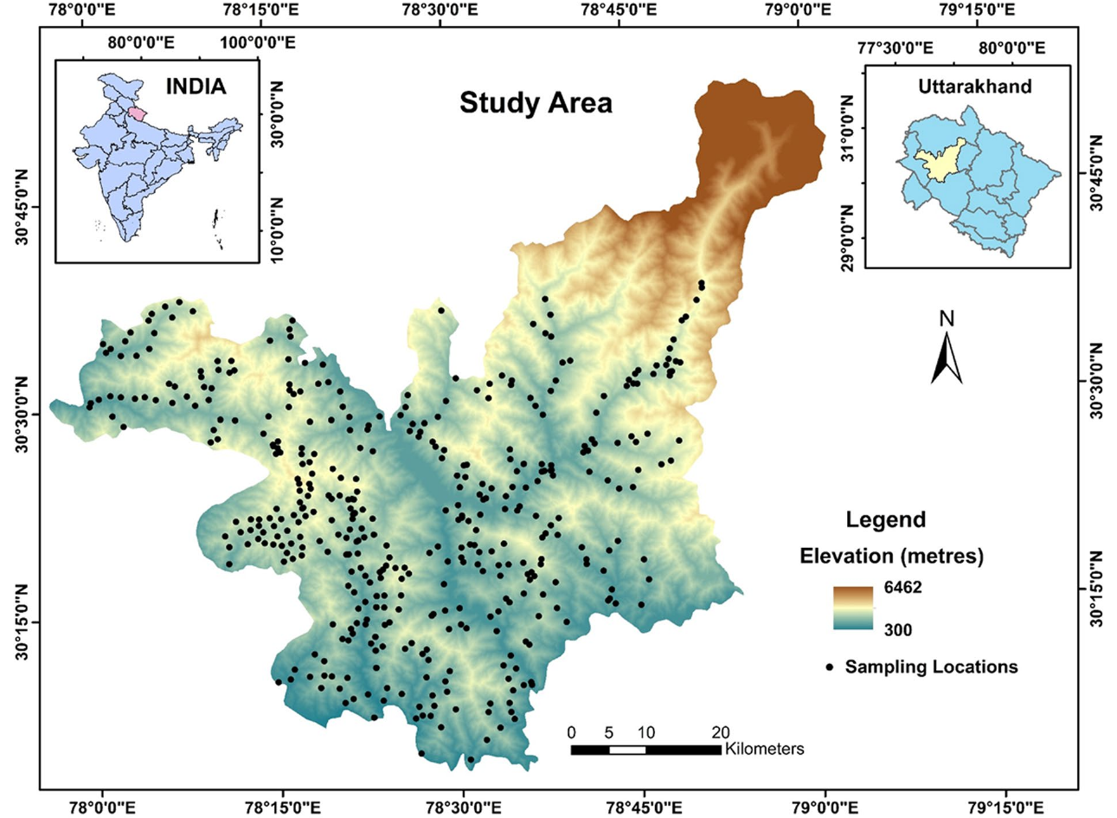
Study area and soil database
~4,400 km²
district area; 300–3,400 m elevation
421
surface samples (0–15 cm), stratified random, 21 strata
55
covariates: terrain, climate, spectral, LULC, lithology
30 m
common grid (SRTM DEM resolution, bilinear resampling)
SOC: 0.105–7.11% (mean 2.35%, median 2.16%, CV 50.4%), positively skewed
Figure: Kalambukattu et al. (2025) Fig. 1; values from Sections 2.1–2.4 and Table 2
Notes:
Tehri Garhwal district, Uttarakhand, North-Western Himalaya. Steep terrain from Shivaliks to Higher Himalaya; inaccessible strata were skipped but represented by similar strata. Samples were sieved and analysed for SOC by Walkley–Black wet digestion at IIRS Dehradun.

Slide 50
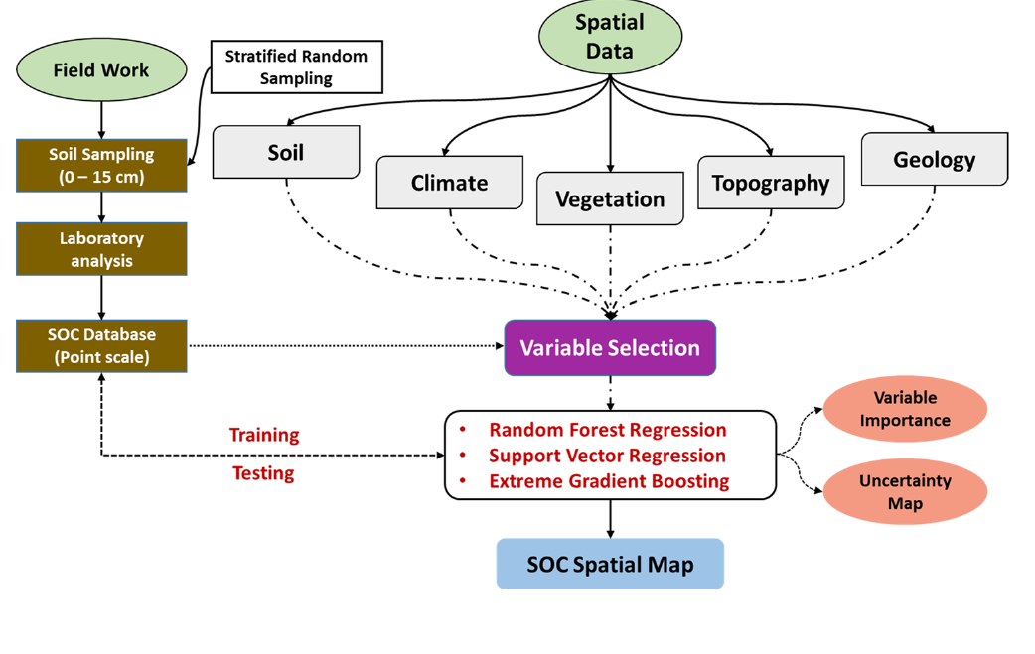
Methodology
Model | Package | Tuned hyperparameters
RF | caret | ntree 500, mtry 2, Nmin 5
SVR (RBF) | e1071 | C 0.25, σ 0.0303
XGB | xgboost | gbtree, depth 1, η 0.3, subsample 0.5, colsample 0.8
Selection: Boruta (R) → 32 covariates
Split: 70% calibration, 30% validation; 10-fold CV
Importance: permutation %IncMSE
Uncertainty: 50 bootstraps → 90% PI; PICP
Workflow from the paper (Fig. 2)
Kalambukattu et al. (2025) Sections 2.5–2.11 and 3.3
Notes:
Feature selection by Boruta kept 32 of 55 covariates. Data were split 70:30 at random; hyperparameters were tuned by 10-fold CV on RMSE. Permutation importance (%IncMSE) ranked covariates. Fifty bootstrap refits gave the mean map and the 5th–95th percentile limits (90% prediction interval), checked with PICP.

Slide 51
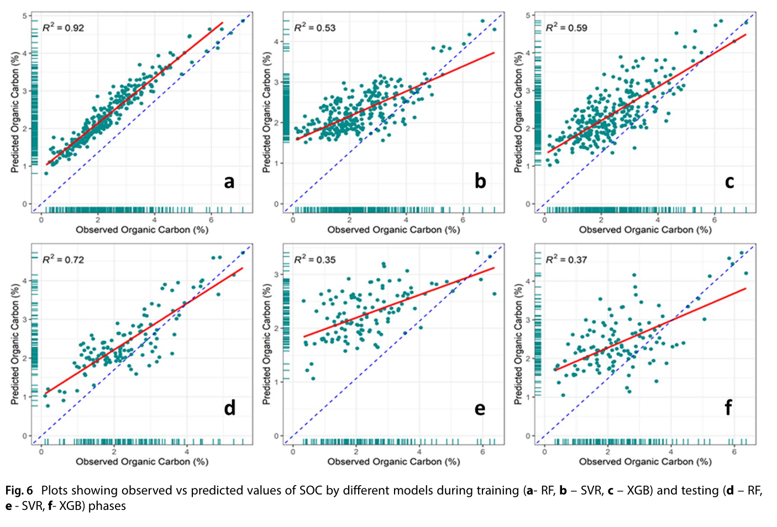
Results: random forest predicts SOC best
Testing | RF | SVR | XGB
RMSE (%) | 0.59 | 1.03 | 0.97
CCC | 0.78 | 0.37 | 0.52
MAE (%) | 0.49 | 0.79 | 0.81
Bias | 0.097 | −0.098 | 0.038
RPD | 1.80 | 1.19 | 1.27
Observed vs predicted SOC: training (a RF, b SVR, c XGB) and testing (d–f)
Kalambukattu et al. (2025) Table 4 and Fig. 6
Notes:
RF had the highest R² and CCC and lowest RMSE in both phases. All models lost accuracy from training to testing, RF the most in absolute terms (0.92 to 0.72) but it still stayed clearly ahead; RPD 1.80 at testing is in the good class. SVR and XGB testing RPD values (1.19, 1.27) fall in the poor class.

Slide 52
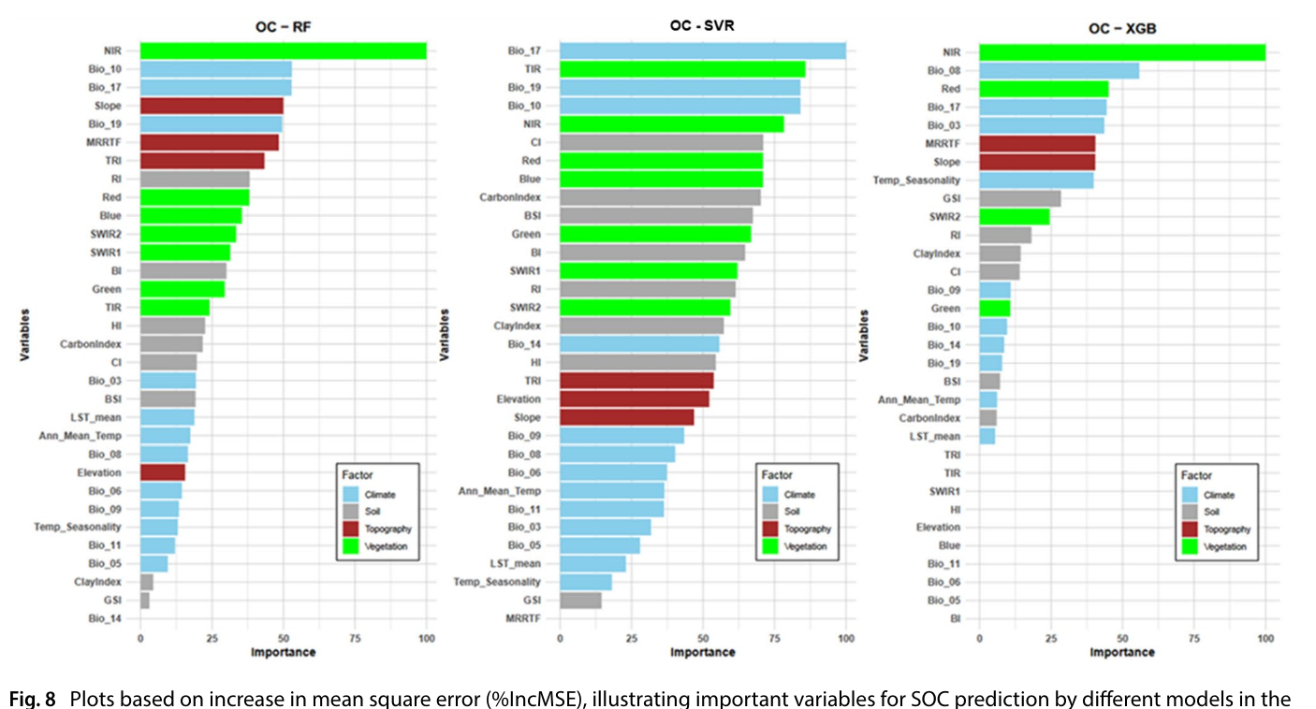
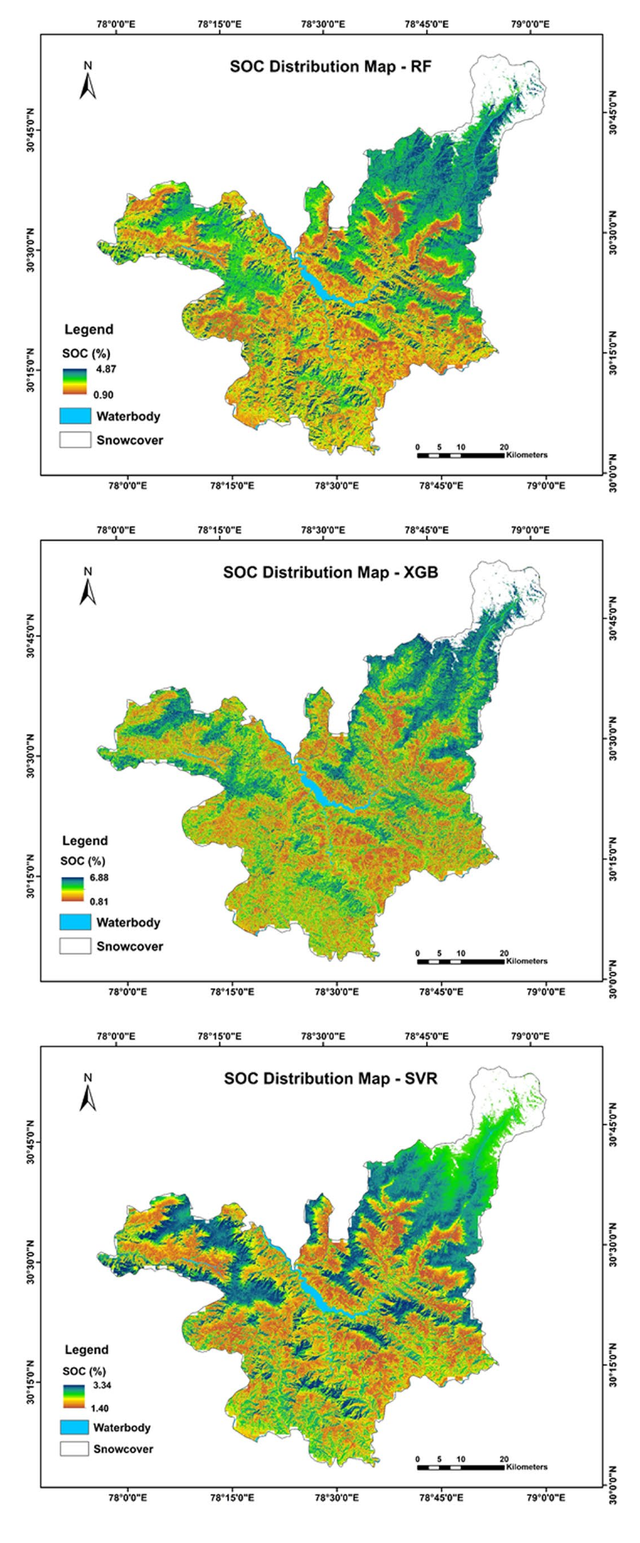
Drivers of SOC and the 30 m maps
Permutation importance (%IncMSE) for RF, SVR and XGB
RF ranking: NIR > Bio10 > Bio17 > Slope > Bio19 > MRRTF > TRI
Common to all models: NIR, Bio17, Bio10, Bio19, MRRTF, slope
Land use: evergreen forest mean 2.88% SOC; croplands 2.32% (low input, tillage, erosion, residue removal)
Kalambukattu et al. (2025) Figs. 8 and 9, Sections 3.4–3.5
Notes:
In RF the top covariates were NIR, Bio10, Bio17, slope, Bio19, MRRTF and TRI: vegetation, climate and topography contribute three each to the top ten. Seasonal precipitation and temperature (Bio17, Bio10, Bio19) mattered more than annual means; elevation itself ranked low. Maps show higher SOC in the north, north-east and north-west under evergreen forest, lower SOC in the warmer, cultivated south and south-west.

Slide 53
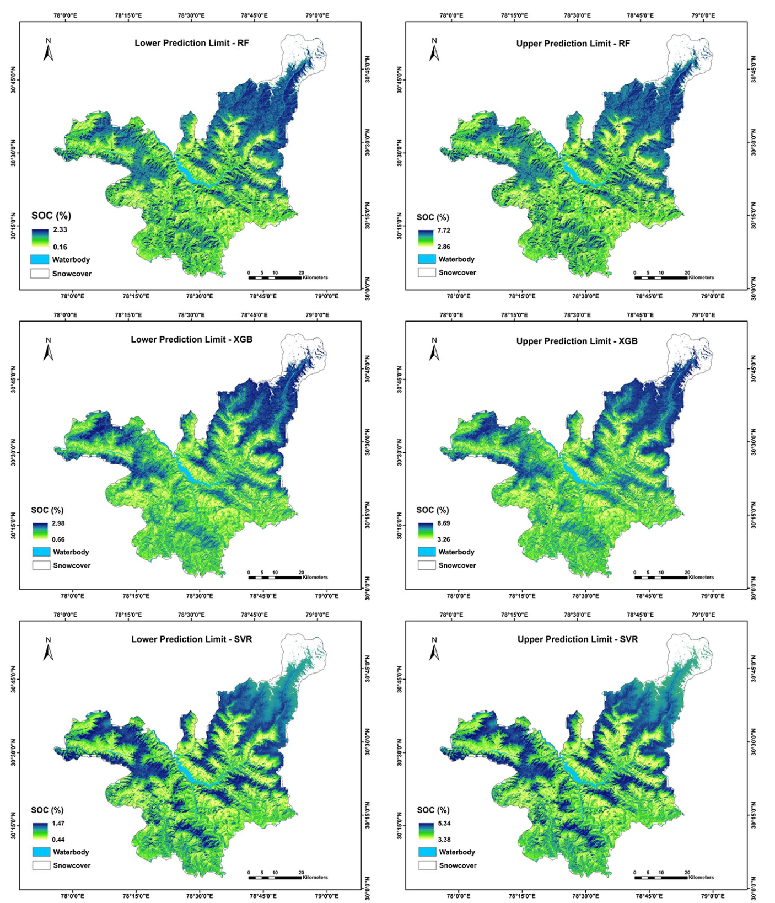
Mapping the uncertainty
90% prediction-interval range
RF
0.16–7.72%
XGB
0.66–8.69%
SVR
0.44–5.34%
Calibration: PICP close to nominal levels; slight over-coverage at 40–80%
Hot spot: north-east (low sampling density, snow, rugged terrain)
Likely cause: 1 km climate covariates miss mountain microclimate
Use: target new samples where the interval is widest
Kalambukattu et al. (2025) Fig. 10 and Section 3.5
Notes:
Lower and upper limits of the 90% prediction interval from 50 bootstrap refits. RF's interval range (0.16–7.72%) matched the observed SOC range best. PICP plots tracked the 1:1 line, with slight over-coverage at 40–80% confidence. Uncertainty was greatest in the north-east: few samples, snow-adjacent and inaccessible terrain, and coarse 1 km climate covariates. These maps can guide future sampling.

Slide 54
Case study II: Surface soil moisture mapping
Das, Rathore, Roy, Chakraborty et al. (2022) Catena 217:106485 — optical–thermal–microwave fusion with ensembles

Slide 55
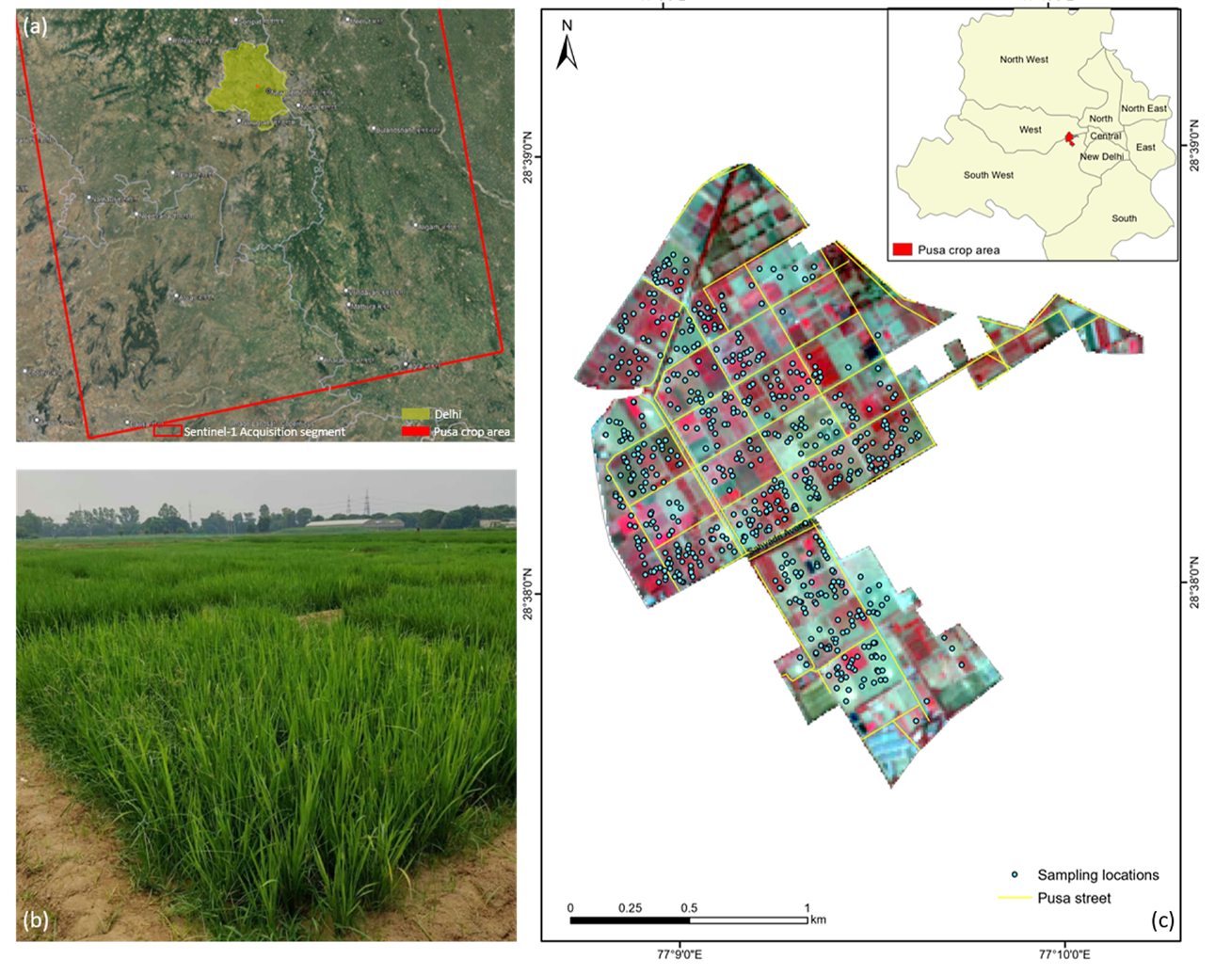
Study area and data
622
in-situ SSM readings (0–5 cm), ML3 ThetaProbe, sites by cLHS
6 dates
Oct 2020 – Mar 2021, synchronous with satellite passes
30
covariates: Sentinel-1 σ° VV/VH, Landsat-8 bands, indices, LST
30 m
all layers resampled (bilinear), UTM 43N
SSM: calibration mean 14.7% (SD 8.0), validation 14.0% (SD 7.3); 70:30 split tested equal by t, F, Mann–Whitney and K–S
Figure: Das et al. (2022) Fig. 1; values from Sections 2.1–2.4 and 3.1
Notes:
IARI research farm, New Delhi: semi-arid, Typic Haplustepts, wheat on about 70% of 242 ha in rabi. Six dates were chosen where Sentinel-1 and cloud-free Landsat-8 coincided between October 2020 and March 2021. The ThetaProbe was laboratory-calibrated (±1.5–2% v/v).

Slide 56
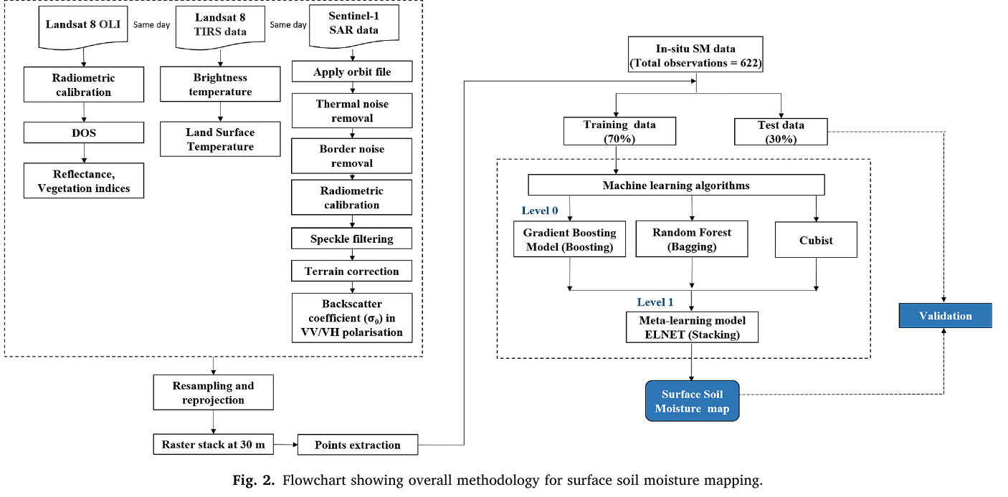
Methodology: three sensors, four models
Microwave
Sentinel-1 C-band σ° VV, VH (IW, GRD)
Optical
Landsat-8 bands B2–B7 + ~20 indices (MNDWI, NDWI, SATVI, NBRI…)
Thermal
Landsat-8 B10 → LST (mono-window)
Level 0: Cubist, GBM (boosting), RF (bagging)
Level 1: elastic-net meta-learner (stacking)
Tuning: 10-fold CV × 5 repeats (caret)
Workflow from the paper (Fig. 2)
Das et al. (2022) Sections 2.2–2.5 and Fig. 2
Notes:
Sentinel-1 GRD was processed in SNAP: orbit file, thermal and border noise removal, radiometric calibration, refined Lee speckle filter, Range-Doppler terrain correction with SRTM, conversion to dB. Landsat-8 was corrected by dark-object subtraction in RStoolbox. LST came from band 10 with the Qin et al. (2001) mono-window algorithm using NDVI-threshold emissivity and transmittance from water vapour.

Slide 57
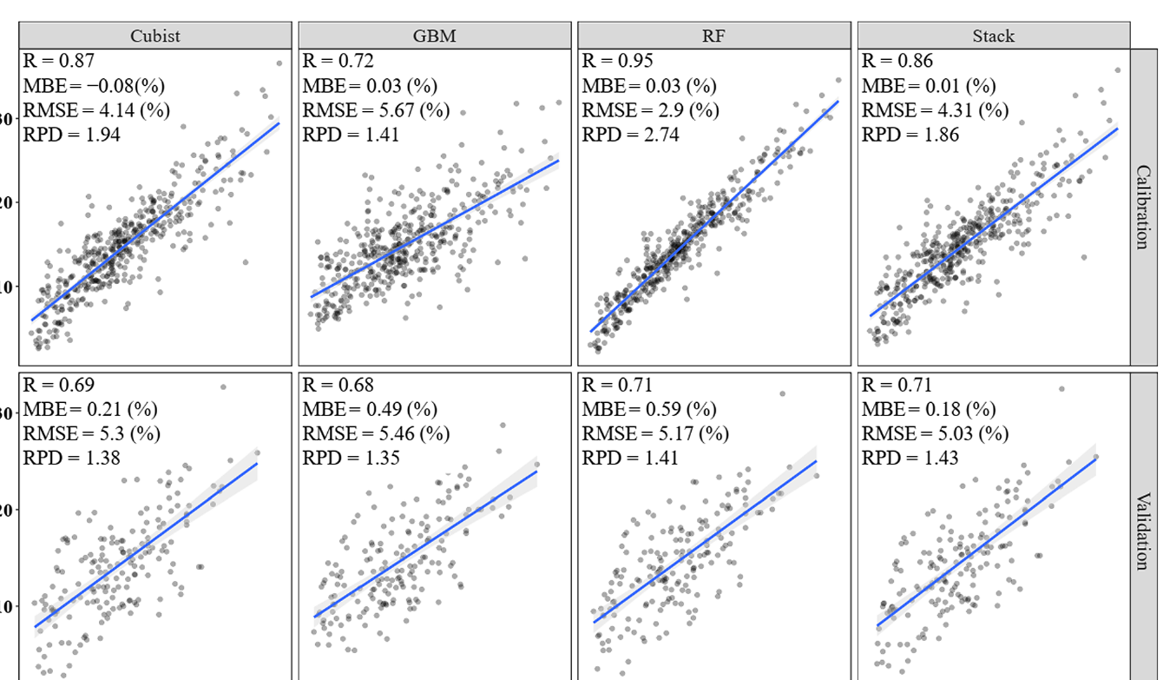
Results: stacking gives the lowest validation error
Validation | Cubist | GBM | RF | Stack
r | 0.69 | 0.68 | 0.71 | 0.71
MBE (%) | 0.21 | 0.49 | 0.59 | 0.18
RPD | 1.38 | 1.35 | 1.41 | 1.43
Predicted vs measured SSM, calibration (top) and validation (bottom)
Top covariates: MNDWI (GBM, RF), Sigma0_VV, LST
Das et al. (2022) Fig. 4, Table 1 and Section 3.3
Notes:
At calibration RF looked excellent (r 0.95, RPD 2.74) but dropped to r 0.71 at validation, a sign of overfitting. The stacked model had the lowest validation RMSE (5.03%) and bias (0.18%) and the highest RPD (1.43); stacking cut RMSE by 5.1, 7.8 and 2.7% relative to Cubist, GBM and RF. Gains are modest, and all validation RPDs sit near the 1.4 good/poor boundary.

Slide 58
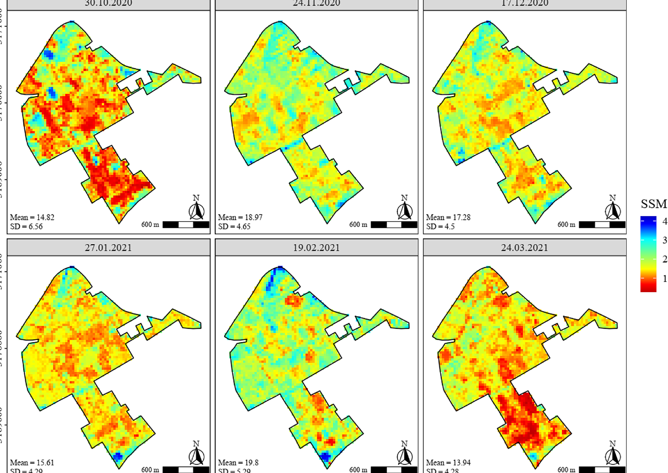
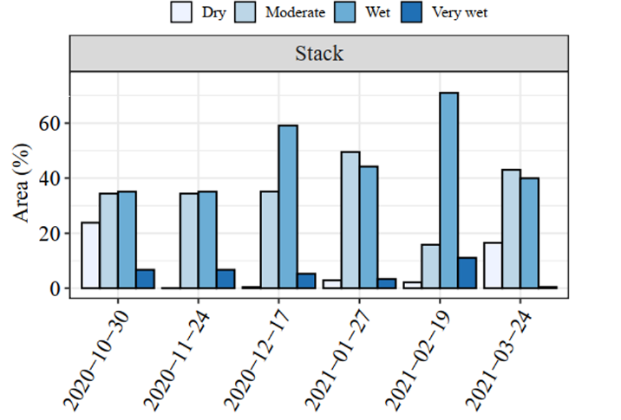
Spatio-temporal soil moisture through the rabi season
Area (%) under each moisture class, stacked model
Oct 30: 20–25% area dry around sowing
Feb 19: wet + very wet dominate (irrigation at grain filling)
Mar 24: drying at crop maturity
Pattern: wet = wheat fields; dry = pulses, bare plots
Das et al. (2022) Figs. 5 and 6, Section 3.4
Notes:
Classes from measured wilting point and field capacity: dry <8%, moderately wet 8–15%, wet 15–26%, very wet >26% v/v. Dry patches on 30 October match fields being prepared for sowing; wet area peaks in February with frequent irrigation at grain filling; dry area expands again by 24 March as irrigation stops at maturity. High-SSM zones overlap irrigated wheat; dry pockets match pulses and bare plots.

Slide 59
Synthesis
Choosing an approach for soil properties and soil moisture

Slide 60
Approaches for mapping soil parameters at a glance
Approach | Examples | Strength | Limitation
Conventional survey | Soil series polygons | Pedological insight | Coarse, static, no uncertainty
Deterministic interpolation | IDW, splines, Thiessen | Simple, fast | No error map, artefacts
Geostatistics | OK, co-kriging, block kriging | BLUP + kriging variance | Needs dense points, stationarity
Hybrid | RK / KED, RF + residual kriging | Covariates + spatial residual | More modelling steps
Machine learning | RF, Cubist, SVR, XGB, ANN | Non-linear, many covariates | Overfitting, extrapolation risk
Ensembles / deep learning | Stacking, CNN, LSTM | Lower bias / variance | Data hungry, less interpretable
Physical SM retrieval | Water-cloud model, change detection | Physically based, transferable | Needs roughness, vegetation data
Downscaling & proximal | SMAP/SMOS downscaling; vis-NIR, EMI, GPR | Dense or frequent data | Calibration, scale mismatch
Compiled from the four papers presented; physical SM methods as discussed in Das et al. (2022)
Notes:
No single method wins everywhere. Kriging is best when the target has strong spatial structure and enough samples; ML wins when exhaustive covariates explain much of the variation; hybrids capture both. For soil moisture, physical and semi-empirical retrieval and downscaling of coarse satellite products are complementary to the data-driven ML route used in the case study.

Slide 61
The two case studies side by side
 | SOC — Himalaya (2025) | Surface soil moisture — IARI farm (2022)
Target, depth | SOC (%), 0–15 cm | Volumetric SSM (%), 0–5 cm
Extent, terrain | ~4,400 km² mountainous district | 242 ha flat irrigated farm
Samples | 421, stratified random | 622 over 6 dates, cLHS
Covariates | 55 → 32 (terrain, climate, spectral, LULC, lithology) | 30 (σ° VV/VH, Landsat bands & indices, LST)
Models | RF, SVR, XGB | Cubist, GBM, RF, stacking (ELNET)
Best model (test) | RF: R² 0.72, RMSE 0.59%, RPD 1.80 | Stack: r 0.71, RMSE 5.03%, RPD 1.43
Key drivers | NIR, Bio10, Bio17, slope, Bio19 | Sigma0_VV, MNDWI, LST
Uncertainty | Bootstrap 90% PI maps + PICP | Train vs validation gap (RF overfit)
Kalambukattu et al. (2025); Das et al. (2022)
Notes:
Both studies share the DSM skeleton: purposive sampling, a 30 m covariate stack, Boruta selection, 70:30 split with cross-validated tuning and multi-metric validation. They differ in target dynamics: SOC is a slowly changing property mapped once; SSM changes within days, so the covariates have to be date-matched and the maps form a time series.

Slide 62
Research gaps and way forward
Temporal density
Longer wavelengths
Better covariates
Few co-incident S-1 / cloud-free Landsat dates; add Sentinel-2, harmonised Landsat–Sentinel and GEE time series
C-band loses soil signal under dense canopy; L- and S-band SAR (NISAR) can see through more vegetation
Terrain and soil texture, bulk density for SSM; fine-resolution climate for mountains
Hybrid models
Explainability
More soil parameters
Krige ML residuals (RF-RK), spatial cross-validation, QRF intervals
SHAP / partial dependence to link drivers to soil processes
Same framework for pH, texture, micronutrients, salinity, soil health indices
Based on limitations stated in Das et al. (2022) Section 3.6 and Kalambukattu et al. (2025) Section 3.5
Notes:
The gaps are mostly stated as limitations by the authors themselves: date-matching between SAR and cloud-free optical scenes limits temporal resolution; C-band saturates under dense canopy; coarse climate layers blur mountain microclimates; and random train/test splits can overstate accuracy where samples are clustered.

Slide 63
Conclusions
DSM turns point soil data and exhaustive covariates into 30 m property maps with explicit uncertainty.
Geostatistics (variogram + kriging) remains the reference when spatial structure is strong; regression-kriging adds covariates.
Random forest gave the best SOC map in the Himalaya (test R² 0.72); stacking gave the lowest soil-moisture error (RMSE 5.03%).
Feature selection, honest validation and uncertainty maps matter as much as the algorithm.
Notes:
Close with the main message: method choice follows data density and how well covariates explain the target; always report uncertainty.

Slide 64
References
Kalambukattu JG, Kumar S, Das B, Roy T (2025). Digital mapping of soil organic carbon in the hilly and mountainous landscape of Indian Himalayan region employing machine-learning techniques. Discover Soil 2:35. doi:10.1007/s44378-025-00060-5
Das B, Rathore P, Roy D, Chakraborty D, Jatav RS, Sethi D, Kumar P (2022). Comparison of bagging, boosting and stacking algorithms for surface soil moisture mapping using optical-thermal-microwave remote sensing synergies. Catena 217:106485. doi:10.1016/j.catena.2022.106485
Hengl T, Heuvelink GBM, Stein A (2004). A generic framework for spatial prediction of soil variables based on regression-kriging. Geoderma 120:75–93. doi:10.1016/j.geoderma.2003.08.018
Oliver MA, Webster R (2014). A tutorial guide to geostatistics: computing and modelling variograms and kriging. Catena 113:56–69.
McBratney AB, Mendonça Santos ML, Minasny B (2003). On digital soil mapping. Geoderma 117:3–52.
Kursa MB, Rudnicki WR (2010). Feature selection with the Boruta package. J. Stat. Softw. 36(11).
Chang CW, Laird DA, Mausbach MJ, Hurburgh CR (2001). Near-infrared reflectance spectroscopy–principal components regression analyses of soil properties. SSSAJ 65:480–490.
Cambardella CA et al. (1994). Field-scale variability of soil properties in central Iowa soils. SSSAJ 58:1501–1511.
Qin Z, Karnieli A, Berliner P (2001). A mono-window algorithm for retrieving land surface temperature from Landsat TM data. Int. J. Remote Sens. 22:3719–3746.
Minasny B, McBratney AB, Malone BP, Wheeler I (2013). Digital mapping of soil carbon. Advances in Agronomy 118:1–47. doi:10.1016/B978-0-12-405942-9.00001-3
Sindhushree TS, Kavya D, Jitendra GH, Tongali NC, Rajeswari B, Phukan P (2025). Digital soil mapping: a review of techniques, applications and emerging trends. Journal of Scientific Research and Reports 31(7):1151–1158. doi:10.9734/jsrr/2025/v31i73329
Hengl T, Heuvelink GBM, Rossiter DG (2007). About regression-kriging: from equations to case studies. Computers & Geosciences 33:1301–1315.
Webster R, Oliver MA (2007). Geostatistics for Environmental Scientists, 2nd ed. Wiley.
Notes:
Primary papers presented, plus key method references.

