Slide 1

Microwave Soil Moisture Estimation in Agriculture
Physics, passive and active retrieval models, and NISAR's algorithms — the methodology you need for the ISRO interview
0.04 m³/m³
200 m
SMAP / SMOS accuracy (~40 km)
NISAR soil moisture (goal 0.06)
Notes:
This deck explains how soil moisture is estimated from microwave satellites, from the physics of the dielectric constant to the operational algorithms of SMAP, SMOS, Sentinel-1 and NISAR. It is built from two documents: the review by Karthikeyan, Pan, Wanders, Nagesh Kumar and Wood (2017) and the NISAR Level-3 Soil Moisture Algorithm Theoretical Basis Document (JPL, 2023). The last two slides are a method-selection matrix and interview questions.

Slide 2



How a microwave signal becomes a soil moisture map
Soil water
ε′ rises from ~3 to 25+
Microwave signal
T_{B} falls · σ⁰ rises
Remove nuisances
roughness · vegetation · T_{s}
Invert a model
τ-ω · IEM · WCM · change detection
Dielectric model
ε′ → m_{v} (Dobson, Mironov)
Soil moisture
top ~5 cm, m³/m³
What the sensor measures
What gets in the way
Sources used
Passive radiometer: brightness temperature T_{B} (K)
Active radar/SAR: backscatter coefficient σ⁰ (dB)
Moist soil looks cooler to a radiometer and brighter to a radar
Surface roughness (h; rms height s, correlation length l)
Vegetation: optical depth τ, albedo ω, water content
Soil temperature, RFI, open water, snow, frozen soil
Speckle and terrain (radar)
Karthikeyan et al. 2017 review (retrieval algorithms)
NISAR L3 Soil Moisture ATBD, JPL D-107679 (2023)
Classic papers: Njoku & Entekhabi 1996; Attema & Ulaby 1978; Oh 1992; Dubois 1995; Wagner 1999
Notes:
The whole chain on one slide. Water in soil raises the dielectric constant. That lowers microwave emission (passive) and raises backscatter (active). Roughness, vegetation and temperature also change the signal, so a model is inverted to separate them. The output is the dielectric constant, which a dielectric mixing model converts to volumetric soil moisture of the top ~5 cm.

Slide 3
Physics basics
01
Why microwaves sense soil water, which band to use, and passive vs active
Notes:
Section 1 covers the physical basis: the dielectric contrast between water and dry soil, how frequency controls sensing depth and vegetation penetration, and how passive and active systems differ.

Slide 4


Why soil moisture, and why microwaves?
Uses in agriculture
Why microwave remote sensing
Drought monitoring: soil moisture is an impact indicator in the Drought Manual 2016
Irrigation scheduling and water accounting
Crop yield forecasting (FASAL) and crop models via data assimilation
Crop insurance (YES-TECH, PMFBY): crop condition and loss assessment
Weather and monsoon forecasts, flood forecasting, root-zone moisture
Dielectric contrast: water ε′ ≈ 80, dry soil ε′ ≈ 3–5
All-weather, day and night: own energy (radar) or thermal emission
Little atmospheric effect at L-, C-, X-band
Penetrates sparse to moderate vegetation at low frequency
Limitation: senses only the top ~1–5 cm (≈ 1/10 to 1/2 of the wavelength)
Remember the one-line answer: moist soil appears cooler to a radiometer and brighter to a radar (Karthikeyan et al. 2017).
Notes:
Soil moisture links the water, energy and carbon cycles. In agriculture it drives drought declaration, irrigation scheduling, yield models and crop insurance. Microwaves are used because the dielectric constant of water (~80) is far higher than that of dry soil (~3–5), the signal works day and night through clouds, and the atmosphere has little effect at low frequencies. The limitation is that only the top few centimetres are sensed.

Slide 5

The key physics: soil dielectric constant
ε′ = 3.03 + 9.3θ + 146θ² − 76.7θ³
Topp et al. (1980) empirical relation
What to say
Complex permittivity ε = ε′ − jε″; ε′ controls reflection, ε″ loss (negligible at L/C/X)
Water ε′ ≈ 80 vs dry soil 3–5, so a small change in water gives a big change in ε′
ε′ also depends on texture (bound water), bulk density, frequency, temperature, salinity
Retrieval chain: signal → ε′ → m_{v} through a dielectric mixing model
Notes:
This chart uses the Topp (1980) empirical equation. As volumetric soil moisture rises from 0 to 0.5 m³/m³, the real part of the dielectric constant rises from about 3 to about 35. The imaginary part (loss) is small at L, C and X band, so retrievals use the real part. Texture, bulk density, temperature, frequency and salinity also affect it, which is why physically based models such as Dobson and Mironov are used operationally.

Slide 6


Which frequency? Why L-band is preferred
Band | Frequency (example) | Wavelength | Sensing depth | Vegetation | Missions
L | 1.26 GHz (NISAR) · 1.41 GHz (SMAP, SMOS) | ~21–24 cm | ~5 cm | Sees through moderate crops (VWC up to ~5 kg/m²) | SMAP, SMOS, NISAR, ALOS-2 PALSAR-2
S | 3.2 GHz (NISAR, ISRO) | ~9 cm | ~2–3 cm | Medium | NISAR S-SAR over India
C | 5.4 GHz | ~5.6 cm | ~1–2 cm | Sparse vegetation only | Sentinel-1, EOS-04 (RISAT-1A), RADARSAT, ASCAT
X | 9.6–10.7 GHz | ~3 cm | < 1 cm | Mostly canopy | TerraSAR-X, AMSR2 (X channel)
Rule of thumb
Trade-off
Sensing depth ≈ 1/10 to 1/2 of the wavelength. Longer wavelength → deeper emission, less vegetation and atmosphere effect.
Passive L-band needs a huge antenna → coarse pixels (~40 km). SAR synthesises an aperture → 10 m, but adds speckle and roughness effects.
Notes:
Lower frequency means longer wavelength, deeper sensing depth, better penetration of vegetation and less atmospheric effect. The trade-off is resolution: a radiometer needs a very large antenna at L-band, so pixels are ~40 km. L-band radiometers also use the protected 1400–1427 MHz band, though RFI still occurs. NISAR flies L-band (NASA) and S-band (ISRO).

Slide 7
Passive vs active microwave at a glance
Feature | Passive (radiometer) | Active (radar / SAR)
Measures | Brightness temperature T_{B} (K), natural emission | Backscatter σ⁰ (dB) of its own pulse
Effect of wet soil | Lower emissivity → lower T_{B} | Higher ε′ → higher σ⁰
Spatial resolution | Coarse: ~25–50 km | SAR 10 m–1 km; scatterometer 25–50 km
Typical accuracy | ~0.04 m³/m³ (SMAP, SMOS) | ~0.06 m³/m³ (NISAR goal)
Main nuisances | Vegetation τ, ω; surface temperature; roughness h; RFI | Roughness s, l; vegetation structure; speckle; terrain
Revisit | 2–3 days | 6–12 days (Sentinel-1, NISAR)
Missions | SMMR, SSM/I, TMI, WindSat, AMSR-E, AMSR2, SMOS, SMAP | ERS SCAT, ASCAT, Sentinel-1, RADARSAT, ALOS-2, EOS-04, NISAR
Link between the two: e = 1 − r (Kirchhoff). The radiometer sees emissivity, the radar sees reflectivity of the same soil.
Notes:
Passive radiometers measure natural emission as brightness temperature. They are accurate (~0.04 m³/m³) but coarse. Active radars measure the backscatter of their own pulse. SAR gives fine resolution but is more sensitive to roughness and vegetation structure, so accuracy is typically ~0.06 m³/m³. Emissivity and reflectivity are linked by e = 1 − r, which is the basis of active–passive fusion.

Slide 8
Dielectric mixing models and Fresnel reflectivity
Model | Inputs | Note
Wang & Schmugge (1980) | m_{v}, clay, sand, porosity | Bound-water transition point
Topp (1980) | m_{v} only | Empirical (TDR), texture independent
Dobson (1985) | f, m_{v}, T, clay, sand, bulk & particle density, salinity | Semi-empirical, 1.4–18 GHz
Mironov (2009) | m_{v}, clay, f | Spectroscopic; used by SMAP and NISAR
Smooth-surface Fresnel reflectivity
R_{H} = | (cosθ − √(ε′ − sin²θ)) / (cosθ + √(ε′ − sin²θ)) |²
R_{V} = | (ε′cosθ − √(ε′ − sin²θ)) / (ε′cosθ + √(ε′ − sin²θ)) |²
Emissivity e = 1 − R (Kirchhoff)
Brightness temperature T_{B} = e · T_{s}
Higher ε′ → higher R → lower e → lower T_{B}. V-pol emissivity is higher than H-pol, and H-pol is more sensitive to soil moisture.
Source: Karthikeyan et al. (2017), Adv. Water Resour. 109:106–120, Table 1
Interview tip: name Mironov for SMAP/NISAR and Dobson as the classic semi-empirical model.
Notes:
Both passive and active algorithms end with a dielectric mixing model that converts ε′ to soil moisture. Topp is empirical and texture-independent; Dobson needs texture, density, temperature and frequency; Mironov is used by SMAP and the NISAR time-series algorithm. For a smooth surface, Fresnel equations give reflectivity from ε′ and incidence angle, and emissivity is 1 − R.

Slide 9
Passive retrieval
02
Emissivity, roughness, the τ-ω model and the operational algorithms (SCA, DCA, LPRM, L-MEB)
Notes:
Section 2 covers passive microwave retrieval: how brightness temperature is modelled for bare and vegetated soil, and how algorithms such as SMAP's single channel algorithm and SMOS's L-MEB invert it.

Slide 10


Passive step by step: emissivity, roughness, temperature
1 · Smooth soil
2 · Roughness (h–Q)
3 · Temperature
Fresnel R_{s} from ε′ and θ
e_{s} = 1 − R_{s}
T_{B} = e_{s}·T_{s}
R_{r}^{H} = [(1−Q)R_{s}^{H} + Q·R_{s}^{V}]·exp(−h·cos²θ)
h = roughness height, Q = polarisation mixing
Roughness raises e and lowers sensitivity
SMAP: land-cover h, Q = 0
T_{s} from thermal IR, 37 GHz V-pol T_{B}, or ECMWF
Usually T_{s} ≈ T_{c} (soil ≈ canopy)
Error of 1 K in T_{s} ≈ error in T_{B}
Also flagged or corrected: open water in the pixel, RFI, snow, frozen soil, dense forest, and heavy rain. At L-band the atmosphere is almost transparent, so T_{B,TOA} ≈ T_{B,canopy}.
Notes:
Step 1 computes smooth-soil emissivity from ε′ with Fresnel equations. Step 2 corrects for roughness with the Wang and Choudhury (1981) h–Q model; roughness increases emissivity and reduces sensitivity to soil moisture. SMAP uses a land-cover dependent h with Q = 0. Step 3 needs the effective surface temperature, taken from thermal infrared, the 37 GHz V-pol channel, or a weather model. At L-band the atmosphere is nearly transparent.

Slide 11
The τ-ω model: how vegetation is handled
Radiometer measures T_{B}
T_{B} = T_{s}e_{s}γ + T_{c}(1−ω)(1−γ)(1 + r_{s}γ)
③ canopy down, reflected by soil
① soil × γ
② canopy up
γ = exp(−τ·secθ): vegetation transmissivity
τ = b·VWC (Jackson & Schmugge 1991); b depends on crop type and frequency
VWC from NDVI or LAI (SMAP uses an NDVI-based climatology)
ω single-scattering albedo, small at L-band (~0–0.1)
r_{s} = 1 − e_{s} soil reflectivity; usually T_{s} ≈ T_{c}
Works well for VWC < ~5 kg/m²; forests attenuate too much
Canopy: τ, ω, T_{c}
Soil: ε′ (m_{v}), roughness h, T_{s}
Terms: ① soil emission through canopy · ② direct canopy emission · ③ canopy emission reflected by soil
Notes:
This is the zero-order radiative transfer model (Mo et al. 1982) used by almost every passive algorithm. The signal has three parts: soil emission weakened by the canopy, upward canopy emission, and downward canopy emission reflected by the soil and weakened again. The transmissivity γ depends on vegetation optical depth τ, which is linked to vegetation water content through τ = b·VWC (Jackson and Schmugge 1991). VWC usually comes from NDVI. Above roughly 5 kg/m² of VWC the soil signal is too weak.

Slide 12
Passive retrieval as a flow: forward model + optimisation
Guess m_{v}
Dielectric model → ε′
Fresnel + h–Q → e_{s}
τ-ω model → T_{B,mod}
Ancillary: NDVI→VWC, soil texture, land cover, T_{s}
Update m_{v} (and τ)
J minimum?
Cost J = Σ(T_{B,obs} − T_{B,mod})²
No
Output
m_{v} (m³/m³)
VOD τ
Quality flags
Yes
Two ways to invert
Retrieved m_{v} (+ τ, flags)
Observed T_{B} (H, V; angles)
Forward + optimisation (L-MEB, LPRM, DCA)
Direct inversion at one channel (SCA): T_{B} → e_{s} → ε′ → m_{v}
Notes:
Most passive algorithms run a forward model: guess soil moisture, compute ε′, emissivity, add roughness and vegetation, model T_B, compare with the observed T_B, and update the guess until the cost function is minimum. Some algorithms also solve for τ (and temperature). The simpler inverse approach (SMAP's SCA) inverts the equations directly at one polarisation.

Slide 13
Passive algorithms you should be able to name
Algorithm | Used by | Retrieves | Key idea
SCA – Single Channel Algorithm (Jackson & Schmugge 1989) | SMAP baseline | m_{v} | One polarisation; τ from NDVI-based VWC; ancillary T_{s}
DCA – Dual Channel Algorithm (Owe et al. 2001) | SMAP option, AMSR | m_{v} + τ | Uses H and V T_{B} together
LPRM – Land Parameter Retrieval Model (Owe et al. 2008) | AMSR-E, AMSR2, TMI, SSM/I; ESA CCI | m_{v} + τ | Polarisation difference links τ to soil emissivity; T_{s} from 37 GHz V-pol
L-MEB (Wigneron et al. 2007) | SMOS Level 2 (Kerr et al. 2012) | m_{v} + τ (+ roughness) | Multi-angle cost-function minimisation
LSMEM (Drusch 2001; Pan 2014) | AMSR-E | m_{v} (+ τ) | Land surface microwave emission model
Regression / neural networks | SMOS-NN, merged products | m_{v} | Statistical link between T_{B} and reference soil moisture
Lesson from SMOS vs SMAP: a dedicated mission, RFI-hardened hardware and a simple algorithm (SCA) gave the most accurate soil moisture.
Notes:
These are the main passive algorithms. They differ mainly in what they retrieve. SCA retrieves only soil moisture and takes τ from NDVI. DCA, LPRM and the two-parameter L-MEB retrieve soil moisture and τ together using multiple channels or angles. Karthikeyan et al. note that SMAP's simple SCA, with a design hardened against RFI, performed better than more complex schemes.

Slide 14
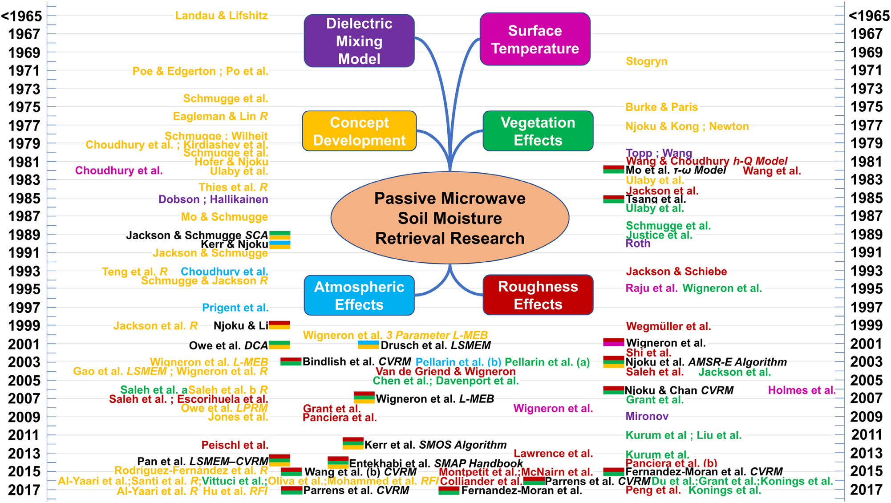

Four decades of passive research in one diagram
Milestones
1980–85 Topp, Wang–Schmugge, Dobson dielectric models
1981 Wang & Choudhury h–Q roughness
1982 Mo et al. τ-ω model
1989 SCA (Jackson & Schmugge)
2001 DCA (Owe et al.)
2007 L-MEB (Wigneron)
2008 LPRM (Owe et al.)
2012 SMOS algorithm (Kerr)
2014 SMAP handbook (Entekhabi)
Fig. 1 of the review: passive microwave soil moisture retrieval research, 1965–2017. Source: Karthikeyan et al. (2017), Adv. Water Resour. 109:106–120
Notes:
This is Figure 1 of the Karthikeyan et al. 2017 review. It sorts passive retrieval research by year into branches: dielectric mixing models, surface temperature, concept development, vegetation effects, atmospheric effects and roughness effects. Use it to remember the milestones: h–Q roughness (1981), τ-ω (1982), Dobson (1985), SCA (1989), L-MEB (2007), LPRM (2008), the SMOS algorithm (2012) and the SMAP handbook (2014).

Slide 15
Active retrieval
03
Radar backscatter, physical, semi-empirical and empirical models, the water cloud model, change detection and fusion
Notes:
Section 3 covers radar-based retrieval, which is what matters for field-scale agriculture and for NISAR, Sentinel-1 and EOS-04.

Slide 16
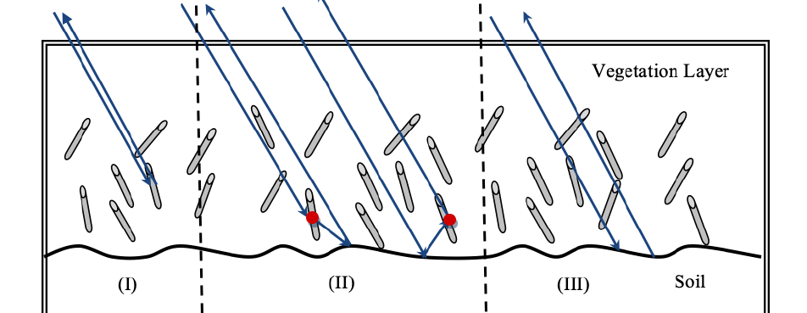

What controls radar backscatter σ⁰
Factors
Soil: ε′ (m_{v}), rms height s, correlation length l
Vegetation: VWC, structure (stems, leaves), row direction
Sensor: frequency, polarisation, incidence angle θ
  Low θ → more soil-moisture sensitive; high θ → more roughness sensitive
Co-pol (HH, VV) → soil; cross-pol (HV) → vegetation volume
L-band σ⁰ changes ~6–8 dB over the full soil moisture range
Three mechanisms: (I) vegetation volume, (II) double bounce, (III) soil surface. Source: NISAR L3 Soil Moisture ATBD, JPL D-107679 (2023)
σ⁰_{pq} = σ⁰_{s}(ε′, s, l)·e^{−τ} + σ⁰_{v}(VWC) + σ⁰_{sv}
NISAR ATBD Eq. 3.1 (distorted Born approximation, single scattering)
The core problem: a wet smooth field and a dry rough field can give the same σ⁰. Multi-polarisation or a time series is needed to break this ambiguity.
Notes:
For a vegetated field, total backscatter is the soil surface term attenuated twice by the canopy, plus vegetation volume scattering, plus soil–vegetation interaction (double bounce). Soil moisture only enters through the dielectric constant of the soil term. Roughness, vegetation and the sensor geometry all change σ⁰, so the retrieval must separate them. Co-polarised channels carry more soil information; cross-polarised HV is dominated by vegetation volume.

Slide 17
Four families of active retrieval models
Active (radar) soil moisture models
Physical
Semi-empirical
Empirical
Change detection
IEM / AIEM, SPM, GOM / POM, SSA, NMM3D
Inputs: ε′, s, l, f, θ, polarisation
+ Physically based, transferable
− Needs roughness data, heavy computing
Oh (1992), Dubois (1995), calibrated IEM
Inputs: multi-pol σ⁰, θ, λ
+ Simple, no correlation length
− Bare / sparse soil, validity limits
σ⁰ = a + b·m_{v}
Inputs: σ⁰ + in-situ data
+ Easy to apply
− Site- and season-specific
TU Wien, NBMI, alpha ratio
Inputs: long σ⁰ time series
+ Roughness and vegetation cancel
− Gives relative wetness; needs long record
Over crops: bare-soil model + vegetation model (water cloud model), or use data cubes per crop type as NISAR does.
Notes:
The review groups active models into four classes. Physical models solve electromagnetic scattering. Semi-empirical models simplify physics using field data. Empirical models fit a local regression. Change detection uses a time series and assumes roughness and vegetation change slowly. For vegetated crops, any bare-soil model is combined with a vegetation model such as the water cloud model.

Slide 18
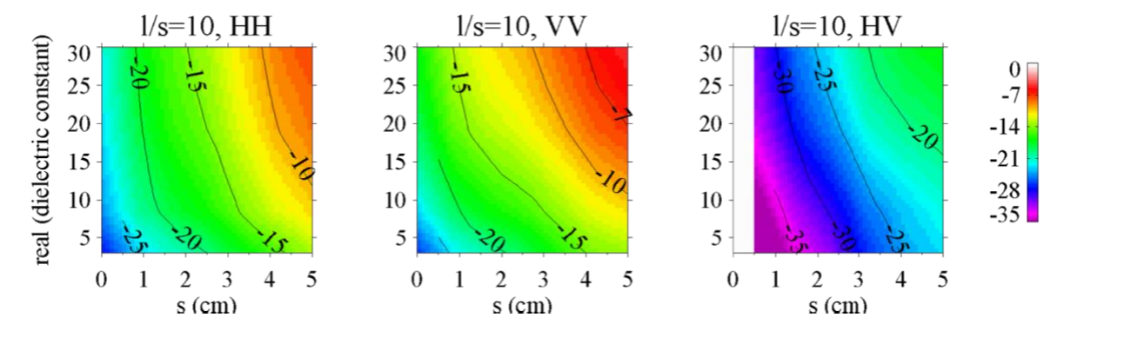

Physical models: IEM and NISAR's NMM3D look-up tables
IEM (Fung et al. 1992), bare soil:
σ⁰_{pq} = (k²/2)·e^{−2k_{z}²s²} Σ_{n=1→∞} s^{2n}|I^{n}_{pq}|² W^{(n)}(−2k_{x}, 0) / n!
k_{z} = k cosθ, k_{x} = k sinθ; W^{(n)} = Fourier transform of the n-th power of the surface autocorrelation
How it is used
NMM3D σ⁰ (dB) for HH, VV, HV vs rms height s and ε′ (l/s = 10). Source: NISAR L3 Soil Moisture ATBD, JPL D-107679 (2023)
Valid for bare soil, single scattering; AIEM (Chen 2003) extends it
IEM best on smooth surfaces; Oh better on rough soils
Inversion: forward runs → look-up table → match observed σ⁰ → (ε′, s) → m_{v}
NMM3D (NISAR): 200 cases; s up to 0.21λ (ks = 1.32, ~5 cm at L-band); tables within 0.2 dB
Read the figure: σ⁰ rises with both ε′ (wetness) and s (roughness): the same colour can be reached by different combinations. That is the ambiguity.
Notes:
The Integral Equation Model (Fung et al. 1992) simulates backscatter from a randomly rough bare surface given ε′, rms height, correlation length, frequency and angle. It is complex, so in practice it is run forward to build a look-up table or train a regression or neural network, and then inverted. NISAR uses numerical solutions of Maxwell's equations in 3D (NMM3D) for 200 roughness and permittivity cases, stored as interpolation tables accurate to 0.2 dB.

Slide 19
Semi-empirical and empirical models: Oh, Dubois, linear
Oh et al. (1992)
Dubois et al. (1995)
Empirical
p = σ⁰_{HH}/σ⁰_{VV} = [1 − (2θ/π)^{1/(3R_{0})}·e^{−ks}]²
q = σ⁰_{HV}/σ⁰_{VV} = 0.23·√R₀·(1 − e^{−ks})
R₀ = |(1−√ε′)/(1+√ε′)|²
Needs HH, VV, HV → solves m_{v} and s together
Valid: 0.1 < ks < 6; 0.09 < m_{v} < 0.31; 10°–70°
Only rms height needed (no correlation length)
σ⁰_{HH} = 10^{−2.75}(cos^{1.5}θ/sin⁵θ)·10^{0.028ε′tanθ}·(ks·sinθ)^{1.4}λ^{0.7}
σ⁰_{VV} = 10^{−2.35}(cos³θ/sin³θ)·10^{0.046ε′tanθ}·(ks·sinθ)^{1.1}λ^{0.7}
Two co-pol channels → ε′ and s
Valid: 1.5–11 GHz; s 0.3–3 cm; 30°–65°
Fails over vegetation with NDVI > 0.4
σ⁰ (dB) = a + b·m_{v}
a, b fitted from field data (fixed roughness, vegetation)
Add an exponential roughness term (Baghdadi)
Comparison studies: IEM best on smooth, Oh on rough; calibrated IEM best overall (Choker 2017)
Coefficients do not transfer between sites
Notes:
The Oh model uses ratios of polarisations: the co-pol ratio p and cross-pol ratio q depend on roughness ks and the nadir Fresnel reflectivity R0, so multi-pol data give both soil moisture and roughness. The Dubois model uses HH and VV with ε′, angle, ks and wavelength and is valid when NDVI is below about 0.4. Empirical models fit a linear relation between σ⁰ in dB and soil moisture, but the coefficients change from site to site.

Slide 20

Water cloud model: the workhorse for crops
σ⁰ = σ⁰_{veg} + δ²·σ⁰_{soil}
σ⁰_{veg}
δ²·σ⁰_{soil}
σ⁰_{veg} = A·V₁·cosθ·(1 − δ²)
δ² = exp(−2B·V₂·secθ) (two-way attenuation)
σ⁰_{soil} = C + D·m_{v} (or IEM / Oh / Dubois)
Canopy = 'water cloud' (V₁, V₂)
Notes
V₁, V₂: VWC, LAI, NDVI, or SAR-based (RVI, VH/VV)
A, B (vegetation) and C, D (soil) are calibrated by least squares for each crop
Use σ⁰ in linear units inside the equation, not dB
Neglects soil–vegetation interaction: fine for co-pol, low–medium biomass
Soil: σ⁰_{soil} = C + D·m_{v}
Notes:
The water cloud model (Attema and Ulaby 1978) treats the canopy as a cloud of water droplets. Total backscatter equals vegetation backscatter plus soil backscatter attenuated twice through the canopy. The interaction term is neglected for co-polarisation. V1 and V2 are vegetation descriptors such as VWC, LAI or NDVI. A, B, C and D are fitted for each crop and site. After removing the vegetation term, soil backscatter is inverted linearly for soil moisture, or with IEM or Oh.

Slide 21

Crop-field workflow: Sentinel-1 / EOS-04 + Sentinel-2 + WCM
SAR (Sentinel-1 / EOS-04 GRD)
Calibrate WCM: fit A, B, C, D
Practical tips
Orbit file, thermal noise removal
Radiometric calibration → σ⁰
Speckle filter (Lee), terrain correction
VV, VH in linear units
Use one orbit and incidence angle per time series
VV is usually more soil-sensitive than HH at C-band; VH tracks vegetation
Calibrate per crop and growth stage
Alternative: machine learning (RF, ANN) with σ⁰, θ, NDVI as inputs
ubRMSE = √(RMSE² − bias²)
Remove vegetation: σ⁰_{soil} = (σ⁰ − σ⁰_{veg}) / δ²
Optical (Sentinel-2 L2A)
Cloud mask, same date ± few days
NDVI, LAI, NDWI → V₁, V₂
Invert: m_{v} = (σ⁰_{soil} − C) / D
Mask urban, water, dense crop → map
Field campaign
Gravimetric / TDR m_{v} (0–5 cm)
Plant sampling → VWC; roughness
Split into calibration / validation
Validate: R, bias, RMSE, ubRMSE
Notes:
This is the standard methodology of Indian field studies. SAR data are calibrated to σ⁰, speckle filtered and terrain corrected. Optical data give NDVI or LAI for the vegetation descriptors. Field data give soil moisture and vegetation water content for calibration and validation. The model is calibrated, the vegetation term removed, soil backscatter inverted, and the map validated with R, RMSE and ubRMSE.

Slide 22
Change detection: let time cancel roughness and vegetation
m_{s}(t) = [σ⁰(t, θ_{ref}) − σ⁰_{dry}] / [σ⁰_{wet} − σ⁰_{dry}] × 100
TU Wien (Wagner et al. 1999): relative wetness 0–100% (degree of saturation); θ_{ref} = 40°
NBMI (Shoshany 2000) = (σ⁰_{t1} − σ⁰_{t2}) / (σ⁰_{t1} + σ⁰_{t2})
Alpha ratio: σ⁰(t₂)/σ⁰(t₁) ≈ |α(t₂)/α(t₁)|² (used by NISAR)
Assumes roughness and vegetation change slower than m_{v}
Needs a long record and the same geometry; × porosity → m³/m³
Operational: ASCAT (WARP, H SAF); Copernicus Sentinel-1 1 km (Bauer-Marschallinger 2019)
Illustrative series: wet spells after rain push σ⁰ towards the wet reference.
Strength: no roughness data needed. Weakness: crop growth changes σ⁰ too.
Notes:
If roughness and vegetation change more slowly than soil moisture, changes in backscatter over time are caused by soil moisture. The TU Wien method (Wagner et al. 1999) scales each observation between the driest and wettest backscatter ever recorded for that pixel at a reference angle, giving relative wetness from 0 to 100%. It is used for ASCAT (WARP) and the Copernicus Sentinel-1 1 km product. Ratio methods such as the alpha approximation are used in NISAR's time-series algorithm.

Slide 23
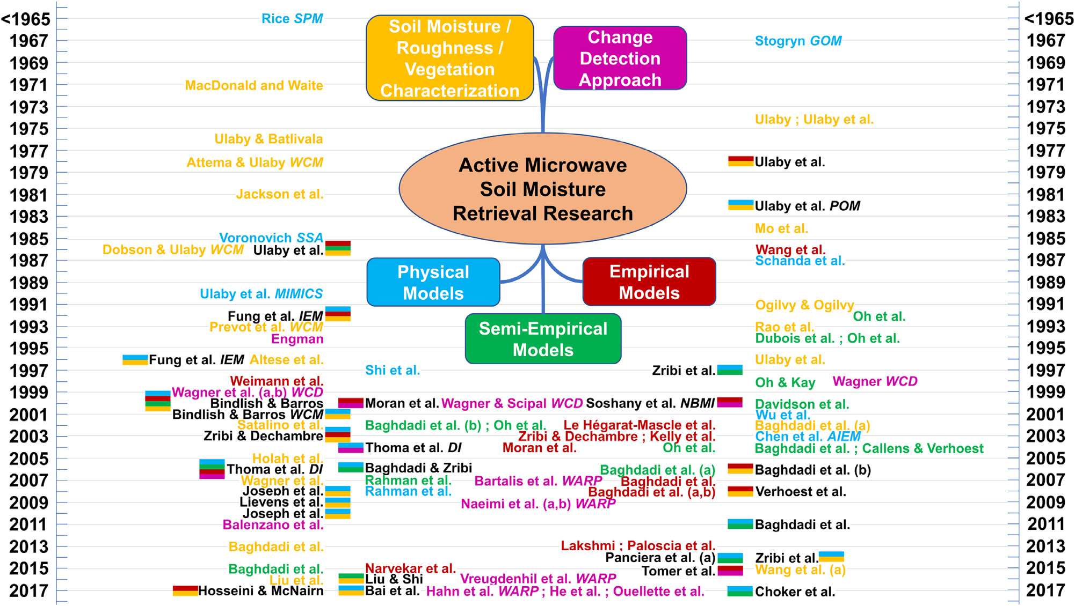
Four decades of active research in one diagram
Milestones
1978 Attema & Ulaby water cloud model
1990 MIMICS canopy model
1992 Fung IEM; Oh model
1995 Dubois model
1999 Wagner change detection
2003 AIEM (Chen et al.)
2007–09 WARP for ASCAT
2015+ Sentinel-1 with WCM + IEM
Fig. 2 of the review: active microwave soil moisture retrieval research, 1965–2017. Source: Karthikeyan et al. (2017), Adv. Water Resour. 109:106–120
Notes:
Figure 2 of the review groups active research into characterisation of soil moisture, roughness and vegetation; physical models; semi-empirical models; empirical models; and change detection. Key milestones: water cloud model (1978), IEM (1992), Oh (1992), Dubois (1995), TU Wien change detection (1999), AIEM (2003), WARP for ASCAT (2007–2009), and the Sentinel-1 water cloud and IEM couplings after 2015.

Slide 24
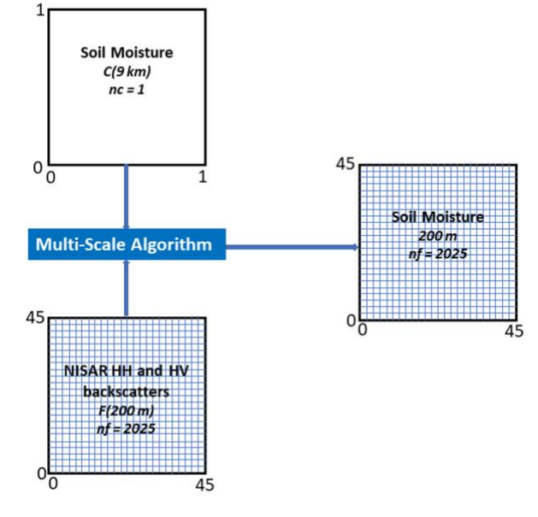

Active–passive fusion and downscaling
fine = coarse + β·[σ_{fine} − σ_{coarse}] + heterogeneity term
SMAP heritage
Physics link
Radiometer 36 km + radar 3 km → 9 km (2015)
Radar failed July 2015
SMAP/Sentinel-1 product: 3 km and 1 km
e = 1 − r: emissivity and radar reflectivity are two views of the same soil
β = sensitivity of soil moisture (or T_{B}) to σ⁰ within a coarse cell
One 9 km cell holds 45 × 45 = 2025 cells of 200 m. Source: NISAR L3 Soil Moisture ATBD, JPL D-107679 (2023)
Other downscaling routes: optical/thermal (soil evaporative efficiency, DISPATCH; LST–NDVI triangle) and machine learning with terrain, soil and vegetation covariates.
Notes:
Radiometers are accurate but coarse; radars are fine but noisy. Fusion uses the fine radar pattern to disaggregate the coarse radiometer or model soil moisture. SMAP was designed with a 36 km radiometer and a 3 km radar to give a 9 km product; after the radar failed in July 2015, Sentinel-1 was used instead to give 3 km and 1 km products. NISAR's multiscale fusion algorithm applies the same idea at 200 m. Optical and thermal downscaling (e.g. DISPATCH, triangle method) is an alternative.

Slide 25
NISAR and the ISRO angle
04
Mission, soil moisture product, the three retrieval algorithms, tests over India, and the processing workflow
Notes:
Section 4 is based on the NISAR Level-3 soil moisture algorithm document. It is the most likely area for ISRO questions.

Slide 26
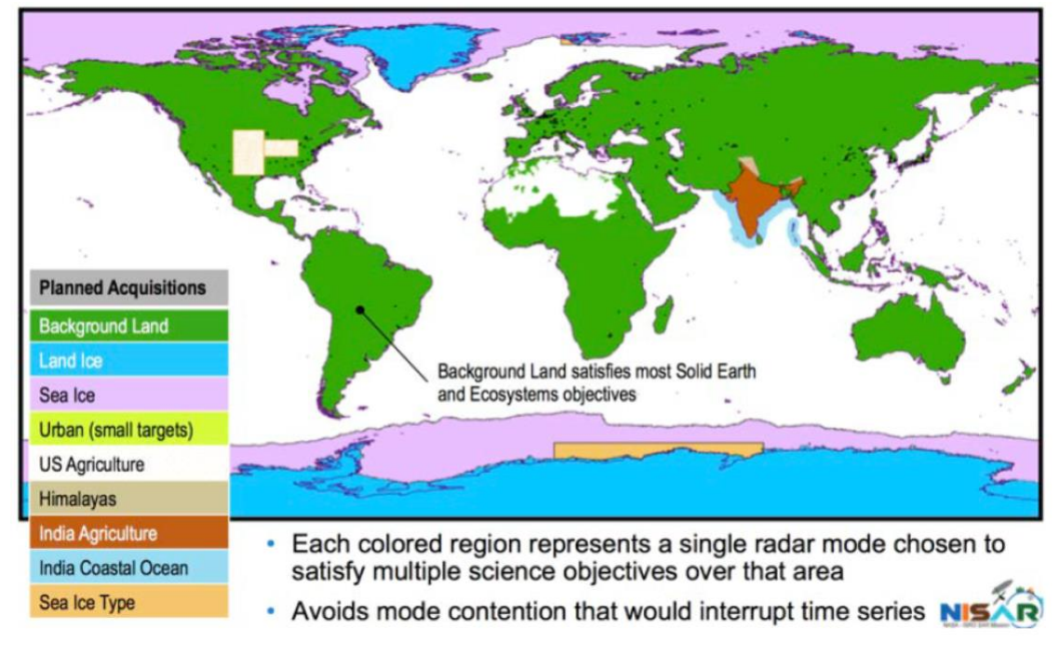
NISAR: NASA-ISRO Synthetic Aperture Radar
Parameter | Value
Agencies | NASA (L-band SAR) + ISRO (S-band SAR, bus, launch)
Launch | 30 July 2025, GSLV-F16, Sriharikota
Orbit | 747 km, sun-synchronous, 98.5°, 6 AM / 6 PM
Repeat | 12 days (6 days asc + desc)
Swath | 240 km (SweepSAR, 12 m reflector)
Frequency | L-band 1.26 GHz; S-band 3.2 GHz
Incidence angle | 34°–48°
Polarisation | Dual-pol HH + HV global; quad-pol in parts of India and USA
Resolution | ~8 m azimuth; soil moisture at 200 m
NISAR observation plan: note the 'India Agriculture' and 'India Coastal Ocean' target modes. Source: NISAR L3 Soil Moisture ATBD, JPL D-107679 (2023)
ISRO angle: S-band + L-band over India improved crop retrievals (corn ubRMSE better by up to 0.010 m³/m³ in SMEX02 tests).
Notes:
NISAR is a joint NASA and ISRO mission. NASA provided the L-band SAR and ISRO provided the S-band SAR, the spacecraft bus and the GSLV launch. It launched on 30 July 2025 from Sriharikota. Its 12 m reflector and SweepSAR technique give a 240 km swath with high resolution and a 12-day repeat. Dual-pol HH and HV is collected globally, quad-pol over selected parts of India and the USA. ISRO specified India agriculture and coastal targets, including S-band.

Slide 27
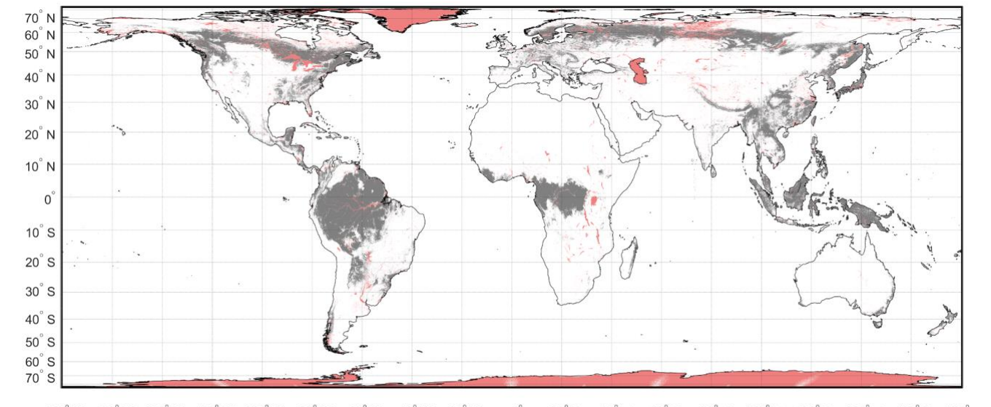

NISAR soil moisture product (L3_SME2)
200 m
12 (6) d
72 h
0.06
spatial resolution (EASE-Grid 2.0)
repeat; 6 days with asc + desc
latency
m³/m³ goal (VWC < 5 kg/m²)
Three algorithms in one product
PMI – Physical Model Inversion: invert per-crop scattering 'data cubes' with a time series
TSR – Time-Series Ratio (alpha method): ratios of successive σ⁰
DSG / Multiscale fusion: disaggregate 9 km ECMWF / SMAP soil moisture with NISAR HH and HV
Flags: urban, permanent snow/ice, water → no retrieval; VWC > 5 kg/m² → retrieved, flagged; heavy rain, frozen soil, snow → skip
Coverage: grey = VWC > 5 kg/m² (flagged); red = no retrieval. Source: NISAR L3 Soil Moisture ATBD, JPL D-107679 (2023)
Product: top ~5 cm volumetric soil moisture + uncertainty + quality flags (HDF5)
Notes:
The NISAR Level-3 soil moisture product gives 200 m soil moisture on EASE-Grid 2.0, on average twice every 12 days, with a 72-hour latency. The accuracy goal is 0.06 m³/m³ where vegetation water content is below 5 kg/m². Urban areas, permanent snow and ice, and permanent water get no retrieval. Dense vegetation is retrieved but flagged. Heavy rain, frozen ground and snow skip retrieval. Three algorithms run side by side in one file.

Slide 28
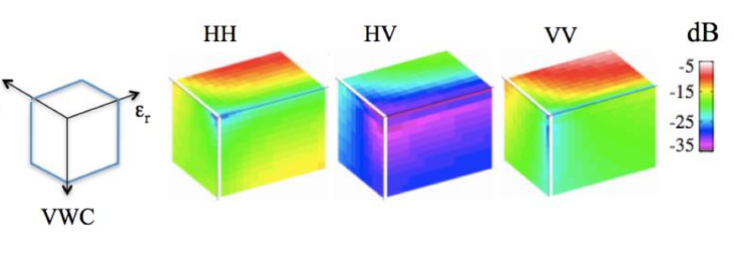
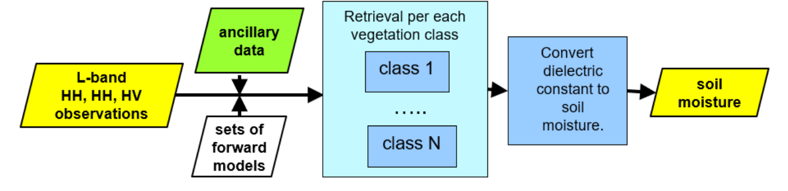
NISAR algorithm 1: Physical Model Inversion (PMI)
Forward models per cover type → data cube (s, ε′, VWC)
1
Pick cube from land cover / crop map; VWC from ancillary or HV
2
Time series of σ⁰ (N = 3 NISAR dates baseline)
3
L-band data cubes (HH, HV, VV). Source: NISAR L3 Soil Moisture ATBD, JPL D-107679 (2023)
Minimise C = Σ_{t} w[σ⁰_{obs}(t) − σ⁰_{fwd}(s, VWC_{t}, ε′_{t})]²
4
One roughness s for the series, one ε′ per date
5
ε′ → m_{v} with a dielectric model
6
Overall flow of the PMI algorithm. Source: NISAR L3 Soil Moisture ATBD, JPL D-107679 (2023)
Notes:
PMI inverts forward scattering models stored as look-up 'data cubes' with three axes: rms height s, dielectric constant ε′ and vegetation water content. There are cubes for nine cover types including corn, wheat, soybean, grass and shrub (used for cotton). VWC is taken from ancillary data or NISAR HV, which selects a slice of the cube. Roughness is assumed constant through a short time series while ε′ is solved for each date by least squares; ε′ is then converted to soil moisture.

Slide 29
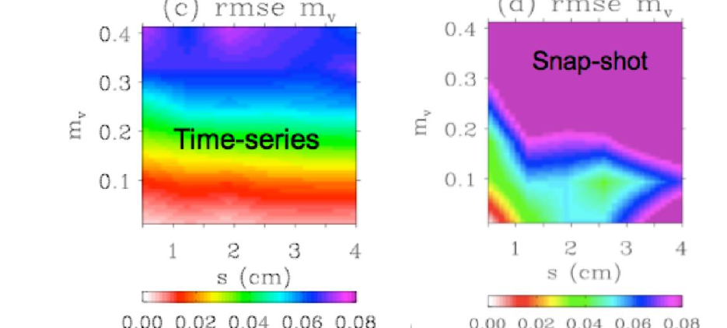
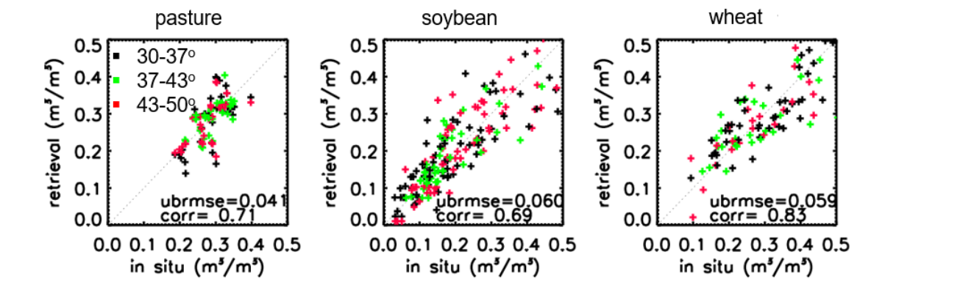
Why a time series, and how well PMI works over crops
Retrieval error: time series (left) vs snapshot (right). Source: NISAR L3 Soil Moisture ATBD, JPL D-107679 (2023)
PMI retrievals vs in-situ over pasture, soybean and wheat (SMAPVEX12). Source: NISAR L3 Soil Moisture ATBD, JPL D-107679 (2023)
Test data | Crop / cover | ubRMSE (m³/m³)
SMAPVEX12 UAVSAR | Grass · wheat · soybean | 0.041 · 0.059 · 0.060
SMEX02 L + S band | Corn · soybean | 0.031 · 0.057
ALOS PALSAR-2 (AMPM 2019) | Corn · soybean · cotton | 0.057 · 0.067 · 0.070
SMAP radar, 3 km | Cropland average | 0.067
Takeaways
Meets the 0.06 goal for most crops
Wrong crop cube → error up to +0.024 (corn): crop maps matter
HH alone works with soil-texture bounds
Notes:
A single co-pol measurement cannot separate roughness and ε′. Because roughness changes slowly, a time series of N dates has N + 1 unknowns (N ε′ values and one s) and 2N observations with dual co-pol, so the problem becomes well-posed. Monte Carlo simulations show much lower errors for the time-series approach than the snapshot approach. The table summarises validation results reported in the NISAR algorithm document.

Slide 30
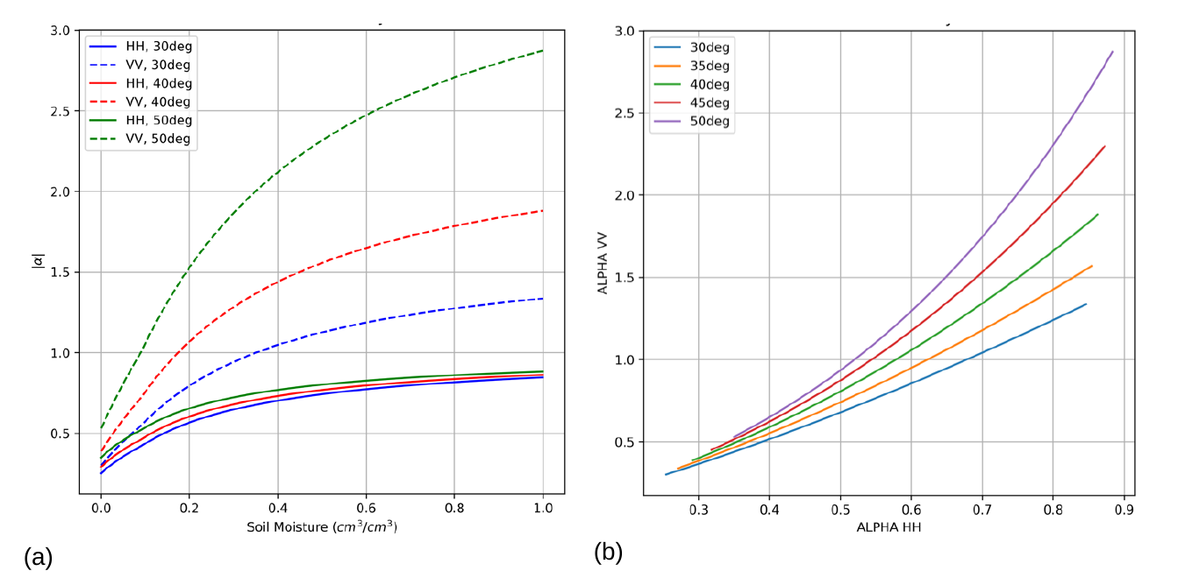
NISAR algorithm 2: Time-Series Ratio (alpha method)
σ⁰_{pp} = 4πk⁴h²cos⁴θ·|α_{pp}|²·W(2k·sinθ, 0)
σ⁰_{pp}(t₂) / σ⁰_{pp}(t₁) ≈ |α_{pp}(t₂) / α_{pp}(t₁)|²
1
N acquisitions (same geometry) → N − 1 ratios
2
Add α_{min}, α_{max} bounds from SMAP climatology
3
Least squares → α_{pp}(t) for each date
|α_{HH}| (a) and |α_{VV}| (b) vs soil moisture, 30–50°: VV has a wider dynamic range. Source: NISAR L3 Soil Moisture ATBD, JPL D-107679 (2023)
4
α → m_{v} with Mironov dielectric model and soil texture
Performance (SMAP radar, 3 km)
5
Products: 'rapid' (latest date) and 'averaged'
ubRMSE 0.054 (VV), 0.067 (HH) m³/m³; R ≈ 0.7–0.8
Notes:
The time-series ratio method assumes vegetation attenuated surface scattering dominates and that roughness and vegetation stay nearly constant between two acquisitions. With the small perturbation model, backscatter equals a roughness term times the squared alpha coefficient, which depends only on ε′ and angle. The ratio of two dates therefore cancels roughness. N dates give N − 1 ratios, which is underdetermined, so bounds on alpha from a SMAP soil-moisture climatology are added. Alpha is then converted to soil moisture with the Mironov model.

Slide 31
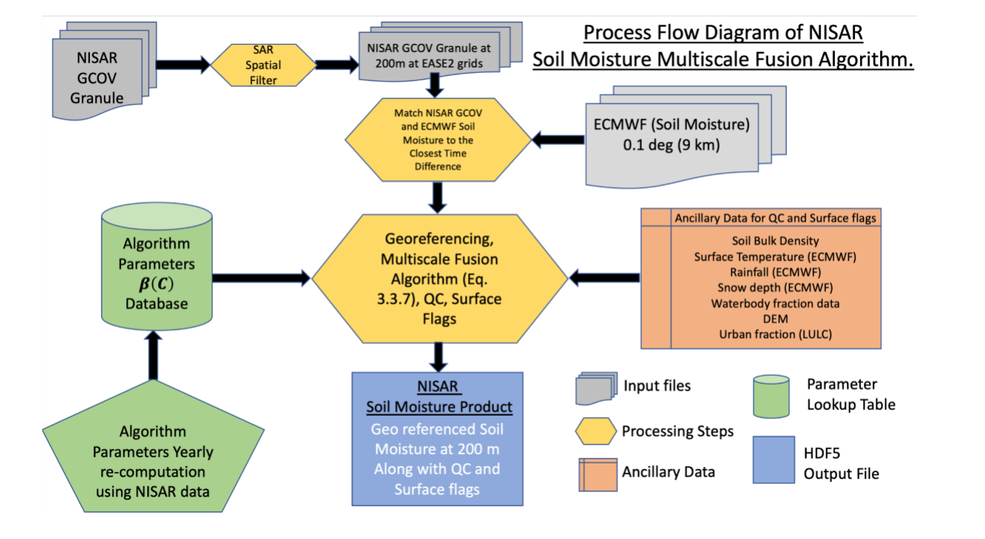
NISAR algorithm 3: Multiscale fusion (disaggregation)
SM(C, t) = α(C) + β(C)·σ_{HH}(C, t) [9 km, dB]
SM(F, t) = SM(C, t) + β(C)·{[σ_{HH}(F, t) − σ_{HH}(C, t)] + Γ·[σ_{HV}(C) − σ_{HV}(F)]}
C = 9 km coarse cell (ECMWF / SMAP); F = 200 m fine cell; 2025 F per C
β(C): from time-series regression of coarse SM on aggregated HH (look-up per land cover pre-launch)
Γ = ∂σ_{HH}/∂σ_{HV} within the cell: converts HV vegetation/roughness heterogeneity to HH space
Very few free parameters; purely data-driven once β is known
Same 12-day track only (no asc/desc mixing) so incidence angle is constant
Process flow of the multiscale fusion algorithm. Source: NISAR L3 Soil Moisture ATBD, JPL D-107679 (2023)
Notes:
The fusion algorithm assumes soil moisture is linear in co-pol backscatter in dB. At the 9 km scale, a time series of ECMWF or SMAP soil moisture against aggregated NISAR HH gives the sensitivity β. At 200 m, coarse soil moisture is adjusted by β times the HH anomaly, plus a heterogeneity term from HV that captures sub-pixel vegetation and roughness differences, scaled by Γ. It needs no ancillary data once β is known. Aggregating 10 m data to 200 m reduces speckle about twenty times.

Slide 32
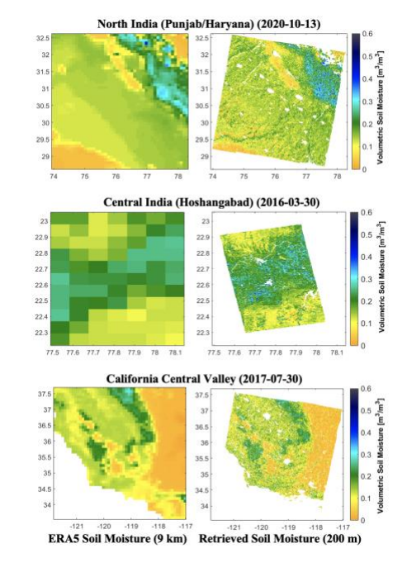
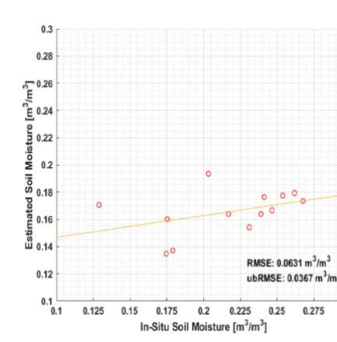

Fusion tested over India: Punjab, Haryana and Central India
What to say
Tested with ALOS PALSAR-2 L-band as NISAR proxy
Regions: North India (Punjab–Haryana, Oct 2020), Central India (Hoshangabad, Mar 2016)
Punjab validation ubRMSE 0.037 m³/m³
Compared with SMAP/Sentinel-1 1 km: PALSAR-2 slightly wetter, because L-band senses deeper than C-band
13 fields near Ludhiana, Punjab: RMSE 0.063, ubRMSE 0.037 m³/m³. Source: NISAR L3 Soil Moisture ATBD, JPL D-107679 (2023)
Use for India: field-scale soil moisture for drought, irrigation and crop insurance, through kharif clouds.
ERA5 9 km (left) vs 200 m retrieval (right): North India, Central India, California. Source: NISAR L3 Soil Moisture ATBD, JPL D-107679 (2023)
Notes:
Before launch the fusion algorithm was tested with ALOS PALSAR-2 L-band data over North India (Punjab, Haryana, Uttarakhand, Uttar Pradesh, Madhya Pradesh), Central India (Hoshangabad, MP), Oklahoma, California and Manitoba. ERA5 9 km soil moisture was disaggregated to 200 m, showing field-scale patterns not visible in the coarse input. Over 13 fields near Ludhiana in Punjab the ubRMSE was 0.037 m³/m³, within the 0.06 goal.

Slide 33
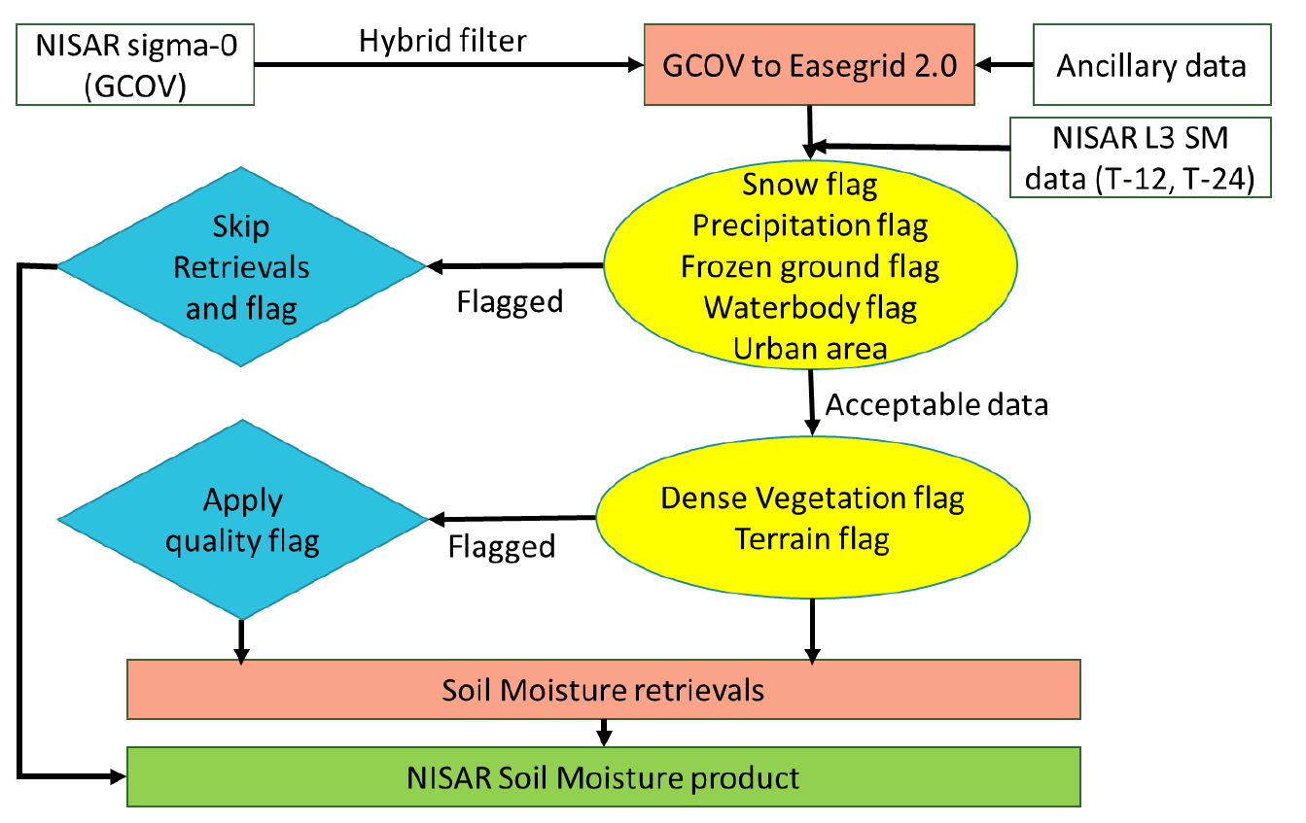
NISAR end-to-end processing workflow
Input: L2 GCOV σ⁰ (HH, HV), ~10 m, terrain corrected
1
Hybrid filter: per-cell mean and SD; 3×3 median where SD high; drop outliers
2
Average to 200 m EASE-Grid 2.0
3
Ancillary: ECMWF SM, ESA WorldCover, crop maps, VWC (MODIS NDVI climatology), SoilGrids texture, DEM, rain, snow, frozen ground
4
Flags: skip or flag pixels
5
Algorithm flow of the NISAR L3 soil moisture product. Source: NISAR L3 Soil Moisture ATBD, JPL D-107679 (2023)
Run PMI, TSR, DSG → HDF5 with m_{v}, uncertainty, flags
6
ISRO's own product: NRSC distributes an EOS-04 (C-band SAR) surface soil moisture product; its algorithm document is on Bhoonidhi.
Notes:
The input is the Level-2 GCOV product: radiometrically terrain-corrected backscatter at about 10 m. A hybrid spatial filter removes outliers from water, urban structures and speckle, and the data are averaged to the 200 m EASE-Grid 2.0. Ancillary data provide flags and model inputs. Pixels with snow, rain, frozen ground, water or urban cover skip retrieval; dense vegetation and steep terrain are retrieved with a quality flag. The three algorithms then write soil moisture, uncertainty and flags into an HDF5 file.

Slide 34
Choosing a method: comparison matrix
Approach | Examples | Needs | Strength | Limitation | Scale
Passive τ-ω | SMAP SCA, SMOS L-MEB, LPRM | T_{B}, T_{s}, VWC (NDVI) | Accurate (~0.04), global | Coarse; RFI; dense vegetation | 9–40 km
Physical | IEM/AIEM, NMM3D LUT | σ⁰, s, l, θ | Physics-based, transferable | Roughness data, heavy computing | Field
Semi-empirical | Oh, Dubois | Multi-pol σ⁰ | Simple, solves m_{v} + s | Bare or sparse soil only | Field
Empirical | σ⁰ = a + b·m_{v} | σ⁰ + in situ | Easy | Site-specific | Field
Water cloud model | S-1 + S-2 + WCM | σ⁰, NDVI/LAI, field data | Handles crops | Calibrate A–D per crop | 10 m–1 km
Change detection | TU Wien, alpha ratio | Long σ⁰ series | No roughness needed; operational | Relative; crop growth bias | 1–25 km
Fusion | SMAP/S-1, NISAR DSG | Coarse SM + SAR | Fine and accurate | Depends on β, Γ | 200 m–3 km
Machine learning | RF, ANN, LSTM | σ⁰, NDVI, terrain, soil | Captures non-linearity | Needs training data; black box | Any
Notes:
This matrix summarises every approach: what it needs, its strength, its limitation and the scale it works at. In an interview, choose the method by the question: global and accurate means passive; field scale over crops means SAR with a water cloud model or data cubes; operational time series means change detection or time-series ratio; and fine plus accurate means fusion.

Slide 35
Likely interview questions with one-line answers
Q. Why L-band?
Q. What is the τ-ω model?
Q. How is roughness removed?
→ Senses ~5 cm, sees through crops up to ~5 kg/m² VWC, little atmosphere effect
→ T_{B} = soil emission × γ + canopy emission (direct + soil-reflected); τ = b·VWC
→ Passive: h–Q model. Active: multi-pol (Oh), LUT inversion, or fixed s in a time series
Q. How is vegetation removed?
Q. Passive vs active?
Q. Change detection assumption?
→ Passive: τ from NDVI. Active: water cloud model, HV-based correction, crop data cubes
→ T_{B}, ~40 km, ~0.04 vs σ⁰, 10 m–1 km, ~0.06, noisier
→ Roughness and vegetation constant; output is relative wetness 0–1
Q. NISAR soil moisture specs?
Q. NISAR vs Sentinel-1?
Q. How do you validate?
→ 200 m, 12 (6) days, 72 h latency, 0.06 goal; PMI, TSR, DSG
→ L-band goes deeper and sees through canopy; HV for vegetation; S-band over India
→ In situ (TDR, gravimetric), R, bias, RMSE, ubRMSE = √(RMSE² − bias²)
Read in order: 1 Njoku & Entekhabi 1996 (physics) · 2 Karthikeyan et al. 2017 (all algorithms) · 3 Attema & Ulaby 1978 + Sentinel-1 WCM papers (crops) · 4 Wagner 1999, Bauer-Marschallinger 2019 (change detection) · 5 NISAR L3 SM ATBD 2023 + EOS-04 SSM ATBD (ISRO)
Notes:
Practise these answers aloud. Each is one or two sentences. If asked to go deeper, use the slide on that topic. The bottom strip lists the five documents to read in order.

