Slide 1

Satellite-based Evapotranspiration Estimation
Concepts and methodology: surface energy balance, SEBAL, METRIC, SEBS, triangle methods, TSEB/ALEXI, temporal and spatial scaling, and ISRO's Kalpana-1 approach — for the ISRO interview
λE = Rn − G − H
EF ≈ constant
ET as the residual of the energy balance
how one snapshot becomes daily ET
Notes:
This deck explains how evapotranspiration is estimated from satellites. It is built mainly from three papers: the methodology review by Li et al. (2009, Sensors), the original SEBAL formulation by Bastiaanssen et al. (1998, Journal of Hydrology), and the ISRO Space Applications Centre study by Bhattacharya et al. (2010, Journal of Hydrology) that estimated clear-sky ET over India from Kalpana-1. Material on METRIC, SEBS, SSEBop, TSEB, ALEXI and FAO-56 comes from the standard papers listed on the last slide. The focus is on concepts and method, not results.

Slide 2
From satellite radiance to crop water use
Satellite radiance: VIS · NIR · TIR
Surface variables: albedo, NDVI, LAI, LST, ε
Energy balance: Rn, G, H → λE
Instantaneous ET at overpass
Scaling: daily, seasonal, field to region
Uses: irrigation, water budget, drought
What this deck covers
01
ET fundamentals
02
Energy-balance building blocks
03
SEBAL and METRIC
terms, SPAC, energy balance, FAO-56, eddy covariance and ground methods, LST and optical inputs
Rn, G, H, roughness, stability; thermal indices
hot/cold pixels, flow charts, Ts–albedo, SEBS, SSEBop
04
Contextual, two-source, global
05
Scaling
06
ISRO case and outlook
triangle, TSEB, ALEXI, MOD16, PT-JPL, GLEAM, VI-Kc, assimilation
instantaneous → daily (worked example) → seasonal; field ↔ region
Kalpana-1 method, errors, applications, missions, Q&A
Notes:
This is the whole chain in one picture. A satellite measures reflected sunlight in visible and near-infrared bands and emitted heat in thermal bands. From these we derive surface variables: albedo, vegetation index, leaf area and land surface temperature. These go into an energy-balance model that computes net radiation, soil heat flux and sensible heat, and leaves latent heat (ET) as the remainder. That gives ET at the moment of overpass, which must then be scaled to daily and seasonal totals before it is useful for irrigation, water accounting or drought monitoring.

Slide 3
ET fundamentals
01
What ET is, the energy balance behind it, how it is measured on the ground, and what satellites can contribute
Notes:
The first section builds the basics that every method uses: the definitions of the different kinds of ET, the surface energy balance, the Penman–Monteith and FAO-56 crop coefficient approach, ground measurement methods used for validation, the satellite inputs, and the families of satellite methods.

Slide 4

ET concepts and terminology
ET = E + T
PET
Controls on ET
Evaporation (soil, wet canopy) + transpiration (stomata). ~60% of land precipitation returns as ET
Potential ET: loss when water is not limiting; set by energy and atmospheric demand
ET
Energy-limited (≈ PET)
ET0 / ETr
ETc = Kc × ET0
Reference ET: FAO-56 grass (ET0) or ASCE alfalfa (ETr); weather only
Crop ET under standard (non-stressed) conditions; Kc follows crop stage
Water-limited
ETa
λ ≈ 2.45 MJ kg⁻¹
Actual ET = Ks × Kc × ET0: includes water stress. Satellites estimate ETa
1 mm d⁻¹ ≈ 2.45 MJ m⁻² d⁻¹ ≈ 28.4 W m⁻² (24-h mean)
θ_{wp}
θ_{crit}
Soil moisture →
Drivers: Rn, VPD, wind, Ta; soil water; LAI and stomata
Uses: irrigation scheduling, basin water accounting, crop water productivity (yield ÷ ET), drought (ESI = 1 − ET/PET), yield models, climate studies
Notes:
Evapotranspiration is evaporation from soil and wet surfaces plus transpiration through stomata. It needs three things: water, energy to vaporise it, and a mechanism to carry vapour away (wind and a vapour pressure deficit). Several related terms come up constantly. Potential ET is what a surface would lose if water were never limiting. Reference ET, ET0, is the FAO-56 standard for a well-watered short grass and depends only on weather. Crop ET under standard conditions, ETc, is Kc times ET0. Actual ET is what really happens after water stress and management; satellites estimate actual ET. A useful conversion: the latent heat of vaporisation is about 2.45 megajoules per kilogram, so 1 millimetre per day of ET equals about 28.4 watts per square metre on a 24-hour average. On the right, ET rises with soil moisture until a critical value; below it ET is water-limited, above it energy-limited.

Slide 5



How ET happens: the soil–plant–atmosphere continuum
Soil
Ψ ≈ −0.03 MPa
Roots
uptake
Xylem
cohesion–tension
Leaf
Ψ ≈ −1.5 MPa
Stomata
r_{s}: control valve
Atmosphere
Ψ ≈ −100 MPa
Water moves down the water-potential gradient →
T = ρc_{p}[e_{s}(T_{leaf}) − e_{a}] / [γλ(r_{s} + r_{a})]
Soil evaporation: two stages
Stage 1: wet surface, energy-limited (≈ potential)
Stage 2: falling rate, limited by water supply to surface (FAO-56: REW, TEW)
Stomatal (canopy) control
Open with light (PAR); close with high VPD, high CO₂, soil drying, ABA
Canopy resistance r_{c} ≈ r_{s,leaf} / LAI_{active}
FAO-56 grass: r_{s} = 100/(0.5 × 24 × h) ≈ 70 s m⁻¹
Why partition E and T?
Only T is linked to biomass and yield (water productivity); T/ET rises with LAI; two-source models and sap flow separate them
Notes:
Transpiration is driven by a gradient of water potential from moist soil, through roots, xylem and leaves, out through the stomata into dry air. Water potential falls from about minus 0.03 megapascals in wet soil to around minus 1.5 in a leaf, and to minus 100 or lower in air at moderate humidity, so the air pulls water out of the plant. Like current in a circuit, the flux equals the vapour pressure difference between the leaf interior and the air divided by stomatal and aerodynamic resistances. Stomata open with light and close with high vapour pressure deficit, high CO2, soil drying and the hormone ABA, so canopy resistance is the plant's control valve. Soil evaporation goes through two stages: an energy-limited first stage while the surface is wet, then a falling-rate stage limited by how fast water reaches the surface. For crops, transpiration is typically more than half of ET at full cover, and separating E from T matters because only T is linked to biomass.

Slide 6
ET links the water and energy cycles
Water: P + I = ET + R + D + ΔS
Budyko framework
ET/P
Energy: Rn = λE + H + G
energy limit ET = PET
1
water limit ET = P
Same water flux, two views: λE (W m⁻²) = λ × ET (kg m⁻² s⁻¹)
Land ET ≈ 60% of precipitation; irrigation ≈ 70% of global water withdrawals (Li et al. 2009)
ET is the least-measured term of the water cycle → satellites give the spatial pattern
Irrigated fields in dry regions: ET > P; consumptive use = ET − effective rainfall
catchments
humid
arid
Aridity index PET/P →
Notes:
ET is the one term that appears in both the water balance and the energy balance. In the water balance, precipitation plus irrigation equals ET plus runoff, drainage and the change in storage; on land, ET returns about 60 percent of precipitation to the atmosphere, according to Li et al. In the energy balance, latent heat is the energy carried away by that same water. The Budyko framework puts the two together. On the horizontal axis is the aridity index, potential ET over precipitation; on the vertical, actual ET over precipitation. In humid regions on the left, ET is limited by energy and approaches the potential rate; in arid regions on the right, ET is limited by water and approaches precipitation. Real catchments follow a curve below both limits. This is why satellite ET is so useful for irrigated agriculture in semi-arid India: irrigation pushes ET above what rainfall alone would allow, and the excess is a direct measure of water consumed.

Slide 7
Surface energy balance: the physical basis
Rn = G + H + λE → λE = Rn − G − H
L↑ = εσT_{s}⁴
L↓
Bowen ratio
Evaporative fraction
Rs↓
αRs↑
H
λE
β = H / λE
wet crop β < 0.3; desert β > 5
EF = λE / (Rn − G) = 1/(1 + β)
0 (dry) → 1 (wet)
Assumptions in remote-sensing use
One-dimensional, vertical fluxes; no horizontal advection
Photosynthesis (~5–6%) and canopy storage neglected
Instantaneous: valid only at overpass time, clear sky
Typical midday G/Rn: 0.05 (dense crop) to 0.5 (dry bare soil)
G
Rn = (1 − α)Rs↓ + L↓ − L↑
Notes:
Every residual satellite method rests on this equation. Net radiation Rn is the energy the surface absorbs: incoming shortwave minus reflected shortwave, plus incoming longwave from the atmosphere minus longwave emitted by the surface. That energy is split into soil heat flux G that warms the ground, sensible heat H that warms the air, and latent heat λE that evaporates water. If we can map Rn, G and H, latent heat is what is left. Photosynthesis, canopy heat storage and horizontal advection are normally neglected; Bhattacharya et al. note that metabolic energy is about 5–6%. Two ratios matter: the Bowen ratio, H over λE, and the evaporative fraction, λE over available energy Rn − G. Evaporative fraction is the key quantity that many methods estimate and that stays nearly constant during a clear day.

Slide 8



FAO-56 Penman–Monteith reference ET (ET0)
ET₀ = [0.408Δ(R_{n} − G) + γ·(900/(T + 273))·u₂(e_{s} − e_{a})] ÷ [Δ + γ(1 + 0.34u₂)]
ET₀ mm d⁻¹ · R_{n}, G MJ m⁻² d⁻¹ · T mean air temp. (°C) at 2 m · u₂ wind at 2 m (m s⁻¹) · e_{s} − e_{a} VPD (kPa) · Δ, γ kPa °C⁻¹
Reference crop
Radiation in FAO-56
Missing data and alternatives
Hypothetical grass, h = 0.12 m
r_{s} = 70 s m⁻¹, albedo 0.23
r_{a} = 208/u₂; well watered, full cover
Depends on weather only
R_{s} = (0.25 + 0.50 n/N) R_{a} (Angstrom)
R_{ns} = (1 − 0.23) R_{s}
R_{nl} from T_{max}⁴, T_{min}⁴, e_{a}, R_{s}/R_{so}
R_{n} = R_{ns} − R_{nl}; daily G ≈ 0
Hargreaves: 0.0023(T + 17.8)(T_{max} − T_{min})^{0.5} R_{a}
Pan: ET₀ = K_{p} × E_{pan}
Priestley–Taylor: λE = 1.26·Δ/(Δ + γ)·(R_{n} − G)
ET0 vs ETr: FAO-56 uses grass (ET0); ASCE uses 0.5 m alfalfa (ETr ≈ 1.2–1.3 × ET0), which METRIC uses to calibrate its cold pixel. Satellite ET divided by ET0 gives an actual Kc map
Notes:
FAO Irrigation and Drainage Paper 56 (Allen, Pereira, Raes and Smith, 1998) is the world standard for crop water requirements. It defines a hypothetical reference crop: a well-watered grass 0.12 metres tall, with a fixed surface resistance of 70 seconds per metre and an albedo of 0.23. Fixing the surface makes reference ET depend only on weather, so it can be compared across places and seasons. The FAO-56 Penman–Monteith equation on the slide comes from the full Penman–Monteith equation with those values inserted: 900 over T plus 273 and 0.34 times wind speed come from the aerodynamic resistance, 208 divided by wind speed at 2 metres. Net radiation is built from solar radiation using the Angstrom equation and a longwave term. When data are missing, FAO-56 allows radiation from temperature range, humidity from minimum temperature, a default wind of 2 metres per second, or the Hargreaves temperature equation, and pan evaporation can be converted with a pan coefficient. Priestley–Taylor, a simpler energy-only form, is used inside several satellite models.

Slide 9
Computing ET0 step by step (FAO-56)
Inputs
Intermediate (FAO-56 equations)
Elevation z
P = 101.3[(293 − 0.0065z)/293]^{5.26}; γ = 0.665×10⁻³P
Net longwave
R_{nl} = σ[(T_{max,K}⁴ + T_{min,K}⁴)/2](0.34 − 0.14√e_{a})(1.35R_{s}/R_{so} − 0.35)
T_{max}, T_{min}
e°(T) = 0.6108·exp(17.27T/(T + 237.3)); e_{s} = [e°(T_{max}) + e°(T_{min})]/2; Δ = 4098e°(T)/(T + 237.3)²
T_{dew} or RH
e_{a} = e°(T_{dew}) or [e°(T_{min})RH_{max} + e°(T_{max})RH_{min}]/200
ET₀
FAO-56 PM (mm d⁻¹)
Wind u_{z} at height z
u₂ = u_{z} · 4.87 / ln(67.8z − 5.42)
Then
Sunshine n (or R_{s}); latitude, DOY
R_{a}(lat, DOY) → R_{s} = (0.25 + 0.5n/N)R_{a}; R_{so} = (0.75 + 2×10⁻⁵z)R_{a}; R_{ns} = 0.77R_{s}
R_{n} = R_{ns} − R_{nl}; G_{day} ≈ 0; insert in PM
Tips: e_{s} uses the mean of e° at T_{max} and T_{min} (non-linear curve) · if data are missing use T-based R_{s} (Hargreaves k_{Rs}), e_{a} from T_{min}, or u₂ = 2 m s⁻¹ · ET₀ grids for India come from IMD station or reanalysis data
Notes:
FAO-56 gives a complete recipe for daily reference ET from standard weather data, and examiners like to ask how each term is obtained. From elevation you get atmospheric pressure and the psychrometric constant. From maximum and minimum temperature you get saturation vapour pressure, using the mean of the values at Tmax and Tmin rather than at mean temperature, and the slope of the vapour pressure curve. Actual vapour pressure comes preferably from dew point, otherwise from relative humidity. Wind measured at any height is converted to 2 metres with a logarithmic profile. Extraterrestrial radiation comes from latitude and day of year; solar radiation from sunshine hours with the Angstrom equation; net shortwave uses albedo 0.23; net longwave uses temperature, humidity and relative cloudiness. Daily soil heat flux is taken as zero. All of these feed the Penman–Monteith equation.

Slide 10
FAO-56 crop coefficient and water stress
Kc curve (single coefficient)
Crop | Kc ini | Kc mid | Kc end
Wheat (spring) | 0.30 | 1.15 | 0.25–0.40
Rice | 1.05 | 1.20 | 0.90–0.60
Maize (grain) | 0.30 | 1.20 | 0.60–0.35
Sugarcane | 0.40 | 1.25 | 0.75
Kc
Kc_{mid}
1.0
0.5
Dual Kc and water stress
Kc_{ini}
Kc_{end}
ETc = (K_{s}·K_{cb} + K_{e}) × ET₀
TAW = 1000(θ_{FC} − θ_{WP})Z_{r}; RAW = p·TAW
K_{s} = (TAW − D_{r}) / [(1 − p)TAW] when D_{r} > RAW
soil evaporation dominates
0.0
Initial
Development
Mid-season
Late
Shape follows ground cover; values shown: spring wheat (FAO-56 Table 12)
Satellite link: K_{cb} ≈ linear in NDVI/SAVI (VI-based Kc) · ET_{a}(energy balance)/ET₀ = actual Kc map · METRIC ETrF is the alfalfa-based Kc; it feeds irrigation scheduling
Notes:
Crop ET is reference ET multiplied by a crop coefficient that captures how the crop differs from grass in height, albedo, canopy resistance and soil evaporation. FAO-56 describes Kc over the season with four stages: initial, when soil evaporation dominates; development, when Kc rises with ground cover; mid-season, the peak at full cover; and late season, falling as leaves senesce. The table gives FAO-56 values for major Indian crops; the mid and end values are adjusted for wind and humidity when the climate differs from a sub-humid reference. The dual approach splits Kc into basal Kcb for transpiration and Ke for soil evaporation after rain or irrigation. Under water shortage, a stress coefficient Ks reduces ET once root-zone depletion exceeds readily available water, which is a fraction p of total available water. Remote sensing links in two ways: Kcb can be estimated from NDVI or SAVI, and energy-balance ET divided by reference ET gives the actual crop coefficient, including stress.

Slide 11
FAO-56 dual Kc and root-zone water balance
Root-zone 'bucket'
ETc_{adj} = (K_{s}·K_{cb} + K_{e}) × ET₀
Field capacity
Soil evaporation Ke
Root-zone balance
D_{r}
K_{e} = K_{r}(K_{c,max} − K_{cb}) ≤ f_{ew}K_{c,max}
K_{r} = 1 until REW evaporated, then falls to 0 at TEW
D_{r,i} = D_{r,i−1} − (P − RO)_{i} − I_{i} − CR_{i} + ETc_{i} + DP_{i}
TAW = 1000(θ_{FC} − θ_{WP})Z_{r}
TAW
RAW = p·TAW
Water stress Ks
Climate adjustment
K_{s} = (TAW − D_{r}) / [(1 − p)TAW]
p ≈ 0.5 (wheat 0.55, rice 0.2)
K_{c,mid} += [0.04(u₂ − 2) − 0.004(RH_{min} − 45)](h/3)^{0.3}
Wilting point
Ks = 1 while D_{r} ≤ RAW; falls to 0 at TAW
Notes:
The dual crop coefficient separates transpiration from soil evaporation. Basal Kcb represents a crop with a dry soil surface but enough root-zone water. Ke adds evaporation from wet soil after rain or irrigation; it is large right after wetting and falls as the topsoil dries, through a reduction coefficient Kr based on readily and total evaporable water, and it is capped by the energy available and the exposed, wetted soil fraction. Water stress enters through Ks, from a daily root-zone water balance. Depletion increases with ET and decreases with rain, irrigation and capillary rise. Total available water is the difference between field capacity and wilting point over the root depth; readily available water is a fraction p of it, around 0.5 for many crops. While depletion is below RAW, Ks equals one; beyond it, Ks falls linearly to zero at TAW. Irrigation is scheduled when depletion reaches RAW. FAO-56 also adjusts Kc mid and end for climates with wind other than 2 metres per second or minimum humidity other than 45 percent.

Slide 12
Ground ET measurement: the validation standard
Method | Principle | Footprint | Notes
Weighing lysimeter | Mass change of an isolated soil–crop block | Point (few m²) | Only direct measure; benchmark (IARI has lysimeters)
Eddy covariance | Covariance of w′ and q′ at 10–20 Hz | ~100 × sensor height | Energy closure gap 10–30%; night errors
Bowen ratio (BREB) | ΔT, Δe gradients → β; λE = (Rn − G)/(1 + β) | Field (100 m) | Simple, portable; fails when β → −1
Scintillometer (LAS) | Refractive-index fluctuations → H along a beam | 0.5–5 km path | Matches km pixels (MODIS, INSAT)
Soil water balance | ET = P + I − D − R − ΔS | Field / basin | Weekly scale; drainage uncertain
Sap flow | Heat-pulse velocity in stems | Plant | Transpiration only (E/T partition)
Scale mismatch: a 30 m Landsat pixel can be checked with a flux tower, but a 1–8 km pixel cannot — hence scintillometers or two-step up-scaling (used in the Kalpana-1 study)
Notes:
Satellite ET has to be checked against ground measurements, and each method has a different footprint and error. The weighing lysimeter is the only direct measurement: it weighs a soil block, so the change in mass is ET. Eddy covariance measures fast turbulent fluctuations of vertical wind and humidity; its footprint is roughly a hundred times the sensor height, but the measured fluxes usually do not close the energy balance by 10–30%. The Bowen ratio energy balance method measures temperature and humidity gradients and partitions available energy; the Kalpana-1 study used portable Bowen ratio units. Scintillometers measure sensible heat over a path of hundreds of metres to kilometres, closest to a satellite pixel. Soil water balance and sap flow are also used. Li et al. stress that the lack of ground truth at satellite pixel scale is one of the main open problems.

Slide 13
Lysimeter and Bowen ratio energy balance
Weighing lysimeter
Bowen ratio energy balance (BREB)
ET
β = γ·ΔT/Δe
λE = (Rn − G)/(1 + β)
H = β·λE
T₂, e₂
Δz ≈ 1 m
T₁, e₁
load cells / scale
drainage D
Assumes equal eddy diffusivities for heat and vapour (K_{h} = K_{w})
Needs Rn, G and two-level T, e; no wind data
Fails near β = −1 (sunrise, sunset) and with advection
Used (portable units) at the SAC crop sites
ET = P + I − D − ΔW/(ρ_{w}A)
Direct, 0.01–0.05 mm resolution · point scale · crop inside must match field
Notes:
The weighing lysimeter is a large tank of soil, often 1 to 3 metres across and 1 to 2 metres deep, set flush with the field and planted with the same crop. It sits on a precise scale, so ET over an hour or a day is the loss of mass not explained by rain, irrigation or drainage. Good lysimeters resolve a few hundredths of a millimetre. The crop inside must match the surrounding field in height and density, otherwise edge and oasis effects bias the result. IARI New Delhi and several Indian agricultural universities operate lysimeters, which are used to derive crop coefficients. The Bowen ratio energy balance method measures air temperature and vapour pressure at two heights above the crop. Assuming heat and vapour are carried by the same eddies, the ratio of their gradients times the psychrometric constant gives the Bowen ratio, and available energy is split accordingly. It is cheap, portable and needs no wind measurements, which is why the SAC team used portable Bowen ratio units at its crop sites; it fails when the Bowen ratio is near minus one, at sunrise and sunset.

Slide 14


Eddy covariance: principle and instruments
x = x̄ + x′ (Reynolds decomposition)
3-D sonic (u, v, w, T_{s})
IRGA (q, CO₂)
λE = λ·ρ_{a}·cov(w′, q′)
w′ > 0, q′ > 0
H = ρ_{a}c_{p}·cov(w′, T′); F_{c} = cov(w′, c′)
Set-up
Assumptions
Sampling 10–20 Hz
Average 30 min
Height ≈ 2 × canopy
Fetch ≈ 100 × height
Flat, homogeneous surface
w̄ = 0 after rotation
Stationary turbulence
No advection or storage
w′ < 0, q′ < 0
both give w′q′ > 0 → upward vapour flux
Notes:
Eddy covariance is the standard micrometeorological method for measuring ET, sensible heat and CO2 flux directly. Near the ground, vertical transport happens through turbulent eddies. Each variable is split, by Reynolds decomposition, into a mean and a fluctuation. Over a flat, uniform surface the mean vertical wind is zero, so the net upward flux of water vapour is the time average of the product of the vertical wind fluctuation and the humidity fluctuation, their covariance. If rising air is on average moister than sinking air, there is an upward water flux. The same applies to temperature for sensible heat and to CO2 concentration. This needs a three-dimensional sonic anemometer, which measures the three wind components and sonic temperature, and a fast infrared gas analyser for water vapour and CO2, both sampled 10 to 20 times a second and averaged over 30 minutes. The tower must sit in a uniform field with enough upwind fetch, roughly 100 times the measurement height, and the instrument height is typically about twice the canopy height.

Slide 15
Eddy covariance: processing chain, footprint and closure
Raw 10–20 Hz u, v, w, T_{s}, q, c
Despike, QC flags
Coordinate rotation (w̄ = 0): double / planar fit
Time-lag removal; 30-min covariances
Corrections: sonic T, spectral, WPL density
Stationarity, turbulence tests; u* filter
Gap filling (MDS); footprint; closure check
Half-hourly / daily λE, H, F_{c}
Flux footprint
Energy balance closure
wind
Closure ratio = (H + λE)/(Rn − G) ≈ 0.7–0.9
Causes: large eddies, advection, storage, footprint mismatch with Rn and G sensors
Fix: Bowen-ratio-preserving forced closure, or report residual
Networks: FLUXNET, AsiaFlux; key for validating satellite ET
tower
Source area grows with height and stable air; ~100 × height upwind
Notes:
Raw 10 or 20 hertz data go through a standard processing chain before they become fluxes. Spikes and instrument faults are removed. The coordinate system is rotated so that the mean vertical wind is zero, by double rotation or the planar-fit method. The time lag between the sonic and the gas analyser is removed, especially for closed-path systems. Covariances are computed over 30 minutes. Sonic temperature is corrected for humidity, spectral losses from path averaging and sensor separation are corrected, and the Webb–Pearman–Leuning correction accounts for air density changes caused by heat and water fluxes. Quality tests check stationarity and turbulence, night data with low friction velocity are filtered, and gaps are filled, for example by marginal distribution sampling. A footprint model shows which upwind area the flux represents. Finally the energy balance closure is checked: turbulent fluxes usually add up to only 70 to 90 percent of available energy. The gap is often closed by preserving the Bowen ratio. Li et al. note that closure gaps can reach 20 percent even without advection, which limits validation of satellite ET.

Slide 16

What satellites provide for ET
Sensor | TIR pixel | Revisit | Typical ET use
Landsat 8/9 TIRS | 100 m (→ 30 m) | 16 d (8 d pair) | Field ET: SEBAL, METRIC
ASTER / ECOSTRESS | 90 m / 70 m | irregular | Research, diurnal sampling
MODIS Terra/Aqua | 1 km | 1–2 per day | MOD16, SEBS, triangle
Kalpana-1 VHRR | 8 km | 30 min–3 h | Indian regional ET (SAC)
INSAT-3D/3DR Imager | 4 km (split TIR) | 15–30 min | LST, ET, ALEXI-type
TRISHNA (ISRO–CNES) | ~57 m | ~3 days (planned) | Field-scale ET, water stress
Inputs and where they come from
VIS/NIR: albedo, NDVI, LAI, f_{c}, z_{0m}, ε
TIR: LST by split-window or single-channel (needs ε, water vapour)
Weather: T_{a}, u, e_{a}, Rs from stations, reanalysis, NWP
DEM: slope, aspect, lapse-rate correction
Land cover: masks, roughness, crop type
Why LST is the key variable: evaporation cools the surface, so for the same energy input a wet crop is several degrees cooler than a stressed one — thermal data turn this contrast into H and λE
Notes:
Satellites never measure ET directly. Optical bands give albedo, vegetation indices, leaf area index, fractional cover, emissivity and roughness. Thermal infrared bands give land surface temperature, which carries the strongest signal: a field that evaporates freely stays cool, and a stressed field heats up. Air temperature, wind speed and humidity still come from weather stations, reanalysis or weather models, and a digital elevation model corrects for slope and altitude. The table lists the thermal sensors used for ET. Landsat and ECOSTRESS give field-scale detail but revisit rarely; MODIS gives daily one-kilometre data; Indian geostationary sensors on Kalpana-1 and INSAT-3D give several images a day at coarse resolution. The planned ISRO–CNES TRISHNA mission is designed specifically for high-resolution thermal monitoring of ET and water stress.

Slide 17


Land surface temperature from thermal infrared
L_{sensor} = τ·[ε·B(T_{s}) + (1 − ε)·L↓] + L↑
B Planck function · τ atmospheric transmittance · L↓ downwelling sky radiance · L↑ path radiance (SEBAL eq. 4)
Single-channel
Split-window
Temperature–emissivity separation
One TIR band + water vapour or profile (MODTRAN)
Landsat 8/9 band 10
Needs good atmospheric data
T_{s} = T₁₁ + a(T₁₁ − T₁₂) + b, coefficients depend on ε, water vapour
MODIS, INSAT-3D/3DR, Sentinel-3
Multi-band TIR solves T_{s} and ε together
ASTER, ECOSTRESS
Good over bare soil and rocks
Emissivity from NDVI
Accuracy and caveats
ε = ε_{v}P_{v} + ε_{s}(1 − P_{v}); P_{v} = [(NDVI − NDVI_{s})/(NDVI_{v} − NDVI_{s})]²
1–2 K; 1% ε error ≈ 0.5–0.7 K; view angle up to 5 K (Li 2009); clouds block TIR
Notes:
Land surface temperature is the most important satellite input, so it is worth knowing how it is retrieved. A thermal sensor measures radiance at the top of the atmosphere. Part comes from the surface, emitted according to Planck's law and its emissivity, part is downwelling sky radiance reflected by the surface, and part is emitted by the atmosphere itself, and the surface signal is reduced by atmospheric transmittance. SEBAL's paper writes exactly this equation. Three families of methods invert it. Single-channel methods, used for Landsat band 10, correct one band using water vapour or an atmospheric profile. Split-window methods use two adjacent bands near 11 and 12 micrometres, which are absorbed differently by water vapour, so their difference corrects the atmosphere; MODIS, INSAT-3D and Sentinel-3 use this. Temperature–emissivity separation, used for ASTER and ECOSTRESS, solves for both from several bands. Emissivity is usually estimated from NDVI. Typical accuracy is 1 to 2 kelvin, and view angle can change temperature by up to 5 degrees over sparse canopies.

Slide 18
Optical inputs: albedo, NDVI, LAI, cover and roughness
Parameter | Typical equation | Used for
Broadband albedo | Landsat (Liang 2001): α = 0.356ρ₁ + 0.130ρ₃ + 0.373ρ₄ + 0.085ρ₅ + 0.072ρ₇ − 0.0018 | Rn, G/Rn, S-SEBI, Kalpana-1 EF
TOA → surface (SEBAL) | α = (α_{toa} − α_{path}) / τ_{sw}² | Albedo without radiative transfer model
NDVI, SAVI | (ρ_{NIR} − ρ_{R})/(ρ_{NIR} + ρ_{R}); SAVI with L = 0.5 | Cover, ε, G, triangle, Kcb
LAI (METRIC) | LAI = −ln[(0.69 − SAVI)/0.59] / 0.91 | z_{0m}, ε, TSEB canopy fraction
Fractional cover | f_{c} = [(NDVI − NDVI_{min})/(NDVI_{max} − NDVI_{min})]² | TSEB, Kd in FAO-56, ε
Roughness z_{0m} | 0.018·LAI (METRIC crops) or exp(a + b·NDVI) (SEBAL) | r_{ah}, u*
Broadband ε₀ | 0.95 + 0.01·LAI (METRIC) or 1.009 + 0.047 ln NDVI | Longwave L↑
Scale mismatch: optical bands are 10–30 m but thermal bands 60–1000 m, so T_{s} and NDVI describe different areas unless the thermal band is sharpened (section 5)
Notes:
The visible and near-infrared bands supply the other surface parameters. Broadband albedo is a weighted sum of narrow-band surface reflectances, for example Liang's formula for Landsat; SEBAL instead corrects top-of-atmosphere albedo with a path radiance term and two-way transmittance. NDVI and SAVI measure greenness; METRIC estimates LAI from SAVI with an empirical equation, and fractional cover from scaled NDVI. These feed the emissivity, the soil heat flux ratio and the momentum roughness length, which METRIC takes as 0.018 times LAI for crops. The same NDVI drives the vegetation axis of the triangle method, the basal crop coefficient and the canopy fraction seen by a two-source model. The equations in the table are typical forms; coefficients vary by sensor and region and should be checked against local data.

Slide 19
Families of satellite ET methods
Remote-sensing ET methods
Empirical
Residual energy balance
Contextual space
PM / PT with RS inputs
Data assimilation
Jackson: ET_{d} = Rn_{d} − B(Ts − Ta)^{n}; VI regression; machine learning
Single-source: SEBI, SEBAL, METRIC, SEBS, S-SEBI, SSEBop
Two-source: TSEB, ALEXI, DisALEXI
Ts–VI triangle (Jiang & Islam), trapezoid / WDI (Moran), Ts–albedo (S-SEBI)
MOD16 (PM), PT-JPL, GLEAM; VI-based Kc × ET0
Land surface model + LST / soil moisture via EnKF or 4D-Var
simple, site-specific
physical, needs anchors or met data
image-only, needs wet & dry pixels
global, daily, coarse
continuous, compute-heavy
Single-source vs two-source: single-source is simpler and fine over dense crops; two-source is needed over sparse or row crops, where soil and canopy temperatures differ by up to 10 °C
Notes:
Li et al. (2009) sort remote-sensing ET methods by how much physics they use. Empirical methods regress daily ET on the surface–air temperature difference. Residual energy-balance methods compute Rn, G and H and take λE as the remainder; single-source models treat soil and vegetation as one surface, while two-source models separate them. Contextual methods use the scatter of surface temperature against a vegetation index or albedo within one image to find dry and wet limits. A fourth group drives Penman–Monteith or Priestley–Taylor with satellite inputs, as in the global MODIS MOD16 and GLEAM products, and the crop-coefficient approach uses NDVI-based Kc. Finally, data assimilation merges satellite temperature or soil moisture into a land surface model to give continuous ET. The rest of the deck follows this tree.

Slide 20
Energy-balance building blocks
02
How each term — net radiation, soil heat flux and sensible heat — is computed from satellite data, and simple thermal indices
Notes:
Before looking at full models, this section shows how each term of the energy balance is computed from satellite data. Net radiation and soil heat flux are fairly easy; sensible heat flux is the hard part because it depends on aerodynamic resistance and atmospheric stability. The last slide covers simple thermal indices.

Slide 21
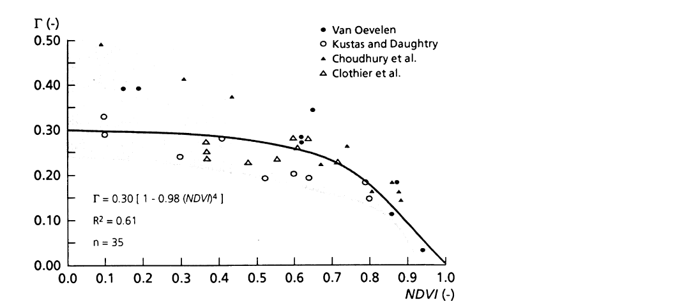
Net radiation and soil heat flux
Rn = (1 − α)Rs↓ + ε_{a}σT_{a}⁴ − ε_{s}σT_{s}⁴
α: broadband albedo from weighted narrow bands (atmospherically corrected)
Rs↓: solar constant × cos θ_{z} × transmissivity τ_{sw}
ε_{s} = 1.009 + 0.047 ln NDVI (Van de Griend & Owe; used by SEBAL and Kalpana-1)
ε_{a}: from T_{a} or vapour pressure; accuracy of Rn ≈ 5–10%
G/Rn = (T_{s}/α)(0.0032α + 0.0062α²)(1 − 0.978 NDVI⁴)
SEBAL Fig. 3: soil heat flux fraction Γ falls with NDVI (canopy extinction) — Bastiaanssen et al. 1998
G/Rn ≈ 0.05 (full canopy, wet soil) to 0.5 (dry bare soil)
Errors 20–30%, but G is small at midday; daily G ≈ 0
Physical meaning
Bare, hot, bright soil conducts more heat down; a dense canopy intercepts radiation so little reaches the soil
Notes:
Net radiation is computed pixel by pixel from albedo, incoming solar radiation, surface emissivity and surface temperature. Albedo is a weighted sum of narrow-band reflectances; incoming solar radiation depends on sun angle, date, elevation and atmospheric transmissivity; surface emissivity can be estimated from NDVI with the Van de Griend and Owe formula, which both SEBAL and the Kalpana-1 study used; atmospheric emissivity comes from air temperature or vapour pressure. Satellite net radiation is accurate to about 5–10 percent. Soil heat flux cannot be seen from space, so it is estimated as a fraction of net radiation. SEBAL's formula makes G/Rn increase with surface temperature and albedo and decrease strongly as NDVI rises because the canopy shades the soil. The figure from Bastiaanssen et al. shows the extinction factor falling as NDVI increases. G at midday is 5 to 50 percent of Rn, but over a whole day it is close to zero.

Slide 22
Sensible heat flux: the hardest term
H = ρ_{a}c_{p}(T_{aero} − T_{a}) / r_{ah} = ρ_{a}c_{p} dT / r_{ah}
Stability iteration (SEBAL)
Start: neutral, ψ = 0
r_{ah} = [ln((z − d)/z_{0h}) − ψ_{h}] / (k u*)
u* from wind at blending height (100–200 m)
Roughness: z_{0m} ≈ 0.12 h or exp(a + b·NDVI); d ≈ 0.67 h
Excess resistance: kB⁻¹ = ln(z_{0m}/z_{0h}) ≈ 2.3 (single-source)
Stability: Monin–Obukhov L = −ρc_{p}u*³T_{a}/(kgH); L < 0 unstable (day)
Problem 1: T_{aero} ≠ T_{s} (2–10 °C over partial cover)
Problem 2: dT needed to ~0.5 K; T_{a} interpolated from sparse stations
repeat 3–4× until H stable
r_{ah} from u*, z_{0h}
H = ρc_{p}dT / r_{ah}
L from u*, H → ψ_{m}, ψ_{h}
Unstable daytime → ψ > 0 → lower r_{ah} → larger H
Notes:
Sensible heat flux is written like Ohm's law: a temperature difference divided by a resistance. The temperature difference is between the aerodynamic surface temperature and air temperature at a reference height, and the resistance depends on wind speed, surface roughness and atmospheric stability. Three problems make this hard. First, satellites see radiometric surface temperature, which differs from the aerodynamic temperature by 2 to 10 degrees over partial canopies; the excess resistance kB⁻¹ is used to correct for it. Second, the required accuracy of the temperature difference is about half a degree, which neither satellite LST nor interpolated air temperature can achieve. Third, the resistance depends on H itself through the Monin–Obukhov length, so it must be solved iteratively, as in the loop on the right. SEBAL usually converges in three or four iterations. These problems are exactly what the hot and cold pixel calibration in SEBAL and METRIC is designed to avoid.

Slide 23
Wind profile, roughness and the kB⁻¹ problem
Logarithmic wind profile
u(z) = (u*/k)·[ln((z − d)/z_{0m}) − ψ_{m}], k = 0.41
z
u(z)
Momentum
Heat
d ≈ 0.67h
z_{0m} ≈ 0.123h (FAO-56)
from NDVI, LAI or land cover
z_{0h} ≈ 0.1·z_{0m}
kB⁻¹ = ln(z_{0m}/z_{0h})
≈ 2.3 dense crops; ≫ 2 sparse; < 0 bare soil
canopy h
d + z_{0m}: u = 0
Why it matters
d ≈ 0.67h
T_{aero} ≠ T_{rad}: kB⁻¹ absorbs the difference in single-source models
SEBAL: dT calibrated at anchors → kB⁻¹ = 2.3 adequate; SEBS: dynamic kB⁻¹; TSEB: not needed
Blending height 100–200 m: wind assumed uniform over the scene
wind speed →
Notes:
Near the surface, wind speed increases with the logarithm of height. Extrapolating the profile downward, wind reaches zero not at the ground but at a height equal to the zero-plane displacement d plus the momentum roughness length z0m. For a crop, d is about two thirds of canopy height and z0m about one eighth. Heat is transferred less efficiently than momentum, because momentum is also carried by pressure forces on leaves while heat must diffuse through the leaf boundary layer, so the effective source of heat sits lower, at z0h. The ratio is expressed as kB inverse, the natural log of z0m over z0h. A value of about 2.3 is common for dense vegetation, but over sparse canopies it can be much larger, and over bare soil even negative. This term is how single-source models patch the difference between the radiometric surface temperature the satellite sees and the aerodynamic temperature the equations need. SEBAL largely sidesteps it, because dT is calibrated at the anchors; two-source models avoid it by modelling soil and canopy separately.

Slide 24

Atmospheric stability: Monin–Obukhov similarity
L = −ρ_{a}c_{p}u*³T_{a} / (k·g·H)
Stability functions (unstable)
x = (1 − 16 z/L)^{0.25}
ψ_{m} = 2 ln[(1 + x)/2] + ln[(1 + x²)/2] − 2 arctan x + π/2
ψ_{h} = 2 ln[(1 + x²)/2]
Stable: ψ_{m} = ψ_{h} = −5 z/L
Condition | L, ζ = z/L | Typical case | Effect on resistance
Unstable | L < 0 | Sunny day, dry warm surface (H > 0) | ↓ lower, larger fluxes
Neutral | |L| → ∞, ψ = 0 | Overcast, windy | log profile
Stable | L > 0 | Night; irrigated field under advection (H < 0) | ↑ higher, damped
Physical picture
In SEBAL / METRIC
Mechanical turbulence (shear, u*) vs buoyancy (H)
|L| = height where buoyancy equals shear production
Midday crops: usually unstable, −ζ ~ 0.1–1
Start neutral → compute H → L → ψ → new u*, r_{ah} → repeat
Converges in 3–4 loops; hot pixel dT updated each loop
Ignoring stability over-estimates ET when |T_{c} − T_{a}| > 2 °C (Hatfield)
Notes:
The log profile holds only in neutral air. On a sunny day the ground heats the air from below, buoyant parcels rise and turbulence is enhanced: the atmosphere is unstable, resistance to heat transfer is lower and fluxes are larger. At night, or over a cool irrigated field with warm air advected over it, the air is stable, turbulence is suppressed and resistance increases. Monin–Obukhov similarity theory describes this with the Obukhov length L, which compares mechanical turbulence from wind shear with buoyant turbulence from heating. L is negative when unstable and positive when stable, and the stability correction functions psi modify the log profile and the resistance. Because L depends on H and friction velocity, which in turn depend on the resistance, SEBAL and METRIC iterate. Hatfield et al. found that ignoring stability can overestimate ET when the canopy–air temperature difference exceeds about 2 degrees.

Slide 25
Thermal indices: simplified Ts − Ta method and CWSI
λE_{d} = Rn_{d} − B (T_{s} − T_{a})^{n}
CWSI concept
T_{c} − T_{a}
Upper limit (no transpiration)
Jackson et al. (1977), irrigated wheat: B = 0.064, n = 1
B, n depend on roughness, wind, stability, fractional cover (Carlson)
Assumes daily G ≈ 0 and midday H represents the day
Simple; ~1 mm d⁻¹ error; site-specific coefficients
crop
T_{c} − T_{a} = 0
CWSI = [(T_{c} − T_{a}) − LL] / (UL − LL) = 1 − ET/PET
Lower baseline (well watered)
LL: non-water-stressed baseline; UL: non-transpiring canopy
Full cover only → WDI (trapezoid) for partial cover
VPD (kPa) →
Notes:
The oldest satellite approach, from Jackson and colleagues in 1977, relates daily ET directly to daily net radiation and the midday difference between surface and air temperature. B and n are site-specific coefficients that depend on roughness, wind and stability; Carlson linked them to fractional vegetation cover. It assumes daily soil heat flux is zero and that one midday measurement represents the day. Its error is around 1 millimetre per day, but the coefficients do not transfer between regions. The Crop Water Stress Index uses the same signal at field scale: for a given vapour pressure deficit, the canopy–air temperature difference lies between a lower baseline for a fully transpiring crop and an upper limit for a non-transpiring crop. CWSI is the relative position between them, from 0 (no stress) to 1 (full stress). Moran's Water Deficit Index extends this to partial cover using the trapezoid shown in section 4.

Slide 26
SEBAL and METRIC
03
Single-source residual models calibrated internally with hot and cold pixels; plus SEBS and SSEBop
Notes:
This section covers the single-source residual models, which are the most widely used for agriculture. SEBAL, formulated by Bastiaanssen et al. in 1998, and its extension METRIC by Allen et al. in 2007, both avoid the need for accurate absolute surface temperature and air temperature by calibrating the sensible heat flux inside each image using a hot and a cold pixel. SEBS and SSEBop are two related approaches.

Slide 27
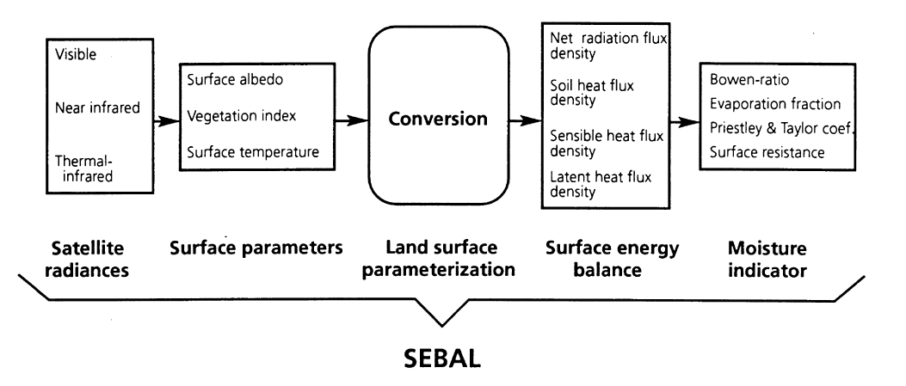


SEBAL: concept and assumptions
Key ideas
λE is the residual of the instantaneous energy balance
Inputs: T₀, surface reflectance r₀, NDVI + few field data (Rs transmittance, vegetation height, wind)
Hot pixel (λE = 0) and cold pixel (H = 0) anchor H
Works from metres to kilometres; any VIS–NIR–TIR sensor
SEBAL Fig. 1: radiances → surface parameters → land-surface parameterisation → energy balance → moisture indicators (Bastiaanssen et al. 1998)
Advantages
Disadvantages
Minimal ground data · physical concept, any climate · no land-use classification · no PBL or hydrology model · modular
Clear sky only · needs both dry and wet pixels in the scene · roughness poorly described · flat terrain (no slope correction) · subjective pixel choice
Notes:
SEBAL, the Surface Energy Balance Algorithm for Land, was designed to work in heterogeneous terrain with almost no ground data. Its components, in the paper's Figure 1, go from satellite radiances to surface parameters such as albedo, vegetation index and surface temperature, then to the land surface parameterisation, the energy balance fluxes and finally moisture indicators like evaporative fraction. Latent heat is the residual. The key idea is that the image itself contains extremes: a dry pixel where latent heat is zero and a wet pixel where sensible heat is zero. Using these, the near-surface temperature difference is calibrated for that image and time, so there is no need for land-use maps, boundary-layer models or accurate air temperature. The paper lists its advantages and disadvantages in Table 1, summarised at the bottom.

Slide 28
SEBAL step by step
Inputs
Landsat / MODIS VIS–NIR
1 Surface parameters: α, NDVI, LAI, ε, T_{s}
2 Net radiation Rn
3 Soil heat flux G
4 z_{0m}, u*, wind at 200 m
5 Select hot & cold pixels
Thermal band → T_{s}
DEM
10 EF, ET_{inst}, ET₂₄
9 λE = Rn − G − H
8 Stability correction (ψ, L)
7 H = ρc_{p}dT / r_{ah}
6 Fit dT = a + b·T_{s}
Weather station: u, Rs
iterate until H converges (3–4 loops)
Outputs
Maps of Rn, G, H, λE, EF, instantaneous and daily ET; also crop coefficient (ET/ET0), water productivity, irrigation performance
Notes:
This flow chart is the SEBAL procedure in the order it is computed. Satellite visible, near-infrared and thermal bands, a digital elevation model, and wind speed and solar radiation from one weather station are the inputs. Step 1 derives albedo, NDVI, LAI, emissivity and surface temperature. Step 2 computes net radiation, step 3 soil heat flux, and step 4 roughness and friction velocity, extrapolating wind to a blending height of 100 to 200 metres where it is assumed uniform. Step 5 selects the hot and cold pixels. Step 6 fits the linear dT–Ts relation through them. Step 7 computes H for every pixel, and step 8 corrects for stability, feeding back to step 6 because the hot pixel's resistance changes. Once H is stable, step 9 gives latent heat as the residual, and step 10 converts it to evaporative fraction, instantaneous ET and daily ET.

Slide 29
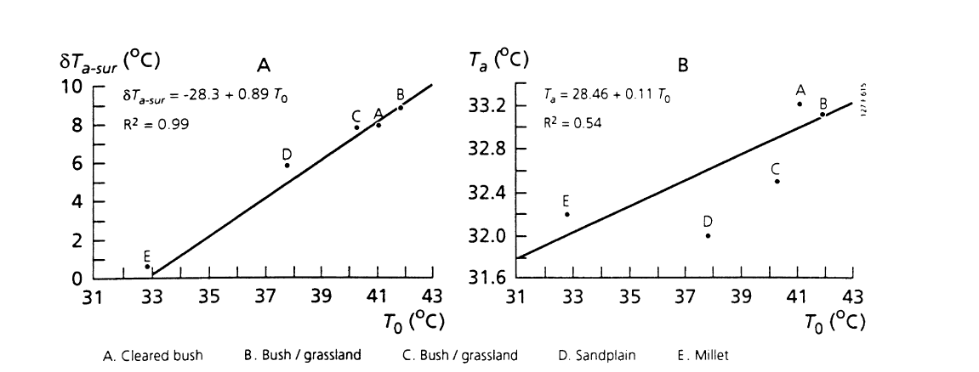
Hot and cold pixels: the dT–Ts calibration
Cold (wet) pixel
Hot (dry) pixel
Irrigated full-cover crop or water; low T_{s}, high NDVI
H ≈ 0 → dT_{cold} = 0
METRIC: λE = 1.05 ETr·λ
Dry bare fallow; high T_{s}, low NDVI
λE ≈ 0 → H = Rn − G
dT_{hot} = H·r_{ah}/(ρc_{p})
SEBAL Fig. 5 (HAPEX-Sahel): δT_{a} vs T₀ is linear (R² 0.99), T_{a} vs T₀ is not
dT
hot: (T_{hot}, dT_{hot})
Why it works
dT = a + b·T_{s}
T_{s} only distributes dT; H is anchored at both ends
No need for accurate T_{a}, emissivity or atmospheric correction
Pixel choice is the main source of error
cold: (T_{cold}, 0)
T_{s} →
Notes:
This is the heart of SEBAL and METRIC. Instead of computing dT from satellite surface temperature and station air temperature, which would need half-degree accuracy, SEBAL inverts the sensible heat equation at two anchor pixels. At the cold pixel, a well-watered crop or water body, all available energy goes to evaporation, so H is zero and dT is zero. At the hot pixel, dry bare soil, latent heat is zero, so H equals Rn minus G and dT follows from the resistance. A straight line through these two points gives dT for every other pixel from its surface temperature. Bastiaanssen et al. checked the linearity with field data from HAPEX-Sahel in Niger, shown on the right, and from Egypt and China: dT versus T0 is almost perfectly linear, whereas air temperature itself varies little. Because surface temperature is only used to distribute dT, errors in absolute temperature or atmospheric correction largely cancel.

Slide 30
Selecting hot and cold pixels in practice
Mask cropland; remove clouds, water, urban
Good cold pixel
1
Cold candidates: NDVI top ~5%, LAI ≥ 3–4, α 0.18–0.25
Irrigated, full-cover crop resembling alfalfa or grass reference
Not a water body in METRIC (different G and albedo)
2
Coldest T_{s} among them; homogeneous 3 × 3 window
3
Hot candidates: NDVI < 0.2, bare dry soil, high T_{s}
4
Good hot pixel
Check: no recent rain (soil water balance), not roads or burnt land
Bare fallow field, dry for several days; λE ≈ 0 (or soil-water-balance value)
5
Fix dT_{cold}, dT_{hot} → a, b; check ET_{cold} ≈ 1.05 ETr
6
Automation: CIMEC picks anchors from NDVI/T_{s} percentiles (EEFlux, OpenET)
Notes:
Because the whole image is calibrated on two pixels, their selection is the largest source of error in SEBAL and METRIC; Li et al. call it subjective. In practice the choice follows a filtering sequence. Mask cropland first. For the cold pixel, keep the greenest fields, the top few percent of NDVI with LAI of about 3 to 4 or more and an albedo typical of a full crop, then take the coolest of these and check that the surrounding pixels are similar, so the anchor is not a mixed edge pixel. For the hot pixel, take dry bare agricultural soil with low NDVI and high temperature, avoiding roads, buildings, burnt land and wet soil after recent rain; METRIC runs a daily soil water balance to estimate residual evaporation there. Automated methods such as CIMEC, used in EEFlux and OpenET, choose anchors statistically from percentiles of NDVI and temperature. A 1-kelvin shift in the hot pixel temperature can change field ET by several percent, so anchors should be documented and checked against reference ET.

Slide 31
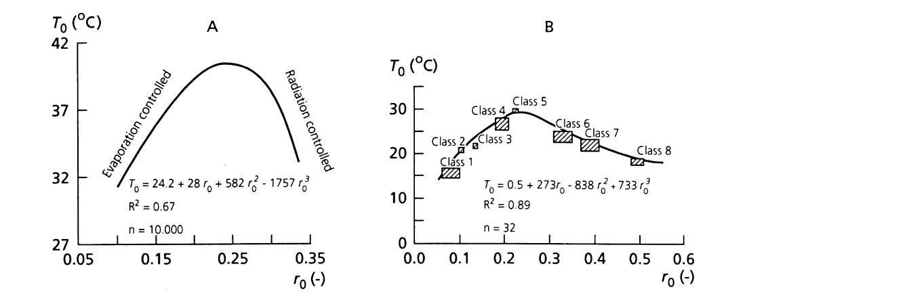
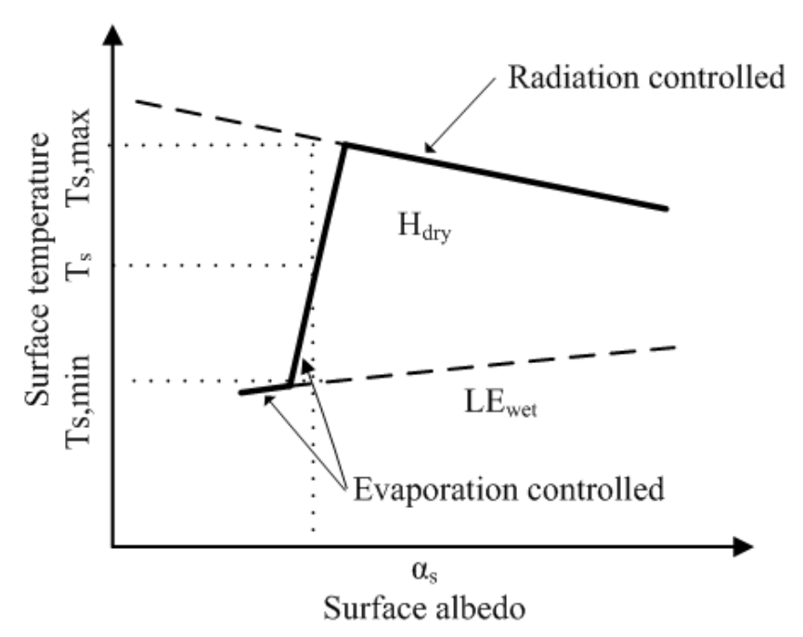
Surface temperature–albedo space: SEBAL and S-SEBI
SEBAL Fig. 4: T₀–r₀ from Landsat TM, Qattara Depression (Bastiaanssen et al. 1998)
S-SEBI concept (Li et al. 2009, Fig. 1, after Roerink et al. 2000)
Evaporation-controlled
Radiation-controlled
EF = (T_{H} − T_{s}) / (T_{H} − T_{λE})
T₀ rises with r₀: drying soil brightens and warms
Wet edge: λE = Rn − G, H = 0
T₀ falls with r₀: λE ≈ 0, H = Rn − G
SEBAL: dry pixels → area-effective r_{ah}, u*
T_{H} = a_{H} + b_{H}α (dry edge), T_{λE} = a_{λE} + b_{λE}α (wet edge), fitted to the scatter
No ground data; extremes vary with albedo
Needs uniform atmosphere and both extremes in the scene
Notes:
Bastiaanssen et al. plot surface temperature against surface reflectance from Landsat TM over the Qattara Depression in Egypt. On wet to moderately dry land, temperature rises with albedo: drying soil becomes brighter and evaporates less, so it warms. This is the evaporation-controlled branch. Beyond a turning point, evaporation has stopped and brighter surfaces simply absorb less radiation, so they get cooler: the radiation-controlled branch. SEBAL uses pixels on this negative slope, where latent heat is close to zero, to identify dry land and to estimate the area-wide aerodynamic resistance and friction velocity. S-SEBI, by Roerink, Su and Menenti (2000), turns the same picture into a complete method: fit an upper dry edge and a lower wet edge as straight lines in albedo, and the evaporative fraction of any pixel is its relative position between them. It needs no ground data, and unlike SEBAL its extreme temperatures change with albedo. It does assume the atmosphere is the same across the scene. ISRO's Kalpana-1 method in section 5 uses exactly this approach.

Slide 32
METRIC: SEBAL adapted for agriculture
 | SEBAL (Bastiaanssen 1998) | METRIC (Allen et al. 2007)
Cold pixel | H = 0, λE = Rn − G (water body or wet crop) | ET = 1.05 × ETr (alfalfa reference, weather station)
Hot pixel | λE = 0, H = Rn − G | λE from daily soil water balance (residual evaporation)
Pixel choice | Hydrological extremes in scene | Agricultural fields resembling alfalfa reference
Weather data | Minimal (wind, Rs transmittance) | Hourly weather station: ETr, wind, humidity
Daily scaling | Constant EF: ET₂₄ = EF × Rn₂₄ | Constant ETrF: ET₂₄ = ETrF × ETr₂₄
Terrain | Flat surfaces | DEM slope, aspect, lapse-rate corrections
Typical use | Basins, any climate, data-poor regions | Field-scale water rights, irrigation (Landsat 30 m)
Why 1.05 ETr? In arid irrigated areas, warm dry air advected over a wet field supplies extra energy, so λE can exceed Rn − G (H < 0). Tying the cold pixel to ETr captures this oasis effect and makes METRIC ET consistent with FAO/ASCE Kc
Notes:
METRIC, Mapping EvapoTranspiration at high Resolution with Internalized Calibration, was developed by Allen, Tasumi and Trezza (2007) from SEBAL for water-rights and irrigation work in Idaho. The energy balance and the dT–Ts calibration are the same. The differences are in how the anchors are set and how ET is extended in time. At the cold pixel, METRIC does not assume H equals zero; it sets ET to 1.05 times the hourly alfalfa reference ET from a weather station, because a well-watered crop can transpire more than the available energy when warm dry air is advected over it. At the hot pixel, a daily soil water balance checks whether residual evaporation from recent rain is still present. Cold pixels are chosen in agricultural fields that look like the alfalfa reference. Daily ET is obtained with the reference ET fraction, ETrF, instead of evaporative fraction, which handles afternoon advection and changing wind and humidity better. METRIC also corrects for slope, aspect and elevation using a DEM.

Slide 33
METRIC step by step
Inputs
Landsat VIS–NIR–TIR
1 α (terrain-corrected), NDVI, LAI, ε
2 T_{s}; lapse-rate T_{s,datum}
3 Rn with slope/aspect
4 G = f(T_{s}, α, NDVI)
5 z_{0m} from LAI; u at 200 m
DEM: slope, aspect, z
10 ET₂₄ = ETrF × ETr₂₄; seasonal
9 λE → ET_{inst} → ETrF
8 H with stability iteration
7 dT = a + b·T_{s,datum}
6 Cold: ET = 1.05 ETr; hot: soil water balance
Hourly weather → ETr (ASCE PM)
iterate
Terrain
Anchors
Time
Rs on slopes; lapse-rate datum T_{s}
Tied to ETr: consistent with FAO/ASCE Kc
ETrF interpolation between images
Notes:
METRIC follows the SEBAL sequence with three practical upgrades. Inputs are Landsat bands, a DEM and hourly data from an agricultural weather station, from which the hourly and daily alfalfa reference ET are computed with the standardised ASCE Penman–Monteith equation. Surface albedo, NDVI, LAI and emissivity are computed, and solar radiation on each pixel uses slope and aspect from the DEM. Surface temperature is adjusted to a common datum elevation with a lapse rate before fitting the dT relation, so mountains do not look like cold pixels. Soil heat flux uses a surface temperature, albedo and NDVI or LAI formula, and roughness comes from LAI or land cover. Wind is taken to 200 metres. The cold pixel is assigned 1.05 times reference ET, and the hot pixel's ET comes from a soil water balance. After the stability iteration, latent heat gives instantaneous ET, the reference ET fraction, daily ET, and through interpolation between images, seasonal ET.

Slide 34
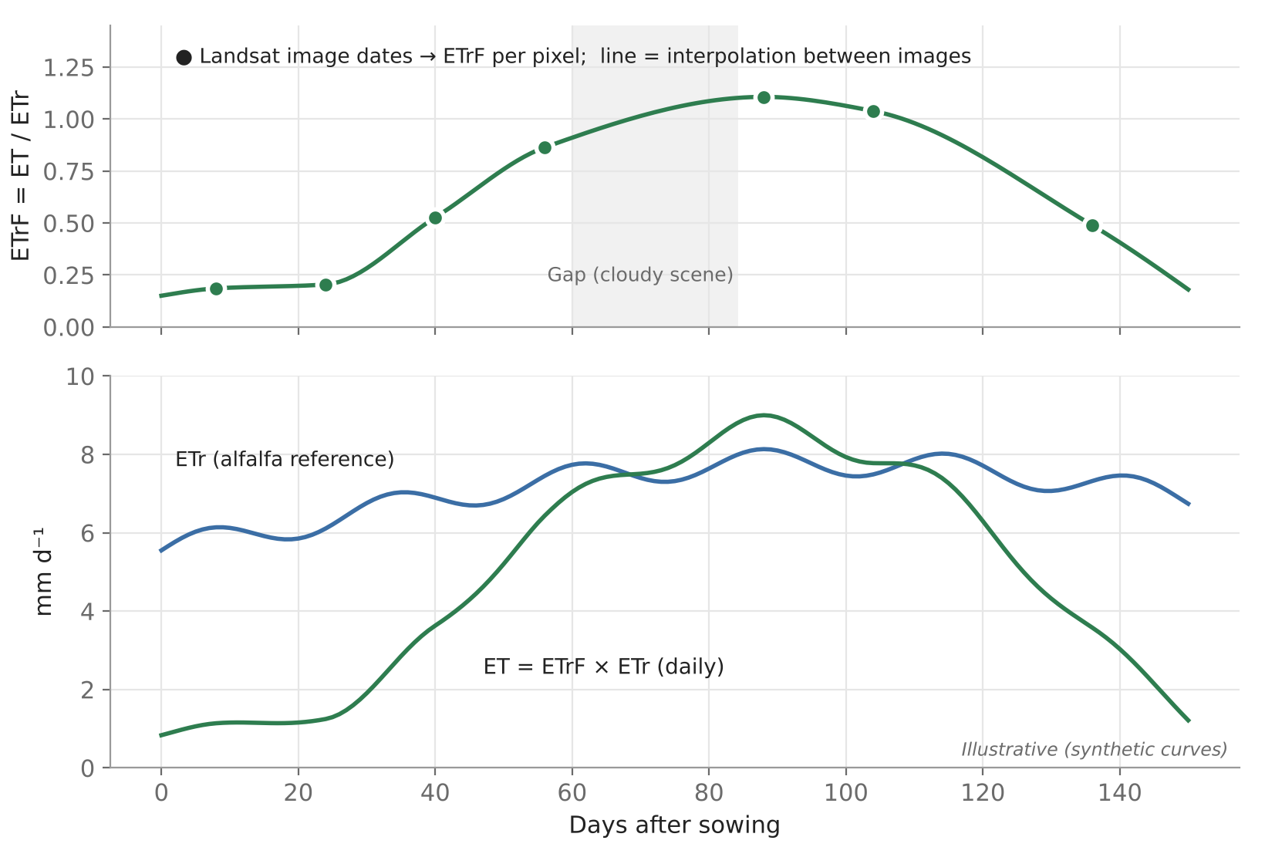
METRIC: from image dates to seasonal ET
Run the energy balance for each clear Landsat image
1
ET_{inst} = 3600·λE / (λ·ρ_{w}) (mm h⁻¹)
2
ETrF = ET_{inst} / ETr_{inst} (behaves like Kc)
3
ET₂₄ = C_{rad} × ETrF × ETr₂₄ (C_{rad} = slope correction)
4
Interpolate ETrF between images (spline); fill cloud gaps
5
Seasonal ET = Σ ETrF(t) × ETr(t)
6
Weather between images enters through ETr, crop development through ETrF
Illustrative: ETrF at image dates (top), interpolated and multiplied by daily ETr (bottom)
Notes:
A single Landsat image gives ET for one day. To get seasonal crop water use, METRIC computes the reference ET fraction, ETrF, for each cloud-free image. ETrF is instantaneous ET divided by the alfalfa reference ET at the same time, and it behaves like a crop coefficient: it is low at sowing, peaks at full cover and falls at senescence. ETrF is interpolated between image dates, usually with a spline, and multiplied by the daily reference ET from the weather station, which carries the day-to-day weather. Summing gives seasonal ET. Cloudy periods simply widen the interpolation gap, and a rain shortly after an image needs a soil-evaporation adjustment. The figure is a synthetic illustration of the procedure.

Slide 35
Other single-source models: SEBS and SSEBop
SEBS (Su 2002)
SSEBop (Senay et al. 2013)
H_{dry} = Rn − G (λE = 0)
H_{wet}: Penman–Monteith with r_{s} = 0 (λE potential)
EF_{r} = 1 − (H − H_{wet}) / (H_{dry} − H_{wet})
EF = EF_{r} · λE_{wet} / (Rn − G)
Physical dry and wet limits per pixel (no anchor pixels)
Dynamic kB⁻¹ for heat roughness; PBL (BAS) + surface-layer (MOST) similarity
Accuracy ~10–15% in field tests; many inputs, complex
T_{c} = c × T_{a,max} (cold boundary)
dT = Rn_{clear}·r_{ah}/(ρc_{p}); T_{h} = T_{c} + dT
ETf = (T_{h} − T_{s}) / dT
ET_{a} = ETf × k × ET₀
Predefined boundaries: no pixel picking, no H iteration
Few inputs (LST, T_{a}, ET₀); operational for MODIS, Landsat (USGS, FEWS NET)
Simplified physics; relies on accurate T_{a} and ET₀
Notes:
Two other single-source models are worth knowing. SEBS, the Surface Energy Balance System by Su (2002), does not pick anchor pixels. It computes, for every pixel, the sensible heat at a theoretical dry limit, where latent heat is zero, and at a wet limit, where evaporation is at the potential rate with zero surface resistance, using a Penman–Monteith-type equation. The actual H from similarity theory is placed between these limits to give the relative evaporative fraction. SEBS also computes the heat roughness length dynamically through kB⁻¹ instead of using a fixed value. Its drawbacks are the many input parameters and a complex solution. SSEBop, the operational simplified SSEB by Senay et al. (2013), used by USGS and FEWS NET, goes the other way. It predefines the cold boundary as a fraction of air temperature and the hot–cold temperature difference from clear-sky net radiation for each pixel and day, so ET fraction is a simple temperature ratio multiplied by reference ET.

Slide 36
Contextual, two-source and global models
04
Triangle and trapezoid, TSEB, ALEXI/DisALEXI, MOD16, PT-JPL, GLEAM, VI-based Kc and data assimilation
Notes:
This section covers methods that use the spread of pixels within an image, the triangle and trapezoid; two-source models that treat soil and canopy separately, with ALEXI and DisALEXI; the global Penman–Monteith and Priestley–Taylor products MOD16, PT-JPL and GLEAM; the vegetation-index crop coefficient method; and data assimilation.

Slide 37
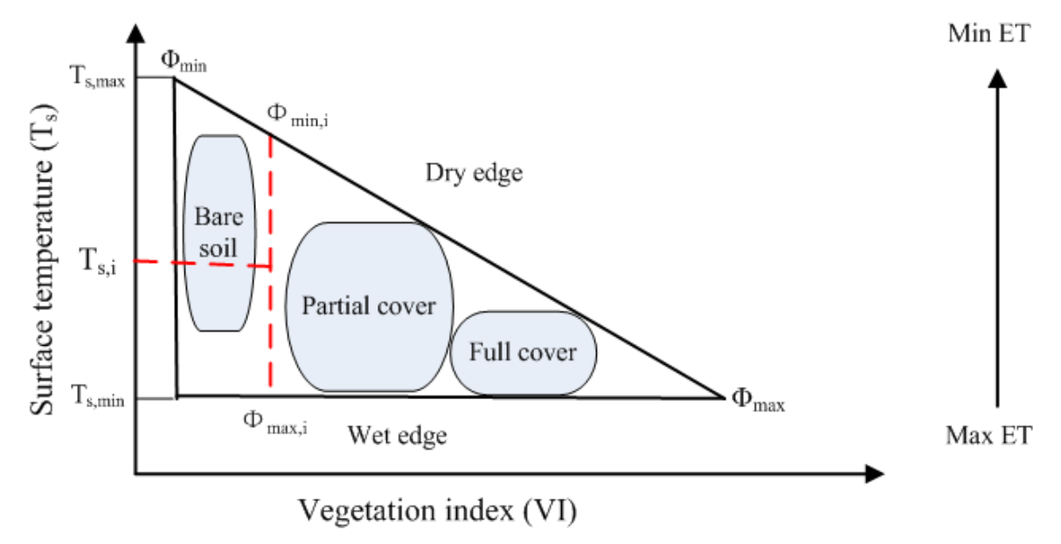
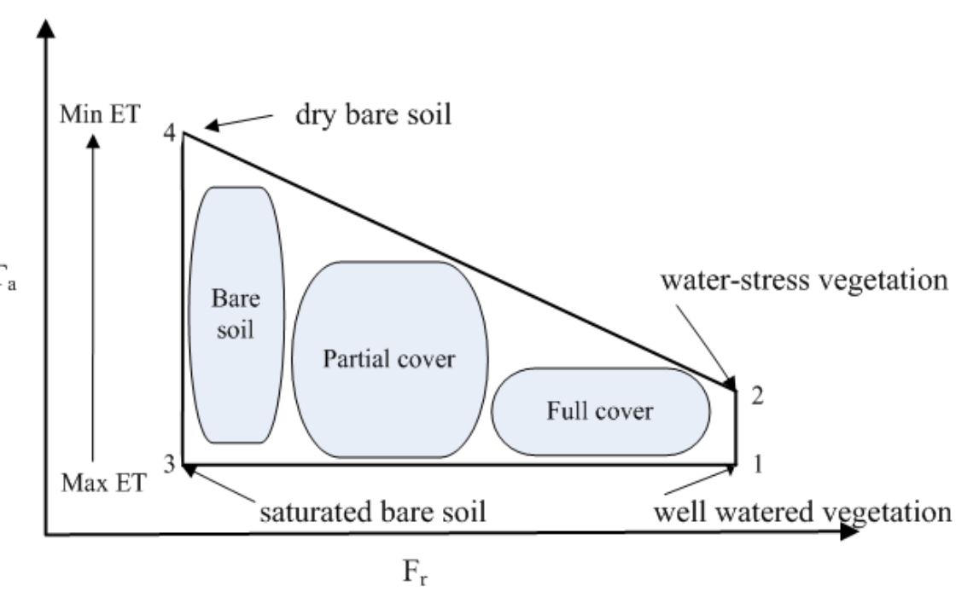
Ts–VI triangle and trapezoid
Ts–VI triangle (Li et al. 2009, Fig. 2)
Ts–Ta vs fractional cover trapezoid (Li et al. 2009, Fig. 3, after Moran 1994)
λE = φ·(Rn − G)·Δ/(Δ + γ), φ: 0 (dry edge) → 1.26 (wet edge)
WDI = 1 − λE/λE_{p} = [(T_{s}−T_{a}) − (T_{s}−T_{a})_{min}] / [(T_{s}−T_{a})_{max} − (T_{s}−T_{a})_{min}]
Image-only, insensitive to atmospheric correction
Needs full range of wetness and cover; subjective edges
Four vertices from Penman–Monteith: CWSI for partial cover
Fewer pixels needed, but more ground weather data
Notes:
When surface temperature is plotted against a vegetation index for many pixels with a full range of soil moisture and cover, the points fill a triangle. The upper edge, the dry edge, is the hottest temperature for each amount of vegetation, where soil moisture is unavailable. The lower edge, the wet edge, is the coolest, evaporating at the potential rate. The two meet at full vegetation cover. Jiang and Islam (1999) used this to scale a Priestley–Taylor coefficient phi from zero at the driest bare soil to 1.26 at the wettest full cover, interpolating linearly within the triangle, so ET can be mapped from satellite data alone. It needs many pixels on flat ground with a wide range of wetness and cover, and the edges are somewhat subjective. Moran et al. (1994) defined a trapezoid of surface minus air temperature against cover, with four vertices computed from Penman–Monteith: well-watered and stressed full cover, saturated and dry bare soil. The Water Deficit Index is one minus actual over potential ET and extends CWSI to partial cover. It needs fewer pixels but more weather inputs.

Slide 38
Triangle method step by step
Compute T_{s} and NDVI (or scaled NDVI, f_{c}); mask cloud and water
φ interpolation
1
T_{s}
Scatter all pixels; fit dry edge (max T_{s} per NDVI bin) and wet edge (min T_{s})
dry edge φ: 0 → 1.26
2
Set φ_{min} = 0 at driest bare soil, φ_{max} = 1.26 at wettest full cover
NDVI bin
3
φ on dry edge rises linearly with NDVI; φ on wet edge = 1.26
pixel: φ by T_{s}
4
Each pixel: interpolate φ linearly with T_{s} between edges in its NDVI bin
5
wet edge φ = 1.26
λE = φ(Rn − G)·Δ/(Δ + γ); EF = φ·Δ/(Δ + γ)
NDVI →
6
TVDI = (T_{s} − T_{s,min})/(T_{s,max} − T_{s,min}): soil moisture index
Notes:
This is how the Ts–VI triangle is applied in practice, following Jiang and Islam as summarised by Li et al. First, compute surface temperature and NDVI, often scaled between their minimum and maximum, and remove clouds and water. Plot every pixel. The dry edge is found by taking the maximum temperature in each NDVI bin and fitting a line; the wet edge is the minimum temperature, often taken as nearly flat. Next set the Priestley–Taylor parameter phi: zero at the driest bare-soil corner and 1.26 at the wettest full-cover corner. Along the dry edge, phi increases linearly with NDVI; along the wet edge it is 1.26. Within each NDVI bin, phi is interpolated linearly with temperature between the two edges. Latent heat is phi times available energy times delta over delta plus gamma, and the evaporative fraction is phi times delta over delta plus gamma. Variants include Stisen's non-linear interpolation, day–night temperature differences, and the Temperature Vegetation Dryness Index, which uses the same space as a soil moisture indicator.

Slide 39
Two-source energy balance (TSEB)
Series resistance network
Solution steps
T_{a} (ref. height)
1
Partition Rn into Rn_{c} and Rn_{s} using LAI (Beer's law)
2
First guess: λE_{c} = 1.26·f_{g}·Δ/(Δ + γ)·Rn_{c} (Priestley–Taylor)
r_{a}
T_{ac} (canopy air)
H_{c} = Rn_{c} − λE_{c} → T_{c}
3
r_{x}
r_{s}
T_{soil} from T_{RAD} and T_{c}; H_{s} through soil resistance
4
T_{c} canopy → H_{c}, λE_{c}
T_{soil} → H_{s}, λE_{s}
λE_{s} = Rn_{s} − G − H_{s}; if λE_{s} < 0 → reduce α (stress), repeat
5
H = H_{c} + H_{s}; λE = λE_{c} + λE_{s}
T_{RAD}(θ)⁴ = f(θ)·T_{c}⁴ + [1 − f(θ)]·T_{soil}⁴
Why two sources
f(θ) = 1 − exp(−0.5·Ω·LAI / cos θ)
Partial and row crops · separates E and T · view-angle effects · no empirical kB⁻¹ · basis of ALEXI
Notes:
Single-source models struggle over partial canopies because the radiometric temperature mixes hot soil and cool leaves, so it differs from the aerodynamic temperature. The two-source model of Norman, Kustas and Humes (1995) splits the surface into soil and canopy. The measured radiometric temperature is a fourth-power mix of canopy and soil temperatures, weighted by the fraction of vegetation seen at the view angle, which depends on LAI and clumping. To solve for the two temperatures, TSEB starts by assuming the canopy transpires at the Priestley–Taylor rate with alpha 1.26. That gives canopy H and canopy temperature, then soil temperature from the mix, then soil H through a soil resistance, and soil evaporation as the residual. If soil evaporation comes out negative, the canopy must be stressed, so alpha is reduced and the loop repeated. The resistances can be in series, as drawn, or in parallel. TSEB separates evaporation from transpiration and needs no empirical excess resistance; it needs LAI, canopy height and leaf size.

Slide 40
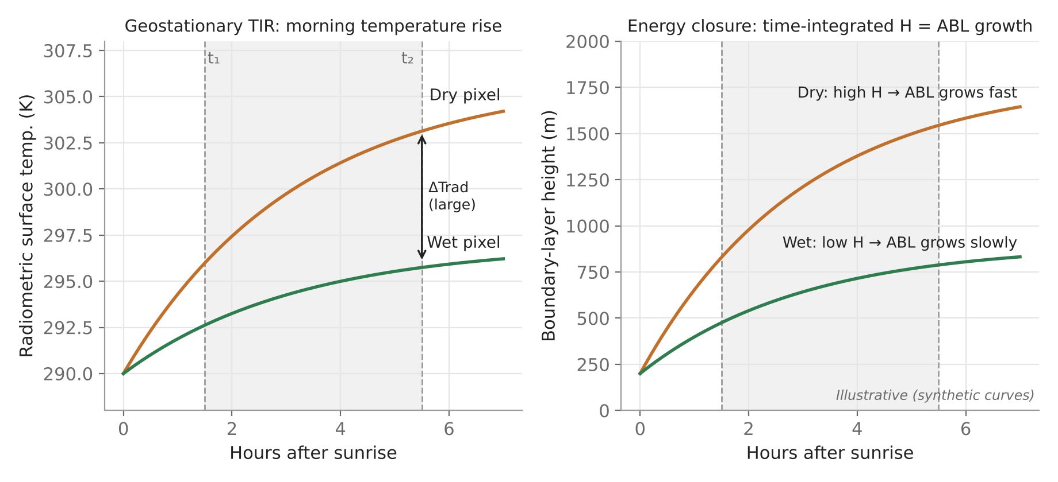


ALEXI: using the morning temperature rise
How it closes the balance
ΔT_{RAD} between t₁ ≈ 1.5 h and t₂ ≈ 5.5 h after sunrise
TSEB at both times → time-integrated H
Slab ABL model: ∫H dt = growth and warming of the ABL (morning sounding)
Air temperature becomes an output, not an input
Illustrative: a dry pixel heats faster and grows a deeper boundary layer between t₁ and t₂
Strengths
Limits
Product
No T_{a}; time difference cancels ε and atmospheric errors
Geostationary only; 5–10 km; clear mornings; poor at high latitudes
ESI = 1 − ET/PET for drought (US, global)
Notes:
ALEXI, the Atmosphere–Land Exchange Inverse model of Anderson et al. (1997), removes the need for air temperature, one of the weakest inputs. Instead of absolute surface temperature, it uses the rise in radiometric temperature between two geostationary images in the morning, about 1.5 and 5.5 hours after sunrise. A time difference cancels most errors from emissivity and atmospheric correction. TSEB is applied at both times, and the energy partitioning is closed by a simple model of the atmospheric boundary layer: the sensible heat put into the air over the morning must equal the energy needed to grow and warm the boundary layer, as seen in morning radiosondes. A dry pixel warms fast and grows a deep boundary layer; a wet pixel warms slowly. ALEXI runs at 5–10 km over continents with GOES or Meteosat. Its ratio of actual to potential ET gives the Evaporative Stress Index, used for flash-drought monitoring. The figure is a synthetic illustration.

Slide 41

DisALEXI and data fusion: from continent to field
GOES / Meteosat
morning ΔT_{RAD}
ALEXI
ET, T_{a} at 5–10 km
DisALEXI
TSEB with MODIS / Landsat T_{s}, LAI
STARFM fusion
Landsat + MODIS
Daily ET at 30 m
(field scale)
adjust T_{a} until fine-scale ET averages to the ALEXI value
DisALEXI
Thermal sharpening
Fusion and ensembles
ALEXI T_{a} at blending height (~50 m) as boundary
TSEB on each fine pixel
Mass-conserving: aggregate = ALEXI
Landsat TIR 100 m → 30 m
Regress T_{s} on NDVI / reflectance at coarse scale, apply at fine scale (DisTrad, TsHARP)
STARFM: MODIS timing + Landsat detail → daily 30 m
OpenET: ensemble of SEBAL, METRIC, SSEBop, DisALEXI, PT-JPL, SIMS
Notes:
ALEXI gives reliable but coarse ET. DisALEXI disaggregates it to field scale. It takes the ALEXI air temperature at the blending height, about 50 metres, as the upper boundary, and runs TSEB with high-resolution surface temperature and LAI from MODIS at 1 kilometre or Landsat at 30 to 100 metres. The air temperature is adjusted until the fine-resolution fluxes, averaged back to the ALEXI pixel, match the ALEXI value. This keeps the fine map consistent with the coarse one. Because Landsat sees each place only every 8 to 16 days, the STARFM fusion method combines frequent MODIS with sharp Landsat to make a daily 30-metre series, as Semmens et al. (2016) did over vineyards. Thermal sharpening, using the finer optical bands to downscale the 100-metre Landsat thermal band to 30 metres, is often applied first. This chain is one of the six models in the OpenET ensemble.

Slide 42
MOD16: Penman–Monteith with MODIS inputs
MOD16 ET = λE_{wet canopy} + λE_{transpiration} + λE_{soil}
Wet canopy evaporation
Transpiration
Soil evaporation
Fraction wet F_{wet} = RH⁴ (RH > 70%)
PM with aerodynamic + wet-surface resistances
G_{s} = C_{L}·m(T_{min})·m(VPD)·LAI
C_{L}: max stomatal conductance per biome
PM for dry canopy fraction
Potential (PM) × (RH/100)^{VPD/β}
Wet and saturated soil fractions
Inputs
Output
Limitation
MODIS land cover, LAI/FPAR, albedo + GMAO T, VPD, Rs
8-day, 500 m–1 km, global (day + night summed)
No LST: misses irrigation and soil water stress
Notes:
MOD16, developed by Mu, Heinsch, Zhao and Running (2007) and improved in 2011, is NASA's global MODIS ET product. It does not use surface temperature. Instead it runs the Penman–Monteith equation separately for three components: evaporation of water intercepted on wet leaves, transpiration from dry leaves, and evaporation from the soil. Satellite inputs are MODIS land cover, LAI and FPAR, and albedo; weather comes from the GMAO reanalysis. The key step is the surface conductance for transpiration: a maximum stomatal conductance for each land cover is reduced by multipliers for low minimum temperature and high vapour pressure deficit, and scaled by LAI. Soil evaporation is the potential rate reduced by a moisture constraint based on relative humidity and vapour pressure deficit. The wet fraction of the surface is estimated from relative humidity. Day and night are computed separately and summed. MOD16 provides 8-day ET at 500 metres to 1 kilometre globally. Its weakness is that water stress is only inferred from the atmosphere, so it can miss irrigation and soil-moisture effects.

Slide 43
PT-JPL and GLEAM: Priestley–Taylor based products
PT-JPL (Fisher et al. 2008)
GLEAM (Miralles et al. 2011)
λE = λE_{c} + λE_{s} + λE_{i}
λE_{c} = (1 − f_{wet}) f_{g} f_{T} f_{M} · α·Δ/(Δ + γ)·Rn_{c}
λE_{s} = [f_{wet} + f_{SM}(1 − f_{wet})] · α·Δ/(Δ + γ)·(Rn_{s} − G)
f_{g} = fAPAR/fIPAR (green fraction); f_{T} temperature optimum; f_{M} = fAPAR/fAPAR_{max}
f_{SM} = RH^{VPD/β}; f_{wet} = RH⁴
Three components: canopy transpiration, soil evaporation, interception
No calibration; used for ECOSTRESS (70 m)
E = S × E_{p} + E_{i}
E_{p}: Priestley–Taylor potential evaporation
S: evaporative stress from microwave soil moisture and vegetation optical depth
Multi-layer soil water balance driven by precipitation; assimilates satellite SM
E_{i}: rainfall interception (Gash model)
Daily, 0.25°, global; partitions E, T, interception
Link: microwave soil moisture (SMOS, AMSR, SMAP)
Notes:
Two other global approaches start from Priestley–Taylor potential evaporation and reduce it with stress factors. PT-JPL, by Fisher, Tu and Baldocchi (2008), splits net radiation between canopy and soil and computes canopy transpiration, soil evaporation and interception separately. Each is the Priestley–Taylor rate multiplied by eco-physiological constraints: a green canopy fraction from the ratio of absorbed to intercepted PAR, a temperature constraint peaking at an optimum temperature, a plant moisture constraint from FAPAR relative to its maximum, a soil moisture constraint from relative humidity and VPD, and a wet-surface fraction from relative humidity to the fourth power. It needs no calibration and is one of the algorithms used for NASA's ECOSTRESS. GLEAM, by Miralles et al. (2011), combines Priestley–Taylor with an evaporative stress factor derived from satellite microwave soil moisture and vegetation optical depth, a multi-layer soil water balance driven by precipitation, and the Gash model for rainfall interception. It gives daily ET at 0.25 degrees and links directly to the microwave soil moisture methods.

Slide 44
VI-based crop coefficient method
Sentinel-2 / Landsat NDVI (5–16 d, 10–30 m)
K_{cb} = a·NDVI + b (or SAVI, f_{c})
× ET₀ (station or gridded)
+ K_{e} and × K_{s} from soil water balance
ETc_{adj}: field-scale crop ET
FAO-56: K_{cb} = K_{c,min} + K_{d}(K_{cb,full} − K_{c,min})
Strengths
Limits
K_{d} = min(1, M_{L}·f_{c,eff}, f_{c,eff}^{1/(1 + h)}) — density coefficient
Kcb–NDVI relations are crop- and sensor-specific: calibrate with lysimeter or flux data
Optical only; 10 m; frequent; simple; irrigation advisories
Gives potential crop ET; stress missed without water balance or thermal data
Thermal vs optical: NDVI lags water stress by days to weeks, LST responds within hours — combining a VI-Kc water balance with thermal ET (e.g. METRIC ETrF) gives the best irrigation information
Notes:
The simplest operational approach combines FAO-56 with optical remote sensing. The basal crop coefficient rises with canopy cover in almost the same way as a vegetation index, so Kcb can be estimated as a linear function of NDVI or SAVI, an idea going back to Bausch and Neale (1987) and reviewed by Pôças et al. (2020). FAO-56 itself gives a cover-based formula, using a density coefficient from effective ground cover and height. Multiplying satellite Kcb by reference ET from a weather station or a gridded product gives crop ET under unstressed conditions, and adding soil evaporation and a stress coefficient from a soil water balance gives actual ET. With Sentinel-2 every five days at 10 metres, this works at field scale even without a thermal band. Its weakness is that NDVI responds to stress slowly, so short-term water stress is missed unless the soil water balance is run; thermal-based energy balance methods detect stress directly.

Slide 45

Data assimilation for continuous ET
Assimilation cycle
Sequential
Model forecast (LSM: Noah, CLM)
EnKF, optimal interpolation, particle filter: update state when each observation arrives
Forcing: rain, Rs, T, u
Observation: LST, SM, LAI
Variational
3D/4D-Var: adjust model over a window to fit all observations (retrospective)
Update / analysis (EnKF, 4D-Var)
Pros and cons (Li et al. 2009)
Continuous in time and space, merges sensors · computationally demanding, model-dependent
continuous ET, soil moisture, fluxes
Notes:
Satellite ET models give snapshots on clear days. Data assimilation fills the gaps by combining observations with a dynamic model. Li et al. describe a data assimilation system as three components: a set of observations, a dynamic model, and an assimilation technique. The model, usually a land surface model such as Noah or CLM, steps forward in time with weather forcing. When an observation arrives, such as land surface temperature, microwave soil moisture or LAI, the model state is corrected in proportion to the relative uncertainty of the model and the observation. Sequential methods like the ensemble Kalman filter update the state at each observation time; variational methods like 4D-Var adjust the model over a whole window to fit all observations. The result is continuous ET, with intermediate variables such as soil moisture and fluxes, at the model's time step and resolution. The cost is computing power and dependence on model structure. Margulis et al. found assimilation slightly better than the triangle method.

Slide 46
Scaling: instantaneous to daily and seasonal ET
05
How one satellite snapshot becomes daily and seasonal ET, with a worked example; spatial scaling between field and region
Notes:
This section covers scaling, which every satellite method needs: from the instant of overpass to daily totals, with the assumptions behind each method and a worked numerical example, then to seasonal totals and between spatial resolutions.

Slide 47
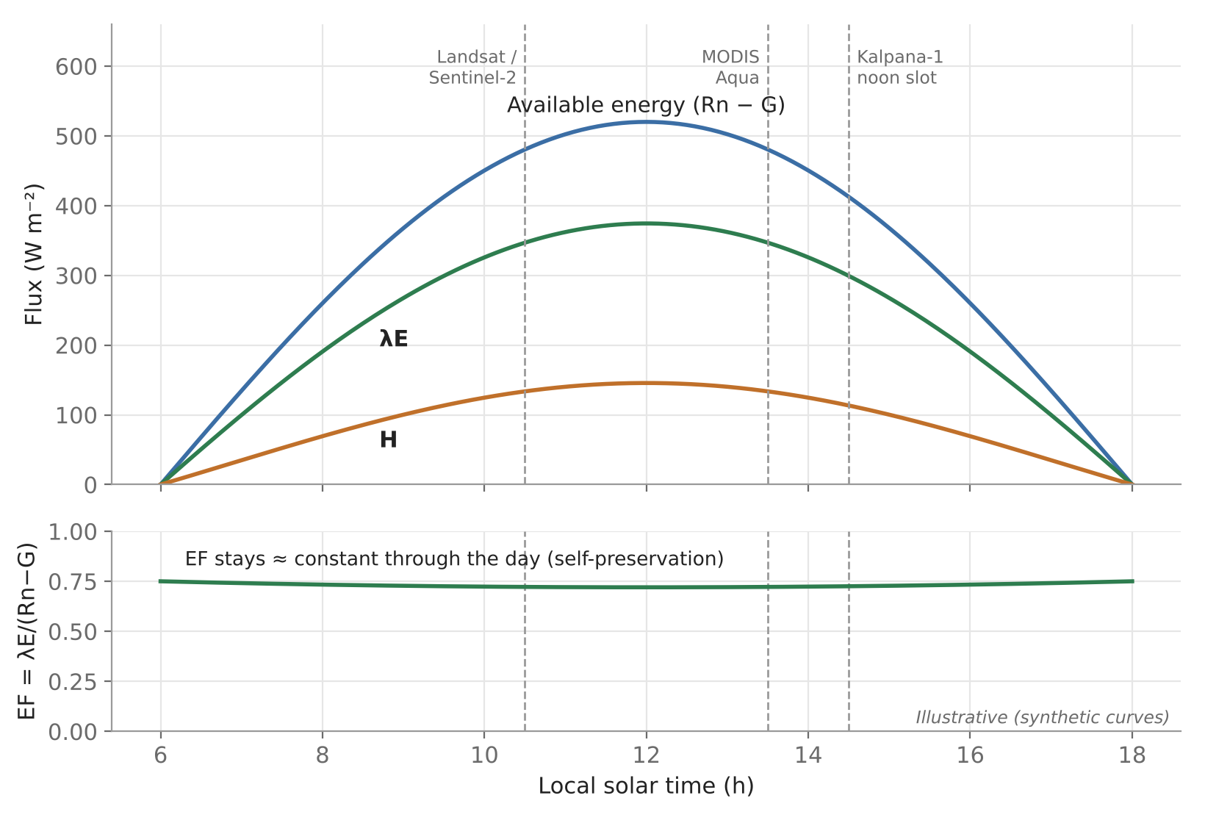
Instantaneous to daily ET: why and on what assumption
ET₂₄ = (1/λ) ∫ λE(t) dt
Self-preservation
Energy partitioning set by slow variables (soil moisture, LAI, r_{s}); Rn and T_{s} change fast
Midday vs daily EF: r² = 0.89 on clear days (Hapex-Mobilhy, in Li 2009)
Where it fails
EF concave: midday EF slightly low → daily ET under-estimated
Night ET ≈ 10% of daily; afternoon advection in arid areas; clouds
Illustrative: fluxes vary strongly, EF ≈ constant on a clear day; dashed lines = overpass times
Notes:
A polar-orbiting satellite sees a field once, at a fixed local time: about 10:30 for Landsat, Sentinel-2 and MODIS-Terra, and 13:30 for MODIS-Aqua. The energy balance therefore gives latent heat in watts per square metre at that instant, while irrigation and water accounting need millimetres per day. Daily ET is the integral of latent heat over the day divided by the latent heat of vaporisation. Since only one value is known, every method assumes that some ratio stays constant through the day and scales it by a quantity that can be computed for the whole day from weather data. The most common is evaporative fraction. Its justification, called self-preservation, is that on clear days the partition of energy is controlled by slowly changing land surface properties, soil moisture, vegetation and resistances, while radiation and temperature change quickly; Bhattacharya et al. use the same reasoning. The figure shows available energy, latent and sensible heat changing strongly through the day while their ratio stays nearly flat. EF is in fact slightly higher in early morning and late afternoon, so the midday value tends to underestimate daily ET a little; night-time ET adds roughly 10 percent; and clouds or afternoon advection break the assumption.

Slide 48
Instantaneous to daily ET: the four methods
1 Constant EF (Sugita & Brutsaert 1991)
2 Constant ETrF (METRIC, Allen 2007)
EF_{i} = λE_{i} / (Rn − G)_{i}
ETrF = ET_{inst} / ETr_{inst}
λE₂₄ = EF_{i} × Rn₂₄ (G₂₄ ≈ 0); ALEXI: × 1.1 for night
ET₂₄ = C_{rad} × ETrF × ETr₂₄
Used in: SEBAL, SEBS, S-SEBI, triangle
Used in: METRIC; handles advection and wind
3 Sine function (Jackson 1983)
4 Geostationary integration
ET_{d} / ET_{i} = 2N / [π·sin(πt/N)]
Λ_{d} ≈ Λ_{noon}; Q_{d} = 2Q_{noon} / [π·sin(π(t_{sat} − t_{rise})/(t_{set} − t_{rise}))]
N = day length (h), t = hours since sunrise
or sum half-hourly λE (INSAT-3D)
Used in: Clear days; MODIS, Landsat
Used in: Kalpana-1 (SAC); ALEXI
Notes:
Li et al. review three main methods, and geostationary data allow a fourth. The constant evaporative fraction method, from Sugita and Brutsaert, multiplies the instantaneous EF by daily available energy; daily soil heat flux is taken as zero, so daily net radiation is enough. ALEXI multiplies EF by 1.1 to include night-time ET. METRIC holds the reference ET fraction constant and multiplies it by daily alfalfa reference ET from a weather station; because reference ET includes the afternoon rise in vapour pressure deficit and wind, this captures advection better than EF. The sine method of Jackson assumes ET follows the sine-shaped course of solar radiation between sunrise and sunset, so the ratio of daily to instantaneous ET depends only on day length and the time since sunrise. Bhattacharya et al. use a version of the sine method to convert noon available energy to a daytime average, then apply the noon evaporative fraction. Finally, geostationary satellites such as INSAT-3D can sample every half hour and integrate directly, which the SAC authors proposed for the future.

Slide 49
Worked example: from a Landsat snapshot to mm per day
At overpass (11:00)
Method 1: constant EF
Rn₂₄ = 13.5 MJ m⁻² d⁻¹, G₂₄ ≈ 0
λE₂₄ = 0.72 × 13.5 = 9.75 MJ m⁻² d⁻¹
ET₂₄ = 9.75 / 2.45 = 4.0 mm d⁻¹
Rn = 600 W m⁻²
G = 60 W m⁻²
H = 150 W m⁻²
λE = 600 − 60 − 150 = 390 W m⁻²
EF = 390 / 540 = 0.72
ET_{inst} = 390 × 3600 / 2.45×10⁶
= 0.57 mm h⁻¹
Method 2: constant ETrF
ETr_{inst} = 0.75 mm h⁻¹ → ETrF = 0.57/0.75 = 0.76
ETr₂₄ = 6.0 mm d⁻¹
ET₂₄ = 0.76 × 6.0 = 4.6 mm d⁻¹
Method 3: sine function
N = 12 h, t = 5 h → 2N/[π sin(5π/12)] = 7.9 h
ET_{d} = 0.57 × 7.9
ET_{d} ≈ 4.5 mm d⁻¹ (daytime)
Methods differ by ~15%: EF misses afternoon demand; ETrF captures advection. Useful constants: λ = 2.45 MJ kg⁻¹; 1 mm d⁻¹ ≈ 28.4 W m⁻²
Notes:
Here is a complete numerical example for one irrigated wheat pixel, with illustrative but realistic numbers. At the 11:00 overpass, the energy balance gives net radiation 600, soil heat flux 60 and sensible heat 150 watts per square metre, so latent heat is 390 and evaporative fraction 0.72. Converting the instant: 390 divided by 2.45 million joules per kilogram, times 3600 seconds, is 0.57 millimetres per hour. Method 1: daily net radiation is 13.5 megajoules per square metre; with daily soil heat flux zero, daily latent energy is 0.72 times 13.5, or 9.75 megajoules, which divided by 2.45 gives 4.0 millimetres per day. Method 2: the hourly alfalfa reference ET at 11:00 is 0.75 millimetres per hour, so ETrF is 0.76; with daily reference ET of 6.0 millimetres, ET is 4.6 millimetres per day. Method 3: with sunrise at 6:00 and 12 hours of daylight, the overpass is 5 hours after sunrise; the sine factor is 24 over pi times the sine of 75 degrees, about 7.9 hours, so ET is 0.57 times 7.9, about 4.5 millimetres per day. The spread of about 15 percent shows that the choice of scaling method matters, and why METRIC prefers ETrF in advective, semi-arid conditions.

Slide 50

Seasonal gap filling and spatial scaling
Time: daily → seasonal
Nested pixel scales
Space: field ↔ region
Interpolate EF, ETrF or Kc_{act} between clear images × daily ET₀
Composite (8-day Kalpana-1, MODIS)
Fusion (STARFM), geostationary frequency
Microwave soil moisture and LSM data assimilation (EnKF) for cloudy days
TIR coarser than VNIR → thermal sharpening
Non-linear models: aggregation errors grow with heterogeneity
Up-scaling (aggregate fine ET) vs downscaling (DisALEXI)
Validation: match footprint to pixel; two-step up-scaling
30 m (Landsat): flux tower, lysimeter
1 km (MODIS): scintillometer
8 km (Kalpana-1): aggregate 8 × 8 MODIS
f(mean input) ≠ mean f(input)
Notes:
Two further scaling problems remain. In time, daily estimates exist only on clear-sky overpass days, so seasonal totals need gap filling: interpolate a slowly varying ratio such as EF, ETrF or an actual Kc between images and multiply by daily reference ET; composite over 8 days as the Kalpana-1 study did; fuse sensors; or use a land surface model with data assimilation, which Li et al. note gives continuous fluxes at higher computing cost. In space, thermal pixels are coarser than optical ones, so the temperature and vegetation inputs do not match unless the thermal band is sharpened. Because the equations are non-linear, averaging inputs and then computing flux is not the same as computing flux and then averaging, especially over heterogeneous fields. And validation needs the footprint to match the pixel, which is why scintillometers or stepwise up-scaling are used. Li et al. list scaling and pixel-scale validation among the main unresolved problems.

Slide 51
ISRO case study, applications and outlook
06
Kalpana-1 ET over India (SAC, ISRO), error sources, uses of satellite ET, Indian missions, and a method comparison
Notes:
The final section walks through the ISRO Space Applications Centre method for ET over India from Kalpana-1, then looks at error sources and sensitivity, applications, Indian missions and future directions, and closes with a comparison of methods, an end-to-end workflow and interview questions.

Slide 52
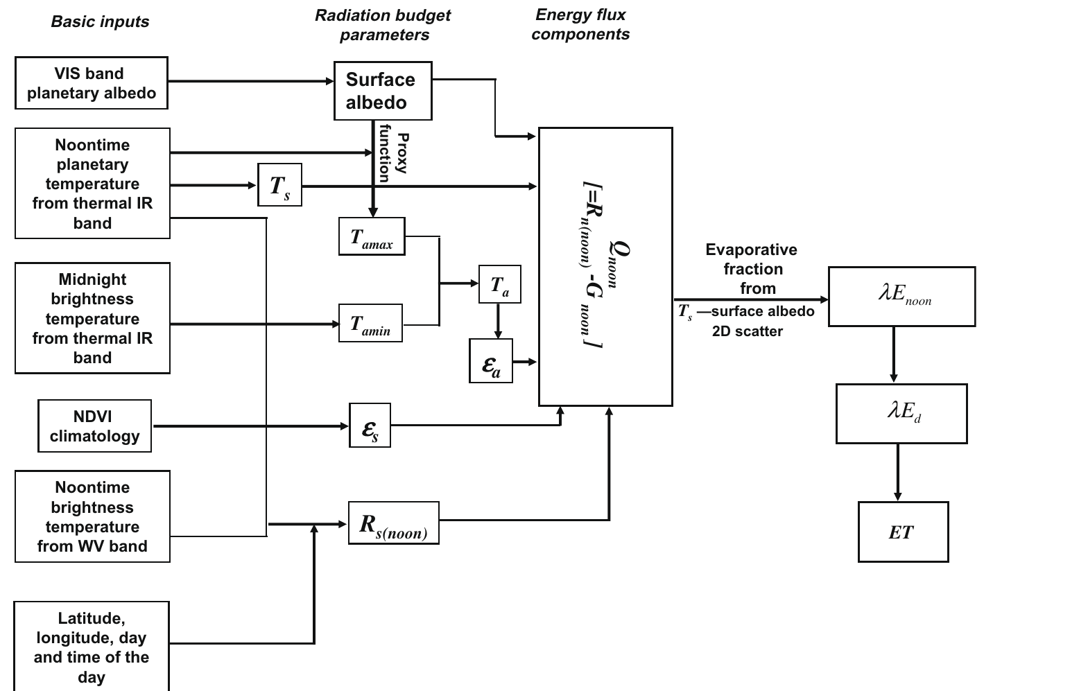
ISRO case: Kalpana-1 ET over India — processing flow
Method summary
Sensor: Kalpana-1 VHRR (VIS, WV, TIR), 74°E
Slots: 0900 GMT noon (14:30 IST) and 2100 GMT night; rabi 2005–06
Grid: 0.08° (~8 km)
Q_{noon} = Rn_{noon} − G_{noon} (G as SEBAL)
T_{a}: from noon–midnight temperatures via proxy function
λE_{noon} = Q_{noon} × Λ_{noon}
Daily: Λ_{d} ≈ Λ_{noon}; sine-scaled Q_{d}
No in-situ inputs required
Fig. 1: ET processing chain for Kalpana-1 VHRR (Bhattacharya et al. 2010, SAC-ISRO)
Notes:
Bhattacharya, Mallick, Patel and Parihar at the Space Applications Centre, Ahmedabad, built the first ET processing chain for India from an Indian geostationary satellite. Kalpana-1's VHRR sensor has visible, water vapour and thermal infrared bands at 74 degrees East. They used the noon slot at 0900 GMT, 2:30 pm local time, and a night slot at 2100 GMT, avoiding early-morning fog and the time when the moon enters the field of view. All bands were resampled to 0.08 degrees. The flow chart from the paper shows the chain: visible planetary albedo gives surface albedo; noon thermal and water vapour bands give land surface temperature and insolation; noon and midnight temperatures give maximum and minimum air temperature through a proxy function; NDVI climatology gives emissivity. Together these give noon available energy, the evaporative fraction comes from the temperature–albedo scatter, and the product gives noon latent heat, then daytime latent heat and daily ET. No ground data are needed.

Slide 53
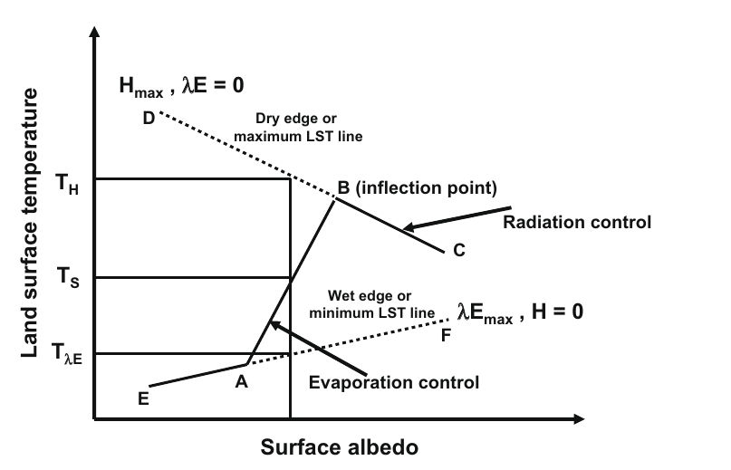
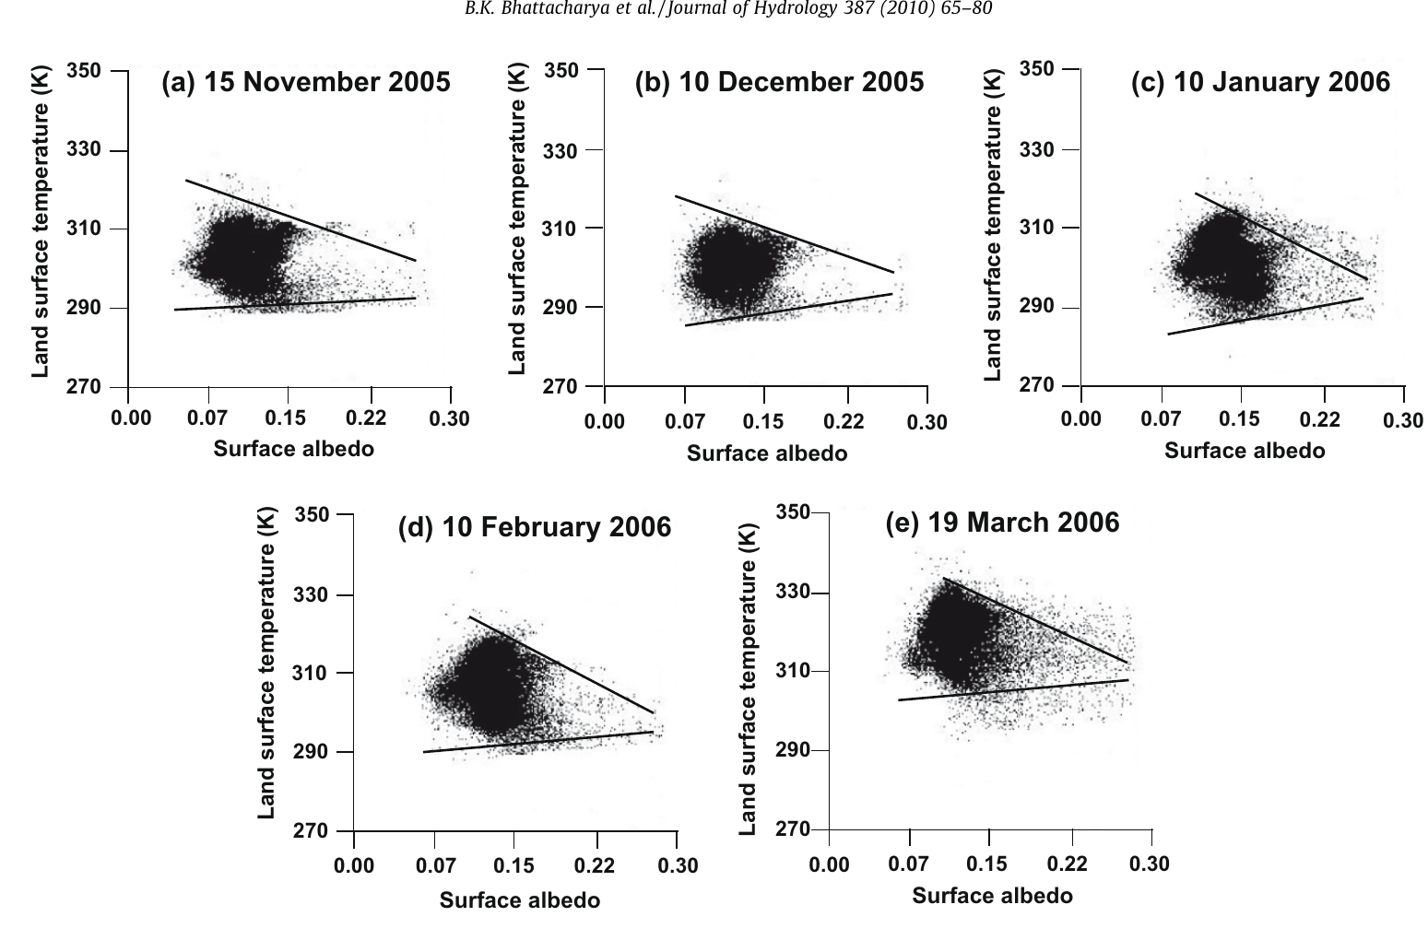
Kalpana-1: evaporative fraction from Ts–albedo space
Fig. 2: conceptual Ts–albedo space (Bhattacharya et al. 2010)
Λ = λE/(H + λE) = (T_{H} − T_{s}) / (T_{H} − T_{λE})
Fig. 3: daily Ts–albedo scatters with fitted dry and wet edges, rabi 2005–06
Limitations (from the paper)
T_{H}, T_{λE}: dry and wet edges, linear in albedo, fitted each day
Why albedo, not NDVI: VHRR has no red/NIR band
Varying atmosphere across the domain · needs wet and dry pixels · advection at coarse scale · error grows with heterogeneity
Notes:
Because Kalpana-1 VHRR has no red or near-infrared band, NDVI-based triangle methods could not be used from the same platform, so the team used the temperature–albedo space of S-SEBI. In the conceptual figure, surface temperature first rises with albedo along the evaporation-controlled branch up to an inflection point B, then falls along the radiation-controlled branch. The upper line D–C is the dry edge, where latent heat is zero and sensible heat is maximum; the lower line E–F is the wet edge, where sensible heat is zero. For each day, both edges are fitted by regression on albedo classes, and the evaporative fraction of every pixel is its relative position between them. The right panel shows real scatters on five dates over the rabi season, with the fitted edges. The method is simple and needs no ground data, but it fails if the atmosphere varies strongly across India or if wet and dry pixels are missing, and large-scale advection can alter the partitioning at 8 km.

Slide 54
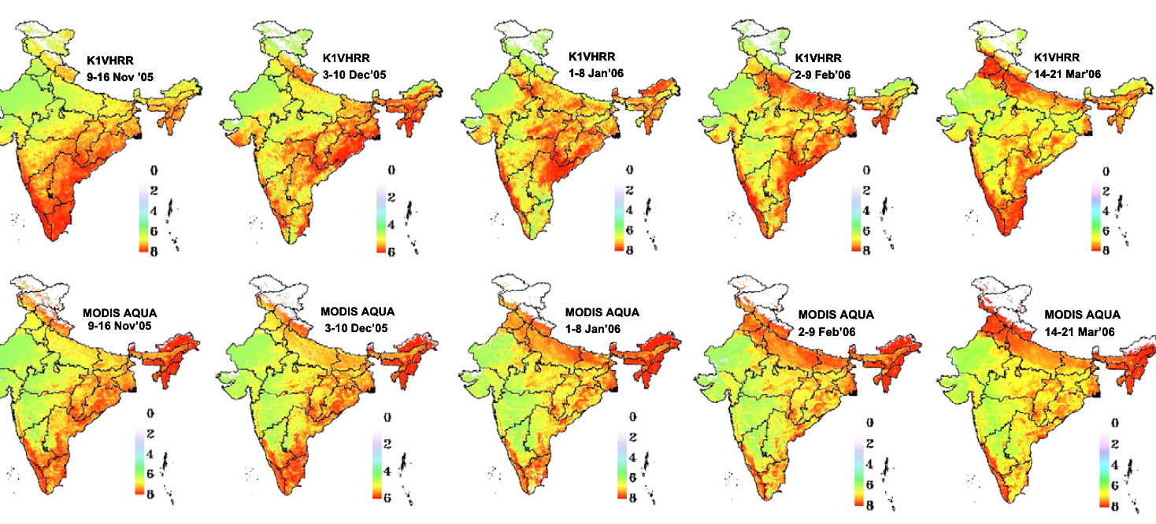
Kalpana-1: two-step validation and ET maps
Step 1
In situ (5 crop sites, Bowen ratio) → validate MODIS-Aqua ET at 0.01°
Step 2
Aggregate 8 × 8 MODIS → 0.08°; compare with Kalpana-1 over Indian cropland
Sites: wheat (Ludhiana, Hissar), sorghum (Bijapur), groundnut (Dhenkanal), rice (Nadia)
Fig. 9: 8-day ET (mm d⁻¹) from Kalpana-1 (top) and aggregated MODIS-Aqua (bottom), Nov 2005 – Mar 2006
Next steps (authors)
25–32%
r = 0.80
↑ heterogeneity
INSAT-3D: 4 km split-window TIR, half-hourly → daily integral; two-source for sparse canopies
daily ET error vs field
8-day ET vs MODIS (n = 52,853); RMSD 26%
error grows with partial cover
Notes:
Validating an 8-kilometre pixel directly against a tower is not meaningful, so the study used a two-step approach. First, MODIS-Aqua ET at about 1 kilometre, computed with the same algorithm, was validated against field energy-balance measurements at five 2 by 2 kilometre crop sites: wheat at Ludhiana and Hissar, sorghum at Bijapur, groundnut at Dhenkanal and rice at Nadia, measured with portable Bowen ratio units every 14 days. Second, 8 by 8 MODIS pixels were averaged to the Kalpana-1 grid and compared wall to wall over Indian cropland, using 8-day composites to reduce data gaps. The maps show 8-day ET from both sensors across the rabi season. Results in brief: daily ET errors of 25 to 32 percent, 8-day RMSD of 26 percent with a correlation of 0.80 over nearly 53,000 pixel pairs, and larger errors where fields are heterogeneous. The authors expected INSAT-3D, with 4-kilometre split-window thermal bands and half-hourly data, to improve this.

Slide 55
Error sources and sensitivity
Component | Typical uncertainty | Note
Net radiation Rn | 5–10% | albedo, LST, ε, Rs
Soil heat flux G | 20–30% | small at midday; ≈ 0 daily
Sensible heat H | 15–20% | r_{ah}, dT; ~ground-method error
EC closure (truth) | 10–30% | limits validation
SEBAL ET | ~85% daily, ~95% seasonal | Bastiaanssen; Li 2009
Kalpana-1 ET | 25–32% daily; 26% 8-day | coarse, heterogeneous pixels
S_{v} = |(f_{x+} − f_{x−}) / f_{r}| (Bhattacharya et al. 2010)
Sensitivity of λE (Kalpana-1, ±10% inputs; ±1 K for T_{s})
T_{s} (±1 K)
0.14–0.45
Insolation R_{s}
0.22–0.30
Albedo
0.07 to >1
T_{a}
0.07–0.14
NDVI
0.00–0.05
Takeaway: LST and radiation dominate; anchors (SEBAL/METRIC) and time differences (ALEXI) tame these errors
Bars: range of S_{v}(λE) across 5 crops and 3 stages (Table 5); scale 0–1
Notes:
No satellite ET estimate is better than its inputs. Li et al. summarise typical uncertainties: satellite net radiation 5 to 10 percent, soil heat flux 20 to 30 percent but small at midday, and sensible heat from the bulk transfer equation about 15 to 20 percent, similar to the uncertainty of the ground methods themselves. SEBAL's authors report typical accuracy of about 85 percent at daily and 95 percent at seasonal scale, because random errors partly cancel over time. The Kalpana-1 study ran a one-at-a-time sensitivity analysis: each input was changed by plus or minus 10 percent, or 1 kelvin for surface temperature, and the relative change in each flux recorded. Latent heat was most sensitive to surface temperature and insolation, sensitive to albedo especially for some crops and stages, moderately to air temperature, and hardly at all to NDVI, which only enters through emissivity and soil heat flux. In single-source models with independent air temperature, a 1-kelvin error in dT can change H by tens of watts per square metre; that is why internal calibration matters.

Slide 56
Applications of satellite ET in agriculture
Irrigation scheduling
Irrigation performance
Water productivity
ETa vs ETc deficit; advisories with ET0 forecasts
Relative ET = ETa/ETp: adequacy, equity, uniformity in commands
WP = yield / ET (kg m⁻³); FAO WaPOR
Drought monitoring
Yield forecasting
Water accounting
ESI = 1 − ET/PET; ET anomalies; flash drought
ET/PET stress in crop models; water-limited yield
Consumptive use, groundwater depletion, basin budgets (WA+)
Indian relevance: canal command assessment, groundwater-stressed Punjab–Haryana, crop water budgets for FASAL-type forecasts and drought declaration
Notes:
Satellite ET is used in many ways. For irrigation, comparing actual ET with crop water requirement shows where and when fields are under-irrigated, and the ratio of actual to potential ET over a command area measures irrigation adequacy, equity and uniformity. Dividing yield or biomass by ET gives water productivity in kilograms per cubic metre, which FAO's WaPOR portal maps across Africa and the Near East using an energy-balance based model. Drought monitoring uses ET anomalies and the Evaporative Stress Index, which responds faster than vegetation indices and can warn of flash droughts. Crop models and yield forecasts use ET or its stress ratio. Basin water accounting uses ET to quantify consumptive use and groundwater depletion, as irrigated ET above rainfall must come from surface or groundwater. ET maps also calibrate hydrological and land surface models and help detect water-rights violations, the original purpose of METRIC.

Slide 57
Indian missions and future directions
Mission / sensor | Relevance to ET
Kalpana-1 VHRR (2002–2017) | First Indian geostationary ET (SAC, 8 km)
INSAT-3D / 3DR Imager | 4 km split-window LST, insolation; 15–30 min (MOSDAC)
TRISHNA (ISRO–CNES, planned) | ~57 m TIR, few-day revisit: field-scale ET, water stress
EOS-04 RISAT-1A, NISAR | Microwave soil moisture: cloudy-day constraint, GLEAM-type
Resourcesat LISS/AWiFS, Sentinel-2 | NDVI → Kcb; land cover; albedo
ECOSTRESS, Landsat Next, LSTM | International high-resolution thermal
Future directions
Ensembles (OpenET) to reduce model spread
Machine-learning hybrids trained on flux towers (FLUXCOM)
Assimilation of LST + soil moisture into land surface models
SIF for transpiration and E/T partitioning
All-weather ET with microwave LST and soil moisture
Key gap: frequent, high-resolution thermal data — TRISHNA is designed to fill it for Indian agriculture
Notes:
For an ISRO interview it is worth knowing the Indian context. The Kalpana-1 work at SAC showed that ET could be mapped over India from a geostationary platform. INSAT-3D and 3DR followed, with split-window thermal bands at 4 kilometres and imaging every 15 to 30 minutes, and their land surface temperature and insolation products are distributed through MOSDAC. The planned ISRO–CNES TRISHNA mission will carry a thermal imager with about 57-metre resolution and a revisit of a few days, designed for ET, crop water stress and irrigation monitoring; high-resolution thermal data are the main missing piece for field-scale ET. Soil moisture from microwave missions such as EOS-04 and NISAR can constrain ET models on cloudy days, and the Resourcesat and Sentinel-2 optical sensors give crop coefficients. Internationally, ECOSTRESS, Landsat Next and ESA's LSTM mission are adding thermal capacity. Research directions include ensembles such as OpenET, machine-learning hybrids trained on flux towers, assimilation into land surface models, and using sun-induced fluorescence to estimate transpiration.

Slide 58
Comparing methods and their limitations
Method | Type | Key inputs | Strength | Limitation
Simplified Ts − Ta | Empirical | Rn_{d}, T_{s}, T_{a} | Very simple | Site-specific B, n
Ts–VI triangle | Contextual | T_{s}, VI, Rn − G | No ground data | Needs full wetness range; edges subjective
SEBAL | Single-source | T_{s}, α, NDVI, u | Internal calibration; minimal data | Anchor choice; flat terrain
METRIC | Single-source | + hourly ETr, DEM | Advection; slope; field scale | Anchor choice; needs weather station
SEBS | Single-source | T_{s}, LAI, T_{a}, u, RH | Physical limits; dynamic kB⁻¹ | Many parameters
S-SEBI / Kalpana-1 | Contextual | T_{s}, α | Image only | Uniform atmosphere; extremes needed
TSEB | Two-source | T_{RAD}(θ), LAI, h, T_{a}, u | Sparse crops; E/T split | More inputs; component temps
ALEXI / DisALEXI | Two-source + ABL | ΔT_{RAD} (geo), LAI | No T_{a}; robust | Geostationary; coarse; clear sky
MOD16 / PT-JPL / GLEAM | PM / PT | LAI, Rn, met reanalysis | Global, daily | Coarse; stress parameterised
Common problems (Li et al. 2009):
Clouds, revisit
Model assumptions
LST, ε accuracy
Sparse met data
Scale effects
Pixel validation
Notes:
This table condenses Li et al.'s comparison with additions for METRIC, SSEBop and the global products. When choosing, think about the scale and the data available. For field-scale irrigation with Landsat and a weather station, METRIC or SEBAL. For data-poor regions, SEBAL, S-SEBI or the triangle, which need little or no ground data. For sparse canopies or separating evaporation and transpiration, TSEB. For continental drought monitoring without air temperature, ALEXI. For global daily products, MOD16, PT-JPL or GLEAM. The bottom row lists the six common problem areas from Li et al.: clouds and revisit, model assumptions, accuracy of land surface variables, sparse weather data, scaling, and validation at pixel scale.

Slide 59
End-to-end workflow and choosing a model
Data
VNIR, TIR, weather (ET0, u), DEM
Pre-processing
cloud mask, atmos. correction, LST, α, NDVI, LAI, ε
Model
SEBAL / METRIC / SEBS / S-SEBI / TSEB / ALEXI / PM-PT
Instantaneous λE
λE = Rn − G − H or EF × (Rn − G)
Daily ET
constant EF or ETrF; sine; geostationary
Seasonal ET
interpolate EF/ETrF/Kc × daily ET0
Validation
EC, lysimeter, BREB, LAS; footprint, closure
Products
irrigation, WP, drought, water accounting
Which model?
Field irrigation, Landsat + weather station → METRIC / SEBAL
Little ground data → S-SEBI, triangle, SEBAL
Sparse or row crops; E/T split → TSEB
Regional drought, no T_{a} → ALEXI / DisALEXI
Global, daily → MOD16, PT-JPL, GLEAM
Optical only, 10 m → VI-Kc + water balance
Notes:
To finish, here is the complete workflow you can draw in an interview. Start with data: optical and thermal satellite bands, weather data for reference ET and wind, and a DEM. Pre-process: cloud masking, atmospheric correction, land surface temperature, albedo, NDVI, LAI and emissivity. Choose a model to suit the purpose and data: METRIC or SEBAL for field-scale irrigation with Landsat; S-SEBI or the triangle where ground data are scarce; TSEB for sparse or row crops; ALEXI and DisALEXI for regional drought monitoring; MOD16, PT-JPL or GLEAM when global daily coverage matters. The model gives instantaneous latent heat. Scale to daily with constant EF or ETrF, then to seasonal by interpolating between clear days and multiplying by daily reference ET. Validate with eddy covariance, lysimeters, Bowen ratio or scintillometers, remembering footprint and closure. Finally, deliver products for irrigation, water productivity, drought and water accounting.

Slide 60

Interview questions: quick answers
Q. Why is ET a residual?
Q. How does eddy covariance work?
Q. ET0 vs ETc vs ETa?
→ H and G can be modelled from T_{s} and NDVI; λE = Rn − G − H
→ λE = λρ·cov(w′, q′): sonic + IRGA at 10–20 Hz, 30-min averages
→ Weather-only reference · Kc × ET0 · actual with stress (Ks)
Q. Hot and cold pixel?
Q. SEBAL vs METRIC?
Q. Instant to daily?
→ λE = 0 and H = 0 anchors; fix dT = a + bT_{s}, avoid T_{a} errors
→ METRIC: cold pixel = 1.05 ETr, ETrF scaling, slope correction
→ Constant EF (self-preservation), sine function, or constant ETrF
Q. One- vs two-source?
Q. What does ALEXI add?
Q. Indian satellite ET?
→ Two-source separates soil and canopy: sparse crops, E/T split
→ Morning ΔT from geostationary + ABL closure: no T_{a} needed
→ Kalpana-1 Ts–albedo EF at 8 km (SAC); INSAT-3D; TRISHNA next
Read: Li et al. 2009 (review) · Bastiaanssen et al. 1998 (SEBAL) · Bhattacharya et al. 2010 (Kalpana-1, SAC) · Allen et al. 1998 (FAO-56) · Allen et al. 2007 (METRIC) · Su 2002 (SEBS) · Norman et al. 1995 (TSEB) · Anderson et al. 1997 (ALEXI) · Mu et al. 2011 (MOD16) · Baldocchi 2003 (eddy covariance)
Notes:
These are questions an ISRO interview panel may ask on satellite ET, with one-line answers. Practise expanding each into two or three sentences, and be ready to draw the SEBAL flow chart, the hot and cold pixel line, the Ts–albedo or Ts–NDVI scatter, and the diurnal curves that justify constant evaporative fraction.

