Slide 1
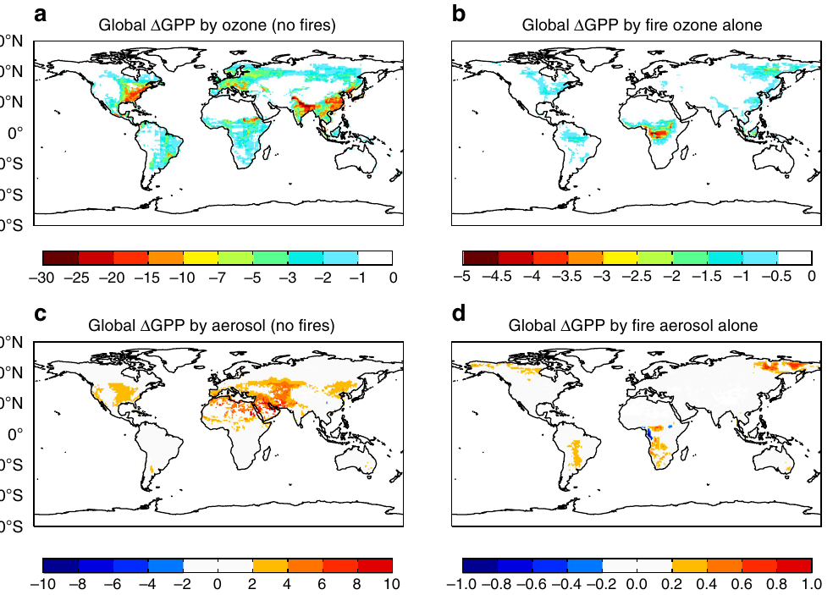
Co-pollutant ozone and aerosol type
6 · Mechanisms of aerosol impact
% change in global GPP: ozone (a, b) and aerosol (c, d); left: all sources except fire, right: fire alone
Effect on GPP or NPP | Pg C yr⁻¹ | Reference
Ozone, global (all sources except fire) | −4.0 ± 1.9 | Yue & Unger, 2018
Aerosol, global (all sources except fire) | +1.0 ± 0.2 | Yue & Unger, 2018
Fire pollution: ozone / aerosol / net | −0.91 / +0.05 / −0.86 | Yue & Unger, 2018
Black carbon, global (all‑sky) | −0.28 | Zhou et al., 2022
Ozone, China NPP (2010) | −0.59 (−14%) | Yue et al., 2017
Fire uncertainty: ±0.44 / ±0.30 / ±0.74
Lesson: a pollution effect is not an aerosol effect. Ozone damage exceeds the aerosol gain; black carbon lowers GPP, while sulfate, nitrate and organic aerosols give most of the gain.
Yue & Unger, 2018, Fig. 4
Notes:
Two further factors decide whether air pollution helps or harms plants: the co-pollutant ozone, and the type of aerosol.
Ozone forms from the same emissions as aerosol, nitrogen oxides and volatile organic compounds, so polluted air usually carries both. Ozone enters leaves through the stomata and damages photosynthesis, while aerosol works through diffuse light. Yue and Unger, 2018, combined several models with measurement datasets for 2002 to 2011. With all emissions except fires, ozone reduced global GPP by 4.0 plus or minus 1.9 petagrams of carbon per year, about 2.9 percent, while aerosol increased it by only 1.0 plus or minus 0.2. So globally, ozone damage is about four times the aerosol benefit.
Fire pollution was assessed separately. Fire emissions caused a further GPP loss of 0.86 petagrams per year: ozone removed 0.91, and aerosol added only 0.05, with an uncertainty of plus or minus 0.30, so the fire-aerosol benefit is essentially zero. The paper calls the net negative impact of fire pollution an increasing threat in a warming world.
The figure is Fig. 4 of Yue and Unger. The top row is ozone, the bottom row aerosol; the left column is all sources except fire, the right column fire alone. Ozone damage, panel a, is largest in the eastern United States, about 8.2 percent, eastern China, 7.5 percent, and Europe, 4.7 percent, where anthropogenic emissions are large. Aerosol gains, panel c, above 2 percent appear only in western Asia, North Africa and the central United States, arid or semi-arid regions where cloud is not abundant enough to mask the diffuse effect; in wetter, cloudier regions dense cloud already supplies diffuse light and aerosol adds little. Fire ozone, panel b, hits tropical Africa and South America, and fire aerosol, panel d, gives only small changes.
Aerosol type matters as well. Zhou and colleagues, 2022, found that black carbon, which absorbs rather than scatters light, reduces global GPP by 0.28 petagrams per year under all-sky conditions, whereas anthropogenic sulfate and nitrate provide about a third of the aerosol diffuse benefit and natural organic carbon about a fifth.
The same holds in China. Yue and colleagues, 2017, found that ozone reduced China's NPP by 0.59 petagrams, or 14 percent, in 2010, larger than the aerosol gain of about 0.20 petagrams from the previous slide.
The lesson is that a pollution effect is not the same as an aerosol effect. A study that relates productivity to pollution without separating ozone and aerosol type cannot attribute the result to the diffuse-light mechanism.

