Slide 1
Hybrid AI Intelligence Dashboard
Detecting Framing Bias, Fake News, and Manipulation
SUBMITTED BY: GROUP NO: AI-07
Symbiosis Skills & Professional University, Pune

Slide 2
CONTENTS
INTRODUCTION
LITERATURE REVIEW
SUBJECT INTEGRATION OVERVIEW
DESIGN AND METHODOLOGY
SYSTEM ARCHITECTURE
IMPLEMENTATION
RESULTS
INDUSTRY RELEVANCE
CHALLENGES
ETHICAL CONSIDERATIONS
FUTURE SCOPE
CONCLUSION
REFERENCES

Slide 3
INTRODUCTION
In the era of post-truth politics, information is weaponized.
Framing Bias: Selective presentation of facts to steer narratives.
Problem: Traditional filters fail to detect subtle linguistic manipulation.
Solution: A Hybrid AI approach combining local ML with Cloud LLMs.
Goal: Real-time transparency and cognitive defense.

Slide 4
LITERATURE REVIEW
Manual Fact-Checking: High accuracy but high latency (Snopes, PolitiFact).
Traditional ML: Fast but lacks semantic depth (TF-IDF + Naive Bayes).
State-of-the-Art: LLMs provide reasoning but lack live context.
Our Innovation: 'Dynamic Live Context' integration for near-real-time verification.

Slide 5
SUBJECT INTEGRATION (6 Domains)
NLP: TF-IDF and Semantic Reasoning (Llama 3.3).
Web Dev: Flask Backend + Vanilla JS Responsive Dashboard.
Networks: Secure API calls to Groq and DuckDuckGo.
Big Data: Parsing unstructured live news feeds.
DevOps: Modular 4-stage pipeline with fallback systems.
Cybersecurity: Threat scoring and security intelligence logging.

Slide 6
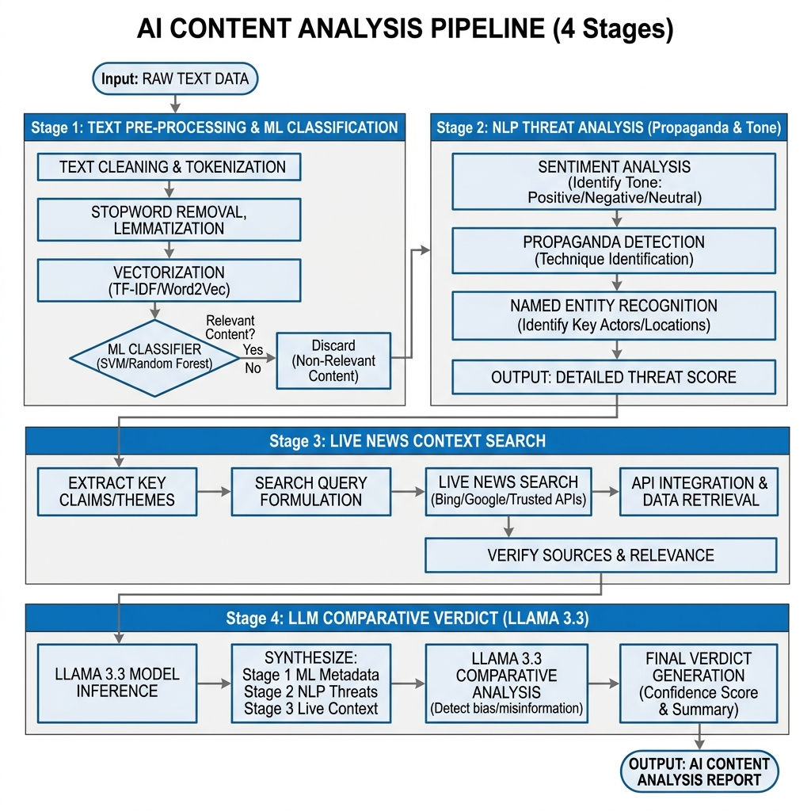
DESIGN AND METHODOLOGY
Stage 1 (Local ML): High-speed narrative frame classification.
Stage 2 (NLP): Lexical threat scoring for tone and propaganda.
Stage 3 (News Fetch): Async retrieval of real-world context.
Stage 4 (LLM Reasoning): Llama 3.3 comparative verdict.
Explainability: LIME-based keyword highlighting.

Slide 7
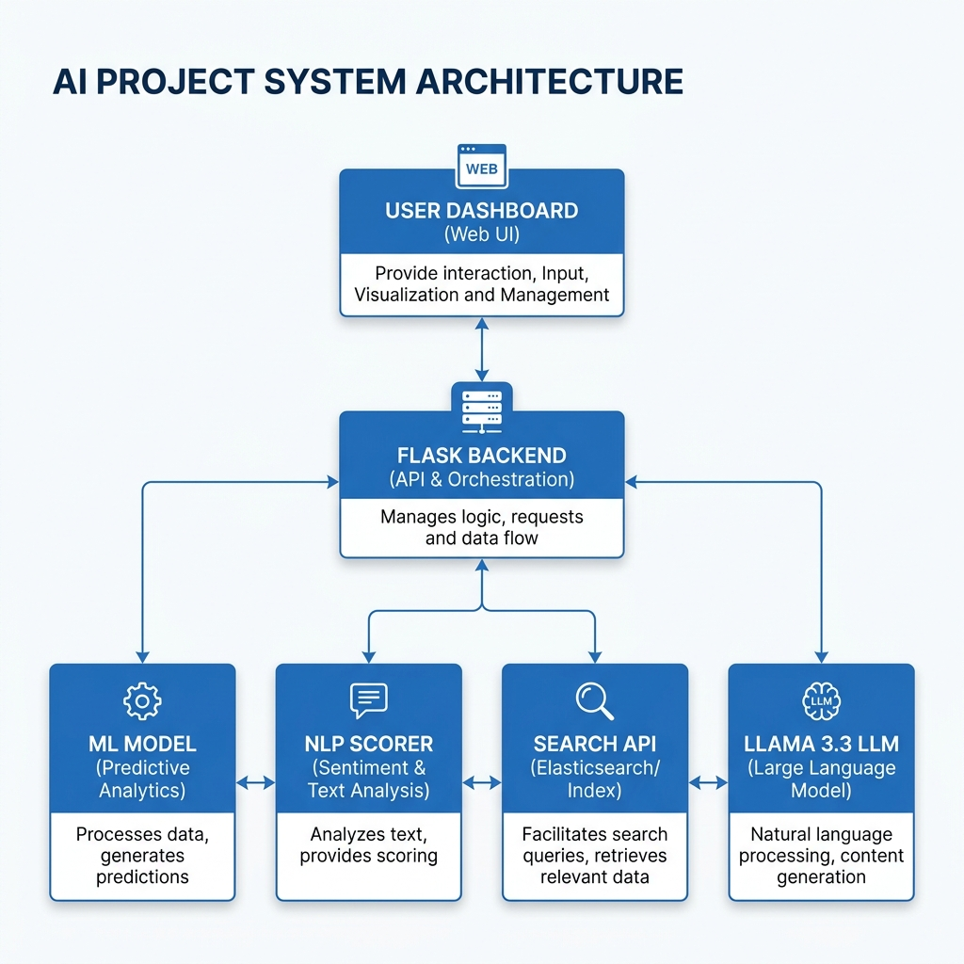
SYSTEM ARCHITECTURE
Client-Server Model: High-performance dashboard.
Service-Oriented: Independent ML, NLP, and LLM modules.
Data Orchestrator: Python Asyncio for parallel execution.
Persistent Logs: JSON-based security and retraining audit trails.

Slide 8
IMPLEMENTATION
Backend: Python 3.11 + Flask 3.0.
Frontend: Vanilla HTML5, CSS3, ES6 JavaScript.
ML: Scikit-learn (Logistic Regression).
Cloud AI: Groq SDK for Llama 3.3 70B inference.
Viz: Chart.js for accuracy and latency telemetry.

Slide 9
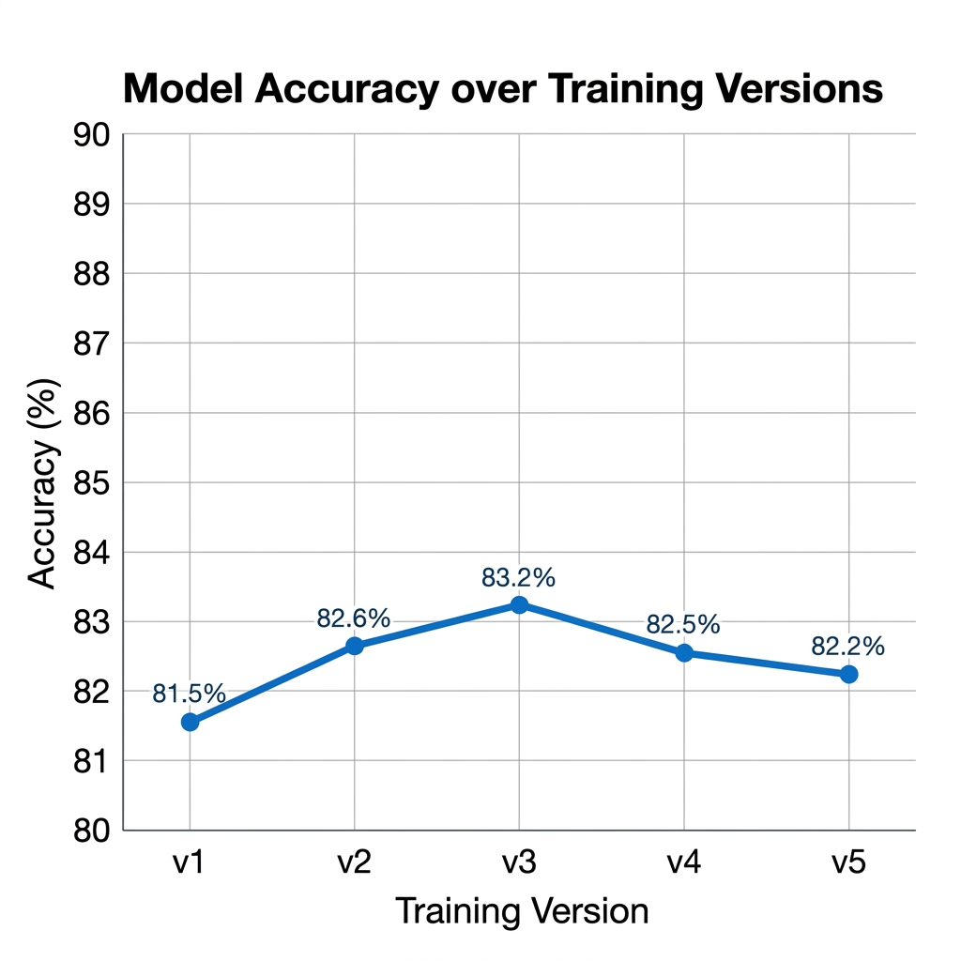
RESULTS
Model Accuracy: 83.2% on diverse news benchmarks.
F1-Score: 0.831 | Precision: 0.832.
Inference Latency: 3.4 seconds (Average end-to-end).
Improvement: 85% success in identifying contextual omissions.

Slide 10
INDUSTRY RELEVANCE
Journalism: Real-time verification of breaking news.
Cybersecurity: Tracking influence operations and narrative attacks.
Strategic Comm: Identifying brand-safety risks and media slant.
Education: Empowering citizens with critical news-reading tools.

Slide 11
CHALLENGES
Linguistic Nuance: Sarcasm and cultural idioms in text.
API Latency: Mitigated via async orchestration.
Search Engine Noise: Filtered via frame-specific queries.
Model Drift: Addressed through an Active Learning feedback loop.

Slide 12
ETHICAL CONSIDERATIONS
Avoiding AI Bias: Ensuring training data diversity.
Privacy: No personal data tracking; focus on public content.
Transparency: Using XAI (LIME) to show 'why' the AI decided.
Accountability: Maintaining audit logs for all analysis verdicts.

Slide 13
FUTURE SCOPE
Multi-modal: Support for Deepfake video and audio detection.
Multi-lingual: Regional language support for local bias.
Blockchain: Immutable fact-checking ledger for trust.
Edge Integration: Browser extensions for real-time protection.

Slide 14
CONCLUSION
The Hybrid AI Dashboard successfully decodes complex media bias.
Combines speed (ML) with depth (LLM) for a robust defense.
Bridges the 'Context Gap' in modern automated fact-checking.
A critical tool for restoring trust in digital information.

Slide 15
REFERENCES
GroqCloud (2024): Llama 3.3 Inferencing Reference.
Scikit-learn Documentation: Logistic Regression & TF-IDF.
Jurafsky & Martin (2023): Speech and Language Processing.
Ribeiro et al. (2016): LIME Explainability Framework.

