Slide 1
Which features detect white rust? Filter, wrapper and embedded feature selection on the K1–K4 spectral feature pool
23 methods from crop-disease research compared under one honest protocol · stable and informative disease-specific features
2264 leaf spectra (378 healthy, 1886 white-rust diseased) · 4 dates · 3 growth stages · 3 varieties · 4150 features
Animesh Panda · Division of Agricultural Physics, ICAR-IARI, New Delhi

Slide 2
Key results at a glance
SVM-RFE
87.1 %
0.65
84.5 %
best method overall (composite ranking)
QDA balanced accuracy on new plots with its 10 features
stability: Jaccard of the 20 training-set selections (±10 nm)
four-tier RF-17 set of Part C on the same plots (reference)
SFFS (QDA criterion), SVM-RFE and CARS give the most accurate 10-feature sets on new plots (86.8–87.9 % balanced accuracy), 2.3–3.4 points above the four-tier RF-17 set and 8.5–9.6 points above the four-tier CART-13 set.
SVM-RFE is the best all-round method for this dataset (composite rank 1): accurate with QDA (87.1 %) and RF (87.2 %), moderately stable (Jaccard 0.65). ReliefF is the most stable (0.84) and still accurate (84.9 %).
Univariate filters (r = ANOVA F = Fisher score, χ², MI) need redundancy control: skipping near-duplicate bands raises their accuracy by 3.6–6.1 points.
J–M is a poor criterion for choosing features here: the J–M-optimised sets have the highest J–M (1.75–1.80) but only 70–73 % accuracy on new plots.
Water features dominate the disease signature: 970-nm band width and 1940-nm band position/symmetry, plus derivative bands at 1915–1934 nm and 848–911 nm. CARS, LASSO and SVM-RFE partly rely on bands next to the detector joins, which needs caution.

Slide 3
Why feature selection? 4150 correlated features, 2264 leaves
Hyperspectral data are high-dimensional and strongly collinear: neighbouring bands carry almost the same information (Thomas et al. 2018).
Too many features → over-fitting, unstable covariance matrices (QDA needs fewer features than leaves per class), costly sensors.
Feature selection keeps a few original, interpretable features — unlike PCA, the selected wavelengths can guide a multispectral disease sensor (Wei et al. 2021).
Different selectors answer different questions: which feature is individually discriminating (filter), which subset classifies best (wrapper), which features a model relies on (embedded).
Goal here: features that are (1) informative — separate healthy and diseased leaves on new plots, (2) stable — chosen again when the data change, (3) disease-specific — physiologically interpretable.
Filter
score each feature by a statistic, independent of a classifier
fast; ignores interactions; redundant top lists
Wrapper
search subsets, scored by a classifier or a separability criterion
finds complementary features; slow; can over-fit
Embedded
selection is part of model fitting (trees, penalties, PLS)
middle ground in cost; model-specific
References: Guyon & Elisseeff 2003; Saeys et al. 2007; Kohavi & John 1997; Thomas et al. 2018; Wei et al. 2021

Slide 4
The 23 methods compared (as used in crop-disease studies)
Filter (11)
Wrapper (6)
Embedded (7)
Pearson r — Pearson
ANOVA F — Abdulridha 2023
Fisher score — Duda 2001
Chi-square — Abdulridha 2023
Mutual information — Kraskov 2004
ReliefF — Kononenko 1994; Mahlein 2013
J–M (univariate) — Das 2020
mRMR — Peng 2005
SPA — Araújo 2001; Zhu 2017
MC-UVE — Centner 1996; Cai 2008
CWT scalogram — Cheng 2010
SVM-RFE — Guyon 2002; Wei 2021; Liu 2024
RF-RFE — Wei 2021; Liu 2024
CARS — Li 2009; Zhu 2017
SFFS (QDA) — Pudil 1994; Mustafa 2023
SFFS (J–M) — Pudil 1994; Das 2020
Genetic algorithm — Leardi 1992; Nagasubramanian 2018
RF importance — Breiman 2001; Chen 2004
CART importance — Breiman 1984; Das 2020
Boruta — Kursa 2010; Mustafa 2023
PLS-VIP — Wold 2001; Chong 2005
LASSO — Tibshirani 1996
Gradient boosting — Friedman 2001; Chen 2016
Consensus (Borda) — Saeys 2008

Slide 5
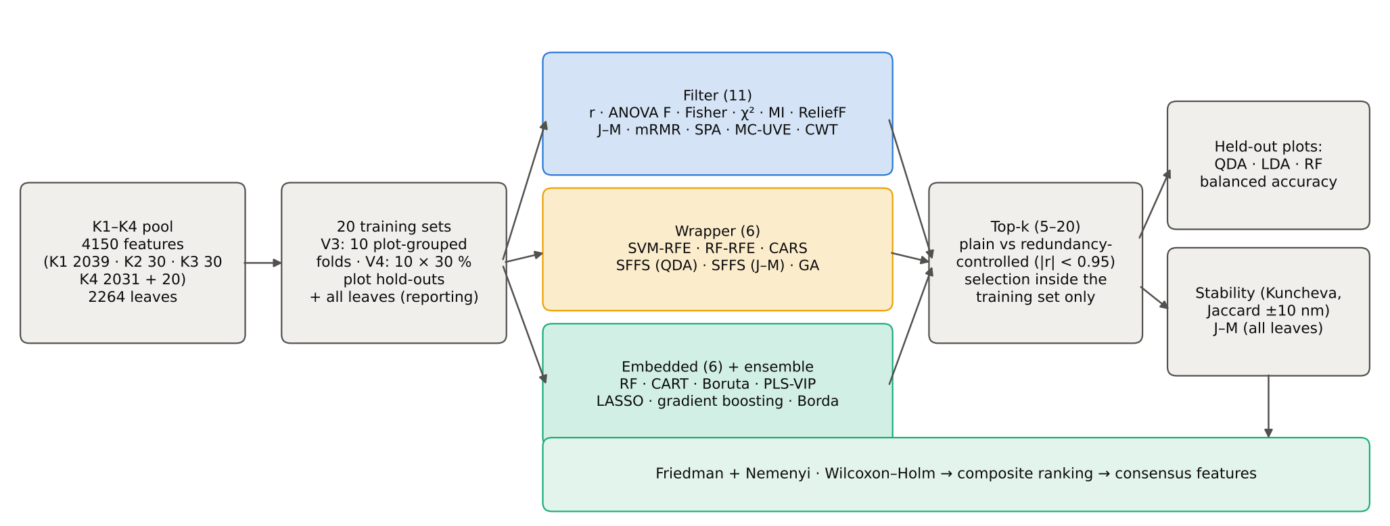
Study design: one protocol for every method
Selection runs only inside the training leaves of each of 20 units (10 plot-grouped folds + 10 hold-outs of 30 % of plots) — no selection bias (Ambroise & McLachlan 2002).
Same leaves, same pool, same units, same classifiers (QDA equal priors = Tier 4 of Das et al. 2020; LDA; Balanced RF) → differences come from the selector only.
Top-k with k = 5–20; 'redundancy-controlled' = skip a feature correlated |r| ≥ 0.95 with one already chosen (cf. Wei et al. 2021, 20-nm minimum distance).

Slide 6
Filter methods
Pearson r · ANOVA F · Fisher score · chi-square · mutual information · ReliefF · univariate J–M · mRMR · SPA · MC-UVE · CWT separability scalogram

Slide 7
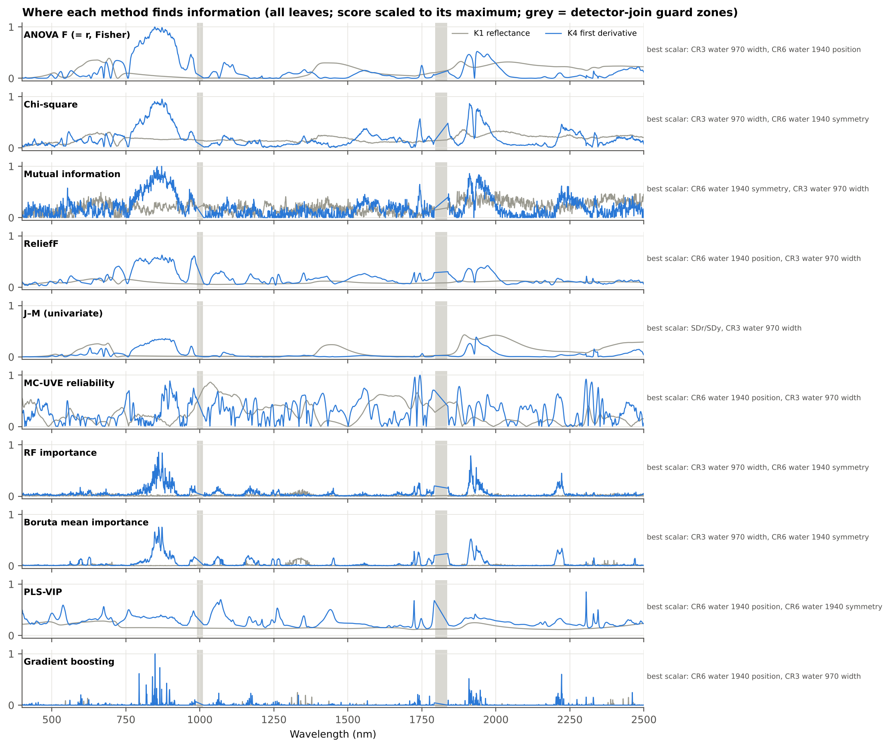
Univariate filters: where does each statistic find information?
Pearson r, ANOVA F and Fisher score are algebraically equivalent for two classes (r² = F/(F + n − 2)) → identical rankings (verified: Spearman ρ = 1).
Chi-square (Abdulridha et al. 2023) bins each feature into quantiles; mutual information (Kraskov et al. 2004) also captures non-linear dependence.
All univariate filters peak on the same few regions — first-derivative bands near 850–875 nm and 1910–1950 nm and the continuum-removed water features — so their top-10 lists are made of neighbouring bands.
References: Pearson 1895; Duda et al. 2001; Abdulridha et al. 2023; Kraskov et al. 2004; Das et al. 2020

Slide 8
Multivariate filters: ReliefF, mRMR, SPA and MC-UVE
Method | Principle | Top-5 (all leaves)
ReliefF | nearest hit / nearest miss differences (k = 10, L1) | CR6 water 1940 position, CR3 water 970 width, CR6 water 1940 symmetry, D1_872, D1_873
mRMR | max relevance (F) / min redundancy (|r|) quotient | D1_848, D1_1053, D1_847, CR6 water 1940 position, CR3 water 970 width
SPA | successive projections: least collinear chain; length by inner CV | D1_873, D1_2141, D1_674, SDr/SDb, D1_1052
MC-UVE | stability of PLS coefficients vs artificial noise variables | D1_1744, D1_1743, D1_1745, D1_1742, D1_1726
ReliefF (Kononenko 1994; used by Mahlein et al. 2013 to build disease indices): nearest hit / nearest miss differences; class-balanced instances.
SPA (Araújo et al. 2001; Zhu et al. 2017): picks the least collinear chain; 20 variables chosen by inner CV — minimal collinearity, but not necessarily the most discriminating features.
MC-UVE (Centner et al. 1996): 1760 of 4150 features have PLS coefficients more stable than every artificial noise variable — UVE removes noise, it does not pick a short list.
mRMR (Peng et al. 2005): relevance (F) divided by redundancy (mean |r|) — built-in redundancy control.
References: Kira & Rendell 1992; Kononenko 1994; Mahlein et al. 2013; Peng et al. 2005; Araújo et al. 2001; Zhu et al. 2017; Centner et al. 1996; Cai et al. 2008

Slide 9
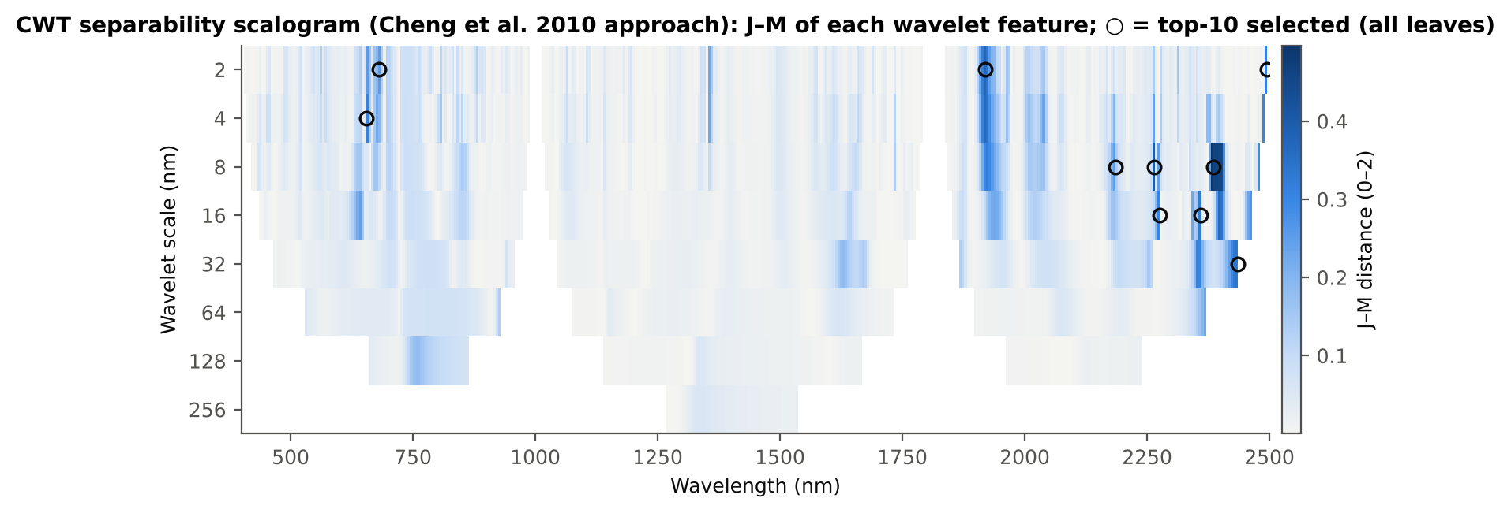
Continuous wavelet analysis: separability scalogram (Cheng et al. 2010)
Each spectrum is decomposed with the Mexican-hat wavelet at 8 dyadic scales (2–256 nm): 3368 wavelet features; the J–M of every coefficient forms the scalogram.
Top features (all leaves): CWT s8 2385, CWT s8 2265, CWT s2 1920, CWT s32 2435, CWT s16 2360, CWT s4 655.
Small scales behave like derivatives (absorption-feature shape), large scales like continuum-removed band depths — wavelet features combine K2 and K4 information.
References: Cheng et al. 2010; Das et al. 2020 (J–M)

Slide 10
Wrapper methods
SVM-RFE · RF-RFE · CARS · SFFS (QDA criterion) · SFFS (J–M criterion) · genetic algorithm

Slide 11
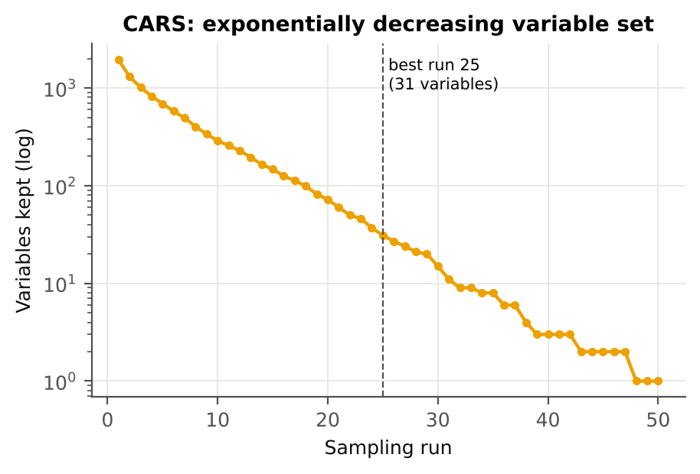
Recursive feature elimination and CARS
Method | Principle | Top-6 (all leaves)
SVM-RFE | recursive elimination by |w| of a linear SVM | CR3 water 970 width, CR6 water 1940 position, D1_454, D1_2329, D1_2305, D1_982
RF-RFE | recursive elimination by Balanced-RF importance | D1_872, CR6 water 1940 symmetry, D1_1164, CR3 water 970 width, D1_862, D1_1914
CARS | Monte-Carlo PLS, exponential decay + adaptive reweighted sampling | D1_2205, ARI, D1_1723, D1_1749, D1_453, D1_982
RFE removes the least important features step by step and re-fits the model each time (Guyon et al. 2002); Wei et al. (2021) found RFE better than chi-square for peanut stem rot.
CARS (Li et al. 2009) keeps an exponentially shrinking set by PLS-coefficient weights and adaptive reweighted sampling: best run 25 with 31 variables.
References: Guyon et al. 2002; Wei et al. 2021; Liu et al. 2024 (as cited); Li et al. 2009; Zhu et al. 2017

Slide 12
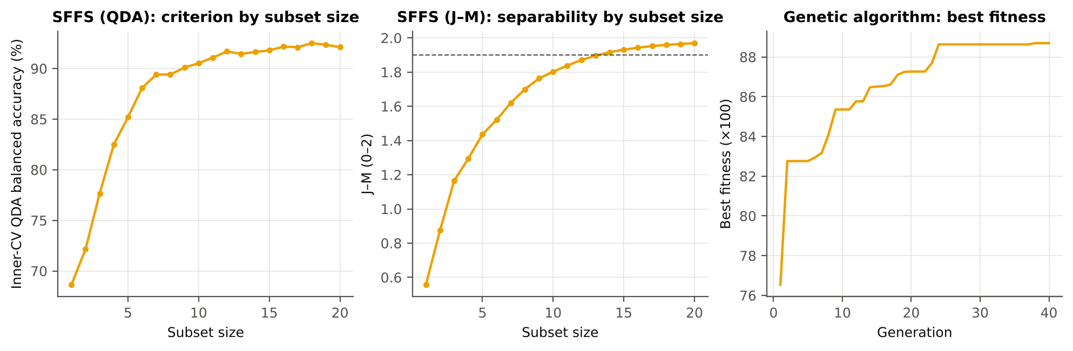
Sequential floating forward selection and the genetic algorithm
SFFS (Pudil et al. 1994; used by Mustafa et al. 2023): add the best feature, drop features while that helps. Criterion = inner-CV QDA balanced accuracy (ML-based) or J–M (Das Tier 3).
SFFS (QDA), 10 features: CR3 water 970 width, D1_938, CR6 water 1940 position, R1386, ARI, D1_913, D1_745, D1_1353, D1_1365, D1_1057.
GA (Leardi et al. 1992; Nagasubramanian et al. 2018 for charcoal rot): 50 chromosomes × 40 generations, fitness = QDA BA − size penalty; best chromosome 14 features.
Candidates for SFFS/GA: the 100 most significant, mutually non-redundant (|r| < 0.95) features of each training set.
References: Pudil et al. 1994; Mustafa et al. 2023; Leardi et al. 1992; Nagasubramanian et al. 2018; Das et al. 2020

Slide 13
Embedded methods
Random Forest importance · CART importance · Boruta · PLS-VIP · LASSO · gradient boosting · consensus (Borda)

Slide 14
Tree-based importance, PLS-VIP and LASSO
Method | Principle | Top-5 (all leaves)
RF importance | Balanced Random Forest mean decrease in Gini | CR3 water 970 width, D1_861, D1_873, D1_1915, D1_857
CART importance | Gini importance of a pruned CART tree (equal priors) | D1_861, CR3 water 970 width, CR6 water 1940 symmetry, D1_1164, D1_1163
Gradient boosting | gradient-boosted trees split-gain importance (XGBoost family) | D1_849, D1_865, D1_795, D1_2222, D1_840
PLS-VIP | variable importance in projection of PLS-DA | CR6 water 1940 position, D1_2305, CR6 water 1940 symmetry, D1_1070, D1_1071
LASSO | L1-penalised logistic regression (order of entry) | CR6 water 1940 position, CR3 water 970 width, D1_848, D1_1724, D1_2330
PLS-VIP: 15 components; 1349 features with VIP > 1 (Wold et al. 2001; Chong & Jun 2005).
LASSO: 127 non-zero coefficients at the cross-validated penalty (Tibshirani 1996).
CART uses only 11 features in its pruned tree — the same mechanism as Tier 2 of Das et al. (2020).
References: Breiman 2001; Breiman et al. 1984; Friedman 2001; Chen & Guestrin 2016; Wold et al. 2001; Chong & Jun 2005; Tibshirani 1996

Slide 15
Boruta: all-relevant selection with shadow features
192
201
3757
features confirmed (all leaves)
tentative
rejected
Every real feature competes with a shuffled copy of itself (a 'shadow'); a feature that beats the best shadow significantly often (binomial test, Bonferroni) is confirmed (Kursa & Rudnicki 2010).
Boruta finds ALL features carrying disease information (all-relevant), so its confirmed set is large: it is a screening tool, not a minimal set; for top-k the ranking by mean importance is used.
Top features by mean importance: CR3 water 970 width, D1_861, D1_872, D1_873, CR6 water 1940 symmetry, D1_862, D1_863, D1_848.
Mustafa et al. (2022, 2023) used Boruta to pick fusarium-head-blight-sensitive features before a final SFFS step — the same two-stage idea as Boruta → SFFS here.
References: Kursa & Rudnicki 2010; Mustafa et al. 2022, 2023

Slide 16
Which method works best?
Accuracy on new plots · redundancy · stability · statistical tests · composite ranking

Slide 17
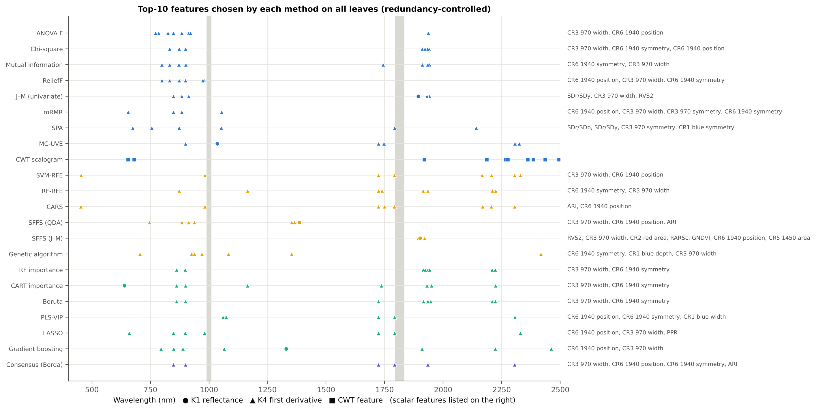
What each method picks (10 features, all leaves, redundancy-controlled)

Slide 18
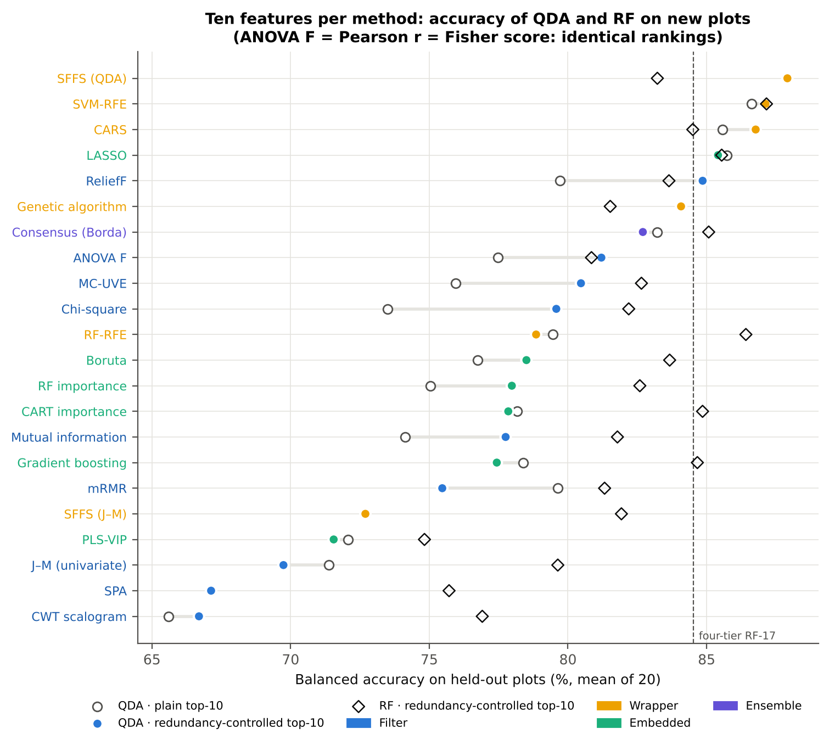
Accuracy of 10 selected features on leaves of new plots
With 10 features, SFFS (QDA) reaches 87.9 %, SVM-RFE 87.1 %, CARS 86.8 %, LASSO 85.4 %, ReliefF 84.9 % and the genetic algorithm 84.1 % (QDA balanced accuracy, mean of 20 held-out sets).
Univariate filters stay at 78–81 % (ANOVA F 81.2 %, χ² 79.6 %, MI 77.8 %), as do the tree importances (RF 78.0 %, CART 77.8 %, gradient boosting 77.4 %) and Boruta (78.5 %). PLS-VIP, univariate J–M, SPA and the CWT scalogram fall to 67–72 %.
With a Random Forest instead of QDA the differences shrink (75–87 %). The best RF results are on the SVM-RFE (87.2 %), RF-RFE (86.4 %) and LASSO (85.5 %) features.

Slide 19
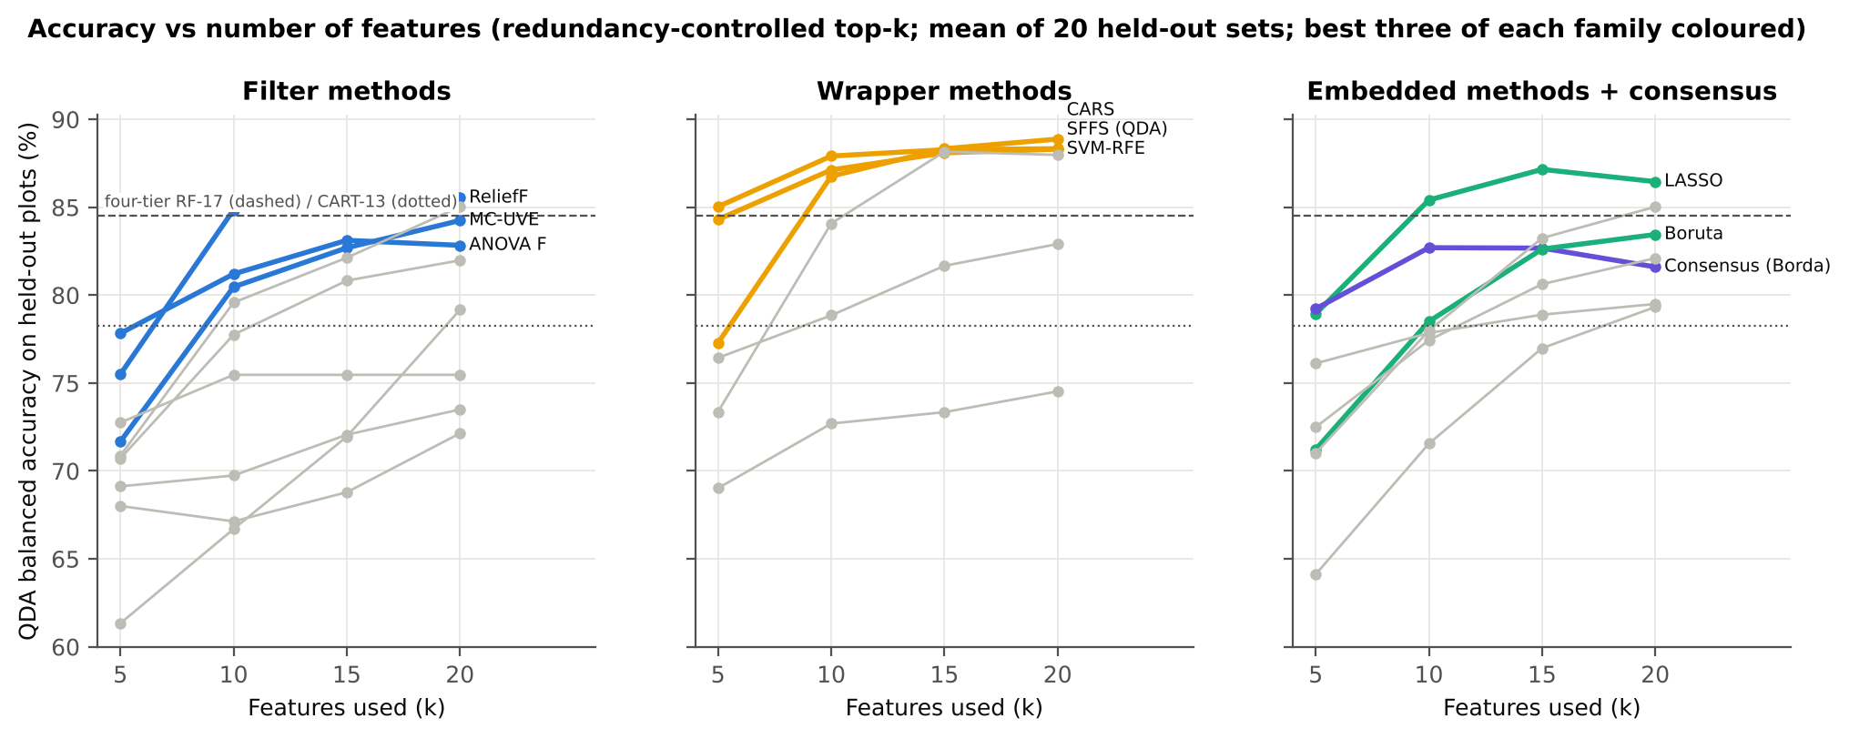
How many features are needed?
Accuracy rises from 5 to 15 features and then levels off (SFFS 85.0 → 87.9 → 88.3 → 88.3 %; CARS 77.3 → 86.8 → 88.3 → 88.9 %). SFFS and SVM-RFE already exceed 84 % with five features; 10–15 features are enough.

Slide 20
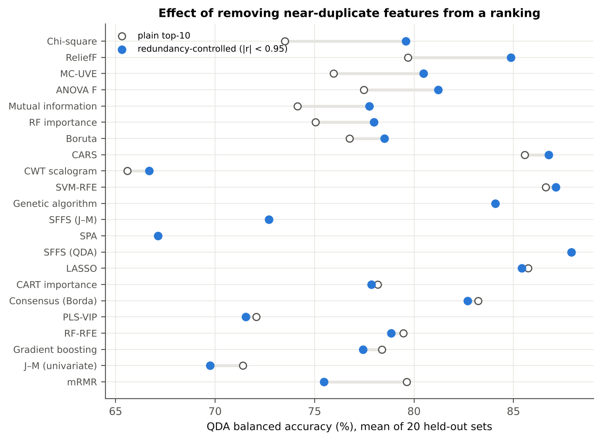
Redundancy control: skip near-duplicate features
Top-ranked features of a univariate ranking are neighbouring bands of the same region (e.g. D1_848–D1_920) and carry almost the same information.
Skipping a feature correlated |r| ≥ 0.95 with one already chosen raised accuracy for χ² (+6.1 points), ReliefF (+5.2), MC-UVE (+4.5), ANOVA F (+3.7), mutual information (+3.6) and RF importance (+2.9).
Methods that already handle redundancy (SFFS, GA, SPA, CARS, LASSO) gain nothing. This agrees with Wei et al. (2021), where a minimum distance between selected wavelengths improved disease classification.
References: Wei et al. 2021 (minimum distance between selected wavelengths)

Slide 21
Detector-join check: do selectors exploit bands next to the ASD joins?
Method | Near-join share | QDA BA | Join bands excluded | Δ | p
SVM-RFE | 18.0 % | 87.1 % | 85.6 % | -1.5 pts | 0.001
LASSO | 15.0 % | 85.4 % | 82.2 % | -3.2 pts | 0.001
CARS | 13.5 % | 86.8 % | 82.2 % | -4.6 pts | 0.000
ReliefF | 11.0 % | 84.9 % | 83.9 % | -0.9 pts | 0.027
PLS-VIP | 10.5 % | 71.6 % | 71.0 % | -0.5 pts | 0.679
Consensus (Borda) | 7.5 % | 82.7 % | 80.2 % | -2.5 pts | 0.002
RF-RFE | 4.5 % | 78.9 % | 78.4 % | -0.5 pts | 0.208
SPA | 4.5 % | 67.1 % | 67.0 % | -0.2 pts | 0.441
MC-UVE | 4.0 % | 80.5 % | 80.8 % | +0.3 pts | 0.063
CART importance | 3.8 % | 77.8 % | 77.6 % | -0.3 pts | 0.310
SFFS (QDA) | 3.5 % | 87.9 % | 86.9 % | -1.1 pts | 0.121
Boruta | 3.0 % | 78.5 % | 77.7 % | -0.8 pts | 0.028
Linear-model selectors pick bands next to the ASD detector joins (≈ 1000 and 1800 nm) more often: SVM-RFE 18 % of its top-10 selections within 10 nm of a join, LASSO 15 %, CARS 13.5 %, ReliefF 11 % (univariate filters 0 %).
Excluding such bands lowers CARS by 4.6 points (to 82.2 %), LASSO by 3.2 (to 82.2 %), the consensus by 2.5 and SVM-RFE by 1.5 (to 85.6 %). SFFS (QDA) loses only 1.1 points (not significant; 86.9 %).
Part of the advantage of CARS and LASSO may therefore come from residual splice effects (or from the 970-nm water-band shoulder at 981 nm). SFFS (QDA) and SVM-RFE remain the best methods after this correction.
References: Guard zones 988–1012 and 1793–1837 nm (first derivative); see Part K of the main analysis

Slide 22
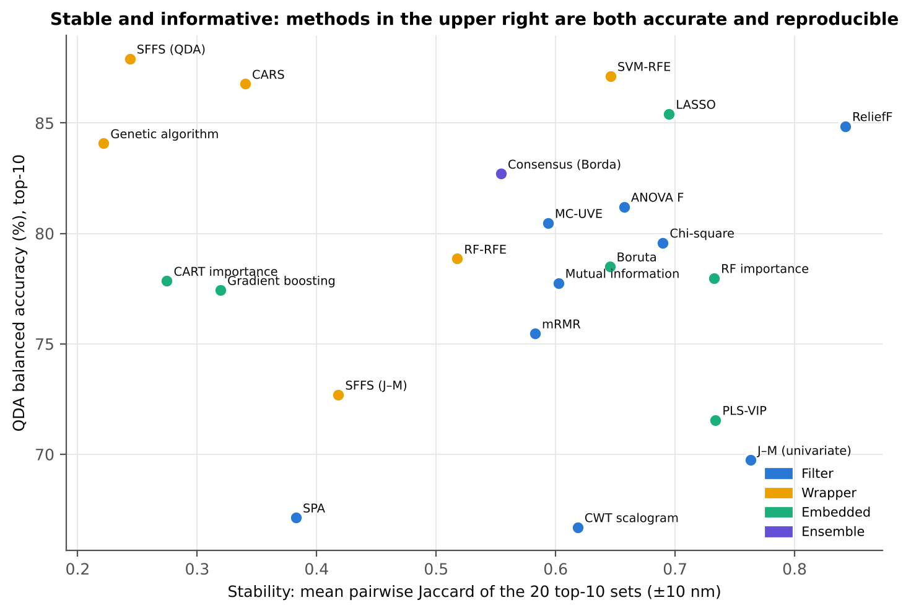
Stable and informative: stability against accuracy
Method | Kuncheva | Jaccard exact | Jaccard ±10 nm
ReliefF | 0.64 | 0.49 | 0.84
J–M (univariate) | 0.59 | 0.44 | 0.76
PLS-VIP | 0.65 | 0.49 | 0.73
RF importance | 0.53 | 0.38 | 0.73
LASSO | 0.73 | 0.58 | 0.69
Chi-square | 0.48 | 0.33 | 0.69
ANOVA F | 0.41 | 0.27 | 0.66
SVM-RFE | 0.56 | 0.41 | 0.65
Boruta | 0.47 | 0.32 | 0.65
CWT scalogram | 0.75 | 0.62 | 0.62
Mutual information | 0.33 | 0.21 | 0.60
MC-UVE | 0.47 | 0.32 | 0.59
Accuracy and stability trade off. Filters and penalised or importance-based methods are stable (ReliefF 0.84, univariate J–M 0.76, RF importance 0.73, LASSO 0.70, χ² 0.69, SVM-RFE 0.65); search-based wrappers are not (CARS 0.34, SFFS 0.24, GA 0.22) because many equally good feature combinations exist in collinear spectra.
References: Kuncheva 2007; Nogueira et al. 2018

Slide 23
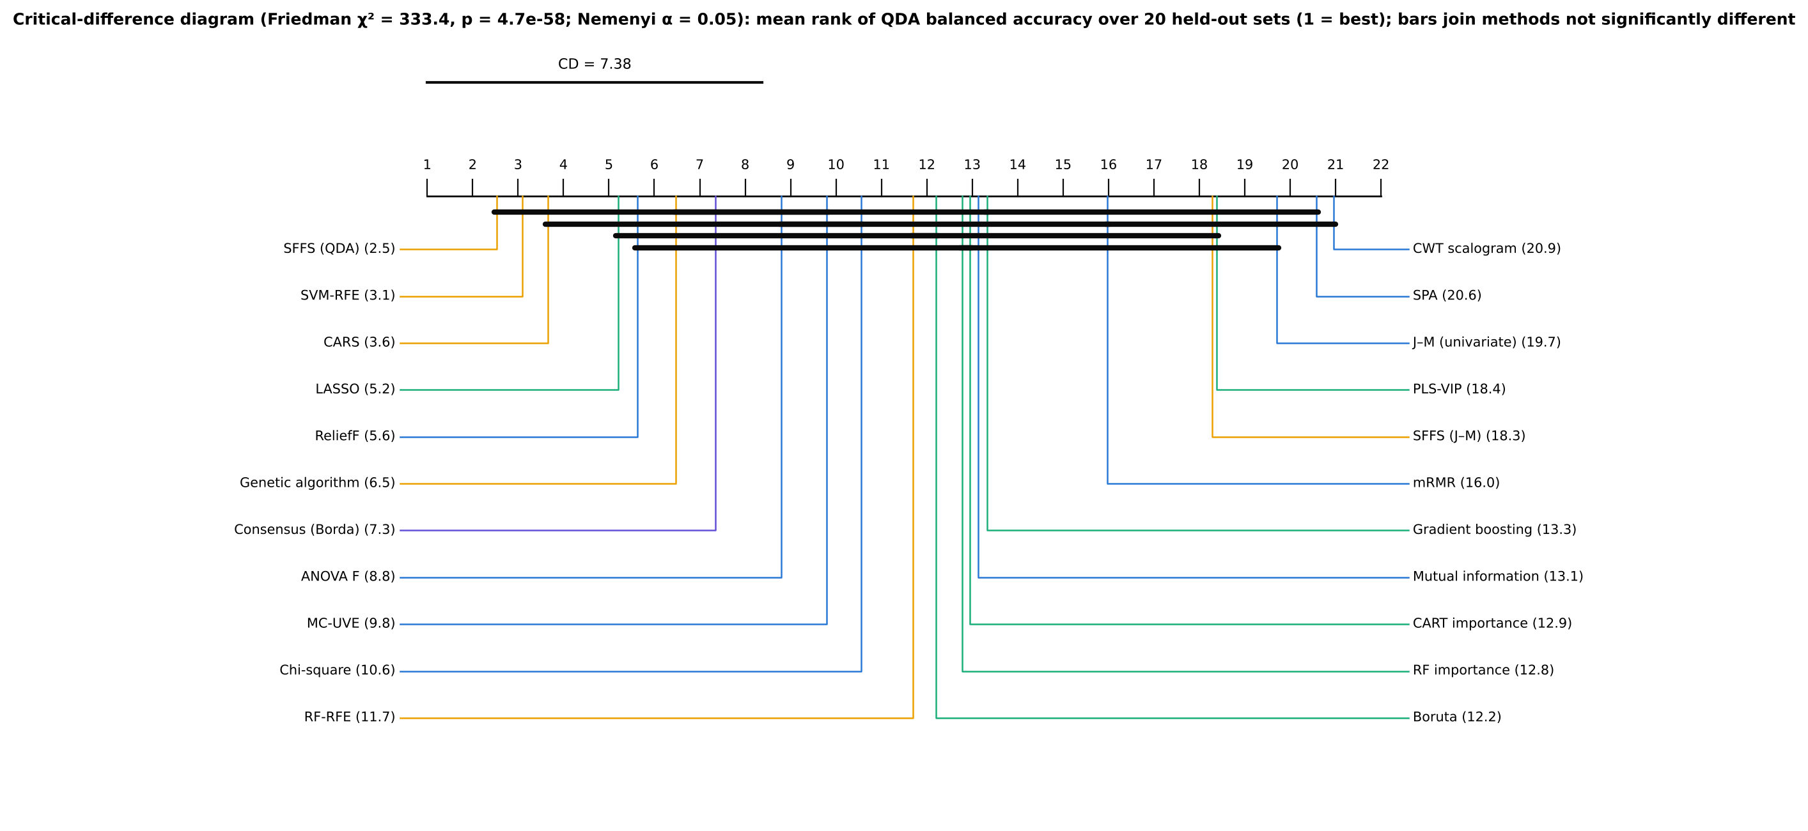
Are the differences between methods significant?
Other method | Δ BA (best − other) | Best better | Holm p | Sig.
Chi-square | +8.3 pts | 20/20 | 4.0e-05 | yes
Mutual information | +10.2 pts | 20/20 | 4.0e-05 | yes
mRMR | +12.4 pts | 20/20 | 4.0e-05 | yes
J–M (univariate) | +18.2 pts | 20/20 | 4.0e-05 | yes
SPA | +20.8 pts | 20/20 | 4.0e-05 | yes
RF importance | +9.9 pts | 20/20 | 4.0e-05 | yes
RF-RFE | +9.1 pts | 20/20 | 4.0e-05 | yes
Friedman test across the 22 distinct methods and 20 units: χ² = 333.4, p = 4.7 × 10⁻⁵⁸; Nemenyi critical difference 7.4 ranks.
SFFS (QDA), SVM-RFE and CARS are not significantly different (Holm p = 0.55). Every other method is significantly less accurate than SFFS (Holm p ≤ 0.003).
References: Friedman 1937 via Demšar 2006 (Friedman–Nemenyi); Holm-corrected Wilcoxon tests

Slide 24
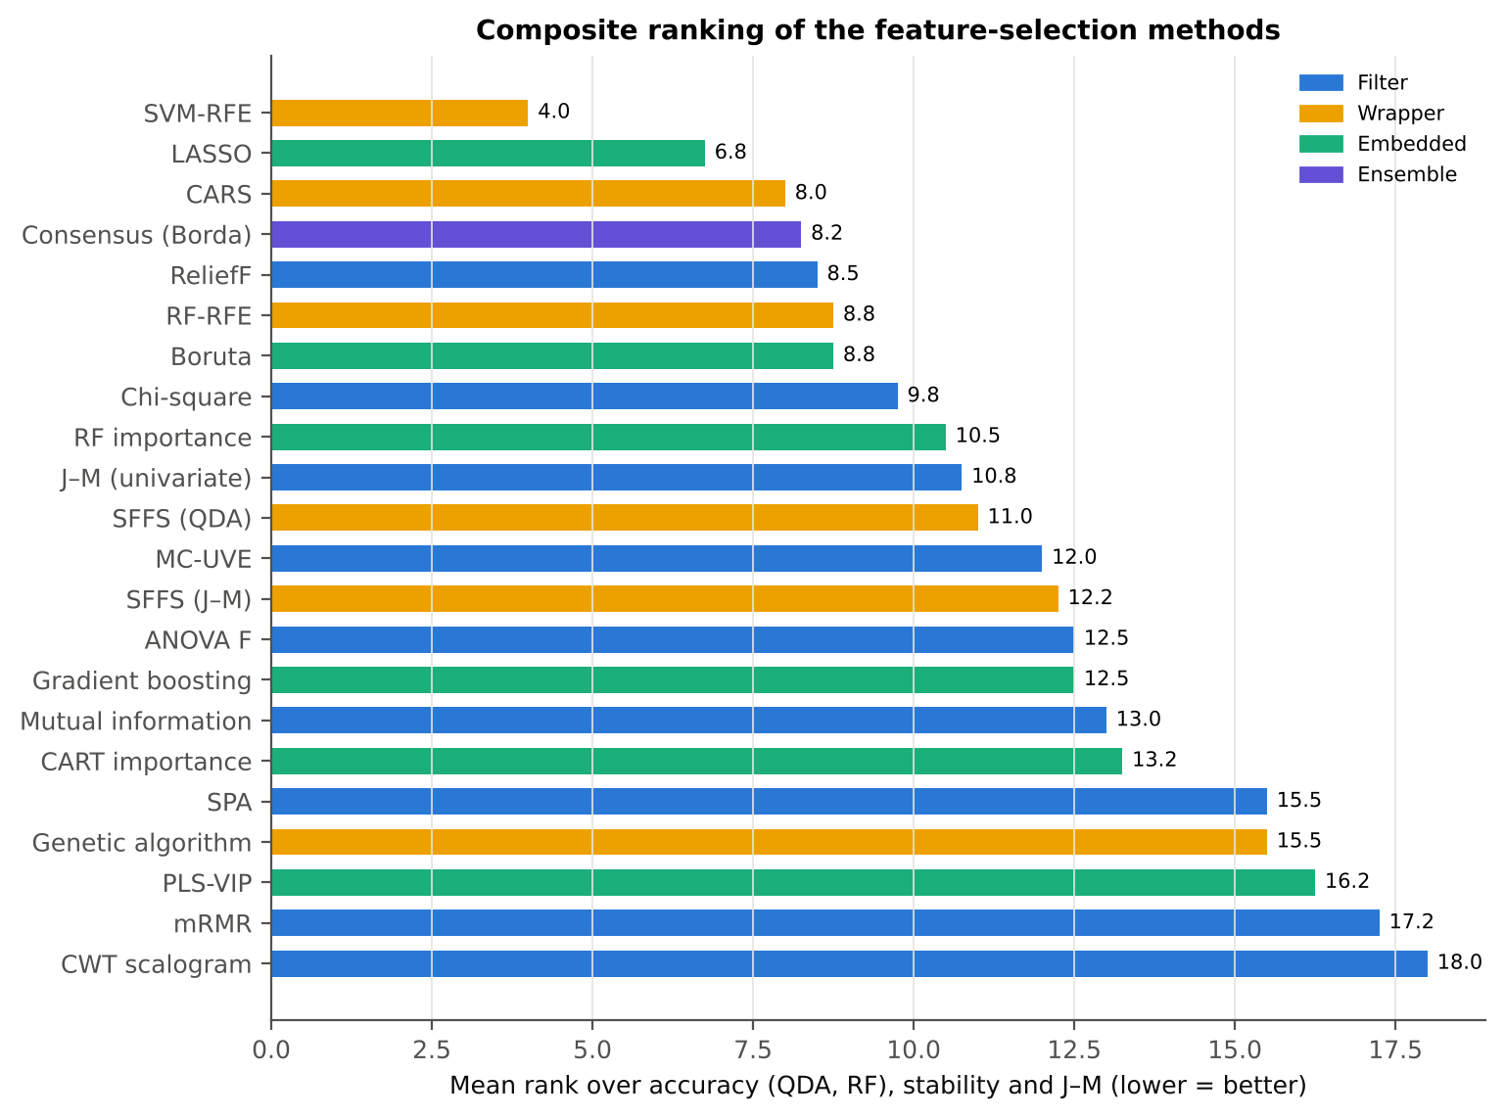
Composite ranking: accuracy, stability and separability together
# | Method | Family | QDA BA | RF BA | Stability | J–M | Mean rank
1 | SVM-RFE | Wrapper | 87.1 % | 87.2 % | 0.65 | 1.56 | 4.0
2 | LASSO | Embedded | 85.4 % | 85.5 % | 0.69 | 1.38 | 6.8
3 | CARS | Wrapper | 86.8 % | 84.5 % | 0.34 | 1.58 | 8.0
4 | Consensus (Borda) | Ensemble | 82.7 % | 85.1 % | 0.55 | 1.49 | 8.2
5 | ReliefF | Filter | 84.9 % | 83.6 % | 0.84 | 1.21 | 8.5
6 | Boruta | Embedded | 78.5 % | 83.7 % | 0.65 | 1.51 | 8.8
6 | RF-RFE | Wrapper | 78.9 % | 86.4 % | 0.52 | 1.50 | 8.8
8 | Chi-square | Filter | 79.6 % | 82.2 % | 0.69 | 1.45 | 9.8
9 | RF importance | Embedded | 78.0 % | 82.6 % | 0.73 | 1.43 | 10.5
10 | J–M (univariate) | Filter | 69.7 % | 79.6 % | 0.76 | 1.75 | 10.8
11 | SFFS (QDA) | Wrapper | 87.9 % | 83.2 % | 0.24 | 1.43 | 11.0
12 | MC-UVE | Filter | 80.5 % | 82.6 % | 0.59 | 1.28 | 12.0

Slide 25
Best selectors vs the four-tier sets (Das et al. 2020 approach, Part C)
Method | vs | Method BA | Four-tier BA | Δ | Wins | p
SFFS (QDA) | Four-tier CART-13 | 87.9 % | 78.3 % | +9.6 pts | 19/20 | 0.000
SFFS (QDA) | Four-tier RF-17 | 87.9 % | 84.5 % | +3.4 pts | 15/20 | 0.001
SVM-RFE | Four-tier CART-13 | 87.1 % | 78.3 % | +8.9 pts | 20/20 | 0.000
SVM-RFE | Four-tier RF-17 | 87.1 % | 84.5 % | +2.6 pts | 15/20 | 0.004
CARS | Four-tier CART-13 | 86.8 % | 78.3 % | +8.5 pts | 20/20 | 0.000
CARS | Four-tier RF-17 | 86.8 % | 84.5 % | +2.3 pts | 15/20 | 0.019
LASSO | Four-tier CART-13 | 85.4 % | 78.3 % | +7.1 pts | 19/20 | 0.000
LASSO | Four-tier RF-17 | 85.4 % | 84.5 % | +0.9 pts | 13/20 | 0.165
Consensus (Borda) | Four-tier CART-13 | 82.7 % | 78.3 % | +4.4 pts | 16/20 | 0.003
Consensus (Borda) | Four-tier RF-17 | 82.7 % | 84.5 % | -1.8 pts | 8/20 | 0.105
ReliefF | Four-tier CART-13 | 84.9 % | 78.3 % | +6.6 pts | 18/20 | 0.000
ReliefF | Four-tier RF-17 | 84.9 % | 84.5 % | +0.3 pts | 8/20 | 0.956
Boruta | Four-tier CART-13 | 78.5 % | 78.3 % | +0.2 pts | 12/20 | 0.701
Boruta | Four-tier RF-17 | 78.5 % | 84.5 % | -6.0 pts | 0/20 | 0.000
The four-tier analysis of Part C (CART-13: 78.3 %; RF-17: 84.5 % on the same 20 held-out sets) is beaten by SFFS (QDA) (+3.4 points vs RF-17, 15/20 sets, p = 0.001), SVM-RFE (+2.6, p = 0.004) and CARS (+2.3, p = 0.019).
LASSO and ReliefF are equivalent to RF-17 (p = 0.17 and 0.96); Boruta's top-10 is 6.0 points worse (0/20, p < 0.001). Against CART-13 every method in this table except Boruta gains 4–10 points.

Slide 26
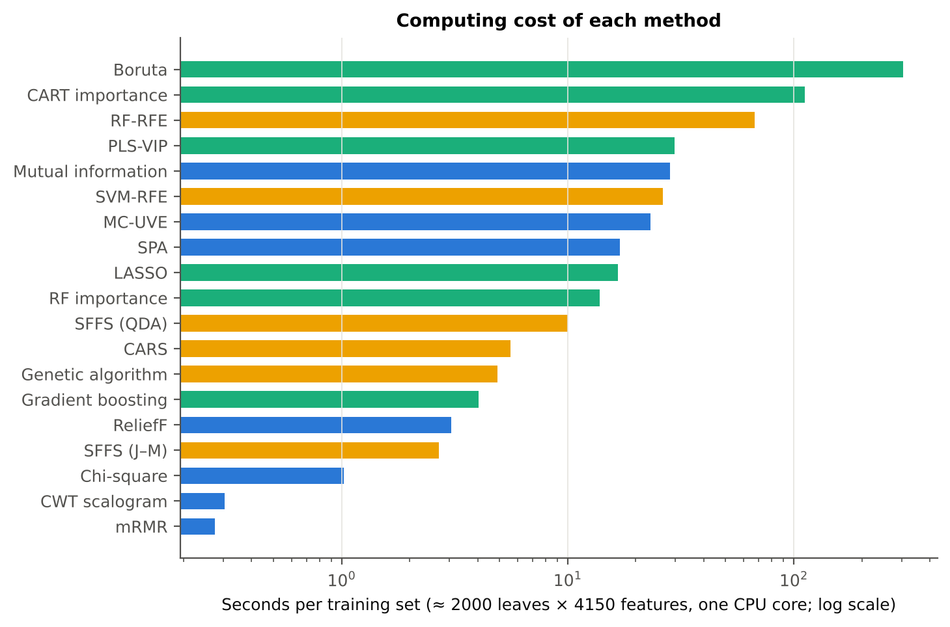
Computing cost
Per training set (≈ 2000 leaves × 4150 features, one CPU core): univariate filters, χ², mRMR and the CWT scalogram ≤ 1 s; ReliefF 3 s; gradient boosting 4 s; GA 5 s; CARS 6 s; SFFS 10 s; RF importance 14 s; LASSO 17 s; SPA 17 s; MC-UVE 23 s; SVM-RFE 26 s; mutual information 28 s; PLS-VIP 30 s; RF-RFE 67 s; CART (with pruning by inner CV) 112 s; Boruta 304 s.
SFFS and the GA are fast here only because they search a pre-filtered pool of 100 non-redundant candidates.

Slide 27
Stable, informative, disease-specific features
Features chosen by many methods in many training sets

Slide 28
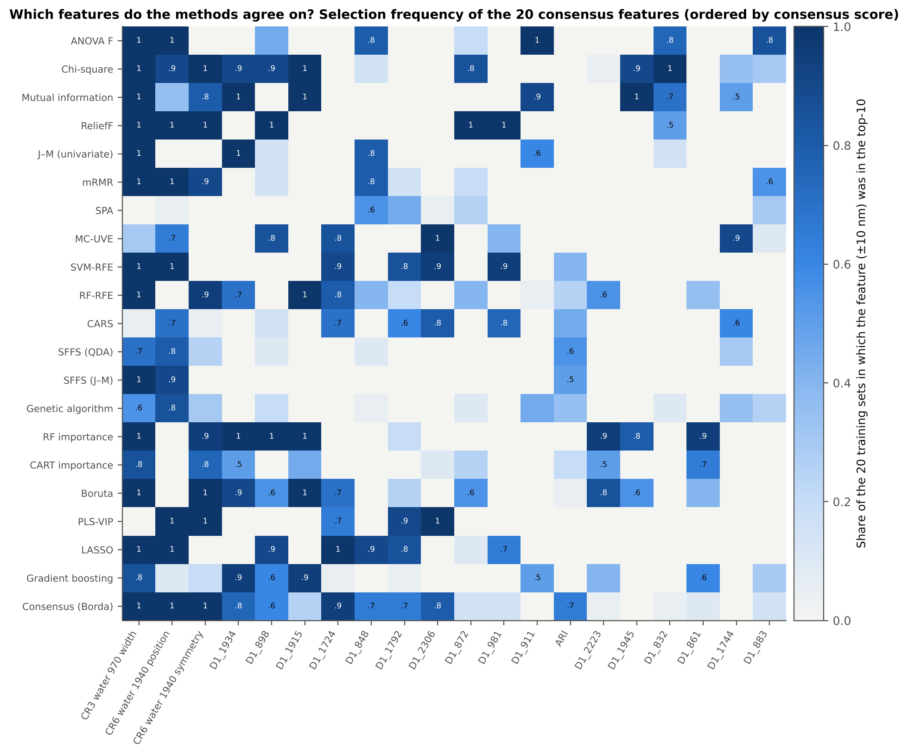
Where the methods agree

Slide 29
Consensus disease-specific features
Feature | Type | Consensus | Methods ≥ 50 % | AUC | Diseased | Note
CR3 water 970 width | K2 CR | 0.78 | 17 | 0.765 | lower
CR6 water 1940 position | K2 CR | 0.59 | 13 | 0.686 | higher
CR6 water 1940 symmetry | K2 CR | 0.48 | 10 | 0.669 | higher
D1_1934 | K4 D1 band | 0.37 | 9 | 0.754 | higher
D1_898 | K4 D1 band | 0.36 | 8 | 0.758 | higher
D1_1915 | K4 D1 band | 0.32 | 6 | 0.701 | lower
D1_1724 | K4 D1 band | 0.31 | 8 | 0.516 | lower | complementary
D1_848 | K4 D1 band | 0.25 | 6 | 0.785 | higher
D1_1792 | K4 D1 band | 0.25 | 5 | 0.591 | higher | next to join; complementary
D1_2306 | K4 D1 band | 0.22 | 5 | 0.563 | lower | complementary
D1_872 | K4 D1 band | 0.19 | 3 | 0.786 | higher
D1_981 | K4 D1 band | 0.19 | 4 | 0.618 | higher | next to join
D1_911 | K4 D1 band | 0.17 | 4 | 0.733 | higher
ARI | K3 vegetation index | 0.16 | 3 | 0.646 | higher
D1_2223 | K4 D1 band | 0.16 | 4 | 0.639 | higher
The width of the 970-nm water feature (CR3) is the most universal disease feature: 17 of 21 methods choose it in at least half of the training sets (consensus 0.78; AUC 0.77; narrower in diseased leaves). Next come the 1940-nm water feature position (0.59; 13 methods; shifted to longer wavelengths in diseased leaves) and symmetry (0.48; 10 methods).
Derivative bands follow: D1_1934 (0.37) and D1_1915 (0.32) on the 1940-nm water band wing, and D1_898 (0.36), D1_848 (0.25), D1_872 and D1_911 across the NIR plateau.
D1_1724, D1_2306 and D1_1792 are weak on their own (AUC < 0.60) but complementary in multivariate sets. D1_1792 and D1_981 lie within 10 nm of a detector join and need caution.
A 10-feature consensus set gives J–M 1.60 and 82.2 % (Das protocol). The honest in-fold Borda consensus reaches 82.7 % on new plots — a consensus is stable and interpretable, but not more accurate than the best single method.

Slide 30
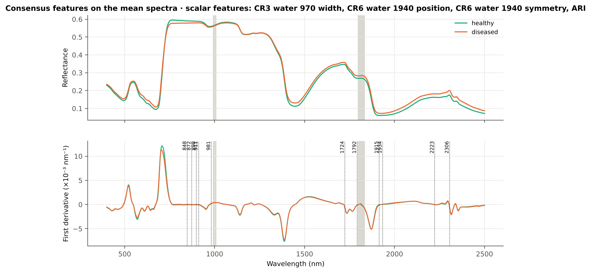
Consensus features on the healthy and diseased spectra
970 and 1940 nm: liquid-water absorption. White rust pustules rupture the epidermis and disturb leaf water status, changing the depth, width and shape of the water bands.
848–911 nm (first derivative): slope of the NIR plateau, set by mesophyll scattering. Hyphae and pustules alter the internal leaf structure.
1724 and 2223–2306 nm: C–H, lignin, cellulose and protein (dry-matter) absorption. These are complementary rather than strong on their own.
ARI: anthocyanins accumulate in stressed, infected leaves.

Slide 31
Conclusions

Slide 32
Conclusions
For discriminating healthy and white-rust leaves from the K1–K4 feature pool, wrapper methods that search for complementary features — SFFS with a QDA criterion, SVM-RFE and CARS — give the most accurate compact feature sets (≈ 87–88 % with 10 features on new plots), significantly better than univariate filters (78–81 %) and tree importances (77–79 %).
SVM-RFE is the best all-round method (composite rank 1): it is as accurate as SFFS, accurate with both QDA and RF, more stable than the other wrappers, and robust to the detector-join check (85.6 % after excluding join-adjacent bands).
ReliefF, LASSO and RF importance are the most stable selectors; ReliefF combines high stability (0.84) with good accuracy (84.9 %) and is the best filter.
Univariate rankings (Pearson r = ANOVA F = Fisher score for two classes, χ², MI) must be combined with redundancy control; J–M-driven selection, SPA, PLS-VIP top-k and the CWT scalogram are not suitable for this dataset.
Boruta, MC-UVE and PLS-VIP (VIP > 1) are screening tools: they keep about 120 (Boruta) to 1300–1400 (PLS-VIP, MC-UVE) relevant features rather than a compact set.
The stable disease-specific signature of white rust is the leaf-water signal — 970-nm band width and 1940-nm band position and symmetry, with derivative bands at 1915–1934 nm — together with the NIR-plateau slope at 848–911 nm. Dry-matter bands (1724, 2223–2306 nm) and ARI add complementary information.

Slide 33
Recommendations: which method to use
Use SVM-RFE (linear SVM, balanced weights) with redundancy control as the main selector for this dataset. Report SFFS (QDA) and CARS as equally accurate alternatives, and give their selection frequencies because their exact feature sets are unstable.
For interpretation and sensor design, use the consensus features (CR3 970-nm width, CR6 1940-nm position and symmetry, D1 1915–1934 nm, D1 848–911 nm) or ReliefF, which are reproducible across training sets.
Always select features inside the training data only, evaluate on new plots, and report accuracy together with stability (Jaccard or Kuncheva) and a Friedman–Nemenyi comparison.
Apply a redundancy rule (|r| < 0.95, or a minimum spectral distance) to any ranking-based method, and exclude or flag bands within 10 nm of the detector joins.
Use Boruta or MC-UVE as a first screening step and a wrapper (SFFS or RFE) for the final compact set, as Mustafa et al. (2023) did with Boruta followed by SFFS.

Slide 34
Quality control: implementation checks
Check | Result | Status
Pearson |r|, ANOVA F and Fisher score rank features identically (two classes: r² = F/(F+n−2), F | min ρ = 1.000000 | PASS
ANOVA F implementation | max relative Δ = 5.5e-07 (floating-point level) | PASS
Chi-square implementation | 361.3849 vs 361.3849 | PASS
J–M used by SFFS (J–M) and the evaluation | |Δ| = 3.5e-14 | PASS
Fast QDA used inside SFFS / GA | 100.00 % identical predictions | PASS
PLS-VIP normalisation | 1.000000 | PASS
SPA chain | identical | PASS
No plot in both training and test leaves | 0 shared plots | PASS
CWT implementation | best scale 16 nm | PASS
Boruta convergence | 192 / 201 / 3757 after 100 runs | PASS

Slide 35
References (1/4)
Abdulridha J, Min A, Rouse MN, Kianian S, Isler V, Yang C. 2023. Evaluation of stem rust disease in wheat fields by drone hyperspectral imaging. Sensors 23(8):4154. doi:10.3390/s23084154
Ambroise C, McLachlan GJ. 2002. Selection bias in gene extraction on the basis of microarray gene-expression data. Proceedings of the National Academy of Sciences 99:6562–6566.
Araújo MCU, Saldanha TCB, Galvão RKH, Yoneyama T, Chame HC, Visani V. 2001. The successive projections algorithm for variable selection in spectroscopic multicomponent analysis. Chemometrics and Intelligent Laboratory Systems 57(2):65–73.
Breiman L, Friedman JH, Olshen RA, Stone CJ. 1984. Classification and regression trees. Belmont (CA): Wadsworth.
Breiman L. 2001. Random forests. Machine Learning 45:5–32.
Cai W, Li Y, Shao X. 2008. A variable selection method based on uninformative variable elimination for multivariate calibration of near-infrared spectra. Chemometrics and Intelligent Laboratory Systems 90(2):188–194.
Centner V, Massart D-L, de Noord OE, de Jong S, Vandeginste BM, Sterna C. 1996. Elimination of uninformative variables for multivariate calibration. Analytical Chemistry 68(21):3851–3858.
Chen C, Liaw A, Breiman L. 2004. Using random forest to learn imbalanced data. Technical Report 666, Department of Statistics, University of California, Berkeley.
Chen T, Guestrin C. 2016. XGBoost: a scalable tree boosting system. Proceedings of the 22nd ACM SIGKDD International Conference on Knowledge Discovery and Data Mining, 785–794.
Cheng T, Rivard B, Sánchez-Azofeifa GA, Feng J, Calvo-Polanco M. 2010. Continuous wavelet analysis for the detection of green attack damage due to mountain pine beetle infestation. Remote Sensing of Environment 114(4):899–910. doi:10.1016/j.rse.2009.12.005
Chong I-G, Jun C-H. 2005. Performance of some variable selection methods when multicollinearity is present. Chemometrics and Intelligent Laboratory Systems 78(1–2):103–112.

Slide 36
References (2/4)
Das B, Sahoo RN, Biswas A, Pargal S, Krishna G, Verma R, Chinnusamy V, Sehgal VK, Gupta VK. 2020. Discrimination of rice genotypes using field spectroradiometry. Geocarto International 35(1):64–77. doi:10.1080/10106049.2018.1506507
Demšar J. 2006. Statistical comparisons of classifiers over multiple data sets. Journal of Machine Learning Research 7:1–30.
Duda RO, Hart PE, Stork DG. 2001. Pattern classification, 2nd edn. New York: Wiley.
Friedman JH. 2001. Greedy function approximation: a gradient boosting machine. Annals of Statistics 29(5):1189–1232.
Guyon I, Elisseeff A. 2003. An introduction to variable and feature selection. Journal of Machine Learning Research 3:1157–1182.
Guyon I, Weston J, Barnhill S, Vapnik V. 2002. Gene selection for cancer classification using support vector machines. Machine Learning 46:389–422.
Kira K, Rendell LA. 1992. A practical approach to feature selection. Proceedings of the 9th International Workshop on Machine Learning, 249–256.
Kohavi R, John GH. 1997. Wrappers for feature subset selection. Artificial Intelligence 97:273–324.
Kononenko I. 1994. Estimating attributes: analysis and extensions of RELIEF. In: Machine Learning: ECML-94. Lecture Notes in Computer Science 784. Berlin: Springer, 171–182.
Kraskov A, Stögbauer H, Grassberger P. 2004. Estimating mutual information. Physical Review E 69:066138.
Kuncheva LI. 2007. A stability index for feature selection. Proceedings of the 25th IASTED International Multi-Conference: Artificial Intelligence and Applications, 390–395.

Slide 37
References (3/4)
Kursa MB, Rudnicki WR. 2010. Feature selection with the Boruta package. Journal of Statistical Software 36(11):1–13.
Leardi R, Boggia R, Terrile M. 1992. Genetic algorithms as a strategy for feature selection. Journal of Chemometrics 6(5):267–281.
Lemaître G, Nogueira F, Aridas CK. 2017. Imbalanced-learn: a Python toolbox to tackle the curse of imbalanced datasets in machine learning. Journal of Machine Learning Research 18(17):1–5.
Li H, Liang Y, Xu Q, Cao D. 2009. Key wavelengths screening using competitive adaptive reweighted sampling method for multivariate calibration. Analytica Chimica Acta 648(1):77–84.
Liu et al. 2024. [Recursive feature elimination (RFE) for crop-disease spectral features — cited as given in the request; full bibliographic details could not be verified and must be completed by the author.]
Mahlein A-K, Rumpf T, Welke P, Dehne H-W, Plümer L, Steiner U, Oerke E-C. 2013. Development of spectral indices for detecting and identifying plant diseases. Remote Sensing of Environment 128:21–30.
Mustafa G, Zheng H, et al. 2023. Fusarium head blight monitoring in wheat ears using machine learning and multimodal data from asymptomatic to symptomatic periods. Frontiers in Plant Science 13:1102341. doi:10.3389/fpls.2022.1102341
Mustafa G, Zheng H, Khan IH, Tian L, Jia H, Li G, Cheng T, Tian Y, Cao W, Zhu Y, Yao X. 2022. Hyperspectral reflectance proxies to diagnose in-field fusarium head blight in wheat with machine learning. Remote Sensing 14(12):2784.
Nagasubramanian K, Jones S, Sarkar S, Singh AK, Singh A, Ganapathysubramanian B. 2018. Hyperspectral band selection using genetic algorithm and support vector machines for early identification of charcoal rot disease in soybean stems. Plant Methods 14:86.
Nogueira S, Sechidis K, Brown G. 2018. On the stability of feature selection algorithms. Journal of Machine Learning Research 18(174):1–54.
Pearson K. 1895. Note on regression and inheritance in the case of two parents. Proceedings of the Royal Society of London 58:240–242.

Slide 38
References (4/4)
Pedregosa F, Varoquaux G, Gramfort A, et al. 2011. Scikit-learn: machine learning in Python. Journal of Machine Learning Research 12:2825–2830.
Peng H, Long F, Ding C. 2005. Feature selection based on mutual information: criteria of max-dependency, max-relevance, and min-redundancy. IEEE Transactions on Pattern Analysis and Machine Intelligence 27(8):1226–1238.
Pudil P, Novovičová J, Kittler J. 1994. Floating search methods in feature selection. Pattern Recognition Letters 15(11):1119–1125.
Rumpf T, Mahlein A-K, Steiner U, Oerke E-C, Dehne H-W, Plümer L. 2010. Early detection and classification of plant diseases with support vector machines based on hyperspectral reflectance. Computers and Electronics in Agriculture 74(1):91–99.
Saeys Y, Abeel T, Van de Peer Y. 2008. Robust feature selection using ensemble feature selection techniques. In: Machine Learning and Knowledge Discovery in Databases (ECML PKDD 2008). Lecture Notes in Artificial Intelligence 5212. Berlin: Springer, 313–325.
Saeys Y, Inza I, Larrañaga P. 2007. A review of feature selection techniques in bioinformatics. Bioinformatics 23(19):2507–2517.
Thomas S, Kuska MT, Bohnenkamp D, Brugger A, Alisaac E, Wahabzada M, Behmann J, Mahlein A-K. 2018. Benefits of hyperspectral imaging for plant disease detection and plant protection: a technical perspective. Journal of Plant Diseases and Protection 125:5–20.
Tibshirani R. 1996. Regression shrinkage and selection via the lasso. Journal of the Royal Statistical Society Series B 58(1):267–288.
Wei X, Johnson MA, Langston DB, Mehl HL, Li S. 2021. Identifying optimal wavelengths as disease signatures using hyperspectral sensor and machine learning. Remote Sensing 13(14):2833. doi:10.3390/rs13142833
Wold S, Sjöström M, Eriksson L. 2001. PLS-regression: a basic tool of chemometrics. Chemometrics and Intelligent Laboratory Systems 58(2):109–130.
Zhu H, Chu B, Zhang C, Liu F, Jiang L, He Y. 2017. Hyperspectral imaging for presymptomatic detection of tobacco disease with successive projections algorithm and machine-learning classifiers. Scientific Reports 7:4125. doi:10.1038/s41598-017-04501-2

