Slide 1
Discriminating healthy and diseased plots from SMACC endmembers: four-tier analysis with CART and Random Forest
Method of Das et al. (2020): Tier 1 ANOVA → Tier 2 CART (or Random Forest) → Tier 3 Jeffries–Matusita distance → Tier 4 QDA
47 plots (plot 4 excluded) · 2158 endmember spectra kept separately (1078 healthy = 11 × 98; 1080 diseased = 36 × 30) · 483 reflectance bands
Notes:
This presentation applies the four-tier hierarchical method of Das et al. (2020, Geocarto International 35:64–77) to separate healthy from diseased plots in one hyperspectral image.
Input: SMACC endmembers extracted plot by plot — 98 endmembers from each of the 11 healthy plots (1–3, 5–12; plot 4 was excluded) and 30 from each of the 36 diseased plots (13–48). Every endmember is analysed as a separate sample; nothing is averaged. That gives 1078 healthy and 1080 diseased spectra over 483 reflectance bands (399–2398 nm).
Tier 2 is run twice: with CART, as in the paper, and with Random Forest instead of CART, for comparison. Everything else is identical, so differences come from the band-selection step only.
Every step is also done in the accompanying Excel workbook (Four_Tier_47plots.xlsx), mostly with live formulas, and cross-checked against Python.

Slide 2
Abbreviations (1/2)
Abbreviation | Meaning
AD | Allocation disagreement: share of predictions misplaced although class totals agree (Pontius & Millones 2011)
ANOVA | Analysis of variance (one-way, Tier 1)
AUC / ROC-AUC | Area under the receiver operating characteristic curve
B | Bhattacharyya distance (basis of the J–M distance)
BA | Balanced accuracy = (sensitivity + specificity) / 2; 0.5 = chance
C (block) | Control block: plots 1–3 and 5–12 (plot 4 excluded), not inoculated = healthy
CART | Classification and regression tree (Tier 2)
CI | Confidence interval (95%, plot-cluster bootstrap)
cp | Complexity parameter of rpart pruning (0.01)
CV | Cross-validation
CV1 | Validation of Das et al. (2020): random stratified 10-fold CV of QDA on the Tier-2 bands (repeated 10 times)
CV2 | Plot-grouped nested 4-fold CV (× 10) — main result
CV3 | Leave-one-plot-out CV (47 folds)
Abbreviation | Meaning
CV4 | Leave-one-treatment-combination-out CV (variety × inoculation date, 12 folds)
CV5 | Leave-one-variety-out CV (3 folds)
CV6 | Leave-one-inoculation-date-out CV (4 folds)
D / H | Diseased / healthy class
D1–D4 | Inoculation-date codes (days after sowing) from the treatment sheet
DAS | Days after sowing
d (Cohen's d) | Standardised mean difference between classes
EM | Endmember (one SMACC spectrum)
F | ANOVA F statistic
F1 | F1 score = harmonic mean of producer's and user's accuracy of a class
FDR | False discovery rate (Benjamini–Hochberg correction)
HSD | Honestly significant difference (Tukey post-hoc test)
J–M / JM | Jeffries–Matusita distance, 0–2 scale; 1.94 = separability threshold
V1–V3 are varieties; validation schemes are CV1–CV6. 'D' alone = diseased, D1–D4 = inoculation dates; 'R' + wavelength = reflectance, R1–R3 = inoculated blocks.
Notes:
All abbreviations used on the slides and in the workbook (sheet 'Abbreviations').
Two pairs look alike: V1–V3 are the three varieties from the treatment sheet, whereas CV1–CV6 are the six validation schemes. 'D' alone means diseased, while D1–D4 are the four inoculation dates (days after sowing). 'R2380' means reflectance at 2380 nm, while R1, R2 and R3 are the inoculated replication blocks.

Slide 3
Abbreviations (2/2)
Abbreviation | Meaning
K / k | Number of selected bands; in SMOTE, k = 5 nearest neighbours
LOPO | Leave-one-plot-out (= CV3)
MCC | Matthews correlation coefficient
MDI | Mean decrease in impurity (Gini importance of Random Forest)
mtry | Number of bands tried at each Random Forest split (√p)
N / n | Number of spectra (N = all, n = per class or plot)
NIR | Near infrared (750–1,350 nm)
nm | Nanometre
OA | Overall accuracy = correct predictions / all predictions
p | p-value; also number of bands entering a model
PA | Producer's accuracy = correct / reference total of a class (1 − omission error)
QD | Quantity disagreement: error from wrong class proportions
QDA | Quadratic discriminant analysis (Tier 4)
Abbreviation | Meaning
R1, R2, R3 | Inoculated replication blocks (plots 37–48, 25–36, 13–24) = diseased
rpart | R package for CART used by Das et al. (2020); its settings are reproduced here
Tier | One of the four sequential steps of the method of Das et al. (2020)
R2380 etc. | Reflectance at that wavelength (nm), e.g. in CART split rules
RF | Random Forest
ROI | Region of interest (plot polygon)
Class weights | Each class given equal total weight; used only in the block-vs-block negative control
SD | Standard deviation
SMACC | Sequential maximum angle convex cone (endmember extraction)
SWIR-1 / SWIR-2 | Short-wave infrared 1 (1,350–1,800 nm) / 2 (1,800–2,400 nm)
UA | User's accuracy = correct / predicted total of a class (1 − commission error)
V1–V3 | Variety codes from the treatment sheet
VIS | Visible range (400–700 nm)
Notes:
All abbreviations used on the slides and in the workbook (sheet 'Abbreviations').
Two pairs look alike: V1–V3 are the three varieties from the treatment sheet, whereas CV1–CV6 are the six validation schemes. 'D' alone means diseased, while D1–D4 are the four inoculation dates (days after sowing). 'R2380' means reflectance at 2380 nm, while R1, R2 and R3 are the inoculated replication blocks.

Slide 4
Workflow at a glance
A
Data
B
Four-tier analysis
C
Validation
D
Checks & controls
SMACC endmembers per plot
2158 spectra, kept separate
All 483 bands, reflectance only
Treatment design + plot map
Data check
Tier 1: ANOVA + Tukey HSD
Tier 2: CART | RF instead
Tier 3: J–M distance per band and per set
Tier 4: QDA
CV1: as Das et al. (10-fold)
CV2: plot-grouped nested
CV3: leave-one-plot-out
CV4–6: by treatment level
Permutation tests
Error matrices + 95% CIs
Block-vs-block negative control
Band-removal sensitivity
Python ↔ Excel checks
›
›
›
Two analysis configurations: CART + QDA (the paper) and RF + QDA (comparison). Band selection is repeated inside every training fold in CV2–CV6. Seed 42 for all random steps.
Notes:
A – Data: the endmember spectra are read exactly as supplied, labelled by plot and class, and linked to the treatment sheet (block, variety, inoculation date) and to the plot polygons (EXCEPTPLOT4.xml).
B – The four tiers of Das et al. (2020). Tier 1 keeps bands whose class means differ (one-way ANOVA, p < 0.05, Tukey HSD). Tier 2 reduces them to a small set with CART — or, for comparison, with Random Forest. Tier 3 measures how separable the classes are on those bands with the Jeffries–Matusita distance. Tier 4 classifies with quadratic discriminant analysis.
C – Validation. CV1 is exactly the validation of the paper (10-fold cross-validation of QDA). Because spectra from the same plot are not independent, the main result is CV2, which holds out whole plots and repeats the band selection inside each fold. CV3–CV6 and the permutation tests check the result from other angles.
D – Controls: complete accuracy assessment with confidence intervals, a negative control for the location effect, a sensitivity analysis with the band removal of the paper, and live Excel recomputation of every key number.

Slide 5
A · Data
SMACC endmembers from 47 plots, the treatment design and a check of the spectra
Notes:
Part A describes the input data and checks it before any statistics are run. Problems found here (out-of-range values, unequal sampling) affect how later results must be read.

Slide 6
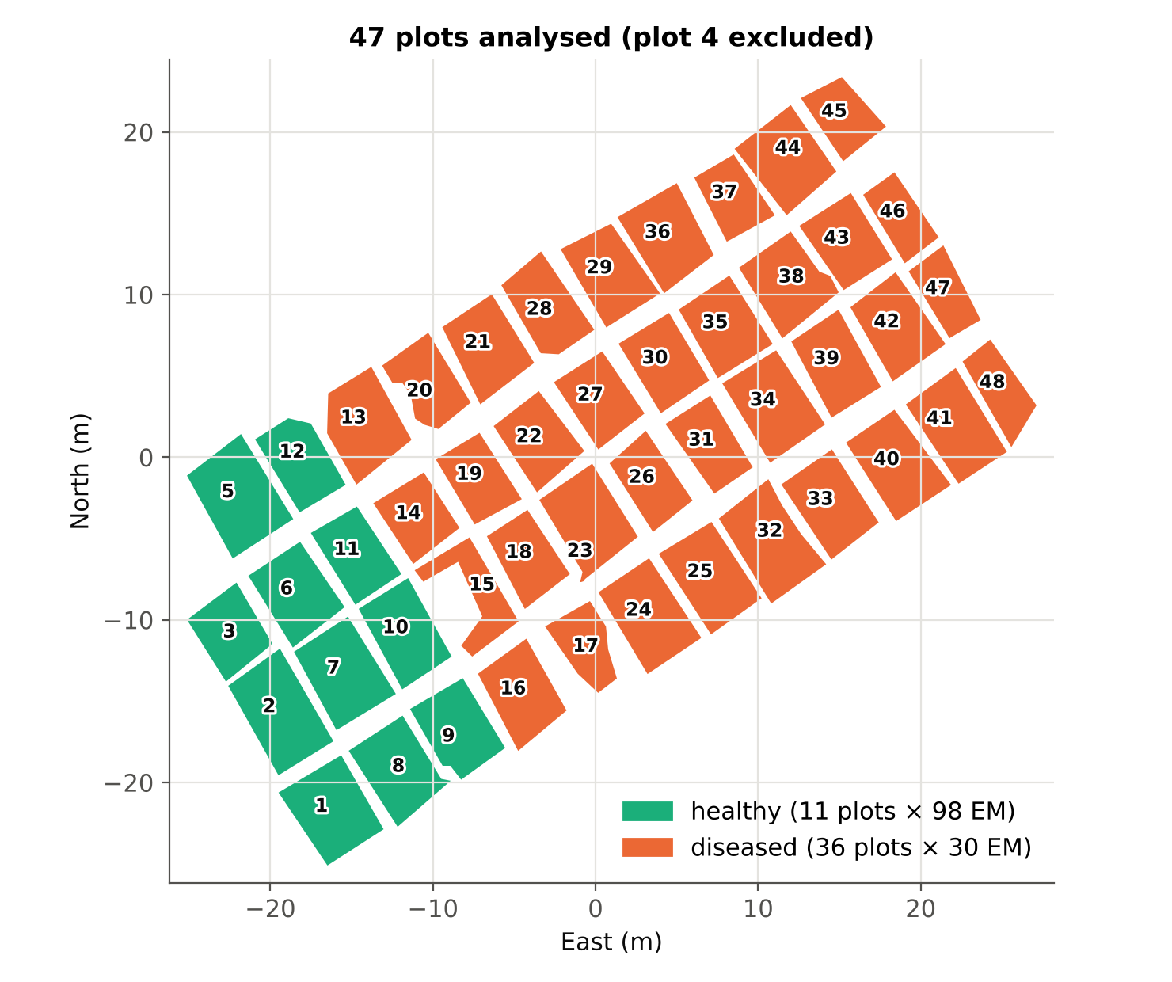
47 plots and the analysis data set
2158
1078 / 1080
endmember spectra analysed
healthy / diseased spectra
483
11 / 36
reflectance bands (399–2398 nm)
healthy / diseased plots
Healthy: plots 1–3 and 5–12, 98 SMACC endmembers each; plot 4 excluded
Diseased: plots 13–48, 30 SMACC endmembers each
Endmembers are not averaged: each is one sample labelled with its plot's class
Spectra are balanced (1 : 1.002) by design; plots are not (11 : 36)
Notes:
The map shows the 47 plot polygons from EXCEPTPLOT4.xml (WGS-84 converted to local metres). Green = healthy plots, orange = diseased plots. Plot 4 is absent from the ROI file and from the spectra.
Sampling: 98 endmembers per healthy plot × 11 plots = 1078; 30 per diseased plot × 36 plots = 1080. The two classes therefore have almost the same number of spectra, so no re-sampling or class weighting is needed for the main analysis.
The plots, however, are not balanced (11 vs 36). Each healthy plot contributes 98 spectra and each diseased plot 30, so a healthy plot weighs about three times more than a diseased plot. This is why the accuracy is also reported at plot level and why balanced accuracy is reported next to overall accuracy.
Endmembers are analysed individually as requested. Note that SMACC endmembers are the most extreme spectra of a plot (the 'corners' of the data cloud), not random pixels, which increases within-class variability.

Slide 7
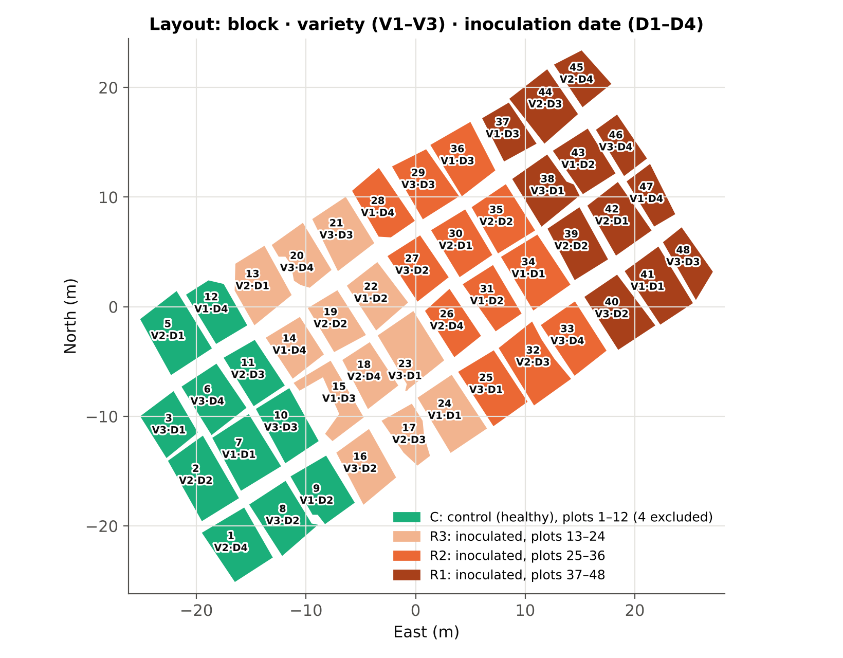
Treatment design (treatment_detail.xlsx)
Block | Plots | Treatment | Class
C | 1–3, 5–12 | Control (not inoculated) | Healthy
R3 | 13–24 | Inoculated, replication 3 | Diseased
R2 | 25–36 | Inoculated, replication 2 | Diseased
R1 | 37–48 | Inoculated, replication 1 | Diseased
Each block: 3 varieties (V1, V2, V3) × 4 inoculation dates (D1, D2, D3, D4, days after sowing); plot 4 (C, V1·D3) is missing
Blocks run west → east (C, R3, R2, R1), centres ≈ 13 m apart
All healthy plots form one block, so class and location are confounded (Hurlbert 1984); CV4–CV6 and the negative control use this design
Notes:
The treatment sheet shows a blocked layout. Block C holds the uninoculated control plots (healthy); blocks R3, R2 and R1 hold the inoculated plots (diseased). Every block contains the same 12 treatment combinations: 3 varieties × 4 inoculation dates.
Why this matters for validation: plots, not endmembers, are the experimental units. Moreover, all healthy plots lie together at the west end of the field. Any west–east gradient (soil, moisture, illumination, sowing order) is therefore mixed with the healthy–diseased difference. Hurlbert (1984) calls this spatially segregated treatments; it is the main limitation of the data, and later slides measure it.
The design also allows validation by treatment level: leaving out one variety, one inoculation date, or one variety × date combination at a time (CV4–CV6).

Slide 8
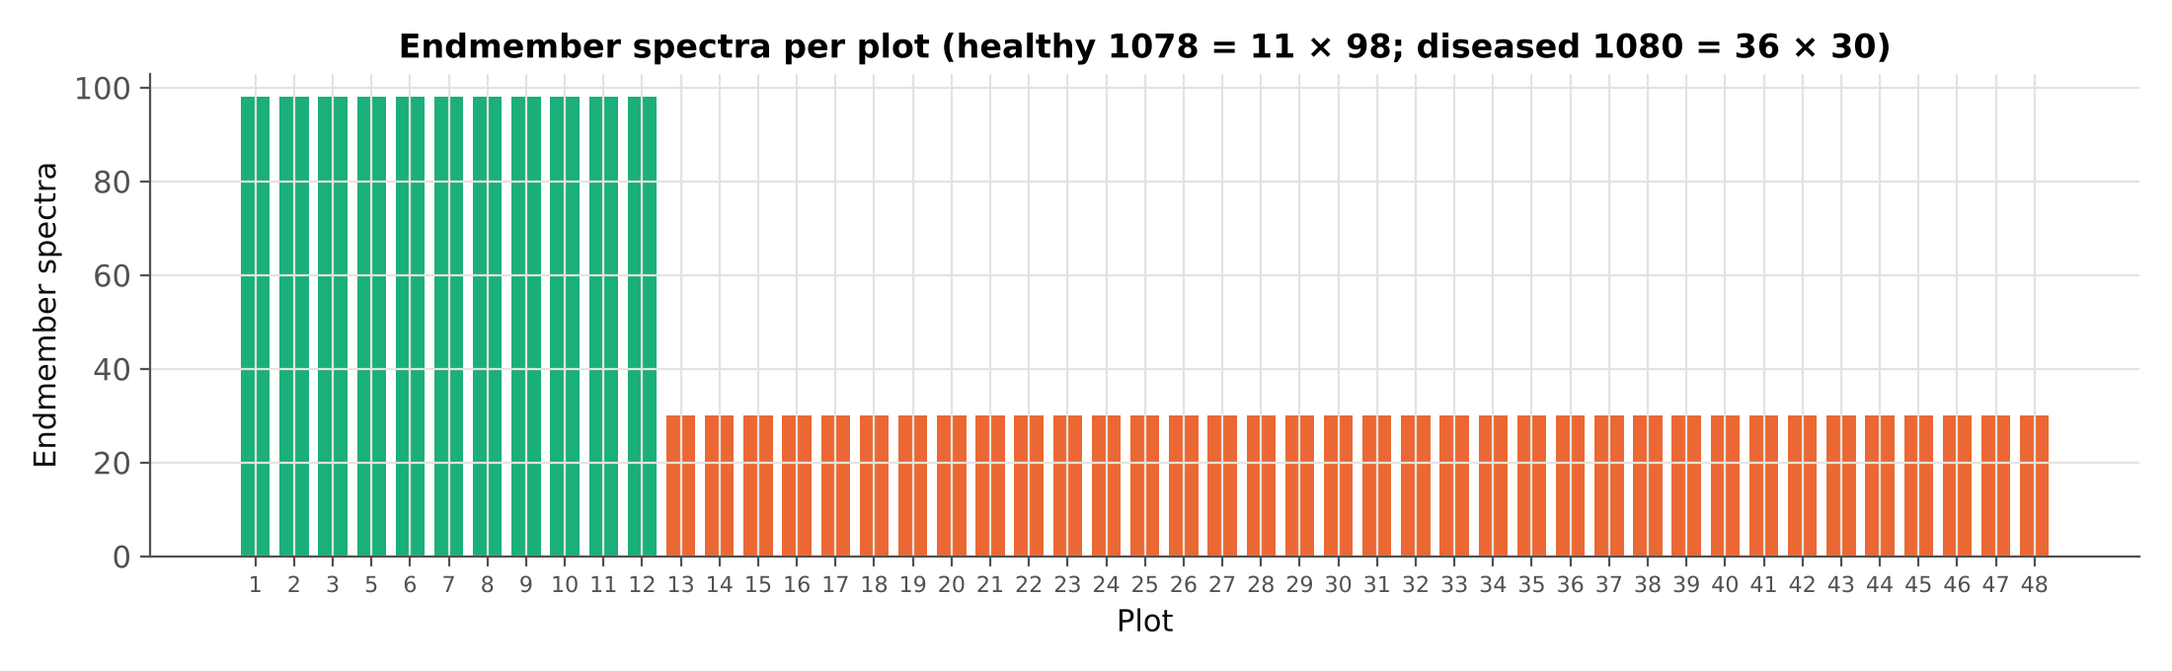
Endmember spectra per plot
Healthy plots contribute 98 spectra each (1078), diseased plots 30 each (1080): equal class totals, unequal plot weights
Spectra of one plot share soil, illumination and treatment; they are not independent replicates, which is why validation must hold out whole plots
Notes:
The bar chart confirms the extraction design: 98 endmembers in every healthy plot and 30 in every diseased plot (checked automatically and with COUNTIF in sheet 2_Data_Summary).
Because a plot's endmembers come from the same small area, they are correlated. Treating them as independent replicates inflates the apparent evidence (pseudo-replication; Hurlbert 1984). This is handled by (i) reporting the ANOVA also on plot means and (ii) validating with whole plots held out.

Slide 9
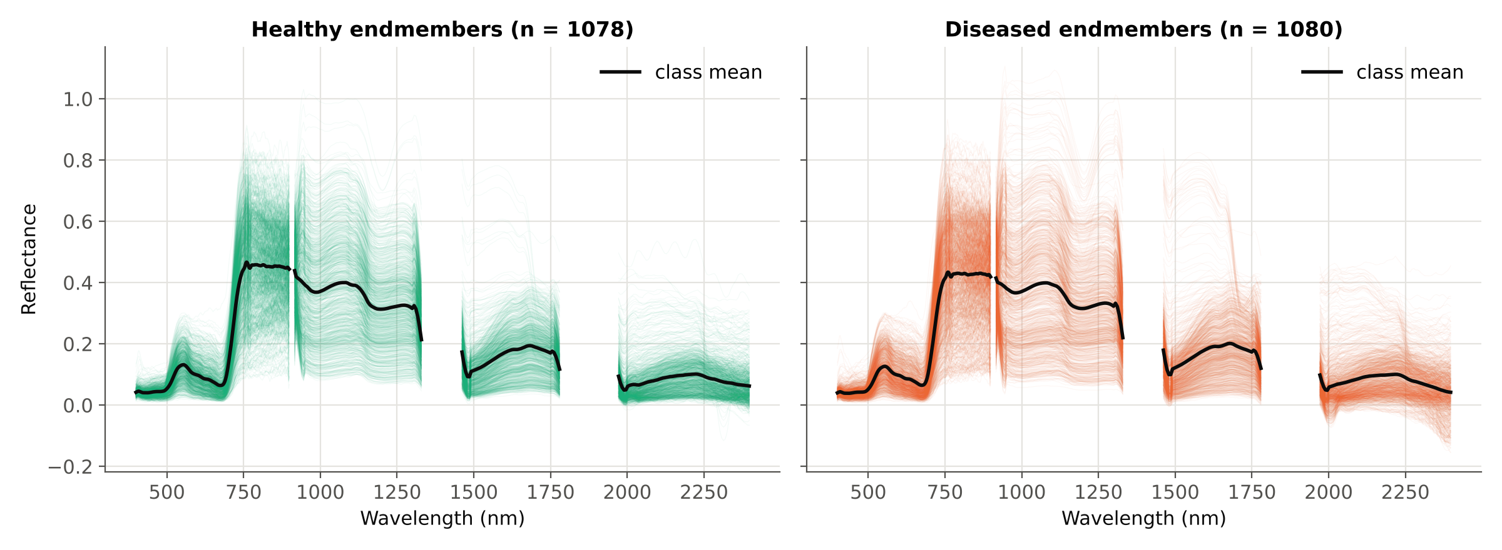
All endmember spectra
Thin lines: individual endmembers (1078 healthy, 1080 diseased); black: class mean. Gaps are water-absorption bands missing from the image. SMACC selects extreme spectra, hence the wide spread.
Notes:
Every endmember spectrum is drawn as a thin line; the black line is the class mean. Both classes show the typical vegetation shape: low visible reflectance with a green peak, a steep red edge near 700–750 nm, a high near-infrared plateau and water-absorption features in the SWIR.
The spread within each class is large compared with the difference between the class means. This already suggests that the classes overlap strongly — confirmed by the J–M distances in Tier 3.
The gaps (≈1330–1460 nm and ≈1780–1970 nm) are bands absent from the image because of atmospheric water vapour.

Slide 10
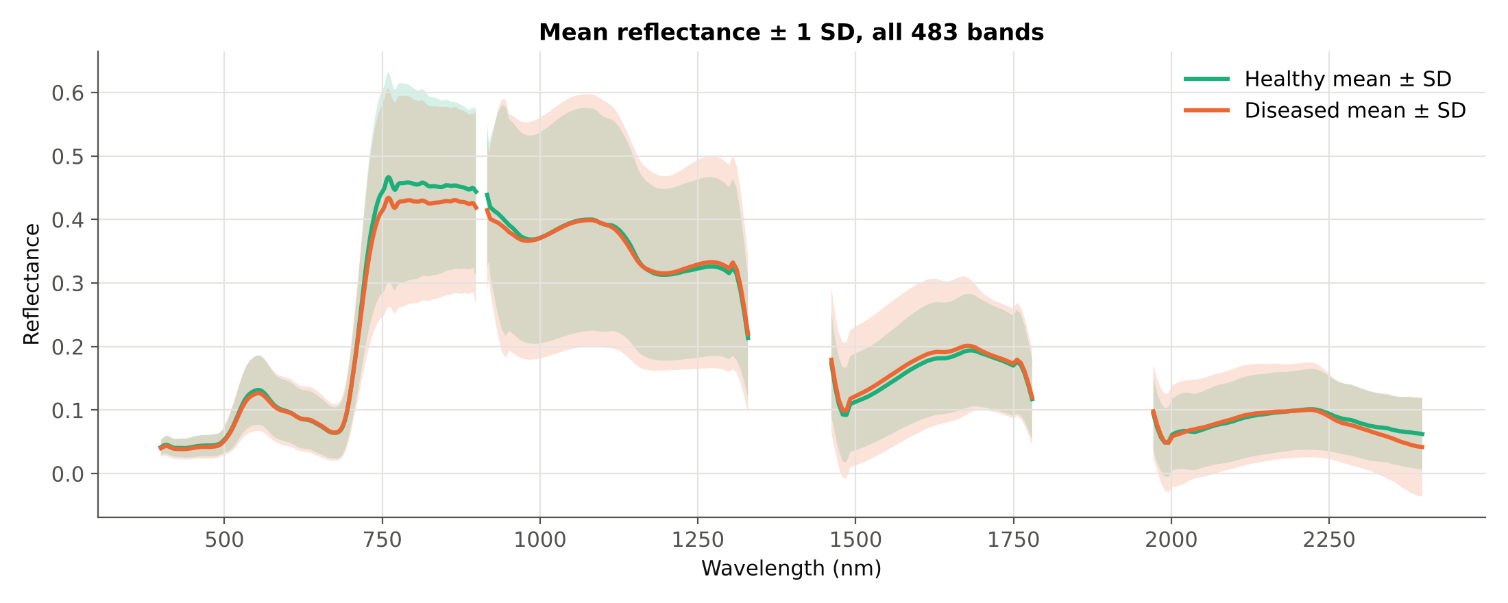
Class means and variability
Mean ± 1 SD per class. The two bands overlap almost everywhere: the class difference is small relative to the spread within each class.
Notes:
Class means with ±1 standard deviation. The healthy mean is slightly higher in the near-infrared plateau and the diseased mean slightly lower in parts of the visible and SWIR, but the shaded bands overlap almost completely.
Interpretation: disease effects in these data are subtle relative to the natural variability among endmembers. Statistical tests with thousands of spectra can still detect such small differences (Tier 1), but classification of individual spectra will be difficult (Tier 4).

Slide 11
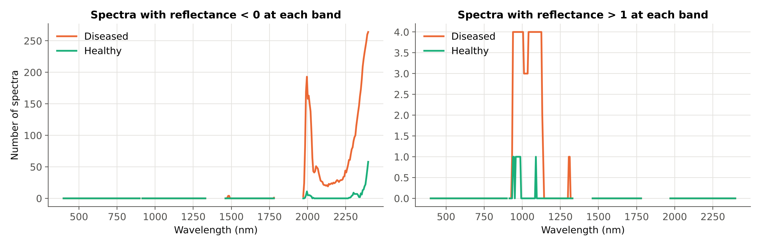
Data check: everything is analysed
2158
483
Reflectance < 0 (physically impossible) in 79 healthy and 299 diseased spectra, mostly at the SWIR-2 edge
Reflectance > 1 in 1 healthy and 4 diseased spectra (specular or saturated pixels)
Values are kept unchanged (reflectance only, no editing); the sensitivity analysis repeats everything without the bands ≥ 2350 nm, as Das et al. removed them
Checked: 2158 × 483 values, no missing values, no duplicates, 98/30 endmembers per plot, plot 4 absent
spectra analysed: none removed
bands analysed: none removed
Notes:
Before analysis the data were checked automatically (sheet 18_Cross_Checks) and by formulas in Excel (sheet 2_Data_Summary).
Reflectance must lie between 0 and 1. Negative values occur mainly in the SWIR-2 region above ≈2000 nm, where the sensor signal is weak and atmospheric correction is uncertain; they are far more frequent in diseased spectra. A few spectra exceed 1 (specular reflection or saturation).
Following the request to analyse reflectance values only, nothing was edited or removed. Instead, the sensitivity analysis (Step 14) repeats Tiers 1–4 without the bands ≥ 2350 nm, which Das et al. (2020) removed as noisy. If conclusions hold without these bands, the noisy edge is not driving them.

Slide 12
B · Methods and why they are used
The four tiers, the validation schemes and the accuracy measures, each with its reference
Notes:
Part B explains each method before the results: what is done, why it is done, and which publication it comes from. All references were checked against the journal, publisher or repository record.

Slide 13
Four-tier method: what each tier does and why
Tier | What is done here | Why | Reference
1 · ANOVA | One-way ANOVA per band, p < 0.05; Tukey HSD; FDR, Bonferroni, Welch, Levene, Cohen's d and plot-mean ANOVA as checks | Keeps bands whose class means differ; removes uninformative bands before selection | Das et al. 2020; Tukey 1949; Benjamini & Hochberg 1995; Welch 1947; Levene 1960; Cohen 1988; Hurlbert 1984
2 · CART | rpart-equivalent tree (Gini, minsplit 20, minbucket 7, maxdepth 30, cp 0.01) on the significant bands; bands used in splits are kept | A small set of complementary bands; same tool and settings as the paper | Breiman et al. 1984; Therneau & Atkinson (rpart)
2 · RF | Random Forest (500 trees, mtry = √p) importance ranking; top bands with |r| < 0.95; same number as CART | Requested comparison: ensemble ranking, less dependent on one tree | Breiman 2001; Strobl et al. 2008
3 · J–M | Jeffries–Matusita distance JM = 2(1 − e^−B) for each selected band and for the set; threshold 1.94 | How separable the classes are on the chosen bands (0 = none, 2 = complete) | Bhattacharyya 1943; Richards 2013; Das et al. 2020
4 · QDA | Quadratic discriminant analysis on the selected bands; 10-fold CV as in the paper, plus plot-based validation | The classifier of the paper; allows a different covariance matrix per class | Das et al. 2020
Das et al. (2020) used 14 rice genotypes (91 pairs); here there are 2 classes (1 pair), so Tukey HSD gives exactly the ANOVA decision (checked at all 483 bands).
Notes:
Tier 1 – one-way ANOVA tests at each band H0: mean reflectance(healthy) = mean reflectance(diseased). Das et al. used p < 0.05 and then Tukey HSD for all genotype pairs. With two classes there is only one pair, so the Tukey decision equals the ANOVA decision. Extra checks are added because 483 tests are run (FDR and Bonferroni corrections), variances may differ (Welch and Levene tests), significance says nothing about size (Cohen's d), and spectra of a plot are not independent (ANOVA on plot means).
Tier 2 – CART (classification and regression tree) recursively splits the spectra with the band and threshold that best separates the classes (Gini impurity), then prunes the tree with the complexity parameter cp = 0.01, exactly as R's rpart used by Das et al. The bands that appear in the pruned tree form the selected subset. As requested, Tier 2 is also run with Random Forest: 500 trees each grown on bootstrap samples and random subsets of bands; bands are ranked by their mean decrease in Gini impurity. Highly correlated neighbours (|r| ≥ 0.95) are skipped, because RF importance spreads over correlated bands (Strobl et al. 2008), and the same number of bands as CART is kept so the comparison is fair.
Tier 3 – the J–M distance is based on the Bhattacharyya distance B, which uses both class means and class covariance matrices. JM = 2(1 − e^−B) ranges from 0 (identical distributions) to 2 (no overlap). Das et al. used 1.94 as the threshold for 'separable'.
Tier 4 – QDA assigns each spectrum to the class with the highest posterior probability under a multivariate normal model with a separate covariance matrix for each class.

Slide 14
Class balance: spectra balanced, plots not
What the design gives
References
1078 healthy vs 1080 diseased spectra: ratio 1 : 1.002 → no re-sampling or class weighting needed for training
11 healthy vs 36 diseased plots: each healthy plot weighs ≈ 3.3 diseased plots
Overall accuracy (OA) is therefore reported together with balanced accuracy (BA), producer's and user's accuracy per class and MCC
Class weights are used only in the block-vs-block negative control, where blocks have 98 vs 30 spectra per plot
He & Garcia (2009): accuracy is misleading when classes are unequal
Brodersen et al. (2010): balanced accuracy, 0.5 = chance
Chicco & Jurman (2020): MCC for binary problems
Breiman et al. (1984); Chen, Liaw & Breiman (2004): class weights / priors in CART and RF
Notes:
In the previous data set the classes were imbalanced and re-sampling was needed. Here the extraction design (98 endmembers per healthy plot, 30 per diseased plot) makes the two classes almost equal at spectrum level, so classifiers are trained on the data as they are. This follows Das et al., who did not re-balance.
At plot level there remain 11 healthy and 36 diseased plots. Plot-level results (majority vote of a plot's spectra) are therefore summarised with balanced accuracy, which averages the accuracy of the two classes and is not inflated by the larger class.
In the negative-control analysis, block C (98 spectra per plot) is compared with single inoculated blocks (30 per plot); there, class weights make each class count equally.

Slide 15
Validation design (1/2): the paper's CV and plot-based CV
CV1 · Das et al. (2020): QDA with 10-fold CV
CV2 · Plot-grouped nested 4-fold (× 10) — main result
Exactly as in the paper: Tier-2 bands chosen on all spectra, then QDA cross-validated with 10 random folds of spectra (repeated 10× here; repetition 1 = the paper's single run). Reported as error matrix, OA, PA, UA. Optimistic: spectra of the same plot fall in training and test, and the bands were chosen with the test spectra.
Whole plots are held out (≈3 healthy + 9 diseased per fold). Tier 1, Tier 2 and QDA are all refitted on the training plots only. Repeated 10 times with different plot splits.
CV3 · Leave-one-plot-out (47 folds)
Permutation test (100 ×)
Each plot predicted by a model built on the other 46; a plot is called diseased if > 50% of its spectra are. Shows which plots fail.
Plot labels shuffled (11 healthy / 36 diseased kept) and CV2 re-run: is the observed balanced accuracy better than chance?
References: Das et al. 2020 (CV1); Hurlbert 1984 (pseudo-replication); Roberts et al. 2017 (grouped CV); Ambroise & McLachlan 2002 (selection inside the folds); Ojala & Garriga 2010 (permutation test).
Notes:
CV1 reproduces the validation of the paper so the results can be compared directly with the 98% of Das et al. In the paper, field spectra of genotype plots were cross-validated in 10 folds using the CART bands; the same is done here.
Two weaknesses of CV1 for these data: (1) random folds put endmembers of the same plot in both the training and the test set, so the model is tested on near-copies of training spectra; (2) the bands were selected using all spectra, including those later used for testing — selection bias (Ambroise & McLachlan 2002). Both make CV1 optimistic.
CV2 removes both problems: entire plots are held out and every tier is refitted on the training plots only (nested validation). It is the honest estimate of how well a new plot would be classified, and is therefore the main result (Roberts et al. 2017).
CV3 (leave-one-plot-out) gives a prediction for every plot, which can be mapped and checked in the field. The permutation test answers whether the CV2 accuracy could have arisen by chance: plot labels are shuffled 100 times and the whole pipeline re-run (Ojala & Garriga 2010).

Slide 16
Validation design (2/2): using the treatment design
CV4 · Leave-one-treatment-combination-out (12 folds)
CV5 · Leave-one-variety-out (3 folds)
Hold out the plots sharing one variety × inoculation date (1 control + 3 inoculated; the V1×D3 fold has no control because plot 4 is missing). Tests transfer to unseen treatment combinations (Meyer et al. 2018).
Train on two varieties, test on the third. Disease detection should not depend on the variety.
CV6 · Leave-one-inoculation-date-out (4 folds)
Negative control: block vs block
Train on three inoculation dates, test on the fourth.
Classify two INOCULATED blocks (e.g. R3 vs R1). They cannot differ by disease, so their accuracy measures the block/location effect (Lipsitch et al. 2010).
Restricted permutation (4 labellings)
Sensitivity: band removal of Das et al.
Treatments were applied to whole blocks, so blocks are the exchangeable units: each block in turn is called 'healthy' (Anderson & ter Braak 2003). Smallest possible p = 1/4.
Tiers 1–4 repeated without bands ≥ 2350 nm, which the paper removed as noisy; the other removed ranges are already absent from the image.
All schemes are nested: Tier 1, Tier 2 and QDA are refitted without the test plots.
Notes:
These analyses use the treatment sheet. CV4–CV6 are leave-group-out validations: a whole treatment level is withheld from training, which is stricter than random plot splits because the model must generalise to a combination, variety or inoculation date it has never seen.
The negative control and the restricted permutation address the main weakness of the design: all healthy plots are in block C. If two inoculated blocks — which received the same treatment — can be told apart about as well as control vs inoculated, the separation reflects location rather than disease.
In the restricted permutation, the 'healthy' label is given in turn to each of the four blocks and the whole CV2 pipeline is re-run. With only four possible labellings the smallest attainable p-value is 0.25: this is a property of the design, not of the analysis.
The sensitivity analysis follows the paper's band removal (1350–1430, 1800–1950 and 2350–2500 nm). The first two ranges are not in the image; removing bands ≥ 2350 nm tests whether the noisy detector edge drives the results.

Slide 17
Accuracy measures: how they are calculated
Measure | Formula (error matrix: rows = reference, columns = predicted) | Why | Reference
Error (confusion) matrix | Counts of reference × predicted classes | Basis of all measures; reported by Das et al. | Congalton 1991
Overall accuracy (OA) | (correct healthy + correct diseased) / all | Measure used in the paper (98%) | Congalton 1991; Das et al. 2020
Producer's accuracy (PA) | correct of a class / reference total of that class (= 1 − omission error) | How well each class is found | Story & Congalton 1986
User's accuracy (UA) | correct of a class / predicted total of that class (= 1 − commission error) | How reliable a predicted label is | Story & Congalton 1986
Balanced accuracy (BA) | (PA healthy + PA diseased) / 2; 0.5 = chance | Not inflated by the larger class (plots 11 : 36) | Brodersen et al. 2010
Kappa | (OA − chance agreement) / (1 − chance agreement) | Common in remote sensing; its use is debated | Cohen 1960; Pontius & Millones 2011
F1, MCC | F1 = 2·PA·UA/(PA+UA); MCC = correlation of reference and prediction | Single-number summaries robust to class size | Chicco & Jurman 2020
Quantity / allocation disagreement | Wrong class totals / wrong placement; sum = 1 − OA | Explains where the error comes from | Pontius & Millones 2011
95% confidence interval | Plots resampled with replacement within each class, 2000× | Spectra of a plot are not independent | Field & Welsh 2007; Olofsson et al. 2014
Notes:
All accuracy measures are computed from the error matrix, exactly as in remote-sensing practice (Congalton 1991; Story & Congalton 1986). Das et al. reported the error matrix with overall, producer's and user's accuracy; these are given for every validation scheme, together with the additional measures in the table.
Why so many measures: overall accuracy can look good if one class dominates; producer's accuracy shows how many diseased (or healthy) samples are found; user's accuracy shows how trustworthy a 'diseased' label is in a map; balanced accuracy averages the two producer's accuracies and is the main summary here.
Confidence intervals: because spectra of the same plot are correlated, resampling individual spectra would give intervals that are too narrow. Instead whole plots are resampled (cluster bootstrap), separately within the healthy and diseased plots (11 and 36), 2000 times; the 2.5th and 97.5th percentiles form the 95% interval (Field & Welsh 2007; Olofsson et al. 2014).
Every measure in the error-matrix blocks of the workbook (sheet 13_Accuracy) is recomputed by Excel formulas and matches Python to < 1e-9.

Slide 18
C · Results, tier by tier
Tier 1 → Tier 2 (CART and RF) → Tier 3 → Tier 4 and validation
Notes:
Part C presents the results in the order of the method. For Tier 2 and Tier 3 both CART and Random Forest are shown side by side.

Slide 19
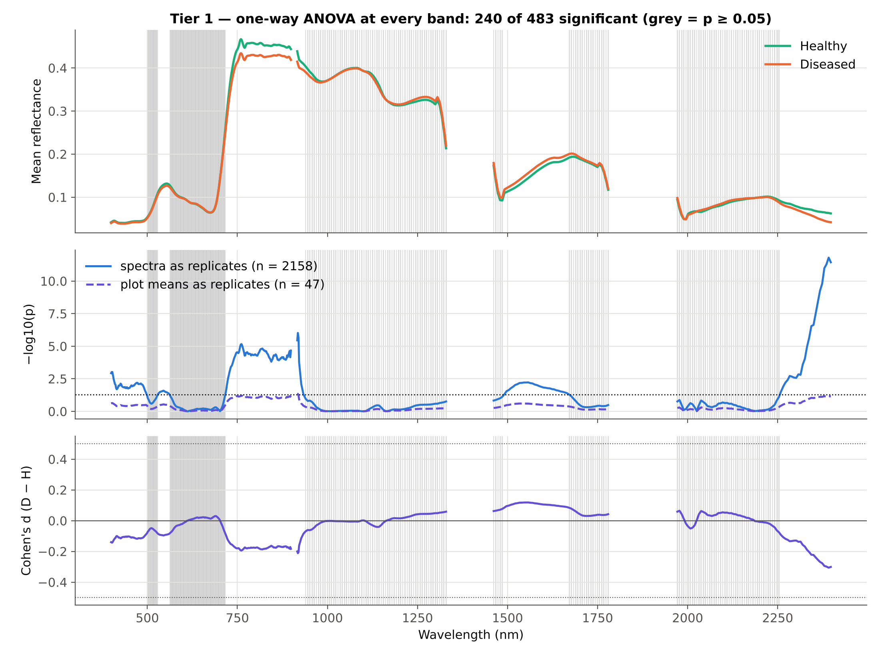
Tier 1 · 240 of 483 bands differ at p < 0.05
What Tier 1 shows
240 bands significant with spectra as replicates (206 after FDR, 98 after Bonferroni); Tukey HSD gives the same 240
Diseased lower at 210 and higher at 30 of the significant bands
Effects are small: largest |d| = 0.31 (2392 nm); 0 bands reach |d| ≥ 0.5
With the 47 plot means as replicates only 2 bands are significant: spectrum-level p-values are inflated by pseudo-replication
Notes:
Top panel: class means; grey shading marks the 243 bands that are not significant (p ≥ 0.05). Middle: −log10(p) for the test with spectra as replicates (blue) and with plot means as replicates (purple, dashed); the dotted line is p = 0.05. Bottom: Cohen's d, the mean difference in units of the pooled standard deviation (0.2 small, 0.5 medium, 0.8 large; Cohen 1988).
Following Das et al., the 240 bands with p < 0.05 are passed to Tier 2. They lie mainly in VIS (76 of 172), Red-edge (19 of 28), NIR (91 of 157), SWIR-1 (30 of 54), SWIR-2 (24 of 72).
Caution: with 2158 spectra even tiny differences become 'significant'. Effect sizes are small (max |d| = 0.31). When each plot is reduced to its mean (n = 47), almost no band remains significant (2). The spectrum-level test treats correlated endmembers of one plot as independent and overstates the evidence (Hurlbert 1984). The band list is still used for Tier 2, as in the paper, but the validation must be done at plot level.

Slide 20
Tier 1 · how robust is the band list?
Test | Replicates | Bands significant (of 483) | Use
One-way ANOVA, p < 0.05 | 2158 spectra | 240 | Passed to Tier 2 (as in Das et al.)
Tukey HSD, p < 0.05 | 2158 spectra | 240 | Identical decision (one pair)
ANOVA + FDR (Benjamini–Hochberg) | 2158 spectra | 206 | Controls false discoveries over 483 tests
ANOVA + Bonferroni | 2158 spectra | 98 | Strictest control
Welch test (unequal variances) | 2158 spectra | 240 | Levene: variances differ at 367 bands
ANOVA on plot means | 47 plots | 2 | Pseudo-replication check (Hurlbert 1984)
Region | VIS | Red-edge | NIR | SWIR-1 | SWIR-2
Bands | 172 | 28 | 157 | 54 | 72
p < 0.05 (spectra) | 76 | 19 | 91 | 30 | 24
p < 0.05 (plot means) | 0 | 0 | 2 | 0 | 0
Notes:
The table compares the paper's criterion with stricter alternatives. FDR keeps the expected share of false discoveries below 5% across the 483 tests (Benjamini & Hochberg 1995); Bonferroni controls the chance of even one false discovery. The Welch test does not assume equal variances; Levene's test shows that the variances do differ at many bands, which also justifies QDA (separate covariance per class) rather than LDA.
The decisive line is the last one: when the 47 plots — the true experimental units — are the replicates, very few bands differ. The healthy–diseased difference is real at spectrum level but weak relative to the variation among plots.
All these counts are recomputed live in sheet 4_Tier1_ANOVA (F, p, sums of squares, Cohen's d and single-band J–M are Excel formulas on the raw data).

Slide 21
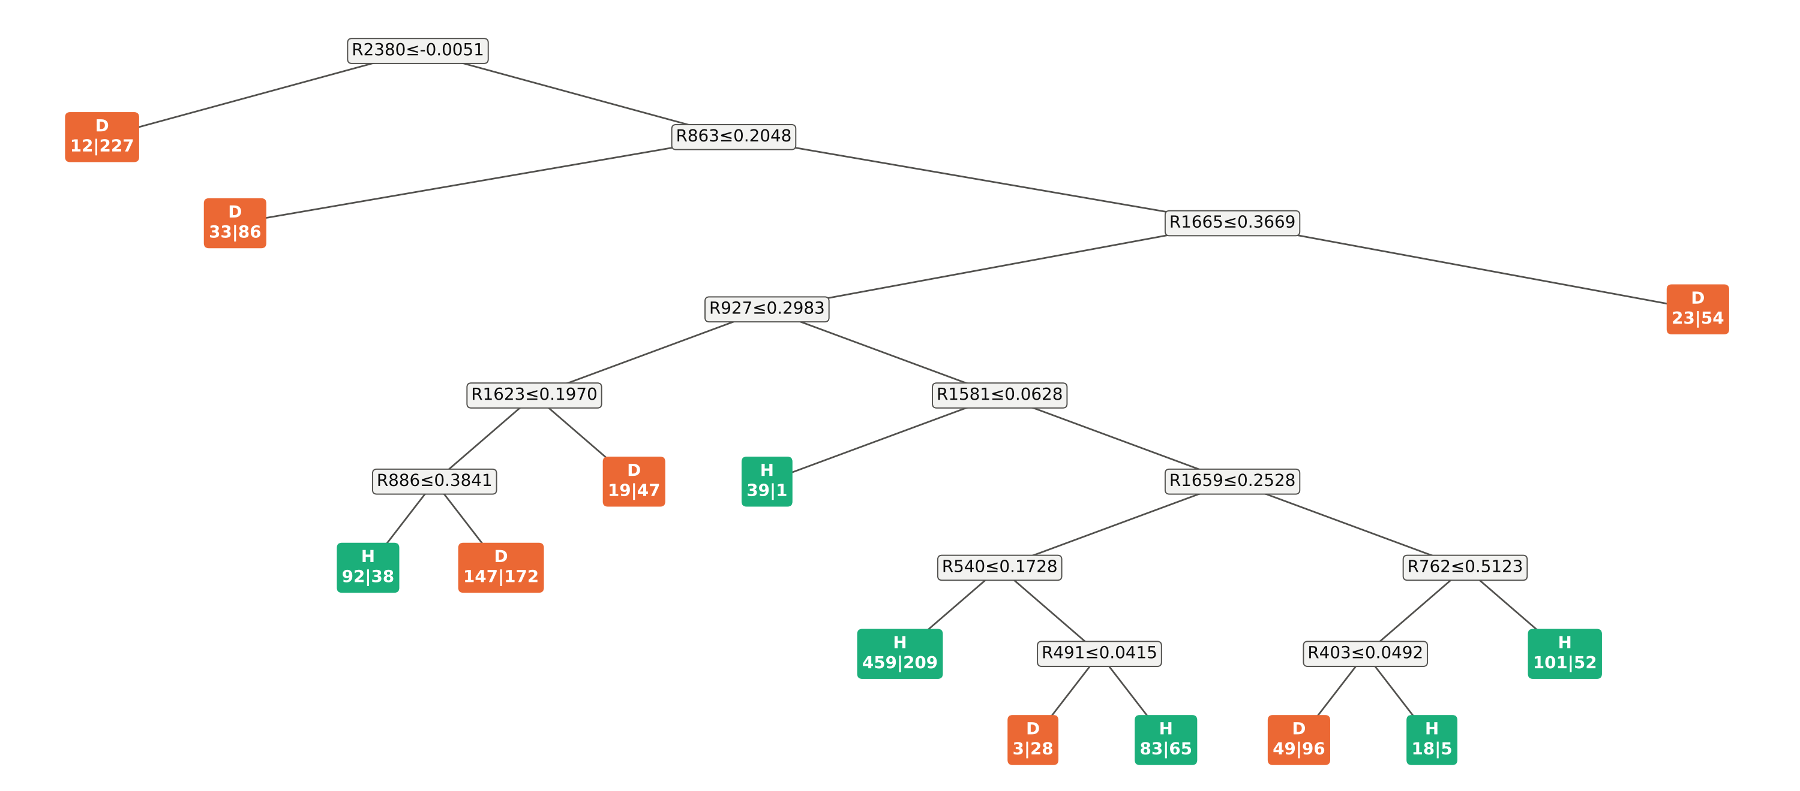
Tier 2 · the CART tree
Tree grown on all 2158 spectra and pruned at cp = 0.01: 12 splits using 12 bands; resubstitution accuracy 69.6%. Boxes: split rule (R = reflectance at that wavelength, left = true); leaves: predicted class and healthy | diseased spectra. Root split R2380 ≤ -0.0051.
Notes:
This is the Tier-2 CART model of Das et al. (rpart: Gini splitting, minimum 20 spectra to split, 7 per leaf, maximum depth 30, pruned with complexity parameter cp = 0.01). Each box is a rule 'reflectance at band ≤ threshold'; spectra satisfying it go left. Leaves show the predicted class and how many healthy | diseased spectra reach them.
The first (root) split uses 2380 nm with threshold -0.0051: the left branch holds 12 healthy and 227 diseased spectra. This band lies in the noisy SWIR-2 edge where reflectance is near zero or negative, so the tree partly exploits sensor noise — one reason for the sensitivity analysis.
The 12 bands used anywhere in the pruned tree are the selected wavebands passed to Tiers 3 and 4. The resubstitution accuracy (69.6%) is measured on the training spectra themselves and is not a validation result.

Slide 22
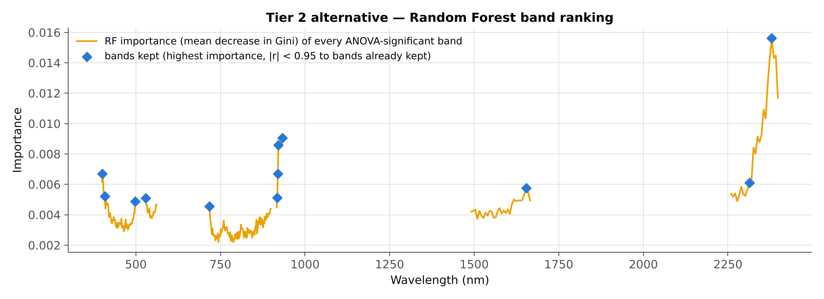
Tier 2 · bands selected by CART and by Random Forest
# | 1 | 2 | 3 | 4 | 5 | 6 | 7 | 8 | 9 | 10 | 11 | 12
CART (nm) | 2380 | 864 | 1666 | 927 | 1624 | 1582 | 886 | 1660 | 540 | 762 | 491 | 403
RF (nm) | 2380 | 933 | 921 | 401 | 920 | 2314 | 1654 | 408 | 918 | 530 | 498 | 718
CART: bands in order of first use in the tree (root first); RF: highest importance first, neighbours with |r| ≥ 0.95 skipped, 12 bands kept (= CART)
Shared regions: VIS (< 700 nm), red-edge/NIR (700–1350), SWIR-1 (1350–1800), SWIR-2 (> 1800); edge bands (< 420 or > 2350 nm): CART 2, RF 3
Notes:
Top: Random Forest importance (mean decrease in Gini impurity) of every ANOVA-significant band, with the kept bands marked. RF importance forms broad peaks because neighbouring bands are highly correlated; the |r| < 0.95 filter keeps one band per peak (Strobl et al. 2008).
Table: the bands selected on all spectra by each method. CART bands are listed in order of first use in the tree (the root split first); RF bands in order of importance. The number of RF bands was set equal to the number of CART bands, so Tier 3 and Tier 4 compare equally sized band sets.
Both methods pick bands from several spectral regions, but the exact wavelengths differ. Inside the validation folds the selected bands also change from fold to fold (see 'Are the same bands chosen in every fold?'), so individual wavelengths should not be over-interpreted.

Slide 23
Tier 3 · J–M distance of each band selected in Tier 2
# | CART band (nm) | J–M of this band | J–M of first k bands | RF band (nm) | J–M of this band | J–M of first k bands
1 | 2379.6 | 0.0677 | 0.068 | 2379.6 | 0.0677 | 0.068
2 | 863.5 | 0.0128 | 0.083 | 933.4 | 0.0080 | 0.075
3 | 1665.5 | 0.0256 | 0.168 | 921.4 | 0.0084 | 0.099
4 | 927.4 | 0.0076 | 0.322 | 401.1 | 0.0087 | 0.106
5 | 1623.5 | 0.0370 | 0.463 | 919.7 | 0.0114 | 0.114
6 | 1581.5 | 0.0515 | 0.512 | 2313.5 | 0.0132 | 0.296
7 | 886.3 | 0.0142 | 0.519 | 1653.5 | 0.0281 | 0.443
8 | 1659.5 | 0.0273 | 0.560 | 408.2 | 0.0097 | 0.448
9 | 540.0 | 0.0048 | 0.564 | 918.0 | 0.0139 | 0.454
10 | 761.5 | 0.0103 | 0.571 | 529.5 | 0.0050 | 0.466
11 | 490.8 | 0.0057 | 0.595 | 497.8 | 0.0047 | 0.490
12 | 402.9 | 0.0097 | 0.612 | 717.6 | 0.0060 | 0.497
Set |  | max 0.0677 | 0.612 |  | max 0.0677 | 0.497
Reading the table
Every single band has J–M ≤ 0.068 on the 0–2 scale: alone, no band separates the classes
All 12 bands together: CART 0.612, RF 0.497
Threshold of Das et al.: 1.94 — not reached
Best band anywhere in the spectrum: 0.076 at 2392 nm
Notes:
This table gives the Jeffries–Matusita distance of every individual band selected in Tier 2, for CART and for Random Forest, plus the cumulative J–M of the first k bands and of the whole set (last row).
Single-band J–M: JM = 2(1 − e^−B), with the one-dimensional Bhattacharyya distance B = (μD − μH)² / (4(σH² + σD²)) + ½ ln((σH² + σD²) / (2σHσD)). It uses the class means and variances of that one band. The same value is computed by an Excel formula for all 483 bands in sheet 4_Tier1_ANOVA (column R) and linked into sheets 5–7.
Interpretation: on the 0–2 scale, individual bands reach at most 0.068. Combining bands raises the distance (multivariate J–M uses the covariance between bands), but even the full set stays far below the 1.94 threshold that Das et al. used for 'separable'. Healthy and diseased endmembers overlap strongly.
For CART the cumulative column follows the order of first use in the tree; for RF the order of importance.

Slide 24
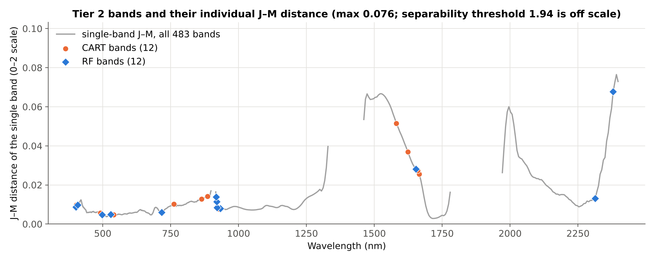
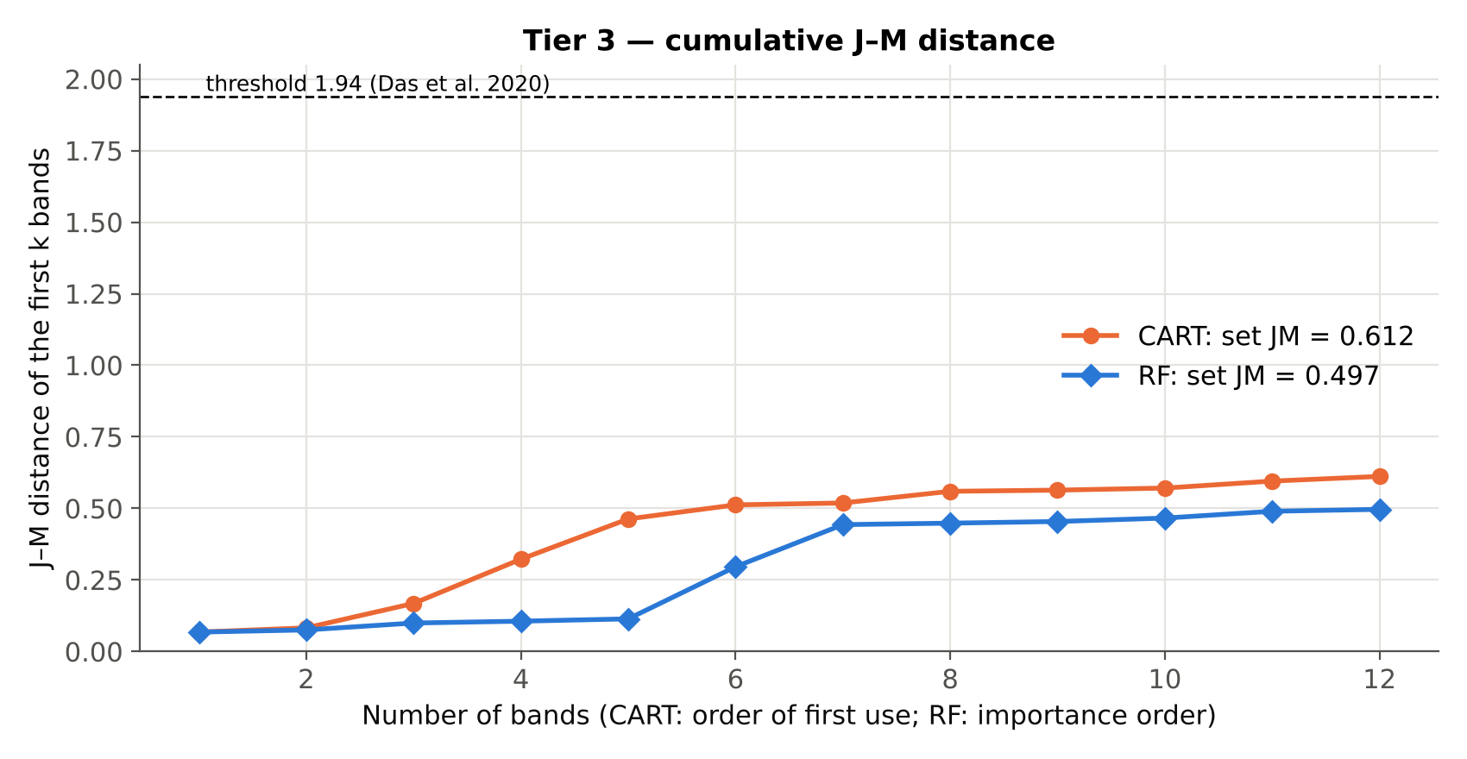
Tier 3 · separability on the spectrum and with more bands
What the figures show
Top: J–M of every single band (grey) with the CART and RF bands marked; the highest values are in the SWIR
Bottom: J–M grows as bands are added but levels off near 0.61, far below 1.94
CART bands reach a higher set J–M than RF bands (0.612 vs 0.497)
Conclusion of Tier 3: the classes are statistically different but not separable in the sense of Das et al.
Notes:
Top figure: the grey line is the J–M distance of each band on its own; markers show where the CART (orange) and RF (blue) bands lie on this curve. Both methods choose some bands with relatively high single-band J–M, but also bands with low individual J–M that add information in combination with others.
Bottom figure: J–M of the first k selected bands. Adding bands helps at first and then flattens out. The dashed line is the 1.94 threshold of Das et al.; neither set comes close. In the paper all genotype pairs exceeded 1.94 with 17 CART bands, which explains their 98% accuracy; here the much lower J–M predicts modest accuracy, which Tier 4 confirms.

Slide 25
Tier 4 · QDA validated as in Das et al. (CV1)
CART bands + QDA (repetition 1)
RF bands + QDA (repetition 1)
Reference \ Predicted | Healthy | Diseased | Total | Producer's acc.
Healthy | 952 | 126 | 1078 | 88.3%
Diseased | 674 | 406 | 1080 | 37.6%
Total | 1626 | 532 | 2158
User's acc. | 58.5% | 76.3% |  | OA 62.9%
Reference \ Predicted | Healthy | Diseased | Total | Producer's acc.
Healthy | 916 | 162 | 1078 | 85.0%
Diseased | 636 | 444 | 1080 | 41.1%
Total | 1552 | 606 | 2158
User's acc. | 59.0% | 73.3% |  | OA 63.0%
10-fold CV, mean of 10 repetitions | OA | BA | Kappa | AUC
CART + QDA | 0.631 ± 0.002 | 0.632 ± 0.002 | 0.263 ± 0.003 | 0.694 ± 0.002
RF + QDA | 0.637 ± 0.004 | 0.637 ± 0.004 | 0.275 ± 0.008 | 0.691 ± 0.004
Bands chosen on all spectra, QDA with 10 random folds of spectra, as in Das et al. (2020: OA 98% for 14 genotypes). Optimistic for these data: endmembers of one plot fall in training and test, and the bands were chosen using the test spectra.
Notes:
This slide reproduces Tier 4 of the paper. The error matrix of the first repetition corresponds to the single run reported by Das et al.; the table shows the mean ± SD over 10 repetitions with different random folds.
Result: overall accuracy 63.1% with the CART bands and 63.7% with the RF bands, compared with 98% in the paper. Producer's accuracy shows how many healthy and diseased spectra are found; user's accuracy how often a predicted label is correct.
Why this is not the final answer: in random 10-fold CV the training set always contains endmembers from the same plots as the test endmembers, and the CART/RF bands were chosen with all spectra. Both inflate accuracy. The following slides therefore validate with whole plots held out (CV2–CV6).

Slide 26
Main result · balanced accuracy under every validation scheme
Reading the chart
0.5 = chance; 1.0 = perfect
CV1 (paper's method): 0.63 / 0.64
Plot-based schemes CV2–CV6: 0.60–0.64
CV2 (main): CART 0.620, RF 0.622
CART and RF differ by only a few points under every scheme
Notes:
Each bar is the balanced accuracy of all spectrum predictions of one scheme (for CV1 and CV2 pooled over 10 repetitions). CV1 = validation of Das et al.; CV2 = plot-grouped nested CV (main); CV3 = leave-one-plot-out; CV4 = leave-one-treatment-combination-out; CV5 = leave-one-variety-out; CV6 = leave-one-inoculation-date-out.
Key message: under every scheme the accuracy is clearly above chance but moderate (about 0.60–0.64 with whole plots held out). The difference between CV1 and CV2 is the optimism of random spectrum-level cross-validation for these data.
CART and Random Forest in Tier 2 lead to very similar QDA accuracy; neither band-selection method is clearly better here.

Slide 27
Accuracy assessment · error matrices of the main validation (CV2)
CART + QDA (21580 predictions)
RF + QDA (21580 predictions)
Reference \ Predicted | Healthy | Diseased | Total | Producer's acc.
Healthy | 9080 | 1700 | 10780 | 84.2%
Diseased | 6503 | 4297 | 10800 | 39.8%
Total | 15583 | 5997 | 21580
User's acc. | 58.3% | 71.7% |  | OA 62.0%
Reference \ Predicted | Healthy | Diseased | Total | Producer's acc.
Healthy | 8993 | 1787 | 10780 | 83.4%
Diseased | 6364 | 4436 | 10800 | 41.1%
Total | 15357 | 6223 | 21580
User's acc. | 58.6% | 71.3% |  | OA 62.2%
Measure (95% CI by plot bootstrap) | CART + QDA | RF + QDA
Overall accuracy | 62.0% (58.2–65.8%) | 62.2% (58.3–66.2%)
Balanced accuracy | 62.0% (58.3–65.9%) | 62.2% (58.3–66.2%)
Kappa | 0.240 (0.165–0.317) | 0.245 (0.166–0.324)
PA healthy / PA diseased | 84.2% / 39.8% | 83.4% / 41.1%
UA healthy / UA diseased | 58.3% / 71.7% | 58.6% / 71.3%
MCC · F1 healthy · F1 diseased | 0.268 · 0.69 · 0.51 | 0.270 · 0.69 · 0.52
Quantity / allocation disagreement | 22.3% / 15.8% | 21.2% / 16.6%
Notes:
Error matrices of the main validation (CV2), summed over 10 repetitions: every spectrum is predicted 10 times, always by a model trained without its plot. Rows are the true classes, columns the predictions.
Producer's accuracy (PA) of diseased = share of diseased spectra recognised as diseased (sensitivity); PA of healthy = share of healthy spectra recognised as healthy (specificity). User's accuracy (UA) = share of predicted labels that are correct.
Confidence intervals come from resampling whole plots (cluster bootstrap), so they reflect the plot-to-plot variability, which is the relevant uncertainty for new plots.
Quantity disagreement shows whether one class is predicted too often; allocation disagreement shows errors that cancel in the totals. Their sum equals 1 − OA (Pontius & Millones 2011). All values are recomputed by Excel formulas in sheet 13_Accuracy.
Why healthy is found far more often than diseased (PA 84% vs 40%): the two class means are almost equal, but diseased endmembers are more variable (mean SD 0.097 vs 0.085; log-determinant of the covariance on the CART bands -90.3 vs -94.4). QDA then assigns spectra near the common mean to the tighter (healthy) class and calls a spectrum diseased only when it lies in the wider tails of the diseased distribution. The large quantity disagreement reflects this: too many spectra are labelled healthy. Disease therefore appears mainly as increased spectral variability rather than as a shift of the mean.

Slide 28
Accuracy of every validation scheme (spectrum level)
Tier 2 | Validation | OA | BA (95% CI) | Kappa | PA H | UA H | PA D | UA D | MCC | QD / AD
CART | CV1 Das et al.: random 10-fold | 63.1% | 63.2% | 0.26 | 89% | 59% | 38% | 77% | 0.31 | 26% / 11%
 | CV2 Plot-grouped nested (main) | 62.0% | 62.0% (58–66%) | 0.24 | 84% | 58% | 40% | 72% | 0.27 | 22% / 16%
 | CV3 Leave-one-plot-out | 60.2% | 60.2% (56–65%) | 0.20 | 85% | 57% | 35% | 70% | 0.24 | 25% / 15%
 | CV4 Leave-one-treatment-out | 62.8% | 62.8% (58–67%) | 0.26 | 88% | 58% | 38% | 76% | 0.30 | 25% / 12%
 | CV5 Leave-one-variety-out | 63.6% | 63.6% (59–68%) | 0.27 | 84% | 60% | 43% | 73% | 0.30 | 20% / 16%
 | CV6 Leave-one-date-out | 61.3% | 61.3% (57–66%) | 0.23 | 84% | 58% | 39% | 71% | 0.25 | 23% / 16%
RF | CV1 Das et al.: random 10-fold | 63.7% | 63.7% | 0.27 | 86% | 59% | 41% | 75% | 0.31 | 22% / 14%
 | CV2 Plot-grouped nested (main) | 62.2% | 62.2% (58–66%) | 0.24 | 83% | 59% | 41% | 71% | 0.27 | 21% / 17%
 | CV3 Leave-one-plot-out | 60.5% | 60.5% (56–65%) | 0.21 | 81% | 57% | 40% | 68% | 0.23 | 21% / 19%
 | CV4 Leave-one-treatment-out | 63.1% | 63.1% (59–68%) | 0.26 | 85% | 59% | 41% | 74% | 0.29 | 22% / 15%
 | CV5 Leave-one-variety-out | 62.7% | 62.7% (59–67%) | 0.25 | 84% | 59% | 41% | 72% | 0.28 | 22% / 16%
 | CV6 Leave-one-date-out | 62.9% | 62.9% (58–67%) | 0.26 | 86% | 59% | 40% | 74% | 0.29 | 23% / 14%
H = healthy, D = diseased. CV1 has no CI because its folds split the spectra of each plot between training and test. Plot-level matrices: sheet 13_Accuracy and slide on leave-one-plot-out.
Notes:
This table brings together the full accuracy assessment for both Tier-2 methods and all six validation schemes. It is the complete version of the bar chart.
Points to note: (1) accuracy under CV1 (the paper's method) is higher than under the plot-based schemes; (2) the plot-based schemes agree with each other, so the estimate is stable; (3) look at PA and UA of each class to see whether errors are balanced or one class is systematically missed.

Slide 29
Are the same bands chosen in every training fold?
CART band (nm) | Share of 40 folds | RF band (nm) | Share of 40 folds
2379.6 | 65% | 919.7 | 95%
921.4 | 35% | 918.0 | 78%
927.4 | 33% | 921.4 | 65%
863.5 | 33% | 2379.6 | 45%
2373.5 | 28% | 401.1 | 33%
2391.6 | 25% | 898.6 | 30%
402.9 | 15% | 896.9 | 30%
1539.5 | 15% | 2391.6 | 28%
919.7 | 15% | 406.4 | 28%
933.4 | 12% | 927.4 | 25%
Stability of band selection
In CV2, Tier 1 and Tier 2 are repeated in each of the 40 training folds (4 folds × 10 repetitions)
Bands per fold: CART 11.7, RF 11.2 on average
Even the most frequent bands are chosen in only part of the folds: the band set depends on which plots are in the training set
Report spectral regions rather than single wavelengths
Notes:
Because band selection is part of the model, it is repeated inside every training fold (nested validation). This table counts how often each wavelength was selected over the 40 training folds of CV2.
A band chosen in 100% of the folds would be a robust marker. Here selection varies considerably, which is expected when classes overlap strongly: many bands carry similar weak information, and small changes in the training plots change which one wins. Interpretation should therefore focus on regions (e.g. visible, red-edge, SWIR) rather than on exact wavelengths.

Slide 30
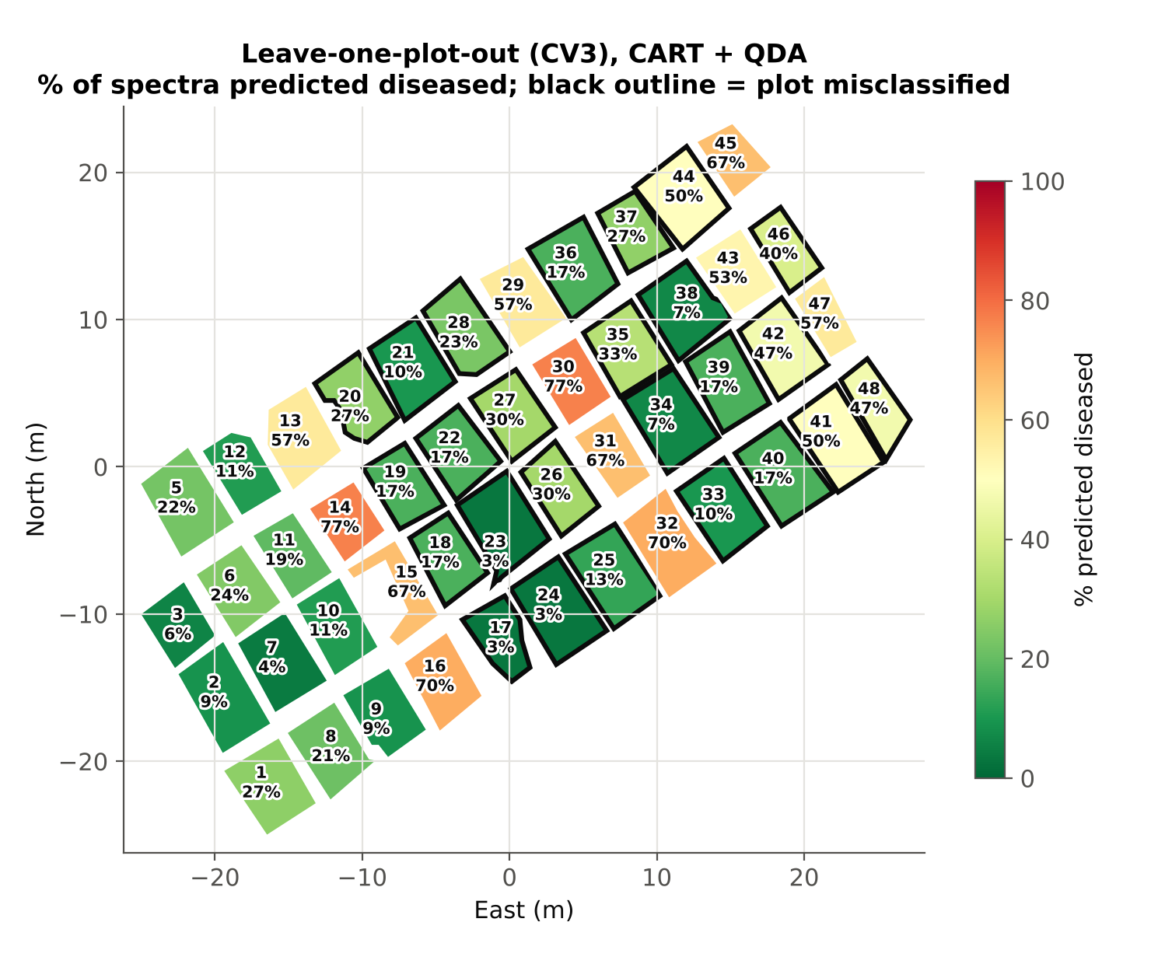

Leave-one-plot-out (CV3): which plots are misclassified?
Plot level
CART: 22/47 plots correct, plot BA 0.65
RF: 22/47 plots correct, plot BA 0.65
Tier 2 | Spectrum BA | Plot BA | Healthy plots wrong | Diseased plots wrong
CART | 0.602 | 0.653 | none | 25 plots
RF | 0.605 | 0.653 | none | 25 plots
Notes:
Each plot was predicted by a model built from the other 46 plots (all tiers refitted). The colour shows the share of the plot's endmembers predicted diseased; a plot is called diseased if more than 50% are. Black outlines mark plots whose majority call is wrong.
The maps show whether errors are spatially clustered. Errors concentrated in one part of the field would point to a location effect rather than to disease.

Slide 31
Validation using the treatment design (CV4–CV6)
Tier 2 | Scheme | BA (95% CI) | OA | Kappa | Plot BA | Plots correct
CART | CV2 Plot-grouped nested (main) | 0.620 (58–66%) | 62.0% | 0.24 | 0.67 | —
 | CV4 Leave-one-treatment-out | 0.628 (58–67%) | 62.8% | 0.26 | 0.69 | 25/47
 | CV5 Leave-one-variety-out | 0.636 (59–68%) | 63.6% | 0.27 | 0.71 | 26/47
 | CV6 Leave-one-date-out | 0.613 (57–66%) | 61.3% | 0.23 | 0.64 | 21/47
RF | CV2 Plot-grouped nested (main) | 0.622 (58–66%) | 62.2% | 0.24 | 0.69 | —
 | CV4 Leave-one-treatment-out | 0.631 (59–68%) | 63.1% | 0.26 | 0.69 | 25/47
 | CV5 Leave-one-variety-out | 0.627 (59–67%) | 62.7% | 0.25 | 0.68 | 24/47
 | CV6 Leave-one-date-out | 0.629 (58–67%) | 62.9% | 0.26 | 0.71 | 26/47
What it shows
Holding out a whole variety, inoculation date or treatment combination gives BA 0.61–0.64, close to CV2
The weak discrimination is not tied to one variety or date: the model transfers, but stays weak
The CV4 fold V1×D3 contains no control plot (plot 4 missing); pooled predictions are still valid
Notes:
CV4–CV6 withhold an entire treatment level from training (Meyer et al. 2018 call this target-oriented validation). If the model relied on something specific to one variety or one inoculation date, accuracy would drop for that level.
Accuracy stays at the same level as CV2, so the result is consistent across varieties and inoculation dates. Per-fold accuracies are listed in sheet 11_CV4-6_Design.
These schemes keep the spatial layout intact (block C is always west of the inoculated blocks), so they cannot remove the block/location confound — that is the purpose of the next two slides.

Slide 32
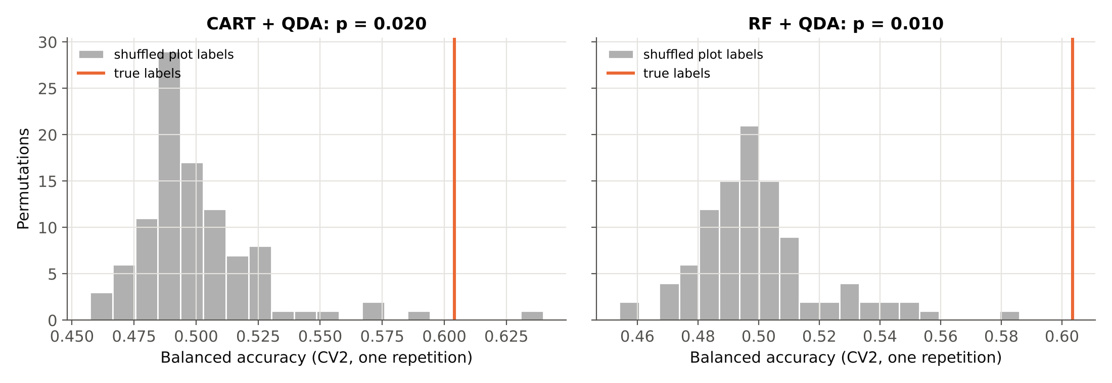
Permutation test: better than chance?
Tier 2 | Observed BA | Null mean | Null 95% | Null max | p
CART | 0.604 | 0.501 | 0.546 | 0.640 | 0.020
RF | 0.604 | 0.500 | 0.542 | 0.586 | 0.010
Plot labels shuffled 100 times (11 healthy / 36 diseased kept) and the CV2 pipeline (one repetition) re-run each time
Shuffled labels give BA ≈ 0.50; the true labels give 0.604 (CART) and 0.604 (RF): p = 0.020 and 0.010 (smallest possible 0.010)
Because whole plots are permuted, this tests the plot-level class difference (Ojala & Garriga 2010) — but not whether that difference is disease or location (next slides)
Notes:
The permutation test asks: if the healthy/diseased labels were assigned to plots at random, how high would the accuracy be? The labels of whole plots are shuffled (keeping 11 healthy and 36 diseased), and the full nested pipeline is re-run each time. The grey histogram is this null distribution; the orange line is the accuracy with the true labels.
The true accuracy exceeds 98 of 100 shuffled accuracies for CART (p = 0.020) and 99 of 100 for RF (p = 0.010), so the plots labelled healthy and diseased differ spectrally beyond chance at the 5% level.
Limitation: plots of block C share a location. A plot-label permutation cannot distinguish disease from location; the block-level analyses that follow address this.

Slide 33
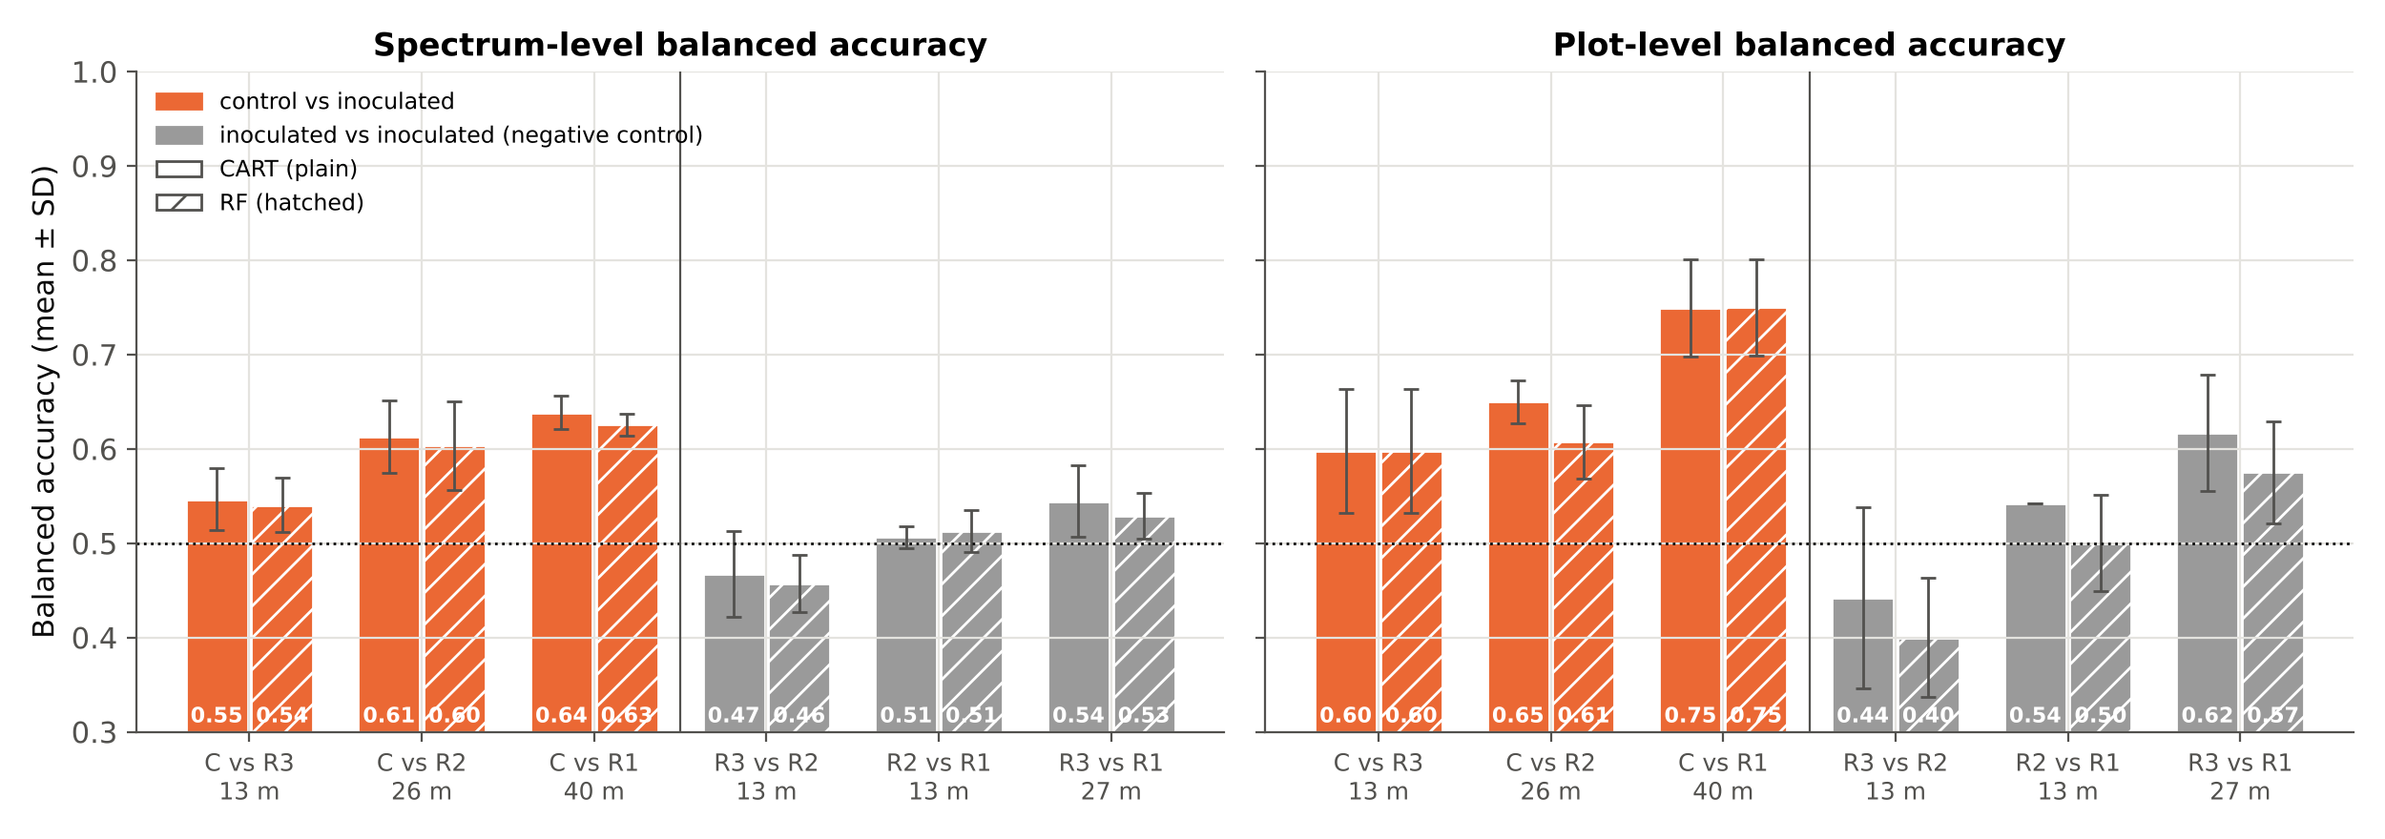
Negative control: block vs block
Control vs inoculated: mean BA 0.60 (CART) / 0.59 (RF); inoculated vs inoculated: 0.51 / 0.50
Same distance (≈ 27 m): C vs R2 0.61 / 0.60 against R3 vs R1 0.54 / 0.53
But inoculated blocks also differ in Tier 1 (R3 vs R1: 256 bands; plot means 135), and C vs R accuracy rises with distance (C vs R3 0.55 → C vs R1 0.64)
Notes:
A negative control is a comparison where the effect of interest cannot exist (Lipsitch et al. 2010). Two inoculated blocks received the same treatment, so any accuracy above 0.5 between them reflects block or location differences, not disease.
Orange bars: the control block against each inoculated block; grey bars: inoculated blocks against each other. Same pipeline, plot-grouped CV with 5 repetitions, class weights because block C has 98 endmembers per plot versus 30.
If the grey bars were as high as the orange ones, the healthy–diseased separation could be entirely location. Higher orange bars, especially at equal distance (C vs R2 against R3 vs R1, both ≈ 27 m apart), indicate a difference specific to the control block — consistent with a disease effect, though a difference unique to block C (e.g. its management or position) cannot be excluded.

Slide 34
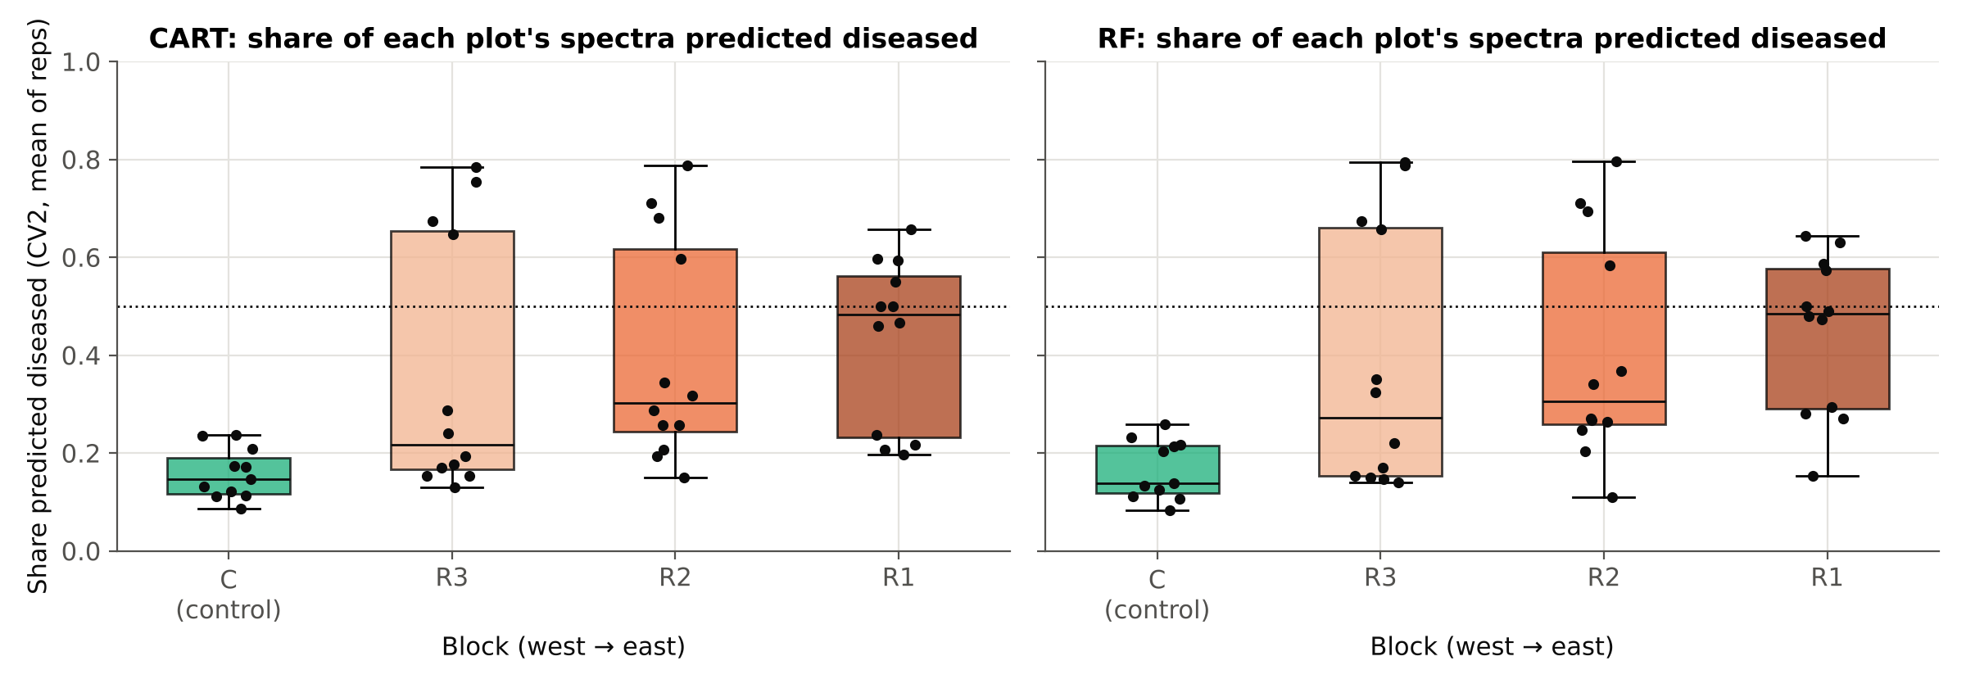
Detection by block, variety and inoculation date
Block called healthy | C (true) | R3 | R2 | R1 | p
CART | 0.617 | 0.498 | 0.510 | 0.564 | 0.25
RF | 0.621 | 0.488 | 0.485 | 0.571 | 0.25
Restricted permutation: CV2 balanced accuracy (class weights, 5 reps) when each block in turn is called healthy; smallest possible p = 0.25.
Share of spectra predicted diseased by block (CART, CV2): C 16%, R3 36%, R2 40%, R1 43% (RF 17% → 45%)
Among inoculated plots detection does not differ by inoculation date (Kruskal–Wallis p = 0.87 CART, 0.93 RF) or variety (p = 0.60, 0.73); between inoculated blocks p = 0.50 / 0.60
The true labelling ranks first of 4 (CART) and first of 4 (RF), p = 0.25 / 0.25: with one control block, disease and block cannot be separated statistically
Notes:
Box plots: for each plot, the share of its endmembers predicted diseased in CV2, grouped by block from west to east. A clear increase from R3 to R1 would mean the classifier responds to position along the field as well as to treatment.
Kruskal–Wallis tests (Kruskal & Wallis 1952) compare these shares among inoculation dates and varieties within the diseased plots. If disease severity increased with earlier inoculation, a difference among dates would be expected; none is found.
Restricted permutation: since the treatment was applied block-wise, the honest permutation exchanges whole blocks. There are only four ways to choose the 'healthy' block, so the p-value cannot be smaller than 0.25 even if the true labelling gives the best accuracy. This is a limit of the field design, not of the analysis; it can only be removed by replicating control plots in every block in future trials.

Slide 35
Sensitivity analysis: band removal of Das et al.
Tier 2 | Bands | Selected bands | J–M set | CV1 OA | CV2 BA | CV2 plot BA
CART, all 483 bands | 483 | 12 | 0.612 | 63.1% | 62.0% | 67.2%
CART, bands < 2350 nm | 475 | 9 | 0.408 | 60.8% | 60.4% | 66.9%
RF, all 483 bands | 483 | 12 | 0.497 | 63.7% | 62.2% | 68.6%
RF, bands < 2350 nm | 475 | 9 | 0.294 | 63.2% | 60.1% | 65.9%
Das et al. removed 1350–1430, 1800–1950 and 2350–2500 nm; the first two ranges are not in the image, so 8 bands ≥ 2350 nm were removed and all tiers repeated
Without them the set J–M changes to 0.408 (CART) and 0.294 (RF); plot-grouped BA becomes 0.604 and 0.601
CART bands without the edge: 2344, 863, 1665, 921, 561, 797, 1659, 2284, 777 nm
Notes:
The sensitivity analysis applies the band removal used by Das et al. The noisy edge above 2350 nm contains most of the negative reflectance values and was used by CART for its first split. Repeating the whole analysis without it tests whether the results depend on sensor noise.
Read the table by comparing each pair of rows: if accuracy stays similar without the edge bands, the conclusions do not depend on them; a clear drop would mean the noisy region was carrying part of the separation.

Slide 36
Comparison: CART vs Random Forest in Tier 2
Measure | CART | RF
Bands selected | 12 | 12
J–M of the set (Tier 3) | 0.612 | 0.497
Largest single-band J–M | 0.068 | 0.068
CV1 BA — Das et al.: random 10-fold | 0.632 | 0.637
CV2 BA — Plot-grouped nested (main) | 0.620 | 0.622
CV3 BA — Leave-one-plot-out | 0.602 | 0.605
CV4 BA — Leave-one-treatment-out | 0.628 | 0.631
CV5 BA — Leave-one-variety-out | 0.636 | 0.627
CV6 BA — Leave-one-date-out | 0.613 | 0.629
CV1 overall accuracy (paper's measure) | 63.1% | 63.7%
CV2 plot-level BA | 0.672 | 0.686
Permutation p / block permutation p | 0.020 / 0.25 | 0.010 / 0.25
What the comparison shows
CART gives the higher set J–M; RF ranks bands with less dependence on a single tree
Balanced accuracy is higher with CART in 1 of 6 schemes and with RF in 5; differences are small compared with the CIs
Both reach the same conclusion: statistically different but weakly separable classes
Choice of Tier-2 method matters less than the validation scheme
Notes:
This slide answers the comparison asked for: CART (as in Das et al.) versus Random Forest in Tier 2, with all other tiers identical.
The two methods select different wavelengths but lead to similar separability and similar QDA accuracy under every validation scheme. The width of the confidence intervals (about ±3–5 percentage points) is larger than most CART–RF differences, so neither method is clearly superior for these data.
Practical recommendation: keep CART for comparability with the paper, report RF as a robustness check, and interpret spectral regions rather than individual bands.

Slide 37
Every step was cross-checked
Step | Checks | What was checked | Result
Data | 5 | 2158 × 483; 98/30 endmembers per plot; plot 4 absent; no missing or duplicate spectra | PASS
Design | 2 | 47 ROIs; block C = healthy plots; R1–R3 = diseased plots | PASS
Tier 1 | 2 | manual F = scipy; Tukey = ANOVA decision at all bands | PASS
Tier 3 | 2 | 1-D closed-form J–M = matrix form; cumulative = set J–M | PASS
Tier 2 | 3 | bands ⊂ significant set; RF = CART band count; custom pruned tree = sklearn | PASS
Validation | 7 | no plot in training and test; every spectrum tested once; permutation nulls ≈ 0.5 | PASS
Tier 4 | 2 | hand-coded QDA = sklearn; BA = (sens + spec)/2 | PASS
Accuracy | 4 | matrix totals; OA = 1 − QD − AD; kappa = sklearn; OA = accuracy | PASS
Excel ↔ Python | live | ANOVA F and p, single-band and set J–M, error-matrix accuracies, LOPO plot BA, permutation p recomputed by Excel formulas | PASS
27 of 27 Python checks pass; live Excel checks in sheet 18_Cross_Checks of Four_Tier_47plots.xlsx. QDA needed the ridge fallback in 0 fits.
Notes:
Each step was checked in two independent ways. Python checks run during the analysis (for example: the hand-written ANOVA equals scipy, Tukey equals the ANOVA decision, the re-implemented rpart pruning reproduces scikit-learn, a hand-coded QDA equals scikit-learn, no plot appears in both training and test, every spectrum is tested exactly once).
In the workbook, key numbers are recomputed with Excel formulas directly from the raw spectra (ANOVA F and p for all 483 bands, single-band J–M, the J–M of the whole CART and RF sets with matrix formulas, every accuracy measure of every error matrix, the plot-level accuracy of leave-one-plot-out and the permutation p-values). Sheet 18 compares them with Python and shows ALL PASS.

Slide 38
D · Discussion, summary and conclusion
What the results mean, their limits and what to do next
Notes:
Part D interprets the results, lists their limitations and gives the conclusion.

Slide 39
Discussion
Statistically different, weakly separable
Validation decides the accuracy
240 bands differ (Tier 1) but effect sizes are small and the set J–M is 0.61 / 0.50, far below 1.94. Das et al. separated genotypes with averaged field spectra; here single SMACC endmembers mix leaves, lesions, soil and shadow.
The paper's 10-fold CV gives OA 63% / 64%; holding out whole plots gives BA 0.60–0.64. Spectra of one plot are not independent (Hurlbert 1984), so plot-based validation is the honest estimate.
Why diseased spectra are missed
Location confound
PA healthy 84% vs PA diseased 40%. Class means are nearly equal but diseased endmembers vary more (SD 0.097 vs 0.085), so QDA calls only the outlying diseased spectra 'diseased': disease shows as variability, not a mean shift.
All healthy plots form block C at the west end. Control vs inoculated (BA 0.60) exceeds inoculated vs inoculated (0.51), suggesting a real control–inoculated difference, but with one control block the restricted permutation cannot go below p = 0.25.
CART vs RF; treatment levels
Data quality
CART and RF select different wavelengths but give similar accuracy (CV2 BA 0.620 vs 0.622). Holding out a variety, date or combination gives BA 0.61–0.64; detection does not differ by date or variety.
299 diseased and 79 healthy spectra contain negative reflectance (mainly SWIR-2). CART's root split uses 2380 nm; the sensitivity analysis without bands ≥ 2350 nm gives CV2 BA 0.604 / 0.601.
Notes:
1. The four tiers of Das et al. work as intended, but the data are much harder than in the paper. Das et al. separated 14 rice genotypes with field spectroradiometer measurements of uniform plots; here healthy and diseased canopies are compared through individual SMACC endmembers, which are extreme pixels mixing leaves, lesions, soil and shadow. The class difference is small relative to within-class variation (Tier 3).
2. The validation scheme changes the answer more than any other choice. Random 10-fold CV of spectra (the paper's method) overstates accuracy because near-identical endmembers from one plot are both trained and tested. Plot-based validation is the appropriate estimate for classifying new plots.
3. The error matrices are asymmetric: most healthy spectra are recognised, most diseased spectra are not. Diseased endmembers are more variable than healthy ones while the class means are almost the same, so QDA assigns the bulk of the spectra to the tighter healthy class. For practical use this means the method flags only the most strongly affected spectra; it is not a reliable detector of every diseased plot.
4. CART and RF lead to the same conclusion, and results are consistent across varieties and inoculation dates.
5. The main limitation is the design: the control plots form one contiguous block. The negative control suggests a genuine difference between control and inoculated plots beyond distance, but statistical proof of a disease effect is impossible with one control block.
6. Out-of-range reflectance in the SWIR-2 region is a data-quality issue; the sensitivity analysis shows how much the results depend on it.

Slide 40
Summary
2158
240
12 + 12
endmember spectra (1078 healthy from 11 plots, 1080 diseased from 36 plots) × 483 bands, analysed individually
bands significant in Tier 1 (only 2 with plot means as replicates)
bands selected in Tier 2 by CART and by Random Forest
0.61 / 0.50
63% / 64%
0.62 / 0.62
J–M of the CART / RF band sets (Tier 3); single bands ≤ 0.068; threshold 1.94
overall accuracy with the validation of Das et al. (CV1, optimistic)
balanced accuracy with whole plots held out (CV2, main); permutation p = 0.020
Notes:
Summary of the main numbers. The first value in each pair refers to CART in Tier 2, the second to Random Forest.
The most important contrast is between the two accuracy boxes: the paper's validation (CV1) and plot-based validation (CV2). The second is the realistic accuracy for new plots.

Slide 41
Conclusion
The four-tier method of Das et al. (2020) was applied step by step to all 2158 SMACC endmembers of 47 plots, with Random Forest replacing CART in Tier 2 for comparison; every step is reproduced in Excel and cross-checked.
Healthy and diseased spectra differ statistically, but separability is low: J–M 0.61 (CART) and 0.50 (RF), no single band above 0.07, all far below 1.94.
With the paper's validation QDA reaches 63% / 64% overall accuracy; with whole plots held out the balanced accuracy is 0.60–0.64, with healthy spectra recognised far more often than diseased (PA 84% vs 40%). CART and RF perform similarly.
Because all control plots form one block, part of the separation may be location. Next trials should replicate control plots in every block, record plot-level disease scores and add an independent date.
Notes:
Conclusion in four points: (1) the method was applied completely and transparently; (2) the classes differ but overlap strongly; (3) accuracy depends on how it is validated, and plot-based validation gives the realistic, moderate value, with CART and RF equivalent; (4) the experimental design limits causal interpretation.
Recommendations: randomise control plots within each replication, measure disease severity per plot for a continuous response, keep atmospheric correction under control in the SWIR-2, and validate on an image from another date.

Slide 42
References (1/3)
Das B, Sahoo RN, Biswas A, Pargal S, Krishna G, Verma R, Chinnusamy V, Sehgal VK, Gupta VK (2020) Discrimination of rice genotypes using field spectroradiometry. Geocarto International 35(1):64–77. doi:10.1080/10106049.2018.1506507
Gruninger JH, Ratkowski AJ, Hoke ML (2004) The sequential maximum angle convex cone (SMACC) endmember model. Proc. SPIE 5425, Algorithms and Technologies for Multispectral, Hyperspectral, and Ultraspectral Imagery X. doi:10.1117/12.543794
Tukey JW (1949) Comparing individual means in the analysis of variance. Biometrics 5(2):99–114
Benjamini Y, Hochberg Y (1995) Controlling the false discovery rate: a practical and powerful approach to multiple testing. Journal of the Royal Statistical Society B 57(1):289–300. doi:10.1111/j.2517-6161.1995.tb02031.x
Welch BL (1947) The generalization of 'Student's' problem when several different population variances are involved. Biometrika 34(1/2):28–35. doi:10.2307/2332510
Levene H (1960) Robust tests for equality of variances. In: Olkin I et al. (eds) Contributions to Probability and Statistics: Essays in Honor of Harold Hotelling. Stanford University Press, pp 278–292
Cohen J (1988) Statistical Power Analysis for the Behavioral Sciences, 2nd ed. Lawrence Erlbaum Associates, Hillsdale, NJ
Hurlbert SH (1984) Pseudoreplication and the design of ecological field experiments. Ecological Monographs 54(2):187–211
Breiman L, Friedman JH, Olshen RA, Stone CJ (1984) Classification and Regression Trees. Wadsworth, Belmont, CA
Therneau TM, Atkinson EJ. An introduction to recursive partitioning using the RPART routines. Mayo Foundation; R package rpart (rpart.control defaults: minsplit 20, cp 0.01, maxdepth 30)
Breiman L (2001) Random forests. Machine Learning 45(1):5–32. doi:10.1023/A:1010933404324
Notes:
References cited in this presentation. Each was checked against the journal, publisher, repository or library record; sheet 17_References of the workbook lists what each reference is used for and the record it was checked against.

Slide 43
References (2/3)
Strobl C, Boulesteix A-L, Kneib T, Augustin T, Zeileis A (2008) Conditional variable importance for random forests. BMC Bioinformatics 9:307. doi:10.1186/1471-2105-9-307
Richards JA (2013) Remote Sensing Digital Image Analysis. Springer, Berlin
Bhattacharyya A (1943) On a measure of divergence between two statistical populations defined by their probability distributions. Bulletin of the Calcutta Mathematical Society 35:99–109
He H, Garcia EA (2009) Learning from imbalanced data. IEEE Transactions on Knowledge and Data Engineering 21(9):1263–1284
Chen C, Liaw A, Breiman L (2004) Using random forest to learn imbalanced data. Technical Report 666, Department of Statistics, University of California, Berkeley
Brodersen KH, Ong CS, Stephan KE, Buhmann JM (2010) The balanced accuracy and its posterior distribution. Proc. 20th International Conference on Pattern Recognition, 3121–3124. doi:10.1109/ICPR.2010.764
Chicco D, Jurman G (2020) The advantages of the Matthews correlation coefficient (MCC) over F1 score and accuracy in binary classification evaluation. BMC Genomics 21:6. doi:10.1186/s12864-019-6413-7
Cohen J (1960) A coefficient of agreement for nominal scales. Educational and Psychological Measurement 20(1):37–46. doi:10.1177/001316446002000104
Story M, Congalton RG (1986) Accuracy assessment: a user's perspective. Photogrammetric Engineering and Remote Sensing 52(3):397–399
Congalton RG (1991) A review of assessing the accuracy of classifications of remotely sensed data. Remote Sensing of Environment 37(1):35–46. doi:10.1016/0034-4257(91)90048-B
Olofsson P, Foody GM, Herold M, Stehman SV, Woodcock CE, Wulder MA (2014) Good practices for estimating area and assessing accuracy of land change. Remote Sensing of Environment 148:42–57. doi:10.1016/j.rse.2014.02.015
Notes:
References cited in this presentation. Each was checked against the journal, publisher, repository or library record; sheet 17_References of the workbook lists what each reference is used for and the record it was checked against.

Slide 44
References (3/3)
Pontius RG Jr, Millones M (2011) Death to Kappa: birth of quantity disagreement and allocation disagreement for accuracy assessment. International Journal of Remote Sensing 32(15):4407–4429. doi:10.1080/01431161.2011.552923
Field CA, Welsh AH (2007) Bootstrapping clustered data. Journal of the Royal Statistical Society B 69(3):369–390. doi:10.1111/j.1467-9868.2007.00593.x
Roberts DR, Bahn V, Ciuti S, et al. (2017) Cross-validation strategies for data with temporal, spatial, hierarchical, or phylogenetic structure. Ecography 40(8):913–929. doi:10.1111/ecog.02881
Ambroise C, McLachlan GJ (2002) Selection bias in gene extraction on the basis of microarray gene-expression data. PNAS 99(10):6562–6566. doi:10.1073/pnas.102102699
Meyer H, Reudenbach C, Hengl T, Katurji M, Nauss T (2018) Improving performance of spatio-temporal machine learning models using forward feature selection and target-oriented validation. Environmental Modelling & Software 101:1–9. doi:10.1016/j.envsoft.2017.12.001
Lipsitch M, Tchetgen Tchetgen E, Cohen T (2010) Negative controls: a tool for detecting confounding and bias in observational studies. Epidemiology 21(3):383–388. doi:10.1097/EDE.0b013e3181d61eeb
Anderson MJ, ter Braak CJF (2003) Permutation tests for multi-factorial analysis of variance. Journal of Statistical Computation and Simulation 73(2):85–113. doi:10.1080/00949650215733
Kruskal WH, Wallis WA (1952) Use of ranks in one-criterion variance analysis. Journal of the American Statistical Association 47(260):583–621. doi:10.2307/2280779
Ojala M, Garriga GC (2010) Permutation tests for studying classifier performance. Journal of Machine Learning Research 11:1833–1863
Pedregosa F, et al. (2011) Scikit-learn: machine learning in Python. Journal of Machine Learning Research 12:2825–2830
Notes:
References cited in this presentation. Each was checked against the journal, publisher, repository or library record; sheet 17_References of the workbook lists what each reference is used for and the record it was checked against.

