Slide 1
Discriminating healthy and diseased canopy from SMACC endmembers
Four-tier hierarchical analysis (ANOVA → CART → J–M distance → QDA) after Das et al. (2020), with Random Forest comparison and cross-validation checks
Image subset_200526 · 24 Feb 2026 · 300 + 300 SMACC endmembers · reflectance only

Slide 2
Workflow at a glance
A
Before the analysis
B
Four-tier analysis
C
Comparison
D
Cross-checks
Hyperspectral image (483 bands)
ROIs: healthy & diseased
Pixel extraction + NDVI filter
SMACC: 300 endmembers / class
Data check (no spectra removed)
Tier 1: one-way ANOVA per band
Tier 2: CART band selection
Tier 3: J–M distance
Tier 4: QDA, 10-fold CV
RF instead of CART (Tier 2)
RF instead of QDA (Tier 4)
Same folds as QDA
Band importance
Nested & spatial-block CV
Permutation test
Location-only control
Sensitivity analyses
Excel ↔ Python checks
›
›
›
Input: 600 SMACC endmembers (300 healthy, 300 diseased) × 483 bands → 600 spectra × 463 bands analysed. Reflectance values only; seed 42 for every random step.

Slide 3
A · Steps before the analysis
From the hyperspectral image to 300 healthy and 300 diseased SMACC endmembers, and a check of those spectra

Slide 4
Input hyperspectral image
Property | Value (from the ENVI header)
File | subset_200526 (+ .hdr), acquired 24-02-2026
Format | ENVI, band-interleaved-by-line, 32-bit float
Size | 2,355 columns × 2,142 rows × 483 bands
Spectral range | 399.4–2,397.6 nm (≈1.76 nm VNIR, ≈6 nm SWIR)
Bands already absent | ≈899–916, 1,330–1,460, 1,780–1,970 nm (water vapour)
Coordinates | Geographic WGS-84
Pixel size | ≈2.25 × 2.22 cm on the ground
Pre-processing in header | Mask applied (masked pixels = 0); smoothed spectra (band names '…_rd_smt')
483
spectral bands in the image
≈ 2.2 cm
ground pixel size: single leaves, soil gaps and shadow are resolved
400–2400 nm
VNIR + SWIR coverage, water bands removed

Slide 5
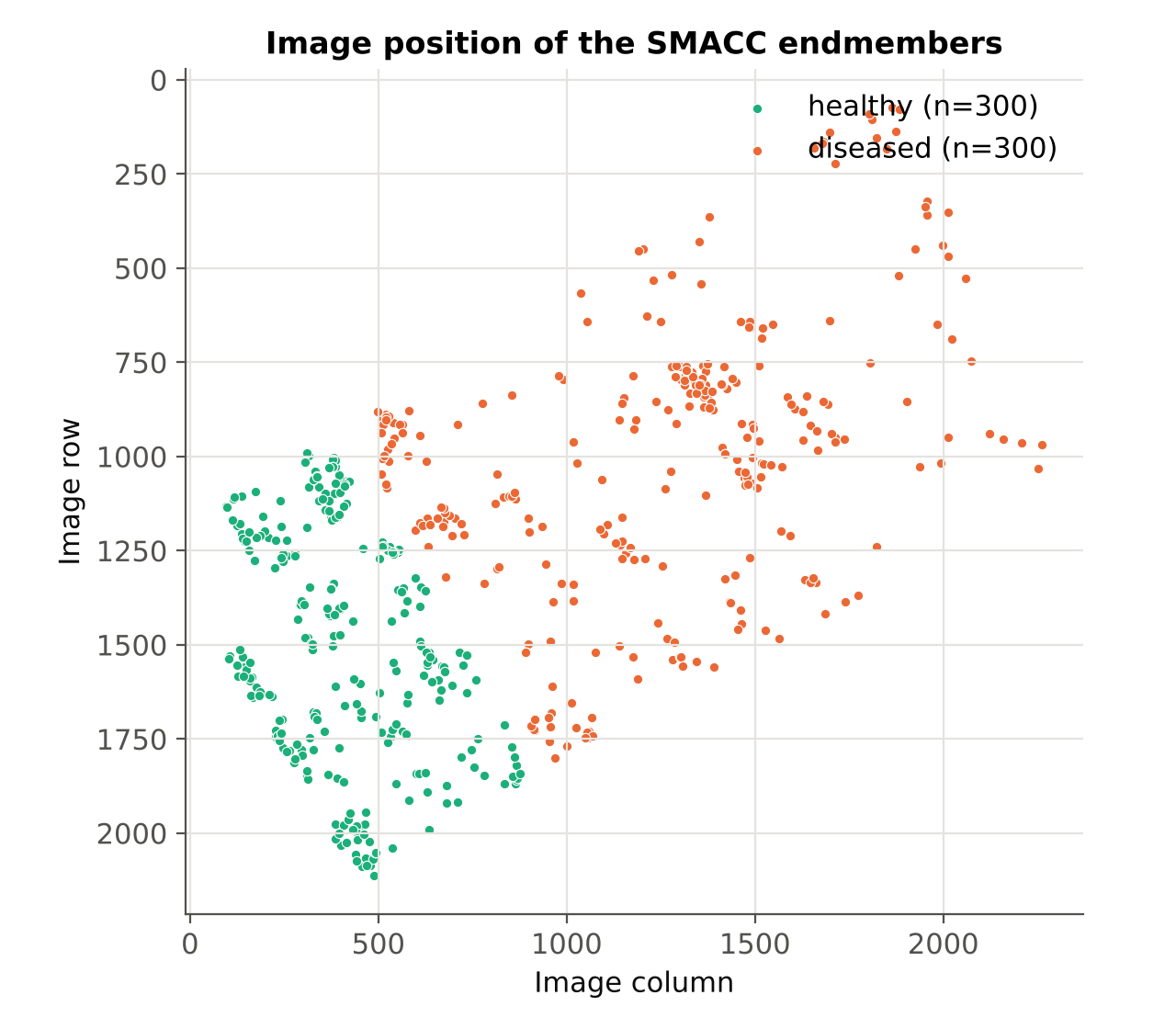
Regions of interest and endmember positions
ROI file | Polygons | Pixels inside | Area
healthy.xml | 1 (7 vertices) | ≈ 601,000 | ≈ 300 m²
diseased.xml | 1 (5 vertices) | ≈ 1,940,000 | ≈ 966 m²
ROIs digitised in ENVI over a healthy area and a diseased area, irrespective of plot, and exported as XML in WGS-84
The two polygons share one boundary: healthy and diseased samples come from two neighbouring blocks of the field
Every endmember keeps its pixel row/column and lon/lat, which allows spatial checks later (Part D)

Slide 6
How the 300 endmembers per class were extracted
1
ROI → pixels
2
Remove no-data
Polygon vertices converted from lon/lat to image pixels; a pixel belongs to the ROI if its centre lies inside
All-zero (masked) and NaN spectra discarded
3
Vegetation filter
4
Random subset
NDVI = (R800 − R670)/(R800 + R670) ≥ 0.30 removes soil, water and shadow (minimum NDVI in the file: 0.31)
Up to 100,000 pixels per class drawn at random (memory; neighbouring 2 cm pixels are near-identical)
5
SMACC
6
Save
Run separately per class on 463 bands (420–2,350 nm), positivity + convex-cone constraints, 300 iterations
All 483 bands of each selected pixel + row/col + lon/lat → CSV and ENVI spectral libraries
Settings as in smacc_endmember_extraction.ipynb (defaults). The NDVI filter is confirmed by the data: no endmember has NDVI < 0.30 at 670/800 nm.

Slide 7
SMACC — sequential maximum angle convex cone
Start: residual R = all pixel spectra H (N pixels × 463 bands)
Pick the pixel with the largest residual norm ‖rᵢ‖; store its original spectrum as the next endmember
Project every residual on that pixel's residual w: Oᵢ = (rᵢ·w)/(w·w)
Positivity: coefficients ≤ 0 set to 0. Convex cone: limit αᵢ so no earlier abundance turns negative
Update residuals rᵢ ← rᵢ − αᵢw and abundances
Repeat until 300 endmembers per class
Model
h = Σ fₖ·sₖ + r, fₖ ≥ 0
Key property
SMACC returns the most extreme (purest, most distinct) spectra of each ROI, not typical ones. This matters when they are used as samples for statistics (see Discussion).
Gruninger, Ratkowski & Hoke (2004), Proc. SPIE 5425.

Slide 8
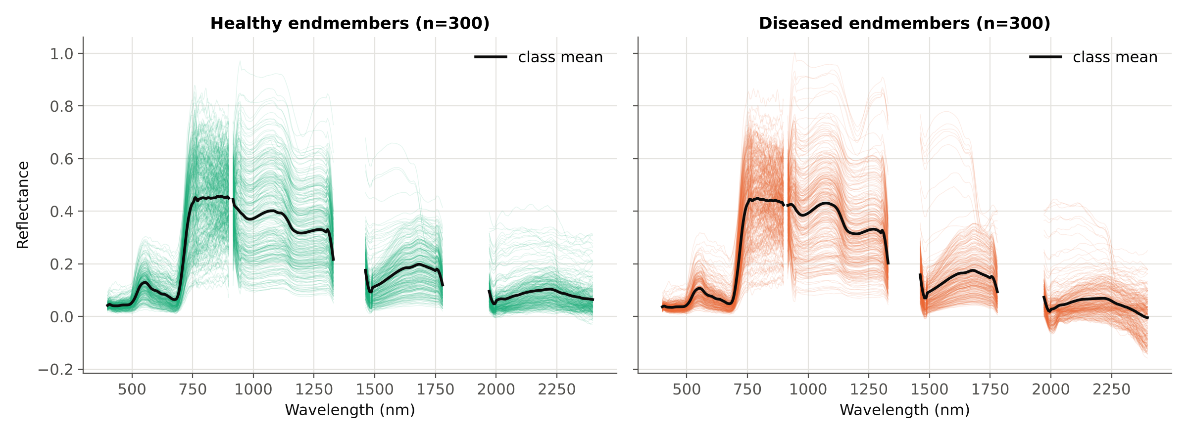
The 600 extracted endmember spectra
Thin lines: individual endmembers (n = 300 per class); black: class mean. Gaps are the water-vapour bands removed before extraction.

Slide 9
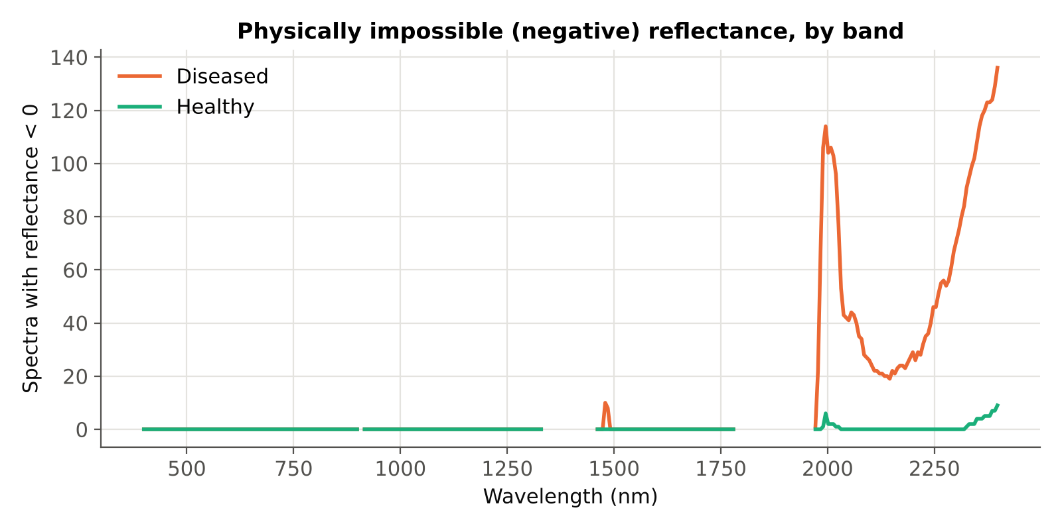
Data check: all 600 spectra are analysed
600
463
spectra analysed — none removed
of 483 bands used (420–2,350 nm)
No spectrum is removed: every SMACC endmember (300 healthy, 300 diseased) enters the analysis
Only the noisy detector edges (< 420 nm and > 2,350 nm, 20 bands) are excluded
Negative (physically impossible) reflectance occurs in 142 diseased and 11 healthy spectra, almost all in SWIR-2 (1,970–2,400 nm) — a radiometric-quality warning for that region, tested in the sensitivity analysis
142
11
diseased spectra with values < 0
healthy spectra with values < 0

Slide 10
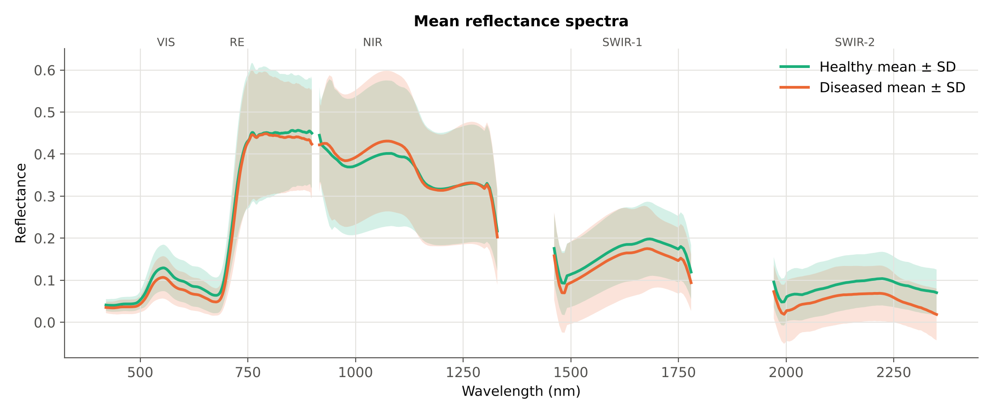
Analysis data set: reflectance only
600
300 / 300
463
0
endmember spectra analysed
healthy / diseased
reflectance bands (420–2,350 nm)
transformations (no indices, derivatives or normalisation)
Mean ± SD. Diseased is lower in VIS, SWIR-1 and SWIR-2; slightly higher around 950–1,100 nm.

Slide 11
B · Four-tier hierarchical analysis
Tier 1 ANOVA → Tier 2 CART → Tier 3 Jeffries–Matusita distance → Tier 4 QDA, as in Das et al. (2020)

Slide 12
The four tiers, adapted from 14 genotypes to 2 classes
Tier | Das et al. (2020) | This study
Data | 336 field spectra, 14 rice genotypes (91 pairs) | 600 image endmembers, 2 classes (1 pair)
1 · ANOVA | One-way ANOVA per band, p < 0.05; Tukey HSD; count of significant pairs per band | One-way ANOVA per band, p < 0.05; Tukey HSD (same as ANOVA with 1 pair); FDR, Bonferroni and Cohen's d added
2 · CART | rpart on reflectance → 17 bands | rpart-equivalent tree on the significant bands (Gini, minsplit 20, minbucket 7, cp 0.01)
3 · J–M | J–M per genotype pair on CART bands; threshold 1.94 (of 2) | J–M healthy vs diseased on CART bands; threshold 1.94 (0–2 scale)
4 · QDA | QDA, 10-fold CV; confusion matrix, OA, PA, UA → 98% | QDA, 10-fold CV (+ 10× repeated); plus nested and spatial-block CV
J–M is reported on the 0–2 scale, JM = 2(1 − e^(−B)); the paper prints the √ form but uses the 0–2 threshold. Tier 2 is also repeated with Random Forest instead of CART (Part C).

Slide 13
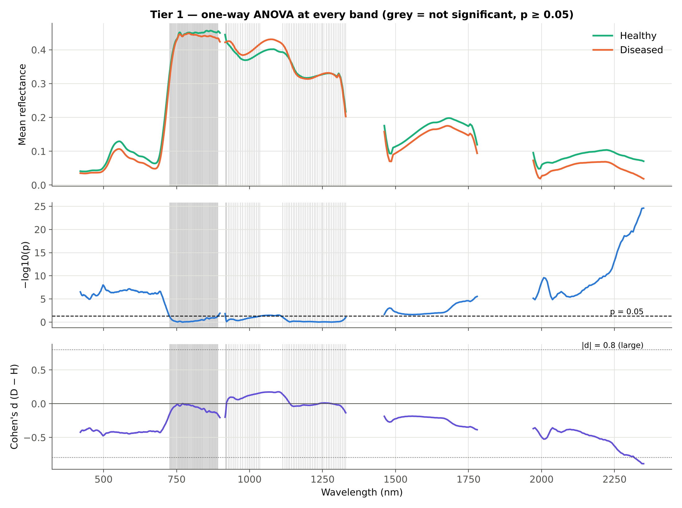
Tier 1 · 309 of 463 bands differ significantly
What the test shows
309 bands significant at p < 0.05 (298 after FDR, 242 after Bonferroni)
All VIS, SWIR-1 and SWIR-2 bands significant; most NIR bands not
Strongest band 2349.5 nm (F = 118.6), at the noisy end of SWIR-2
Effects are small to moderate: largest |d| = 0.89; only 6 bands reach |d| ≥ 0.8

Slide 14
Tier 1 by spectral region
Region | Bands | p < 0.05 | FDR q < 0.05 | Bonferroni | Max-F band (nm) | Max F | Direction
VIS (420-700) | 160 | 160 | 160 | 160 | 497.8 | 33.8 | D < H
Red-edge (700-750) | 28 | 14 | 13 | 5 | 701.7 | 22.1 | D < H
NIR (750-1330) | 157 | 17 | 7 | 0 | 898.6 | 6.3 | D < H
SWIR-1 (1460-1780) | 54 | 54 | 54 | 13 | 1779.5 | 22.3 | D < H
SWIR-2 (1970-2350) | 64 | 64 | 64 | 64 | 2349.5 | 118.6 | D < H
Total | 463 | 309 | 298 | 242
With two classes Tukey HSD tests one pair, so it gives exactly the same decision as the ANOVA at every band (checked)
Diseased is lower in VIS, red-edge, SWIR-1 and SWIR-2; only a NIR shoulder (≈1,040–1,110 nm) is slightly higher. A darker visible signal is opposite to the usual chlorosis response
Many tests (463): the FDR column is the safer list of differing bands

Slide 15
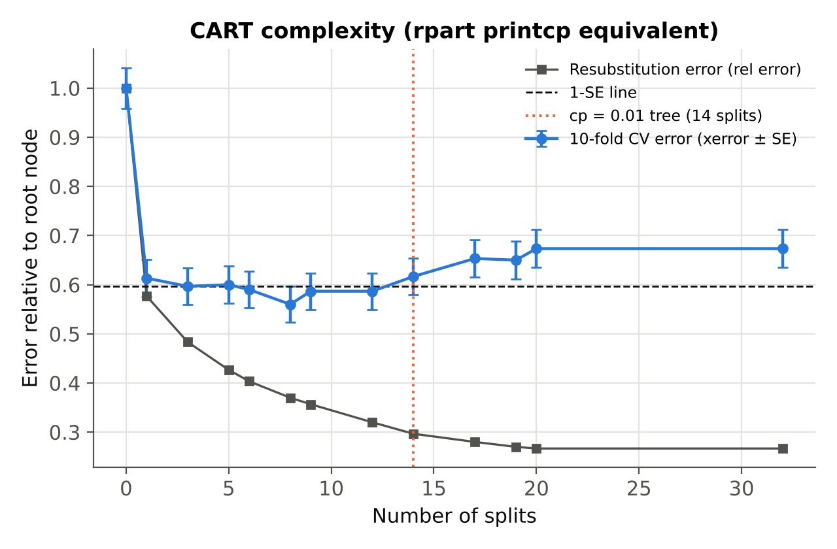
Tier 2 · CART settings and tree size
Settings (R rpart defaults)
Input: 309 ANOVA-significant bands
Gini splitting; minsplit 20; minbucket 7
Cost-complexity pruning on misclassification, cp = 0.01 (as rpart)
10-fold cross-validation of every subtree (printcp)
cp = 0.01 tree: 14 splits, 14 bands, resubstitution accuracy 85.2%
1-SE tree: 6 splits, 6 bands (586, 675, 1065, 1623, 2062, 2350 nm)
CV error is lowest at about 8 splits; the cp = 0.01 tree used by the paper (14 splits) lies just above the 1-SE line, i.e. slightly over-fitted.

Slide 16
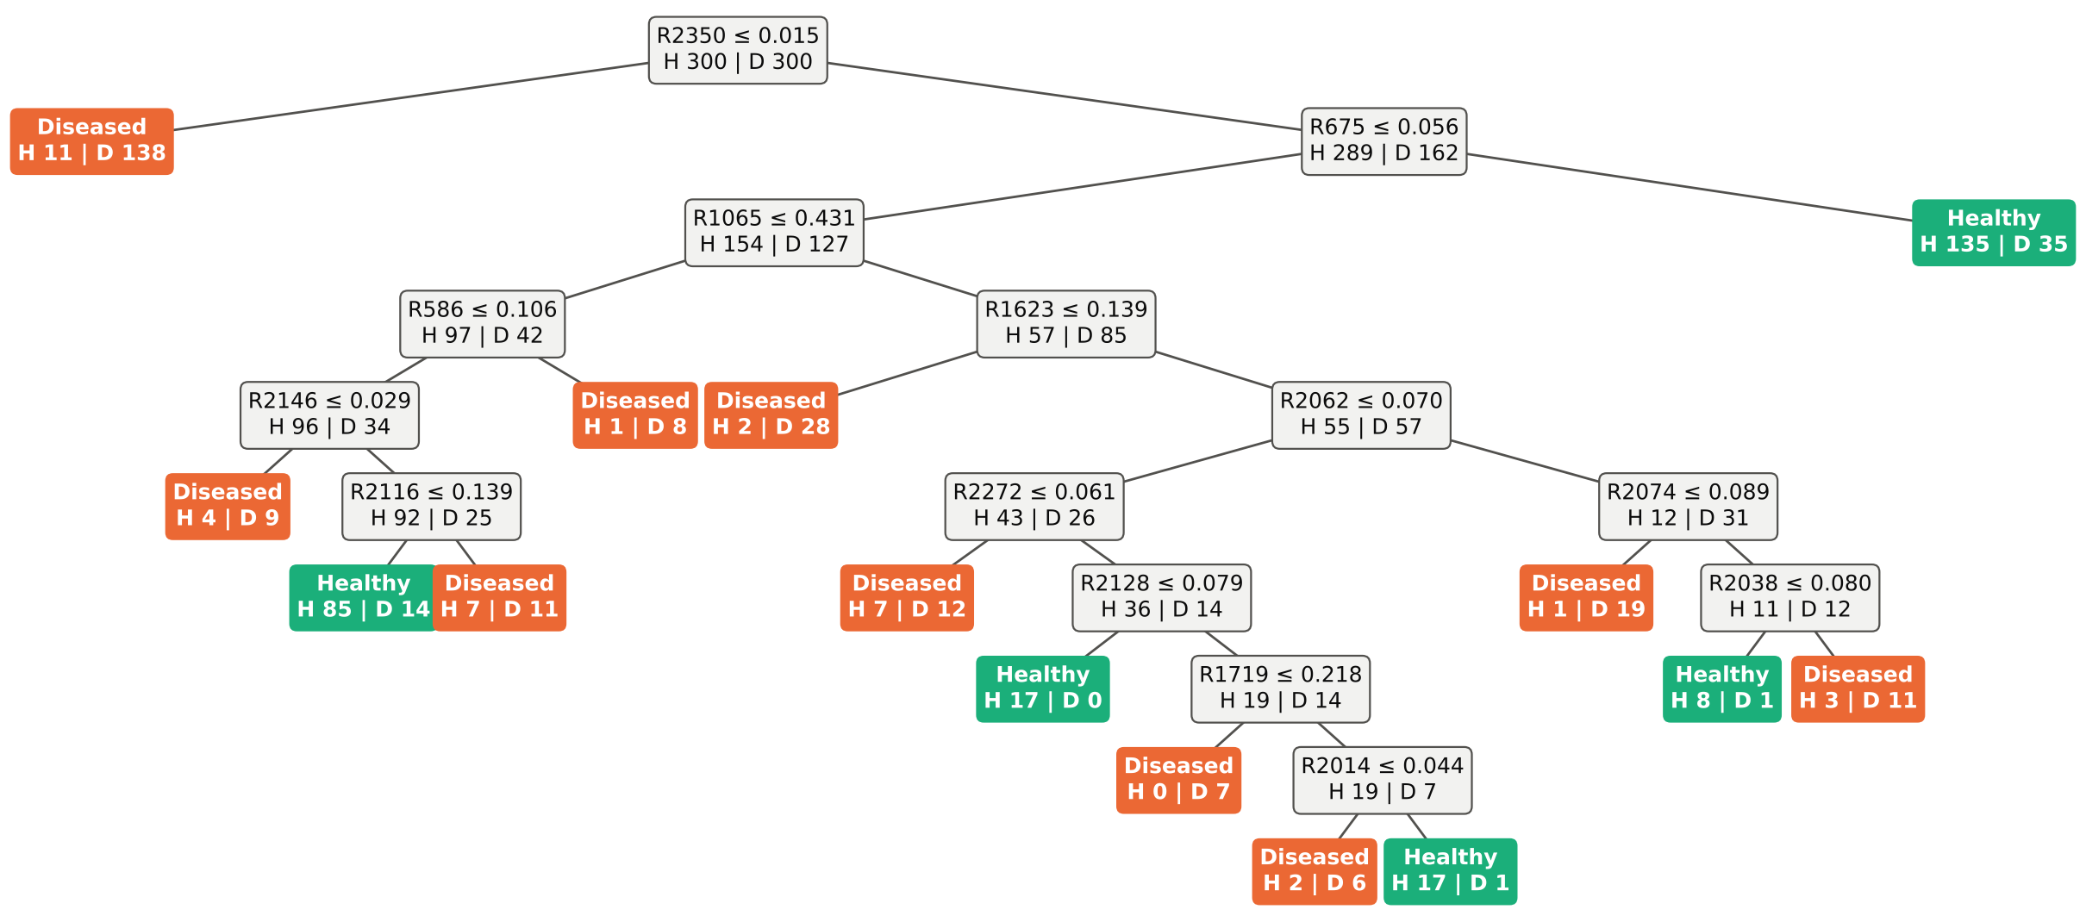
Tier 2 · The CART tree
First split R2349.5 ≤ 0.0145 sends 149 spectra (138 diseased) left; CV accuracy of the tree itself as a classifier: 71.0%.

Slide 17
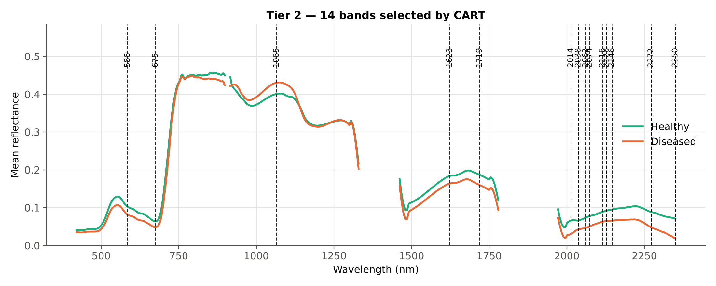
Tier 2 · 14 bands selected by CART
Band (nm) | Importance
2349.5 | 45.5%
675.4 | 8.1%
1065.4 | 7.8%
1623.5 | 5.4%
2115.5 | 4.3%
585.7 | 4.2%
2061.5 | 4.0%
1719.5 | 3.7%
2145.5 | 3.4%
2013.5 | 3.4%
2037.5 | 3.1%
2127.5 | 2.5%
2073.5 | 2.5%
2271.5 | 2.1%
9 of 14 bands lie in SWIR-2; 2349.5 nm alone carries 46% of the tree's importance
Outside SWIR-2: 586 (VIS), 675 (VIS), 1065 (NIR), 1623 (SWIR-1), 1719 (SWIR-1)

Slide 18
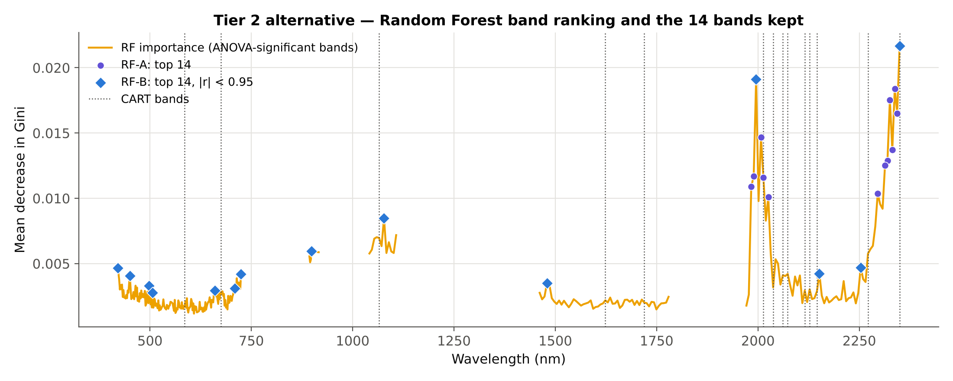
Tier 2 alternative · Random Forest selects the bands
How RF replaces CART
Input: the same 309 ANOVA-significant bands
Random Forest, 500 trees, mtry = √p, seed 42; bands ranked by mean decrease in Gini
Keep 14 bands — as many as CART — for a fair comparison
RF-A: the top bands by importance only
RF-B: the same ranking, but a band is skipped if |r| ≥ 0.95 with a band already kept
Selection | Bands (nm)
CART | 586, 675, 1065, 1623, 1719, 2014, 2038, 2062, 2074, 2116, 2128, 2146, 2272, 2350
RF-A | 1984, 1990, 1996, 2008, 2014, 2026, 2296, 2314, 2320, 2326, 2332, 2338, 2344, 2350
RF-B | 420, 450, 498, 507, 660, 709, 725, 899, 1077, 1479, 1996, 2152, 2254, 2350

Slide 19
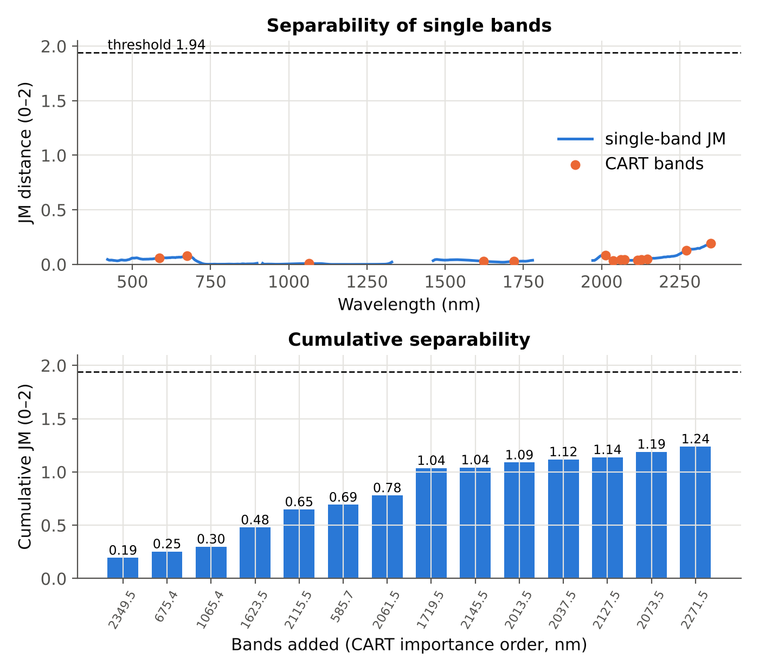
Tier 3 · J–M distance 1.239: below the 1.94 threshold
Quantity (14 CART bands) | Value
Mahalanobis term ⅛ dᵀC⁻¹d | 0.2279
Covariance term ½ ln(|C| / √|CH||CD|) | 0.7380
Bhattacharyya distance B | 0.9658
JM = 2(1 − e^(−B)), 0–2 scale | 1.2387
√ form (0–1.414) | 1.1130
Separable (≥ 1.94)? | No
With all 309 significant bands the covariance matrix has rank 299 (< 309), so J–M cannot be computed — the reason the paper uses CART bands
Most of the distance comes from different covariance, not different means
Best single band: 2349.5 nm (JM 0.194). Separability rises with each band but stays far below 1.94.

Slide 20
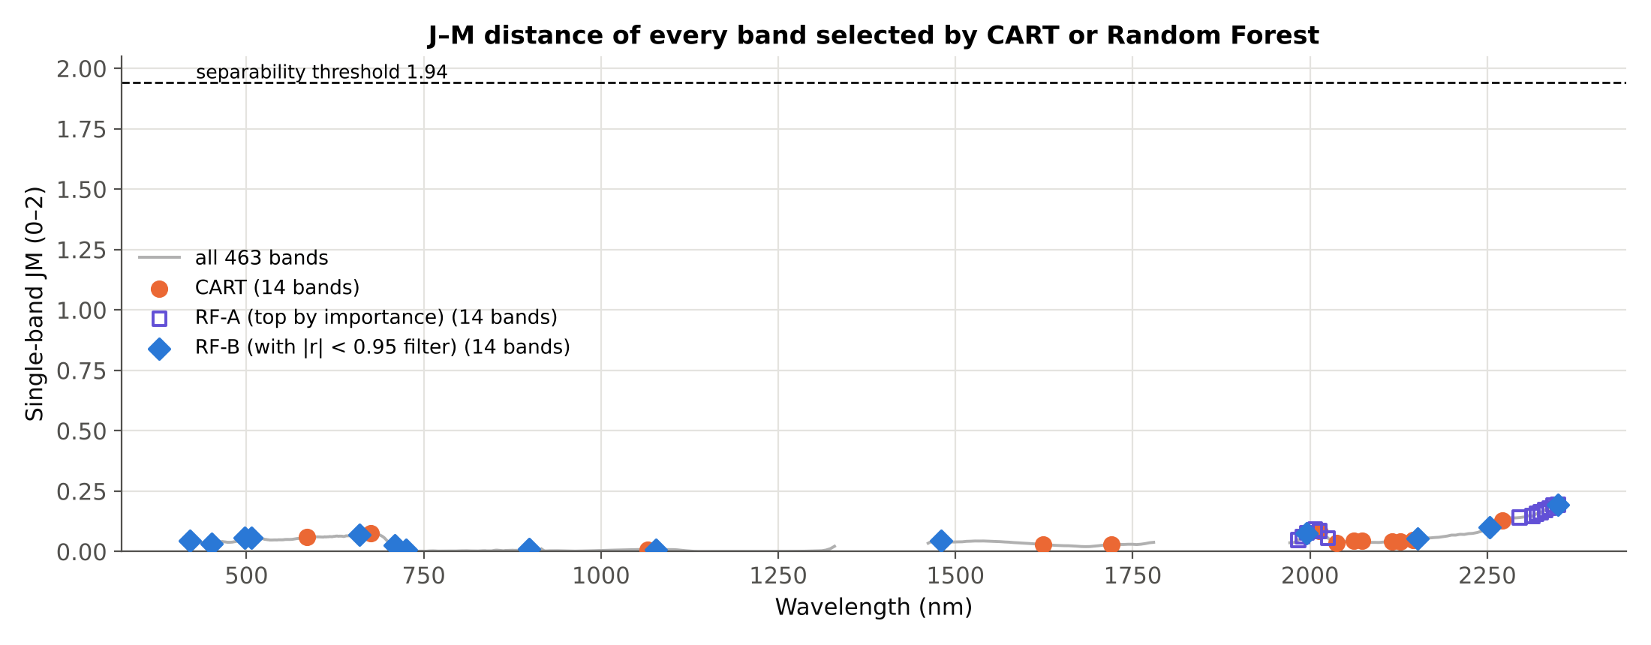
J–M distance of every band selected by CART or RF
What it shows
38 different bands were selected by CART, RF-A or RF-B
Single-band JM ranges from 0.007 (725 nm) to 0.194 (2350 nm) — every band is far below 1.94
No single band separates the classes; separability only grows when bands are combined
Even combined, the best set (CART, JM 1.24) stays below the threshold
Full per-band list: sheet 6b_JM_Selected_Bands
Band set | Bands | Multi-band JM (0–2) | √JM | ≥ 1.94?
CART (cp = 0.01) | 14 | 1.239 | 1.113 | no
RF top-14 (importance only) | 14 | 0.876 | 0.936 | no
RF top-14, redundancy filter |r| < 0.95 | 14 | 0.934 | 0.966 | no

Slide 21
Tier 4 · QDA, 10-fold cross-validation: 78.2%
Reference ↓ / Predicted → | Healthy | Diseased | Total | Producer's acc.
Healthy | 266 | 34 | 300 | 88.7%
Diseased | 97 | 203 | 300 | 67.7%
Total | 363 | 237 | 600
User's acc. | 73.3% | 85.7%
78.2%
overall accuracy (10-fold CV)
0.56
Cohen's kappa
Bands: the 14 CART bands; equal priors; stratified folds
Diseased spectra are often called healthy (97 of 300); healthy are recognised better
Paper-style validation: bands were chosen on all data before CV (see Part D)
77.1% ± 0.7%
mean ± SD over 10 repeated 10-fold CVs

Slide 22
C · Random Forest comparison
Random Forest in place of QDA (Tier 4) and in place of CART (Tier 2); same data, same 10 folds, 500 trees, mtry = √(number of bands)

Slide 23
Random Forest as the Tier-4 classifier
Model / bands | Bands | CV OA | Kappa | OOB OA | PA healthy | PA diseased
QDA · CART bands (four-tier) | 14 | 78.2% | 0.56 | – | 88.7% | 67.7%
RF · CART bands | 14 | 74.8% | 0.50 | 75.0% | 82.7% | 67.0%
RF · all ANOVA-significant bands | 309 | 73.2% | 0.46 | 74.3% | 79.0% | 67.3%
RF · all 463 bands | 463 | 76.2% | 0.52 | 75.7% | 81.7% | 70.7%
Settings
Reading the table
500 trees, Gini, bootstrap samples
mtry = √p (3, 17 or 21 bands per split)
Same stratified folds as QDA; seed 42
On the same 14 bands QDA (78.2%) is ahead of RF (74.8%) in paper-style CV
RF on all bands: 76.2%, with no band selection
OOB agrees with CV within 1.5 points

Slide 24
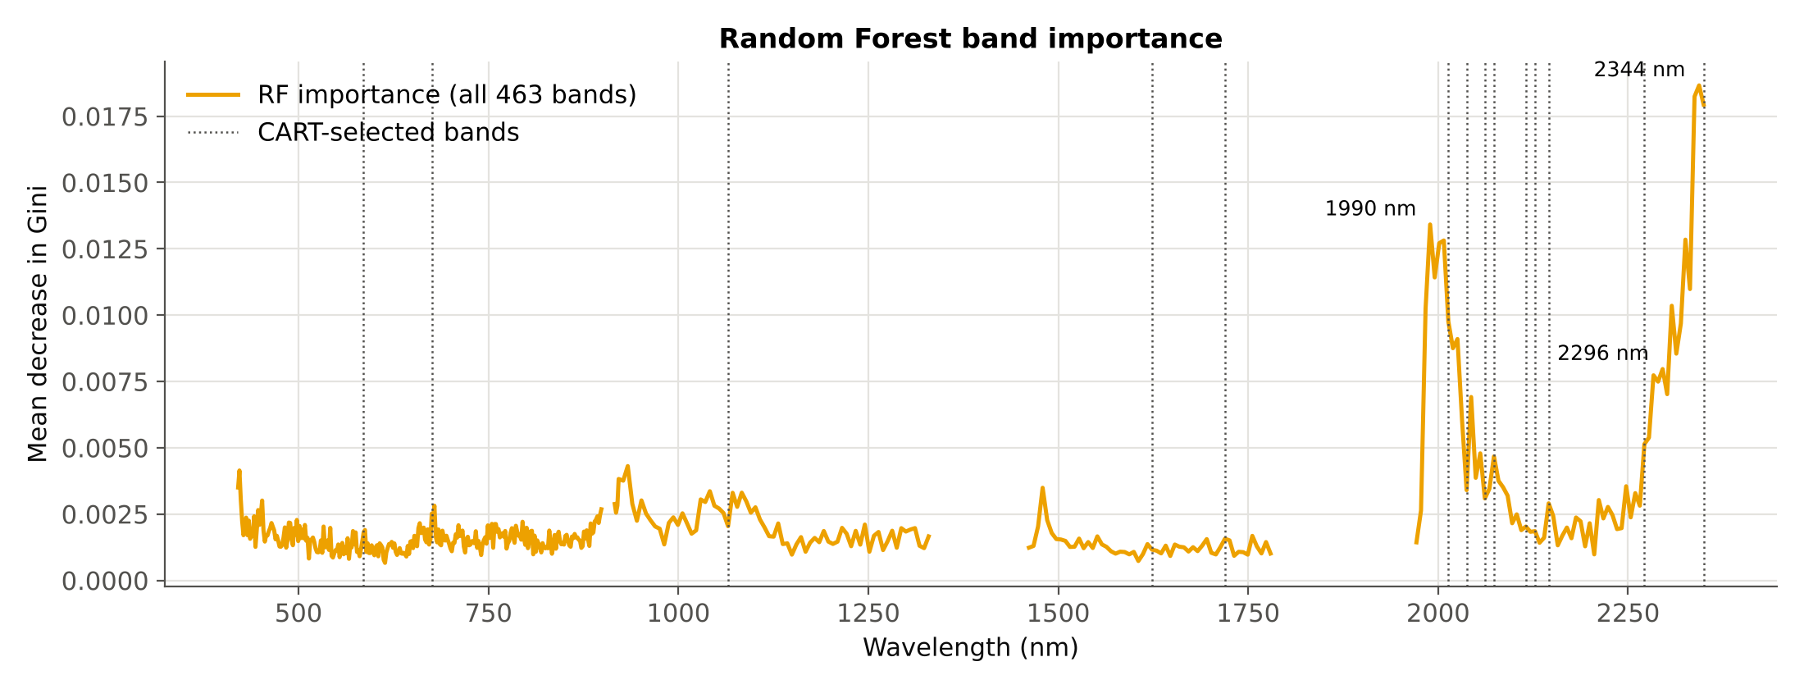
Where Random Forest finds the information
Top RF bands: 2344, 2338, 2350, 1990, 2326 nm — the same SWIR-2 region that dominates CART and ANOVA
Two independent methods agree on where the difference is; whether that difference is physiological or radiometric is discussed in Part D

Slide 25
QDA vs Random Forest (paper-style validation)
Bar | What it is
QDA · CART bands | The four-tier pipeline of the paper: 14 CART bands → QDA
RF · CART bands | RF replaces QDA in Tier 4, same bands
RF · significant bands | RF on all 309 Tier-1 bands (no CART)
RF · all bands | RF on all 463 bands (no Tier 1, no Tier 2)
What the figure tells
All four lie between 73% and 78%: about one spectrum in four or five is misclassified
The classifier matters less than the information in the bands
These are paper-style (optimistic) numbers; Part D shows stricter validation

Slide 26
Tier 2 comparison · CART vs Random Forest band selection
Tier 2 selection | JM (0–2) | QDA paper-style | QDA 10× mean | QDA nested | QDA spatial | RF classifier
CART (as in the paper) | 1.239 | 78.2% | 77.1% | 73.2% | 68.7% | 74.8%
RF-A: top by importance | 0.876 | 66.2% | 66.7% | 66.2% | 65.3% | 66.3%
RF-B: importance + |r| < 0.95 | 0.934 | 76.7% | 75.8% | 74.7% | 70.2% | 77.2%
Result
CART gives the highest JM (1.24) and paper-style accuracy (78.2%)
RF-B holds up better when selection is validated: nested 74.7% vs 73.2%, spatial 70.2% vs 68.7%
RF-A picks near-identical SWIR-2 neighbours (r ≈ 0.999) and is worst (66.2%)

Slide 27
D · Cross-checks and validation
Is the accuracy real, and does it come from disease? Nested CV, spatial blocks, permutation test, location control, sensitivity and step-by-step checks

Slide 28
Accuracy under stricter validation
What changes
Nested: ANOVA + CART redone inside each training fold — no information from test spectra
Spatial: whole spatial blocks held out (next slide)
QDA falls from 78.2% to 73.2% (nested) and 68.7% (spatial)
RF on all bands holds best: 72.0% spatial

Slide 29
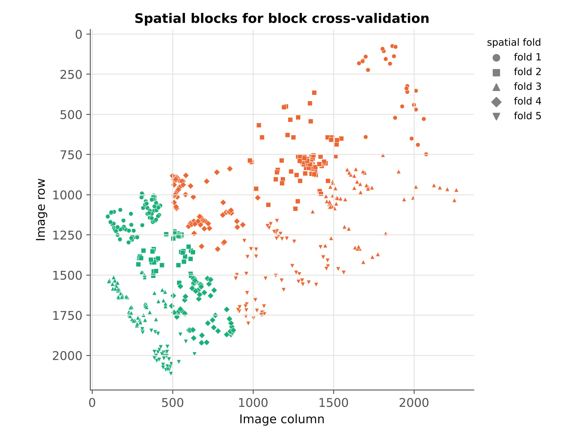
Spatial-block cross-validation
Fold | Test spectra | QDA | RF (CART) | RF (all)
1 | 113 | 65.5% | 60.2% | 63.7%
2 | 139 | 74.1% | 74.8% | 77.0%
3 | 119 | 70.6% | 68.9% | 68.1%
4 | 121 | 73.6% | 78.5% | 81.0%
5 | 108 | 57.4% | 56.5% | 68.5%
Pooled | 600 | 68.7% | 68.3% | 72.0%
Five k-means blocks per class on pixel position; each fold holds out one healthy and one diseased block
Band selection (ANOVA + CART) repeated inside every fold
Accuracy varies by block: the signal is not uniform across the field

Slide 30
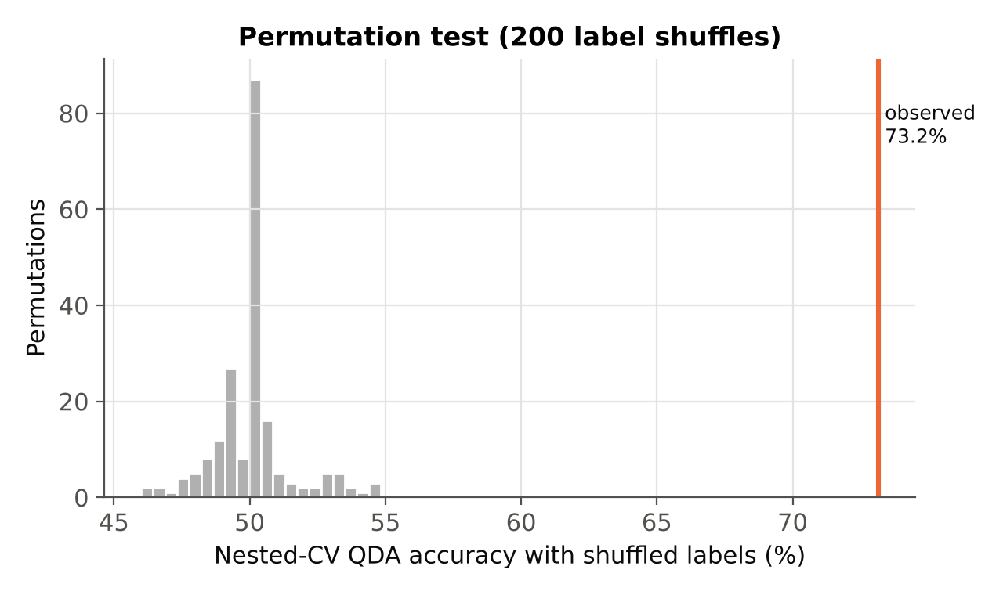
Permutation test and location-only control
Control: two halves of the same class | n | QDA paper-style | QDA nested
healthy: half A vs half B | 153 vs 147 | 63.3% | 63.7%
diseased: half A vs half B | 171 vs 129 | 54.7% | 47.3%
Interpretation
Two halves of the healthy region separate at ≈ 63% although both are healthy: part of the spectral difference is position in the field
The diseased halves are near chance (47%–55%)
Healthy vs diseased (73%–78%) exceeds the healthy-halves control, so disease adds signal, but location effects are not small
200 label shuffles through the full nested pipeline: null mean 50.0%, maximum 54.8%
Observed 73.2%: p = 0.005 (the smallest possible with 200 shuffles) — the signal is real

Slide 31
Sensitivity analyses
Case | Significant bands | CART bands | JM (0–2) | QDA OA | RF OA (all bands)
Main analysis: 600 spectra, 420-2350 nm (463 bands) | 309 | 14 | 1.239 | 78.2% | 76.2%
SWIR-2 excluded (420-1780 nm, 399 bands) | 245 | 13 | 0.499 | 63.2% | 70.5%
VNIR only (420-1000 nm) | 179 | 19 | 0.585 | 57.8% | 61.8%
All 483 bands incl. noisy edges (399-2398 nm) | 329 | 13 | 1.041 | 75.7% | 75.5%
Removing SWIR-2 lowers JM to 0.50, QDA to 63.2% and RF to 70.5%; VNIR alone gives 58%–62%. The discrimination leans on the noisiest region
Keeping the noisy edge bands changes little (QDA 75.7%, RF 75.5%)
The selected CART bands change with every data variant, so individual bands should not be over-interpreted

Slide 32
Every step was cross-checked
Step | Checks | Examples | Result
Data | 5 | 600 × 489, 300/300, no missing values, no duplicate pixels | PASS
Data check | 1 | 600 spectra × 463 bands, no spectra removed | PASS
Tier 1 | 5 | manual F = scipy; t² = F; Tukey = ANOVA at all bands | PASS
Tier 2 | 2 | custom pruning reproduces sklearn tree; rel error = 1 − accuracy | PASS
Tier 3 | 5 | log-det = direct det; 1-D closed form; covariance full rank | PASS
Tier 4 | 3 | hand-coded QDA = sklearn; OA and N consistent | PASS
RF | 2 | seed reproducibility; OOB ≈ CV | PASS
Validation | 1 | permutation null centred at 50% | PASS
Tier 2 (RF) | 7 | RF bands ⊂ significant set; |r| filter; reproducible ranking; full-rank covariance | PASS
Excel ↔ Python | 15 | F, p, JM, B, OA, kappa (CART and RF bands) recomputed by live Excel formulas | PASS
31 Python checks + 15 live Excel checks, all PASS. Details: sheet 11_Cross_Checks of Four_Tier_Analysis.xlsx.

Slide 33
Discussion
Moderate, not near-perfect, separation
SWIR-2 drives the result — with a caveat
JM 1.24 (threshold 1.94) and 68%–78% accuracy vs 98% in Das et al. Their samples were 50-scan field spectra of uniform plots; here they are 2 cm image pixels with mixed leaves, lesions and shadow.
The strongest bands (≈2,300–2,350 nm) sit in the noisiest region; 142 diseased spectra have negative reflectance there. Without SWIR-2, QDA falls to 63% and RF to 71%.
Unexpected visible signal
Location and validation
Diseased canopy is darker in the visible, not brighter as chlorosis would cause; canopy structure, illumination or region effects are plausible and should be checked in the field.
Halves of the healthy region separate at ≈ 63%; spatial-block CV lowers QDA to 69%. Paper-style CV overstates accuracy by 5–10 points.
CART vs RF in Tier 2
QDA vs RF in Tier 4
CART bands give the best JM and paper-style accuracy; redundancy-filtered RF bands generalise better (spatial 70% vs 69%). Raw RF importance picks redundant neighbours.
QDA wins in paper-style CV (78% vs 76%), but RF on all bands is best under nested (76%) and spatial (72%) validation.

Slide 34
Summary
600
309
14
endmembers analysed (300 H / 300 D), none removed, on 463 reflectance bands
bands differ significantly (Tier 1); all VIS, SWIR-1 and SWIR-2
bands kept by CART (Tier 2); 9 in SWIR-2, 2349.5 nm most important
1.24
78.2%
72.0%
J–M distance (Tier 3), below 1.94; no single band exceeds 0.19
QDA accuracy (Tier 4), kappa 0.56; 73.2% nested, 68.7% spatial
best spatial-block accuracy: RF on all bands (RF-B bands + QDA: 70.2%)

Slide 35
Conclusion
The four-tier method of Das et al. (2020) was applied to all 600 SMACC endmembers, with Random Forest tested both in place of CART (Tier 2) and of QDA (Tier 4); every step was cross-checked.
Healthy and diseased spectra differ significantly (permutation p = 0.005), but separation is moderate: JM 1.24 < 1.94 and realistic accuracy 68%–76%.
CART + QDA scores highest only under the paper's optimistic validation; RF band selection (with a redundancy filter) and RF classification on all bands are more robust.
Before relying on the SWIR-2 bands: verify radiometric calibration, sample random pixels or plot means instead of SMACC extremes, add plot-level ground truth and an independent date.

Slide 36
References
Das B, Sahoo RN, Biswas A, Pargal S, Krishna G, Verma R, Chinnusamy V, Sehgal VK, Gupta VK (2020) Discrimination of rice genotypes using field spectroradiometry. Geocarto International 35(1):64–77. doi:10.1080/10106049.2018.1506507
Gruninger JH, Ratkowski AJ, Hoke ML (2004) The sequential maximum angle convex cone (SMACC) endmember model. Proc. SPIE 5425. doi:10.1117/12.543794
Breiman L, Friedman JH, Olshen RA, Stone CJ (1984) Classification and Regression Trees. Wadsworth, Belmont, CA
Breiman L (2001) Random forests. Machine Learning 45:5–32
Richards JA (2013) Remote Sensing Digital Image Analysis, 5th ed. Springer, Berlin (Jeffries–Matusita distance)
Benjamini Y, Hochberg Y (1995) Controlling the false discovery rate. Journal of the Royal Statistical Society B 57:289–300
Roberts DR et al. (2017) Cross-validation strategies for data with temporal, spatial, hierarchical, or phylogenetic structure. Ecography 40:913–929

