Slide 1
Hyperspectral characterisation and AI-based detection of white rust (Albugo candida) in Indian mustard
Disease-specific spectral features from ASD spectroradiometer data and discrimination of healthy and diseased leaves
Animesh Panda · Division of Agricultural Physics, ICAR-IARI, New Delhi
PhD thesis seminar
Notes:
Opening. This seminar presents the results of the two research objectives: characterisation of white rust through disease-specific spectral features, and discrimination of healthy and diseased mustard leaves with AI-based models.

Slide 2
Outline of the seminar
1
Objectives
Two research objectives and the questions they answer
2
Materials and methods
Dataset, quality control, features, feature selection, AI models, validation
3
Objective 1 results
Spectral response to white rust and disease-specific features
4
Objective 2 results
Healthy vs diseased discrimination with AI-based models
5
Conclusions
Key findings, limitations and future work
Notes:
The talk follows the two objectives: methods, characterisation results, discrimination results, then conclusions.

Slide 3


Research objectives
Objective 1
Characterisation of white rust
Objective 2
Discrimination of healthy and diseased leaves
Obtain disease-specific spectral features from ASD spectroradiometer data
Using various AI-based (machine-learning) models
How does white rust change leaf reflectance?
Which regions and features are sensitive?
Which features are stable across methods, dates, growth stages and varieties?
Can a new index beat published vegetation indices?
Which preprocessing and feature type work best?
Which of 23 feature-selection methods gives the best compact set?
Which of 10 classifiers is most accurate on new plots?
Does the model transfer to new dates, varieties, stages and sensors?
Link: the disease-specific features found in Objective 1 become the compact inputs of the AI models in Objective 2
Notes:
Objective 1 asks WHAT white rust does to the leaf spectrum and which features are disease specific. Objective 2 asks HOW WELL AI models can use these spectra to separate healthy and diseased leaves.

Slide 4
Materials and methods
01
Dataset · quality control · spectral features · feature selection · AI models · validation

Slide 5
Experimental material and dataset
Date | Healthy | Diseased | Total
11 Feb | 72 | 356 | 428
24 Feb | 90 | 450 | 540
03 Mar | 108 | 540 | 648
13 Mar | 108 | 615 | 723
Total | 378 | 1961 | 2339
48
4
plots (12 healthy, 36 diseased)
measurement dates
2339
1 : 5.2
leaf spectra (2290 after QC)
healthy : diseased
Instrument: ASD FieldSpec with contact probe, 350–2500 nm, 1-nm sampling
Design: 48 plots = 3 varieties × 16 (4 healthy + 12 diseased per variety)
Stages: vegetative, flowering, pod formation
Units: every plot on every date = 192 plot-date units
The 23-method feature-selection study used the 2264 leaf spectra of the 1-nm K1–K4 pool (378 healthy, 1886 diseased).
Notes:
Each of the 48 plots was measured on all four dates, so plots (not spectra) are the independent units; this is why all validation is plot-grouped.

Slide 6
Analysis workflow
Raw data
2339 ASD spectra, 48 plots × 4 dates
Quality control
splice fix, 400–2400 nm, outlier vote → 2290
Preprocessing
SG smoothing, SNV / MSC / derivative
Feature extraction
bands, VIs, NDSI, derivatives, CR, CWT
Objective 1 · Characterisation
Spectral response
mean / difference spectra, Cohen d, J–M
Variance & indices
PCA, PERMANOVA, 46 VIs, new MWRI, CWT
23 feature-selection methods
filter · wrapper · embedded
Disease-specific features
stable across methods, dates, stages, varieties
Objective 2 · Discrimination
Feature scenarios
10 scenarios, 23 selectors, OFCs
10 AI classifiers
LDA … LS-SVM, RF, XGBoost, ELM, MLP
Nested plot-grouped CV
25 × 4 folds, BA, MCC, AUC
Best pooled model
transfer, sensors, learning curve
Disease-specific features (Objective 1) feed the compact feature scenarios (Objective 2). Leakage rule: every step that learns from labels (MSC, date normalisation, NDSI search, feature selection, tuning) is fitted on training plots only.
Notes:
Common steps first; then the two objectives branch. The characterisation track feeds the disease-specific features into the modelling track.

Slide 7
Quality control and preprocessing
1
Splice correction
additive offset at the 1000 / 1800 nm detector joins
2
Edge trimming
keep 400–2400 nm (350–400 nm SNR only 40)
3
Outlier vote
Hotelling T², Q residual, Isolation Forest, SAM; removed if ≥ 3 of 4 rules → 49 removed, 2290 kept
4
Smoothing
Savitzky–Golay, 11-nm window, 2nd order
5
Resampling
10-nm band means (201 bands) for modelling
Transformations
SNV, MSC, first derivative, date normalisation
Key finding
Noisy 350–400 nm edge removed; all 49 outliers came from diseased plots. Removing or keeping them changes BA by only −1.6 to +0.4 points (E6).
6
Notes:
Outlier screening was label-free, so it could be done before cross-validation. Experiment E6 confirmed results do not depend on it.

Slide 8
Spectral features extracted
Modelling pool (10-nm, ≈ 2,100 features)
Feature-selection pool (1-nm, 4,150 features)
 | Feature family | n
F1 | Reflectance bands (SNV) | 201
F2 | Published vegetation indices + red-edge parameters | 46
F3 | New NDSI from band-pair search (in-fold) | 3
F4 | First-derivative bands and edge features | 221
F5 | Continuum removal: depth, width, area, position | 24
F6 | Continuous wavelet transform (Mexican hat, 8 scales) | 1608
 | Feature group | n
K1 | Reflectance 400–2500 nm | 2039
K2 | Continuum-removed absorption features (6 bands) | 30
K3 | Vegetation indices | 30
K4 | First-derivative bands + edge parameters | 2051
What the features capture
Three physiological windows are covered: pigments (400–700 nm), leaf structure (700–1300 nm) and water / dry matter (1300–2400 nm). Features were computed from smoothed spectra; NDSI search, selection and scaling were fitted inside training folds only. Image texture and colour features were not applicable to point spectra.
Notes:
Two feature pools were built: F1–F6 at 10-nm resolution for the modelling experiments and the 1-nm K1–K4 pool for the 23-method feature-selection study.

Slide 9
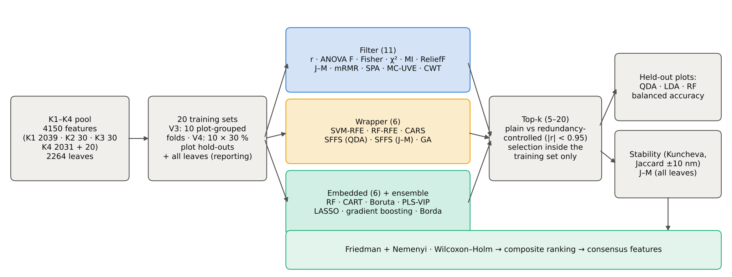
Feature selection: 23 methods under one protocol
Filter (11)
Pearson r, ANOVA F, Fisher, χ², MI, ReliefF, J–M, mRMR, SPA, MC-UVE, CWT
Wrapper (6)
SVM-RFE, RF-RFE, CARS, SFFS (QDA), SFFS (J–M), GA
Embedded (6) + consensus
RF, CART, Boruta, PLS-VIP, LASSO, gradient boosting, Borda
Notes:
Selection always ran inside the training plots of each of 20 units, so test plots never influenced the chosen features.

Slide 10
AI models and validation design
Ten classifiers (tuned in inner CV)
Nested, plot-grouped cross-validation
LDA linear
PLS-DA linear
Test
Train
Train
Train
Train
Test
Train
Train
Fold 1–4
Logistic regression linear
kNN instance
Train
Train
Test
Train
SVM (RBF) kernel
LS-SVM kernel
Train
Train
Train
Test
Outer: 4 folds of whole plots (1 healthy + 3 diseased per variety)
Inner: 3-fold plot-grouped CV for selection and tuning
Repeats: 25 × 4 = 100 test folds
Metrics: balanced accuracy (BA), sensitivity, specificity, MCC, κ, AUC
Statistics: Friedman–Nemenyi, Wilcoxon–Holm
Random forest trees
XGBoost trees
ELM neural
MLP neural
QDA (equal priors), LDA and balanced RF were used to score the 23 selectors. CNNs not used: only 48 independent plots.
Notes:
Balanced accuracy is the main metric because the classes are 1:5 imbalanced. Plot-grouped folds prevent repeated scans of the same plot from leaking between training and test.

Slide 11
Objective 1 results: characterisation of white rust
02
Spectral response · sensitive regions · indices · disease-specific features

Slide 12
Spectral response of mustard leaves to white rust
Key finding
Diseased leaves reflect more in the visible (+15 % near 690 nm: chlorophyll loss) and in the SWIR water bands (+14 % at 1450 nm, +19 % near 2010 nm: water loss). NIR reflectance is only slightly lower (−0.019 at 760 nm).
Notes:
Visible: chlorophyll loss. SWIR: water loss. NIR barely changes because the white sori add scattering while the mesophyll collapses.

Slide 13
The disease signal grows with the epidemic
Date | Stage | SAM (°)
11 Feb | vegetative | 0.96
24 Feb | flowering | 1.17
03 Mar | flowering / pod | 3.58
13 Mar | pod formation | 2.31
Key finding
The healthy–diseased spectral angle rises from 0.96° (11 Feb) to 3.58° (03 Mar), tracking disease development. Early differences are small and mainly in the SWIR, so date effects must be handled by the model.
Notes:
SAM = spectral angle between the healthy and diseased mean spectra. The early date has almost no class difference outside the SWIR.

Slide 14
Sensitive regions: effect size and separability
Region (nm) | Direction | max |d| | Peak (nm)
580–710 | Diseased > healthy | 0.98 | 650
1390–1560 | Diseased > healthy | 0.69 | 1420
1840–2400 | Diseased > healthy | 0.85 | 1890
Key finding
Three FDR-significant regions: red/visible (580–710 nm), SWIR-1 water (1390–1560 nm) and SWIR-2 water / dry matter (1840–2400 nm). NIR reflectance is not significant, but its first derivative at 850–870 nm is the strongest VNIR feature (NIR-slope change from mesophyll damage).
Notes:
Tests were done on 192 plot-date means to avoid pseudo-replication; FDR-controlled. J–M ranges 0 (no separation) to 2 (complete).

Slide 15
Red-edge and derivative parameters
Parameter | Healthy | Diseased | p
REP (linear interp., nm) | 715.7 ± 1.4 | 714.5 ± 1.9 | < 0.001
REP (derivative max, nm) | 708.1 ± 3.2 | 705.9 ± 3.7 | < 0.001
REV (×10⁻³) | 12.77 ± 1.5 | 12.24 ± 1.5 | 0.039
SDr | 0.471 ± 0.059 | 0.447 ± 0.058 | 0.016
λ blue edge (nm) | 521.7 ± 0.6 | 521.2 ± 0.9 | < 0.001
λ yellow edge (nm) | 570.1 ± 0.3 | 570.4 ± 0.6 | < 0.001
Key finding
The red edge shifts to shorter wavelengths in diseased leaves (REP 715.7 → 714.5 nm) and its amplitude falls (REV, SDr). A blue shift with lower red-edge amplitude indicates chlorophyll loss.
Notes:
REP = wavelength of the steepest red-edge slope; REV = its height; SDr = sum of first derivative over the red edge.

Slide 16
Date dominates the spectra; disease is a subtle signal
PC (variance) | Class | Date | Stage | Variety
PC1 (55.8 %) | 0.01 | 0.70 | 0.53 | 0.00
PC2 (30.2 %) | 0.01 | 0.49 | 0.18 | 0.00
PC3 (8.4 %) | 0.01 | 0.12 | 0.03 | 0.00
PC4 | 0.07 | 0.02 | 0.01 | 0.00
η² of principal-component scores by factor
Key finding
Date explains 31.2 % of spectral variance, disease only 1.1 % — yet disease is significant (pseudo-F 15.3, p = 0.001) plus 1.6 % disease × date. Variety is not significant (p = 0.18). PCA cannot separate the classes, so supervised feature selection is needed.
Disease p = 0.001, Date p = 0.001, Stage p = 0.013, Disease × Date p = 0.001
Notes:
PERMANOVA on plot-date mean SNV spectra, 999 restricted permutations. η² = share of a PC's variance explained by each factor.

Slide 17
Published vegetation indices are weak and date-dependent
Index | Trait | AUC | d 11F | d 24F | d 03M | d 13M
PSSRb | Chlorophyll b | 0.668 | 0.15 | −1.92 | −2.43 | −1.11
WI | Water | 0.666 | −0.60 | −0.24 | −2.21 | −2.00
HI | Disease (healthy index) | 0.664 | −0.67 | −2.63 | −2.55 | −2.60
ARI2 | Anthocyanin | 0.659 | 0.63 | 2.49 | 2.49 | 3.01
NDVI | Chlorophyll / biomass | 0.659 | 0.11 | −1.59 | −2.22 | −1.17
Key finding
The best published index reaches only AUC 0.668 (PSSRb). Chlorophyll indices (NDVI, SR, PSSR) show no difference on 11 Feb; date-consistent indices are mainly water, anthocyanin and disease indices (WI, HI, ARI2).
Notes:
AUC 0.5 = chance, 1 = perfect. d per date tests whether the index moves the same way on every date.

Slide 18
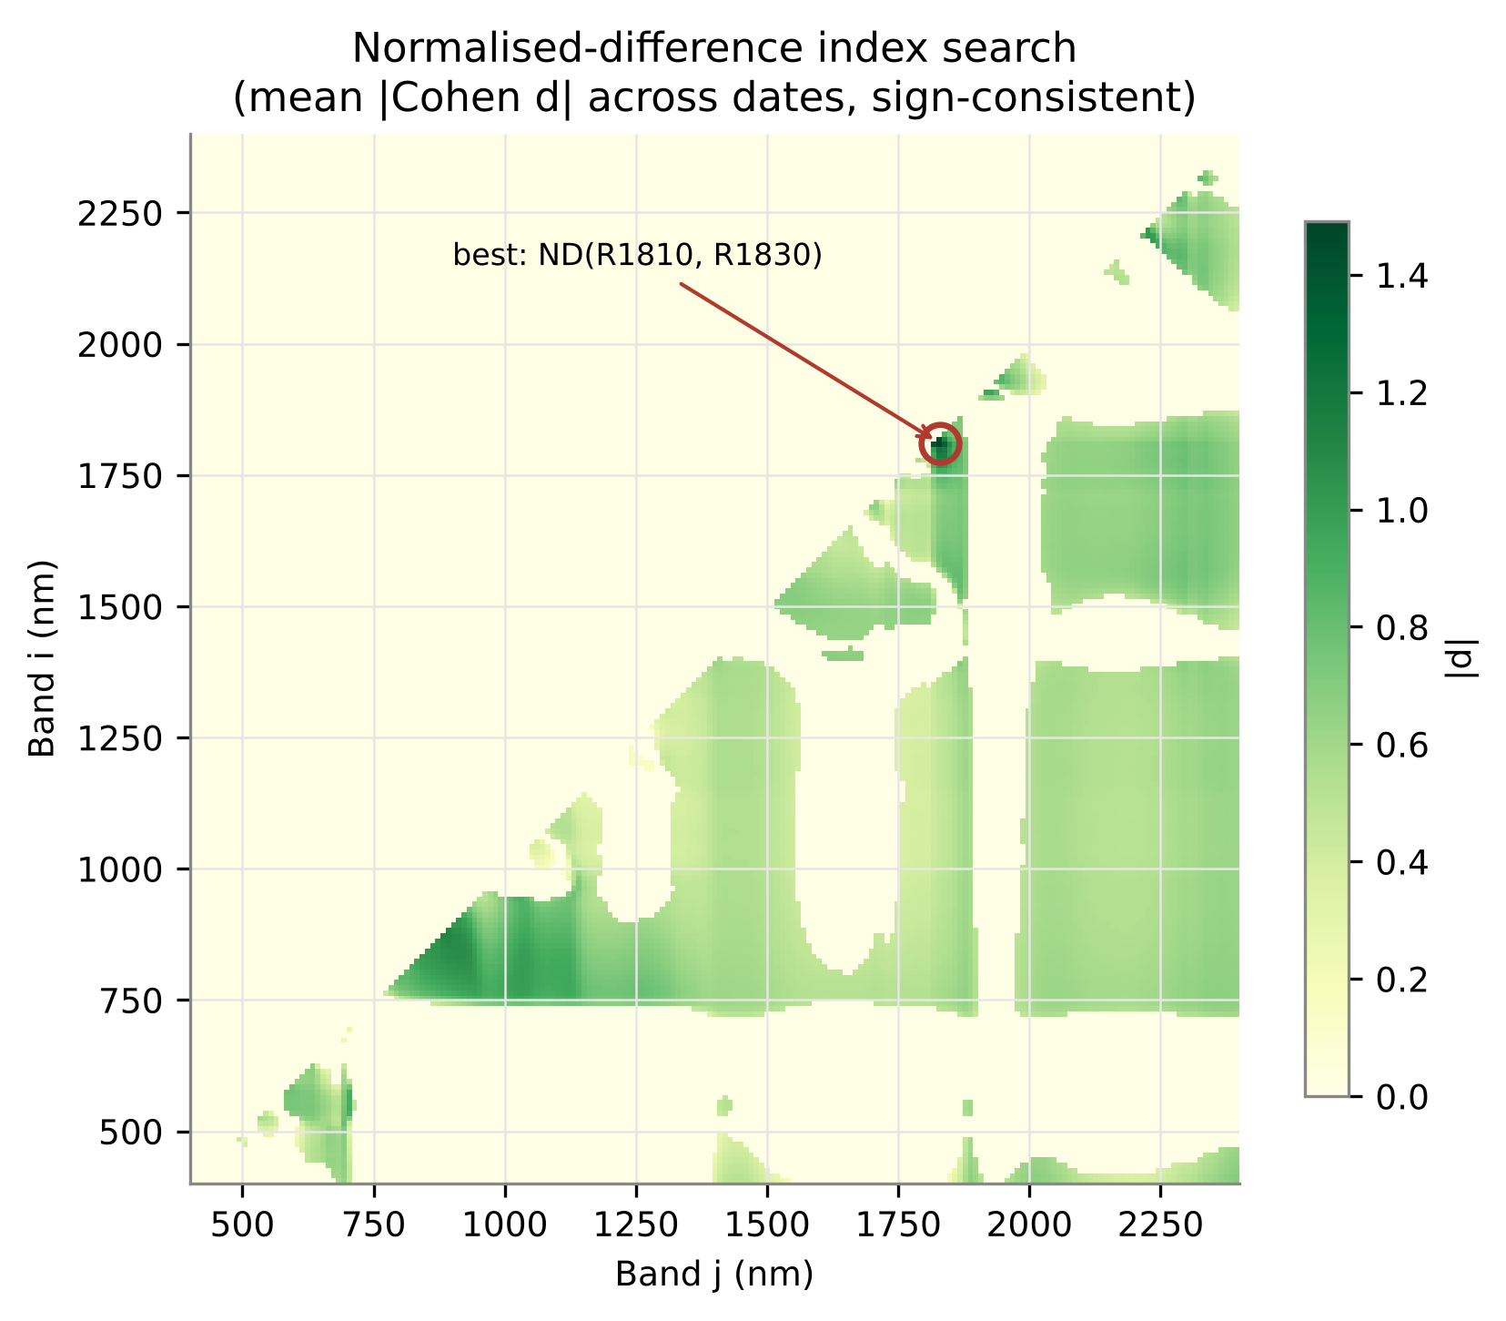
A new Mustard White Rust Index (MWRI)
MWRI = (R1810 − R1830) / (R1810 + R1830)
AUC 0.869 · mean |d| 1.49 (≥ 1.32 on every date)
Index | mean |d| | AUC
MWRI: ND(R1810, R1830) | 1.49 | 0.869
ND(R1820, R1830) | 1.44 | 0.834
MWRI-NIR: ND(R870, R890) (join-free) | 1.11 | 0.774
Best published index (PSSRb) | — | 0.668
Key finding
MWRI lies on the shoulder of the 1940-nm water band and beats all 46 published indices (AUC 0.87 vs 0.67). It sits 10–30 nm from the ASD 1800-nm detector join, so the join-free MWRI-NIR (NIR slope, AUC 0.77) is the safer choice for other sensors.
Notes:
Every two-band normalised difference (20,100 pairs) was scored by its sign-consistent effect size across dates.

Slide 19
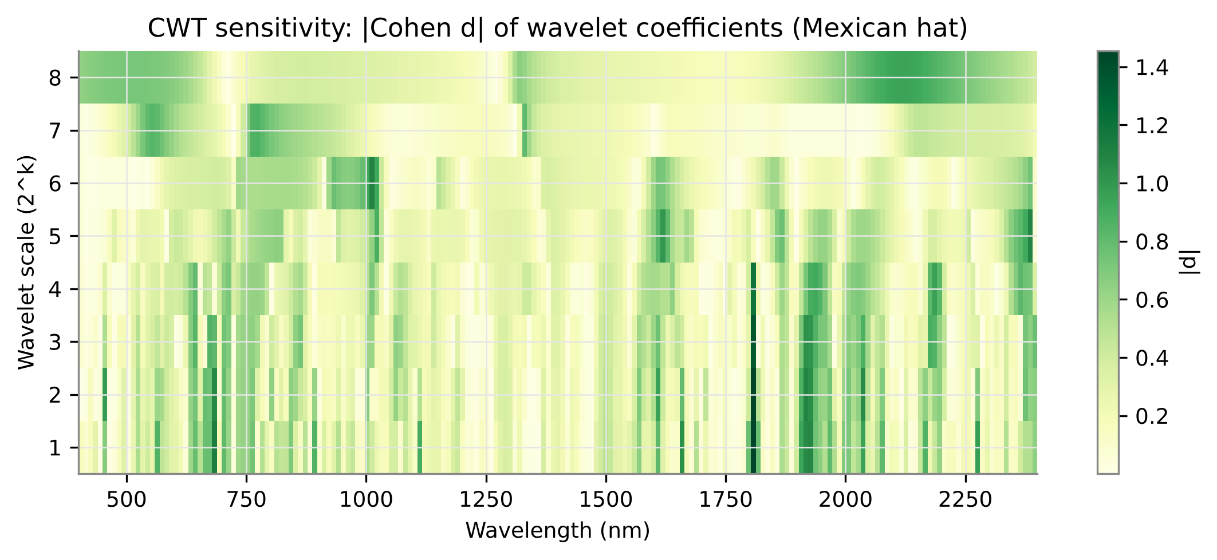
Wavelet (CWT) features capture shape changes
Wavelength | Scale | |d|
1810 nm | 1 | 1.46
1810 nm | 2 | 1.44
680 nm | 1 | 1.13
1920 nm | 2 | 1.10
1010 nm | 6 | 1.09
2390 nm | 5 | 1.09
Key finding
The most sensitive wavelet coefficients sit at 1810 nm (fine scales, |d| up to 1.46), 680 nm (chlorophyll well), 1920 nm (water) and 1010 nm (NIR shape). Wavelet maxima exceed those of single bands (|d| < 1), so wavelets are strong candidate features.
Notes:
Mexican-hat wavelet at 8 dyadic scales. Small scales behave like derivatives, large scales like band depths.

Slide 20
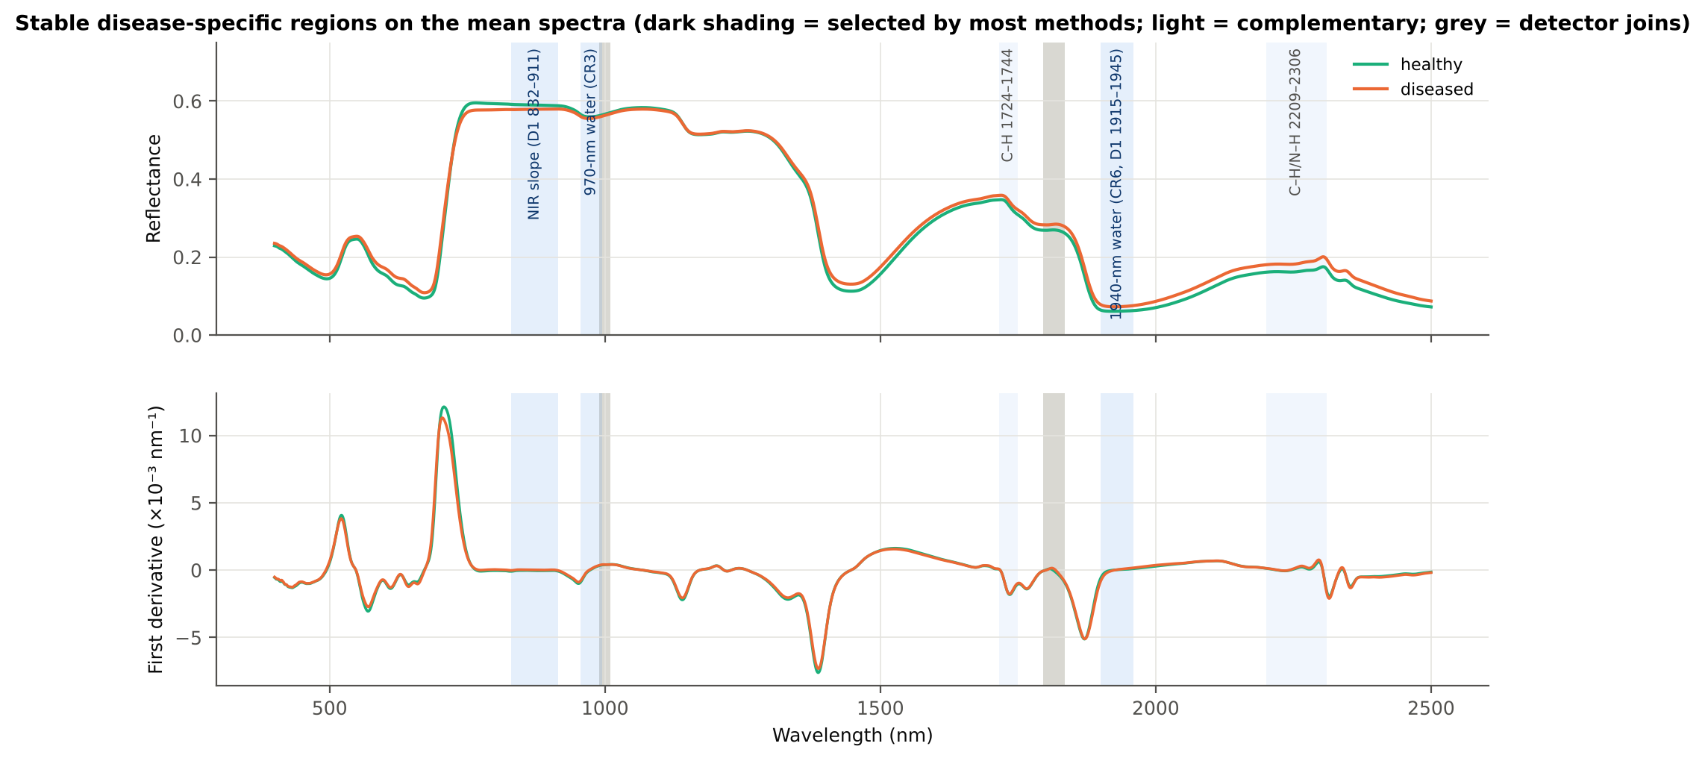
Feature selection: five regions chosen by most methods
Water: 970-nm and 1940-nm continuum-removed bands chosen by 18 of 21 methods
Structure: first-derivative slope across the NIR plateau (16 methods)
Dry matter: C–H near 1730 and 2200–2300 nm adds complementary information
Pigments: red edge and visible are chosen by few methods
Spectral region / feature group | Meaning | Methods
CR 970-nm water band | liquid water (O–H) | 18
CR 1940-nm water band | liquid water (O–H) | 18
D1 NIR plateau 760–930 nm | mesophyll structure | 16
D1 C–H band 1700–1792 nm | lignin, cellulose, waxes | 12
D1 1940-nm band wing 1840–1990 nm | liquid water | 11
Key finding
White rust changes leaf water and structure more consistently than chlorophyll.
Notes:
Shading on the mean spectra: dark = chosen by most methods; light = complementary; grey = ASD detector joins.

Slide 21
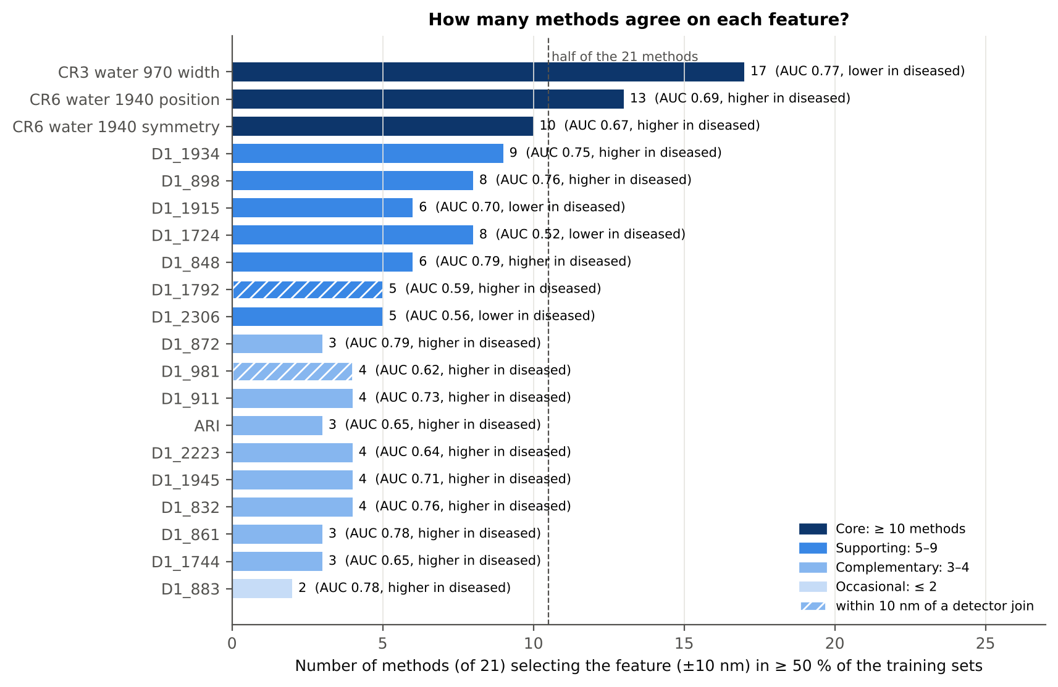
How many methods agree on each feature?
Core (≥ 10 of 21 methods)
CR3 970-nm width (17), CR6 1940-nm position (13), CR6 1940-nm symmetry (10)
Supporting (5–9)
D1_1934 (9), D1_898 (8), D1_1724 (8), D1_1915 (6), D1_848 (6), D1_2306 (5)
Complementary (3–4)
D1_872, D1_911, D1_832, D1_1945, D1_2223, ARI, D1_1744
Neighbouring 1-nm bands are interchangeable: the NIR-slope region 832–911 nm is stable even when the exact band varies.
Notes:
A feature counts for a method if it (±10 nm) is in the redundancy-controlled top-10 in at least half of the 20 training sets.

Slide 22
The disease-specific features: tier, AUC and direction
Feature | Tier | Methods (of 21) | AUC | Healthy → diseased | In diseased
CR3 970-nm water band width | Core | 17 | 0.77 | 64.2 → 60.9 | lower
CR6 1940-nm water band position | Core | 13 | 0.69 | 1912.2 → 1916.6 | higher
CR6 1940-nm water band symmetry | Core | 10 | 0.67 | 0.238 → 0.250 | higher
D1_1934 (1940-nm band wing) | Supporting | 9 | 0.75 | 0.032 → 0.056 | higher
D1_898 (NIR slope) | Supporting | 8 | 0.76 | −0.037 → 0.017 | higher
D1_1915 (1940-nm band wing) | Supporting | 6 | 0.70 | −0.045 → −0.123 | lower
D1_848 (NIR slope) | Supporting | 6 | 0.79 | −0.031 → 0.031 | higher
ARI (anthocyanin index) | Complementary | 3 | 0.65 | −1.003 → −0.593 | higher
D1_2223 (2200-nm dry matter) | Complementary | 4 | 0.64 | −0.019 → 0.000 | higher
D1_1724 (C–H 1730 nm) | Complementary* | 8 | 0.52 | −0.660 → −0.663 | lower
D1_2306 (C–H/N–H 2300 nm) | Complementary* | 5 | 0.56 | −0.607 → −0.647 | lower
* weak alone (AUC < 0.60) but complementary in multivariate models; used in the recommended 11-feature set.
Key finding
Diseased leaves: narrower 970-nm band, 1940-nm band shifted to longer λ and more asymmetric, NIR slope turns positive.
Notes:
Derivative values ×10⁻³ nm⁻¹; CR width and position in nm. AUC is direction-free.

Slide 23
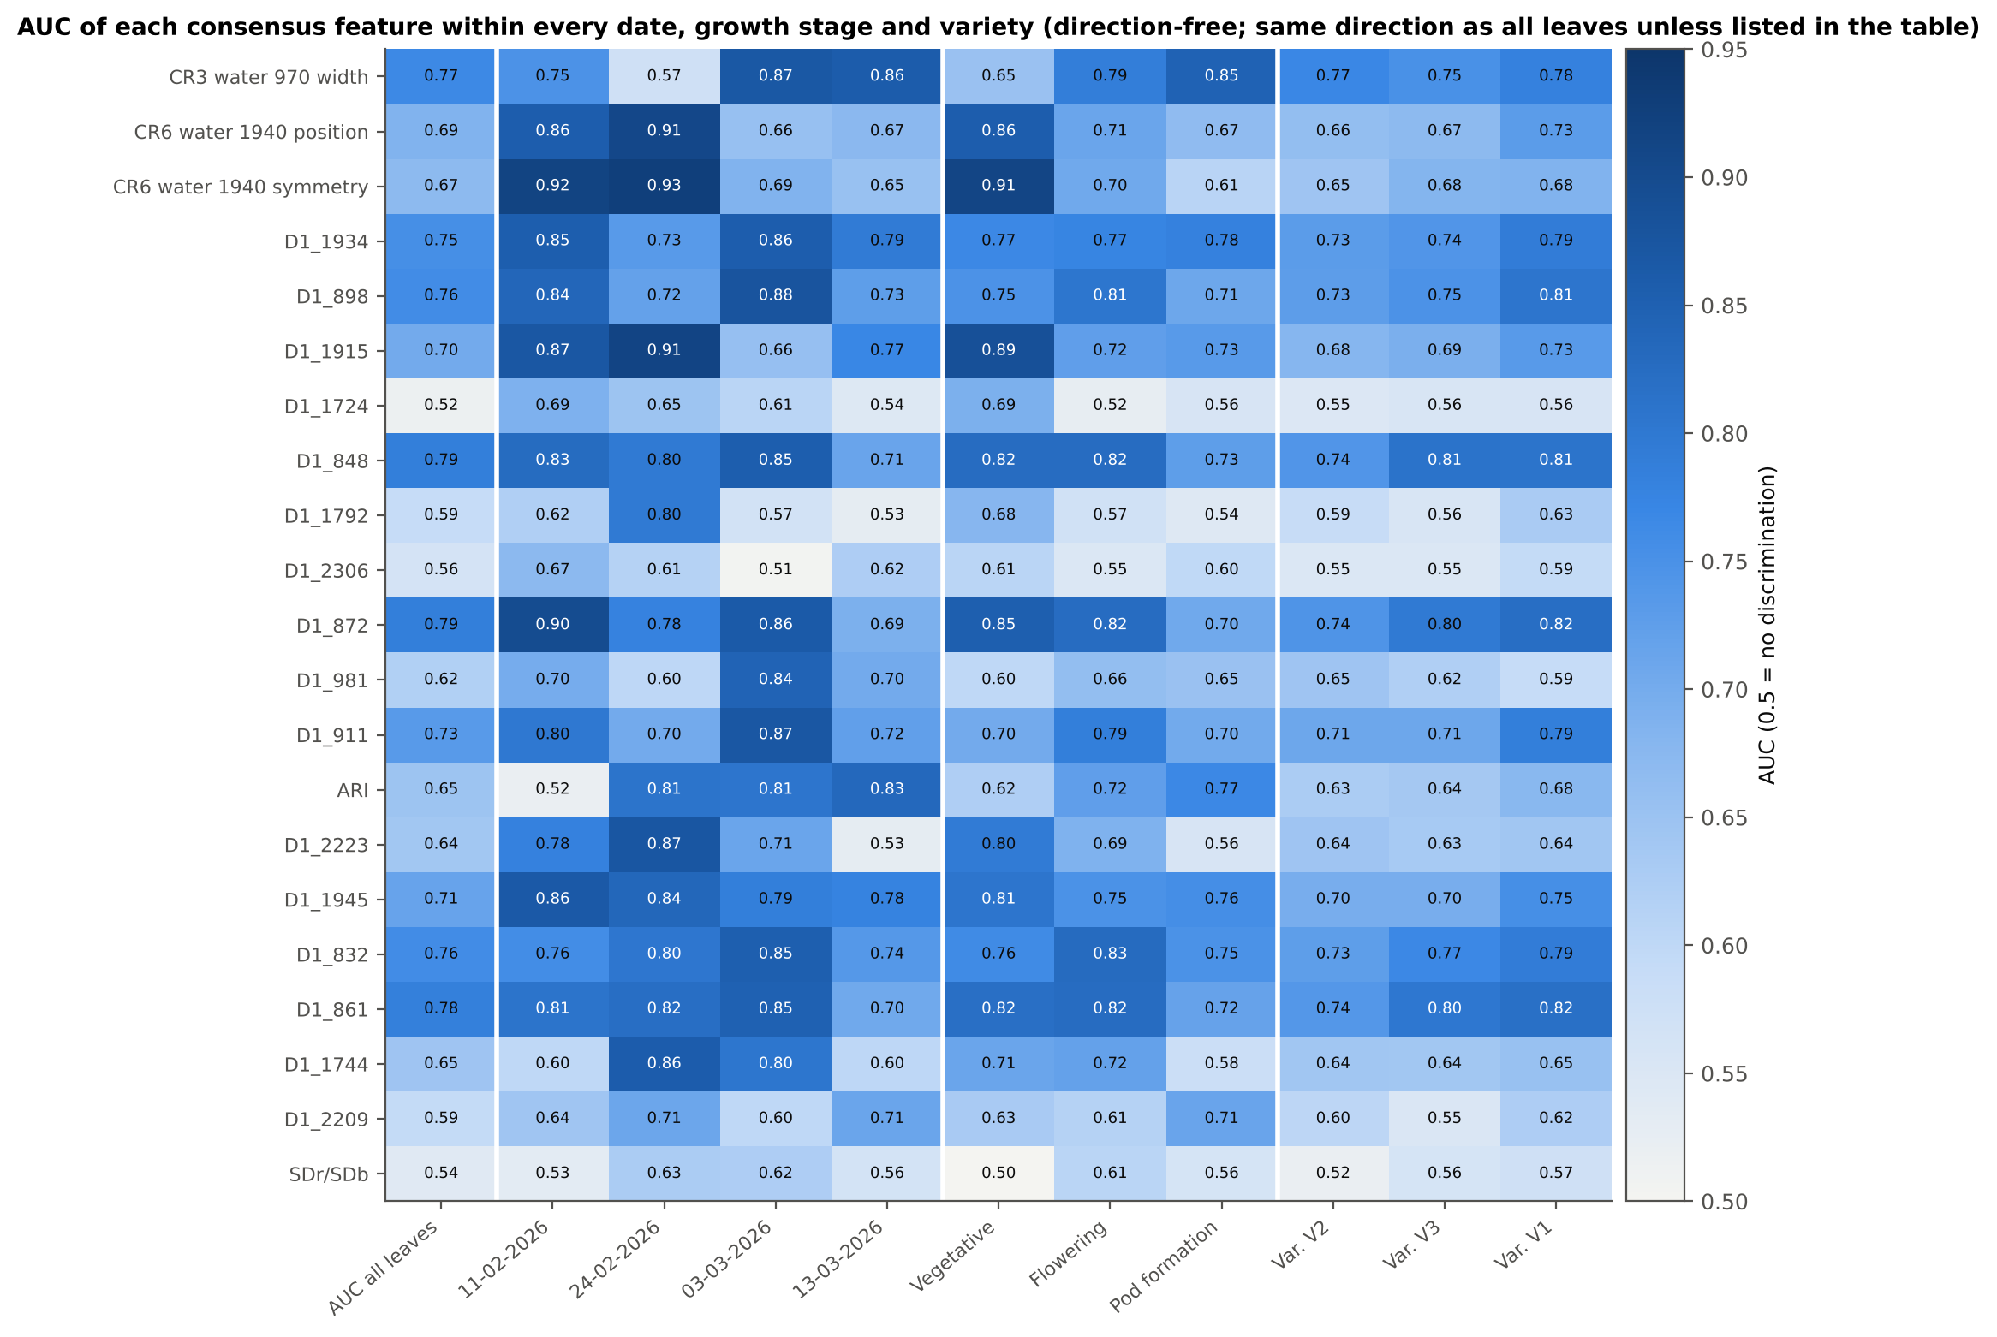
Stable across dates, growth stages and varieties
All seven stable features (3 water CR features, D1_1934, D1_1915, D1_848, D1_898) change in the same direction on all 4 dates, 3 stages and 3 varieties
Water-band position / symmetry and D1_1915 are strongest early (vegetative; AUC 0.86–0.93)
The 970-nm width is strongest at flowering and pod formation (AUC 0.79–0.87)
NIR-slope derivatives (D1_832–911) are the most even (AUC 0.69–0.90 in every stratum)
Caution
D1_1724 is not consistent alone (direction differs on 2 of 4 dates).
Notes:
Direction-free AUC computed separately within each stratum.

Slide 24
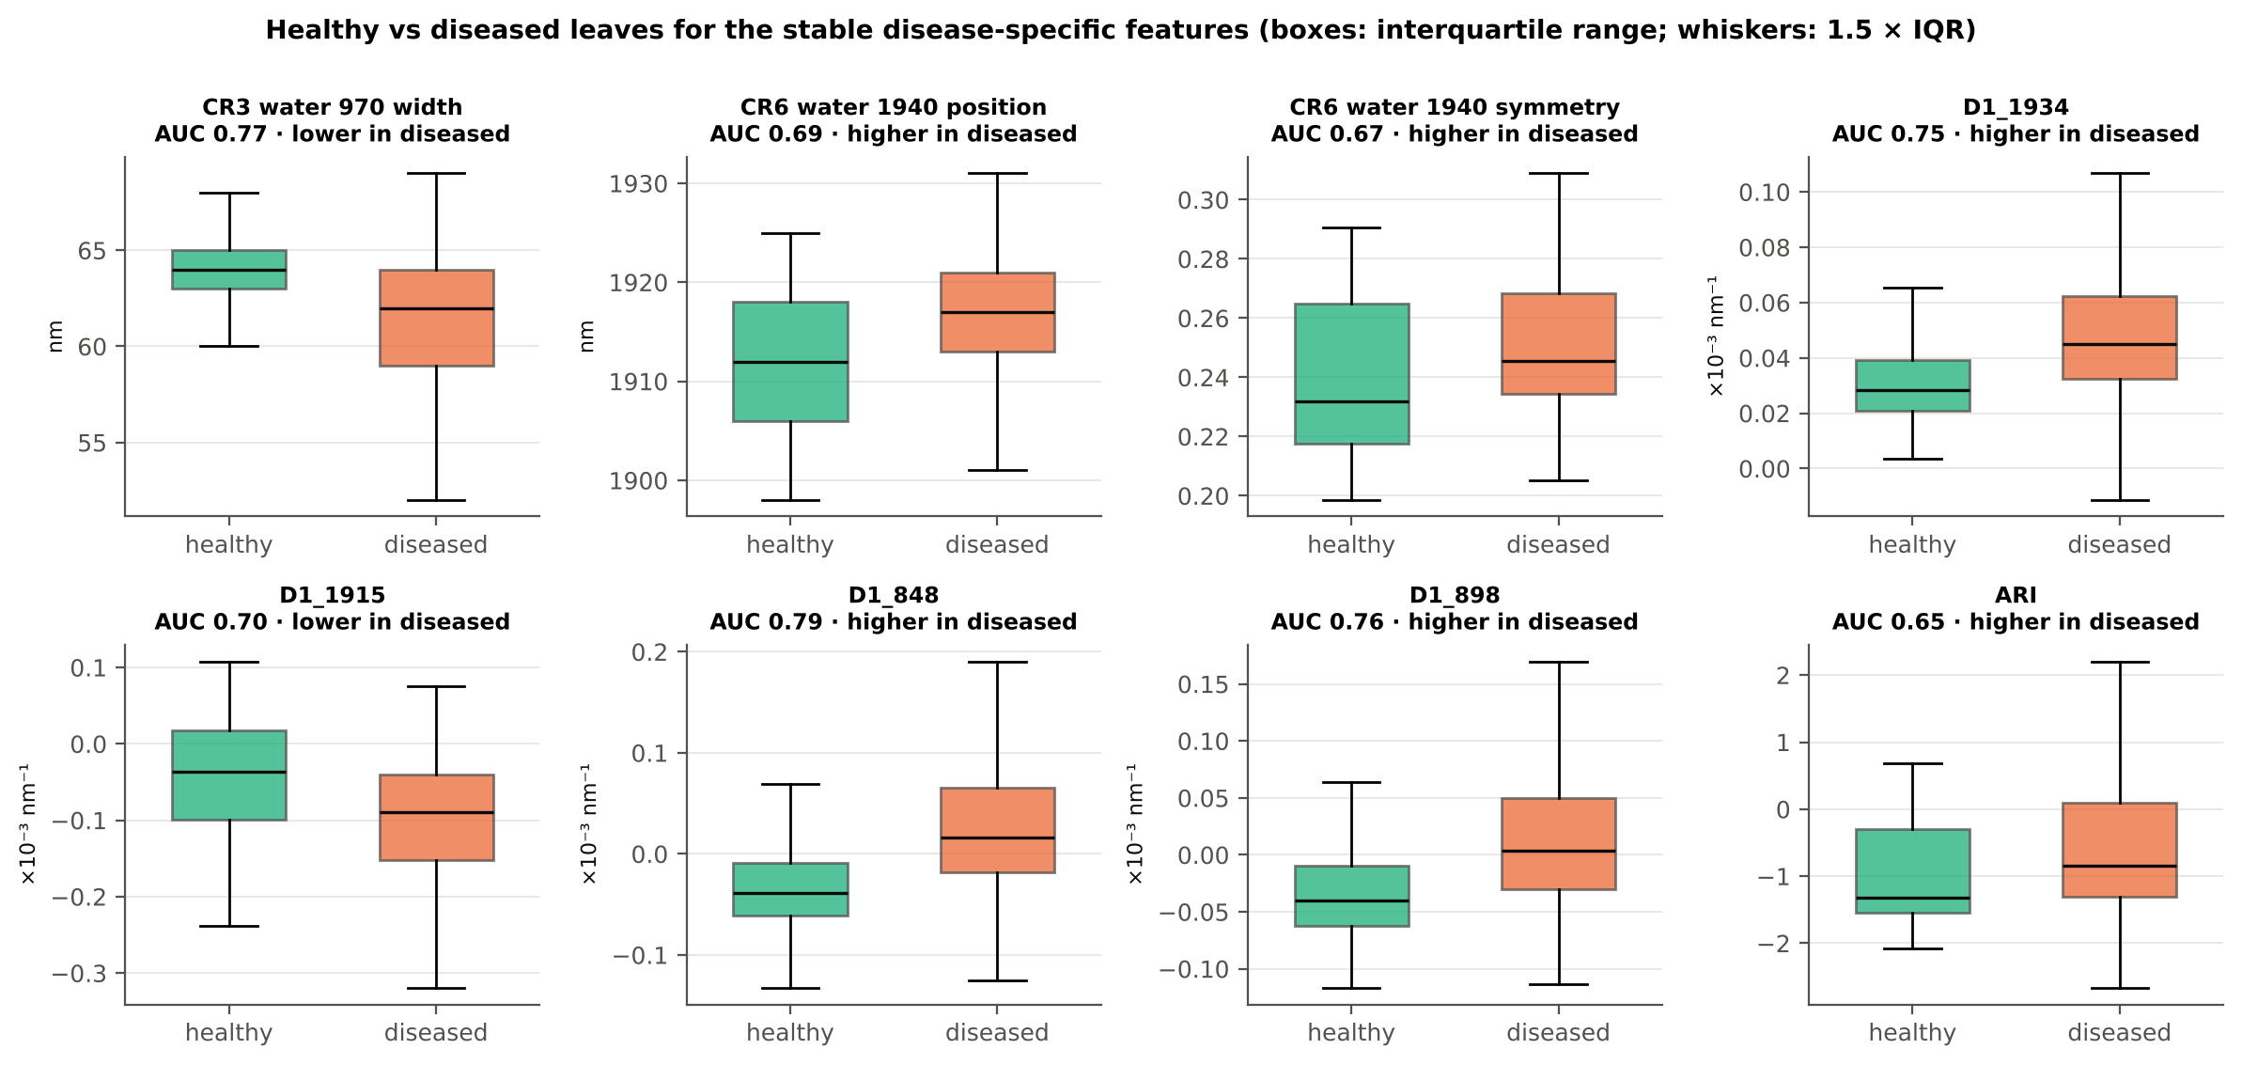
Healthy vs diseased leaves for the stable features
Diseased leaves: narrower 970-nm water band, 1940-nm band shifted to longer wavelengths, steeper 1940-nm wing, positive NIR slope, higher ARI.
Notes:
Boxes: interquartile range; whiskers: 1.5 × IQR.

Slide 25



What the disease-specific features mean physiologically
Feature | Change in diseased leaves | Interpretation
970-nm water band width | narrower (64.2 → 60.9 nm) | Lower / redistributed leaf water: pustules rupture the epidermis and increase water loss
1940-nm water band position | shifted to longer λ (1912 → 1917 nm) | Change in the water absorption shape (free vs bound water)
1940-nm water band symmetry | more asymmetric (0.238 → 0.250) | Same water signal, shape of the band
D1 1915 / 1934 nm | steeper wing of the 1940-nm band | Water-band depth and slope change
D1 832–911 nm (848, 898) | slope turns from negative to slightly positive | Altered mesophyll scattering by hyphae, pustules and cell damage
ARI (anthocyanin) | higher (−1.00 → −0.59) | Anthocyanin accumulation in stressed tissue
D1 1724, 2223, 2306 nm | small shifts (weak alone) | C–H / N–H absorption of cellulose, lignin and proteins: dry-matter changes
Water loss
Structural damage
Pigment stress
Notes:
Absorption-feature assignments as summarised by Thomas et al. (2018) and Mahlein et al. (2013).

Slide 26
Objective 1 summary: disease-specific features of white rust
1 · Core (always use)
2 · Stable supporting
3 · Complementary
CR3 970-nm water band WIDTH — narrower
CR6 1940-nm band POSITION — longer λ
CR6 1940-nm band SYMMETRY — more asymmetric
D1 1934 nm — higher in diseased
D1 1915 nm — lower in diseased
D1 848 nm and D1 898 nm — NIR slope
ARI — anthocyanin index
D1 2223 nm — 2200-nm dry matter
D1 1724 / 2306 nm — C–H, N–H
10–17 of 21 methods; same direction on every date, stage and variety
6–9 methods; consistent in all strata; any band within ±10 nm works
weak alone, but raise RF accuracy to 85.6 % and AUC to 0.91
Take-home
White rust acts mainly through LEAF WATER (970- and 1940-nm bands), with mesophyll damage (NIR slope) and pigment stress (red-edge blue shift, ARI). A new index, MWRI = ND(R1810, R1830), reaches AUC 0.87 against 0.67 for the best published index.
Notes:
These three tiers are the answer to Objective 1 and the input to the compact models of Objective 2.

Slide 27
Objective 2 results: discrimination of healthy and diseased leaves
03
Preprocessing · 10 feature scenarios × 10 classifiers · feature-selection methods · transfer tests

Slide 28
Effect of preprocessing (E1)
94.6 %
first derivative + logistic regression (best)
92.1 %
SNV + logistic regression
Key finding
First derivatives give the highest accuracy for every classifier: they remove the date-dependent brightness offset and keep the slope information that carries the disease signal.
Notes:
Same full-spectrum models under six preprocessing options; 10 × 4-fold plot-grouped CV.

Slide 29
Model comparison: 10 feature scenarios × 10 classifiers
Feature scenario | LDA | PLS-DA | LR | kNN | SVM | LS-SVM | RF | XGB | ELM | MLP
S1 Full spectrum (SNV) | 85.9 | 85.1 | 91.9 | 70.6 | 87.9 | 91.4 | 66.3 | 76.5 | 90.3 | 85.2
S2 Bands, robust sel. | 66.5 | 66.4 | 66.6 | 61.6 | 66.6 | 66.6 | 59.1 | 64.6 | 66.5 | 66.4
S3 Veg. indices | 64.1 | 63.9 | 64.0 | 64.0 | 66.6 | 66.2 | 60.1 | 65.5 | 66.8 | 65.8
S4 New NDSI (top-3) | 79.4 | 79.4 | 80.7 | 80.0 | 82.1 | 82.1 | 77.8 | 80.2 | 82.4 | 80.8
S5 Derivatives | 82.1 | 82.1 | 81.9 | 79.4 | 83.2 | 83.2 | 78.4 | 81.9 | 83.2 | 82.2
S6 Continuum removal | 75.8 | 75.7 | 75.7 | 73.8 | 77.8 | 78.4 | 75.8 | 76.8 | 77.8 | 76.5
S7 Wavelets (CWT) | 82.1 | 81.9 | 83.6 | 86.6 | 87.6 | 87.7 | 84.0 | 86.2 | 87.7 | 86.9
S8 Combined F1–F6 | 83.2 | 83.2 | 83.9 | 86.5 | 88.2 | 88.7 | 84.5 | 86.5 | 88.4 | 87.2
S9 SPA bands | 78.9 | 78.8 | 78.6 | 72.0 | 82.2 | 83.3 | 66.5 | 74.3 | 82.9 | 81.6
S10 GA-PLS bands | 81.7 | 81.1 | 82.2 | 70.8 | 84.5 | 86.5 | 65.4 | 73.1 | 85.8 | 81.7
Key finding
Highest BA: S1 full SNV spectrum + logistic regression (91.9 %). Best compact model: S8 combined features + LS-SVM (88.7 % with a median of 7 features). Single-family band and index selections (S2, S3) are weakest (≤ 67 %).
Notes:
Each cell = balanced accuracy (%) on plots never seen in training, mean of 25 repeats of nested plot-grouped 4-fold CV.

Slide 30
Which classifier works best?
Classifier | Mean rank | Mean BA (%)
LS-SVM | 2.11 | 81.4
ELM | 2.48 | 81.2
SVM | 2.87 | 80.7
MLP | 4.79 | 79.4
Logistic regression | 5.74 | 78.9
XGBoost | 6.43 | 76.6
LDA | 6.65 | 78.0
PLS-DA | 7.03 | 77.8
kNN | 7.74 | 74.5
Random forest | 9.16 | 71.8
Key finding
Kernel and neural models (LS-SVM, ELM, SVM) rank best (Friedman χ² = 1392.5, p < 0.001); kNN and random forest rank worst.
Notes:
Friedman test across all scenarios × repeats; lower mean rank = better. Nemenyi critical difference = 0.86 ranks.

Slide 31
Best models in detail: confusion matrices and metrics
Pipeline | BA (%) | Sens. | Spec. | MCC | κ | AUC
Best: S1 SNV spectrum + LR | 91.9 ± 0.7 | 0.932 | 0.906 | 0.769 | 0.761 | 0.976
Compact: S8 (~7 features) + LS-SVM | 88.7 ± 1.4 | 0.881 | 0.892 | 0.667 | 0.646 | 0.955
Best · spectra
Best · plot-date
Compact · spectra
Compact · plot-date
 | Pred H | Pred D
True H | 343 | 35
True D | 132 | 1780
 | Pred H | Pred D
True H | 47 | 1
True D | 7 | 137
 | Pred H | Pred D
True H | 334 | 44
True D | 217 | 1695
 | Pred H | Pred D
True H | 45 | 3
True D | 15 | 129
Key finding
At the plot-date level the best model misclassifies only 1 of 48 healthy and 7 of 144 diseased plot-dates. Most spectrum-level errors are diseased-plot leaves predicted healthy — leaves in diseased plots may be symptom-free (plot-level labels).
Notes:
Representative repeat (median BA). Plot-date prediction = majority vote of the spectra of one plot on one date.

Slide 32
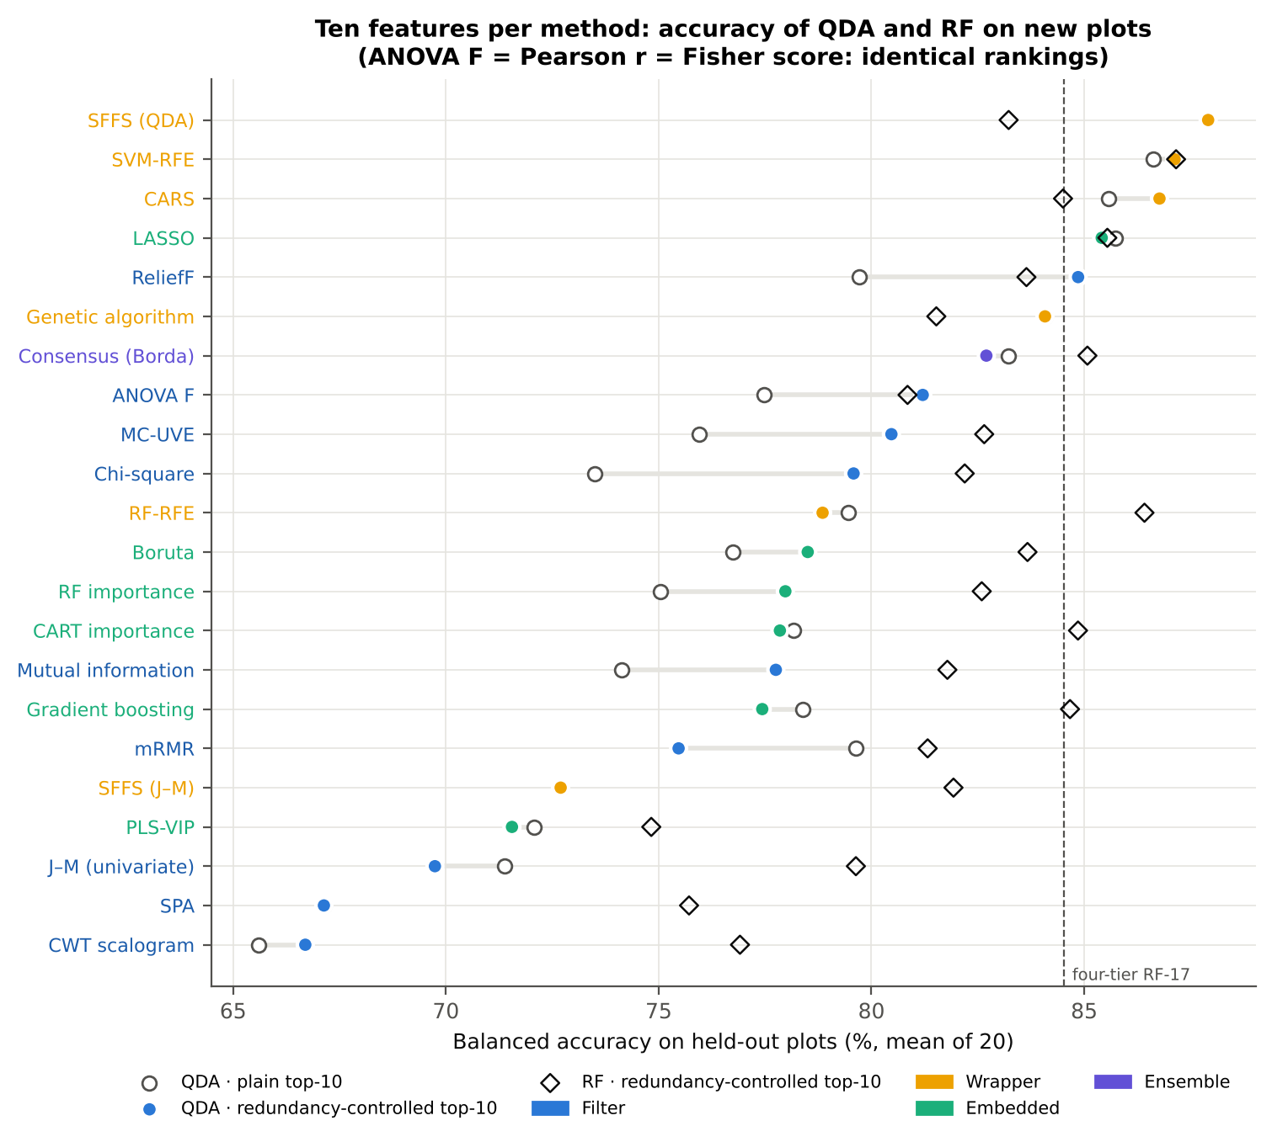
Which feature-selection method gives the best 10 features?
Wrappers win: SFFS (QDA) 87.9 %, SVM-RFE 87.1 %, CARS 86.8 % (QDA)
Univariate filters: 78–81 %; tree importances 77–79 %
Weak: PLS-VIP, J–M, SPA, CWT scalogram (67–72 %)
Redundancy control (skip |r| ≥ 0.95) raises filters by 3.6–6.1 points
Accuracy levels off at 10–15 features
Key finding
SFFS (QDA), SVM-RFE and CARS are not significantly different (Holm p = 0.55); every other method is significantly less accurate (Friedman χ² = 333.4, p < 10⁻⁵⁷).
Notes:
23 methods, 10 features each, QDA and RF balanced accuracy on held-out plots (mean of 20). Dashed line = earlier four-tier RF-17 set.

Slide 33
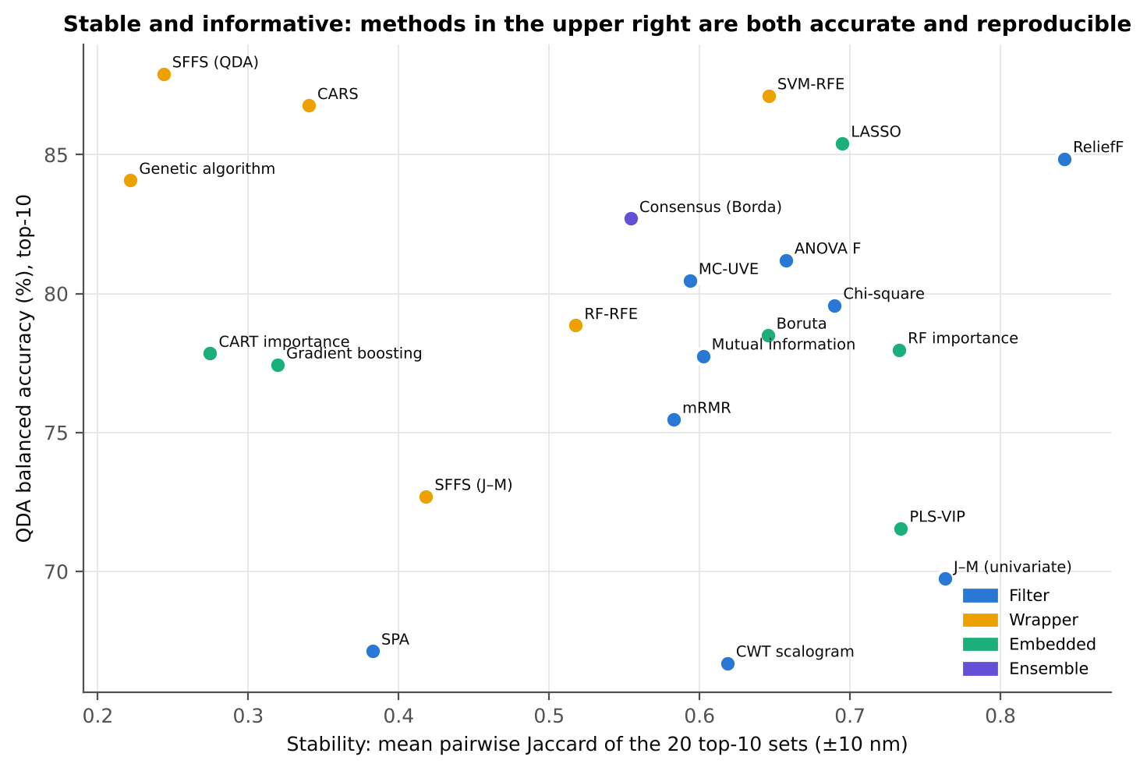
Accurate and stable: SVM-RFE ranks first
# | Method | QDA BA | RF BA | Stability
1 | SVM-RFE | 87.1 % | 87.2 % | 0.65
2 | LASSO | 85.4 % | 85.5 % | 0.69
3 | CARS | 86.8 % | 84.5 % | 0.34
4 | Borda consensus | 82.7 % | 85.1 % | 0.55
5 | ReliefF | 84.9 % | 83.6 % | 0.84
Key finding
Accuracy and stability trade off: search wrappers (SFFS 0.24, GA 0.22) are unstable because many equally good combinations exist in collinear spectra. SVM-RFE is accurate with both QDA and RF and moderately stable; ReliefF is the most stable (0.84).
Notes:
Stability = mean pairwise Jaccard of the 20 top-10 sets (±10 nm). Composite rank = mean rank over QDA and RF accuracy, stability and J–M.

Slide 34
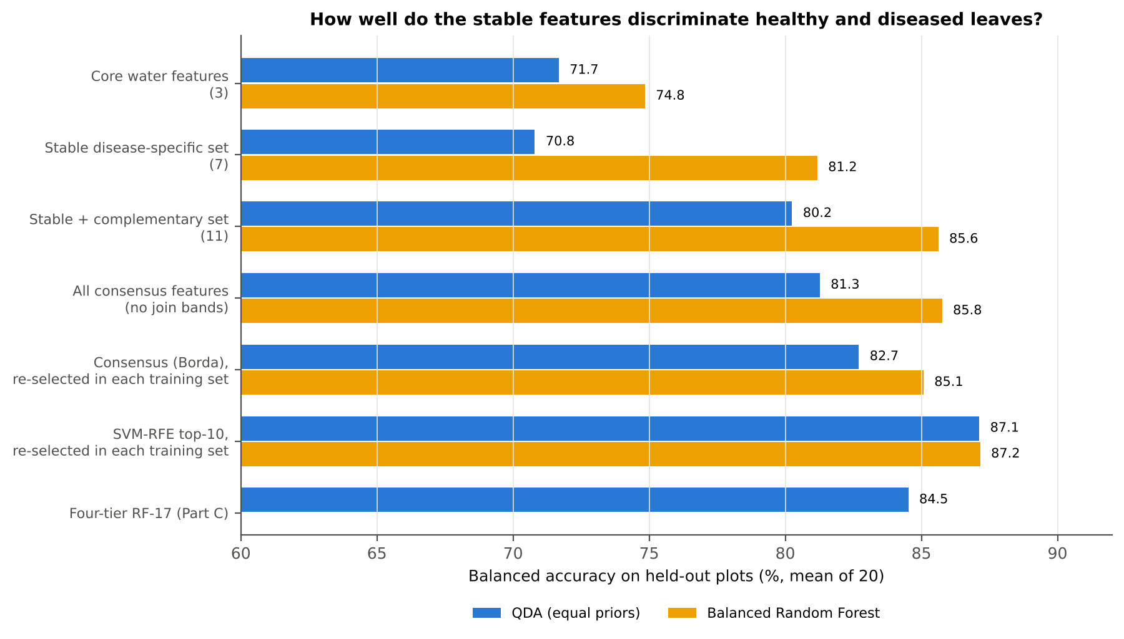
Using the disease-specific features as a classifier
Feature set | k | QDA | RF | AUC
Core water features | 3 | 71.7 | 74.8 | 0.81
Stable set | 7 | 70.8 | 81.2 | 0.81
Stable + complementary | 11 | 80.2 | 85.6 | 0.91
Key finding
Stable features alone are not the most accurate. Adding four weak but complementary features (ARI, D1_1724, D1_2223, D1_2306) raises RF to 85.6 % and AUC to 0.91 — the recommended 11-feature set. Re-selecting with SVM-RFE in each training set remains best (87.2 %).
Notes:
Fixed sets were defined from selection frequencies over the same training sets, so their accuracies are slightly optimistic.

Slide 35
Best selectors inside the AI pipeline (E8)
92.3 %
ReliefF top-10 + SVM (best 10-feature model)
87.9 %
full 201-band SNV spectrum + SVM
Key finding
Ten well-chosen features match or beat the whole spectrum: ReliefF 92.3 %, Borda 91.8 %, CARS and SVM-RFE 91.3 % with an SVM.
Notes:
The top selectors were re-run on the F1–F6 pool inside the same plot-grouped outer folds (20 test sets) and classified with QDA, SVM and RF.

Slide 36
Optimal feature combinations (OFCs, Tian et al. 2021)
Feature set | n | SVM BA
OFC-LDA | 4.8 | 86.9
OFC-kNN | 6.1 | 90.0
OFC-SVM | 6.6 | 90.4
All disease-specific | 9.0 | 91.3
Full spectrum (SNV) | 201 | 87.8
Key finding
Compact OFCs of 5–7 features keep full-spectrum accuracy. All nine disease-specific features + SVM reach 91.3 %, above the 201-band spectrum.
Notes:
OFC = combination found by SFFS with a given classifier as judge, after date-stable ReliefF screening and VIF < 10; each OFC is tested with LDA, kNN and SVM.

Slide 37
Final compact feature set: no multicollinearity
Final feature | Meaning | AUC | VIF
FD1810 | 1st derivative, 1940-nm water shoulder | 0.66 | 2.7
WF1800_s1 | wavelet 1800 nm, fine scale | 0.70 | 2.4
WF1810_s4 | wavelet 1810 nm, scale 4 | 0.78 | 3.2
WF2040_s3 | wavelet 2040 nm (SWIR water) | 0.69 | 3.1
FD850 | 1st derivative, NIR slope | 0.78 | 1.6
CR1800–2100 pos | 1940-nm water band position | 0.66 | 2.2
WF710_s2 | wavelet 710 nm, red edge | 0.63 | 1.4
Selection stage | n | max VIF | Cond. no.
Date-stable ReliefF candidates | 40 | 131,387 | 4,048,234
After |r| < 0.98 | 38 | 128,254 | 1,637
After VIF < 10 | 12 | 9.0 | 9.2
Final set after SFFS-LDA | 7 | 3.2 | 4.9
Key finding
The seven final features (max |r| 0.69, max VIF 3.2) each add separate information. They fall in the same regions found in Objective 1: the 1940-nm water band, the NIR slope and the red edge — the two analyses agree.
A |r| < 0.95 rule alone is not enough: ReliefF top-10 (max VIF 119) and Borda top-10 (74) remain collinear.
Notes:
Final robust set selected on all spectra after date-stable ReliefF, |r| < 0.98, VIF < 10 and SFFS-LDA.

Slide 38
Is the signal an instrument artefact? Detector-join check
Linear selectors pick bands next to the joins more often (SVM-RFE 4/10, ReliefF 8/10 near-join features)
Removing them costs SVM-RFE only 2.4 points (91.3 → 88.9 %)
Robust S8 loses most (−7.4) because it relies on 1800–1840 nm features
Key finding
The disease signal is not a detector artefact, but for a sensor use join-free features: SVM-RFE on join-free features is the safest choice.
Notes:
Near join = within 20 nm (or the wavelet half-width) of the ASD 1000/1800 nm joins; features removed before selection and the selection repeated.

Slide 39
Performance within each date, variety and growth stage
Key finding
With one pooled model every date, variety and stage stays above 86 % BA for the best model (lowest 13 Mar 86.9 %, highest 24 Feb 96.6 %). Varieties perform alike (89.5–93.8 %), so one model serves all three varieties.
Best = S1 SNV + LR; Compact = S8 + LS-SVM
Notes:
One pooled model; accuracy computed separately within each sub-group (25 repeats).

Slide 40
Transfer to an unseen date, variety or stage (E2)
93–94 %
Unseen variety
78–87 %
Unseen stage
50–86 %
Unseen date
Key finding
The model fails on 13 Mar (50 %) when that date is unseen: the late-season signature is absent from other dates. Every season stage must be in the training data.
Notes:
Model trained without a whole date / variety / stage and tested on it (plots kept separate).

Slide 41
Training-set size, multispectral sensors and metadata
Key finding
BA rises from 83.1 % (12 plots) to 91.5 % (36 plots) without a plateau — more plots would help. Broad-band sensors lose much accuracy (Sentinel-2 ≤ 73.9 %, UAV ≤ 66.8 %): hyperspectral detail matters. Adding date / variety / stage as inputs changes BA by only −2.7 to +0.8 points (E3), so the spectral model is context-independent.
Notes:
E4: training plots sub-sampled per variety × class. E5: hyperspectral data resampled to Sentinel-2 MSI (10 bands) and a 5-band UAV camera.

Slide 42
Comparison with published accuracies
Study | Crop / disease / task | Reported accuracy
Tian et al. 2021 | Rice leaf blast, per stage | OA 0.65–0.99
Lv et al. 2023 | Maize southern corn leaf blight | OA 0.87 / 0.93
Zhang et al. 2012 | Wheat powdery mildew, 3 classes | OA 0.89, κ 0.84
Zhu et al. 2017 | Tobacco TMV, 4 classes | Acc. 0.98
Nguyen et al. 2023 | Wheat yellow rust, UAV | OA 0.79
This study | First derivative + LR (full spectrum) | BA 0.95
This study | SNV + LR (full spectrum, 25 repeats) | BA 0.92, MCC 0.77
This study | 10 selected features + SVM | BA 0.92
This study | ~7 date-stable features + LS-SVM | BA 0.89
Key finding
Our accuracies are comparable with published single-experiment values although they were obtained under stricter validation (whole plots held out, selection and tuning inside training folds) and are reported as balanced accuracy and MCC because of the 1:5 class imbalance.
Notes:
Published values come mostly from single experiments with random splits; ours from plot-grouped nested CV pooled over 4 dates, 3 varieties and 3 stages.

Slide 43
Objective 2 summary: discrimination with AI models
94.6 %
91.9 %
92.3 %
88.7 %
first-derivative spectrum + logistic regression (E1)
SNV spectrum + LR, MCC 0.77, AUC 0.976 (main CV)
only 10 features (ReliefF) + SVM
~7 date-stable features + LS-SVM (sensor-ready)
Preprocessing: first derivatives remove the date offset and give the highest accuracy
Classifiers: LS-SVM, ELM and SVM rank best; kNN and RF worst
Feature selection: wrappers (SVM-RFE, SFFS, CARS) and ReliefF give the best compact sets; SVM-RFE is the best all-round method
Generalisation: one model serves all varieties (93–94 %), but every season stage must be in the training data
Notes:
Four numbers summarise Objective 2.

Slide 44
Conclusions
Objective 1 · Characterisation
Objective 2 · Discrimination
1
White rust raises visible and SWIR reflectance, blue-shifts the red edge and changes the NIR slope; significant after removing date, variety and stage effects.
1
Best pooled model: first-derivative / SNV full spectrum + logistic regression (BA 94.6 % / 91.9 %, AUC 0.976) under strict plot-grouped validation.
2
Date dominates the spectra (31 % of variance vs 1.1 % for disease), so slope-based features are essential.
2
Ten features from ReliefF or SVM-RFE + SVM (91–92 %) match the whole spectrum; ~7 date-stable features + LS-SVM give 88.7 %.
3
The most stable disease-specific features are leaf-water features: 970-nm band width and 1940-nm band position and symmetry (10–17 of 21 methods), plus 1915–1934 nm and NIR-slope (848–911 nm) derivatives.
3
SVM-RFE is the best all-round selector (accurate, stable, robust to the detector-join check).
4
New index MWRI = ND(R1810, R1830): AUC 0.87 vs 0.67 for the best of 46 published indices.
4
One model serves all varieties, but unseen dates fail and broad-band sensors lose accuracy: train on all season stages with hyperspectral data.
Notes:
Objective 1 conclusions on the left; Objective 2 on the right.

Slide 45


Limitations and future work
Limitations
Future work
Labels are plot-level: leaves in diseased plots may be symptom-free, which caps achievable accuracy
Only 12 healthy plots: the healthy class drives the uncertainty of every metric
The strongest index (1810–1830 nm) lies next to the ASD 1800-nm detector join
One season and one site; severity (PDI) and leaf-layer scores were not available
Score severity per leaf for severity regression and multi-class models
Validate on a second season / location as an independent test
Add pre-symptomatic dates with inoculated plots for early detection
PROSPECT-D inversion for pigment and water traits; upscale MWRI and join-free features to UAV / satellite bands
Notes:
Plot-level labels and one season are the main limitations.

Slide 46
Key references
Ambroise C, McLachlan GJ (2002) Selection bias in gene extraction on the basis of microarray gene-expression data. PNAS 99:6562–6566.
Anderson MJ (2001) A new method for non-parametric multivariate analysis of variance. Austral Ecology 26:32–46.
Das B, Sahoo RN, et al. (2020) Discrimination of rice genotypes using field spectroradiometry. Geocarto International 35:64–77.
Demšar J (2006) Statistical comparisons of classifiers over multiple data sets. JMLR 7:1–30.
Guyon I, Weston J, Barnhill S, Vapnik V (2002) Gene selection for cancer classification using support vector machines. Machine Learning 46:389–422.
Kononenko I (1994) Estimating attributes: analysis and extensions of RELIEF. ECML-94, LNCS 784:171–182.
Li H, Liang Y, Xu Q, Cao D (2009) Key wavelengths screening using competitive adaptive reweighted sampling. Analytica Chimica Acta 648:77–84.
Lv Z, Meng R, et al. (2023) Combining multiple spectral enhancement features for detection of southern corn leaf blight. Precision Agriculture 24:1593–1618.
Mahlein A-K, Rumpf T, et al. (2013) Development of spectral indices for detecting and identifying plant diseases. Remote Sensing of Environment 128:21–30.
Mandal N, et al. (2023) Univariate and multivariate hyperspectral models of rice blast severity. Frontiers in Plant Science.
Pudil P, Novovičová J, Kittler J (1994) Floating search methods in feature selection. Pattern Recognition Letters 15:1119–1125.
Thomas S, Kuska MT, et al. (2018) Benefits of hyperspectral imaging for plant disease detection and plant protection. J Plant Dis Prot 125:5–20.
Tian L, Xue B, et al. (2021) Spectroscopic detection of rice leaf blast infection from asymptomatic to mild stages. Remote Sensing of Environment 257:112350.
Wei X, Johnson MA, et al. (2021) Identifying optimal wavelengths as disease signatures using hyperspectral sensor and machine learning. Remote Sensing 13:2833.
Zhang J-C, Pu R, et al. (2012) Detecting powdery mildew of winter wheat using leaf level hyperspectral measurements. Comput Electron Agric 85:13–23.
Zhu H, Chu B, et al. (2017) Hyperspectral imaging for presymptomatic detection of tobacco disease with SPA and machine-learning classifiers. Sci Rep 7:4125.

Slide 47
Thank you
Questions and suggestions are welcome
Animesh Panda · Division of Agricultural Physics, ICAR-IARI, New Delhi

