Slide 1
Discrimination of healthy and white-rust-diseased mustard from plot-average leaf spectra
Four-tier hierarchical analysis (Das et al., 2020) with imbalance correction · CART vs Random Forest · disease-sensitive features from raw reflectance
192 plot-average spectra (48 healthy, 144 diseased) · 48 plots × 4 dates · ASD FieldSpec contact probe, 400–2500 nm
Animesh Panda · Division of Agricultural Physics, ICAR-IARI, New Delhi

Slide 2
The study at a glance
192
48 : 144
2264
8264
plot-average spectra (48 plots × 4 dates)
healthy : diseased (1 : 3.0)
leaf spectra averaged
features in the combined pool
Question: which bands and which disease-sensitive features separate healthy from white-rust-diseased mustard when all dates, growth stages and varieties are combined — at the plot level?
Step 1 · Four tiers of Das et al. (2020) on raw reflectance: statistical screening → CART (and Random Forest) band selection → Jeffries–Matusita separability → QDA classification.
Step 2 · Disease-sensitive features from the raw reflectance (continuum removal, vegetation indices, first/second/third derivatives, red-edge parameters).
Step 3 · The same four tiers on the combined pool (reflectance + all features) → disease-specific features.
Every step corrected for the 1 : 3 class imbalance and validated on new plots and new dates.

Slide 3
Data: leaf spectra averaged to one spectrum per plot and date
Date | Class | Plot averages | Leaf spectra | Min leaves per plot | Max leaves per plot
11-02-2026 | Healthy | 12 | 72 | 3 | 9
11-02-2026 | Diseased | 36 | 356 | 5 | 15
24-02-2026 | Healthy | 12 | 90 | 6 | 9
24-02-2026 | Diseased | 36 | 450 | 10 | 15
03-03-2026 | Healthy | 12 | 108 | 9 | 9
03-03-2026 | Diseased | 36 | 540 | 15 | 15
13-03-2026 | Healthy | 12 | 108 | 9 | 9
13-03-2026 | Diseased | 36 | 540 | 15 | 15
Four ASD export workbooks (11-02, 24-02, 03-03 and 13-03-2026); exact duplicate spectra removed (75 block-2 copies, 4 unnamed copies) → 2264 unique leaf spectra.
Plot average = mean of all leaf spectra of a plot on a date, at every band: 192 spectra (48 healthy, 144 diseased).
Cross-check: 197 of 197 plot-average (=AVERAGE) columns of the source workbooks are identical to these averages at all 2151 bands.
Water-absorption bands kept (contact probe, no atmospheric path); 350–399 nm detector edge removed (noise).
The same plot appears on four dates → plot-grouped validation and a random plot effect.

Slide 4
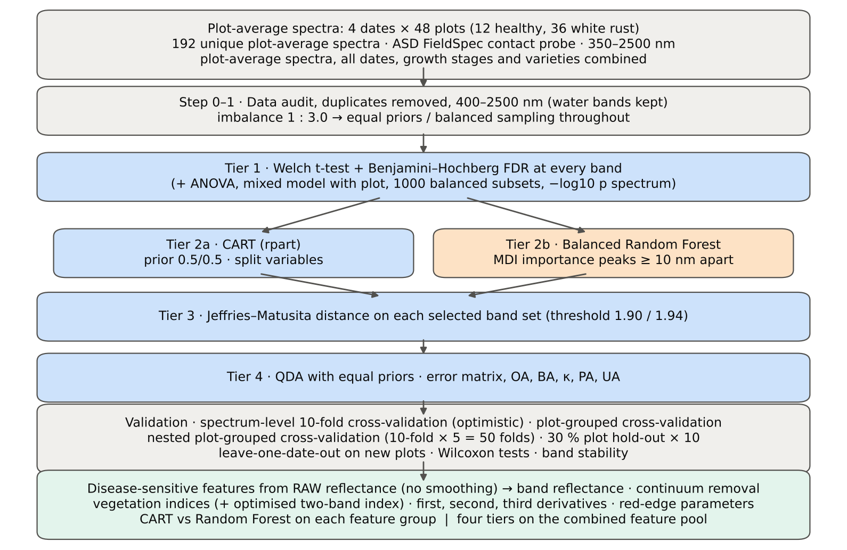
Workflow of the analysis

Slide 5
Corrections applied to the protocol of Das et al. (2020)
Issue | Correction | Why
Class imbalance (48 : 144 = 1 : 3.0) | rpart prior = (0.5, 0.5); Balanced Random Forest; QDA with equal priors; balanced accuracy; 1000 balanced subsets in Tier 1 | otherwise every model favours 'diseased'
Two classes only | Welch t-test instead of ANOVA + Tukey (ANOVA reported) | unequal variances; one pair
2101 tests | Benjamini–Hochberg false-discovery rate (q < 0.05) | ≈ 105 false positives at α = 0.05
Same plot on 4 dates | mixed model with random plot effect; plot-grouped folds | the dates of a plot are not independent
Selection bias | Tier 1, selection and classifier refitted in every training set | selecting and testing on the same spectra is optimistic
Detector joins | guard zones (990–1010, 1795–1835 nm) excluded from the feature sets; no smoothing (features from raw reflectance) | instrument steps must not be read as disease

Slide 6
Validation design — identical folds in every step
Scheme | How | What it estimates
Spectrum-level 10-fold cross-validation (protocol of Das et al.) | features chosen once on all spectra; random 10 folds | the protocol of the paper (optimistic: same plot on other dates in training)
Nested plot-grouped cross-validation | 10 plot-grouped folds × 5 repeats; Tier 1, selection and classifier refitted inside each training set | the honest accuracy for new plots
30 % plot hold-out validation | 4 healthy + 11 diseased plots held out × 10 splits; everything refitted | independent test plots
Leave-one-date-out validation on new plots | train on three dates (training plots), test the fourth date (test plots); 40 units | transfer to an unseen date and unseen plots
Balanced accuracy (BA) = ½ (recall healthy + recall diseased) is the headline metric; overall accuracy alone would be inflated by the 3 : 1 majority of diseased spectra.

Slide 7
Step 1 · Four tiers on raw reflectance
Welch t-test + FDR → CART (rpart, equal priors) and Balanced Random Forest → Jeffries–Matusita distance → QDA with equal priors

Slide 8
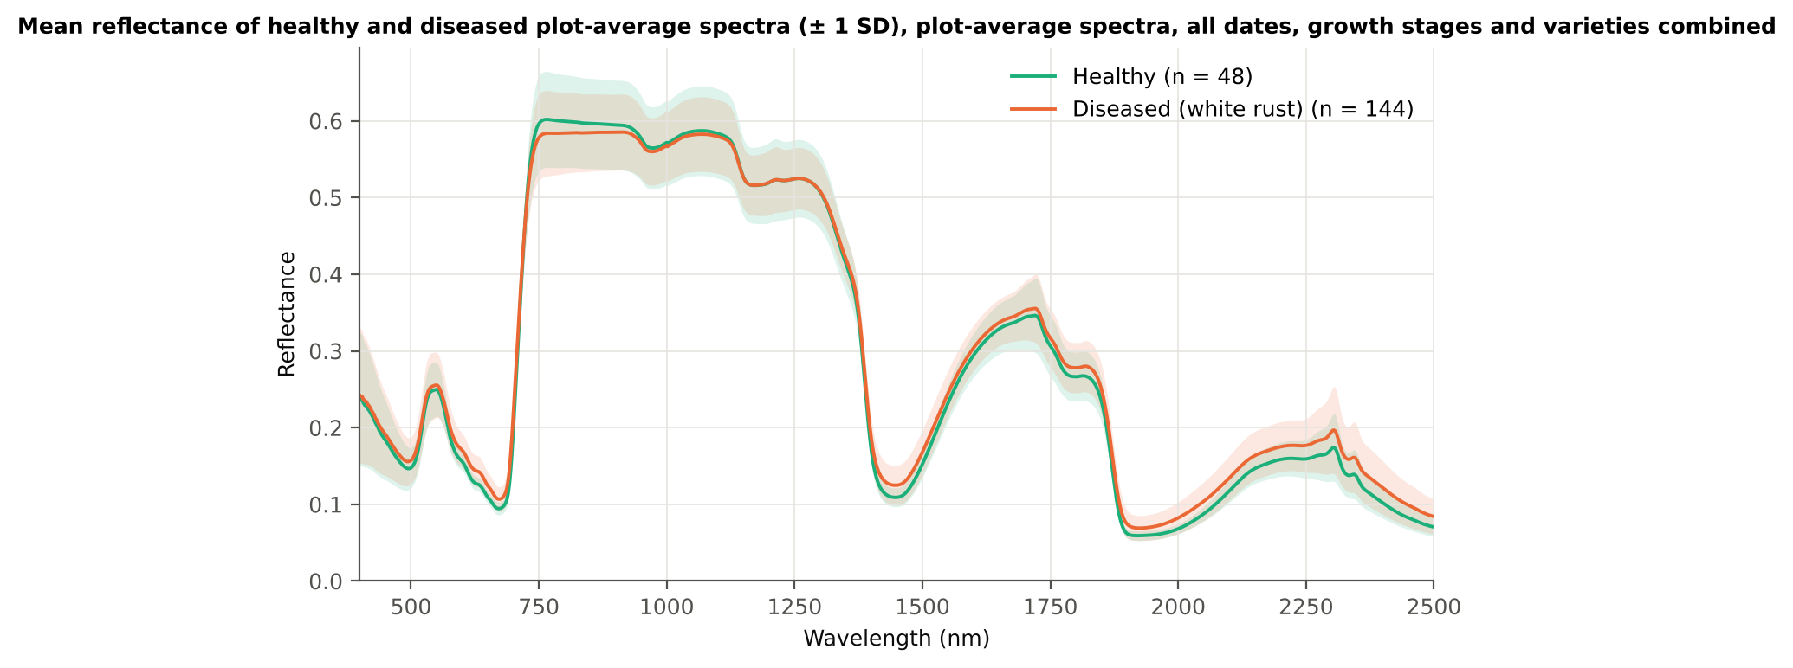
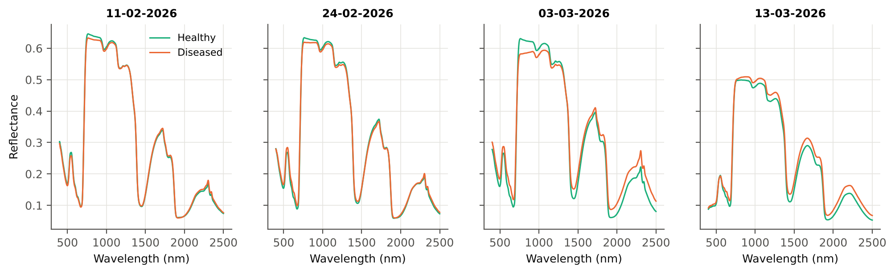
Mean plot-average spectra of healthy and diseased plots

Slide 9
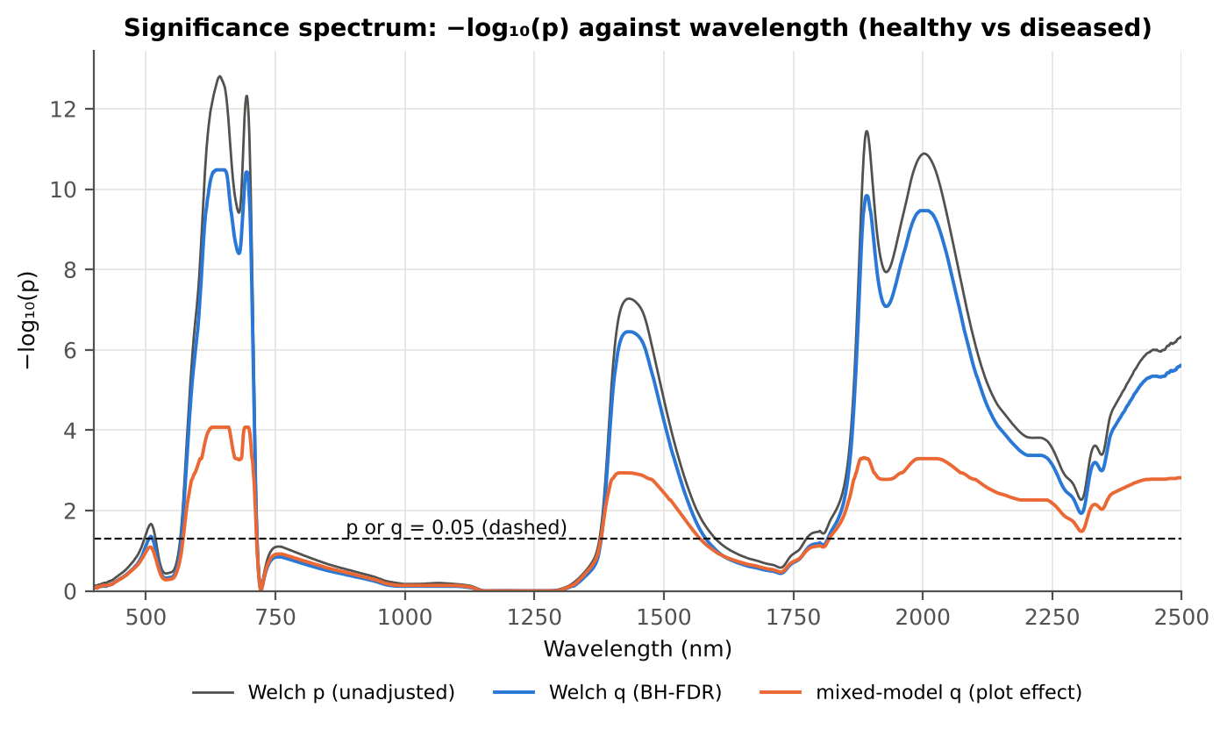
Tier 1 · statistical screening of 2101 bands
Test | Significant bands
Welch t-test + BH-FDR q < 0.05 (used for Tier 2) | 1039
One-way ANOVA p < 0.05, uncorrected (rule of Das et al.) | 1111
One-way ANOVA + BH-FDR q < 0.05 | 1023
Welch t-test p < 0.05, uncorrected | 1120
Mixed model (random plot effect) + BH-FDR q < 0.05 | 1014
Balanced subsets (48 vs 48): significant in ≥ 95 % of 1000 subsets | 515
Levene test p < 0.05 (unequal variances → Welch) | 704
−log₁₀(p) of every band against wavelength (Welch, FDR-adjusted and mixed-model q). Dashed line: p = 0.05.

Slide 10
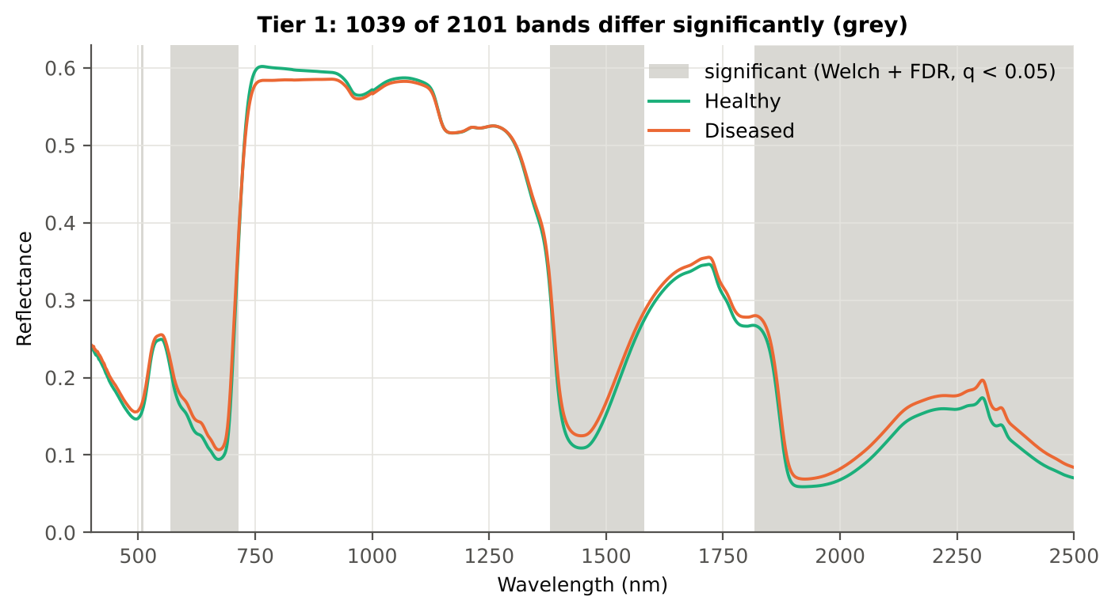
Tier 1 · where the significant bands are
Region | Bands | Welch+FDR significant | Mixed-model significant | Band of max |t| | Max t
Blue (400–499) | 100 | 0 | 0 | 499 | 2.1
Green (500–599) | 100 | 38 | 28 | 599 | 5.7
Red (600–679) | 80 | 80 | 80 | 643 | 8.0
Red edge (680–759) | 80 | 35 | 34 | 695 | 7.8
NIR (760–1349) | 590 | 0 | 0 | 760 | -1.8
Water band I (1350–1430) | 81 | 51 | 52 | 1430 | 5.7
SWIR-1 (1431–1799) | 369 | 151 | 139 | 1432 | 5.7
Water band II (1800–1950) | 151 | 134 | 131 | 1892 | 7.4
SWIR-2 (1951–2349) | 399 | 399 | 399 | 2003 | 7.2
SWIR-2 end (2350–2500) | 151 | 151 | 151 | 2498 | 5.3

Slide 11
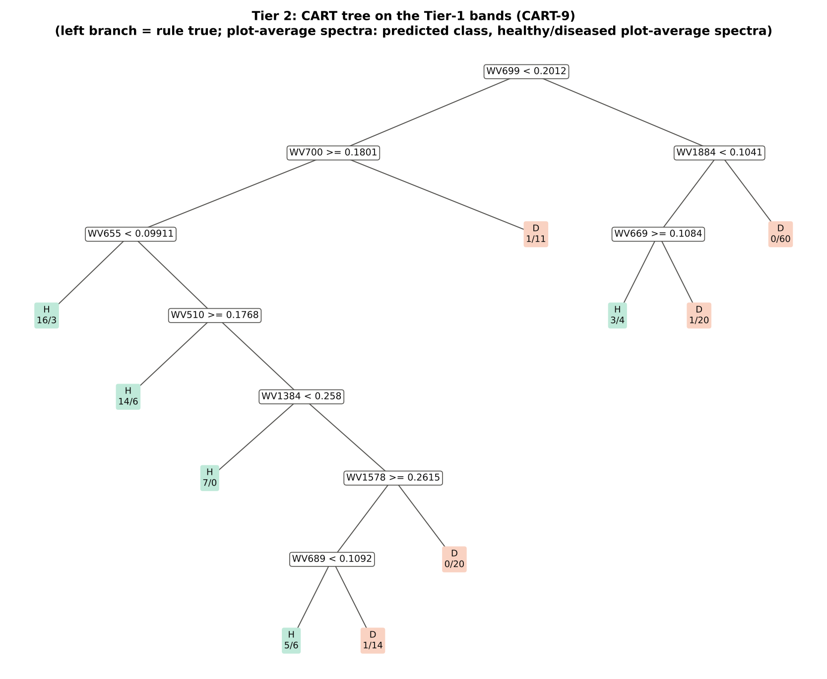
Tier 2 · CART selects 9 bands (rpart, prior 0.5 / 0.5)
CART bands (order of use): 699, 700, 1884, 655, 669, 510, 1384, 1578, 689 nm.
Equal priors give the 48 healthy spectra the same weight as the 144 diseased ones.
The bands used as split variables form the CART set passed to Tiers 3 and 4.

Slide 12
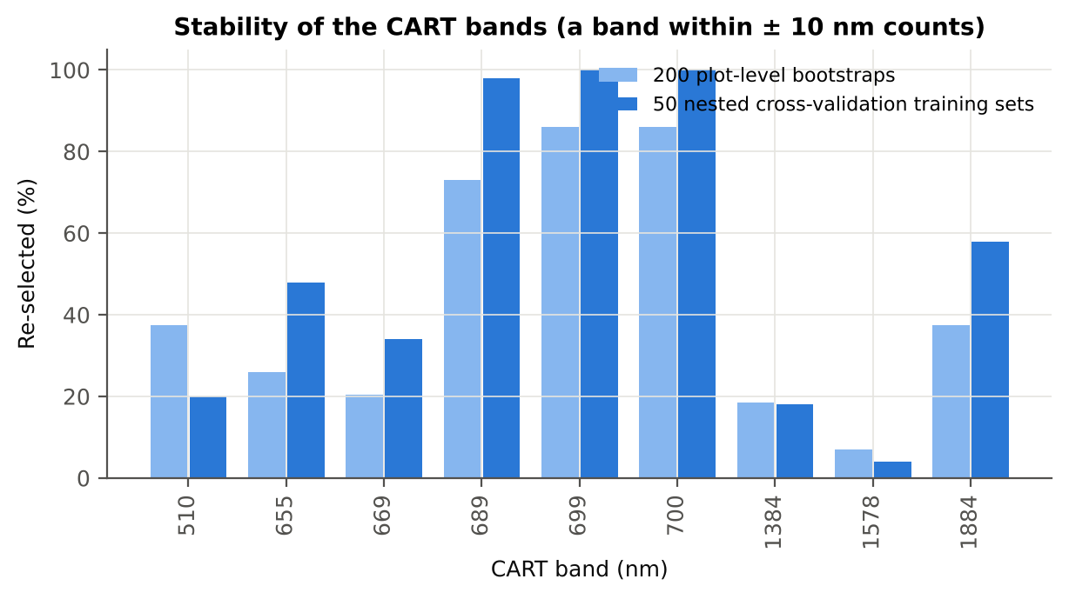
Tier 2 · how stable are the CART bands?
Band (nm) | Region | First used at node | Bootstrap re-selection (±10 nm) | Nested cross-validation re-selection (±10 nm)
510 | Green | 9 | 37.5 % | 20.0 %
655 | Red | 4 | 26.0 % | 48.0 %
669 | Red | 6 | 20.5 % | 34.0 %
689 | Red edge | 78 | 73.0 % | 98.0 %
699 | Red edge | 1 | 86.0 % | 100.0 %
700 | Red edge | 2 | 86.0 % | 100.0 %
1384 | Water band I | 19 | 18.5 % | 18.0 %
1578 | SWIR-1 | 39 | 7.0 % | 4.0 %
1884 | Water band II | 3 | 37.5 % | 58.0 %

Slide 13
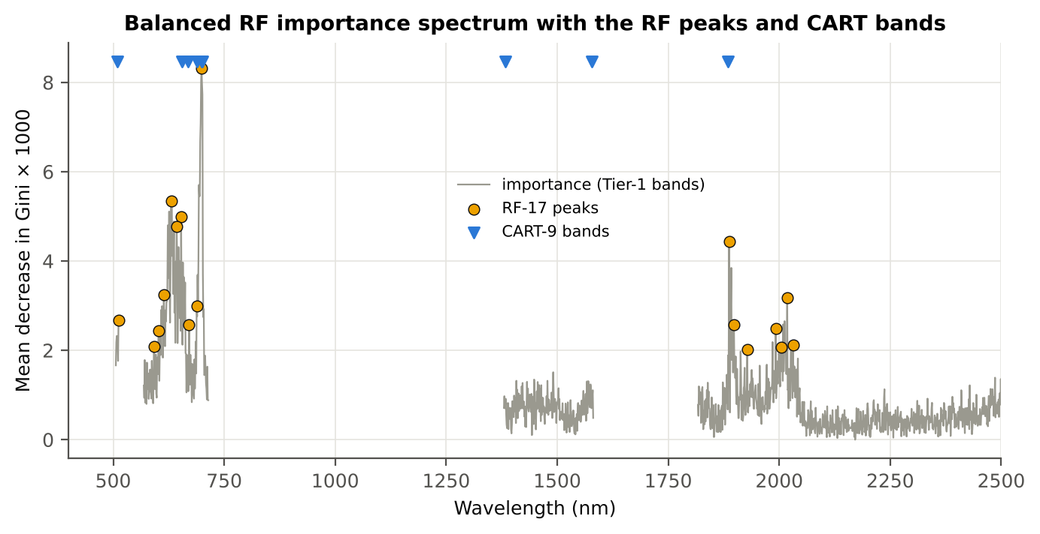
Tier 2 · Random Forest importance: the RF-17 bands
RF-17 (highest importance peaks ≥ 10 nm apart): 699, 632, 653, 643, 1887, 614, 2018, 688, 512, 1898, 671, 1992, 602, 2031, 592, 2005, 1928 nm.
Balanced Random Forest: 1000 trees, each grown on a bootstrap sample with equal numbers of healthy and diseased spectra; importance = mean decrease in Gini impurity.

Slide 14
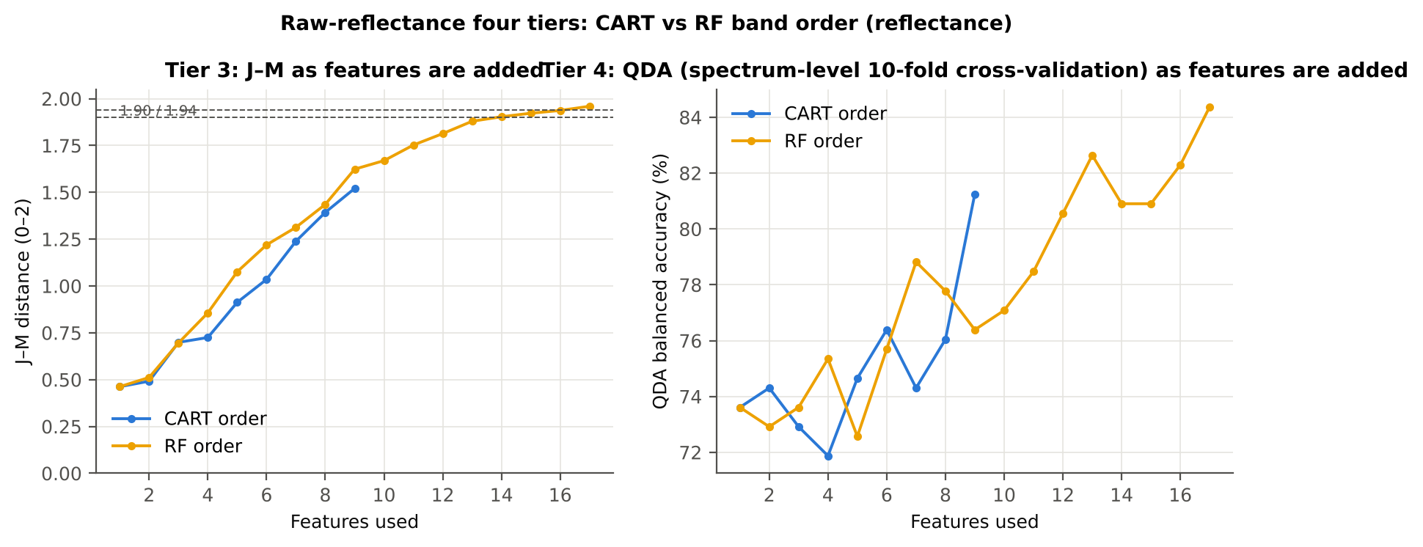
Tier 3 · Jeffries–Matusita separability
Set | Features | JM
CART-9 | 9 | 1.521
CART-1 (1-SE) | 1 | 0.462
RF-17 | 17 | 1.960
RF-10 | 10 | 1.669
RF-9 (size-matched) | 9 | 1.624
J–M (0–2) on the CART bands = 1.521, on the RF-17 bands = 1.960; the classes count as separable at ≥ 1.90 (Das et al. used 1.94).

Slide 15
Tier 4 · QDA with equal priors
CART bands (CART-9)
Random Forest bands (RF-17)
Classified \ Reference | Healthy | Diseased | User's accuracy
Healthy | 41 | 33 | 55.4 %
Diseased | 7 | 111 | 94.1 %
Producer's accuracy | 85.4 % | 77.1 % | BA 81.3 % · κ 0.529
Classified \ Reference | Healthy | Diseased | User's accuracy
Healthy | 37 | 12 | 75.5 %
Diseased | 11 | 132 | 92.3 %
Producer's accuracy | 77.1 % | 91.7 % | BA 84.4 % · κ 0.683
Spectrum-level 10-fold cross-validation (protocol of Das et al.). Error matrix layout of Das et al. (2020, Table 2): rows = classified, columns = reference. Producer's accuracy = recall of a class; user's accuracy = precision. Balanced accuracy and κ correct for the class imbalance.

Slide 16
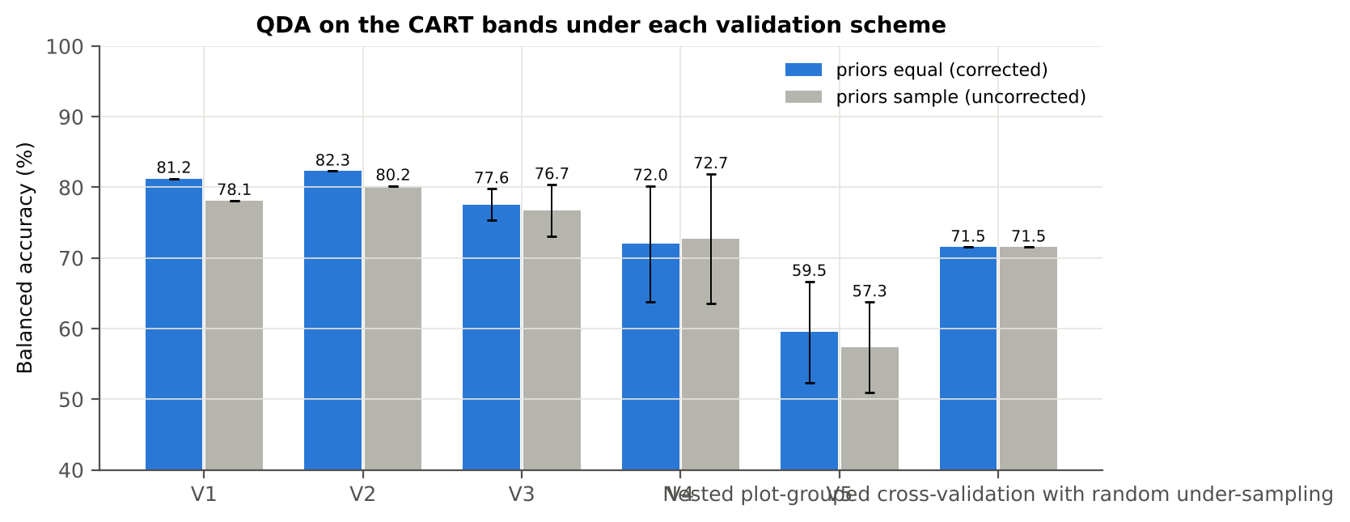
Validation of the raw-reflectance pipelines
Pipeline | Spectrum-level 10-fold | Nested plot-grouped | 30 % plot hold-out | Leave-one-date-out
CART classifier | 63.9 % | 64.6 % | 64.0 % | 53.6 %
Random Forest classifier | 76.0 % | 75.6 % | 73.0 % | 55.5 %
QDA on CART bands | 81.3 % | 77.6 % | 72.0 % | 59.5 %
QDA on Random Forest bands | 84.4 % | 86.8 % | 79.7 % | 51.8 %
Balanced accuracy. Spectrum-level 10-fold reproduces the paper; nested plot-grouped and 30 % plot hold-out are honest estimates for new plots; leave-one-date-out tests transfer to an unseen date.

Slide 17
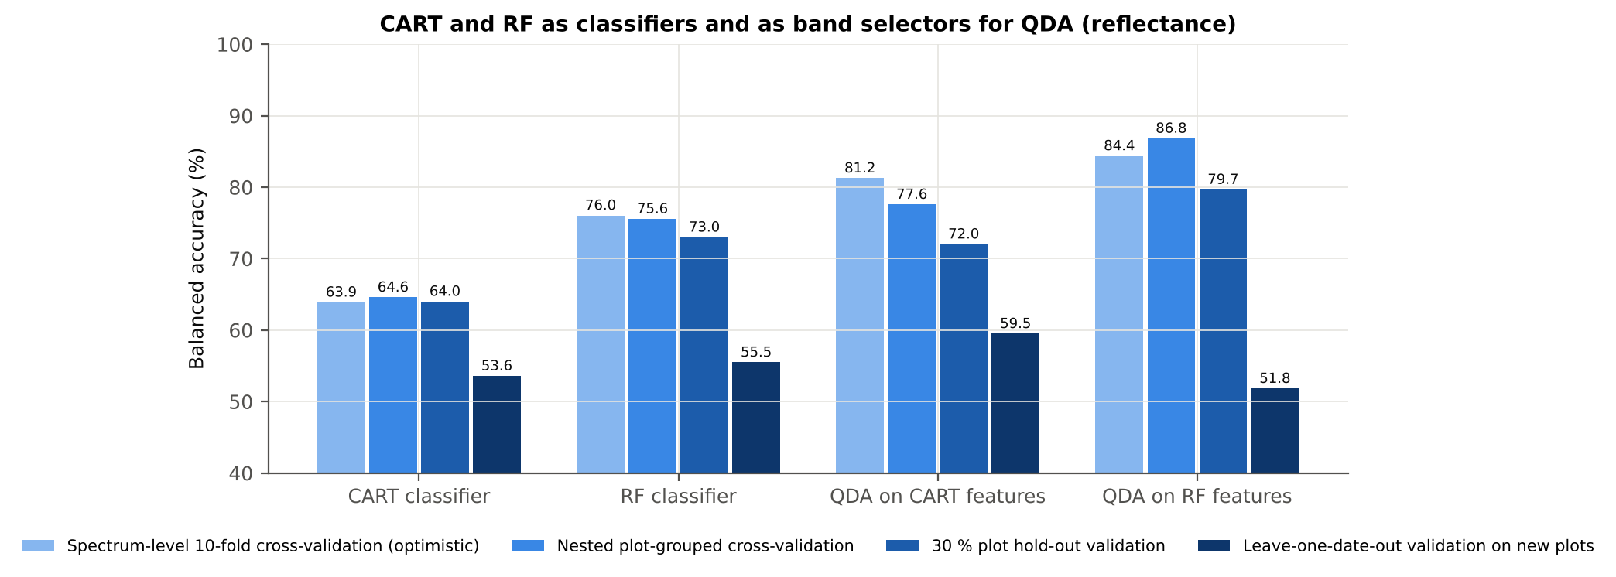
CART versus Random Forest on raw reflectance
Comparison | Validation | Mean difference | Wilcoxon p
RF classifier − CART classifier | Nested plot-grouped cross-validation (folds) | +11.6 pts | 6.9e-07
RF classifier − CART classifier | 30 % plot hold-out validation (splits) | +9.0 pts | 0.004
QDA on RF features − QDA on CART features | Nested plot-grouped cross-validation (folds) | +9.8 pts | 7.5e-06
QDA on RF features − QDA on CART features | 30 % plot hold-out validation (splits) | +7.6 pts | 0.186
QDA on CART features − CART classifier | Nested plot-grouped cross-validation (folds) | +13.7 pts | 3.5e-07
QDA on CART features − CART classifier | 30 % plot hold-out validation (splits) | +8.0 pts | 0.004

Slide 18
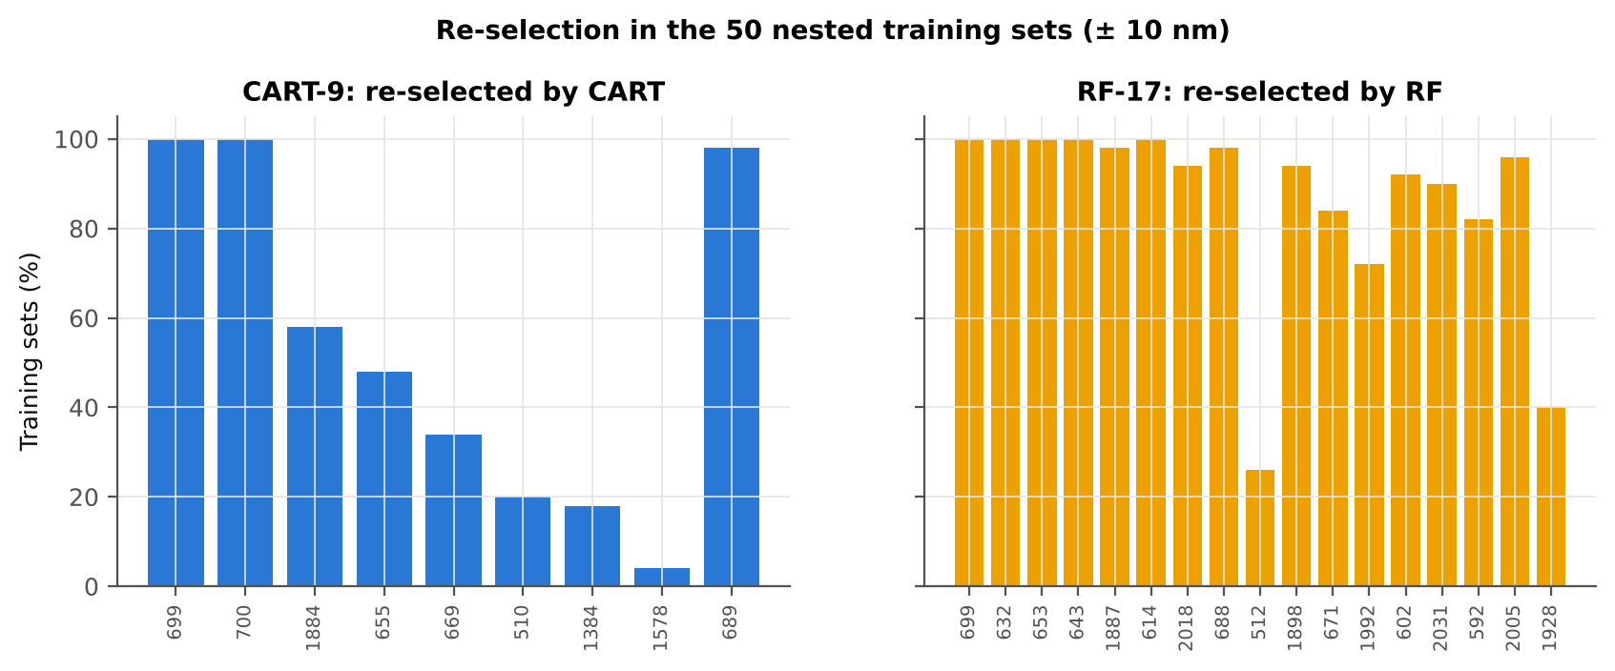
Stability of the selected bands
Method | Mean features | Unique features (union) | Mean pairwise Jaccard (±10 nm)
CART | 7.3 | 145 | 0.268
RF | 17.0 | 327 | 0.670

Slide 19
Step 2 · Disease-sensitive features from raw reflectance
Band reflectance · continuum-removal parameters · vegetation indices · optimised two-band index · first/second/third derivatives · red-edge parameters · correlation spectra

Slide 20
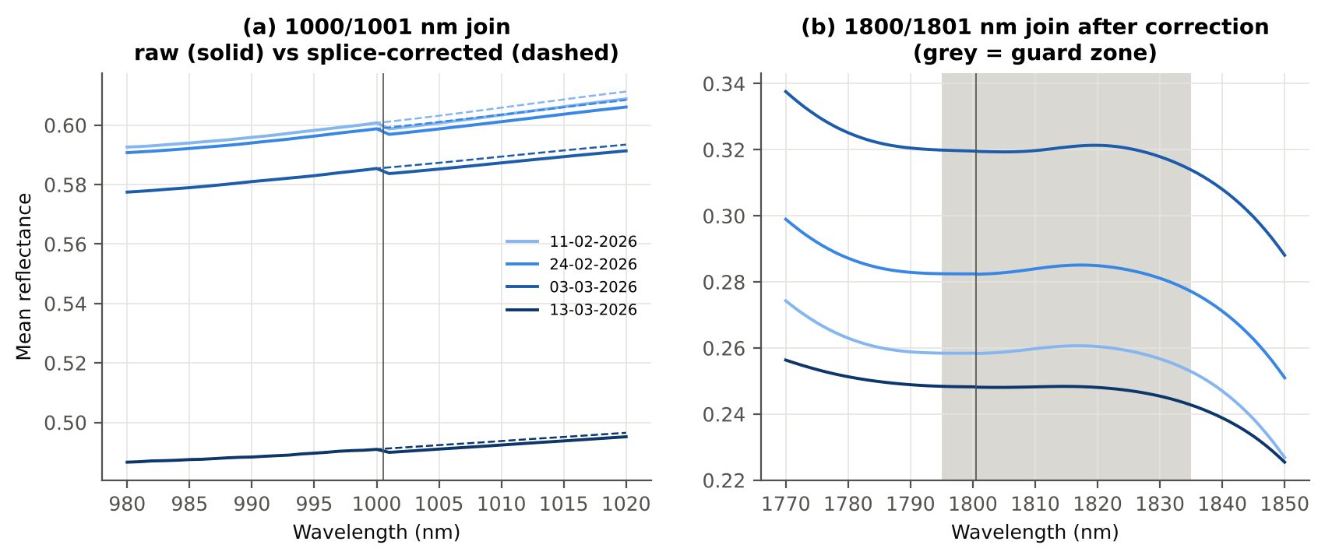
Detector joins and noise (information only)
All features are computed from the raw plot-average reflectance, as requested: no splice correction, no smoothing.
Derivatives: central finite differences on the 1-nm grid (first, second and third order).
Bands beside the detector joins (990–1010 and 1795–1835 nm) carry an instrument step and are excluded from the reflectance and derivative feature sets.

Slide 21
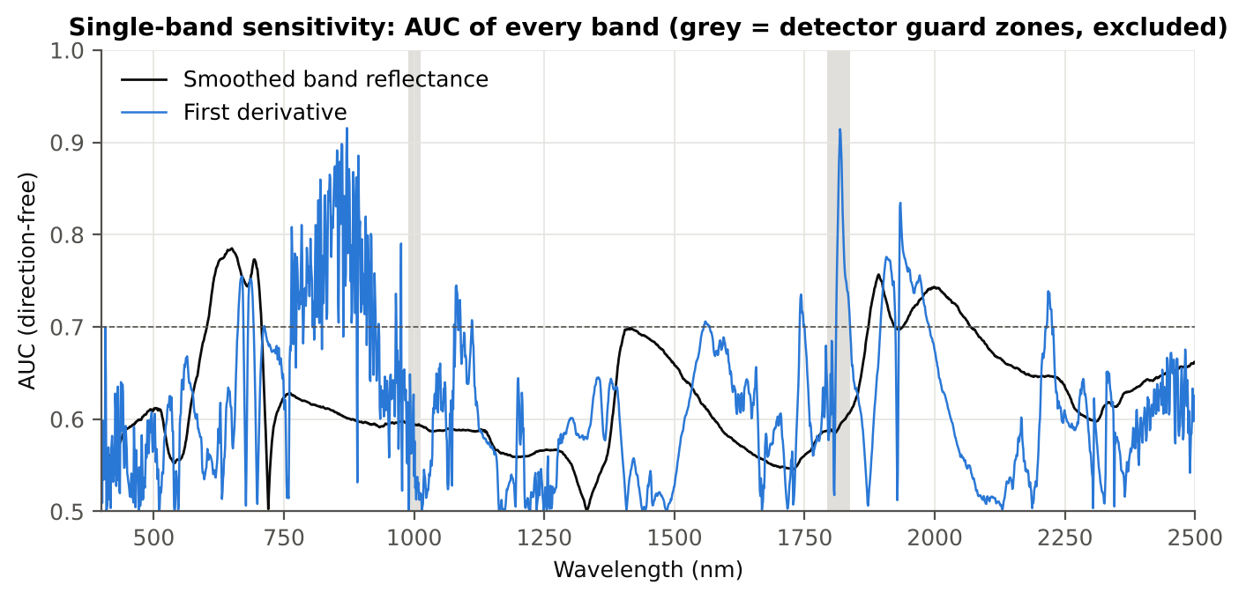
Band reflectance and derivatives: AUC of every band
Region | Wavelength (nm) | AUC | Direction
400–499 | 494 | 0.611 | D > H
500–599 | 599 | 0.693 | D > H
600–679 | 650 | 0.785 | D > H
680–759 | 693 | 0.773 | D > H
760–1349 | 761 | 0.628 | D < H
1350–1430 | 1415 | 0.699 | D > H
1431–1799 | 1431 | 0.693 | D > H
1800–1950 | 1892 | 0.757 | D > H
1951–2349 | 1998 | 0.743 | D > H
2350–2500 | 2498 | 0.662 | D > H

Slide 22
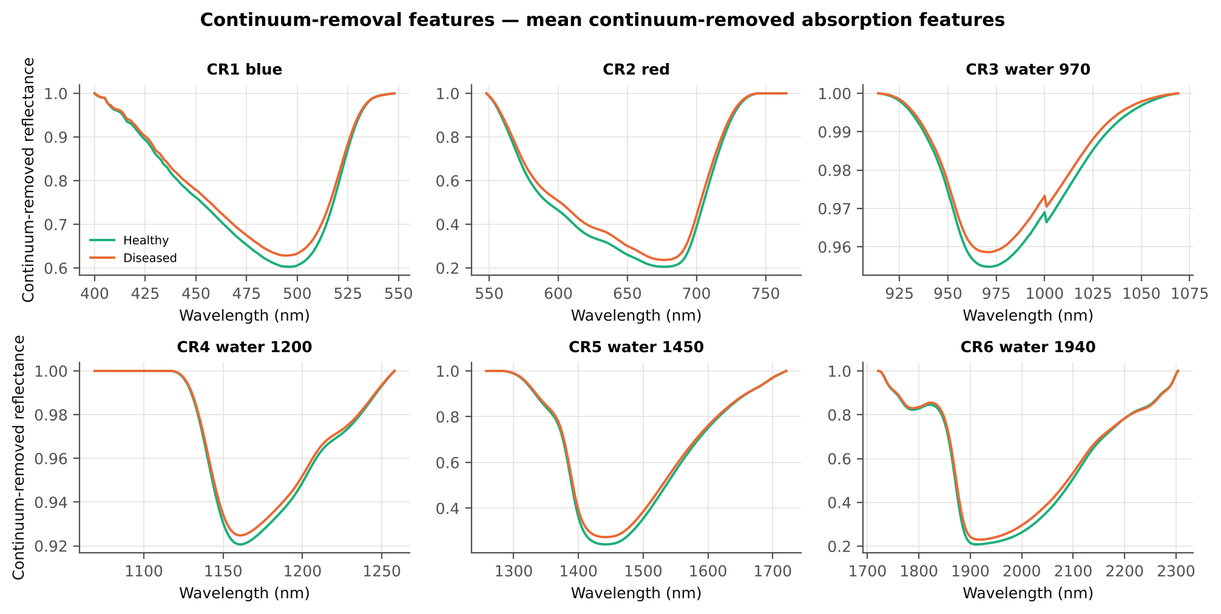
Continuum-removal parameters
name | AUC | Direction | BA plot-grouped cross-validation
CR3 water 970 depth/area | 0.792 | D > H | 78.1 %
CR3 water 970 width | 0.757 | D < H | 74.0 %
CR6 water 1940 position | 0.743 | D > H | 70.4 %
CR2 red right area | 0.736 | D < H | 70.0 %
CR6 water 1940 symmetry | 0.718 | D > H | 71.9 %
CR2 red area | 0.716 | D < H | 69.0 %
CR2 red depth/area | 0.710 | D > H | 68.7 %
CR2 red width | 0.696 | D < H | 69.8 %

Slide 23
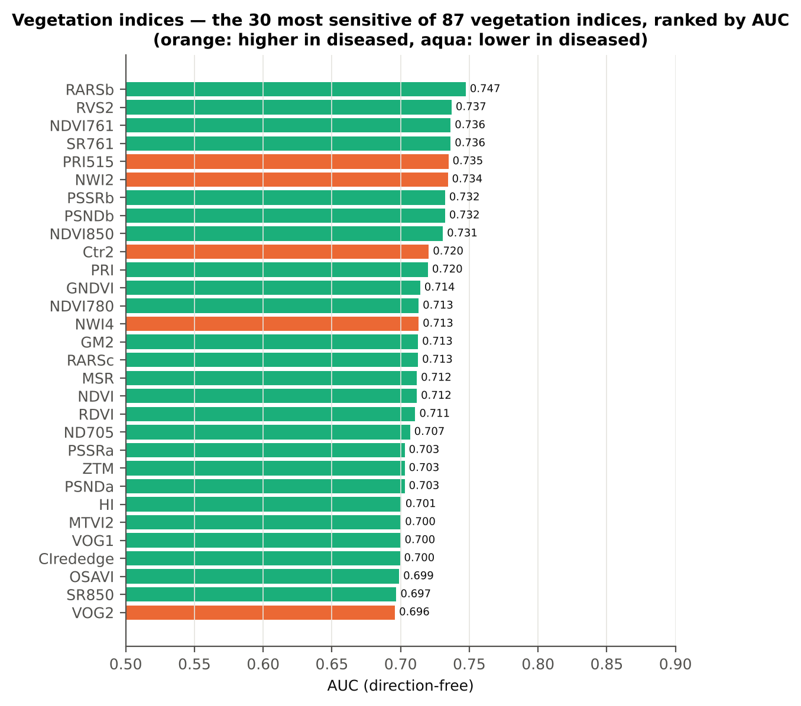
Vegetation indices — 87 indices
name | AUC | Direction | BA plot-grouped cross-validation
RARSb | 0.747 | D < H | 71.3 %
RVS2 | 0.737 | D < H | 64.2 %
NDVI761 | 0.736 | D < H | 64.0 %
SR761 | 0.736 | D < H | 64.0 %
PRI515 | 0.735 | D > H | 61.5 %
NWI2 | 0.734 | D > H | 71.1 %
PSSRb | 0.732 | D < H | 70.8 %
PSNDb | 0.732 | D < H | 70.8 %
NDVI850 | 0.731 | D < H | 68.0 %
Ctr2 | 0.720 | D > H | 64.3 %
31 indices of the flowering-stage workbook (Activity 1.4 table) + further pigment, red-edge, water and disease indices; AUC is direction-free (0.5 = no separation).

Slide 24
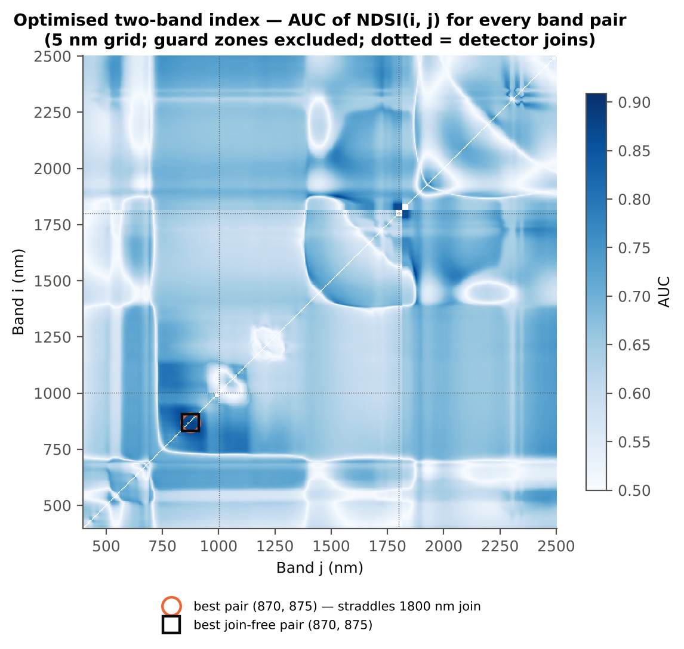
Optimised two-band index
name | AUC | BA plot-grouped cross-validation
NDSI(870,872) | 0.916 | 86.2 %
DI(870,872) | 0.916 | 81.8 %
Every band pair searched (5-nm grid, refined at 1 nm), pairs straddling a detector join excluded. Honest balanced accuracy with the pair searched inside training plots only: 78.5 % (cross-validation).

Slide 25
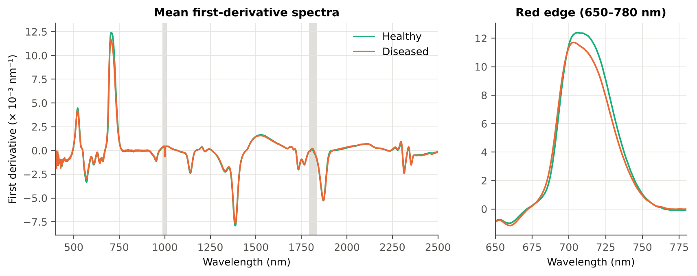
First-, second- and third-derivative spectra
Derivative | Significant (FDR) | Best AUC outside guard | at (nm)
First derivative (central difference of raw reflectance) | 677 | 0.916 | 871
Second derivative (central difference of raw reflectance) | 488 | 0.829 | 741
Third derivative (central difference of raw reflectance) | 375 | 0.832 | 738

Slide 26
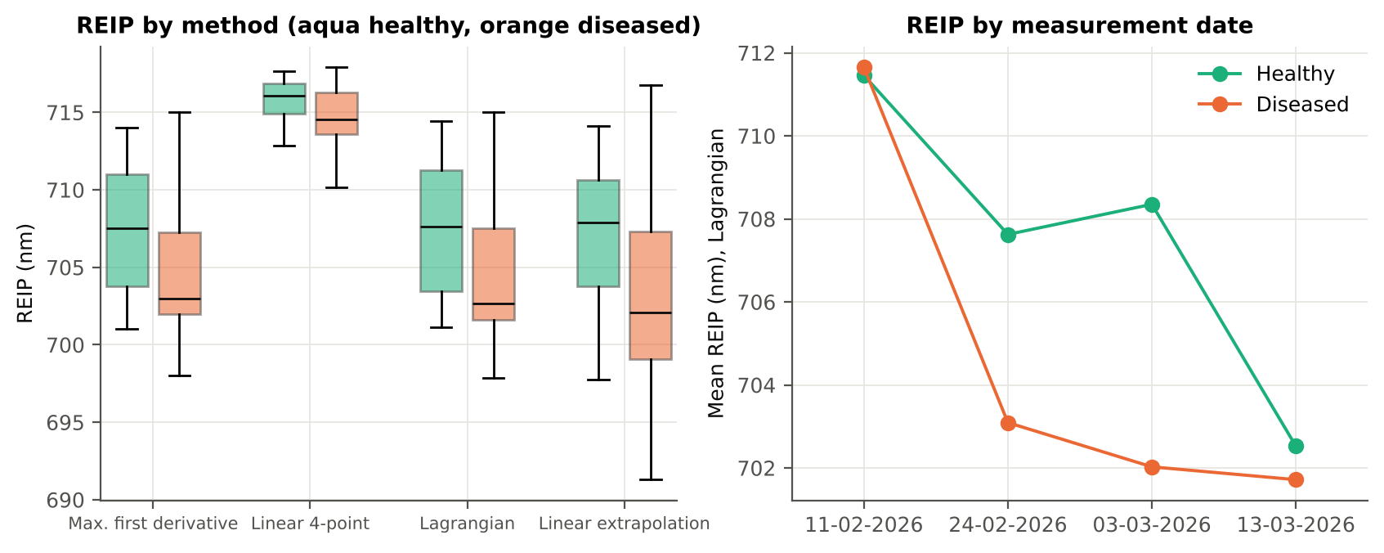
Red-edge parameters and the red-edge inflection point
name | AUC | Direction
Ro (red well reflectance) | 0.752 | D > H
REIP, Lagrangian interpolation (nm) | 0.702 | D < H
REIP, linear extrapolation (nm) | 0.700 | D < H
λr = REP (red-edge position, nm) | 0.696 | D < H
REP, linear 4-point (nm) | 0.690 | D < H
Red-edge slope (R750 − R700)/50 | 0.690 | D < H
λo (red well position, nm) | 0.675 | D > H
SDr (red-edge area) | 0.670 | D < H
SDy (yellow-edge area) | 0.642 | D > H
Dr = REV (red-edge amplitude) | 0.638 | D < H
Dy (yellow-edge amplitude) | 0.636 | D > H
Rg/Ro | 0.626 | D < H

Slide 27
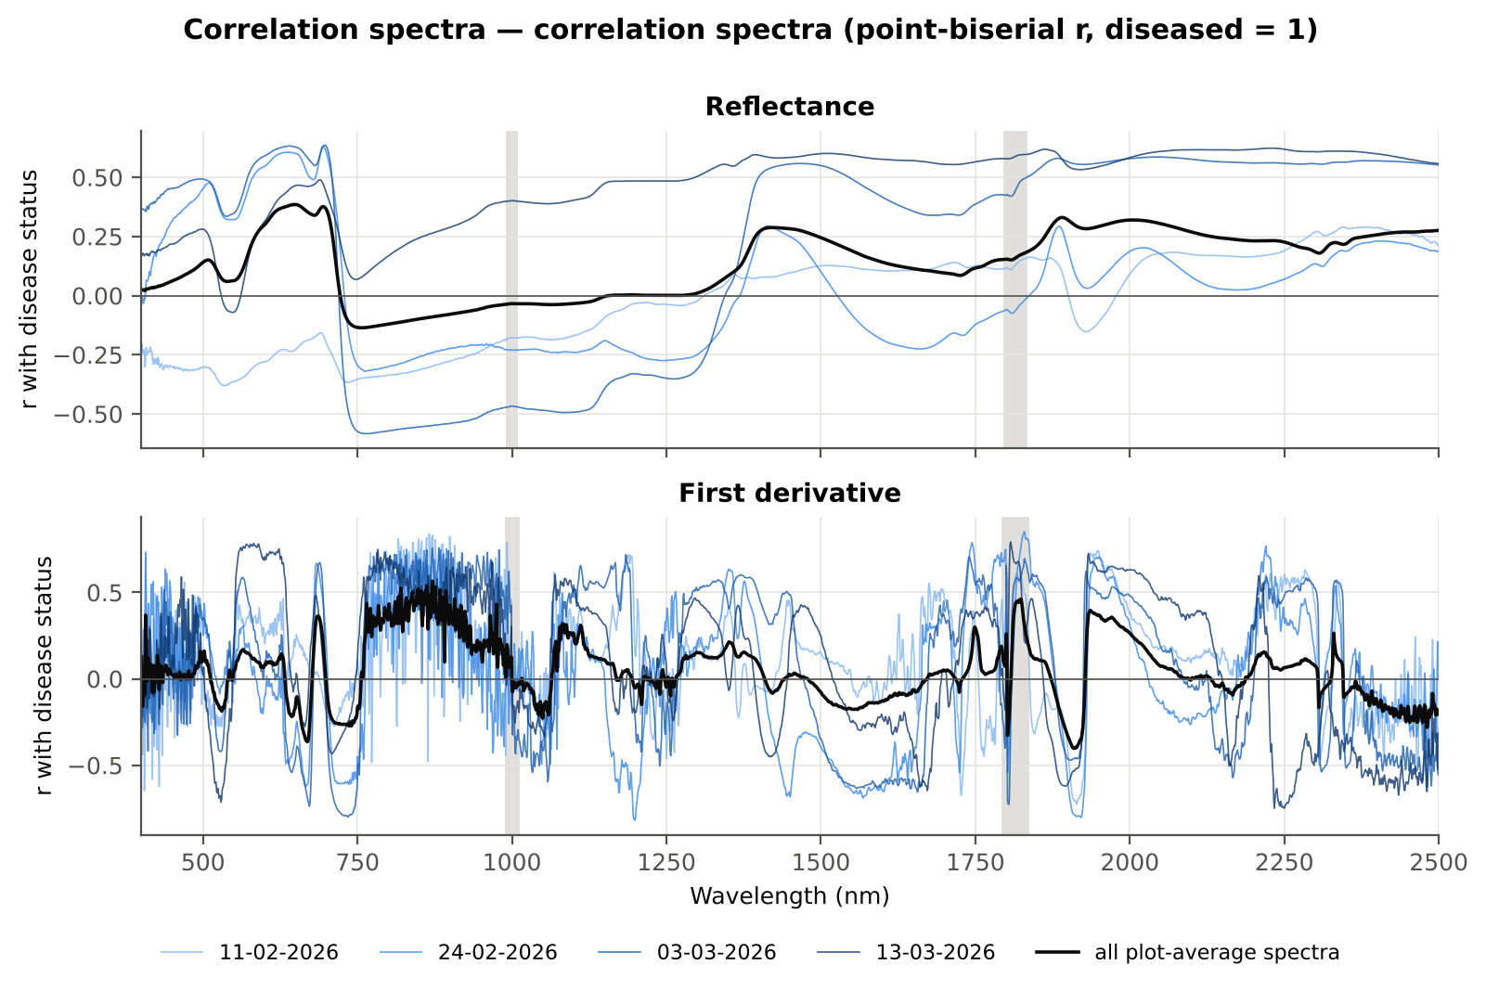
Correlation spectra with disease status
Spectrum | Region (nm) | Band of max |r| | r
Reflectance | 400–499 | 499 | +0.139
Reflectance | 500–599 | 599 | +0.298
Reflectance | 600–679 | 648 | +0.385
Reflectance | 680–759 | 695 | +0.376
Reflectance | 760–1349 | 760 | -0.136
Reflectance | 1350–1430 | 1421 | +0.288
Reflectance | 1431–1799 | 1431 | +0.287
Reflectance | 1800–1950 | 1890 | +0.330
Reflectance | 1951–2349 | 2005 | +0.320

Slide 28
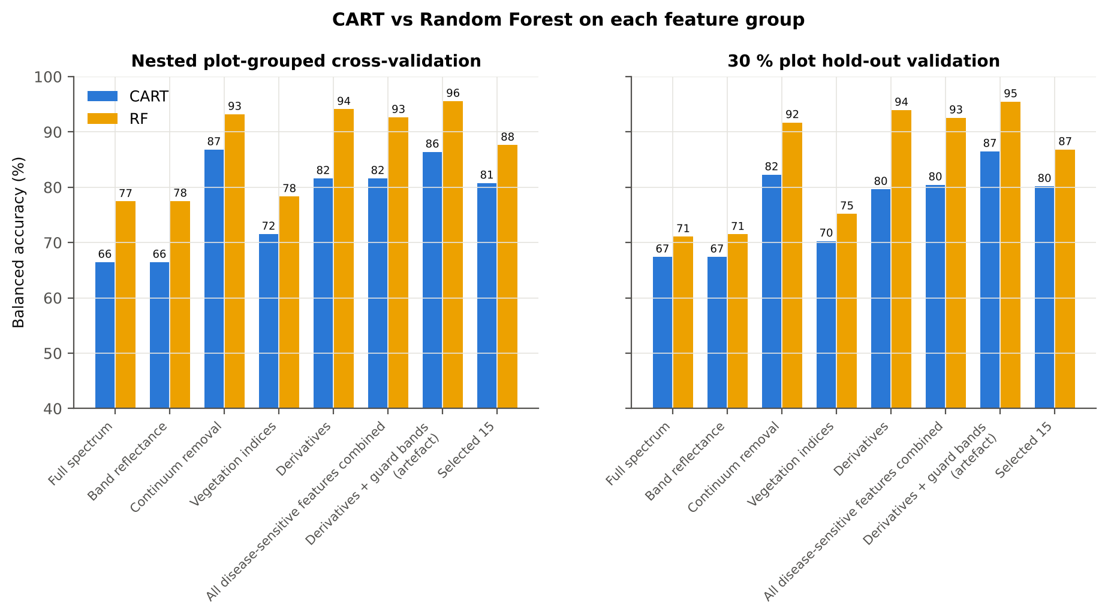
CART versus Random Forest on each feature group
Feature group | Features | CART cross-validation | RF cross-validation
Full spectrum (raw reflectance) | 2101 | 66.5 % | 77.4 %
Band reflectance | 2039 | 66.5 % | 77.5 %
Continuum-removal parameters | 48 | 86.8 % | 93.2 %
Vegetation indices | 87 | 71.5 % | 78.3 %
Derivatives + edge parameters | 6092 | 81.6 % | 94.1 %
All disease-sensitive features combined pool | 8266 | 81.6 % | 92.6 %
Derivatives incl. guard-zone bands (artefact test) | 6326 | 86.4 % | 95.6 %
Selected (top 15 non-redundant, chosen inside each training set) | 15 | 80.8 % | 87.6 %

Slide 29
Step 3 · Four tiers on the combined feature pool
Raw reflectance + continuum removal + vegetation indices + derivatives + red-edge parameters (8264 features) → disease-specific features

Slide 30
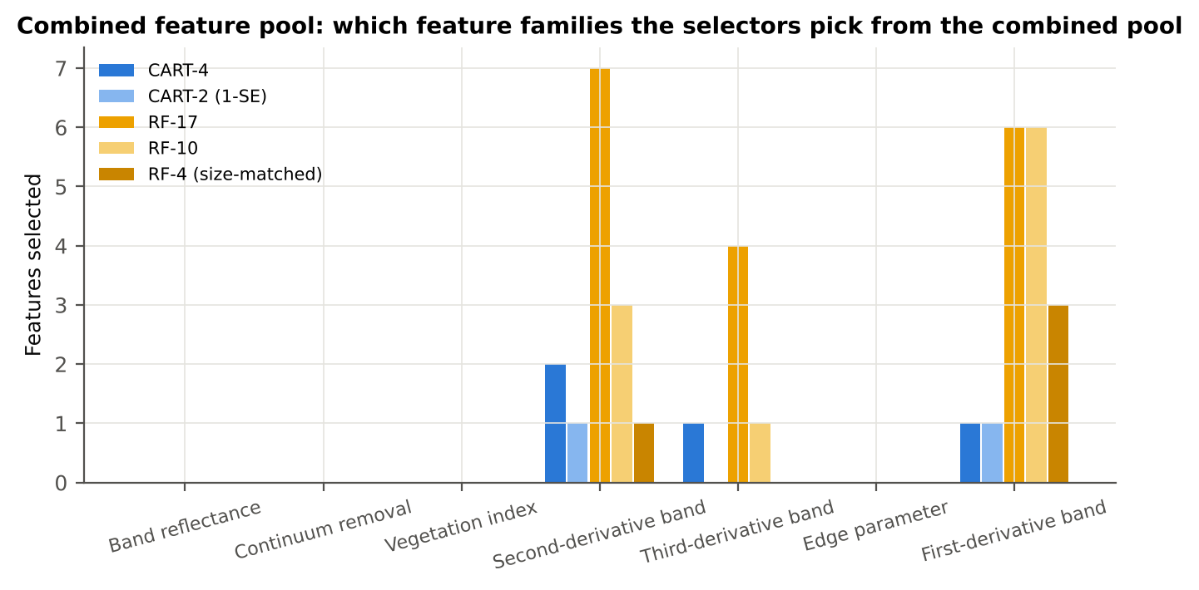
The combined feature pool
Feature type | Features | Tier-1 significant | CART-4 | CART-2 (1-SE) | RF-17 | RF-10 | RF-4 (size-matched)
Band reflectance | 2039 | 1000 | 0 | 0 | 0 | 0 | 0
Continuum removal | 48 | 25 | 0 | 0 | 0 | 0 | 0
Vegetation index | 85 | 58 | 0 | 0 | 0 | 0 | 0
Second-derivative band | 2019 | 489 | 2 | 1 | 7 | 3 | 1
Third-derivative band | 2019 | 394 | 1 | 0 | 4 | 1 | 0
Edge parameter | 23 | 12 | 0 | 0 | 0 | 0 | 0
First-derivative band | 2031 | 638 | 1 | 1 | 6 | 6 | 3
8266 features from the raw plot-average reflectance; 8264 after removing exact duplicates; Tier 1 (Welch + FDR): 2616 significant.
Columns 4–8: number of features of each type in the CART and Random Forest sets.

Slide 31
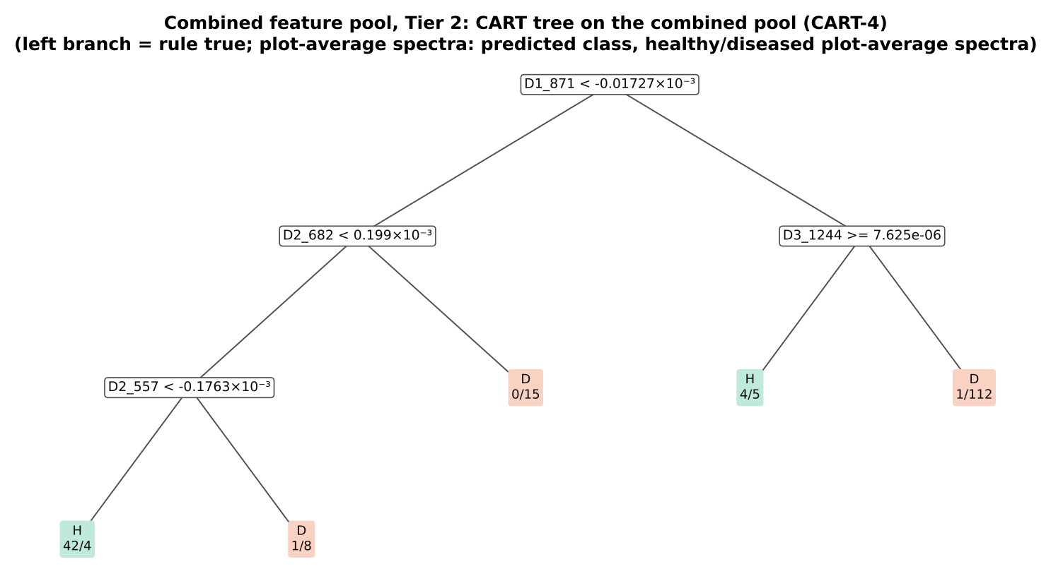
Tier 2 · CART (CART-4) and Random Forest (RF-17) features
CART (CART-4): first derivative 871 nm; second derivative 682 nm; third derivative 1244 nm; second derivative 557 nm.
Random Forest (RF-17): first derivative 871 nm; first derivative 852 nm; second derivative 737 nm; first derivative 893 nm; second derivative 682 nm; third derivative 738 nm; first derivative 839 nm; first derivative 784 nm; second derivative 1240 nm; first derivative 820 nm; third derivative 1240 nm; second derivative 934 nm; second derivative 889 nm; third derivative 888 nm; second derivative 1720 nm; third derivative 1077 nm; second derivative 1918 nm.

Slide 32
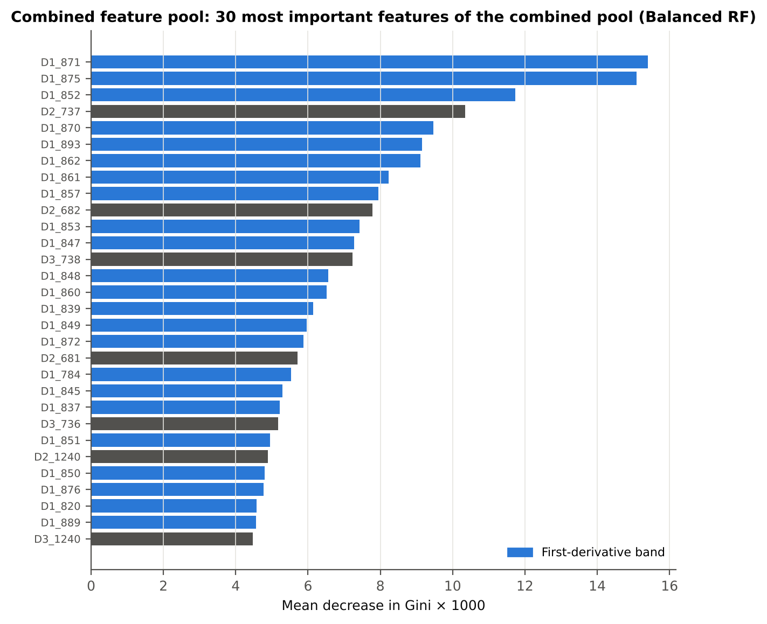
Tier 2 · Random Forest importance in the combined pool

Slide 33
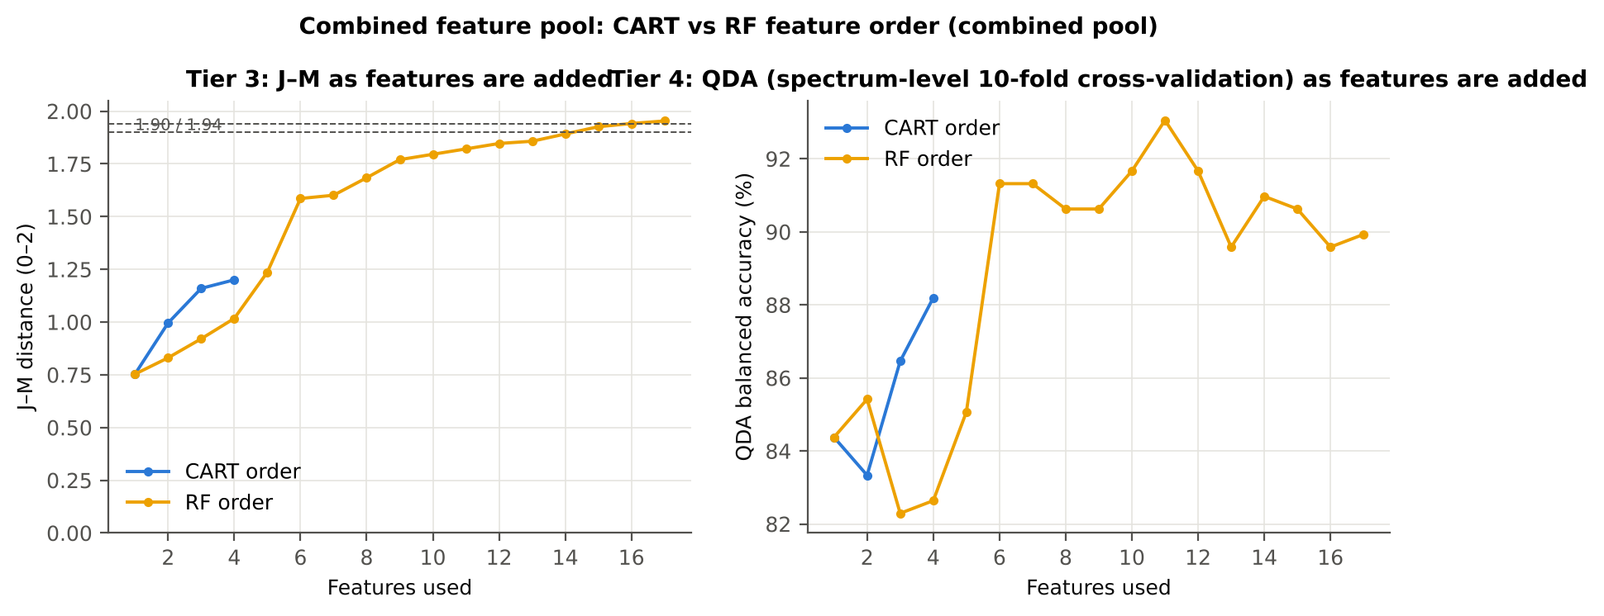
Tiers 3 and 4 · separability and QDA on the selected features
Set | Features | JM
CART-4 | 4 | 1.200
CART-2 (1-SE) | 2 | 0.996
RF-17 | 17 | 1.954
RF-10 | 10 | 1.796
RF-4 (size-matched) | 4 | 1.017
QDA on RF-17 features (spectrum-level 10-fold)
Classified \ Reference | Healthy | Diseased | User's accuracy
Healthy | 40 | 5 | 88.9 %
Diseased | 8 | 139 | 94.6 %
Producer's accuracy | 83.3 % | 96.5 % | BA 89.9 % · κ 0.816
J–M on the CART features = 1.200, on the RF-17 features = 1.954.

Slide 34
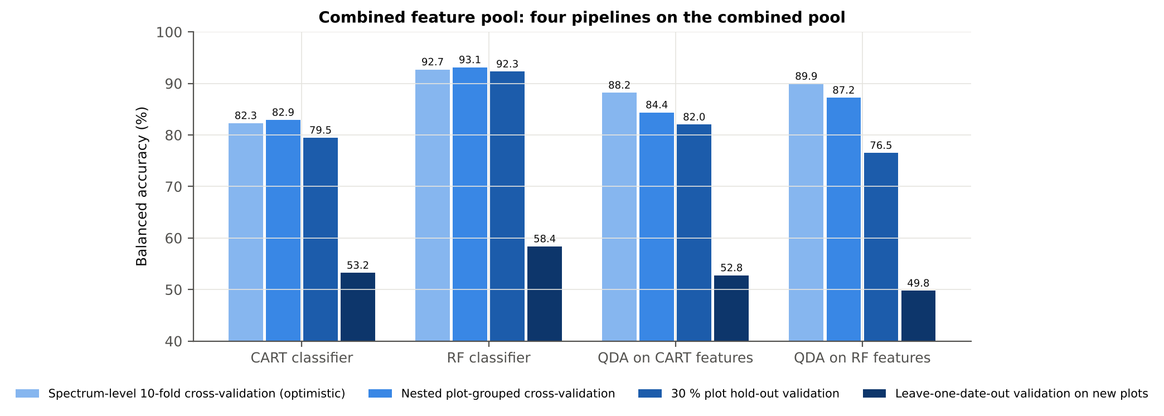
Validation of the combined-pool pipelines
Pipeline | Spectrum-level 10-fold | Nested plot-grouped | 30 % plot hold-out | Leave-one-date-out
CART classifier | 82.3 % | 82.9 % | 79.5 % | 53.2 %
Random Forest classifier | 92.7 % | 93.1 % | 92.3 % | 58.4 %
QDA on CART bands | 88.2 % | 84.4 % | 82.0 % | 52.8 %
QDA on Random Forest bands | 89.9 % | 87.2 % | 76.5 % | 49.8 %
Nested plot-grouped cross-validation: raw reflectance, QDA on CART bands 77.6 % → combined pool, QDA on RF-17 features 87.2 %; Random Forest classifier 75.6 % → 93.1 %.

Slide 35
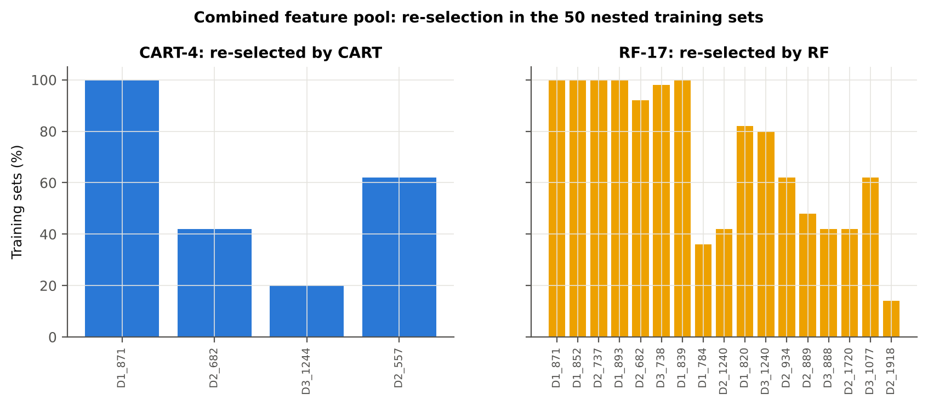
Stability of the selected pool features
Method | Mean features | Unique features (union) | Mean pairwise Jaccard (±10 nm)
CART | 3.9 | 29 | 0.350
RF | 17.0 | 125 | 0.562
Selector | Feature type | Share
CART | First-derivative band | 46.9 %
CART | Second-derivative band | 38.3 %
CART | Third-derivative band | 13.8 %
CART | Continuum removal | 1.0 %
RF | First-derivative band | 45.5 %
RF | Second-derivative band | 27.5 %
RF | Third-derivative band | 22.7 %
RF | Continuum removal | 2.8 %
RF | Band reflectance | 1.2 %
RF | Vegetation index | 0.2 %

Slide 36
Disease-specific features: diseased vs healthy plots
Feature | Type | Selected by | Mean healthy | Mean diseased | Direction | AUC | q (FDR) | Re-selected CART / RF
First derivative at 871 nm | First derivative | CART + Random Forest | -4.8e-05 | 1.6e-05 | D > H | 0.916 | 1.4e-20 | 100 % / 100 %
First derivative at 852 nm | First derivative | Random Forest | -5.6e-05 | 1.5e-05 | D > H | 0.891 | 4.1e-18 | 10 % / 100 %
Second derivative at 737 nm | Second derivative | Random Forest | -3.4e-04 | -2.5e-04 | D > H | 0.806 | 3.4e-08 | 0 % / 100 %
First derivative at 893 nm | First derivative | Random Forest | -5.5e-05 | 4.5e-06 | D > H | 0.886 | 1.0e-17 | 0 % / 100 %
Second derivative at 682 nm | Second derivative | CART + Random Forest | 1.3e-04 | 2.1e-04 | D > H | 0.806 | 1.5e-14 | 42 % / 92 %
Third derivative at 738 nm | Third derivative | Random Forest | 2.3e-05 | -1.2e-05 | D < H | 0.832 | 3.8e-13 | 0 % / 98 %
First derivative at 839 nm | First derivative | Random Forest | -3.4e-05 | 3.3e-05 | D > H | 0.860 | 1.6e-14 | 10 % / 100 %
First derivative at 784 nm | First derivative | Random Forest | -7.1e-05 | 2.1e-05 | D > H | 0.810 | 4.0e-09 | 0 % / 36 %
Second derivative at 1240 nm | Second derivative | Random Forest | -7.9e-06 | 1.5e-06 | D > H | 0.762 | 1.5e-09 | 22 % / 42 %
First derivative at 820 nm | First derivative | Random Forest | -7.9e-05 | -3.6e-06 | D > H | 0.860 | 5.1e-14 | 0 % / 82 %
Third derivative at 1240 nm | Third derivative | Random Forest | -7.2e-06 | -6.4e-07 | D > H | 0.814 | 2.4e-12 | 20 % / 80 %
Second derivative at 934 nm | Second derivative | Random Forest | 8.4e-06 | -4.5e-05 | D < H | 0.763 | 2.6e-08 | 0 % / 62 %
Second derivative at 889 nm | Second derivative | Random Forest | 3.6e-05 | -1.3e-05 | D < H | 0.745 | 6.5e-09 | 0 % / 48 %
Third derivative at 888 nm | Third derivative | Random Forest | 2.6e-05 | -7.1e-06 | D < H | 0.723 | 2.3e-06 | 4 % / 42 %
Second derivative at 1720 nm | Second derivative | Random Forest | -3.1e-05 | -4.0e-05 | D < H | 0.657 | 1.4e-03 | 0 % / 42 %
Third derivative at 1077 nm | Third derivative | Random Forest | 8.7e-07 | -8.8e-06 | D < H | 0.723 | 1.1e-09 | 8 % / 62 %
Second derivative at 1918 nm | Second derivative | Random Forest | 4.4e-06 | 1.3e-05 | D > H | 0.815 | 2.2e-10 | 2 % / 14 %
Third derivative at 1244 nm | Third derivative | CART | 1.5e-06 | -1.2e-06 | D < H | 0.645 | 2.0e-02 | 20 % / 80 %
Second derivative at 557 nm | Second derivative | CART | -2.2e-04 | -1.9e-04 | D > H | 0.721 | 1.3e-05 | 62 % / 4 %
Features of the combined pool chosen by CART and by Random Forest (highest importance peaks) on all 192 plot-average spectra; AUC is direction-free; re-selected = share of the 50 nested cross-validation training sets in which a feature within ±10 nm (same type) was selected again.

Slide 37
Synthesis
All approaches side by side · transfer to an unseen date · conclusions

Slide 38
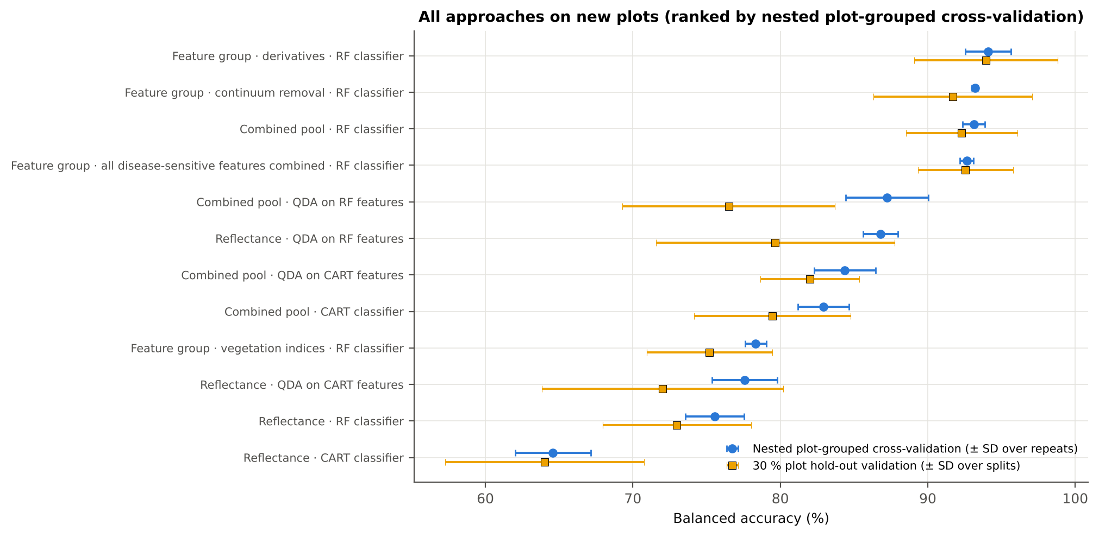
All approaches on new plots

Slide 39
All approaches · balanced accuracy table
Approach | Nested plot-grouped | 30 % plot hold-out | Leave-one-date-out
Feature group · derivatives incl. guard bands (artefact): RF | 95.6 % | 95.5 % | –
Feature group · derivatives + edge: RF | 94.1 % | 93.9 % | –
Feature group · continuum removal: RF | 93.2 % | 91.7 % | –
Combined feature pool · four tiers: RF classifier (Balanced RF) | 93.1 % | 92.3 % | 58.4 %
Feature group · all disease-sensitive features combined: RF | 92.6 % | 92.6 % | –
Feature group · selected 15: QDA | 88.7 % | 85.1 % | –
Feature group · selected 15: RF | 87.6 % | 86.8 % | –
Combined feature pool · four tiers: QDA on RF-17 (RF-selected) | 87.2 % | 76.5 % | 49.8 %
Feature group · continuum removal: CART | 86.8 % | 82.3 % | –
Raw reflectance · four tiers: QDA on RF-17 (RF-selected) | 86.8 % | 79.7 % | 51.8 %
Feature group · derivatives incl. guard bands (artefact): CART | 86.4 % | 86.5 % | –
Combined feature pool · four tiers: QDA on CART-4 (CART-selected) | 84.4 % | 82.0 % | 52.8 %
Combined feature pool · four tiers: CART classifier (rpart) | 82.9 % | 79.5 % | 53.2 %
Feature group · all disease-sensitive features combined: CART | 81.6 % | 80.5 % | –

Slide 40
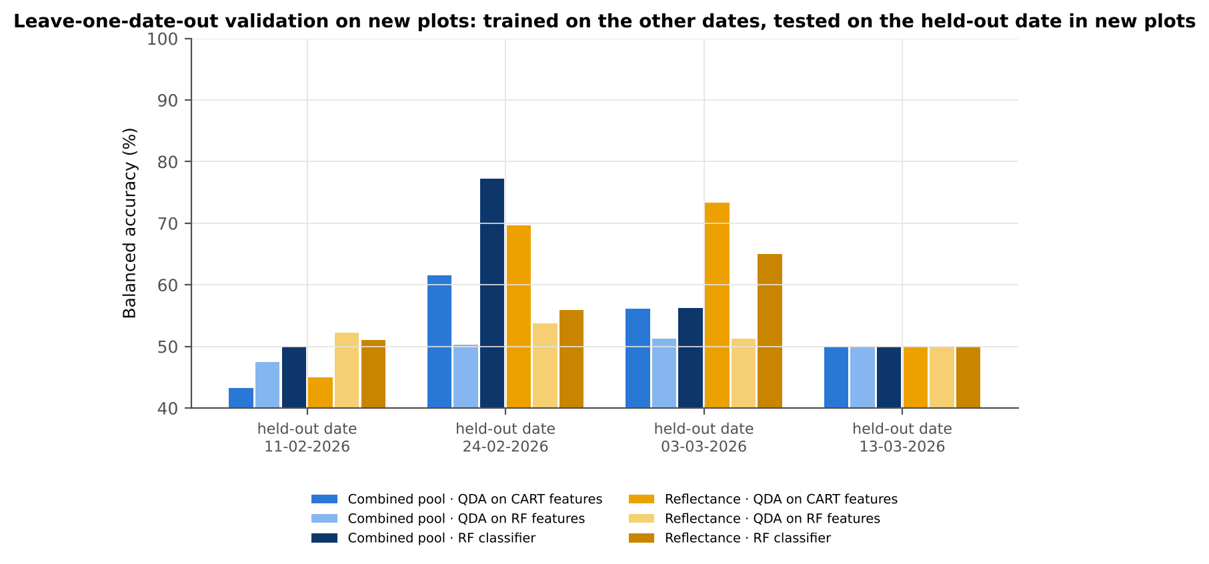
Transfer to an unseen date
Feature set · pipeline | 11-02-2026 | 24-02-2026 | 03-03-2026 | 13-03-2026
Reflectance · CART classifier | 48.8 % | 53.2 % | 61.3 % | 51.1 %
Reflectance · RF classifier | 51.0 % | 55.9 % | 65.0 % | 50.0 %
Reflectance · QDA on CART features | 45.0 % | 69.7 % | 73.3 % | 50.0 %
Reflectance · QDA on RF features | 52.3 % | 53.8 % | 51.2 % | 50.0 %
Combined pool · CART classifier | 50.0 % | 55.5 % | 58.4 % | 49.1 %
Combined pool · RF classifier | 50.0 % | 77.3 % | 56.2 % | 50.0 %
Combined pool · QDA on CART features | 43.3 % | 61.6 % | 56.1 % | 50.0 %
Combined pool · QDA on RF features | 47.5 % | 50.3 % | 51.2 % | 50.0 %
Balanced accuracy on each held-out date: trained on the other three dates (training plots of a hold-out split), tested on the held-out date (test plots of the split). the last date, 13-03-2026, is predicted at chance level by every pipeline.

Slide 41
Conclusions
Tier 1: healthy and white-rust plot-average spectra differ significantly at 1039 of 2101 bands (Welch + BH-FDR); 1014 bands remain significant with a random plot effect and 515 in ≥ 95 % of 1000 balanced subsets. The most sensitive single band (raw reflectance) reaches AUC 0.79 at 650 nm.
Tier 2: CART (rpart, prior 0.5/0.5) selected 9 bands (root 699 nm): 699, 700, 1884, 655, 669, 510, 1384, 1578, 689 nm. The Balanced RF importance peaks (RF-17) were 699, 632, 653, 643, 1887, 614, 2018, 688, 512, 1898, 671, 1992, 602, 2031, 592, 2005, 1928 nm.
Tier 3: J–M = 1.52 on the CART bands and 1.96 on the RF bands: only the RF bands reach the 1.90 separability threshold (and the 1.94 threshold of Das et al.).
Tier 4: QDA with equal priors on the CART bands gives BA 81.2 % in the paper's protocol (spectrum-level 10-fold cross-validation; healthy recall 85.4 %, diseased recall 77.1 %) and 77.6 % ± 2.2 % (nested plot-grouped cross-validation) / 72.0 % (30 % plot hold-out validation) on new plots.
CART vs RF: as classifiers RF beats CART by 11.6 points (nested plot-grouped cross-validation, RF better in 40 of 50 folds, p = 6.9e-07); as band selectors for QDA the RF bands give +9.8 points vs the CART bands (p = 7.5e-06). RF selection is more stable than CART selection (Jaccard ±10 nm 0.67 vs 0.27).
Disease-sensitive features: the strongest group for RF is derivatives + edge parameters (BA 94.1 %, nested plot-grouped cross-validation) vs 77.5 % for reflectance; best single features: first derivative at 871 nm (AUC 0.92), CR3 water 970 depth/area (AUC 0.79), RARSb (AUC 0.75), Ro (red well reflectance) (AUC 0.75). REIP (Lagrangian interpolation) shifts by -2.9 nm in diseased plot-average spectra (AUC 0.70).
Combined feature pool (four tiers on the combined band reflectance + continuum-removal features + vegetation indices + derivative and edge features pool, 8264 features, 2616 significant): CART chose 4 features, RF 17 (J–M 1.20 / 1.95); QDA on the RF features reaches 87.2 % (nested plot-grouped cross-validation) / 76.5 % (30 % plot hold-out validation), +0.4 points vs QDA on RF reflectance bands; best pipeline on the pool: RF classifier (93.1 %, nested plot-grouped cross-validation).
Transfer (leave-one-date-out validation on new plots): QDA on CART reflectance bands 59.5 %, QDA on combined-pool RF features 49.8 % — a clear drop from the nested plot-grouped cross-validation estimate (87.2 %); the date/stage effect limits transfer. Best pipeline under transfer: reflectance: QDA on CART features (59.5 %).

Slide 42
Recommendations and cross-checks
Use first-derivative and continuum-removed features rather than single reflectance bands for the plot-average data; the four-tier selection with RF importance on the combined pool and a QDA or RF classifier is the recommended pipeline.
Report balanced accuracy with both class recalls and the priors used; the classes are imbalanced (1 : 3.0) and equal priors / balanced sampling were applied throughout.
Base conclusions on the plot-grouped estimates (nested plot-grouped cross-validation 10-fold × 5 = 50 folds, 30 % plot hold-out validation 10 hold-outs), not on the spectrum-level 10-fold cross-validation estimate.
Interpret features near the ASD detector joins (≈ 1000 and 1800 nm) with care; guard zones were excluded from the rankings.
For application to a new date, the most robust pipeline here was reflectance: QDA on CART features (leave-one-date-out validation on new plots BA 59.5 %); accuracy on an unseen date is much lower than within the date, so calibrate with plot-average spectra of the target date or growth stage.
51
8
checks passed
flagged (limitations, reported)
0
Every step was verified by an independent implementation or recomputation (SciPy, statsmodels, R rpart/MASS/nlme/randomForest, Excel formulas); see the 33_Cross_Checks sheet of the workbook.
failed

Slide 43
Key references
Ambroise C, McLachlan GJ. 2002. Selection bias in gene extraction on the basis of microarray gene-expression data. Proceedings of the National Academy of Sciences 99:6562–6566.
Benjamini Y, Hochberg Y. 1995. Controlling the false discovery rate: a practical and powerful approach to multiple testing. Journal of the Royal Statistical Society B 57:289–300.
Bhattacharyya A. 1943. On a measure of divergence between two statistical populations defined by their probability distributions. Bulletin of the Calcutta Mathematical Society 35:99–109.
Breiman L, Friedman JH, Olshen RA, Stone CJ. 1984. Classification and regression trees. Belmont (CA): Wadsworth.
Breiman L. 2001. Random forests. Machine Learning 45:5–32.
Brodersen KH, Ong CS, Stephan KE, Buhmann JM. 2010. The balanced accuracy and its posterior distribution. Proceedings of the 20th International Conference on Pattern Recognition, 3121–3124.
Chen C, Liaw A, Breiman L. 2004. Using random forest to learn imbalanced data. Technical Report 666, Department of Statistics, University of California, Berkeley.
Cho MA, Skidmore AK. 2006. A new technique for extracting the red edge position from hyperspectral data: the linear extrapolation method. Remote Sensing of Environment 101:181–193.
Clark RN, Roush TL. 1984. Reflectance spectroscopy: quantitative analysis techniques for remote sensing applications. Journal of Geophysical Research 89(B7):6329–6340.
Das B, Sahoo RN, Biswas A, Pargal S, Krishna G, Verma R, Chinnusamy V, Sehgal VK, Gupta VK. 2020. Discrimination of rice genotypes using field spectroradiometry. Geocarto International 35(1):64–77. doi:10.1080/10106049.2018.1506507
Dawson TP, Curran PJ. 1998. A new technique for interpolating the reflectance red edge position. International Journal of Remote Sensing 19:2133–2139.
Gitelson, A.A., Merzlyak, M.N., 1996. Signature analysis of leaf reflectance spectra: algorithm development for remote sensing of chlorophyll. Journal of Plant Physiology 148, 494–500.
Gong P, Pu R, Heald RC. 2002. Analysis of in situ hyperspectral data for nutrient estimation of giant sequoia. International Journal of Remote Sensing 23:1827–1850.
Guyot G, Baret F. 1988. Utilisation de la haute résolution spectrale pour suivre l'état des couverts végétaux. Proceedings of the 4th International Colloquium on Spectral Signatures of Objects in Remote Sensing, ESA SP-287, 279–286.

Slide 44
Key references (continued)
Haboudane, D., Miller, J.R., Tremblay, N., Zarco-Tejada, P.J., Dextraze, L., 2002. Integrated narrow-band vegetation indices for prediction of crop chlorophyll content for application to precision agriculture. Remote Sensing of Environment 81, 416–426.
Horler DNH, Dockray M, Barber J. 1983. The red edge of plant leaf reflectance. International Journal of Remote Sensing 4:273–288.
Hurlbert SH. 1984. Pseudoreplication and the design of ecological field experiments. Ecological Monographs 54:187–211.
Kokaly RF, Clark RN. 1999. Spectroscopic determination of leaf biochemistry using band-depth analysis of absorption features and stepwise multiple linear regression. Remote Sensing of Environment 67:267–287.
Lemaître G, Nogueira F, Aridas CK. 2017. Imbalanced-learn: a Python toolbox to tackle the curse of imbalanced datasets in machine learning. Journal of Machine Learning Research 18(17):1–5.
Mahlein A-K, Rumpf T, Welke P, Dehne H-W, Plümer L, Steiner U, Oerke E-C. 2013. Development of spectral indices for detecting and identifying plant diseases. Remote Sensing of Environment 128:21–30.
Mahlein A-K. 2016. Plant disease detection by imaging sensors — parallels and specific demands for precision agriculture and plant phenotyping. Plant Disease 100:241–251.
Pinheiro J, Bates D, R Core Team. 2023. nlme: linear and nonlinear mixed effects models. R package.
Richards JA. 2013. Remote sensing digital image analysis. 5th ed. Berlin: Springer.
Saharan GS, Verma PR, Meena PD, Kumar A. 2014. White rust of crucifers: biology, ecology and management. New Delhi: Springer India.
Swain PH, Davis SM. 1978. Remote sensing: the quantitative approach. New York: McGraw-Hill.
Thenkabail, P.S., Smith, R.B., De Pauw, E., 2000. Hyperspectral vegetation indices and their relationships with agricultural crop characteristics. Remote Sensing of Environment 71, 158–182.
Therneau T, Atkinson B. 2023. rpart: recursive partitioning and regression trees. R package version 4.1.23.
Tsai, F., Philpot, W., 1998. Derivative analysis of hyperspectral data. Remote Sensing of Environment 66, 41–51.

Slide 45
Key references (continued)
Varma S, Simon R. 2006. Bias in error estimation when using cross-validation for model selection. BMC Bioinformatics 7:91.
Venables WN, Ripley BD. 2002. Modern applied statistics with S. 4th ed. New York: Springer.
Welch BL. 1947. The generalization of 'Student's' problem when several different population variances are involved. Biometrika 34:28–35.
Full list (100 references, including the source of every vegetation index) in the Word report.

