Slide 1
Healthy vs diseased plots from SMACC endmembers: four-tier analysis with imbalance handling
Four-tier method of Das et al. (2020): ANOVA → CART → J–M distance → QDA, with Random Forest in place of CART in Tier 2 for comparison
48 plots (1–12 healthy, 13–48 diseased) · 1417 endmember spectra kept separately · all 483 reflectance bands

Slide 2
Abbreviations (1/2)
Abbreviation | Meaning
AD | Allocation disagreement: share of predictions misplaced although class totals agree (Pontius & Millones 2011)
ANOVA | Analysis of variance (one-way, Tier 1)
AUC / ROC-AUC | Area under the receiver operating characteristic curve
B | Bhattacharyya distance (basis of the J–M distance)
BA | Balanced accuracy = (sensitivity + specificity) / 2; 0.5 = chance
C (block) | Control block: plots 1–12, not inoculated = healthy
CART | Classification and regression tree (Tier 2)
CART-S0 … RF-S3 | Configuration = Tier-2 method (CART or RF) + imbalance strategy (S0–S3), always followed by QDA
CI | Confidence interval (95%, plot-cluster bootstrap)
cp | Complexity parameter of rpart pruning (0.01)
CV | Cross-validation
CV1 | Paper-style random stratified 10-fold CV (× 5), bands chosen on all data
CV2 | Plot-grouped nested 4-fold CV (× 10) — main result
CV3 | Leave-one-plot-out CV (48 folds)
Abbreviation | Meaning
CV4 | Leave-one-treatment-combination-out CV (variety × inoculation date, 12 folds)
CV5 | Leave-one-variety-out CV (3 folds)
CV6 | Leave-one-inoculation-date-out CV (4 folds)
D / H | Diseased / healthy class
D1–D4 | Inoculation-date codes (days after sowing) from the treatment sheet
DAS | Days after sowing
d (Cohen's d) | Standardised mean difference between classes
EM | Endmember (one SMACC spectrum)
F | ANOVA F statistic
F1 | F1 score = harmonic mean of producer's and user's accuracy of a class
FDR | False discovery rate (Benjamini–Hochberg correction)
HSD | Honestly significant difference (Tukey post-hoc test)
J–M / JM | Jeffries–Matusita distance, 0–2 scale; 1.94 = separability threshold
K / k | Number of selected bands; in SMOTE, k = 5 nearest neighbours
V1–V3 are varieties; validation schemes are CV1–CV6. 'D' alone = diseased, D1–D4 = inoculation dates; 'R' + wavelength = reflectance, R1–R3 = inoculated blocks.

Slide 3
Abbreviations (2/2)
Abbreviation | Meaning
LOPO | Leave-one-plot-out (= CV3)
MCC | Matthews correlation coefficient
MDI | Mean decrease in impurity (Gini importance of Random Forest)
mtry | Number of bands tried at each Random Forest split (√p)
N / n | Number of spectra (N = all, n = per class or plot)
NIR | Near infrared (750–1,350 nm)
nm | Nanometre
OA | Overall accuracy = correct predictions / all predictions
p | p-value; also number of bands entering a model
PA | Producer's accuracy = correct / reference total of a class (1 − omission error)
QD | Quantity disagreement: error from wrong class proportions
QDA | Quadratic discriminant analysis (Tier 4)
R1, R2, R3 | Inoculated replication blocks (plots 37–48, 25–36, 13–24) = diseased
R2380 etc. | Reflectance at that wavelength (nm), e.g. in CART split rules
Abbreviation | Meaning
RF | Random Forest
ROI | Region of interest (plot polygon)
S0 | Imbalance strategy: no correction
S1 | Imbalance strategy: class weighting (cost-sensitive)
S2 | Imbalance strategy: random under-sampling
S3 | Imbalance strategy: SMOTE over-sampling
SD | Standard deviation
SMACC | Sequential maximum angle convex cone (endmember extraction)
SMOTE | Synthetic minority over-sampling technique
SWIR-1 / SWIR-2 | Short-wave infrared 1 (1,350–1,800 nm) / 2 (1,800–2,400 nm)
UA | User's accuracy = correct / predicted total of a class (1 − commission error)
V1–V3 | Variety codes from the treatment sheet
VIS | Visible range (400–700 nm)

Slide 4
Workflow at a glance
A
Data
B
Four-tier analysis
C
Class imbalance
D
Validation & checks
48 plot ROIs
SMACC: 30 endmembers / plot
1417 spectra kept separately
All 483 bands, reflectance only
Data check
Tier 1: ANOVA + Tukey per band
Tier 2: CART or RF band selection
Tier 3: J–M distance
Tier 4: QDA
Healthy : diseased = 1 : 2.96
S0 no correction
S1 class weighting
S2 random under-sampling
S3 SMOTE
Paper-style 10-fold; plot-grouped (main); leave-one-plot-out
Leave-one-treatment / variety / date-out
Block-vs-block negative control
Permutation tests
Error matrices + CIs; Excel checks
›
›
›
8 analysis configurations = 2 Tier-2 methods (CART, RF) × 4 imbalance strategies (S0–S3). Every re-sampling and every band selection is done on training data only. Seed 42 for all random steps.

Slide 5
A · Data
48 plot ROIs, 30 SMACC endmembers per plot, every endmember kept as a separate spectrum

Slide 6
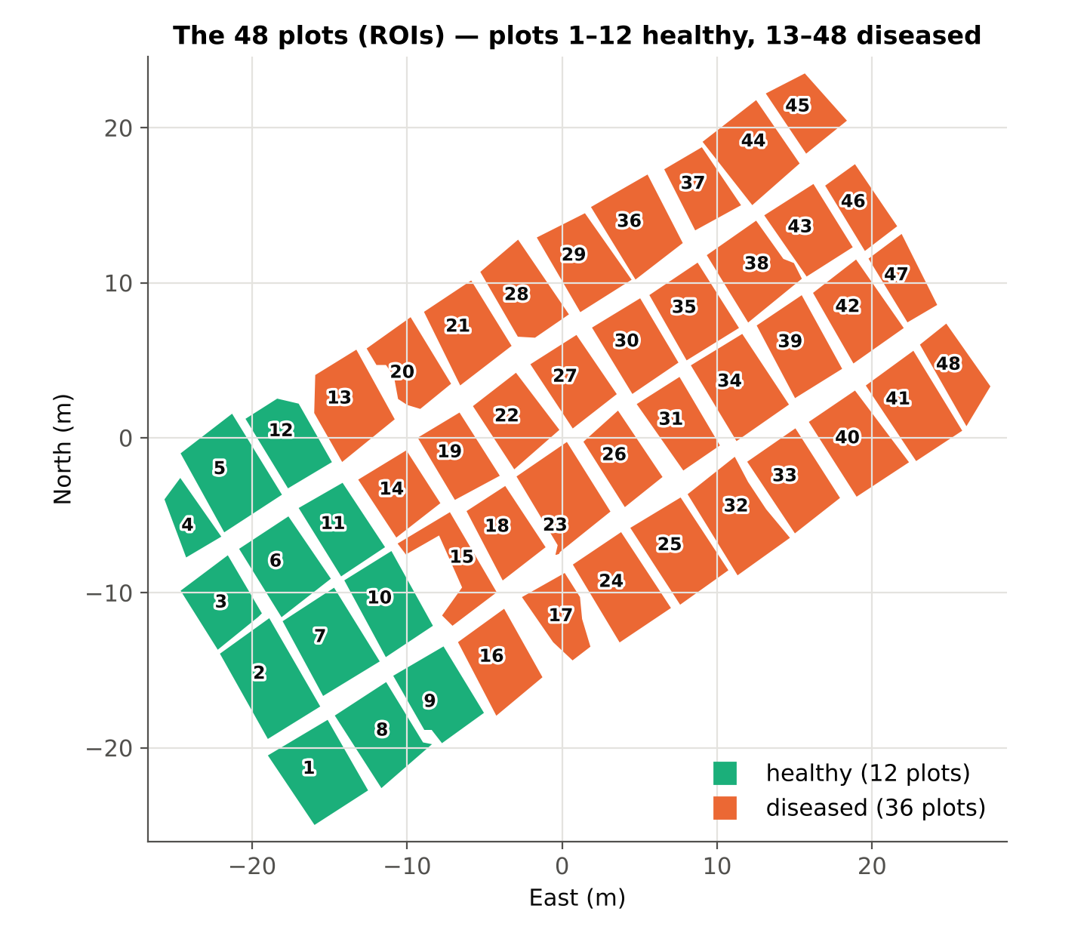
48 plots and the analysis data set
1417
358 / 1059
endmember spectra analysed
healthy / diseased spectra
483
1 : 2.96
reflectance bands (399–2398 nm)
class ratio (imbalanced)
Plot polygons from 48_plot_roi_new.xml (ROI #1–#48, WGS-84), drawn in local metres
30 SMACC endmembers per plot (Gruninger et al. 2004); 23 were removed before this analysis, so plots keep 26–30
Endmembers are not averaged: each is one sample, labelled by its plot's class
Healthy plots 1–12 lie together at the west end of the field: class and position are partly confounded

Slide 7
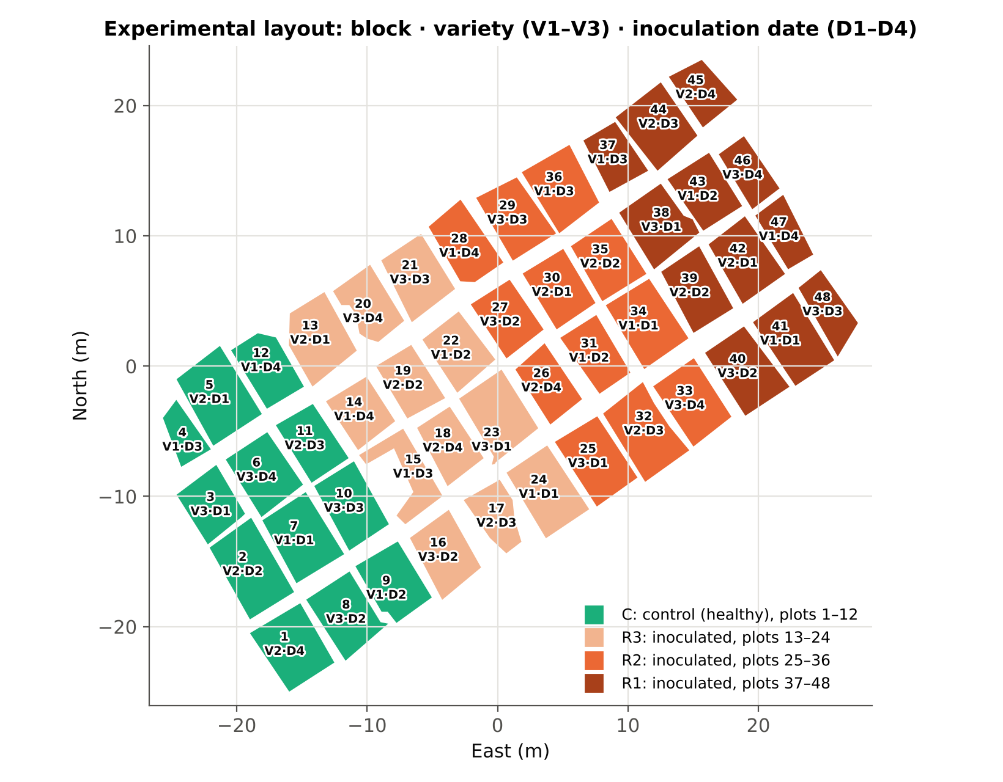
Treatment design (treatment_detail.xlsx)
Block | Plots | Treatment | Class
C | 1–12 | Control (not inoculated) | Healthy
R3 | 13–24 | Inoculated, replication 3 | Diseased
R2 | 25–36 | Inoculated, replication 2 | Diseased
R1 | 37–48 | Inoculated, replication 1 | Diseased
Every block contains all 3 varieties (V1, V2, V3) × 4 inoculation dates (D1, D2, D3, D4, days after sowing), once each (checked)
Blocks run west → east: C, R3, R2, R1; block centres are ≈ 13 m apart
All healthy plots form one block, so healthy vs diseased is confounded with block/location (Hurlbert 1984). The validation is extended to measure this (Part D of the methods)

Slide 8
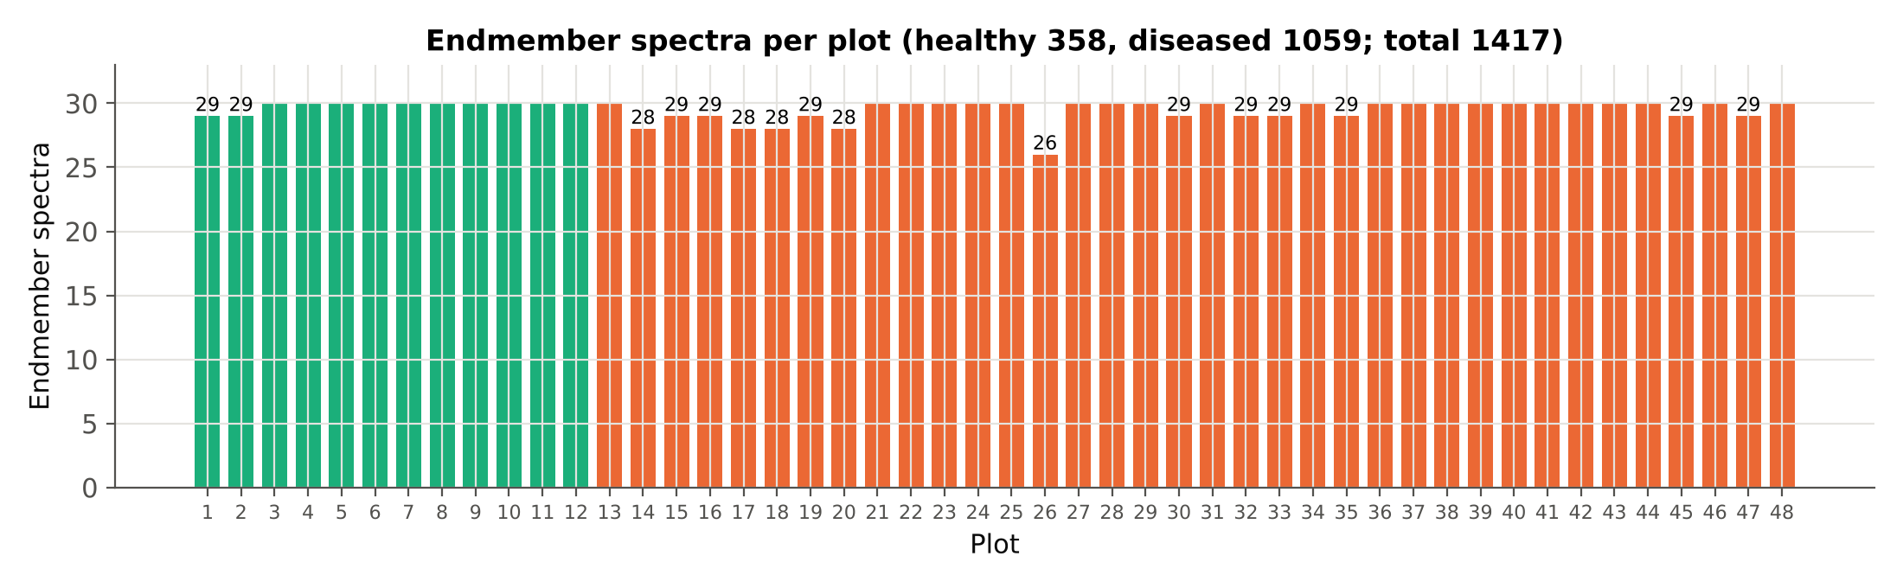
Endmember spectra per plot
Healthy plots: 29–30 spectra each (358 in total); diseased plots: 26–30 each (1059 in total)
Spectra of one plot share soil, illumination and management: they are not independent samples. This is why validation is done by plot (Part D)

Slide 9
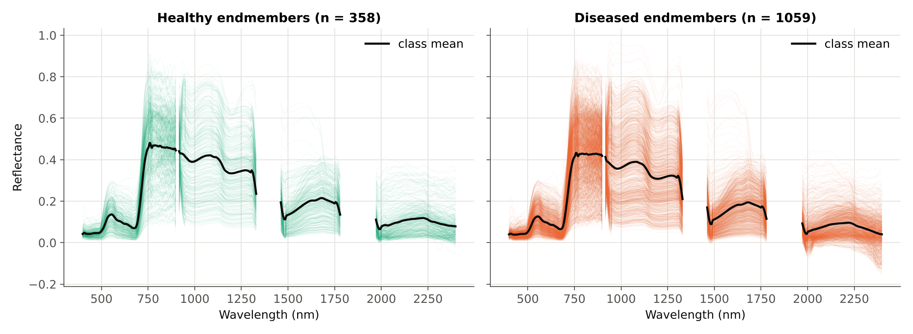
All endmember spectra
Thin lines: individual endmembers (358 healthy, 1059 diseased); black: class mean. Gaps are the water-absorption bands absent from the image. SMACC picks the most extreme spectra of each plot, hence the wide spread.

Slide 10
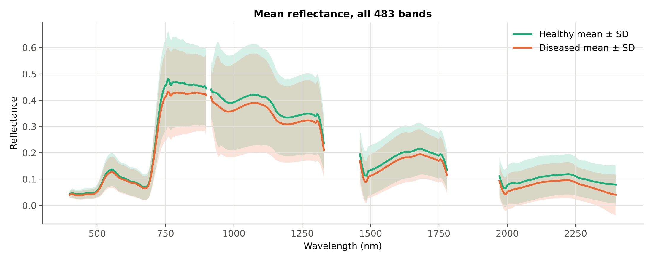
Class means and variability
Mean ± 1 SD per class over all 483 bands. The two bands overlap almost everywhere: the class difference is small compared with the spread within each class.

Slide 11
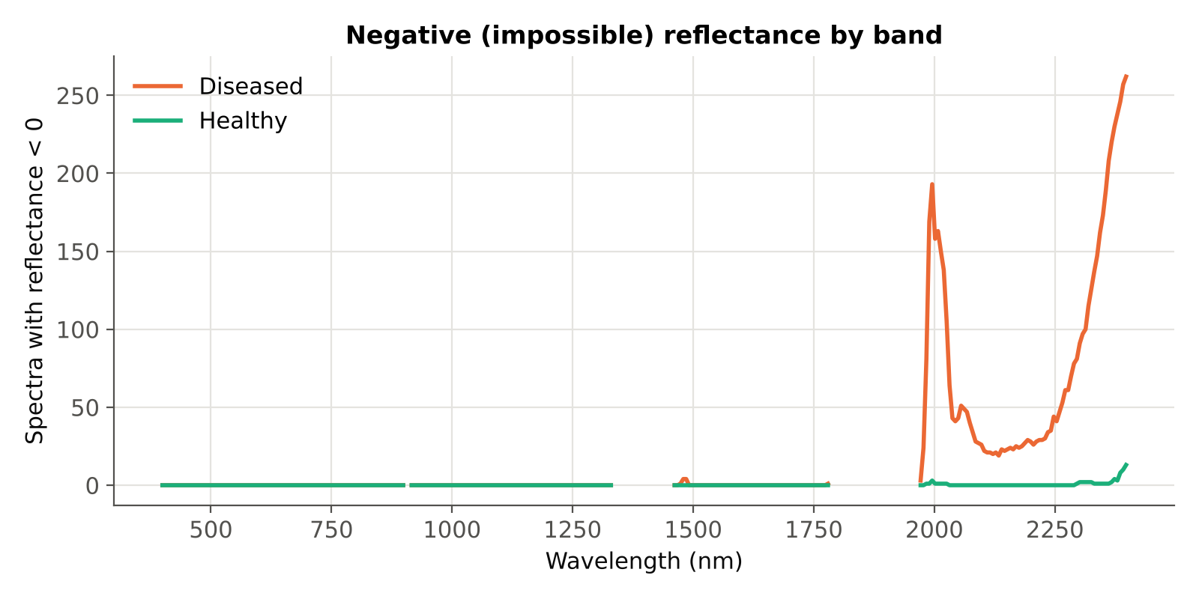
Data check: everything is analysed
1417
483
spectra analysed: none removed in this step
bands analysed: none excluded
As requested, all uploaded endmembers and all wavelengths are used, including the detector edges (< 420 nm, > 2,350 nm)
Negative reflectance (physically impossible) in 21 healthy and 296 diseased spectra, at 76 bands, mainly the noisy ends of the range
These values are kept (no editing of data), but bands chosen there are flagged when the results are interpreted
Checks passed: 1417 × 483 values, no missing values, plots 1–12 = healthy, 13–48 = diseased, each spectrum in exactly one plot

Slide 12
B · Methods and why they are used
Four-tier method, imbalance strategies, validation design and accuracy measures, each with its reference

Slide 13
Four-tier method: what each tier does and why
Tier | What is done here | Why | Reference
1 · ANOVA | One-way ANOVA per band, p < 0.05; Tukey HSD; FDR and Bonferroni reported; plot-mean ANOVA as a check | Keeps only bands where class means differ; removes uninformative bands before selection | Das et al. 2020; Tukey 1949; Benjamini & Hochberg 1995; Hurlbert 1984
2a · CART | rpart-equivalent tree (Gini, minsplit 20, minbucket 7, cp 0.01) on the significant bands; bands used in splits are kept | Picks a small set of complementary bands; same settings as the paper | Breiman et al. 1984; Therneau & Atkinson (rpart)
2b · RF | Random Forest (500 trees, mtry = √p) importance ranking; top bands with |r| < 0.95; same number of bands as CART | Comparison requested: a more stable, ensemble-based band ranking | Breiman 2001; Strobl et al. 2008
3 · J–M | Jeffries–Matusita distance JM = 2(1 − e^−B) per band and for the selected set; 1.94 threshold | Measures how separable the classes are on the chosen bands (0 = none, 2 = complete) | Richards 2013; Das et al. 2020
4 · QDA | Quadratic discriminant analysis on the selected bands | Classifier used in the paper; allows a different covariance per class | Das et al. 2020
Das et al. (2020) used 14 rice genotypes; here there are 2 classes, so Tukey HSD tests one pair and gives the same decision as the ANOVA (checked at every band).

Slide 14
Why class imbalance matters (1 : 2.96)
The problem
References
1059 diseased vs 358 healthy spectra: a model that calls everything “diseased” already reaches 74.7% overall accuracy
Trees and QDA (with empirical priors) are pulled towards the majority class: healthy plots are under-detected
Overall accuracy is therefore misleading; balanced accuracy, MCC, kappa and per-class F1 are reported instead
Imbalance handling must be fitted on training folds only, or the test result is optimistic
He & Garcia (2009) IEEE TKDE: review of imbalanced learning; why accuracy misleads
Brodersen et al. (2010) ICPR: balanced accuracy
Chicco & Jurman (2020) BMC Genomics: MCC for imbalanced binary problems
Santos et al. (2018) IEEE CIM: re-sample inside the cross-validation, never before

Slide 15
Four imbalance strategies compared
Strategy | How it is applied (training folds only) | Why | Method reference | Used for imbalance in
S0 No correction | Data as is; QDA with empirical priors | Baseline, as in Das et al. | Das et al. 2020 | —
S1 Class weighting (cost-sensitive) | Weight N/(2n_k) per class in CART (= rpart prior) and RF (class_weight = balanced); QDA equal priors | Keeps every spectrum; no synthetic data | Breiman et al. 1984; Chen, Liaw & Breiman 2004 | Chen et al. 2004 (weighted RF); He & Garcia 2009
S2 Random under-sampling | Diseased training spectra randomly reduced to the healthy count | Simple; removes majority dominance | He & Garcia 2009; Lemaître et al. 2017 | Chen et al. 2004 (balanced RF)
S3 SMOTE | Synthetic healthy spectra by interpolation between 5 nearest healthy neighbours | Adds minority information without discarding data | Chawla et al. 2002; Lemaître et al. 2017 | Cuenca-Romero et al. 2024 (wheat rust, hyperspectral); Douzas et al. 2019 (land cover)
S1 class weights: healthy 1417/(2·358) ≈ 1.98, diseased 1417/(2·1059) ≈ 0.67 (on the full data; recomputed in each training fold). The test spectra are never re-sampled.
Cuenca-Romero et al. (2024) used SMOTE on imbalanced hyperspectral data to detect yellow and brown rust in wheat: a direct plant-disease example
Douzas et al. (2019) used SMOTE-type over-sampling for imbalanced land-cover classes in remote sensing

Slide 16
Validation design and why
CV1 · Paper-style random 10-fold (× 5)
CV2 · Plot-grouped nested 4-fold (× 10) — main result
As in Das et al.: bands chosen once on all data, then QDA cross-validated on randomly split spectra. Reported for comparison only: it is optimistic because spectra of the same plot fall in training and test, and the bands were chosen with the test spectra.
Whole plots are held out (3 healthy + 9 diseased per test fold). Tier 1, Tier 2, re-sampling and QDA are all redone inside each training fold. Repeated 10 times with different plot splits.
CV3 · Leave-one-plot-out (48 folds)
Permutation test (100 ×)
Each plot predicted by a model built on the other 47 plots; a plot is called diseased if > 50% of its spectra are. Shows which plots are misclassified.
Plot labels shuffled (12 healthy / 36 diseased kept) and CV2 repeated: tells whether the observed balanced accuracy is better than chance.
References: Hurlbert 1984 (pseudo-replication); Roberts et al. 2017 (grouped/block CV); Ambroise & McLachlan 2002 (selection inside the folds); Santos et al. 2018 (re-sampling inside the folds); Ojala & Garriga 2010 (permutation test).

Slide 17
Validation using the treatment design and why
CV4 · Leave-one-treatment-combination-out (12 folds)
CV5 · Leave-one-variety-out (3 folds)
Hold out the 4 plots sharing a variety × inoculation date (1 control + 3 inoculated). The model never saw that combination: tests transfer to new treatment levels (Meyer et al. 2018).
Train on two varieties, test on the third (4 control + 12 inoculated plots). Disease detection should not depend on the variety.
CV6 · Leave-one-inoculation-date-out (4 folds)
Negative control: block vs block
Train on three inoculation dates, test on the fourth (3 + 9 plots).
Classify two INOCULATED blocks (e.g. R3 vs R1) with the same pipeline. They cannot differ by disease, so their accuracy measures the block/location effect (Lipsitch et al. 2010).
Restricted permutation (4 labellings)
Detection by block, variety and date
Treatments were applied to whole blocks, so blocks are the exchangeable units (Anderson & ter Braak 2003): label each block in turn 'healthy'. The smallest attainable p is 1/4.
Share of each plot's spectra predicted diseased, compared between blocks, varieties and inoculation dates (Kruskal & Wallis 1952).
All schemes are nested: Tier 1, Tier 2, re-balancing and QDA are refitted without the test plots. Every test fold keeps the 1 healthy : 3 diseased plot ratio.

Slide 18
Accuracy measures reported
Measure | Definition | Why | Reference
Balanced accuracy (BA) — main | (sensitivity + specificity) / 2 | Not inflated by the majority class; 0.5 = chance | Brodersen et al. 2010
Sensitivity / specificity | Correct diseased / correct healthy | Shows which class fails | He & Garcia 2009
MCC | Correlation of observed and predicted classes | Uses all four cells; robust to imbalance | Chicco & Jurman 2020
Kappa | Agreement beyond chance | Used in remote sensing and by Das et al. | Cohen 1960
F1 per class, ROC-AUC | Precision–recall balance; ranking quality | Complementary views | He & Garcia 2009
Plot-level BA | Majority vote of a plot's spectra vs its true class | Plots are the real units of interest | Hurlbert 1984
Overall accuracy (OA), error matrix | Correct / total, from the reference × predicted matrix | Standard remote-sensing report; inflated by the majority class | Congalton 1991; Das et al. 2020
Producer's / user's accuracy (PA, UA) | PA = correct / reference total; UA = correct / predicted total | Omission and commission error per class | Story & Congalton 1986
Quantity / allocation disagreement | Wrong class proportions / wrong placement; sum = 1 − OA | Explains the errors; alternative to kappa | Pontius & Millones 2011
95% confidence intervals | Plots resampled with replacement within each class (2000×) | Spectra of a plot are not independent | Field & Welsh 2007; Olofsson et al. 2014

Slide 19
C · Results, tier by tier
Tier 1 → Tier 2 (CART and RF) → Tier 3 → Tier 4, then validation

Slide 20
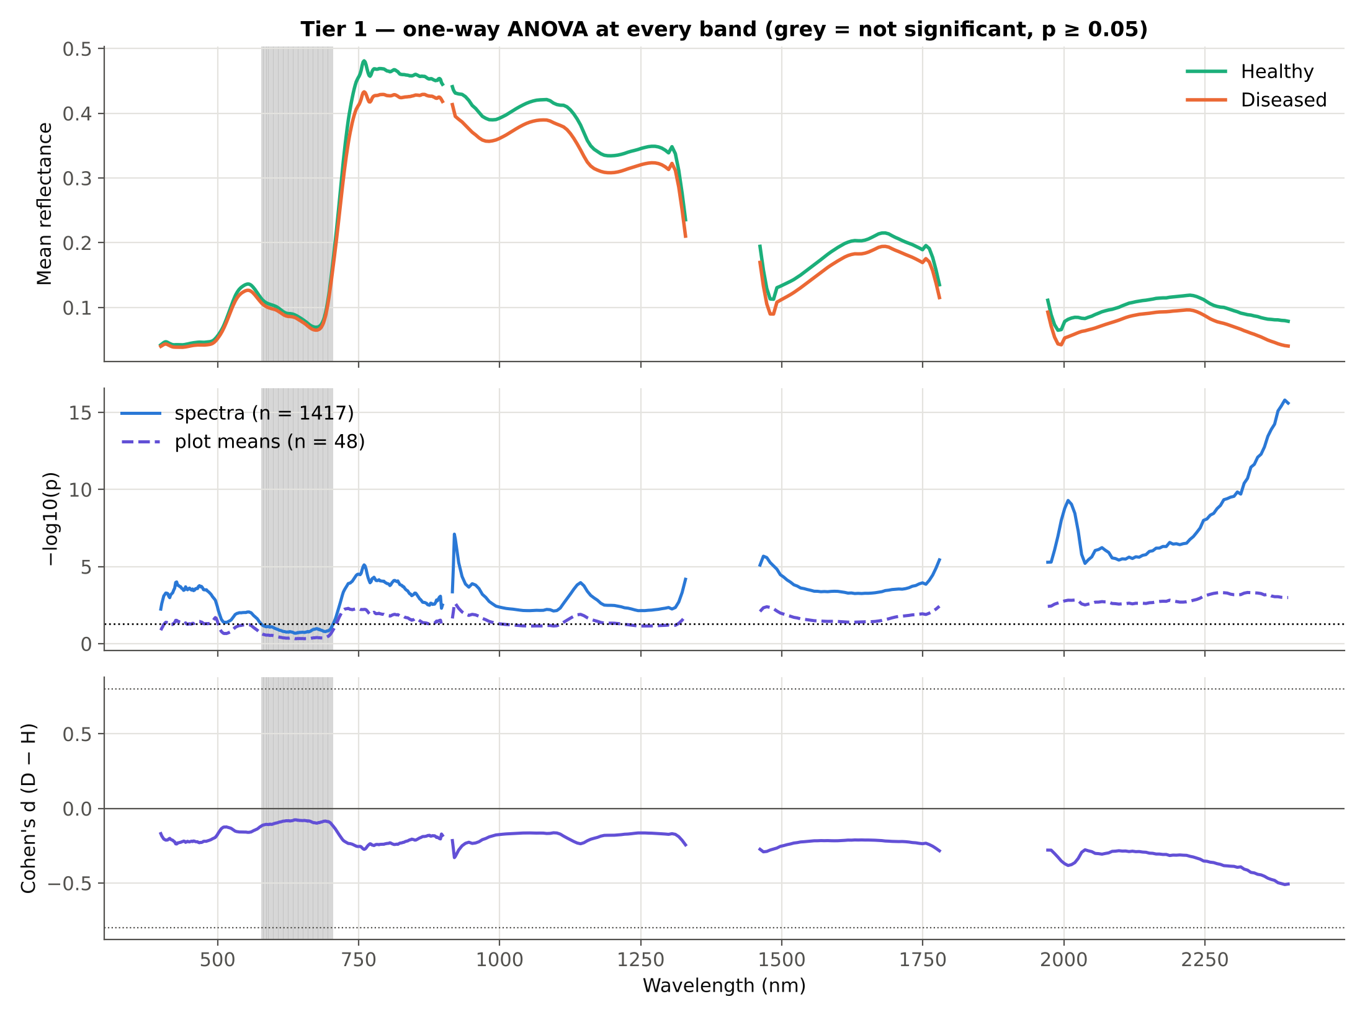
Tier 1 · 411 of 483 bands differ at p < 0.05
What Tier 1 shows
411 bands significant with all spectra as replicates; 407 after FDR and 132 after Bonferroni
Tukey HSD gives the same 411 bands (one pair)
Effect sizes are small: largest |d| = 0.51 (2392 nm); 3 bands |d| ≥ 0.5, 0 bands |d| ≥ 0.8
With the 48 plot means as replicates only 302 bands are significant: the spectrum-level test is inflated by pseudo-replication

Slide 21
Tier 1 · how robust is the band list?
Test | Replicates | Bands significant (of 483) | Use
One-way ANOVA, p < 0.05 | 1417 spectra | 411 | Passed to Tier 2 (as in Das et al.)
Tukey HSD, p < 0.05 | 1417 spectra | 411 | Identical decision (one pair)
ANOVA + FDR (Benjamini–Hochberg) | 1417 spectra | 407 | Controls false discoveries over 483 tests
ANOVA + Bonferroni | 1417 spectra | 132 | Strictest control
Welch t-test (unequal variances) | 1417 spectra | 409 | Levene: variances differ at 93 bands
ANOVA on plot means | 48 plots | 302 | Pseudo-replication check (Hurlbert 1984)
The band list is stable across tests that use spectra as replicates; with plots as replicates fewer bands remain, so p-values from spectra overstate the evidence
Inside every validation fold Tier 1 is recomputed on the training spectra only

Slide 22
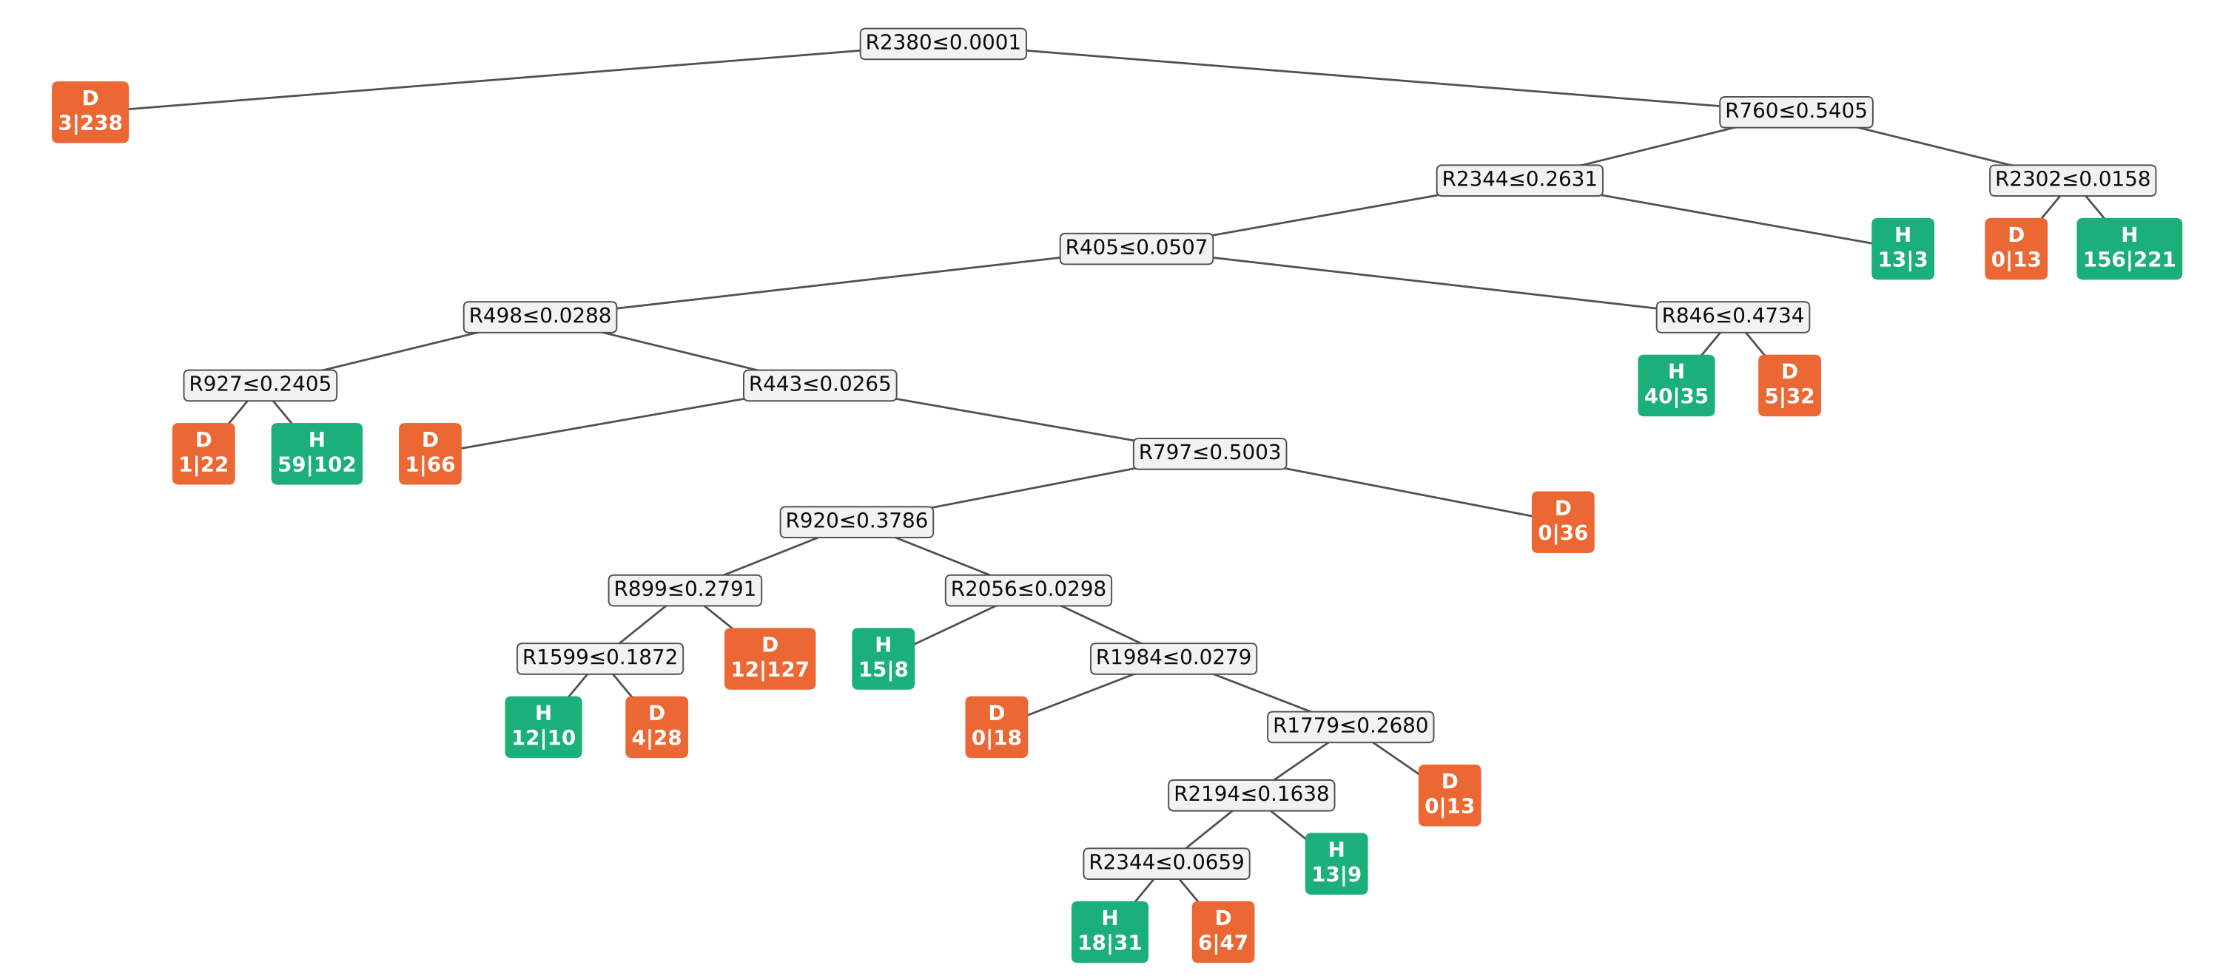
Tier 2a · CART tree (class-weighted, S1)
Tree grown on all 1417 spectra with class weights (S1), pruned at cp = 0.01: 18 splits on 17 bands. Boxes: split rule (R = reflectance at that wavelength); leaves: predicted class and healthy | diseased spectra. The first split (R2380 ≤ 0.0001) isolates 241 spectra with zero or negative reflectance at 2,380 nm, 238 of them diseased: the tree exploits the noisy edge band.

Slide 23
Tier 2a · CART bands for each imbalance strategy
Strategy | Bands | Selected wavelengths (nm) | Edge bands*
S0 none | 22 | 399, 405, 428, 452, 466, 475, 479, 760, 846, 858, 885, 927, 945, 1996, 2008, 2044, 2050, 2326, 2344, 2356, 2380, 2398 | 5
S1 class weights | 17 | 405, 443, 498, 760, 797, 846, 899, 920, 927, 1600, 1780, 1984, 2056, 2194, 2302, 2344, 2380 | 2
S2 under-sampling | 14 | 494, 498, 505, 711, 855, 885, 890, 920, 1497, 1726, 2008, 2344, 2374, 2380 | 2
S3 SMOTE | 21 | 470, 505, 577, 916, 920, 939, 951, 1143, 1155, 1233, 1293, 1317, 1329, 1461, 1636, 1990, 2272, 2326, 2368, 2380, 2392 | 3
The selected bands change with the imbalance strategy: individual bands should not be over-interpreted
Recurring regions: blue/green (≈ 400–500 nm), red-edge/NIR (≈ 700–950 nm) and SWIR-2 (≈ 2,000–2,400 nm)
* Edge bands < 420 or > 2,350 nm are kept as requested but are the noisiest part of the sensor

Slide 24
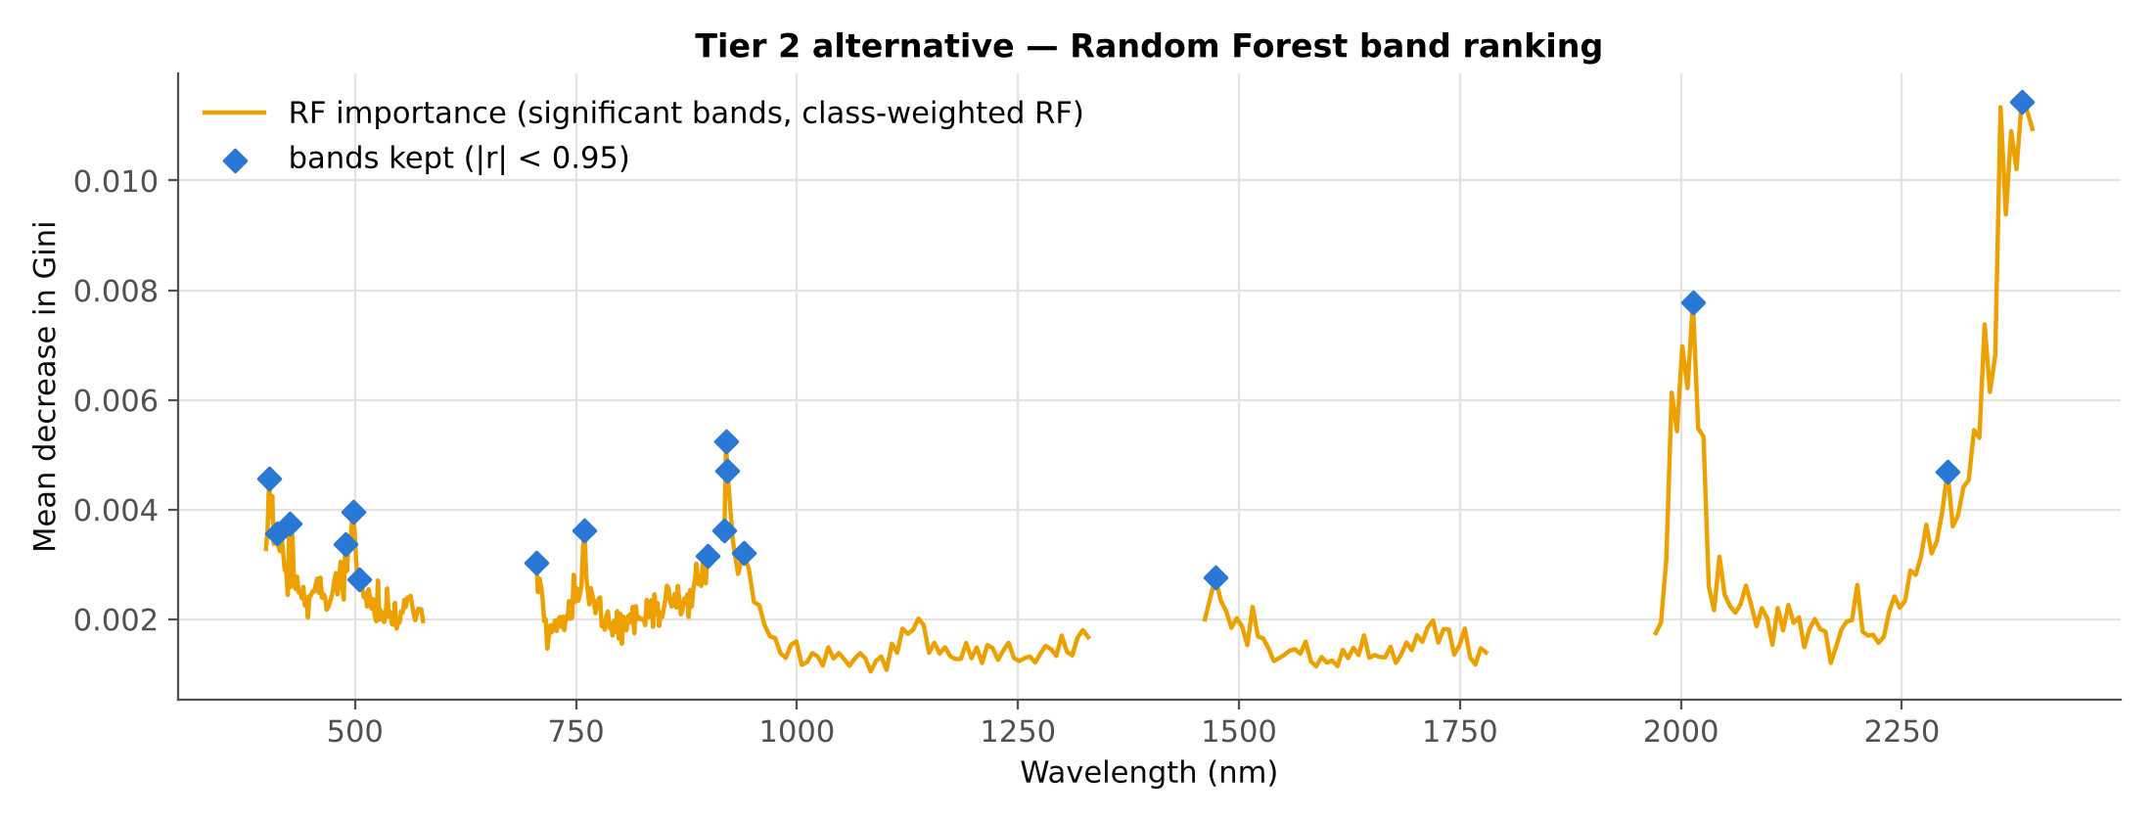
Tier 2b · Random Forest instead of CART
Strategy | Bands | RF-selected wavelengths (nm), in order of importance
S0 none | 22 | 2386, 2014, 920, 921, 401, 406, 890, 918, 498, 2284, 760, 456, 421, 505, 705, 939, 1485, 1467, 719, 2158, 1299, 1744
S1 class weights | 17 | 2386, 2014, 920, 921, 2302, 403, 498, 426, 760, 918, 412, 489, 939, 899, 705, 1473, 505
S2 under-sampling | 14 | 2362, 2014, 920, 921, 918, 399, 897, 498, 408, 712, 512, 486, 2248, 939
S3 SMOTE | 21 | 2386, 2014, 920, 933, 921, 2278, 918, 758, 403, 897, 412, 426, 496, 707, 1461, 479, 505, 834, 1491, 1726, 721
RF ranks all ANOVA-significant bands; neighbours with |r| ≥ 0.95 to an already chosen band are skipped (Strobl et al. 2008) so that the same number of bands as CART is kept.

Slide 25
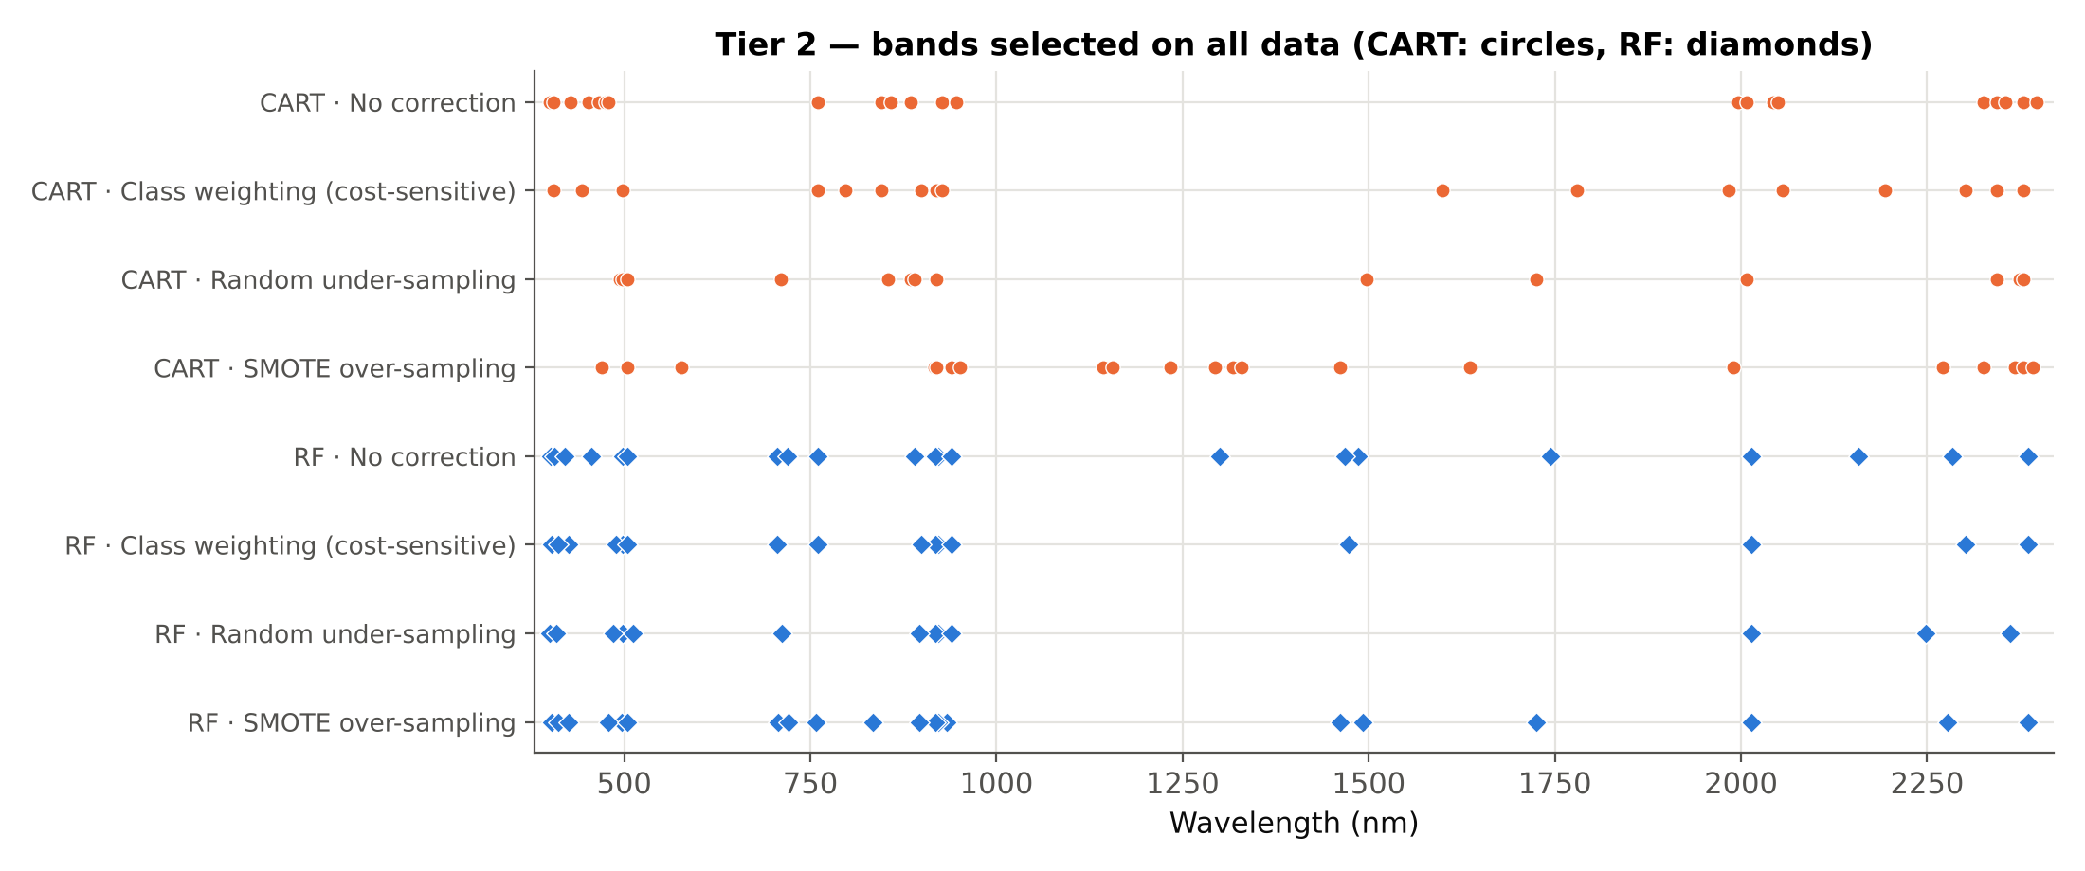
Which bands were selected? CART vs RF
Each row is one configuration (Tier-2 method × imbalance strategy); ticks are the selected wavelengths on the full data. Background: −log10 p of Tier 1.

Slide 26
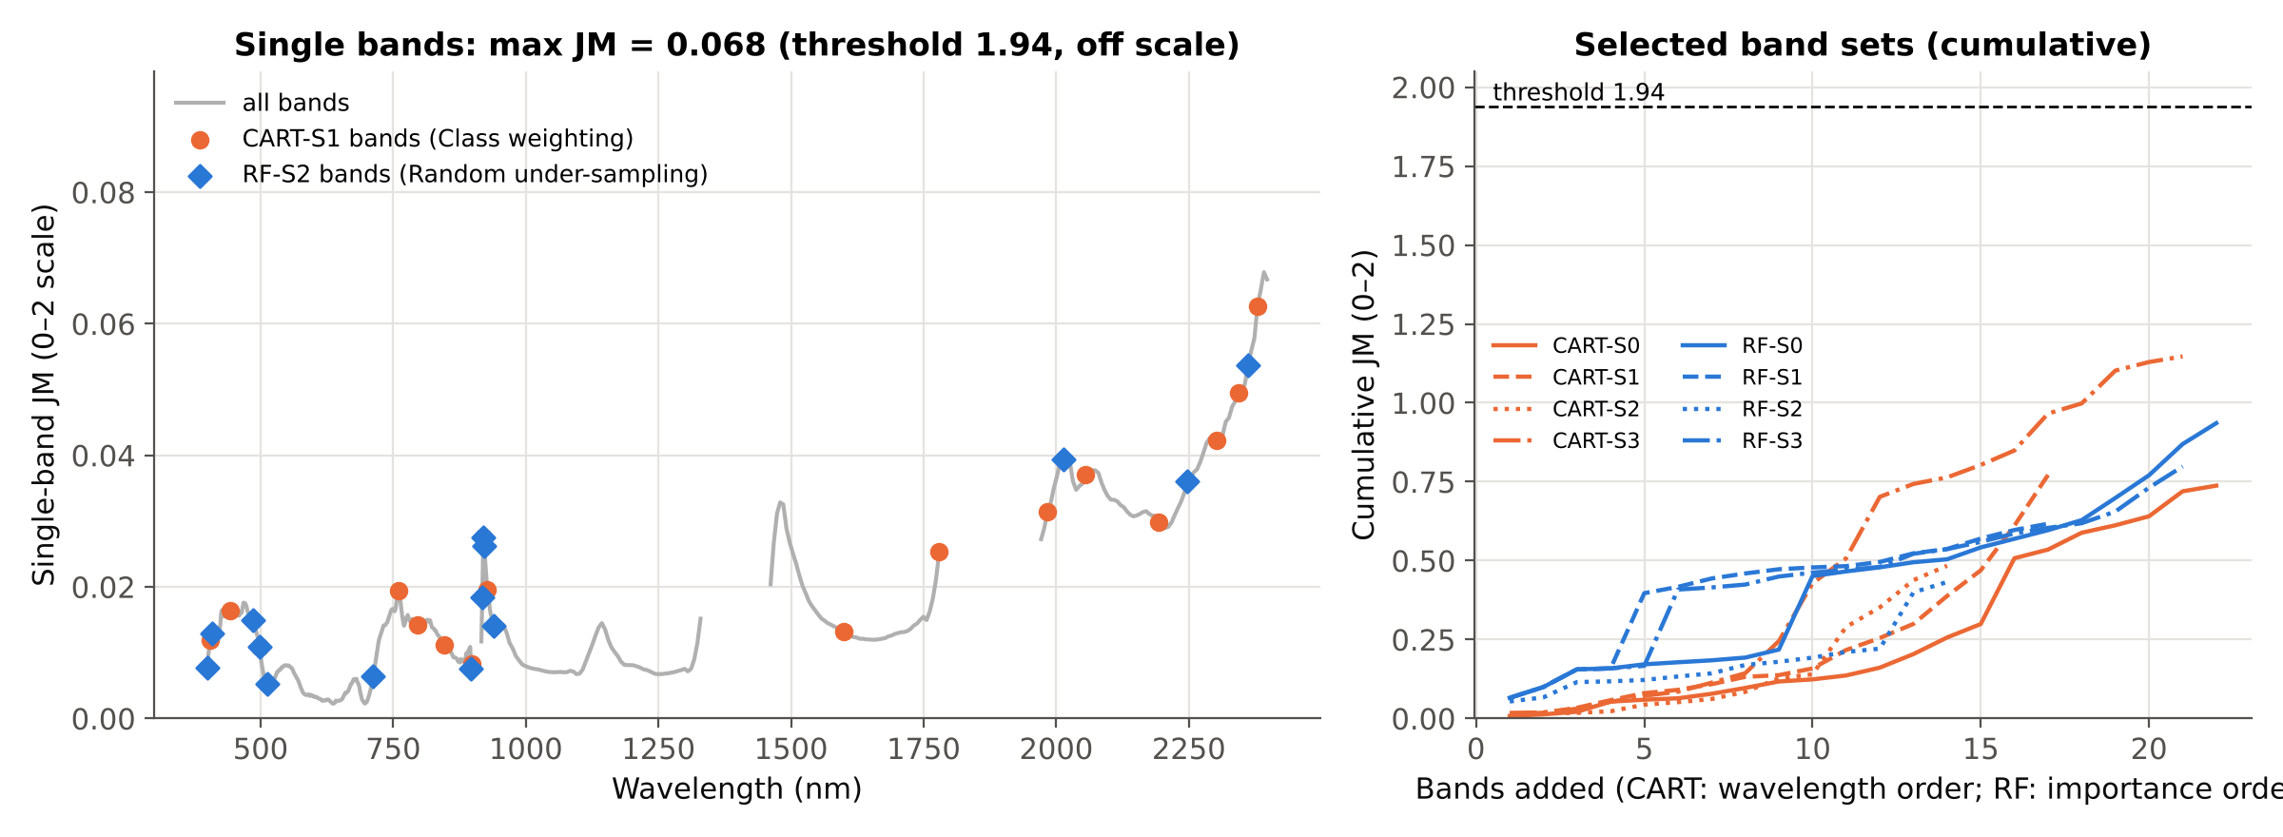
Tier 3 · Jeffries–Matusita distance
Configuration | Bands | JM (0–2)
CART-S0 | 22 | 0.737
CART-S1 | 17 | 0.771
CART-S2 | 14 | 0.484
CART-S3 | 21 | 1.147
RF-S0 | 22 | 0.935
RF-S1 | 17 | 0.617
RF-S2 | 14 | 0.432
RF-S3 | 21 | 0.798
No configuration reaches the 1.94 threshold of Das et al.: the best is CART-S3 with JM = 1.147
The best single band reaches only JM = 0.068 (2392 nm)
Healthy and diseased endmembers overlap strongly in spectral space

Slide 27
Tier 3 · J–M of each band selected by CART in Tier 2
# | S0 none: band (nm) | JM band | JM cumul. | S1 class weights: band (nm) | JM band | JM cumul. | S2 under-sampling: band (nm) | JM band | JM cumul. | S3 SMOTE: band (nm) | JM band | JM cumul.
1 | 399.4 | 0.0077 | 0.008 | 404.6 | 0.0119 | 0.012 | 494.3 | 0.0125 | 0.012 | 469.7 | 0.0176 | 0.018
2 | 404.6 | 0.0119 | 0.013 | 443.3 | 0.0164 | 0.018 | 497.8 | 0.0109 | 0.016 | 504.9 | 0.0071 | 0.019
3 | 427.5 | 0.0165 | 0.021 | 497.8 | 0.0109 | 0.034 | 504.9 | 0.0071 | 0.018 | 576.9 | 0.0045 | 0.031
4 | 452.1 | 0.0161 | 0.053 | 759.7 | 0.0194 | 0.058 | 710.5 | 0.0056 | 0.023 | 916.2 | 0.0117 | 0.053
5 | 466.2 | 0.0170 | 0.059 | 796.7 | 0.0143 | 0.080 | 854.7 | 0.0108 | 0.044 | 919.7 | 0.0275 | 0.072
6 | 475.0 | 0.0164 | 0.064 | 845.9 | 0.0112 | 0.091 | 884.6 | 0.0087 | 0.052 | 939.4 | 0.0141 | 0.085
7 | 478.5 | 0.0159 | 0.078 | 898.6 | 0.0083 | 0.108 | 889.8 | 0.0097 | 0.061 | 951.4 | 0.0146 | 0.113
8 | 759.7 | 0.0194 | 0.097 | 919.7 | 0.0275 | 0.132 | 919.7 | 0.0275 | 0.084 | 1143.4 | 0.0145 | 0.143
9 | 845.9 | 0.0112 | 0.117 | 927.4 | 0.0196 | 0.137 | 1497.4 | 0.0267 | 0.127 | 1155.4 | 0.0119 | 0.245
10 | 858.2 | 0.0101 | 0.124 | 1599.5 | 0.0132 | 0.158 | 1725.5 | 0.0136 | 0.140 | 1233.4 | 0.0072 | 0.428
11 | 884.6 | 0.0087 | 0.136 | 1779.5 | 0.0253 | 0.217 | 2007.5 | 0.0390 | 0.290 | 1293.4 | 0.0074 | 0.507
12 | 927.4 | 0.0196 | 0.161 | 1983.5 | 0.0315 | 0.255 | 2343.5 | 0.0495 | 0.352 | 1317.4 | 0.0089 | 0.702
13 | 945.4 | 0.0134 | 0.204 | 2055.5 | 0.0370 | 0.299 | 2373.5 | 0.0578 | 0.438 | 1329.4 | 0.0152 | 0.743
14 | 1995.5 | 0.0350 | 0.256 | 2193.5 | 0.0299 | 0.388 | 2379.6 | 0.0627 | 0.484 | 1461.4 | 0.0204 | 0.764
15 | 2007.5 | 0.0390 | 0.299 | 2301.5 | 0.0423 | 0.469 |  |  |  | 1635.5 | 0.0121 | 0.803
16 | 2043.5 | 0.0353 | 0.507 | 2343.5 | 0.0495 | 0.611 |  |  |  | 1989.5 | 0.0327 | 0.849
17 | 2049.5 | 0.0357 | 0.535 | 2379.6 | 0.0627 | 0.771 |  |  |  | 2271.5 | 0.0390 | 0.966
18 | 2325.5 | 0.0457 | 0.588 |  |  |  |  |  |  | 2325.5 | 0.0457 | 0.998
19 | 2343.5 | 0.0495 | 0.612 |  |  |  |  |  |  | 2367.5 | 0.0559 | 1.102
20 | 2355.5 | 0.0508 | 0.640 |  |  |  |  |  |  | 2379.6 | 0.0627 | 1.129
21 | 2379.6 | 0.0627 | 0.720 |  |  |  |  |  |  | 2391.6 | 0.0678 | 1.147
22 | 2397.6 | 0.0667 | 0.737
Set |  | max 0.067 | 0.737 |  | max 0.063 | 0.771 |  | max 0.063 | 0.484 |  | max 0.068 | 1.147
Bands in wavelength order (all bands used in the pruned tree). JM band = J–M of that single band (0–2 scale); JM cumul. = J–M of the first k bands together; last row = J–M of the whole set. No single band exceeds JM 0.068; the 1.94 threshold is not reached.

Slide 28
Tier 3 · J–M of each band selected by RF in Tier 2
# | S0 none: band (nm) | JM band | JM cumul. | S1 class weights: band (nm) | JM band | JM cumul. | S2 under-sampling: band (nm) | JM band | JM cumul. | S3 SMOTE: band (nm) | JM band | JM cumul.
1 | 2385.6 | 0.0652 | 0.065 | 2385.6 | 0.0652 | 0.065 | 2361.5 | 0.0536 | 0.054 | 2385.6 | 0.0652 | 0.065
2 | 2013.5 | 0.0394 | 0.099 | 2013.5 | 0.0394 | 0.099 | 2013.5 | 0.0394 | 0.067 | 2013.5 | 0.0394 | 0.099
3 | 919.7 | 0.0275 | 0.156 | 919.7 | 0.0275 | 0.156 | 919.7 | 0.0275 | 0.115 | 919.7 | 0.0275 | 0.156
4 | 921.4 | 0.0262 | 0.158 | 921.4 | 0.0262 | 0.158 | 921.4 | 0.0262 | 0.117 | 933.4 | 0.0160 | 0.159
5 | 401.1 | 0.0094 | 0.171 | 2301.5 | 0.0423 | 0.397 | 918.0 | 0.0185 | 0.122 | 921.4 | 0.0262 | 0.167
6 | 406.4 | 0.0122 | 0.178 | 402.9 | 0.0106 | 0.417 | 399.4 | 0.0077 | 0.133 | 2277.5 | 0.0404 | 0.408
7 | 889.8 | 0.0097 | 0.184 | 497.8 | 0.0109 | 0.443 | 896.9 | 0.0076 | 0.143 | 918.0 | 0.0185 | 0.415
8 | 918.0 | 0.0185 | 0.193 | 425.7 | 0.0161 | 0.459 | 497.8 | 0.0109 | 0.169 | 758.0 | 0.0187 | 0.424
9 | 497.8 | 0.0109 | 0.218 | 759.7 | 0.0194 | 0.473 | 408.2 | 0.0130 | 0.180 | 402.9 | 0.0106 | 0.450
10 | 2283.5 | 0.0419 | 0.451 | 918.0 | 0.0185 | 0.478 | 712.3 | 0.0064 | 0.193 | 896.9 | 0.0076 | 0.462
11 | 759.7 | 0.0194 | 0.466 | 411.7 | 0.0126 | 0.483 | 511.9 | 0.0052 | 0.211 | 411.7 | 0.0126 | 0.470
12 | 455.6 | 0.0162 | 0.479 | 489.0 | 0.0140 | 0.496 | 485.5 | 0.0150 | 0.221 | 425.7 | 0.0161 | 0.480
13 | 420.5 | 0.0125 | 0.495 | 939.4 | 0.0141 | 0.523 | 2247.5 | 0.0361 | 0.399 | 496.1 | 0.0121 | 0.522
14 | 504.9 | 0.0071 | 0.504 | 898.6 | 0.0083 | 0.537 | 939.4 | 0.0141 | 0.432 | 707.0 | 0.0043 | 0.536
15 | 705.3 | 0.0037 | 0.542 | 705.3 | 0.0037 | 0.570 |  |  |  | 1461.4 | 0.0204 | 0.559
16 | 939.4 | 0.0141 | 0.569 | 1473.4 | 0.0311 | 0.597 |  |  |  | 478.5 | 0.0159 | 0.586
17 | 1485.4 | 0.0325 | 0.596 | 504.9 | 0.0071 | 0.617 |  |  |  | 504.9 | 0.0071 | 0.604
18 | 1467.4 | 0.0267 | 0.628 |  |  |  |  |  |  | 833.6 | 0.0127 | 0.618
19 | 719.3 | 0.0100 | 0.698 |  |  |  |  |  |  | 1491.4 | 0.0289 | 0.655
20 | 2157.5 | 0.0311 | 0.770 |  |  |  |  |  |  | 1725.5 | 0.0136 | 0.731
21 | 1299.4 | 0.0075 | 0.869 |  |  |  |  |  |  | 721.1 | 0.0109 | 0.798
22 | 1743.5 | 0.0150 | 0.935
Set |  | max 0.065 | 0.935 |  | max 0.065 | 0.617 |  | max 0.054 | 0.432 |  | max 0.065 | 0.798
Bands in order of RF importance (after the |r| < 0.95 filter). JM band = J–M of that single band (0–2 scale); JM cumul. = J–M of the first k bands together; last row = J–M of the whole set. No single band exceeds JM 0.068; the 1.94 threshold is not reached.

Slide 29
Tier 4 · QDA with paper-style validation (CV1)
Tier 2 | S0 none | S1 class weights | S2 under-sampling | S3 SMOTE
CART | 0.588 (OA 70.7%) | 0.614 (OA 56.8%) | 0.627 (OA 60.1%) | 0.762 (OA 76.4%)
RF | 0.682 (OA 75.5%) | 0.624 (OA 60.1%) | 0.619 (OA 58.1%) | 0.615 (OA 61.8%)
Balanced accuracy (overall accuracy in brackets); random stratified 10-fold × 5, bands chosen once on all spectra, as in Das et al. (2020)
Best: CART-S3, BA 0.762. This scheme is optimistic: spectra of one plot are in both training and test sets, and the bands were selected with the test spectra (Ambroise & McLachlan 2002)
The realistic estimate is the plot-grouped nested validation on the next slides

Slide 30
Main result · plot-grouped nested validation (CV2)
Reading the chart
0.5 = chance for balanced accuracy
Spectrum level: 0.58–0.62; best CART-S1
Plot level (majority vote): best RF-S2 at 0.76
Imbalance correction (S1–S3) clearly helps at plot level compared with S0
RF on all 483 bands as benchmark: 0.55 / 0.50

Slide 31
CV2 in detail (mean ± SD over 10 repetitions)
Config. | BA | Kappa | MCC | Sensitivity (D) | Specificity (H) | AUC | Plot BA | Bands/fold
CART-S0 | 0.579 ± 0.032 | 0.16 ± 0.07 | 0.16 ± 0.07 | 0.81 ± 0.02 | 0.35 ± 0.06 | 0.66 ± 0.04 | 0.54 ± 0.05 | 24.3
CART-S1 | 0.615 ± 0.031 | 0.19 ± 0.05 | 0.20 ± 0.05 | 0.63 ± 0.02 | 0.60 ± 0.07 | 0.67 ± 0.03 | 0.74 ± 0.07 | 21.5
CART-S2 | 0.611 ± 0.016 | 0.17 ± 0.03 | 0.19 ± 0.03 | 0.59 ± 0.03 | 0.63 ± 0.03 | 0.66 ± 0.03 | 0.75 ± 0.06 | 20.1
CART-S3 | 0.600 ± 0.021 | 0.17 ± 0.04 | 0.18 ± 0.04 | 0.64 ± 0.04 | 0.57 ± 0.04 | 0.66 ± 0.03 | 0.71 ± 0.07 | 17.8
RF-S0 | 0.585 ± 0.022 | 0.17 ± 0.05 | 0.17 ± 0.05 | 0.81 ± 0.02 | 0.36 ± 0.03 | 0.67 ± 0.03 | 0.56 ± 0.04 | 20.9
RF-S1 | 0.604 ± 0.018 | 0.17 ± 0.03 | 0.18 ± 0.03 | 0.62 ± 0.02 | 0.59 ± 0.03 | 0.66 ± 0.02 | 0.73 ± 0.09 | 19.9
RF-S2 | 0.614 ± 0.020 | 0.18 ± 0.03 | 0.20 ± 0.03 | 0.61 ± 0.02 | 0.62 ± 0.04 | 0.66 ± 0.03 | 0.76 ± 0.05 | 19.1
RF-S3 | 0.588 ± 0.020 | 0.14 ± 0.03 | 0.15 ± 0.03 | 0.61 ± 0.02 | 0.57 ± 0.05 | 0.64 ± 0.02 | 0.68 ± 0.05 | 17.3
RF all bands | 0.549 ± 0.016 | 0.10 ± 0.03 | 0.10 ± 0.03 | 0.78 ± 0.01 | 0.32 ± 0.03 | 0.63 ± 0.02 | 0.50 ± 0.04 | 483
Tier 1, Tier 2, re-sampling and QDA refitted in every training fold; test plots never seen. D = diseased, H = healthy. The RF benchmark is a class-weighted RF classifier on all bands (no Tier 1–3).

Slide 32
Accuracy assessment · error matrices (plot-grouped CV2)
CART-S1 + QDA (Class weighting (cost-sensitive))
RF-S2 + QDA (Random under-sampling)
Reference \ Predicted | Healthy | Diseased | Total | PA
Healthy | 2148 | 1432 | 3580 | 60.0% (56–63%)
Diseased | 3910 | 6680 | 10590 | 63.1% (57–69%)
Total | 6058 | 8112 | 14170
UA | 35.5% | 82.3%
Reference \ Predicted | Healthy | Diseased | Total | PA
Healthy | 2220 | 1360 | 3580 | 62.0% (59–66%)
Diseased | 4161 | 6429 | 10590 | 60.7% (54–67%)
Total | 6381 | 7789 | 14170
UA | 34.8% | 82.5%
Measure | Value | 95% CI (plot bootstrap)
Overall accuracy | 62.3% | 58.0–66.8%
Balanced accuracy | 61.5% | 58.2–65.0%
Kappa | 0.188 | 0.129–0.254
MCC · F1 healthy · F1 diseased | 0.203 · 0.45 · 0.71
Quantity / allocation disagreement | 17.5% / 20.2%
Measure | Value | 95% CI (plot bootstrap)
Overall accuracy | 61.0% | 56.4–65.6%
Balanced accuracy | 61.4% | 57.8–64.9%
Kappa | 0.180 | 0.121–0.245
MCC · F1 healthy · F1 diseased | 0.198 · 0.45 · 0.70
Quantity / allocation disagreement | 19.8% / 19.2%
Error matrices summed over 10 repetitions × 1417 spectra (each spectrum predicted once per repetition, always from plots not used for training). PA = producer's accuracy (1 − omission error), UA = user's accuracy (1 − commission error) (Story & Congalton 1986). CI: 2000 stratified bootstrap resamples of plots (Field & Welsh 2007).

Slide 33
Accuracy of every configuration (95% CI by plot bootstrap)
Config. | Validation | OA | BA (95% CI) | Kappa (95% CI) | PA H | UA H | PA D | UA D | Quantity / allocation disagr.
CART-S0 | plot-grouped | 69.4% | 57.9% (55–60%) | 0.16 (0.11–0.22) | 35% | 38% | 81% | 79% | 2% / 28%
 | leave-one-plot-out | 67.5% | 55.2% (52–59%) | 0.11 (0.04–0.20) | 30% | 34% | 80% | 77% | 3% / 30%
CART-S1 | plot-grouped | 62.3% | 61.5% (58–65%) | 0.19 (0.13–0.25) | 60% | 35% | 63% | 82% | 17% / 20%
 | leave-one-plot-out | 59.0% | 60.5% (55–66%) | 0.16 (0.08–0.25) | 64% | 34% | 57% | 82% | 23% / 18%
CART-S2 | plot-grouped | 60.2% | 61.1% (58–64%) | 0.17 (0.12–0.23) | 63% | 34% | 59% | 83% | 21% / 19%
 | leave-one-plot-out | 60.2% | 61.2% (57–66%) | 0.17 (0.11–0.26) | 63% | 34% | 59% | 83% | 21% / 19%
CART-S3 | plot-grouped | 61.7% | 60.0% (57–63%) | 0.17 (0.10–0.23) | 57% | 34% | 64% | 81% | 16% / 22%
 | leave-one-plot-out | 59.6% | 62.0% (58–66%) | 0.18 (0.12–0.25) | 67% | 35% | 57% | 84% | 24% / 17%
RF-S0 | plot-grouped | 69.4% | 58.5% (56–61%) | 0.17 (0.11–0.24) | 36% | 39% | 81% | 79% | 2% / 29%
 | leave-one-plot-out | 69.1% | 57.9% (54–62%) | 0.16 (0.08–0.24) | 35% | 38% | 81% | 79% | 2% / 29%
RF-S1 | plot-grouped | 61.2% | 60.4% (57–64%) | 0.17 (0.11–0.24) | 59% | 34% | 62% | 82% | 18% / 21%
 | leave-one-plot-out | 55.6% | 56.5% (52–61%) | 0.10 (0.02–0.18) | 58% | 30% | 55% | 80% | 23% / 21%
RF-S2 | plot-grouped | 61.0% | 61.4% (58–65%) | 0.18 (0.12–0.24) | 62% | 35% | 61% | 83% | 20% / 19%
 | leave-one-plot-out | 59.1% | 60.8% (56–65%) | 0.17 (0.09–0.24) | 64% | 34% | 57% | 83% | 23% / 18%
RF-S3 | plot-grouped | 59.8% | 58.8% (55–63%) | 0.14 (0.08–0.21) | 57% | 33% | 61% | 81% | 18% / 22%
 | leave-one-plot-out | 54.8% | 56.2% (52–60%) | 0.09 (0.03–0.16) | 59% | 30% | 53% | 79% | 25% / 21%
Spectrum level. H = healthy, D = diseased. Without correction (S0) PA healthy is low: healthy spectra are absorbed by the majority class. UA healthy stays below 50% in every configuration: many spectra predicted healthy are diseased. Plot-level matrices and all schemes: sheet 14_Accuracy.

Slide 34
Are the same bands chosen in every fold?
Band (nm) | CART-S1: share of folds | Band (nm) | RF-S2: share of folds
2379.6 | 47% | 919.7 | 100%
919.7 | 45% | 918.0 | 82%
2397.6 | 42% | 921.4 | 70%
927.4 | 40% | 2007.5 | 42%
2391.6 | 40% | 933.4 | 35%
496.1 | 35% | 1467.4 | 35%
921.4 | 25% | 399.4 | 33%
497.8 | 25% | 401.1 | 30%
Stability of band selection
40 training folds (4 folds × 10 repetitions) per configuration
CART-S1 and RF-S2 are the best-performing strategies of each Tier-2 method in CV2
Even the most frequent bands are chosen in only part of the folds: the band set depends on which plots are in the training set
Report regions (blue, red-edge/NIR, SWIR-2) rather than single wavelengths

Slide 35
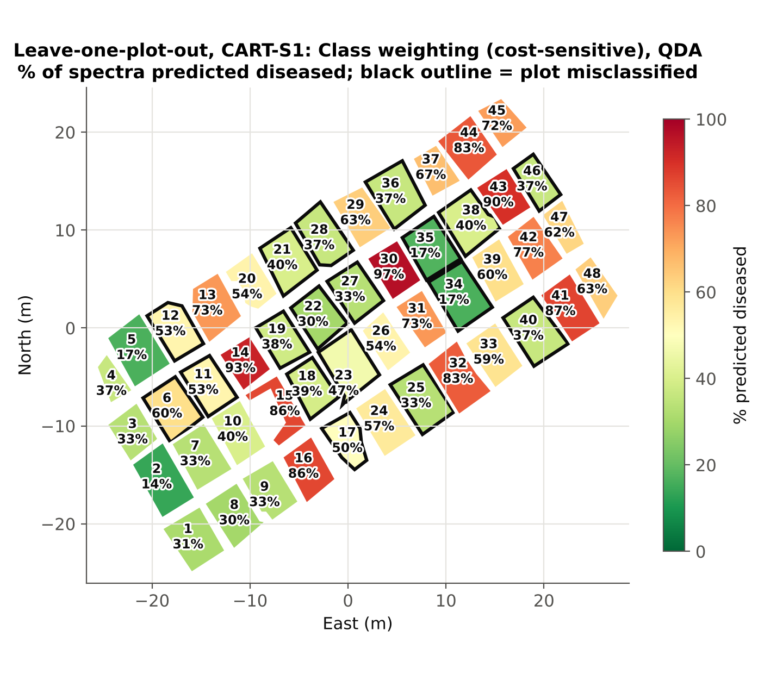
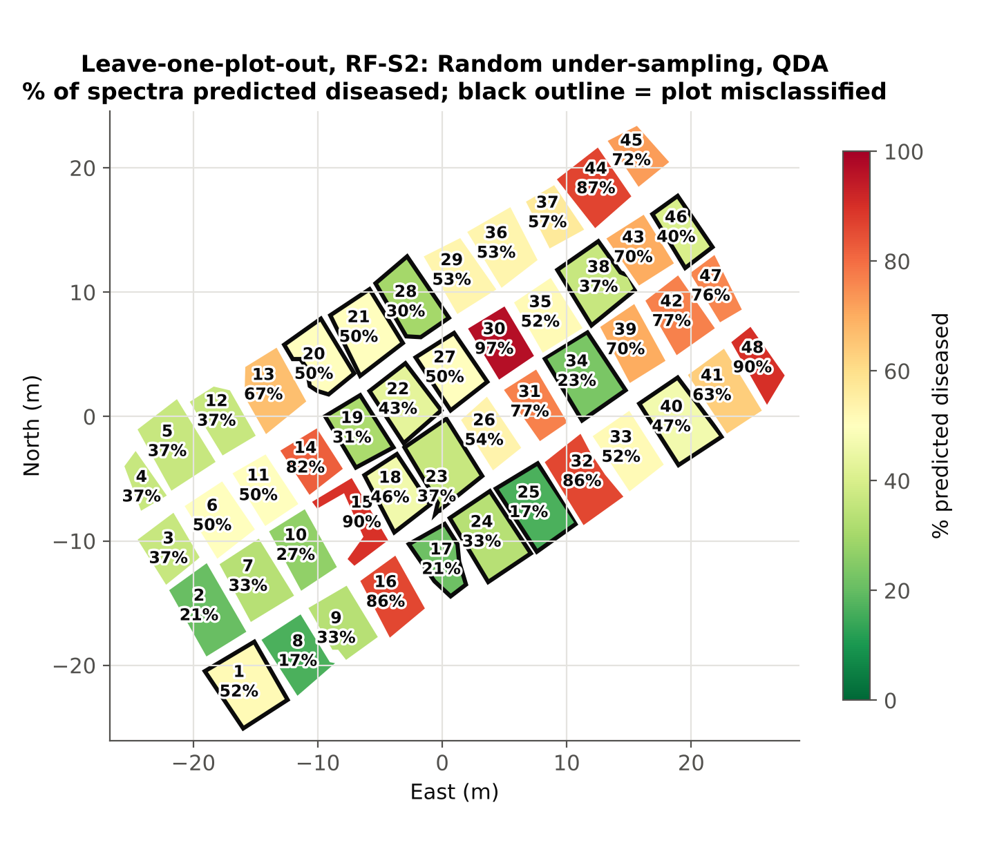
Leave-one-plot-out (CV3): which plots are misclassified?
Plot level
CART-S1: 30/48 plots, plot BA 0.67
RF-S2: 32/48 plots, plot BA 0.75
Best plot BA of 8: CART-S3 0.81
S0 looks good on plots correct (CART 37/48) only because it calls nearly all plots diseased
Configuration | Spectrum BA | Plot BA | Healthy plots wrong | Diseased plots wrong
CART-S1 | 0.605 | 0.667 | 6, 11, 12 | 15 plots
RF-S2 | 0.608 | 0.750 | 1 | 15 plots

Slide 36
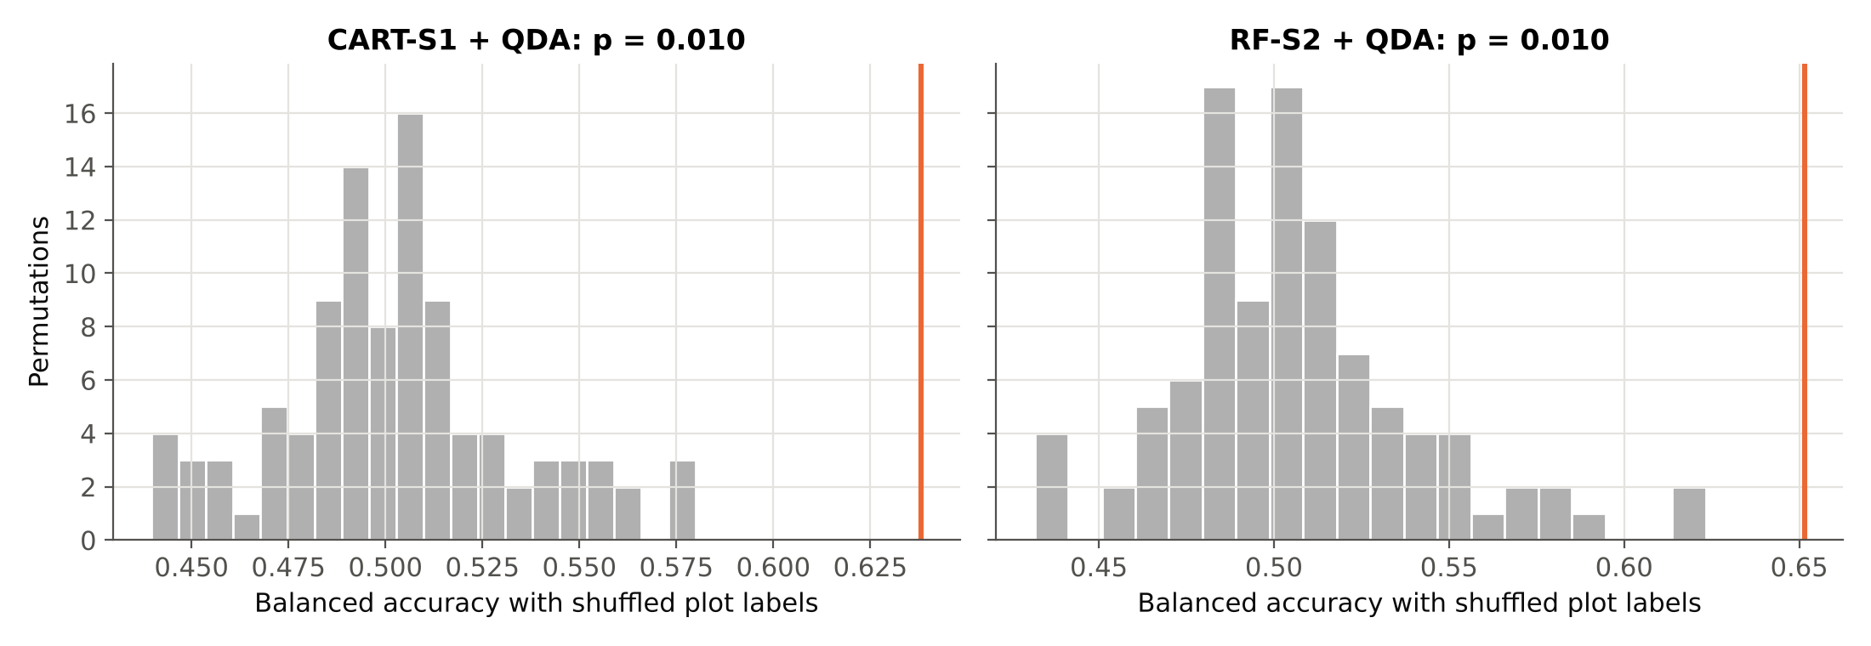
Permutation test: better than chance?
Tier 2 | Strategy | Observed BA | Null mean | Null 95% | p
CART | S1 | 0.638 | 0.503 | 0.556 | 0.010
RF | S2 | 0.651 | 0.506 | 0.572 | 0.010
Plot labels were shuffled 100 times (12 healthy / 36 diseased kept) and the full nested pipeline rerun (one 4-fold repetition each)
Observed = balanced accuracy of CV2 repetition 1 with the true labels. CART: p = 0.010; RF: p = 0.010 (smallest possible p with 100 permutations = 0.010)
Because whole plots are permuted, this tests the plot-level class difference (Ojala & Garriga 2010). In 80 of 800 permuted folds Tier 1 found no significant band; these folds predict by prior (BA 0.5), as the pipeline would

Slide 37
Validation using the treatment design (CV4–CV6)
Configuration | CV2 plot-grouped | CV4 leave-one-treatment-out | CV5 leave-one-variety-out | CV6 leave-one-date-out | CV4–CV6 plot BA
CART-S0 | 0.579 | 0.583 (0.54–0.63) | 0.571 (0.53–0.61) | 0.618 (0.57–0.67) | 0.54 · 0.54 · 0.61
CART-S1 | 0.615 | 0.623 (0.57–0.68) | 0.635 (0.58–0.69) | 0.686 (0.63–0.74) | 0.72 · 0.75 · 0.82
CART-S2 | 0.611 | 0.622 (0.58–0.66) | 0.650 (0.61–0.69) | 0.636 (0.58–0.68) | 0.78 · 0.75 · 0.82
CART-S3 | 0.600 | 0.615 (0.56–0.67) | 0.649 (0.60–0.70) | 0.613 (0.55–0.67) | 0.74 · 0.78 · 0.81
RF-S0 | 0.585 | 0.604 (0.57–0.63) | 0.625 (0.58–0.67) | 0.582 (0.52–0.66) | 0.58 · 0.65 · 0.56
RF-S1 | 0.604 | 0.635 (0.59–0.68) | 0.629 (0.58–0.67) | 0.618 (0.56–0.68) | 0.74 · 0.79 · 0.72
RF-S2 | 0.614 | 0.617 (0.57–0.66) | 0.632 (0.59–0.68) | 0.607 (0.54–0.67) | 0.69 · 0.76 · 0.74
RF-S3 | 0.588 | 0.577 (0.54–0.62) | 0.616 (0.57–0.66) | 0.588 (0.55–0.63) | 0.71 · 0.78 · 0.71
What it shows
Balanced accuracy 0.57–0.69 when a whole treatment level is held out, similar to CV2 (0.58–0.62)
The weak separation is not specific to one variety or inoculation date: the model transfers, but stays weak
Brackets: 95% CI by plot bootstrap
These folds still keep the control block C intact in its location, so they cannot remove the block confound (next slides)

Slide 38
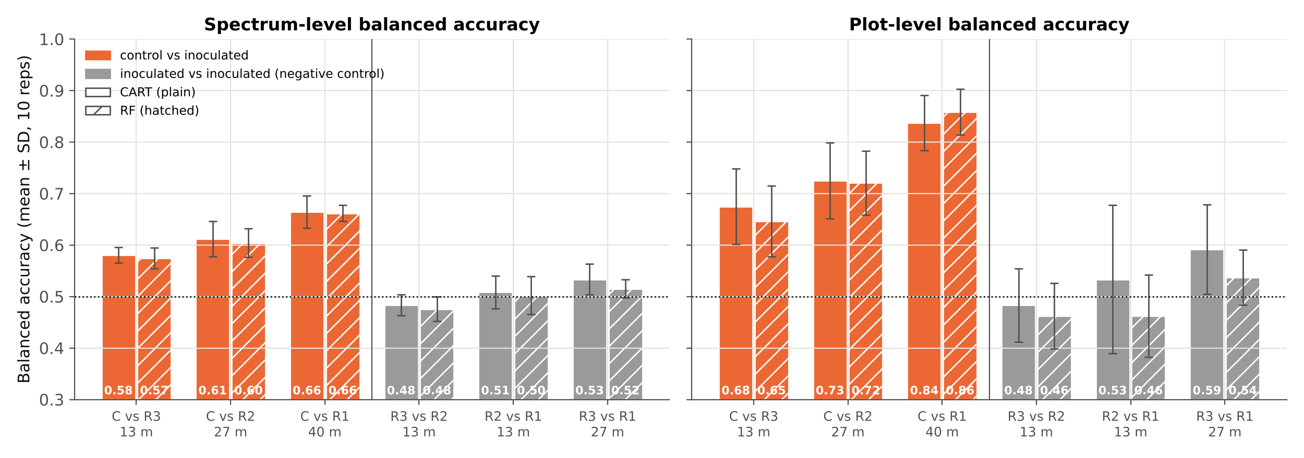
Negative control: block vs block
Control vs inoculated: mean BA 0.62 (CART) / 0.61 (RF); inoculated vs inoculated: 0.51 / 0.50
At the same distance (≈ 27 m): C vs R2 0.61 / 0.60 against R3 vs R1 0.53 / 0.52: the control block differs more than location alone explains
But Tier 1 also finds many significant bands between inoculated blocks (R3 vs R1: 242; plot means 136) and C vs R accuracy rises with distance (C vs R3 0.58 → C vs R1 0.66): a west–east gradient adds to the class difference

Slide 39
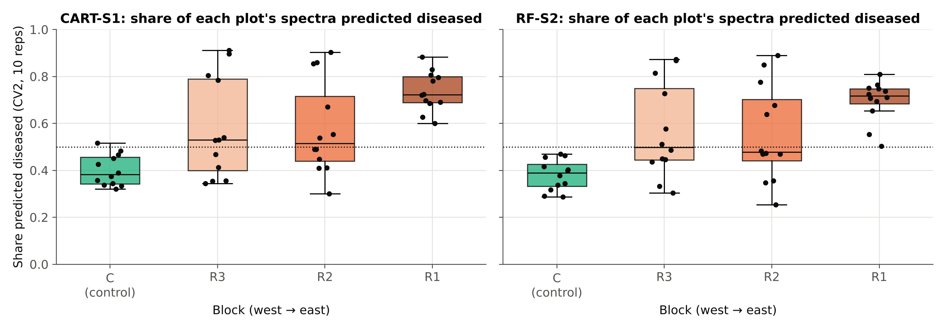
Detection by block, variety and inoculation date
Block labelled healthy | C (true) | R3 | R2 | R1 | p
CART-S1 | 0.615 | 0.485 | 0.499 | 0.552 | 0.25
RF-S2 | 0.614 | 0.489 | 0.474 | 0.532 | 0.25
Restricted permutation: CV2 balanced accuracy when each block in turn is called healthy. p ≥ 0.25 is the smallest possible with 4 blocks.
Share of spectra predicted diseased rises from west to east: C 40%, R3 58%, R2 58%, R1 74% (CART; RF 38% → 70%)
Among inoculated plots detection does not differ by inoculation date (Kruskal–Wallis p = 0.96 CART, 0.88 RF) or variety (p = 0.83, 0.83); between inoculated blocks p = 0.08 / 0.15
The true labelling ranks first of 4 for both methods (p = 0.25), the best this design allows: disease and block cannot be separated statistically with one control block

Slide 40
Comparison: CART vs RF in Tier 2 and the imbalance strategies
Config. | Bands | JM | CV1 BA | CV2 BA | CV2 plot BA | CV3 plot BA (correct) | CV4 BA | CV5 BA | CV6 BA
CART-S0 | 22 | 0.737 | 0.588 | 0.579 | 0.543 | 0.54 (37/48) | 0.583 | 0.571 | 0.618
CART-S1 | 17 | 0.771 | 0.614 | 0.615 | 0.737 | 0.67 (30/48) | 0.623 | 0.635 | 0.686
CART-S2 | 14 | 0.484 | 0.627 | 0.611 | 0.751 | 0.79 (33/48) | 0.622 | 0.650 | 0.636
CART-S3 | 21 | 1.147 | 0.762 | 0.600 | 0.707 | 0.81 (34/48) | 0.615 | 0.649 | 0.613
RF-S0 | 22 | 0.935 | 0.682 | 0.585 | 0.556 | 0.57 (37/48) | 0.604 | 0.625 | 0.582
RF-S1 | 17 | 0.617 | 0.624 | 0.604 | 0.732 | 0.60 (25/48) | 0.635 | 0.629 | 0.618
RF-S2 | 14 | 0.432 | 0.619 | 0.614 | 0.760 | 0.75 (32/48) | 0.617 | 0.632 | 0.607
RF-S3 | 21 | 0.798 | 0.615 | 0.588 | 0.683 | 0.76 (31/48) | 0.577 | 0.616 | 0.588
What the comparison shows
Paper-style CV is optimistic by up to 0.16 BA compared with plot-grouped CV
CART vs RF in Tier 2: best CV2 BA 0.615 (CART) vs 0.614 (RF): no clear winner
S0 (no correction) gives the weakest plot-level result: healthy plots are missed
S1/S2/S3 perform similarly; S1 (class weights) needs no synthetic or discarded data
RF classifier on all 483 bands with class weights only: BA 0.55, plot BA 0.50: it still favours the majority class

Slide 41
Every step was cross-checked
Step | Checks | What was checked | Result
Data | 4 | 1417 × 483; plots 1–12 healthy; no missing values; unique spectra | PASS
Tier 1 | 2 | manual F = scipy; Tukey = ANOVA decision at all bands | PASS
Imbalance | 2 | under-sampling and SMOTE give equal class counts | PASS
Tier 3 | 1 | 1-D closed-form J–M = matrix form | PASS
Validation | 5 | no plot in training and test; SMOTE on training only; permutation nulls ≈ 0.5 | PASS
Tier 4 | 3 | hand-coded QDA = sklearn; BA = (sens + spec)/2; confusion matrix total = N | PASS
Tier 2 | 3 | class weights equalise the root; custom tree = sklearn; bands ⊂ significant set | PASS
Design | 3 | 48 plots; C = plots 1–12; each block holds every variety × date once | PASS
Reproducibility | 1 | CV2 re-run with the shared pipeline module reproduces all 80 stored repetitions | PASS
Accuracy | 5 | pooled matrix totals; OA = 1 − QD − AD; kappa = sklearn; CV3 matrix = stored result | PASS
Validation design | 4 | every spectrum tested once; both classes in every fold; true labelling = main result | PASS
Excel ↔ Python | live | ANOVA F and p, weights, J–M, design layout, all accuracy measures of every error matrix recomputed by Excel formulas | PASS
33 of 33 Python checks pass; live Excel checks in sheet 18_Cross_Checks of Four_Tier_48plots.xlsx. QDA needed the ridge fallback in 0 fits.

Slide 42
D · Discussion, summary and conclusion
What the results mean, their limits, and what to do next

Slide 43
Discussion
Weak to moderate separation
Pseudo-replication
JM ≤ 1.15 (threshold 1.94) and plot-grouped BA 0.58–0.62, far below the 98% of Das et al. Their samples were averaged field spectra of uniform plots; here single SMACC endmembers mix leaves, lesions, soil and shadow.
411 bands are significant with spectra as replicates but only 302 with plot means. Spectra of one plot are not independent, so plot-grouped validation is the honest estimate (Hurlbert 1984; Roberts et al. 2017).
Imbalance handling helps at plot level
CART vs RF in Tier 2
Without correction the minority (healthy) class is under-predicted. Class weighting, under-sampling and SMOTE all raise plot-level BA (best 0.76); applied inside folds only (Santos et al. 2018).
Similar performance (CV2 BA 0.615 vs 0.614). RF ranking is more stable in principle; CART picks complementary bands. The bands change from fold to fold for both.
Block / location confound
All wavelengths kept
All healthy plots form block C at the west end. Inoculated blocks also differ from each other, and the share predicted diseased rises west → east (40% → 74%). Control vs inoculated (BA 0.62) beats inoculated vs inoculated (0.51), so some disease signal is likely, but with one control block it cannot be proven (restricted permutation p = 0.25).
Edge bands (< 420, > 2,350 nm) and negative reflectance are retained as requested; some selected bands lie there (CART-S1: 2 edge bands). CART's first split uses near-zero/negative R2380. The ≈ 918–921 nm bands, chosen in most RF folds, sit just after the 899–916 nm gap where Tier 1 shows a narrow spike: check for a sensor artefact.

Slide 44
Summary
1417
411
17 / 22
endmember spectra (358 healthy, 1059 diseased) × 483 bands, all kept separately
bands significant in Tier 1 (only 302 with plot means)
CART bands with / without class weights; RF selects the same number
1.15
0.62
0.76
highest J–M distance (CART-S3), below the 1.94 threshold
best plot-grouped balanced accuracy (CART-S1); paper-style up to 0.76
best plot-level BA (RF-S2); plot-label permutation p = 0.010, block-level p = 0.25 (minimum possible)

Slide 45
Conclusion
The four-tier method of Das et al. (2020) was applied to all 1417 endmembers of 48 plots and all 483 bands, with Random Forest replacing CART in Tier 2 for comparison and four ways of handling the 1 : 2.96 imbalance.
Healthy and diseased spectra differ statistically, but separability is low (JM ≤ 1.15) and realistic plot-grouped balanced accuracy is 0.62 at best (plot level 0.76).
Imbalance correction is needed: class weighting (S1) is the simplest choice that keeps all data; CART and RF in Tier 2 perform similarly.
Paper-style random cross-validation overstates accuracy; plots must be the validation unit. Holding out whole varieties, inoculation dates or treatment combinations gives similar, weak accuracy (BA ≈ 0.62).
The control plots form a single block, and inoculated blocks also differ along the field: part of the healthy–diseased separation is location. Next season: randomise control plots within every replication, add plot-level disease scores and an independent date.

Slide 46
References (1/3)
Das B, Sahoo RN, Biswas A, Pargal S, Krishna G, Verma R, Chinnusamy V, Sehgal VK, Gupta VK (2020) Discrimination of rice genotypes using field spectroradiometry. Geocarto International 35(1):64–77. doi:10.1080/10106049.2018.1506507
Gruninger JH, Ratkowski AJ, Hoke ML (2004) The sequential maximum angle convex cone (SMACC) endmember model. Proc. SPIE 5425, Algorithms and Technologies for Multispectral, Hyperspectral, and Ultraspectral Imagery X. doi:10.1117/12.543794
Tukey JW (1949) Comparing individual means in the analysis of variance. Biometrics 5(2):99–114
Benjamini Y, Hochberg Y (1995) Controlling the false discovery rate: a practical and powerful approach to multiple testing. Journal of the Royal Statistical Society B 57(1):289–300. doi:10.1111/j.2517-6161.1995.tb02031.x
Hurlbert SH (1984) Pseudoreplication and the design of ecological field experiments. Ecological Monographs 54(2):187–211
Breiman L, Friedman JH, Olshen RA, Stone CJ (1984) Classification and Regression Trees. Wadsworth, Belmont, CA
Therneau TM, Atkinson EJ. An introduction to recursive partitioning using the RPART routines. Mayo Foundation; R package rpart (rpart.control defaults: minsplit 20, cp 0.01, maxdepth 30)
Breiman L (2001) Random forests. Machine Learning 45(1):5–32. doi:10.1023/A:1010933404324
Strobl C, Boulesteix A-L, Kneib T, Augustin T, Zeileis A (2008) Conditional variable importance for random forests. BMC Bioinformatics 9:307. doi:10.1186/1471-2105-9-307
Richards JA (2013) Remote Sensing Digital Image Analysis. Springer, Berlin
Chawla NV, Bowyer KW, Hall LO, Kegelmeyer WP (2002) SMOTE: Synthetic Minority Over-sampling Technique. Journal of Artificial Intelligence Research 16:321–357. doi:10.1613/jair.953

Slide 47
References (2/3)
He H, Garcia EA (2009) Learning from imbalanced data. IEEE Transactions on Knowledge and Data Engineering 21(9):1263–1284
Chen C, Liaw A, Breiman L (2004) Using random forest to learn imbalanced data. Technical Report 666, Department of Statistics, University of California, Berkeley
Douzas G, Bacao F, Fonseca J, Khudinyan M (2019) Imbalanced learning in land cover classification: improving minority classes' prediction accuracy using the geometric SMOTE algorithm. Remote Sensing 11(24):3040. doi:10.3390/rs11243040
Cuenca-Romero C, Apolo-Apolo OE, Rodríguez Vázquez JN, Egea G, Pérez-Ruiz M (2024) Tackling unbalanced datasets for yellow and brown rust detection in wheat. Frontiers in Plant Science 15:1392409. doi:10.3389/fpls.2024.1392409
Santos MS, Soares JP, Abreu PH, Araújo H, Santos J (2018) Cross-validation for imbalanced datasets: avoiding overoptimistic and overfitting approaches. IEEE Computational Intelligence Magazine 13(4):59–76. doi:10.1109/MCI.2018.2866730
Lemaître G, Nogueira F, Aridas CK (2017) Imbalanced-learn: a Python toolbox to tackle the curse of imbalanced datasets in machine learning. Journal of Machine Learning Research 18(17):1–5
Brodersen KH, Ong CS, Stephan KE, Buhmann JM (2010) The balanced accuracy and its posterior distribution. Proc. 20th International Conference on Pattern Recognition, 3121–3124. doi:10.1109/ICPR.2010.764
Chicco D, Jurman G (2020) The advantages of the Matthews correlation coefficient (MCC) over F1 score and accuracy in binary classification evaluation. BMC Genomics 21:6. doi:10.1186/s12864-019-6413-7
Cohen J (1960) A coefficient of agreement for nominal scales. Educational and Psychological Measurement 20(1):37–46. doi:10.1177/001316446002000104
Story M, Congalton RG (1986) Accuracy assessment: a user's perspective. Photogrammetric Engineering and Remote Sensing 52(3):397–399
Congalton RG (1991) A review of assessing the accuracy of classifications of remotely sensed data. Remote Sensing of Environment 37(1):35–46. doi:10.1016/0034-4257(91)90048-B

Slide 48
References (3/3)
Olofsson P, Foody GM, Herold M, Stehman SV, Woodcock CE, Wulder MA (2014) Good practices for estimating area and assessing accuracy of land change. Remote Sensing of Environment 148:42–57. doi:10.1016/j.rse.2014.02.015
Pontius RG Jr, Millones M (2011) Death to Kappa: birth of quantity disagreement and allocation disagreement for accuracy assessment. International Journal of Remote Sensing 32(15):4407–4429. doi:10.1080/01431161.2011.552923
Field CA, Welsh AH (2007) Bootstrapping clustered data. Journal of the Royal Statistical Society B 69(3):369–390. doi:10.1111/j.1467-9868.2007.00593.x
Roberts DR, Bahn V, Ciuti S, et al. (2017) Cross-validation strategies for data with temporal, spatial, hierarchical, or phylogenetic structure. Ecography 40(8):913–929. doi:10.1111/ecog.02881
Ambroise C, McLachlan GJ (2002) Selection bias in gene extraction on the basis of microarray gene-expression data. PNAS 99(10):6562–6566. doi:10.1073/pnas.102102699
Meyer H, Reudenbach C, Hengl T, Katurji M, Nauss T (2018) Improving performance of spatio-temporal machine learning models using forward feature selection and target-oriented validation. Environmental Modelling & Software 101:1–9. doi:10.1016/j.envsoft.2017.12.001
Lipsitch M, Tchetgen Tchetgen E, Cohen T (2010) Negative controls: a tool for detecting confounding and bias in observational studies. Epidemiology 21(3):383–388. doi:10.1097/EDE.0b013e3181d61eeb
Anderson MJ, ter Braak CJF (2003) Permutation tests for multi-factorial analysis of variance. Journal of Statistical Computation and Simulation 73(2):85–113. doi:10.1080/00949650215733
Kruskal WH, Wallis WA (1952) Use of ranks in one-criterion variance analysis. Journal of the American Statistical Association 47(260):583–621. doi:10.2307/2280779
Ojala M, Garriga GC (2010) Permutation tests for studying classifier performance. Journal of Machine Learning Research 11:1833–1863
Pedregosa F, et al. (2011) Scikit-learn: machine learning in Python. Journal of Machine Learning Research 12:2825–2830

