Slide 1
Disease-specific spectral features of white rust in mustard leaves: what 23 feature-selection methods agree on
Features chosen by filter, wrapper and embedded methods · features stable across methods, dates, growth stages and varieties · a feature set to discriminate healthy and diseased leaves
2264 leaf spectra (378 healthy, 1886 diseased) · ASD contact probe, 1-nm · K1–K4 pool of 4150 features · 20 plot-grouped training sets
Animesh Panda · Division of Agricultural Physics, ICAR-IARI, New Delhi

Slide 2
Key messages
3
5
7 / 7
85.6 %
core water features chosen by 10–17 of the 21 methods
stable spectral regions (selected by ≥ 11 of 21 methods)
stable features keep the same direction on every date, stage and variety
RF balanced accuracy on new plots with the 11-feature recommended set
The most stable disease-specific signal is LEAF WATER: the width of the 970-nm water band (narrower in diseased leaves) and the position and symmetry of the 1940-nm water band (shifted and more asymmetric) — chosen by 17, 13 and 10 of 21 methods.
Derivative bands on the 1940-nm water-band wing (1915, 1934 nm) and across the NIR plateau (848–911 nm; leaf structure) are the next most stable features.
All seven stable features change in the same direction on all 4 dates, 3 growth stages and 3 varieties.
Stable features alone are not the most accurate: weak but complementary features (anthocyanin index ARI, C–H bands 1724 / 2223 / 2306 nm) raise QDA accuracy from 70.8 % to 80.2 % and RF to 85.6 %.

Slide 3
How 'disease-specific' and 'stable' were judged
23 methods (11 filter, 6 wrapper, 6 embedded + Borda consensus) selected features from the same K1–K4 pool (4150 features) inside 20 plot-grouped training sets — never using the test plots.
For each method, the redundancy-controlled top-10 features (|r| < 0.95 between chosen features) of each training set were recorded.
Selection frequency = share of the 20 training sets in which a feature (± 10 nm, same spectral series) was in the top-10.
STABLE across methods = selected in ≥ 50 % of training sets by many methods (core ≥ 10 of 21; supporting 5–9; complementary 3–4). Pearson r and Fisher score count once (identical to ANOVA F).
STABLE across conditions = same direction of change and useful AUC within every date, growth stage and variety.
INFORMATIVE = balanced accuracy on held-out plots, AUC and effect size (Hedges g).
Features within 10 nm of an ASD detector join (≈ 1000, 1800 nm) are flagged as possible artefacts.
Filter (11)
Pearson r · ANOVA F · Fisher · χ² · MI · ReliefF · J–M · mRMR · SPA · MC-UVE · CWT
Wrapper (6)
SVM-RFE · RF-RFE · CARS · SFFS (QDA) · SFFS (J–M) · GA
Embedded (6) + consensus
RF · CART · Boruta · PLS-VIP · LASSO · gradient boosting · Borda

Slide 4
Where are the disease-specific features?
Spectral regions selected by the different feature-selection methods

Slide 5
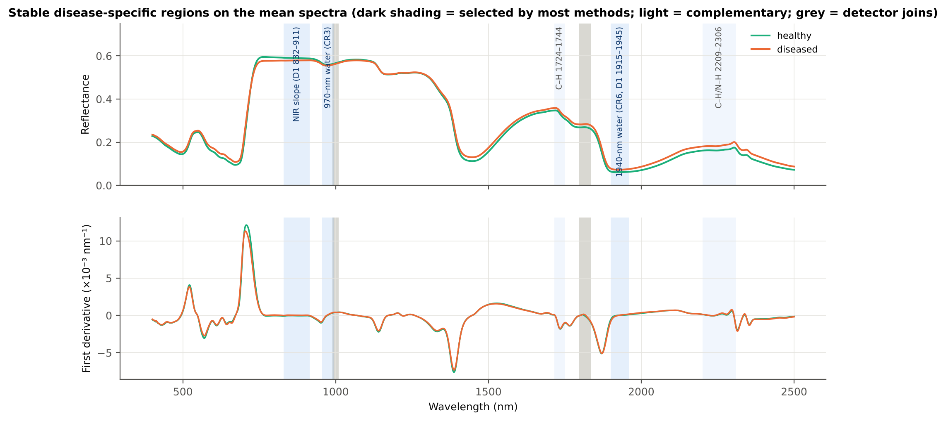
Five spectral regions are selected by most methods
Liquid water: continuum-removed 970-nm and 1940-nm water bands (18 of 21 methods each) and the 1940-nm band wing in the first derivative (11 methods).
Leaf structure: first-derivative slope across the NIR plateau 760–930 nm (16 methods).
Dry matter: C–H absorption near 1730 nm (12 methods) and 2200–2300 nm (6 methods) — complementary information.
Pigments (red edge, visible) are chosen by few methods: white rust changes water and structure more consistently than chlorophyll.
Spectral region / feature group | Meaning | Methods ≥ 50 %
CR 970-nm water band | liquid water (O–H, 970 nm) | 18
CR 1940-nm water band | liquid water (O–H, 1940 nm) | 18
D1 NIR plateau 760–930 nm | mesophyll structure (NIR scattering) | 16
D1 C–H band 1700–1792 nm | C–H: lignin, cellulose, waxes (1730 nm) | 12
D1 1940-nm water band 1840–1990 nm | liquid water (1940 nm) | 11
D1 1200-nm water band 1000–1300 nm | water (1200 nm) | 8

Slide 6
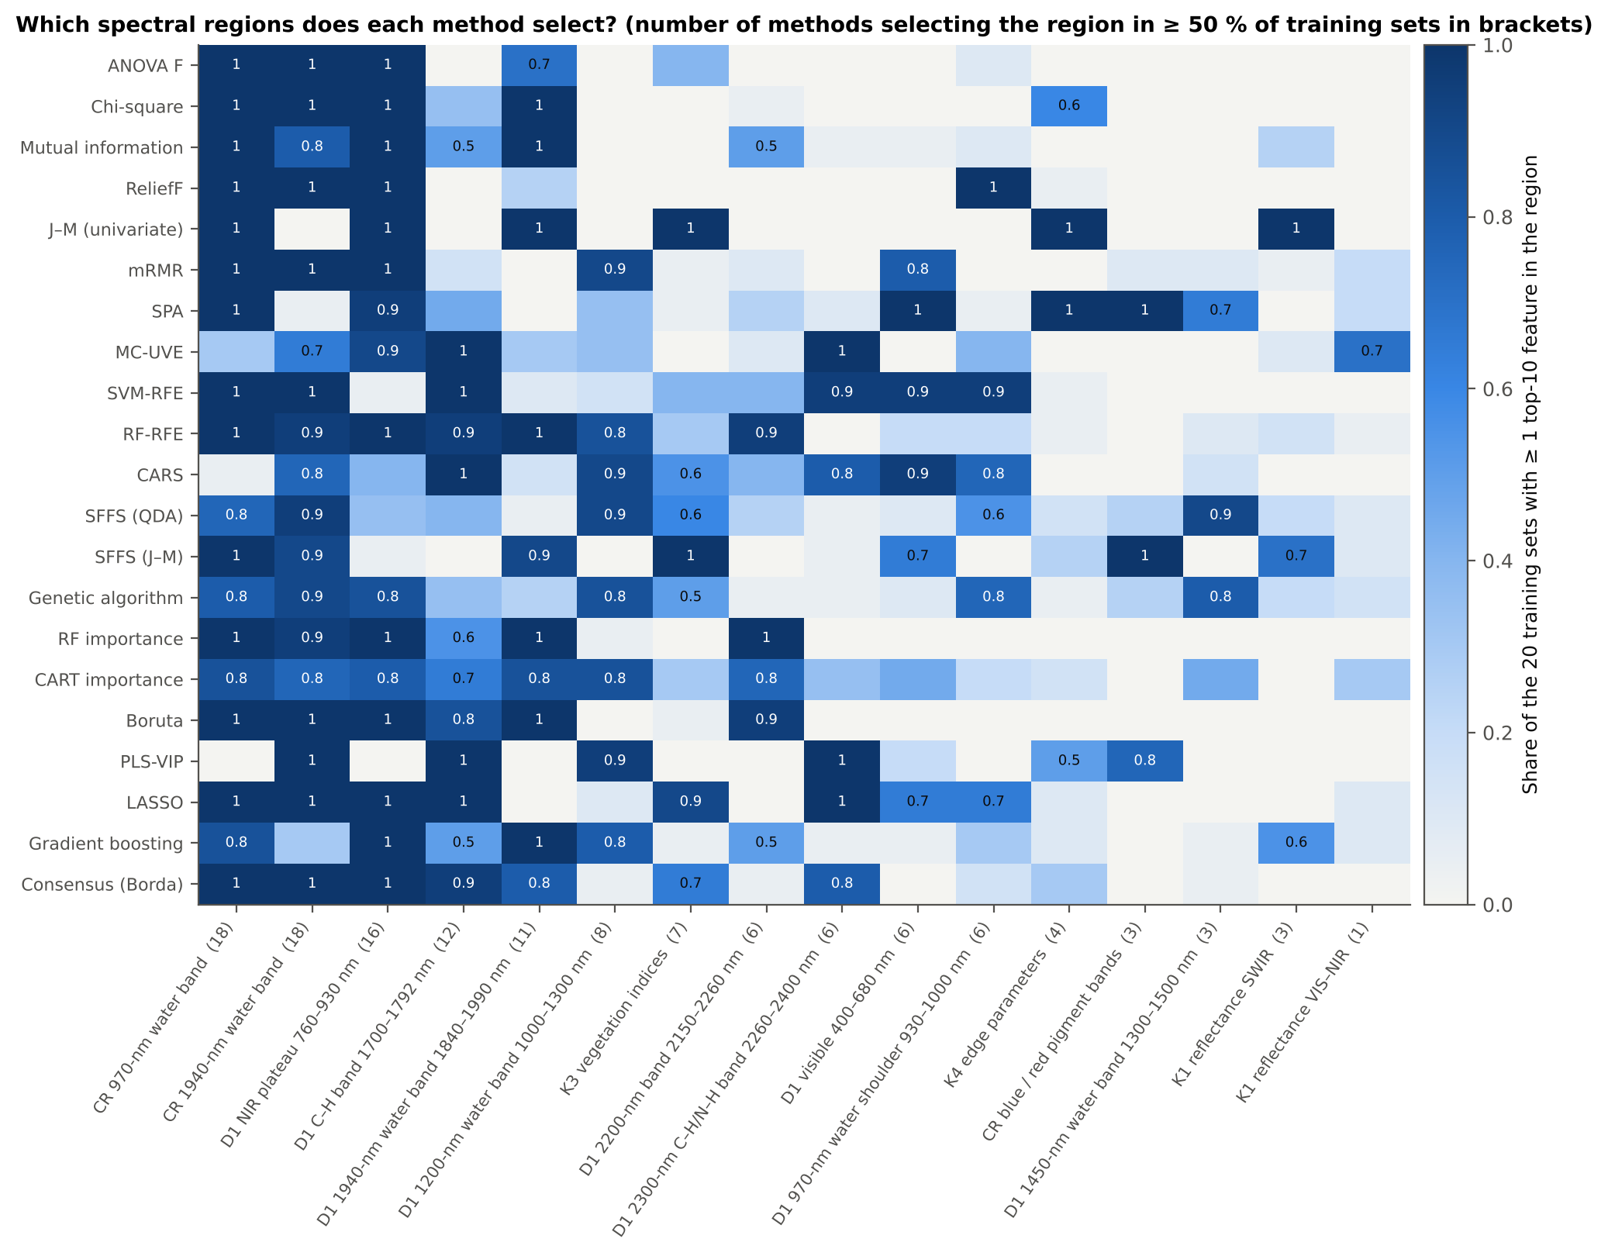
Which regions does each method select?
Cells = share of the 20 training sets in which the method's top-10 contains ≥ 1 feature of the region; brackets = number of methods with ≥ 50 %.
Almost every method takes the 970-nm and 1940-nm water features and the NIR-plateau slope.
Linear and PLS-based selectors (SVM-RFE, CARS, LASSO, PLS-VIP) add the 1730 and 2300 nm C–H regions and the 970-nm shoulder.
SPA and SFFS (J–M) differ most: they favour uncorrelated or variance-based features (pigment CR bands, edge parameters).

Slide 7
Disease-specific features chosen by each method
Top-10 features on all leaves (redundancy-controlled) and the regions they belong to

Slide 8
Filter methods: features and regions
Method | Top-10 features (all leaves, redundancy-controlled) | Regions (number of features)
ANOVA F | D1_848, D1_884, CR3 water 970 width, D1_825, CR6 water 1940 position, D1_913, D1_920, D1_785, D1_1937, D1_772 | D1 NIR plateau 760–930 nm (7); CR 970-nm water band (1); CR 1940-nm water band (1); D1 1940-nm water band 1840–1990 nm (1)
Chi-square | CR3 water 970 width, D1_872, CR6 water 1940 symmetry, D1_1911, D1_1939, D1_832, CR6 water 1940 position, D1_899, D1_1933, D1_1922 | D1 1940-nm water band 1840–1990 nm (4); D1 NIR plateau 760–930 nm (3); CR 1940-nm water band (2); CR 970-nm water band (1)
Mutual information | D1_871, D1_1911, D1_1942, D1_901, D1_832, D1_1934, CR6 water 1940 symmetry, D1_1743, D1_799, CR3 water 970 width | D1 NIR plateau 760–930 nm (4); D1 1940-nm water band 1840–1990 nm (3); CR 1940-nm water band (1); D1 C–H band 1700–1792 nm (1); CR 970-nm water band (1)
ReliefF | CR6 water 1940 position, CR3 water 970 width, CR6 water 1940 symmetry, D1_872, D1_981, D1_977, D1_899, D1_798, D1_973, D1_832 | D1 NIR plateau 760–930 nm (4); D1 970-nm water shoulder 930–1000 nm (3); CR 1940-nm water band (2); CR 970-nm water band (1)
J–M (univariate) | SDr/SDy, CR3 water 970 width, R1894, D1_1934, RVS2, D1_884, D1_848, D1_1941, D1_913, D1_1931 | D1 1940-nm water band 1840–1990 nm (3); D1 NIR plateau 760–930 nm (3); K4 edge parameters (1); CR 970-nm water band (1); K1 reflectance SWIR (1); K3 vegetation indices (1)
mRMR | D1_848, D1_1053, CR6 water 1940 position, CR3 water 970 width, D1_655, CR3 water 970 symmetry, CR6 water 1940 symmetry, D1_884 | D1 NIR plateau 760–930 nm (2); CR 1940-nm water band (2); CR 970-nm water band (2); D1 1200-nm water band 1000–1300 nm (1); D1 visible 400–680 nm (1)
SPA | D1_873, D1_2141, D1_674, SDr/SDb, D1_1052, SDr/SDy, D1_756, D1_1792, CR3 water 970 symmetry, CR1 blue symmetry | K4 edge parameters (2); D1 NIR plateau 760–930 nm (1); D1 2000–2150 nm (1); D1 visible 400–680 nm (1); D1 1200-nm water band 1000–1300 nm (1); D1 red edge 680–760 nm (1); D1 C–H band 1700–1792 nm (1); CR 970-nm water band (1); CR blue / red pigment bands (1)
MC-UVE | D1_1744, D1_1725, D1_2305, D1_2304, D1_2306, D1_1724, D1_899, D1_1747, D1_2324, R1035 | D1 C–H band 1700–1792 nm (4); D1 2300-nm C–H/N–H band 2260–2400 nm (4); D1 NIR plateau 760–930 nm (1); K1 reflectance VIS–NIR (1)
CWT scalogram | CWT s8 2385, CWT s8 2265, CWT s2 1920, CWT s32 2435, CWT s16 2360, CWT s4 655, CWT s2 2495, CWT s16 2275, CWT s2 680, CWT s8 2185 | wavelet features: SWIR 2185–2495 nm, red 655–680 nm, 1920 nm

Slide 9
Wrapper methods: features and regions
Method | Top-10 features (all leaves, redundancy-controlled) | Regions (number of features)
SVM-RFE | CR3 water 970 width, CR6 water 1940 position, D1_454, D1_2329, D1_2305, D1_982, D1_1791, D1_1724, D1_2166, D1_2206 | D1 2300-nm C–H/N–H band 2260–2400 nm (2); D1 C–H band 1700–1792 nm (2); D1 2200-nm band 2150–2260 nm (2); CR 970-nm water band (1); CR 1940-nm water band (1); D1 visible 400–680 nm (1); D1 970-nm water shoulder 930–1000 nm (1)
RF-RFE | D1_872, CR6 water 1940 symmetry, D1_1164, CR3 water 970 width, D1_1914, D1_2210, D1_1934, D1_2224, D1_1738, D1_1724 | D1 1940-nm water band 1840–1990 nm (2); D1 2200-nm band 2150–2260 nm (2); D1 C–H band 1700–1792 nm (2); D1 NIR plateau 760–930 nm (1); CR 1940-nm water band (1); D1 1200-nm water band 1000–1300 nm (1); CR 970-nm water band (1)
CARS | D1_2205, ARI, D1_1723, D1_1749, D1_453, D1_982, D1_2305, D1_2168, CR6 water 1940 position, D1_1791 | D1 C–H band 1700–1792 nm (3); D1 2200-nm band 2150–2260 nm (2); K3 vegetation indices (1); D1 visible 400–680 nm (1); D1 970-nm water shoulder 930–1000 nm (1); D1 2300-nm C–H/N–H band 2260–2400 nm (1); CR 1940-nm water band (1)
SFFS (QDA) | CR3 water 970 width, D1_938, CR6 water 1940 position, R1386, ARI, D1_884, D1_913, D1_745, D1_1353, D1_1365 | D1 NIR plateau 760–930 nm (2); D1 1450-nm water band 1300–1500 nm (2); CR 970-nm water band (1); D1 970-nm water shoulder 930–1000 nm (1); CR 1940-nm water band (1); K1 reflectance SWIR (1); K3 vegetation indices (1); D1 red edge 680–760 nm (1)
SFFS (J–M) | RVS2, CR3 water 970 width, CR2 red area, RARSc, GNDVI, CR6 water 1940 position, D1_1921, CR5 water 1450 area, D1_1894, R1901 | K3 vegetation indices (3); D1 1940-nm water band 1840–1990 nm (2); CR 970-nm water band (1); CR blue / red pigment bands (1); CR 1940-nm water band (1); CR 1450-nm water band (1); K1 reflectance SWIR (1)
Genetic algorithm | CR6 water 1940 symmetry, D1_1353, CR1 blue depth, D1_2417, CR3 water 970 width, D1_926, D1_1083, D1_938, D1_970, D1_705 | D1 970-nm water shoulder 930–1000 nm (2); CR 1940-nm water band (1); D1 1450-nm water band 1300–1500 nm (1); CR blue / red pigment bands (1); D1 2400–2500 nm (1); CR 970-nm water band (1); D1 NIR plateau 760–930 nm (1); D1 1200-nm water band 1000–1300 nm (1); D1 red edge 680–760 nm (1)

Slide 10
Embedded methods and consensus: features and regions
Method | Top-10 features (all leaves, redundancy-controlled) | Regions (number of features)
RF importance | CR3 water 970 width, D1_861, D1_1915, D1_1934, CR6 water 1940 symmetry, D1_898, D1_2222, D1_1923, D1_1942, D1_2209 | D1 1940-nm water band 1840–1990 nm (4); D1 NIR plateau 760–930 nm (2); D1 2200-nm band 2150–2260 nm (2); CR 970-nm water band (1); CR 1940-nm water band (1)
CART importance | D1_861, CR3 water 970 width, CR6 water 1940 symmetry, D1_1164, D1_1950, D1_900, D1_1736, D1_1931, R639, D1_2224 | D1 NIR plateau 760–930 nm (2); D1 1940-nm water band 1840–1990 nm (2); CR 970-nm water band (1); CR 1940-nm water band (1); D1 1200-nm water band 1000–1300 nm (1); D1 C–H band 1700–1792 nm (1); K1 reflectance VIS–NIR (1); D1 2200-nm band 2150–2260 nm (1)
Boruta | CR3 water 970 width, D1_861, CR6 water 1940 symmetry, D1_1916, D1_1934, D1_2223, D1_2209, D1_899, D1_1946, D1_1724 | D1 1940-nm water band 1840–1990 nm (3); D1 NIR plateau 760–930 nm (2); D1 2200-nm band 2150–2260 nm (2); CR 970-nm water band (1); CR 1940-nm water band (1); D1 C–H band 1700–1792 nm (1)
PLS-VIP | CR6 water 1940 position, D1_2305, CR6 water 1940 symmetry, D1_1070, CR1 blue width, D1_1792, D1_1724, D1_2306, D1_1073, D1_1060 | D1 1200-nm water band 1000–1300 nm (3); CR 1940-nm water band (2); D1 2300-nm C–H/N–H band 2260–2400 nm (2); D1 C–H band 1700–1792 nm (2); CR blue / red pigment bands (1)
LASSO | CR6 water 1940 position, CR3 water 970 width, D1_848, D1_1724, D1_2330, D1_1792, D1_898, PPR, D1_981, D1_660 | D1 NIR plateau 760–930 nm (2); D1 C–H band 1700–1792 nm (2); CR 1940-nm water band (1); CR 970-nm water band (1); D1 2300-nm C–H/N–H band 2260–2400 nm (1); K3 vegetation indices (1); D1 970-nm water shoulder 930–1000 nm (1); D1 visible 400–680 nm (1)
Gradient boosting | D1_849, D1_795, D1_2222, D1_1909, D1_888, CR6 water 1940 position, CR3 water 970 width, R1330, D1_2461, D1_1064 | D1 NIR plateau 760–930 nm (3); D1 2200-nm band 2150–2260 nm (1); D1 1940-nm water band 1840–1990 nm (1); CR 1940-nm water band (1); CR 970-nm water band (1); K1 reflectance SWIR (1); D1 2400–2500 nm (1); D1 1200-nm water band 1000–1300 nm (1)
Consensus (Borda) | CR3 water 970 width, CR6 water 1940 position, CR6 water 1940 symmetry, D1_1934, D1_848, D1_1724, D1_2305, D1_1792, ARI, D1_899 | CR 1940-nm water band (2); D1 NIR plateau 760–930 nm (2); D1 C–H band 1700–1792 nm (2); CR 970-nm water band (1); D1 1940-nm water band 1840–1990 nm (1); D1 2300-nm C–H/N–H band 2260–2400 nm (1); K3 vegetation indices (1)

Slide 11
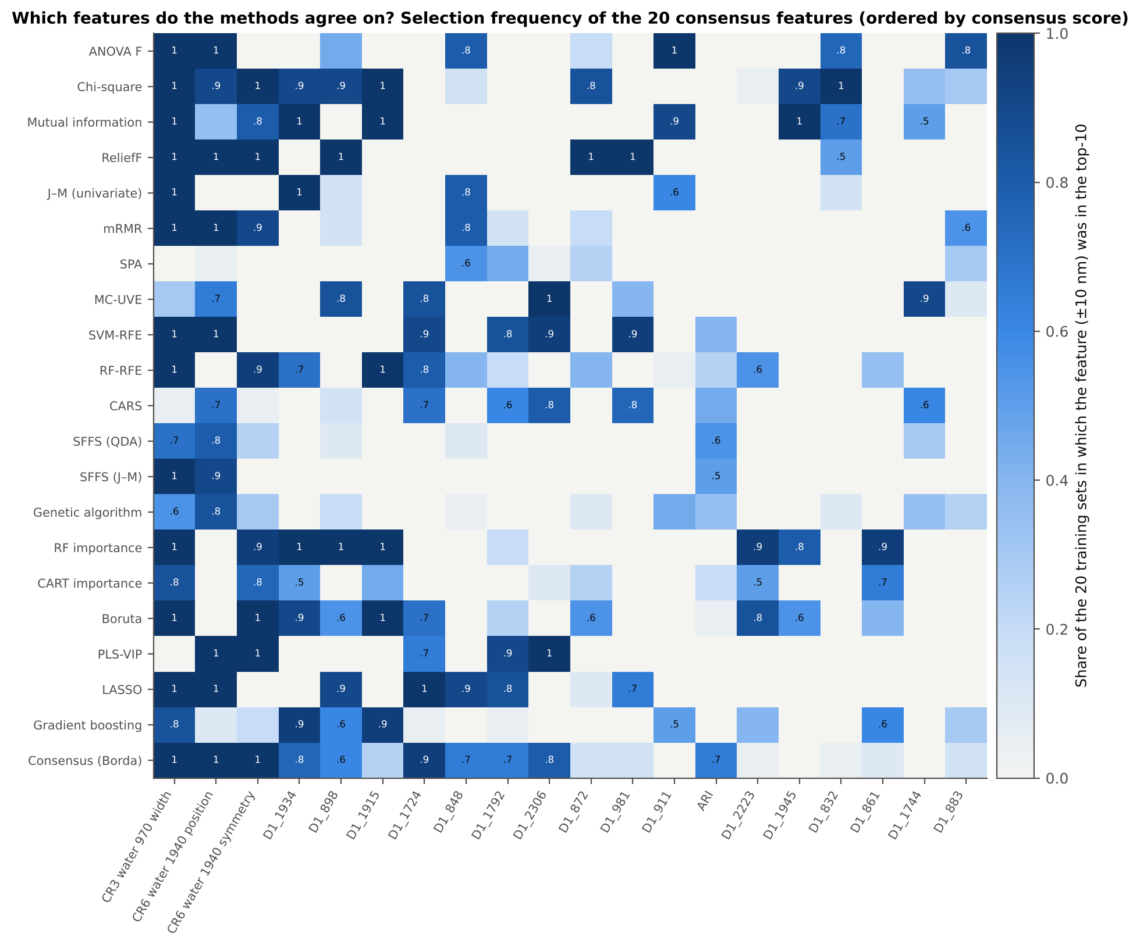
Which exact features do the methods agree on?

Slide 12
Features stable across most methods
Agreement between methods, consistency across dates, stages and varieties, and difference between healthy and diseased leaves

Slide 13
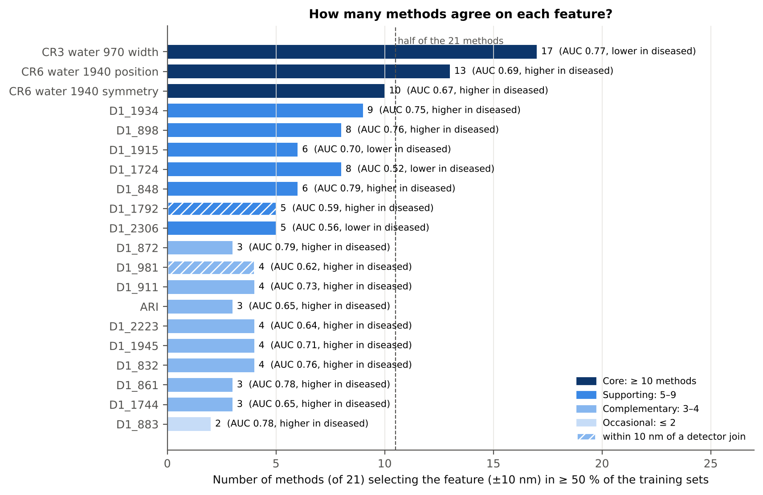
How many methods agree on each feature?
Core (≥ 10 of 21 methods): CR3 970-nm width (17), CR6 1940-nm position (13), CR6 1940-nm symmetry (10).
Supporting (5–9): D1_1934 (9), D1_898 (8), D1_1724 (8), D1_1915 (6), D1_848 (6), D1_2306 (5), D1_1792 (5, next to the 1800-nm join).
Complementary (3–4): D1_872, D1_911, D1_832, D1_861 (same NIR-slope region as D1_848/898), D1_1945, D1_2223, D1_2209, ARI, D1_1744, SDr/SDb, D1_981 (next to the 1000-nm join).
Neighbouring 1-nm bands are interchangeable: the NIR-slope REGION (832–911 nm) is stable even though the exact band varies between methods.

Slide 14
The stable features: tier, AUC and change from healthy to diseased
Feature | Tier | Methods ≥ 50 % | AUC | Healthy → diseased | Note
CR3 water 970 width | Core | 17 | 0.77 | 64.2 → 60.9 (lower)
CR6 water 1940 position | Core | 13 | 0.69 | 1912.2 → 1916.6 (higher)
CR6 water 1940 symmetry | Core | 10 | 0.67 | 0.238 → 0.250 (higher)
D1_1934 | Supporting | 9 | 0.75 | 0.032 → 0.056 (higher)
D1_898 | Supporting | 8 | 0.76 | -0.037 → 0.017 (higher)
D1_1915 | Supporting | 6 | 0.70 | -0.045 → -0.123 (lower)
D1_1724 | Supporting | 8 | 0.52 | -0.660 → -0.663 (lower) | weak alone
D1_848 | Supporting | 6 | 0.79 | -0.031 → 0.031 (higher)
D1_1792 | Supporting | 5 | 0.59 | -0.133 → -0.124 (higher) | near detector join
D1_2306 | Supporting | 5 | 0.56 | -0.607 → -0.647 (lower) | weak alone
D1_872 | Complementary | 3 | 0.79 | -0.045 → 0.009 (higher)
D1_981 | Complementary | 4 | 0.62 | 0.188 → 0.225 (higher) | near detector join
D1_911 | Complementary | 4 | 0.73 | -0.050 → 0.005 (higher)
ARI | Complementary | 3 | 0.65 | -1.003 → -0.593 (higher)
D1_2223 | Complementary | 4 | 0.64 | -0.019 → -0.000 (higher)
D1_1945 | Complementary | 4 | 0.71 | 0.052 → 0.104 (higher)
Derivative values ×10⁻³ nm⁻¹; CR width and position in nm. AUC is direction-free (0.5 = no discrimination).

Slide 15
Which methods select the core and supporting features?
Feature | Methods selecting it in ≥ 50 % of the training sets
CR3 water 970 width | ANOVA F, Chi-square, Mutual information, ReliefF, J–M (univariate), mRMR, SVM-RFE, RF-RFE, SFFS (QDA), SFFS (J–M), Genetic algorithm, RF importance, CART importance, Boruta, LASSO, Gradient boosting, Consensus (Borda)
CR6 water 1940 position | ANOVA F, Chi-square, ReliefF, mRMR, MC-UVE, SVM-RFE, CARS, SFFS (QDA), SFFS (J–M), Genetic algorithm, PLS-VIP, LASSO, Consensus (Borda)
CR6 water 1940 symmetry | Chi-square, Mutual information, ReliefF, mRMR, RF-RFE, RF importance, CART importance, Boruta, PLS-VIP, Consensus (Borda)
D1_1934 | Chi-square, Mutual information, J–M (univariate), RF-RFE, RF importance, CART importance, Boruta, Gradient boosting, Consensus (Borda)
D1_898 | Chi-square, ReliefF, MC-UVE, RF importance, Boruta, LASSO, Gradient boosting, Consensus (Borda)
D1_1915 | Chi-square, Mutual information, RF-RFE, RF importance, Boruta, Gradient boosting
D1_1724 | MC-UVE, SVM-RFE, RF-RFE, CARS, Boruta, PLS-VIP, LASSO, Consensus (Borda)
The water-band continuum features are chosen by all three families — filters, wrappers and embedded methods — which is why they are the most trustworthy disease markers.
Derivative features are chosen mainly by filters and tree-based methods; wrappers replace some of them by complementary features.

Slide 16
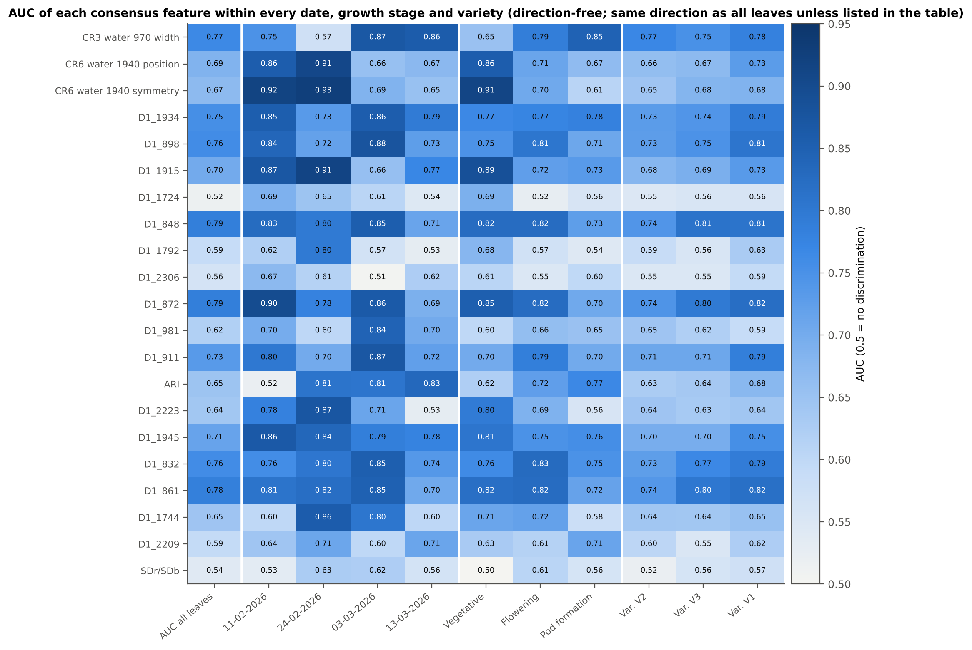
Stable across dates, growth stages and varieties?
All seven stable features (3 water CR features, D1_1934, D1_1915, D1_848, D1_898) change in the SAME direction on all 4 dates, in all 3 growth stages and all 3 varieties.
Water-band position / symmetry and D1_1915 are strongest early in the season and at the vegetative stage (AUC 0.86–0.93), the 970-nm width at flowering and pod formation (0.79–0.87).
NIR-slope derivatives (D1_832–911) are the most even (AUC 0.69–0.90 in every stratum).
D1_1724 is NOT consistent on its own (direction differs on 2 of 4 dates) — it only helps in combination.

Slide 17
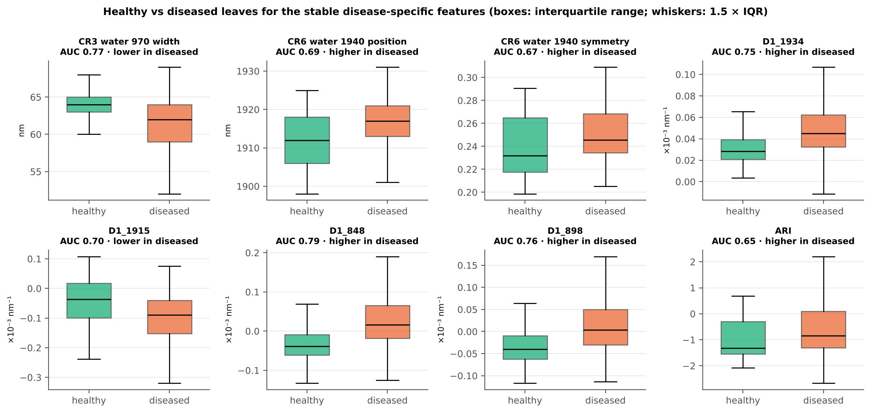
Healthy vs diseased leaves for the stable features

Slide 18
What the stable features mean physiologically
Feature | Change in diseased leaves | Interpretation
CR3 970-nm water band width | narrower (64.2 → 60.9 nm) | Lower / redistributed leaf water: pustules rupture the epidermis and increase water loss
CR6 1940-nm water band position | shifted to longer wavelength (1912 → 1917 nm) | Change in the water absorption shape (free vs bound water)
CR6 1940-nm water band symmetry | more asymmetric (0.238 → 0.250) | Same water signal, shape of the band
D1 1915 / 1934 nm | steeper wing of the 1940-nm band | Water-band depth and slope change
D1 832–911 nm (848, 898) | slope turns from negative to slightly positive | Altered mesophyll scattering (hyphae, pustules, cell damage) on the NIR plateau
ARI (anthocyanin index) | higher (−1.00 → −0.59) | Anthocyanin accumulation in stressed tissue
D1 1724, 2223, 2306 nm | small shifts (weak alone) | C–H / N–H absorption of cellulose, lignin, proteins — dry-matter changes
Absorption-feature assignments as summarised by Thomas et al. (2018) and Mahlein et al. (2013).

Slide 19
Using the stable features to discriminate healthy and diseased leaves

Slide 20
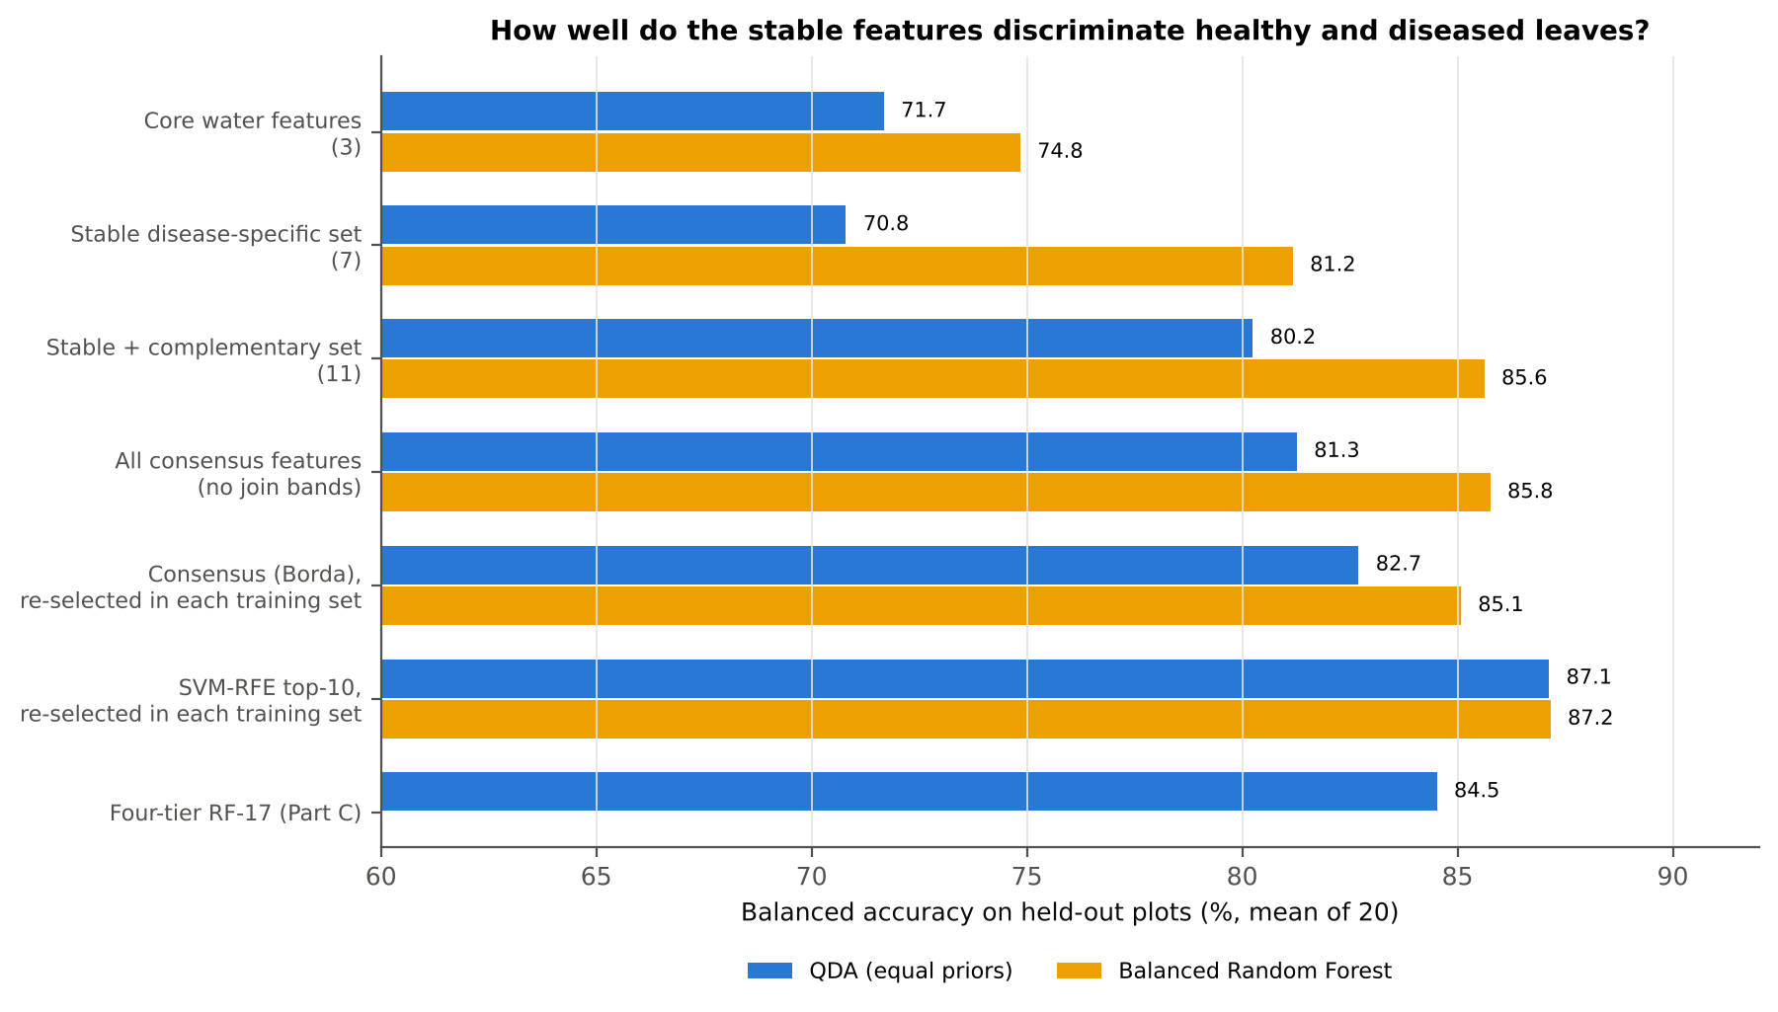
How well do the stable features discriminate?
Feature set | k | QDA BA | LDA BA | RF BA | AUC | J–M
Core water features (3) | 3 | 71.7 % | 69.8 % | 74.8 % | 0.811 | 0.65
Stable disease-specific set (7) | 7 | 70.8 % | 71.9 % | 81.2 % | 0.809 | 1.30
Stable + complementary set (11) | 11 | 80.2 % | 81.4 % | 85.6 % | 0.910 | 1.55
All consensus features (no join bands) | 15 | 81.3 % | 83.7 % | 85.8 % | 0.927 | 1.78
Water features alone (3): RF 74.8 %. Adding the stable derivatives (7): RF 81.2 %.
Adding 4 complementary features (11): QDA 80.2 %, RF 85.6 %, AUC 0.910 — close to the four-tier RF-17 set (84.5 %).
A selector re-run on each training set (SVM-RFE) remains best (QDA 87.1 %, RF 87.2 %).
Fixed sets were defined from selection frequencies over the same 20 training sets, so their accuracies are slightly optimistic; the Borda consensus re-selected inside each training set gives the honest consensus estimate.

Slide 21
Recommended disease-specific features for healthy vs diseased mustard leaves
1 · Core (always use)
2 · Stable supporting
3 · Complementary (in models)
CR3 970-nm water band WIDTH — narrower in diseased
CR6 1940-nm water band POSITION — shifted to longer λ
CR6 1940-nm water band SYMMETRY — more asymmetric
chosen by 10–17 of 21 methods; same direction on every date, stage and variety
D1 1934 nm — higher in diseased
D1 1915 nm — lower in diseased
D1 848 nm (NIR slope 832–872)
D1 898 nm (NIR slope 883–911)
chosen by 6–9 methods; consistent in all strata; any band within ±10 nm works
ARI — anthocyanin index
D1 2223 nm — 2200-nm dry-matter band
D1 1724 nm — C–H 1730 nm
D1 2306 nm — C–H/N–H 2300 nm
weak alone, but raise RF to 85.6 % and AUC to 0.91
flag: D1_981, D1_1792 (detector joins)
Recommended discriminating set = 1 + 2 + 3 (11 features): QDA 80.2 %, LDA 81.4 %, RF 85.6 %, AUC 0.91 on new plots.

Slide 22
Cautions
Stable ≠ maximally accurate: the most reproducible features describe one signal (water + structure); a wrapper (SVM-RFE, SFFS) that adds complementary features per training set is ≈ 2–7 points more accurate.
The exact 1-nm band within a stable region varies between methods (ASD data are interpolated from ≈ 3–10 nm resolution): report regions, or any band within ±10 nm.
D1_981 and D1_1792 lie within 10 nm of the ASD detector joins (1000, 1800 nm) — they may carry splice residuals and should not be used for a sensor without checking.
D1_1724 changes direction between dates; use it only inside a multivariate model.
Results come from pooled data (4 dates, 3 stages, 3 varieties); transfer to an unseen date was weaker in the main analysis — calibrate with all growth stages.

Slide 23
Conclusions
Across 21 distinct feature-selection methods, the white-rust signal in mustard leaves is dominated by LEAF WATER: the 970-nm water-band width and the 1940-nm water-band position and symmetry are selected by 10–17 methods and are the most stable disease-specific features.
First-derivative features on the 1940-nm water-band wing (1915, 1934 nm) and the NIR-plateau slope (832–911 nm) are stable across methods and across all dates, growth stages and varieties.
Dry-matter (C–H 1724, 2223, 2306 nm) and pigment-stress (ARI) features are complementary: weak alone, they add the information that turns the stable features into an accurate classifier.
Recommended set for discriminating healthy and diseased leaves: 3 core + 4 supporting + 4 complementary features (RF 85.6 %, AUC 0.910 on new plots); for maximum accuracy, re-select with SVM-RFE (87 %).

Slide 24
References (1/2)
Abdulridha J, Min A, Rouse MN, Kianian S, Isler V, Yang C. 2023. Evaluation of stem rust disease in wheat fields by drone hyperspectral imaging. Sensors 23(8):4154. doi:10.3390/s23084154
Ambroise C, McLachlan GJ. 2002. Selection bias in gene extraction on the basis of microarray gene-expression data. Proceedings of the National Academy of Sciences 99:6562–6566.
Araújo MCU, Saldanha TCB, Galvão RKH, Yoneyama T, Chame HC, Visani V. 2001. The successive projections algorithm for variable selection in spectroscopic multicomponent analysis. Chemometrics and Intelligent Laboratory Systems 57(2):65–73.
Breiman L. 2001. Random forests. Machine Learning 45:5–32.
Centner V, Massart D-L, de Noord OE, de Jong S, Vandeginste BM, Sterna C. 1996. Elimination of uninformative variables for multivariate calibration. Analytical Chemistry 68(21):3851–3858.
Cheng T, Rivard B, Sánchez-Azofeifa GA, Feng J, Calvo-Polanco M. 2010. Continuous wavelet analysis for the detection of green attack damage due to mountain pine beetle infestation. Remote Sensing of Environment 114(4):899–910. doi:10.1016/j.rse.2009.12.005
Das B, Sahoo RN, Biswas A, Pargal S, Krishna G, Verma R, Chinnusamy V, Sehgal VK, Gupta VK. 2020. Discrimination of rice genotypes using field spectroradiometry. Geocarto International 35(1):64–77. doi:10.1080/10106049.2018.1506507
Demšar J. 2006. Statistical comparisons of classifiers over multiple data sets. Journal of Machine Learning Research 7:1–30.
Guyon I, Weston J, Barnhill S, Vapnik V. 2002. Gene selection for cancer classification using support vector machines. Machine Learning 46:389–422.
Kononenko I. 1994. Estimating attributes: analysis and extensions of RELIEF. In: Machine Learning: ECML-94. Lecture Notes in Computer Science 784. Berlin: Springer, 171–182.
Kuncheva LI. 2007. A stability index for feature selection. Proceedings of the 25th IASTED International Multi-Conference: Artificial Intelligence and Applications, 390–395.
Kursa MB, Rudnicki WR. 2010. Feature selection with the Boruta package. Journal of Statistical Software 36(11):1–13.
Li H, Liang Y, Xu Q, Cao D. 2009. Key wavelengths screening using competitive adaptive reweighted sampling method for multivariate calibration. Analytica Chimica Acta 648(1):77–84.

Slide 25
References (2/2)
Liu et al. 2024. [Recursive feature elimination (RFE) for crop-disease spectral features — cited as given in the request; full bibliographic details could not be verified and must be completed by the author.]
Mahlein A-K, Rumpf T, Welke P, Dehne H-W, Plümer L, Steiner U, Oerke E-C. 2013. Development of spectral indices for detecting and identifying plant diseases. Remote Sensing of Environment 128:21–30.
Mustafa G, Zheng H, Khan IH, Tian L, Jia H, Li G, Cheng T, Tian Y, Cao W, Zhu Y, Yao X. 2022. Hyperspectral reflectance proxies to diagnose in-field fusarium head blight in wheat with machine learning. Remote Sensing 14(12):2784.
Mustafa G, Zheng H, et al. 2023. Fusarium head blight monitoring in wheat ears using machine learning and multimodal data from asymptomatic to symptomatic periods. Frontiers in Plant Science 13:1102341. doi:10.3389/fpls.2022.1102341
Nogueira S, Sechidis K, Brown G. 2018. On the stability of feature selection algorithms. Journal of Machine Learning Research 18(174):1–54.
Peng H, Long F, Ding C. 2005. Feature selection based on mutual information: criteria of max-dependency, max-relevance, and min-redundancy. IEEE Transactions on Pattern Analysis and Machine Intelligence 27(8):1226–1238.
Pudil P, Novovičová J, Kittler J. 1994. Floating search methods in feature selection. Pattern Recognition Letters 15(11):1119–1125.
Saeys Y, Abeel T, Van de Peer Y. 2008. Robust feature selection using ensemble feature selection techniques. In: Machine Learning and Knowledge Discovery in Databases (ECML PKDD 2008). Lecture Notes in Artificial Intelligence 5212. Berlin: Springer, 313–325.
Thomas S, Kuska MT, Bohnenkamp D, Brugger A, Alisaac E, Wahabzada M, Behmann J, Mahlein A-K. 2018. Benefits of hyperspectral imaging for plant disease detection and plant protection: a technical perspective. Journal of Plant Diseases and Protection 125:5–20.
Tibshirani R. 1996. Regression shrinkage and selection via the lasso. Journal of the Royal Statistical Society Series B 58(1):267–288.
Wei X, Johnson MA, Langston DB, Mehl HL, Li S. 2021. Identifying optimal wavelengths as disease signatures using hyperspectral sensor and machine learning. Remote Sensing 13(14):2833. doi:10.3390/rs13142833
Wold S, Sjöström M, Eriksson L. 2001. PLS-regression: a basic tool of chemometrics. Chemometrics and Intelligent Laboratory Systems 58(2):109–130.
Zhu H, Chu B, Zhang C, Liu F, Jiang L, He Y. 2017. Hyperspectral imaging for presymptomatic detection of tobacco disease with successive projections algorithm and machine-learning classifiers. Scientific Reports 7:4125. doi:10.1038/s41598-017-04501-2

