Slide 1
Plot-level hyperspectral discrimination of healthy and white-rust (Albugo candida) diseased mustard plots
Plot-average ASD contact-probe spectra, derived spectral features and machine-learning classification across four dates
Animesh Panda | Division of Agricultural Physics, ICAR-IARI, New Delhi
PhD research seminar | Methodology - Results - Discussion

Slide 2
Outline of the seminar
1
Introduction
2
Review of literature
Why discriminate plots, not leaves
Ten studies and what each contributed
3
Objectives
4
Materials and methods
Five objectives and hypotheses
Design, features, screening, selection, classifiers, validation
5
Results
6
Discussion and conclusions
Spectral response, features, models, controls and experiments
Meaning, comparison, caveats, recommendations

Slide 3
1. Introduction
From leaf spectra to a plot-level decision

Slide 4
Why a plot-level model?
The plot (field unit) is where scouting and fungicide decisions are made
  Leaf spectra vary with leaf position, pustule cover and probe placement; averaging the leaves of a plot gives a stable plot signature
  Plot averages approach what canopy, UAV and satellite sensors record
  The previous chapter modelled single leaves; this chapter asks whether the plot average alone separates healthy from diseased plots
Inputs: 48 plots x 4 dates of plot-average raw reflectance and the features derived from it
Pigments (400-750 nm)
Chlorophyll loss and anthocyanin / carotenoid change: visible reflectance, red edge, VIs.
Structure (750-1300 nm)
Haustoria and pustules alter mesophyll scattering: NIR level and slope.
Water and dry matter (1300-2400 nm)
Water status and leaf constituents: 1450 / 1940 nm absorption, derivatives, continuum removal.
Source: Saharan et al. 2014; Zhang et al. 2012; Tian et al. 2021; Lv et al. 2023; Panda 2026 (R2)

Slide 5
Research gaps for plot-level disease discrimination
Few plots, many features
Repeated measurements
n = 48 plots per date against > 2 000 candidate features: selection and validation must avoid optimistic bias (Ambroise & McLachlan 2002; Varma & Simon 2006).
The same plots are measured on four dates; ignoring this inflates tests and CV accuracy (Roberts et al. 2017).
Design confounding
Feature families not compared
Healthy controls often sit in a separate block; field position and leaf sampling can mimic a disease effect (Hurlbert 1984).
Reflectance, derivatives, continuum removal, VIs, red-edge, wavelets and optimised indices are rarely compared under one plot-level design.
Source: Synthesis of the reviewed studies and methods literature

Slide 6
2. Review of literature
Ten studies on spectral disease detection used to build the methodology

Slide 7
Reviewed studies: designs, methods and best reported accuracy
Study | Crop / disease | Sensor | Key methods | Best result
Mandal et al. 2022, 2023 | Rice blast | ASD canopy | SG, 10-nm bands, red-edge, VIs, NDSI map, J-M, GA-PLS, PLS/RF/SVM | SVM R² 0.94
Selvaprakash et al. 2026 | Rice blast | ASD leaf | Derivatives, PCA, outlier screening, RF, new blast index | F1 0.95
Tian et al. 2021 | Rice leaf blast | ASD leaf clip | Bands + VIs + CWT, temporal stability, VIF, SFFS-OFC | OA 65-98.7 %
Lv et al. 2023 | Maize SCLB | Leaf clip | Date normalisation, FD + CWT + indices, ReliefF, SFFS-SVM | OA 87.1 %
Terentev et al. 2023 | Wheat leaf rust | HSI | Band means, VIs, cross-experiment linear SVM | Acc. 98 %
Zhang et al. 2012 | Wheat powdery mildew | ASD | Derivative edges, continuum removal, VIs, FLDA | OA 0.89
Zhu et al. 2017 | Tobacco TMV | HSI | SPA, PLS-DA, LS-SVM, ELM, BPNN | Acc. 98.3 %
Huang et al. 2020 | Wheat FHB | HSI | SPA, image features, PSO-SVM | Acc. 92 %
Nguyen et al. 2023 | Wheat yellow rust | UAV 5-band | VIs, class imbalance, SVM/RF/MLP/3D-CNN | OA 79 %
Panda 2026 (R1, R2) | Mustard white rust | ASD contact probe | 23 selectors; leaf-level pooled models | Leaf BA 0.92-0.95
Source: Papers provided by the researcher; Panda 2026 = researcher's own feature-selection study and leaf-level chapter

Slide 8
What each study contributed to the plot-level methodology
Step | Method adopted | From
Spectral characterisation | Mean, difference and ratio spectra; correlation spectrum; red-edge parameters; J-M distance | Zhang 2012; Mandal 2022, 2023
Feature families | 10-nm bands, 1st-3rd derivatives, continuum removal, 87 VIs, red-edge, CWT, optimised NDSI/SR/DI | Mandal 2023; Zhang 2012; Lv 2023; Tian 2021
Temporal stability | Features retained only when separable on >= 3 of 4 dates; per-date standardisation | Tian 2021; Lv 2023
Feature selection | ReliefF + VIF + SFFS; OFC with LDA/kNN/SVM; SPA; GA-PLS; SVM-RFE, LASSO, CARS, Borda | Tian 2021; Zhu 2017; Huang 2020; Mandal 2023; Panda 2026
Classifiers | LDA, PLS-DA, LR, kNN, SVM, LS-SVM, RF, XGBoost, ELM, MLP | Zhu 2017; Nguyen 2023; Tian 2021; Mandal 2023
Validation | Repeated k-fold, transfer to unseen dates (cross-experiment), class-balanced metrics | Tian 2021; Terentev 2023; Nguyen 2023
Not applicable | Image texture, 3D-CNN, severity regression (no images, no severity scores) | Huang 2020; Nguyen 2023; Mandal 2022
Source: Synthesis by the author

Slide 9
3. Objectives
Plot-level discrimination of healthy and diseased plots

Slide 10
Objectives and hypotheses
# | Objective | Hypothesis
O1 | Characterise the plot-level spectral response to white rust on four dates | H1: diseased plots differ in pigment, red-edge and water regions on every date
O2 | Rank seven feature families and identify date-stable disease features | H2: derivative / wavelet and water-region features separate plots best
O3 | Compare 12 feature scenarios x 10 classifiers under plot-grouped validation | H3: a compact selected set matches the full-spectrum models
O4 | Test robustness: single dates, unseen dates/varieties, permutation, design and leaf-number controls | H4: the separation is a disease effect, not a design artefact
O5 | Compare plot-average models with the leaf-level models | H5: plot averaging is at least as accurate as leaf-level prediction

Slide 11
4. Materials and methods
Design, features, screening, selection, classifiers and validation

Slide 12
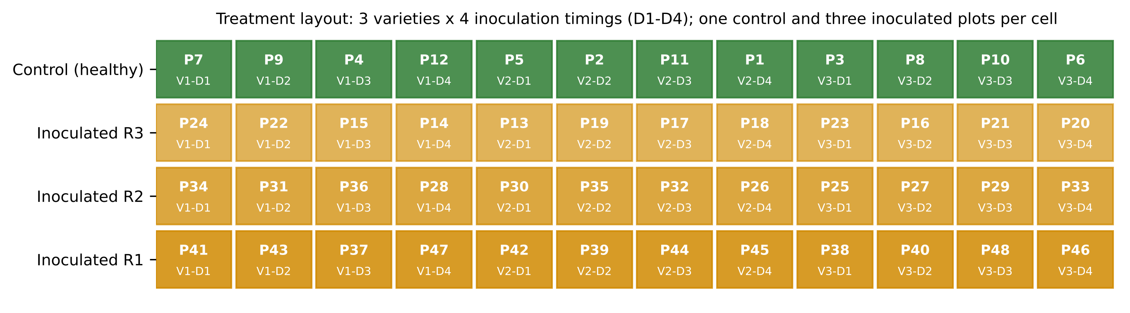
Experimental design and plot-average dataset
48
4
plots (12 control, 36 inoculated)
dates (11 Feb - 13 Mar 2026)
192
3 x 4
  Plot average = mean of all leaf spectra of a plot on a date (ASD contact probe, 350-2500 nm, 1 nm)
  Each cell (variety x inoculation timing D1-D4) holds 1 control + 3 inoculated plots
  Controls are all in one block (C); inoculated plots in blocks R1-R3
  Diseased plots averaged more leaves (5-15) than controls (3-9) - tested in E9
plot-average spectra
varieties x inoculation timings
Date | Healthy plots | Diseased plots | Leaves / H plot | Leaves / D plot
11 Feb | 12 | 36 | 6.0 | 10.0
24 Feb | 12 | 36 | 7.5 | 12.5
03 Mar | 12 | 36 | 9.0 | 15.0
13 Mar | 12 | 36 | 9.0 | 15.0
Source: Treatment layout file; PlotAverage_Features workbooks (sheets 01-03)

Slide 13
Feature families derived from the raw plot-average reflectance
Family | Features | Definition | References
Reflectance (REF) | 201 | 10-nm means of raw 400-2400 nm reflectance | Mandal et al. 2023
1st / 2nd / 3rd derivative | 201 each | Central differences (1 nm), averaged to 10 nm | Tsai & Philpot 1998; Zhang 2012
Continuum removal (CR) | 48 | 6 absorption windows x depth, position, width, area, asymmetry... | Clark & Roush 1984; Kokaly & Clark 1999
Vegetation indices (VI) | 87 | Pigment, red-edge, water and disease indices (e.g. HI, PMI, LRDSI) | Mahlein 2013; Ashourloo 2014; see refs
Red-edge parameters (RE) | 23 | REIP by 4 methods; blue/yellow/red edge amplitude, position, area | Horler 1983; Guyot & Baret 1988; Gong 2002
Wavelet (CWT) | 1608 | Mexican-hat coefficients, scales 2^1-2^8, every 10 nm | Cheng 2011; Tian 2021; Lv 2023
Optimised two-band indices | 3 x 20 100 pairs | NDSI, SR, DI of every 10-nm pair; best pairs found inside each training fold | Mandal 2023; Tian 2021; Zhu 2017
Smoothed branch (detector-join correction + Savitzky-Golay 11/2) was built identically and compared in E1. The workbook's own optimised indices were chosen on all plots of a date, so they are reported descriptively only.
Source: PlotAverage_Features workbooks (sheets 02-12); this analysis (CWT, 10-nm binning, in-fold index search)

Slide 14
Methodological flowchart: step by step
Step 1. Data assembly
4 workbooks + treatment layout: 192 plot-dates
Step 2. Quality control
noise, joins, leaf number, T²/Q flags
Step 3. Characterisation
mean / difference spectra, band-wise tests, J-M
Step 4. Feature families
REF, FD1-3, CR, VI, RE, CWT, NDSI/SR/DI
Step 8. Classification
12 scenarios x 10 classifiers, nested cell-grouped CV
Step 7. Selection
robust ReliefF+VIF+SFFS, SPA, GA-PLS, OFC, 6 selectors
Step 6. Design checks
matched control, block contrast, inoculation timing
Step 5. Screening
AUC, Hedges g, FDR per date; LMM; PCA, PERMANOVA
Step 9. Statistics
Friedman-Nemenyi, corrected t, Wilcoxon-Holm
Step 10. Experiments
E1-E10: branch, dates, transfer, permutation, controls
Step 11. Interpretation
final features, VIF, importance, progression
Outcome
validated plot-level classifier and diagnostic features
Tan = data; green = features and models; blue = evaluation. Every step that uses labels (index search, selection, tuning) runs inside the training plots of each fold.

Slide 15
Steps 2-6 flowchart: characterisation and screening
192 plot-average spectra
raw branch (main)
Seven feature families
+ in-fold NDSI / SR / DI
Per-date tests
Welch t, FDR, Hedges g, AUC
Stability
q < 0.05 and same sign on >= 3 dates
Separability
J-M, sensitive regions
Mixed models
z ~ disease + date + variety + (1|plot)
Multivariate
PCA, eta², PERMANOVA
Design checks
matched control, blocks, timing
Where white rust acts
sensitive regions, family ranking (R3-R8)
How large vs nuisance
date, variety, block effects (R9-R11)
Candidate features
date-stable, non-redundant pools (Step 7)
Plots are the experimental units: statistics are computed on the 48 plots of each date (no leaf-level pseudo-replication); repeated dates are handled by the mixed model and by plot-level permutations.
Source: Benjamini & Hochberg 1995; Hedges 1981; Richards & Jia 2006; Bates et al. 2015; Anderson 2001; Hurlbert 1984

Slide 16
Step 8 flowchart: nested, cell-grouped cross-validation
12 cells = variety x inoculation
each: 1 control + 3 inoculated plots
Outer split: 4 folds of 3 cells
one cell per variety; all 4 dates of a plot together
Test fold: 3 healthy + 9 diseased plots
48 plot-dates never seen in training
Training: 9 cells (36 plots, 144 plot-dates)
inner 3-fold cell CV inside
Index search
NDSI/SR/DI best pairs
Feature selection
robust / SPA / GA-PLS
Scaling
z-score on training
Tuning
grid, inner BA
Predict the test fold -> metrics
repeat with 20 random cell assignments
BA = (sensitivity + specificity) / 2; MCC, kappa, macro-F1, ROC-AUC and PR-AUC also reported (12 : 36 class ratio).
Source: Varma & Simon 2006; Roberts et al. 2017; Ambroise & McLachlan 2002; Chicco & Jurman 2020

Slide 17
Feature scenarios and classifiers compared
 | Feature scenario | Source
S1 | Reflectance, full spectrum (201 bands) | Zhang 2012; Terentev 2023
S2 | First derivative, full (201) | Mandal 2022; Lv 2023
S3 | Second derivative, full (201) | Tsai & Philpot 1998
S4 | Third derivative, full (201) | Tsai & Philpot 1998
S5 | Continuum-removal parameters (48) | Zhang 2012
S6 | Vegetation indices (87) | Mandal 2023; Mahlein 2013
S7 | Red-edge parameters (23) | Mandal 2022; Gong 2002
S8 | Optimised two-band indices (in-fold NDSI/SR/DI) | Mandal 2023; Tian 2021
S9 | CWT coefficients + robust selection | Lv 2023; Cheng 2011
S10 | All families combined + robust selection | Tian 2021; Lv 2023
S11 | SPA bands (reflectance) | Huang 2020; Zhu 2017
S12 | GA-PLS bands (reflectance) | Mandal 2023
Classifier | Setting
LDA | shrinkage, equal priors
PLS-DA | 1-16 latent variables
LR | L2, class-balanced
kNN | k = 5/15/35, oversampled
SVM | RBF, class-balanced
LS-SVM | kernel ridge form
RF | 200 trees
XGBoost | 300 trees
ELM | random tanh layer
MLP | 1-2 hidden layers
Robust selection (S9, S10): ReliefF top 10 % on >= 3 of 4 dates -> |r| < 0.98 -> VIF < 10 -> SFFS-LDA (Tian 2021; Lv 2023).
Source: Classifier references: Cortes & Vapnik 1995; Suykens & Vandewalle 1999; Breiman 2001; Chen & Guestrin 2016; Huang et al. 2006

Slide 18
Supporting experiments: what each one tests
 | Experiment | Question | Basis
E1 | Raw vs smoothed branch | Does SG smoothing / join correction help plot averages? | Mandal 2023
E2 | Single-date models | Can one date alone separate the plots? How early? | Tian 2021
E3 | Leave-one-date / variety-out | Transfer to an unseen date or variety (+/- date normalisation) | Terentev 2023; Lv 2023
E4 | Date normalisation in CV | Does removing the date shift help the pooled model? | Lv 2023
E5 | Label-permutation test | Is the accuracy above what random labels give? | Ojala & Garriga 2010
E6 | Block controls | Control vs each block, and block vs block (both diseased) | Hurlbert 1984
E7 | OFC from SFFS-LDA/kNN/SVM | Optimal feature combinations of disease-sensitive features | Tian 2021
E8 | Six published selectors | SVM-RFE, LASSO, CARS, ReliefF, SFFS-QDA, Borda | Panda 2026 (R1)
E9 | Equal leaf numbers | Plot means rebuilt from 3 random leaves per plot | This study
E10 | Leaf vs plot level | Plot averages vs leaf models of the previous chapter | Panda 2026 (R2)

Slide 19
5. Results
Spectral response, features, classification and robustness checks

Slide 20
R1. Quality control: noise and the leaf-number difference
Date | Leaves H | Leaves D | p (noise H vs D)
11 Feb | 6.0 | 10.0 | 0.677
24 Feb | 7.5 | 12.5 | < 0.001
03 Mar | 9.0 | 15.0 | 0.592
13 Mar | 9.0 | 15.0 | < 0.001
What it shows: Noise of each raw plot average (SD of the high-frequency residual). Fewer averaged leaves give noisier averages; the grey bars show the ratio expected from the leaf numbers alone.
Finding: Diseased-plot averages were 6 % less noisy on average (ratio 0.87-0.99), less than the 22 % expected from leaf numbers. The difference is small but could favour noise-sensitive features (3rd derivative), so E9 rebuilt every plot from 3 leaves. PCA T²/Q flagged 4 of 192 plot-dates; none removed.
Source: Sheets 03_QC; Fig25

Slide 21
R2. Mean plot-average spectra of healthy and diseased plots
What it shows: Mean raw reflectance of the 12 control and 36 inoculated plots on each date (10-nm bands).
Finding: Healthy and diseased plot spectra share the typical leaf shape; their difference is small relative to the date-to-date change (see PERMANOVA). Mean D - H by region - 11 Feb: VIS -0.006, NIR -0.006, SWIR +0.004; 24 Feb: VIS +0.016, NIR -0.008, SWIR +0.001; 03 Mar: VIS +0.029, NIR -0.024, SWIR +0.030; 13 Mar: VIS +0.011, NIR +0.015, SWIR +0.023.
Source: 04_Mean_Spectra; Fig02

Slide 22
R3. Difference spectra (diseased - healthy) by date
What it shows: Diseased minus healthy reflectance; positive = diseased plots reflect more.
Finding: The difference spectra change sign and size between dates, so a single reflectance band cannot separate the plots on every date. The most consistent differences are in the visible / red-edge region and around the 1400-1950 nm water bands; these regions dominate the derivative and wavelet features.
Source: 04_Mean_Spectra; Zhang et al. 2012; Mandal et al. 2022

Slide 23
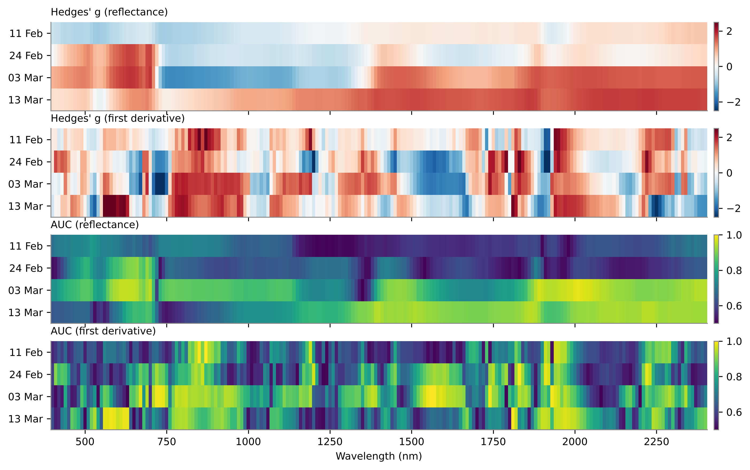
R4. Band-wise effect sizes and sensitive regions
Family | Region (nm) | Direction | Mean AUC
REF | 590-719 | D > H | 0.822
FD1 | 680-699 | D > H | 0.752
FD1 | 710-729 | D < H | 0.822
FD1 | 770-919 | D > H | 0.882
FD1 | 1080-1099 | D > H | 0.761
FD1 | 1690-1709 | D > H | 0.717
FD1 | 1740-1779 | D > H | 0.803
FD1 | 1810-1859 | D > H | 0.831
FD1 | 1900-1929 | D < H | 0.907
FD1 | 1940-2009 | D > H | 0.903
FD1 | 2210-2299 | D > H | 0.854
What it shows: Heat strips: Hedges' g (red = diseased higher) and AUC of every 10-nm band per date; the table lists contiguous regions significant (FDR q < 0.05) with the same sign on >= 3 of 4 dates.
Finding: 10 first-derivative and 1 reflectance regions were stable on >= 3 dates. Strongest: FD1 1900-1929 nm (D < H, AUC 0.91); FD1 1940-2009 nm (D > H, AUC 0.90); FD1 770-919 nm (D > H, AUC 0.88).

Slide 24
R5. Separability of the seven feature families
Family | Features | Sig. >= 3 dates | Sig. 4 dates
Continuum-removal parameters | 48 | 17 | 3
Wavelet (CWT) coefficients | 1608 | 366 | 74
First derivative | 201 | 66 | 31
Second derivative | 201 | 60 | 12
Third derivative | 201 | 30 | 4
Red-edge parameters | 23 | 2 | 0
Reflectance (10 nm) | 201 | 14 | 0
Vegetation indices | 87 | 48 | 0
What it shows: AUC of the best date-stable feature of each family and of its median feature (0.5 = chance, 1 = perfect separation of the 48 plots on a date).
Finding: Best families: Second derivative (0.96), Wavelet (CWT) coefficients (0.96), First derivative (0.95). Reflectance itself is weakest (0.81; no band significant on all 4 dates); slopes and band shapes are more date-stable than band levels.

Slide 25
R6. Most discriminating features of each family
Family | Feature | Direction | Dates q<0.05 | Mean AUC | 11 Feb | 24 Feb | 03 Mar | 13 Mar
REF | R2370 | D > H | 2 | 0.806 | 0.70 | 0.65 | 0.94 | 0.93
REF | R1880 | D > H | 2 | 0.804 | 0.61 | 0.71 | 0.95 | 0.94
FD1 | D1_1940 | D > H | 4 | 0.954 | 0.97 | 0.92 | 0.97 | 0.95
FD1 | D1_1950 | D > H | 4 | 0.951 | 0.96 | 0.93 | 0.95 | 0.96
FD2 | D2_1920 | D > H | 4 | 0.958 | 0.95 | 0.98 | 0.94 | 0.95
FD2 | D2_1940 | D > H | 4 | 0.940 | 0.92 | 0.96 | 0.91 | 0.96
FD3 | D3_690 | D < H | 3 | 0.866 | 0.65 | 0.99 | 0.99 | 0.83
FD3 | D3_1740 | D < H | 4 | 0.852 | 0.84 | 0.94 | 0.84 | 0.78
CR | CR6 water 1721–2304 nm position (nm) | D > H | 4 | 0.902 | 0.95 | 0.98 | 0.85 | 0.84
CR | CR6 water 1721–2304 nm asymmetry | D > H | 4 | 0.896 | 0.94 | 0.97 | 0.88 | 0.80
VI | ARI2 | D > H | 3 | 0.901 | 0.66 | 0.99 | 0.96 | 0.99
VI | HI | D < H | 3 | 0.901 | 0.66 | 0.99 | 0.97 | 0.99
RE | Red-edge slope (R750 − R700)/50 (1/nm) | D < H | 3 | 0.832 | 0.68 | 0.94 | 0.99 | 0.72
RE | Yellow-edge area SDy | D > H | 2 | 0.791 | 0.71 | 0.60 | 0.86 | 0.99
CWT | WF1920_s2 | D < H | 4 | 0.957 | 0.96 | 0.98 | 0.93 | 0.96
CWT | WF1930_s3 | D < H | 4 | 0.949 | 0.95 | 0.98 | 0.92 | 0.96
What it shows: Two best date-stable features of every family with their AUC on each date.
Finding: Columns 6-9: AUC per date (green = higher). Top-ranked features sit at D1_1910, D1_1940, D1_1950, D1_1970, D2_1920, D2_1930 - mostly the 1900-1950 nm water-absorption shoulder and the NIR plateau slope.

Slide 26
R7. Vegetation indices: the 15 best of 87
Index | Equation | Reference | Min AUC
ARI2 | R800(1/R550 − 1/R700) | Gitelson et al., 2001 | 0.66
HI | (R534 − R698) / (R534 + R698) − 0.5R704 | Mahlein et al., 2013 | 0.66
ARI | 1/R550 − 1/R700 | Gitelson et al., 2001 | 0.60
Lic | R440 / R690 | Lichtenthaler et al., 1996 | 0.60
CLSI | (R698 − R570) / (R698 + R570) − R734 | Mahlein et al., 2013 | 0.78
LRDSI2 | 4.2(R695 / R455) − 0.38 | Ashourloo et al., 2014 | 0.63
Ctr1 | R695 / R420 | Carter, 1994 | 0.57
RVSI | (R714 + R752) / 2 − R733 | Merton and Huntington, 199 | 0.69
NCPI | (R670 − R450) / (R670 + R450) | Peñuelas et al., 1994 | 0.58
What it shows: The 15 indices with the highest mean AUC whose direction is the same on all four dates.
Finding: Best indices: ARI2 (0.90), HI (0.90), ARI (0.88), Lic (0.88), CLSI (0.87). Anthocyanin / carotenoid and red-edge stress indices lead; but their minimum AUC across dates (0.60-0.78) shows weaker date stability than derivative features.

Slide 27
R8. Red-edge and continuum-removal parameters
Parameter | Date | Healthy | Diseased | p
REIP, Lagrangian interpolation | 11 Feb | 711.5 | 711.7 | 0.841
REIP, Lagrangian interpolation | 24 Feb | 707.6 | 703.1 | 0.001
REIP, Lagrangian interpolation | 03 Mar | 708.4 | 702.0 | < 0.001
REIP, Lagrangian interpolation | 13 Mar | 702.5 | 701.7 | 0.106
Red-edge amplitude Dr | 11 Feb | 0.01360 | 0.01330 | 0.047
Red-edge amplitude Dr | 24 Feb | 0.01360 | 0.01320 | 0.068
Red-edge amplitude Dr | 03 Mar | 0.01320 | 0.01180 | < 0.001
Red-edge amplitude Dr | 13 Mar | 0.01020 | 0.009800 | 0.026
Red-edge area SDr | 11 Feb | 0.5470 | 0.5359 | 0.107
Red-edge area SDr | 24 Feb | 0.5424 | 0.5174 | < 0.001
Red-edge area SDr | 03 Mar | 0.5323 | 0.4607 | < 0.001
Red-edge area SDr | 13 Mar | 0.3975 | 0.3828 | 0.067
Yellow-edge area SDy | 11 Feb | -0.08690 | -0.08270 | 0.026
Yellow-edge area SDy | 24 Feb | -0.08880 | -0.08510 | 0.241
Yellow-edge area SDy | 03 Mar | -0.08480 | -0.07360 | < 0.001
Yellow-edge area SDy | 13 Mar | -0.03960 | -0.02870 | < 0.001
Red-edge slope | 11 Feb | 0.009000 | 0.008800 | 0.148
Red-edge slope | 24 Feb | 0.008700 | 0.007800 | < 0.001
Red-edge slope | 03 Mar | 0.008500 | 0.006700 | < 0.001
Red-edge slope | 13 Mar | 0.005900 | 0.005500 | 0.020
CR parameter | Dir. | Mean AUC
CR6 water 1721–2304 nm position (nm) | D > H | 0.902
CR6 water 1721–2304 nm asymmetry | D > H | 0.896
CR6 water 1721–2304 nm right area (nm) | D < H | 0.886
CR5 water 1258–1721 nm depth | D < H | 0.808
CR3 water 914–1069 nm right area (nm) | D < H | 0.804
CR3 water 914–1069 nm depth / area (1/nm | D > H | 0.792
CR2 red 548–765 nm depth | D < H | 0.785
CR2 red 548–765 nm width (nm) | D < H | 0.780
What it shows: Class means of key red-edge parameters by date (Welch p) and the best continuum-removal parameters.
Finding: Red-edge parameters separate the plots moderately (best stable AUC 0.83); diseased plots have a lower red-edge slope and amplitude (chlorophyll loss) on most dates. The best CR parameter is CR6 water 1721–2304 nm position (nm) (AUC 0.90), i.e. the shape of the 1721-2304 nm water / dry-matter absorption.
Source: 08_CR_RedEdge_Deriv; Mandal et al. 2022; Gong et al. 2002; Kokaly & Clark 1999

Slide 28
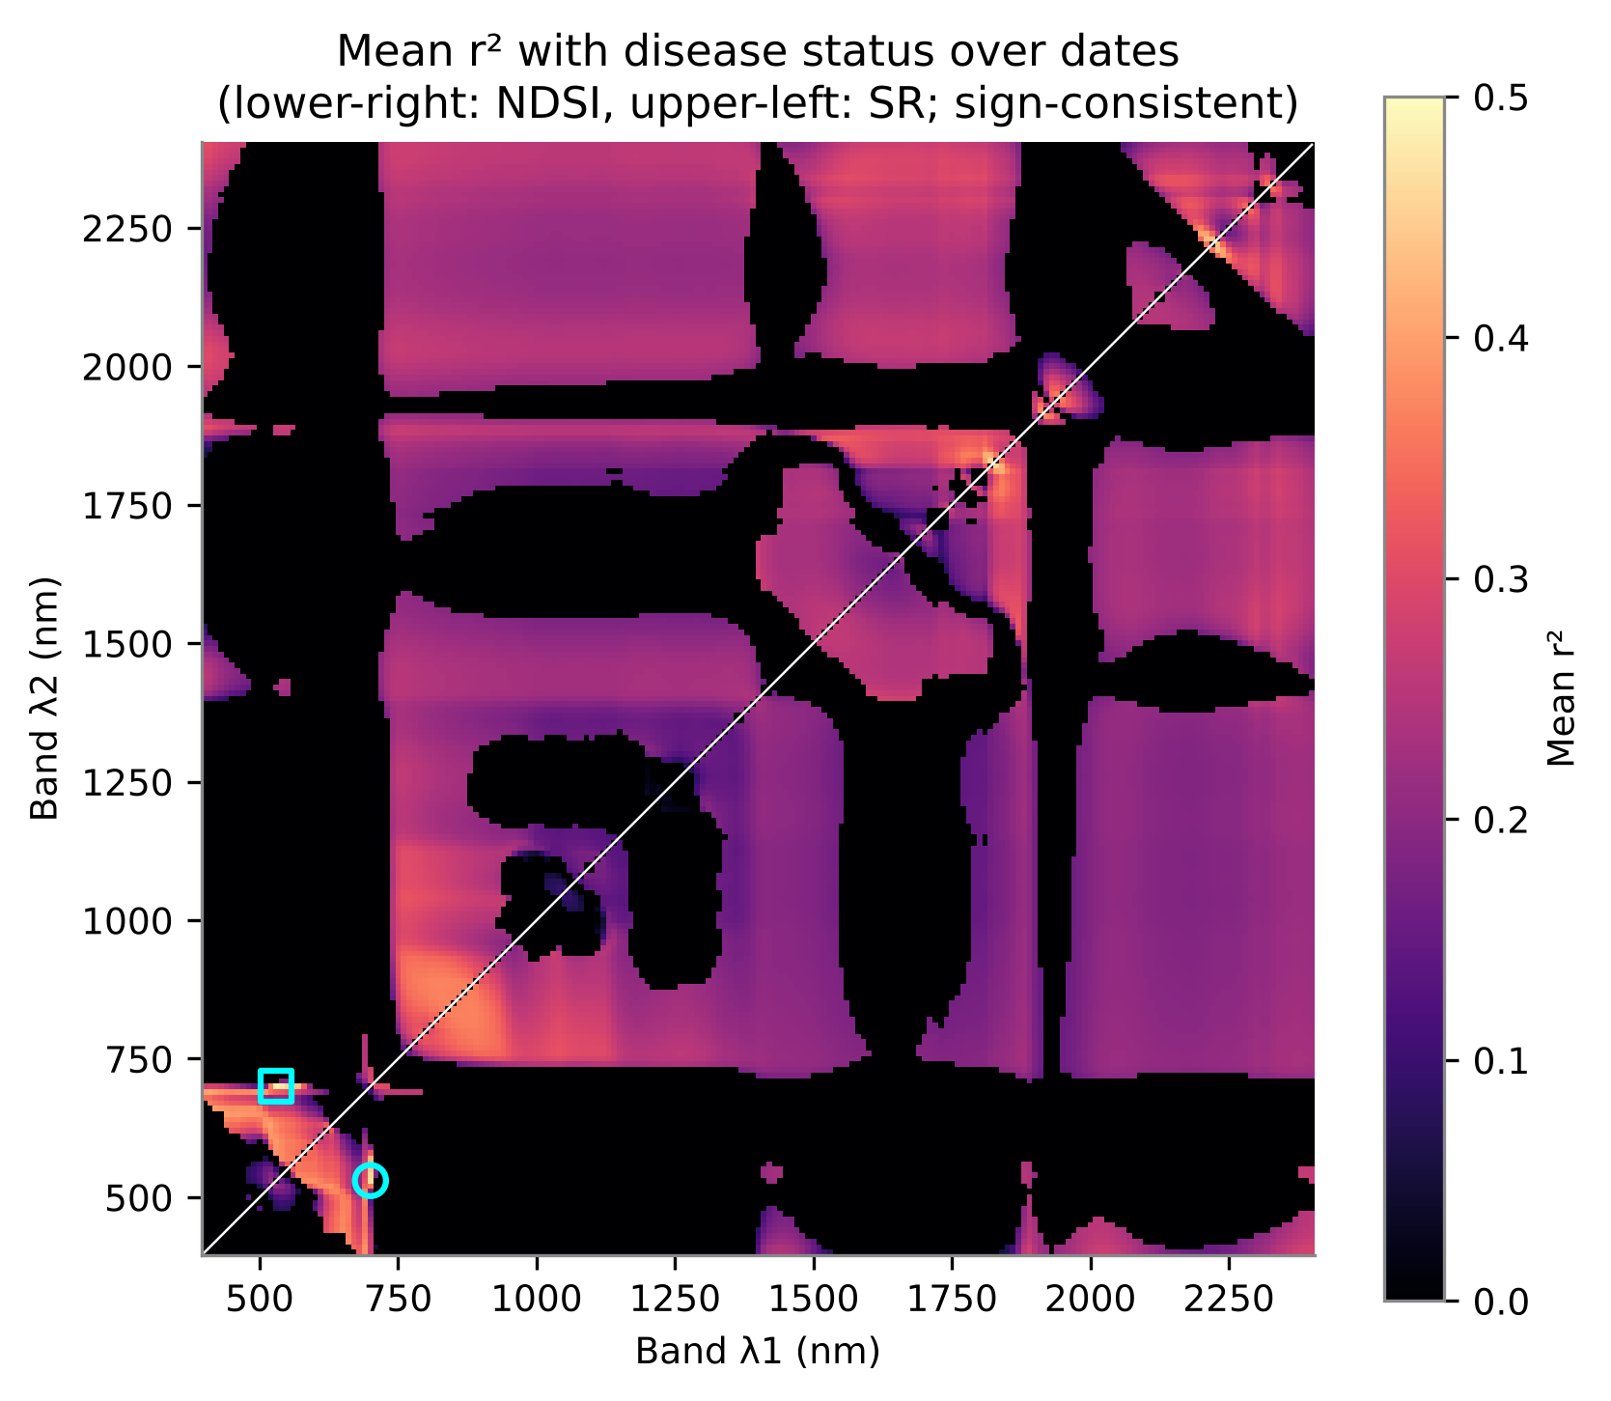
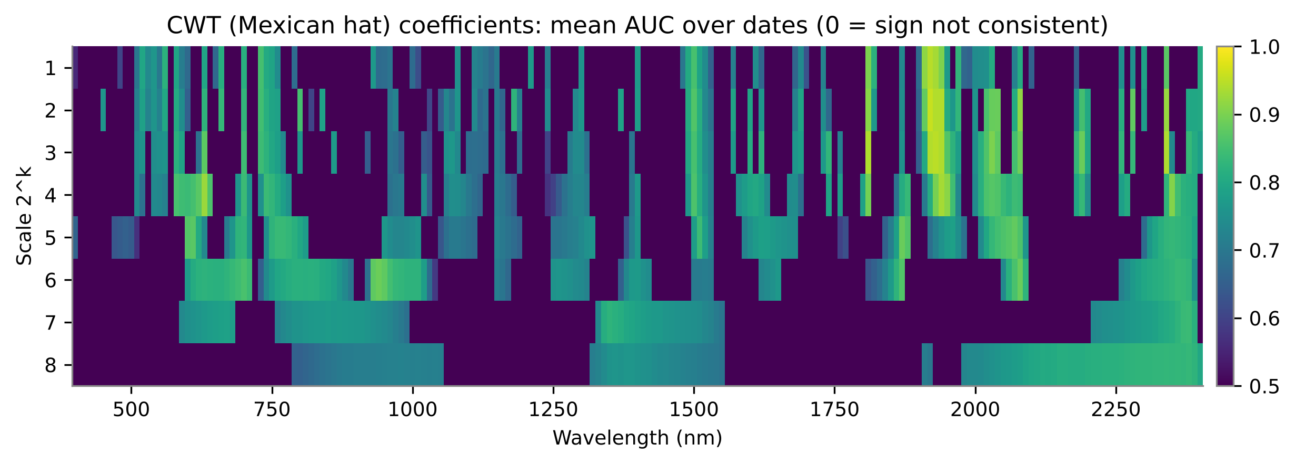
R9. Optimised two-band indices and wavelet scalogram
Index | Bands (nm) | Mean r² | Min r²
NDSI | 530, 700 | 0.466 | 0.226
NDSI | 540, 700 | 0.461 | 0.235
SR | 530, 700 | 0.481 | 0.229
SR | 540, 700 | 0.477 | 0.239
DI | 1940, 1950 | 0.423 | 0.259
DI | 1930, 1950 | 0.415 | 0.273
What it shows: r² of every NDSI/SR pair with disease status, averaged over dates.
Finding: Best pairs: NDSI(530,700) mean r² 0.47, SR(530,700) 0.48, DI(1940,1950) 0.42. The green-red pair is a pigment index; it is weakest on 11 Feb and strongest on 13 Mar, as disease advanced.
What it shows: Mean AUC of every Mexican-hat wavelet coefficient (scale 2^1-2^8) - small scales capture narrow slope features.
Finding: High mean AUC (> 0.93) concentrates at small scales (2^1-2^3) around 1810-1950 nm and in the NIR shoulder; large scales (broad shape) separate less - disease changes narrow absorption features.

Slide 29
R10. Repeated-measures mixed models
Feature | Effect (SD) | q | ICC
ARI | 0.52 | < 0.001 | 0.06
ARI2 | 0.53 | < 0.001 | 0.10
HI | -0.54 | < 0.001 | 0.06
CR6 water 1721–2304 nm asymmetry | 0.69 | < 0.001 | 0.07
CR6 water 1721–2304 nm position (n | 0.95 | < 0.001 | 0.13
D2_1810 | 1.10 | < 0.001 | 0.00
PRI | -0.34 | < 0.001 | 0.00
GM2 | -0.75 | < 0.001 | 0.01
RARSc | -0.75 | < 0.001 | 0.01
RVSI | 0.60 | < 0.001 | 0.00
What it shows: Mixed model per feature with plot as random effect: tests disease after date and variety, using all 192 plot-dates without pseudo-replication.
Finding: 156 of 183 features (VIs, CR, red-edge and the top bands/derivatives) had a significant disease effect after date and variety (FDR q < 0.05); 171 also changed with date (disease x date). Between-plot ICC was moderate, so repeated dates are not independent - supporting plot-grouped validation.
Source: 10_Mixed_Models; Bates et al. 2015

Slide 30
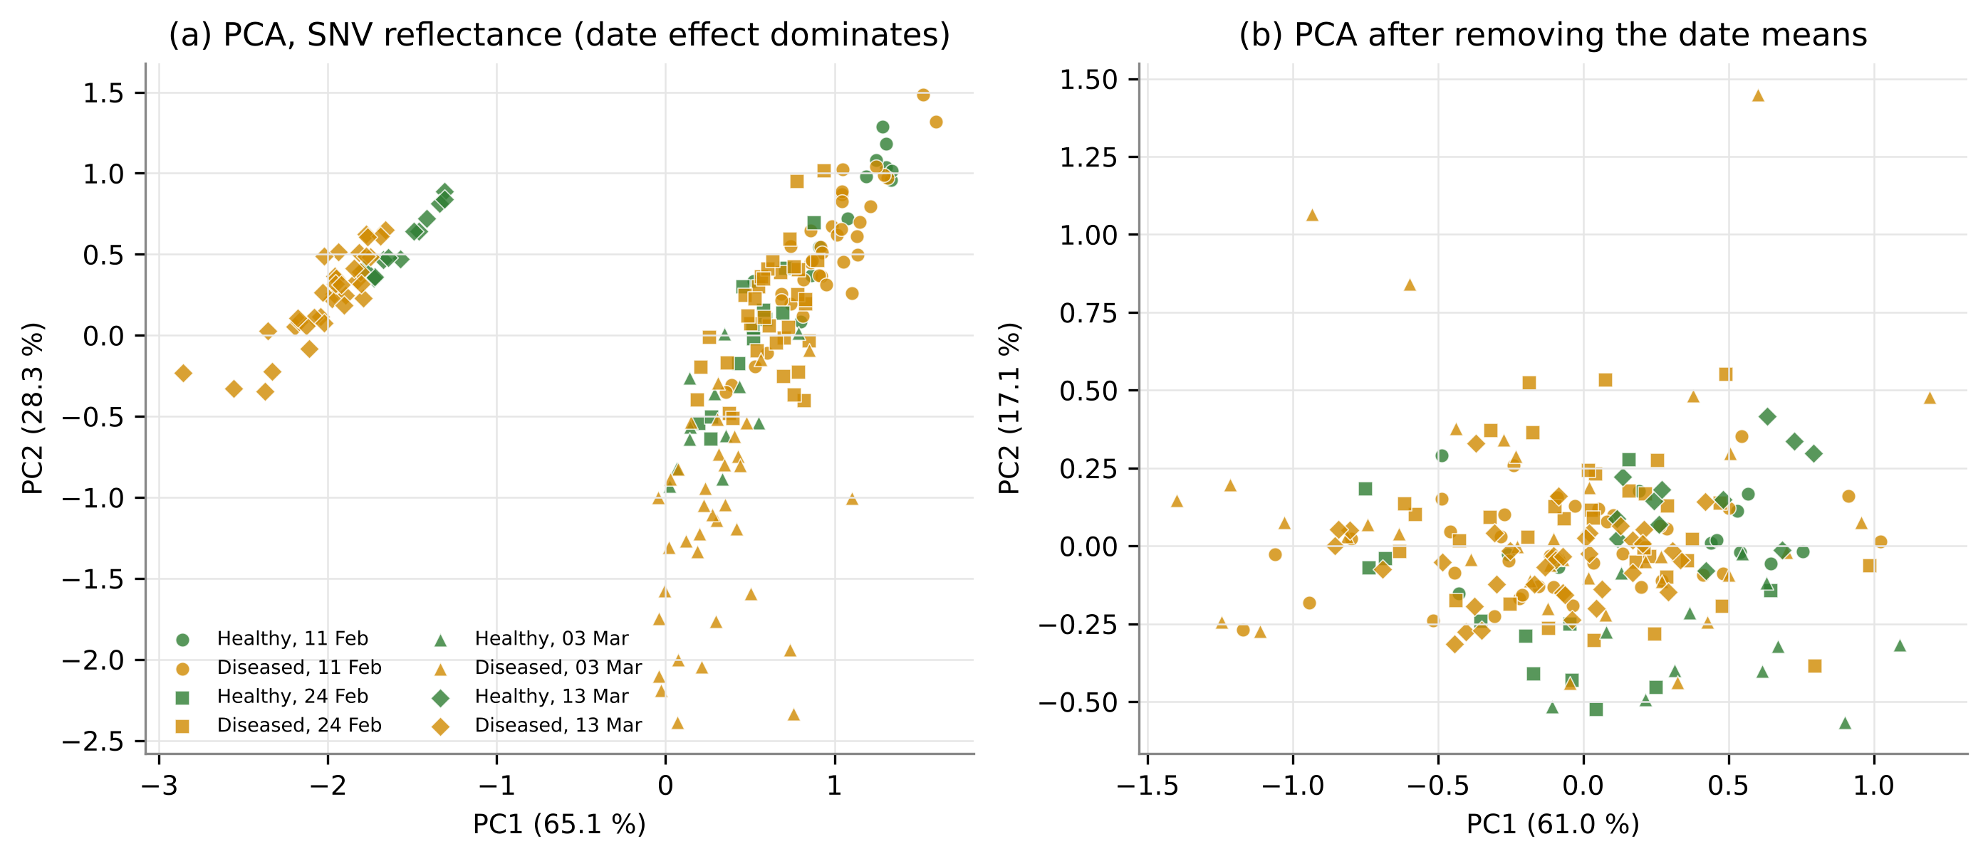
R11. PCA and PERMANOVA: date dominates, disease is significant
Response | Term | R² % | p
Reflectance | Disease | 1.3 | 0.001
Reflectance | Date | 25.7 | 0.001
Reflectance | Variety | 0.4 | 0.089
Reflectance | Inoculation | 1.1 | 0.002
Reflectance | Stage | 0.3 | 0.056
Reflectance | Disease:Date | 1.8 | 0.001
Reflectance | Disease:Variety | 0.4 | 0.191
Scalar features | Disease | 4.7 | 0.001
Scalar features | Date | 21.0 | 0.001
Scalar features | Variety | 0.8 | 0.016
Scalar features | Inoculation | 3.1 | 0.001
Scalar features | Stage | 0.5 | 0.027
Scalar features | Disease:Date | 3.6 | 0.001
Scalar features | Disease:Variety | 0.3 | 0.720
What it shows: Share of multivariate spectral variation explained by each factor; disease permuted as whole plots within cells.
Finding: Reflectance: date 25.7 %, disease 1.3 % (p = 0.001), disease x date 1.8 %. Scalar features: disease 4.7 %. Disease is a small but highly significant part of the variation; inoculation timing is also significant.

Slide 31
R12. Design checks on the features: disease effect vs field position
Family | 11 Feb | 24 Feb | 03 Mar | 13 Mar
CR | 21 % | 46 % | 92 % | 77 %
CWT | 100 % | 100 % | 100 % | 100 %
FD1 | 100 % | 100 % | 100 % | 90 %
FD2 | 85 % | 100 % | 100 % | 80 %
FD3 | 75 % | 85 % | 90 % | 50 %
RE | 17 % | 65 % | 78 % | 56 %
REF | 35 % | 5 % | 100 % | 100 %
VI | 15 % | 78 % | 92 % | 79 %
% of features with a significant matched-control effect (inoculated minus its own control)
What it shows: Disease contrast (control vs inoculated) compared with the largest contrast between the three inoculated blocks, which estimates field-position effects.
Finding: For every family the control-vs-inoculated effect exceeds the largest block-to-block effect among inoculated plots (median ratio 1.0-2.2); matched-control tests (inoculated vs its own control in the same cell) are significant for most derivative / wavelet features on every date. Field position alone does not explain the disease contrast, but cannot be fully excluded (controls share one block).

Slide 32
R13. Main CV: balanced accuracy of 12 feature scenarios x 10 classifiers
Feature scenario | LDA | PLS-DA | LR | kNN | SVM | LS-SVM | RF | XGBoost | ELM | MLP
S1 Reflectance, full spectrum (201 ba | 0.904 | 0.917 | 0.922 | 0.774 | 0.853 | 0.917 | 0.715 | 0.725 | 0.918 | 0.691
S2 First derivative, full (201) | 0.968 | 0.955 | 0.961 | 0.890 | 0.952 | 0.966 | 0.907 | 0.918 | 0.958 | 0.847
S3 Second derivative, full (201) | 0.954 | 0.942 | 0.952 | 0.934 | 0.960 | 0.954 | 0.922 | 0.948 | 0.952 | 0.897
S4 Third derivative, full (201) | 0.905 | 0.876 | 0.906 | 0.847 | 0.932 | 0.930 | 0.866 | 0.909 | 0.883 | 0.859
S5 Continuum-removal parameters (48) | 0.915 | 0.904 | 0.929 | 0.853 | 0.944 | 0.957 | 0.906 | 0.924 | 0.943 | 0.745
S6 Vegetation indices (87) | 0.852 | 0.901 | 0.842 | 0.739 | 0.779 | 0.820 | 0.748 | 0.771 | 0.824 | 0.674
S7 Red-edge parameters (23) | 0.824 | 0.792 | 0.784 | 0.774 | 0.781 | 0.804 | 0.763 | 0.753 | 0.801 | 0.667
S8 Optimised two-band indices (in-fol | 0.882 | 0.879 | 0.876 | 0.910 | 0.916 | 0.928 | 0.869 | 0.884 | 0.940 | 0.759
S9 CWT coefficients + robust selectio | 0.876 | 0.878 | 0.887 | 0.912 | 0.916 | 0.926 | 0.895 | 0.890 | 0.924 | 0.748
S10 All families combined + robust sel | 0.881 | 0.877 | 0.896 | 0.933 | 0.930 | 0.935 | 0.894 | 0.900 | 0.928 | 0.753
S11 SPA bands (reflectance) | 0.897 | 0.895 | 0.900 | 0.746 | 0.868 | 0.923 | 0.720 | 0.746 | 0.893 | 0.652
S12 GA-PLS bands (reflectance) | 0.900 | 0.906 | 0.906 | 0.772 | 0.872 | 0.921 | 0.716 | 0.742 | 0.916 | 0.645
What it shows: Balanced accuracy on held-out cells (plots never seen in training on any date), mean of 20 x 4-fold; darker = better.
Finding: Best overall: S2 First derivative, full (201) + LDA (BA 0.968, MCC 0.912, AUC 0.990). Derivative and wavelet scenarios are best for almost every classifier; reflectance, VIs and red-edge parameters are lower. Linear models (LR, LDA, PLS-DA, SVM) match or beat tree ensembles at n = 144 training plot-dates.

Slide 33
R14. Best classifier of every feature scenario
Scenario | Best clf | BA (95 % CI) | AUC
S1 Reflectance, full sp | LR | 0.922 (0.917-0.927) | 0.978
S2 First derivative, fu | LDA | 0.968 (0.964-0.971) | 0.990
S3 Second derivative, f | SVM | 0.960 (0.955-0.965) | 0.983
S4 Third derivative, fu | SVM | 0.932 (0.926-0.938) | 0.977
S5 Continuum-removal pa | LS-SVM | 0.957 (0.951-0.963) | 0.992
S6 Vegetation indices ( | PLS-DA | 0.901 (0.889-0.914) | 0.951
S7 Red-edge parameters | LDA | 0.824 (0.817-0.831) | 0.919
S8 Optimised two-band i | ELM | 0.940 (0.932-0.947) | 0.981
S9 CWT coefficients + r | LS-SVM | 0.926 (0.913-0.938) | 0.967
S10 All families combine | LS-SVM | 0.935 (0.925-0.946) | 0.979
S11 SPA bands (reflectan | LS-SVM | 0.923 (0.917-0.930) | 0.977
S12 GA-PLS bands (reflec | LS-SVM | 0.921 (0.913-0.928) | 0.972
What it shows: Best classifier of each feature scenario with the 95 % CI over repeats.
Finding: Ranking of best pipelines: S2 0.97, S3 0.96, S5 0.96, S8 0.94, S10 0.94, S4 0.93. Compact selected sets: S8 + ELM BA 0.940 with a median of 9 features.

Slide 34
R15. Statistical comparison of classifiers and feature sets
Comparison | chi² | p | CD
Classifiers | 1113.9 | < 0.001 | 0.87
Feature scenarios | 1290.2 | < 0.001 | 1.18
Best vs | ΔBA | p (Holm)
S3-SVM | 0.008 | 0.025
S5-LS-SVM | 0.011 | 0.009
S8-ELM | 0.028 | < 0.001
S10-LS-SVM | 0.032 | < 0.001
S4-SVM | 0.036 | < 0.001
What it shows: Average rank of classifiers (blocks = scenario x repeat) and of feature sets (blocks = classifier x repeat); lower = better.
Finding: Classifiers differ (Friedman p < 0.001); best average ranks: LS-SVM, ELM, SVM. Feature sets differ (p < 0.001); best: S3, S2, S5. Pairwise tests show which scenarios are statistically indistinguishable from the best pipeline (corrected t and Wilcoxon-Holm in 17_Model_Comparison).
Source: Demsar 2006; Nadeau & Bengio 2003; Holm 1979

Slide 35
R16. Best pipelines: confusion matrices and ROC curves
Best overall: S2 + LDA
Best compact: S8 + ELM
Best VI model: S6 + PLS-DA
Obs \ Pred | H | D
Healthy | 46 | 2
Diseased | 4 | 140
Obs \ Pred | H | D
Healthy | 46 | 2
Diseased | 11 | 133
Obs \ Pred | H | D
Healthy | 43 | 5
Diseased | 13 | 131
BA 0.965 | MCC 0.918 | κ 0.918
BA 0.941 | MCC 0.836 | κ 0.830
BA 0.903 | MCC 0.767 | κ 0.763
What it shows: Counts of the repeat with the median BA (192 plot-dates); ROC curves averaged over the 20 repeats.
Finding: Best pipeline (S2 + LDA): 2 of 48 healthy and 4 of 144 diseased plot-dates misclassified in the median repeat. Compact (S8 + ELM) and VI model (PLS-DA) err more often on the minority healthy class. Mean ROC-AUC 0.990.

Slide 36
R17. Best pipeline by date, variety and inoculation timing
What it shows: The pooled model evaluated separately within each date, variety and inoculation timing.
Finding: BA by date: 11 Feb 0.94, 24 Feb 1.00, 03 Mar 1.00, 13 Mar 0.93. By variety: V1 0.99, V2 0.94, V3 0.98; by inoculation timing: D1 0.98, D2 0.98, D3 0.96, D4 0.95.

Slide 37
R18. Disease call through the season and by inoculation timing
Date | Score H | Score D | ρ timing | p
11 Feb | -6.60 | 5.60 | -0.16 | 0.350
24 Feb | -7.98 | 8.82 | -0.22 | 0.187
03 Mar | -8.16 | 9.44 | -0.33 | 0.046
13 Mar | -5.81 | 7.52 | -0.28 | 0.098
Plot decision over 4 dates (mean vote): BA 1.000, sensitivity 1.000, specificity 1.000
What it shows: Fraction of the 20 repeats in which a plot-date was called diseased, by date and inoculation timing.
Finding: Inoculated plots are called diseased on almost every date (lowest on 11 Feb, the earliest stage); controls are almost never called diseased, except some on 13 Mar (pod formation). Combining the 4 dates per plot gives BA 1.000. Within diseased plots, earlier inoculation tends to give higher scores (Spearman rho -0.33 to -0.16), significant only on 03 Mar.

Slide 38
R19. E1 - raw vs smoothed plot averages, and E4 - date normalisation
What it shows: Same folds, same classifiers: raw vs Savitzky-Golay smoothed plot averages (E1); and with per-date standardisation (E4).
Finding: Smoothing helped the noise-sensitive higher derivatives most (S4 +0.053, S3 +0.018 mean BA change over classifiers) and changed reflectance / index scenarios little (S10 -0.014, S7 -0.001); best raw and smoothed pipelines are within 0.016 BA. Per-date standardisation inside the pooled CV changed BA by +0.022 on average.

Slide 39
R20. E2 - single-date models (48 plots each)
What it shows: Models trained and tested within one date (48 plots, 4 cell-folds x 10).
Finding: Best single-date BA: 11 Feb 0.94, 24 Feb 0.98, 03 Mar 1.00, 13 Mar 0.97. Separation is already possible on the first date and is highest when symptoms are fully developed; pooling dates (main CV) gives a model that works on all dates at once.

Slide 40
R21. E3 - transfer to an unseen date or variety
What it shows: Training without one date (LODO) or one variety (LOVO) and predicting it.
Finding: LODO best BA (without / with date normalisation): 11 Feb 0.86/0.90, 24 Feb 1.00/1.00, 03 Mar 0.94/1.00, 13 Mar 0.67/0.99. Without normalisation accuracy on an unseen date can drop sharply (best pipeline on 13 Mar: 0.67); per-date standardisation of the features restores it (0.99). LOVO: V1 0.99, V2 0.95, V3 0.99 - varieties transfer well.

Slide 41
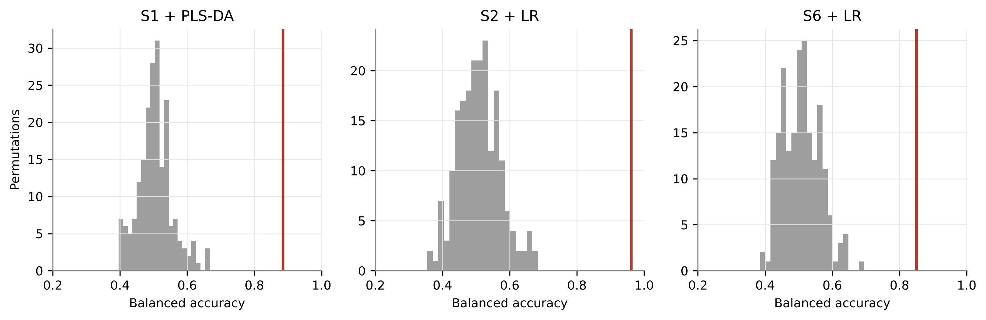
R22. E5 - label-permutation test
Pipeline | Observed BA | Null mean (SD) | Null 95th pct | p | Permutations
S1 Reflectance + PLS-DA | 0.885 | 0.504 (0.050) | 0.598 | 0.005 | 200
S2 First derivative + LR | 0.962 | 0.509 (0.063) | 0.612 | 0.005 | 200
S6 Vegetation indices (87) + LR | 0.851 | 0.508 (0.056) | 0.597 | 0.005 | 200
What it shows: The whole CV repeated with labels shuffled between plots of the same cell; grey = null distribution, red = observed.
Finding: Observed BA lies far outside the permutation null in every pipeline (S1+PLS-DA: 0.885 vs null 0.50, p = 0.005, S2+LR: 0.962 vs null 0.51, p = 0.005, S6+LR: 0.851 vs null 0.51, p = 0.005). The classifiers learn a real class signal.

Slide 42
R23. E6 - field-design controls
What it shows: Control vs each inoculated block (true disease contrast) and block vs block (both inoculated: field-position only).
Finding: Control vs each block: BA 0.92-0.98. Block vs block (both inoculated): BA 0.79-0.87. The disease contrast is larger by about 0.14 BA, but inoculated blocks are themselves separable: field position and / or different disease development between blocks carries spectral signal, so part of the healthy-vs-diseased accuracy may reflect block rather than disease.

Slide 43
R24. E7 - optimal feature combinations (Tian et al. 2021)
Set | Median size | Best BA
All DSFs | 4.0 | 0.920 (kNN)
OFC-LDA | 1.5 | 0.877 (SVM)
OFC-kNN | 3.0 | 0.901 (kNN)
OFC-SVM | 3.5 | 0.909 (kNN)
What it shows: Disease-sensitive features (top 5 % ReliefF on >= 3 dates, VIF < 10) reduced by SFFS with LDA, kNN or SVM as wrapper.
Finding: Best OFC result: All DSFs + kNN BA 0.920 with a median of 4 features. DSF / OFC sets of only 2-4 features reach BA 0.88-0.92, i.e. most of the accuracy of the full derivative spectrum (0.968), as Tian et al. (2021) reported for blast.

Slide 44
R25. E8 - six published feature-selection methods (Panda 2026)
What it shows: Six selectors from the researcher's filter/wrapper/embedded comparison applied to the combined plot-level pool.
Finding: Best selector: SVM-RFE (k = 15) + LR, BA 0.979. Order: SVM-RFE 0.98, CARS 0.96, Consensus (Borda) 0.95, ReliefF 0.95, LASSO 0.95, SFFS (QDA) 0.92. All selectors favour small-scale CWT and 2nd / 3rd-derivative features at the red-edge / NIR shoulder (780-850 nm), the 950 and 1230 nm water bands and 2170 nm; SVM-RFE was also the top selector at leaf level (Panda 2026).

Slide 45
R26. E9 - equal leaf numbers: is the separation a leaf-count artefact?
What it shows: Plot means rebuilt from the leaf spectra with all leaves and with only 3 random leaves per plot (equal for both classes).
Finding: BA all leaves -> 3 leaves: S1 0.92->0.87, S2 0.97->0.92, S3 0.96->0.93, S4 0.96->0.87, S6 0.83->0.81. Rebuilt all-leaf means equal the workbook values (max |diff| 6e-16). Accuracy stays high with equal leaf numbers, so the separation is not an artefact of averaging more leaves in diseased plots; the drop (largest for the noise-sensitive third derivative) reflects noisier 3-leaf means, i.e. averaging more leaves per plot improves detection.

Slide 46
R27. E10 - plot-average models vs leaf-level models
Approach | Pipeline | BA
Leaf spectrum | S1 + LR | 0.919
Plot-date | S1 + LR | 0.971
Plot-date | S2 First derivative, full (201) | 0.968
Plot-date | S8 Optimised two-band indices (i | 0.940
What it shows: Best leaf-level models of the previous chapter vs the plot-average models of this chapter.
Finding: Leaf spectra (leaf-level models): BA 0.919; Leaf models, majority vote per plot-date: BA 0.971; Plot-average spectra (this analysis), best overall: BA 0.968; Plot-average spectra (this analysis), best compact: BA 0.940. Plot averages reach the accuracy of aggregated leaf models with one spectrum per plot.

Slide 47
R28. Final feature set: importance, correlation and VIF
 | CR6 water | D1_910 | D1_1940 | CR4 water | WF910_s1 | WF1800_s2
CR6 water 1721–230 | 1.00 | 0.10 | -0.30 | -0.59 | -0.13 | -0.14
D1_910 | 0.10 | 1.00 | 0.53 | -0.56 | -0.57 | -0.13
D1_1940 | -0.30 | 0.53 | 1.00 | -0.12 | -0.39 | 0.36
CR4 water 1069–125 | -0.59 | -0.56 | -0.12 | 1.00 | 0.47 | 0.29
WF910_s1 | -0.13 | -0.57 | -0.39 | 0.47 | 1.00 | -0.08
WF1800_s2 | -0.14 | -0.13 | 0.36 | 0.29 | -0.08 | 1.00
Feature | Family | AUC | g | VIF
CR4 water 1069–1258 nm positio | Continuum-removal | 0.552 | 0.17 | 2.97
D1_910 | First | 0.795 | 1.14 | 2.51
CR6 water 1721–2304 nm left ar | Continuum-removal | 0.616 | 0.21 | 2.16
D1_1940 | First | 0.783 | 1.09 | 2.36
WF910_s1 | Wavelet | 0.641 | -0.45 | 1.71
WF1800_s2 | Wavelet | 0.573 | 0.41 | 1.61
What it shows: Final robust feature set fitted on all data: permutation importance, correlation and VIF.
Finding: 6 features, max VIF 3.0, max |r| 0.59, multivariate J-M 1.39 (of 2). Most important: CR4 water 1069–1258 nm position (nm).

Slide 48
Summary of results
Question | Answer from the analysis
Do plot spectra differ? | Yes - PERMANOVA disease p = 0.001; 156 of 183 features significant in mixed models; date effect much larger.
Which features? | Second derivative and Wavelet (CWT) coefficients (AUC up to 0.96); 1810-1950 nm water shoulder and red-edge / NIR slope.
Best plot-level model | S2 First derivative, full (201) + LDA: BA 0.968, MCC 0.912, AUC 0.990.
Compact model | S8 + ELM: BA 0.940 with ~9 features.
Best compact selection (E8) | SVM-RFE, 15 features + LR: BA 0.979 (10 x 4-fold).
Best published-index model | VIs (S6) + PLS-DA: BA 0.901.
Transfer | Unseen date BA 0.90-1.00 with per-date normalisation (0.67-1.00 without); unseen variety 0.95-0.99.
Artefact checks | Permutation p = 0.005 (null BA 0.50); 3-leaf plot means BA 0.93; caveat: inoculated blocks separable from each other (BA 0.79-0.87).

Slide 49
6. Discussion and conclusions
What the plot-level results mean

Slide 50
Discussion 1: what white rust does to the plot-average spectrum
Spectral mechanism
Why derivatives and wavelets win
Inoculated plots show changes in the visible / red-edge region (pigment loss, anthocyanin and carotenoid indices rise, red-edge slope falls), as reported for blast, rusts and mildew (Zhang 2012; Mandal 2022; Ashourloo 2014).
The largest and most date-stable changes are in the shape of the water-absorption features (1400-1950 nm) and of the NIR plateau: white rust pustules and haustoria disturb mesophyll structure and leaf water.
The disease signal is small against the seasonal (date / growth-stage) change, so features that describe local shape (slopes, curvature, wavelet coefficients) are more robust than absolute reflectance.
Derivatives and small-scale CWT coefficients remove the brightness level that varies with date, leaf angle and probe contact and keep the band shape (Tsai & Philpot 1998; Lv 2023; Tian 2021).
Averaging 3-15 leaves suppresses random noise, so even second / third derivatives of raw plot averages are usable; Savitzky-Golay smoothing helps mainly the third derivative (E1).
Exhaustively optimised two-band indices recover a pigment ratio (green / red) but explain less variance than derivative features, consistent with Mandal et al. (2023).

Slide 51
Discussion 2: comparison with the reviewed studies
Study | Their finding | This study (plot level)
Zhang et al. 2012 | Derivative and CR features beat VIs for powdery mildew (OA 0.89) | Same pattern: derivative / CWT > CR > VIs at plot level
Mandal et al. 2022, 2023 | Red-edge shift and optimised NDSI track blast severity | Red-edge slope lower in diseased plots; best NDSI is a green-red pigment pair
Tian et al. 2021 | Date-stable OFCs from SFFS give 65-98.7 % OA | OFCs with few features keep most of the accuracy (E7)
Lv et al. 2023 | FD + CWT best; date normalisation helps asymptomatic stages | FD / CWT best; per-date standardisation +0.02 BA pooled (E4) and essential for unseen dates (E3)
Terentev et al. 2023 | Cross-experiment validation needed for honest accuracy | Unseen-date (LODO) accuracy lower than pooled CV (E3)
Zhu 2017; Huang 2020 | SPA selects few informative bands | SPA reflectance bands are weaker than derivative features
Panda 2026 (leaf level) | Leaf pooled models BA 0.92-0.95 | Plot averages give comparable or higher BA with one spectrum per plot (E10)

Slide 52
Discussion 3: is the separation really disease? Evidence and caveats
Evidence for a disease effect
Caveats
Matched-control tests: inoculated plots differ from their own control in the same variety x inoculation cell on every date.
Control-vs-inoculated effects exceed block-to-block effects (R12, E6).
Label permutation within cells destroys the accuracy (E5).
Accuracy holds when every plot mean is rebuilt from 3 leaves (E9) and for unseen varieties (E3).
All controls are in one block (plots 1-12): disease and field position cannot be separated completely (Hurlbert 1984); inoculated blocks are also separable from each other (E6).
Controls averaged fewer leaves; E9 tested this directly.
Only 12 healthy plots: the minority class drives the uncertainty (wide CIs on specificity).
No severity score per plot: the model is binary and its probability is not a severity estimate.
One season and site; transfer to other years and to canopy / UAV sensors is untested.

Slide 53
Recommended plot-level protocol
1
Sample: measure >= 9 leaves per plot with the contact probe and average them
2
Pre-process: trim 400-2400 nm; use raw averages (smoothing optional)
3
Features: first / second derivative or CWT (small scales) of the plot average
4
Model: LDA on the first derivative, or LR on ~15 SVM-RFE-selected derivative / wavelet features
5
Normalise: standardise features within each date (all plots of the date, no labels) before applying the model to a new date
6
Validate: cell- or plot-grouped CV; report BA, MCC; test unseen dates
7
Decide: combine the calls of successive dates per plot for the final plot decision

Slide 54
Conclusions
  Plot-average spectra separate healthy and white-rust diseased mustard plots on every date; disease explains a small but highly significant share of spectral variation (PERMANOVA p = 0.001).
  Derivative and wavelet features of the raw plot average are the most discriminating and date-stable; the best pipeline (S2 + LDA) reached BA 0.968 on held-out plots.
  Compact sets work as well: SVM-RFE with 15 features + LR reached BA 0.979 (E8) and optimised two-band indices + ELM 0.940; the best published vegetation indices reached BA 0.901.
  Design controls (matched controls, block contrasts, permutations, equal leaf numbers) support a genuine disease effect, but the single control block remains a limitation.
  Standardising the features within each date (Lv et al. 2023) raised the first-derivative LDA model to BA 0.991 in the pooled CV (E4); for a date not seen in training, per-date standardisation is essential (E3); varieties transfer without it.
  Plot averaging gives accuracy comparable to leaf-level models with far fewer spectra to process, and is the natural input for canopy-scale sensors.

Slide 55
Limitations and future work
Limitations
Future work
All controls are in one block (plots 1-12): disease and field position cannot be separated completely (Hurlbert 1984); inoculated blocks are also separable from each other (E6).
Controls averaged fewer leaves; E9 tested this directly.
Only 12 healthy plots: the minority class drives the uncertainty (wide CIs on specificity).
No severity score per plot: the model is binary and its probability is not a severity estimate.
One season and site; transfer to other years and to canopy / UAV sensors is untested.
Randomise controls across blocks and equalise leaves per plot in the next season.
Record visual severity per plot to model severity, not only presence.
Validate on an independent season / site and simulate canopy, UAV and satellite bands.
Test the derivative / CWT features on canopy spectra and multispectral sensors.

Slide 56
References: papers reviewed
Huang, L., Li, T., Ding, C., Zhao, J., Zhang, D., Yang, G. (2020). Diagnosis of the severity of Fusarium head blight of wheat ears on the basis of image and spectral feature fusion. Sensors, 20, 2887.
Lv, Z., Meng, R., Chen, G., Zhao, F., Xu, B., Zhao, Y., Huang, Z., Zhou, L., Zeng, L., Yan, J. (2023). Combining multiple spectral enhancement features for improving spectroscopic asymptomatic detection and symptomatic severity classification of southern corn leaf blight. Precision Agriculture, 24, 1593-1618.
Mandal, N., et al. (2022). Spectral characterisation of rice blast severity using hyperspectral reflectance. Journal of Agrometeorology.
Mandal, N., et al. (2023). Univariate and multivariate hyperspectral models of rice blast severity. Frontiers in Plant Science.
Nguyen, C., Sagan, V., Skobalski, J., Severo, J.I. (2023). Early detection of wheat yellow rust disease and its impact on terminal yield with multi-spectral UAV-imagery. Remote Sensing, 15, 3301.
Selvaprakash, et al. (2026). Early detection of rice blast using leaf hyperspectral reflectance. Plant Science Today.
Terentev, A., Badenko, V., Shaydayuk, E., Emelyanov, D., Eremenko, D., Klabukov, D., Fedotov, A., Dolzhenko, V. (2023). Hyperspectral remote sensing for early detection of wheat leaf rust caused by Puccinia triticina. Agriculture, 13, 1186.
Tian, L., Xue, B., Wang, Z., Li, D., Yao, X., Cao, Q., Zhu, Y., Cao, W., Cheng, T. (2021). Spectroscopic detection of rice leaf blast infection from asymptomatic to mild stages with integrated machine learning and feature selection. Remote Sensing of Environment, 257, 112350.
Zhang, J.-C., Pu, R., Wang, J., Huang, W., Yuan, L., Luo, J. (2012). Detecting powdery mildew of winter wheat using leaf level hyperspectral measurements. Computers and Electronics in Agriculture, 85, 13-23.
Zhu, H., Chu, B., Zhang, C., Liu, F., Jiang, L., He, Y. (2017). Hyperspectral imaging for presymptomatic detection of tobacco disease with successive projections algorithm and machine-learning classifiers. Scientific Reports, 7, 4125.
Panda, A. (2026, unpublished). Which features detect white rust? Filter, wrapper and embedded feature selection on the K1-K4 spectral feature pool of mustard leaves (23 methods). Division of Agricultural Physics, ICAR-IARI, New Delhi. Workbook and presentation provided by the researcher.
Panda, A. (2026, unpublished). Leaf-level hyperspectral discrimination of white rust in Indian mustard (previous chapter of this thesis; same 48 plots and four dates).

Slide 57
References: methods
Ambroise, C., McLachlan, G.J. (2002). Selection bias in gene extraction on the basis of microarray gene-expression data. PNAS, 99, 6562-6566.
Anderson, M.J. (2001). A new method for non-parametric multivariate analysis of variance. Austral Ecology, 26, 32-46.
Araujo, M.C.U., Saldanha, T.C.B., Galvao, R.K.H., Yoneyama, T., Chame, H.C., Visani, V. (2001). The successive projections algorithm for variable selection in spectroscopic multicomponent analysis. Chemometrics and Intelligent Laboratory Systems, 57, 65-73.
Barker, M., Rayens, W. (2003). Partial least squares for discrimination. Journal of Chemometrics, 17, 166-173.
Barnes, R.J., Dhanoa, M.S., Lister, S.J. (1989). Standard normal variate transformation and de-trending of near-infrared diffuse reflectance spectra. Applied Spectroscopy, 43, 772-777.
Bates, D., Maechler, M., Bolker, B., Walker, S. (2015). Fitting linear mixed-effects models using lme4. Journal of Statistical Software, 67(1), 1-48.
Benjamini, Y., Hochberg, Y. (1995). Controlling the false discovery rate: a practical and powerful approach to multiple testing. Journal of the Royal Statistical Society B, 57, 289-300.
Breiman, L. (2001). Random forests. Machine Learning, 45, 5-32.
Chen, T., Guestrin, C. (2016). XGBoost: a scalable tree boosting system. Proceedings of the 22nd ACM SIGKDD, 785-794.
Cheng, T., Rivard, B., Sanchez-Azofeifa, A. (2011). Spectroscopic determination of leaf water content using continuous wavelet analysis. Remote Sensing of Environment, 115, 659-670.
Chicco, D., Jurman, G. (2020). The advantages of the Matthews correlation coefficient (MCC) over F1 score and accuracy in binary classification evaluation. BMC Genomics, 21, 6.
Clark, R.N., Roush, T.L. (1984). Reflectance spectroscopy: quantitative analysis techniques for remote sensing applications. Journal of Geophysical Research, 89(B7), 6329-6340.
Cohen, J. (1960). A coefficient of agreement for nominal scales. Educational and Psychological Measurement, 20, 37-46.
Cortes, C., Vapnik, V. (1995). Support-vector networks. Machine Learning, 20, 273-297.
Demsar, J. (2006). Statistical comparisons of classifiers over multiple data sets. Journal of Machine Learning Research, 7, 1-30.
Geladi, P., MacDougall, D., Martens, H. (1985). Linearization and scatter-correction for near-infrared reflectance spectra of meat. Applied Spectroscopy, 39, 491-500.

Slide 58
References: methods (cont.)
Hueni, A., Bialek, A. (2017). Cause, effect, and correction of field spectroradiometer interchannel radiometric steps. IEEE Journal of Selected Topics in Applied Earth Observations and Remote Sensing, 10, 1542-1551.
Huang, G.-B., Zhu, Q.-Y., Siew, C.-K. (2006). Extreme learning machine: theory and applications. Neurocomputing, 70, 489-501.
Kokaly, R.F., Clark, R.N. (1999). Spectroscopic determination of leaf biochemistry using band-depth analysis of absorption features and stepwise multiple linear regression. Remote Sensing of Environment, 67, 267-287.
Leardi, R., Lupianez Gonzalez, A. (1998). Genetic algorithms applied to feature selection in PLS regression: how and when to use them. Chemometrics and Intelligent Laboratory Systems, 41, 195-207.
Liu, F.T., Ting, K.M., Zhou, Z.-H. (2008). Isolation forest. Proceedings of the IEEE International Conference on Data Mining, 413-422.
Lundberg, S.M., Lee, S.-I. (2017). A unified approach to interpreting model predictions. Advances in Neural Information Processing Systems, 30.
Mahlein, A.-K., Rumpf, T., Welke, P., Dehne, H.-W., Pluemer, L., Steiner, U., Oerke, E.-C. (2013). Development of spectral indices for detecting and identifying plant diseases. Remote Sensing of Environment, 128, 21-30.
Nadeau, C., Bengio, Y. (2003). Inference for the generalization error. Machine Learning, 52, 239-281.
Pudil, P., Novovicova, J., Kittler, J. (1994). Floating search methods in feature selection. Pattern Recognition Letters, 15, 1119-1125.
Richards, J.A., Jia, X. (2006). Remote Sensing Digital Image Analysis: An Introduction (4th ed.). Springer, Berlin.
Roberts, D.R., Bahn, V., Ciuti, S., Boyce, M.S., Elith, J., Guillera-Arroita, G., et al. (2017). Cross-validation strategies for data with temporal, spatial, hierarchical, or phylogenetic structure. Ecography, 40, 913-929.
Robnik-Sikonja, M., Kononenko, I. (2003). Theoretical and empirical analysis of ReliefF and RReliefF. Machine Learning, 53, 23-69.
Saharan, G.S., Verma, P.R., Meena, P.D., Kumar, A. (2014). White Rust of Crucifers: Biology, Ecology and Management. Springer India (verify edition).
Savitzky, A., Golay, M.J.E. (1964). Smoothing and differentiation of data by simplified least squares procedures. Analytical Chemistry, 36, 1627-1639.
Suykens, J.A.K., Vandewalle, J. (1999). Least squares support vector machine classifiers. Neural Processing Letters, 9, 293-300.
Torrence, C., Compo, G.P. (1998). A practical guide to wavelet analysis. Bulletin of the American Meteorological Society, 79, 61-78.

Slide 59
References: methods (cont.)
Tsai, F., Philpot, W. (1998). Derivative analysis of hyperspectral data. Remote Sensing of Environment, 66, 41-51.
van der Maaten, L., Hinton, G. (2008). Visualizing data using t-SNE. Journal of Machine Learning Research, 9, 2579-2605.
Varma, S., Simon, R. (2006). Bias in error estimation when using cross-validation for model selection. BMC Bioinformatics, 7, 91.
Wold, S., Antti, H., Lindgren, F., Ohman, J. (1998). Orthogonal signal correction of near-infrared spectra. Chemometrics and Intelligent Laboratory Systems, 44, 175-185.
Ojala, M., Garriga, G.C. (2010). Permutation tests for studying classifier performance. Journal of Machine Learning Research, 11, 1833-1863.
Hurlbert, S.H. (1984). Pseudoreplication and the design of ecological field experiments. Ecological Monographs, 54, 187-211.
Hedges, L.V. (1981). Distribution theory for Glass's estimator of effect size and related estimators. Journal of Educational Statistics, 6, 107-128.
Welch, B.L. (1947). The generalization of Student's problem when several different population variances are involved. Biometrika, 34, 28-35.
Hanley, J.A., McNeil, B.J. (1982). The meaning and use of the area under a receiver operating characteristic (ROC) curve. Radiology, 143, 29-36.
Fawcett, T. (2006). An introduction to ROC analysis. Pattern Recognition Letters, 27, 861-874.
Kruskal, W.H., Wallis, W.A. (1952). Use of ranks in one-criterion variance analysis. Journal of the American Statistical Association, 47, 583-621.
Holm, S. (1979). A simple sequentially rejective multiple test procedure. Scandinavian Journal of Statistics, 6, 65-70.
Wilcoxon, F. (1945). Individual comparisons by ranking methods. Biometrics Bulletin, 1, 80-83.

Slide 60
References: feature-selection methods
Das, B., Sahoo, R.N., Biswas, A., Pargal, S., Krishna, G., Verma, R., Chinnusamy, V., Sehgal, V.K., Gupta, V.K. (2020). Discrimination of rice genotypes using field spectroradiometry. Geocarto International, 35(1), 64-77.
Guyon, I., Elisseeff, A. (2003). An introduction to variable and feature selection. Journal of Machine Learning Research, 3, 1157-1182.
Guyon, I., Weston, J., Barnhill, S., Vapnik, V. (2002). Gene selection for cancer classification using support vector machines. Machine Learning, 46, 389-422.
Kira, K., Rendell, L.A. (1992). A practical approach to feature selection. Proceedings of the 9th International Workshop on Machine Learning, 249-256.
Kohavi, R., John, G.H. (1997). Wrappers for feature subset selection. Artificial Intelligence, 97, 273-324.
Kononenko, I. (1994). Estimating attributes: analysis and extensions of RELIEF. Machine Learning: ECML-94, LNCS 784, Springer, 171-182.
Kuncheva, L.I. (2007). A stability index for feature selection. Proceedings of the 25th IASTED International Multi-Conference: Artificial Intelligence and Applications, 390-395.
Kursa, M.B., Rudnicki, W.R. (2010). Feature selection with the Boruta package. Journal of Statistical Software, 36(11), 1-13.
Li, H., Liang, Y., Xu, Q., Cao, D. (2009). Key wavelengths screening using competitive adaptive reweighted sampling method for multivariate calibration. Analytica Chimica Acta, 648(1), 77-84.
Mustafa, G., Zheng, H., Khan, I.H., Tian, L., Jia, H., Li, G., Cheng, T., Tian, Y., Cao, W., Zhu, Y., Yao, X. (2022). Hyperspectral reflectance proxies to diagnose in-field fusarium head blight in wheat with machine learning. Remote Sensing, 14(12), 2784.
Mustafa, G., Zheng, H., et al. (2023). Fusarium head blight monitoring in wheat ears using machine learning and multimodal data from asymptomatic to symptomatic periods. Frontiers in Plant Science, 13, 1102341.
Saeys, Y., Abeel, T., Van de Peer, Y. (2008). Robust feature selection using ensemble feature selection techniques. ECML PKDD 2008, LNAI 5212, Springer, 313-325.
Saeys, Y., Inza, I., Larranaga, P. (2007). A review of feature selection techniques in bioinformatics. Bioinformatics, 23(19), 2507-2517.
Thomas, S., Kuska, M.T., Bohnenkamp, D., Brugger, A., Alisaac, E., Wahabzada, M., Behmann, J., Mahlein, A.-K. (2018). Benefits of hyperspectral imaging for plant disease detection and plant protection: a technical perspective. Journal of Plant Diseases and Protection, 125, 5-20.
Tibshirani, R. (1996). Regression shrinkage and selection via the lasso. Journal of the Royal Statistical Society B, 58(1), 267-288.
Wei, X., Johnson, M.A., Langston, D.B., Mehl, H.L., Li, S. (2021). Identifying optimal wavelengths as disease signatures using hyperspectral sensor and machine learning. Remote Sensing, 13(14), 2833.

Slide 61
References: feature-selection methods (cont.)
Nogueira, S., Sechidis, K., Brown, G. (2018). On the stability of feature selection algorithms. Journal of Machine Learning Research, 18(174), 1-54.
Belsley, D.A., Kuh, E., Welsch, R.E. (1980). Regression Diagnostics: Identifying Influential Data and Sources of Collinearity. Wiley, New York.
Chong, I.-G., Jun, C.-H. (2005). Performance of some variable selection methods when multicollinearity is present. Chemometrics and Intelligent Laboratory Systems, 78, 103-112.
Dormann, C.F., Elith, J., Bacher, S., et al. (2013). Collinearity: a review of methods to deal with it and a simulation study evaluating their performance. Ecography, 36, 27-46.

Slide 62
References: vegetation index and red-edge sources
Apan, A., Held, A., Phinn, S., Markley, J. (2004). Detecting sugarcane 'orange rust' disease using EO-1 Hyperion hyperspectral imagery. International Journal of Remote Sensing, 25, 489-498.
Ashourloo, D., Mobasheri, M.R., Huete, A. (2014). Developing two spectral disease indices for detection of wheat leaf rust (Puccinia triticina). Remote Sensing, 6, 4723-4740.
Barnes, E.M., Clarke, T.R., Richards, S.E., et al. (2000). Coincident detection of crop water stress, nitrogen status and canopy density using ground-based multispectral data. Proc. 5th Int. Conf. Precision Agriculture, Bloomington, USA.
Blackburn, G.A. (1998). Quantifying chlorophylls and caroteniods at leaf and canopy scales: an evaluation of some hyperspectral approaches. Remote Sensing of Environment, 66, 273-285.
Broge, N.H., Leblanc, E. (2001). Comparing prediction power and stability of broadband and hyperspectral vegetation indices for estimation of green leaf area index and canopy chlorophyll density. Remote Sensing of Environment, 76, 156-172.
Dash, J., Curran, P.J. (2004). The MERIS terrestrial chlorophyll index. International Journal of Remote Sensing, 25, 5403-5413.
Datt, B. (1999). Visible/near infrared reflectance and chlorophyll content in Eucalyptus leaves. International Journal of Remote Sensing, 20, 2741-2759.
Daughtry, C.S.T., Walthall, C.L., Kim, M.S., de Colstoun, E.B., McMurtrey, J.E. (2000). Estimating corn leaf chlorophyll concentration from leaf and canopy reflectance. Remote Sensing of Environment, 74, 229-239.
Filella, I., Serrano, L., Serra, J., Penuelas, J. (1995). Evaluating wheat nitrogen status with canopy reflectance indices and discriminant analysis. Crop Science, 35, 1400-1405.
Galvao, L.S., Formaggio, A.R., Tisot, D.A. (2005). Discrimination of sugarcane varieties in southeastern Brazil with EO-1 Hyperion data. Remote Sensing of Environment, 94, 523-534.
Gamon, J.A., Penuelas, J., Field, C.B. (1992). A narrow-waveband spectral index that tracks diurnal changes in photosynthetic efficiency. Remote Sensing of Environment, 41, 35-44.
Gamon, J.A., Surfus, J.S. (1999). Assessing leaf pigment content and activity with a reflectometer. New Phytologist, 143, 105-117.
Gamon, J.A., Huemmrich, K.F., Wong, C.Y.S., et al. (2016). A remotely sensed pigment index reveals photosynthetic phenology in evergreen conifers. PNAS, 113, 13087-13092.
Gao, B.-C. (1996). NDWI - a normalized difference water index for remote sensing of vegetation liquid water from space. Remote Sensing of Environment, 58, 257-266.
Gitelson, A.A., Kaufman, Y.J., Merzlyak, M.N. (1996). Use of a green channel in remote sensing of global vegetation from EOS-MODIS. Remote Sensing of Environment, 58, 289-298.
Gitelson, A.A., Merzlyak, M.N., Chivkunova, O.B. (2001). Optical properties and nondestructive estimation of anthocyanin content in plant leaves. Photochemistry and Photobiology, 74, 38-45.

Slide 63
References: vegetation index and red-edge sources (cont.)
Gitelson, A.A., Zur, Y., Chivkunova, O.B., Merzlyak, M.N. (2002). Assessing carotenoid content in plant leaves with reflectance spectroscopy. Photochemistry and Photobiology, 75, 272-281.
Gitelson, A.A., Gritz, Y., Merzlyak, M.N. (2003). Relationships between leaf chlorophyll content and spectral reflectance and algorithms for non-destructive chlorophyll assessment in higher plant leaves. Journal of Plant Physiology, 160, 271-282.
Guyot, G., Baret, F. (1988). Utilisation de la haute resolution spectrale pour suivre l'etat des couverts vegetaux. Proc. 4th Int. Colloquium on Spectral Signatures of Objects in Remote Sensing, ESA SP-287, 279-286.
Haboudane, D., Miller, J.R., Tremblay, N., Zarco-Tejada, P.J., Dextraze, L. (2002). Integrated narrow-band vegetation indices for prediction of crop chlorophyll content for application to precision agriculture. Remote Sensing of Environment, 81, 416-426.
Hardisky, M.A., Klemas, V., Smart, R.M. (1983). The influence of soil salinity, growth form, and leaf moisture on the spectral radiance of Spartina alterniflora canopies. Photogrammetric Engineering and Remote Sensing, 49, 77-83.
Hunt, E.R., Rock, B.N. (1989). Detection of changes in leaf water content using near- and middle-infrared reflectances. Remote Sensing of Environment, 30, 43-54.
Jordan, C.F. (1969). Derivation of leaf-area index from quality of light on the forest floor. Ecology, 50, 663-666.
Merton, R., Huntington, J. (1999). Early simulation results of the ARIES-1 satellite sensor for multi-temporal vegetation research derived from AVIRIS. Summaries of the 8th JPL Airborne Earth Science Workshop, Pasadena, 299-307.
Merzlyak, M.N., Gitelson, A.A., Chivkunova, O.B., Rakitin, V.Y. (1999). Non-destructive optical detection of pigment changes during leaf senescence and fruit ripening. Physiologia Plantarum, 106, 135-141.
Nagler, P.L., Daughtry, C.S.T., Goward, S.N. (2000). Plant litter and soil reflectance. Remote Sensing of Environment, 71, 207-215.
Penuelas, J., Baret, F., Filella, I. (1995). Semi-empirical indices to assess carotenoids/chlorophyll a ratio from leaf spectral reflectance. Photosynthetica, 31, 221-230.
Penuelas, J., Pinol, J., Ogaya, R., Filella, I. (1997). Estimation of plant water concentration by the reflectance water index WI (R900/R970). International Journal of Remote Sensing, 18, 2869-2875.
Rondeaux, G., Steven, M., Baret, F. (1996). Optimization of soil-adjusted vegetation indices. Remote Sensing of Environment, 55, 95-107.
Rouse, J.W., Haas, R.H., Schell, J.A., Deering, D.W. (1974). Monitoring vegetation systems in the Great Plains with ERTS. NASA SP-351, 309-317.
Serrano, L., Penuelas, J., Ustin, S.L. (2002). Remote sensing of nitrogen and lignin in Mediterranean vegetation from AVIRIS data. Remote Sensing of Environment, 81, 355-364.
Sims, D.A., Gamon, J.A. (2002). Relationships between leaf pigment content and spectral reflectance across a wide range of species, leaf structures and developmental stages. Remote Sensing of Environment, 81, 337-354.

Slide 64
References: vegetation index and red-edge sources (cont.)
Vogelmann, J.E., Rock, B.N., Moss, D.M. (1993). Red edge spectral measurements from sugar maple leaves. International Journal of Remote Sensing, 14, 1563-1575.
Gong, P., Pu, R., Heald, R.C. (2002). Analysis of in situ hyperspectral data for nutrient estimation of giant sequoia. International Journal of Remote Sensing, 23, 1827-1850.
Horler, D.N.H., Dockray, M., Barber, J. (1983). The red edge of plant leaf reflectance. International Journal of Remote Sensing, 4, 273-288.
Dawson, T.P., Curran, P.J. (1998). A new technique for interpolating the reflectance red edge position. International Journal of Remote Sensing, 19, 2133-2139.
Cho, M.A., Skidmore, A.K. (2006). A new technique for extracting the red edge position from hyperspectral data: the linear extrapolation method. Remote Sensing of Environment, 101, 181-193.
Filella, I., Penuelas, J. (1994). The red edge position and shape as indicators of plant chlorophyll content, biomass and hydric status. International Journal of Remote Sensing, 15, 1459-1470.

Slide 65
Thank you
Questions and suggestions are welcome

