Slide 1
Eddy Covariance Tower & Large Aperture Scintillometer in Agriculture
Rn
H
LE
G
Principles, equations, installation, data processing and Indian case studies, prepared for the ISRO scientist interview
Based on: ICAR-NRRI Research Bulletin 29 (Chatterjee et al., 2021) • Danodia et al., J. Earth Syst. Sci. 126:69 (2017), IARI–IIRS (ISRO) • Kipp & Zonen LAS/XLAS instruction manual
Notes:
Two micrometeorological tools dominate field measurement of surface energy and gas fluxes over crops: the eddy covariance (EC) tower, which is a point measurement over a few hectares, and the large aperture scintillometer (LAS), which averages sensible heat flux along a path of 250 m to 4.5 km. This deck covers the theory, installation, processing and the Indian studies from ICAR-NRRI Cuttack (rice) and IARI New Delhi with IIRS-ISRO (maize–wheat).

Slide 2
Why measure surface fluxes: the energy balance
Rn = H + LE + G (+ S storage)
Why agriculture needs these numbers
Actual crop ET (ETa) → irrigation scheduling, crop coefficients (Kc), water productivity
Calibration/validation of satellite ET models: SEBAL, METRIC, SEBS, TSEB
Carbon budgets: NEE, GPP, ecosystem respiration; CH₄ from rice
Inputs and checks for crop, hydrological and climate models
Bowen ratio (β = H/LE) and evaporative fraction EF = LE/(Rn − G) show crop water status
Rn
Net radiation
Rn = (SW↓ − SW↑) + (LW↓ − LW↑); measured by a 4-component net radiometer
H
Sensible heat flux
Heat carried by turbulence that changes air temperature (EC: w′T′; LAS: from Cn²)
LE
Latent heat flux
Energy used for evapotranspiration; ET (mm) = LE / λ, λ ≈ 2.45 MJ kg⁻¹
G
Soil heat flux
Conduction into soil; soil heat flux plates (e.g. at 5–10 cm) plus storage above plate
Notes:
Available energy Rn − G is split into turbulent fluxes H and LE. EC measures H and LE (and CO2, CH4) directly; LAS measures H, and LE is obtained as the residual Rn − G − H. Sign convention in the IARI study: radiative fluxes towards the surface are positive, non-radiative fluxes away from the surface are positive.

Slide 3
Flux measurement methods at a glance
Method | What it measures | Spatial scale | Key strength | Key limitation
Closed chamber + GC | CH₄, N₂O, CO₂ (discrete samples) | < 1 m² | Cheap, treatment comparison | Disturbs plants; interpolated between samples
Bowen ratio energy balance | H, LE from T and e gradients | 100 m | Simple, low cost | Unreliable under advection
Eddy covariance | H, LE, CO₂, CH₄, momentum (direct) | Few hundred m (2–3 ha fetch) | Direct, continuous, 10 Hz | Many corrections; needs flat homogeneous fetch; closure gap
Large aperture scintillometer | Path-averaged H (LE as residual) | 250 m – 4.5 km (XLAS to 8 km) | Matches satellite pixel scale; low maintenance | Relies on MOST; saturation; no CO₂
Weighing lysimeter | ET by mass change | 1–10 m² | Reference standard for ET | Fixed site, expensive
Satellite energy balance | ET maps from LST, albedo, NDVI | 30 m – 5 km | Regional, repeatable | Needs ground validation (EC/LAS)
Notes:
EC and LAS are complementary: EC gives direct fluxes of energy and gases at a point (fetch about 100 times the sensor height); LAS gives sensible heat averaged over kilometres, which matches MODIS/INSAT pixel sizes and is valuable for validating remote-sensing ET.

Slide 4
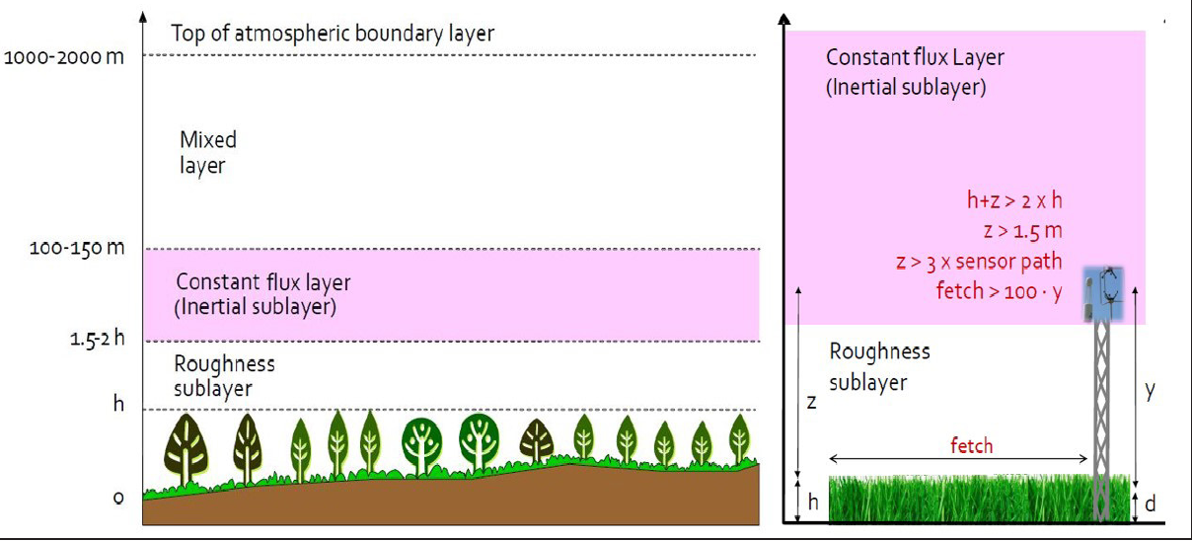
Where fluxes are measured: the atmospheric surface layer
Planetary boundary layer (PBL): 100 m (night) to 1–2 km (day); directly heated/cooled by the surface
Surface layer = constant-flux layer: lowest ~10% of PBL (20 m night, ~100 m day); fluxes ≈ constant with height
Roughness sublayer: up to ~1.5–3 × canopy height h; flow disturbed by individual plants, so avoid it
MOST (Monin–Obukhov similarity theory): flux–profile relations depend on (z − d)/L, L = Obukhov length
Fetch & footprint: upwind area the sensor sees; rule of thumb fetch ≈ 100 × sensor height
Atmospheric layers and EC installation (Burba & Anderson 2010, in ICAR-NRRI Bulletin 29)
Both instruments must sit inside the constant-flux layer and above the roughness sublayer.
Notes:
Obukhov length L = −u*³ T / (k g w′T′) (equivalently u*² T /(k g T*)). L < 0 means unstable (daytime), L > 0 stable (night). The EC tower rule from the NRRI bulletin: sensor height 1.5–2 × canopy height, fetch 100 × height; the Kipp & Zonen manual uses 3 × obstacle height for the top of the roughness sublayer.

Slide 5
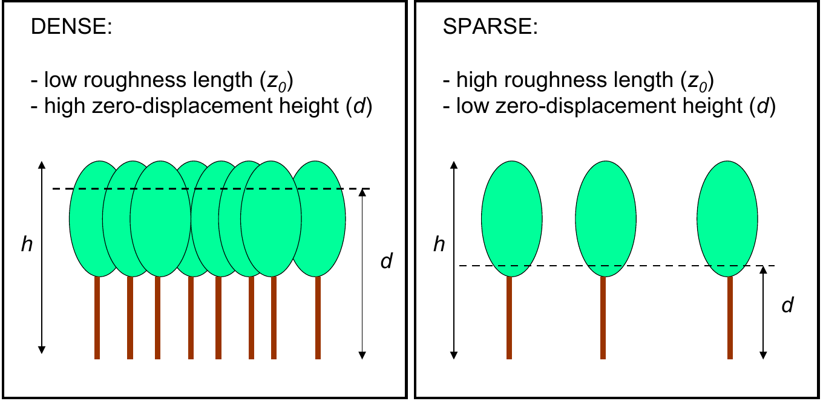
Roughness length (z₀) and zero-plane displacement (d)
Rules of thumb for a dense crop of height h
d ≈ 0.67 h (IARI study) / 0.7 h (K&Z manual)
z₀ ≈ 0.1 h
Sparse elements: use d = 0
z₀: height where the log wind profile extrapolates to zero; sets mechanical turbulence
d: the effective 'raised ground' inside a dense canopy; measurement height is used as (z − d)
Dense canopy → high d, low z₀; sparse → low d, high z₀
Typical z₀: open grass 0.03 m, cultivated low crops 0.1 m, mature forest 1.0 m
Night-time LAS fluxes are very sensitive to z₀; daytime (free convection) much less
Dense vs sparse roughness elements (Kipp & Zonen LAS manual, Fig. 18)
Log wind profile (neutral): u(z) = (u*/k) · ln[(z − d)/z₀], k = 0.40
Notes:
Interviewers often ask why d = 2/3 h. Inside a dense canopy momentum is absorbed by the upper leaves, so the canopy behaves as if the ground were raised to about two-thirds of its height. Both EC and LAS calculations use the effective height z − d.

Slide 6
Part A — Eddy Covariance (EC) Tower
A
Direct, high-frequency measurement of energy, water vapour, CO₂ and CH₄ exchange over a crop

Slide 7
EC principle: covariance of vertical wind and scalar
Air moves as rotating eddies. Each eddy has velocity components u (horizontal), v (lateral) and w (vertical). The net vertical transport of any quantity s = average of w × s over 30 min.
1
Vertical flux
F = ρₐ · mean(w s)
2
Reynolds decomposition
w = w̄ + w′ , s = s̄ + s′
3
Assume mean(w′)=mean(s′)=0, ρ′ ≈ 0, w̄ ≈ 0 (flat, homogeneous)
F ≈ ρₐ · mean(w′ s′)
H
LE
CO₂
CH₄
H = ρₐ cₚ · mean(w′T′)
LE = λ ρₐ · mean(w′q′)
Fc = ρₐ · mean(w′c′) = NEE
F_CH₄ = ρₐ · mean(w′c′_CH₄)
Notes:
Primes are deviations from the 30-min mean, overbars are time averages. Mean of a deviation is zero by definition; density fluctuations are handled by the WPL correction; w̄ ≈ 0 after coordinate rotation over flat terrain. Sign: positive flux = upward (to atmosphere), negative NEE = uptake by crop.

Slide 8
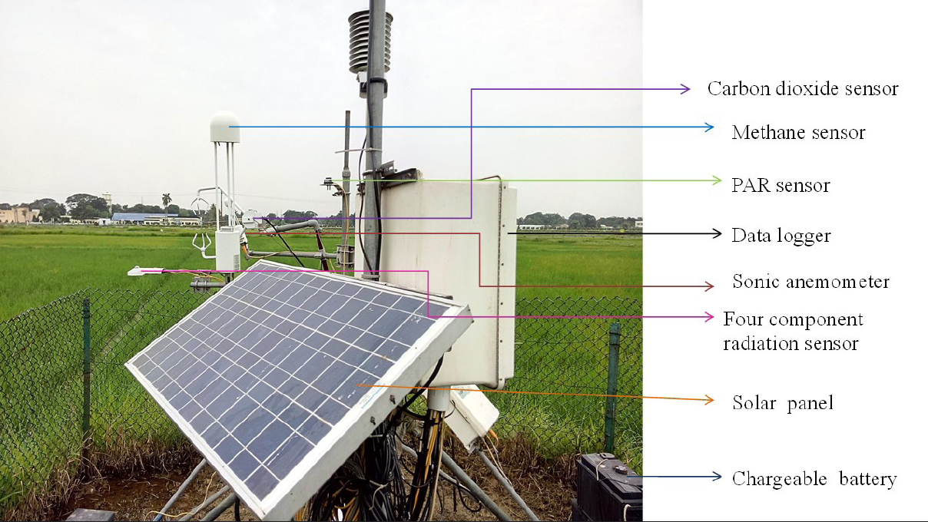
Components of an open-path EC system
Sensor (example) | Measures
3-D sonic anemometer (CSAT3) | u, v, w and sonic temperature at 10 Hz
Open-path IRGA (LI-7500A) | CO₂ and H₂O densities
Open-path CH₄ analyser (LI-7700) | CH₄ density
4-component net radiometer (CNR4) | SW↓, SW↑, LW↓, LW↑, Rn, albedo
Quantum sensor (LI-190) | PAR
T/RH probe (HMP45C), fine-wire thermocouple | Air temperature, humidity
Soil temp. probes + heat flux plates | Soil T (5, 15, 30 cm), G
Data logger (CR3000) + solar power | 10 Hz storage, power
Open-path EC system in lowland rice, ICAR-NRRI Cuttack (Bulletin 29, Fig. 1)
Open path: low power, good frequency response, but data lost in rain and needs WPL density correction. Closed path: air pumped through a tube; works in rain, less maintenance for long-term runs, but tube attenuation of water vapour.
Notes:
Sonic anemometer principle: transit time of ultrasonic pulses between transducer pairs in both directions gives wind speed along each path (and speed of sound gives sonic temperature). IRGA principle: absorption of infrared at CO2 (4.26 µm) and H2O (2.59 µm) bands. The LI-7500A head is tilted about 15° to shed rain. The sensors are aligned facing the prevailing wind.

Slide 9
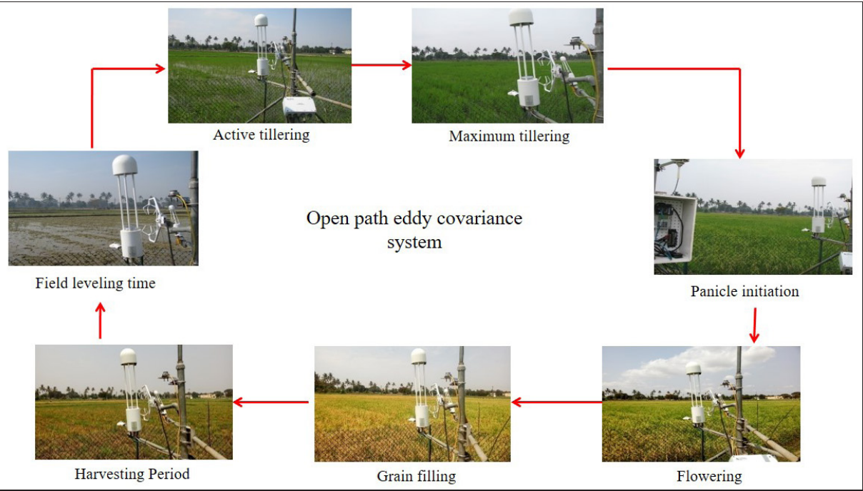
Siting and installation rules
1
Terrain
Flat, horizontal, homogeneous crop; same variety and management across the fetch
2
Height
Inside constant-flux layer: about 1.5–2 × canopy height (h + z > 2h, z > 1.5 m)
3
Fetch
≈ 100 × sensor height in the dominant wind direction (1 m sensor → 100 m of same crop)
4
Sampling
Fast response 5–40 Hz (typically 10 Hz); averaging period 30 min
5
Turbulence
Flux carried fully by turbulent eddies; no flow convergence/divergence
EC tower through rice growth stages (Bulletin 29, Fig. 3)
NRRI Cuttack site: 20.45°N, 85.94°E; sensors at 1.5 m in a 2.25 ha paddy; fetch 150 m (S–SE winds); 5–8 cm standing water.
Notes:
Fetch requirement comes from the footprint: the area contributing to the flux grows with measurement height and atmospheric stability (longer at night). If the tower is too low, it sits in the roughness sublayer; too high, and the footprint extends beyond the field.

Slide 10
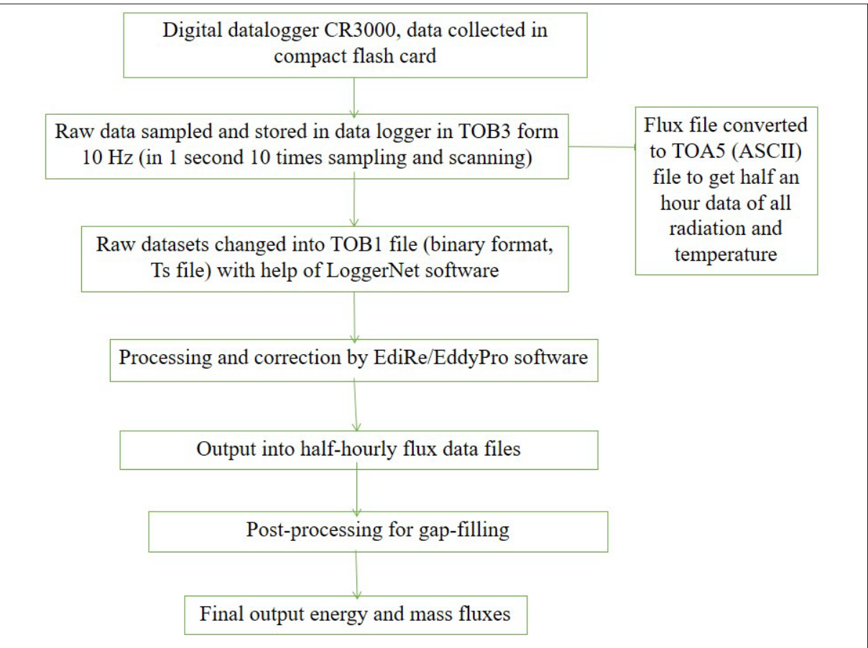
Raw data to fluxes: processing workflow
Data logger (CR3000) records 10 Hz raw data → TOB3 files on flash card
LoggerNet converts to TOB1 (binary) / TOA5 (ASCII, 30-min met data)
Processing in EddyPro / EdiRe: corrections and quality control
Half-hourly fluxes (H, LE, Fc, F_CH₄, τ)
Filtering (u*, spikes, QC flags) and gap filling
Final energy and mass fluxes → daily, seasonal, annual budgets
Original flowchart, ICAR-NRRI Bulletin 29 (Fig. 4)
Notes:
Gap filling at NRRI: gaps longer than 3 h filled by mean diurnal variation in a 10-day window; shorter gaps by look-up tables or linear interpolation (Falge et al. 2001). Reported output is 30-min mean flux after quality control.

Slide 11
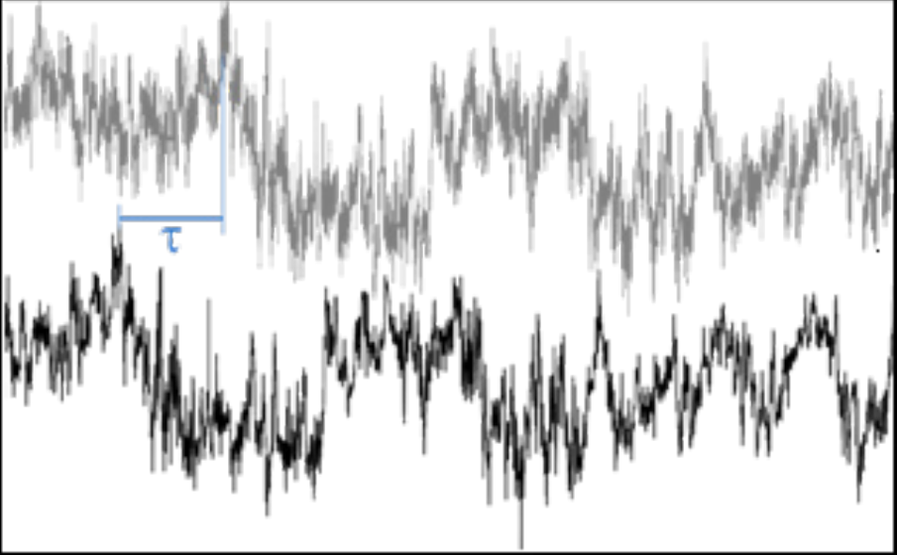
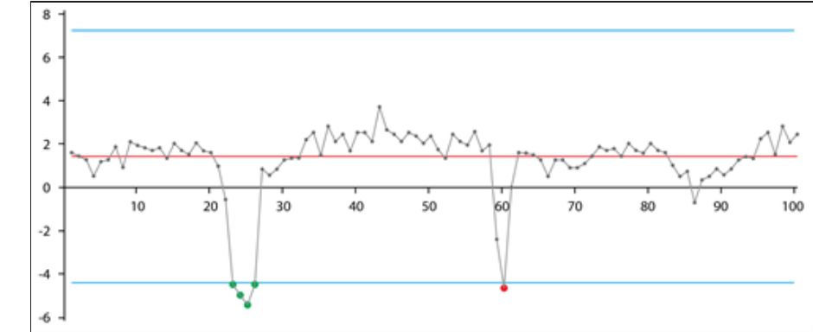
Flux corrections (1/2): cleaning the raw time series
1
Coordinate rotation
2
Time-lag compensation
Removes sonic tilt so mean w = 0. Double rotation for flat, homogeneous fields; planar fit for slopes or uneven canopy.
Sensor separation and electronics delay; lag found by maximum cross-correlation between w and the scalar.
Time lag τ between w and scalar (LI-COR, in Bulletin 29)
3
Despiking
4
Detrending
Vickers & Mahrt (1997): flag values beyond mean ± 3.5σ (u, v, CO₂, H₂O), ± 5σ (w), ± 8σ (CH₄).
Block averaging (default) or linear/running mean removes low-frequency drift.
Spike detection: red = spike, blue = plausibility range
Notes:
Coordinate rotation forces the mean vertical wind to zero so that horizontal wind does not leak into w′. Time lag: an open-path IRGA a few cm from the sonic has almost no lag; a closed-path system has a tube delay, which for water vapour varies with humidity because H2O sticks to tube walls.

Slide 12
Flux corrections (2/2): density, spectra and filtering
5
WPL density correction
Webb–Pearman–Leuning: open-path IRGAs measure gas density; heat and water vapour change air density, which mimics a gas flux. WPL converts to the true flux (mixing-ratio basis).
6
Spectral / frequency response
Recovers flux lost to path averaging, sensor separation, tube attenuation and finite sampling (high- and low-pass filtering).
7
Sonic temperature
Sonic anemometer gives virtual (sonic) temperature; its flux is converted to the true sensible heat flux.
8
u* filtering
Discard calm-night data below a threshold friction velocity (~0.1 m s⁻¹), when turbulence cannot carry the flux to the sensor.
9
Gap filling
Mean diurnal variation in a 10-day window for gaps > 3 h; look-up tables or linear interpolation for shorter gaps.
Notes:
The most-asked corrections are WPL, coordinate rotation and u* filtering. WPL matters because warm rising air is less dense, which looks like a CO2 deficit even with no true flux. The u* threshold is chosen where night-time NEE stops increasing with u*.

Slide 13
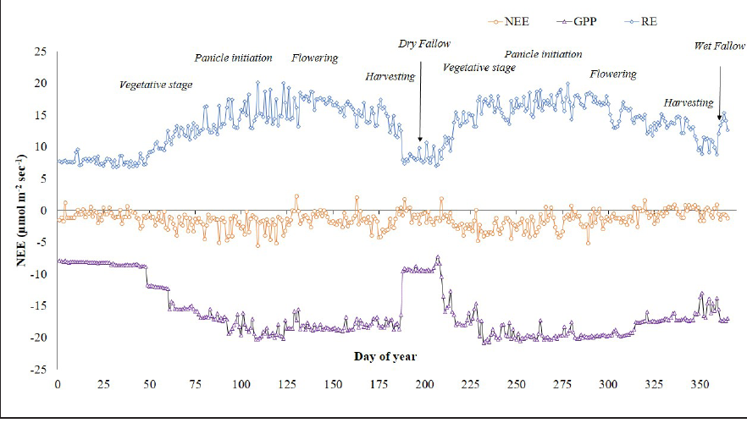
Partitioning NEE into GPP and ecosystem respiration
NEE = RE − GPP (negative NEE = net uptake)
Night: GPP = 0, so NEEₙ = REₙ
Fit REₙ to air temperature: RE = R₀ · Q₁₀^((T − T₀)/10)
Extrapolate RE to daytime with daytime T
NEE, GPP and RE over a rice–rice year, Cuttack (Bulletin 29, Fig. 8)
GPP = RE − NEE (day)
Q₁₀ method partitioned better than the rectangular hyperbola in lowland rice
GPP −8.11 to −18.92 and RE 7.83 to 15.45 µmol CO₂ m⁻² s⁻¹
NEE peak uptake 11:30–12:30; night = CO₂ source
Light response: NEE = −(α β Q)/(α Q + β) + γ
α = quantum yield, β = max uptake, γ = RE, Q = PAR
Notes:
Q10 is the factor by which respiration increases for a 10 °C rise (often about 2). Partitioning matters because NEE alone cannot tell whether a change in uptake came from photosynthesis or respiration. NEP ≈ −NEE.

Slide 14
Methane, N₂O and the carbon balance of rice
Methane (NEME)
Nitrous oxide & water
Net ecosystem carbon balance
Needs organic C + anaerobic soil (Eh ≤ −200 mV) + methanogens
Escapes by ebullition, diffusion through floodwater, plant aerenchyma
Diurnal peak 13:30–14:30 (soil temperature driven)
Seasonal peak active tillering → panicle emergence
Cuttack: 2.86 (dry season) vs 4.19 (wet season) mg CH₄ m⁻² h⁻¹
N₂O: GWP 298, lifetime ~121 years; flux driven mainly by soil moisture
Intermittent flooding raises N₂O 30–45× vs continuous flooding (trade-off with CH₄)
Fast N₂O analysers on EC towers are replacing manual chambers
Fc and FH₂O positively correlated (r² 0.44–0.76): shared stomatal pathway
ETa (rice): 2.31 (dry) and 2.24 (wet season) mm d⁻¹
NECB = NEP + I − HA − METH − DOC − ER − FI − VOC
I = manure/stubble/root inputs; HA = harvest; METH = CH₄-C; DOC = dissolved C; ER = erosion; FI = fire
Cuttack NEP: +3.83 (dry) and +2.51 (wet season) Mg C ha⁻¹ → lowland rice was a net C sink
Notes:
Smith et al. (2010) stress that tower NEE alone is not the carbon budget of a cropland: harvest removal, manure and CH4 losses must be added. CH4 GWP-100 is about 28 (AR5) to 27 (AR6). Rice contributes about 18% of India's agricultural methane according to the bulletin.

Slide 15
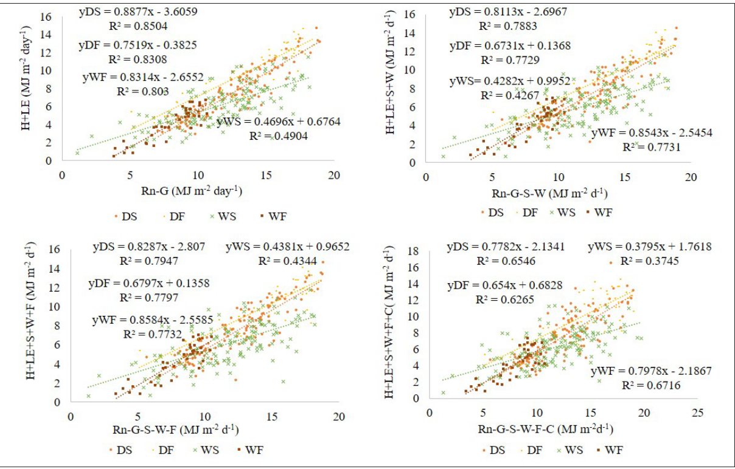
Energy balance closure: testing data quality
V = Rn − G − S − W − C − F vs H + LE
OLS
Regress H + LE on V: slope b and intercept a. Perfect closure: a = 0, b = 1.
EBR
EBR = Σ(H + LE) / Σ(Rn − G). Typical 0.7–0.9; Cuttack 0.50–0.72.
RHF
Residual = (Rn − G) − (H + LE). > 0 means turbulent flux under-measured.
Why closure fails: missing storage terms (soil S, standing water W, canopy C, photosynthesis F), large eddies and advection, footprint mismatch between Rn (small) and EC (large), instrument errors. In rice, rain and changing water depth worsen closure in the wet season.
OLS closure plots by season, Cuttack (Bulletin 29, Fig. 11)
Notes:
Storage terms: S = soil heat storage above the flux plate, W = heat stored in the floodwater, C = canopy heat storage, F = photosynthetic energy. Adding them raised EBR only slightly at Cuttack. Residual heat flux distinguished seasons best, followed by OLS.

Slide 16
Derived quantities from EC data
ET
ETa = LE / (λ ρw)
β
Bowen ratio β = H / LE
λ = 2.501 − 0.00236 Tₐ (MJ kg⁻¹)
Rice 0.21–0.64 (low: open water, low stomatal resistance)
EF
EF = LE / (Rn − G)
α
Albedo = SW↑ / SW↓
Fraction of available energy used for ET
Rice 0.09–0.24; rises to panicle initiation, then falls
rₐ
rₐ = ρ cₚ (Tₛ − Tₐ) / H
r꜀
Canopy resistance from LE, qₛ − qₐ
Aerodynamic resistance to heat transfer
Resistances rise as the season advances
Cuttack rice energy partitioning: H = 1–23%, LE = 23–66%, G = 5–10% of available energy. LE was 1.2–63.9 × H. During the day Rn is the main source and LE the main sink; at night G becomes the main source.
Notes:
A low Bowen ratio means most energy goes into evaporation (well-watered crop); a high Bowen ratio means dry conditions. Note: the NRRI bulletin text states this the other way round in one sentence, but the standard definition is that low β means LE dominates.

Slide 17
Eddy covariance: advantages and limitations
+
Advantages
−
Limitations
Direct measurement of the flux: no empirical exchange coefficients
Continuous, automated, non-destructive, half-hourly to annual
Measures energy, water and gases (CO₂, CH₄, N₂O) together
Integrates over a field (2–3 ha), not a plant
Backbone of FLUXNET/AsiaFlux; validates models and satellite products
Point measurement: one ecosystem type; mixed fields are hard to interpret
Needs flat, homogeneous terrain with long fetch
Complex processing; many assumptions and corrections
Energy balance seldom closes (typically 10–30% gap)
Night-time low turbulence (u* filtering), rain on open-path sensors, insects/dirt
Expensive sensors (especially N₂O and CH₄ analysers)
Notes:
If asked how to reduce uncertainty: careful siting, footprint analysis, standard processing (EddyPro), u* filtering, closure checks, and cross-comparison with chambers, lysimeters or LAS.

Slide 18
Part B — Large Aperture Scintillometer (LAS)
B
Path-averaged sensible heat flux over 250 m – 4.5 km from the 'twinkling' of a light beam

Slide 19
Scintillation principle
Path length L: 250 m – 4.5 km (LAS), 1 – 8 km (XLAS) • Aperture D = 0.15 m (LAS), 0.33 m (XLAS)
Transmitter
880 nm LED
Receiver
photodiode
Turbulent eddies of warm and cool air → refractive index (n) fluctuations → intensity fluctuations (scintillation)
Why 880 nm?
Why large aperture?
What is measured?
In the near-infrared, refractive index fluctuations are caused mainly by temperature, so LAS signal ≈ heat flux (humidity effect is a small correction).
Averages out eddies smaller than D (~0.15 m) → avoids saturation and responds to inertial-subrange eddies; allows km-long paths.
Variance of log intensity σ²lnI → structure parameter of refractive index Cn² (typical 10⁻¹⁸ – 10⁻¹³ m⁻²ᐟ³).
Notes:
The same physics makes stars twinkle and the road shimmer on a hot day. A scintillometer quantifies that shimmer. Unlike EC, it does not need fast-response sonic and gas sensors; it needs only the beam, plus basic weather data (T, P, wind speed) and an estimate of roughness.

Slide 20
From Cn² to sensible heat flux: the equations
1
Cn² from scintillation
Cn² = 1.12 σ²lnI D⁷ᐟ³ L⁻³
2
Remove humidity effect (β = Bowen ratio)
Cn² ≈ (A_T² / T²) C_T² (1 + 0.03/β)², A_T ≈ −0.78×10⁻⁶ P/T
3
MOST similarity (unstable, L < 0)
C_T² (z − d)²ᐟ³ / T*² = 4.9 [1 − 6.1 (z − d)/L]⁻²ᐟ³
4
Scales
T* = −H / (ρ cₚ u*), L = u*² T / (k g T*)
5
Friction velocity from wind speed
u* = k u / [ln((z_u − d)/z₀) − Ψm((z_u − d)/L) + Ψm(z₀/L)]
6
Iterate steps 3–5 until H converges; then
LE = Rn − G − H → ET = LE / λ
Free convection shortcut (daytime, high beam): H = ρ cₚ b (z − d) (g/T)¹ᐟ² (C_T²)³ᐟ⁴ with b ≈ 0.48 (K&Z manual) or 0.57 (used in IARI study)
Notes:
Step 2: the near-infrared LAS sees mostly temperature fluctuations; the factor (1 + 0.03/β)² corrects for humidity. Over dry surfaces β > 3 and the correction is tiny; over wet crops β < 0.5 and it matters. IARI used β ≈ 0.5 as typical for an irrigated agro-ecosystem. Stable (night) function: fT = 4.9[1 + 2.2 (z − d)/L]^(2/3); there is no consensus on the stable function. Ψm is the integrated stability function for momentum.

Slide 21
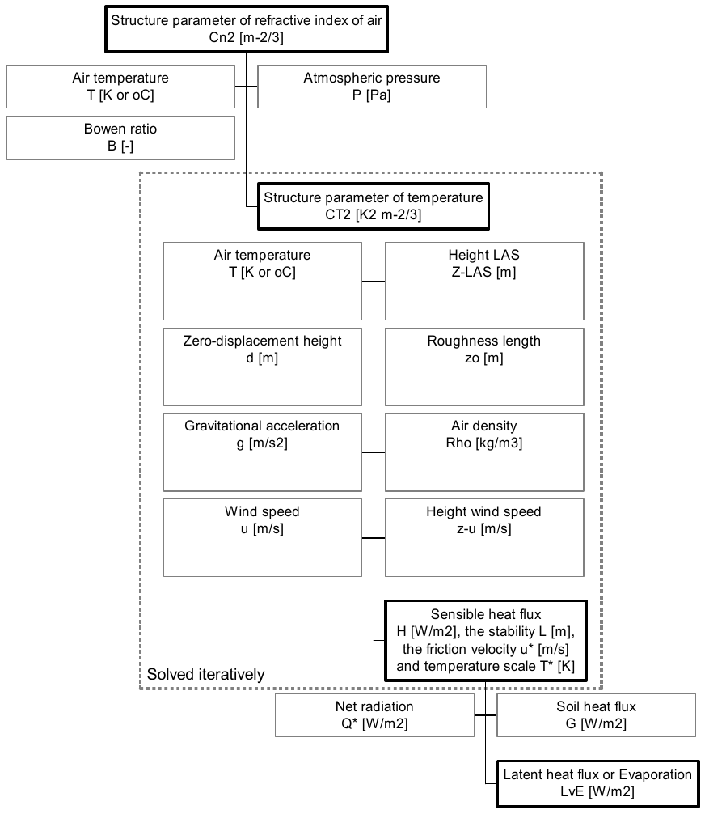
LAS data processing workflow
LAS receiver: U_CN2 (log Cn² signal), signal strength U_DEMOD, every 1 s → 5–10 min averages
Cn² = 10^(U_CN2 − 12) (average with variance correction 1.15 σ²)
Cn² + T, P, Bowen ratio → C_T²
C_T² + z_LAS, d, z₀, wind speed u → iterate MOST → H, u*, L, T*
Rn and G from AWS → LE = Rn − G − H
Daily ET, EF, Bowen ratio → validation of satellite ET
Steps to derive H (Kipp & Zonen manual, Fig. 13)
Notes:
Because U_CN2 is a logarithmic signal, averaging the voltage and then converting gives a biased Cn²; the manual recommends either converting each 1 s value first, or applying the variance correction Cn² = 10^(U_CN2 − 12 + 1.15 σ²). Software: WINLAS (manual) or EVATION (used at IARI).

Slide 22
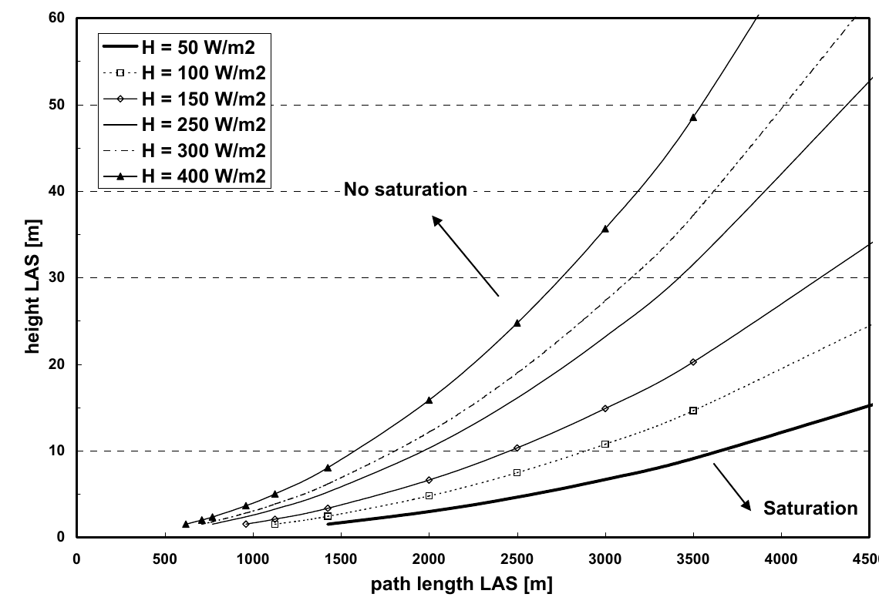
Installing a LAS: height, saturation and alignment
Saturation: if scintillation is too strong, σ²lnI no longer relates to Cn². Avoid by raising the beam or shortening the path; worse over dry (high-H) surfaces
Example: wet area (H ≈ 100 W m⁻²), 3 km path → height ≥ 10–12 m (add d over dense crops)
Upper limit: beam must stay in constant-flux layer (≤ ~100 m) and above roughness sublayer (~3h)
Orientation: roughly N–S so low sun never shines into the optics; clear line of sight
Alignment & care: pan/tilt using signal strength, vibration-free mounts, heated windows, silica gel, periodic cleaning
Minimum LAS height vs path length for different H (K&Z manual, Fig. 1a)
LAS specs: 880 nm LED, 7 kHz modulation, Cn² range 10⁻¹⁷–10⁻¹² m⁻²ᐟ³, min height 1.5 m (LAS) / 3 m (XLAS)
Notes:
The flux derived from Cn² is very sensitive to the effective beam height, so it must be measured carefully. Over non-flat terrain the effective height is computed by weighting the beam height above the surface along the path with the path-weighting function.

Slide 23
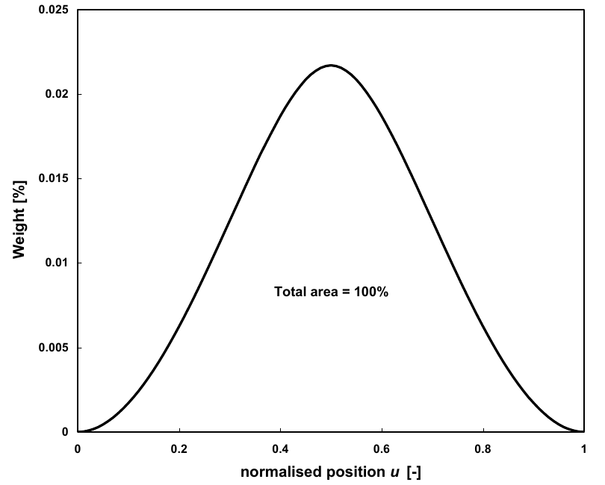
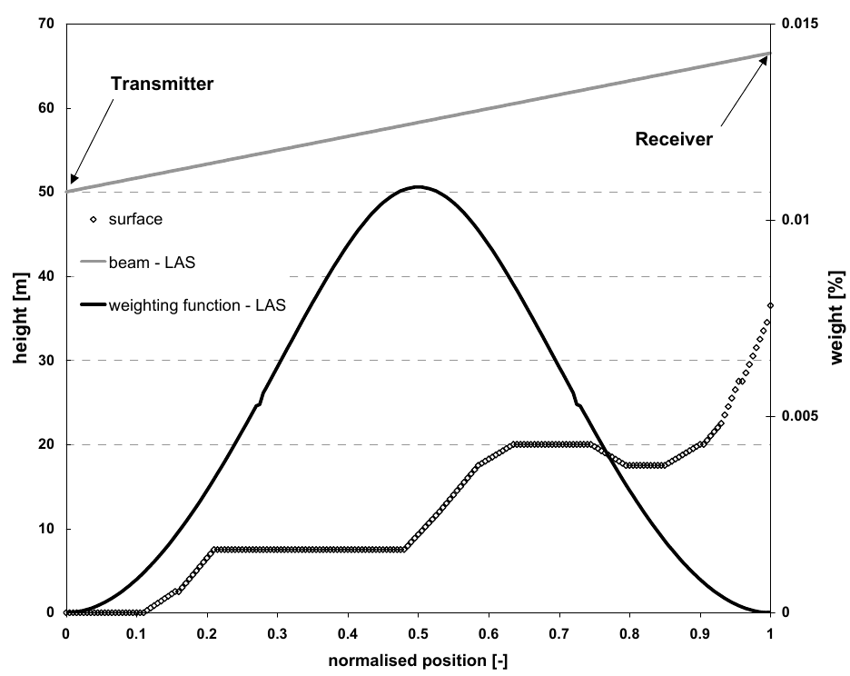
Path-weighting function and effective height
Bell-shaped path weighting (K&Z manual, Fig. 16)
Sloping path: effective height = 46 m (K&Z manual, Fig. 17)
LAS is most sensitive at the centre of the path and insensitive near the ends → the centre of the path must cover the crop of interest (IARI: central zone was maize/wheat)
Footprint = path-weighting × upwind source area: an elongated area of several hectares to km², comparable to a satellite pixel
Notes:
This is why an LAS can be compared directly with MODIS or Landsat ET pixels: its measurement integrates over a strip of land rather than a point. For validation, the satellite ET is weighted with the LAS footprint.

Slide 24
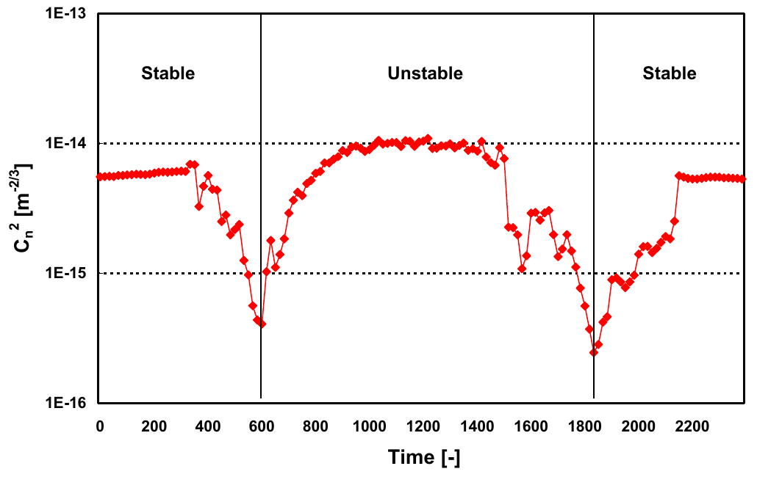
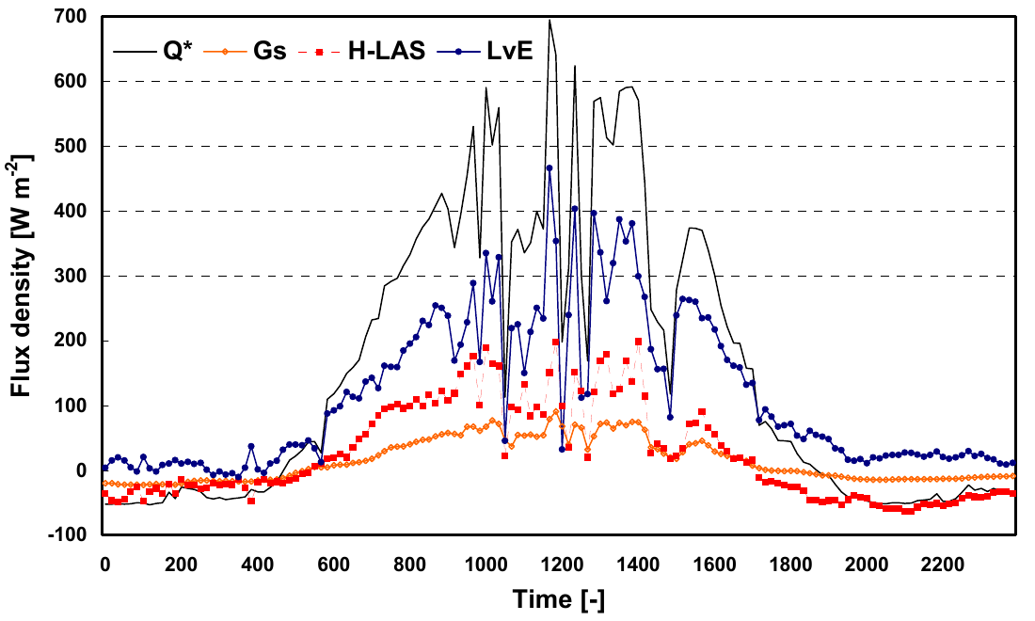
What LAS data look like
Diurnal Cn²: drops at sunrise and sunset (K&Z manual, Fig. 11)
Rn (Q*), G, H-LAS and LE from LAS + AWS (K&Z manual, Fig. 15)
Interpretation: Cn² is high in unstable daytime and lower at night; it dips to a minimum near sunrise and sunset when H changes sign (neutral, almost no temperature fluctuation). Because LAS cannot tell the sign of H from Cn², stability (day/night) must be decided from other data, such as the temperature gradient or Rn.
Notes:
Cn² depends on the square of temperature fluctuations, so it is always positive. The direction of H is assigned from the sign of net radiation or a vertical temperature difference.

Slide 25
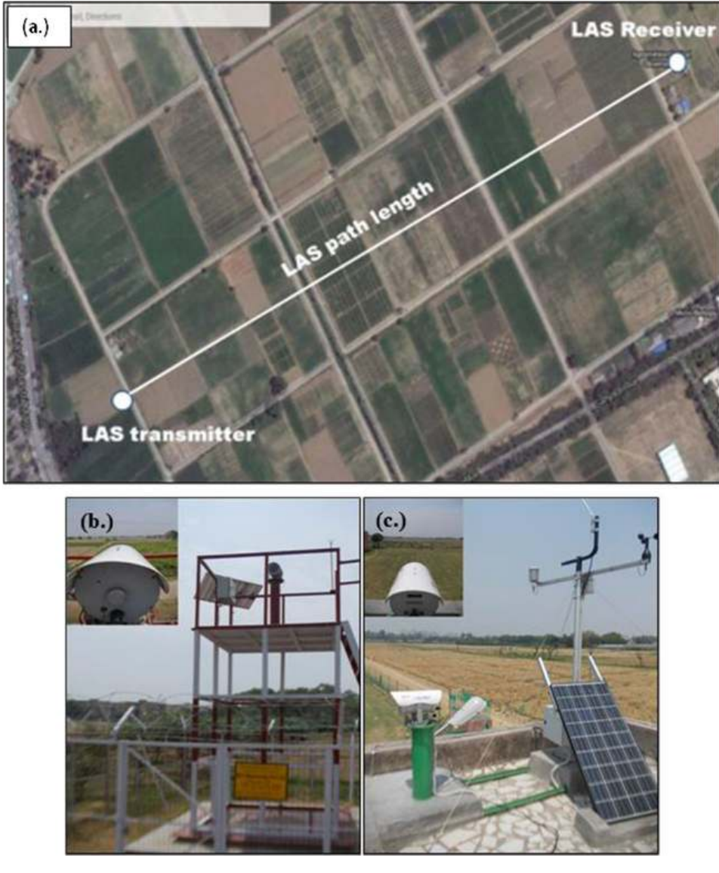
Case study: LAS over maize–wheat at IARI, New Delhi
Danodia, Sehgal, Patel, Dhakar, Mukherjee, Saha & Senthil Kumar (2017), J. Earth Syst. Sci. 126:69 — ICAR-IARI and IIRS-ISRO, Dehradun
Item | Set-up
Location | IARI farm, 28.63°N, 77.15°E, 220 m; semi-arid sub-tropical
Instrument | Kipp & Zonen LAS MkII, 990 m path, 4.5 m height, NE–SW
Crops | Maize (kharif) and wheat (rabi), June 2014 – May 2015
Support data | AWS at 5 min: NR-LITE net radiometer, CMP3 pyranometer, 2-level wind/T/RH, soil heat flux plate at 10 cm
Field data | LAI (LAI-2000), crop height, soil moisture (TDR, 12.5 cm) every fortnight, >70 points along path
Processing | EVATION software; β ≈ 0.5 for C_T²; d = 0.67h, z₀ = 0.1h; free-convection H with b = 0.57
LAS path, transmitter and receiver at IARI (Danodia et al. 2017, Fig. 1)
Notes:
This is the key ISRO-linked LAS paper to quote. The authors argue LAS fluxes are at a scale comparable to coarse-resolution satellite ET products and recommend using them for calibrating and validating SEBAL/METRIC and crop models.

Slide 26
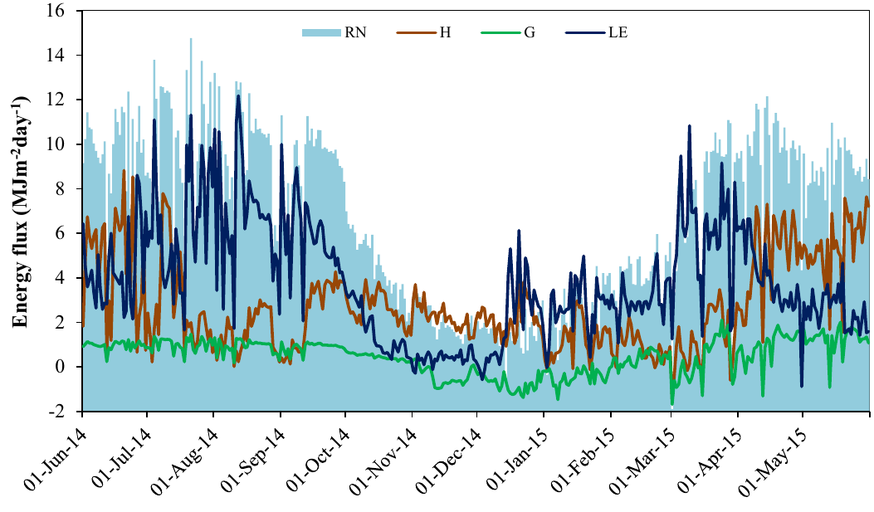
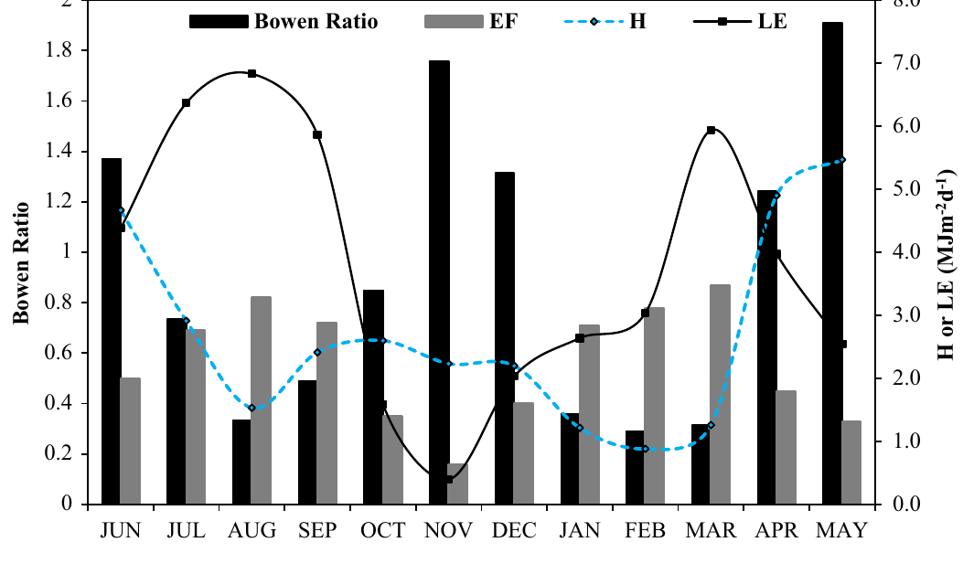
IARI results: fluxes follow the crop calendar
0.76 / 0.88
543 mm
Bowen ratio, kharif / rabi
Annual ET (mean 1.58 mm d⁻¹)
R² 0.80
R² 0.83
LAI vs LE (positive)
LAI vs Bowen ratio (negative)
Daily Rn, H, G, LE over the year (Fig. 5)
0.16–0.87
≈ 7%
Evaporative fraction range
Annual G/Rn (soil is an energy source in winter)
Monthly Bowen ratio and EF (Fig. 6)
Notes:
Pattern: H > LE in the June and May fallows and in November between seasons; LE ≈ 4 × H in the monsoon (6.82 vs 1.56 MJ m⁻² d⁻¹); LE dominates from mid-December to March in wheat. Soil moisture correlated negatively with H (R² 0.68). Mean ET 2.04 mm/d in kharif and 1.45 mm/d in rabi. Peaks: Rn 490.5, H 231.7, G 91.9, LE 297.3 W m⁻². Limitation: poor visibility (fog) and stable nights cause errors; G/Rn becomes large in winter.

Slide 27
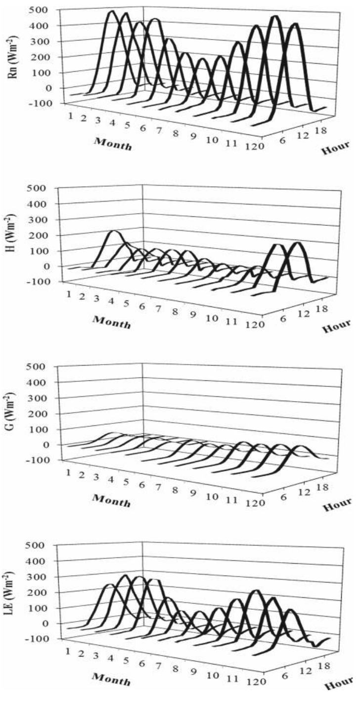
Diurnal and seasonal behaviour across crops
Maize–wheat, IARI (LAS)
Lowland rice, Cuttack (EC)
Rn, H, LE, G all follow the diurnal Rn curve
G peaks 1.5–2 h before/after Rn due to soil thermal inertia
Minimum β at maximum LAI; β > 1 in fallow
Monsoon: LE about 4 × H; fallow: H about 5 × LE
Errors in fog and heavy monsoon rain
H peaks 11:00–12:30; LE 12:30–13:30; G 09:00–10:00
LE dominates tillering → grain filling; H matters early
Water vapour flux peaks 13:30–14:00 (no midday stomatal closure under flooding)
Net radiation higher in dry season; albedo 0.09–0.24
Standing water stores heat and changes the microclimate
Monthly diurnal Rn, H, G, LE at IARI (Fig. 4)
Notes:
A comparison of the two crops is a good interview answer: flooded rice keeps LE high all day, while upland crops under water stress show midday stomatal closure and higher H.

Slide 28
EC tower vs LAS: side-by-side
Aspect | Eddy covariance tower | Large aperture scintillometer
Measures directly | H, LE, CO₂, CH₄, momentum | Cn² → H only (LE as residual)
Physical basis | Covariance w′s′ (Reynolds averaging) | Optical scintillation + MOST
Spatial scale | Point; footprint ~100 × height (ha) | Path 0.25–4.5 km; km² footprint
Sensor frequency | 10–20 Hz sonic + gas analysers | Low-rate log Cn² signal (1 s)
Terrain needs | Flat, homogeneous, long fetch | Tolerates heterogeneous landscapes
Corrections | Many (rotation, WPL, spectral, lag …) | Few; needs z_LAS, d, z₀, β, u
Main weaknesses | Closure gap, complexity, small area | Saturation, MOST assumptions, sign of H, no gases
Best use in RS | Carbon/water flux site validation, GPP/ET models | Validating pixel-scale ET (MODIS/INSAT, SEBAL/METRIC)
Notes:
Studies comparing the two over crops (e.g. Evans 2012; CSU irrigated fields) generally find good agreement in H, with LAS often 10–30% higher, partly because of different source areas and the EC closure deficit.

Slide 29
How these measurements feed ISRO remote sensing
EC tower and LAS fluxes (H, LE, NEE)
Footprint matching with satellite pixels
Calibrate / validate RS models (SEBAL, METRIC, SEBS, VPM, LUE)
ET, GPP and crop-water stress maps
Irrigation advisories, crop models, carbon budgets
Satellite inputs
Why LAS suits validation
LST (Landsat TIRS, MODIS, INSAT-3D/3DR/3DS, ECOSTRESS), albedo, NDVI/LAI, Rn; future ISRO–CNES TRISHNA thermal mission
LAS path (~1–5 km) matches MODIS/INSAT pixels; EC suits Landsat/Sentinel-scale fields
Carbon applications
Water applications
Tower NEE/GPP calibrate light-use-efficiency models (εmax) and validate MODIS GPP over Indian croplands and forests
Crop coefficients (Kc = ETa/ET₀), irrigation scheduling, water productivity, drought/stress indices (EF, β)
Notes:
Interview line: 'Ground flux measurements are the truth against which satellite energy-balance ET is judged. EC gives direct but small-footprint fluxes; LAS gives sensible heat at the scale of a satellite pixel. Together they let us validate products from INSAT-3D, MODIS and, in future, TRISHNA.'

Slide 30
Likely interview questions
Q. Why is the EC flux written as ρ·mean(w′s′)?
Q. What is the WPL correction?
Reynolds decomposition: mean of deviations is zero and w̄ ≈ 0 over flat terrain, so only the covariance term carries net transport.
Corrects gas density fluctuations caused by heat and water vapour changing air density (open-path sensors).
Q. Why does the energy balance not close?
Q. Why does LAS use 880 nm?
Storage terms, large eddies/advection, footprint mismatch, instrument errors; EBR typically 0.7–0.9.
Near-IR refractive index fluctuations are dominated by temperature, so Cn² relates to H.
Q. What is saturation in LAS?
Q. How is LE obtained with LAS?
Scintillation too strong for weak-scattering theory; raise the beam or shorten the path.
As the residual LE = Rn − G − H using an AWS net radiometer and soil heat flux plates.
Notes:
Other possible questions: What is u* filtering? (removing low-turbulence night data below about 0.1 m/s). What is fetch? (upwind distance of uniform surface; about 100 × height). Q10? (respiration change per 10 °C). Bowen ratio over rice? (0.21–0.64). Effective height of LAS? (path-weighted beam height above d).

Slide 31
Key numbers to remember
10 Hz
100 × z
0.67–0.7 h
0.1 h
EC sampling; 30-min averaging
EC fetch rule of thumb
Zero-plane displacement d
Roughness length z₀
880 nm
0.25–4.5 km
~0.1 m s⁻¹
0.7–0.9
LAS LED wavelength
LAS path (XLAS to 8 km)
u* threshold for night data
Typical energy balance ratio
Notes:
Close with the integration message: EC and LAS provide the ground truth that makes satellite ET, GPP and crop-stress products trustworthy.

