Slide 1
Spectroscopic detection of white rust in mustard with ML-SFFS
Step-by-step application and critical re-evaluation of Tian et al. (2021), Remote Sensing of Environment 257, 112350
Plot-average hyperspectral data · 48 plots · 4 dates (11 Feb – 13 Mar 2026)
Notes:
Title. The deck follows the workbook and the thesis chapter step by step (Steps 1–7).

Slide 2
Aim: early detection with few interpretable features
The method
The data
The questions
Tian et al. (2021) detected rice leaf blast from the asymptomatic to the mild stage by (1) data preparation, (2) selecting disease-specific spectral features (DSSFs) by thresholding, consistency across dates and VIF, and (3) ML-SFFS: sequential floating forward selection wrapped around LDA, k-NN or SVM.
48 mustard plots: 3 varieties × 4 inoculation timings (D1–D4) × 3 replications + 12 uninoculated controls. Leaf spectra averaged per plot on 4 dates (T1–T4). Features: reflectance, 1st–3rd derivatives, continuum-removal, 87 vegetation indices, red-edge parameters (+ wavelets).
Which spectral features are disease-specific? How few are needed? How accurate is detection on each date and infection stage – and how much of the paper's accuracy survives an unbiased (nested) evaluation?
Notes:
Three blocks: method, data, research questions.

Slide 3
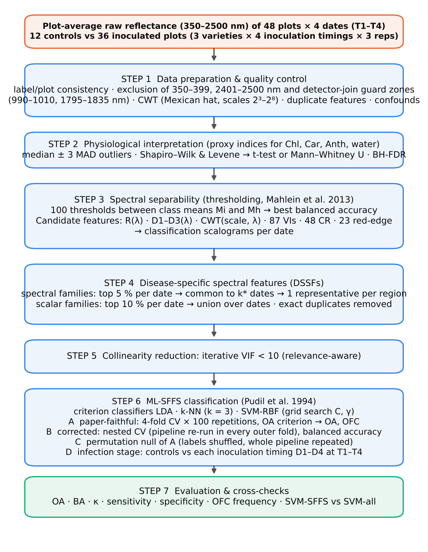
Workflow: Tian et al. (2021) applied in seven steps
Steps 1–5 build the pool of DSSFs exactly as in the paper (with corrections C1–C9)
Step 6 selects the optimal feature combination (OFC) with ML-SFFS
A = paper-faithful (4-fold CV × 100), B = nested CV (unbiased), C = permutation null, D = infection stages
Step 7 = cross-checks: Excel formulas, independent recomputation, reference verification
Notes:
The workflow mirrors Fig. 2 of Tian et al.; evaluation is reported in four ways.

Slide 4
Data and experimental design
48
4
19,548
12 : 36
plots: 12 controls + 36 inoculated
dates T1–T4, vegetative → pod formation
candidate features per date
healthy : diseased – imbalanced
Block | V1 (D1–D4) | V2 (D1–D4) | V3 (D1–D4) | Role
C | 1 1 1 1 | 1 1 1 1 | 1 1 1 1 | uninoculated controls (healthy)
R1 | 1 1 1 1 | 1 1 1 1 | 1 1 1 1 | inoculated, replication 1
R2 | 1 1 1 1 | 1 1 1 1 | 1 1 1 1 | inoculated, replication 2
R3 | 1 1 1 1 | 1 1 1 1 | 1 1 1 1 | inoculated, replication 3
D1–D4 = inoculation timings (days after sowing). Controls were measured first on every date and form their own block – a confound reported as C9.
Notes:
Balanced factorial design; note the separate control block.

Slide 5
Corrections to the paper's procedure (C1–C9)
Code | Issue | Correction
C1 | Spectral range and instrument artefacts | Bands 350–399 nm and 2401–2500 nm (low signal-to-noise at the detector ends) and the detector-join guard zones 990–1010 nm and 1795–1835 nm (ASD VNIR/SWIR1 and SWIR1/SWIR2 joi…
C2 | Class imbalance (12 healthy vs 36 diseased plots) | Balanced accuracy BA = (sensitivity + specificity)/2 chooses the optimal threshold and ranks the features; OA, BA, κ, sensitivity and specificity are all reported. In the corr…
C3 | Multi-date consistency rule | Explicit rule: a feature is 'common' if it is in the top 5 % on at least k* of the 4 dates, where k* is the largest k (4, 3, 2) that leaves ≥ 1 common feature in that family. …
C4 | Selection bias / optimistic accuracy | Procedure A replicates the paper exactly. Procedure B (nested CV) repeats the whole pipeline – separability, DSSF pool, VIF, SFFS and SVM tuning – inside every outer training …
C5 | Collinearity reduction rule | Iterative VIF: while any VIF ≥ 10, the least separable (lowest mean BA) of the features with VIF ≥ 10 is removed; the plain 'drop the highest VIF' rule is reported for compari…
C6 | Feature scaling and classifier details | Features z-scored inside each training fold (scaler never sees test plots); k-NN k = 3, Euclidean (Minkowski p = 2), uniform weights; SVM-RBF with exponential grid C ∈ {2⁻¹, 2…
C7 | Statistical tests | Same decision rule (Shapiro–Wilk + Levene → Student t, else Mann–Whitney U, outliers = median ± 3 MAD) plus Benjamini–Hochberg FDR over all tests.
C8 | No measured leaf biochemistry | Published index proxies of the same constituents were tested (CIrededge, MTCI, REIP, CRI1, ARI, PRI, WI, NDWI).
C9 | Experimental design confounds (treatment file) | The 12 control plots form their own block (C), separate from the inoculated replications R1–R3, and were always measured first on every date (spectra 1–100). Variety and inocu…
Notes:
Each correction is explained in the workbook (sheet S03) and the thesis chapter (Table 3).

Slide 6
Steps 1–2 · Data preparation and physiology
Quality control, instrument artefacts, confounds, physiological proxies

Slide 7
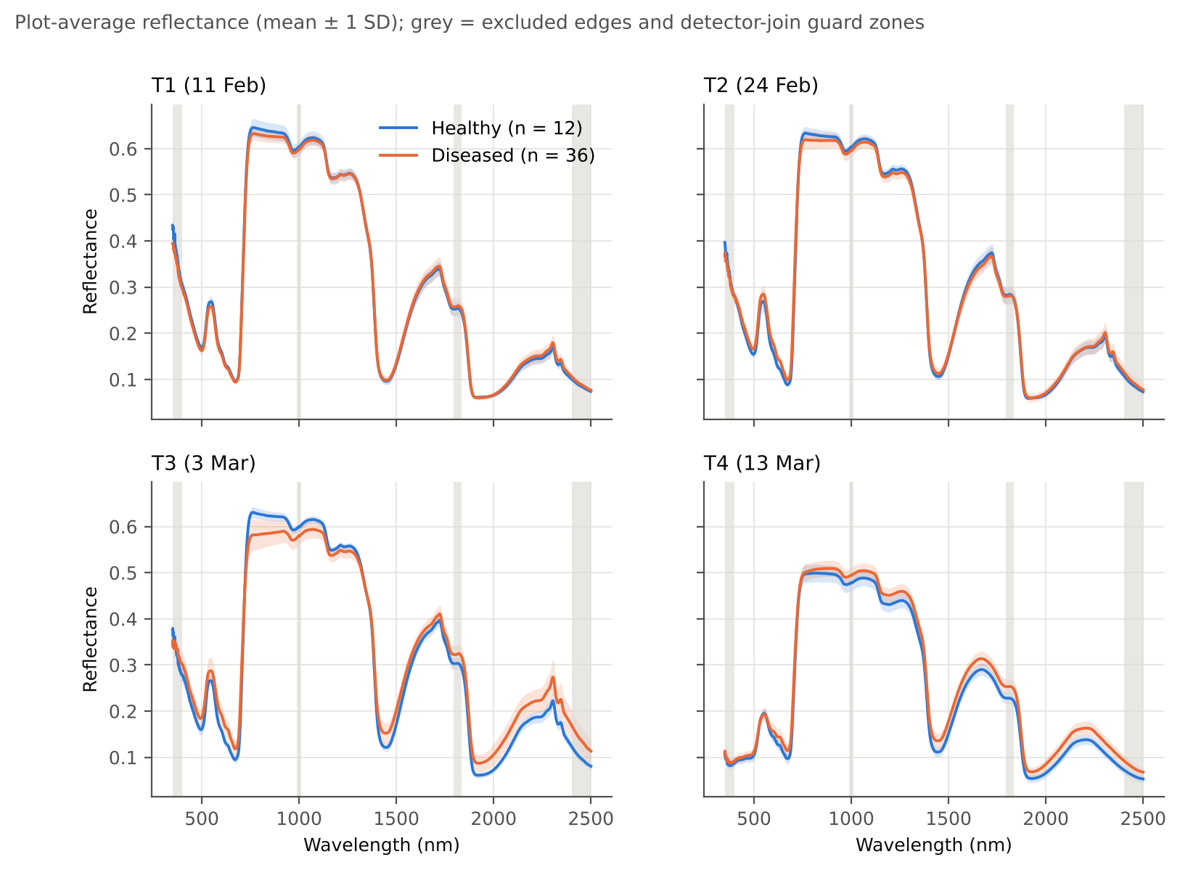
Step 1 · Plot-average spectra and quality control
Labels, varieties and treatment identical across all files (PASS)
Detector edges and joins (grey) excluded: derivatives at 1825–1830 nm separated the classes 'perfectly' – an instrument step, not biology (C1)
mCARI1 ≡ MTVI1 and RARSc ≡ GM2 in the source workbooks (duplicates)
CWT (Mexican hat, scales 2³–2⁸) computed to follow the paper
Notes:
Spectra are means ± 1 SD. Diseased plots: higher red reflectance and a flatter NIR plateau.

Slide 8
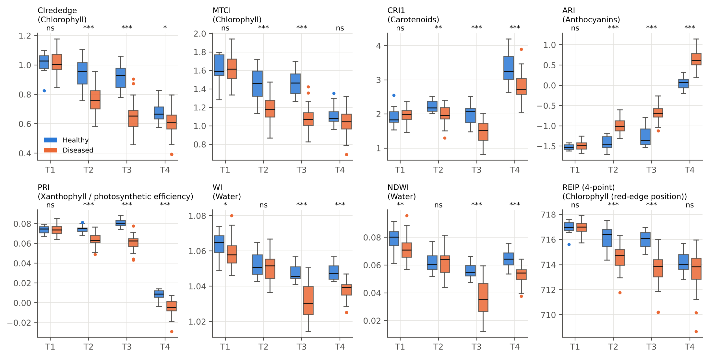
Step 2 · Water first, then pigments: the physiological basis
T1: only the water indices (WI, NDWI) lower in diseased plots
T2–T4: chlorophyll (CIrededge, MTCI, REIP), carotenoid (CRI1) and PRI lower; anthocyanin (ARI) higher
22 of 32 tests significant after BH-FDR
Same pattern as rice blast in Tian et al. (Fig. 4), but water before pigments
Notes:
Proxies replace the paper's measured biochemistry (C8). Test rule: median ± 3 MAD outliers, Shapiro–Wilk + Levene → t-test or Mann–Whitney, BH-FDR.

Slide 9
Steps 3–5 · Feature selection
Thresholding separability → DSSFs → VIF

Slide 10
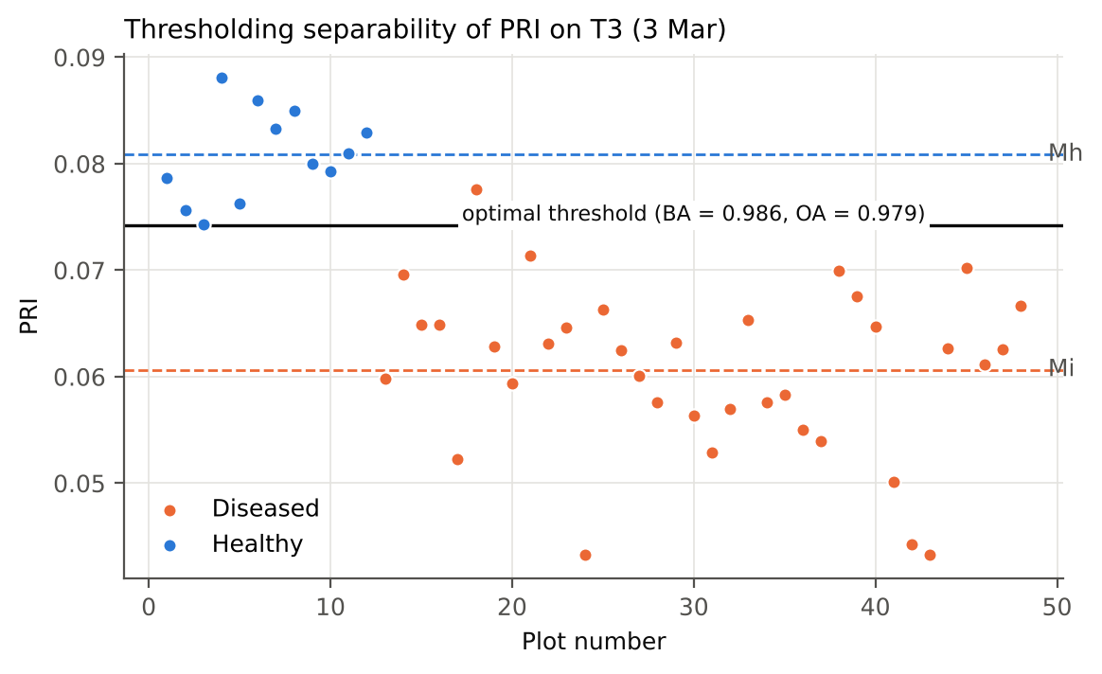
Step 3 · Separability of a single feature by thresholding
How it works
The interval between the class means Mh and Mi is divided into 100 steps; each step is tried as a threshold. Separability = balanced accuracy BA = (sensitivity + specificity)/2 at the best threshold (C2). With 12 vs 36 plots, calling every plot 'diseased' already gives OA = 75 % but BA = 50 %.
Notes:
Analogue of Fig. 3 in Tian et al.; BA replaces OA because the classes are imbalanced.

Slide 11
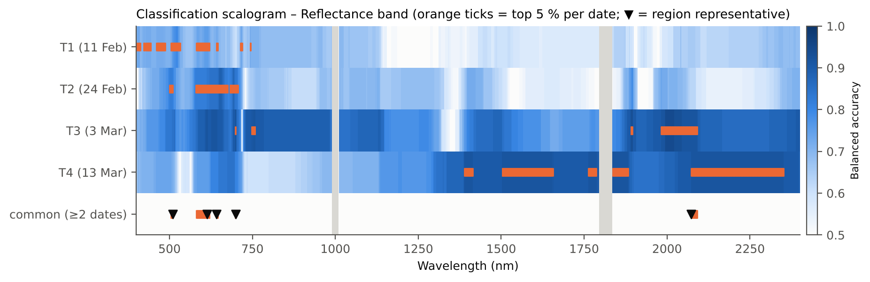
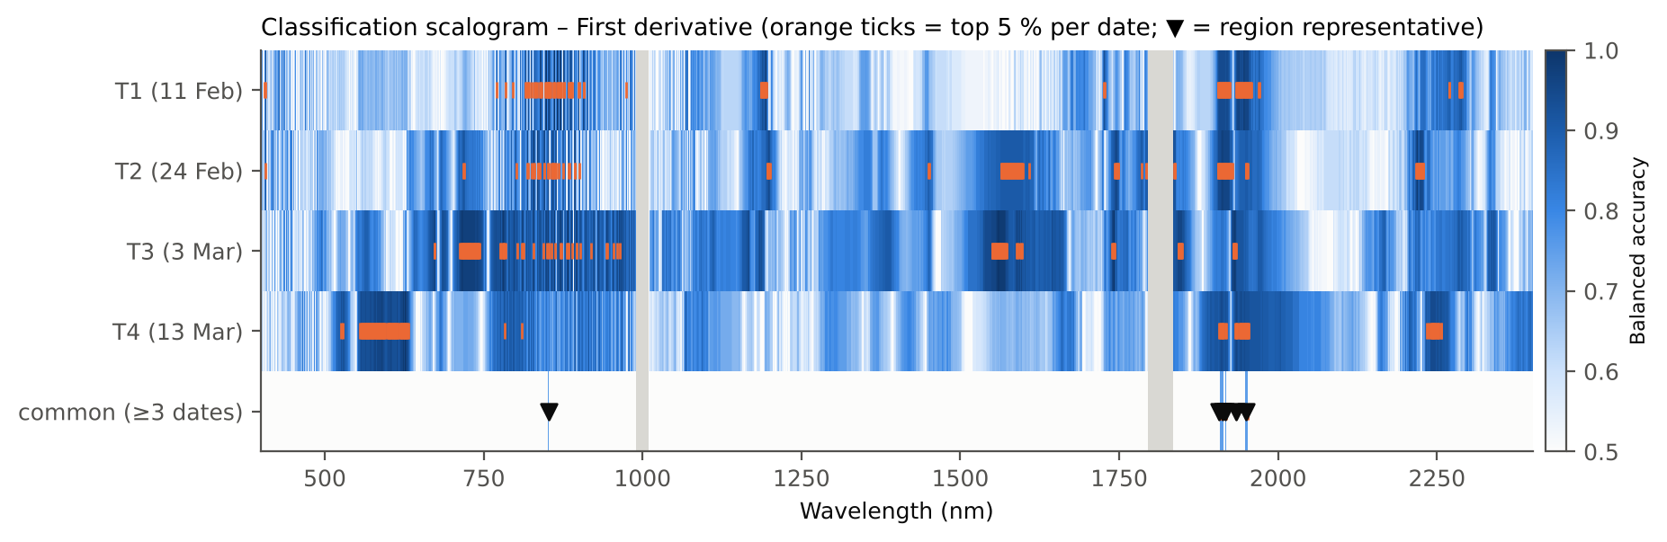
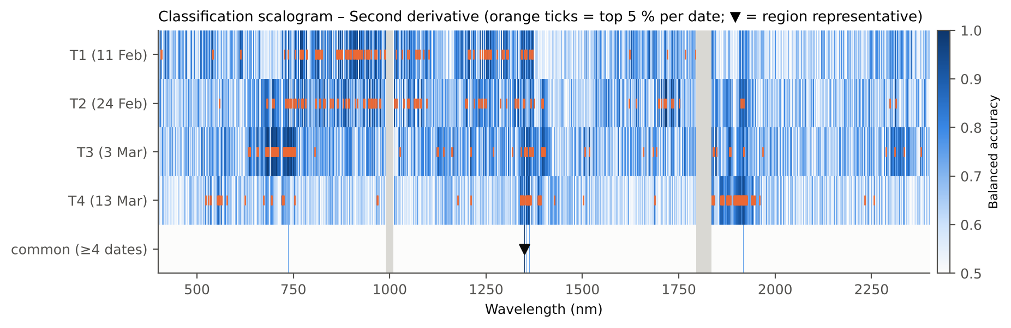
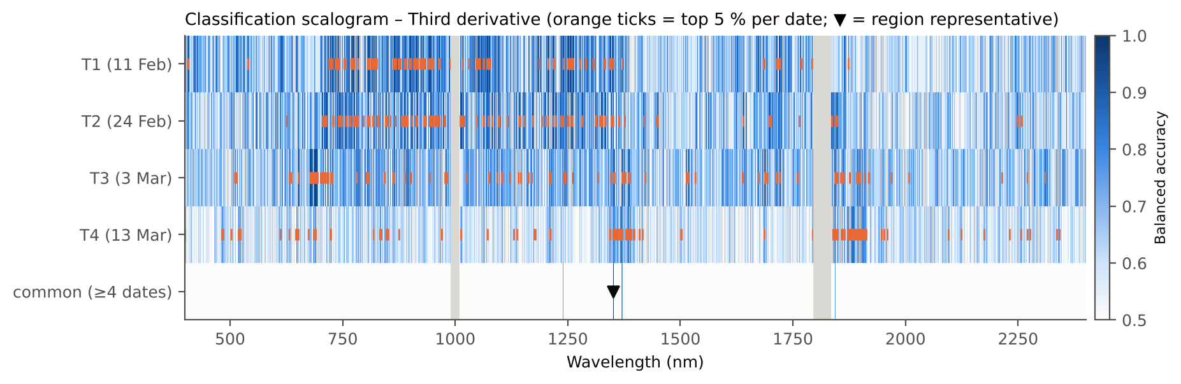
Step 3 · Classification scalograms
Notes:
T1: visible bands and the NIR slope; T2: red / red edge; T3: nearly everything; T4: SWIR.

Slide 12
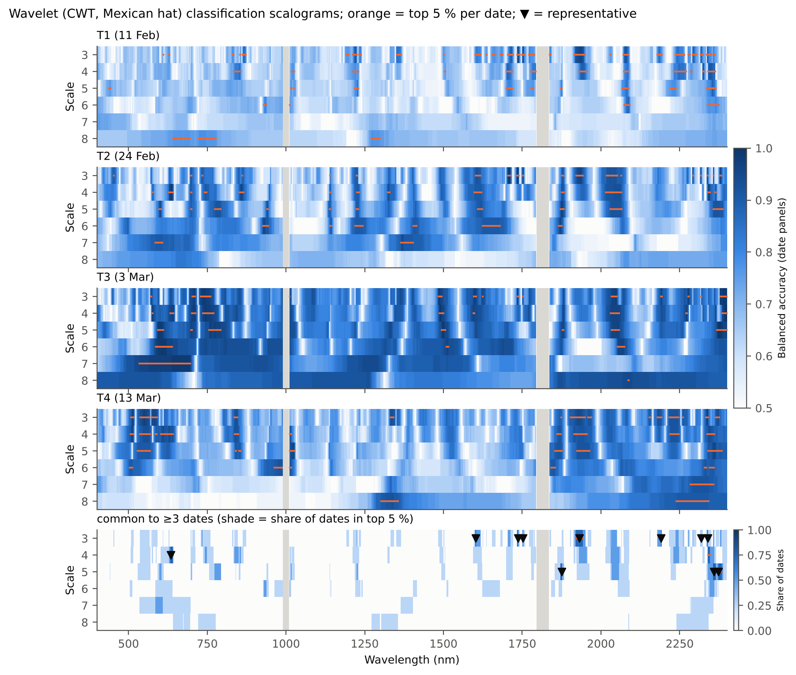
Step 3 · Wavelet scalograms (scales 3–8)
Top 5 % per date (orange)
Common to ≥ k* dates (bottom), k* = largest of 4/3/2 with common features (C3)
One representative per connected region (▼)
Notes:
Analogue of Fig. 7 of Tian et al.

Slide 13
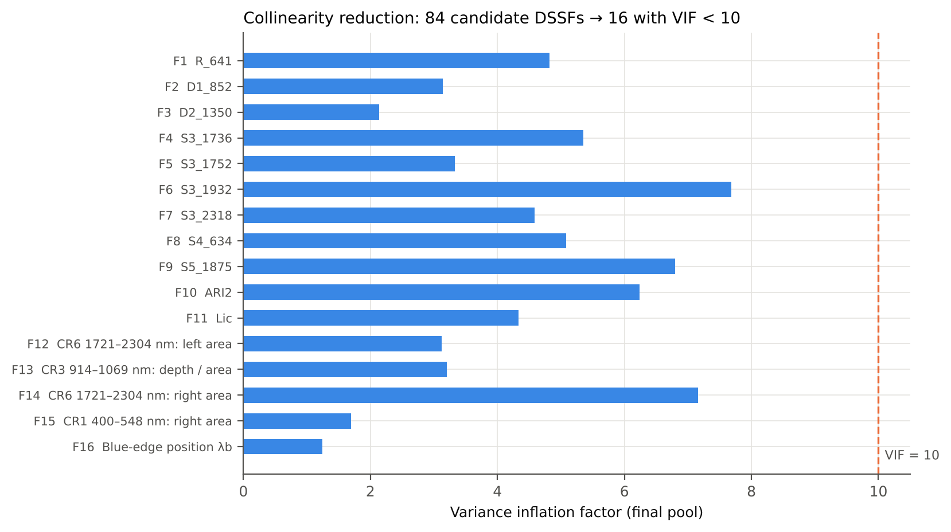
Steps 4–5 · 19,548 candidates → 16 DSSFs
19,548
candidate features per date
85
region representatives + top-10 % scalar features
16
DSSFs with VIF < 10
Notes:
Relevance-aware VIF (C5): among features with VIF ≥ 10 the least separable is removed first.

Slide 14
Step 5 · The 16 disease-specific spectral features
Code | Feature | Family | Mean BA | VIF
F1 | R_641 | Reflectance band | 0.823 | 4.8
F2 | D1_852 | First derivative | 0.906 | 3.1
F3 | D2_1350 | Second derivative | 0.917 | 2.1
F4 | S3_1736 | Wavelet coefficient | 0.924 | 5.4
F5 | S3_1752 | Wavelet coefficient | 0.858 | 3.3
F6 | S3_1932 | Wavelet coefficient | 0.927 | 7.7
F7 | S3_2318 | Wavelet coefficient | 0.906 | 4.6
F8 | S4_634 | Wavelet coefficient | 0.892 | 5.1
F9 | S5_1875 | Wavelet coefficient | 0.906 | 6.8
F10 | ARI2 | Vegetation index | 0.878 | 6.2
F11 | Lic | Vegetation index | 0.865 | 4.3
F12 | CR6 1721–2304 nm: left area (nm) | Continuum-removal parameter | 0.882 | 3.1
F13 | CR3 914–1069 nm: depth / area (1/nm) | Continuum-removal parameter | 0.806 | 3.2
F14 | CR6 1721–2304 nm: right area (nm) | Continuum-removal parameter | 0.868 | 7.2
F15 | CR1 400–548 nm: right area (nm) | Continuum-removal parameter | 0.681 | 1.7
F16 | Blue-edge position λb (nm) | Red-edge parameter | 0.625 | 1.2
What they measure
Pigments: R641, wavelet 634 nm, Lic, ARI2
NIR structure: slope at 852 nm
Water: 970, 1350, 1875–1940 nm
Dry matter (C–H): 1736, 1752, 2318 nm
Blue-edge position
NIR slope ≈ WF850/866 and yellow edge ≈ WF608 of Tian et al.
Notes:
Analogue of Table 2 of Tian et al.

Slide 15
Step 6 · ML-SFFS classification
A paper-faithful · B nested CV · C permutation null · D infection stages

Slide 16
6A · Paper-faithful: one to four features give 95–100 % OA
Date | Classifier | Most frequent OFC | OFC freq. % | Mean OA % | Mean BA %
T1 | LDA | F5 | 48 | 94.9 | 95.6
T1 | kNN | F5, F13 | 18 | 97.4 | 97.6
T1 | SVM | F5, F8, F13 | 30 | 99.7 | 99.6
T2 | LDA | F2, F8 | 61 | 99.7 | 99.7
T2 | kNN | F2, F8 | 98 | 100.0 | 100.0
T2 | SVM | F2, F8 | 67 | 100.0 | 100.0
T3 | LDA | F2, F4 | 52 | 100.0 | 100.0
T3 | kNN | F13 | 33 | 100.0 | 100.0
T3 | SVM | F5 | 81 | 100.0 | 100.0
T4 | LDA | F1, F8, F13 | 26 | 99.9 | 99.8
T4 | kNN | F9, F13 | 38 | 100.0 | 100.0
T4 | SVM | F1, F3, F4, F13 | 30 | 100.0 | 100.0
4-fold CV × 100 repetitions, SFFS with OA criterion – exactly as Tian et al.
Mean OA 94.9–100 %; SVM-SFFS best (as in the paper)
On T2 the pair F2 + F8 (NIR slope + yellow–red edge) is the OFC of all three classifiers
Codes: see DSSF slide
Notes:
Analogue of Table 3 of Tian et al.

Slide 17
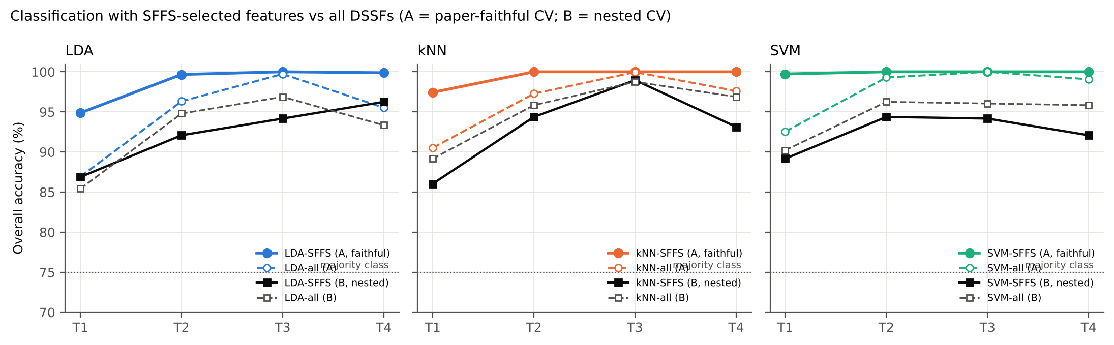
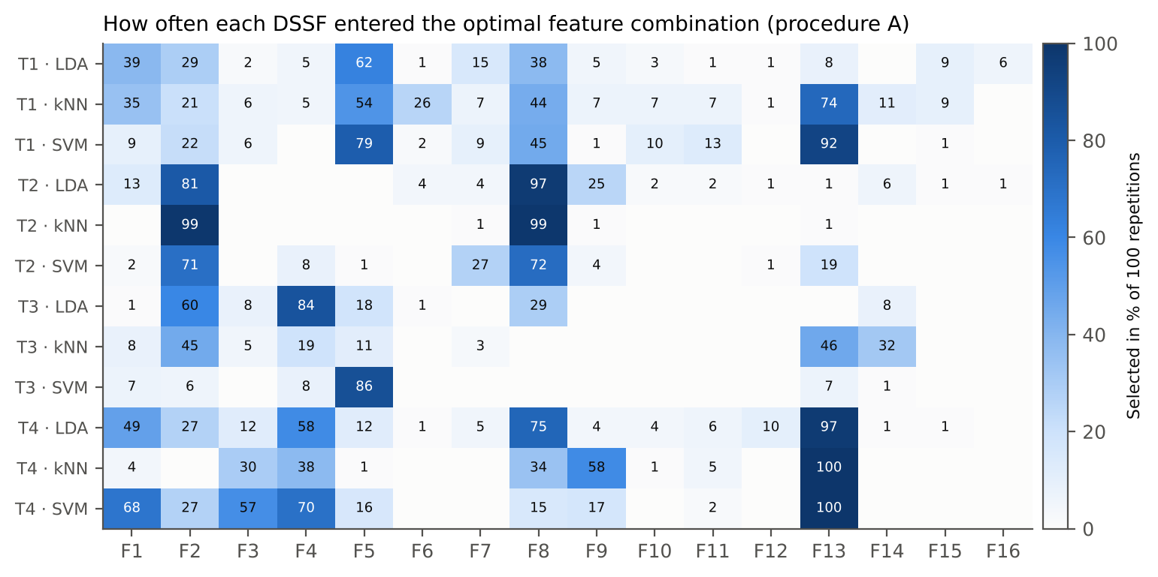
6A · SFFS vs all DSSFs, and which features are chosen
Notes:
SFFS gains most on T1 (as SVM-SFFS vs SVM-all in Tian et al., Fig. 8). Under nested CV (black) the gain largely disappears.

Slide 18
6B · Nested CV: honest accuracy is lower but still high
83.5–98.8 %
balanced accuracy on held-out plots (nested CV)
1.2–14.1
percentage points of optimism in the paper-faithful estimate
Whole pipeline (separability, DSSF pool, VIF, SFFS, SVM tuning) re-run inside every outer fold (C4).
Notes:
Ambroise & McLachlan (2002), Varma & Simon (2006), Cawley & Talbot (2010).

Slide 19
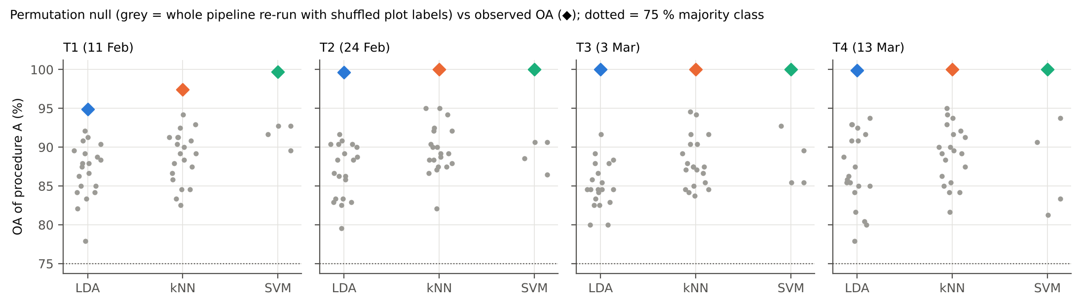
6C · Random labels still give 85.1–91.7 % OA
85.1–91.7 %
73.4–84.4 %
p = 0.048
mean OA with shuffled labels (procedure A)
mean BA with shuffled labels
true labels beat every permutation (LDA, k-NN)
Notes:
20 permutations × 5 repetitions for LDA and k-NN; 4 × 2 for SVM (indicative). Ojala & Garriga (2010).

Slide 20
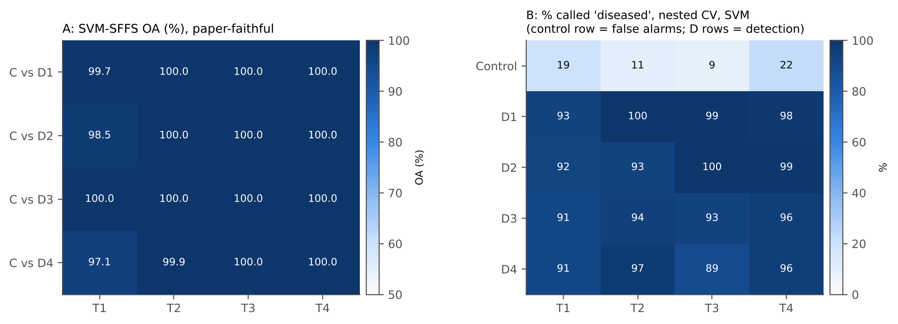
6D · Infection stages: every inoculation timing is detected
Nested CV (SVM): 89–100 % of inoculated plots detected in every group and date
False alarms on controls: 9–22 %
No consistent ordering by inoculation timing; 9 plots per group → 1 plot = 11 points
Paper-faithful per-stage SVM-SFFS OA 97.1–100.0 % (optimistic)
Notes:
Stage = date × inoculation timing; analogue of the per-DAI results of Tian et al.

Slide 21
Interpretation, cross-checks and conclusions
What the features mean, how robust the results are, what to report

Slide 22
Why these features: the physiology behind the DSSFs
NIR structure
Pigments
Water
Dry matter
Slope at 852 nm: controls decline 800–900 nm, diseased plots flat or rising – pustules disrupt epidermis and mesophyll scattering (cf. WF850 of Tian et al.).
Red reflectance up, Lic down, ARI2 up: chlorophyll loss and anthocyanin accumulation; yellow–red edge wavelet at 634 nm (cf. WF608).
970, 1350 and 1875–1940 nm features; water indices lower already on T1.
Wavelets at 1736, 1752, 2318 nm lie in C–H absorptions of cellulose, lignin and protein (Kokaly & Clark, 1999).
Notes:
Interpretations rest on spectral proxies (no measured biochemistry).

Slide 23
Cross-checks: 18 PASS, 3 FLAG
Step | Check | Status
1 | Class labels identical for the 48 plots on all 4 dates | PASS
1 | Treatment file agrees with the spectral workbooks | PASS
1 | Design balanced (each Variety x Inoculation timing once per block C, R1, R2, R3) | PASS
1 | Measurement order of the control plots | FLAG
1 | First derivative of the workbook = central difference of the reflectance | PASS
1 | CWT coefficients (PyWavelets 'mexh') = direct convolution with the Mexican-hat (Ricker) wavelet | PASS
1 | Identical vegetation indices in the source workbooks | FLAG
2 | BH-FDR q ≥ p for every test and decision rule applied | PASS
3 | Threshold separability agrees with the threshold-free AUC | PASS
3 | 100-step threshold grid vs exhaustive optimal threshold | PASS
4 | Representative features lie inside the analysed range and outside the guard zones | PASS
5 | VIF of the final pool recomputed with statsmodels | PASS
6 | OA, BA and kappa functions = scikit-learn | PASS
6 | SFFS finds the optimum of an exhaustive search | PASS
6 | Nested CV: every plot tested exactly once per repetition, same test plots on every date | PASS
6 | Scaler and SVM parameters fitted on training plots only | PASS
6 | 100 repetitions per date and classifier in procedure A | PASS
6 | 100 repetitions per stage (date × inoculation timing × classifier) in procedure D | PASS
6 | Observed OA of procedure A exceeds every permuted-label OA (LDA, k-NN) | PASS
6 | Permuted-label OA of procedure A far above 75 % majority / 50 % BA chance | FLAG
6 | Nested (B) accuracy ≤ faithful (A) accuracy | PASS
Also verified
Excel formulas reproduce class means, threshold BA of all 16 DSSFs × 4 dates and the summary accuracies exactly
45 references checked; 5 errors found in the reference list of Tian et al. (2021)
Notes:
FLAGs: control block measured first (confound), duplicate indices in source workbooks, optimism of procedure A.

Slide 24
Conclusions
The ML-SFFS workflow runs step by step on plot-average spectra: 19,548 candidates → 16 DSSFs covering pigments, NIR structure, water and dry matter
White rust lowers water indices first (T1), then chlorophyll and carotenoids; anthocyanins rise
Paper-faithful ML-SFFS: 1–4 features, OA 94.9–100 %, SVM best – but optimistic
Nested CV (report this): BA 83.5–98.8 %, best on T1 86.4 %; optimism 1.2–14.1 points
All inoculation timings and varieties detected similarly; the control-block confound must be removed in future trials
Notes:
Report procedure B as the accuracy of the method; A only for comparison with the paper.

Slide 25
Limitations and next steps
Limitations
Next steps
Controls in one block and measured first (C9)
12 vs 36 plots; 9 per inoculation group
No measured biochemistry – proxies only (C8)
Inoculation dates (DAS) not available → no DAI
SVM permutation test small; stage-wise pool from all plots
One season, one site
Randomise controls among blocks and measurement order
Record inoculation dates; express stages as DAI
Measure chlorophyll, anthocyanin and water on a subset of leaves
Validate the stable DSSF core (852, 634, 970/1350/1940 nm, ARI2) on an independent season
Notes:
These points are expanded in Section 5.4–5.5 of the chapter.

Slide 26
Reference cross-check: errors in Tian et al.'s reference list
Reference | Correct citation
Fisher (1936) | Correct title: 'The use of multiple measurements in taxonomic problems', Ann. Eugenics 7 (2), 179–188
Chang and Lin (2011) | LIBSVM: a library for support vector machines. ACM TIST 2 (3), 27:1–27:27
Huang et al. (2019) | PNAS 116 (31), 15386–15391; authors Huang, Li, Risinger, Enslow, Zeman, Gong, Yang, Schanze
Jacquemoud and Féret (1990) | Jacquemoud, S., Baret, F., 1990. PROSPECT. Remote Sens. Environ. 34, 75–91
Leys et al. (2013) as used in Tian et al. | Leys et al. recommend the median ± k·MAD (k = 2.5 moderately, 3 very conservative); median ± 3 MAD is used here
Key references: Tian et al. (2021) RSE 257:112350 · Pudil et al. (1994) PRL 15:1119–1125 · Mahlein et al. (2013) RSE 128:21–30 · Cheng et al. (2010) RSE 114:899–910 · Ambroise & McLachlan (2002) PNAS 99:6562–6566 · Varma & Simon (2006) BMC Bioinf. 7:91 · Brodersen et al. (2010) ICPR · Ojala & Garriga (2010) JMLR 11:1833–1863. Full verified list: workbook sheet S24 and chapter references.
Notes:
All 45 references were checked against publisher/repository records.

