Slide 1
Discriminating healthy and white-rust-diseased mustard leaves with field spectroradiometry
Four-tier hierarchical analysis (Das et al., 2020) with imbalance correction · CART vs Random Forest · disease-sensitive features (K) · four tiers on the combined feature pool
2264 leaf spectra (378 healthy, 1886 diseased) · 4 dates · 3 growth stages · 3 varieties · ASD contact probe, 400–2500 nm
Animesh Panda · Division of Agricultural Physics, ICAR-IARI, New Delhi

Slide 2
Key results at a glance
1653/2101
1.27
72.0 %
83.7 %
bands differ significantly (Tier 1, Welch + FDR)
J–M on CART-11 bands (threshold 1.90)
QDA on CART bands, honest nested CV (V3)
QDA on RF-selected features of the combined pool (V3)
Healthy and white-rust leaves differ significantly at 1653 of 2101 bands even with all dates, stages and varieties pooled (1604 bands with a plot random effect), but the differences are small: no single reflectance band reaches AUC 0.70.
The four-tier method on reflectance (Part A) gives J–M 1.27 (CART-11) and 1.67 (RF-17), below the 1.90 separability threshold, and QDA with equal priors reaches 72 % balanced accuracy on new plots (V3 72.0 %, V4 72.8 %).
Random Forest is the better classifier (+6 points over CART, 48 of 50 folds) and the far more stable band selector (Jaccard 0.72 vs 0.30); as a band selector for QDA, CART bands were slightly better on reflectance.
Disease-sensitive features carry much more information: first-derivative bands (845–875 nm, 1915–1945 nm) and continuum-removed water features (970 nm width, 1940 nm symmetry). The four-tier analysis of the combined pool reaches 83.7 % (V3) and 84.6 % (V4) with QDA on 17 RF-selected features, +15 points over reflectance.
Transfer to an unseen date in unseen plots is poor (53–62 %): growth stage changes the spectra more than the disease; pod-formation leaves of 13-03-2026 were all called diseased when that date was held out.

Slide 3
Data: 2264 unique leaf spectra pooled over dates, stages and varieties
Date | Healthy | Diseased | Total
11-02-2026 | 72 | 356 | 428
24-02-2026 | 90 | 450 | 540
03-03-2026 | 108 | 540 | 648
13-03-2026 | 108 | 540 | 648
Four ASD export files, one column per leaf; plot-average columns ignored (leaf level only).
79 exact copies removed: 75 in the second block of 13-03-2026, 4 unnamed spectra of plot 27 (11-02-2026).
48 plots: 12 healthy controls (plots 1–12), 36 inoculated; every plot measured on all four dates.
Diseased : healthy = 4.99 : 1 → equal priors, balanced sampling and balanced accuracy throughout.
Leaf level and disease score not used — healthy vs diseased only.
Growth stage | Healthy | Diseased
Flowering | 195 | 965
Pod formation | 90 | 450
Vegetative | 93 | 471
Variety | Healthy | Diseased
V1 | 126 | 620
V2 | 126 | 640
V3 | 126 | 626

Slide 4
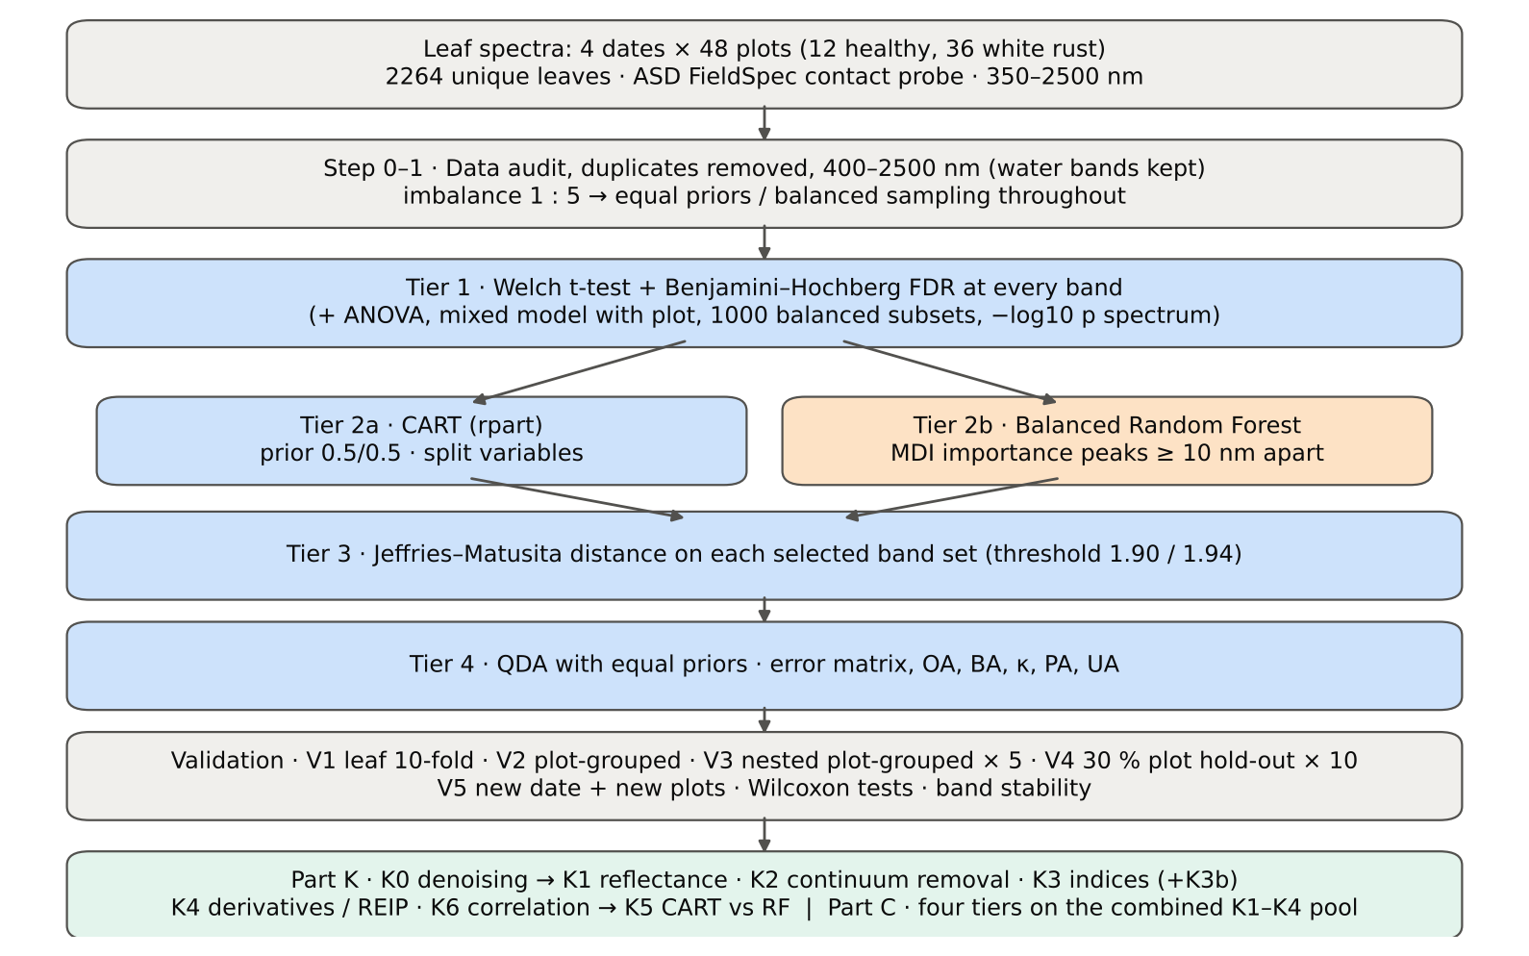
Workflow: Das et al. (2020) four tiers, extended and validated

Slide 5
Corrections to the published protocol and how validation was made honest
Issue | Correction
Class imbalance 1 : 5 | equal priors (QDA, rpart), balanced RF, balanced accuracy, 1000 balanced subsets
Two classes, unequal variances | Welch t-test (ANOVA reported for comparison)
2101 tests | Benjamini–Hochberg FDR
Leaves nested in plots, plots on 4 dates | mixed model; all honest folds grouped by plot across dates
Selection bias | Tier 1 + selection + classifier refitted in every training set (V3, V4, V5)
Water bands | kept — contact probe (Das et al. removed them for canopy data)
Detector joins (1000, 1800 nm) | splice correction + guard zones in Part K
Scheme | Test leaves | Refitted
V1 | leaf-level 10-fold (paper) | classifier only
V2 | plot-grouped 10-fold | classifier only
V3 | plot-grouped 10-fold × 5, nested | everything
V4 | 30 % of plots × 10 | everything
V5 (extra) | new date + new plots | everything

Slide 6
Part A · The four-tier method of Das et al. (2020)
Step 0–1 data and band set → Tier 1 statistical screening → Tier 2 CART band selection → Tier 3 J–M separability → Tier 4 QDA → validation

Slide 7
Step 0–1 · Data audit and band set: 350–399 nm removed, water bands kept
Check | Result | Status
Missing values in spectra | 0 | PASS
Reflectance range (350–2500 nm) | 0.026 – 0.935 | PASS
Wavelength grid identical in all files | 350–2500 nm, 1 nm, 2151 bands | PASS
Plot-average formula columns ignored | 197 | PASS
Second data block 13-03-2026: exact copies of block 1 (same plot) | 75 of 75 identical → removed | PASS
Exact duplicates among the remaining spectra | 4 (the unnamed plot-27 spectra of 11-02-2026) → removed | FLAG
Each plot has one class on every date | 48 of 48 plots | PASS
Each plot has one variety on every date | 48 of 48 plots | PASS
Healthy = plots 1–12, diseased = plots 13–48 | consistent | PASS
Repeated ASD file names within a date (counter restarted on 13-03-2026) | 75 names repeated; spectra differ (max |Δ| ≥ 0.025) → distin | PASS
Range (nm) | Noise (SD) | × 500–699 nm
350–399 | 6.4e-03 | 115.7
400–499 | 7.7e-04 | 13.9
500–699 | 5.6e-05 | 1.0
700–1000 | 7.1e-05 | 1.3
1001–1349 | 5.2e-05 | 0.9
1350–1430 | 1.7e-05 | 0.3
1431–1799 | 1.1e-05 | 0.2
1800–1950 | 1.9e-05 | 0.3
1951–2349 | 1.7e-05 | 0.3
2350–2500 | 7.9e-05 | 1.4
Noise = SD of the Savitzky–Golay residual; the 350–399 nm detector edge is ~116 × noisier than 500–699 nm and was removed.

Slide 8
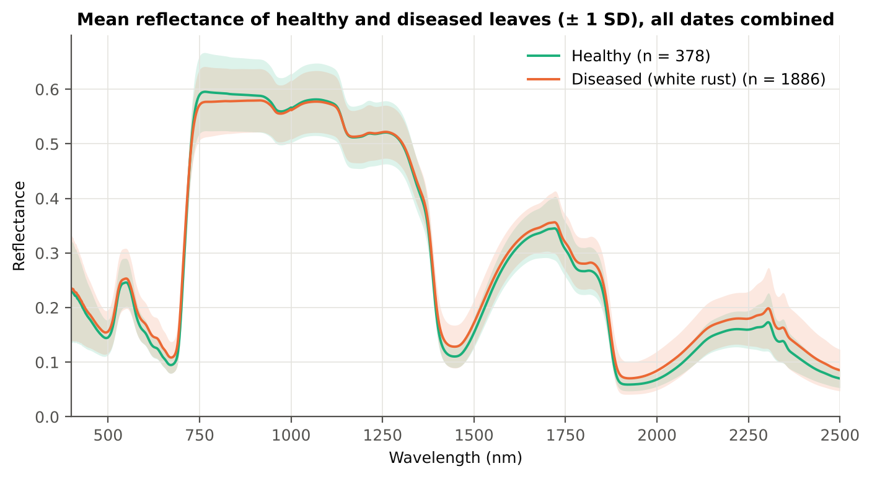
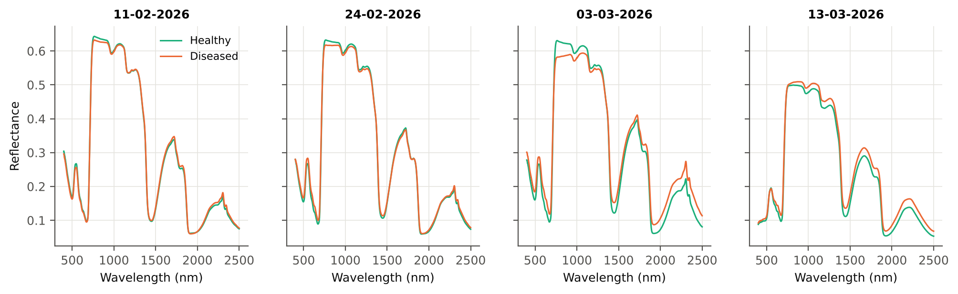
Mean spectra: diseased leaves brighter in VIS and SWIR, darker in NIR
Diseased leaves reflect slightly more in the visible (chlorophyll loss, white pustules) and in the SWIR beyond 1350 nm (lower leaf water), and less on the NIR plateau at 750–930 nm (damage to the mesophyll structure).
The differences are small compared with the variation between dates and growth stages (lower panels): the mean spectra of the four dates differ more than healthy and diseased leaves within a date.

Slide 9
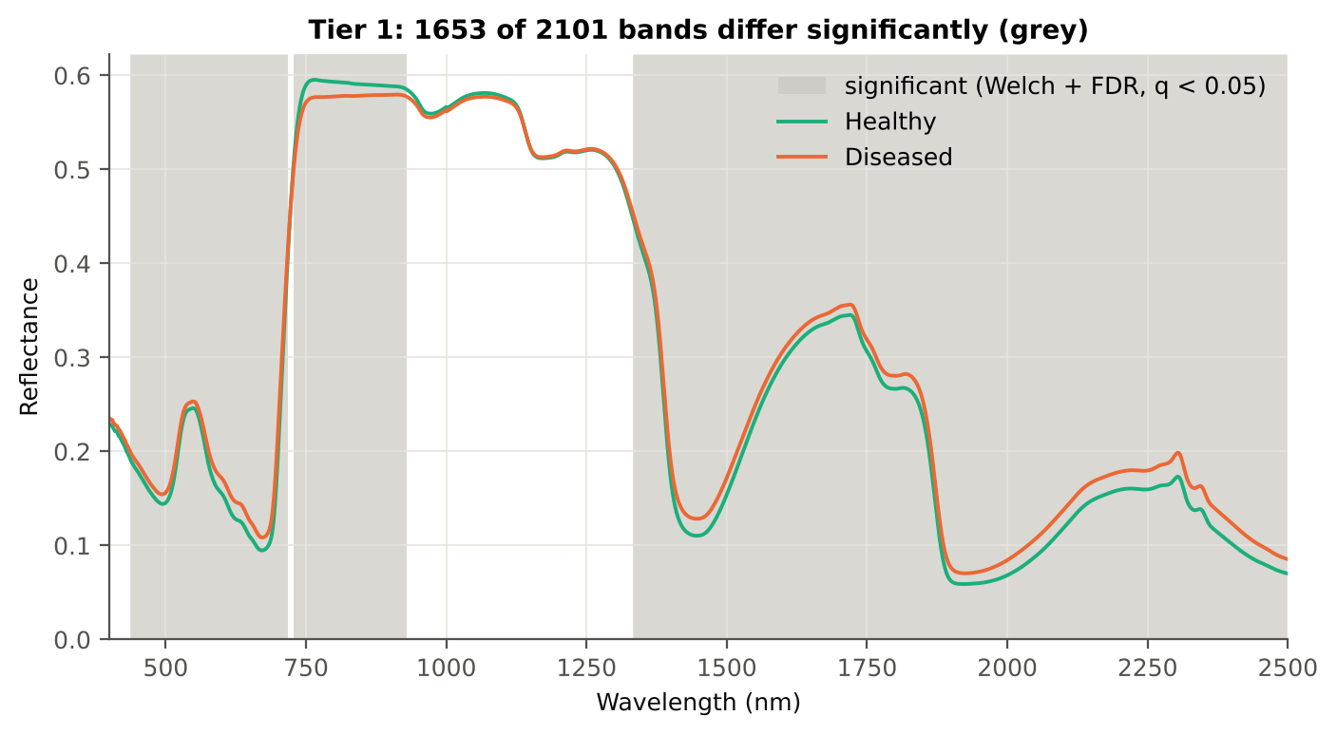
Tier 1 · 1653 of 2101 bands differ significantly (Welch + FDR)
Test | Significant bands
Welch t-test + BH-FDR q < 0.05 (used for Tier 2) | 1653
One-way ANOVA p < 0.05, uncorrected (rule of Das et al.) | 1675
One-way ANOVA + BH-FDR q < 0.05 | 1667
Welch t-test p < 0.05, uncorrected | 1664
Mixed model (random plot effect) + BH-FDR q < 0.05 | 1604
Balanced subsets (378 vs 378): significant in ≥ 95 % of 1000 subsets | 1335
Levene test p < 0.05 (unequal variances → Welch) | 1386
Range (nm) | Bands | Result
400–436 | 37 | not significant
437–718 | 282 | significant
719–727 | 9 | not significant
728–930 | 203 | significant
931–1332 | 402 | not significant
1333–2500 | 1168 | significant
Mixed model with a random plot effect: 1604 bands remain significant (pseudo-replication check).

Slide 10
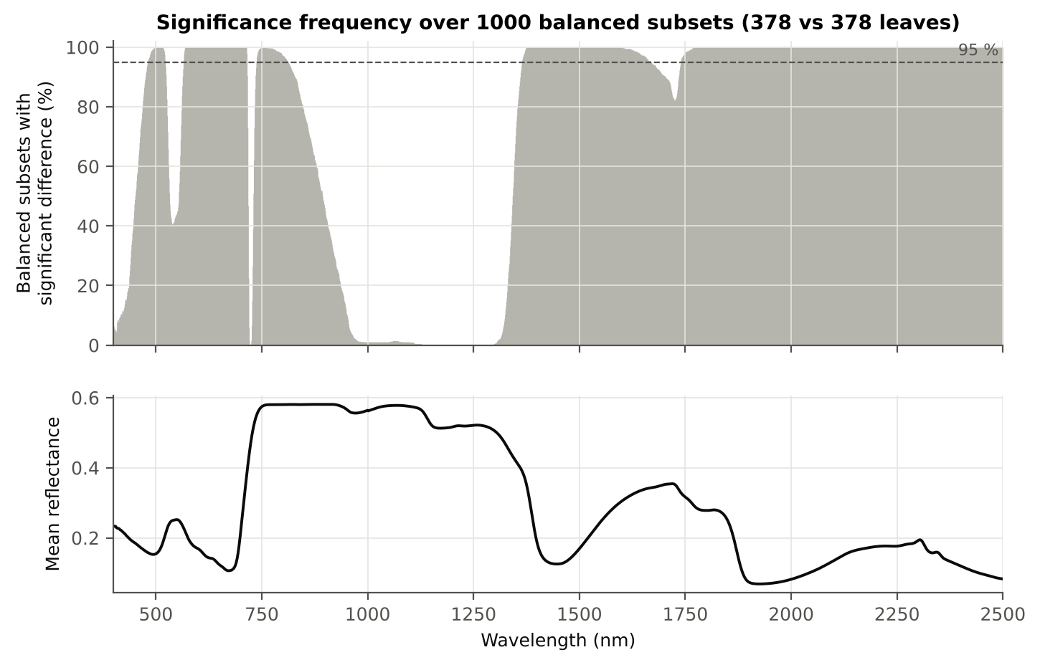
Tier 1 · Significance frequency over 1000 balanced subsets (Das et al. Fig. 5)
378 healthy vs 378 randomly drawn diseased leaves, 1000 times.
Median 1568 significant bands per subset (min 1287, max 1751).
1335 bands significant in ≥ 95 % of subsets; 1109 in all.
The imbalance inflates significance only slightly: the significant regions are the same.

Slide 11
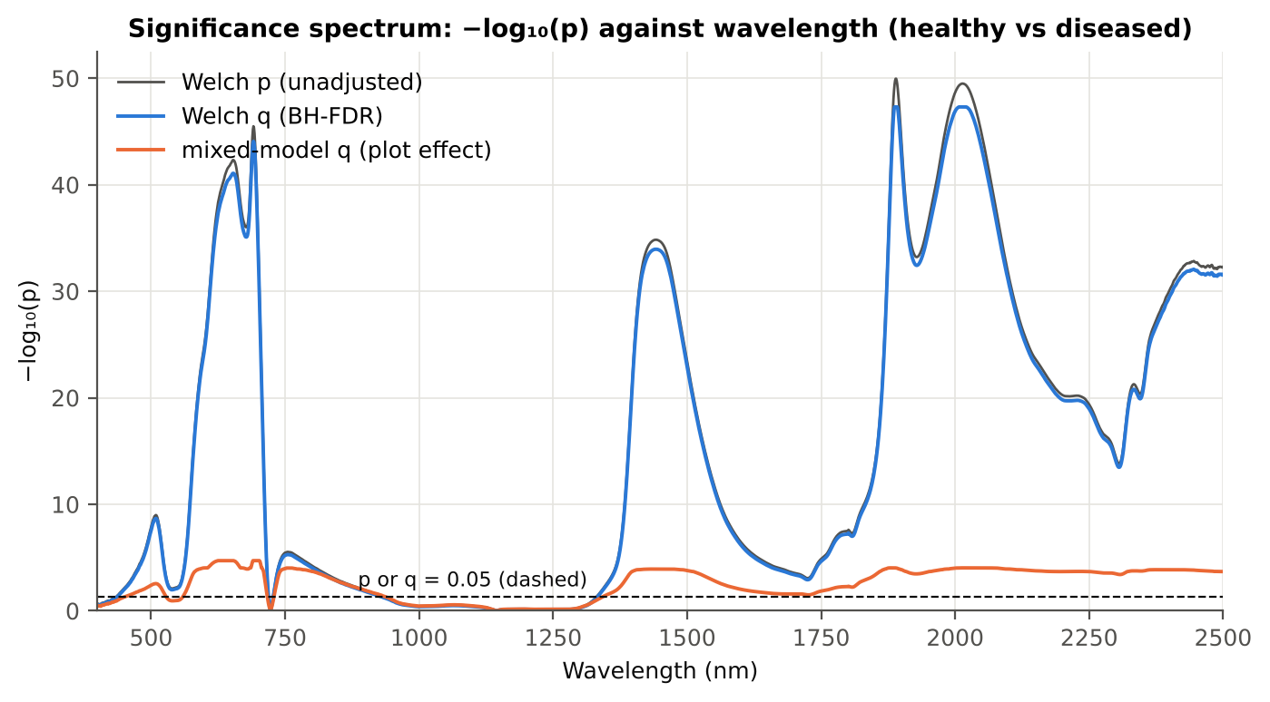
Tier 1 · −log₁₀(p) against wavelength
Region | Bands | Welch+FDR significant | Mixed-model significant
Blue (400–499) | 100 | 63 | 49
Green (500–599) | 100 | 100 | 70
Red (600–679) | 80 | 80 | 80
Red edge (680–759) | 80 | 71 | 67
NIR (760–1349) | 590 | 188 | 187
Water band I (1350–1430) | 81 | 81 | 81
SWIR-1 (1431–1799) | 369 | 369 | 369
Water band II (1800–1950) | 151 | 151 | 151
SWIR-2 (1951–2349) | 399 | 399 | 399
SWIR-2 end (2350–2500) | 151 | 151 | 151
The Welch test is extremely significant in the red / red edge (≈ 650–700 nm) and in the water bands (1400–1450, 1880–2020 nm); it is not significant at 931–1332 nm (NIR) or at 719–727 nm, where the healthy and diseased curves cross.
With a random plot effect (orange) the significance drops by tens of orders of magnitude, because the effective sample size is the number of plots (48), not the number of leaves; still 1604 bands remain significant.

Slide 12
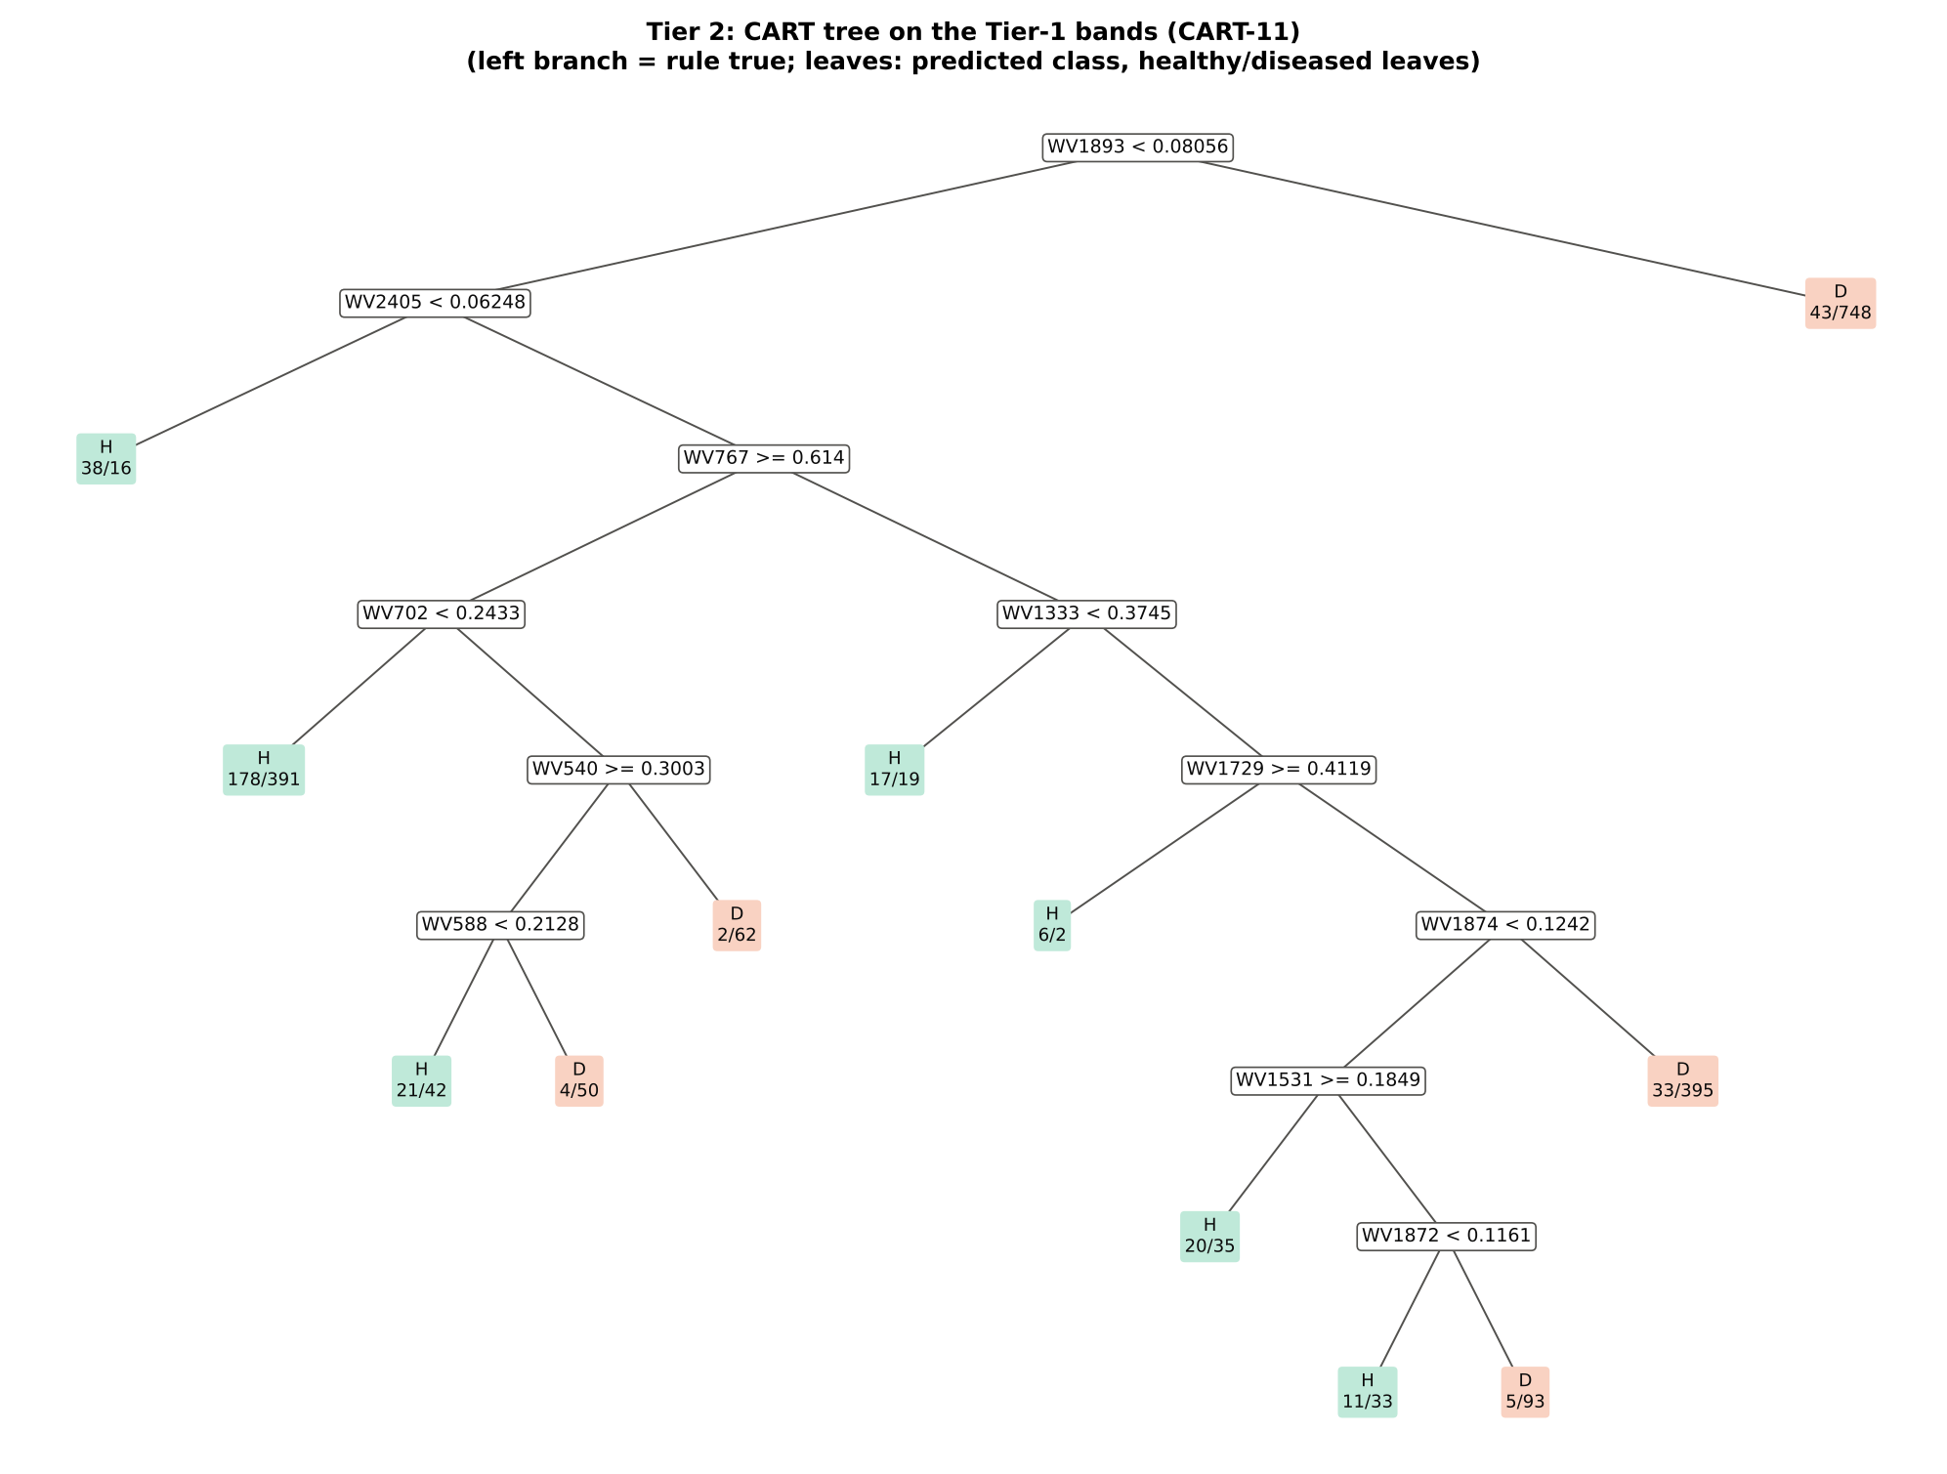
Tier 2 · CART (rpart, prior 0.5/0.5) selects 11 bands
CART-11: 1893, 2405, 767, 702, 1333, 540, 1729, 588, 1874, 1531, 1872 nm

Slide 13
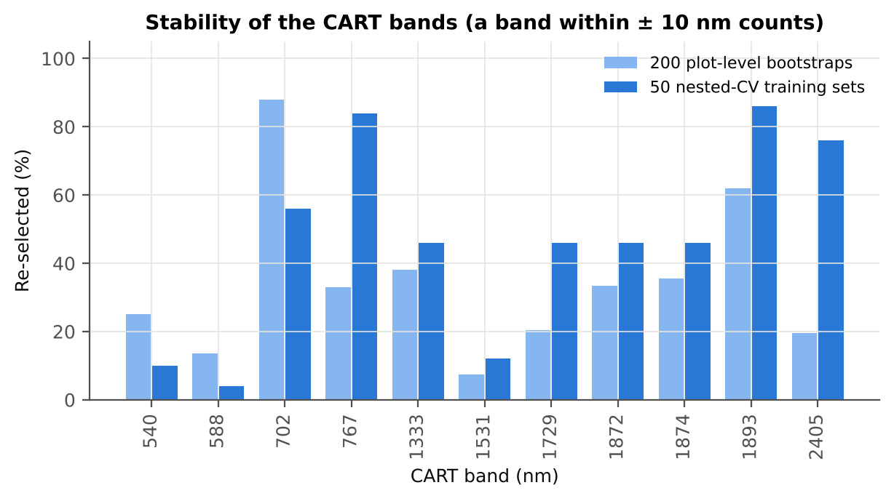
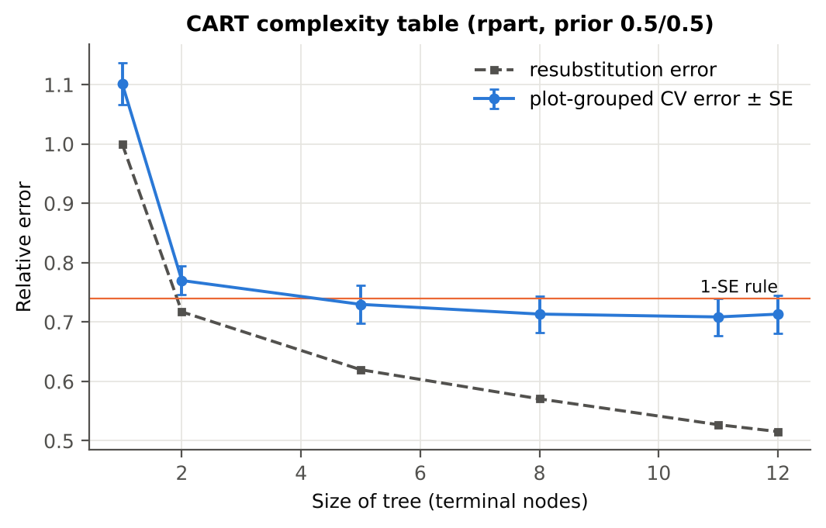
Tier 2 · The CART bands, their regions and how often they are re-selected
Band (nm) | Region | First used at node | Welch t | Bootstrap re-selection (±10 nm) | Nested-CV re-selection (±10 nm) | Mixed model significant
540 | Green | 21 | 2.7 | 25.0 % | 10.0 % | no
588 | Green | 42 | 9.8 | 13.5 % | 4.0 % | yes
702 | Red edge | 10 | 12.1 | 88.0 % | 56.0 % | yes
767 | NIR | 5 | -4.6 | 33.0 % | 84.0 % | yes
1333 | NIR | 11 | 2.1 | 38.0 % | 46.0 % | no
1531 | SWIR-1 | 94 | 8.4 | 7.5 % | 12.0 % | yes
1729 | SWIR-1 | 23 | 3.4 | 20.5 % | 46.0 % | yes
1872 | Water band II | 189 | 12.0 | 33.5 % | 46.0 % | yes
1874 | Water band II | 47 | 12.6 | 35.5 % | 46.0 % | yes
1893 | Water band II | 1 | 15.3 | 62.0 % | 86.0 % | yes
2405 | SWIR-2 end | 2 | 12.0 | 19.5 % | 76.0 % | yes

Slide 14
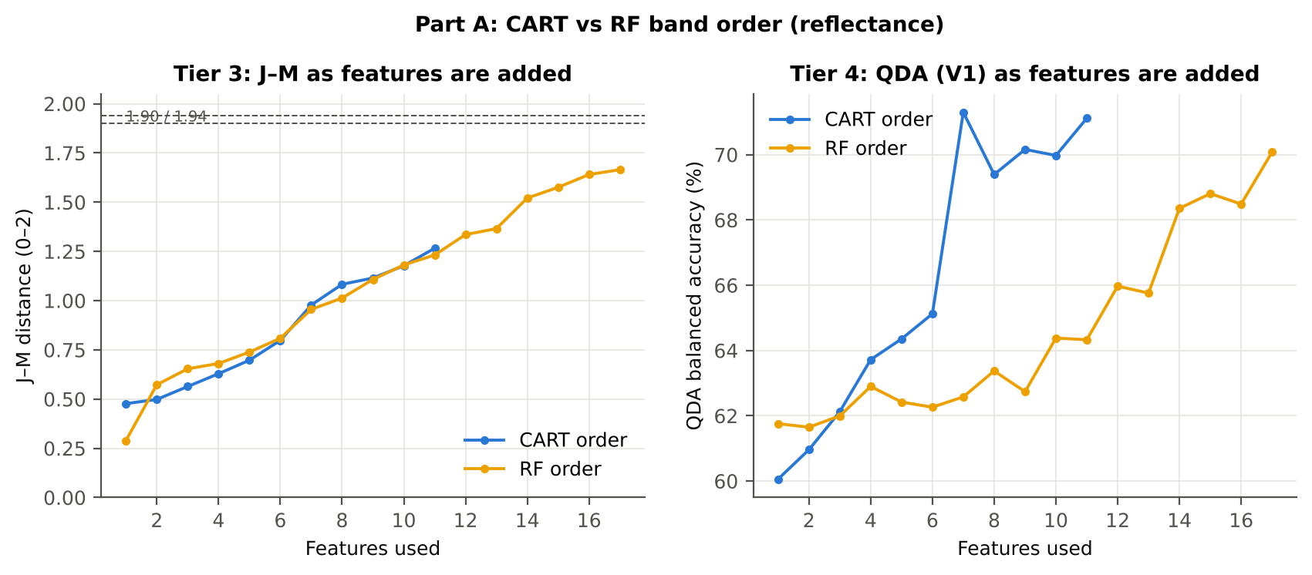
Tier 3 · J–M = 1.27 on the CART bands: not separable at 1.90
Set | Features | JM
CART-11 | 11 | 1.266
CART-4 (1-SE) | 4 | 0.634
RF-17 | 17 | 1.665
RF-10 | 10 | 1.181
RF-11 (size-matched) | 11 | 1.232
J–M increases steadily as bands are added but stays below 1.90 for both band sets: on the CART bands 1.27, on the RF bands 1.67. By the criterion of Das et al. the classes are not spectrally separable — healthy and diseased leaves overlap, as expected when four dates, three stages and three varieties are pooled.
The 1-SE tree (4 bands) gives J–M 0.63.

Slide 15
Tier 4 · QDA with equal priors on the CART bands (Das et al. Table 2)
Classified \ Reference | Healthy | Diseased | Row total | User's acc.
Healthy | 336 | 880 | 1216 | 27.6 %
Diseased | 42 | 1006 | 1048 | 96.0 %
Column total | 378 | 1886 | 2264
Producer's acc. | 88.9 % | 53.3 %
Set | Classifier | OA | BA | PA_H | PA_D | kappa
CART-11 | QDA equal priors | 59.3 % | 71.1 % | 88.9 % | 53.3 % | 0.224
CART-11 | QDA sample priors | 72.2 % | 76.1 % | 82.0 % | 70.3 % | 0.344
CART-11 | LDA equal priors | 75.2 % | 76.6 % | 78.6 % | 74.5 % | 0.374
CART-4 (1-SE) | QDA equal priors | 45.0 % | 63.2 % | 90.5 % | 35.8 % | 0.117
CART-4 (1-SE) | QDA sample priors | 75.0 % | 57.7 % | 31.7 % | 83.6 % | 0.146
CART-4 (1-SE) | LDA equal priors | 60.6 % | 63.4 % | 67.7 % | 59.2 % | 0.160
59.3 %
71.1 %
0.224
overall accuracy
balanced accuracy
Cohen's κ
Equal priors correct the 1 : 5 imbalance: the minority (healthy) class is recognised far better than with sample priors.

Slide 16
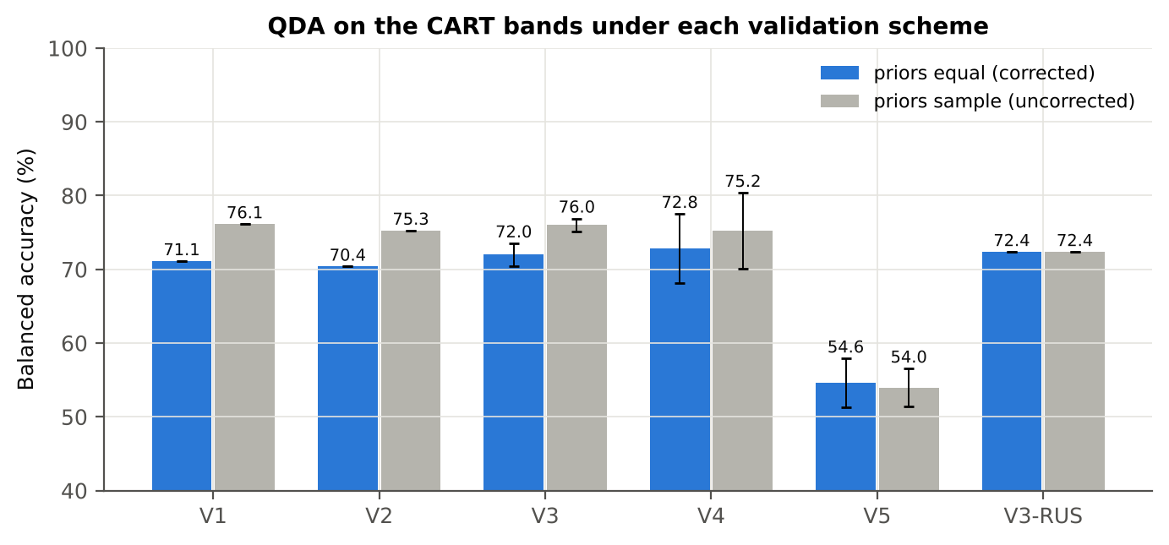
Validation · honest estimates for new plots: 72.0 % (V3) and 72.8 % (V4)
Scheme | Priors | OA | BA | BA_SD | kappa | PA_H | PA_D
V1 · leaf-level 10-fold, bands fixed | equal (corrected) | 59.3 % | 71.1 % | – | 0.224 | 88.9 % | 53.3 %
V2 · plot-grouped 10-fold, bands fixed | equal (corrected) | 58.7 % | 70.4 % | – | 0.216 | 87.8 % | 52.9 %
V3 · nested plot-grouped 10-fold × 5 | equal (corrected) | 61.0 % | 72.0 % | 1.5 % | 0.239 | 88.5 % | 55.5 %
V4 · 30 % plot hold-out × 10 | equal (corrected) | 63.2 % | 72.8 % | 4.7 % | 0.274 | 88.0 % | 57.7 %
V5 · new date and new plots (leave-one-date-out × 10) | equal (corrected) | 63.3 % | 54.6 % | 3.3 % | 0.070 | 40.8 % | 68.3 %
V1 · leaf-level 10-fold, bands fixed | sample (uncorrected) | 72.2 % | 76.1 % | – | 0.344 | 82.0 % | 70.3 %
V2 · plot-grouped 10-fold, bands fixed | sample (uncorrected) | 72.3 % | 75.3 % | – | 0.337 | 79.6 % | 70.9 %
V3 · nested plot-grouped 10-fold × 5 | sample (uncorrected) | 72.1 % | 76.0 % | 0.9 % | 0.342 | 81.9 % | 70.1 %
V4 · 30 % plot hold-out × 10 | sample (uncorrected) | 72.5 % | 75.2 % | 5.2 % | 0.356 | 79.7 % | 70.8 %
V5 · new date and new plots (leave-one-date-out × 10) | sample (uncorrected) | 66.7 % | 54.0 % | 2.6 % | 0.067 | 33.9 % | 74.0 %
V3-RUS · nested + random under-sampling | equal (corrected) | 61.2 % | 72.4 % | – | 0.243 | 89.2 % | 55.6 %
V3-RUS · nested + random under-sampling | sample (uncorrected) | 61.2 % | 72.4 % | – | 0.243 | 89.2 % | 55.6 %
Band set | CART bands | BA V1 | BA V3 nested | BA V4 hold-out
400–2500 nm (main: 350–399 removed) | 11 | 71.1 % | 72.0 % | 72.8 %
350–2500 nm (nothing removed) | 12 | 67.2 % | 68.8 % | 71.5 %
450–2450 nm (both detector edges trimmed) | 11 | 71.1 % | 72.2 % | 73.1 %

Slide 17
Random Forest instead of CART
A1 RF importance as the Tier-2 selector · A2 Tiers 3–4 on each band set · A3 CART and RF as classifiers · A4 band stability

Slide 18
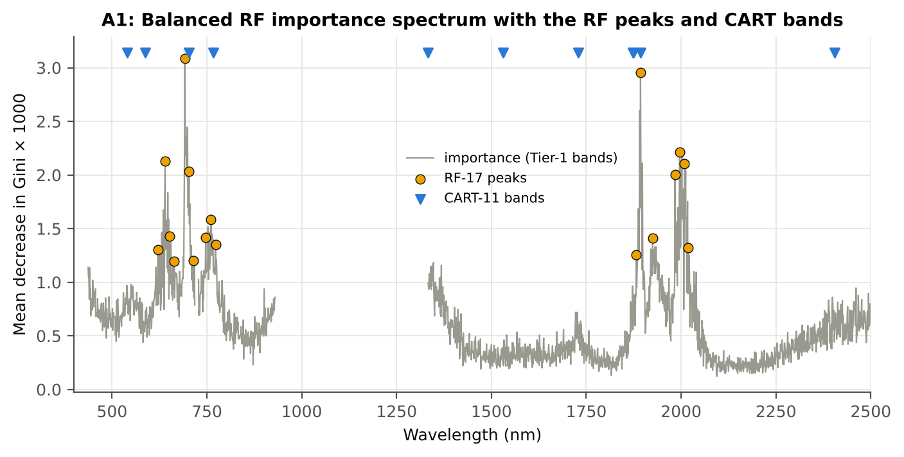
A1 · Where the Random Forest finds the disease signal
Check | Value | Status
Reproducibility: importance of seed 42 vs seed | 0.891 | PASS
R randomForest (stratified sampsize 378 + 378) | ρ = 0.893 | PASS
Permutation importance (drop in AUC, 5 plot-gr | ρ = -0.06 | FLAG
Ordinary RF with class weights only (no balanc | BA 0.703 | PASS
Band set | Wavelengths (nm)
CART-11 | 1893, 2405, 767, 702, 1333, 540, 1729, 588, 1874, 1531, 1872
CART-4 (1-SE) | 1893, 2405, 767, 1333
RF-17 | 692, 1893, 1996, 640, 2009, 703, 1984, 761, 651, 747, 1925, 773, 2019, 621, 1882, 715, 664
RF-10 | 692, 1893, 1996, 640, 2009, 703, 1984, 761, 651, 747
RF-11 (size-matched) | 692, 1893, 1996, 640, 2009, 703, 1984, 761, 651, 747, 1925

Slide 19
A2 · J–M 1.67 (RF) vs 1.27 (CART); QDA BA 70.1 % vs 71.1 %
Set | Features | JM
CART-11 | 11 | 1.266
CART-4 (1-SE) | 4 | 0.634
RF-17 | 17 | 1.665
RF-10 | 10 | 1.181
RF-11 (size-matched) | 11 | 1.232
CART-11
Classified \ Reference | Healthy | Diseased | Row total | User's acc.
Healthy | 336 | 880 | 1216 | 27.6 %
Diseased | 42 | 1006 | 1048 | 96.0 %
Column total | 378 | 1886 | 2264
Producer's acc. | 88.9 % | 53.3 %
On all leaves the RF bands separate the classes better than the CART bands (J–M 1.67 vs 1.27) but QDA on them is not more accurate (BA 70.1 vs 71.1 %): RF picks many correlated bands in the same two regions, CART picks complementary regions (green, red edge, NIR, SWIR).
RF-17 concentrates on the red / red edge (621–773 nm) and on 1882–2019 nm, the same two regions where Tier 1 is most significant.
RF-17
Classified \ Reference | Healthy | Diseased | Row total | User's acc.
Healthy | 348 | 979 | 1327 | 26.2 %
Diseased | 30 | 907 | 937 | 96.8 %
Column total | 378 | 1886 | 2264
Producer's acc. | 92.1 % | 48.1 %

Slide 20
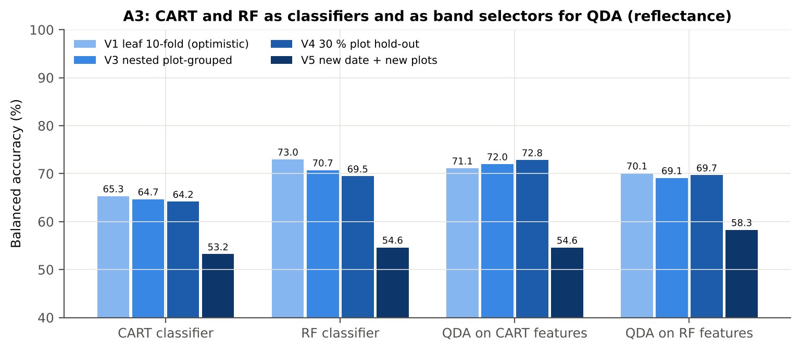
A3 · CART and RF as classifiers and as band selectors (identical folds)
RF beats CART as a classifier by 6.0 points (V3, 48 of 50 folds) and 5.3 points (V4, 10 of 10).
QDA on CART bands beats QDA on RF bands by 3.1 points in V3 (35 of 50 folds, p = 0.003); in V4 the difference is not significant.
Comparison | Units | Mean difference | First better | Second better | Wilcoxon p
RF classifier − CART classifier | V3 nested (folds) | +6.0 pts | 48 | 2 | 9.8e-14
RF classifier − CART classifier | V4 hold-out (splits) | +5.3 pts | 10 | 0 | 0.002
QDA on RF features − QDA on CART features | V3 nested (folds) | -3.1 pts | 15 | 35 | 0.003
QDA on RF features − QDA on CART features | V4 hold-out (splits) | -3.2 pts | 2 | 8 | 0.105
QDA on CART features − CART classifier | V3 nested (folds) | +7.7 pts | 45 | 5 | 1.6e-09
QDA on CART features − CART classifier | V4 hold-out (splits) | +8.7 pts | 9 | 1 | 0.004
QDA on RF features − RF classifier | V3 nested (folds) | -1.4 pts | 21 | 29 | 0.087
QDA on RF features − RF classifier | V4 hold-out (splits) | +0.2 pts | 5 | 5 | 1.000

Slide 21
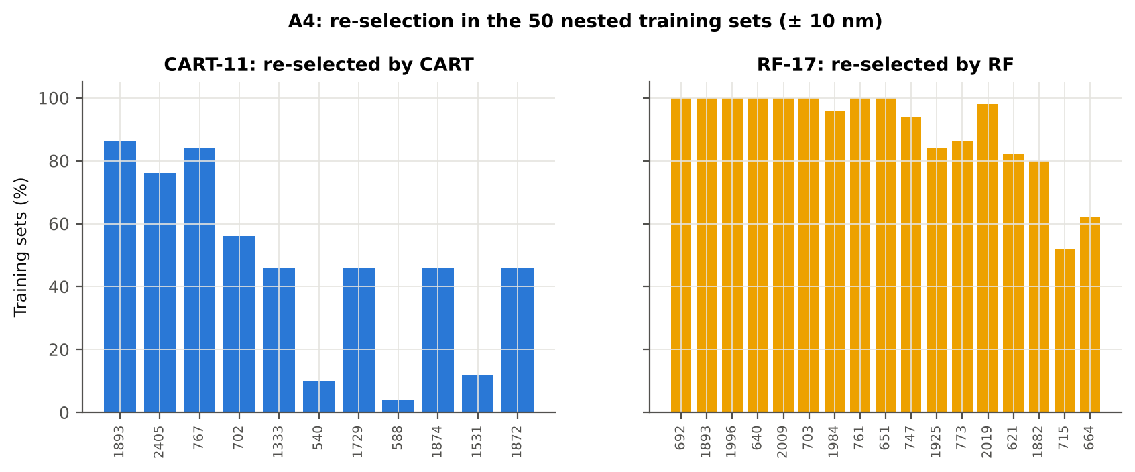
A4 · How stable are the selected bands across 50 training sets?
Method | Mean features | Unique features (union) | Stability index (exact) = all / union | Stability index (±10 nm) | Mean pairwise Jaccard (±10 nm)
CART | 14.4 | 290 | 0.000 | 0.000 | 0.296
RF | 17.0 | 308 | 0.000 | 0.269 | 0.724

Slide 22
Part K · Disease-sensitive feature extraction
K0 denoising → K1 band reflectance · K2 continuum removal · K3 spectral indices (+ K3b optimised index) · K4 first derivative and REIP · K6 correlation spectra → K5 CART vs RF on every feature group

Slide 23
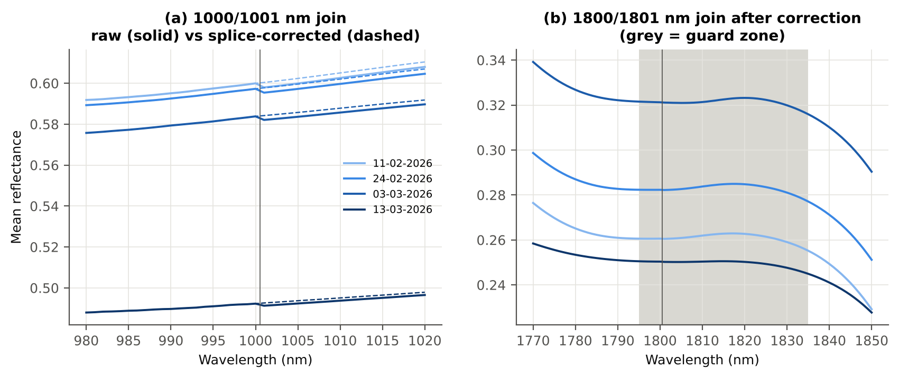
K0 · Splice correction, smoothing and the detector artefact at 1800 nm
Savitzky–Golay: SG(11,2) smoothing, SG(15,2) first and SG(21,2) second derivative.
Signal preserved: r ≥ 0.99999; Tier-1 bands 1653 (raw) vs 1652 (smoothed).
Start-up bump after 1801 nm detected → guard zones 990–1010 and 1795–1835 nm (wider for derivatives) excluded from rankings.
Join | Offset healthy | Offset diseased
1000/1001 nm | 0.0019 | 0.0020
1800/1801 nm | -0.0000 | -0.0001

Slide 24
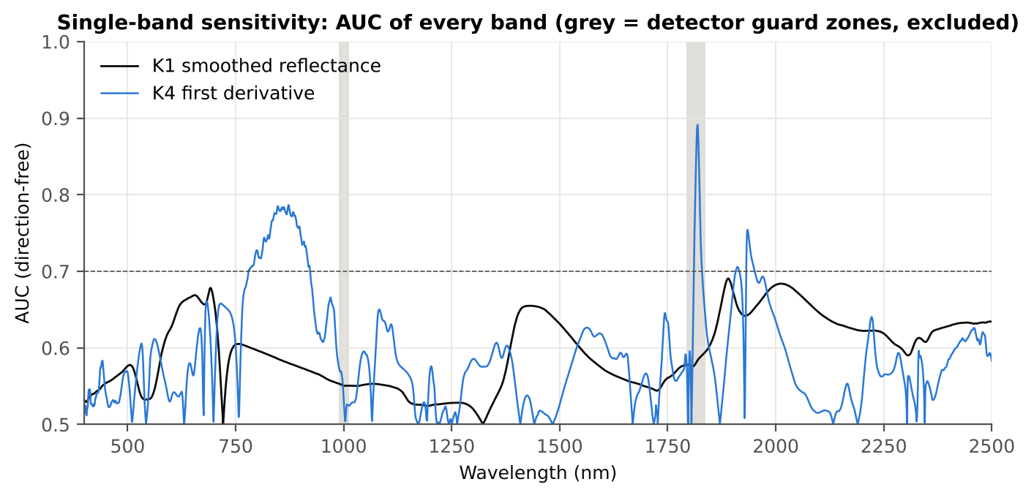
K1 · Band reflectance: best single band 1890 nm (AUC 0.691)
1652 of 2101 smoothed bands significant; 0 bands reach AUC ≥ 0.70.
Threshold chosen on training plots and tested on new plots (CV and hold-out columns).
Region | Wavelength (nm) | AUC | Direction | Hedges g | BA plot-grouped CV | BA hold-out
400–499 | 499 | 0.576 | D > H | 0.28 | 54.3 % | 54.6 %
500–599 | 599 | 0.625 | D > H | 0.44 | 59.1 % | 58.6 %
600–679 | 656 | 0.669 | D > H | 0.54 | 62.8 % | 62.2 %
680–759 | 692 | 0.678 | D > H | 0.56 | 62.5 % | 63.0 %
760–1349 | 760 | 0.605 | D < H | -0.28 | 60.9 % | 59.9 %
1350–1430 | 1430 | 0.655 | D > H | 0.50 | 60.1 % | 60.4 %
1431–1799 | 1431 | 0.655 | D > H | 0.50 | 60.6 % | 60.9 %
1800–1950 | 1890 | 0.691 | D > H | 0.50 | 63.9 % | 63.6 %
1951–2349 | 2010 | 0.684 | D > H | 0.50 | 64.6 % | 64.4 %
2350–2500 | 2496 | 0.634 | D > H | 0.43 | 57.6 % | 58.5 %

Slide 25
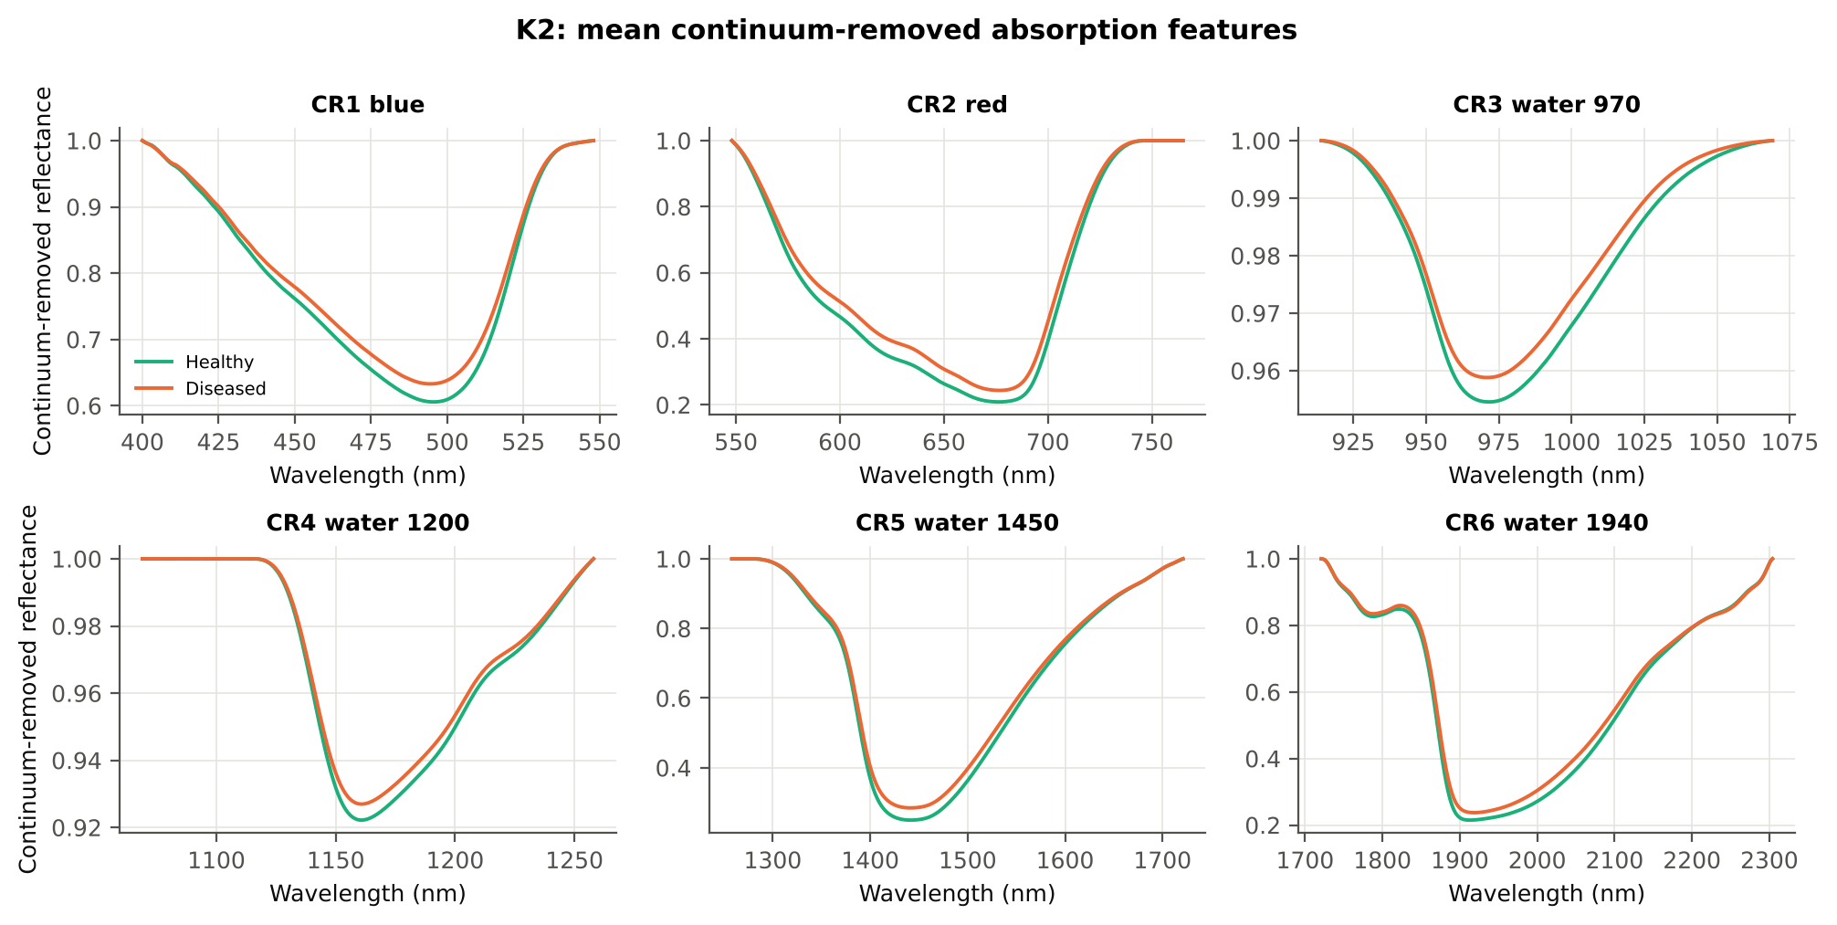
K2 · Continuum-removed absorption features
name | Mean healthy | Mean diseased | AUC | Direction | BA plot-grouped CV | BA hold-out
CR3 water 970 width | 64.159 | 60.944 | 0.765 | D < H | 70.1 % | 70.5 %
CR6 water 1940 position | 1912.193 | 1916.592 | 0.686 | D > H | 64.3 % | 64.6 %
CR6 water 1940 symmetry | 0.238 | 0.250 | 0.669 | D > H | 67.0 % | 67.3 %
CR2 red area | 95.305 | 88.115 | 0.666 | D < H | 62.5 % | 61.8 %
CR2 red width | 129.997 | 124.995 | 0.655 | D < H | 61.4 % | 61.0 %
CR2 red depth | 0.791 | 0.757 | 0.652 | D < H | 58.8 % | 59.6 %
CR3 water 970 area | 3.069 | 2.674 | 0.645 | D < H | 61.1 % | 62.1 %
CR5 water 1450 depth | 0.751 | 0.716 | 0.636 | D < H | 59.0 % | 59.8 %
Depth, position, area, width (FWHM) and symmetry of six absorption windows (30 parameters); ranked by AUC.

Slide 26
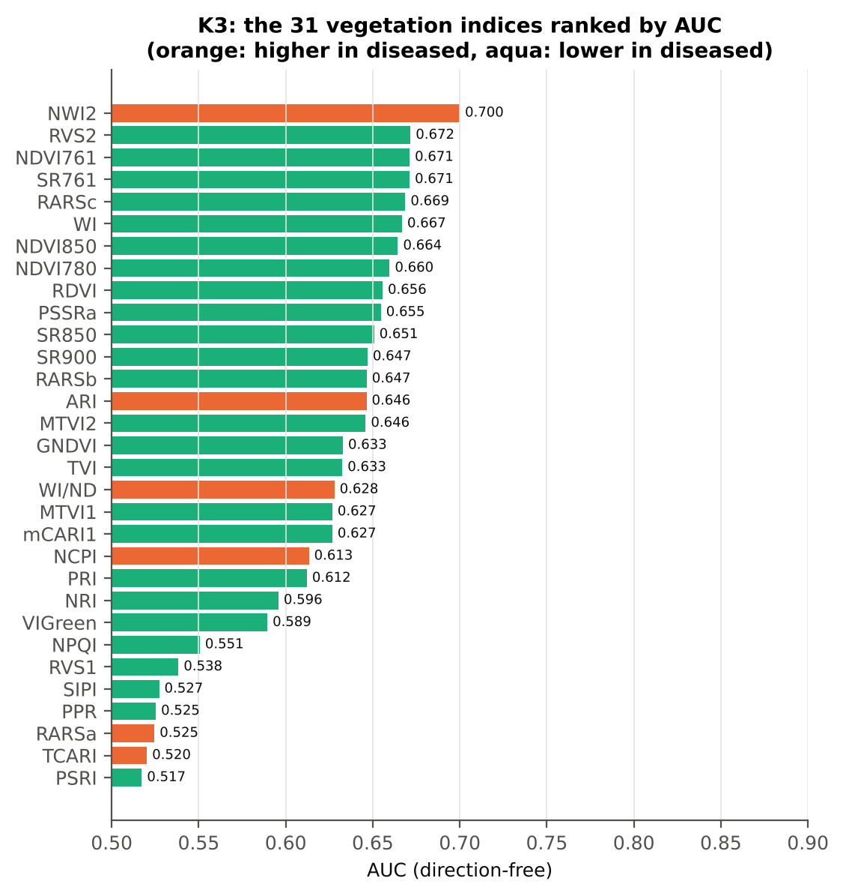
K3 · Disease-sensitive spectral indices (31 indices)
name | Mean healthy | Mean diseased | AUC | Direction | BA plot-grouped CV | BA hold-out
NWI2 | -0.027 | -0.020 | 0.700 | D > H | 65.4 % | 65.8 %
RVS2 | -1.467 | -1.604 | 0.672 | D < H | 61.9 % | 60.7 %
NDVI761 | 0.689 | 0.642 | 0.671 | D < H | 61.7 % | 60.7 %
SR761 | 5.609 | 4.874 | 0.671 | D < H | 61.7 % | 60.7 %
RARSc | 3.068 | 2.711 | 0.669 | D < H | 62.6 % | 61.8 %
WI | 1.052 | 1.043 | 0.667 | D < H | 63.1 % | 63.1 %
NDVI850 | 0.687 | 0.644 | 0.664 | D < H | 61.8 % | 60.9 %
NDVI780 | 0.722 | 0.681 | 0.660 | D < H | 62.6 % | 62.4 %
RDVI | 0.578 | 0.538 | 0.656 | D < H | 59.5 % | 59.6 %
PSSRa | 6.241 | 5.495 | 0.655 | D < H | 60.4 % | 60.9 %
mCARI1 and MTVI1 are algebraically identical; SR761 and NDVI761 rank leaves identically (same AUC). Ranking: AUC on all leaves; BA columns: threshold chosen on training plots, tested on new plots.

Slide 27
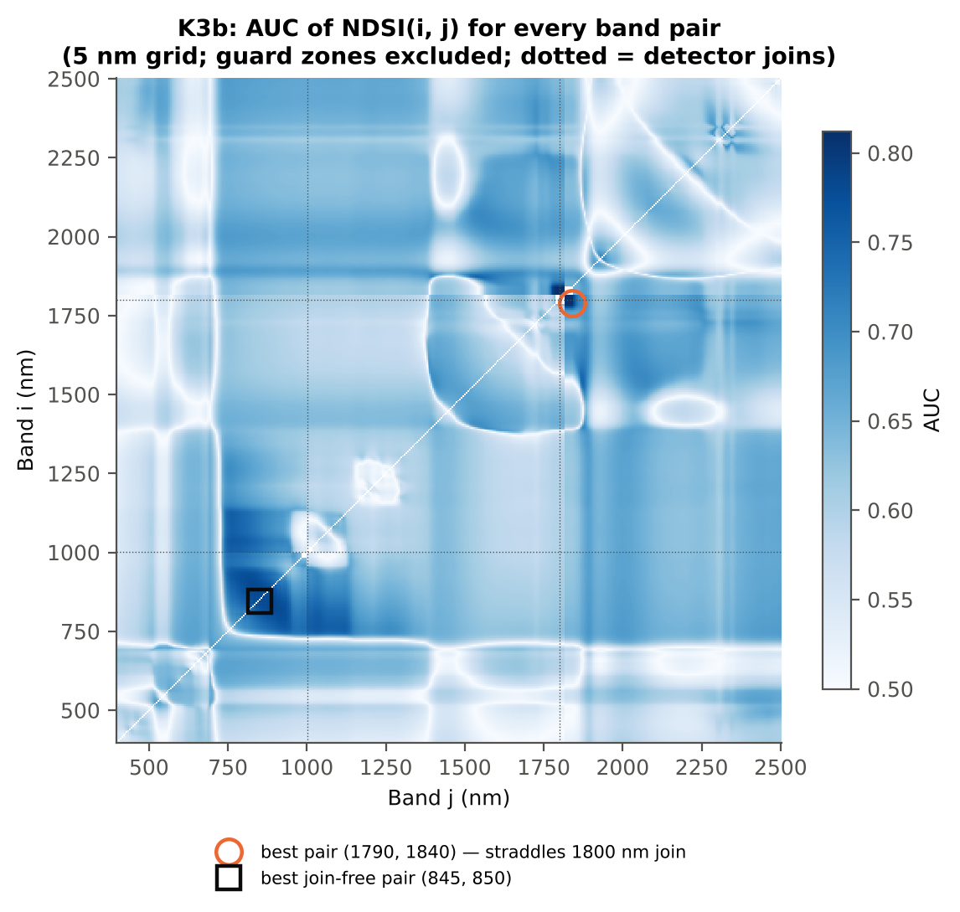
K3b · Optimised two-band index: 82,621 band pairs searched
Index | AUC
NDSI(1790, 1840) | 0.812
NDSI(1785, 1840) | 0.807
NDSI(1780, 1840) | 0.793
DI(870, 875) | 0.791
DI(845, 850) | 0.790
DI(845, 865) | 0.785
name | Mean healthy | Mean diseased | AUC | Direction | BA plot-grouped CV | BA hold-out
NDSI(1794,1837) | 0.019 | 0.013 | 0.821 | D < H | 76.0 % | 76.2 %
DI(872,874) | 1.0e-04 | -6.2e-06 | 0.792 | D < H | 70.6 % | 71.2 %
Honest (search inside training sets) | BA CV | BA hold-out
NDSI, all pairs (straddles 1800 nm join) | 73.0 % | 72.8 %
NDSI, join-free pairs | 70.2 % | 70.7 %
DI, join-free pairs | 70.7 % | 71.3 %
name | Mean healthy | Mean diseased | AUC | Direction | BA plot-grouped CV | BA hold-out
NDSI(849,850) | 3.1e-05 | -2.7e-05 | 0.798 | D < H | 71.5 % | 72.1 %
DI(872,874) | 1.0e-04 | -6.2e-06 | 0.792 | D < H | 70.6 % | 71.2 %

Slide 28
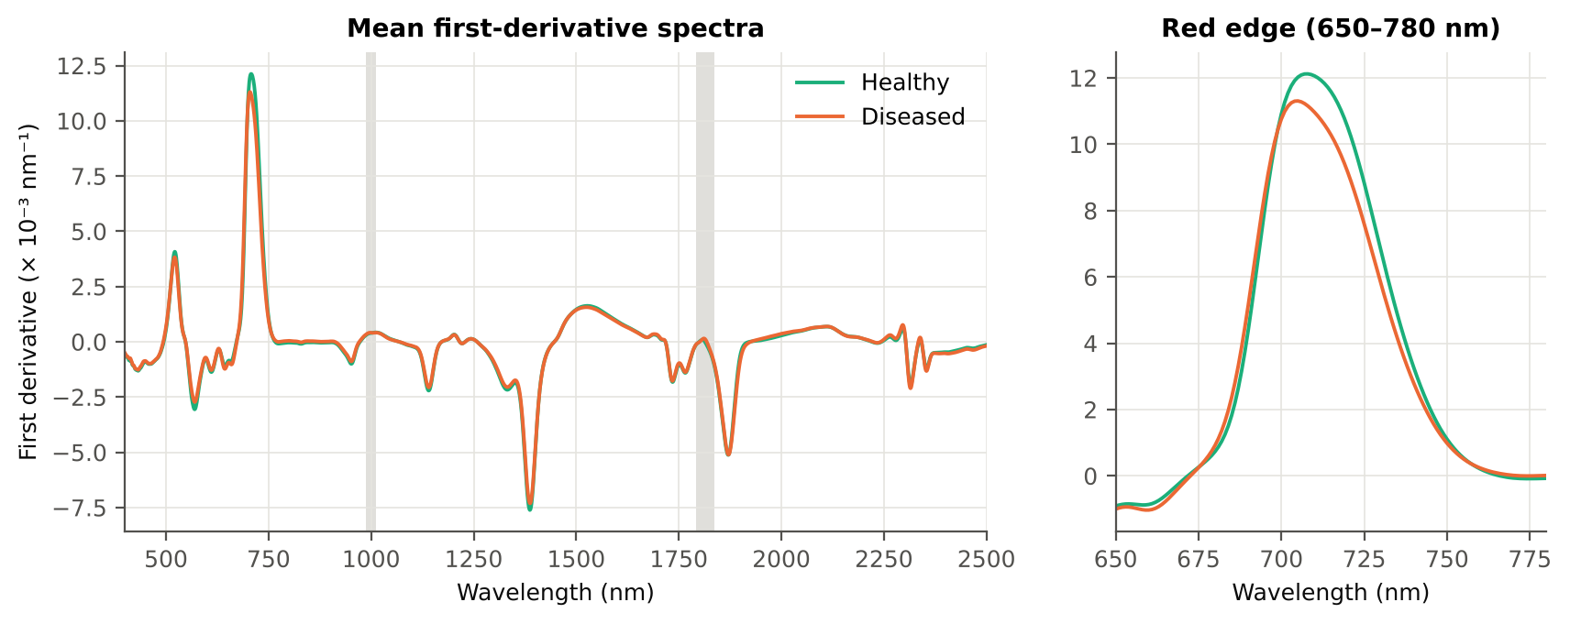
K4 · First-derivative spectra and edge parameters
name | AUC | Direction | BA plot-grouped CV | BA hold-out
Ro (red well reflectance) | 0.659 | D > H | 58.9 % | 59.8 %
λr = REP (red-edge position, n | 0.638 | D < H | 59.0 % | 58.9 %
REP, linear 4-point (nm) | 0.634 | D < H | 61.3 % | 59.7 %
SDr (red-edge area) | 0.630 | D < H | 60.8 % | 60.5 %
λb (blue-edge position, nm) | 0.622 | D < H | 57.6 % | 57.6 %
Dr = REV (red-edge amplitude) | 0.606 | D < H | 58.1 % | 57.6 %
(Rg − Ro)/(Rg + Ro) | 0.604 | D < H | 53.5 % | 54.4 %
Rg/Ro | 0.604 | D < H | 53.5 % | 54.4 %
Derivative | Significant (FDR) | Best AUC outside guard | at (nm) | Best AUC inside guard (excluded)
First derivative (SG 15, 2) | 1488 | 0.786 | 872 | 0.891 at 1819 nm
Second derivative (SG 21, 2) | 1558 | 0.740 | 801 | 0.893 at 1809 nm

Slide 29
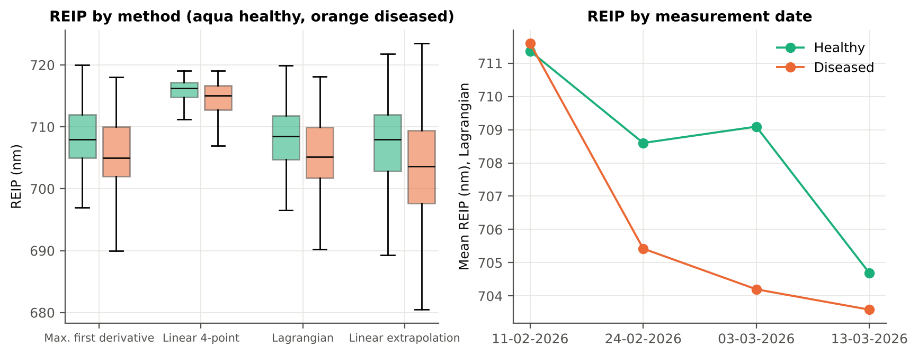
K4b · Red-edge inflection point (REIP): four methods agree on a blue shift
All four REIP estimators shift to shorter wavelengths in diseased leaves (1.5 nm for the linear four-point method, 2.4–3.9 nm for the derivative-based methods; AUC 0.63–0.64), the classical red-edge 'blue shift' of chlorophyll loss. The four methods agree closely (r 0.85–1.00).
The shift is clear at flowering (−3.9 nm, AUC 0.72) and on 03-03-2026 (−4.9 nm), small at pod formation (−1.1 nm) and absent at the vegetative stage and on 11-02-2026 (+0.2 nm), when symptoms were still developing.
name | Mean healthy | Mean diseased | AUC | BA plot-grouped CV | BA hold-out
linear extrapolation | 707.241 | 703.383 | 0.644 | 60.5 % | 59.2 %
Lagrangian interpolation | 708.150 | 705.712 | 0.638 | 59.6 % | 59.1 %
maximum first derivative | 708.143 | 705.703 | 0.638 | 59.0 % | 58.9 %
linear 4-point interpolation | 715.599 | 714.061 | 0.634 | 61.3 % | 59.7 %

Slide 30
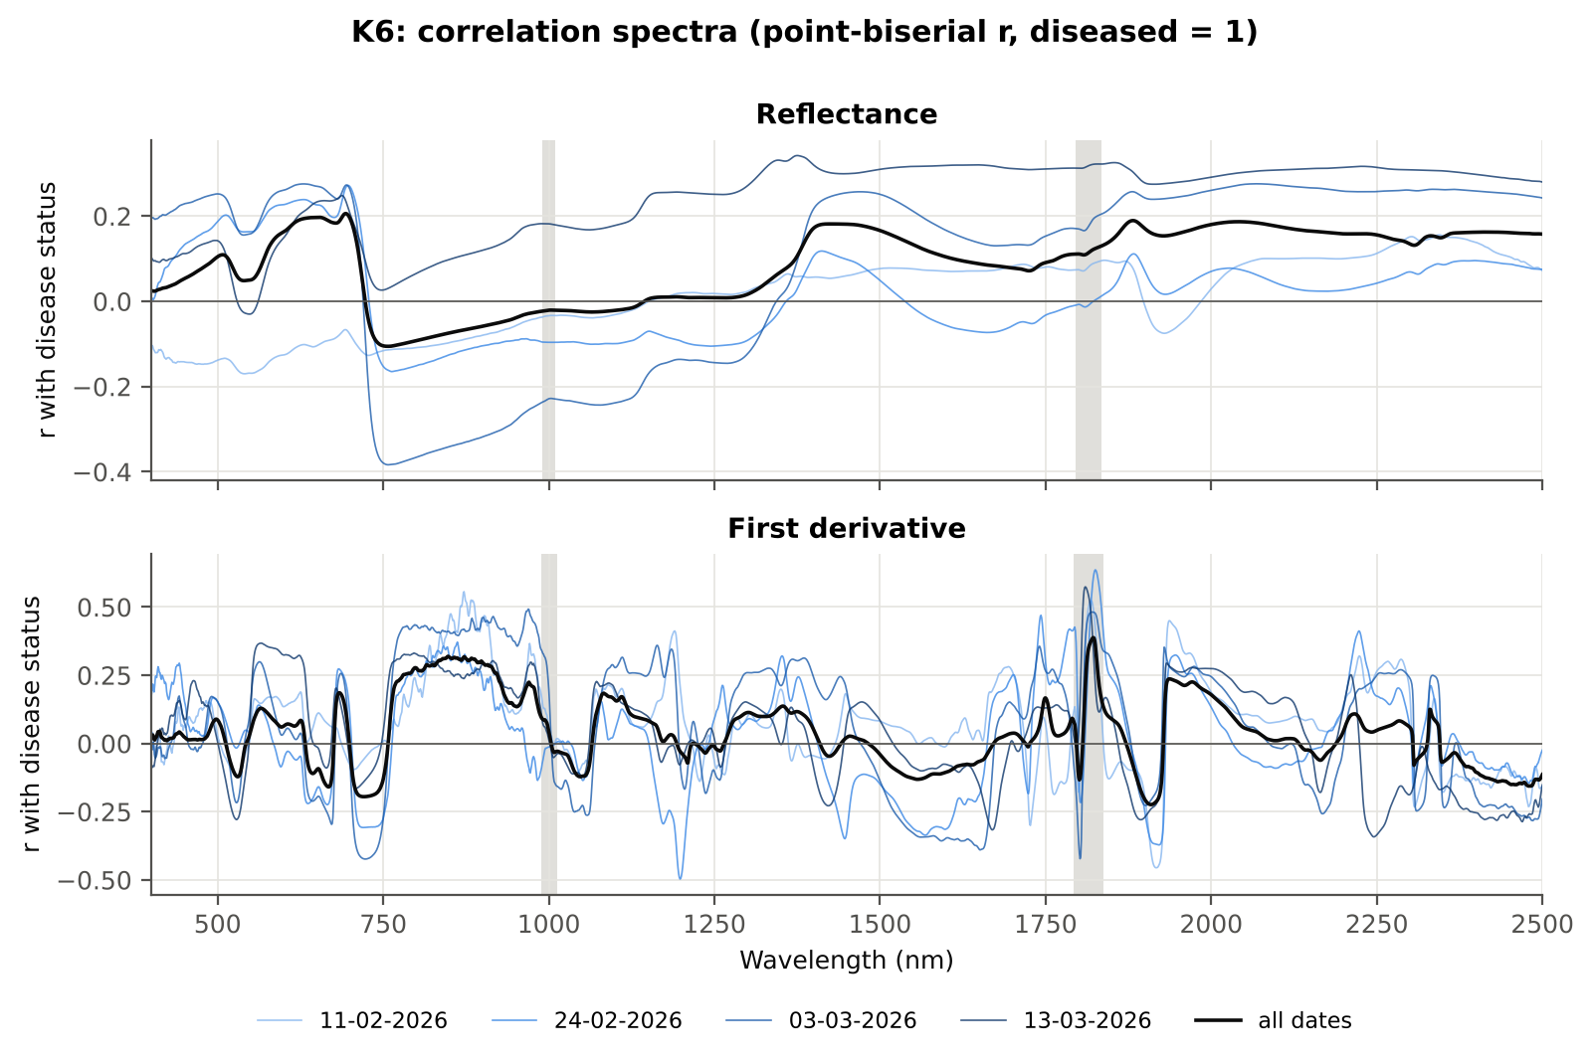
K6 · Correlation spectra: r between band value and disease status
Spectrum | Region (nm) | Band of max |r| | r | Same sign on all 4 dates
Reflectance | 400–499 | 499 | +0.104 | no
Reflectance | 500–599 | 599 | +0.162 | no
Reflectance | 600–679 | 653 | +0.197 | no
Reflectance | 680–759 | 693 | +0.206 | no
Reflectance | 760–1349 | 760 | -0.105 | no
Reflectance | 1350–1430 | 1426 | +0.182 | yes
Reflectance | 1431–1799 | 1431 | +0.182 | yes
Reflectance | 1800–1950 | 1882 | +0.190 | yes
Reflectance | 1951–2349 | 2041 | +0.187 | yes
Reflectance | 2350–2500 | 2418 | +0.163 | yes
First derivative | 400–499 | 498 | +0.089 | yes
First derivative | 500–599 | 565 | +0.129 | yes
First derivative | 600–679 | 667 | -0.159 | no
First derivative | 680–759 | 721 | -0.195 | yes
First derivative | 760–1349 | 848 | +0.319 | yes
First derivative | 1350–1430 | 1353 | +0.137 | yes
First derivative | 1431–1799 | 1750 | +0.167 | yes
First derivative | 1800–1950 | 1937 | +0.237 | yes
First derivative | 1951–2349 | 1971 | +0.226 | yes
First derivative | 2350–2500 | 2483 | -0.156 | yes
Severity scores were not used (healthy vs diseased only), so the point-biserial correlation with the 0/1 status is shown.

Slide 31
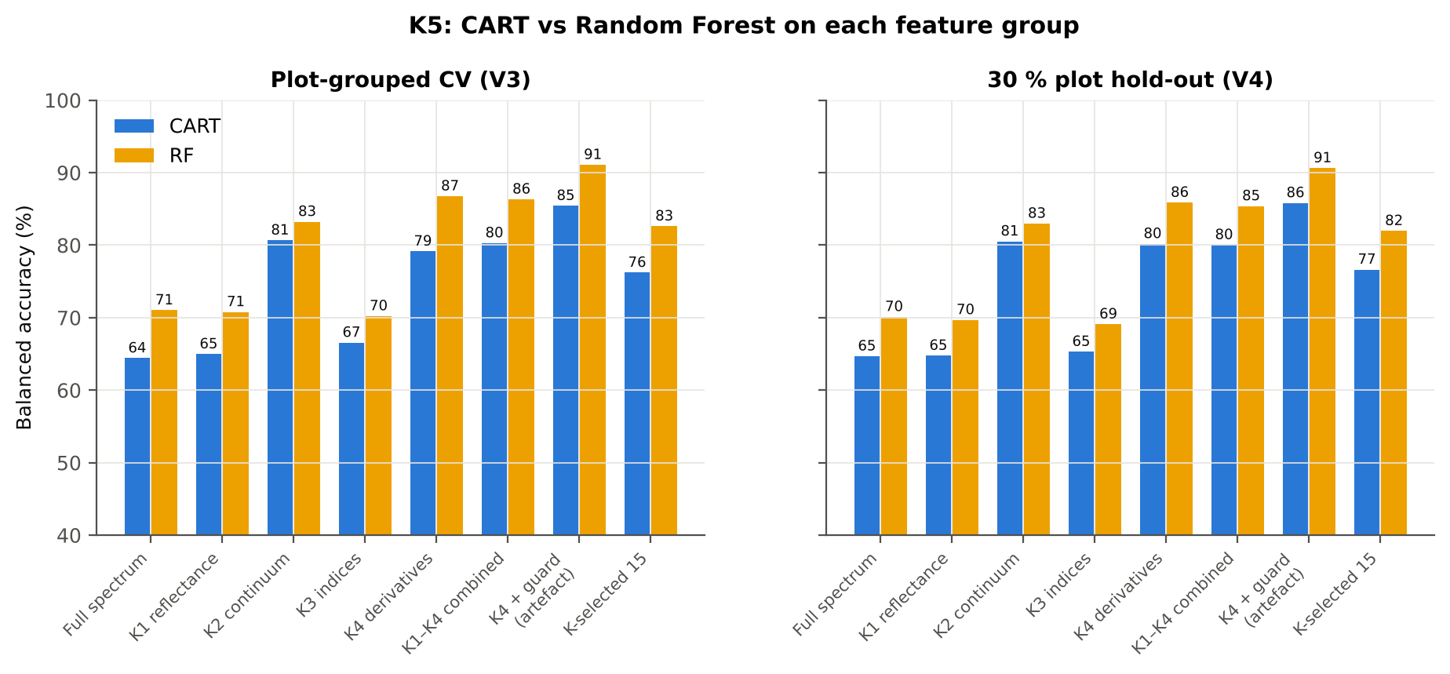
K5 · CART vs Random Forest on each feature group
Feature type | Features | Share of RF importance | Importance per feature (K1 band = 1)
K1 reflectance | 2039 | 19.4 % | 1.00
K2 continuum | 30 | 1.5 % | 5.32
K3 index | 31 | 0.6 % | 2.20
K4 derivative | 2031 | 78.0 % | 4.03
K4 edge | 20 | 0.5 % | 2.46
RF beats CART on every feature group (2–8 points, all p < 0.01).
Derivatives (K4) and continuum-removed parameters (K2) carry far more information than reflectance (K1) or the 31 indices (K3): RF 86.8 % and 83.2 % vs 70.8 % and 70.2 % (V3).
Keeping the guard-zone derivative bands raises RF to 91.1 % — an instrument artefact, not disease, so they are excluded.
Feature group | Features | CART CV | RF CV | CART hold-out | RF hold-out
Full spectrum (raw reflectance) | 2101 | 64.4 % | 71.0 % | 64.7 % | 70.1 %
K1 band reflectance | 2039 | 65.0 % | 70.8 % | 64.8 % | 69.7 %
K2 continuum-removed parameters | 30 | 80.7 % | 83.2 % | 80.5 % | 83.0 %
K3 vegetation indices | 31 | 66.6 % | 70.2 % | 65.3 % | 69.1 %
K4 derivatives + edge parameters | 2051 | 79.2 % | 86.8 % | 80.2 % | 85.9 %
K1–K4 combined pool | 4151 | 80.3 % | 86.3 % | 80.0 % | 85.4 %
K4 incl. guard-zone bands (artefact test) | 2121 | 85.4 % | 91.1 % | 85.8 % | 90.6 %
K-selected (top 15 non-redundant, chosen inside each training set) | 15 | 76.2 % | 82.6 % | 76.6 % | 82.0 %

Slide 32
Part C · The four-tier method on all extracted features
K1 reflectance + K2 continuum removal + K3 indices + K4 derivative bands and edge parameters = 4151 features → Tier 1 → CART / RF selection → J–M → QDA → nested validation

Slide 33
C0–C1 · Pool of 4150 features; 3115 pass Tier 1
Feature type | Features | Tier-1 significant | CART-13 | CART-8 (1-SE) | RF-17 | RF-10 | RF-13 (size-matched)
K1 band reflectance | 2039 | 1610 | 2 | 1 | 0 | 0 | 0
K2 continuum removal | 30 | 25 | 2 | 2 | 2 | 2 | 2
K3 vegetation index | 30 | 23 | 0 | 0 | 0 | 0 | 0
K4 edge parameter | 20 | 17 | 0 | 0 | 0 | 0 | 0
K4 first-derivative band | 2031 | 1440 | 9 | 5 | 15 | 8 | 11
Duplicates removed before Tier 1: MTVI1 (= mCARI1).
RF peaks picked within each spectral series (bands ≥ 10 nm apart); every scalar feature is its own candidate.
Same settings, seeds and folds as Part A; Tier 1 + selection refitted inside every training set in V3–V5.

Slide 34
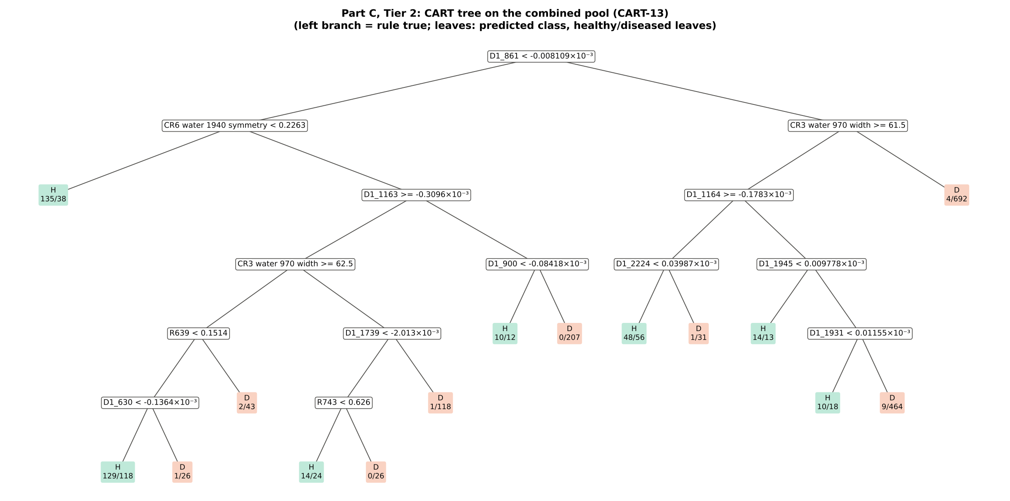
C2 · CART on the combined pool selects 13 features
CART-13: D1_861, CR6 water 1940 symmetry, CR3 water 970 width, D1_1163, D1_1164, D1_900, D1_2224, D1_1945, R639, D1_1739, D1_1931, D1_630, R743

Slide 35
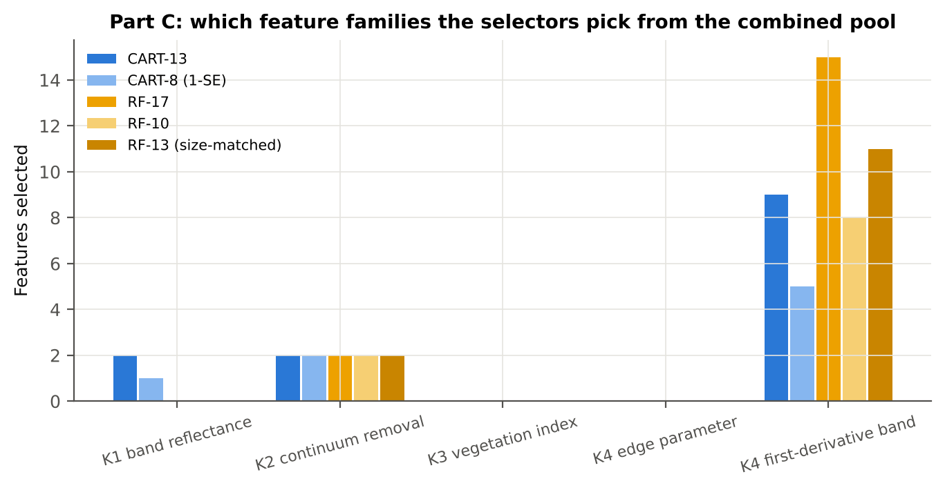
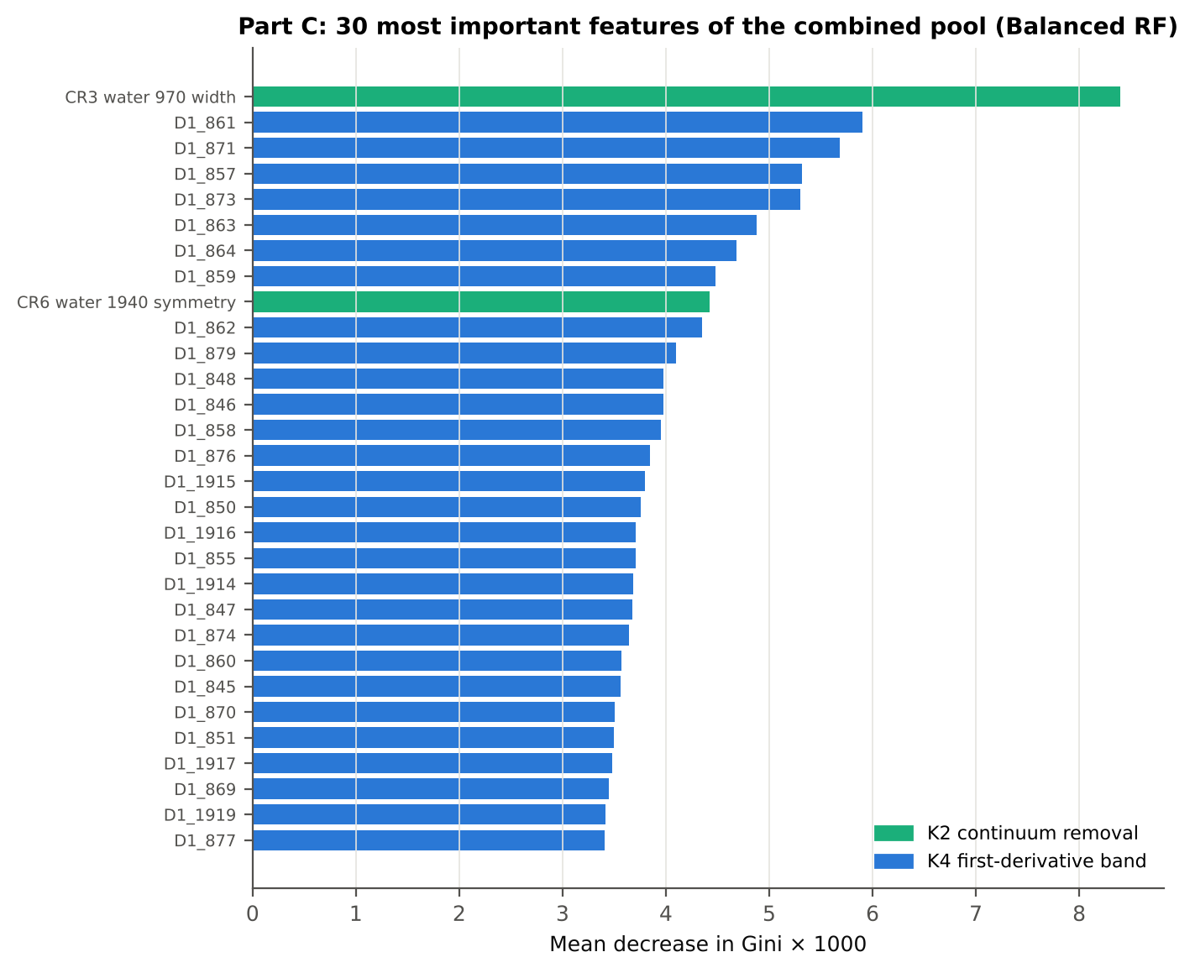
C2 · Which feature families CART and RF pick from the pool
RF-17: CR3 water 970 width, D1_861, D1_871, CR6 water 1940 symmetry, D1_848, D1_1915, D1_888, D1_2223, D1_2209, D1_1944, D1_899, D1_1934, D1_911, D1_1740, D1_837, D1_1792, D1_1163

Slide 36
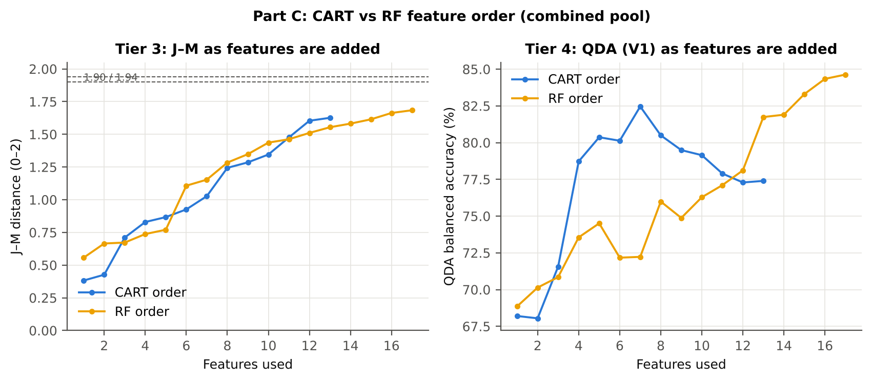
C3–C4 · J–M and QDA on the selected features of the combined pool
Error matrix · QDA on RF-17 (V1)
Set | Features | JM
CART-13 | 13 | 1.626
CART-8 (1-SE) | 8 | 1.197
RF-17 | 17 | 1.684
RF-10 | 10 | 1.437
RF-13 (size-matched) | 13 | 1.554
Classified \ Reference | Healthy | Diseased | Row total | User's acc.
Healthy | 353 | 455 | 808 | 43.7 %
Diseased | 25 | 1431 | 1456 | 98.3 %
Column total | 378 | 1886 | 2264
Producer's acc. | 93.4 % | 75.9 %
Set | Classifier | OA | BA | PA_H | PA_D | kappa | AUC
CART-13 | QDA equal priors | 68.3 % | 77.4 % | 91.0 % | 63.8 % | 0.325 | 0.912
CART-8 (1-SE) | QDA equal priors | 67.5 % | 76.7 % | 90.5 % | 62.9 % | 0.313 | 0.888
RF-17 | QDA equal priors | 78.8 % | 84.6 % | 93.4 % | 75.9 % | 0.476 | 0.937
RF-10 | QDA equal priors | 66.1 % | 76.3 % | 91.5 % | 61.0 % | 0.301 | 0.887
RF-13 (size-matched) | QDA equal priors | 74.0 % | 81.7 % | 93.4 % | 70.1 % | 0.404 | 0.915

Slide 37
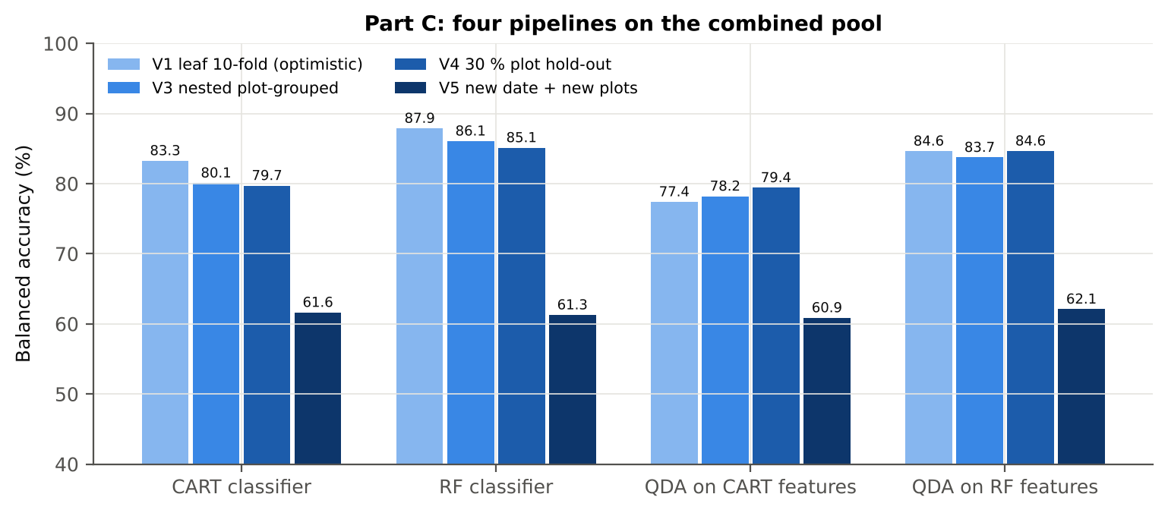
C5 · Honest validation of the combined-pool pipeline
In the combined pool the RF-selected features beat the CART-selected features for QDA by 5.8 points (44 of 50 folds), and QDA on 17 RF features (83.7 %) is close to a Balanced RF on all 4150 features (86.3 %).
Selection is stable: the width of the 970 nm water feature is chosen in all 50 training sets by both selectors, the symmetry of the 1940 nm feature in 50 (RF) and 45 (CART); RF Jaccard 0.82, CART 0.37.
Comparison | Units | Mean difference | First better | Second better | Wilcoxon p
RF classifier − CART classifier | V3 nested (folds) | +5.6 pts | 48 | 2 | 1.1e-09
RF classifier − CART classifier | V4 hold-out (splits) | +5.4 pts | 10 | 0 | 0.002
QDA on RF features − QDA on CART features | V3 nested (folds) | +5.8 pts | 44 | 6 | 1.4e-10
QDA on RF features − QDA on CART features | V4 hold-out (splits) | +5.2 pts | 10 | 0 | 0.002
QDA on CART features − CART classifier | V3 nested (folds) | -1.9 pts | 19 | 31 | 0.058
QDA on CART features − CART classifier | V4 hold-out (splits) | -0.3 pts | 4 | 6 | 0.846
QDA on RF features − RF classifier | V3 nested (folds) | -1.7 pts | 15 | 34 | 0.009
QDA on RF features − RF classifier | V4 hold-out (splits) | -0.5 pts | 6 | 4 | 0.770

Slide 38
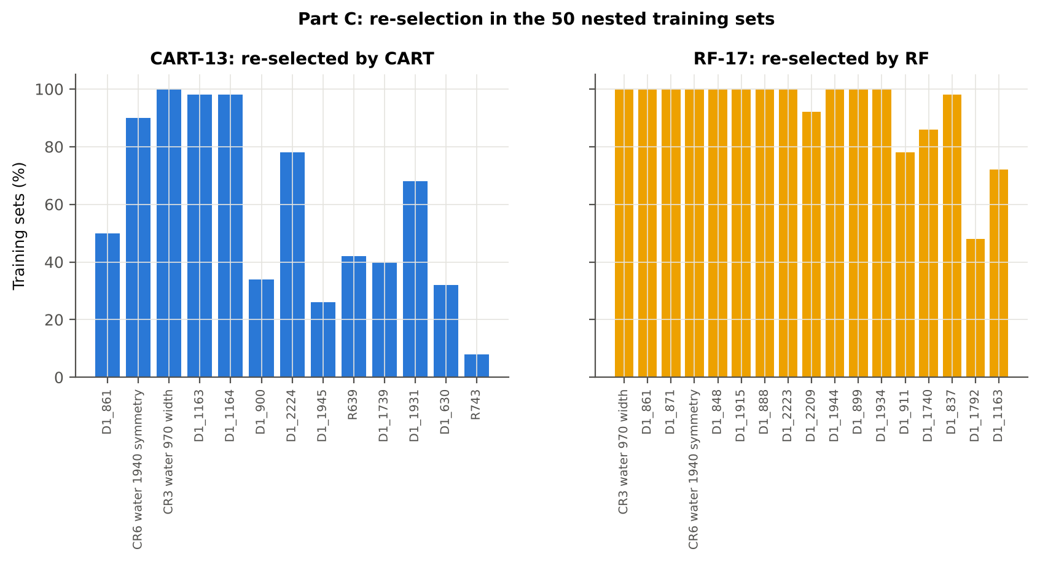
C6 · Stability and the families chosen across 50 training sets
Selector | Feature type | Selected (50 training sets) | Share
CART | K4 first-derivative band | 440 | 71.1 %
CART | K2 continuum removal | 101 | 16.3 %
CART | K1 band reflectance | 43 | 6.9 %
CART | K4 edge parameter | 31 | 5.0 %
CART | K3 vegetation index | 4 | 0.6 %
RF | K4 first-derivative band | 740 | 87.1 %
RF | K2 continuum removal | 109 | 12.8 %
RF | K4 edge parameter | 1 | 0.1 %
Method | Mean features | Unique features (union) | Stability index (±10 nm) | Mean pairwise Jaccard (±10 nm)
CART | 12.4 | 170 | 0.006 | 0.370
RF | 17.0 | 169 | 0.503 | 0.816

Slide 39
C7 · Combined pool vs reflectance only vs K5 (paired tests, same folds)
First | Second | V3 Δ BA | V3 wins | V3 p | V4 Δ BA | V4 wins | V4 p
Combined pool: QDA on CART features | Reflectance: QDA on CART bands | +6.1 pts | 41/50 | 1.1e-06 | +6.6 pts | 9/10 | 0.014
Combined pool: QDA on RF features | Reflectance: QDA on RF bands | +15.0 pts | 50/50 | 7.6e-10 | +15.0 pts | 10/10 | 0.002
Combined pool: RF classifier (Tier-1 features) | Reflectance: RF classifier (Tier-1 bands) | +15.3 pts | 50/50 | 7.6e-10 | +15.7 pts | 10/10 | 0.002
Combined pool: CART classifier (Tier-1 features) | Reflectance: CART classifier (Tier-1 bands) | +15.7 pts | 50/50 | 1.8e-15 | +15.6 pts | 10/10 | 0.002
Combined pool: QDA on RF features | Combined pool: QDA on CART features | +5.8 pts | 44/50 | 1.4e-10 | +5.2 pts | 10/10 | 0.002
Combined pool: QDA on RF features | K5: RF classifier on all 4151 features | -2.1 pts | 13/49 | 0.004 | -0.8 pts | 5/10 | 0.492
Combined pool: QDA on RF features | K5: QDA on 15 features chosen by AUC | +5.7 pts | 43/50 | 1.1e-07 | +5.8 pts | 9/10 | 0.014
Combined pool: RF classifier (Tier-1 features) | K5: RF classifier on all 4151 features | -0.3 pts | 16/39 | 0.115 | -0.3 pts | 4/10 | 0.625
The combined pool beats reflectance alone in every pipeline (+6 to +16 points, 41–50 of 50 folds, all p < 10⁻⁵). QDA on 17 RF-selected features is 2.1 points below an RF on all features in V3 and equal in V4 — a compact, interpretable 17-feature model loses little.

Slide 40
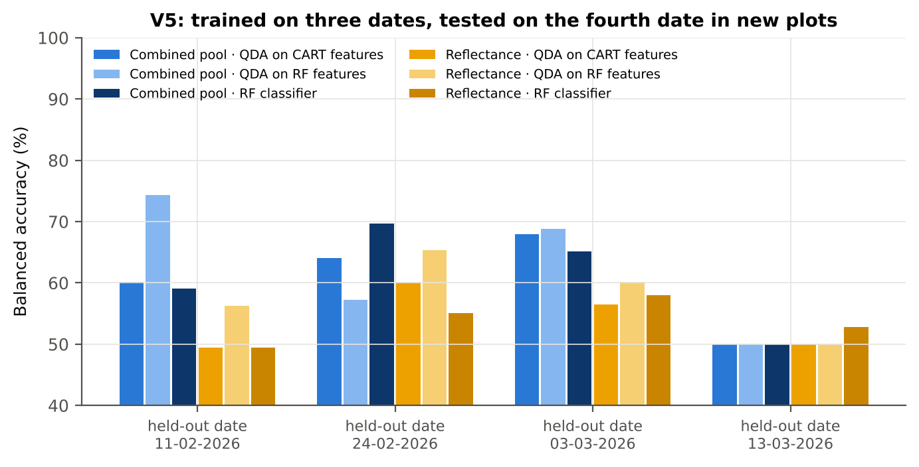
Additional step · V5: an unseen date in unseen plots
Trained on three dates and tested on the fourth date in new plots, accuracy falls to 53–58 % (reflectance) and 61–62 % (combined pool). When 13-03-2026 (mostly pod formation) is held out, every leaf — healthy or diseased — is called diseased: senescing pod-stage leaves resemble diseased leaves spectrally, and the training dates contained few pod-stage leaves.
The disease signal is real but stage-dependent; models must be trained on the growth stages and dates to which they will be applied.
Feature set · pipeline | 11-02-2026 | 24-02-2026 | 03-03-2026 | 13-03-2026
Reflectance · CART classifier | 48.5 % | 50.9 % | 57.2 % | 53.3 %
Reflectance · RF classifier | 49.4 % | 55.1 % | 57.9 % | 52.8 %
Reflectance · QDA on CART features | 49.4 % | 60.0 % | 56.5 % | 50.0 %
Reflectance · QDA on RF features | 56.3 % | 65.4 % | 60.1 % | 50.0 %
Combined pool · CART classifier | 65.4 % | 72.2 % | 59.5 % | 51.6 %
Combined pool · RF classifier | 59.1 % | 69.7 % | 65.1 % | 50.0 %
Combined pool · QDA on CART features | 60.2 % | 64.1 % | 68.0 % | 50.0 %
Combined pool · QDA on RF features | 74.4 % | 57.2 % | 68.8 % | 50.0 %

Slide 41
Additional step · Does the signal hold within each date, stage and variety?
Feature | AUC all leaves | AUC range over dates | over growth stages | over varieties
K1 reflectance R1890 | 0.691 | 0.54–0.83 | 0.53–0.75 | 0.67–0.72
K4 first derivative D1_872 | 0.786 | 0.69–0.90 | 0.70–0.85 | 0.74–0.82
K2 CR3 water 970 width | 0.765 | 0.57–0.87 | 0.65–0.85 | 0.75–0.78
K3 NWI2 | 0.700 | 0.61–0.87 | 0.59–0.77 | 0.66–0.76
K4 edge Ro (red well reflectance) | 0.659 | 0.56–0.74 | 0.54–0.72 | 0.64–0.67
REIP (Lagrangian) | 0.638 | 0.52–0.77 | 0.54–0.72 | 0.60–0.67
The key features work inside every date, growth stage and variety (same direction in nearly all strata), but their AUC varies widely between dates (e.g. D1 at 872 nm 0.69–0.90; CR3 width 0.57–0.87).
Classifier accuracy (V3 out-of-fold) of QDA on the combined-pool RF features is 82–86 % in each variety, 73–88 % in each growth stage (lowest at pod formation) and 68–94 % in each date.

Slide 42
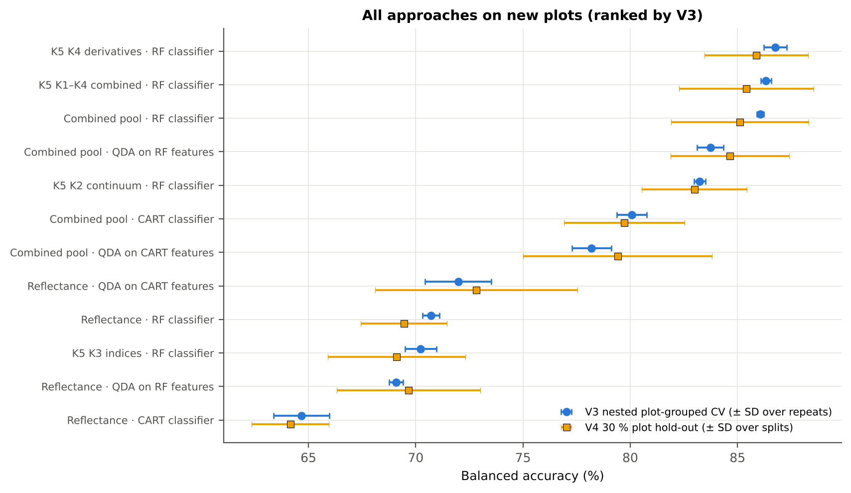
Synthesis · All approaches on new plots
Approach | BA V3 (nested CV) | BA V4 (hold-out plots) | BA V5 (new date + plots)
K5 · K4 incl. guard bands (artefact): RF | 91.1 % | 90.6 % | –
K5 · K4 derivatives + edge: RF | 86.8 % | 85.9 % | –
K5 · K1–K4 combined: RF | 86.3 % | 85.4 % | –
Part C · combined-pool four-tier: RF classifier (Bal | 86.1 % | 85.1 % | 61.3 %
K5 · K4 incl. guard bands (artefact): CART | 85.4 % | 85.8 % | –
Part C · combined-pool four-tier: QDA on RF-17 (RF-s | 83.7 % | 84.6 % | 62.1 %
K5 · K2 continuum removal: RF | 83.2 % | 83.0 % | –
K5 · K-selected 15: RF | 82.6 % | 82.0 % | –
K5 · K2 continuum removal: CART | 80.7 % | 80.5 % | –
K5 · K1–K4 combined: CART | 80.3 % | 80.0 % | –
Part C · combined-pool four-tier: CART classifier (r | 80.1 % | 79.7 % | 61.6 %
K5 · K4 derivatives + edge: CART | 79.2 % | 80.2 % | –

Slide 43
Conclusions
White rust changes mustard leaf reflectance significantly at 1653 of 2101 bands (1604 with a plot random effect), mainly in the red / red edge, the NIR plateau and the water absorption bands, irrespective of date, growth stage and variety.
The four-tier method of Das et al. (2020), corrected for imbalance, selects 11 CART bands (root 1893 nm) that give QDA balanced accuracies of 71–73 % on new plots; the classes are not separable by the J–M criterion (1.27 < 1.90).
Random Forest is a better classifier than CART (+6 points) and a far more stable band selector; RF and CART agree on the red edge (≈ 690–705 nm) and the 1890 nm water band.
First-derivative spectra and continuum-removed water features are the most disease-sensitive features; the red-edge inflection point shows a blue shift of 1.5–3.9 nm in diseased leaves, strongest at flowering.
Applying the four tiers to the combined feature pool (4150 features) raises accuracy to 83.7–84.6 % with QDA on 17 RF-selected features and to 86 % with an RF on all features — 15 points above reflectance alone.
Models transfer poorly to an unseen date (53–62 %) because growth stage changes the spectra more than the disease; practical detection needs stage-specific calibration or training data covering all stages.

Slide 44
Recommendations
Use first-derivative bands (845–875 and 1915–1945 nm) together with the width of the 970 nm and the symmetry of the 1940 nm continuum-removed water features; select them with Random Forest importance and classify with QDA or RF.
Report balanced accuracy and both class recalls; state the priors used (equal priors favour the healthy class here).
Validate with plots grouped across dates and test transfer to new dates; calibrate per growth stage or include all stages in training.
Apply splice correction and guard zones at the ASD detector joins and avoid indices whose bands bracket a join.
Record a disease-severity score per leaf in future campaigns, so that severity-related spectral changes can be modelled directly.

Slide 45
Appendix · Every step was cross-checked (45 PASS, 6 FLAG, 0 FAIL)
Step | What was checked | Result | Status
Step 0 | Missing values in spectra | 0 | PASS
Step 0 | Reflectance range (350–2500 nm) | 0.026 – 0.935 | PASS
Step 0 | Wavelength grid identical in all fil | 350–2500 nm, 1 nm, 2151 bands | PASS
Step 0 | Plot-average formula columns ignored | 197 | PASS
Step 0 | Second data block 13-03-2026: exact | 75 of 75 identical → removed | PASS
Step 0 | Exact duplicates among the remaining | 4 (the unnamed plot-27 spectra of 11-02-2026) → | FLAG
Step 0 | Each plot has one class on every dat | 48 of 48 plots | PASS
Step 0 | Each plot has one variety on every d | 48 of 48 plots | PASS
Step 0 | Healthy = plots 1–12, diseased = plo | consistent | PASS
Step 0 | Repeated ASD file names within a dat | 75 names repeated; spectra differ (max |Δ| ≥ 0.0 | PASS
Tier 3 | J–M implementation (Part A (raw refl | |Δα| = 3.0e-13 | PASS
Tier 4 | QDA implementation (Part A (raw refl | 99.91 % identical predictions — the 2 differing | PASS
Tier 1 | Welch t-statistic | max |Δt| = 3.6e-15 | PASS
Tier 1 | Benjamini–Hochberg q-values | max |Δq| = 1.1e-16 | PASS
Tier 1 | ANOVA equivalence | max relative |F − t²| = 3.8e-14 | PASS
Tier 1 | Class imbalance | median 1568 significant bands per subset vs 1653 | PASS
Tier 2 | CART implementation | root variable rpart 'WV1893< 0.08056' vs sklearn | PASS
Tier 2 | Stability of the selected bands | 1893 nm 86 %; 767 nm 84 %; 2405 nm 76 % | PASS
Tier 3 | J–M formula | 0.0e+00 | PASS
Tier 4 | QDA in R | CART-11 equal: 99.91 % identical; CART-11 sample | PASS
A1 | Reproducibility: importance of seed | 0.891; 17 of 17 peaks within ±10 nm | PASS
A1 | R randomForest (stratified sampsize | ρ = 0.893; 16 of 17 peaks within ±10 nm; R out-o | PASS
Step | What was checked | Result | Status
A1 | Permutation importance (drop in AUC, | ρ = -0.06; shuffling one band hardly changes the | FLAG
A1 | Ordinary RF with class weights only | BA 0.703; healthy recall 0.49: class weights alo | PASS
Tier 1 | Pseudo-replication | 1604 of 2101 bands significant (Welch: 1653); pl | PASS
Tier 1 | Mixed model implementation | Spearman ρ of p-values 1.000; max |ΔICC| 0.000 ( | PASS
Tier 3 | Invertibility of the class covarianc | max 3.3e+07 (well below the ~1e12 limit of doubl | PASS
Tier 3 | J–M is scale-invariant | max |ΔJ–M| = 4.9e-11 | PASS
K0 | Smoothing preserves the signal | r ≥ 0.999988; 1653 (raw) vs 1652 (smoothed) sign | PASS
K0 | Detector artefact at the 1800/1801 n | start-up bump detected → guard zones applied | FLAG
K2 | Convex hull | max |Δ continuum| = 0.0e+00 | PASS
K3 | Duplicated indices | max |mCARI1 − MTVI1| = 4.4e-16 (algebraically id | PASS
K4 | REIP by four methods | r between methods 0.849 – 0.999 | PASS
K4 | REP by two methods (Excel) | see 'largest difference' on sheet K4 | PASS
K4 | Derivative filter | r = 0.9995 | PASS
K6 | Correlation vs t-test | ρ = 0.9829 (r_pb is a monotone function of Stude | PASS
K3b | NDSI vs simple ratio | max |ΔAUC| = 0.0e+00 | PASS
K3b | Selection optimism | honest BA 73.0 % (CV) / 72.8 % (hold-out) vs 76. | FLAG
K3b | Best pair straddles a detector join? | all-pair best NDSI(1794,1837) brackets the 1800/ | FLAG
Part C · Tier 3 | J–M implementation (Part C (combined | |Δα| = 3.3e-15 | PASS
Part C · Tier 4 | QDA implementation (Part C (combined | 99.91 % identical predictions | PASS
Part C · Tier 3 | Invertibility of the class covarianc | max 7.8e+03 (well below the ~1e12 limit of doubl | PASS
Part C · Tier 3 | J–M is scale-invariant | max |ΔJ–M| = 2.4e-14 | PASS
Validation | No plot in both training and test | passed for all folds | PASS
Full register with methods: workbook sheet 33_CrossChecks.

Slide 46
References (1/3)
Ambroise C, McLachlan GJ. 2002. Selection bias in gene extraction on the basis of microarray gene-expression data. Proceedings of the National Academy of Sciences 99:6562–6566.
Babar MA, Reynolds MP, van Ginkel M, Klatt AR, Raun WR, Stone ML. 2006. Spectral reflectance indices as a potential indirect selection criteria for wheat yield under irrigation. Crop Science 46:578–588.
Benjamini Y, Hochberg Y. 1995. Controlling the false discovery rate: a practical and powerful approach to multiple testing. Journal of the Royal Statistical Society B 57:289–300.
Bhattacharyya A. 1943. On a measure of divergence between two statistical populations defined by their probability distributions. Bulletin of the Calcutta Mathematical Society 35:99–109.
Breiman L. 2001. Random forests. Machine Learning 45:5–32.
Breiman L, Friedman JH, Olshen RA, Stone CJ. 1984. Classification and regression trees. Belmont (CA): Wadsworth.
Brodersen KH, Ong CS, Stephan KE, Buhmann JM. 2010. The balanced accuracy and its posterior distribution. Proceedings of the 20th International Conference on Pattern Recognition, 3121–3124.
Chen C, Liaw A, Breiman L. 2004. Using random forest to learn imbalanced data. Technical Report 666, Department of Statistics, University of California, Berkeley.
Cho MA, Skidmore AK. 2006. A new technique for extracting the red edge position from hyperspectral data: the linear extrapolation method. Remote Sensing of Environment 101:181–193.
Clark RN, Roush TL. 1984. Reflectance spectroscopy: quantitative analysis techniques for remote sensing applications. Journal of Geophysical Research 89(B7):6329–6340.
Cohen J. 1960. A coefficient of agreement for nominal scales. Educational and Psychological Measurement 20:37–46.
Congalton RG. 1991. A review of assessing the accuracy of classifications of remotely sensed data. Remote Sensing of Environment 37:35–46.
Das B, Sahoo RN, Biswas A, Pargal S, Krishna G, Verma R, Chinnusamy V, Sehgal VK, Gupta VK. 2020. Discrimination of rice genotypes using field spectroradiometry. Geocarto International 35(1):64–77. doi:10.1080/10106049.2018.1506507
Dawson TP, Curran PJ. 1998. A new technique for interpolating the reflectance red edge position. International Journal of Remote Sensing 19:2133–2139.
Gong P, Pu R, Heald RC. 2002. Analysis of in situ hyperspectral data for nutrient estimation of giant sequoia. International Journal of Remote Sensing 23:1827–1850.
Guyot G, Baret F. 1988. Utilisation de la haute résolution spectrale pour suivre l'état des couverts végétaux. Proceedings of the 4th International Colloquium on Spectral Signatures of Objects in Remote Sensing, ESA SP-287, 279–286.

Slide 47
References (2/3)
Haboudane D, Miller JR, Pattey E, Zarco-Tejada PJ, Strachan IB. 2004. Hyperspectral vegetation indices and novel algorithms for predicting green LAI of crop canopies. Remote Sensing of Environment 90:337–352.
Hanley JA, McNeil BJ. 1982. The meaning and use of the area under a receiver operating characteristic (ROC) curve. Radiology 143:29–36.
Hastie T, Tibshirani R, Friedman J. 2009. The elements of statistical learning. 2nd ed. New York: Springer.
Hedges LV. 1981. Distribution theory for Glass's estimator of effect size and related estimators. Journal of Educational Statistics 6:107–128.
Horler DNH, Dockray M, Barber J. 1983. The red edge of plant leaf reflectance. International Journal of Remote Sensing 4:273–288.
Hurlbert SH. 1984. Pseudoreplication and the design of ecological field experiments. Ecological Monographs 54:187–211.
Kokaly RF, Clark RN. 1999. Spectroscopic determination of leaf biochemistry using band-depth analysis of absorption features and stepwise multiple linear regression. Remote Sensing of Environment 67:267–287.
Kuncheva LI. 2007. A stability index for feature selection. Proceedings of the 25th IASTED International Multi-Conference: Artificial Intelligence and Applications, 390–395.
Lemaître G, Nogueira F, Aridas CK. 2017. Imbalanced-learn: a Python toolbox to tackle the curse of imbalanced datasets in machine learning. Journal of Machine Learning Research 18(17):1–5.
Levene H. 1960. Robust tests for equality of variances. In: Olkin I, editor. Contributions to probability and statistics. Stanford: Stanford University Press; p. 278–292.
Liaw A, Wiener M. 2002. Classification and regression by randomForest. R News 2(3):18–22.
Mahlein A-K. 2016. Plant disease detection by imaging sensors — parallels and specific demands for precision agriculture and plant phenotyping. Plant Disease 100:241–251.
Mahlein A-K, Rumpf T, Welke P, Dehne H-W, Plümer L, Steiner U, Oerke E-C. 2013. Development of spectral indices for detecting and identifying plant diseases. Remote Sensing of Environment 128:21–30.
Pedregosa F, Varoquaux G, Gramfort A, et al. 2011. Scikit-learn: machine learning in Python. Journal of Machine Learning Research 12:2825–2830.
Pinheiro J, Bates D, R Core Team. 2023. nlme: linear and nonlinear mixed effects models. R package.
R Core Team. 2024. R: a language and environment for statistical computing. Vienna: R Foundation for Statistical Computing.

Slide 48
References (3/3)
Richards JA. 2013. Remote sensing digital image analysis. 5th ed. Berlin: Springer.
Roberts DR, Bahn V, Ciuti S, et al. 2017. Cross-validation strategies for data with temporal, spatial, hierarchical, or phylogenetic structure. Ecography 40:913–929.
Saharan GS, Verma PR, Meena PD, Kumar A. 2014. White rust of crucifers: biology, ecology and management. New Delhi: Springer India.
Savitzky A, Golay MJE. 1964. Smoothing and differentiation of data by simplified least squares procedures. Analytical Chemistry 36:1627–1639.
Seabold S, Perktold J. 2010. Statsmodels: econometric and statistical modeling with Python. Proceedings of the 9th Python in Science Conference, 92–96.
Strobl C, Boulesteix A-L, Zeileis A, Hothorn T. 2007. Bias in random forest variable importance measures: illustrations, sources and a solution. BMC Bioinformatics 8:25.
Swain PH, Davis SM. 1978. Remote sensing: the quantitative approach. New York: McGraw-Hill.
Therneau T, Atkinson B. 2023. rpart: recursive partitioning and regression trees. R package version 4.1.23.
Varma S, Simon R. 2006. Bias in error estimation when using cross-validation for model selection. BMC Bioinformatics 7:91.
Venables WN, Ripley BD. 2002. Modern applied statistics with S. 4th ed. New York: Springer.
Welch BL. 1947. The generalization of 'Student's' problem when several different population variances are involved. Biometrika 34:28–35.
Wilcoxon F. 1945. Individual comparisons by ranking methods. Biometrics Bulletin 1:80–83.
Youden WJ. 1950. Index for rating diagnostic tests. Cancer 3:32–35.
Vegetation-index sources (formulas in workbook sheet 17): Jordan 1969; Gitelson & Merzlyak 1996; Gamon et al. 1992; Chappelle et al. 1992; Blackburn 1998; Raun et al. 2001; Peñuelas et al. 1994, 1995, 1997; Barnes et al. 1992; Merzlyak et al. 1999; Haboudane et al. 2002; Gitelson et al. 2001, 2002; Merton 1998; Broge & Leblanc 2001; Roujean & Bréon 1995; Metternicht 2003; Bausch & Duke 1996.

