Slide 1


AEROMIND — Real-Time Onboard AI for Predictive Aircraft Health & Maintenance Intelligence
Project Unique ID:- FY27-605244
Team Name:- AeroMind
Team Leader Name:- Animesh
Project Title:- AeroMind Real-Time Onboard AI for Predictive Air craft Health & Maintenance Intelligence
Project Category:- AI at the Edge Solutions for Aerospace

Slide 2
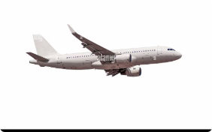

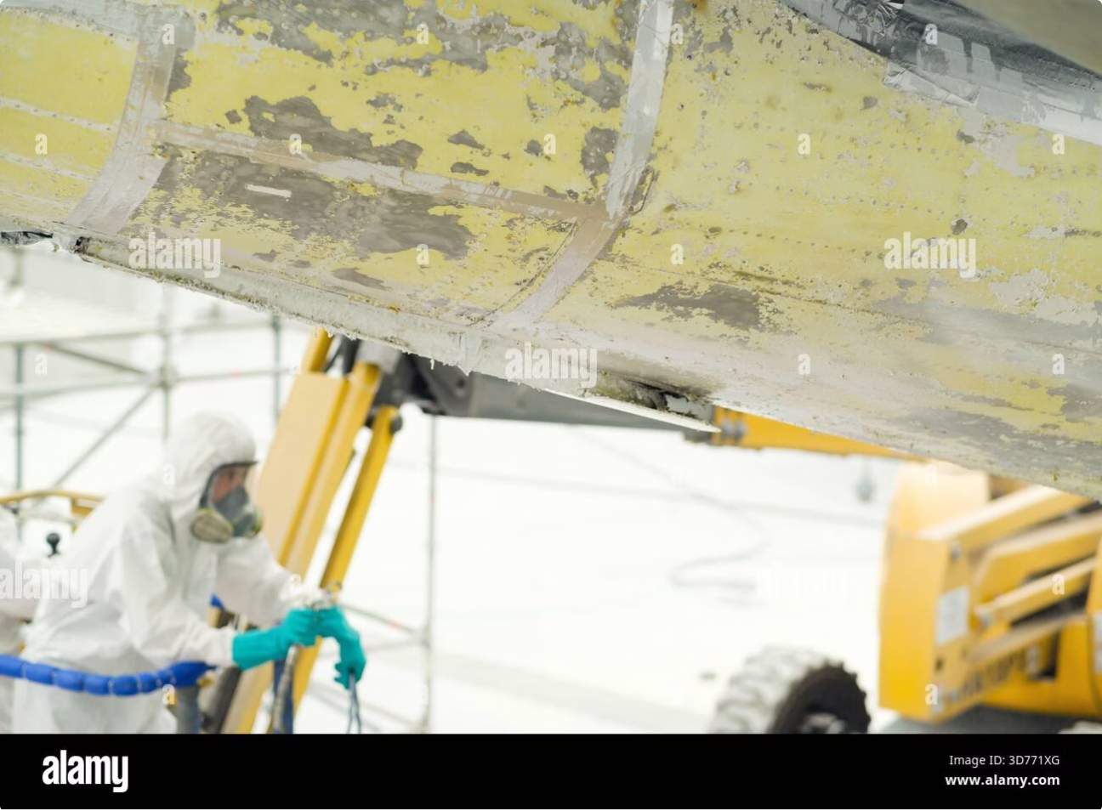
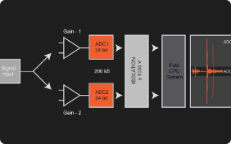

THE PROBLEM
$150K+
Maintenance is scheduled or reactive
Critical faults are often discovered post-flight — inspections and scheduled checks miss progressive degradation.
Average estimated cost per AOG hour — conservative industry benchmark illustrating urgency and ROI potential for predictive onboard intelligence.
Detection happens too late
Late discovery leads to AOG events, passenger disruption, and cascading costs.
Data volume exceeds connectivity
Massive raw sensor streams cannot reliably be transmitted to ground in real time.
Late detection = safety exposure, unplanned downtime, and spiraling repair & logistics costs. Aero operators require edge-native detection that acts in-flight.

Slide 3
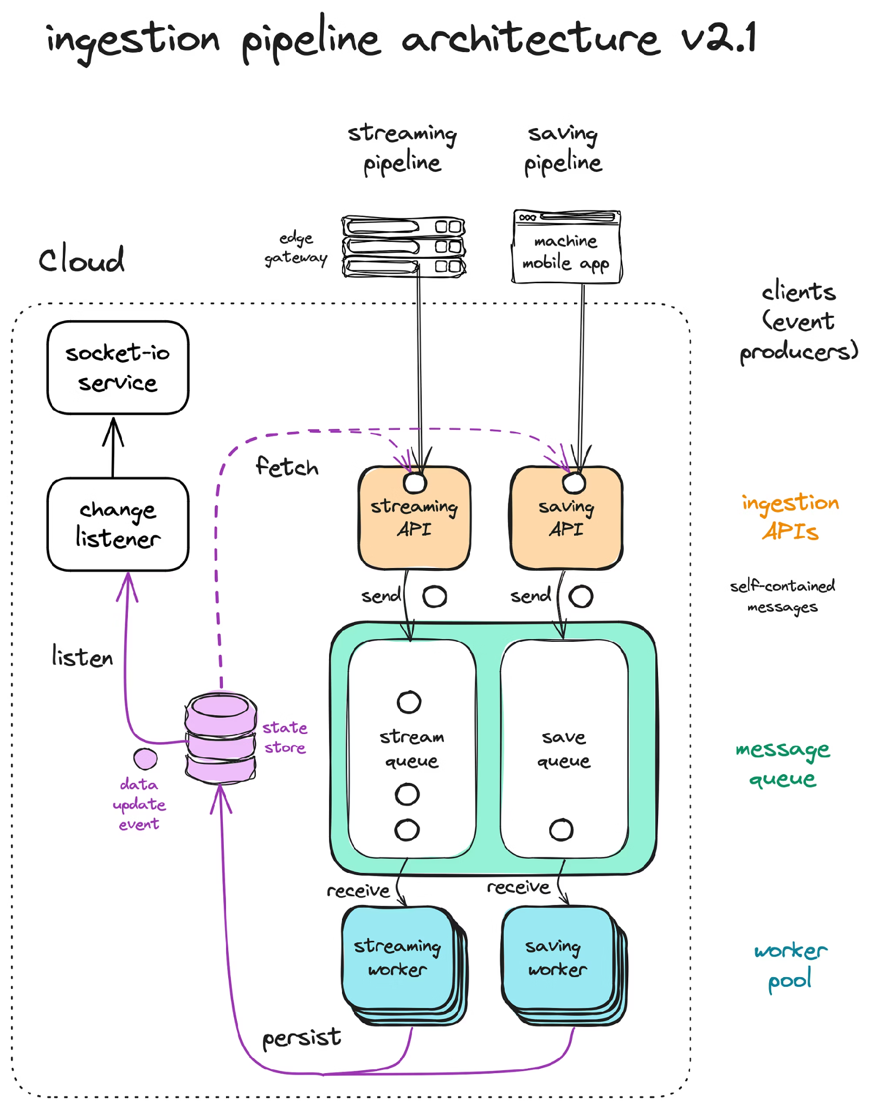

WHY CURRENT SYSTEMS FALL SHORT
Traditional
1
HUMS & sensors produce massive telemetry
Processing after flight — insights arrive too late
Cloud transmission introduces latency and cost
Static threshold alarms can't learn degradation trends
No reliable Remaining Useful Life (RUL) prediction
The Gap
Latency
Minutes → Hours; critical windows are missed
2
Cost
Bandwidth and ground processing drive recurring expense
3
Intelligence
Static rules — no adaptive learning of degradation modes
4
Prediction
Operators lack actionable RUL and fault-confidence metrics

Slide 4
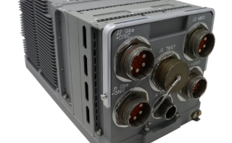

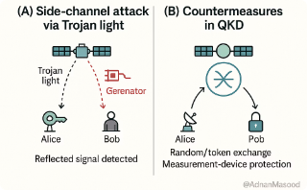
AEROMIND: INTELLIGENCE ONBOARD
Edge AI Inference Engine
Runs continuous, lightweight models directly on aircraft hardware zero dependency on constant connectivity.
Actionable Alerts
Only
Sends concise, high-confidence advisories to crew and ground: fault type, RUL estimate, maintenance priority, and replacement logistics.
Bandwidth
Efficient
Transmits structured insights and summaries not raw sensor streams reducing transmission cost and latency.

Slide 5

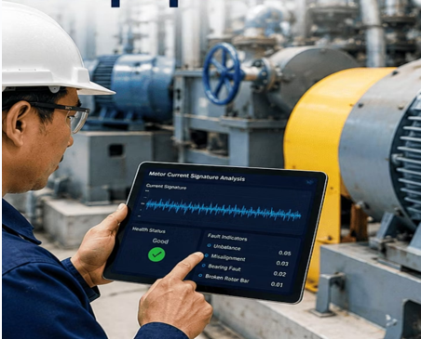

HOW IT WORKS
Electrical sensor
Vibration sensor
Voltage & current
Real-time motion data
Acoustic sensor
Predictive Maintenance Pipeline
Temperature sensor
Sound signatures
Thermal readings
Oil-debris sensor
Pressure sensor
Contaminant levels
Fluid and gas pressure
Multi‑modal sensor fusion ingests vibration, temperature, pressure, oil-debris, acoustic and electrical signals. Lightweight, validated models run continuously onboard to detect anomalies, classify faults, and estimate RUL delivering prioritized maintenance advisories and confidence metrics to crew and MRO.

Slide 6

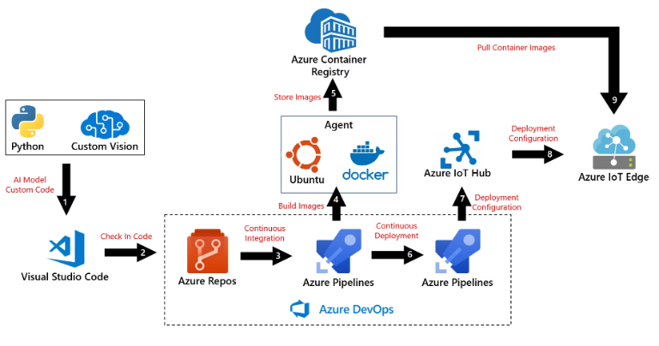
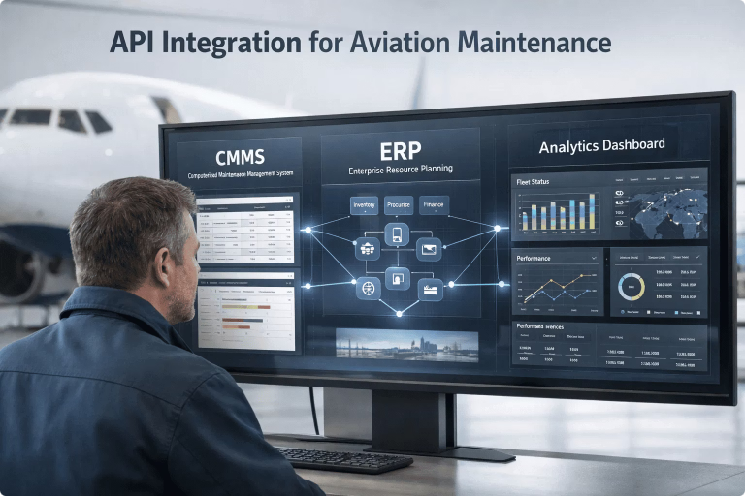
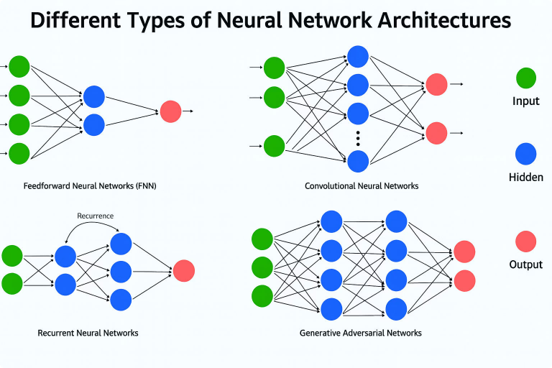
TECHNOLOGY STACK
HARDWARE
AI / ML
DEPLOYMENT
INTEGRATION
NVIDIA Jetson Orin / AGX Xavier
FPGA co-processors for DSP
Ruggedized edge appliances, MIL‑grade connectors
PyTorch / TensorFlow models (LSTM, transformer-lite)
Autoencoders, Isolation Forests, XGBoost ensembles
Federated learning capability for fleet adaptation
ONNX / TensorRT optimized inference
Edge-optimized runtimes, real-time preprocessing
OTA model updates, containerized on-device services
ACARS / SWIM compatibility
MRO & OEM system connectors, REST & message brokers
Privacy-first telemetry alerts only
Stack optimized for deterministic latency, low SWaP-C, and aviation-grade ruggedization. Federated learning updates improve fleet-wide models while preserving aircraft data sovereignty.

Slide 7


IMPACT — KEY BENEFITS
Reduce Unplanned AOG
Intervene before catastrophic failure; reduce AOG incidence and passenger disruption.
Lower Maintenance Costs
Shift from schedule-based to condition-based maintenance, optimizing parts and labor spend.
Earlier Detection
Detect subtle degradation weeks or cycles before threshold alarms would trigger.
Reduce Data Transmission
Transmit structured, compressed advisories — lower bandwidth and cloud processing costs.
Improve Fleet Availability
Higher dispatch reliability through actionable, prioritized maintenance planning.
Increase Safety & Sustainability
Proactive fault management reduces risk and optimizes fuel & maintenance lifecycle impact.
Proof-of-concept results (simulation and NASA C-MAPSS benchmark): RUL error 18–21 cycles vs 50–64 for a naive baseline; ~860x less downlink data. Not yet validated on flight hardware.

Slide 8
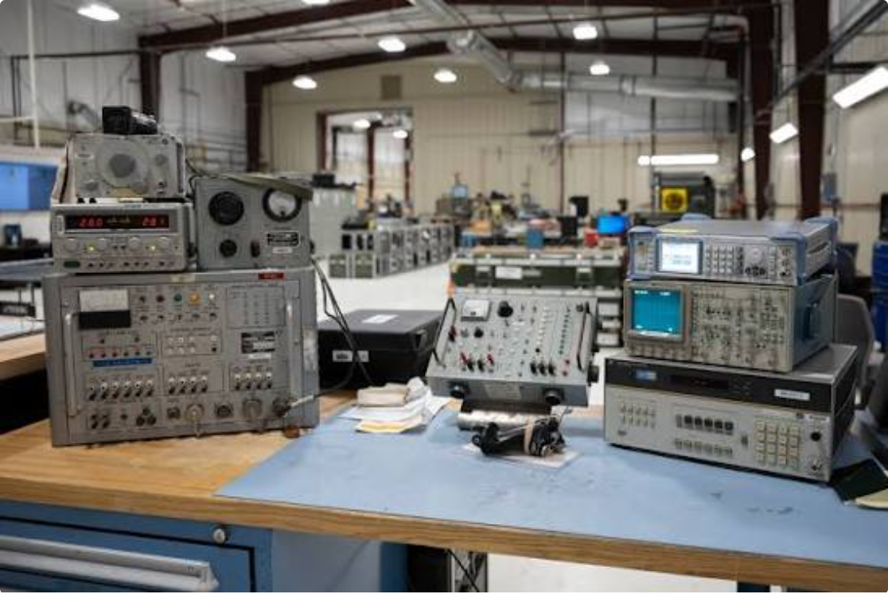

WHERE WE ARE NOW
Status: Proof of Concept Build in Progress. The system architecture and edge model designs are complete; engineering focus is on edge model optimization, sensor integration, and flight-hardware validation. Roadmap targets a flight-ready prototype following bench and ground test cycles.
Complete ✅
Next ⏳
Concept & Architecture
Sensor Integration & Testing
1
2
3
4
Primary focus: hardware-in-the-loop validation and regulatory alignment for airborne deployment.
Edge Model Development
Flight-Ready Prototype
In Progress 🔄
Future ⏳

Slide 9
WHAT SETS US APART
Capability
AeroMind
Competitors
Onboard Real-Time AI
✅
Cloud-Centric: ❌ / OEM-Only: ⚠️
Cloud Independence
✅
❌ / ❌
Cross-System Coverage
✅ (engines, gear, structure, avionics)
⚠️ / ❌
Autonomous Fault Classification
✅
⚠️ / ❌
Federated Fleet Learning
✅
❌ / ❌
Hardware-Agnostic & Edge-Native
✅
❌ / ❌

Slide 10

THE FUTURE OF FLIGHT INTELLIGENCE
AeroMind brings intelligence onboard — enabling real-time, predictive, autonomous maintenance awareness that improves safety, availability, and operational efficiency. Our vision: fleet-wide adaptive learning, deep MRO integration, and aviation-grade deployment readiness.
Smarter Fleet Learning
Deeper MRO Integration
Real-World Readiness
Federated updates yield continuous improvement without moving raw data off aircraft.
Seamless downstream workflows for parts, labor planning, and turn optimization.
Roadmap: flight-ready models, rugged hardware, regulatory alignment, staged rollout
"From scheduled maintenance to intelligent aviation foresight."

