Slide 1
AeroMind
Prototype evidence: what the working system does, and what we measured
Project FY27-605244 · Tata InnoVent 2027 · AI at the Edge Solutions for Aerospace
Every number in this section is regenerated by `python -m aeromind report`. Aircraft data is simulated unless marked REAL DATA.

Slide 2
One second of sensor data in, one decision out
Runs on the aircraft for every 1-second window; only the advisory is downlinked
Sensor health
Fusion
Anomaly score
Persistence gate
Fault class
RUL + interval
Evidence + ACARS
›
›
›
›
›
›
stuck, drift, spikes,
dropout, range
21 features incl.
OAT and altitude
Isolation Forest
+ autoencoder
5 of 8 windows
gradient-boosted trees
on context residuals
p10 / p50 / p90,
conformal
bearing defect
frequencies, ≤220 chars
On the ground
Decision engine
Work order
Fleet ROI
Signed OTA
P(failure before next check) → ground now / replace at next check / defer
task, part, window, evidence and the ACARS text
reactive vs fixed-interval vs AeroMind, with a sensitivity range
Ed25519 + SHA-256; tampered models rejected, rollback

Slide 3
Measured, not promised
Headline results from the prototype
REAL DATA · NASA IMS
SIMULATED
SIMULATED
74.8 h
0.0%
0
warning before a real bearing's outer-race failure
anomaly gate open on healthy flights (98.6% without flight-phase awareness)
false component alarms from 7 kinds of injected sensor failure
SIMULATED
SIMULATED
CPU, NOT JETSON
5/6
141/220
1.2 ms
oil contamination correct at first classification under flight phases
characters: every advisory fits one ACARS downlink block
per window on one CPU thread; 1.8 MB of models

Slide 4
On real data, it sees the failure coming
Left: NASA IMS bearing run-to-failure (REAL). Right: NASA C-MAPSS turbofan RUL benchmark
IMS: alarm and BPFO evidence 74.8 h before the end of the test; bearing 1 has the strongest signature in 98.9% of snapshots once it appears. C-MAPSS: official test split, 3 seeds; C-MAPSS engines are simulated by NASA.

Slide 5
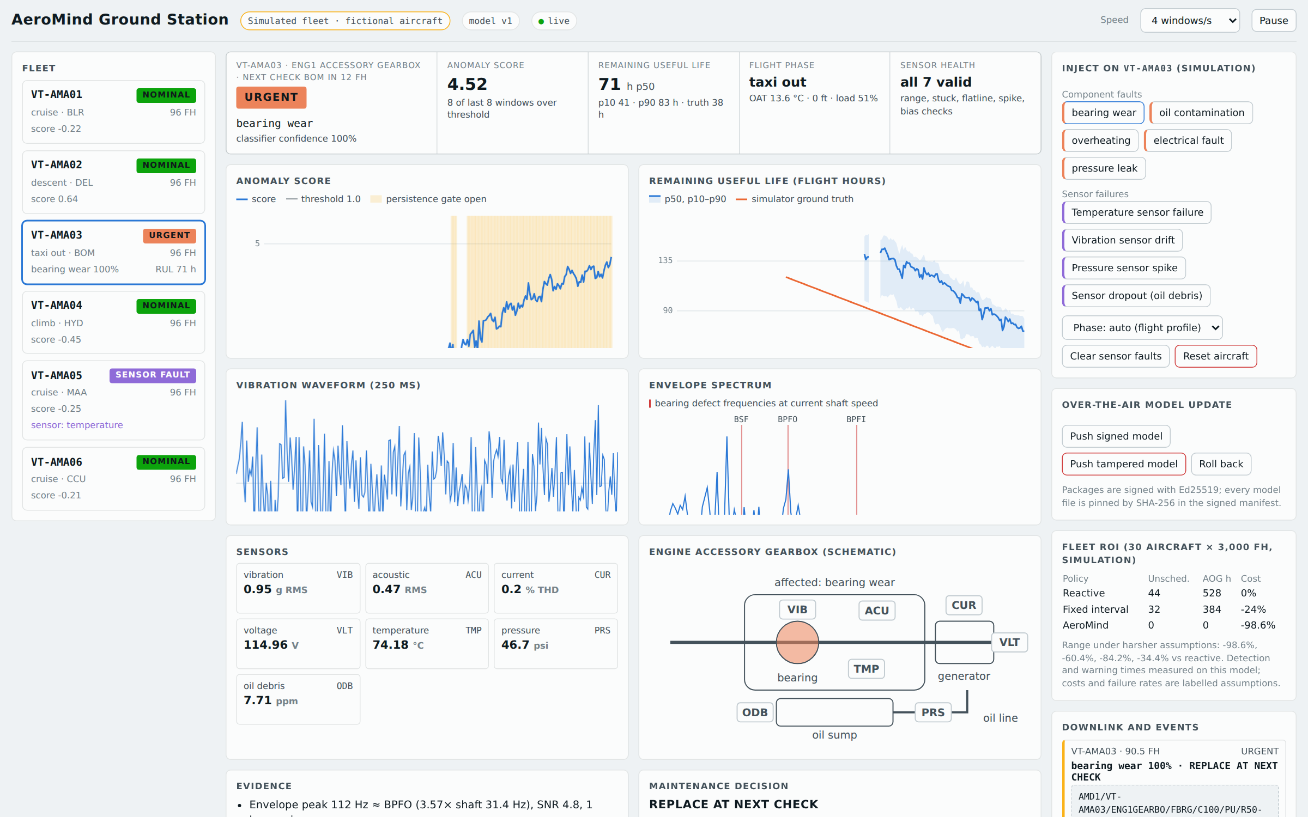
Live demo: break the aircraft, watch it respond
python -m aeromind serve · six simulated aircraft · works offline
1
Inject bearing wear: score rises, gate opens, fault named, RUL falls, physics evidence, decision, work order, ACARS
2
Fail a temperature sensor: SENSOR_FAULT, channel masked, no false gearbox alarm
3
Push a signed model: accepted. Push a tampered one: rejected, fleet stays on the last valid model
4
Drag the what-if slider: the decision changes with the time to the next check

Slide 6
The business case holds under harsh assumptions
Maintenance cost vs reactive, 30 aircraft × 3,000 flight hours (simulation)
Reactive: 44 unscheduled removals, 528 AOG hours
AeroMind as measured: 0 unscheduled, 0 AOG hours, 44 parts (fixed interval: 122)
Harsh case: 67% detection, 10% of the warning time, 5 false advisories per 1,000 windows, AOG at $10k/h
Detection and warning times are measured; costs and failure rates are labelled assumptions

Slide 7
The fleet learns together, without sharing raw data
Each aircraft has seen only 2 of 5 fault types; models share weights only (federated averaging)
Secure model updates
Model packages signed with Ed25519
Every model file pinned by SHA-256 in the signed manifest
Tampered package rejected before install; fleet keeps the last valid model
One-click rollback to the previous version

Slide 8
What is not proven yet, and what comes next
Limits
Next
No flight data: the fleet is simulated; real-data evidence is one bearing rig (IMS) and NASA's simulated engines (C-MAPSS)
Not yet run on a Jetson or TensorRT; timings are CPU
No certification work; decisions follow a configurable prototype policy
Costs and failure rates in the ROI model are assumptions
Jetson build and power/latency measurement (kit ready)
Real multi-sensor data with an operator or MRO partner
Hardware-in-the-loop bench with a vibration sensor
Integration pilot with an MRO work-order system

