Slide 1

BOOLEAN ALGEBRA

Slide 2
INTRODUCTION
Developed by English Mathematician George Boole in between 1815 - 1864.
It is described as an algebra of logic or an algebra of two values i.e True or False.
The term logic means a statement having binary decisions i.e True/Yes or False/No.

Slide 3
APPLICATION OF BOOLEAN ALGEBRA

Slide 4
APPLICATION OF BOOLEAN ALGEBRA
It is used to perform the logical operations in digital computer.
In digital computer True represent by ‘1’ (high volt) and False represent by ‘0’ (low volt)
Logical operations are performed by logical operators. The fundamental logical operators are:
1. AND (conjunction)
2. OR (disjunction)
3. NOT (negation/complement)

Slide 5
AND operator
It performs logical multiplication and denoted by (.) dot.
X Y X.Y
0 0 0
0 1 0
1 0 0
1 1 1

Slide 6
OR operator
It performs logical addition and denoted by (+) plus.
X Y X+Y
0 0 0
0 1 1
1 0 1
1 1 1

Slide 7
NOT operator
It performs logical negation and denoted by (-) bar. It operates on single variable.
X X (means complement of x)
0 1
1 0

Slide 8
Truth Table
Truth table is a table that contains all possible values of logical variables/statements in a Boolean expression.
No. of possible combination =
2^{n}, where n=number of variables used in a Boolean expression.

Slide 9
Truth Table
The truth table for XY + Z is as follows:
Dec X Y Z XY XY+Z
0 0 0 0 0 0
1 0 0 1 0 1
2 0 1 0 0 0
3 0 1 1 0 1
4 1 0 0 0 0
5 1 0 1 0 1
6 1 1 0 1 1
7 1 1 1 1 1

Slide 10
Tautology & Fallacy
If the output of Boolean expression is always True or 1 is called Tautology.
If the output of Boolean expression is always False or 0 is called Fallacy.

Slide 11
Tautology & Fallacy

Slide 12
Exercise
1. Evaluate the following Boolean expression using Truth Table.
(a) X’Y’+X’Y (b) X’YZ’+XY’
(c) XY’(Z+YZ’)+Z’
2. Verify that P+(PQ)’ is a Tautology.
3. Verify that (X+Y)’=X’Y’

Slide 13
Implementation
Boolean Algebra applied in computers electronic circuits. These circuits perform Boolean operations and these are called logic circuits or logic gates.

Slide 14
Logic Gate

Slide 15
Logic Gate
A gate is an digital circuit which operates on one or more signals and produce single output.
Gates are digital circuits because the input and output signals are denoted by either 1(high voltage) or 0(low voltage).
There are three basic gates and are:
1. AND gate
2. OR gate
3. NOT gate

Slide 16
AND gate

Slide 17

AND gate
The AND gate is an electronic circuit that gives a high output (1) only if all its inputs are high.
AND gate takes two or more input signals and produce only one output signal.
Input A | Input B | Output AB
0 | 0 | 0
0 | 1 | 0
1 | 0 | 0
1 | 1 | 1

Slide 18
OR gate

Slide 19

OR gate
The OR gate is an electronic circuit that gives a high output (1) if one or more of its inputs are high.
OR gate also takes two or more input signals and produce only one output signal.
Input A | Input B | Output A+B
0 | 0 | 0
0 | 1 | 1
1 | 0 | 1
1 | 1 | 1

Slide 20
NOT gate

Slide 21

NOT gate
The NOT gate is an electronic circuit that gives a high output (1) if its input is low .
NOT gate takes only one input signal and produce only one output signal.
The output of NOT gate is complement of its input.
It is also called inverter.
Input A | Output A
0 | 1
1 | 0

Slide 22
PRACTICAL APPLICATIONS OF LOGIC GATES

Slide 23
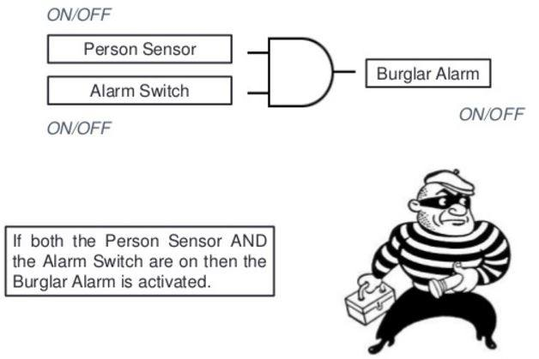
PRACTICAL APPLICATIONS OF LOGIC GATES
AND Gate
So while going out of the house you set the "Alarm Switch" and if the burglar enters he will set the "Person switch", and tada the alarm will ring.

Slide 24
PRACTICAL APPLICATIONS OF LOGIC GATES
AND Gate
Electronic door will only open if it detects a person and the switch is set to unlocked.
Microwave will only start if the start button is pressed and the door close switch is closed.

Slide 25
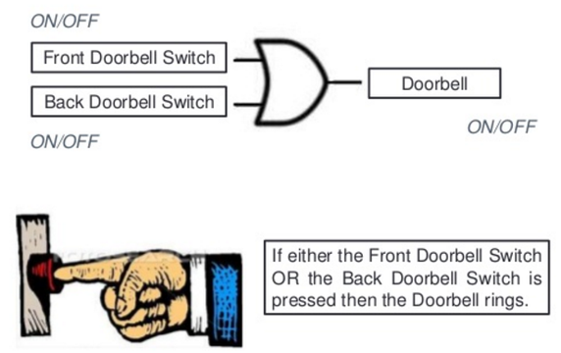
PRACTICAL APPLICATIONS OF LOGIC GATES
OR Gate
You would of course want your doorbell to ring when someone presses either the front door switch or the back door switch..(nice)

Slide 26
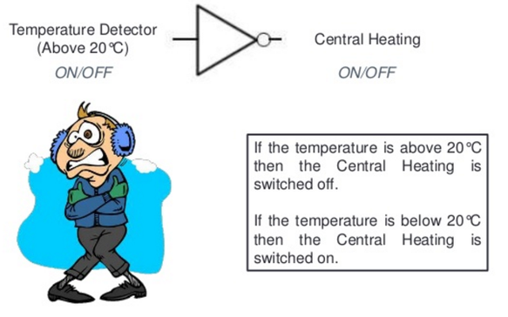
PRACTICAL APPLICATIONS OF LOGIC GATES
NOT Gate
When the temperature falls below 20c the Not gate will set on the central heating system (cool huh).

Slide 27
NAND, NOR XOR, XNOR GATES

Slide 28
NAND Gate
Known as a “universal” gate because ANY digital circuit can be implemented with NAND gates alone.

Slide 29
NAND Gate
NAND
X Y Z
0 0 1
0 1 1
1 0 1
1 1 0
X
Z
Y
Z = ~(X & Y)
nand(Z,X,Y)

Slide 30
NAND Gate
X
F = (X•X)’
= X’+X’
= X’
X
F = X’
X
X
F X•Y
F = ((X•Y)’)’
= (X’+Y’)’
= X’’•Y’’
= X•Y
Y
Y
X
X
F = (X’•Y’)’
= X’’+Y’’
= X+Y
F = X+Y
Y
Y

Slide 31
NOR Gate

Slide 32
NOR Gate
NOR
X Y Z
0 0 1
0 1 0
1 0 0
1 1 0
X
Z
Y
Z = ~(X | Y)
nor(Z,X,Y)

Slide 33
Exclusive-OR Gate

Slide 34
Exclusive-OR Gate
XOR
X Y Z
X
Z
0 0 0
Y
0 1 1
Z = X ^ Y
xor(Z,X,Y)
1 0 1
1 1 0

Slide 35
Exclusive-NOR Gate
XNOR
X Y Z
X
Z
0 0 1
Y
0 1 0
Z = ~(X ^ Y)
Z = X ~^ Y
xnor(Z,X,Y)
1 0 0
1 1 1

Slide 36
POWER CONSUMPTION OF SYSTEM

Slide 37
Basic Theorem of Boolean Algebra
T1 : Properties of 0
(a) 0 + A = A (b) 0 A = 0
T2 : Properties of 1
(a) 1 + A = 1 (b) 1 A = A

Slide 38
Basic Theorem of Boolean Algebra
T3 : Commutative Law
(a) A + B = B + A (b) A B = B A
T4 : Associate Law
(a) (A + B) + C = A + (B + C) (b) (A B) C = A (B C)
T5 : Distributive Law
(a) A (B + C) = A B + A C (b) A + (B C) = (A + B) (A + C)
(c) A+A’B = A+B

Slide 39
Basic Theorem of Boolean Algebra
T6 : Indempotence (Identity ) Law
(a) A + A = A (b) A A = A
T7 : Absorption (Redundance) Law
(a) A + A B = A (b) A (A + B) = A

Slide 40
Basic Theorem of Boolean Algebra
T8 : Complementary Law
(a) X+X’=1
(b) X.X’=0
T9 : Involution
(a) x’’ = x
T10 : De Morgan's Theorem
(a) (X+Y)’=X’.Y’
(b) (X.Y)’=X’+Y’

Slide 41
De Morgan's Theorem

Slide 42

De Morgan's Theorem 1
Theorem 1 A . B = A + B

Slide 43
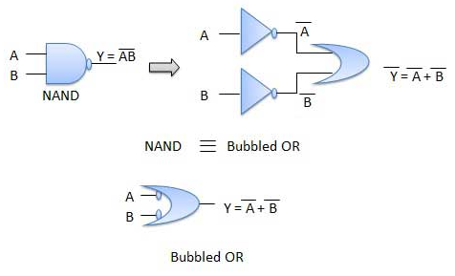
De Morgan's Theorem 1
Theorem 1 A . B = A + B

Slide 44
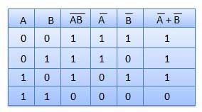
De Morgan's Theorem 1
Theorem 1 A . B = A + B

Slide 45
De Morgan's Theorem 2
Theorem 1 A + B = A . B

Slide 46

De Morgan's Theorem 2
Theorem 2 A + B = A . B

Slide 47
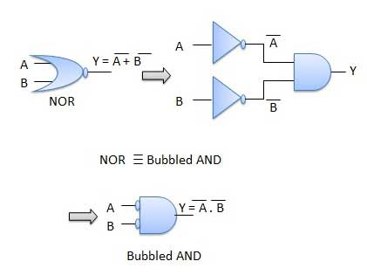
De Morgan's Theorem 2
Theorem 2 A + B = A . B

Slide 48
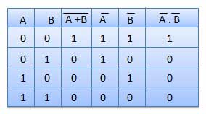
De Morgan's Theorem 2
Theorem 2 A + B = A . B

Slide 49
Thank You

