Slide 1
Unit I Communication Skills
~ Dr. Sarika Tiwari

Slide 2
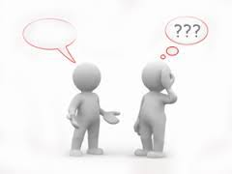
Communication???
The art of successful exchange of information
that culminates in the establishment of mutual understanding between:
1.Two or more persons
2.An individual and a group
3.Two or more groups
Etymylogy: In 3 Latin words => ‘communico’ , ‘communicare’ , ‘communis’
Meaning: ‘to make common’ or ‘to share’

Slide 3


The Intrinsic Need to Socialize and Share

Slide 4
Definitions:
Shorter Oxford English Dictionary:
“Imparting, conveying or exchange of ideas, knowledge etc by speech, writing or signs.”
Webster Dictionary:
“The art of expressing ideas” or “the science of transmitting information”

Slide 5
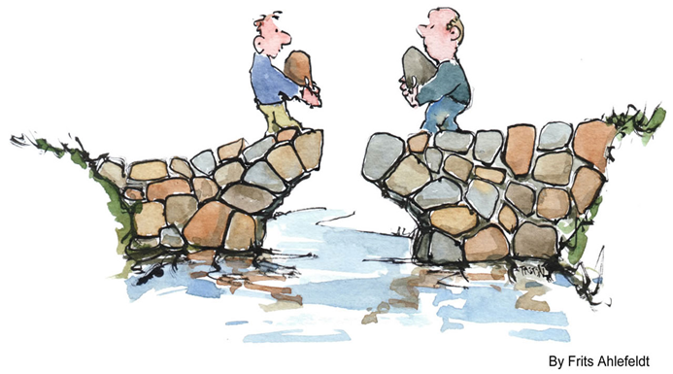
What the Author Say?
“’The transfer of information &understanding from one person to another person.
It is a way of reaching other with facts, ideas, thoughts and values.
It is a bridge of meaning among people so that they can share what the feel and know.
By using this bridge, a person can cross safely the river of misunderstanding that sometimes separates people.”
~ Keith Davis

Slide 6
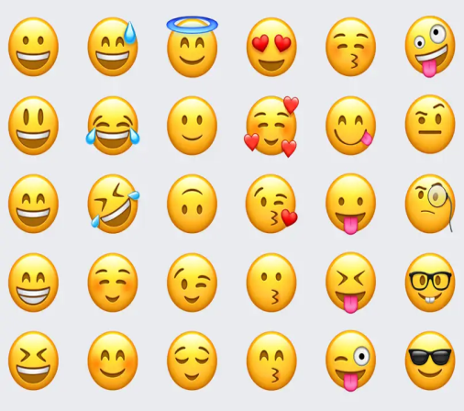

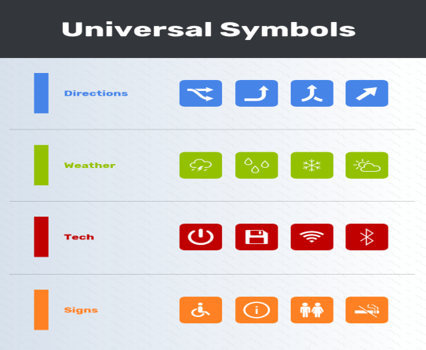

George Vardman defines it as “purposive symbolic interchange resulting I workable understanding & agreement between the sender and the receiver.”
a. Emojis b.Gestures c. Universal Symbols d.Words(symbols)

Slide 7
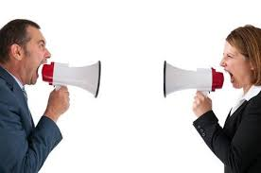
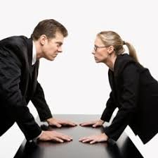
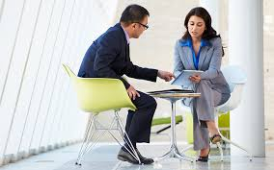
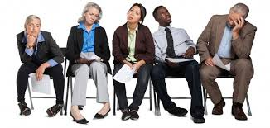
Types of Communication
a. Verbal Communication
b. Non-Verbal Communication

Slide 8
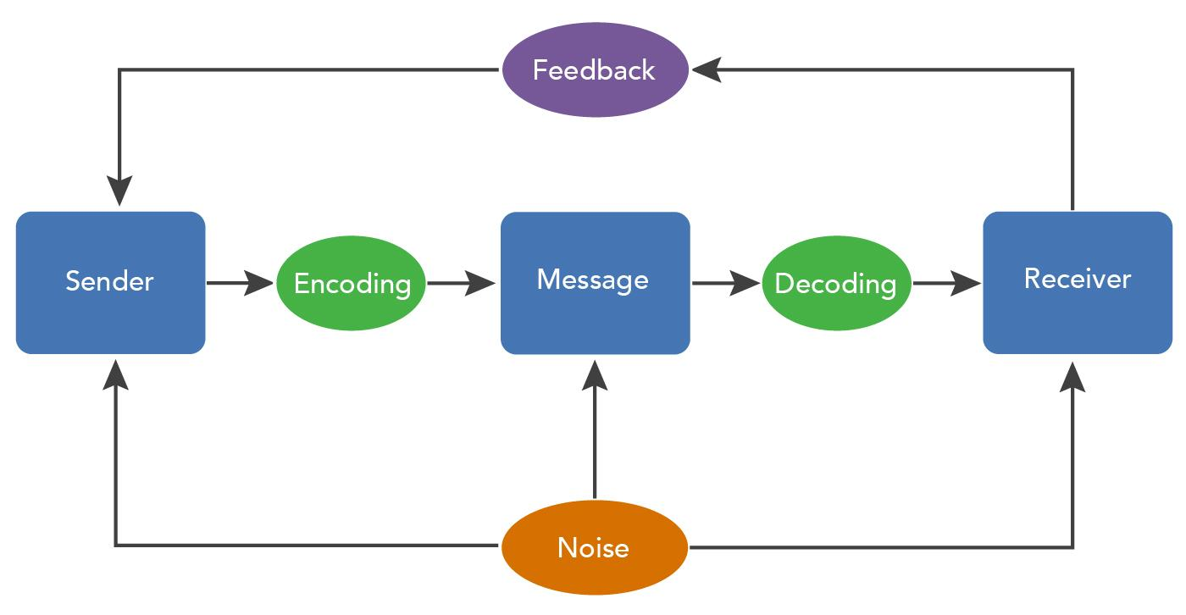
Process of Communication
Idea

Slide 9
Characteristics of Communication
1. Involves at least 2 persons i.e. a sender & a receiver
2. Involves transmission of ideas or views
3. Understanding: an essential component
4.Intentional or Unintentional
5. Purpose
6. A Two-way Process
7. Dynamic process
8. Systematic

Slide 10
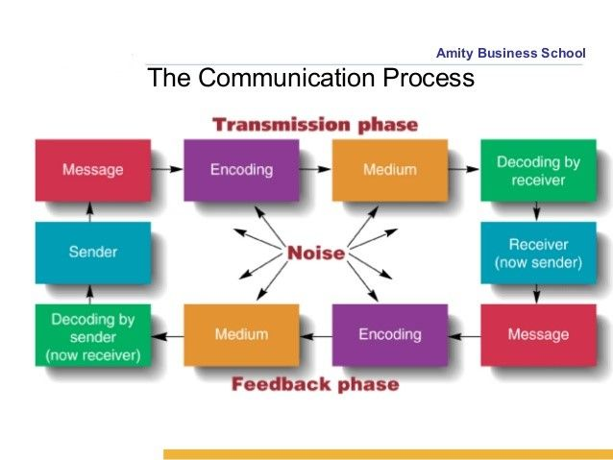

Slide 11
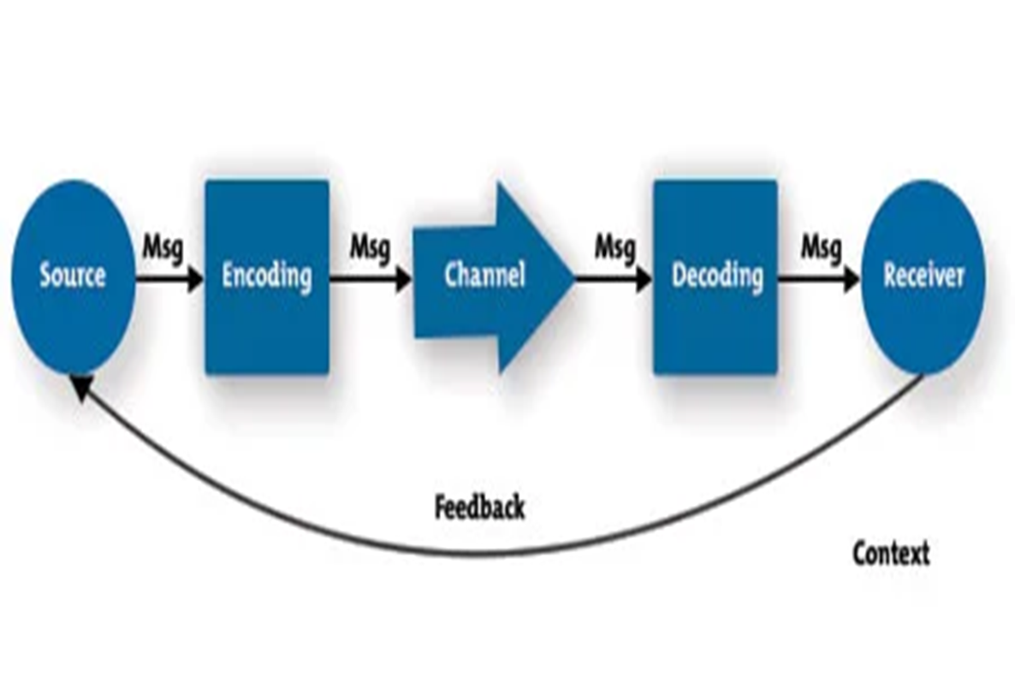

Slide 12
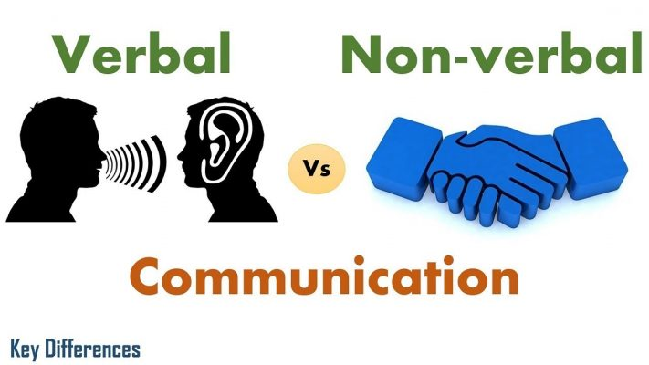
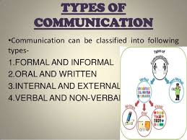

Slide 13
Business Communication
Internal
External
Facilitates Planning
Facilitates Contact in External Envirornment
Coordination
Improves Ability to Handle Competition Better
Promotes Cooperation & Understanding
Improves Public Relations
Helps in Decision-Making
Helps in Damage Control
Increases Morale of Employee

Slide 14
Objectives of Effective Communication
To inform
To integrate
To persuade
To educate
To promote
To advise
To train
To entertain
To order
To motivate
To facilitate decision
To suggest

Slide 15
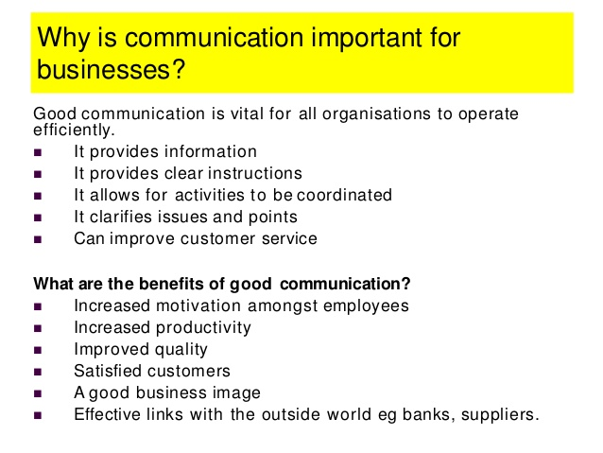
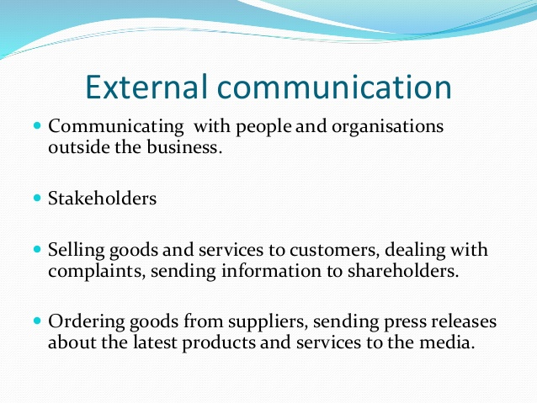
Significance of Communication

Slide 16
7Cs of Effective Communication
S.No. | 7Cs | Short Explanation
1.. | Completeness | Complete the Message
2. | Correctness | Write Perefectly, Mistakes Free
3. | Clarity | Be clearer in Delivering
4 | Conciseness | Be Short, but Complete
5. | Courtesy | Be Soft & Gentle
6. | Concreteness | Be Specific
7. | Consideration | Focus on Receiver

Slide 17
1. Completeness of Information
Hi everyone!
I just wanted to send you all a reminder about the meeting tomorrow!
See you then,
Chris
Hi !
I just wanted to remind everyone about tomorrow's meeting on the new telecommuting policies. The meeting will be at 10 am in the second-level conference room. Please let me know if you can attend.
See you then,
Chris

Slide 18
2. Correctness of Information
Dear David,
Further to our conservation today, I am attaching the plan for the first stage of the project. Hope the one weak deadline is okay with you and your team.
Regards Sally
spellings

Slide 19
3.Conciseness
Hi Suzanne
I think we need to talk about the CSR campaign, I mean the one which we need to do as a quarterly exercise. I think it is a great way of enhancing our brand image. Basically, it would just be a visit to an orphanage but we can sort of do other things too. For instance, we could take the kids out for a short trip to a nearby park or zoo. Let us sit and talk tomorrow.
Regards Jennifer
Hi Suzanne
I need to discuss the quarterly CSR campaign with you. Let us take the kids out this time to a nearby park or zoo instead of just visiting them. This will help enhance our brand image. We’ll talk in detail tomorrow.
Regards Jennifer

Slide 20
4.Concrete
“Hilltop Resort is the best resort. Do come to us on your next holiday”
This is a vague ad message. It is made to sound like just another resort advertisement among a hundred others. The audience will never remember this ad message. There are no concrete details to take away from this message.
“Hilltop Resort is the jewel of the western hills. Take a break from your work. Escape from life’s chaos and stress. Relax and rejuvenate yourself at Hilltop. Go back fresh and energized!”

Slide 21
5. Coherent
Dear Nam,
Thanks for submitting the industry report. Finn will give you some feedback on it. Finn also wanted to find out if you will be available for the client meeting tomorrow. We will be discussing the budget for the next phase of the project.
Regards Shirley
Dear Nam,
Thanks for submitting the industry report. Finn will give you some feedback on it. You will be receiving an email from him with detailed comments.
Regards Shirley

Slide 22
6. Courteous
Hi Drew,
I really do not appreciate how your IT team ignores the requests of my team alone. My team is an important function in this organization too and we have our own IT requirement. Can you ensure that your team responds promptly to my team’s requests hereon?
Regards Stanley
Hi Drew,
I understand that the IT team is swamped with work and gets requests from every department in the organization. My team, however, is working on a high-priority project and I would greatly appreciate if you could ask your team members to respond to my team’s queries promptly and help us complete this project on time. Please do let me know if you need anything from me.
Regards Stanley

Slide 23
7. Clarity
Hi Drew,
I understand that the IT team is swamped with work and gets requests from every department in the organization. My team, however, is working on a high-priority project and I would greatly appreciate if you could ask your team members to respond to my team’s queries promptly and help us complete this project on time. Please do let me know if you need anything from me.
Regards Stanley
Dear James,
As you may know we have signed up XYZ as our new client. I had a meeting with the engineering team yesterday and had discussed the campaign requirements for this project. John Redden from your team had done a pretty good job last time doing the social media campaign for ABC and so I would like him to work on the XYZ campaign too. Would you be available sometime tomorrow to discuss this further?
Regards Kevin

Slide 24
Technical communication
Technical communication is a means to convey scientific, engineering, or other technical information.^{[1]} Individuals in a variety of contexts and with varied professional credentials engage in technical communication. Some individuals are designated as technical communicators or technical writers.
ITC (integrated technical communication) can be defined as the coordination and integration of all technical communication processes, tools, functions, and sources within an organization to convey information and knowledge relevant to optimizing the users’ product experience.

Slide 25
Technical writing comprises the largest segment of technical communications.
It includes various forms of communication, including specialized information and instructional materials for technical and scientific items, such as computer hardware and software, and manufacturing or research equipment.
It covers diverse disciplines, including technical editing/writing, instructional design, training, translation, information architecture, user experience design, document design

Slide 26
Characteristics of Technical Communication
Addresses particular readers;
Helps readers solve problems;
Reflects an organization's goals and culture;
Is produced collaboratively;
Uses design to increase readability; and.
Consists of words or graphics or both.

