Slide 1
Direct Marketing campaigns of a Portuguese banking institution
The purpose of Classification is to predict whether the client will subscribe a term deposit or not.

Slide 2
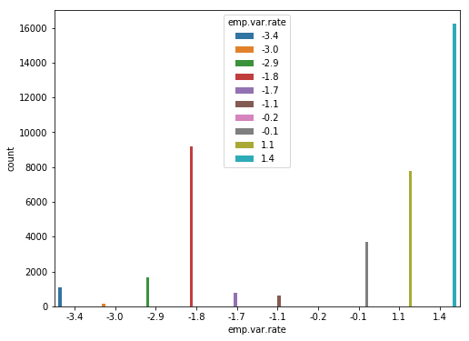
Social and Economic Context Attribute
The emp.var.rate attribute is used to show employment variation rate quarterly. Here we can see that the maximum variation rate is 1.4 while the minimum value is -0.2.

Slide 3
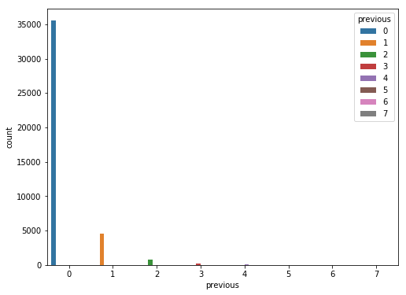
Previous:other attributes
The purpose of this attribute is to find number of contacts performed before this campaign and for this clients. Here we can see that value of zero is more i.e the employee which is never contacted before is more.

Slide 4
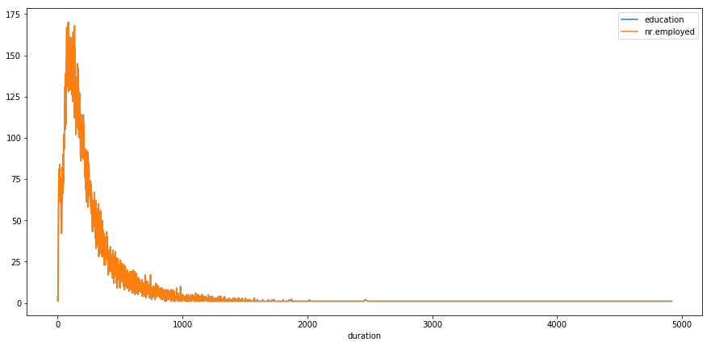
Grouped analysis of duration with education and number of employee
Here duration is last contact duration, in seconds, duration is not known before call performed. Here we see that the combined analysis of Education and number of employee with respect to duration.

Slide 5
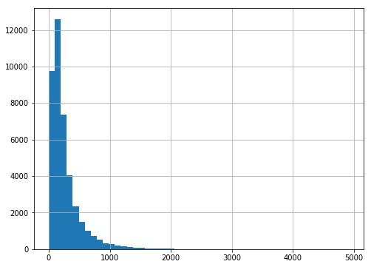
Duration: Related with last contact of the current campaign
This input should only be included for benchmark purposes and should be discarded if the intention is to have a realistic predictive model. We see that the duration is high at initial level.

Slide 6
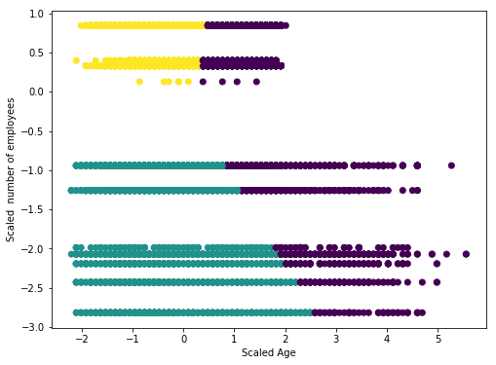
Bank client data (Age) vs Social and Economical Context Attributes (Number of Employee)
This clustering information shows that the age and relation of Number of Employee.

Slide 7
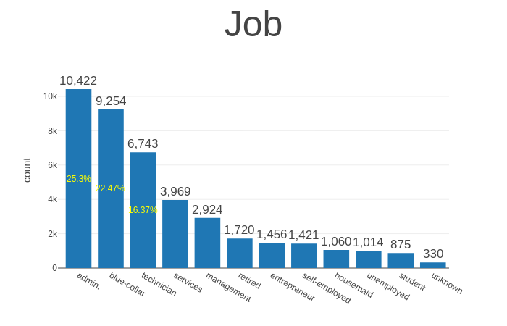
Job Type: Bank-Client Data
This is categorical type variable which shows that type of job doing by employee. Here admin has more number as compare to others.

Slide 8
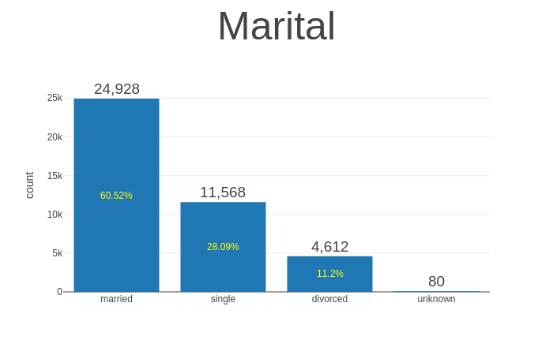
Marital Status: Bank-Client Data
There is lot of category for marital status in which married people are more as compare to others.

Slide 9
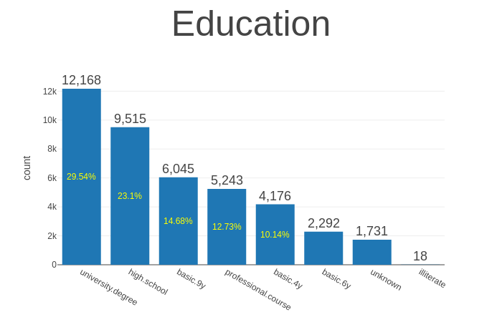
Education: Bank-Client Data
There is a lot of category in this attributes in which we can see that the number of employee from university degree is more.

Slide 10
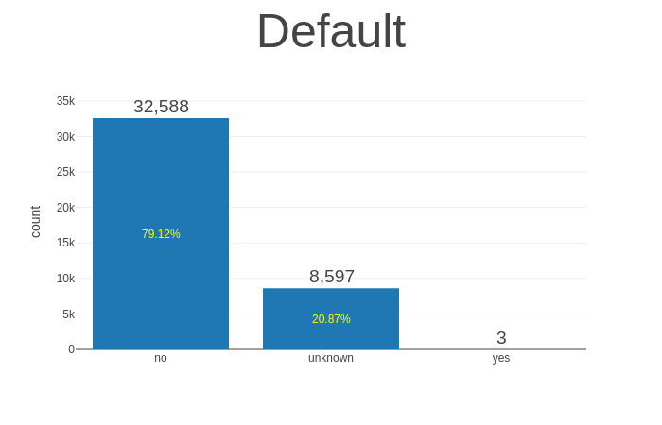
Default Attribute: Bank-Client Data
Here the attribute Default is shows that is there any credit in default? Here we see that the value of no credit is more.

Slide 11
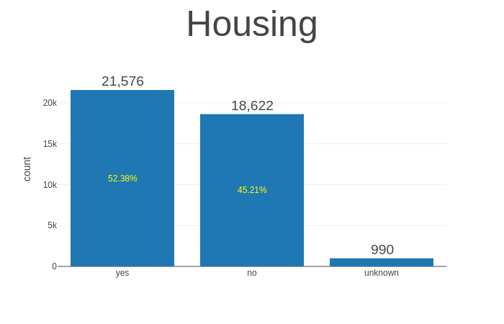
Housing Attribute: Bank-Client Data
This attibute shows that the bank has house loan or not. We can see that 53.33 % employee has housing loan.

Slide 12
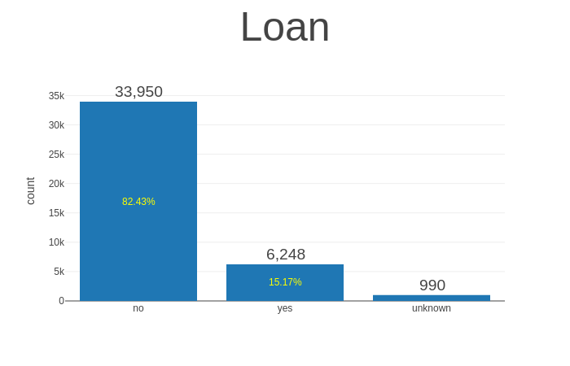
Loan: Bank-Client Data
This attribute shows that whether employee has personal loan or not? This graph shows that more number of employee has no any personal loan.

Slide 13
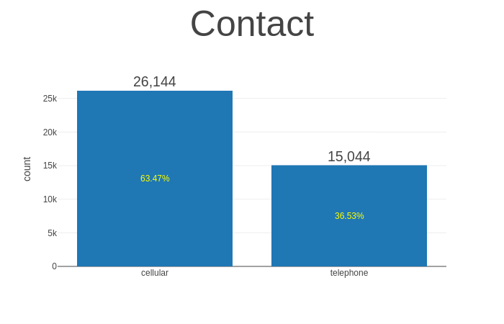
Contact: Related with last contact of current campaign
This attribute is for communication purpose in which 63.47% employee have contact type as cellular phone

Slide 14
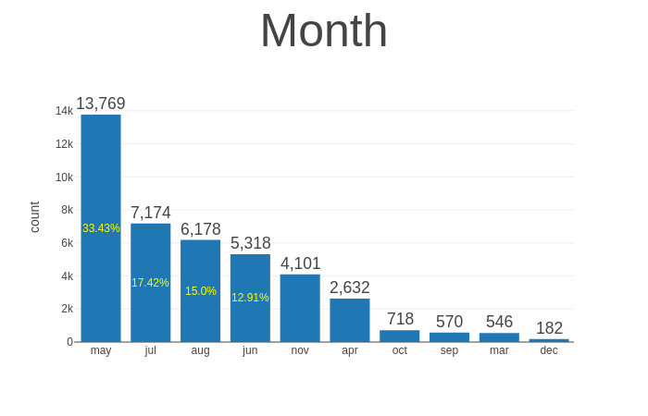
Month: Related with the last contact with current campaign
This attribute will shows the last contact month of year. This shows that in may 33.43% employee have been contacted.

Slide 15
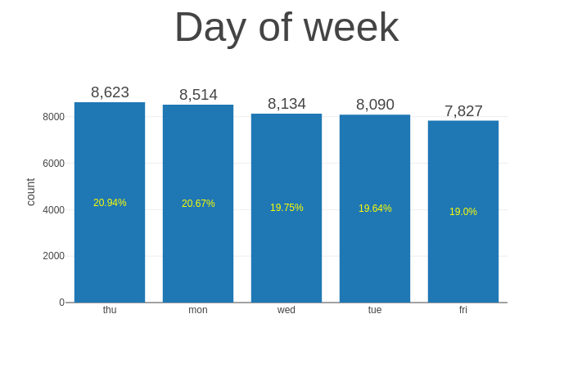
Day of week: Related with content of the current campaign
This attribute represent the last contact day of week. Here we see that on thursday the number of employee contacted is more (20.94%) as compare to others.

Slide 16
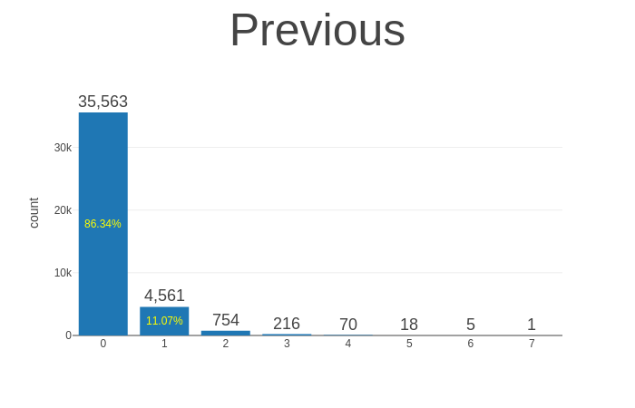
Previous: Other Attribute
Here this attribute shows that the number of contacts performed before this campaign and for this client. We can say the contact never performed before with employee is more.

Slide 17
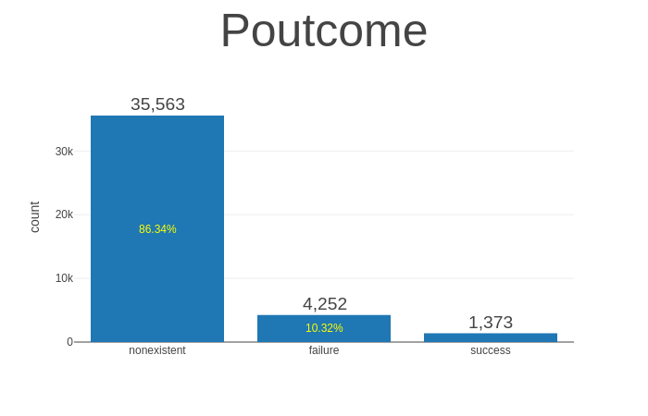
Poutcome:Other attributes
This attribute is used to show the outcome of the previous marketing campaign. Here we see that the nonexistent category is more.

Slide 18
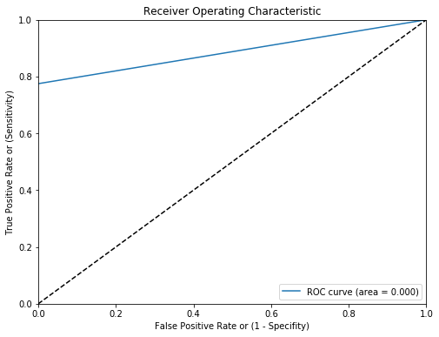
ROC Curve: RandomForestClassifier
The ROC curve. In a Receiver Operating Characteristic curve the true positive rate (Sensitivity) is plotted in function of the false positive rate (100-Specificity) for different cut-off points. Each point on the ROC curve represents a sensitivity/specificity pair corresponding to a particular decision threshold.

Slide 19
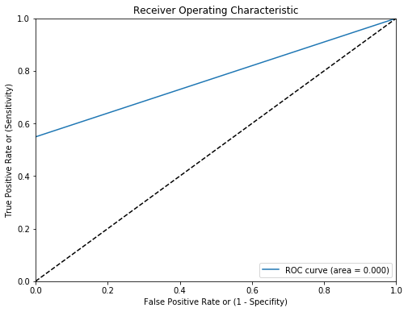
ROC Curve:XGBClassifier
The ROC curve. In a Receiver Operating Characteristic curve the true positive rate (Sensitivity) is plotted in function of the false positive rate (100-Specificity) for different cut-off points. Each point on the ROC curve represents a sensitivity/specificity pair corresponding to a particular decision threshold.

Slide 20
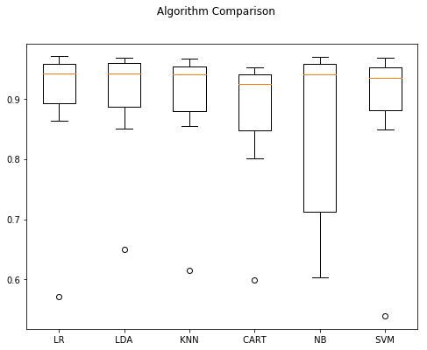
Combined Algorithm Comparision
LR: LogisticRegression
LDA:LinearDiscriminantAnalysis
KNN:KneighborsClassifier
CART:DecisionTreeClassifier
NB:GaussianNB
SVM:SVC
Here we can see that LDA has more accuracy

