Slide 1
IBM QISKIT FALL FEST 2026 | TRACK 1
Spacetime Checks
& Error Detection
A simulation study of Pauli checks, syndrome-based post-selection,
and output-distribution fidelity
DETECT • FILTER • COMPARE
Presented by: [Your Name / Team Name]
IBM Qiskit Fall Fest 2026 • Track 1

Slide 2
1. The problem
Why error detection matters in quantum computation
Quantum noise
Syndrome evidence
Research question
Gate operations and measurements can introduce errors that corrupt computation outcomes.
Extra check operations can reveal patterns consistent with error corruption, but they also add circuit overhead.
How does the placement and separation of spacetime checks relate to fidelity after post-selection?
Our objective: build a reproducible simulator workflow that inserts Pauli checks into a Clifford circuit, rejects shots with non-zero syndrome, and compares the resulting output distributions.
IBM Qiskit Fall Fest 2026 • Track 1
2

Slide 3
2. Project objective & scope
What we built during the sprint
Construct a three-qubit Clifford computation.
Use Qiskit Paulice to search for and insert spacetime Pauli checks.
Inspect check ancillas, support bits and interaction positions.
Implement a custom syndrome-parity post-selection filter.
Compare unfiltered and post-selected measurement distributions.
Run a separate Clifford-only vs T-doped noise simulation.
Main deliverable
A working simulation prototype with measured check configurations and a custom shot-rejection pipeline.
Scope boundary
This is a small-scale simulator study—not a hardware experiment or a complete fault-tolerant logical computation.
IBM Qiskit Fall Fest 2026 • Track 1
3

Slide 4
3. Key concepts
A quick guide to the terminology used in the experiments
Pauli check
Syndrome
Post-selection
An added operation sequence that probes a Pauli-related parity condition using an ancilla/check qubit.
A parity value calculated from selected measured classical bits. Non-zero syndrome marks a shot for rejection.
Keep only shots that satisfy the chosen syndrome conditions; discard the flagged shots.
Interaction span
Distribution fidelity
Difference between the first and last recorded check-ancilla CX instruction indices.
Squared Bhattacharyya coefficient between ideal and observed output probability distributions.
IBM Qiskit Fall Fest 2026 • Track 1
4

Slide 5
4. Experimental workflow
From circuit construction to post-selected results
1
→
2
→
3
→
4
→
5
Build circuit
Generate checks
Noisy simulation
Syndrome filter
Evaluate
3 data qubits
Clifford gates
Paulice search
ancilla insertion
Aer noise model
sample shots
Calculate parity
accept / reject
Compare output
distributions
Tools
Python • Qiskit • Qiskit Aer • Qiskit Paulice • NumPy • Matplotlib
IBM Qiskit Fall Fest 2026 • Track 1
5

Slide 6
5. Custom syndrome filter
How the shot-level acceptance rule works for our one-check configuration
For check support (0, 1, 3):
What the filter does
S = c₀ ⊕ c₁ ⊕ c₃
Reads the measured data bits and check-ancilla bit, then computes their XOR parity.
Accept the shot if S = 0.
Reject the shot if S = 1.
Important limitation
This exact expression is specific to support (0, 1, 3). Later multi-check configurations require support-aware syndrome evaluation.
A zero syndrome is evidence that the check condition passed—not proof that the shot is error-free.
IBM Qiskit Fall Fest 2026 • Track 1
6

Slide 7
6. Post-selection: first integrated result
10,000-shot simulation • same Clifford circuit and ideal target distribution
No checks
Checks, no filter
Checks + filter
Accepted shots
0.97536
0.95597
0.98108
9,380 / 10,000
In this run, adding checks reduced the unfiltered distribution fidelity, while custom post-selection increased it above the no-check baseline.
Acceptance rate: 93.8% • Rejected: 620 shots (6.2%)
IBM Qiskit Fall Fest 2026 • Track 1
7

Slide 8
7. Finding different check configurations
Paulice search methods and observed check-interaction spans
Search configuration | Checks found | Ancilla measured | CX instruction positions | Span
Windowed | 1 | Q3 | 11, 21, 33 | 22
Genetic • seed 1 | 3 | Q4 | 15, 31 | 16
Genetic • seed 7 | 3 | Q4 | 12, 21 | 9
Windowed Genetic | 1 | Q3 | 5, 13 | 8
Span = last minus first recorded CX instruction index for an ancilla with at least two interactions. Genetic configurations also contain other check ancillas with only one recorded CX interaction.
IBM Qiskit Fall Fest 2026 • Track 1
8

Slide 9
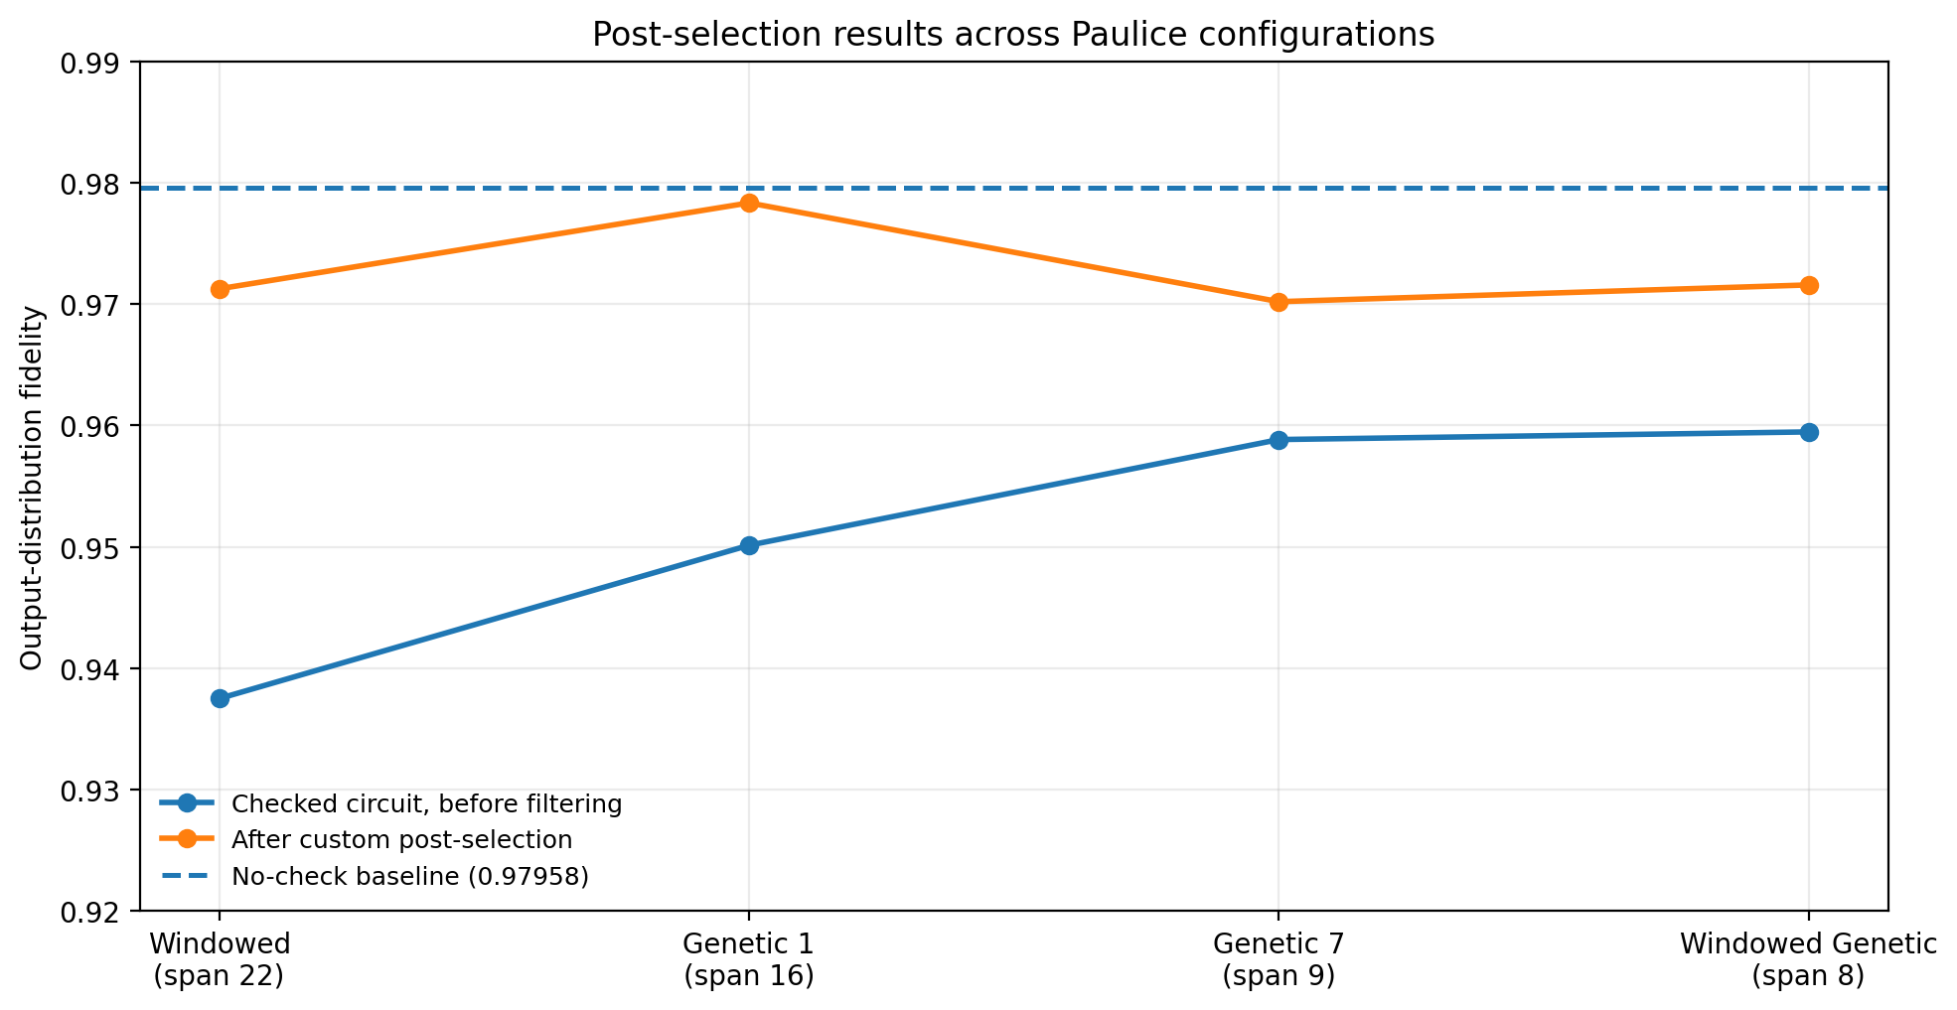
8. Fidelity across check configurations
5,000 shots per configuration • shared Aer noise model
Best post-selected result
Genetic Seed 1
0.97833
No-check baseline
0.97958
Interpretation
Post-selection improved every checked configuration, but none exceeded the baseline in this run.
IBM Qiskit Fall Fest 2026 • Track 1
9

Slide 10
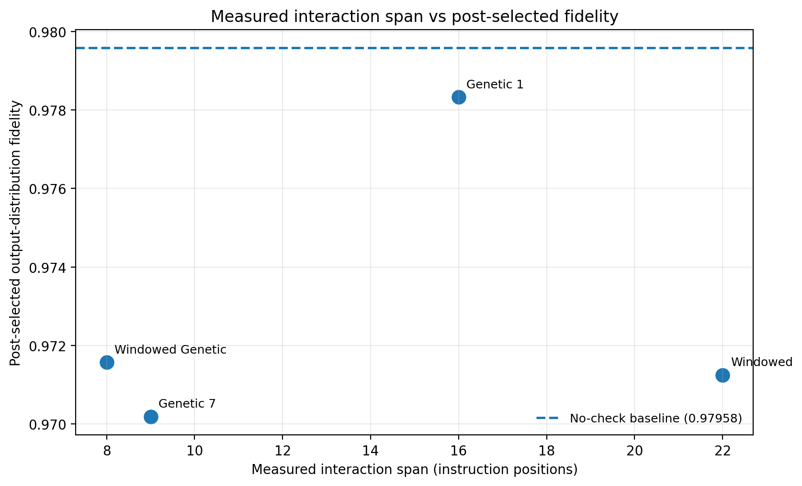
9. Does greater separation improve fidelity?
Observed relationship in this small set of configurations
No monotonic trend
The measured fidelity does not consistently increase or decrease with the reported span.
Confounding factors
Configurations differ in check count, support, and circuit overhead. Span alone is not isolated.
Conclusion: this is an exploratory comparison, not proof of a causal relationship.
IBM Qiskit Fall Fest 2026 • Track 1
10

Slide 11
10. Clifford-only vs T-doped computation
Separate comparison under the same simplified noise model • 10,000 shots
Clifford-only
T-doped
Distribution fidelity: 0.97522
CX gates: 2 • RZ gates: 9
Distribution fidelity: 0.98104
CX gates: 3 • RZ gates: 14
Observed difference: +0.00582 for the T-doped circuit in this run.
What it shows
What it does not show
We simulated a non-Clifford T-doped circuit and evaluated its output distribution.
It does not prove T gates improve robustness. Each circuit is compared with its own ideal distribution.
IBM Qiskit Fall Fest 2026 • Track 1
11

Slide 12
11. Limitations & scientific honesty
What the current prototype does—and does not—establish
Paulice's documented workflow is for Clifford circuits; non-Clifford support is listed as future work. We therefore do not claim validated Paulice checks across the T-doped circuit.
The reported span is an instruction-index proxy, not a physical time or hardware spacetime distance.
Genetic configurations have multiple checks; the reported span is for the ancilla with at least two recorded interactions, not a complete multi-check spacetime metric.
The fidelity metric is squared Bhattacharyya coefficient between classical output distributions—not full quantum-state fidelity or logical-state fidelity.
Results come from a simplified simulator noise model, not calibrated quantum hardware. Step 10 used 5,000 shots and one run per configuration; statistical uncertainty and repeatability need further study.
A zero syndrome does not guarantee that a shot contains no undetected error.
IBM Qiskit Fall Fest 2026 • Track 1
12

Slide 13
12. Conclusion & next steps
What we achieved and how the study can be strengthened
What we achieved
Next improvements
• Built a noisy 3-qubit Clifford simulation
• Generated Paulice spacetime checks
• Implemented custom syndrome filtering
• Compared four check configurations
• Ran a separate T-doped comparison
• Repeat runs with multiple seeds and confidence intervals
• Isolate check separation while holding check count/support constant
• Define a complete multi-ancilla spacetime metric
• Validate on hardware-calibrated noise
• Extend non-Clifford check support when available
Takeaway: syndrome-based post-selection improved the measured output distribution in our initial experiment; the placement study revealed trade-offs, but more controlled experiments are needed to isolate separation effects.
Thank you • Questions?
IBM Qiskit Fall Fest 2026 • Track 1
13

Slide 14
Appendix: questions judges may ask
Short, accurate answers to likely technical questions
What is your fidelity metric?
Squared Bhattacharyya coefficient between ideal and measured classical output distributions.
Why did checks lower raw fidelity?
Checks add ancilla operations and circuit depth, which introduce additional opportunities for noise.
Does zero syndrome mean no error?
No. It means the measured parity condition passed; some errors can remain undetected.
Why not apply Paulice to the T circuit?
The documented Paulice workflow is Clifford-focused; non-Clifford support is listed as future work.
Can you claim span causes the fidelity change?
Not yet. Check count, support and overhead also vary, so the current result is exploratory.
IBM Qiskit Fall Fest 2026 • Track 1
14

