Slide 1


www.recykal.com
DRS Roadmap
Ireland — Deposit Return Scheme
Private & Confidential
© 2026, All rights reserved

Slide 2
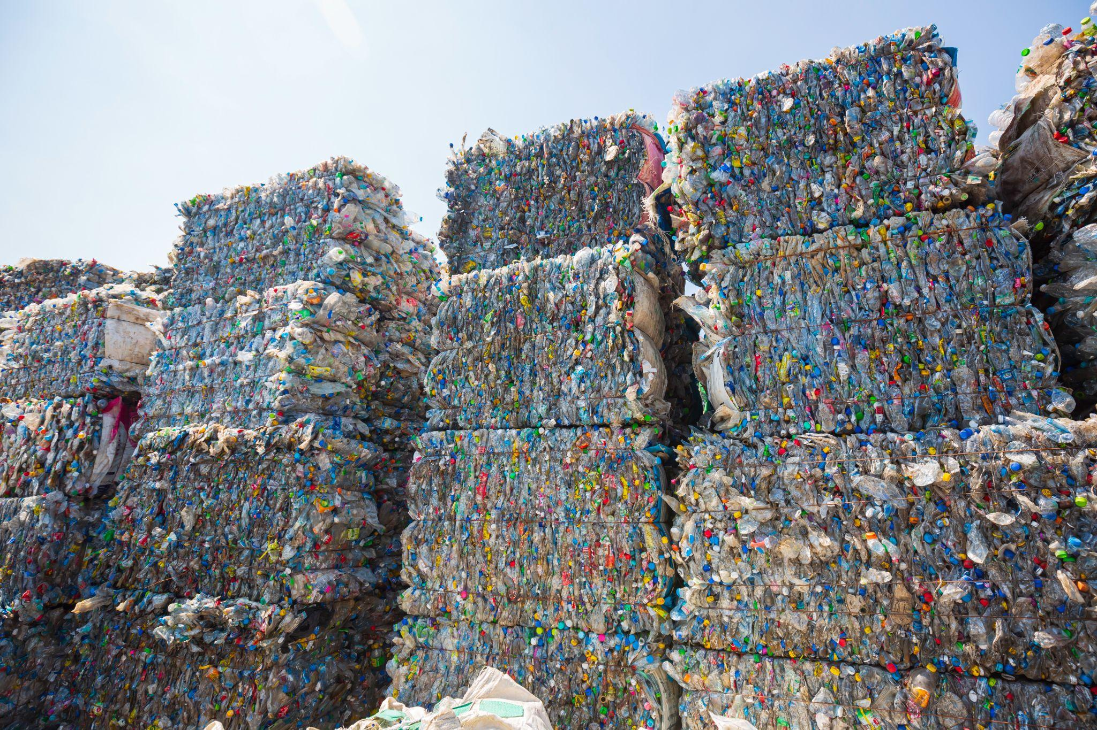
DRS Rollout: Ireland
Deployment roadmap & KPI projections
Private & Confidential
© 2026, All rights reserved

Slide 3
Phase 1
Market Assessment
Private & Confidential
© 2026, All rights reserved

Slide 4
Market Assessment
Ireland generates 190,000 MT of PET & aluminium beverage packaging annually across 5.1M consumers.
DRS legislation in force since Feb 2024Target collection rate: 90% by 2029Current return rate: 78% via 2,900 RVMsRecykal digital DRS reduces capex by 40%
1
190,000 MT annual volume
2
5.1M consumers covered
3
2,900 collection points
4
90% target by 2029
Private & Confidential
© 2026, All rights reserved

Slide 5
Projected Impact
450 Mn containers recovered per year
92% collection rate by year 3
€38 Mn deposit float managed
12,400 MT CO2 equivalent mitigated
Private & Confidential
© 2026, All rights reserved

Slide 6
Rollout Timeline & KPIs
Phase | Timeline | Collection Points | Volume (MT) | Coverage
Pilot — Dublin | Q1 2027 | 120 | 2,400 | 8%
Phase 1 — Leinster | Q3 2027 | 640 | 11,000 | 31%
Phase 2 — Munster | Q1 2028 | 1,180 | 24,500 | 58%
Phase 3 — National | Q4 2028 | 2,050 | 52,000 | 87%
Steady state | 2029+ | 2,400 | 71,000 | 94%
Private & Confidential
© 2026, All rights reserved

Slide 7
Deployment Process
Assess
Pilot
Scale
Optimize
1
2
3
4
. . . .
. . . .
. . . .
Market sizing, regulatory mapping, stakeholder alignment
Deploy smart centers in priority urban zones
Regional rollout with RVM + digital redemption
AI-driven route and fill-level optimization
Private & Confidential
© 2026, All rights reserved

Slide 8
Operating Model
1
Registration
Producers register SKUs on platform
3
Return
Container returned at any collection point
5
Logistics
Optimized reverse logistics to recyclers
Deposit
Consumer pays deposit at purchase
Refund
Instant digital refund via UPI/wallet
Reporting
Real-time compliance dashboards
2
4
6
Private & Confidential
© 2026, All rights reserved

Slide 9
Benefits of Digital DRS
A digitally enabled deposit return system delivers higher recovery at lower cost than RVM-only infrastructure.
1
40% lower capex
Digital redemption removes RVM dependency
2
Full traceability
Every container tracked bottle-to-bale
3
Fraud prevention
AI validation blocks duplicate redemptions
4
Faster rollout
Live in weeks, not years
Private & Confidential
© 2026, All rights reserved

Slide 10
Custom Canvas
Anything can go here via the raw PptxGenJS API.
Private & Confidential
© 2026, All rights reserved

Slide 11

www.recykal.com
Thank You!
Reach out to us on
marketing@recykal.com
or call at +91 7799996255
Private & Confidential
© 2026, All rights reserved

