Slide 1


www.recykal.com
Deposit Return System (DRS)
A Circular Economy Implementation Blueprint for Ireland
Private & Confidential
© 2026, All rights reserved

Slide 2
Operational Scope & Targets
5.03M
11,243
85%
30 Days
Private & Confidential
© 2026, All rights reserved

Slide 3
Material Footprint & Commercial Values
MATERIAL TYPE | TONS / YEAR | EST. UNITS / YEAR | OPPORTUNITY SCORE
PET Bottles | 14,200 t | 42.6 Million | High (0.91)
Beverage Cans | 2,900 t | 14.5 Million | High (0.88)
Glass Bottles | 32,100 t | 64.2 Million | Medium (0.75)
Multi-Layer Plastic (MLP) | 8,400 t | 25.2 Million | Low (0.20)
Private & Confidential
© 2026, All rights reserved

Slide 4
Projected Execution Roadmap
1
2
3
. . . .
. . . .
Private & Confidential
© 2026, All rights reserved

Slide 5
Recykal Technology Moat Advantage
Recykal delivers a unified tech-first circular infrastructure model to secure local operations:
1
2
3
4
Private & Confidential
© 2026, All rights reserved

Slide 6
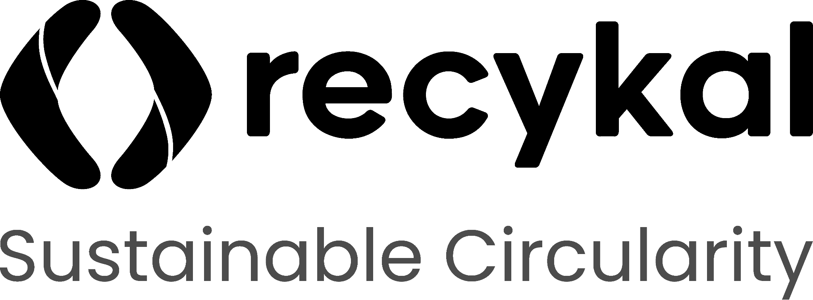
www.recykal.com
Thank You!
Reach out to us on
marketing@recykal.com
or call at +91 77999 96255
Private & Confidential
© 2026, All rights reserved

