Slide 1
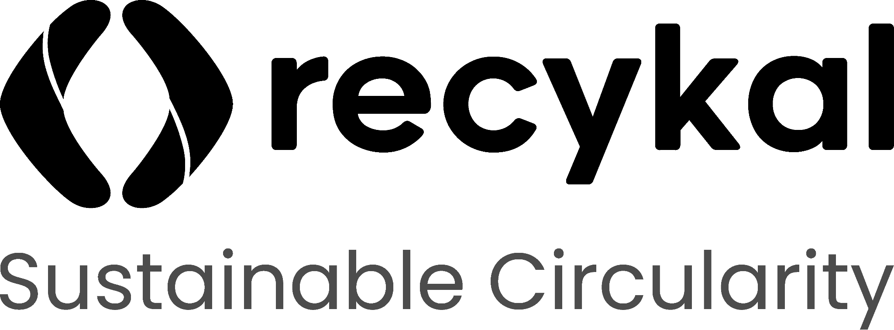
SUSTAINABLE CIRCULARITY
Deposit Return System (DRS)
A Circular Economy Blueprint for Ireland
Active Materials:
PET · Cans · Glass
EPR Objective:
Clean Collection & Compliance
Presented by:

Slide 2
Geographic & Operational Scope
REGIONAL POPULATION
TOUCHPOINTS UNIVERSE
REGULATORY COMPLIANCE ENABLERS
5,033,000
11,243
Ireland has enacted strict waste management mandates aligning with the EU single-use plastics directive. Recykal's DRS implementation plan integrates direct reverse logistics, digital compliance tracking, and brand escrow alignment under the new S.I. No. 320/2021 regulations, ensuring full enforcement of producer liability targets.

Slide 3
Material Flow & Recovery Targets
Estimated annual packing footprint & commercial opportunity values
MATERIAL TYPE | TONS / YEAR | EST. UNITS / YEAR | OPPORTUNITY VALUE SCORE
PET Bottles | 14,200 t | 42.6M | High (0.91)
Glass Bottles | 32,100 t | 64.2M | Medium (0.75)
Beverage Cans | 2,900 t | 14.5M | High (0.88)

Slide 4
Competitor Landscape & Moat Strategy
Key Competitor Segments
Recykal Moat Advantage
• Global DRS Operators: TOMRA, Envipco (Hardware-locked RVM machines, high CapEx)
• Digital PRO Platforms: Karo Sambhav (Compliance-led B2B reporting only)
• Social Offset Platforms: rePurpose, Plastic Bank (PR-led offset collection without strict real-time auditing)
• Hardware-Agnostic SaaS: Integrates with any Reverse Vending Machine fabric, reducing hardware layout costs by 60%.
• Instant UPI/Digital Payouts: Outperforms physical token vouchers with direct digital wallet refunds, raising user return rates.
• Local Body Network Moat: Direct contracts with municipalities blocks entry of global capital competitors.

