Slide 1


Data Extraction in
Mobile Social Ecosystems
Nishant Kumar – ARLES
ARLES Project Group, 8 July 2010

Slide 2
About Me
Nishant Kumar from Varanasi, India
Education
  pre-final year undergraduate student
  pursuing Bachelor of Technology in Computer Engineering
  at Institute of Technology, Banaras Hindu University, Varanasi, India
Past Work
  Facial Expression Analysis
  ( At: Center for Development of Advance Computing, Kolkata
  Indian Government Research Organization )
  Development of an Image Search Engine
  ( Institute of Technology, Banaras Hindu University )
  Development of various applications and software

Slide 3
Overview
Background and Motivation
Data Extraction
  Model
  Implementation
Results (Demo)
Conclusions and Future Work

Slide 4
Background and Motivation

Slide 5
Mobile Social Ecosystems (MSE)
Rich social interactions taking place in today’s mobile
environments
    Wide range of online social networking platforms
    Diffusion of smart phones
      New source of context information for social interaction
  Heterogeneity of devices, platforms & data sources
Need for a middleware to manage Mobile Social Ecosystems

Slide 6
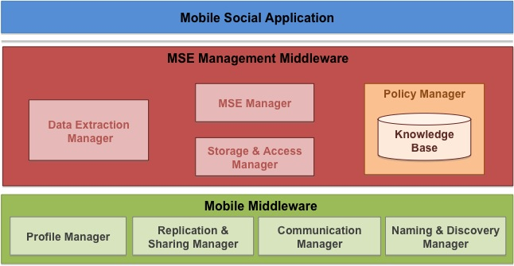
The Yarta Middleware
Collect, manage and enable access to MSE data
J2SE prototype implementation (available on gforge soon..)
Two layered architecture

Slide 7
My Work
Design and implement Data Extraction Manager (DEM)
  Extract data from social data sources
    Online social networking platforms
    Mobile phone
  Infer basic friend relationship from extracted data
  Modular architecture

Slide 8
Data Extraction Manager

Slide 9
Data Extraction Manager Architecture
User (Yarta Middleware)
Data Extraction Manager
DEM Module 1
DEM Module 2
Social Data Inference
Social Data Inference
…….
Data Mapping
Data Mapping
Raw Data Extractor
Raw Data Extractor
Social Data Provider

Slide 10
Data Extraction from
Social Networking Platforms

Slide 11
DEM for Web Social Networking Platforms
User (Yarta Middleware)
Web Social DEM Module
LinkedIn Processor
Facebook Processor
Social Data Inference
Data Mapping Layer
Raw Data Extraction
Social Data Provider
LinkedIn API / Facebook API

Slide 12
Data Extraction from Web DataSource LinkedIn
LinkedIn DEM Module
output
User (Yarta)
LinkedIn Data Inference
initiate
+
authentication
processed
result
Data Mapping
xml result
Raw Data Extractor
query
xml result
LinkedIn API

Slide 13
Data Extraction from New DataSource
New Data Source DEM Module
output
User (Yarta)
New Data Inference
initiate
+
authenticate
processed
result
Data Mapping
result
Raw Data Extractor
query
result
New Data Source

Slide 14
Data Extraction from Web DataSource Facebook
Facebook DEM Module
output
User (Yarta)
Social Data Inference
initiate
+
authenticate
processed
result
Data Mapping
json result
Raw Data Extractor
query
json result
Facebook API

Slide 15
2. Data Extraction from Android Phone

Slide 16
DEM Architecture for Android Phone
User (Yarta Middleware)
Phone DEM Module
Contact Manager
Call Log Manager
SMS Manager
Phone Data Inference
Mapping Layer
Phone Processor
Phone Data Provider
Android ContentProvider

Slide 17
Data Extraction from Android Phone
Android Call Log DEM Module
output
Android Contact
DEM Module
User (Yarta)
Call Log Data Inference
initiate
Data Mapping
result
Phone Processor
query
result
Android Content Provider

Slide 18
Data Extraction from Android Phone
Android New Category Module
output
Android Inference
DEM Module
User (Yarta)
New Data Inference
initiate
Data Mapping
result
Phone Processor
query
result
Android Content Provider

Slide 19
Data Extraction from Android Phone
Android SMS DEM Module
output
Android Contact
DEM Module
User (Yarta)
SMS Data Inference
initiate
Data Mapping
result
Phone Processor
query
result
Android Content Provider

Slide 20
Inferring basic friend relationship
The extracted data is used to find user relation
  Facebook friends
  Linkedin friends
Data extracted from Android phones
  Contact list + Call Log = Call friends
  Contact list + SMS = SMS friends

Slide 21
Full Implementation
USER (Yarta Middleware)
Android Data Processor
LinkedIn Processor
Facebook Processor
Phone Data Inference
Social Data Inference
Social Data Inference
Data Mapping Layer
Data Mapping Layer
Data Mapping Layer
SMS
Manager
Contact
Manager
Call
Manager
Phone Processor
Raw Data Extractor
Raw Data Extractor
Android DataProvider
LinkedIn API
Facebook API

Slide 22
Results

Slide 23
DEM Source Code
Executable on Android phones
Implementation of Android Activities and Threads
7 Java packages
47 Java classes
6.7 KLOC
  10 - 100 LOC : 14 classes
  100 - 600 LOC : Rest

Slide 24
Statistics
Extraction of data from a Facebook profile with 974 friends.
Extraction of data from a LinkedIn profile with 278 connections.
Extraction of friends from SMS stored in Android
Extraction of friends from call history of android phone.
Extraction of contacts from contact list of Android phone.
Extraction of sms from the sms store of Android phone.
Extraction of call history of the Android phone.

Slide 25
DEMO
Data Extraction Manager in action …

Slide 26
Conclusions and Future Work

Slide 27
Summary of Internship (8 weeks)
Study and Analysis
  Data extraction from various social networking platforms
  Data extraction from Android mobile phones
Design of Data Extraction Manager Architecture
First Implementation of DEM on Android
  Data extraction from LinkedIn profile of a user
  Data extraction from contact list and call history of Android mobile phone
  Inference of friends from extracted data from contact and call log of phone
Extension of DEM
  Data extraction from Facebook profile using the same architecture
  Data extraction from SMS list of Android phone using the same architecture
  Implementation of threading for data extraction on Android phones
Documentation and bug reports

Slide 28
Future work
Integration of Data Extraction Manager in Yarta
Advanced inference algorithms of social relationships
Efficiency of execution in terms of time and memory
Data extraction from other social data sources e.g. iPhone

Slide 29
Thank You
Suggestions and Questions
?

