Slide 1
Dataset Mention Extraction and Classification
Animesh Prasad, Chenglei Si and Min-Yen Kan

Slide 2
Task (CI Richtext)
Publication:
....Source: Monitoring the Future: National Survey on Drug Use, 1975-2009 …. Section 2 provides a brief summary of trends in adolescent drinking and smoking, using data for the US from the annual Monitoring the Future survey ….. Trends in Adolescent Drinking and Smoking: Monitoring the Future ….. Systematic annual data on the prevalence of underage drinking and smoking in the US are collected and tracked by several organizations. This section relies on data from the Monitoring the Future (MTF) ….
Datasets (Present): [ ...
56: Monitoring the Future: A Continuing Study of the Lifestyles and Values of Youth, 1984;
101: Monitoring the Future: A Continuing Study of the Lifestyles and Values of Youth, 1989; ...]
Datasets (Not Present): [ ...
100: Monitoring the Future: A Continuing Study of American Youth (12th-Grade Survey), 1996;
108: Current Population Survey, May 1973; ...]
Subtask A: Extraction of the mentions
Subtask B: Classification (attachment) of the mention to a dataset

Slide 3
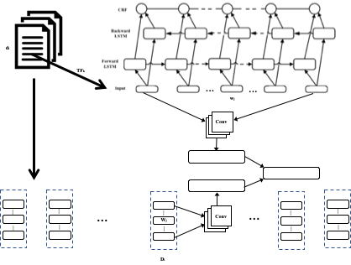
Model
Sequence labelling for extraction
Text classification
k-shot by KB embeddings

Slide 4
Subtask A: Mention Extraction
 | Partial |  |  | Exact
Model | P | R | F1 | P | R | F1
BiLSTM | 29.4 | 32.1 | 30.7 | 11.2 | 12.8 | 12.0
CNN-BiLSTM | 49.8 | 44.7 | 47.1 | 28.6 | 31.2 | 29.8
CNN-BiLSTM-CRF | 54.1 | 44.8 | 48.9 | 35.6 | 33.8 | 34.7
CNN-BiLSTM-Attn-CRF | 58.0 | 50.0 | 53.7 | 34.8 | 38.0 | 36.4
SL E-C | 40.3 | 43.1 | 41.7 | 27.1 | 28.4 | 27.7

Slide 5
Subtask B: Classification
Model | P | R | F1
BiLSTM | 27.5 | 47.4 | 34.8
CNN | 42.8 | 46.5 | 44.6
SL E-C | 31.8 | 49.3 | 49.3

Slide 6
Conclusion
Reasonable performance is easy to achieve, however human performance is difficult due to sparsity.

