Slide 1
Team Name : lone_wolves Problem Statement: Help me with my Mood-with Social-media Health Analysis and Display Engine (SHADE)

Slide 2
The Role of the team members:
Animesh Sharma has focused on mining the tweets of the user and building an UI for the desktop application.
Divya Sanjay has focused on emotion detection
using IBM Watson and creating a playlist to help improve the user’s current mood.
Notes:
The role of each team member :
1. Animesh Sharma has focused on getting the posts of the user from Twitter and building
an UI for the desktop application.
2. Divya Sanjay has focused on emotion detection using IBM Watson and creating a
playlist to help improve the user’s current mood and integrating with the UI.

Slide 3
Tools/Platforms/APIs used:
Language: Python
APIs: Twitter API, Spotify Public API
Platform: IBM Watson Natural Language Understanding Service
Tools: Qt 4 Designer

Slide 4
Implemented Components:
Our desktop application focuses on three main areas:
Mining the user’s Twitter data
Detection of the user’s dominant emotion
Suggesting a suitable playlist
Notes:
The role of each team member :
1. Animesh Sharma has focused on getting the posts of the user from Twitter and building
an UI for the desktop application.
2. Divya Sanjay has focused on emotion detection using IBM Watson and creating a
playlist to help improve the user’s current mood and integrating with the UI.

Slide 5
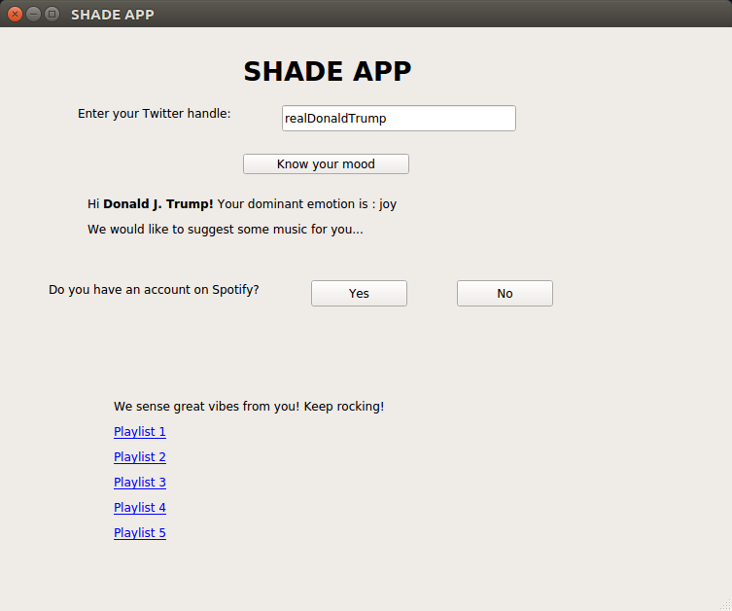





The Workflow:
UI Window
User inputs Twitter handle
Twitter API is used to extract tweets for the past 24 hrs.
The tweets are processed by IBM Watson to predict the dominant emotion
Display the username and dominant emotion
If the user has an account on Spotify, they willl get a selection of playlists to choose from on the Spotify site itself.
If not, we display the link to a playlist on YouTube as well. along with a link to a curated YouTube playlist
Notes:
The role of each team member :
1. Animesh Sharma has focused on getting the posts of the user from Twitter and building
an UI for the desktop application.
2. Divya Sanjay has focused on emotion detection using IBM Watson and creating a
playlist to help improve the user’s current mood and integrating with the UI.

Slide 6
The UI:
Users have to enter their Twitter handle. On clicking the ‘Know your mood’ button, their tweets for the last 24 hours will be accessed.
Once the processing of tweets is finished, the user name and dominant emotion will be displayed.
The user will be asked if they have a Spotify account. Based on their answer, we display links to playlists of songs either on Spotify or on YouTube.

Slide 7
The UI in action
Notes:
The UI in action

Slide 8

Use of IBM Watson:
We used the NaturalLanguageUnderstandingV1 module of IBM Watson API to detect the emotion for each of the user’s tweet.
The tweets were classified into one of the following five emotions: anger, disgust, fear, joy and sadness. Each emotion had a certain score assigned to it.

Slide 9
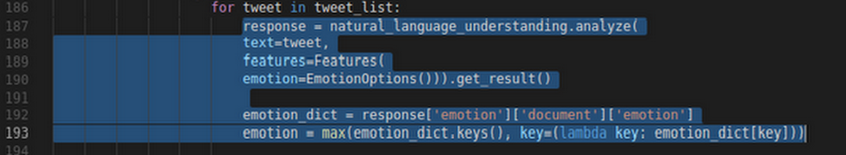
We picked the emotion associated with the highest score as the dominant emotion for that tweet.
After analyzing all the tweets, we decided on an overall dominant emotion.
Use of the Natural Language Understanding Service
Notes:
Use of the Natural Language Understanding Service

Slide 10
SPOTIFY PUBLIC API:
To save the user from the hassle of authentication and providing them fast response is the key feature that we strived for in our application. Thus came the Spotify Public API to our rescue.
We used the search endpoint of the Spotify Public API to extract the URLs of the playlists by passing the dominant emotion of the user as a query parameter.
Finally these URLs are displayed on the UI for the user to immerse themselves in the world of music.

