Slide 1

Job Grids
22PMC113
Animesh Thomas

Slide 2
Table of contents
01
02
03
04
05
06
Abstract
Requirements
Features
Technical Aspects
07
Challenges Faced
Screenshots
Future Enhancement &Conclusion

Slide 3
01
Abstract

Slide 4
The Online Employee Recruitment System is a mini project aimed at simplifying and streamlining the process of employee recruitment for organizations. The system provides a user-friendly interface for both providers and job seekers, facilitating efficient and effective recruitment processes.
Job providers can create job postings with detailed descriptions, qualifications, and application deadlines. Job seekers can easily search and apply for relevant positions through the system, submitting their personal and academic information.
Overall, the Online Employee Recruitment System offers a user-friendly and efficient solution for organizations to attract and hire qualified candidates. It simplifies the recruitment process, saves time and resources, and enhances the overall recruitment experience for both providers and job seekers.

Slide 5
02
PROJECT REQUIREMENTS

Slide 6
User Registration and Login For both Job Seekers and Job Providers(Companies).
Registration form for Jobseekers to submit their personal and academic information.
Feature to Add New Job Openings For Companies.
Feature to Approve New Company Registrations into the System by Verifying Uploaded Documents.
Feature for Jobseekers to Search Jobs as per their requirements

Slide 7
Feature for Applying the jobs.
Feature for Companies to View Job Applications.
Ability to View the resume of the applied candidates.
Ability to Select/Reject Candidates.
Feature For Adding Reviews About the System.

Slide 8
03
FEATURES AND HIGHLIGHTS OF THE PROJECT

Slide 9
Job Posting:
Job providers can create and post job openings with detailed descriptions, qualifications, and application deadlines. This feature allows organizations to effectively communicate their hiring needs and attract suitable candidates.
2.Resume and Cover Letter Submission:
Job seekers can submit their personal and academic information online through the system. This feature eliminates the need for physical paper work and simplifies the application process for candidates.
3.Security and Privacy:
The project prioritizes the security and privacy of applicant information. User authentication ensures that only authorized individuals have access to sensitive data, and secure data storage mechanisms protect applicant data from unauthorized access or breaches

Slide 10
4. Efficiency and Time-saving:
By automating various recruitment processes, the system saves time and reduces manual efforts. Job providers can manage applications, shortlist candidates, and schedule interviews more efficiently, ultimately accelerating the overall recruitment timeline.
5. User-friendly Interface:
The system provides a user-friendly interface for both job providers and job seekers. It is designed to be intuitive and easy to navigate, ensuring a positive user experience for all stakeholders.
6.Candidate feedback system:
A feedback system allows job seekers to provide feedback on their experience throughout the recruitment process. They can share their thoughts on the application process, communication, and overall candidate experience. This feedback can help identify areas for improvement and enhance the recruitment process for future applicants.

Slide 11
7. Advanced Search :
Enhance the search functionality by adding more advanced filters such as location, salary range, experience level, and specific keyword.
8.Notifications and Communication:
Implement a notification system to keep job seekers and companies/recruiters informed about the status of their applications, new job postings, and important updates.

Slide 12
04
TECHNICAL ASPECTS Architecture Database

Slide 13
Backend Framework:
Django is a popular choice for building web applications, and it can be used as the primary backend framework for the project.
Frontend Technologies:
The frontend can be developed using HTML, CSS, and JavaScript.
Database:
A relational database management system (RDBMS) such as MySQL can be used to store and manage applicant data, job postings, and other relevant information.
Authentication and Security:
Django provides built-in authentication and authorization mechanisms, which can be leveraged to handle user registration, login, and access control.

Slide 14
Third-Party Libraries:
Django REST Framework:
This library is used to build APIs for the LMS project, enabling seamless communication between the front-end and backend.
jQuery:
JQuery is a JavaScript library used to simplify DOM manipulation and handle AJAX requests within the project's front-end components.
Bootstrap:
Bootstrap is a popular CSS framework used for responsive web design and UI components, making it easier to create visually appealing and mobile-friendly interfaces.
Pillow
A powerful library for image processing and manipulation.

Slide 15
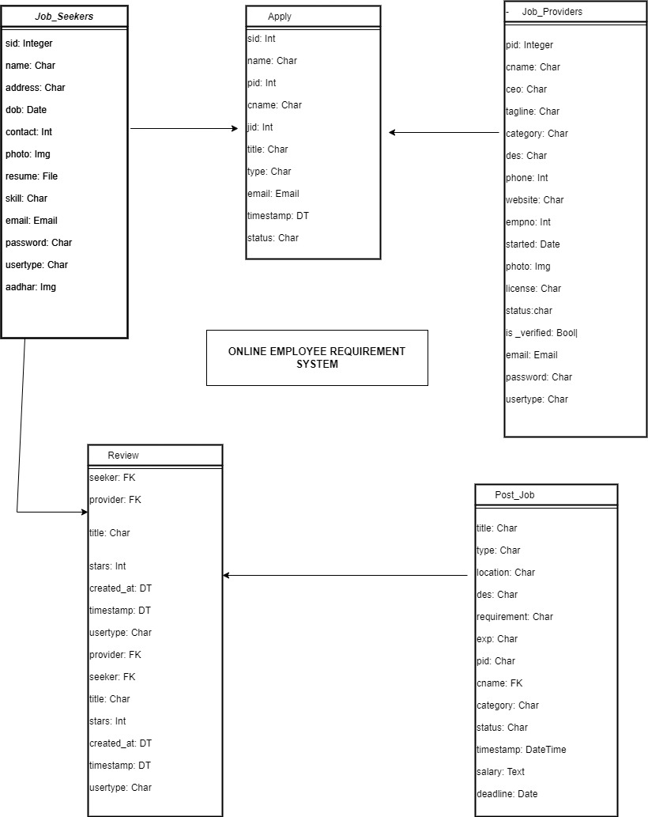
CLASS DIAGRAM:

Slide 16
THE ARCHITECTURE
Models:
The models define the data structures and relationships within the LMS, including entities such as Users, Courses, Enrollments, Content, Assessments, and Grades.
View Models:
View models handle the business logic data flow between the models and templates. They handle user requests, retrieve data from the database, and prepare the data for rendering in the templates.
Templates:
Templates contain the HTML/CSS structure and presentation logic for rendering the user interface. They are responsible for displaying the data fetched from the views and rendering it in a user-friendly format.
Routers:
Routers handle the URL routing and map the incoming requests to the appropriate views or view models. They define the endpoints and HTTP methods for handling user requests

Slide 17
05
CHALLENGES FACED DURING THE DEVELOPMENT

Slide 18
Designing a User-Friendly Interface:
Creating an intuitive and user-friendly interface that caters to both providers and job seekers can be a challenge. Balancing the need for comprehensive functionality with simplicity and ease of use requires careful design and user testing.
2.User Feedback and Iterative Improvements:
Gathering user feedback and incorporating it into iterative improvements can be a challenge. Ensuring effective communication channels for users to provide feedback and managing the feedback loop to prioritize and address issues requires careful coordination.
3.System Requirements:
Defining the requirements of the online employee recruitment system can be challenging.
4. Testing and Quality Assurance:
Thorough testing is crucial to identify and fix any functional or performance issues.

Slide 19
06
IMPORTANT SCREENSHOTS WITH EXPLANATION

Slide 20
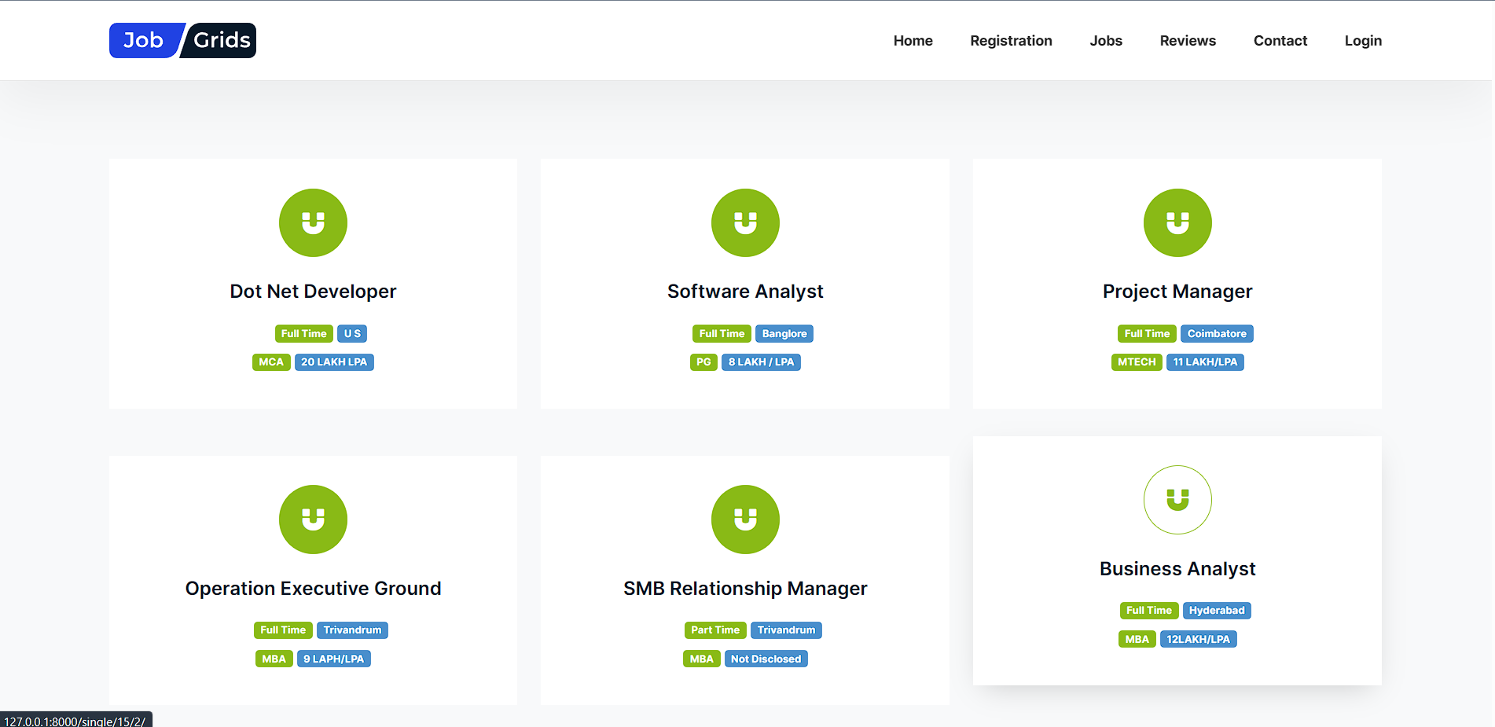
ALL JOBS

Slide 21
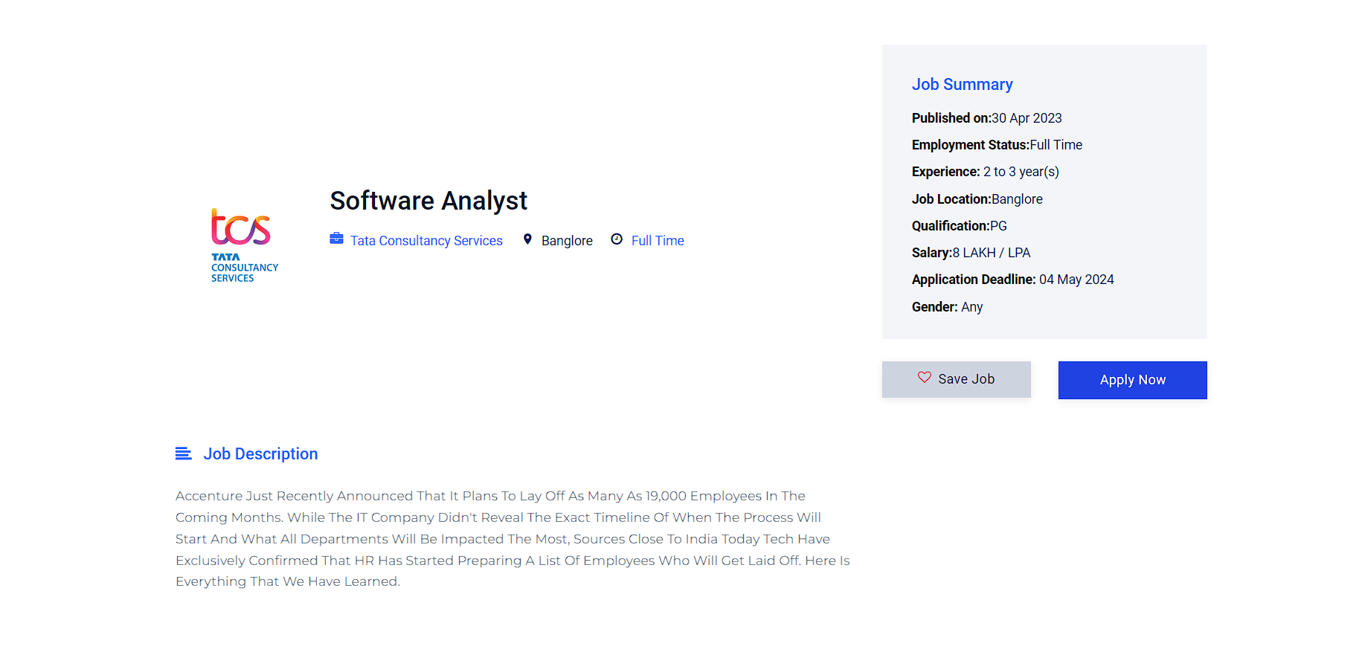
APPLY

Slide 22
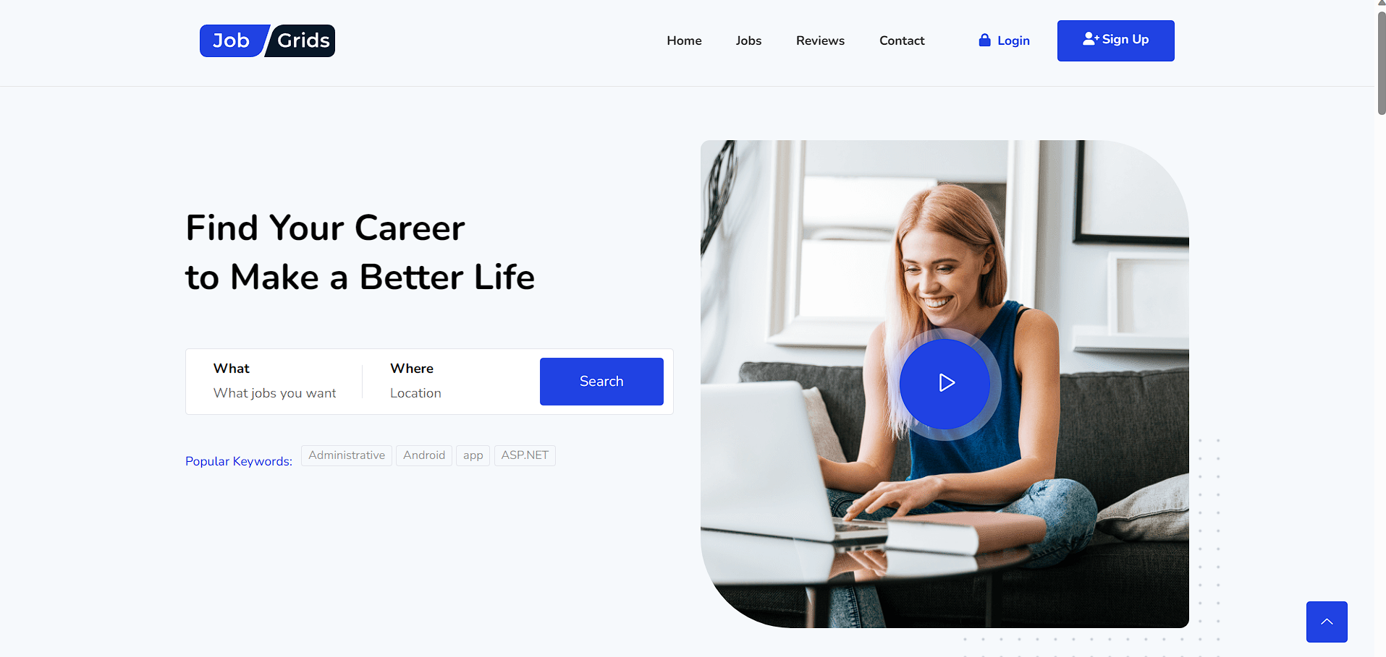
HOME PAGE

Slide 23
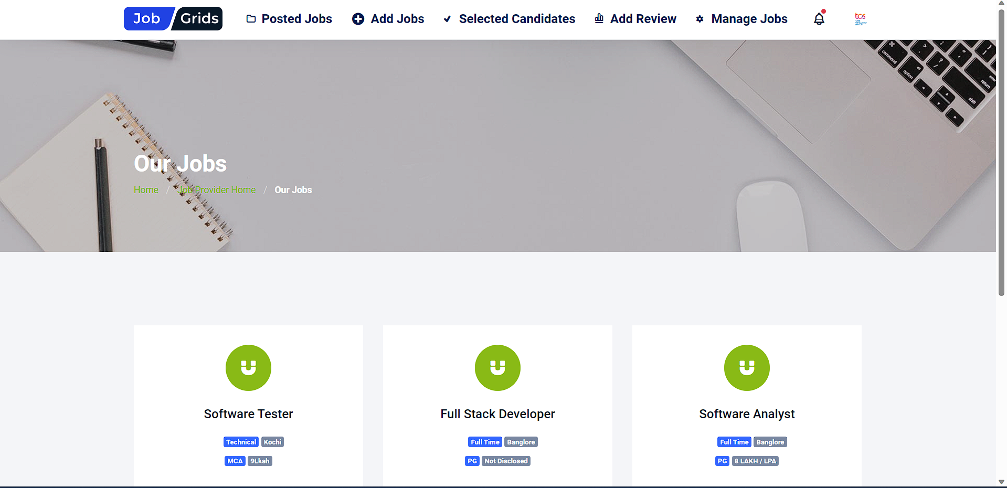
JOB PROVIDER HOME PAGE

Slide 24
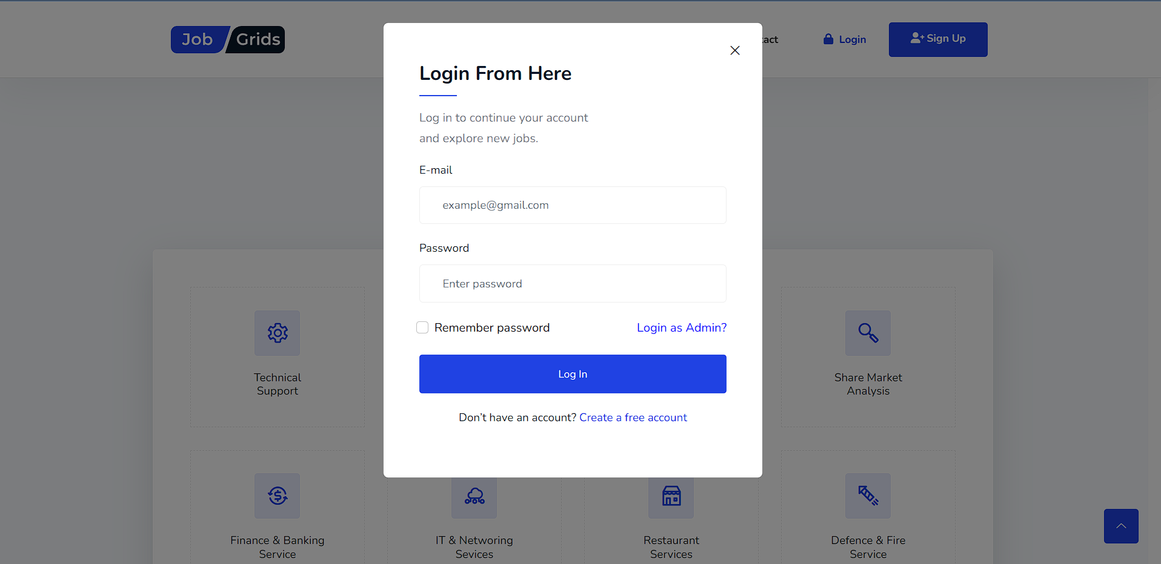
LOGIN

Slide 25
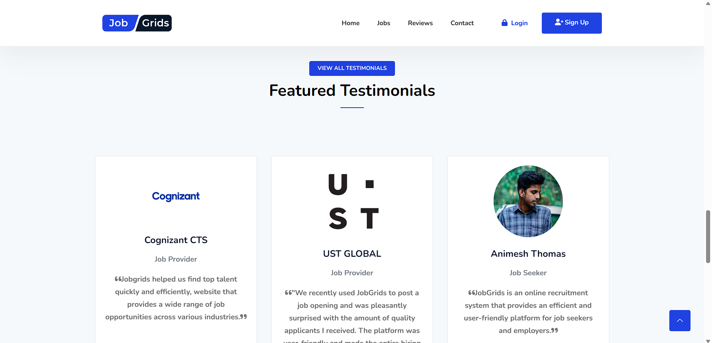
TESTIMONIALS

Slide 26
07
FUTURE ENHANCEMENTS

Slide 27
1.Video Interviews and Assessments:
Integrate video interviewing capabilities, allowing candidates to record or participate in live video interviews directly within the system.
2. Integration with Social Media:
Enable job seekers to share job postings on social media platforms to expand their reach.
3. Personalized Job Recommedations

Slide 28
08
CONCLUSION

Slide 29
In conclusion, the development of an online employee recruitment system in Django and Python can significantly streamline the hiring process for both job seekers and job providers/recruiters. By implementing various features and enhancements, the system can provide a user-friendly and efficient platform for application management, candidate selection, and communication.
The implemented features allow job seekers to search for relevant job opportunities based on their requirements, apply for jobs seamlessly, and receive updates on their application status. Employers can easily manage job applications, review candidate resumes, select or reject candidates. The addition of a review system enables users to provide feedback and share their experiences, contributing to the continuous improvement of the recruitment process.
Overall, the online employee recruitment system in Django and Python provides a comprehensive solution that simplifies the recruitment process, enhances user experience, and helps organizations find the right talent efficiently.

Slide 30
09
REFERENCES

Slide 31
https://stackoverflow.com/
https://djangopackages.org/
https://techvidvan.com/tutorials/online-job-portal-python-django/

Slide 32

Thanks!
Please keep this slide for attribution

