Slide 1

CYCLISTIC
CASE STUDY
CYCLISTIC BIKE SHARE DATA ANALYSIS
Presented by:
July 2024
Animesh Yadav

Slide 2
TABLE OF CONTENT
CASE STUDY PRESENTATION
01
Introduction
04
Causes
02
Business Question
05
Recommendations
03
06
Analysis
Conclusion

Slide 3
QUESTION
Purpose of the Case Study:
Explore 12 months of Cyclistic bike trip data to analyze patterns.
Identify factors influencing subscription purchasing behavior.
Goal: Increase conversion of casual riders to premium members.
Business Problem:
Analyze data to understand and influence subscription purchasing behavior.
Develop strategies to encourage casual riders to purchase subscriptions.

Slide 4
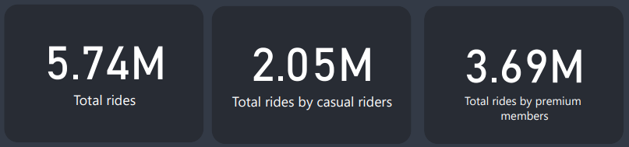
RIDES DISTRIBUTION
Key Findings:
Total Rides: 5.74M
Casual Riders: 2.05M
Premium Members: 3.69M
Insight: Premium members have a higher overall usage, indicating potential for higher revenue from this group.

Slide 5
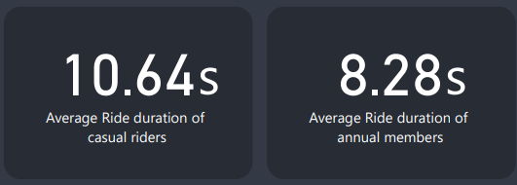
AVERAGE RIDE DURATION
Key Findings:
Average Ride Duration:
Casual riders: 10.64 minutes,
Premium members: 8.28 minutes.
Insight: Casual riders tend to have longer ride durations, suggesting they might use bikes for leisurely trips more often.

Slide 6
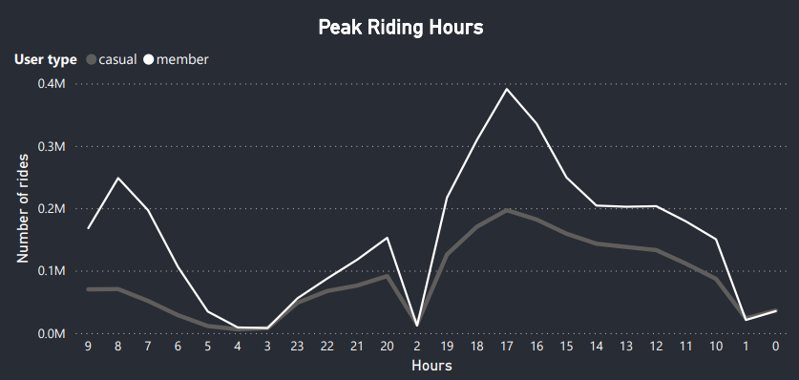
PEAK RIDING HOUR
Key Findings:
Peak Riding Hour: 5 PM for both user types.
Lowest Rides: 3 PM for premium members.
Insight: Understanding peak usage times can help in scheduling targeted marketing efforts.

Slide 7
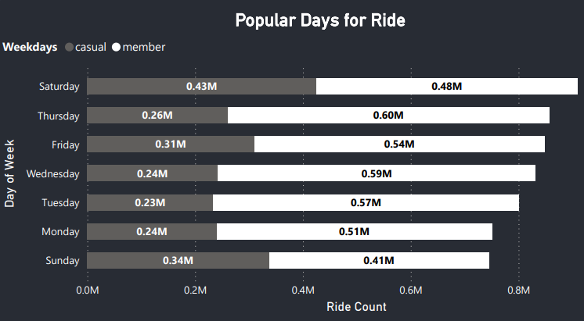
POPULAR DAYS FOR RIDE
Key Findings:
Popular Days: Saturday & Sunday for both user types.
Insight: Weekend promotions could effectively target both casual riders and premium members.

Slide 8
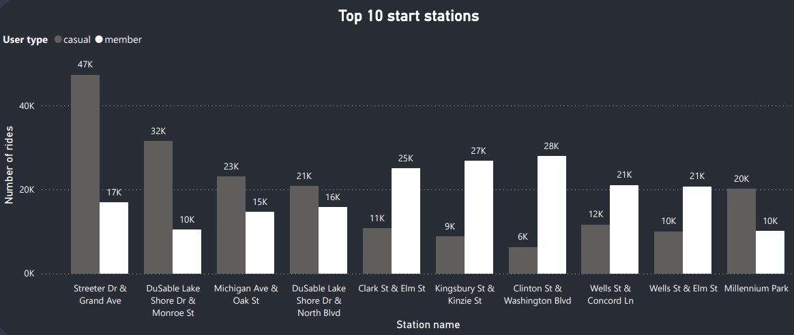
TOP STARTING STATIONS
Key Findings:
Casual Riders: Top stations include (Streeter Dr & Grand Ave), (Dusable Lake Shore Dr & Monroe St).
Premium Members: Top stations include (Clinton St & Washington Blvd), (Kingsbury St & Kinzie St).
Insight: Focusing resources on these popular stations can improve user experience and satisfaction.

Slide 9
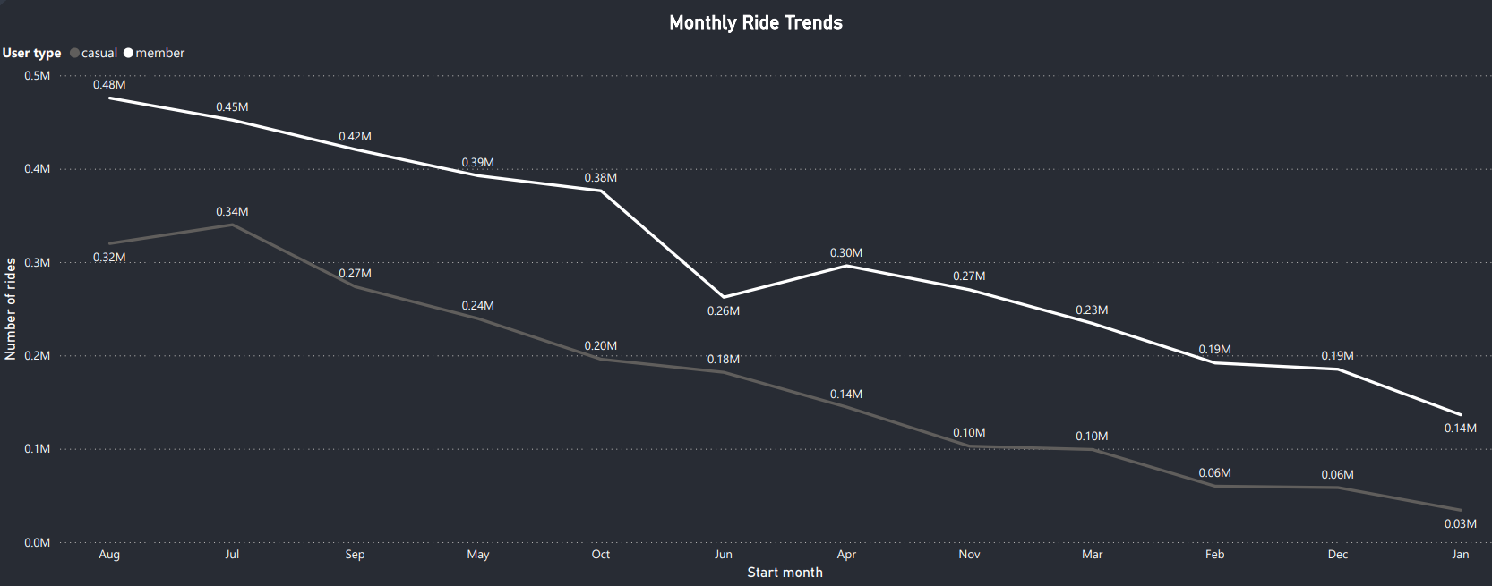
MONTHLY TRENDS
Key Findings:
Popular Months: July to September for both user types.
Insight: High traffic seasonal promotions could effectively target both casual riders and premium members.

Slide 10
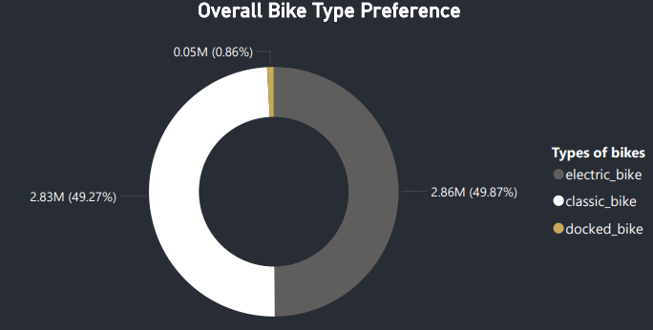
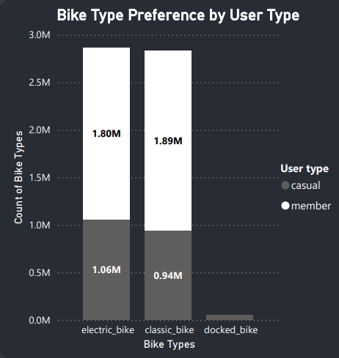
BIKE TYPE PREFERENCES
Key Findings:
Casual Riders: Prefer electric bikes.
Premium Members: Prefer classic bikes.
Insight: Marketing strategies can be tailored based on bike preferences to attract more users.

Slide 11
RECOMMENDATIONS
TARGETED MARKETING CAMPAIGNS
Launch campaigns emphasizing the benefits of premium membership, such as cost savings for frequent riders, convenience, and exclusive perks. Focus on promoting these benefits during peak usage times and popular days for casual riders.
Pros: High engagement during times when casual riders are most active.
Cons: Higher marketing costs.
OPTIMIZED BIKE AVAILABILITY AND PROMOTIONS
Ensure high availability of electric bikes at top stations during weekends and peak hours to cater to casual riders' preferences. Offer limited-time promotions or discounts for upgrading to premium membership, particularly during the summer months when casual ridership peaks.
Pros: Increased user satisfaction and higher likelihood of converting to premium.
Cons: Operational costs to maintain bike availability.

Slide 12
ENHANCED USER EXPERIENCE AT POPULAR STATIONS
Improve amenities and services at the most frequented stations for both casual and premium members. Consider adding features like quick check-in/out kiosks, better signage, and promotional material highlighting the advantages of premium membership.
Pros: Improved user experience and higher retention rates.
Cons: Initial investment in infrastructure.
SEASONAL MEMBERSHIP DISCOUNTS
Offer seasonal discounts for premium memberships during peak months (July to September). Provide attractive deals during the summer when casual ridership is high.
Pros: Higher conversion rates during peak season.
Cons: Potentially lower profit margins during the discount period.
REFERRAL BONUS FOR CURRENT PREMIUM MEMBERS
Incentivize current premium members to refer friends and family to join as premium members. Offer bonuses such as ride credits or discounts for successful referrals
Pros: Organic growth through word-of-mouth.
Cons: Cost of providing referral bonuses.

Slide 13
LOYALTY PROGRAMS FOR FREQUENT RIDERS
Introduce loyalty programs to reward frequent casual riders with points that can be redeemed for discounts on premium memberships. Track rider frequency and offer incentives for upgrading.
Pros: Encourages frequent riders to upgrade.
Cons: Administrative costs of managing the program
FREE TRIAL PERIOD FOR PREMIUM MEMBERSHIP
Offer a limited-time free trial period for casual riders to experience the benefits of premium membership. Allow casual riders to try premium features for a week or a month.
Pros: Provides a risk-free way for casual riders to experience premium benefits.
Cons: Potential short-term loss in revenue.
USER FEEDBACK ANALYSIS FOR CONTINUOUS IMPROVEMENT
Regularly analyze feedback from casual riders to identify pain points and improve services. Use insights to enhance the overall user experience and address barriers to upgrading.
Pros: Continuous improvement based on real user feedback.
Cons: Time and resource-intensive to collect and analyze feedback.

Slide 14

THANK YOU
FOR YOUR NICE ATTENTION

