Slide 1
DATASCI 450: Deriving Knowledge from Data at Scale
CIFAR DEEP Learning
Anish Mohan

Slide 2
Overview
 | How long did you spend in this phase? (mins/days)
Understanding the data | 1 Day
Data Exploration | 1 Day
Features / Feature Engineering | 1 Day
Building the Model | 10 Days
Evaluating the Model | 10 Days
Operationalizing the model (Optional)

Slide 3
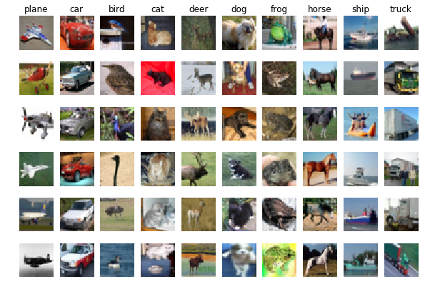
Data
CIFAR Dataset is subset of the Tiny Images dataset.
Tiny images data set contains about 80 Million images of size 32x32. Each image in the original dataset is labeled with non-abstract nouns obtained from Wordnet lexical database.
CIFAR-10 consists of 60,000 images of size 32x32 pixels.
These images have objects/content that belong to the following classes: Airplanes, automobiles, bird, cat, deer, dog, frog, horse, ship and truck. Goal would be to train Deep Neural networks and be able correctly classify a test set.

Slide 4
Features Selection and
Feature Engineering
Did not spend much time in feature engineering; Rather was planning on relying on Neural Networks do discover the features for the dataset.

Slide 5
Model Building
Built 3 models in Tensor Flow:
Linear Neural Network Model
Multi Layer Neural Network Model
Convolution Neural Network Model
Did you consider using any ensemble approach?
Tried implementing drop-out as a proxy for ensemble approach but was not successful
I would expect that ensembling the Neural Network would be helpful to improve results.

Slide 6
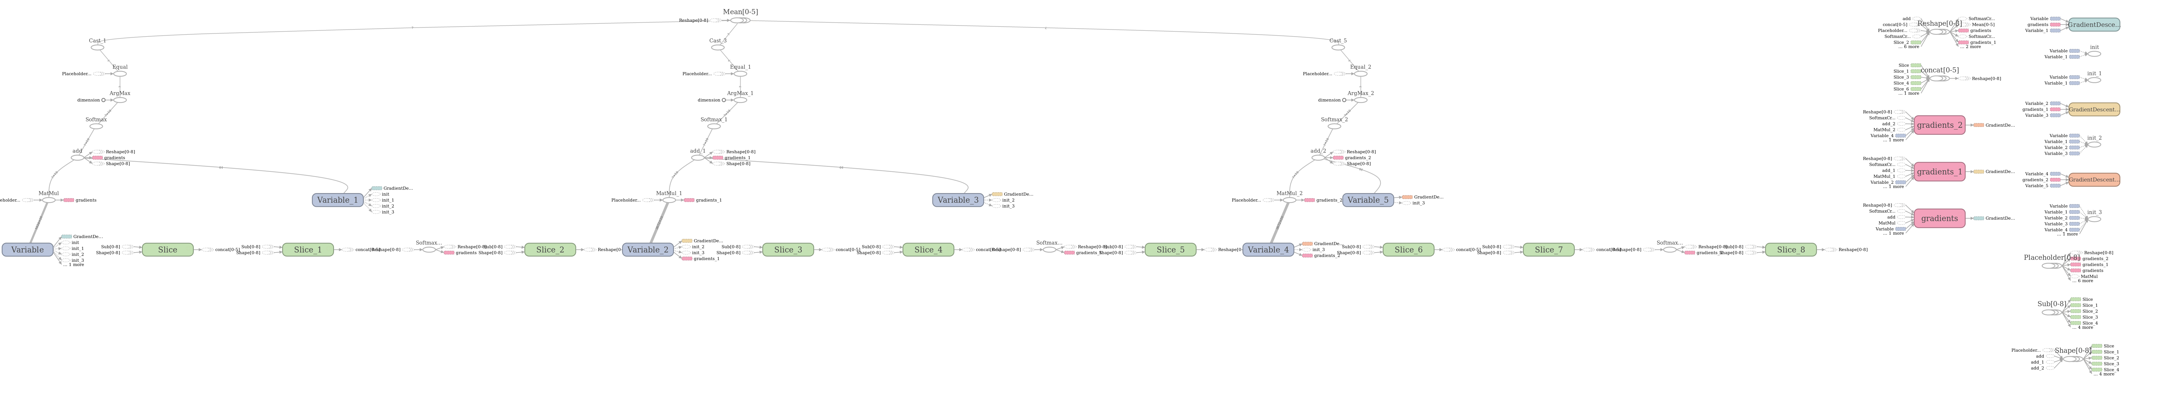
Model Building: Linear Neural Model

Slide 7
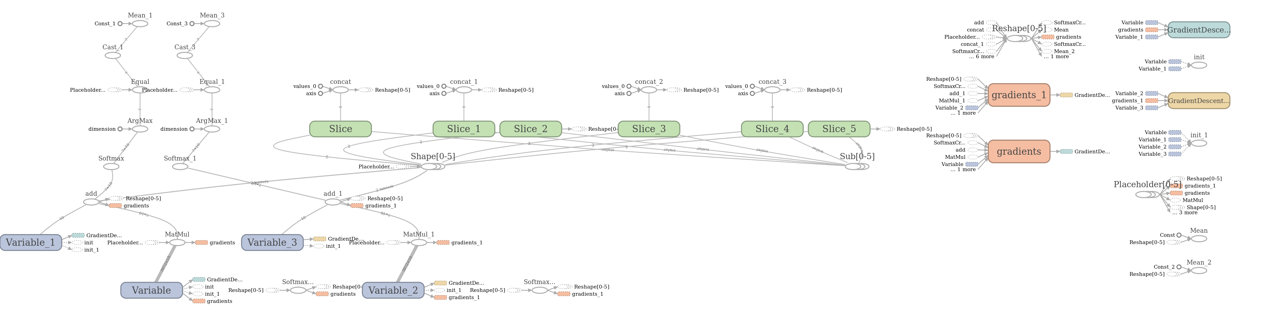
Model Building: Multi Layer Neural Network

Slide 8
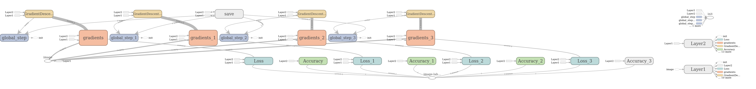
Model Building: Convolutional Neural Network

Slide 9
Model Evaluation
 | Linear Model | Neural Network Model | CNN Model
Training Accuracy | 23% | 11% | 14%
Test Accuracy | 24% | 10% | 10%

Slide 10
Key Learning
Linear Model with Stochastic Gradient proved to be a workable solution for CIFAR data set.
Convolution Network has many parameters that can impact the performance of the Deep network.
My implementation of CNN is faulty as the results seem to be low even after 200-800 iterations.
CNN is expensive and running beyond 800 iterations on a local machine is not practical.

