Slide 1
DATASCI 450: Deriving Knowledge from Data at Scale
CIFAR DEEP Learning
Anish Mohan

Slide 2
Overview
 | How long did you spend in this phase? (mins/days) | Additional Notes
Understanding the data | 1 Day
Data Exploration | 1 Day
Features / Feature Engineering | 1 Day
Building the Model | 3 Days
Evaluating the Model | 10 Days
Operationalizing the model (Optional) | 10-14 Days
Note – Add additional steps/phases

Slide 3
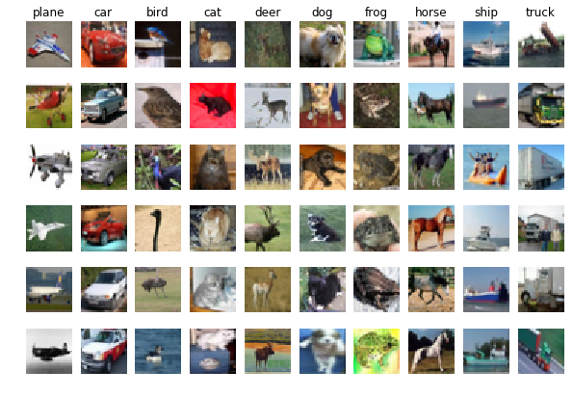
Data
CIFAR Dataset is subset of the Tiny Images dataset.
Tiny images data set contains about 80 Million images of size 32x32. Each image in the original dataset is labeled with non-abstract nouns obtained from Wordnet lexical database.
CIFAR-10 consists of 60,000 images of size 32x32 pixels.
These images have objects/content that belong to the following classes: Airplanes, automobiles, bird, cat, deer, dog, frog, horse, ship and truck. Goal would be to train Deep Neural networks and be able correctly classify a test set.

Slide 4
Features Selection
What are the features selected?
Why did you select the features?

Slide 5
Features Engineering
Describe any data transformation steps
What did you do to transform the data?

Slide 6
Model Building
What was the machine learning algorithm used?
Did you consider using any ensemble approach? Is that useful and applicable in this challenge?
What tools did you use?
Include
Screenshot of your model (with comments)

Slide 7
Model Evaluation
 | Linear Model | Neural Network Model | CNN Model
Training Accuracy | 23% | 11% | 14%
Test Accuracy | 24% | 10% | 10%

Slide 8
Key Learning
Linear Model with Stochastic Gradient proved to be a workable solution for CIFAR data set.
Convolution Network has many parameters that can impact the performance of the Deep network.

