Slide 1


Slide 2
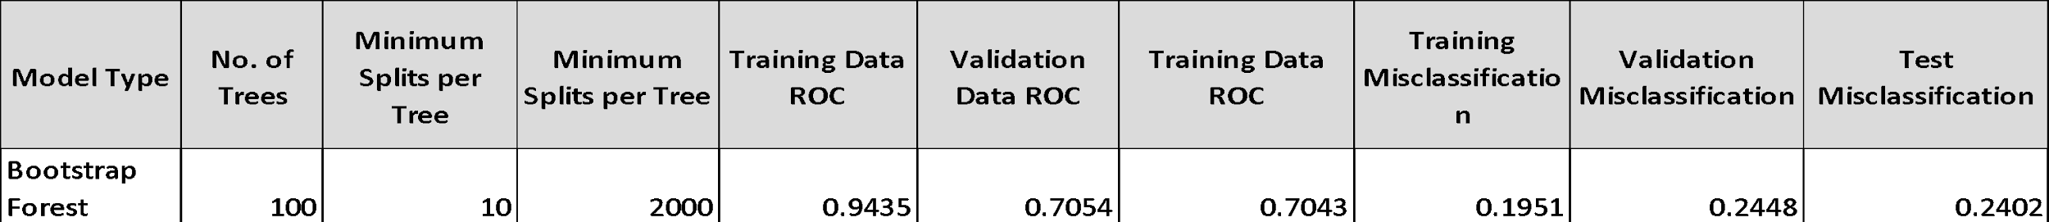
Test for all Methods

Slide 3
Chosen Method
Reasons for choosing Logistic Regression
Highest ROC of 0.738 in Validation data
Lowest Validation misclassification of 0.2219 among all models

Slide 4
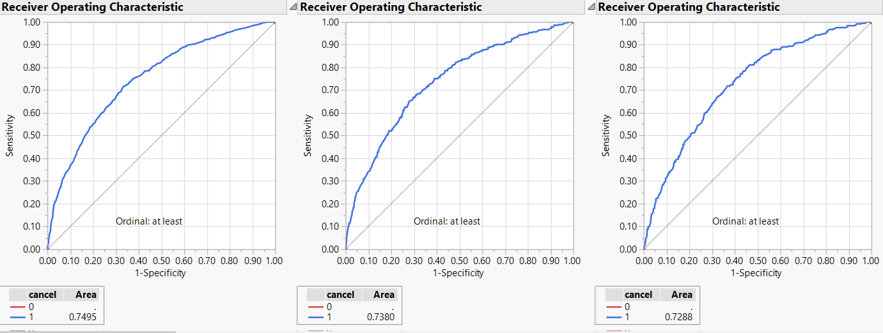
Selected model results

Slide 5
Assumptions testing of Logical Regression
Avoided overfitting and underfitting by variable selection
Tested independence of error terms
Tested multicollinearity
Tested linearity of independent variables and log odds

Slide 6
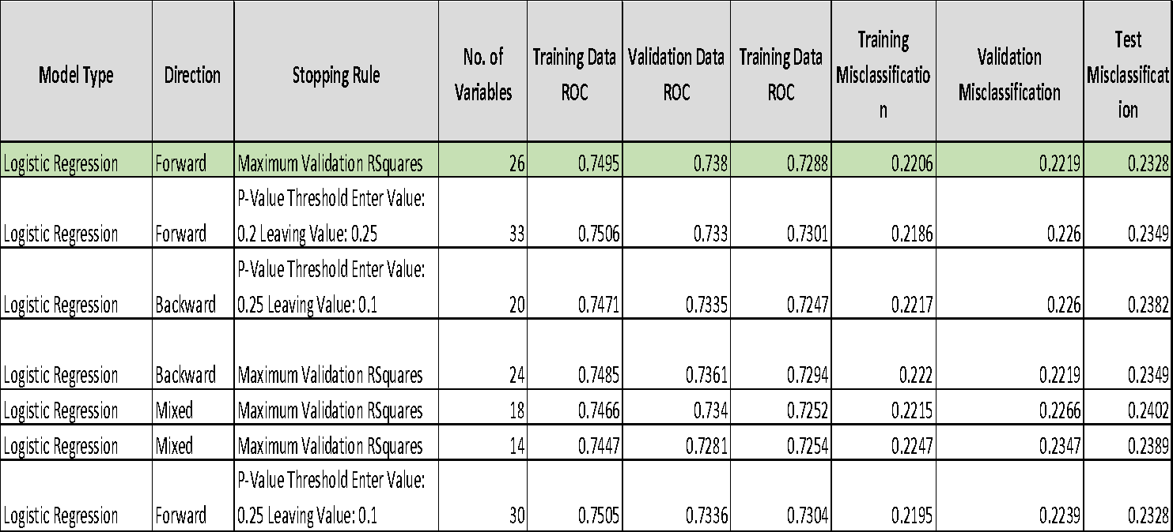
Variable Selection

Slide 7
Variable Selection Criteria
Maximum R square
Maximum Adjusted R square
Minimum RMSE
Minimum MSR
Minimum number of Variables

Slide 8
Questions about the data
What is your process of data collection?How did the zip data have missing value? What is the probability of the data source containing incorrect values?
What is your strategy for customer retention based on the information from this model? Based on grouping?Strategy for serial claimers?
What about defaulting customers? How will you remove them from your retention plan? Good and bad customer?
What are the clauses in fixing your premium? Do you change based on the square footage and life of the dwelling?

