Slide 1
Workspace
Made By:
Jigyassa Lamba (1811020)
Sakshi Pandey(1811030)
Anina Pillai (1811034)

Slide 2
Outline
Project Description
Tools Used
Functionalities
How to Run ? Software and Hardware Requirements
Working Demo
Conclusion

Slide 3



Project Description
Notepad
Journal
Workspace is a three in one desktop application built with the help of Python Programming Language.
Workspace also provides a secure way to store files with the help of its Encryption and Decryption features.Workspace also contains features of paint to create simple and colorful drawing . Along with this a journal application has been added to save our work and work on it using various features provided (user login specific). It makes use of Database Connectivity for user specific content and user login and authentication.
Paint

Slide 4



Tools Used
1.Backend : Python3
Python is an interpreted, object-oriented, high-level programming language with dynamic semantics. Its high-level built in data structures, combined with dynamic typing and dynamic binding.
2. Database: sqlite3
Sqlite 3 is a relational database management system (RDBMS) contained in a C library. In contrast to many other database management systems, SQLite is not a client–server database engine. Rather, it is embedded into the end program.
3. Frontend : Tkinter (module of Python3)
Tkinter is the standard GUI library for Python. Python when combined with Tkinter provides a fast and easy way to create GUI applications. Tkinter provides a powerful object-oriented interface to the Tk GUI toolkit.

Slide 5
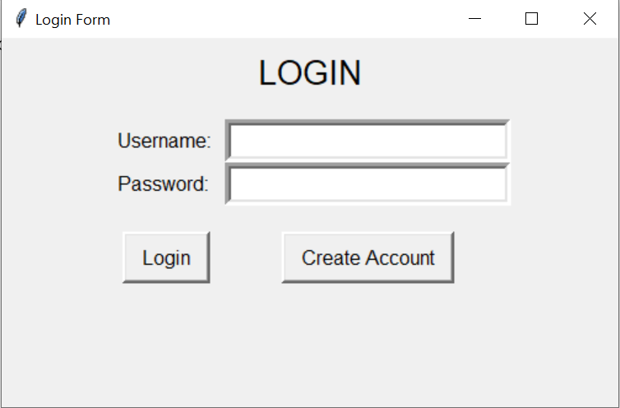
Functionalities
Login/Register: Before using the various functionalities offered by TexEd, you need to create an account. Every time you will use Workspace , you will be prompted to enter your Login Credentials.This feature makes your work more secure and protected.

Slide 6




Functionalities
2.Notepad: Notepad is a basic text editor used for editing existing text documents and creating new one. The basic operations are:
Create a new file , open it and save it.
Edit the file with the help of cut ,copy,paste ,clear.
Find and replace options.
View Toolbar/Status bar options and Change Theme
feature.

Slide 7

Functionalities
Encryption/Decryption : Encryption is the process of translating plain text data (plaintext) into something that appears to be random and meaningless (ciphertext).
Decryption is the process of converting ciphertext back to plaintext.Only authorized parties can decipher a ciphertext back to plaintext and access the original information.
This feature encrypts the file content using the password
provided by user and decrypts when same password is
provided.
It uses AES-256(Advanced Encryption Standard) to
encrypt and Decrypt the data.
The pycryptodome package which should be installed gives access
to an implementation of AES-256

Slide 8


Functionalities
2. Paint : Workspace also provides you with the paint functionality. It is a simple raster graphics editor. When you will click on the Paint option after logging in , you will see the following window.
Save file.
Brush feature to create texture effects
Eraser tool to recorrect your drawings.
Color window to color your drawing.

Slide 9



Functionalities
3. Journal: This application is used to store your records in a systematic way. All your records will be saved in your account only. You can easily add , edit and delete an entry.All the records are saved with proper time and date format.
Add an entry .
Edit the entry
Delete your entry

Slide 10
Functionalities
REDIRECTABLE:
All the three applications can be used by switching to different applications. Work in currently open application should be saved before switching to avoid loss of data.

Slide 11
How to Run?
Installations:
Along with python, make sure you install following libraries for all functionalities of the project to run-
Run the following command on cmd to install pycrptodomex on your pc. This is used for encrypting and decrypting your file content in Notepad Application as it gives us access to an implementation of AES-256 (algorithm used for encryption and decryption).
pip3 install pycryptodomex
Run the following command on cmd to install pillow in your pc. This is important in order to run Paint Application:
pip install pillow
In order to be able to save files of Paint Application in .png format. Install Ghostscript in your system. The details of installation are given in the “Paint” section of the User Manual.

Slide 12
How to Run?
3. Open git Bash in the directory of your PC in which you
wish to download the project. This can be done by right
clicking in the directory and selecting “Git Bash Here”
(Make sure you have git installed in your pc).
Alternatively, you can also run the same commands on
the command prompt(cmd) to download the project in
the concerned director provided you have git installed in
your PC.
Go to the url: https://github.com/sakship31/MyJournal
Copy the https url given under “clone or download” option when you open above url on browser.

Slide 13
How to Run?
5. Go to Git Bash or command prompt and run the following command and paste the copied url and press enter:
git clone https://github.com/sakship31/MyJournal.git
6. To run the project, go to MyJournal directory in command prompt and give the following command:
python startApp.py

Slide 14


Working Demo
Click on the video to view demo of Notepad:
Click on the link to view the user manual:
USER MANUAL Python

Slide 15
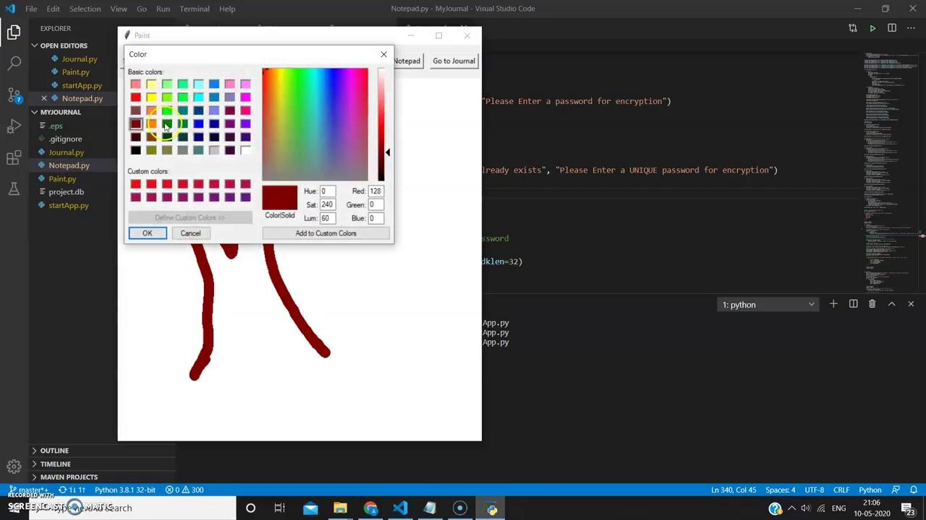
Working Demo
Click on the video to view demo of Paint:
Click on the link to view the user manual:
USER MANUAL Python

Slide 16
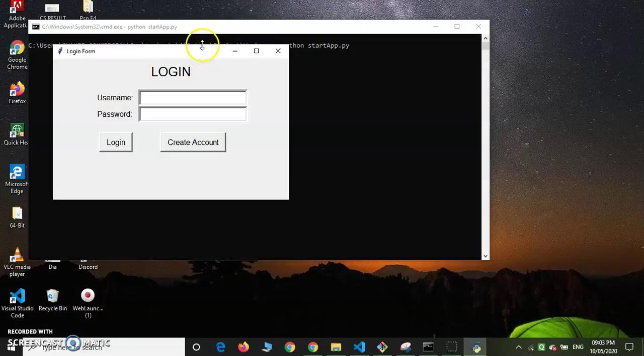
Working Demo
Click on the video to view demo of Journal:
Click on the link to view the user manual:
USER MANUAL Python

Slide 17
Conclusion
Workspace, a smart text editor was developed with the help of python. Various different functionalities were added to enhance its performance. Thus while developing this we learnt the hands on experience with Python, Tkinter which is a module of Python and Database Connectivity with python. Different kinds of users can use it for different purposes , be it storing secure information, maintaining a daily record of your tasks or simply drawing simple and colorful drawings using the paint window.

